Slide 1
Quick Store
A modest application to enter new stores for Uvalde and Temple.

Slide 2
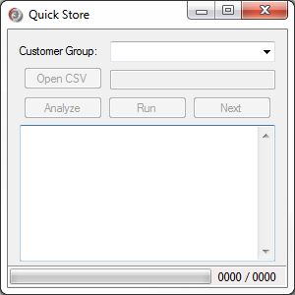
Design
Customer Group
Drop-Down Menu
Open File Button
File Path
Analyze Button
Next Button
Run Button
Console Text Box
Stores Completed
Progress Bar
Stores Remaining

Slide 3
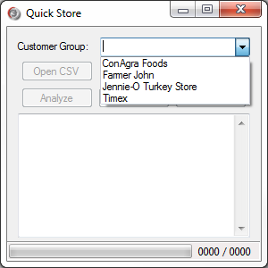
Customer Group Select
To Begin, Select a Customer Group from the Drop-Down Menu
Currently Supported:
ConAgra Foods
Farmer John
Jennie-O Turkey Store
Timex

Slide 4
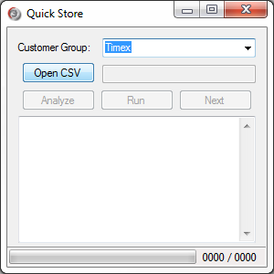
Open the CSV File
Choosing a Customer Group will enable to the Open CSV button.
To Convert a worksheet in Excel to CSV, File > Save As, and choose “CSV (Comma delimited) (*.csv).”

Slide 5
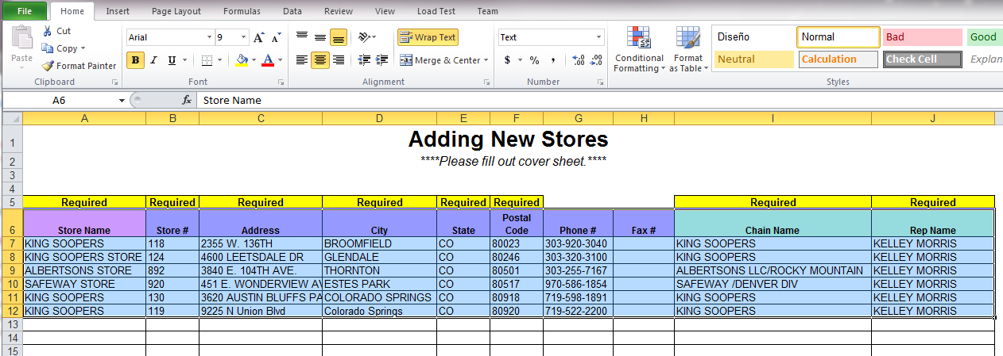
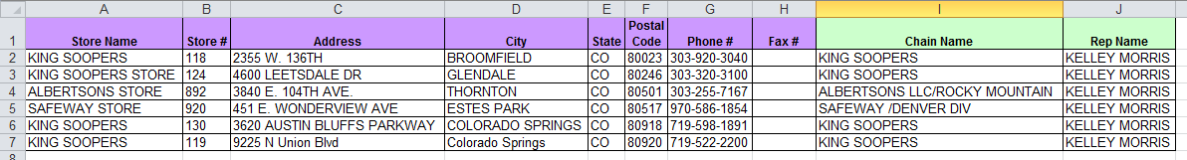
Creating the CSV File
If the column headers are not on Row 2 (above), copy and paste them in a new sheet (below), then save the page as a CSV.

Slide 6
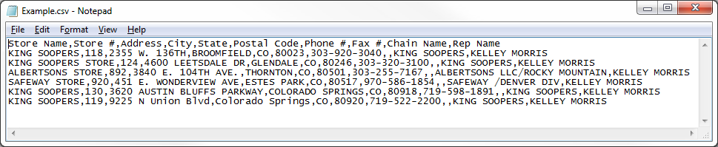
Creating the CSV File, pt. 2
A successful CSV when opened in a word editor, like Notepad.

Slide 7
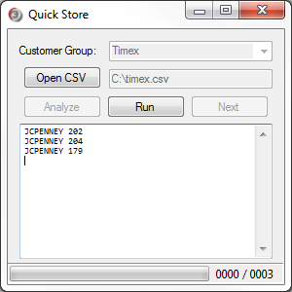
Analyze the CSV File
Upon opening the file, the Analyze button will enable.
Clicking the Analyze button will read the CSV and show all the stores that will be created.

Slide 8
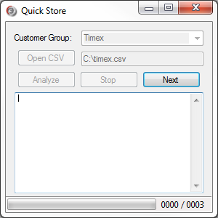
Run Quick Store
Click Run, this readies Quick Store to await your command.
Quick Store will give you about a second to click Next (or press Enter on the keyboard) and then click the first place of data entry on the website.

Slide 9
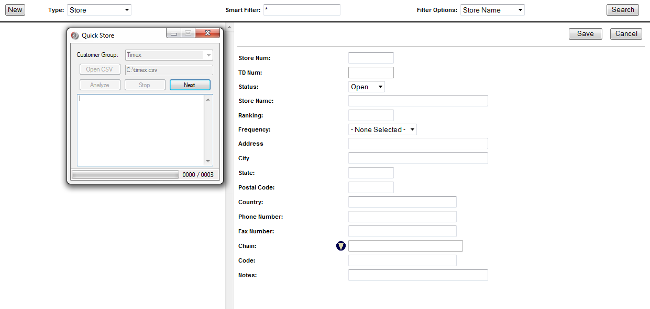
Preparation is Key
Press Next, or ENTER on the keyboard.
2. Click the First Place of Data Entry

Slide 10
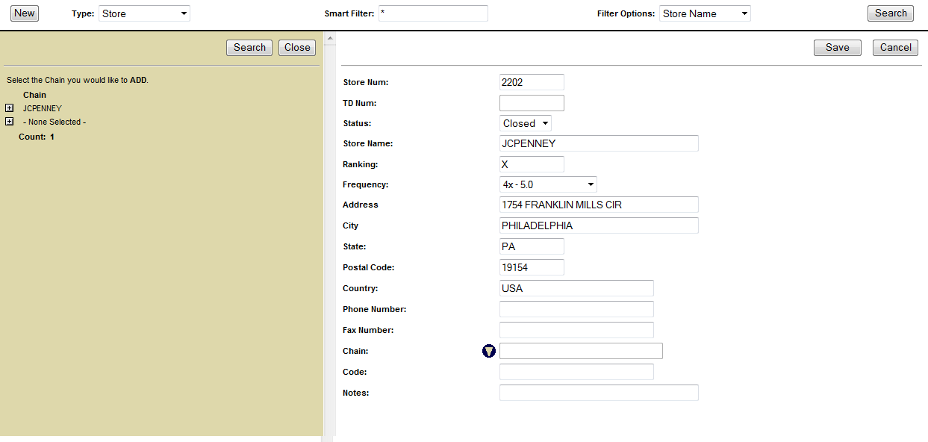
Preparation is Key, pt. 2
Hold tight, and Quick Store will fill out all the fields in the form from your CSV.
Quick Store will also search for the Chain so you don’t have to.

Slide 11
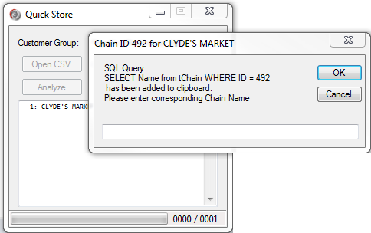
Chain LOOKUP
For PWS, if a Chain ID is given, an input window will add a query to your clipboard to lookup the corresponding Chain Name

Slide 12
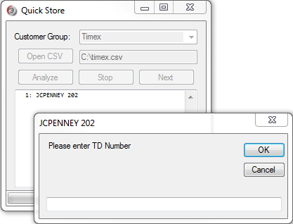
TD Number Not Given in CSV
For some Customer Groups, the TD Number is not present in the CSV.
Quick Store will ask for the number when appropriate, either before entry (i.e. JOTS) or after saving (i.e. TMX, PWS).

Slide 13
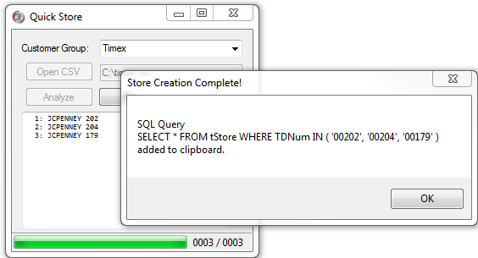
Finishing
When finished adding all the stores, or the process stopped, Quick Store will add a SQL query to your clipboard to show all the stores added.
Stores will also appear in the console textbox.

