Slide 1

Malicious Traffic Pattern Clustering Using K-Means and Hierarchical Clustering
Pakkiru Sai Harshith Reddy — 2520030375 Kasula Yashas — 2520030401
Course: Machine Learning — Department of Computer Science and Engineering
Guide: Mr. Shaik Asif, Assistant Professor, Department of Computer Science and Engineering
A concise study applying unsupervised clustering methods to CICIDS2017 network-flow data to discover suspicious traffic patterns.

Slide 2
Research Roadmap
1. Literature & Problem
Establish context in ML for cybersecurity and define the detection challenge.
2. Data Analysis
Explore CICIDS2017: formats, classes, and representative features.
3. Methodology
Preprocessing, feature selection, two clustering strategies.
4. Implementation
Python pipeline, experiments, visualisation and evaluation.
5. Results & Conclusion
Interpret clusters, assess silhouette structure, recommend analyst workflow.
The roadmap above is a numbered research workflow — each stage flows into the next to form the project's lifecycle.

Slide 3







Literature & Research Direction
ML in Security
Foundations and objectives
Clustering
Group similar traffic behaviors
Unsupervised Learning
Pattern discovery without labels
CICIDS2017
Benchmark dataset for evaluation
Key topics covered: Machine learning in cybersecurity, unsupervised learning paradigms, clustering for intrusion detection, and dataset specifics (CICIDS2017).
Research Direction: Using unsupervised clustering to discover meaningful patterns within network traffic.

Slide 4



Problem Statement — From Volume to Actionable Groups
Massive Traffic
High volume of network flows
Unsupervised Clustering
Automated grouping of flows
Hidden Patterns
Latent structures not labelled
Suspicious Groups
Actionable insights for review
Challenges: high volume of flows, heterogeneity of behaviour, latent structure not labelled, and impracticality of manual inspection at scale.

Slide 5





Abstract — Project Pipeline
Preprocessin g
Feature selection
Dimensionali ty reduction
Clustering
PCA
visualisation
The pipeline organises dataset preparation, parallel clustering experiments, objective evaluation (silhouette) and visual inspection (PCA) to support detection hypotheses without requiring labelled training.

Slide 6
Data Analysis — CICIDS2017 Overview
Dataset Hierarchy
CICIDS2017 categorises flows as BENIGN and multiple attack types. Representative structure:
CICIDS2017
├── BENIGN
├── DDoS
├── DoS
├── PortScan
├── Brute Force
├── Web Attacks
├── Infiltration
├── Bot
└── Heartbleed
Representative Features
Flow Duration Packet Count
Packet Length (mean, std) Flow Bytes/sec
Flow Packets/sec
Format: CSV network-flow records. Dataset contains both benign and labelled attack traces used here only for interpretation (unsupervised experiments do not use labels for training).

Slide 7

Methodology — End-to-End Architecture
Preprocess Data
Feature Prep
Clustering
Analysis
Visual emphasised parallelism: K-Means (partitioning) and Hierarchical (nested dendrogram) operate on the same preprocessed feature space to provide complementary cluster perspectives.
Preprocessing
Missing value handling, outlier checks, and normalization.
Feature Engineering
Selection of flow-level metrics; optional dimensionality reduction (PCA) for visualisation.
Evaluation
Silhouette analysis and visual inspection guide cluster interpretation.

Slide 8










Implementation & Results — Pipeline and Findings
Results (actual run)
K-Means (k = 8): silhouette 0.457, Davies–Bouldin 0.867, purity 92.1%, ARI 0.505
Hierarchical (k = 8): silhouette 0.435, Davies–Bouldin 1.053, purity 87.8%, ARI 0.416
K-Means edges out Hierarchical on every metric; full plots and the metric table follow on the next slides.
Dataset Python
Preprocessin g
Clustering Visualization
PCA cluster scatter plots, the elbow/silhouette curve, the dendrogram, and the full metric table are presented on the following three slides.
Implemented in Python: data ingestion from CSV, preprocessing routines, scikit-learn clustering modules, PCA for 2D projection, silhouette computation. All numeric results are measured on the real CICIDS2017 sample used for this run.

Slide 9
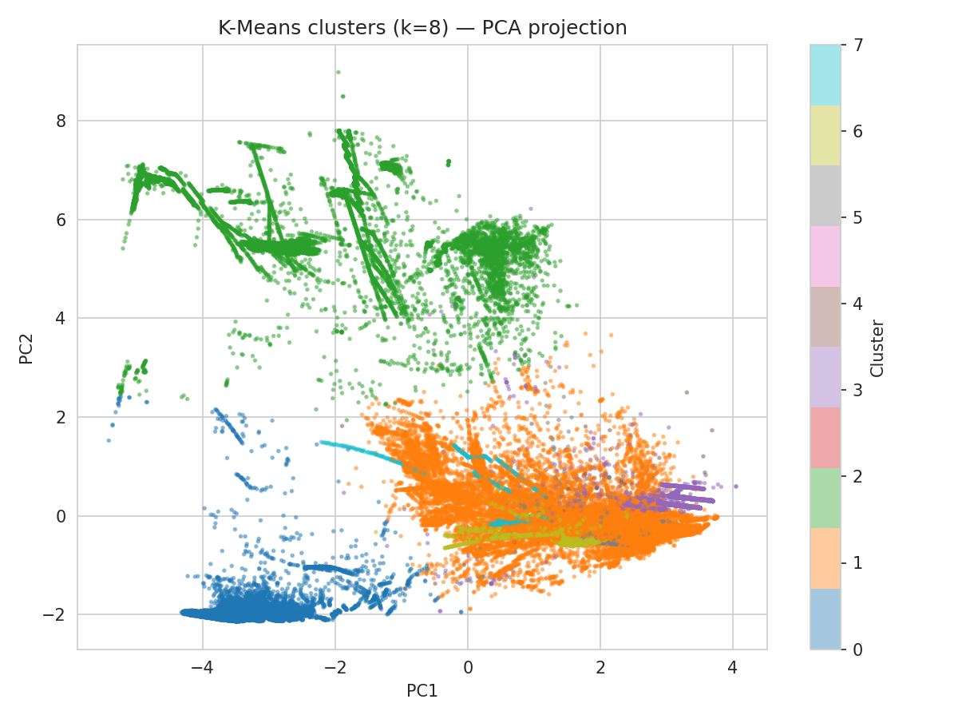
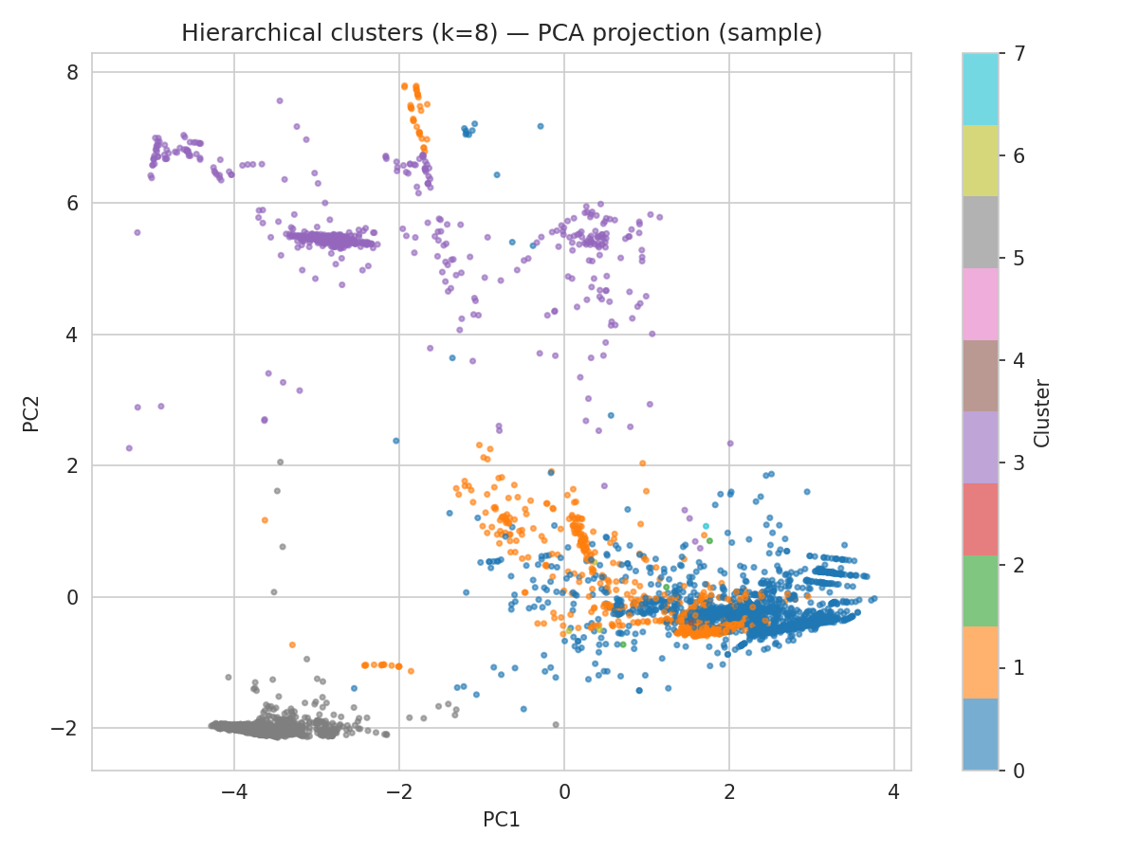
Results — PCA Cluster Visualizations
K-Means (k = 8)
Hierarchical (k = 8)
Both methods project the same preprocessed flow features onto two principal components. K-Means produces tighter, more balanced partitions across the traffic, while Hierarchical isolates several small, high-purity clusters but leaves more points in ambiguous transitional groups.

Slide 10
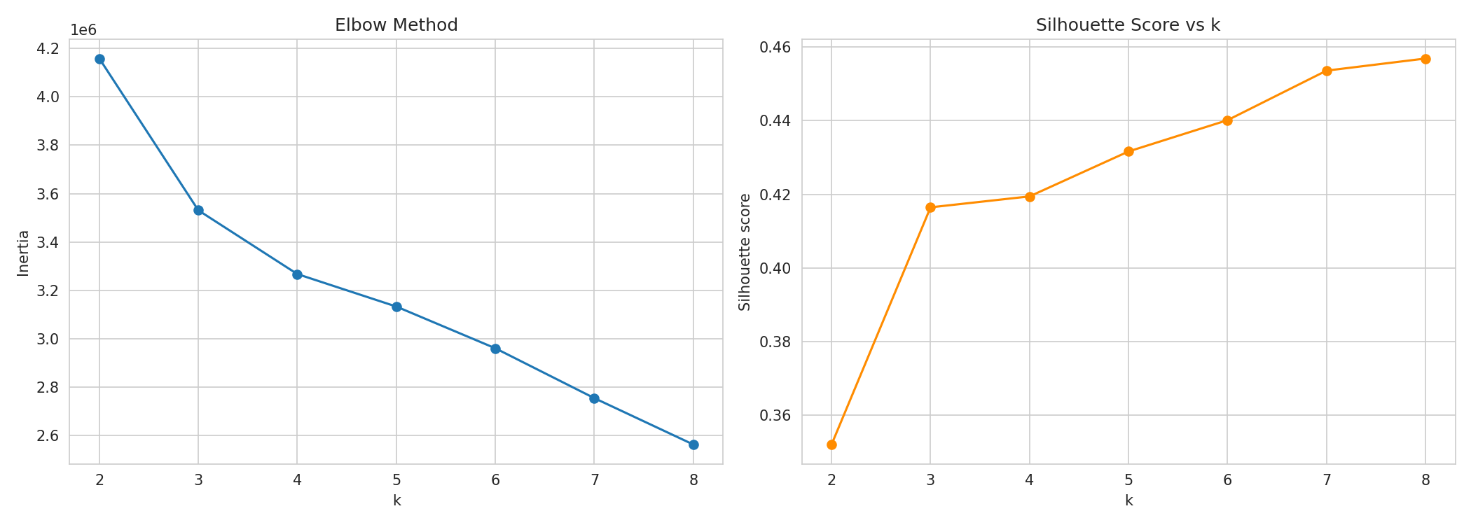
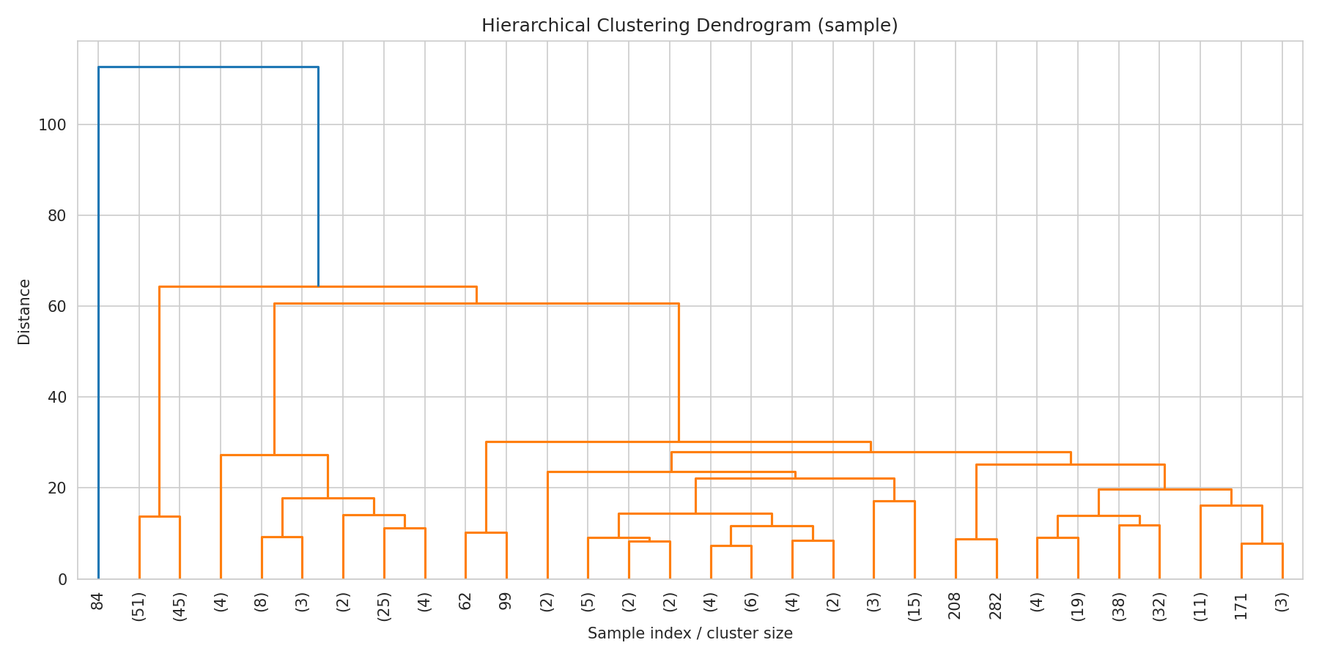
Results — Selecting k and Cluster Structure
Elbow curve and silhouette score across k = 2 to 8 — silhouette peaks at k = 8
Hierarchical dendrogram (sample) — large early merge distances support cutting the tree at k = 8

Slide 11
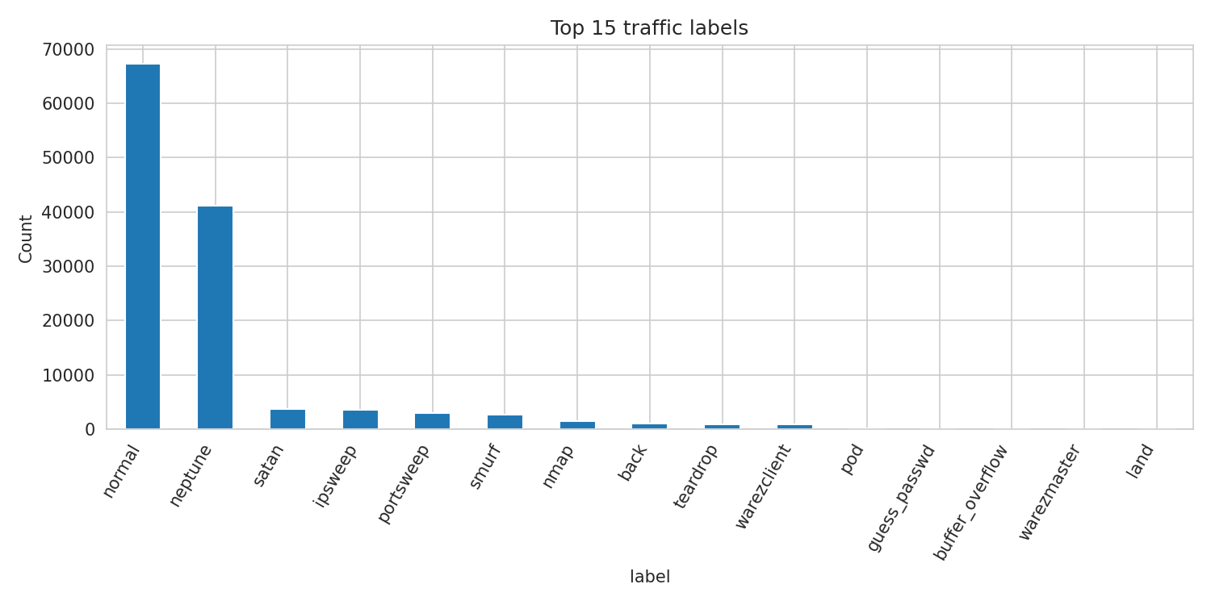
Results — Quantitative Comparison
Method | k | Silhouette Score | Davies-Bouldin Index | Cluster Purity | Adjusted Rand Index
K-Means | 8 | 0.457 | 0.867 | 92.1% | 0.505
Hierarchical | 8 | 0.435 | 1.053 | 87.8% | 0.416
K-Means (k = 8) attains the higher silhouette score, the lower Davies–Bouldin index, and the higher cluster purity, and its clusters align more closely with the CICIDS2017 ground-truth labels (Adjusted Rand Index 0.505 vs. 0.416). Hierarchical clustering still isolates several small, very pure attack-only leaves that K-Means tends to merge into larger groups — a useful secondary lens on the same traffic.
Traffic label distribution — dominated by normal and neptune (DoS) traffic, with a long tail of rarer attack types

Slide 12


Conclusion & Practical Implications
Raw Traffic
Capture network flow records
Traffic Groups
Identify coherent clusters
Clustering
Apply unsupervised algorithms
Insights
Detect suspicious behaviour patterns
Unsupervised clustering can reveal hidden structure within network traffic.
K-Means gives partitioned groupings; Hierarchical reveals nested relationships — both are complementary.
The approach is intended to support analysts in prioritising and interpreting suspicious traffic patterns rather than replacing human judgement.
1 2
Comparison
K-Means → Partitioning (flat clusters)
Comparison
Hierarchical → Nested relationships (dendrogram)

Slide 13
THANK YOU
Questions & Discussion
Malicious Traffic Pattern Clustering Using K-Means and Hierarchical Clustering Team: Pakkiru Sai Harshith Reddy — 2520030375; Kasula Yashas — 2520030401

