Slide 1
ARM
Submitted To - Prof. Animesh Chaturvedi
PRIYANK SONKIYA 17DCS009
RACHIT JAIN 17UCS118
NISHA GOYAL 17UCS112
SHREYA KHANDELWAL 17UCS154

Slide 2
INTRODUCTION
ARM TEMPLATES.
MICROSOFT AZURE
VIRTUAL NETWORKS AND SUBNETS
INFRASTRUCTURE AS A SERVICE/CODE
VIRTUAL MACHINES
CPU ALERTS

Slide 3
ARM TEMPLATES :
MICROSOFT AZURE:
A JSON file to access/configure the MICROSOFT AZURE CLOUD.
Resources are network cards , virtual machines , hosted databases, etc .
Has the facility of incremental deployment i.e changes made to already existing resource group.
Templates offer the functioning of Infrastructure as a Code.
Built on a combination of Linux and Microsoft Windows operating systems.
Used for production, deployment, storage and platform cloud services .
Provisions for - Software (SaaS),Platform(PaaS), Infrastructure (IaaS) as a service.
Fulfills requirements of access controlled and hierarchical organisations.

Slide 4
INFRASTRUCTURE AS A SERVICE/CODE
VIRTUAL NETWORKS AND SUBNETS
provisioning computing infrastructure using definition files .
It is like treating servers , databases, network and other infrastructures as softwares and using a code to configure them.
Provides consistency and reduces redundancy
Heart of network architecture on Azure.
Can be configured using Azure portal, PowerShell and Azure CLI.
A Vnet can be partitioned into small sub-networks using subnetting which is called a SUBNETS.
OUR AIM: to set up Virtual Subnets using ARM templates.

Slide 5
CPU ALERTS
VIRTUAL MACHINES
A method to monitor CPU Metrics.
Metric alerts evaluate at regular intervals to check if conditions on one or more metric time-series are true
When threshold exceeded notify the concerned authority .
Can result the efficient and sustainable use of resources.
OUR AIM: to create alert of cpu utilisation of more than 70%.
VMs are a fundamental unit of computing in the cloud.
Similar to Physical devices (PDs) or Physical computers.
Used with the help of hypervisors i.e middlewares.
OUR AIM: to deploy VM via ARM TEMPLATES .

Slide 6
Problem Statement And Explorations
History
Earlier, setting up IT infrastructure has been a manual process.
This lead to problems such as - expenses for hiring professionals, poor quality and inconsistency.
Keif morris invented Infrastructure as a Code to overcome these.

Slide 7
Problem Statement and Our Ways
Problem 1
Creating Vnets with subnets is the most basic task and they are created in huge numbers so if we give manual input everytime to create them then it leads to inconsistency, wastage of time, energy and efforts.
Our Ways and Solutions
Firstly, we created an ARM template for Vnet with subnet and this reduced the redundancy at an exponential rate.
We deep dived into this subject and then implemented a loop inside this to create the number of subnets asked by the user.

Slide 8
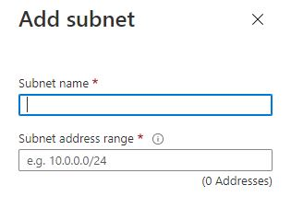
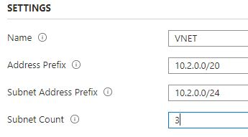
Before
After
Originally , we have to add each subnet like this
Now, we just have to tell the starting subnet address prefix and the count of subnets

Slide 9
Problem Statement and Our Ways
Problem 2
In industries, while creating VMs , we have too many OS image options available which leads to deploying a wrong VM, especially in case of a fresher. This leads to a lot of confusion and wastage of money which could be easily avoided by giving limited options and lead to simplicity .
Solutions
We made tweaks in our code (as shown in our git file) to limit the OS images to Ubuntu and Windows only. Also , VM size is also set there by default , which could be changed , but this avoids the mistake of sometimes selecting an expensive VM due to lack of knowledge.

Slide 10
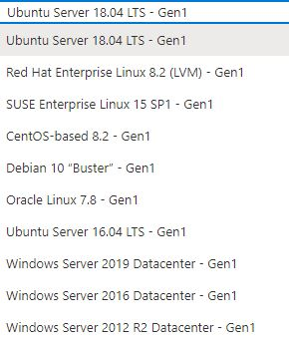

Before
After
We restricted the options of OS images to just 2

Slide 11
Problem Statement and Our Ways
Problem 3
Sometimes, there can be anomalous CPU utilisation which could lead to the VM exhibiting longer response time and inability to accept connections.
Solutions
We made changes in our code by exploiting the concept of CPU metric such that we are able to set certain threshold value, so if a particular VM uses more CPU than threshold, we get notified via email and we could look into the matter.

Slide 12
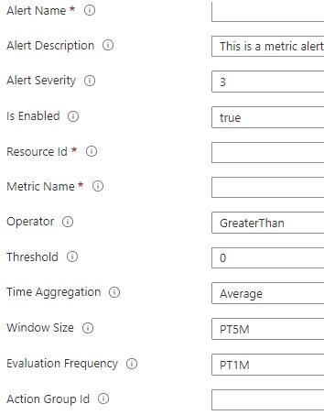
After
We have added only the after ARM template snippet as it was a multi step process and could not be depicted using a single snippet

Slide 13
Thank You.
PRIYANK SONKIYA 17DCS009
RACHIT JAIN 17UCS118
NISHA GOYAL 17UCS112
SHREYA KHANDELWAL 17UCS154

