Slide 1
Version Control Systems
(and an introduction to git)
Steven Fernandez <steve@lonetwin.net>
Jun 2009

Slide 2
What is a Version Control System ?
Editing documents is an iterative activity
Editing source code is an iterative, team activity
A Version Control System (VCS) is a tool which helps us control these activities by keeping track of changes using some manner of data versioning

Slide 3
Why do you need a VCS ?
Helps keep track of changes
  Multiple people typically work on the same code base, simultaneously
  Even with a single coder, the ability to track changes is very useful (for instance, to trace changes that introduced bugs)
Makes it easier to share changes, try out different ideas, revert to an earlier state ...etc

Slide 4
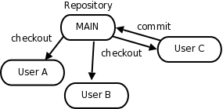
Types of VCS - Simple
Single central repository
All changes tracked in one place, everyone syncs with this main repository
Different branches of development tracked centrally and users work on the copy of a branch
Committing changes or changing the branch involves an update/sync with the server
Examples: cvs, svn

Slide 5
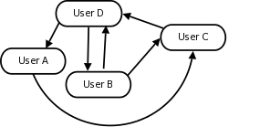
Types of VCS - Distributed
De-centralized repository
Changes tracked in individual repositories. Anyone can sync with any repository
Different branches of development tracked locally
Committing changes or changing branches an inexpensive and fast process
Examples: git, mercurial, bazaar

Slide 6
Introduction to GIT
Designed for distributed development
  Every repository is server as well as client
  Every repository has ability to track history of changes, create branches and sync with any other repository
Tracks content rather than files
Is especially suitable for large projects due to it's speed and it's cheap branching

Slide 7
Getting started with git
Installation:
Fedora: $ yum install git-core
Debian: $ apt-get install git-core
OpenSuse: $ yast install git-core
Mac: $ port install git-core
Windows: http://code.google.com/p/msysgit/
Source Code: http://kernel.org/pub/software/scm/git/
Git command line structure
$ git [action] <arguments>
OR
$ git-action <arguments>

Slide 8
Using git – A new project
Getting help
$ git help <command>
Create a repository
$ mkdir myproject
$ cd myproject
$ git init
Add files to the repository
...<create coolapp.c and coolapp.h>...
$ git add coolapp.c coolapp.h
Commit changes to the repository
$ git commit -m “Created my cool new app”

Slide 9
Using git – Basic Operations
$ vi coolapp.c # Modify your code
$ vi coolapp_client.c # Create a new file
$ git add coolapp_client.c # Tell git about your new file
$ git status # Get a summary of changes since your
# last commit
$ git commit -a -m “Included coolapp client API and created client”
$ git log # show commit logs

Slide 10
Using git – clone and pull
git clone
$ git clone git://git.kernel.org/pub/scm/.../linux-2.6 my2.6
$ cd my2.6
<make some changes>
$ git commit -m “Explain the changes” # commit to your repo.
$ git format-patch origin # Prepare a patch for submission
OR
$ <do nothing !> # Anyone can git-pull or git-clone
# from you
git pull
$ git pull <repository> # Pull changes from <repository> and
# merge into local git repository

Slide 11
Using git – Branches
$ git branch new_feature # create a branch
$ git branch # list all the existing branches
$ git checkout new_feature # switch current branch
<make changes>
$ git commit -a -m “describe changes”
$ git log master.. # see log since branching
$ git checkout -b exprerimental # create a branch and switch to it
<make changes>
$ git commit -a -m “describe changes”
$ git log master..experimental # see log since branching from
# master branch
$ git log new_feature..experimental # see log since branching from
# new_feature branch

Slide 12
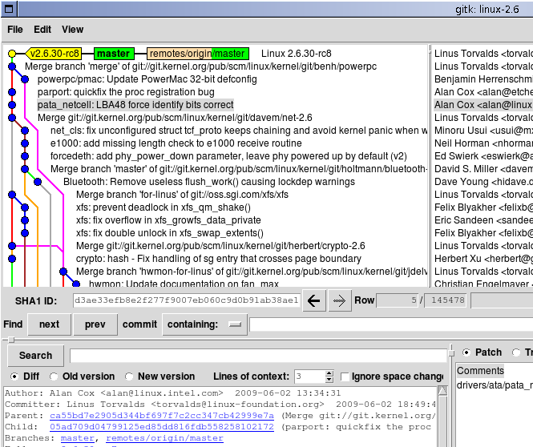
Using git – Tracking changes
$ gitk
$ git log –pretty=oneline foo
$ git diff 6e4291..f404d2e foo
$ git diff HEAD^..HEAD
$ git blame -L 40,60 foo
$ git blame v2.6.18.. -- foo
$ git tag v1.1
$ git revert 6e4291
$ git reset --hard

Slide 13
Resources
Version Control: http://en.wikipedia.org/wiki/Version_control
Essay and comparisons of different version control systems:
http://www.dwheeler.com/essays/scm.html
Introduction to git:
http://kernel.org/pub/software/scm/git/docs/v1.2.6/tutorial.html
Linux Torvalds on git:
http://www.youtube.com/watch?v=4XpnKHJAok8
Free hosting for projects using git:
  http://repo.or.cz
  http://github.com

