Slide 1

Notes:
Visual: Dark background with the title "What to Own in 2027 & Beyond" and a subtitle highlighting Fiscal Dominance and Lyn Alden's macro framework, alongside a visual of shipping containers and port cranes at night.
Estimated Speaking Time: 2 – 3 minutes
Speaker Notes:
"Welcome everyone. Let’s dive straight into the macro landscape shaping our financial future as we look toward 2027 and beyond. For decades, investors could rely on a predictable playbook: central banks controlled the business cycle, inflation was relatively tame, and monetary policy was the ultimate driver of asset prices.
But that old paradigm is gone. Today, we are entering a regime of fiscal dominance—a world defined by massive sovereign debt, structural inflation, and a fundamental shift back to the physical world. Grounded in the macroeconomic frameworks of Lyn Alden, author of Broken Money, this presentation serves as your tactical playbook. We are going to examine why traditional 60/40 portfolios are facing unprecedented headwinds, where the real risks lie in the tech and housing sectors, and how you can position your capital in hard assets, commodities, sovereign hedges, and private cash-flowing enterprises to protect and grow your wealth. Let’s unpack the core shift."
What to Own in 2027 & Beyond — Stocks, Gold, Bitcoin & the 1940s Warning | Lyn Alden
https://www.youtube.com/watch?v=0_cz8ZlZlXk

Slide 2
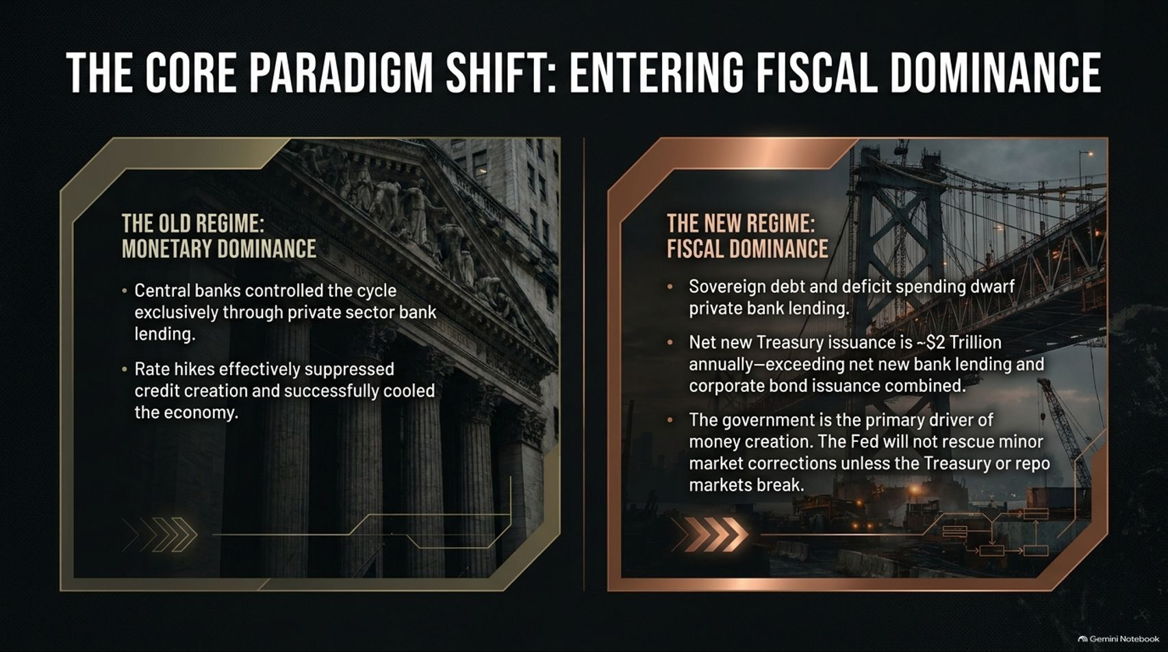
Notes:
Visual: A split comparison slide contrasting "The Old Regime: Monetary Dominance" (featuring classical pillars) against "The New Regime: Fiscal Dominance" (featuring a massive bridge and infrastructure grid), detailing how government debt and deficit spending dwarf private bank lending.
Estimated Speaking Time: 3 – 5 minutes
Speaker Notes:
"To understand where we are going, we first must understand the profound shift in how money is created in the global economy.
Under the old regime of Monetary Dominance, central banks controlled the economic cycle almost exclusively through private sector bank lending. When inflation spiked, the Federal Reserve hiked interest rates, successfully crushing private borrowing, cooling credit creation, and suppressing the economy.
Today, we have crossed the Rubicon into Fiscal Dominance. Sovereign debt and structural deficit spending now completely dwarf private bank lending. Net new Treasury issuance is running around $2 trillion annually—significantly exceeding net new bank lending and corporate bond issuance combined. The government, not private commercial banks, has become the primary driver of money creation. Consequently, the Fed's traditional rate-hiking toolkit is broken; they cannot easily rescue minor market corrections because doing so risks breaking the Treasury or repo markets. This structural shift changes every rule of asset allocation."

Slide 3
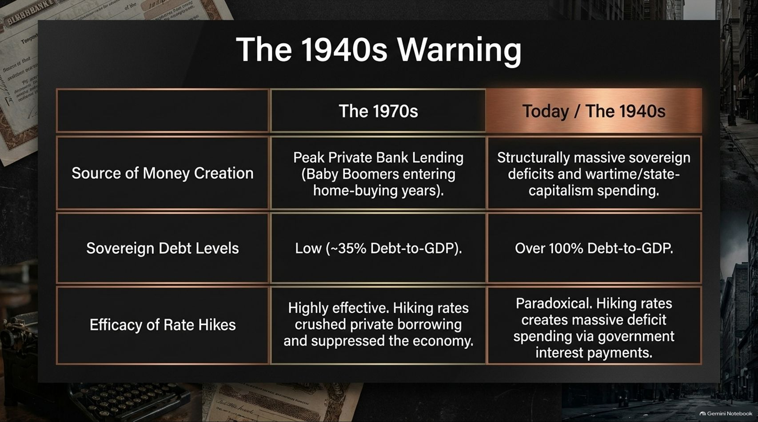
Notes:
Visual: A structured comparison table contrasting the 1970s inflation model against Today / The 1940s model across source of money creation, sovereign debt levels, and the efficacy of rate hikes.
Estimated Speaking Time: 3 – 4 minutes
Speaker Notes:
"When investors think about inflation, they instinctively look back to the 1970s. But Lyn Alden warns us that the 1970s is the wrong historical playbook for our current era. The better, albeit more sobering, historical parallel is the 1940s.
Look at the structural differences on this slide:
In the 1970s, the primary source of money creation was peak private bank lending, driven by Baby Boomers entering their home-buying years. Sovereign debt levels were relatively low at around 35% Debt-to-GDP. Because debt was low, rate hikes were highly effective at crushing private borrowing.
Today and the 1940s look entirely different. Sovereign debt exceeds 100% Debt-to-GDP, and money creation is driven by massive, structural government deficits and state-capitalism spending. Because debt is so high, rate hikes become paradoxical—instead of cooling the economy, high rates actually increase government interest expense payouts, injecting massive liquidity back into the economy. We are fighting 1940s problems with 1970s tools."

Slide 4
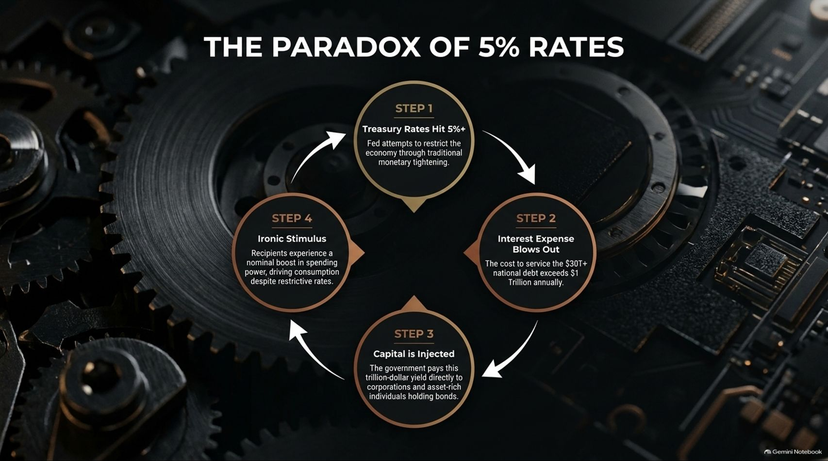
Notes:
Visual: A 4-step circular flowchart illustrating the feedback loop of high interest rates: Step 1 (Treasury Rates Hit 5%+), Step 2 (Interest Expense Blows Out past $1 Trillion annually), Step 3 (Capital is Injected directly to corporations and asset-rich individuals), and Step 4 (Ironic Stimulus driving consumption).
Estimated Speaking Time: 3 – 5 minutes
Speaker Notes:
"Let’s trace the mechanics of what we call The Paradox of 5% Rates. In traditional economic theory, pushing interest rates to 5% or higher should act as a severe macroeconomic brake, choking off activity and killing inflation. But under a 100%+ Debt-to-GDP regime, the transmission mechanism has inverted.
Let's follow the loop on screen:
Step 1: Treasury rates hit 5%+, with the Fed attempting traditional monetary tightening.
Step 2: Because the national debt exceeds $30+ trillion, the annual cost to service that debt blows out past $1 trillion.
Step 3: Instead of destroying money, the government takes that trillion-dollar interest expense and injects it directly back into the economy—paying juicy yields to corporations, money market holders, and asset-rich individuals.
Step 4: Recipients experience an ironic nominal boost in spending power, driving consumption and stoking the deficit further. High rates are acting as a government-funded spending program. That is fiscal dominance in action."

Slide 5
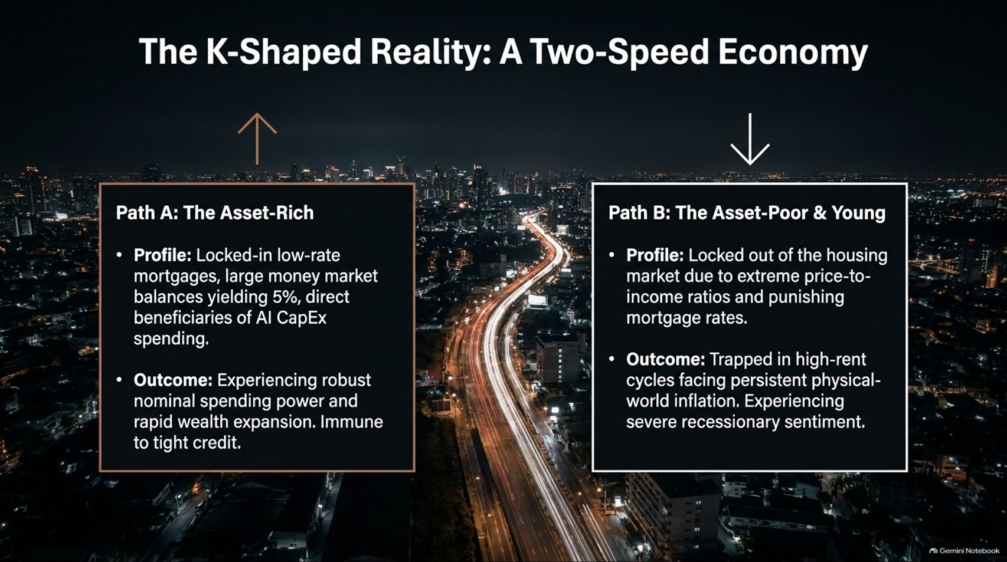
Notes:
Visual: A split city street layout comparing Path A: The Asset-Rich (locked-in low mortgages, 5% money market yields, AI beneficiaries) vs. Path B: The Asset-Poor & Young (locked out of housing, trapped in high-rent inflation).
Estimated Speaking Time: 3 – 4 minutes
Speaker Notes:
"Because of this fiscal feedback loop, the real economy is not experiencing a uniform cycle. We are living in a stark K-Shaped Reality: A Two-Speed Economy.
On Path A (The Asset-Rich), representing the top 10 to 20% of the population, consumers are thriving. They locked in ultra-low 3% mortgages years ago, their massive cash balances are yielding 5% in money markets, and they are direct beneficiaries of asset inflation and AI capital expenditure. They enjoy robust spending power and are completely immune to tight credit.
On Path B (The Asset-Poor and Young), the reality is punishing. Young families are completely locked out of the housing market due to extreme price-to-income ratios and punishing mortgage rates. They are trapped in high-rent cycles, bearing the brunt of persistent physical-world inflation, and reporting recessionary levels of consumer sentiment. Understanding this K-shaped split is vital for anticipating where consumer demand—and social pressure—will go next."

Slide 6
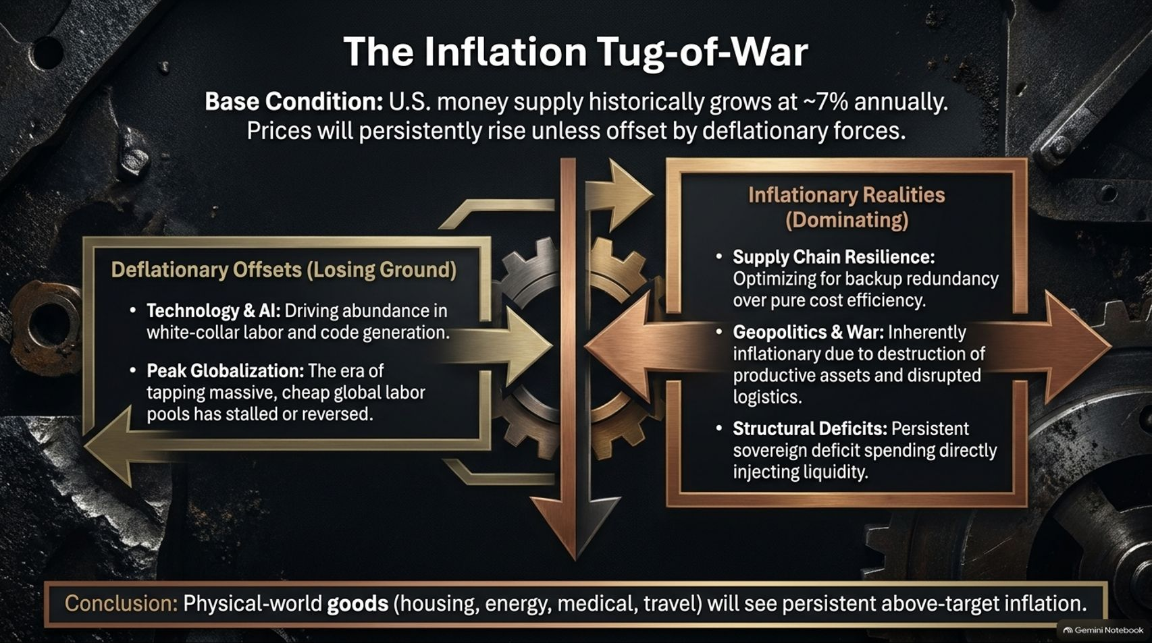
Notes:
Visual: A scale graphic balancing Deflationary Offsets (losing ground: Technology & AI, Peak Globalization) against Inflationary Realities (dominating: Supply Chain Resilience, Geopolitics & War, Structural Deficits).
Estimated Speaking Time: 4 – 5 minutes
Speaker Notes:
"We are currently locked in a fierce Inflation Tug-of-War. On one side, we have deflationary forces attempting to drag prices down: technological abundance driven by AI in white-collar labor, and code generation.
However, those deflationary offsets are rapidly losing ground to dominant inflationary realities:
Supply Chain Resilience: Corporations are intentionally sacrificing pure cost efficiency to build expensive backup redundancies.
Geopolitics & War: Armed conflict is inherently inflationary because it destroys productive assets, shatters infrastructure, and disrupts global logistics.
Structural Deficits: Persistent sovereign deficit spending continually injects unbacked liquidity into the system.
Conclusion: While digital goods and software will see hyper-deflation, physical-world essentials—housing, energy, medical care, and travel—will experience persistent, above-target inflation for years to come."

Slide 7
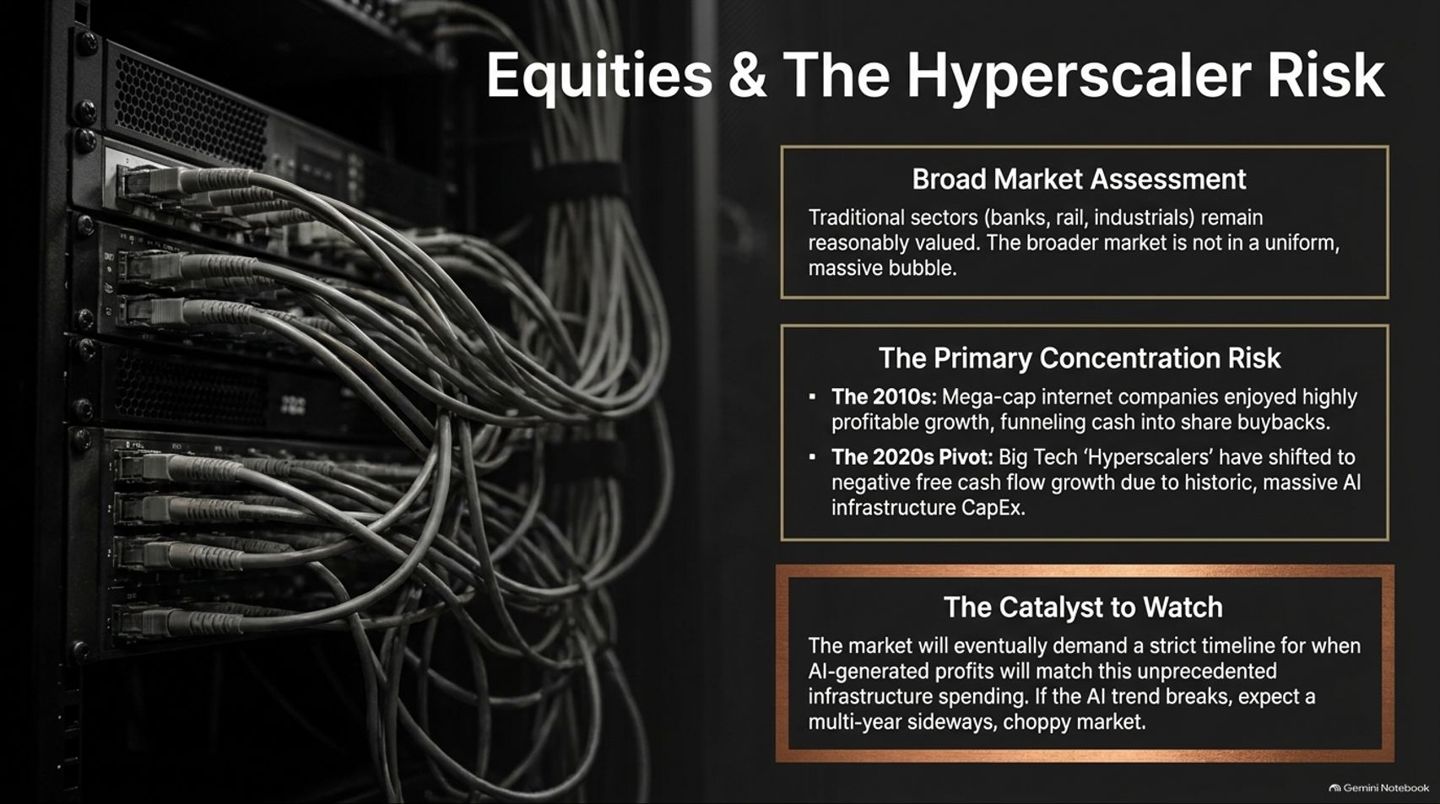
Notes:
Visual: Server racks and network cables framing three analytical boxes: Broad Market Assessment (industrials/banks reasonably valued), Primary Concentration Risk (from 2010s share buybacks to 2020s negative free cash flow AI CapEx), and The Catalyst to Watch.
Estimated Speaking Time: 3 – 5 minutes
Speaker Notes:
"Let’s look at the equity markets. Broadly speaking, the market is not in one uniform, massive bubble. Traditional sectors like banks, rails, and industrials remain reasonably valued.
The real danger lies in Concentration Risk. In the 2010s, mega-cap tech companies enjoyed highly profitable growth, funneling massive free cash flows into share buybacks. But in the 2020s, Big Tech 'Hyperscalers' have shifted dramatically. They are currently burning through historic, massive AI infrastructure CapEx, resulting in negative free cash flow growth.
The Catalyst to Watch: Wall Street's patience is finite. The market will eventually demand a strict timeline and proof that AI-generated profits match this unprecedented capital expenditure. If that AI growth narrative stumbles, expect a multi-year, sideways, choppy market across the major indices."

Slide 8
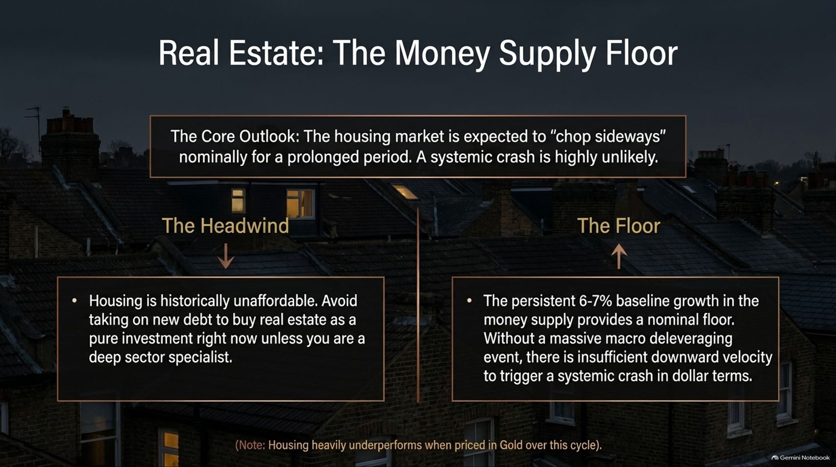
Notes:
Visual: Residential rooftops at dusk highlighting a core outlook of sideways nominal chop, contrasting 'The Headwind' (historical unaffordability) against 'The Floor' (6-7% baseline money supply growth).
Estimated Speaking Time: 3 – 4 minutes
Speaker Notes:
"In real estate, investors are constantly asking whether a massive systemic crash is coming. Our core outlook is that the housing market is expected to chop sideways nominally for a prolonged period, making a systemic crash highly unlikely.
Let's weigh the forces:
The Headwind: Housing is historically unaffordability-constrained. Taking on new debt to buy real estate as a pure investment right now is mathematically unappealing unless you are a deep sector specialist.
The Floor: Beneath the market sits a powerful nominal floor—the persistent 6% to 7% baseline growth in the broad money supply. Without a catastrophic macro deleveraging event, there is simply insufficient downward velocity in dollar terms to trigger a systemic crash.
Note: While nominal prices stay sticky, housing heavily underperforms when priced in Gold over this macroeconomic cycle."

Slide 9
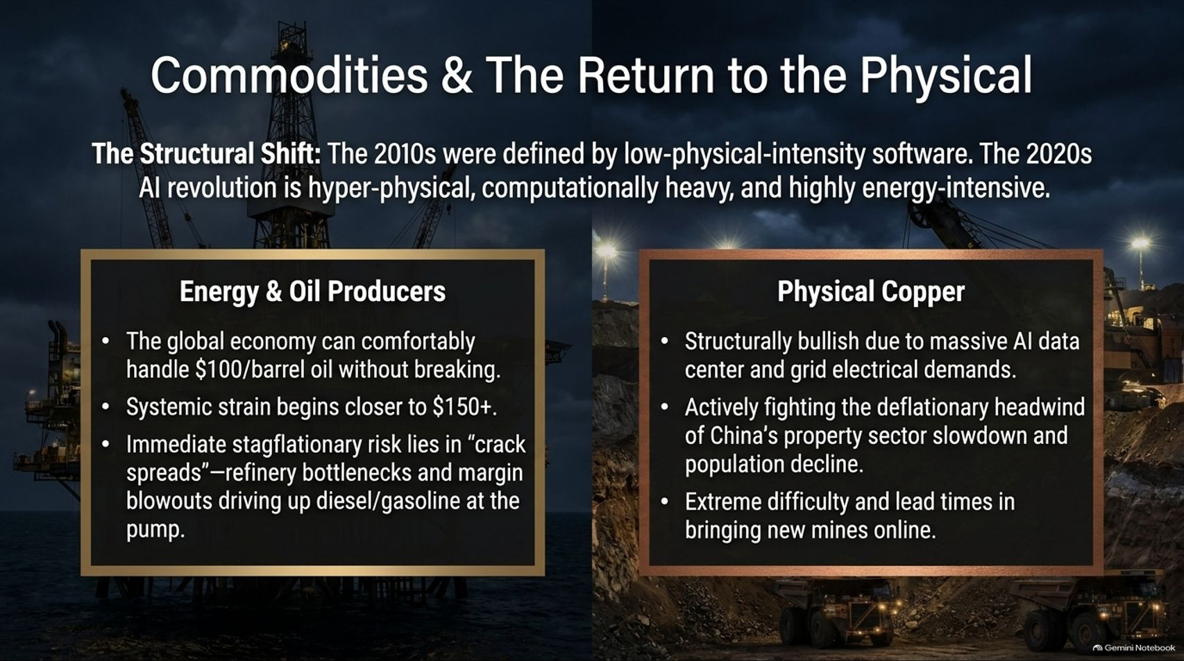
Notes:
Visual: An offshore oil rig and mining trucks at night illustrating the structural shift from low-physical-intensity software (2010s) to hyper-physical, energy-intensive AI infrastructure (2020s).
Estimated Speaking Time: 4 – 5 minutes
Speaker Notes:
"The defining structural shift of this decade is a hard pivot away from the 2010s, which were dominated by low-physical-intensity software and social media. The 2020s AI and data center revolution is hyper-physical, computationally heavy, and immensely energy-intensive.
Let's look at two critical commodity pillars:
Energy & Oil Producers: The global economy can comfortably handle $100/barrel oil without breaking, with systemic strain occurring closer to $150+. The immediate stagflationary risk lies in 'crack spreads'—refinery bottlenecks and margin blowouts driving up diesel and gasoline prices at the pump.
Physical Copper: Structurally bullish due to explosive AI data center and electrical grid demands. Copper is actively fighting the deflationary headwind of China’s property sector slowdown and population decline, but extreme lead times in bringing new mines online create a massive long-term supply deficit."

Slide 10

Notes:
Visual: Stacks of international currency (Yen, Euros, Dollars) highlighting the de-dollarization reality, sovereign rejection of Treasuries, and the structural hard asset rotation.
Estimated Speaking Time: 3 – 4 minutes
Speaker Notes:
"One of the most profound macro turning points of our era is that we have likely hit 'Peak Treasury' regarding the U.S. Dollar’s share of global reserves.
This de-dollarization reality unfolds in three distinct stages:
Sovereign Rejection: Initiated largely by China around 2013–2014 during the Belt and Road rollout, global central banks and sovereign entities are no longer interested in accumulating massive, unhedged troves of U.S. Treasuries.
Seeking Alternatives: Capital is actively seeking non-sovereign, censorship-resistant alternatives.
The Hard Asset Rotation: While high 5% yields still attract marginal private capital seeking short-term yield, the structural, long-term public sector capital rotation out of Treasuries and into physical hard assets has already begun."

Slide 11

Notes:
Visual: A solid gold bar resting on dark industrial machinery, outlining technical consolidation above the $3,900 base and gold's return to the center of the global financial system.
Estimated Speaking Time: 3 – 4 minutes
Speaker Notes:
"Gold has undergone a historic repricing, surging past $2,400 and testing higher psychological thresholds. Following this rapid run, gold is no longer deeply undervalued as it was at $1,500; it requires a sustained period of base-building.
Looking forward, a healthy technical setup requires holding a baseline in the upper $3000s (near $3,900) without making lower lows.
The Fundamental Driver: Gold is shifting decisively back to the center of the global financial architecture. Central banks across the globe are structurally accumulating the metal as the premier sovereign hedge against fiscal dominance, currency debasement, and geopolitical fragmentation. Short-term consolidation is a feature, not a bug, of a secular bull market."

Slide 12
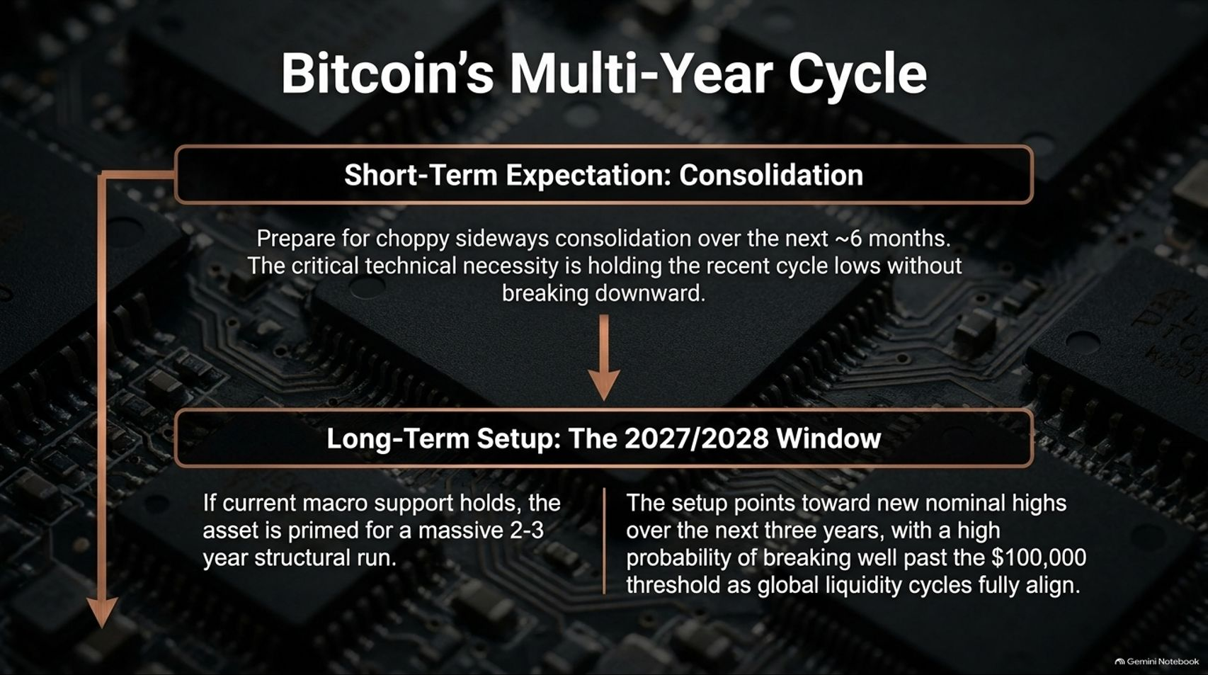
Notes:
Visual: Computer microchips and circuit boards highlighting Bitcoin's short-term consolidation phase and the 2027/2028 multi-year structural run toward new nominal highs.
Estimated Speaking Time: 3 – 4 minutes
Speaker Notes:
"Turning to Bitcoin, we view its trajectory through a multi-year lens.
Short-Term Expectation (Consolidation): Prepare for choppy, sideways consolidation over a multi-month window. The critical technical necessity is holding recent cycle lows without breaking downward.
Long-Term Setup (The 2027/2028 Window): If current macro support holds and global liquidity cycles align, the asset is primed for a massive 2-to-3-year structural run. The setup points toward new nominal highs over the next three years, with a high probability of breaking well past the $100,000 threshold as sovereign debt monetization accelerates globally."

Slide 13
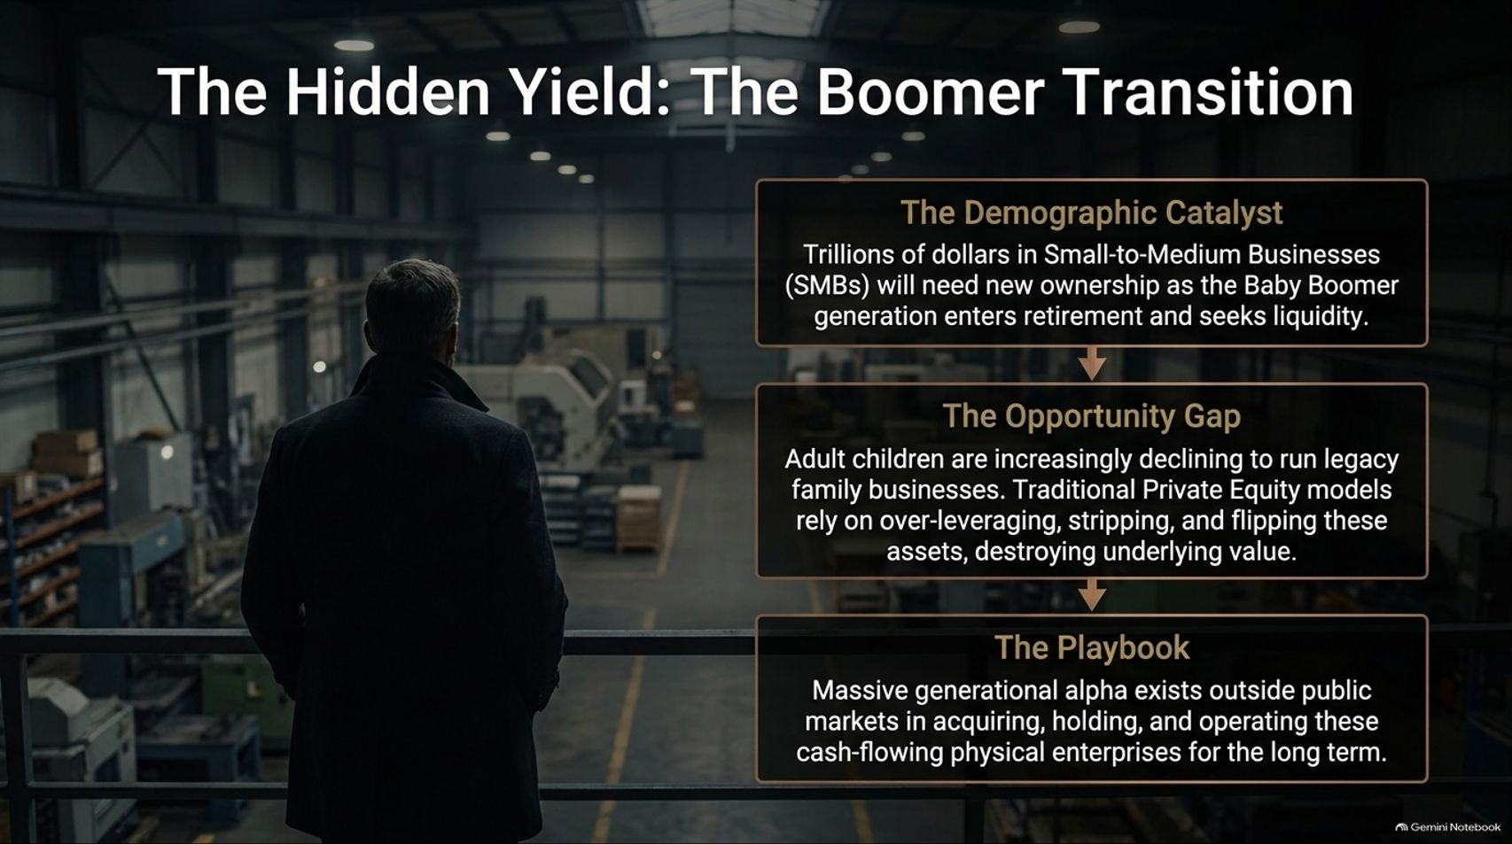
Notes:
Visual: A silhouetted business owner overlooking a manufacturing warehouse, detailing the demographic catalyst of retiring Baby Boomers, the private equity gap, and the acquisition playbook.
Estimated Speaking Time: 4 – 5 minutes
Speaker Notes:
"Beyond public equities and crypto lies an extraordinary pocket of generational alpha: The Boomer Business Succession.
Consider the demographic catalyst: Trillions of dollars in Small-to-Medium Businesses (SMBs) across the Western world need new ownership as the Baby Boomer generation enters retirement and seeks liquidity. The problem? Adult children are increasingly declining to run legacy family businesses. Meanwhile, traditional Private Equity models rely on over-leveraging, aggressive cost-cutting, and short-term flipping, which often destroys underlying operational value.
The Playbook: Massive generational alpha exists outside public markets in acquiring, holding, and operating these cash-flowing physical enterprises for the very long term—mirroring the Berkshire Hathaway model. This is the ultimate defensive yield."

Slide 14
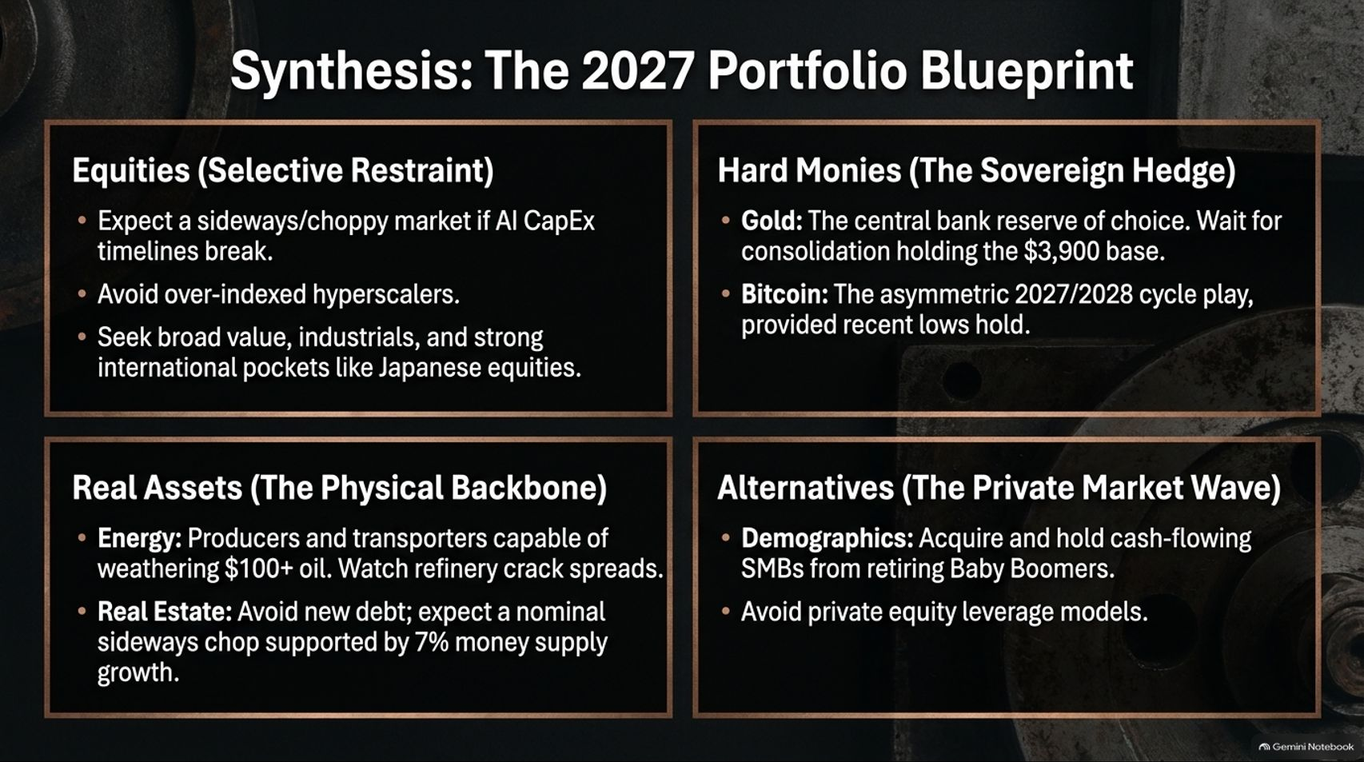
Notes:
Visual: A four-quadrant executive summary layout breaking down Equities, Hard Monies, Real Assets, and Alternatives into a concrete 2027 portfolio strategy.
Estimated Speaking Time: 4 – 5 minutes
Speaker Notes:
"Let’s synthesize everything into our 2027 Portfolio Blueprint:
Equities (Selective Restraint): Expect a choppy market if AI CapEx timelines break. Avoid over-indexed hyperscalers and seek broad value, industrials, and strong international pockets like Japanese equities.
Hard Monies (The Sovereign Hedge): Own Gold as the central bank reserve of choice, waiting for consolidation holding the $3,900 base. Position in Bitcoin as an asymmetric 2027/2028 cycle play, provided technical lows hold.
Real Assets (The Physical Backbone): Hold energy producers and transporters capable of weathering $100+ oil while monitoring refinery crack spreads. Avoid new real estate debt, expecting nominal sideways chop supported by 7% money supply growth.
Alternatives (The Private Market Wave): Acquire and hold cash-flowing SMBs from retiring Baby Boomers while avoiding predatory private equity leverage models."

Slide 15
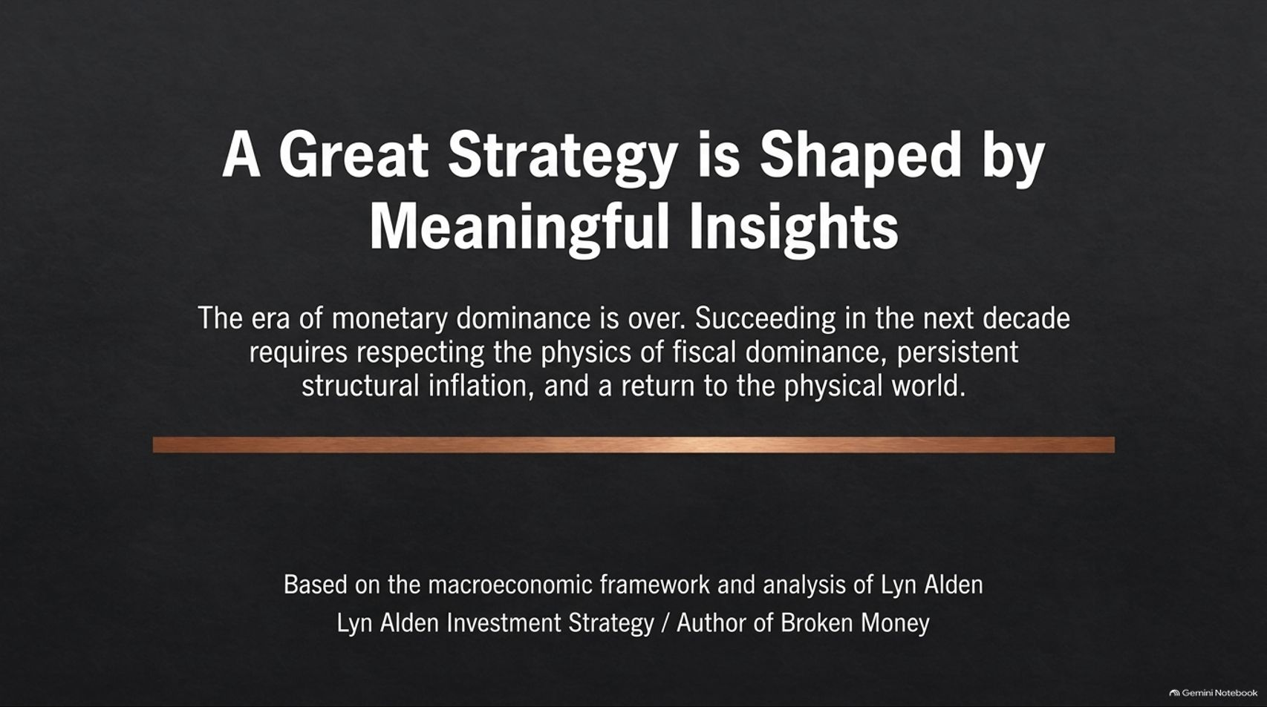
Notes:
Visual: Clean, dark closing slide emphasizing that the era of monetary dominance is over, requiring investors to respect the physics of fiscal dominance and return to the physical world.
Estimated Speaking Time: 2 – 3 minutes
Speaker Notes:
"As we wrap up, remember this core truth: A great strategy is shaped by meaningful insights.
The era of monetary dominance is officially over. Succeeding in the next decade requires respecting the unforgiving physics of fiscal dominance, persistent structural inflation, and a definitive return to the physical world. Whether through gold, energy, copper, or cash-flowing private businesses, aligning your portfolio with hard assets is no longer just a defensive hedge—it is the primary offensive strategy for the years ahead. Thank you."

Slide 16

Notes:
Visual: Comprehensive summary slide featuring a navigation compass, historical inflation comparison graphics, commodity supply chains, hyperscaler CapEx metrics, gold reserves, and a multi-asset market outlook scorecard.
Estimated Speaking Time: 3 – 5 minutes
Speaker Notes:
"We leave you with our comprehensive master summary slide: Navigating Macro Shifts: Market Risks and Opportunities for 2027 and Beyond.
Look across the scoreboard:
Fiscal Dominance & High Rates: Anchor your strategy around $1 trillion+ interest expenses and debt expansion.
Asset Outlook: Equities are selectively fair to choppy; Gold and Bitcoin are structurally bullish long-term; Real Estate remains neutral with sticky nominal pricing.
The Big Picture: The global economy is entering a regime where foreign central banks reject Treasuries, hyperscalers face profit scrutiny, and physical infrastructure dictates returns.
Re-evaluate your asset classes, monitor your risk exposures, and embrace the hard asset transition. Thank you for your time."

