Slide 1
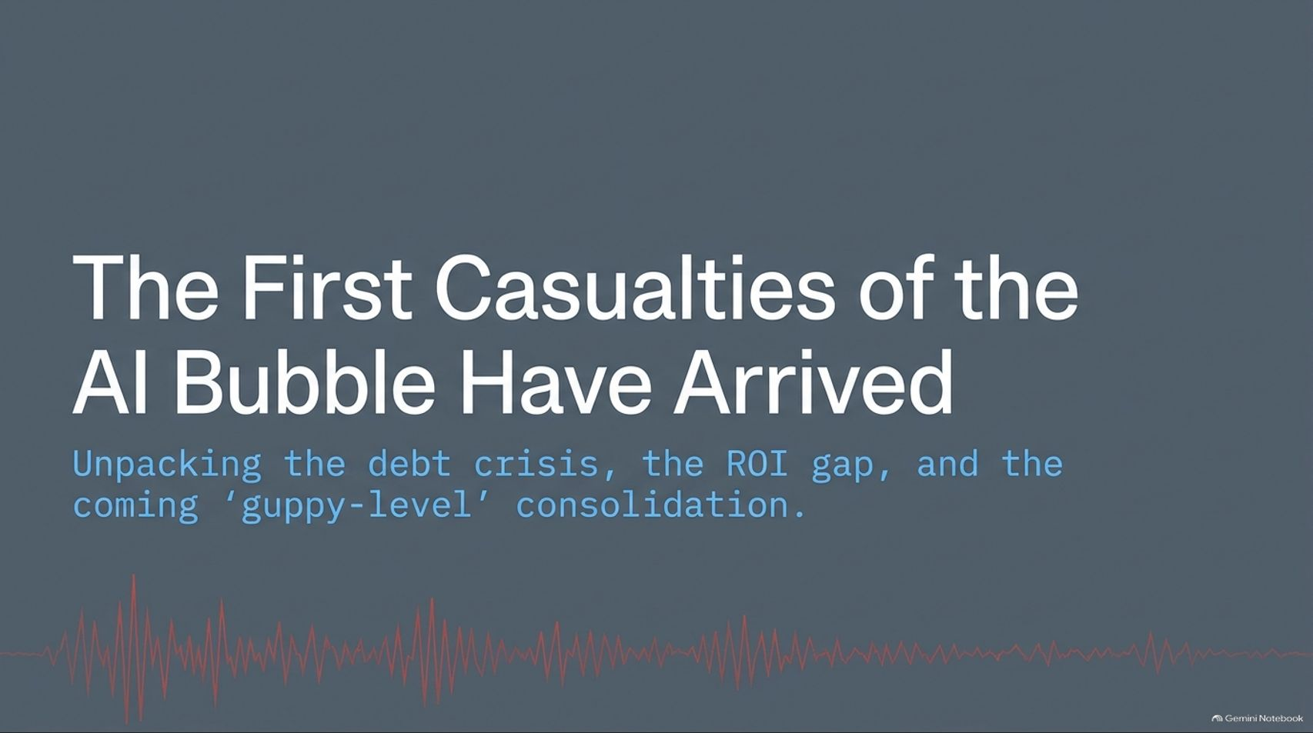
Notes:
Visual: Dark gray title slide with the text "The First Casualties of the AI Bubble Have Arrived", the subtitle "Unpacking the debt crisis, the ROI gap, and the coming 'guppy-level' consolidation", and an audio waveform graphic at the bottom.
Estimated Speaking Time: 2 – 3 minutes
Speaker Notes:
"Welcome everyone. Let’s address the elephant in the room right away. For the past few years, the narrative surrounding artificial intelligence has been linear, euphoric, and seemingly unstoppable: endless growth, infinite capital, and a technological revolution that would change everything overnight. But today, the tone in the markets is shifting dramatically.
As we unpack in this briefing, the first actual casualties of the AI infrastructure and debt bubble have officially arrived. We are moving past the pure hype phase into a high-stakes reckoning. This presentation isn't about whether AI is a transformative technology—it absolutely is. Rather, it’s a hard look at the financial architecture underneath: the drying up of speculative debt, the widening chasm between tech sector gains and corporate S&P 493 returns, and the brutal consolidation wave hitting the over 200 'NeoClouds' currently floating on borrowed time. Let’s examine what is really happening beneath the surface."
The First Casualties of the AI Bubble Have Arrived
https://www.youtube.com/watch?v=zPUudfTrJxY

Slide 2
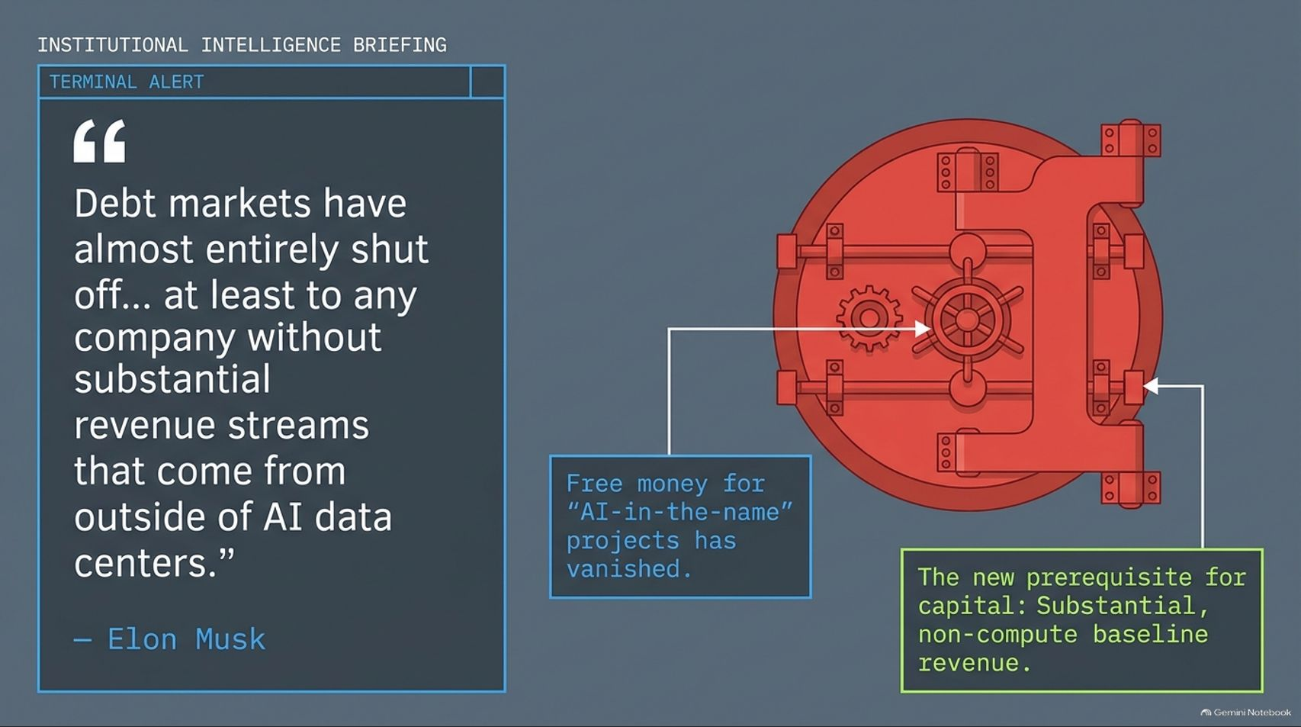
Notes:
Visual: An institutional intelligence terminal layout featuring a large red vault door graphic, a quote from Elon Musk stating, "Debt markets have almost entirely shut off... at least to any company without substantial revenue streams that come from outside of AI data centers." Callout boxes highlight that free money for "AI-in-the-name" projects has vanished and non-compute baseline revenue is now a prerequisite.
Estimated Speaking Time: 3 – 4 minutes
Speaker Notes:
"Let’s start with the hard macro reality straight from the front lines. Look at this alert on your screen, capturing Elon Musk’s recent observations from the debt markets. He notes directly that debt financing has almost entirely shut down—unless a company possesses substantial revenue streams coming from outside of AI data centers.
For the past few years, if you put 'AI' in your corporate deck or slapped together a pitch for a GPU-rental startup, venture capital and debt markets threw money at you. That era of free, speculative money is officially over. The vault door has slammed shut. Lenders are no longer willing to fund massive compute clusters based on pure narrative alone. The new prerequisite for capital is a robust, non-compute baseline revenue model. If you cannot survive without AI hype subsidies, the market is turning its back on you."

Slide 3
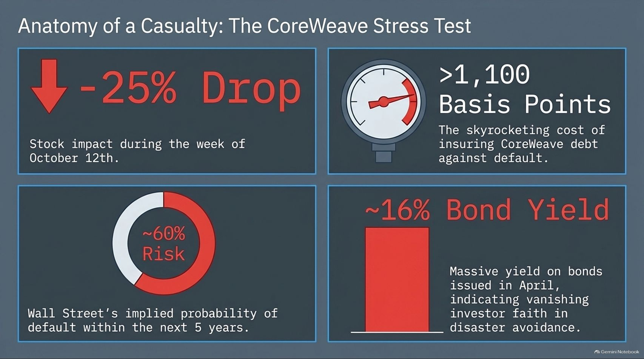
Notes:
Visual: A four-quadrant financial breakdown showing a -25% stock drop during the week of October 12th, a pressure gauge showing >1,100 basis points for debt default insurance, a risk ring indicating ~60% implied probability of default over 5 years, and a bar chart showing a ~16% bond yield.
Estimated Speaking Time: 3 – 5 minutes
Speaker Notes:
"To understand how quickly market sentiment can turn, we only need to look at the poster child of the NeoCloud stress test: CoreWeave. Look at the data points on this slide. During the week of October 12th alone, the market applied immediate pressure.
More alarming is the credit and debt market's verdict: the cost of insuring CoreWeave's debt against default blew past 1,100 basis points, reflecting Wall Street’s pricing of an implied 60% probability of default within the next five years. Furthermore, bonds issued earlier in the year are sitting at a staggering 16% bond yield. When bond yields and credit default swaps spike to these levels, it's a flashing red light indicating that investor faith in disaster avoidance is evaporating. The market is pricing in distress, and the cracks in the GPU-financing pipeline are widening."

Slide 4
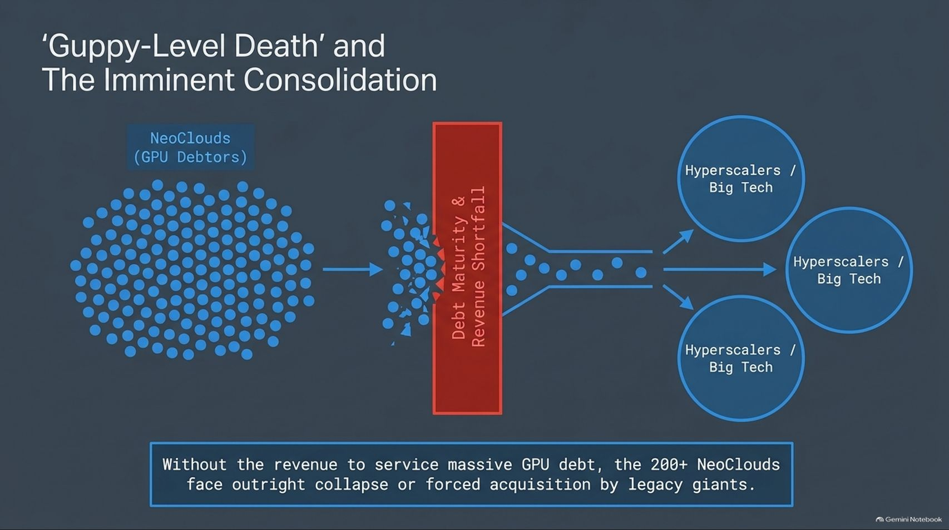
Notes:
Visual: A flowchart showing a dense swarm of blue dots representing 'NeoClouds (GPU Debtors)' funneling through a red barrier labeled 'Debt Maturity & Revenue Shortfall', filtering down into three major blue circles labeled 'Hyperscalers / Big Tech'.
Estimated Speaking Time: 3 – 4 minutes
Speaker Notes:
"What happens when the debt markets shut down for companies whose entire business model relies on borrowing billions to buy Nvidia GPUs and renting them out? Elon Musk termed it bluntly: 'Guppy-level death' and consolidation.
Right now, there are over 200 independent NeoClouds operating in this space. They loaded up on massive debt to purchase bleeding-edge hardware. But as revenue fails to keep pace with debt maturities, these smaller players are hitting a brick wall. Without a diversified revenue stream, they face two options: outright bankruptcy and liquidation, or forced acquisition pennies on the dollar by legacy tech giants and hyperscalers. The 200+ independent NeoClouds are about to be digested by the apex predators of Big Tech."

Slide 5
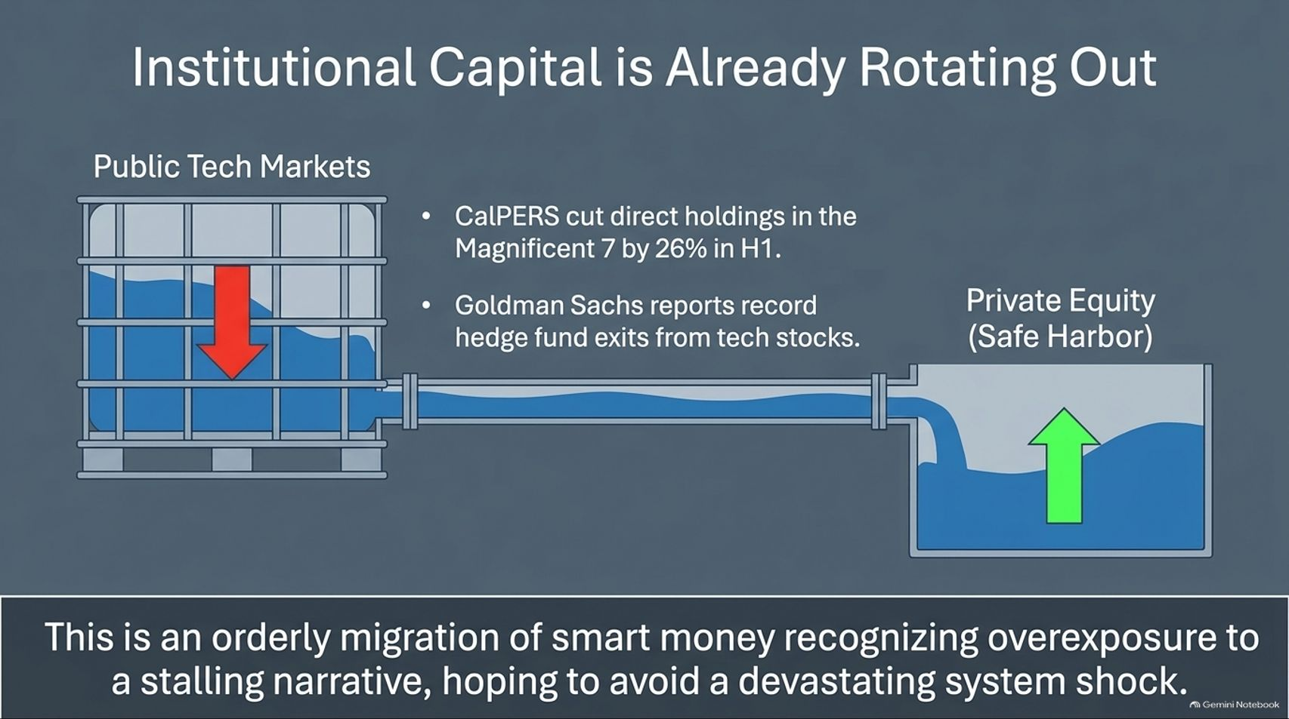
Notes:
Visual: A financial tank diagram showing fluid draining from 'Public Tech Markets' (with a red down arrow as CalPERS cuts holdings by 26% and hedge funds exit) via a pipe into 'Private Equity (Safe Harbor)' where fluid levels are rising with a green up arrow.
Estimated Speaking Time: 3 – 4 minutes
Speaker Notes:
"Smart money doesn't wait for the headline crash; it rotates quietly in advance. Look at where institutional capital is flowing right now. Public tech markets are seeing major institutional pullbacks. For instance, CalPERS cut its direct holdings in the Magnificent 7 by 26% in the first half of the year, and Goldman Sachs prime brokerage reports record hedge fund exits from tech stocks.
Where is that capital going? It’s flowing through the pipe into private equity and safe harbor defensive assets. This is an orderly, calculated migration of institutional capital recognizing overexposure to a stalling narrative. They are de-risking their portfolios to avoid getting caught in a cascading system shock when the broader market wakes up to the capital expenditure mismatch."

Slide 6
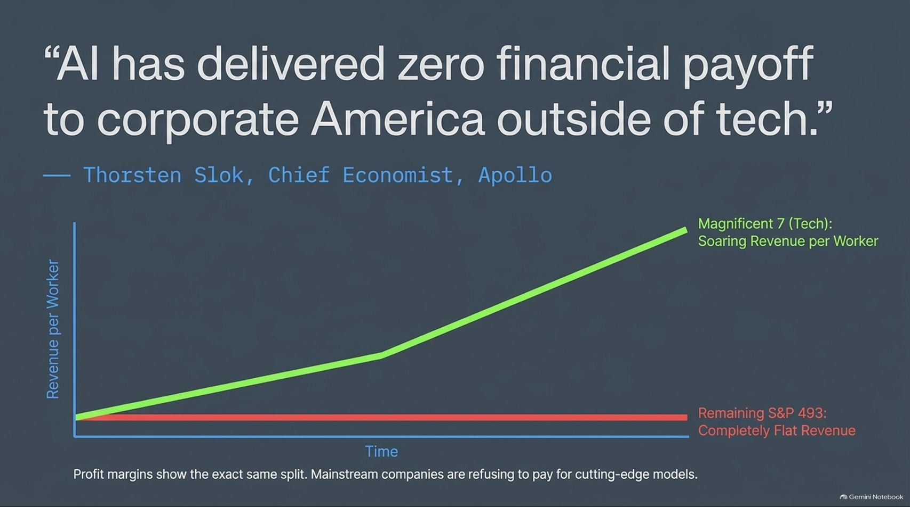
Notes:
Visual: A quote banner from Thorsten Slok, Chief Economist at Apollo, paired with a line chart showing a sharp green upward slope for 'Magnificent 7 (Tech): Soaring Revenue per Worker' and a completely flat red line at the bottom for 'Remaining S&P 493: Completely Flat Revenue'.
Estimated Speaking Time: 4 – 5 minutes
Speaker Notes:
"This brings us to the macroeconomic bombshell dropped by Thorsten Slok, the Chief Economist at Apollo—one of the largest private credit managers in the world. His stark conclusion is that AI has delivered zero financial payoff to corporate America outside of tech.
Look at the chart on this slide. The green line shows the Magnificent 7—pure-play tech giants—experiencing soaring revenue per worker. But look at the flat red line at the bottom: the remaining 493 companies in the S&P 500 have seen completely flat revenue growth attributed to AI. Profit margins show the exact same split. Mainstream, non-tech corporate America is looking at cutting-edge AI models and realizing they aren't willing to pay top dollar for them. They are starting to view token spending not as a growth engine, but as a margin-draining cost center."

Slide 7
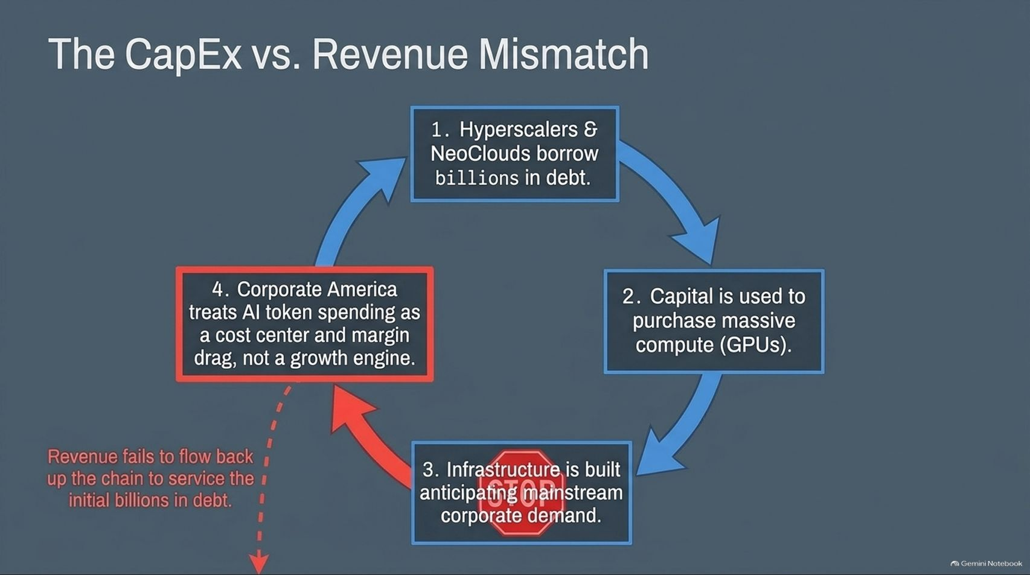
Notes:
Visual: A circular 4-step flowchart showing: 1. Hyperscalers & NeoClouds borrow billions in debt, 2. Capital is used to purchase massive compute (GPUs), 3. Infrastructure is built anticipating mainstream corporate demand (halted by a red STOP sign), and 4. Corporate America treats AI token spending as a cost center, with a red dashed arrow leaking downward showing revenue failing to service the initial debt.
Estimated SpeakingTime: 3 – 4 minutes
Speaker Notes:
"When you map out the financial lifecycle of the current AI buildout, you expose a dangerous structural mismatch. Let’s trace the loop on screen:
Hyperscalers and NeoClouds borrow billions in debt.
That capital is immediately converted into massive compute clusters—buying up every GPU available.
Massive data center infrastructure is built, anticipating that mainstream corporate America will line up to buy enterprise AI solutions.
But as Slok pointed out, corporate America treats AI token usage as a cost center rather than a growth driver.
Look at the red arrow at the bottom: the expected revenue fails to flow back up the chain to service those initial billions in debt. That is the core fracture in the AI bubble."

Slide 8
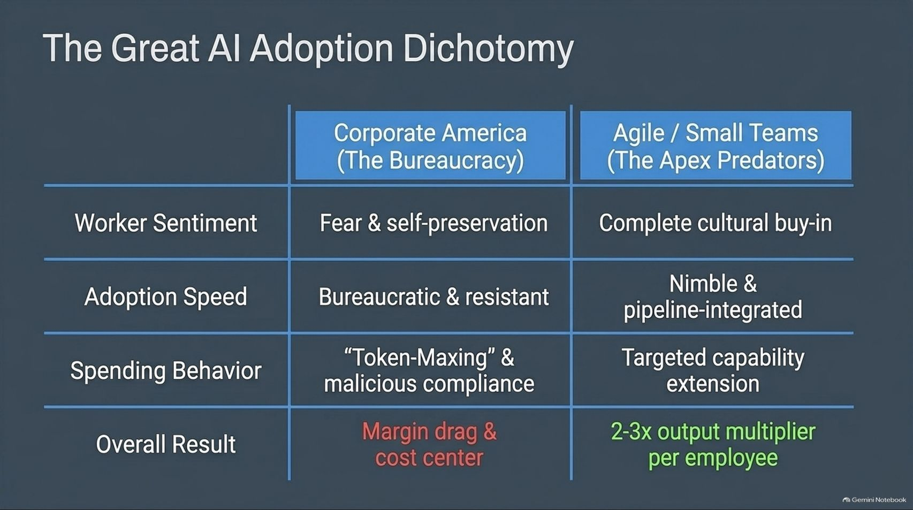
Notes:
Visual: A comparison table contrasting 'Corporate America (The Bureaucracy)' against 'Agile / Small Teams (The Apex Predators)' across worker sentiment, adoption speed, spending behavior, and overall result.
Estimated Speaking Time: 3 – 5 minutes
Speaker Notes:
"Why is there such a massive disconnect between tech sector hype and mainstream corporate reality? It comes down to The Great AI Adoption Dichotomy shown on this slide.
On the left, we have Corporate America—the massive bureaucracy. Worker sentiment is driven by fear and self-preservation. Adoption is slow and resistant because of middle management. Spending behavior is characterized by 'token-maxing' and malicious compliance, resulting in a margin drag and a costly overhead burden.
On the right, look at agile small teams—the apex predators. They have complete cultural buy-in. Their adoption is nimble and deeply integrated into their operational pipelines. Their spending is targeted, and their overall result is a 2 to 3x output multiplier per employee. The technology works brilliantly, but traditional corporate culture is built to reject it."

Slide 9
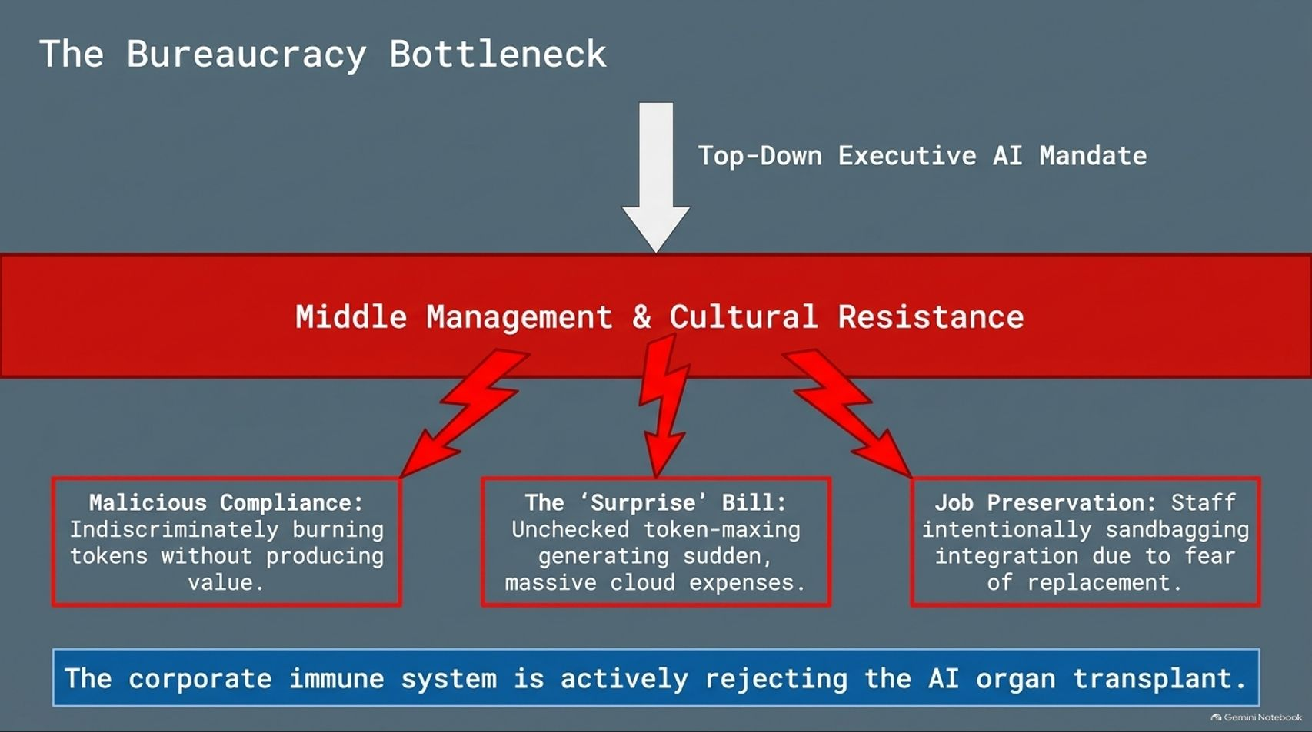
Notes:
Visual: A diagram showing a top-down executive AI mandate crashing into a red barrier labeled 'Middle Management & Cultural Resistance', which triggers three fault lines: Malicious Compliance, The 'Surprise' Bill, and Job Preservation. A concluding banner states that the corporate immune system is rejecting the AI organ transplant.
Estimated Speaking Time: 3 – 5 minutes
Speaker Notes:
"Let’s look closer at why mainstream corporations are failing to capture ROI. When a CEO issues a top-down executive AI mandate, it crashes directly into the brick wall of middle management and cultural resistance.
This resistance manifests in three toxic ways:
Malicious Compliance: Employees indiscriminately burn tokens and run queries without any strategic intent, generating zero business value.
The 'Surprise' Bill: Unchecked token-maxing results in massive, unexpected cloud infrastructure bills that shock CFOs who thought AI would magically save money.
Job Preservation: Terrified staff intentionally sandbag AI integration because they view automation as a direct threat to their employment.
To borrow a biological metaphor: The corporate immune system is actively rejecting the AI organ transplant."

Slide 10
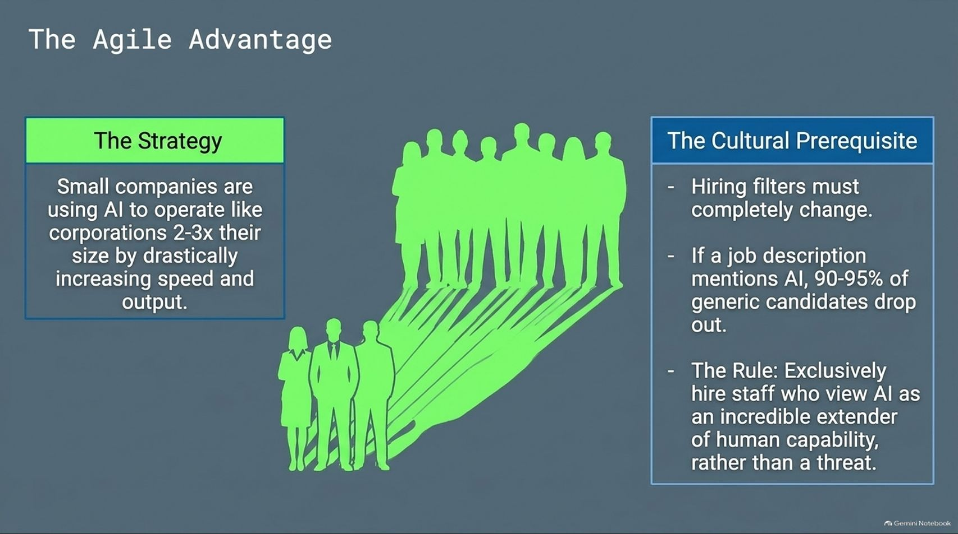
Notes:
Visual: A split layout showing a green strategy box on the left ("Small companies are using AI to operate like corporations 2-3x their size...") and a corporate silhouette casting giant green agile shadows, paired with cultural prerequisites for hiring on the right.
Estimated Speaking Time: 3 – 4 minutes
Speaker Notes:
"In stark contrast to traditional bureaucracies, small, nimble teams are leveraging AI to act like enterprises two to three times their size. How do they achieve this? It starts with a radical shift in their cultural prerequisites and hiring filters.
When these agile teams post a job description mentioning AI, 90 to 95% of generic candidates drop out immediately because they view it with fear. But that's a feature, not a bug. Their golden rule is to exclusively hire staff who view AI as an incredible extender of human capability rather than a threat. By eliminating cultural friction at the interview stage, they build an AI-native engine that out-innovates legacy competitors with a fraction of the headcount."

Slide 11
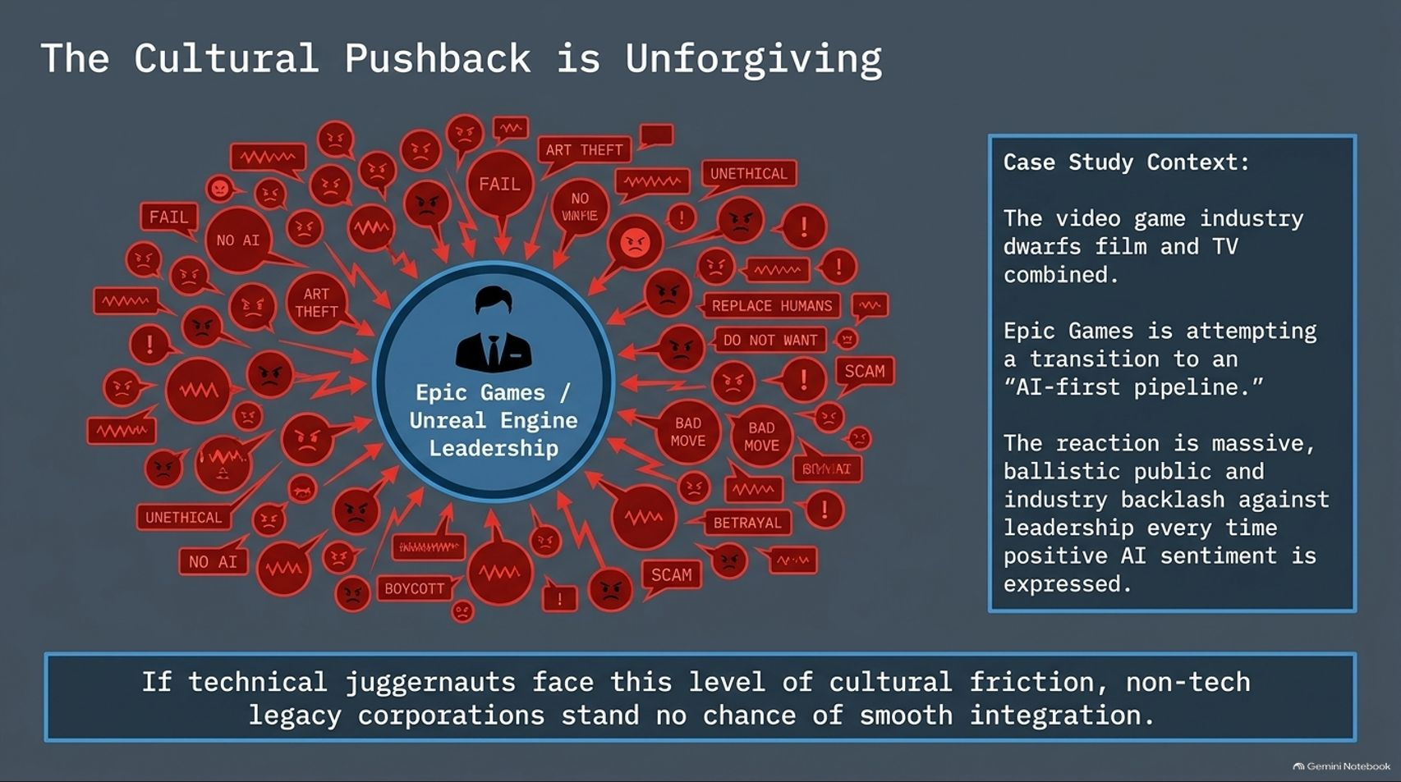
Notes:
Visual: A central icon representing 'Epic Games / Unreal Engine Leadership' surrounded by a chaotic swarm of red protest icons, angry chat bubbles, and tags like 'Art Theft', 'Fail', 'Unethical', and 'Boycott'. A case study box on the right outlines Epic Games' push into an AI-first pipeline.
Estimated Speaking Time: 3 – 4 minutes
Speaker Notes:
"Even technical juggernauts attempting to pivot are hitting massive cultural walls. Look at this case study on Epic Games and Unreal Engine leadership. The video game industry dwarfs film and television combined. When Epic attempted to transition toward an 'AI-first pipeline,' the public and industry backlash was ballistic.
Every time leadership expressed positive AI sentiment, they were swarmed with accusations of art theft, unethical practices, scams, and boycotts. If tech-forward pioneers like Epic Games face this level of toxic cultural friction from their own core user base, non-tech legacy corporations stand zero chance of achieving smooth, frictionless integration."

Slide 12
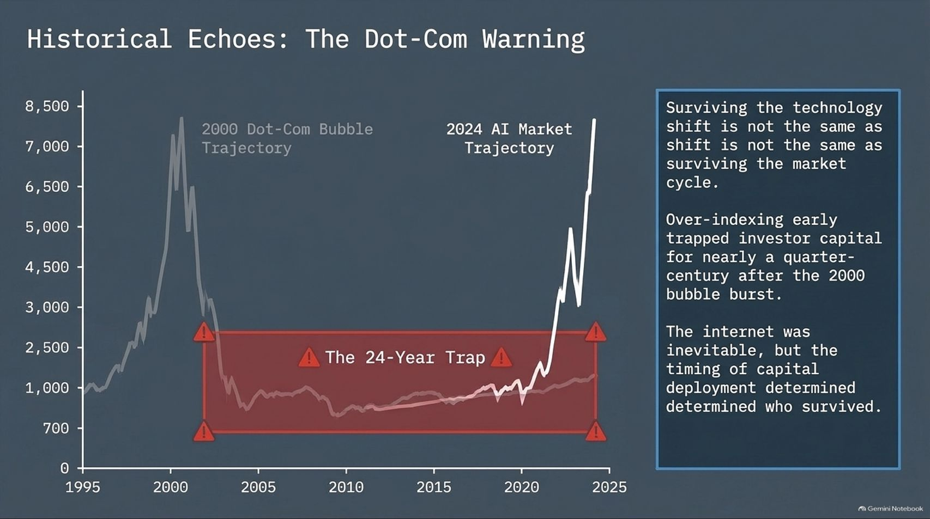
Notes:
Visual: A dual-line chart comparing the 2000 Dot-Com Bubble trajectory against the 2024 AI market trajectory, highlighting a red shaded zone labeled 'The 24-Year Trap' between 2000 and 2024.
Estimated Speaking Time: 4 – 5 minutes
Speaker Notes:
"History doesn't repeat itself, but it often rhymes loudly. Look at this chart comparing the 2000 Dot-Com Bubble trajectory with the 2024 AI market trajectory.
Notice the red zone: The 24-Year Trap. Investors who over-indexed at the exact peak of the dot-com euphoria had their capital trapped for nearly a quarter-century before those market highs were sustainably reclaimed.
The lesson here is profound: Surviving the technology shift is not the same thing as surviving the market cycle. The internet was entirely inevitable—nobody doubted the internet would change the world. But the timing of capital deployment determined who survived and who went bankrupt. Over-paying for infrastructure before mainstream monetization catches up is a fatal mistake."

Slide 13
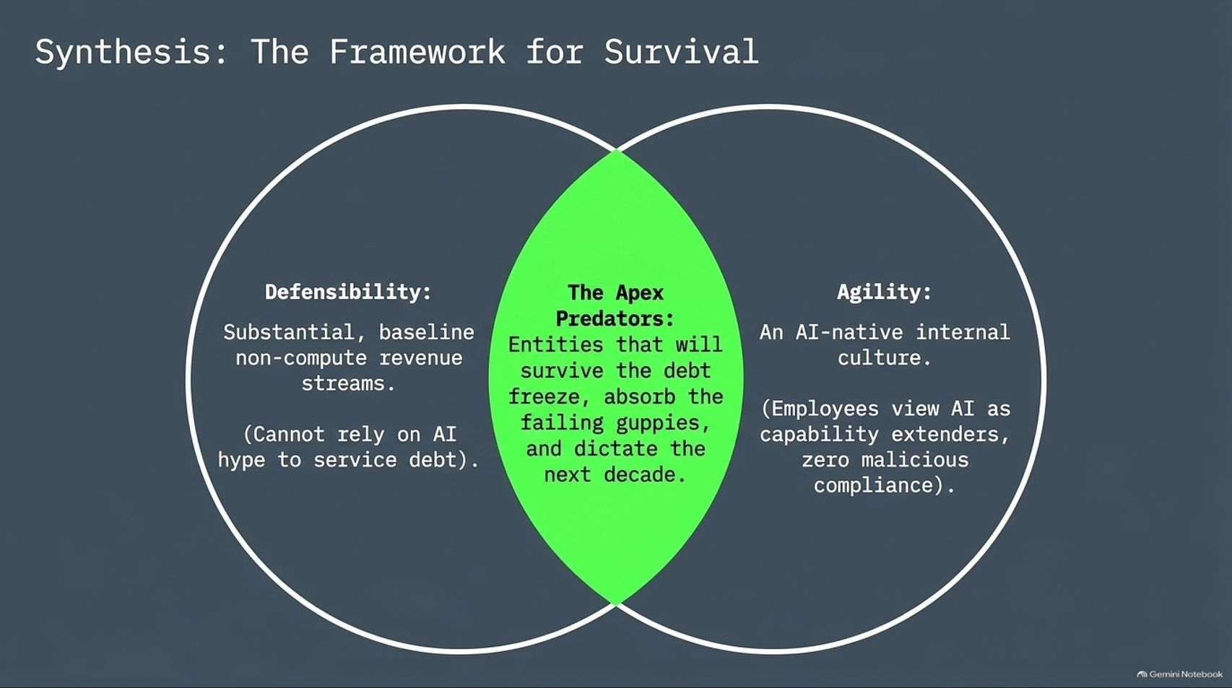
Notes:
Visual: A Venn diagram intersecting two circles—'Defensiveness' (Substantial baseline non-compute revenue streams) and 'Agility' (An AI-native internal culture)—with the overlapping green center labeled 'The Apex Predators'.
Estimated Speaking Time: 3 – 4 minutes
Speaker Notes:
"So how do we synthesize all of this data into a winning playbook? Look at this Venn diagram of survival. To make it through the coming reckoning as an 'Apex Predator,' an entity must sit right at the intersection of two critical traits:
Defensiveness: You must have substantial, baseline non-compute revenue streams. You cannot rely on AI hype or venture debt to service your liabilities.
Agility: You must possess an authentic, AI-native internal culture where employees view technology as a capability extender, completely free of malicious compliance or bureaucratic sandbagging.
Entities possessing both defensiveness and agility will survive the debt freeze, absorb the failing guppies, and dictate the next decade of technology."

Slide 14
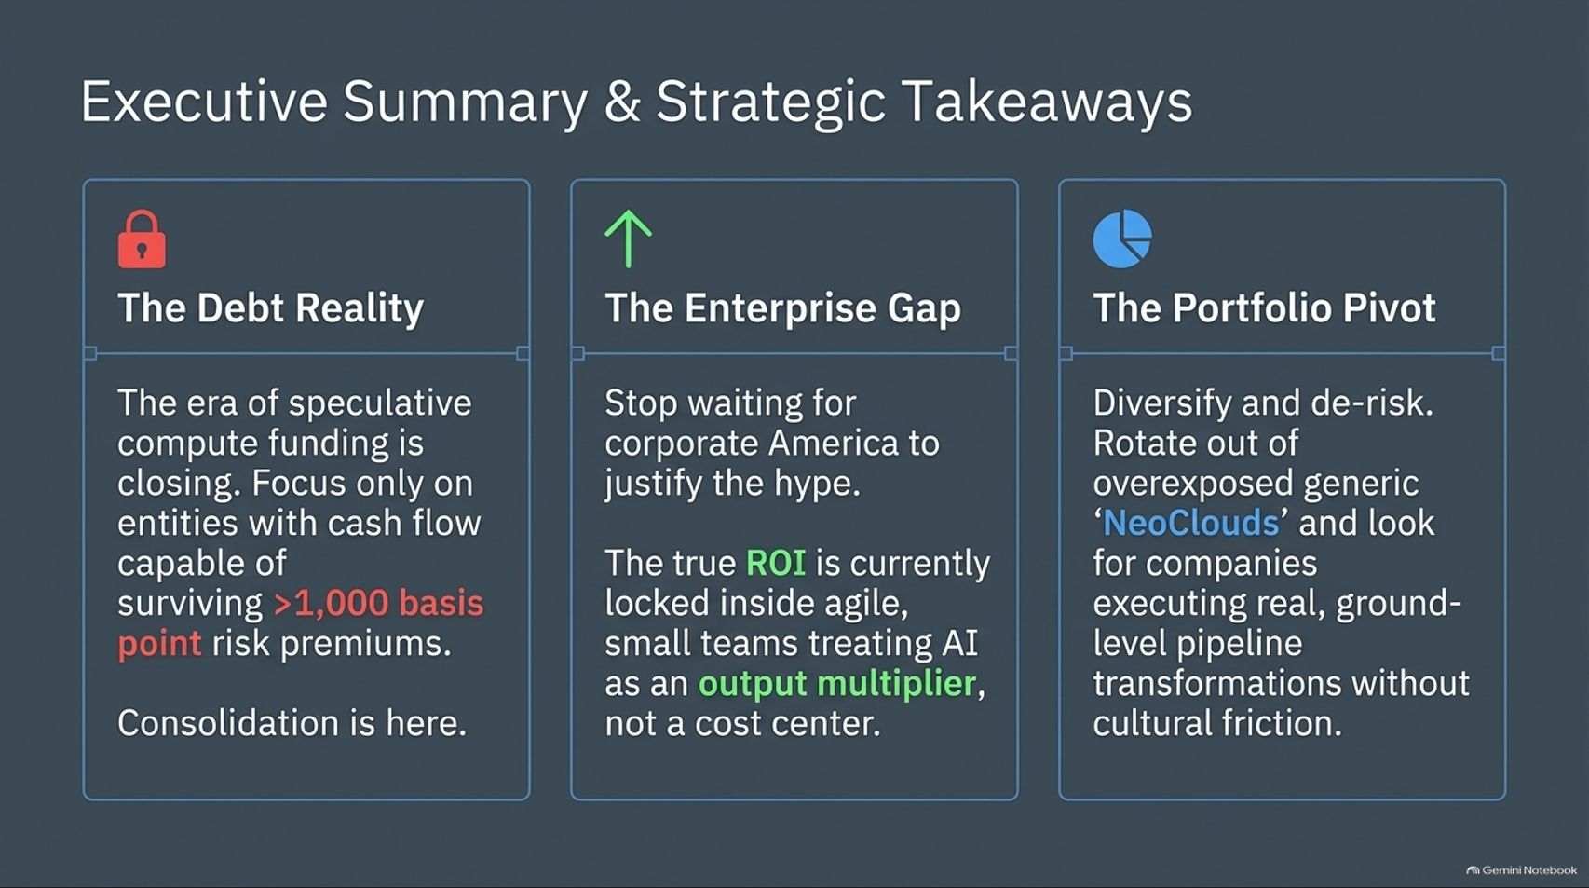
Notes:
Visual: Three structured pillars with icons: 1. The Debt Reality (Lock icon - focus on cash flow surviving >1,000 basis point risk), 2. The Enterprise Gap (Up arrow - true ROI locked in agile teams), and 3. The Portfolio Pivot (Pie chart icon - diversify out of overexposed NeoClouds).
Estimated Speaking Time: 3 – 5 minutes
Speaker Notes:
"Let’s summarize our strategic takeaways across three pillars as we close out this briefing:
Pillar 1: The Debt Reality. The era of speculative compute funding is closing. Focus exclusively on entities capable of surviving risk premiums exceeding 1,000 basis points. Consolidation is here.
Pillar 2: The Enterprise Gap. Stop waiting for corporate America to justify the hype. The true ROI is currently locked inside agile, small teams treating AI as an output multiplier, not a cost center.
Pillar 3: The Portfolio Pivot. Diversify and de-risk. Rotate out of overexposed, generic NeoClouds and seek out companies executing real, ground-level pipeline transformations without cultural friction.
The reckoning is underway—position your capital and your strategy accordingly. Thank you."

Slide 15
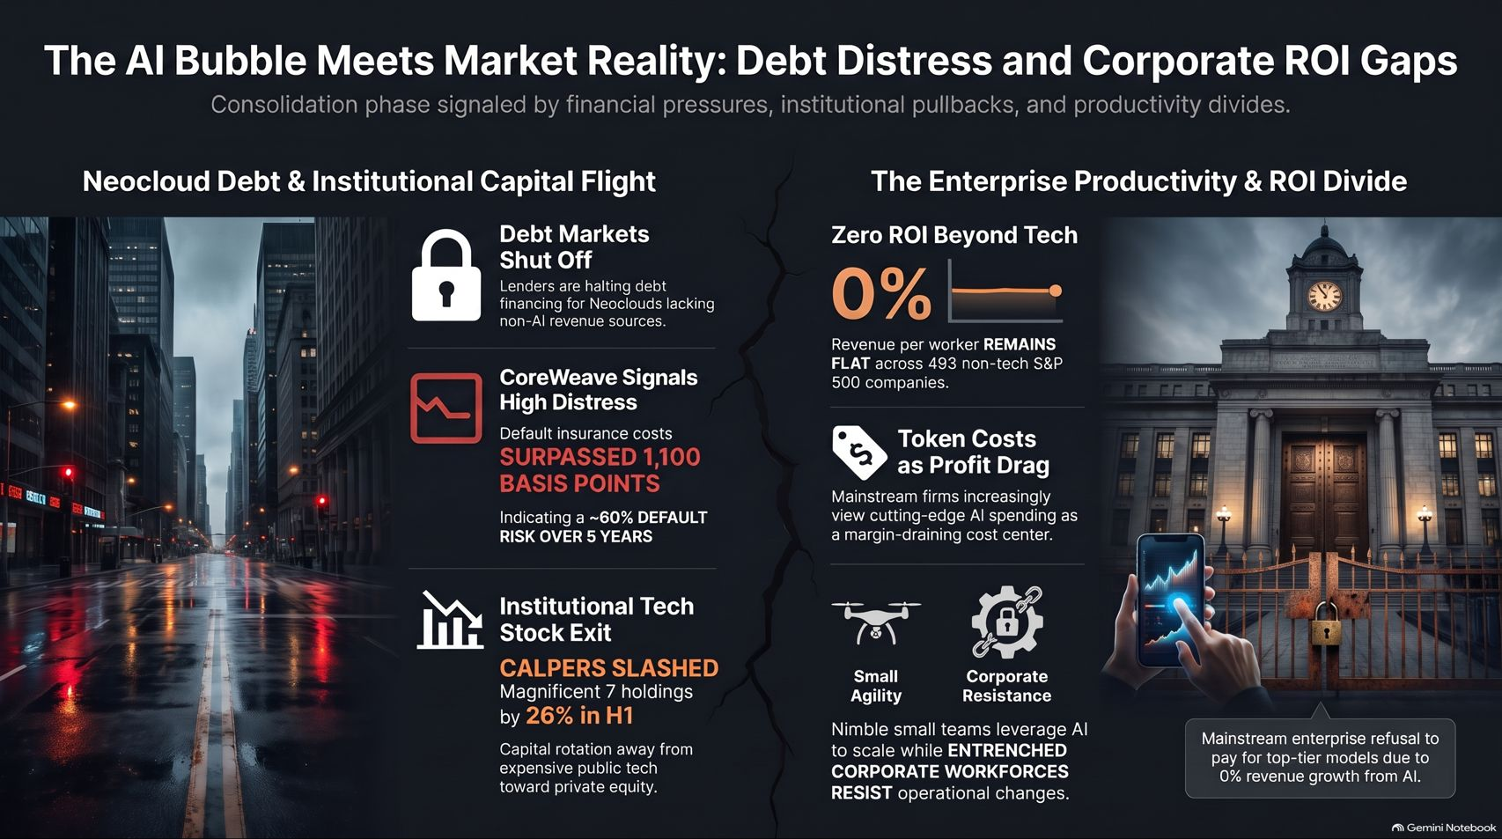
Notes:
Visual: A striking conclusion slide split by a jagged crack down the center. The left side depicts a dark urban street at night with financial warning badges (Debt Markets Shut Off, Coreweave Distress, Institutional Tech Exit). The right side shows a grand classical corporate building with financial metrics (0% ROI Beyond Tech, Token Costs as Drag, Small Agility vs Corporate Resistance).
Estimated Speaking Time: 3 – 4 minutes
Speaker Notes:
"We leave you with this final, striking visual synthesis of the two converging forces shaping our market: on the left, the dark reality of NeoCloud debt distress, spiking credit default swaps, and institutional capital flight; on the right, the monumental productivity and ROI divide plaguing mainstream corporate hierarchies.
The bubble is meeting market reality. The companies and portfolios that navigate this transition successfully will be those that respect the debt math, reject the corporate hype, and embrace true operational agility. Thank you for your time, and stay sharp out there."

