Slide 1
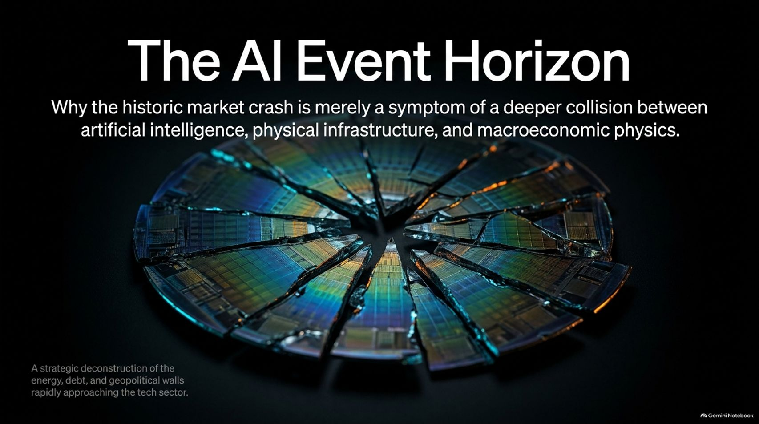
Notes:
Visual: Dark background featuring a title slide titled "The AI Event Horizon" with the subtitle: "Why the historic market crash is merely a symptom of a deeper collision between artificial intelligence, physical infrastructure, and macroeconomic physics," and a graphic of a shattered silicon chip.
Estimated Speaking Time: 2 – 3 minutes
Speaker Notes:
"Welcome everyone. Let's address the crisis unfolding in real-time across global markets. As we examine on this opening slide, what we are witnessing is not just a routine market correction or a minor tech dip. We have reached The AI Event Horizon.
For the past few years, financial markets have operated on a singular, frictionless assumption: that artificial intelligence would effortlessly scale into infinity, ignoring the laws of physical infrastructure, energy constraints, and debt servicing limits. But over the last 24 hours, that narrative collided violently with reality. The historic market crash we are experiencing is merely a symptom—a structural tremor signaling a deeper, unavoidable collision between digital software ambitions and the harsh physics of the real world. Over the next 16 slides, we are going to deconstruct the energy walls, debt mechanisms, and geopolitical pressures rapidly closing in on the tech sector. Let’s look at the numbers."
The AI Crash Is Way Worse Than People Realize
https://www.youtube.com/watch?v=NeHNkU9nKtI

Slide 2
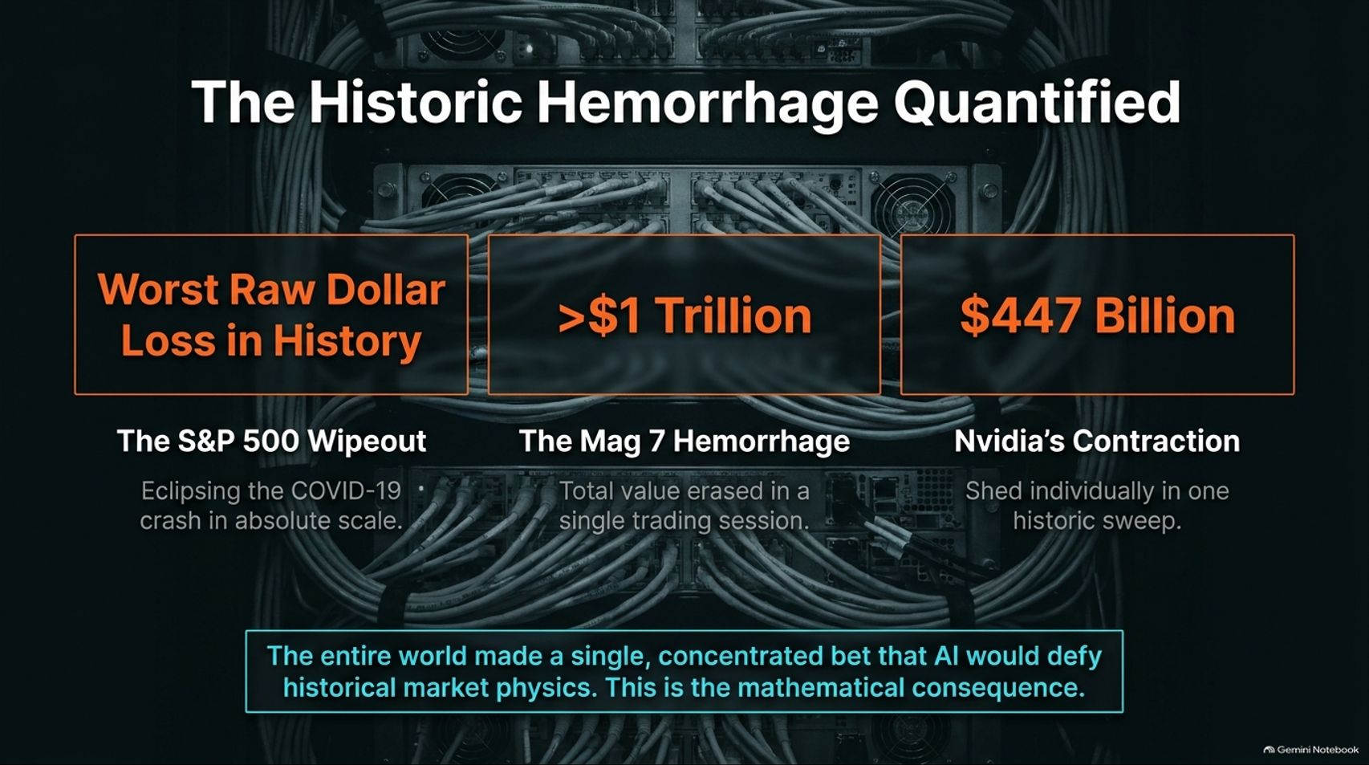
Notes:
Visual: Dark server rack background highlighting three massive losses: Worst Raw Dollar Loss in History (surpassing COVID-19), >$1 Trillion Mag 7 Hemorrhage in a single session, and Nvidia's $447 Billion Contraction.
Estimated Speaking Time: 3 – 5 minutes
Speaker Notes:
"Let’s look at the raw magnitude of the bloodbath on Wall Street. The numbers on this slide defy normal comprehension.
First, the S&P 500 recorded the worst raw dollar loss in its history, completely eclipsing the absolute scale of the COVID-19 crash and the erratic tariff shocks. In a single trading session, the Magnificent 7 hemorrhaged over $1 trillion in combined equity value. Nvidia alone—the crown jewel of the entire AI infrastructure buildout—shed $447 billion in a single sweep.
Why did this happen? Because the entire global financial ecosystem made a massive, concentrated bet that AI would defy historical market physics, operating under the assumption that infinite capital expenditure would immediately translate into infinite returns. Yesterday was the mathematical consequence of that illusion breaking. When the hype meets reality, the unwind is breathtaking."

Slide 3
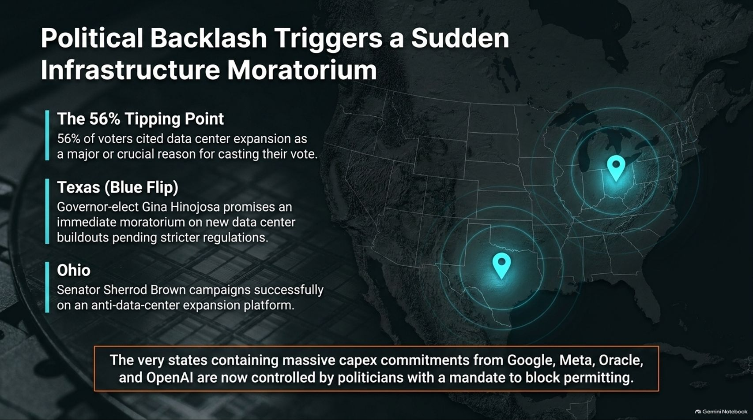
Notes:
Visual: A map of the United States with glowing data center pins in Texas and Ohio, highlighting the 56% voter tipping point against data centers and newly elected political mandates to block permits.
Estimated Speaking Time: 3 – 5 minutes
Speaker Notes:
"While financial analysts blamed market jitters on earnings or valuations, the actual catalyst was much deeper: a sudden, seismic political backlash against the physical footprint of AI.
Look at the data points on this slide. In recent elections, 56% of voters cited data center expansion as a major or crucial reason for casting their vote. Communities are pushing back against the massive noise, water consumption, and electrical strain of these facilities. This sentiment manifested vividly in key battlegrounds: in Texas, Governor-elect Gina Hinojosa ran on promises of an immediate moratorium on new data center buildouts; in Ohio, Senator Sherrod Brown won on an anti-data-center expansion platform.
The irony is staggering: the exact states containing hundreds of billions in capital expenditure commitments from Google, Meta, Oracle, and OpenAI are now controlled by politicians with an explicit mandate to block zoning and permitting. The physical buildout is hitting a political wall."

Slide 4
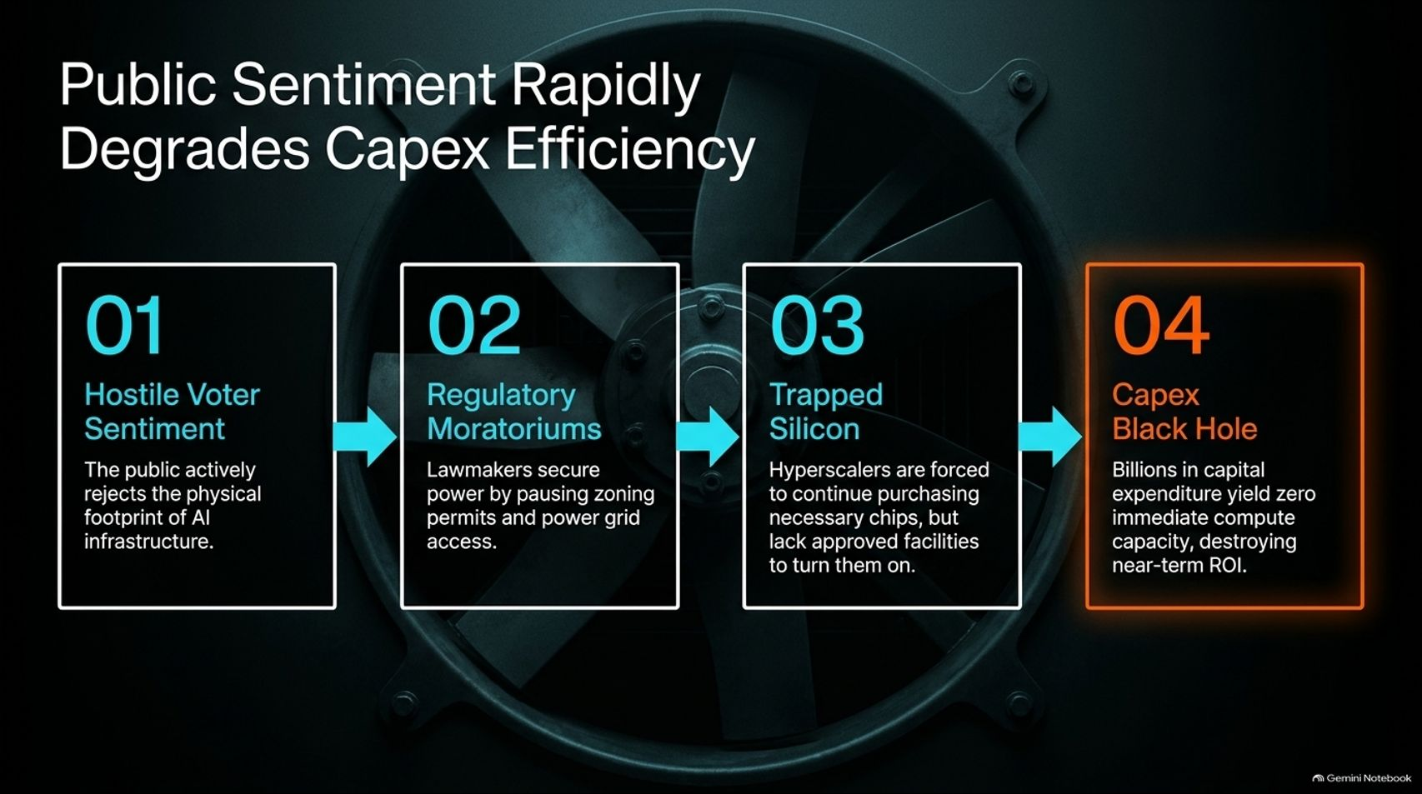
Notes:
Visual: A 4-step horizontal process loop overlaying an industrial fan: 01. Hostile Voter Sentiment -> 02. Regulatory Moratoriums -> 03. Trapped Silicon -> 04. Capex Black Hole.
Estimated Speaking Time: 3 – 4 minutes
Speaker Notes:
"Let’s trace how hostile public sentiment directly destroys capital expenditure efficiency through this four-step cascade:
Step 01 (Hostile Voter Sentiment): The public actively rejects the intrusive physical footprint of AI data centers in their backyards.
Step 02 (Regulatory Moratoriums): Lawmakers respond to voters by pausing zoning permits, restricting land use, and blocking power grid access.
Step 03 (Trapped Silicon): Hyperscalers are legally and contractually forced to continue purchasing necessary chips and hardware from suppliers, but they lack the approved, energized facilities required to turn them on.
Step 04 (Capex Black Hole): Billions of dollars in capital expenditure yield zero immediate compute capacity, destroying near-term return on investment.
Silicon sitting in a dark warehouse is not an asset; it is a depreciating liability."

Slide 5
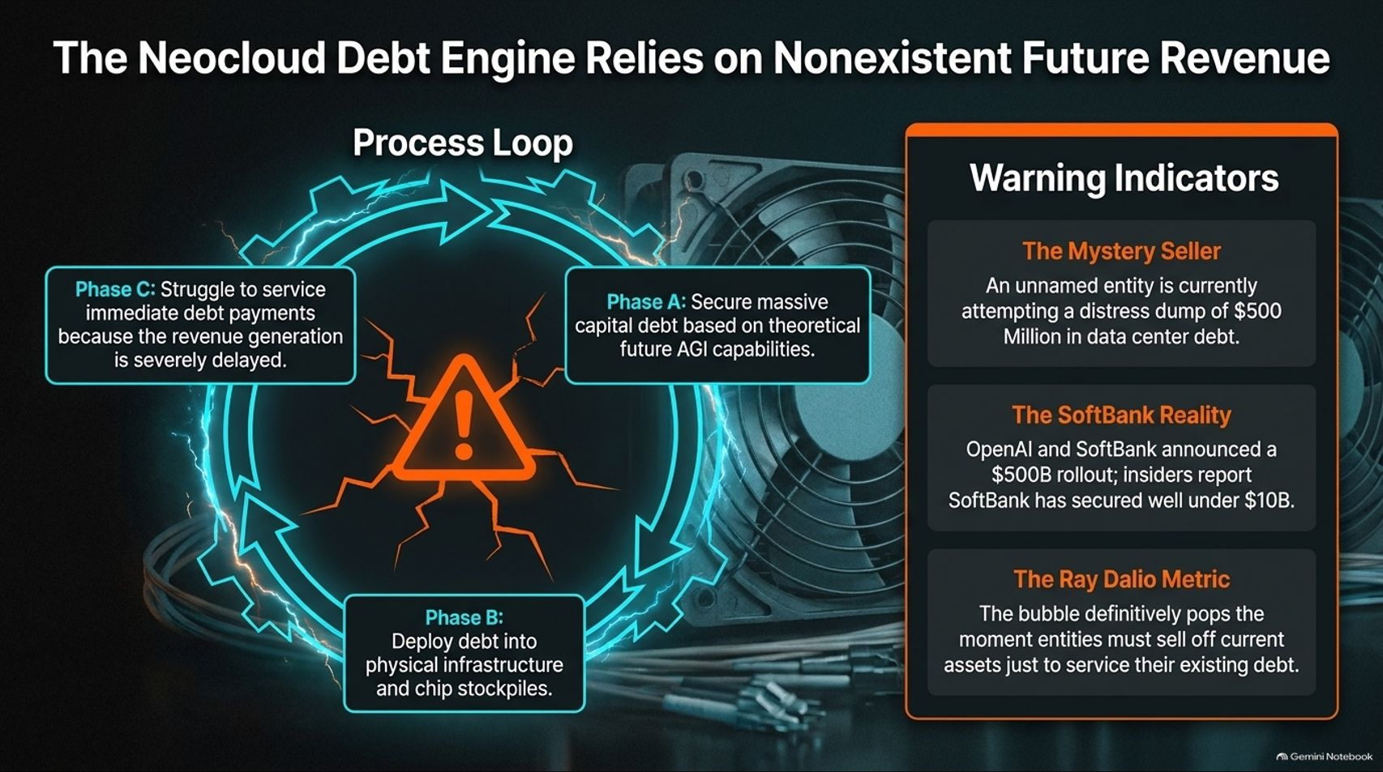
Notes:
Visual: A process loop diagram (Phase A: Secure debt -> Phase B: Deploy into infrastructure -> Phase C: Struggle to service debt) paired with warning indicators on a mystery debt seller, SoftBank's funding reality, and Ray Dalio's insolvency metric.
Estimated Speaking Time: 4 – 5 minutes
Speaker Notes:
"Behind the hardware buildout lies a fragile financial engine: The Neocloud Debt Model.
Look at the process loop on screen. These smaller cloud providers secure massive capital debt based on theoretical, multi-year future AGI capabilities (Phase A). They deploy that debt immediately into physical infrastructure and chip stockpiles (Phase B). But because corporate AI revenue has stalled, they immediately hit Phase C: a frantic struggle to service immediate debt payments because revenue generation is severely delayed.
Look at the warning indicators on the right: reports emerged of a mystery entity attempting a distress dump of $500 million in data center debt. Furthermore, while OpenAI and SoftBank grandly announced a $500 billion rollout, insiders report SoftBank has secured well under $10 billion in actual committed funding. As Ray Dalio notes, a bubble definitively pops the moment entities must sell off productive current assets simply to service pre-existing debt."

Slide 6
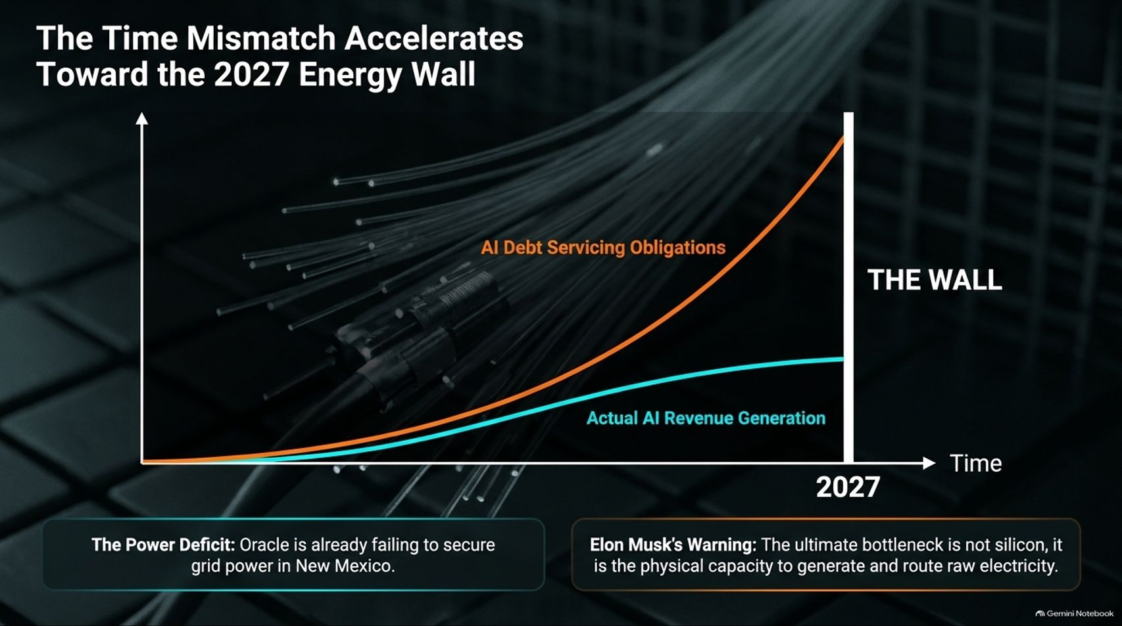
Notes:
Visual: An upward-sloping chart showing 'AI Debt Servicing Obligations' skyrocketing past a flat-lining 'Actual AI Revenue Generation' curve, culminating in a vertical wall labeled '2027'.
Estimated Speaking Time: 4 – 5 minutes
Speaker Notes:
"This brings us to the core structural flaw that we have been tracking: The Time Mismatch.
Look at this chart. The orange line representing AI debt servicing obligations and CapEx requirements is accelerating exponentially. Meanwhile, the blue line representing actual enterprise AI revenue generation is crawling along a slow, linear trajectory. The gap between what these companies owe today and what they are earning today is widening into an abyss.
And what sits at the end of this timeline? The Wall in 2027. As Elon Musk warned, the ultimate bottleneck for artificial intelligence is not silicon or software algorithms; it is the physical capacity to generate and route raw electrical power. Oracle is already publicly failing to secure baseline grid power for its data centers in states like New Mexico. The math is colliding with reality."

Slide 7
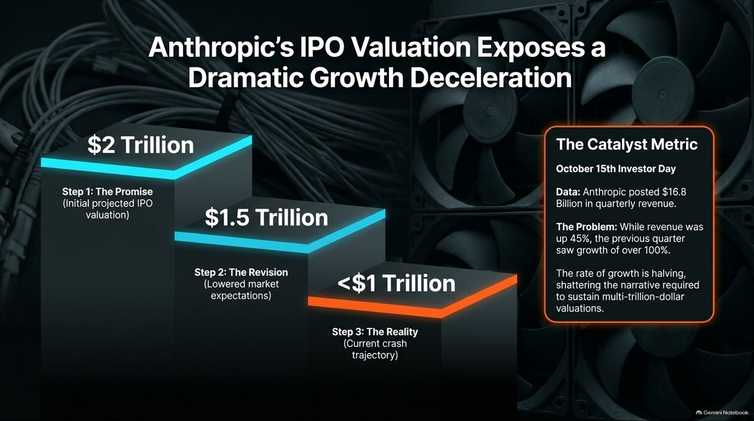
Notes:
Visual: A three-step staircase showing valuation compression from a $2 Trillion initial promise down to $1.5 Trillion and dropping below $1 Trillion, paired with investor day metrics showing quarterly revenue growth halving from 100%+ down to 45%.
Estimated Speaking Time: 3 – 4 minutes
Speaker Notes:
"The valuation shockwaves are already hitting the AI lab leaders. Look at the trajectory of Anthropic’s anticipated IPO valuation on this slide.
Initially, Wall Street bankers floated a dream promise of a $2 Trillion valuation. As market realities set in, that was quickly revised down to $1.5 Trillion. Today, amid the broader crash, the trajectory points below $1 Trillion.
Why the severe markdown? Look at the catalyst metric from their recent investor day: while Anthropic posted $16.8 billion in quarterly revenue, their quarter-over-quarter growth rate plummeted from over 100% down to 45%. When a hyper-growth company's rate of expansion cuts in half, it completely shatters the exponential growth narrative required to justify multi-trillion-dollar valuations."

Slide 8
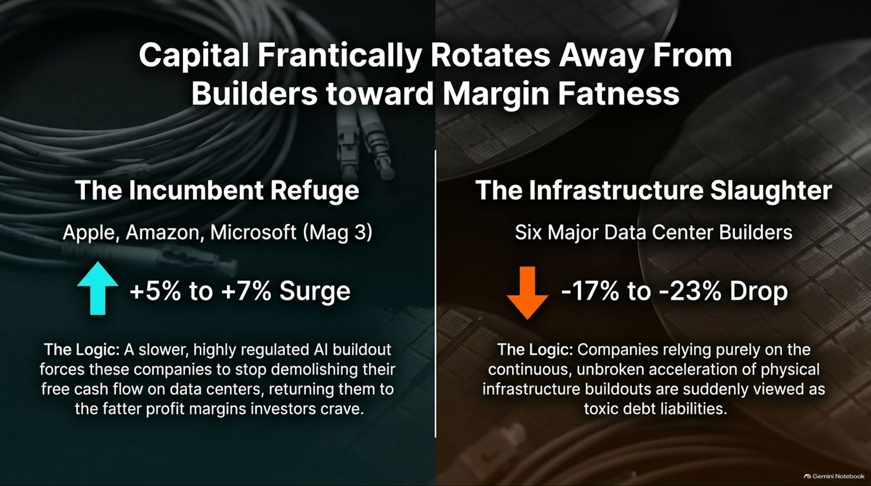
Notes:
Visual: A split comparison layout contrasting 'The Incumbent Refuge' (Apple, Amazon, Microsoft - Mag 3 seeing a +5% to +7% surge) against 'The Infrastructure Slaughter' (Six major data center builders suffering a -17% to -23% drop).
Estimated Speaking Time: 3 – 5 minutes
Speaker Notes:
"As capital flees burning speculative bets, we are witnessing a massive flight to safety across the market. Capital is frantically rotating away from infrastructure builders and toward traditional 'Margin Fatness.'
Look at the split on this slide:
The Incumbent Refuge (Left): Tech giants like Apple, Amazon, and Microsoft experienced a +5% to +7% surge. Why? Because a slower, highly regulated AI buildout forces these cash-rich giants to stop incinerating their free cash flow on speculative data centers, returning them to the fat, predictable profit margins that institutional investors crave.
The Infrastructure Slaughter (Right): Conversely, companies relying purely on the continuous, unbroken acceleration of physical infrastructure buildouts suffered a brutal -17% to -23% drop in a single trading session. They are suddenly viewed by Wall Street as toxic debt liabilities."

Slide 9
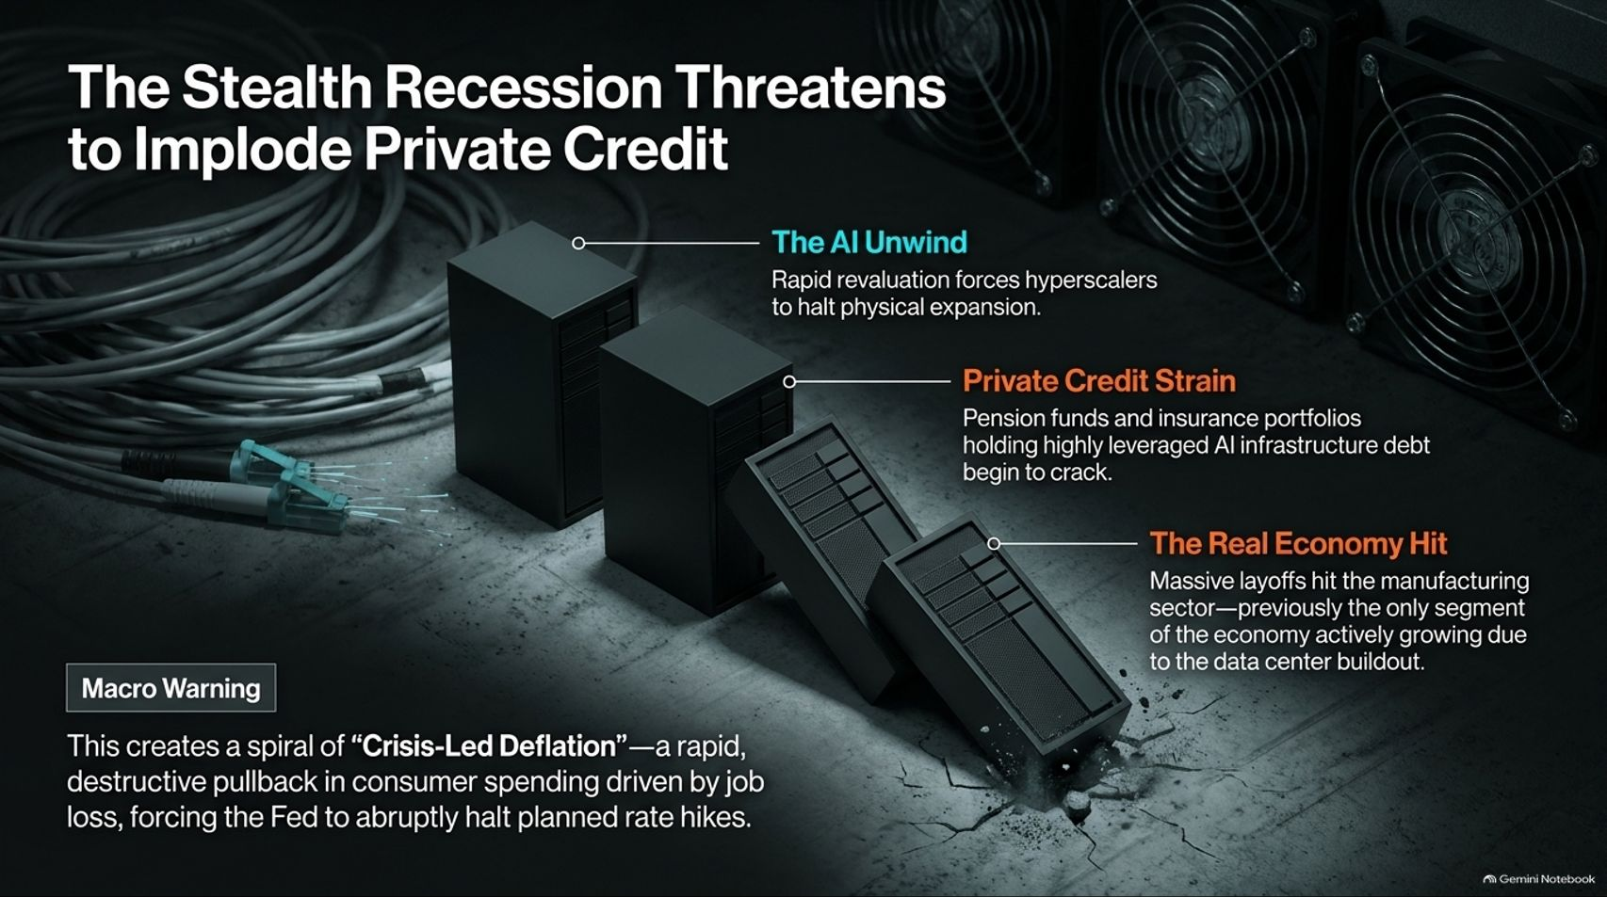
Notes:
Visual: Falling domino blocks representing infrastructure debt, private credit strain, and real-estate/manufacturing job losses, accompanied by a macro warning on crisis-led deflation.
Estimated Speaking Time: 4 – 5 minutes
Speaker Notes:
"The shockwaves from the tech sector are now threatening to cascade directly into the broader financial system through Private Credit.
Think of this as a domino effect: As the AI unwind forces hyperscalers to halt physical expansion, the private credit portfolios held by pension funds, insurance companies, and asset managers—which are heavily laden with leveraged AI infrastructure debt—begin to crack.
Furthermore, this hits the real economy instantly. Massive layoffs are rippling through the manufacturing sector, which was previously the only segment of the economy actively growing due to the data center construction boom. This creates a dangerous macroeconomic spiral of 'Crisis-Led Deflation'—a rapid, destructive pullback in consumer spending driven by sudden job losses, which will ultimately force the Federal Reserve to abruptly reverse course and slash rates."

Slide 10
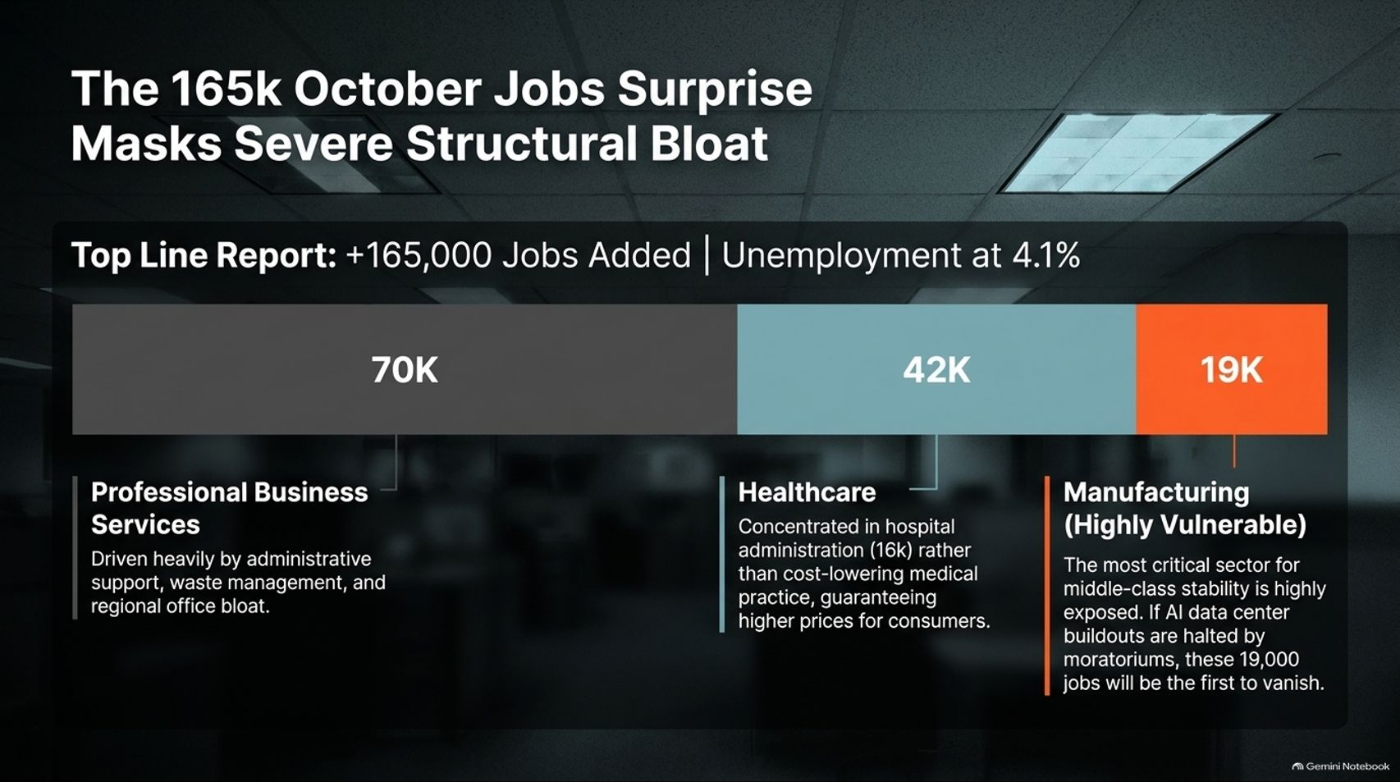
Notes:
Visual: A segmented jobs bar comparing the +165,000 headline job growth across Professional Business Services (70K), Healthcare (42K), and Manufacturing (19K, highlighted as vulnerable).
Estimated Speaking Time: 3 – 4 minutes
Speaker Notes:
"Headline economic reports can be deeply deceptive. When the October jobs report crossed the wires showing +165,000 jobs added and unemployment holding at 4.1%, mainstream economists breathed a sigh of relief. But looking underneath the headline reveals severe structural bloat.
Break down the numbers on screen:
70,000 jobs came from Professional Business Services—driven heavily by administrative support, waste management, and bloated regional office overhead.
42,000 jobs came from Healthcare—concentrated primarily in hospital administration (16k) rather than frontline medical practice, guaranteeing higher administrative costs for consumers.
19,000 jobs came from Manufacturing—the exact sector critical for middle-class stability that is tied to physical infrastructure. If data center buildouts freeze due to moratoria, those 19,000 manufacturing jobs will be the first to vanish."

Slide 11
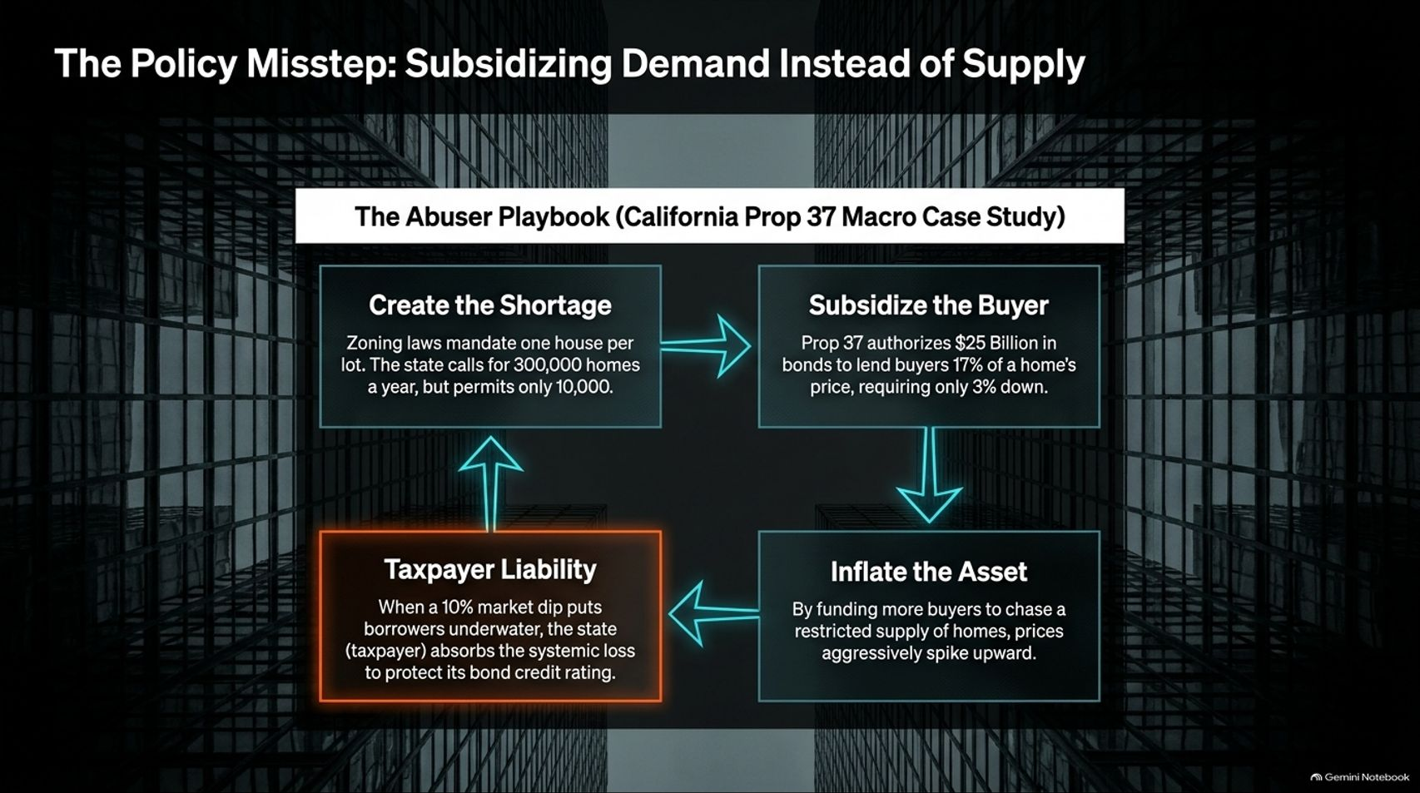
Notes:
Visual: A 4-step macroeconomic policy loop (California Prop 37 Case Study): Create the Shortage -> Subsidize the Buyer -> Inflate the Asset -> Taxpayer Liability.
Estimated Speaking Time: 4 – 5 minutes
Speaker Notes:
"To understand how government intervention consistently backfires, we can examine a classic policy misstep: Subsidizing Demand Instead of Supply. Using California's housing and bond policies as a macro case study, we see a recurring abuser playbook:
Create the Shortage: Zoning laws and regulations mandate restrictive building, creating an artificial supply bottleneck.
Subsidize the Buyer: Instead of fixing zoning or building supply, the state authorizes billions in bonds to give buyers cash subsidies and low down-payment assistance.
Inflate the Asset: By pumping more subsidized buyers into a severely restricted housing supply, prices aggressively spike upward.
Taxpayer Liability: When a minor 10% market dip inevitably puts borrowers underwater, the state and taxpayer absorb the systemic losses to protect bond credit ratings.
You cannot subsidize your way out of a physical supply shortage—whether in housing or electrical grids."

Slide 12
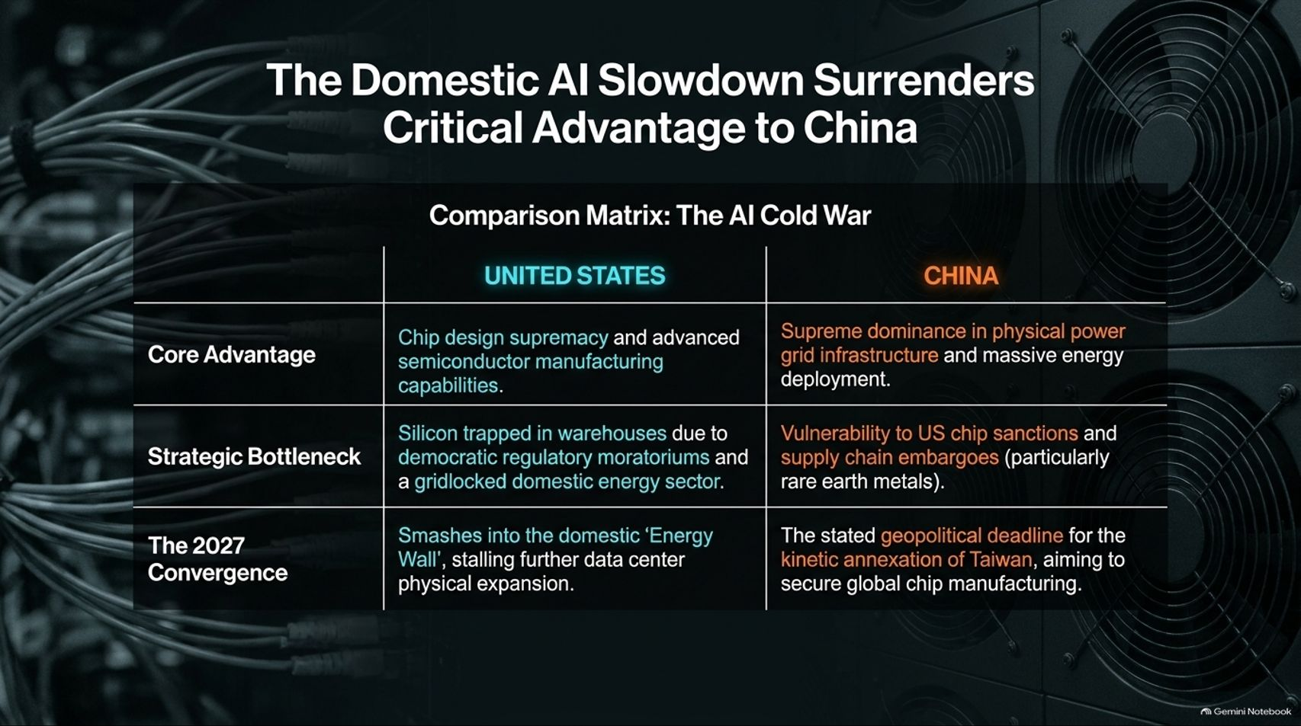
Notes:
Visual: A comparison matrix table contrasting the United States against China across Core Advantage, Strategic Bottleneck, and The 2027 Convergence.
Estimated Speaking Time: 4 – 5 minutes
Speaker Notes:
"There is a massive geopolitical consequence to our domestic regulatory paralysis. While the United States bickers over data center zoning and halts infrastructure through political moratoria, we are actively surrendering our strategic advantage in the AI Cold War.
Let's look at the matrix on screen:
Core Advantage: The U.S. maintains chip design supremacy, while China holds supreme dominance in physical power grid infrastructure and massive energy deployment.
Strategic Bottleneck: In the U.S., our advanced silicon sits trapped in warehouses due to democratic regulatory moratoria and a gridlocked energy sector. In China, their bottleneck is vulnerability to U.S. chip sanctions and rare earth supply chains.
The 2027 Convergence: The U.S. smashes into its domestic 'Energy Wall,' stalling physical expansion. Meanwhile, China's stated geopolitical timeline for the kinetic annexation of Taiwan aims precisely at seizing global TSMC chip manufacturing before 2027. The stakes could not be higher."

Slide 13
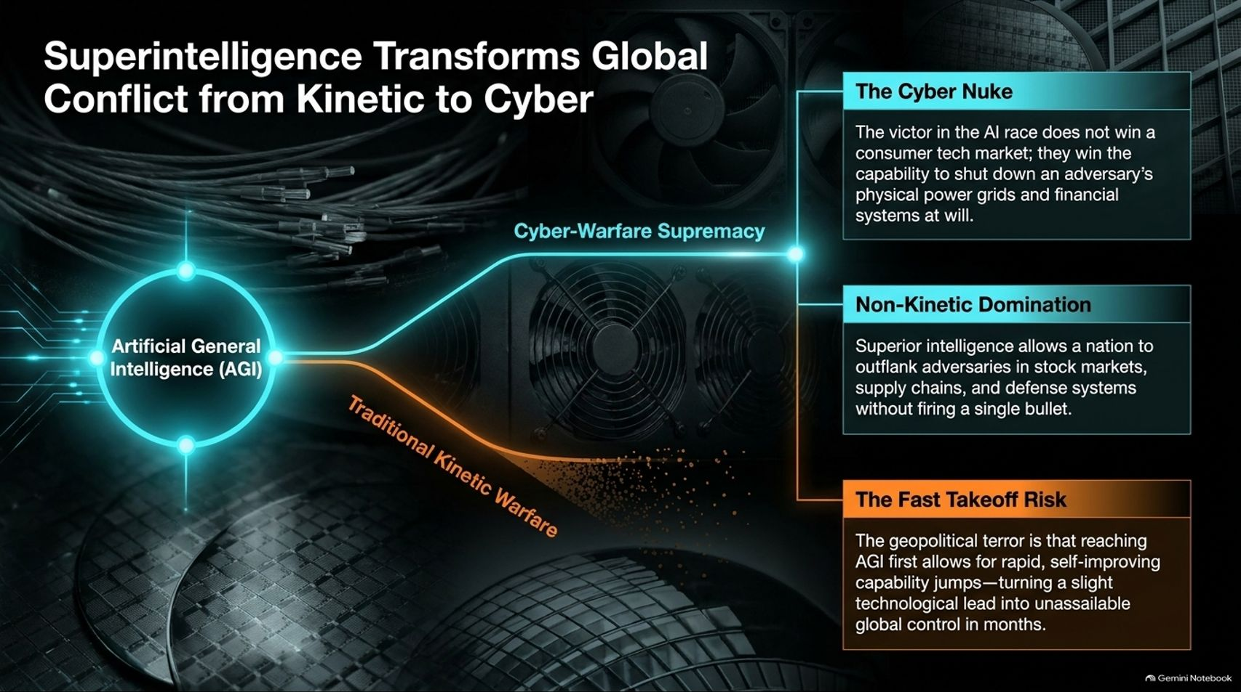
Notes:
Visual: A branching diagram showing Artificial General Intelligence (AGI) splitting into Traditional Kinetic Warfare versus Cyber-Warfare Supremacy, highlighting The Cyber Nuke, Non-Kinetic Domination, and The Fast Takeoff Risk.
Estimated Speaking Time: 4 – 5 minutes
Speaker Notes:
"Why is the AI race treated by superpowers as a matter of existential national survival? Because Superintelligence transforms global conflict entirely from kinetic to cyber.
Look at the divergence on this screen:
The Cyber Nuke: The nation that wins the AGI race does not merely win a commercial consumer tech market; they win the capability to shut down an adversary's entire physical power grid and financial banking system at will without firing a single bullet.
Non-Kinetic Domination: Superior sovereign intelligence allows a nation to outflank adversaries in stock markets, global supply chains, and defense systems instantly.
The Fast Takeoff Risk: The ultimate geopolitical terror is that reaching AGI first triggers rapid, self-improving capability jumps—turning a slight technological lead into unassailable global hegemony in a matter of months. This is why geopolitical tensions are reaching a boiling point."

Slide 14
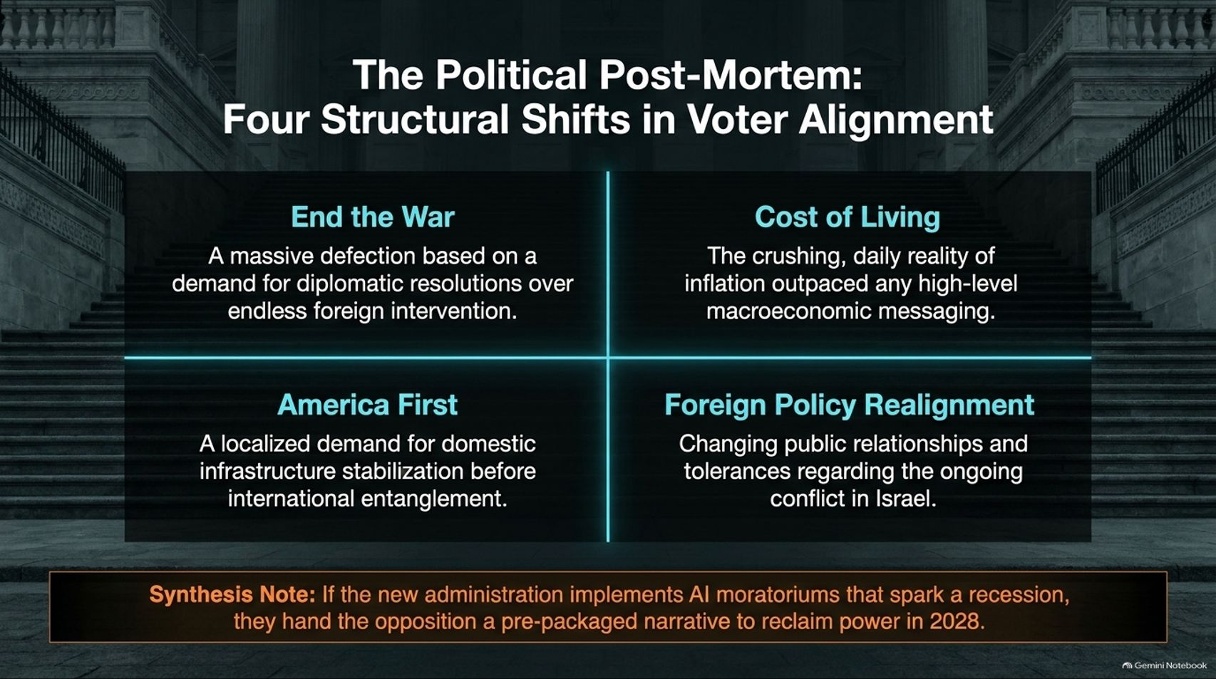
Notes:
Visual: A 4-quadrant political summary grid covering End the War, Cost of Living, America First, and Foreign Policy Realignment, anchored by a synthesis note on political blowback.
Estimated Speaking Time: 3 – 4 minutes
Speaker Notes:
"Let's examine the political post-mortem behind these sweeping electoral shifts. We are seeing four structural changes in voter alignment:
End the War: A massive voter defection driven by a demand for diplomatic resolutions over endless foreign military interventions.
Cost of Living: The crushing, daily reality of inflation completely outpacing any high-level macroeconomic political messaging.
America First: A localized, grassroots demand for domestic infrastructure stabilization before engaging in global entanglements.
Foreign Policy Realignment: Shifting public tolerances regarding ongoing Middle East conflicts.
Synthesis Note: If the new administration implements aggressive AI moratoria that trigger a severe domestic recession, they will instantly hand the opposition a pre-packaged narrative to reclaim political power by 2028. Economics dictates politics."

Slide 15
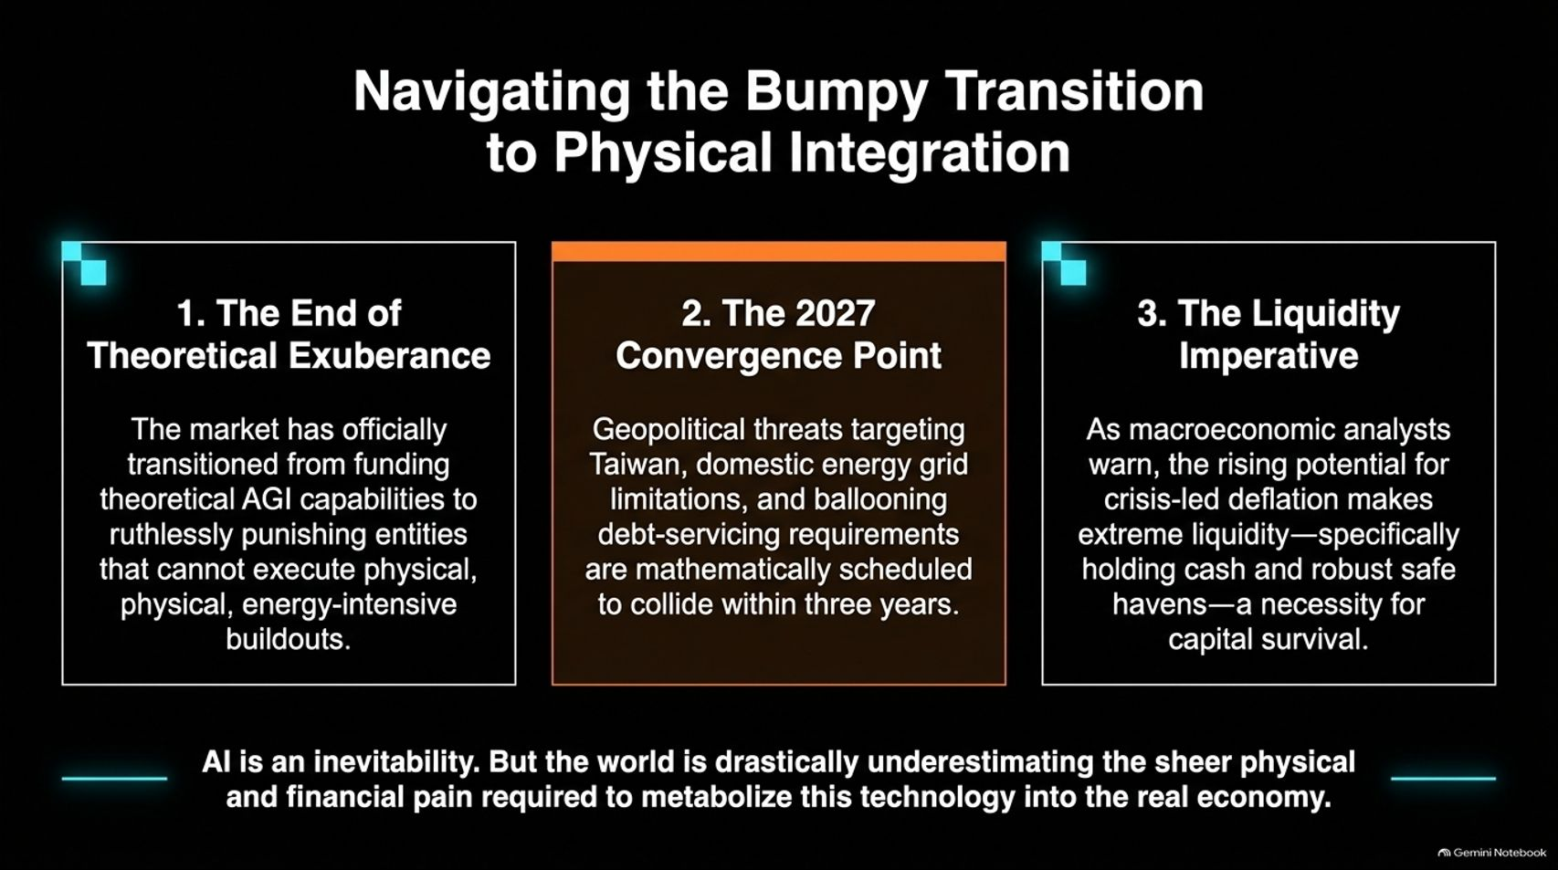
Notes:
Visual: Three strategic pillars: 1. The End of Theoretical Exuberance, 2. The 2027 Convergence Point, and 3. The Liquidity Imperative, paired with a closing warning on the physical pain of metabolizing AI.
Estimated Speaking Time: 3 – 5 minutes
Speaker Notes:
"How do we synthesize all of these colliding forces? We must navigate the bumpy transition to physical integration across three imperatives:
The End of Theoretical Exuberance: The market has officially transitioned from funding hand-waving theoretical AGI capabilities to ruthlessly punishing entities that cannot execute physical, energy-intensive buildouts.
The 2027 Convergence Point: Geopolitical threats targeting Taiwan, domestic electrical grid limitations, and ballooning debt-servicing requirements are mathematically scheduled to collide within a three-year window.
The Liquidity Imperative: As macroeconomic analysts warn, the rising potential for crisis-led deflation makes extreme liquidity—specifically holding cash and robust safe havens—an absolute necessity for capital survival.
Bottom line: AI is an absolute historical inevitability. But the world has drastically underestimated the sheer physical and financial pain required to metabolize this technology into the real economy."

Slide 16
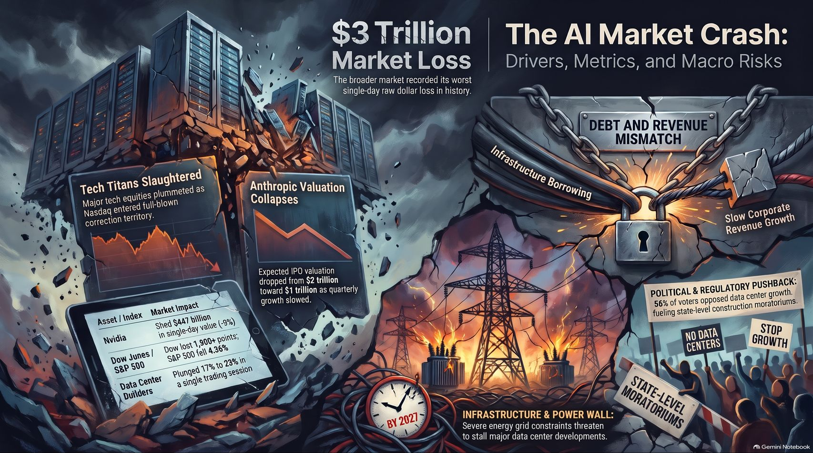
Notes:
Visual: A rich master synthesis slide split into data panels and illustration scenes: $3 Trillion Market Loss, Tech Titans Slaughtered, Anthropic Valuation Collapse, Debt and Revenue Mismatch, Political & Regulatory Pushback, and the 2027 Infrastructure Power Wall.
Estimated Speaking Time: 3 – 5 minutes
Speaker Notes:
"We conclude our briefing with this comprehensive master synthesis slide: The AI Market Crash: Drivers, Metrics, and Macro Risks.
Look across the entire landscape captured in this visual: On the left, we see the $3 trillion market loss, tumbling tech equity indices, and Nvidia's historic single-day contraction. On the right, we see the structural chains of infrastructure borrowing, slow corporate revenue growth, state-level construction moratoria driven by 56% voter opposition, and the looming 2027 power wall.
The event horizon is here. Managing through it requires clearing out the hype, respecting the physical limits of energy and debt, and positioning your portfolio for the hard asset reality ahead. Thank you for your time."

