Slide 1
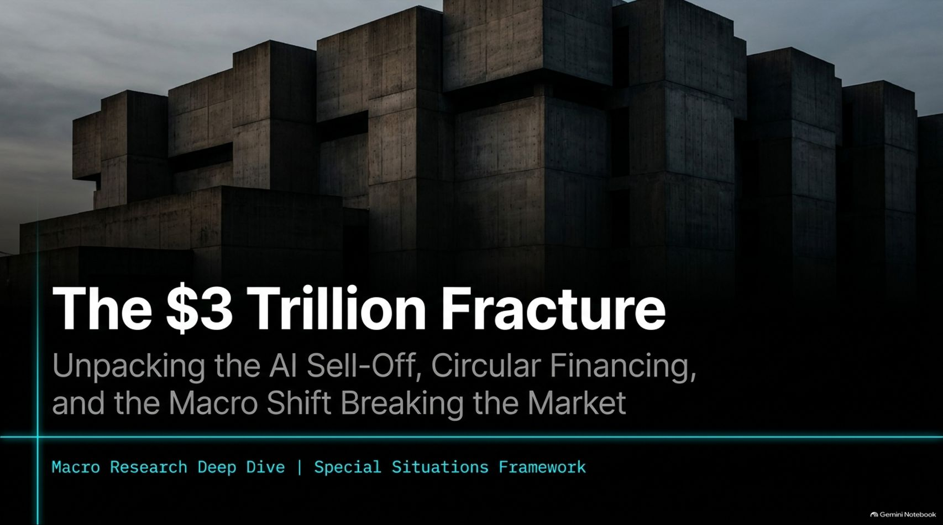
Notes:
Duration: 2 to 3 minutes
Visual Theme: Macro Research Deep Dive | Special Situations Framework
Speaker Notes:
Welcome everyone to today's macro deep dive. We are looking at what we term "The $3 Trillion Fracture"—unpacking the violent AI market sell-off, the hidden mechanics of circular financing, and the tectonic macro shifts breaking the market.
Reference the Video context: As Jay Singh outlines in his recent market analysis, we have just witnessed historic market contractions where trillions of dollars were wiped out in a matter of days. This is not just a routine correction; it is a fundamental stress test of the multi-trillion-dollar artificial intelligence trade.
Over the next 16 slides, we will deconstruct how political shifts, infrastructure bottlenecks, credit freezes, accounting illusions, and institutional deleveraging have converged into a perfect storm. Let's look at the symptoms.
$3 Trillion Wiped Out In Days: This Breaks Next | Jay Singh
https://www.youtube.com/watch?v=EQK4Q6w9pnU

Slide 2
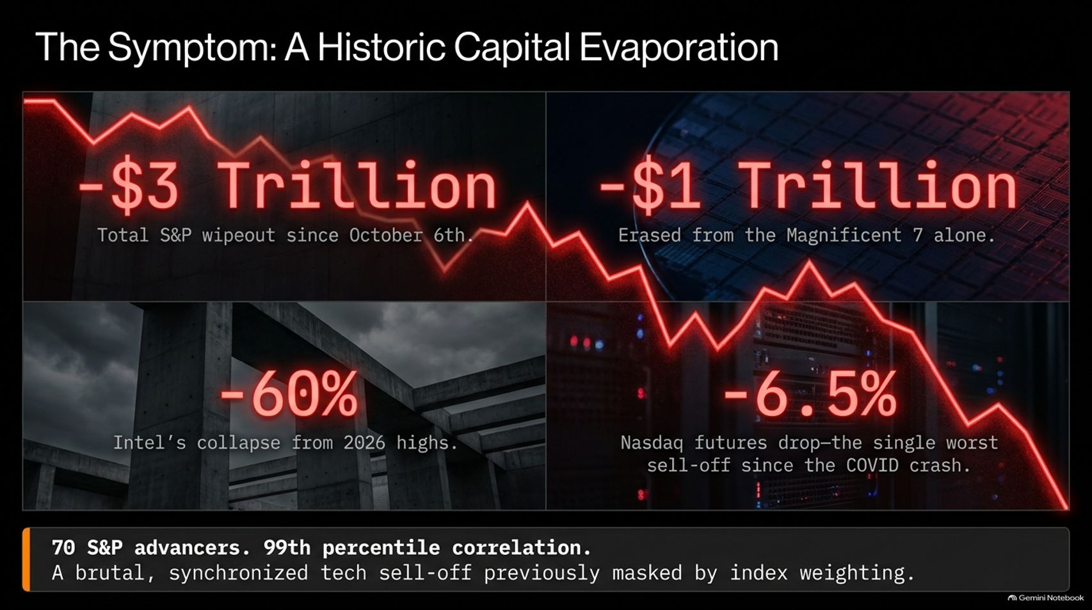
Notes:
Duration: 3 to 4 minutes
Visual Theme: S&P wipeouts, Mega-cap losses, Intel down 60%, Nasdaq drop.
Speaker Notes:
Let's look at the raw damage. We have seen a staggering $-\$3$ trillion total S&P wipeout since October 6th, alongside $-\$1$ trillion erased from the Magnificent 7 alone.
Core bellwethers are getting decimated: Intel has collapsed over $60\%$ from its 2026 highs, and Nasdaq futures experienced a single-day drop of $-6.5\%$, marking the worst sell-off since the COVID crash.
Reference the Video context: During the market session highlighted by Jay Singh, the S&P 500 suffered its worst day since the April tariff shock, with only 70 advancers in the entire index and a $99\text{th}$ percentile correlation. This synchronized tech sell-off was completely masked for months by heavy index weighting, but once the facade broke, index-wide liquidation ensued.

Slide 3
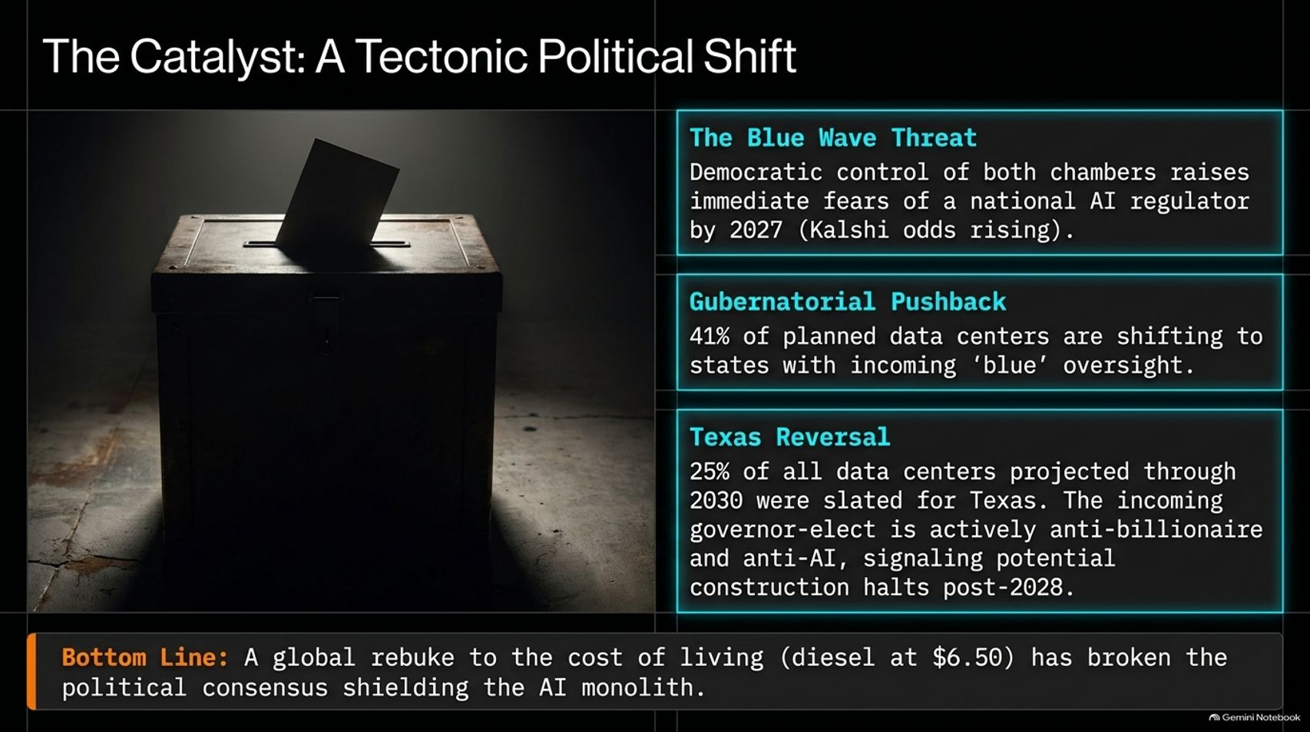

Slide 4
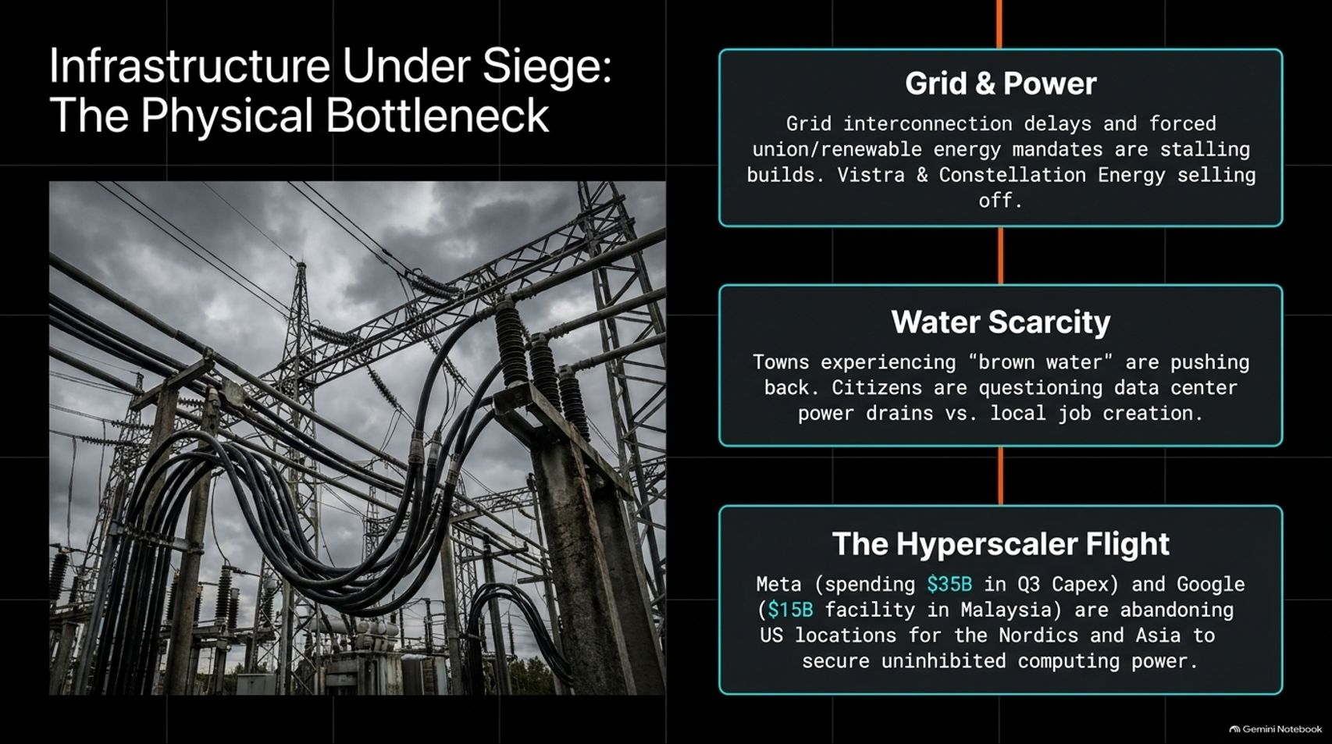
Notes:
Duration: 3 to 4 minutes
Visual Theme: Grid & power delays, water scarcity, hyperscaler flight.
Speaker Notes:
Beyond politics, physical reality is striking back. Infrastructure is under siege.
Grid interconnection delays, combined with forced union and renewable energy mandates, are severely stalling builds. Major energy players like Vistra and Constellation Energy are seeing sharp sell-offs.
Water scarcity is creating local rebellions: towns experiencing "brown water" issues are pushing back against data center power drains that offer minimal local job creation.
Consequently, we are witnessing Hyperscaler Flight. Giants like Meta—spending $\$35\text{B}$ in Q3 CapEx—and Google, with a $\$15\text{B}$ facility in Malaysia, are actively abandoning US locations for the Nordics and Asia to secure uninhibited computing power.

Slide 5
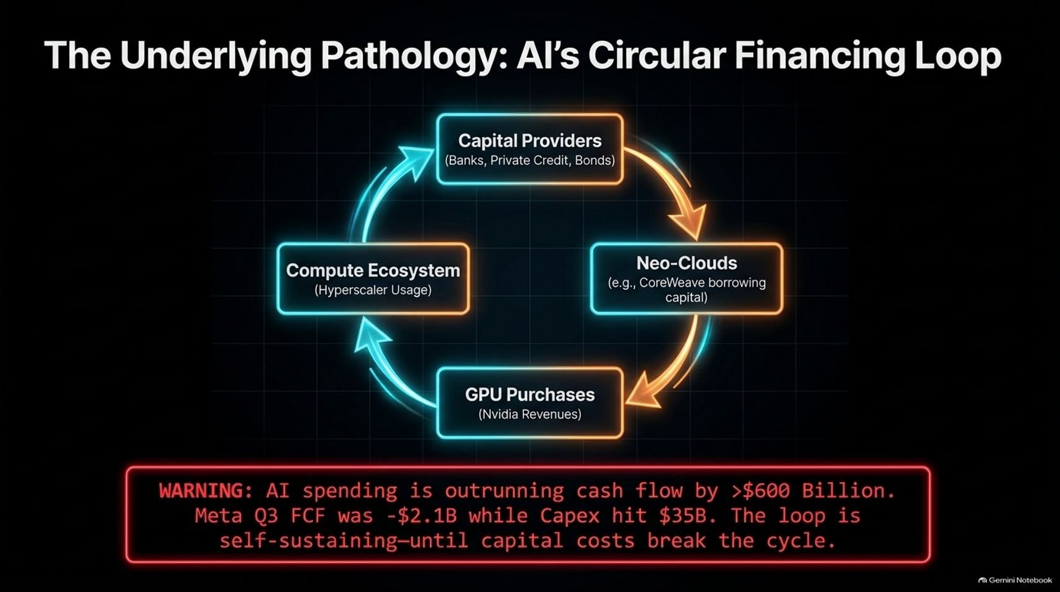
Notes:
Duration: 4 to 6 minutes
Visual Theme: Circular diagram (Capital Providers $\rightarrow$ Neo-Clouds $\rightarrow$ GPU Purchases $\rightarrow$ Compute Ecosystem).
Speaker Notes:
At the heart of the tech bubble is an underlying pathology: AI’s circular financing loop.
Look at the loop: Capital providers (banks, private credit, bond markets) fund Neo-Clouds (like CoreWeave). Neo-Clouds use borrowed capital to purchase massive quantities of GPUs, driving Nvidia's revenues. Those GPUs power the compute ecosystem for hyperscalers, feeding back into financial commitments.
However, the system is fundamentally lopsided: AI spending is outrunning cash flow by more than $\$600$ billion. For instance, Meta's Q3 free cash flow hit $-\$2.1\text{B}$ while CapEx surged to $\$35\text{B}$.
Reference the Video context: As highlighted by the Treasury Borrowing Advisory Committee data referenced by Jay Singh, this self-sustaining loop functions only as long as cheap capital keeps flowing. Once capital costs spike, the cycle breaks.

Slide 6
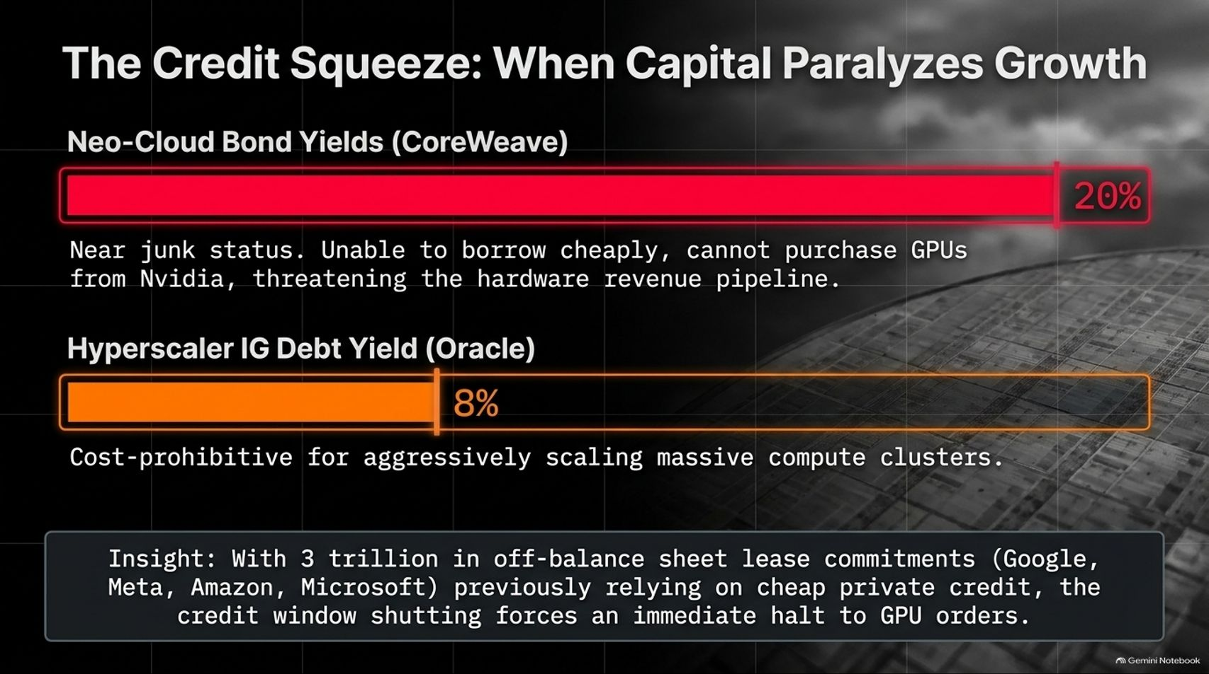
Notes:
Duration: 3 to 5 minutes
Visual Theme: CoreWeave bond yields at $20\%$, Oracle IG debt at $8\%$.
Speaker Notes:
The credit window is slamming shut, creating a severe credit squeeze.
Neo-cloud bond yields—exemplified by CoreWeave—have spiked to $20\%$, pushing them near junk status. Unable to borrow cheaply, they cannot purchase new GPUs from Nvidia, threatening the entire hardware revenue pipeline.
Meanwhile, investment-grade debt yields for hyperscalers like Oracle have climbed to $8\%$, making aggressive scaling of massive compute clusters cost-prohibitive.
Reference the Video context: With over $\$3$ trillion in off-balance sheet lease commitments across Google, Meta, Amazon, and Microsoft previously relying on cheap private credit, the sudden shut-off of the credit window forces an immediate, mandatory halt to GPU orders.

Slide 7
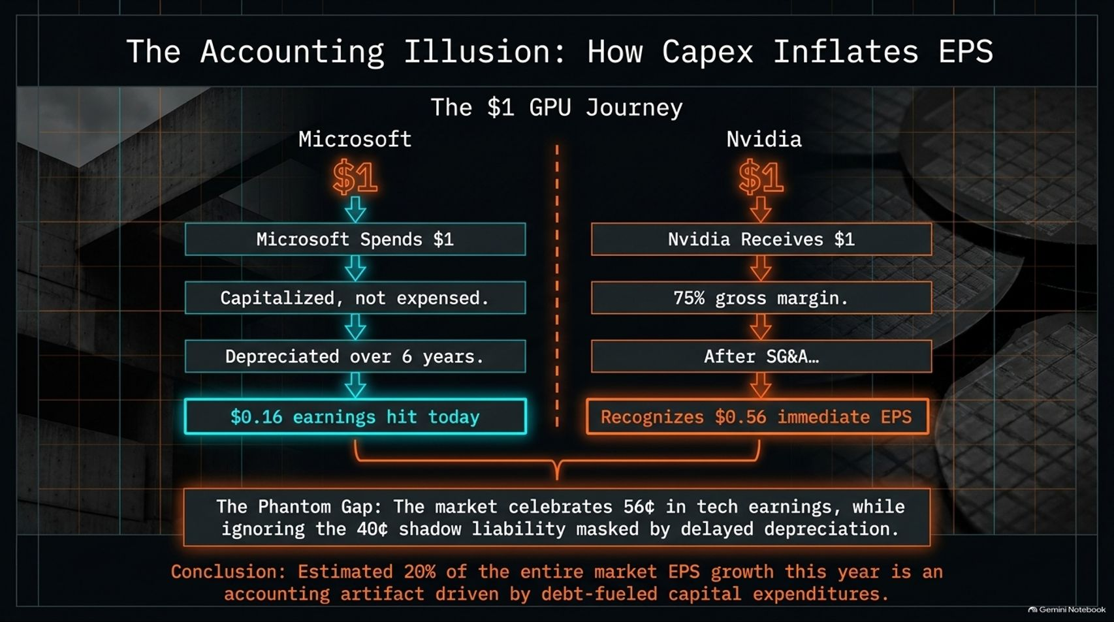
Notes:
Duration: 4 to 6 minutes
Visual Theme: The $\$1$ GPU journey comparison between Microsoft and Nvidia.
Speaker Notes:
Let's expose the accounting illusion driving reported earnings.
When Microsoft spends $\$1$ on Nvidia hardware, Nvidia records $\$1$ in revenue, hits a $75\%$ gross margin, and—after SG&A—recognizes roughly $\$0.56$ in immediate earnings per share (EPS).
On Microsoft's side, that same $\$1$ is capitalized, not expensed. It is depreciated over six years, resulting in only a $\$0.16$ earnings hit today.
The Phantom Gap: The market celebrates strong headline tech earnings while completely ignoring the shadow liability masked by delayed depreciation.
Conclusion: An estimated $20\%$ of entire market EPS growth this year is an accounting artifact driven by debt-fueled capital expenditures rather than organic cash generation.

Slide 8
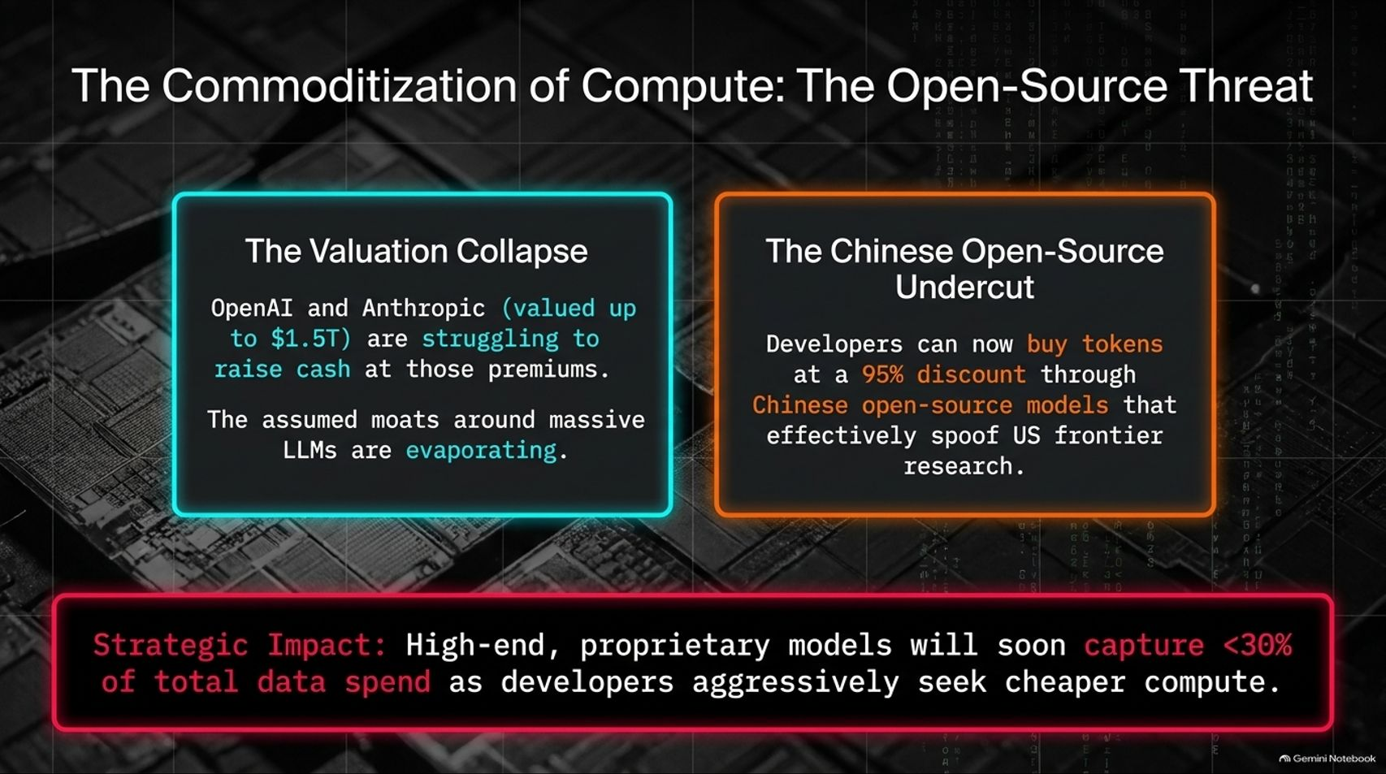
Notes:
Duration: 3 to 5 minutes
Visual Theme: Valuation collapse of OpenAI/Anthropic; Chinese open-source undercut.
Speaker Notes:
The economic moats surrounding proprietary large language models are evaporating rapidly.
Valuation Collapse: OpenAI and Anthropic—previously hyped at valuations up to $\$1.5$ trillion—are struggling to raise cash at those premium valuations.
The Chinese Open-Source Undercut: Developers can now buy tokens at a staggering $95\%$ discount through Chinese open-source models that effectively spoof US frontier research.
Strategic Impact: High-end, proprietary models will soon capture less than $30\%$ of total data spend as developers aggressively pivot toward cheaper, commoditized compute.

Slide 9
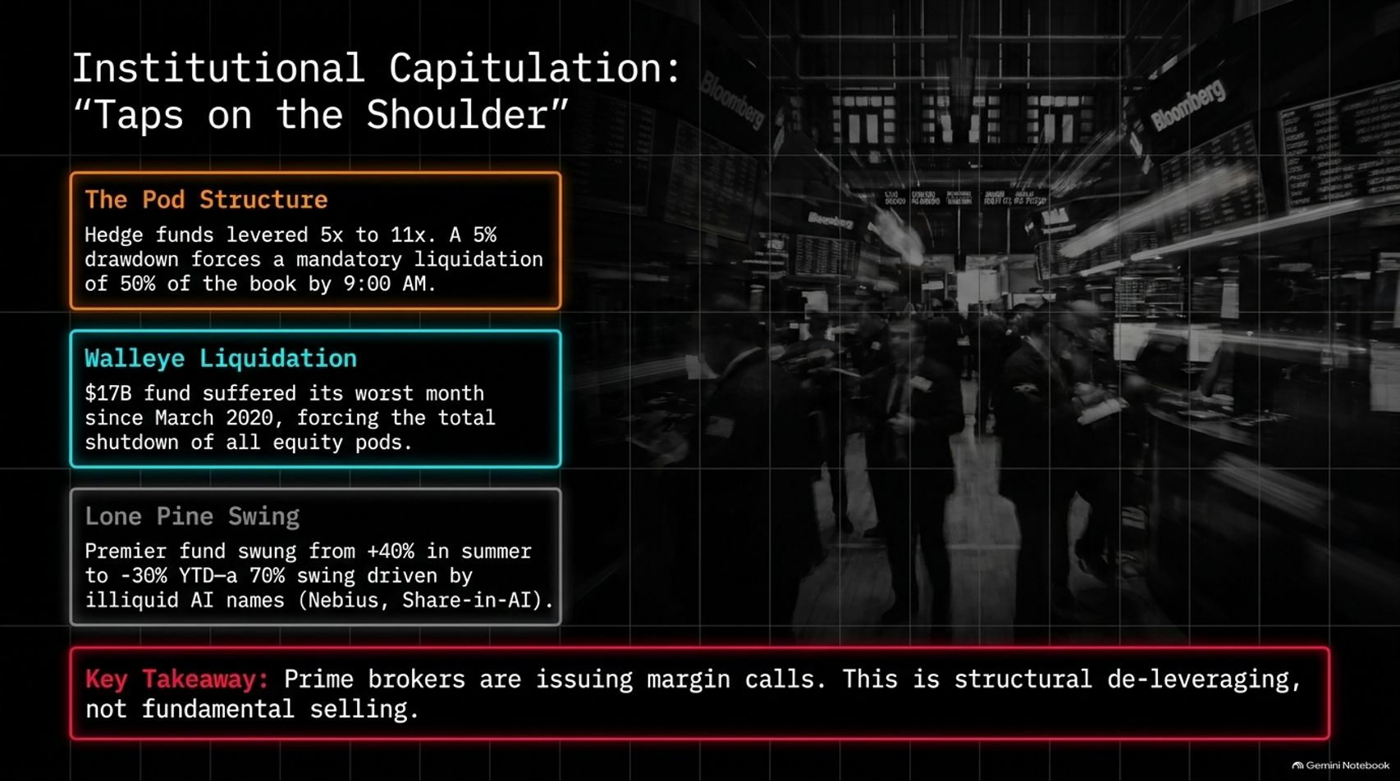
Notes:
Duration: 3 to 5 minutes
Visual Theme: Hedge fund pod structures, Walleye liquidation, Lone Pine swing.
Speaker Notes:
Institutional investors are facing brutal capitulation through what Wall Street calls "taps on the shoulder".
The Pod Structure: Multi-manager hedge funds run leverage between $5\times$ and $11\times$. A minor $5\%$ drawdown triggers a mandatory liquidation of $50\%$ of the book by 9:00 AM.
High-profile casualties include Walleye—a $\$17\text{B}$ fund that suffered its worst month since March 2020, forcing the total shutdown of all equity pods. Lone Pine swung from $+40\%$ in the summer to $-30\%$ year-to-date due to illiquid AI holdings.
Reference the Video context: Prime brokers are issuing relentless margin calls. As Jay Singh points out, this is structural de-leveraging and forced liquidation, not purely fundamental selling.

Slide 10
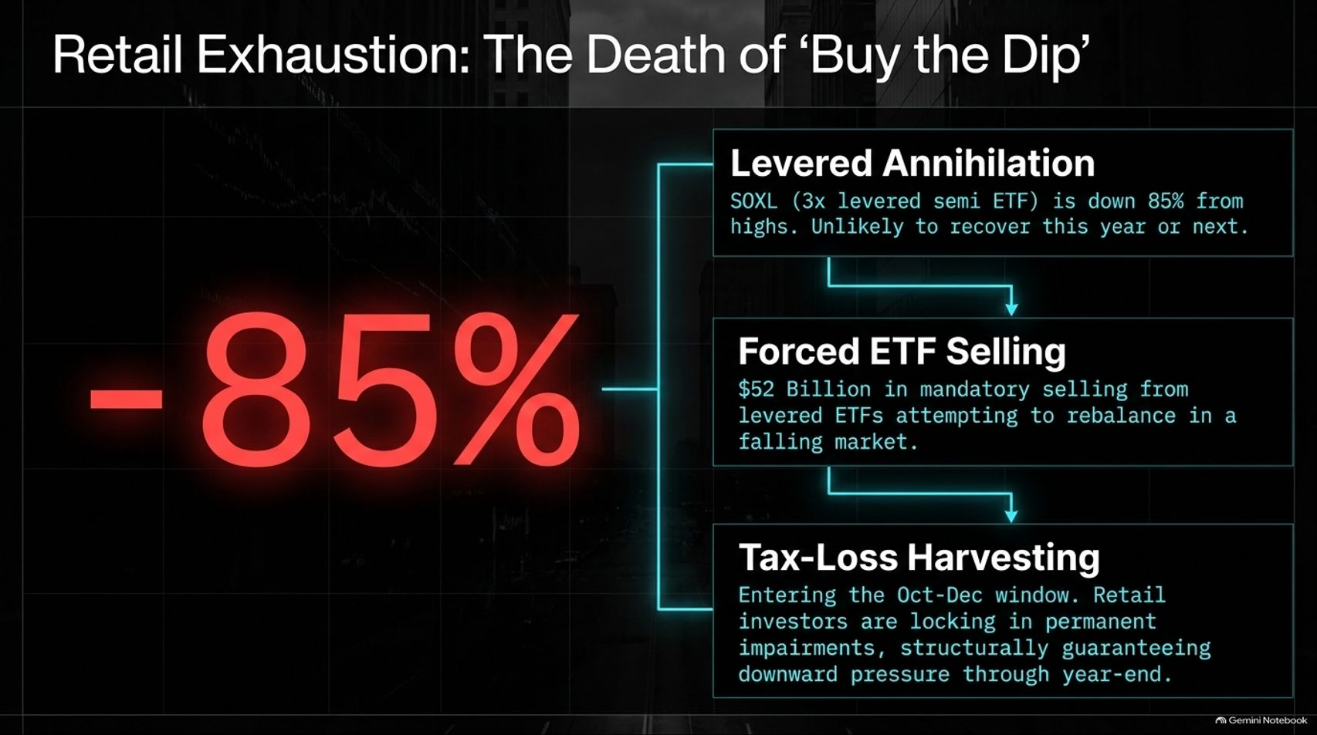
Notes:
Duration: 3 to 4 minutes
Visual Theme: Levered annihilation (-85%), forced ETF selling, tax-loss harvesting.
Speaker Notes:
Retail investors, who religiously "bought the dip" throughout earlier pullbacks, are now completely exhausted.
Levered Annihilation: Products like SOXL ($3\times$ levered semiconductor ETF) are down $85\%$ from their highs and are structurally unlikely to recover anytime soon.
Forced ETF Selling: $\$52$ billion in mandatory selling is hitting the market as levered ETFs attempt to rebalance in a falling market ($-\$20$ billion in SOXL alone).
Tax-Loss Harvesting: Entering the October–December window, retail investors are locking in permanent capital impairments, guaranteeing sustained downward pressure through year-end.

Slide 11
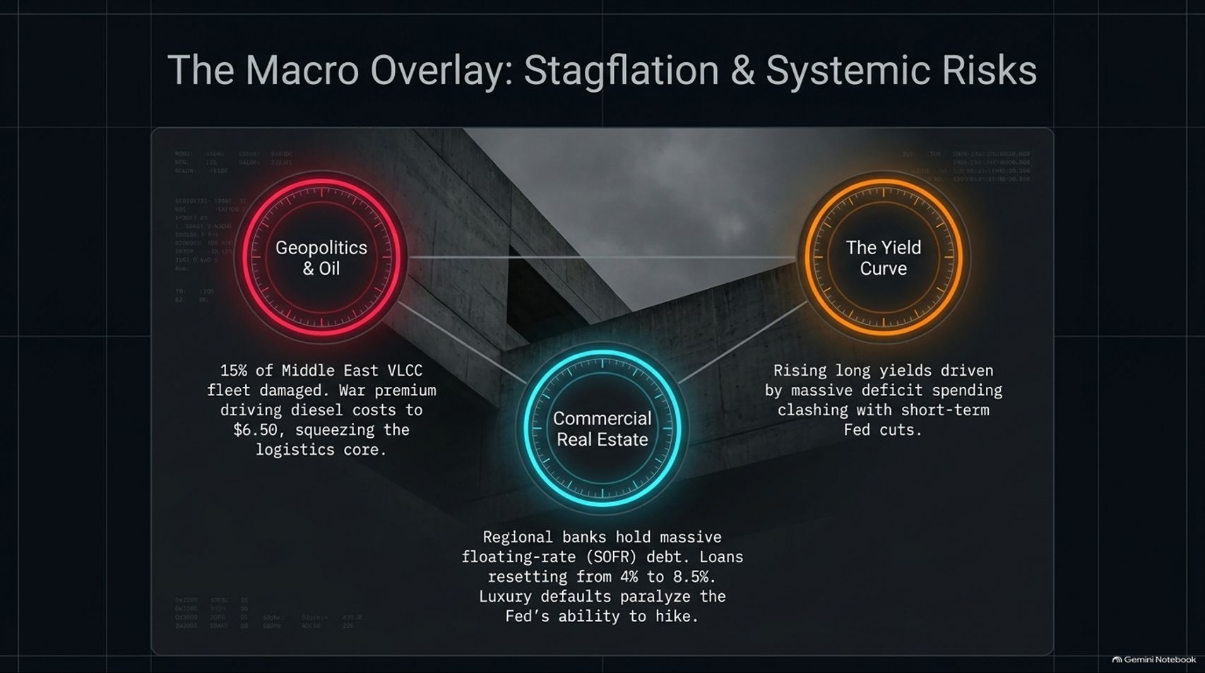
Notes:
Duration: 3 to 5 minutes
Visual Theme: Geopolitics & Oil, Commercial Real Estate, The Yield Curve.
Speaker Notes:
The AI fracture is occurring inside a dangerous macroeconomic overlay featuring stagflationary pressures.
Geopolitics & Oil: With $15\%$ of Middle East VLCC tanker fleets damaged or disrupted, war premiums have driven diesel costs to $\$6.50$, squeezing the global logistics core.
Commercial Real Estate: Regional banks hold massive floating-rate SOFR debt where loans are resetting from $4\%$ to $8.5\%$. Luxury defaults are paralyzing the Fed's ability to hike rates further.
The Yield Curve: Rising long yields, driven by massive deficit spending, are clashing awkwardly with short-term Fed policy.

Slide 12
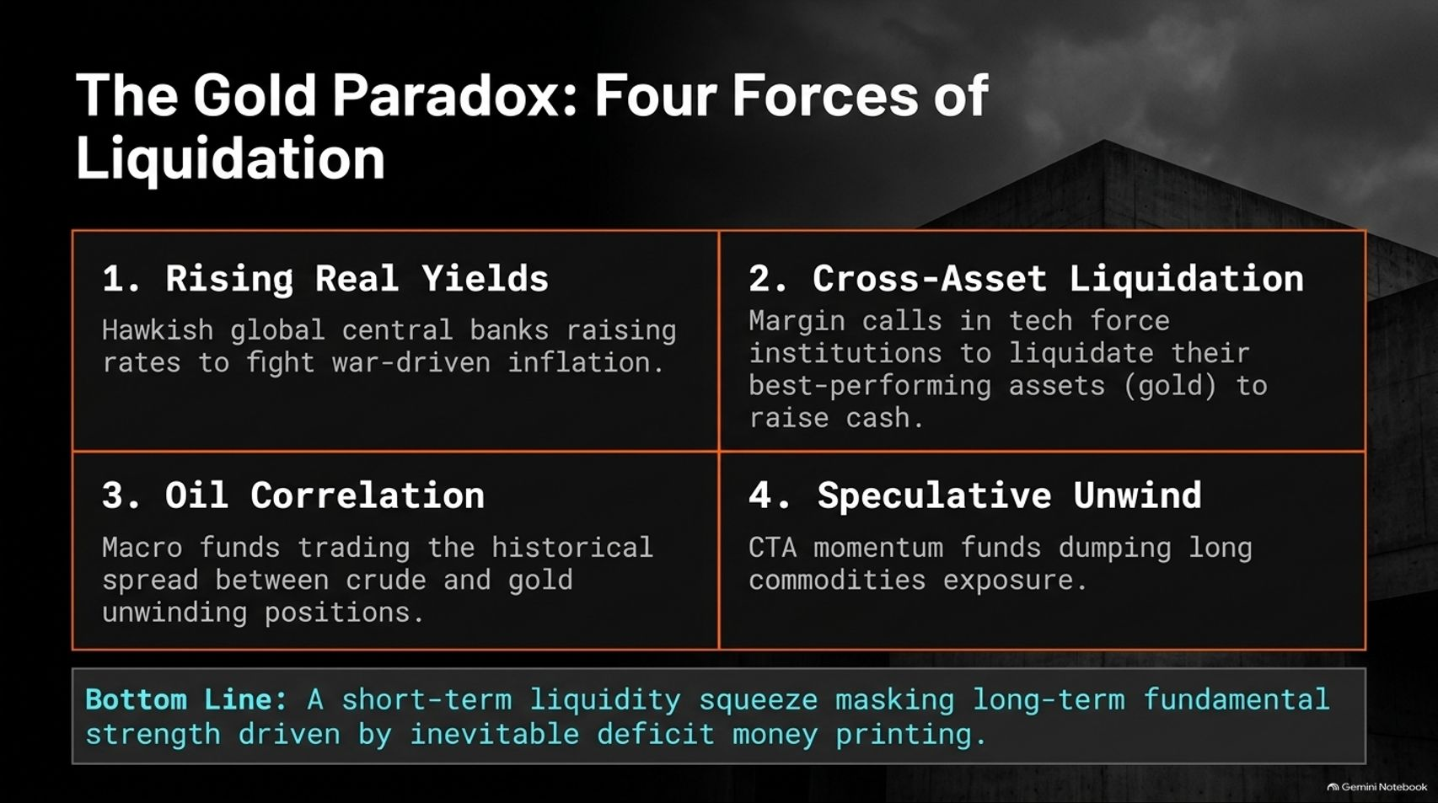
Notes:
Duration: 3 to 5 minutes
Visual Theme: Rising Real Yields, Cross-Asset Liquidation, Oil Correlation, Speculative Unwind.
Speaker Notes:
Why hasn't gold acted as a safe haven during this crisis? We call this the Gold Paradox, driven by four specific forces of liquidation.
Rising Real Yields: Hawkish global central banks are raising rates to combat war-driven inflation.
Cross-Asset Liquidation: Margin calls in tech force institutional funds to liquidate their best-performing assets—including gold—to raise immediate cash.
Oil Correlation: Macro funds trading historical spreads between crude and gold are aggressively unwinding positions.
Speculative Unwind: CTA momentum funds are dumping long commodity exposure.
Bottom Line: This is a short-term liquidity squeeze masking long-term fundamental strength that will inevitably resume once money printing returns.

Slide 13
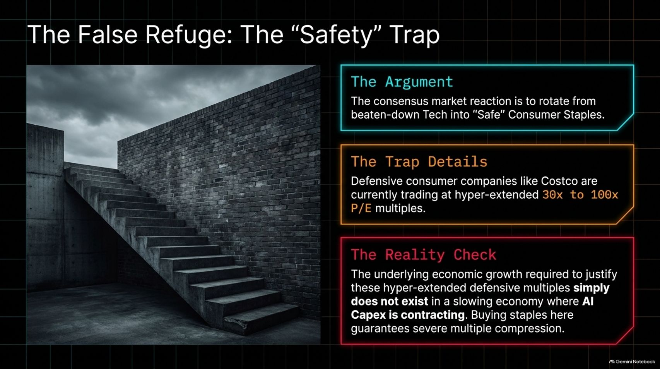
Notes:
Duration: 3 to 4 minutes
Visual Theme: Consumer staples trading at 30x–100x P/E multiples.
Speaker Notes:
Investors trying to escape tech are falling into a classic market trap: rotating blindly into "safe" Consumer Staples.
The Trap Details: Defensive consumer companies like Costco are currently trading at hyper-extended P/E multiples between $30\times$ and $100\times$.
The Reality Check: The underlying economic growth required to justify these defensive multiples simply does not exist in a slowing economy where AI CapEx is contracting. Buying staples here guarantees severe multiple compression.

Slide 14
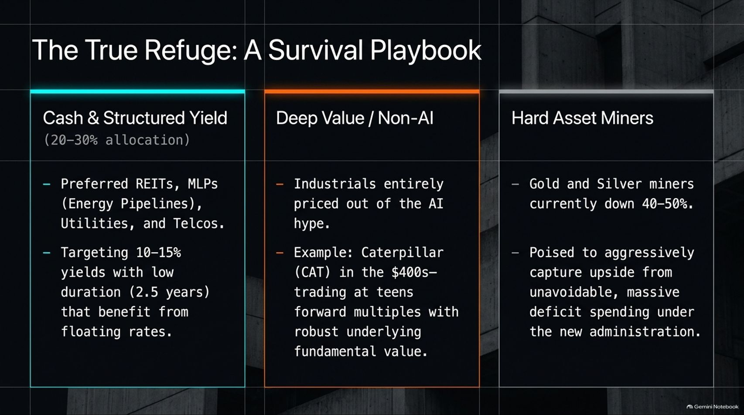
Notes:
Duration: 3 to 5 minutes
Visual Theme: Cash & Structured Yield, Deep Value/Non-AI, Hard Asset Miners.
Speaker Notes:
Where should capital hide in this environment? Here is our 3-pillar survival playbook:
Cash & Structured Yield ($20–30\%$ allocation): Focus on preferred REITs, energy pipeline MLPs, utilities, and telcos targeting $10–15\%$ yields with short duration ($2.5$ years) that benefit from floating rates.
Deep Value / Non-AI: Target industrials entirely priced out of the AI hype. For example, Caterpillar (CAT) trading in the $\$400\text{s}$ at teens forward multiples with robust underlying value.
Hard Asset Miners: Gold and silver miners are currently down $40–50\%$, poised to aggressively capture upside from unavoidable, massive deficit spending under the incoming administration.

Slide 15
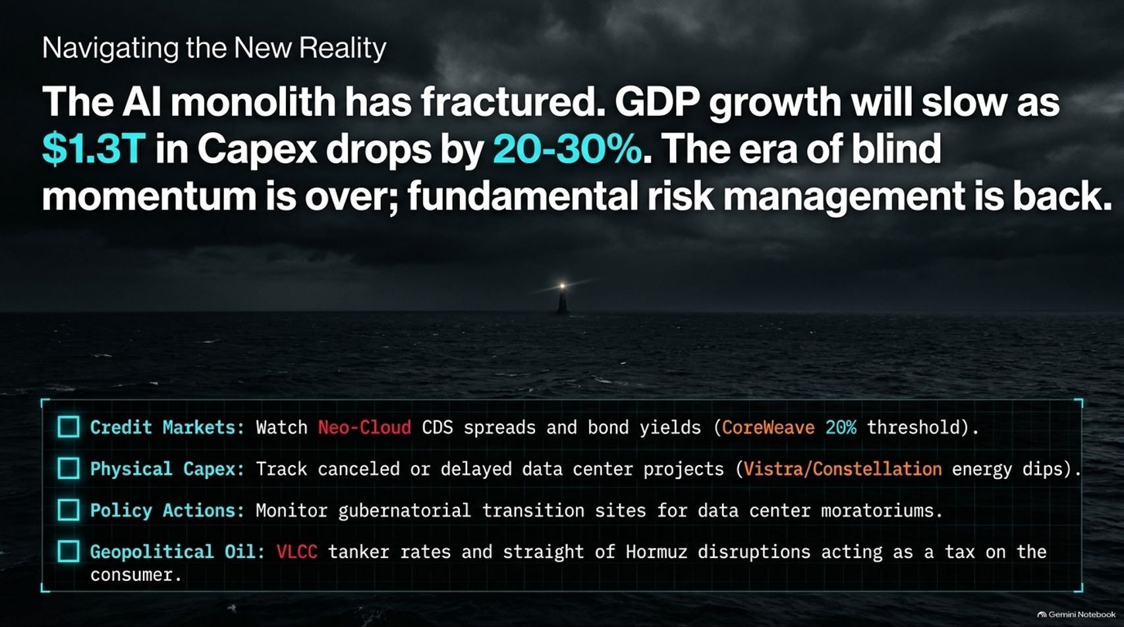
Notes:
Duration: 3 to 4 minutes
Visual Theme: Lighthouse in storm, summary checklist (Credit markets, Physical CapEx, Policy actions, Geopolitical oil).
Speaker Notes:
To summarize: The AI monolith has fractured. GDP growth will slow as $\$1.3$ trillion in CapEx drops by $20–30\%$. The era of blind momentum is officially over; fundamental risk management is back.
Keep your eyes on four critical dashboard metrics moving forward:
Credit Markets: Watch Neo-Cloud CDS spreads and bond yields (keeping a close eye on CoreWeave's $20\%$ threshold).
Physical CapEx: Track canceled or delayed data center projects and energy stock dips.
Policy Actions: Monitor gubernatorial transition websites for incoming data center moratoriums.
Geopolitical Oil: Track VLCC tanker rates and Strait of Hormuz disruptions acting as a direct tax on the consumer.

Slide 16
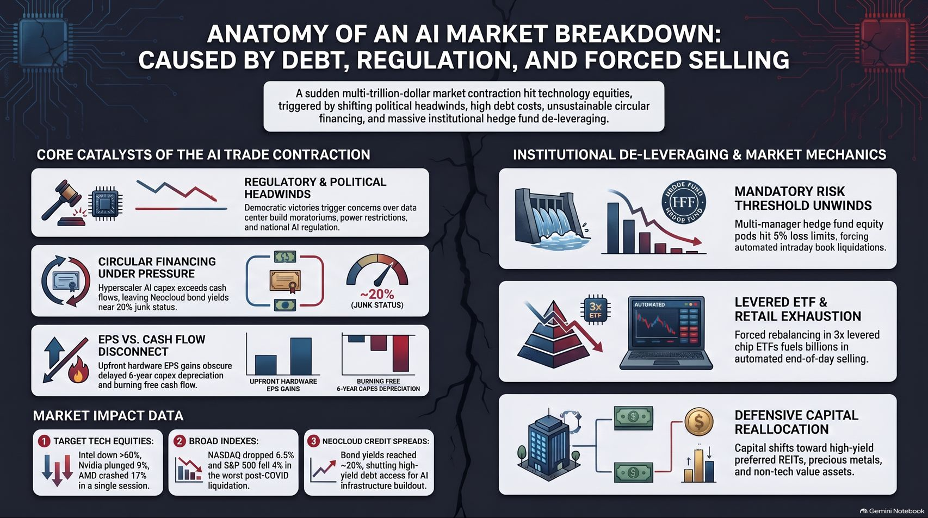
Notes:
Duration: 3 to 5 minutes
Visual Theme: Comprehensive summary split-screen infographic (Core Catalysts vs. Institutional De-leveraging & Market Mechanics).
Speaker Notes:
As we conclude today's presentation, this summary schematic captures the full anatomy of the breakdown: driven by debt, regulation, and forced selling.
On the left, core catalysts show regulatory headwinds, circular financing under pressure, and the EPS versus cash flow disconnect. On the right, market mechanics illustrate multi-manager risk threshold unwinds, levered ETF retail exhaustion, and defensive capital reallocation.
Thank you for your time. Stay disciplined, manage your duration, protect your capital, and utilize specialized research frameworks to navigate this new macro reality.

