Slide 1

Notes:
Estimated Speaking Time: 2 minutes
Opening Hook: Good morning, everyone. Today, we are stripping away the hype, the Silicon Valley myths, and the inflated promises surrounding artificial intelligence, venture capital, and modern wealth creation.
Key Talking Points:
In a landscape dominated by tech hype cycles and quick-fix startup formulas, Mark Cuban’s commentary on The Diary Of A CEO provides a grounded, pragmatic reality check.
We will explore four primary pillars today:
Preparation vs. Luck: The unglamorous mechanics of building true competitive advantages.
Entrepreneurial Grounding: Why sales mastery and month-to-month profitability beat venture funding hype.
Demystifying AI: Understanding AI as a probabilistic, statistical tool rather than an omniscient brain.
Macroeconomic Realities: The current market fragility, corporate tech debt traps, and how to protect wealth in an age of abundance.
Transition: Let's begin with the foundational element that separates those who dream about success from those who actually achieve it: preparation.
Mark Cuban: The Brutal Truth About The Next Market Crash!
https://www.youtube.com/watch?v=6VTSAs4Rsck

Slide 2

Notes:
Estimated Speaking Time: 3 – 4 minutes
Core Concept: Everyone wants to win, but very few are willing to put in the exhaustive, grueling hours required to guarantee victory before even entering the room.
Key Talking Points:
Bobby Knight’s Premise: "Everybody’s got the will to win, but it’s only those with the will to prepare that actually do win." In business, "will to win" is cheap—it's enthusiasm without execution.
The 28-Hour Edge: Cuban shares his experience during the dawn of the personal computer revolution. While others saw PCs as a passing fad or complicated machines, Cuban locked himself in a room for 28-hour stretches. He read software and hardware manuals end-to-end.
Creating an Asymmetric Advantage: By putting in seven or eight hours of grueling study every single day, he guaranteed that when he walked into a client meeting or a board room, he possessed more detailed knowledge than anyone else present.
Modern Application: Today, people look for AI prompts or quick hacks to bypass foundational knowledge. True edge comes from doing the deep work that competitors deem too tedious.
Transition: Once you have the commitment to prepare, what skill must you actually master first?

Slide 3
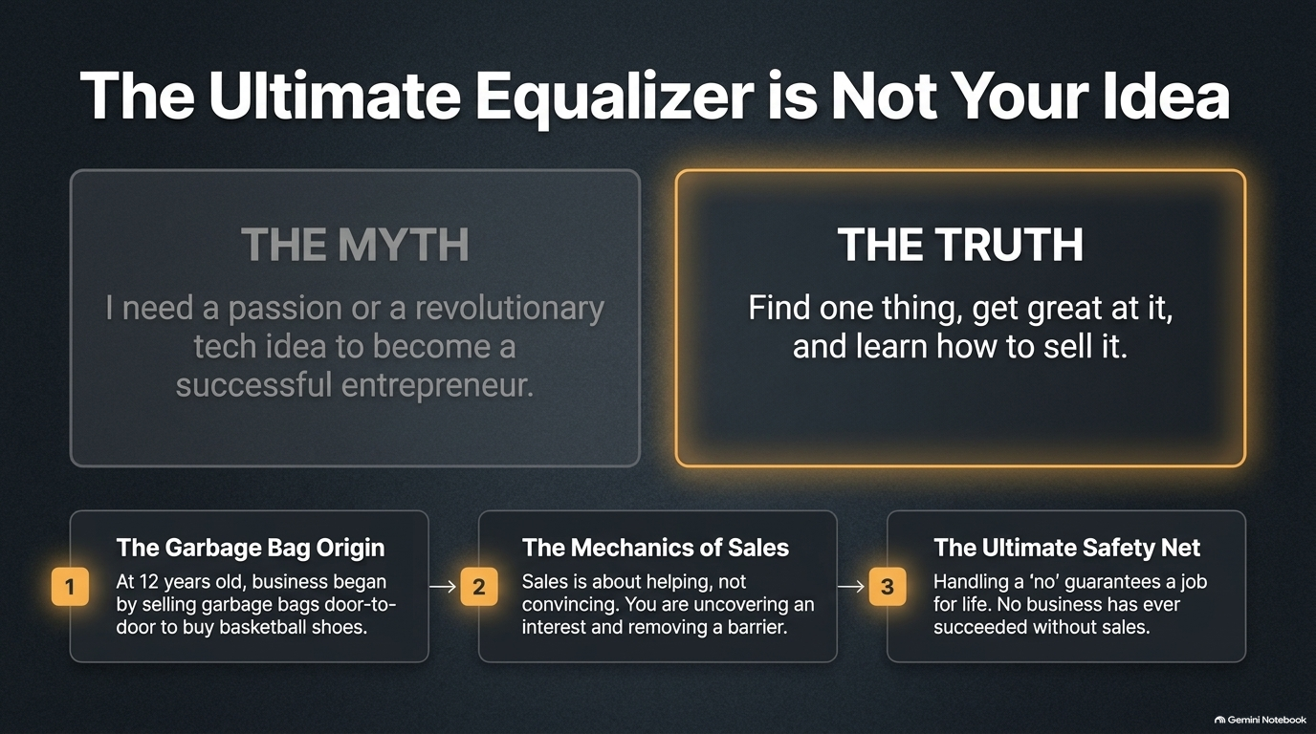
Notes:
Estimated Speaking Time: 3 – 4 minutes
Core Concept: Entrepreneurship is not about having a groundbreaking, world-changing idea; it is about finding one domain, becoming competent, and mastering sales.
Key Talking Points:
Myth vs. Truth:
The Myth: "I need a revolutionary tech patent or a disruptive vision to be an entrepreneur."
The Truth: Find one tangible skill, get exceptionally good at it, and learn how to sell it.
The Garbage Bag Origin: Cuban started his entrepreneurial journey at age 12 selling trash bags door-to-door just to buy a pair of basketball shoes.
The Mechanics of Sales:
Sales is often misunderstood as manipulation or pushiness. Real sales is about helping.
It is the process of uncovering a genuine need or friction point and showing the client how your solution removes that barrier.
The Ultimate Safety Net: If you know how to handle rejection ("no") and solve problems for people, you will never be unemployed. No business in human history has ever survived without revenue and sales.
Transition: Understanding sales leads directly to rethinking how we measure business success.

Slide 4
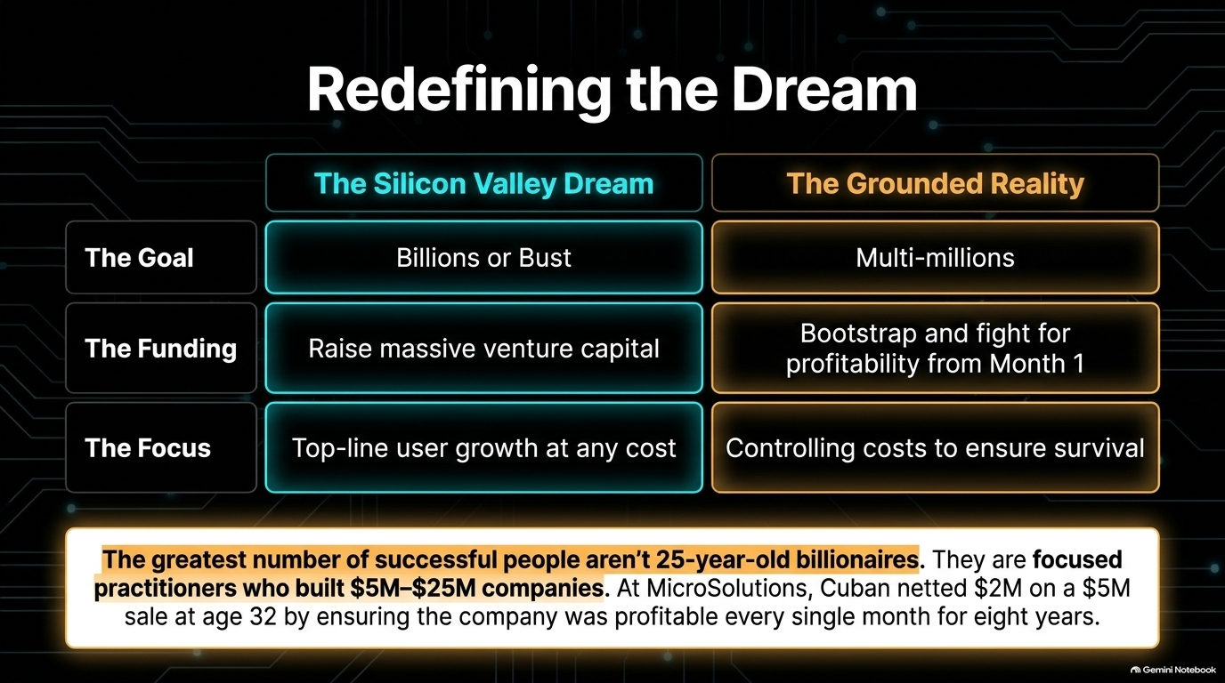
Notes:
Estimated Speaking Time: 4 minutes
Core Concept: The media glorifies unicorn founders who raise hundreds of millions, but sustainable wealth is built in quiet, profitable, mid-sized enterprises.
Key Talking Points:
Silicon Valley Dream vs. Grounded Reality:
Goal: Unicorn valuation ($1B+) vs. Generating multi-millions in real net cash.
Funding: Raising massive Venture Capital rounds vs. Bootstrapping and demanding profit from Day 1.
Focus: Vanity metrics and top-line growth vs. Cost control and unit economics.
The MicroSolutions Benchmark: When Cuban built MicroSolutions, he didn't focus on hyper-scaling through burn rates. He ensured the company was profitable every single month for eight straight years. When it sold for $6M, he netted $2M at age 32—establishing true financial freedom.
Takeaway: The majority of self-made millionaires are not 25-year-old tech founders; they are disciplined practitioners operating $5M–$25M profitable companies.
Transition: How do you decide which business or skill to pursue in the first place?

Slide 5
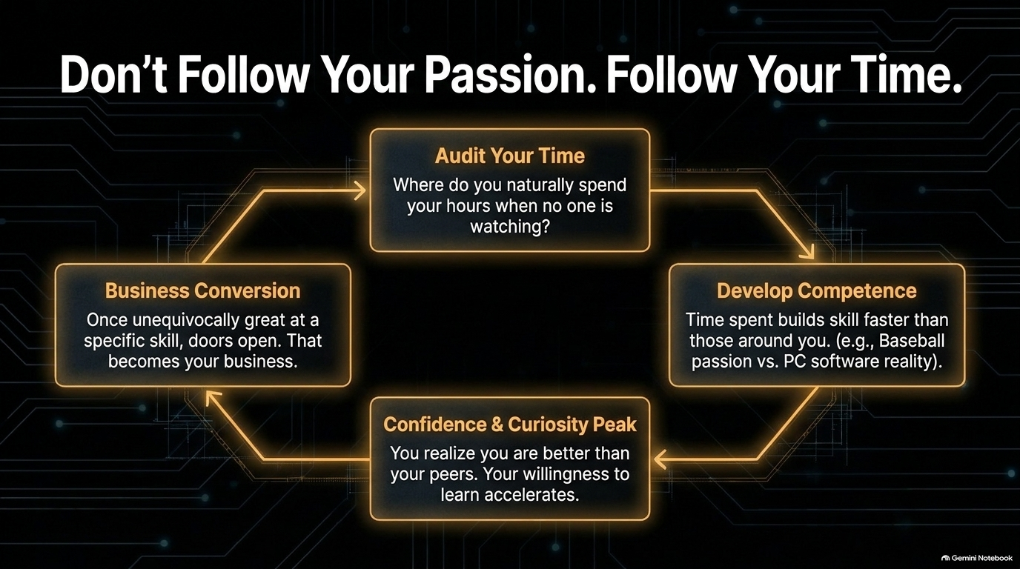
Notes:
Estimated Speaking Time: 3 – 4 minutes
Core Concept: Conventional advice says "follow your passion." Practical reality dictates that you should follow what you actually spend your time doing.
Key Talking Points:
The Passion Trap: You can be passionate about baseball, music, or art, but if you lack natural aptitudes or market demand, passion won't pay the bills. Cuban loved baseball, but he realized quickly he couldn't throw a 90 mph fastball.
The 4-Step Cycle:
Audit Your Time: Where do your hours go when no one is forcing you to work? What topics do you naturally research or read about?
Develop Competence: The hours you invest build mastery faster than your peers.
Confidence & Curiosity Peak: As you realize you are becoming better than others in that space, your motivation accelerates.
Business Conversion: Once you are unequivocally great at something, market demand follows, and that competence becomes your business.
Transition: As you build competence and scale a team, leadership requirements evolve from technical skill to human psychology.

Slide 6
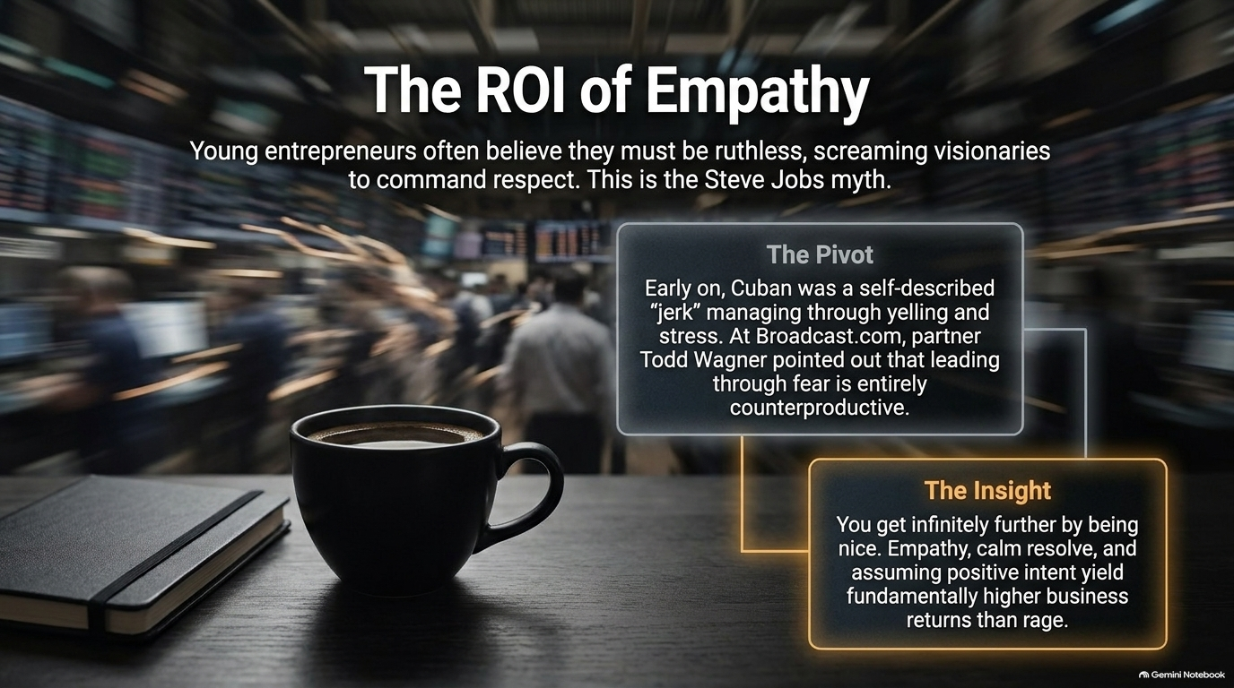
Notes:
Estimated Speaking Time: 3 – 4 minutes
Core Concept: Leading through fear, screaming, and intensity is inefficient and counterproductive; empathy and clear communication yield higher long-term returns.
Key Talking Points:
The Steve Jobs Myth: Young founders often assume that to build a great company, they must be demanding, harsh, and ruthless tyrants.
Cuban’s Pivot: Early in his career, Cuban was a self-described "jerk" who yelled when things went wrong.
The Realization at Broadcast.com: His business partner, Todd Wagner, pulled him aside and pointed out that leading through fear creates friction, defensiveness, and high turnover.
The Power of Being Nice:
Empathy is a practical operational tool. When you assume positive intent and treat employees with calm respect, you reduce organizational friction.
People work harder, share bad news faster, and innovate more freely when they aren't managing fear.
Transition: Let's look at how this philosophy translates to organizational culture and performance, using a real-world sports case study.

Slide 7
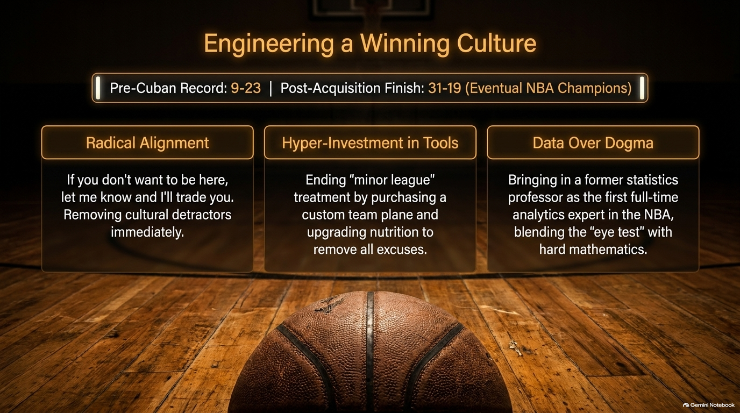
Notes:
Estimated Speaking Time: 4 minutes
Core Concept: Cultural transformation requires alignment, eliminating excuses through investment, and balancing human judgment with empirical data.
Key Talking Points:
The Dallas Mavericks Turnaround: When Cuban bought the Mavs, they had a dismal 9-23 record and decades of losing culture. They finished the season 31-19 and eventually became NBA Champions. How?
Pillar 1: Radical Alignment:
Cuban gave players a clear choice: If you don't want to be here and put in the work, tell me, and I will trade you today. Removing toxic elements immediately is non-negotiable.
Pillar 2: Hyper-Investment in Tools:
He ended the "minor league" treatment by purchasing a custom team plane, upgrading facilities, and hiring top-tier trainers/nutritionists. By treating players like elite assets, he eliminated all excuses for poor performance.
Pillar 3: Data Over Dogma:
Cuban brought in a former statistics professor as the first full-time analytics expert in the NBA. He combined traditional scouting ("the eye test") with quantitative data.
Transition: Now, let's pivot to technology and examine the current state of Artificial Intelligence.

Slide 8
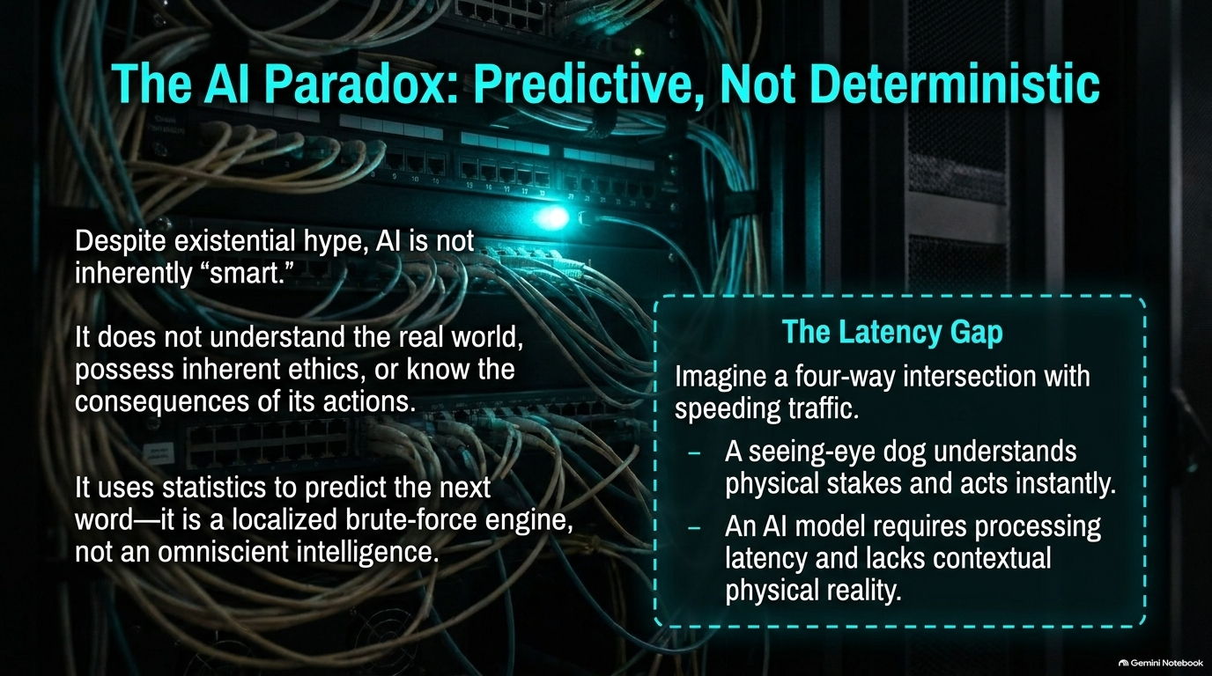
Notes:
Estimated Speaking Time: 4 – 5 minutes
Core Concept: Large Language Models (LLMs) are statistical prediction engines, not conscious or omniscient intelligences.
Key Talking Points:
Demystifying the Hype: Despite marketing narratives claiming AI is reaching human-level general intelligence, LLMs do not "think." They predict the most statistically probable next token (word) based on training data.
Core Limitations:
Lacks real-world spatial awareness.
Lacks inherent ethics, moral reasoning, or understanding of real-world consequences.
The Latency & Context Gap (The Guide Dog Analogy):
Consider a blind person at a busy four-way intersection with speeding cars.
A seeing-eye dog understands physical stakes, senses motion instantly, and stops its owner from stepping into traffic in real time.
An AI system requires sensors, data processing, model inference, and network transmission—introducing latency and lacking instinctual physical awareness.
Transition: If AI is a statistical brute-force tool, where does the real human competitive advantage lie?

Slide 9
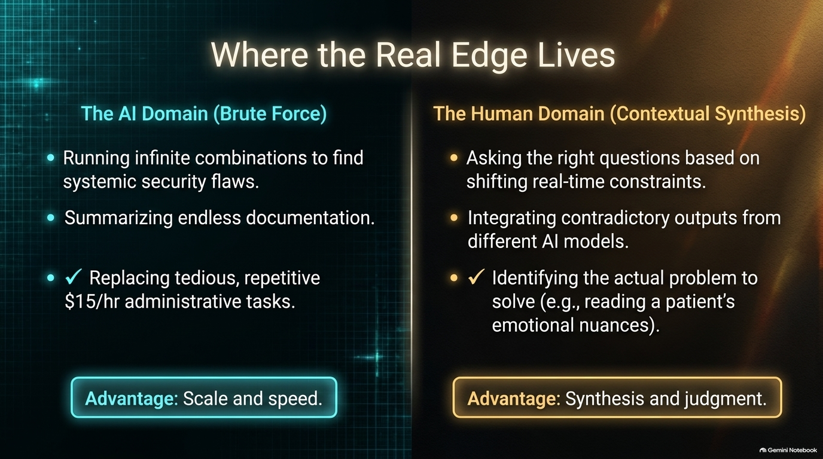
Notes:
Estimated Speaking Time: 3 – 4 minutes
Core Concept: AI excels at brute-force execution and scale; humans excel at contextual synthesis, empathy, and strategic framing.
Key Talking Points:
Comparing the Domains:
AI Domain (Brute Force):
Running millions of permutations to find cybersecurity vulnerabilities.
Summarizing thousands of pages of legal documentation in seconds.
Automating repetitive, $15/hr administrative workflows.
Key Advantage: Scale, computational speed, and pattern matching.
Human Domain (Contextual Synthesis):
Asking the right strategic questions under shifting, ambiguous constraints.
Reconciling conflicting data or hallucinated outputs from multiple AI models.
Nuanced emotional judgment (e.g., a doctor reading a patient's fear, or a founder reading a client's hesitation).
Key Advantage: High-level reasoning, moral judgment, and synthesis.
Transition: How do individuals and organizations leverage this division of labor to stay ahead?

Slide 10
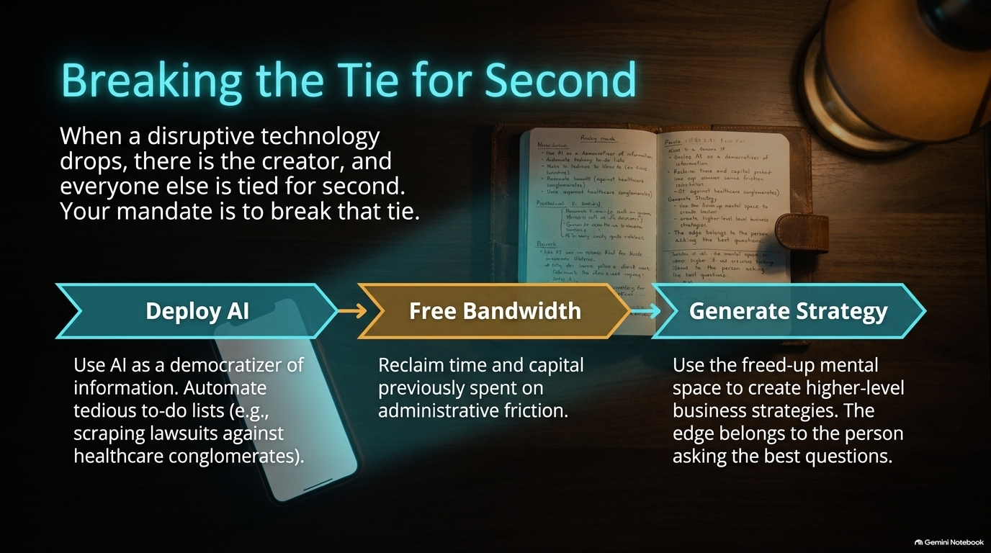
Notes:
Estimated Speaking Time: 4 minutes
Core Concept: When disruptive tech emerges, the creator takes first place, and everyone else is tied for second. To win, you must use AI to clear low-value work and focus on high-level strategy.
Key Talking Points:
The 3-Step Productivity Pipeline:
Deploy AI as a Democratizer: Use AI tools to handle tedious research, data gathering, and administrative overhead. Example: Scraping public court filings to challenge improper billing by healthcare conglomerates.
Free Mental Bandwidth: Reclaim hours previously consumed by routine tasks.
Generate High-Level Strategy: Apply that newly freed bandwidth to strategic thinking, relationship building, and asking better questions.
The Core Thesis: The edge does not belong to the person who prompts AI to generate generic content; it belongs to the person who knows what questions need to be asked.
Transition: While AI offers operational efficiency, what is happening at the macroeconomic and financial market level?

Slide 11

Notes:
Estimated Speaking Time: 3 – 4 minutes
Core Concept: Public markets have detached fundamental intrinsic valuation (discounted cash flows) from speculative sentiment.
Key Talking Points:
The "Meme-ification" of Blue Chips: Major tech equities are increasingly trading like collectibles or meme stocks rather than cash-generating businesses.
The High-Volatility Dynamic:
We see companies valued at hundreds of billions suffer an 18% drop in stock price over a single-penny missed earnings target.
Root Causes:
Algorithmic high-frequency trading reacting to headline text.
Retail options momentum and viral market narratives.
The Fragility Hazard: When market capitalization reflects perceived narrative value rather than underlying free cash flow, systemic fragility reaches peak levels.
Transition: What is driving this capital misallocation at the structural corporate level?

Slide 12
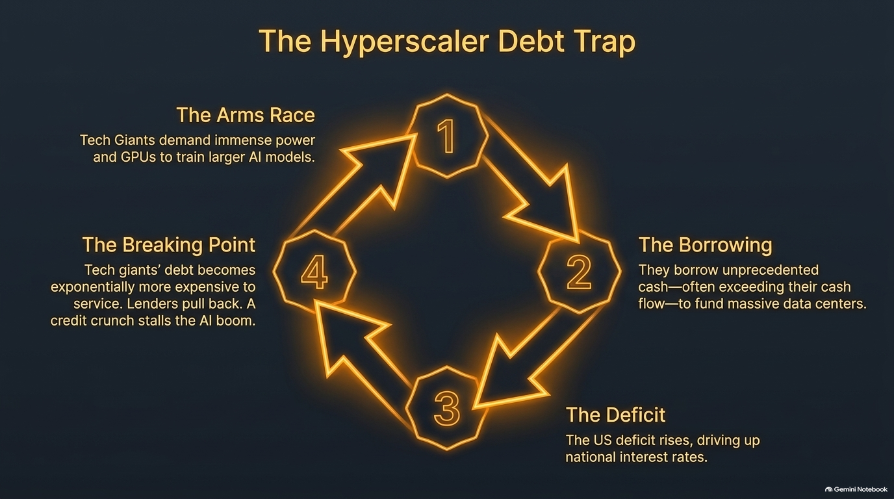
Notes:
Estimated Speaking Time: 4 – 5 minutes
Core Concept: Tech giants are entering a dangerous feedback loop, borrowing massive capital to fund escalating AI infrastructure costs.
Key Talking Points:
The 4-Stage Debt Cycle:
The Arms Race: Hyperscalers (Microsoft, Google, Meta, Amazon) demand exponential power and expensive GPU clusters to train next-gen models.
The Borrowing: To fund multi-billion-dollar data centers, companies borrow unprecedented amounts of debt, exceeding current operational cash flows.
The Macro Deficit: Soaring corporate and sovereign borrowing keeps interest rates elevated across the economy.
The Breaking Point: As debt servicing costs grow exponentially and AI monetization remains slow, credit markets tighten. Lenders pull back, triggering a potential credit crunch.
Transition: Given these market vulnerabilities, how should investors and founders position themselves?

Slide 13
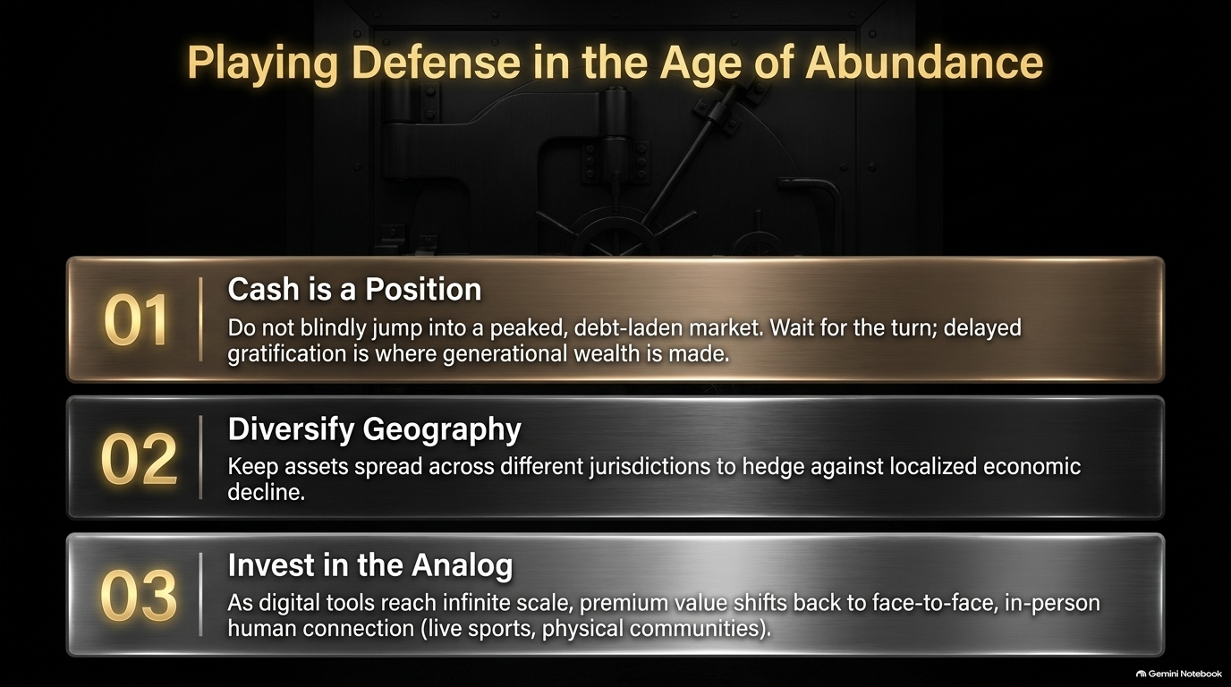
Notes:
Estimated Speaking Time: 4 minutes
Core Concept: When markets are overextended, capital preservation, geographical diversification, and human-centric investments become essential.
Key Talking Points:
Strategy 1: Cash is a Position:
Do not chase overvalued, debt-laden tech bubbles out of FOMO (Fear Of Missing Out).
Holding dry powder (cash/short-term Treasuries) allows you to buy prime assets at steep discounts when the market corrects.
Strategy 2: Diversify Geography:
Spread assets and operations across multiple legal jurisdictions to hedge against localized regulatory or economic shocks.
Strategy 3: Invest in the Analog:
As digital software, content, and synthetic media reach infinite scale and zero marginal cost, value shifts back to scarce physical experiences.
Examples: Live sports, in-person communities, physical real estate, and tangible human connections.
Transition: Beyond financial positioning, what is the ultimate purpose of building wealth?

Slide 14

Notes:
Estimated Speaking Time: 3 – 4 minutes
Core Concept: Money solves financial friction, but it cannot fix internal discontent or substitute for genuine relationships.
Key Talking Points:
The Fundamental Truth: If you are miserable, anxious, or unfulfilled when broke, accumulating millions will only make you an anxious, unfulfilled rich person.
What Money Actually Does: It eliminates the baseline stress of paying bills, healthcare costs, and monthly rent—nothing more, nothing less.
The Ultimate Flex:
True success isn't owning a private jet or displaying luxury items.
True success is:
Maintaining decades-long friendships with people who knew you before you had money.
Complete ownership of your daily schedule (taking off your watch).
Waking up excited about your work and life every single morning.
Transition: Let's summarize the key takeaways from our discussion.

Slide 15
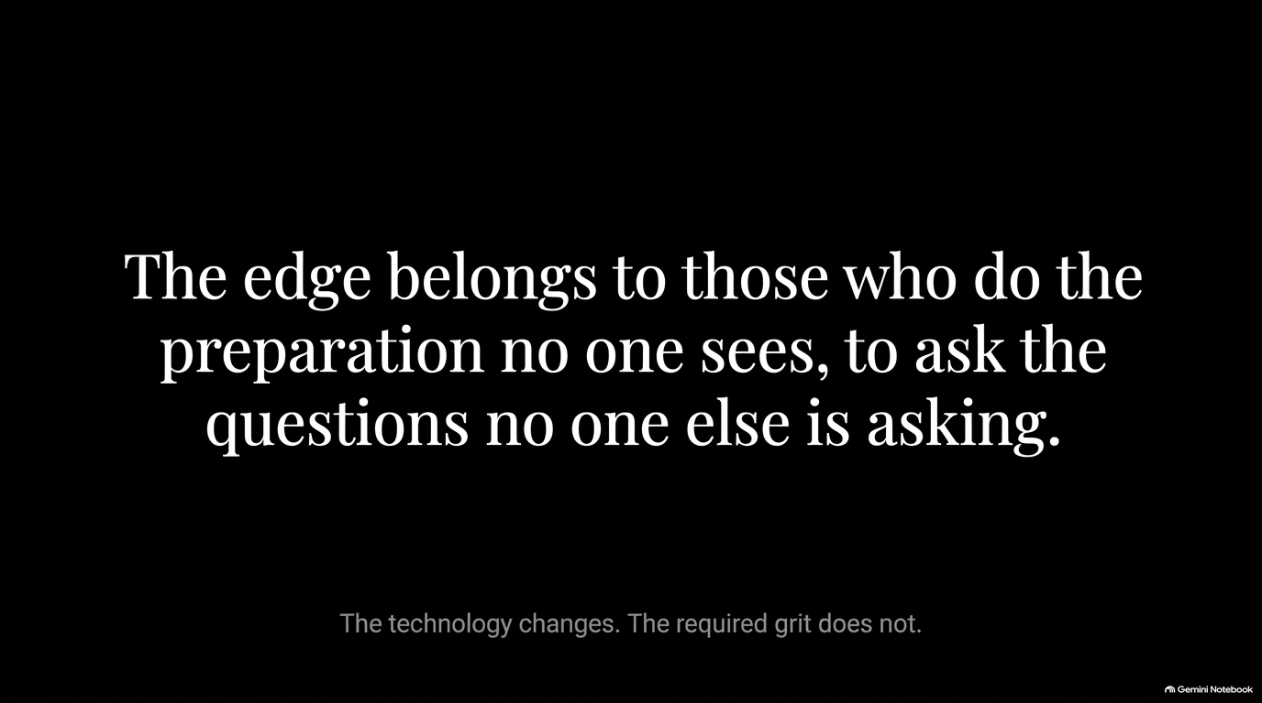
Notes:
Estimated Speaking Time: 2 – 3 minutes
Core Concept: Technology and tools evolve rapidly, but the requirement for unglamorous preparation and human grit remains unchanged.
Summary Statement:
"The edge belongs to those who do the preparation no one sees, to ask the questions no one else is asking."
Final Takeaway:
AI will automate administrative tasks, markets will cycle through bubbles and corrections, and tech trends will come and go.
The entrepreneurs, leaders, and investors who win in the long run are those who master sales, build cash-flow-positive businesses, remain empathetic, and out-prepare everyone else.

Slide 16
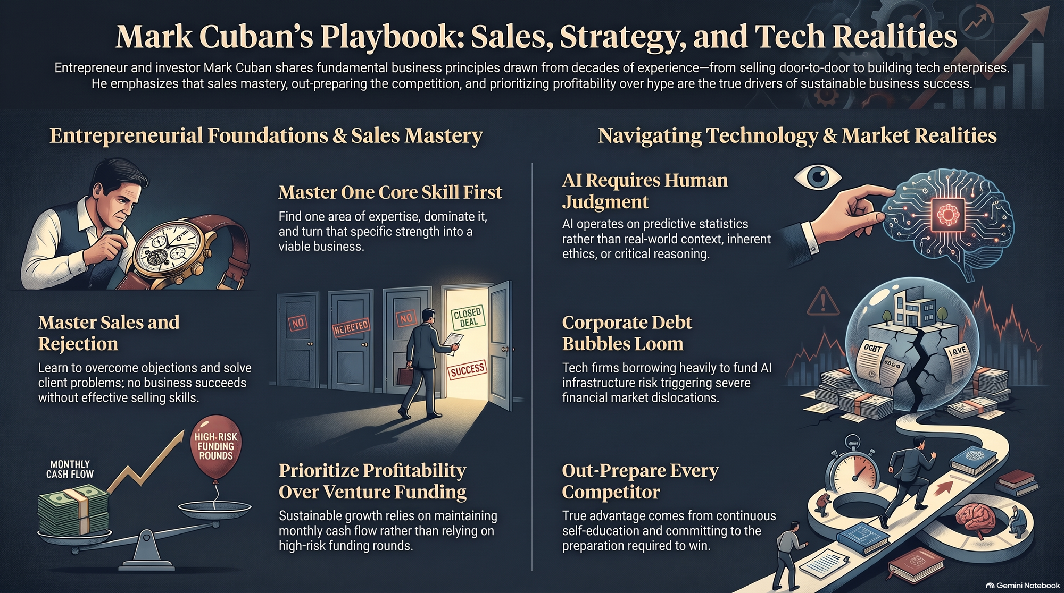
Notes:
Estimated Speaking Time: 3 – 4 minutes
Core Concept: A final review connecting foundational business execution with modern tech realities.
Pillar Highlights:
Master One Core Skill: Focus on deep domain expertise rather than spreading yourself thin.
Master Sales & Rejection: Embrace sales as a problem-solving mechanism; handling "no" is your ultimate job security.
Prioritize Profitability: Build monthly cash-flow-positive businesses instead of relying on venture funding rounds.
AI Requires Human Judgment: Treat AI as a probabilistic tool for efficiency, while providing the critical thinking and contextual synthesis.
Beware Corporate Debt Bubbles: Protect your capital against hyper-leveraged infrastructure bubbles.
Out-Prepare Competitors: Put in the unseen hours to build an unshakeable knowledge advantage.
Q&A Opening: Thank you for your time. I will now open the floor to questions.

