Slide 1
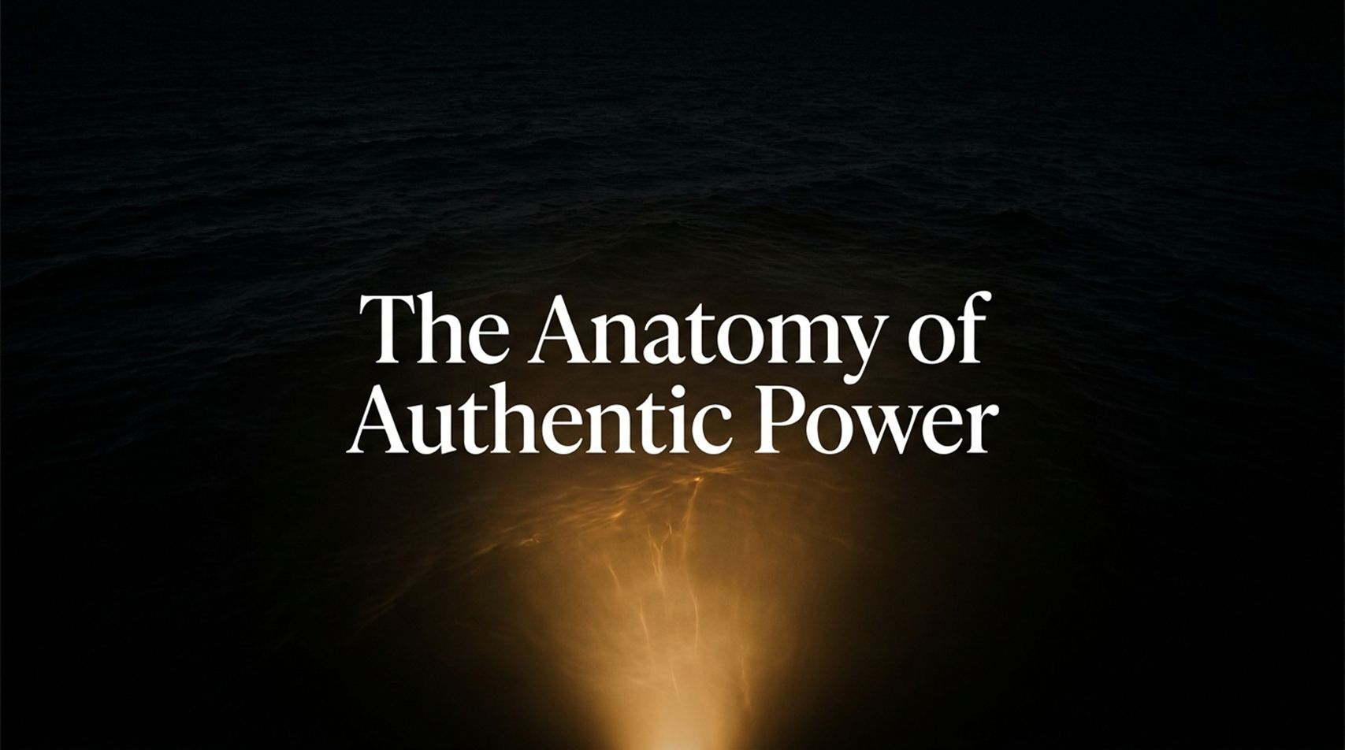
Notes:
Visual Reference: Dark, atmospheric ocean surface illuminated by a warm, concentrated golden light bursting upward from the depths.
Target Timing: 2 – 3 minutes
Speaker Notes:
Opening Hook: Welcome, everyone. Take a moment to look at this image—dark, deep waters pierced by an undeniable, brilliant beam of light rising from the very core. Today, we are not talking about superficial status, external titles, or the loud, manufactured power that dominates our modern feeds. We are going to examine the exact architecture of authentic power.
Core Theme: True power does not come from what you acquire; it comes from who you become. As Oprah Winfrey notes in her profound conversation on living a life of purpose, most of us spend our lives chasing external validation—collecting accolades, trying to fit a mold, or trying to measure up to standards set by a noisy world. But authentic power is an inside-out job.
Setting the Stage: Over our time together today, we are going to dismantle the friction holding you back, learn how to read your internal GPS, reframe your hardships as the exact curriculum you need, and step fully into the legacy you were born to leave. Let’s begin the journey.
Oprah Winfrey: How to Find Your Unique Purpose, Authentic Power, and Calling in Life
https://www.youtube.com/watch?v=adQyLViK_ZU

Slide 2
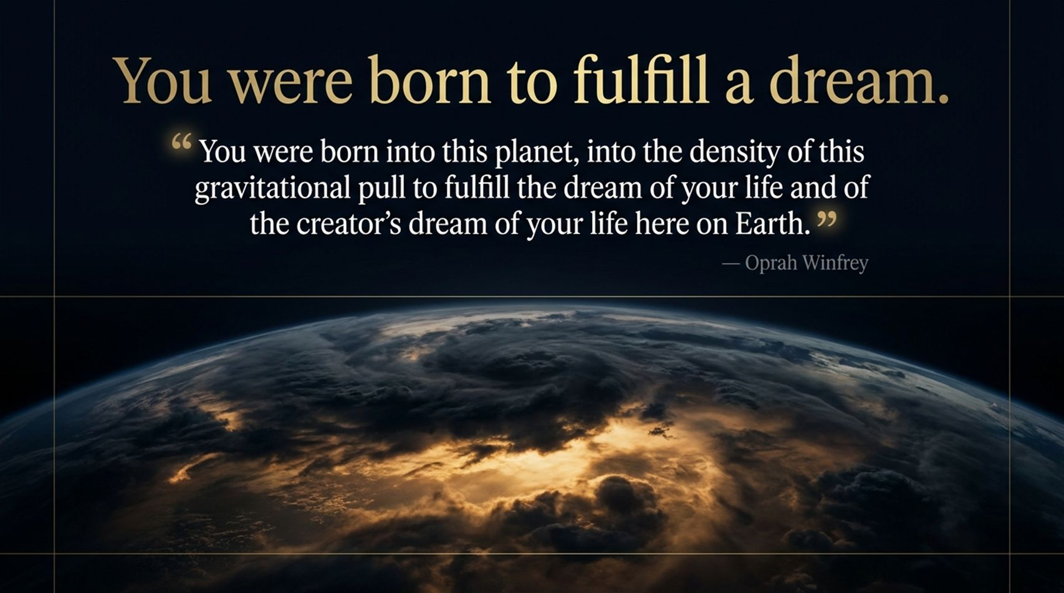
Notes:
Visual Reference: Planet Earth viewed from space, bathed in a breathtaking golden sunrise breaking across the clouds, paired with Oprah Winfrey’s quote: "You were born into this planet, into the density of this gravitational pull to fulfill the dream of your life and of the creator’s dream of your life here on Earth."
Target Timing: 3 – 4 minutes
Speaker Notes:
The Grand Perspective: Let’s start with a cosmic truth. Look at this image of our Earth. You are not an accident. You were intentionally dropped into the density, the chaos, and the gravitational pull of this physical world for a specific reason.
Deconstructing the Quote: Oprah reminds us of a staggering truth: You were born to fulfill a dream. Not just your own ego's little wishlist, but a grander vision held by the universe itself. Yet, how many of us walk through life feeling heavy, exhausted, and disconnected, as if we are slogging through mud?
The Core Shift: Why do we feel that heaviness? Because we have forgotten why we came here. We treat life like a series of survival tasks—pay the bills, answer the emails, survive the week. But you are here as an instrument of service. When you realize that your life belongs to a larger ecosystem of meaning, the weight begins to shift. You stop asking, "How can I get more?" and start asking, "What did I come here to give?"

Slide 3
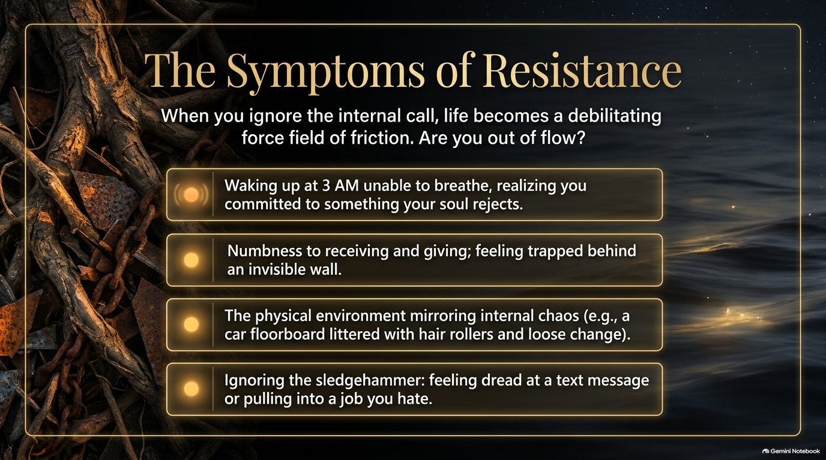
Notes:
Visual Reference: A gnarled root system intertwined with heavy iron chains on the left, transitioning into deep ocean dark on the right, featuring four glowing callout cards detailing physical and emotional friction.
Target Timing: 4 – 5 minutes
Speaker Notes:
Identifying the Friction: How do you know when you are completely out of alignment with your calling? Life tells you. Life speaks to you through friction. If you ignore your internal compass, existence becomes a debilitating force field of resistance.
Walking Through the Symptoms: Look at these symptoms on the screen. Have you ever experienced them?
Waking up at 3:00 AM unable to breathe, chest tight, realizing deep down that you have committed your precious life energy to something your soul utterly rejects.
Emotional numbness—feeling like you are trapped behind an invisible glass wall, unable to truly receive love or give it authentically.
External chaos mirroring internal turmoil—your physical workspace, your car floorboard, or your daily routine falling into complete disarray because your inner world is fractured.
Ignoring the sledgehammer—feeling a sick wave of dread every time you look at a text message or pull your car into the parking lot of a job you despise.
The Takeaway: These aren't just random bad days; they are alarm bells from your soul. The universe uses whispers first. When you ignore the whispers, it uses a 2x4. When you ignore the 2x4, it uses a sledgehammer. Which alarm bell is ringing in your life right now?

Slide 4
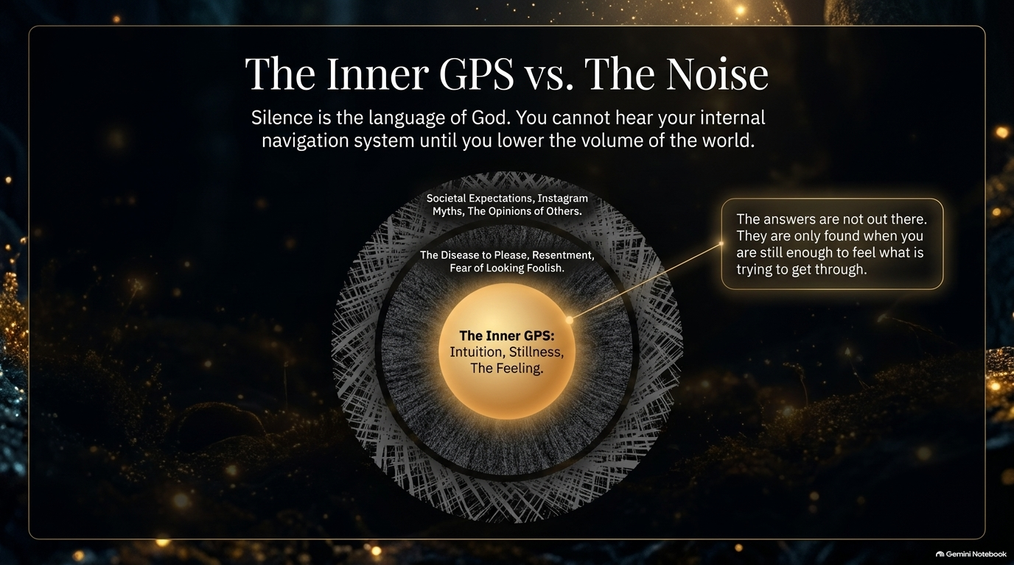
Notes:
Visual Reference: A concentric radar diagram illustrating layers of external noise (societal expectations, fear of looking foolish) surrounding a radiant inner core labeled "The Inner GPS: Intuition, Stillness, The Feeling."
Target Timing: 3 – 5 minutes
Speaker Notes:
The Cacophony of Modern Life: Why can’t we hear our direction? Because the volume of the world is deafening. Look at this diagram. Encasing your true self are layers upon layers of static: societal expectations, Instagram myths, the opinions of strangers, the disease to please, and the paralyzing fear of looking foolish.
Silence as the Language: As the slide says, silence is the language of God. You cannot hear your internal navigation system until you deliberately lower the volume of the world.
The Inner GPS in Action: Your Inner GPS doesn't speak in spreadsheets or logic; it speaks in feelings. It’s that quiet, unmistakable gut reaction when something is right—or when something is terribly wrong. Oprah notes that she is no different from anyone else; she doesn't have a special monopoly on wisdom. The only difference is that she is obedient to her inner GPS. When was the last time you sat in absolute stillness long enough to hear yours?

Slide 5
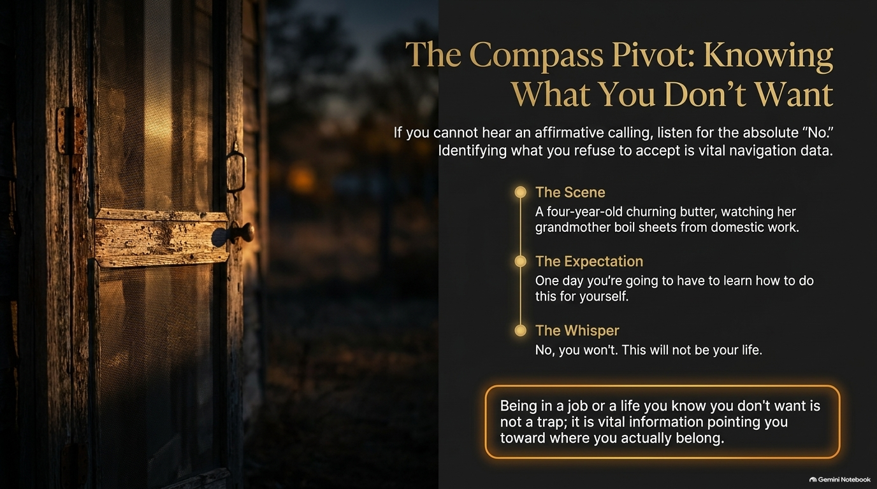
Notes:
Visual Reference: A rustic, weathered wooden cabin door opening to a warm golden sunset, highlighting Oprah's childhood story of churning butter and looking through a screen door.
Target Timing: 4 – 6 minutes
Speaker Notes:
The Affirmative Trap: Many people stay paralyzed for years because they ask an overwhelming question: "What do I want to do with my life?" That question can be so big and vague that it locks us in place. But there is a shortcut. If you cannot hear an affirmative calling yet, listen to the absolute "No."
The Story of the Screen Door: Think about a four-year-old Oprah standing on a back porch in Mississippi, turning butter with a stick while her grandmother boiled white folks' domestic sheets in a iron pot. Her grandmother looks at her and says, "One day, you're going to have to learn how to do this for yourself."
The Whisper of Defiance: In that exact moment, a profound feeling swept through that little girl's body and said: "No, you won't. This will not be your life." She didn't know what her future held, but she knew with absolute certainty what she refused to accept.
Reframing Your Pain: If you are stuck in a job, a relationship, or a life situation that drains your spirit, stop judging yourself for being there. That job you hate isn't just a trap—it is vital navigation data. It is shouting a crystal-clear "No!" that is pointing you directly toward where you actually belong.

Slide 6
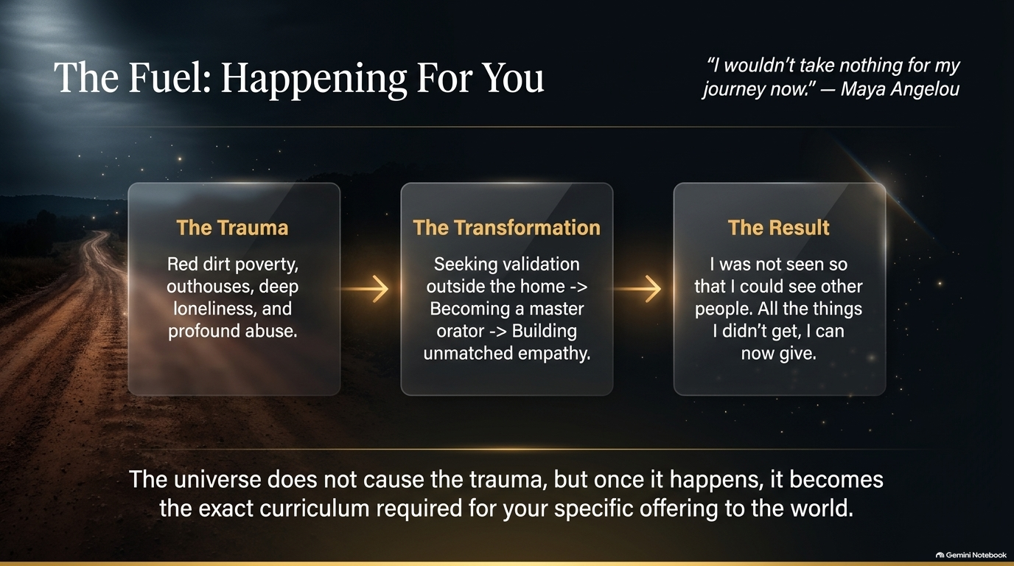
Notes:
Visual Reference: A long, winding dirt road stretching through a rustic landscape into golden light, illustrating the triad of Trauma, Transformation, and Result, anchored by Maya Angelou’s quote: "I wouldn't take nothing for my journey now."
Target Timing: 4 – 6 minutes
Speaker Notes:
The Hardest Pill to Swallow: We arrive at one of the most challenging spiritual concepts to grasp: Everything happens for you, not to you. When you have experienced deep trauma—poverty, loneliness, abuse, or heartbreak—hearing "everything happens for a reason" can feel offensive. Let’s clarify what that actually means.
The Universe's Curriculum: The universe does not cause human cruelty or orchestrate tragedy. But once a hardship occurs, it becomes the exact, custom-designed curriculum required to forge your unique offering to the world.
Tracing the Transformation: Look at the arc on the screen:
The Trauma: Red dirt poverty, profound isolation, and severe abuse.
The Transformation: Seeking external validation, evolving into a master orator, and building unmatched empathy.
The Result: "I was not seen so that I could see other people. All the things I didn't get, I can now give."
Embracing Your History: When you can look back at your darkest chapters and say, "I wouldn't take nothing for my journey now," you reclaim your power. Your pain is no longer an anchor holding you down; it is the raw fuel propelling your destiny.

Slide 7
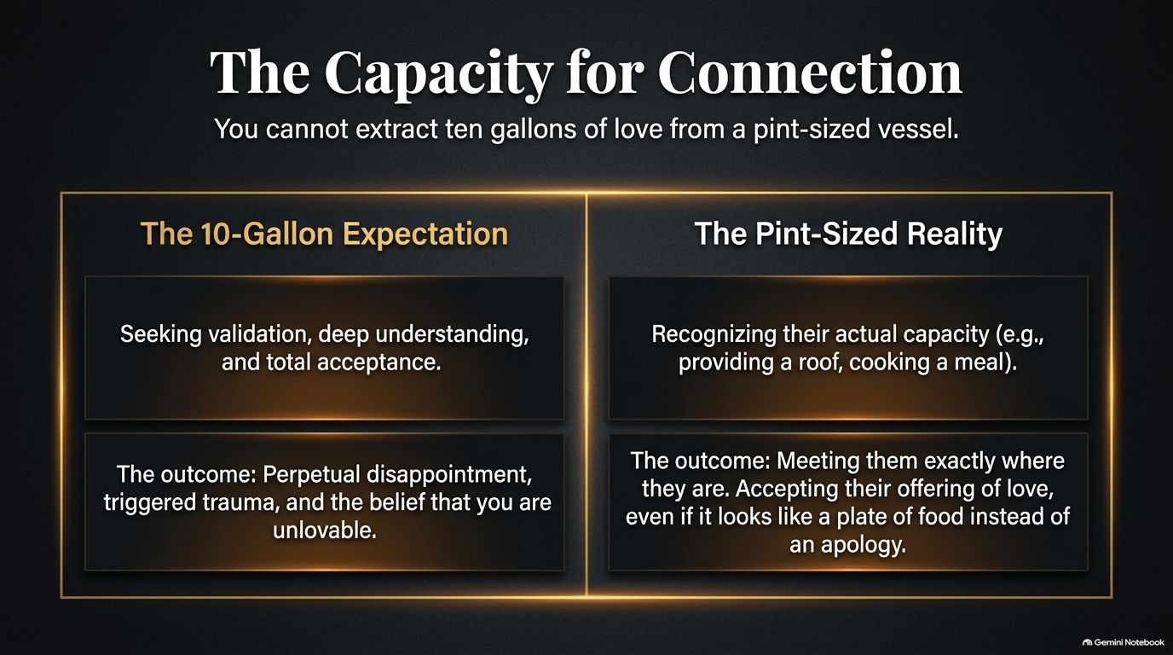
Notes:
Visual Reference: A balanced comparison layout separating "The 10-Gallon Expectation" from "The Pint-Sized Reality," illustrating emotional capacity and realistic acceptance.
Target Timing: 3 – 5 minutes
Speaker Notes:
The Core Metaphor: Here is a liberating truth: You cannot extract ten gallons of love from a pint-sized vessel.
The Trap of Expectation: How many times have we tortured ourselves, our parents, our partners, or our friends by demanding 10-gallon emotional responses from people who only have the capacity for a pint? We expect deep understanding, total emotional validation, and unconditional acceptance from people who are fundamentally unequipped to carry it. When they inevitably fail us, we spiral into perpetual disappointment, trigger old trauma, and falsely conclude that we are unlovable.
The Pint-Sized Reality: Freedom comes when you look at the people in your life and recognize their actual capacity. If a parent couldn't say "I'm proud of you," but worked every day to put food on the table and keep a roof over your head, that was their pint of love.
Radical Acceptance: Meet people exactly where they are. Accept their offering of love—even when it looks like a plate of home-cooked food instead of an emotional apology. Stop punishing people for not being who you want them to be.

Slide 8
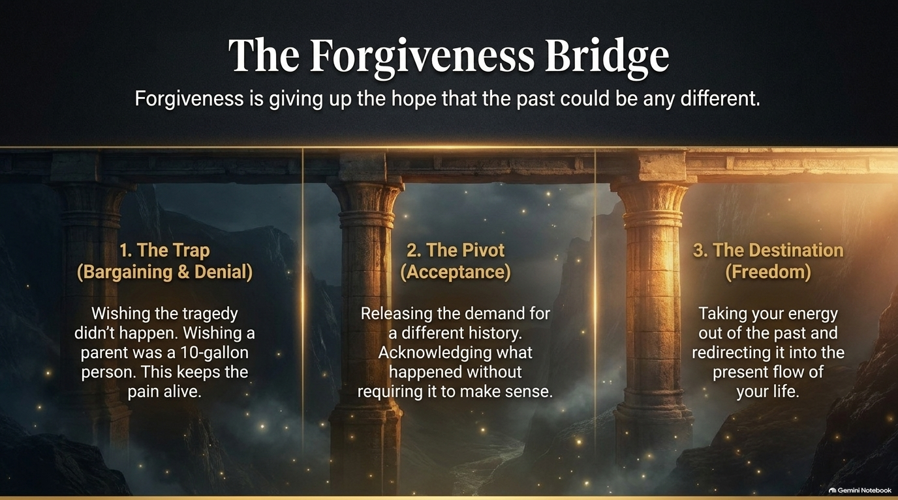
Notes:
Visual Reference: A majestic stone bridge spanning across a misty ravine filled with floating golden light, divided into three pillars: The Trap, The Pivot, and The Destination.
Target Timing: 3 – 5 minutes
Speaker Notes:
Defining True Forgiveness: What is forgiveness, really? Oprah shares a definition that changes everything: Forgiveness is giving up the hope that the past could be any different.
Walking the Three Pillars:
1. The Trap (Bargaining & Denial): Wishing the tragedy never happened. Wishing a parent had been a 10-gallon person. As long as you bargain with the past, you keep the wound bleeding.
2. The Pivot (Acceptance): Releasing the demand for a different history. Acknowledging what happened without requiring it to make logical sense. Moving through the stages of grief—denial, anger, bargaining—until you reach pure acceptance.
3. The Destination (Freedom): Taking your vital life energy out of a past you cannot change and redirecting it entirely into the present flow of your life.
The Takeaway: You do not forgive for them; you forgive to unshackle yourself. Acceptance is the bridge that leads straight to freedom.

Slide 9
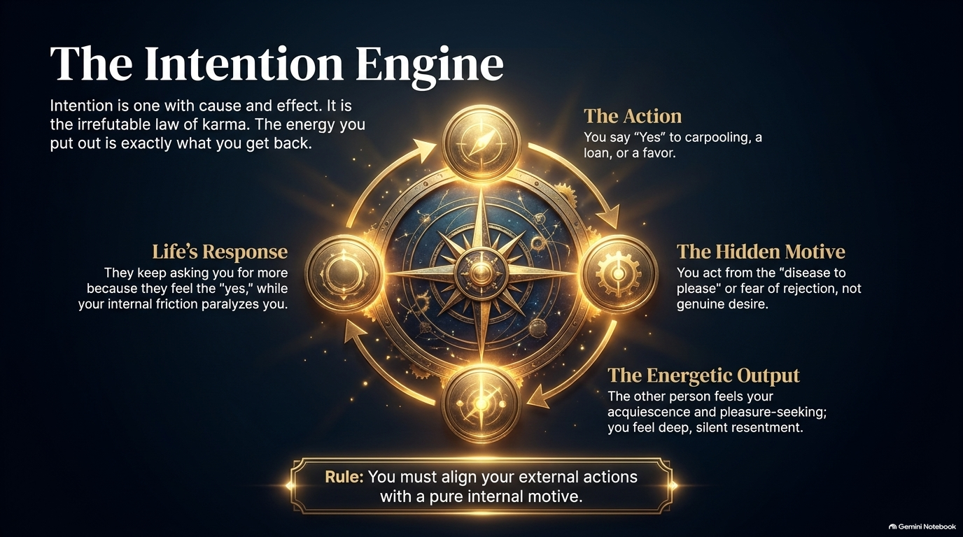
Notes:
Visual Reference: An intricate golden navigational compass mechanism surrounded by cyclical arrows, breaking down Action, Hidden Motive, Energetic Output, and Life's Response.
Target Timing: 4 – 6 minutes
Speaker Notes:
The Irrefutable Law of Karma: Intention is inextricably linked to cause and effect. It is the spiritual law of karma: The energy you put out into the world is exactly what you get back.
The People-Pleasing Trap: Let’s look at how this engine operates in everyday life. You say "Yes" to carpooling, a loan, or a favor. What is your hidden motive? Too often, it’s the "disease to please" or the paralyzing fear of rejection—not a genuine desire to help.
The Energetic Output: Even if your words say "Yes," your energy tells the truth. The other person subconsciously feels your underlying acquiescence and tension, and you are left harboring deep, silent resentment.
Life's Response: Because you projected an energetic "Yes" driven by fear, people keep coming back and asking for more, draining your battery while internal friction paralyzes you.
The Golden Rule: You must align your external actions with a pure internal motive. Learn to say "No" when your soul says no, and your entire energetic reality will transform.

Slide 10
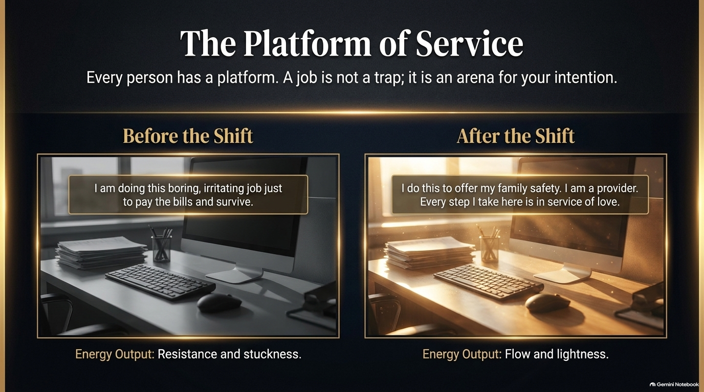
Notes:
Visual Reference: A split-screen visual comparison: on the left, a gloomy, desaturated gray office workspace representing resistance; on the right, the exact same desk illuminated by warm, golden sunlight representing flow.
Target Timing: 3 – 5 minutes
Speaker Notes:
Reframing Your Daily Grind: Every single person has a platform. Many people fall into the trap of believing that their job is a prison sentence. They wake up thinking, "I am just doing this boring, irritating job to pay bills and survive." That mindset generates pure resistance, stuckness, and exhaustion.
The Paradigm Shift: Look at the right side of the screen. What happens when you shift your intention? Same desk, same computer, same tasks—but a completely transformed "why."
The New Narrative: "I do this to offer my family safety. I am a provider. Every step I take here is in service of love."
The Result: When you infuse your mundane daily labor with a sacred intention to serve something greater than yourself, the energetic output shifts instantly from resistance to flow and lightness. A job is never just a job; it is an arena for your intention.

Slide 11
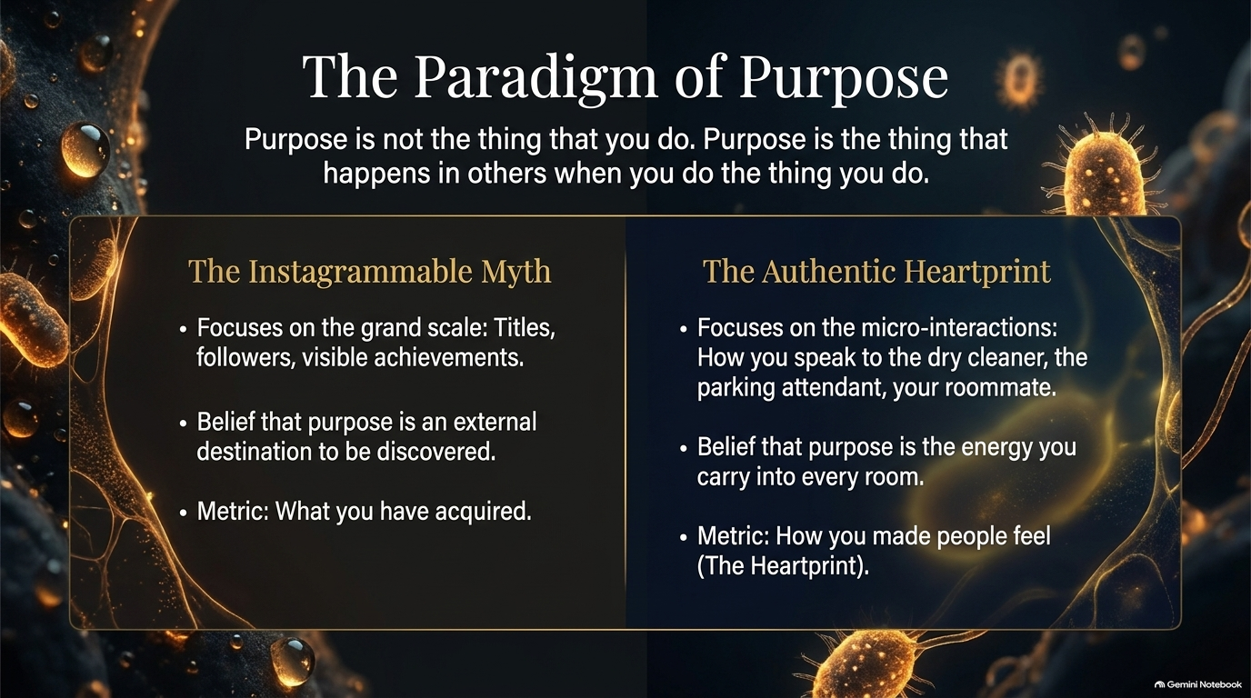
Notes:
Visual Reference: A stark contrast layout comparing "The Instagrammable Myth" on the left with "The Authentic Heartprint" on the right against a microscopic cellular background of glowing light.
Target Timing: 3 – 5 minutes
Speaker Notes:
Redefining Purpose: Let's clear up a massive cultural misconception. Purpose is not the thing that you do. Purpose is the thing that happens in others when you do the thing you do.
The Instagrammable Myth: Society teaches us to look outward. We chase grand titles, follower counts, and visible achievements. We treat purpose like an external buried treasure to be discovered, measuring our worth by what we have acquired.
The Authentic Heartprint: True purpose lives in the micro-interactions. It’s how you speak to the parking attendant, treat the barista, or support your roommate. It is the energetic footprint—the Heartprint—that you leave behind in every single room you enter.
The Ultimate Metric: At the end of your life, no one will care about your title or your net worth. They will remember how you made them feel. That is your true heartprint.

Slide 12
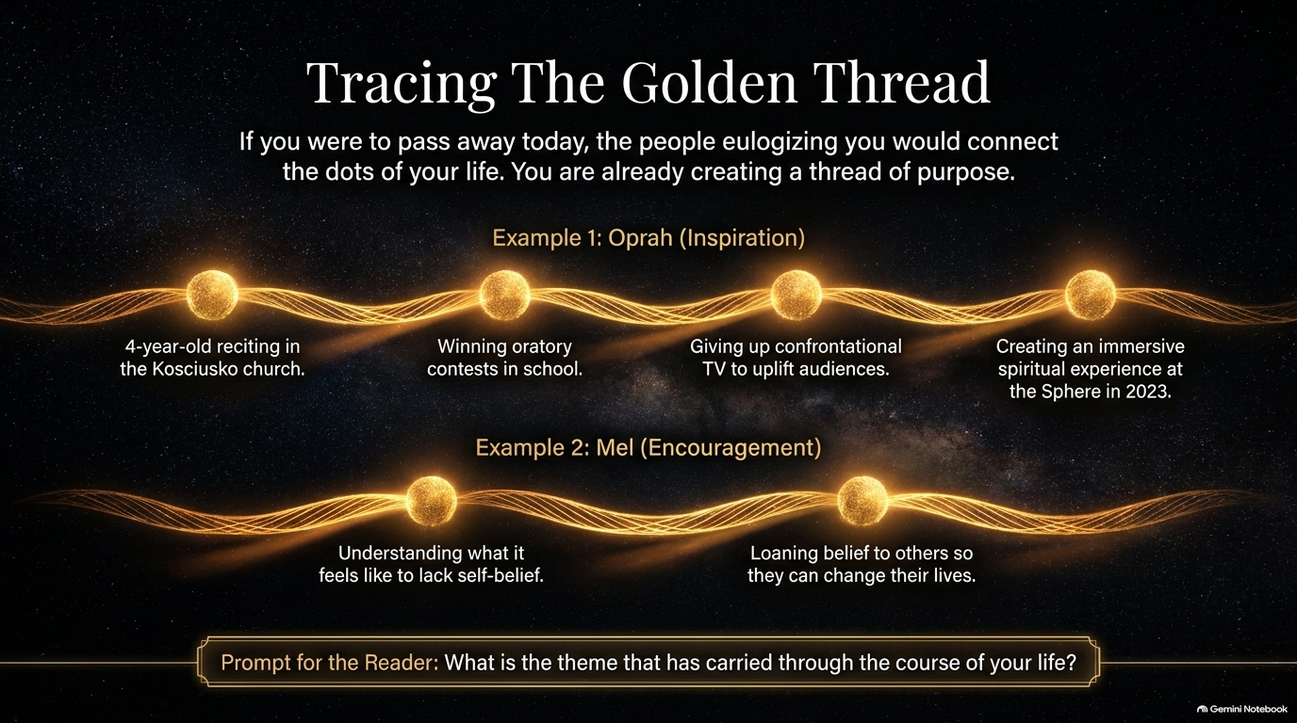
Notes:
Visual Reference: Two horizontal glowing golden threads spanning across a starry galaxy, mapping out the chronological milestones of Oprah Winfrey and Mel Robbins, prompting the audience to find their own theme.
Target Timing: 3 – 5 minutes
Speaker Notes:
Connecting the Dots: If you were to pass away today, the people eulogizing you wouldn't list your resume bullets; they would connect the dots of your life's underlying theme. You are already weaving that thread of purpose every single day.
Examining the Thread: Look at the examples on the screen:
Oprah's Thread (Inspiration): From reciting verses in a small country church at age four, to winning oratory contests, to shifting daytime television, to creating immersive spiritual spaces. The medium changed, but the core thread—inspiration—never did.
Mel's Thread (Encouragement): Understanding self-doubt firsthand and loaning her belief to others so they can transform their lives.
The Prompt for You: What is the golden thread that has carried through the course of your life? What is the consistent gift you have always handed to the world? Identify it, lean into it, and amplify it.

Slide 13
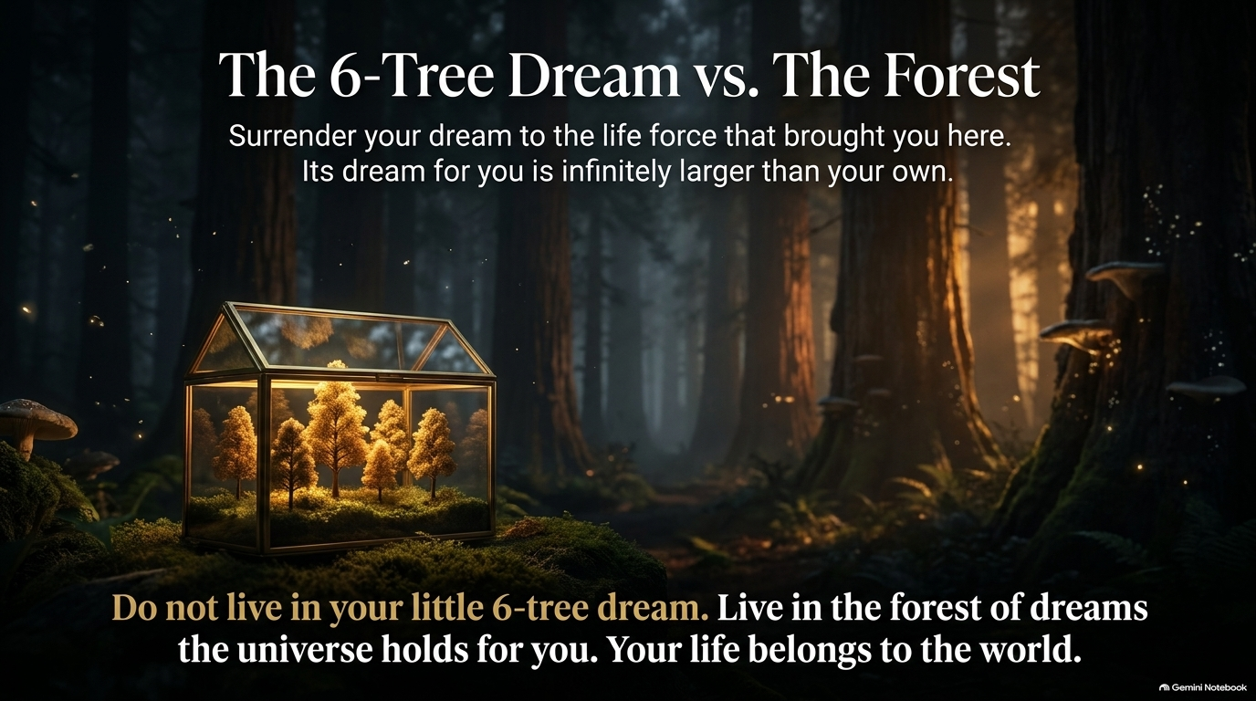
Notes:
Visual Reference: A small, glowing model of miniature golden trees trapped inside a delicate glass terrarium, contrasted against an infinite, majestic ancient redwood forest stretching into golden twilight.
Target Timing: 3 – 5 minutes
Speaker Notes:
The Limitation of Human Ambition: Early in her career, visiting a successful mentor's home, Oprah looked out a window and counted exactly six trees in the front yard. She thought to herself, "If I ever get some money, I'm going to have me some trees." Years later, she bought a home and realized she had manifested her exact dream: six trees outside her kitchen window.
Discovering the Forest: But when she walked out onto her porch, she realized something astonishing. Beyond those six trees stood an entire, infinite forest of hundreds of trees that she hadn't even been able to see through the window. Her human imagination had dreamed up a tiny terrarium; the universe had prepared a sprawling forest.
Surrendering Your Ambition: Do not live in your little 6-tree dream. Surrender your limited vision to the life force that brought you here. The universe's dream for your life is infinitely larger, grander, and more abundant than anything your ego could ever script for yourself. Your life belongs to the world.

Slide 14
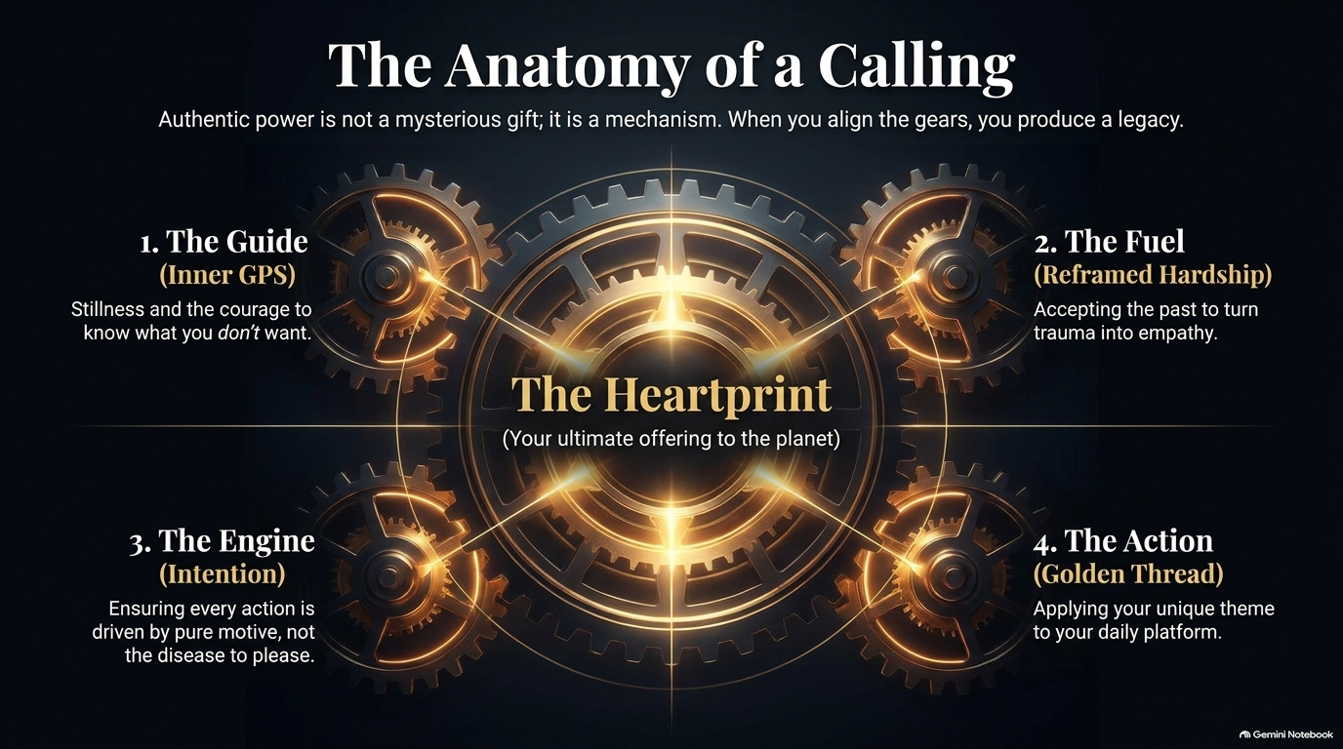
Notes:
Visual Reference: A complex, perfectly synchronized mechanical gear system powered by a radiant central core labeled "The Heartprint," orchestrating The Guide, The Fuel, The Engine, and The Action.
Target Timing: 3 – 5 minutes
Speaker Notes:
The Machinery of Power: Authentic power is not a mysterious, accidental gift bestowed upon the chosen few; it is a precision mechanism. When you align the gears properly, you produce an unstoppable legacy.
Reviewing the Four Gears:
1. The Guide (Inner GPS): Cultivating stillness and the courage to know what you don’t want.
2. The Fuel (Reframed Hardship): Accepting your past trauma and converting it into deep empathy.
3. The Engine (Intention): Ensuring every action is driven by a pure motive rather than the disease to please.
4. The Action (Golden Thread): Applying your unique personal theme to your daily platform.
The Centerpiece: When these four gears spin in harmony, everything converges on the central core: The Heartprint—your ultimate, irreplaceable offering to the planet.

Slide 15
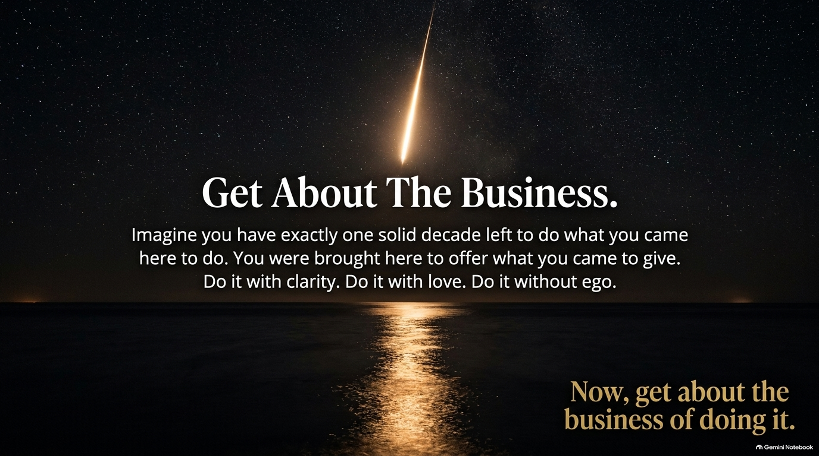
Notes:
Visual Reference: A brilliant shooting star streaking across a tranquil, starry night sky, reflecting a vertical pillar of golden light across a calm dark sea.
Target Timing: 2 – 4 minutes
Speaker Notes:
The Urgency of Time: As Oprah reflects on reaching 72 years of age, she speaks about the undeniable urgency of time. Imagine you have exactly one solid decade left to do what you came here to do. Not forty years, not someday when conditions are perfect—one solid decade.
Stripping Away the Ego: How would that realization change your calendar today? How would it change the projects you say yes to?
The Final Charge: You were brought here to offer what you came to give. Do it with clarity. Do it with love. Do it without ego. Stop waiting for permission. Stop hesitating behind the walls of fear. Now, get about the business of doing it.

Slide 16
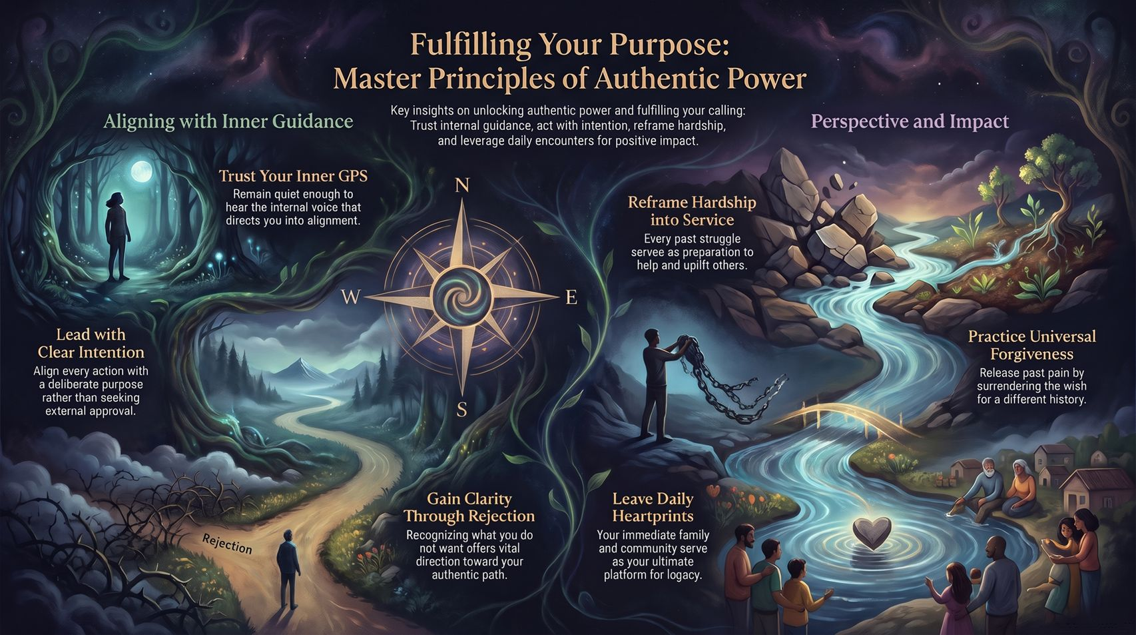
Notes:
Visual Reference: A rich, comprehensive summary illustration featuring a central golden compass dividing two thematic realms: "Aligning with Inner Guidance" on the left and "Perspective and Impact" on the right.
Target Timing: 3 – 5 minutes
Speaker Notes:
Synthesizing the Journey: As we bring our presentation to a close, let's look at the complete master blueprint of authentic power displayed on this slide.
Recap of Core Pillars:
On the Left (Inner Guidance): Trust your Inner GPS by staying quiet enough to hear the internal voice. Lead with clear intention, aligning your actions with purpose rather than external approval. Gain clarity through rejection, treating what you don’t want as vital directional data.
On the Right (Perspective & Impact): Reframe your hardships into service, turning past struggles into preparation to uplift others. Practice universal forgiveness by releasing the wish for a different history. And leave daily heartprints, recognizing your immediate family and community as your ultimate platform for legacy.
Closing Blessing: Remember: You possess a light within you that the world desperately needs. Step out of the noise, honor your inner GPS, and go forth to fulfill the dream of your life. Thank you.

