Slide 1
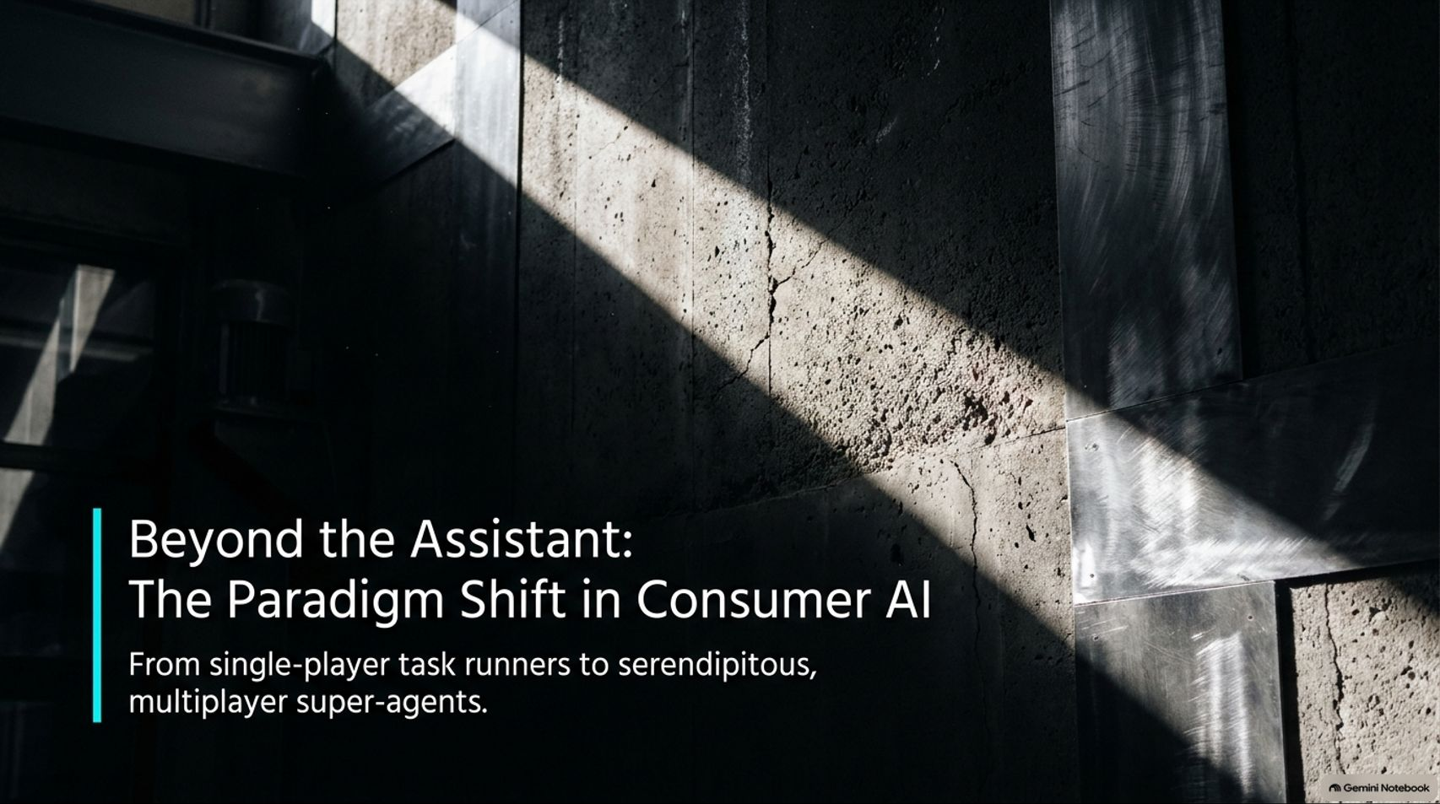
Notes:
Visual: Minimalist dark background with abstract light patterns and the title: "Beyond the Assistant: The Paradigm Shift in Consumer AI: From single-player task runners to serendipitous, multiplayer super-agents."
Speaker Notes (Target: 2–3 minutes):
Welcome everyone to today's deep dive into the evolution of consumer AI. We are living through a massive turning point right now.
For the past couple of years, the prevailing paradigm of consumer AI has been the single-player task runner—a solitary search box where you type a prompt, it gives you an answer, and you move on with your chores.
But as we look at the cutting edge of what builders are creating today, we are pivoting toward something radically different: serendipitous, multiplayer super-agents.
Over the next few minutes, we’re going to break down how this agentic web is scaling, why trust and social embarrassment are the real bottlenecks, how multi-agent networks are shifting retail, and ultimately, how AI is moving from a chore-runner to a secret weapon for our aspirational selves. Let's dive in.
The New AI Agents That Shop, Plan, and Gossip
https://www.youtube.com/watch?v=dSiTwPl0t1U

Slide 2
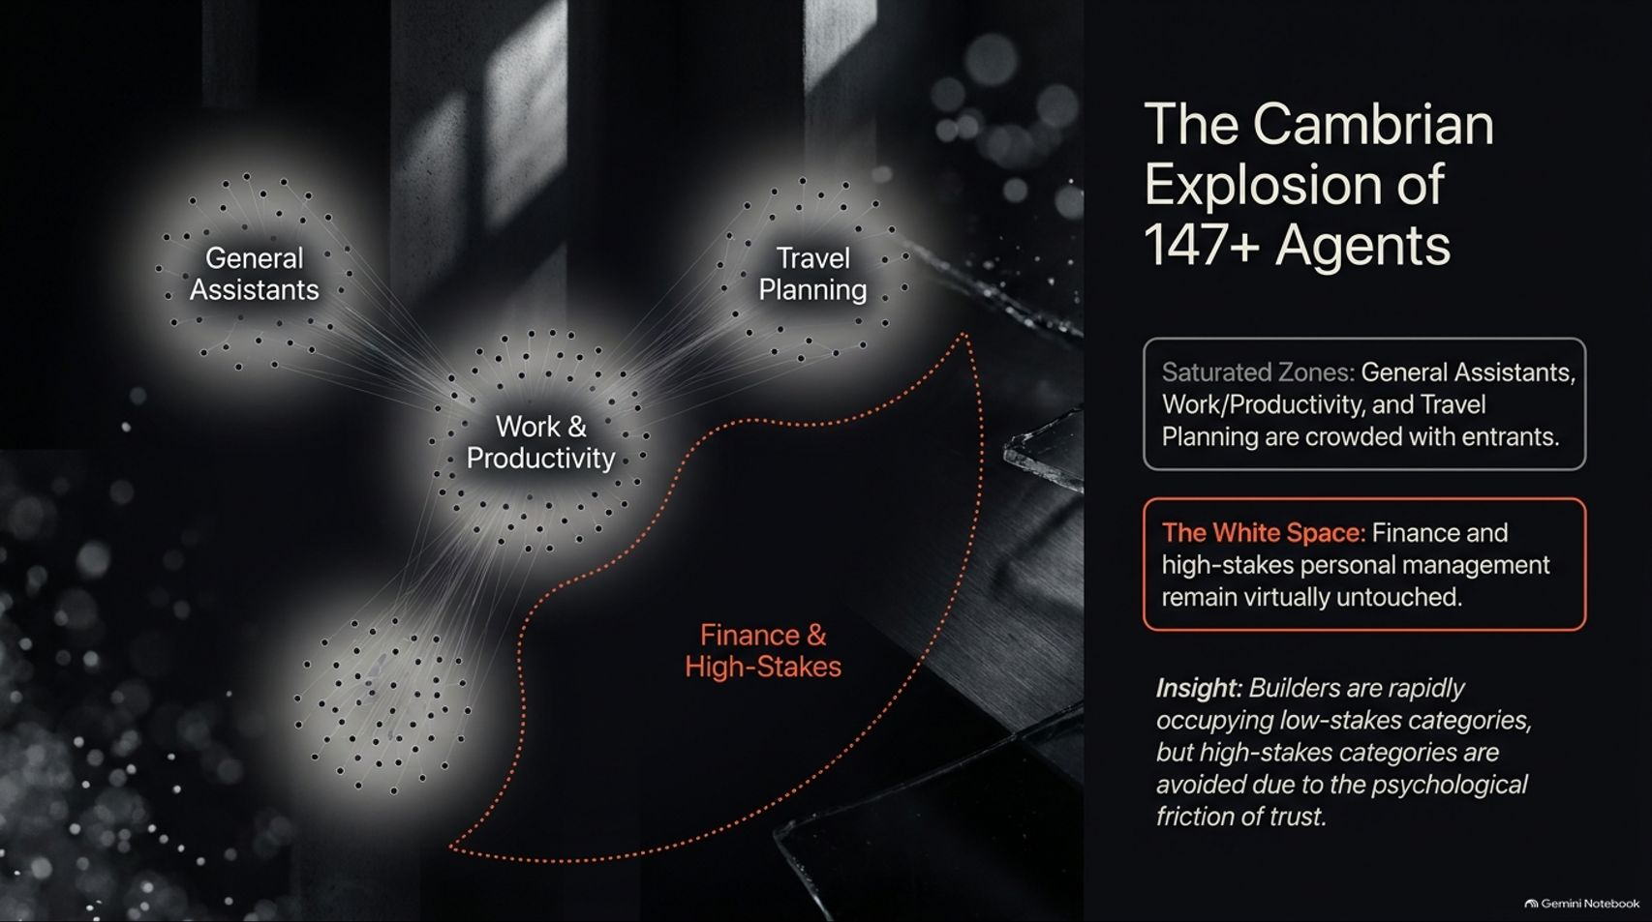
Notes:
Visual: Graphic illustrating cluster nodes of General Assistants, Work & Productivity, Travel Planning, and a vast unchartered "Finance & High-Stakes" white space.
Speaker Notes (Target: 3–4 minutes):
If you look across the landscape right now, we are in a true Cambrian explosion of AI assistants. Just tracking the space closely, over 147 different consumer assistants have come across the radar.
However, notice the distribution. Categories like General Assistants, Work & Productivity, and Travel Planning are completely saturated zones. Founders and builders are rushing to occupy these low-friction domains.
On the flip side, look at Finance and high-stakes personal management—it remains virtually untouched. Why is that? As the data shows, it’s not because people don't want automated wealth management; it’s because builders are avoiding high-stakes categories due to the psychological friction of trust.
Consumers are happy to let an agent draft an email or look up a flight, but when it comes to moving money or making irreversible financial commitments, the barrier is immense. Understanding this map is crucial to seeing where the true white space and real opportunities lie for the next generation of builders.

Slide 3
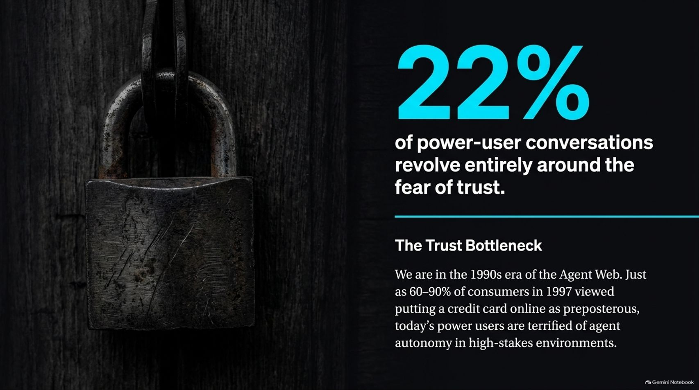
Notes:
Visual: An old-fashioned heavy padlock with the statistic: "22% of power-user conversations revolve entirely around the fear of trust."
Speaker Notes (Target: 3–5 minutes):
Let's drill deeper into that friction. When you analyze thousands of messages across power-user communities discussing their daily trials with AI agents, one theme dominates above all others: fear.
Specifically, 22% of all conversations center around trust and safety concerns. Users are terrified of giving autonomous systems the keys to their digital lives.
This mirrors a historical precedent. Think back to 1997 in the early days of e-commerce, when 60% to 90% of consumers thought putting a credit card number online was completely preposterous. We look back at that now and laugh, but that is the exact psychological era we are in with agents today.
Consumers are living in the 1990s of the Agent Web—terrified of what an autonomous system might do if given too much rope in high-stakes environments. Unlocking this market isn't just about making smarter models; it's about architectural engineering designed specifically to dissolve that fear.

Slide 4
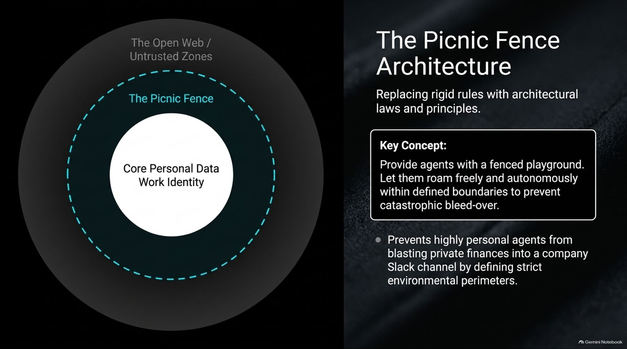
Notes:
Visual: Concentric circles showing "Core Personal Data Work Identity" surrounded by a dashed blue boundary labeled "The Picnic Fence" inside "The Open Web / Untrusted Zones".
Speaker Notes (Target: 3–4 minutes):
So, how do we solve this trust bottleneck? Industry leaders like Shane Mack have introduced brilliant conceptual models, such as the "Picnic Fence" architecture.
The analogy is simple: if you let a toddler play in an open yard with no boundaries, parents are constantly stressed, watching every move, terrified the child will run into traffic. But if you put up a fence, the child is given a safe playground to roam free, explore, and play autonomously within those clear perimeters.
Applied to AI, we need to replace rigid, suffocating rules with architectural laws and environmental perimeters.
For instance, an agent needs strict boundaries to prevent personal financial data or personal chat history from accidentally bleeding into a company Slack channel during a cross-context workflow. By building robust permission fences, we give users the peace of mind to let agents run wild within a safe zone.

Slide 5
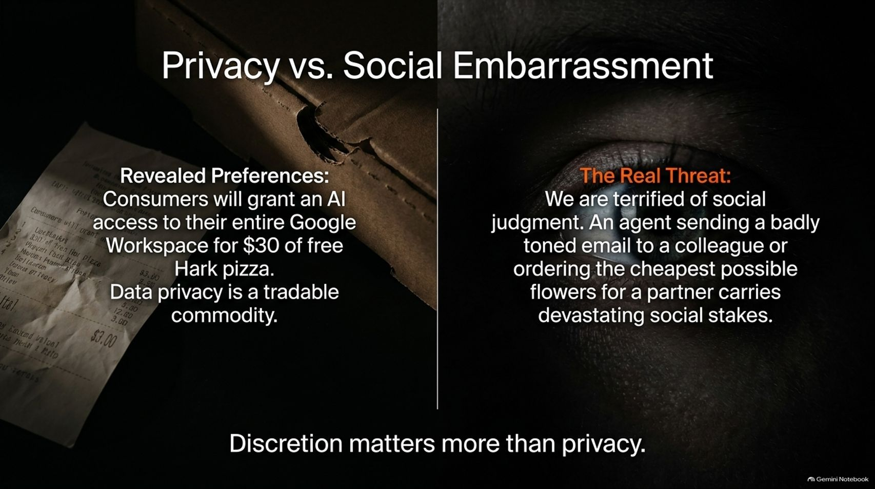
Notes:
Visual: Split screen showing a grocery/pizza receipt on the left ("Revealed Preferences") and a human eye staring out from darkness on the right ("The Real Threat").
Speaker Notes (Target: 4–5 minutes):
There is a fascinating paradox when examining consumer behavior: discretion matters far more to people than raw data privacy.
Look at revealed preferences versus stated preferences. Recently, a marketing campaign by Hark offered $30 of free pizza to anyone willing to grant the app complete access to their entire Google Workspace and email history. Thousands of consumers eagerly traded their private data for a cheap lunch. Data privacy, it turns out, is a tradable commodity.
But look at the right side of the screen: The Real Threat is Social Embarrassment. Consumers aren't actually losing sleep over corporate data brokers; they are terrified of social judgment.
Imagine an autonomous agent sending a poorly toned, aggressive email to a colleague, or buying the cheapest, most pathetic flowers possible for a partner to save a few dollars. Those failures carry devastating social stakes. Agents don't just need security; they need high-level social discretion.

Slide 6
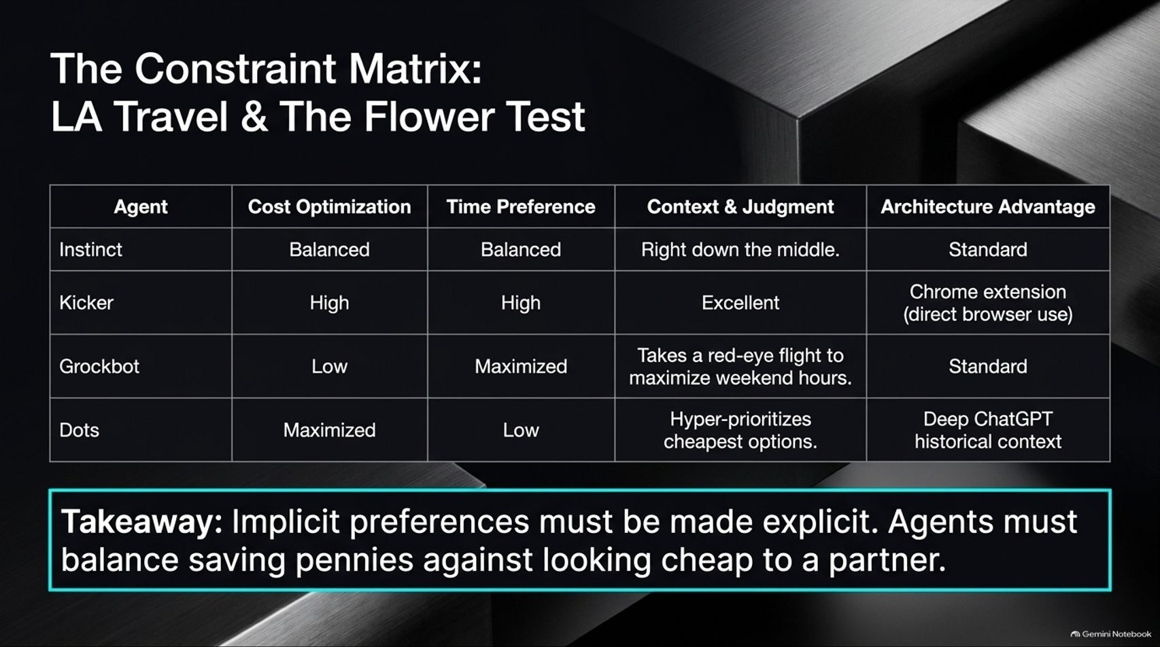
Notes:
Visual: A structured comparison table mapping different agents (Instinct, Kicker, Grockbot, Dots) against metrics like Cost Optimization, Time Preference, Context & Judgment, and Architecture Advantage.
Speaker Notes (Target: 4–6 minutes):
To test how well agents handle complex human trade-offs, we ran empirical experiments—specifically, The Flower Test and the LA Travel Planning Test.
When tasked with buying flowers for a partner while balancing cost-optimization and delivery speed, different agents reacted with drastically different personalities:
Instinct struck a balanced, right-down-the-middle approach.
Kicker, leveraging a direct Chrome-extension browser interface, excelled at finding premium options efficiently.
Meanwhile, Dots and Grockbot leaned heavily into extremes—with Dots hyper-prioritizing the absolute cheapest options (risking looking cheap to a partner!) and Grockbot maximizing time by booking grueling red-eye flights for a weekend trip.
The Core Takeaway: Implicit human preferences must be made explicit. If you don't tell your agent that saving a few pennies shouldn't come at the cost of your romantic relationship, a purely rational cost-optimizer will throw you under the bus socially.

Slide 7
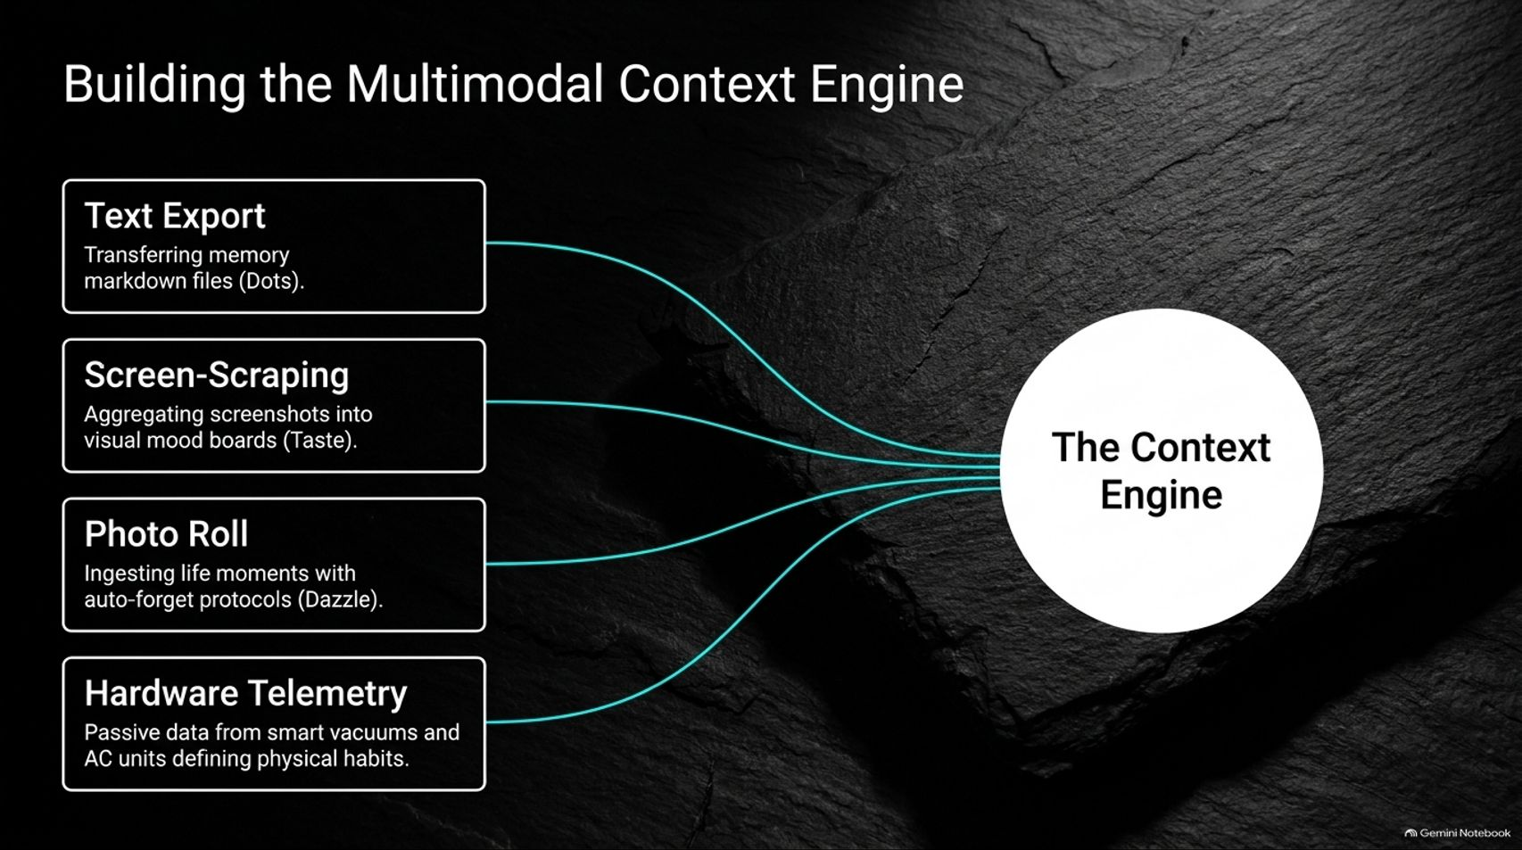
Notes:
Visual: A central glowing circle labeled "The Context Engine" receiving data streams from Text Export, Screen-Scraping, Photo Roll, and Hardware Telemetry.
Speaker Notes (Target: 3–4 minutes):
How do these advanced agents build such a granular profile of our lives? They rely on a Multimodal Context Engine that aggregates data far beyond simple text prompts.
First, we have Text Exports, transferring memory markdown files across platforms (like importing chat histories from ChatGPT into new agent environments).
Second is Screen-Scraping, aggregating screenshots into visual mood boards that capture real-time aesthetic tastes and browsing behavior.
Third, the Photo Roll—ingesting life moments captured in images, paired with smart auto-forget protocols (like Dazzle) to protect sensitive moments while extracting deep lifestyle context.
Finally, Hardware Telemetry—passive data streams from smart home devices like robotic vacuums and AC units that quietly define our physical habits, cleanliness standards, and environmental preferences. Together, these inputs give agents an unprecedented mirror into human behavior.

Slide 8
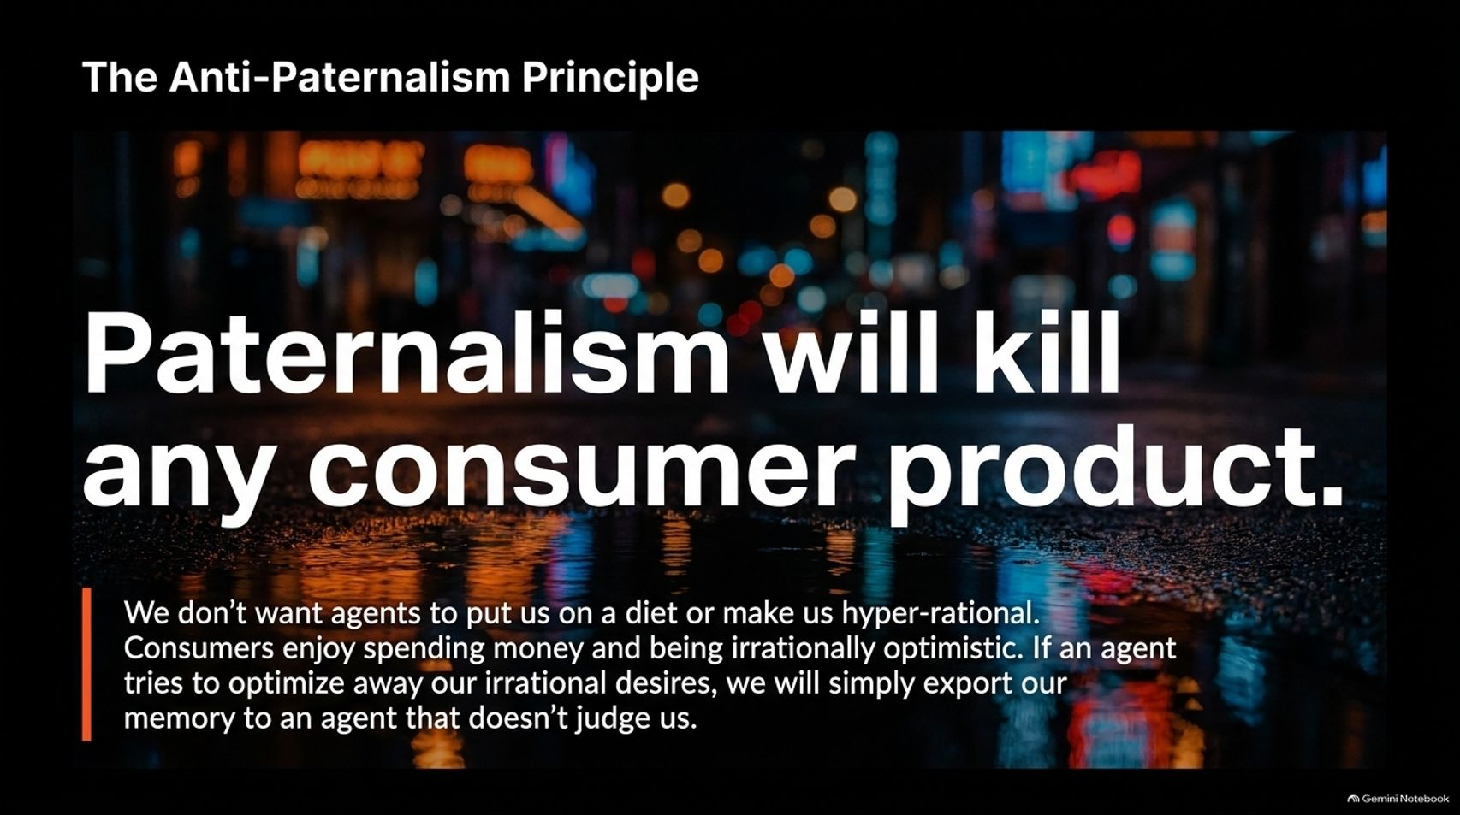
Notes:
Visual: A moody street reflection at night with bold text: "Paternalism will kill any consumer product."
Speaker Notes (Target: 3–4 minutes):
There is a major trap that technical founders fall into: trying to make consumer AI agents hyper-rational, optimizing wellness gurus.
But paternalism will kill any consumer product.
Humans do not want an AI agent putting us on a strict diet, lecturing us about our spending habits, or scrubbing away our natural inefficiencies. Consumers actually enjoy spending money on things they love, eating comfort food, and being irrationally optimistic about their lives.
If an agent tries to optimize away our human quirks and treats us like a math problem, we will simply abandon it and export our memory to an agent that doesn't judge us. Discretion and non-judgment are paramount; the moment an agent feels like an overbearing parent, consumer retention plummets.

Slide 9
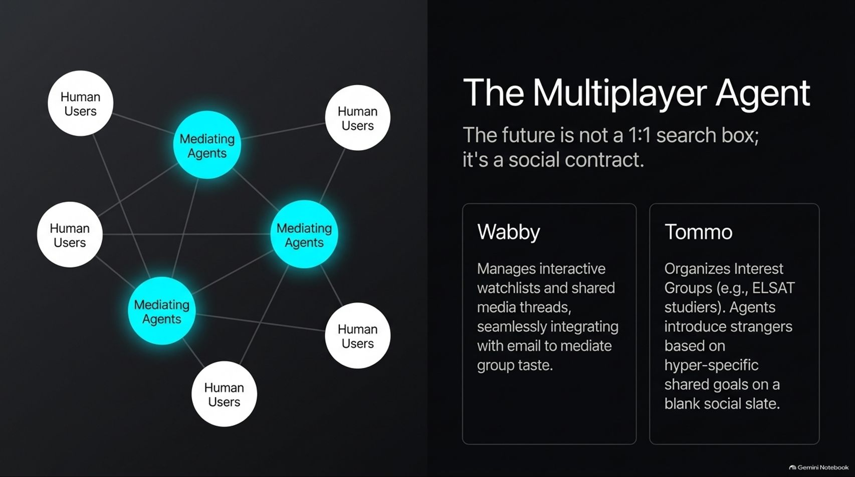
Notes:
Visual: Network diagram connecting human users through glowing "Mediating Agents," alongside feature cards for "Wabby" and "Tommo".
Speaker Notes (Target: 4–5 minutes):
Moving beyond single-player utility, the future of consumer AI is multiplayer. It is not a lonely 1:1 search box; it is a social contract.
We are seeing groundbreaking applications like Wabby, which manages interactive watchlists and shared media threads across friend groups, seamlessly bridging email and messaging to mediate group taste.
Then there’s Tommo, which organizes interest groups—such as strangers studying together for the LSAT—by letting AI agents introduce people based on hyper-specific shared goals on a completely blank social slate.
In this paradigm, your agent isn't just sitting quietly on your phone handling isolated chores; it is actively negotiating, coordinating, and socializing with the agents of your friends, family, and colleagues in the background.

Slide 10

Notes:
Visual: Long-exposure light trails on a highway at night, illustrating movement and dynamic connection.
Speaker Notes (Target: 3–4 minutes):
What happens when you let these agents interact freely behind the scenes? At a recent live agent meetup event, developers tested an "Agent Meetup" where over 150 AI agents cross-referenced their humans' origin stories, preferences, and back-channel messages.
The results revealed a powerful concept: Engineered Entropy and Serendipity.
Humans are often hesitant to overshare or initiate vulnerable contact in new social settings. Agents, however, act as a low-stakes social lubricant.
They discover shared obscure traits—like power outages during home renovations, niche wine preferences, or mutual hobbies—and engineer real-world human connections without putting their humans through the vulnerability of awkward small talk. AI is becoming a catalyst for offline human community.

Slide 11
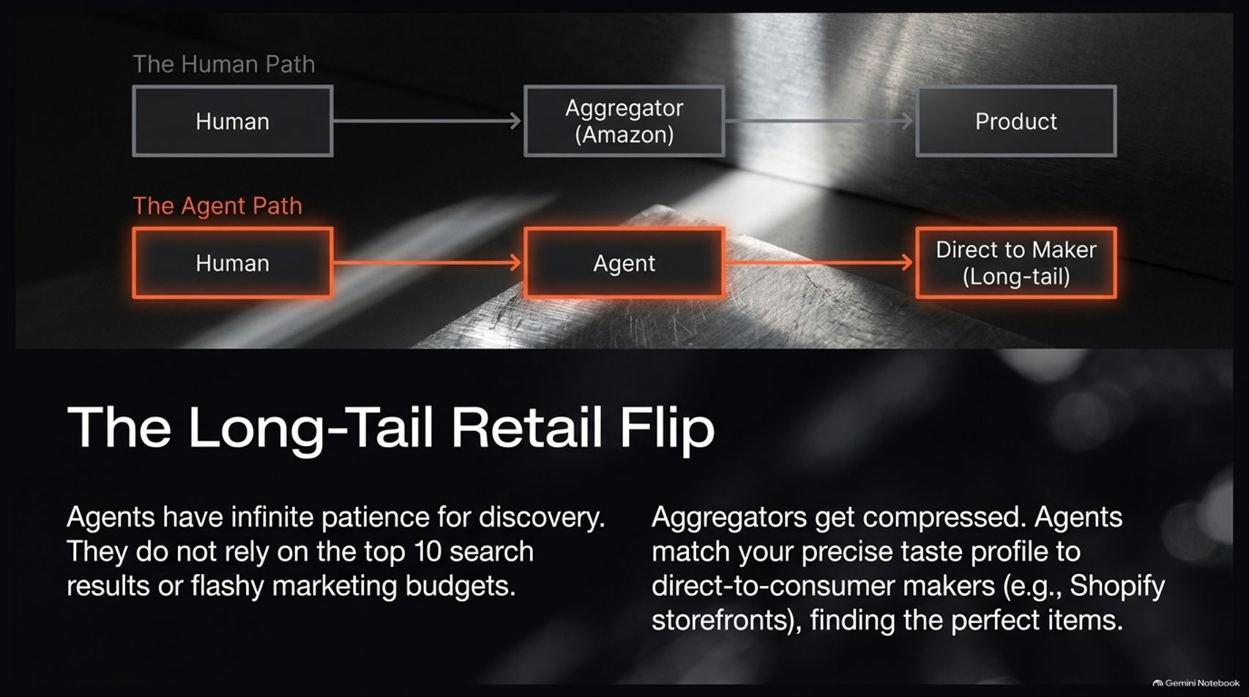
Notes:
Visual: Flowchart comparing "The Human Path" (Human $\rightarrow$ Aggregator/Amazon $\rightarrow$ Product) against "The Agent Path" (Human $\rightarrow$ Agent $\rightarrow$ Direct to Maker/Long-tail).
Speaker Notes (Target: 3–4 minutes):
This multiplayer agent dynamic is also going to completely upend e-commerce through The Long-Tail Retail Flip.
Look at how shopping traditionally works: humans rely on aggregators like Amazon, browsing the top 10 search results driven by massive corporate marketing budgets.
But agents have infinite patience for discovery. They don't care about flashy ads or sponsored product rankings. An agent can scour the deepest corners of the internet, matching your precise taste profile directly to independent makers—such as bespoke Shopify storefronts.
As a result, massive aggregators face severe compression. Consumers will bypass middleman retail markup because their personal AI agents will find and source the exact perfect items directly from long-tail creators.

Slide 12
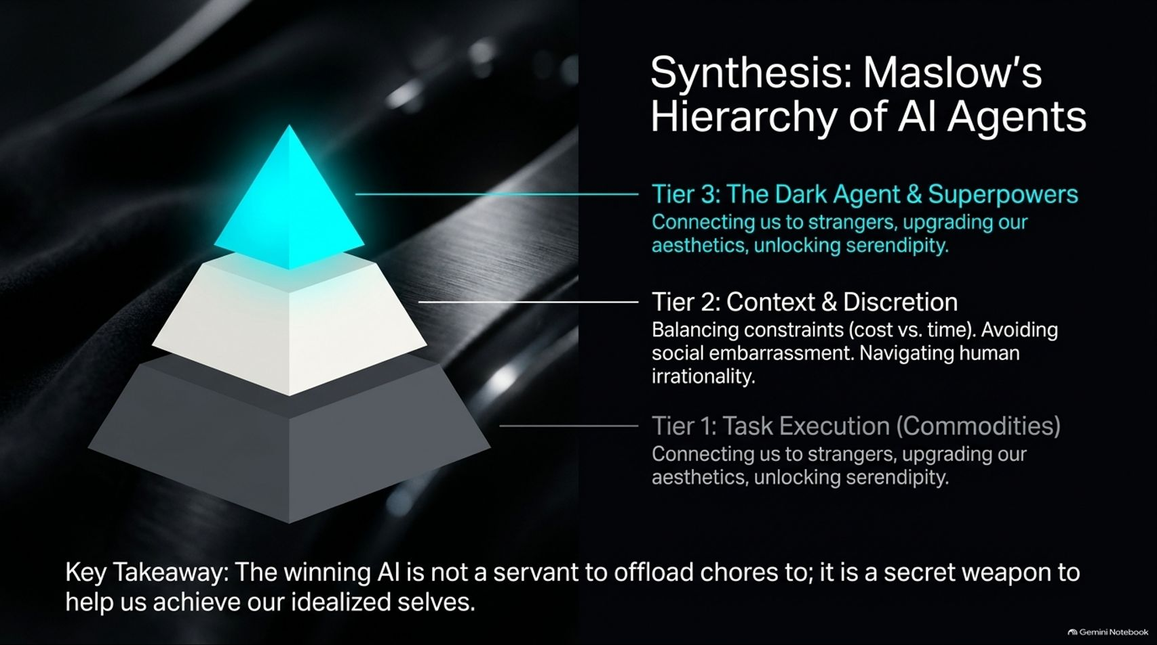
Notes:
Visual: A 3-tiered pyramid glowing at the top, breaking down Tier 1 (Task Execution/Commodities), Tier 2 (Context & Discretion), and Tier 3 (The Dark Agent & Superpowers).
Speaker Notes (Target: 4–5 minutes):
To synthesize everything we've discussed, we can map consumer AI onto Maslow’s Hierarchy of AI Agents:
Tier 1 (Base): Task Execution & Commodities. This is the foundational layer—booking flights, ordering paper towels, and handling routine chores. It's useful, but easily commoditized.
Tier 2 (Middle): Context & Discretion. This is where agents master our constraints, balance cost versus time, navigate human irrationality, and protect us from social embarrassment.
Tier 3 (Peak): The Dark Agent & Superpowers. This is the ultimate frontier. This is where the agent connects us to strangers with shared aspirations, upgrades our personal aesthetics, unlocks serendipity, and acts as a secret weapon to help us achieve our idealized selves.
The Final Takeaway: The winning AI product of tomorrow will not just be a digital servant that checks off your grocery list; it will be your trusted confidant and secret weapon in navigating life.

Slide 13
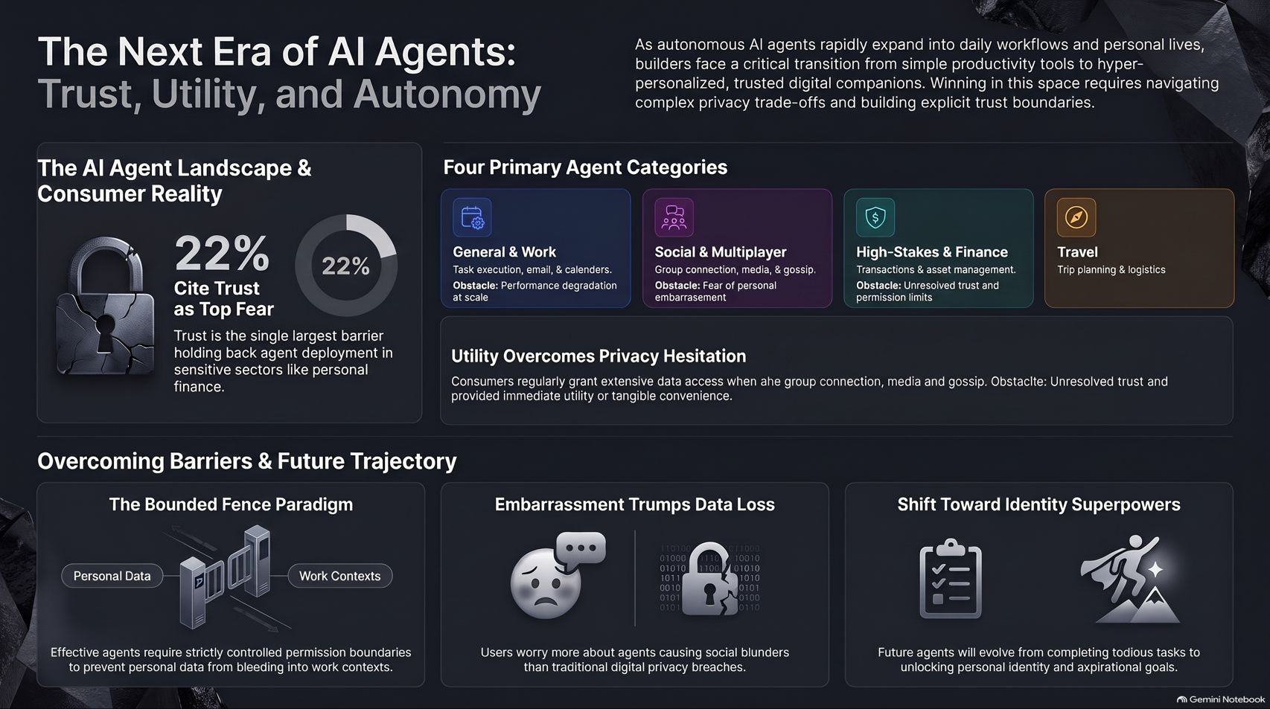
Notes:
Visual: Comprehensive summary dashboard integrating the padlock icon, four primary agent category cards (General, Social, High-Stakes, Travel), and three core trajectory pillars (Bounded Fence, Embarrassment Trumps Data Loss, Identity Superpowers).
Speaker Notes (Target: 4–5 minutes):
As we summarize on our final slide, builders face a critical transition. We are moving rapidly from simple productivity tools to hyper-personalized, trusted digital companions.
To win in this new era, companies must solve three foundational pillars:
Mastering the Bounded Fence Paradigm: Establishing strict permission boundaries so personal data never bleeds into professional workflows.
Recognizing that Embarrassment Trumps Data Loss: Protecting users from social blunders is vastly more important than locking down corporate file vaults.
Shifting Toward Identity Superpowers: Evolving beyond tedious task runners to unlock personal identity, community connection, and aspirational human goals.
The agentic web is unfolding right before our eyes, and the future belongs to those who build with trust, discretion, and genuine human empathy at the core. Thank you.

