Slide 1
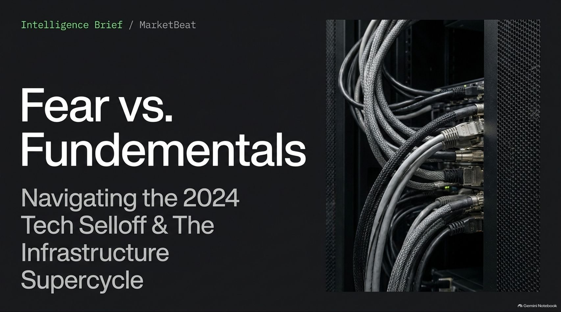
Notes:
The AI Selloff Is Getting Worse (The Dip You’ll Wish You Bought)
https://www.youtube.com/watch?v=4RPOlTRYxWc

Slide 2
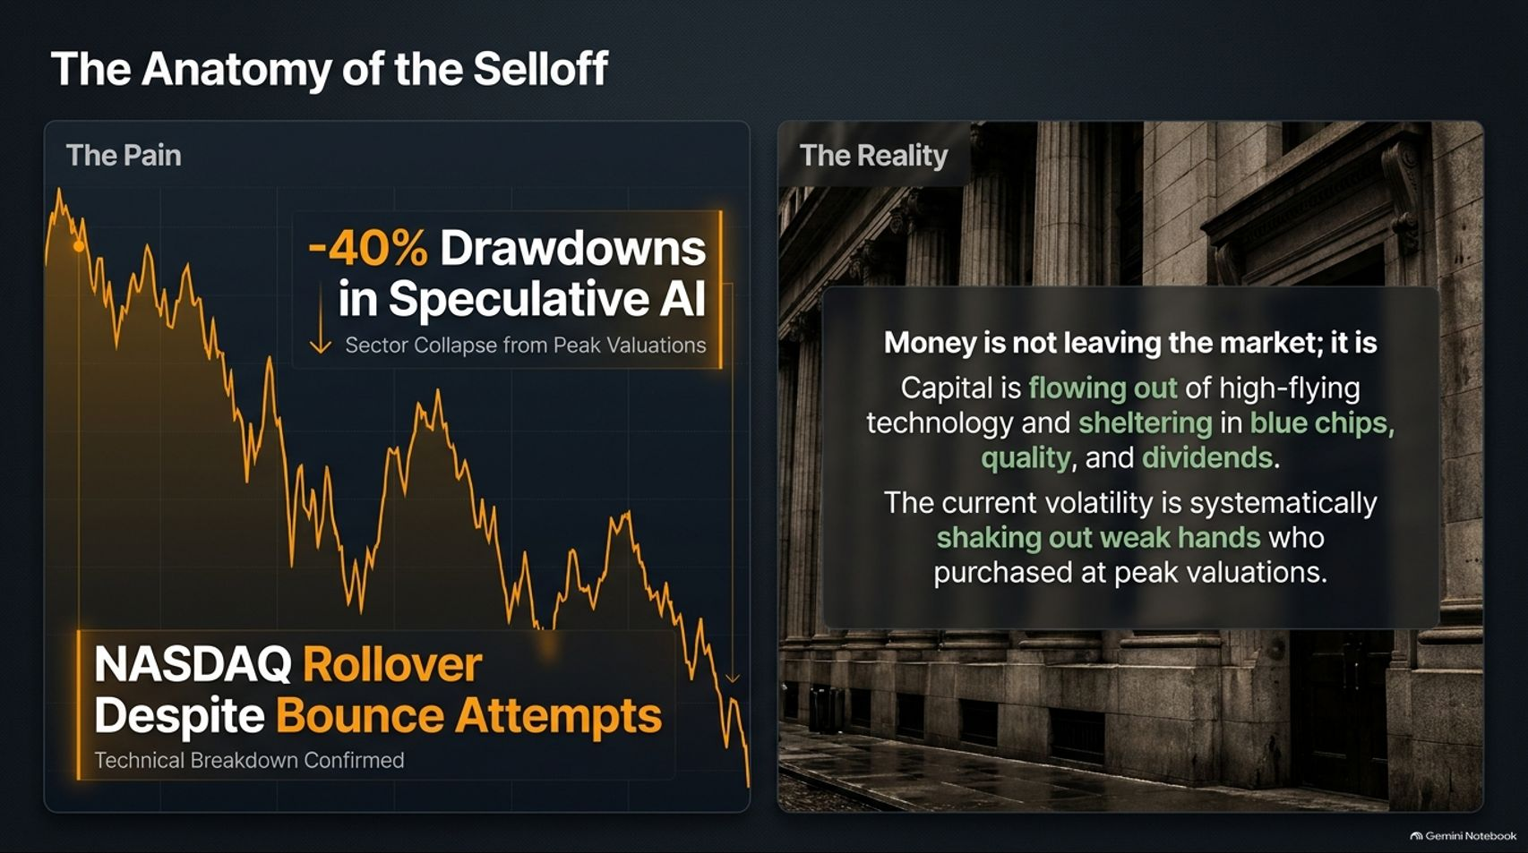
Notes:
Visual: Split screen showing a downward NASDAQ chart with a "-40% Drawdowns in Speculative AI" callout box on the left, paired with Wall Street architecture on the right emphasizing capital rotation into blue chips and quality.
Speaker Notes (Target: 3–4 minutes):
Let's look at the pain first. Many portfolios have taken a beating, with speculative AI names seeing drawdowns of 40% or more from their peak valuations. The NASDAQ has repeatedly rolled over despite various bounce attempts, confirming a technical breakdown in momentum.
But here is the critical reality check: Money is not leaving the market. Capital is simply rotating out of high-flying, over-extended technology and sheltering temporarily in blue chips, high-dividend payers, and defensive quality.
The current volatility is performing a necessary market function—systematically shaking out weak hands who chased peak valuations. If you bought the absolute top, the market is forcing a painful re-evaluation, but the underlying capital pool remains intact.

Slide 3
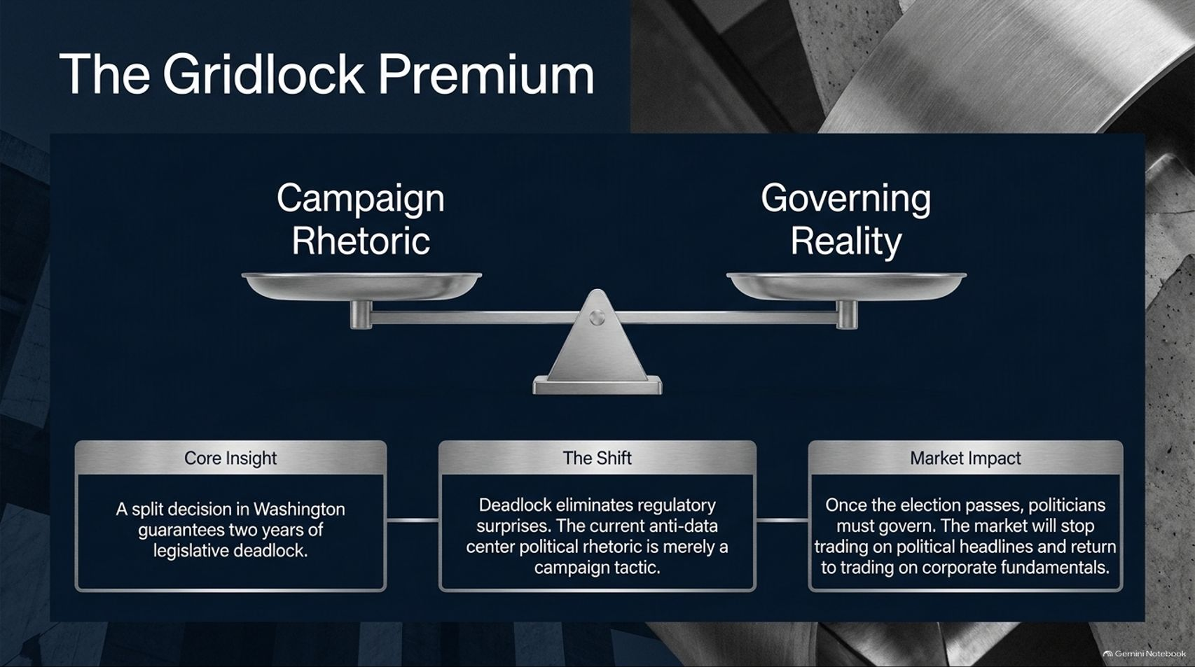
Notes:
Visual: A balanced scale contrasting "Campaign Rhetoric" against "Governing Reality," supported by insights on legislative deadlock and post-election market impact.
Speaker Notes (Target: 3–5 minutes):
Much of the near-term anxiety has been fueled by political headlines. During campaign season, anti-data center rhetoric and regulatory threats against big tech become loud talking points.
However, our core insight here is that a split decision in Washington guarantees at least two years of legislative deadlock.
Deadlock actually eliminates regulatory surprises. Once elections pass, politicians transition from campaigning to governing. The market stops trading on political noise and returns to what matters: corporate fundamentals. The current anti-data center political posturing is largely a campaign tactic that will fade once the ballots are counted.

Slide 4
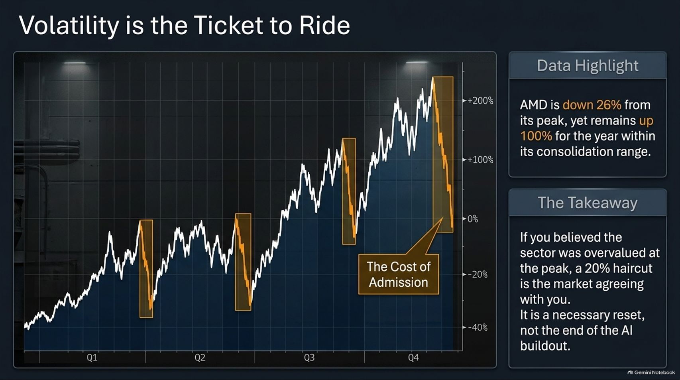
Notes:
Visual: Year-long stock chart with multiple highlighted consolidation dips marked as "The Cost of Admission," alongside data on AMD's performance.
Speaker Notes (Target: 3–4 minutes):
If you want to play the AI infrastructure supercycle, you have to accept a fundamental truth: Volatility is the ticket to ride.
Look at AMD as a prime bellwether. Even after a violent 26% pullback from its peak, it remains up roughly 100% for the year within its broader consolidation range.
If you believed the sector was overvalued at the peak, a 20% to 30% haircut is simply the market agreeing with you. It is a necessary reset, not the end of the AI buildout. Trying to trade every single wiggle without accepting volatility will shake you out right before the next leg up.

Slide 5
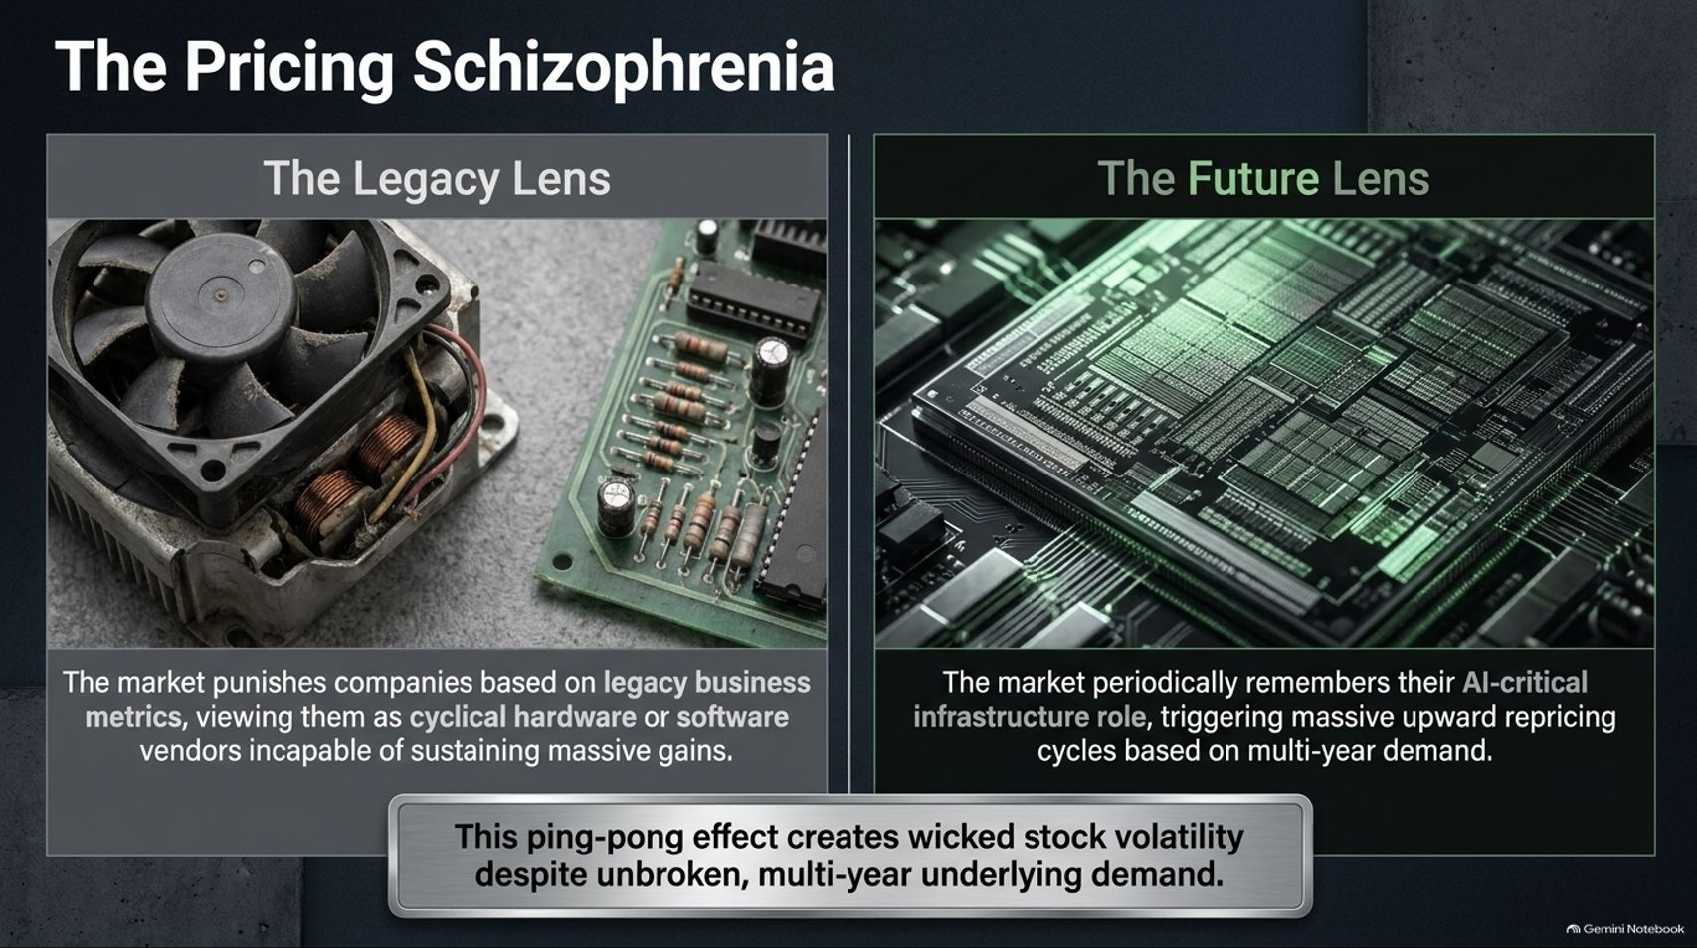
Notes:
Visual: Side-by-side contrast between a dusty legacy fan/circuit board ("The Legacy Lens") and a green-lit advanced silicon wafer ("The Future Lens").
Speaker Notes (Target: 3–4 minutes):
Why are these stocks whipsawing so violently? Because the market is suffering from pricing schizophrenia.
Through The Legacy Lens, the market punishes companies based on traditional cyclical hardware or software metrics, viewing them as standard vendors incapable of sustaining massive growth.
But through The Future Lens, the market periodically remembers their AI-critical infrastructure role, triggering massive upward repricing cycles based on multi-year demand. This constant ping-pong effect creates wicked stock volatility despite unbroken, multi-year underlying demand.

Slide 6
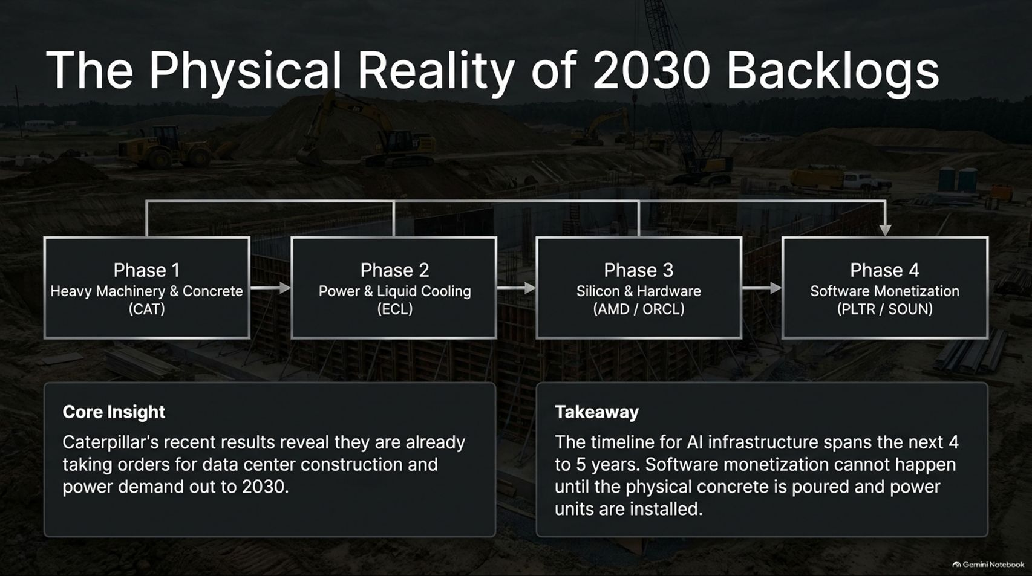
Notes:
Visual: Construction site background with a 4-phase horizontal workflow diagram: Heavy Machinery (CAT) $\rightarrow$ Power & Cooling (ECL) $\rightarrow$ Silicon & Hardware (AMD/ORCL) $\rightarrow$ Software Monetization (PLTR/SOUN).
Speaker Notes (Target: 4–5 minutes):
To understand why fears of an AI bubble are misplaced, you have to look at the physical reality of 2030 backlogs.
Look at Caterpillar's recent results. They aren't just selling tractors; they are taking concrete orders for data center construction and power generation out to 2030.
This timeline spans the next 4 to 5 years. Software monetization and end-user AI applications cannot happen at scale until the physical concrete is poured, electrical substations are built, and liquid cooling units are installed. The infrastructure buildout is operating on a multi-year horizon that far outweighs quarterly market jitters.

Slide 7
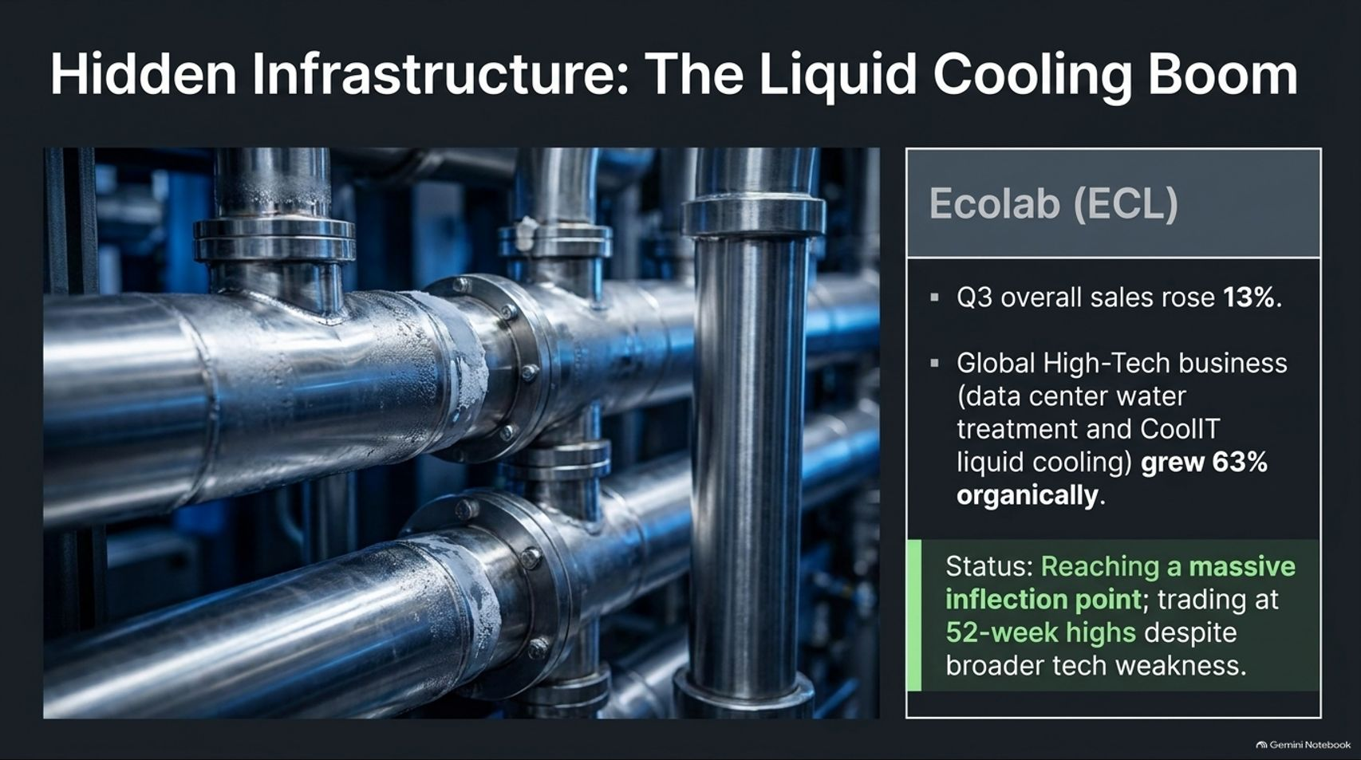
Notes:
Visual: Industrial stainless-steel piping network highlighting Ecolab (ECL), featuring Q3 sales up 13% and Global High-Tech business up 63% organically.
Speaker Notes (Target: 3–4 minutes):
While everyone is fixated on chip designers, the real hyper-growth is happening in hidden infrastructure.
Take Ecolab (ECL). While broader tech stocks have struggled, Ecolab has been trading near 52-week highs.
Their overall Q3 sales rose 13%, but their Global High-Tech business—covering data center water treatment and CoolIT liquid cooling solutions—grew an astonishing 63% organically. This proves we have reached a massive inflection point. AI cannot run without massive thermal management, and companies providing the plumbing and cooling are reaping immediate rewards.

Slide 8
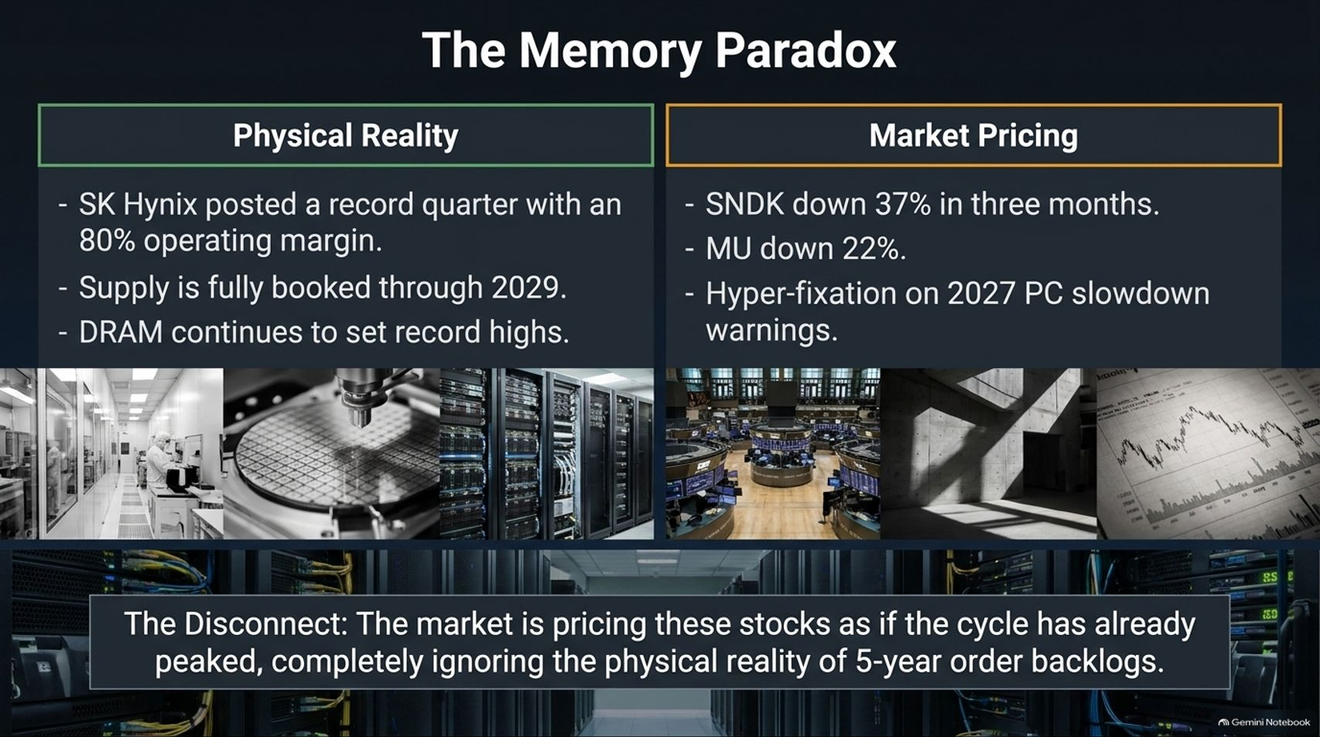
Notes:
Visual: Split layout contrasting "Physical Reality" (SK Hynix 80% operating margin, supply booked through 2029) against "Market Pricing" (SNDK down 37%, MU down 22%, PC slowdown fixation).
Speaker Notes (Target: 4–5 minutes):
One of the starkest disconnects in the market today is The Memory Paradox.
On the physical side, SK Hynix posted a record quarter with an 80% operating margin, and high-bandwidth memory supply is fully booked through 2029. DRAM prices continue to set records.
Yet on the market pricing side, memory stocks like SanDisk (SNDK) and Micron (MU) have seen double-digit drops over short multi-month windows. Why? Because the market is hyper-fixated on temporary PC slowdown warnings for 2027. The market is pricing these stocks as if the cycle has already peaked, completely ignoring the physical reality of multi-year order backlogs.

Slide 9
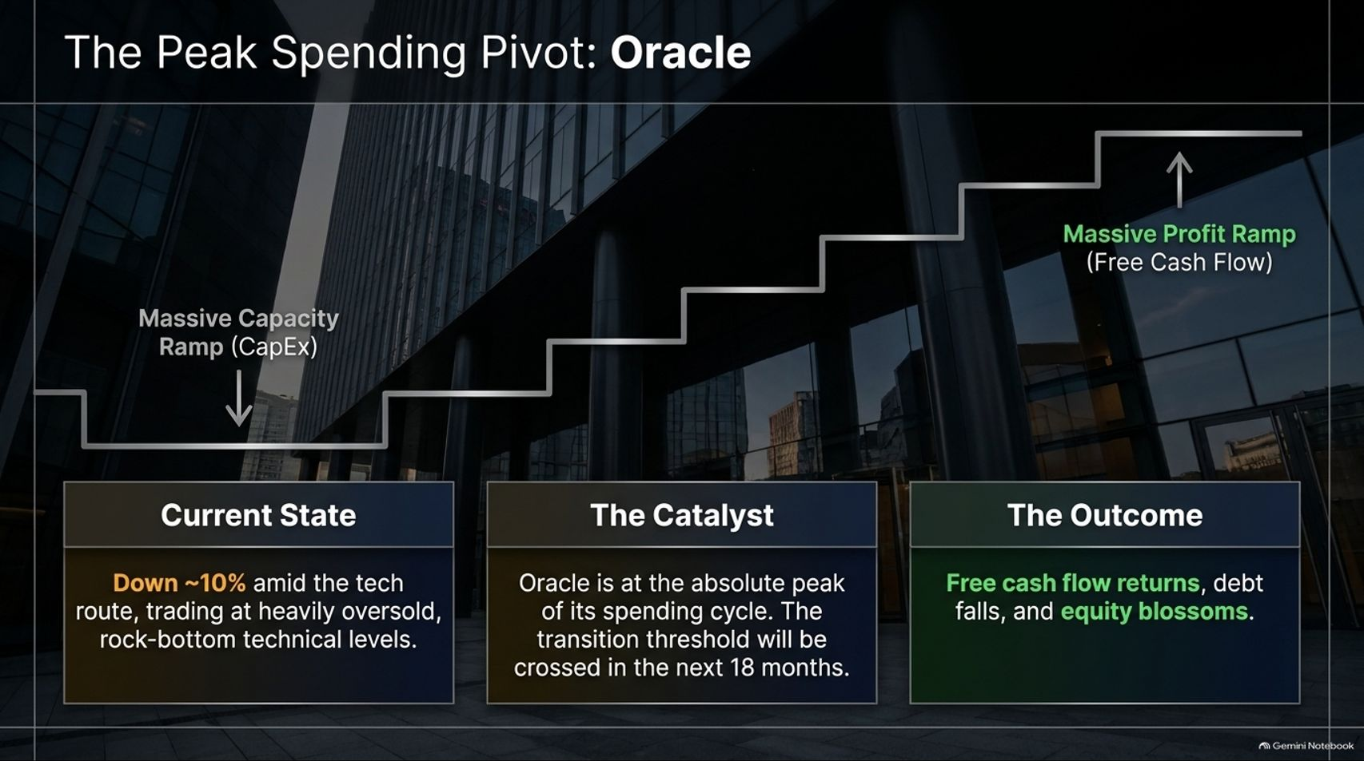
Notes:
Visual: Stepped architectural staircase ascending to "Massive Profit Ramp (Free Cash Flow)," contrasting Oracle’s capital expenditure phase with its upcoming transition threshold.
Speaker Notes (Target: 4–5 minutes):
Let's look at Oracle (ORCL) as a blueprint for how heavy spenders transition into cash cows.
Oracle has been trading down roughly 10% amid the tech rout, sitting at oversold technical levels. But here is the catalyst: Oracle is at the absolute peak of its capital expenditure spending cycle.
Over the next 18 months, that transition threshold will be crossed. As their massive data center capacity ramp completes, capital expenditures will drop, free cash flow will flood back, debt will fall, and equity will blossom. Investors punishing them for spending today are missing the massive profit ramp coming tomorrow.

Slide 10
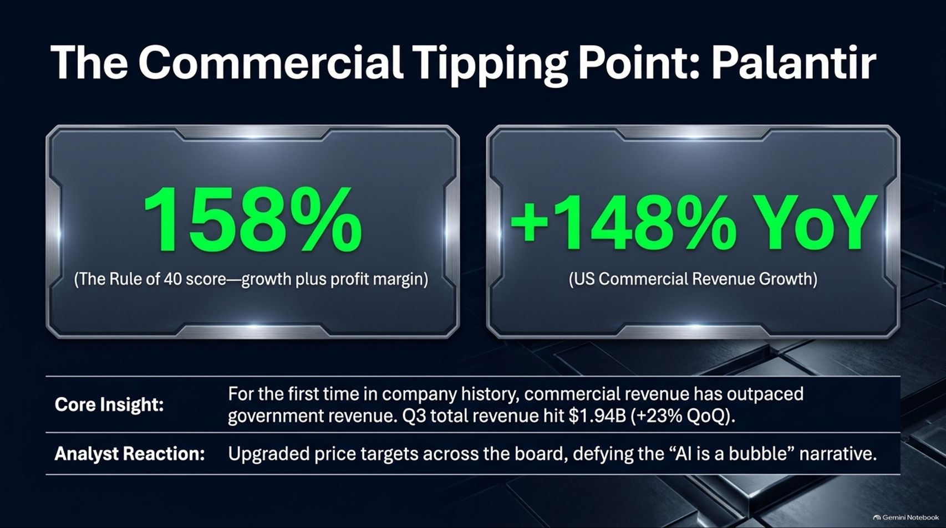
Notes:
Visual: Sleek dashboard cards displaying Palantir's metrics: 158% Rule of 40 score and +148% YoY US Commercial Revenue Growth.
Speaker Notes (Target: 3–4 minutes):
Moving downstream into software application layers, Palantir (PLTR) has officially reached a Commercial Tipping Point.
For the first time in company history, commercial revenue has outpaced government revenue. US commercial revenue surged 148% year-over-year, driving total Q3 revenue to $1.94 billion.
Their Rule of 40 score hit an incredible 158%. Major Wall Street institutions have responded with aggressive price target upgrades across the board, completely defying the simplistic narrative that "AI is a bubble". Software that delivers immediate enterprise ROI is winning big.

Slide 11
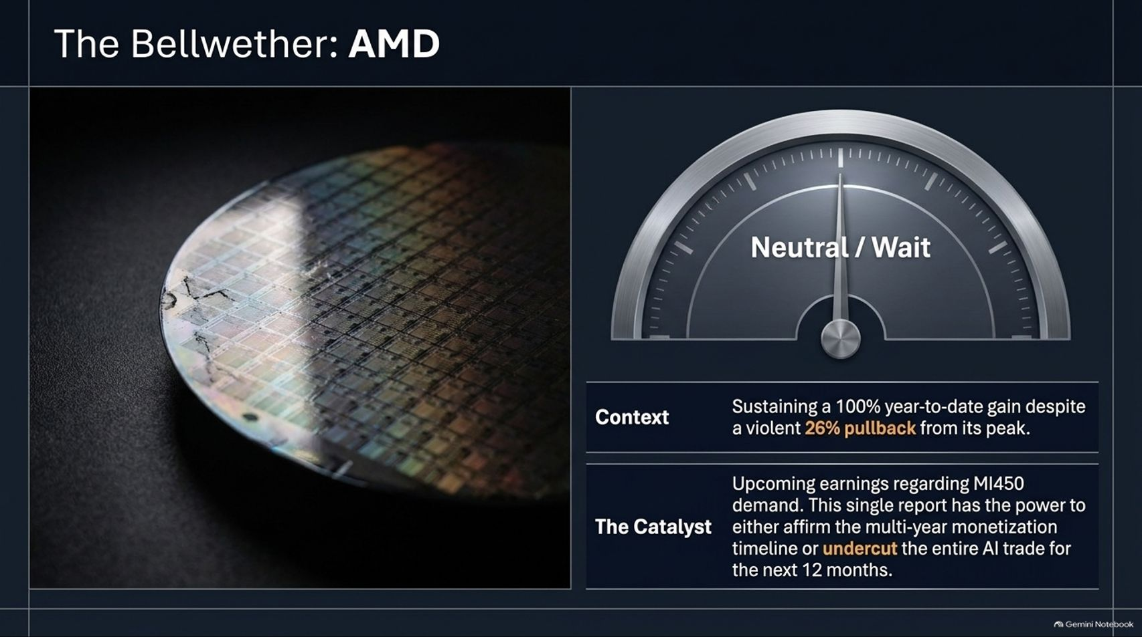
Notes:
Visual: Close-up of a silicon wafer paired with a dashboard gauge pointing squarely to "Neutral / Wait," detailing AMD's MI450 demand catalyst.
Speaker Notes (Target: 3–5 minutes):
AMD sits right at the center of the market's psychological tug-of-war.
While it has sustained a massive 100% year-to-date gain, it has suffered a violent 26% pullback from its highs, putting our outlook at a cautious "Neutral / Wait".
All eyes are locked on upcoming earnings regarding MI450 demand. This single catalyst has the power to either decisively affirm the multi-year monetization timeline or temporarily undercut the entire AI trade for the next 12 months. It is the ultimate litmus test for hardware adoption.

Slide 12
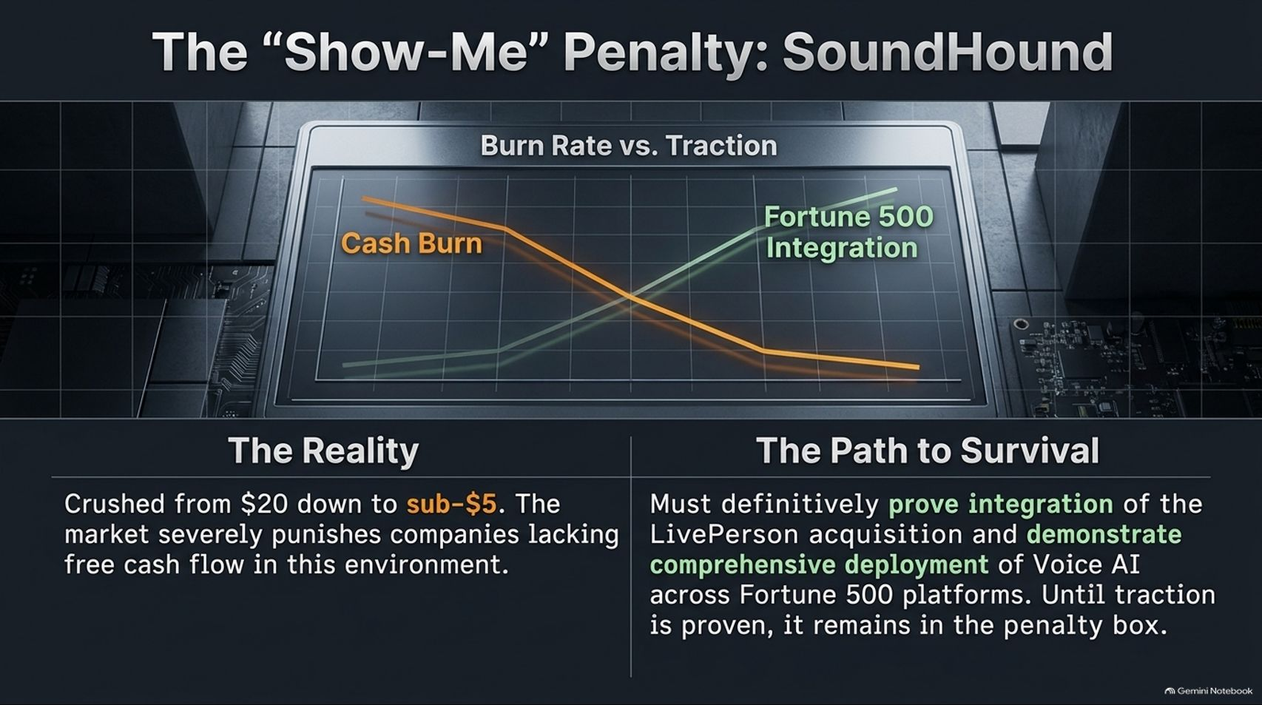
Notes:
Visual: Dual-line graph tracking "Cash Burn" descending as "Fortune 500 Integration" ascends for SoundHound (SOUN).
Speaker Notes (Target: 3–5 minutes):
Not every speculative AI stock gets a free pass. Companies like SoundHound (SOUN) illustrate The "Show-Me" Penalty.
Crushed from highs down to sub-$5 levels, the market is severely punishing smaller-cap firms lacking immediate free cash flow.
To survive and exit the penalty box, SoundHound must definitively prove successful integration of its recent LivePerson acquisition and demonstrate comprehensive, scaled deployment of Voice AI across Fortune 500 platforms. Until concrete execution matches the hype, speculative names will remain heavily penalized.

Slide 13
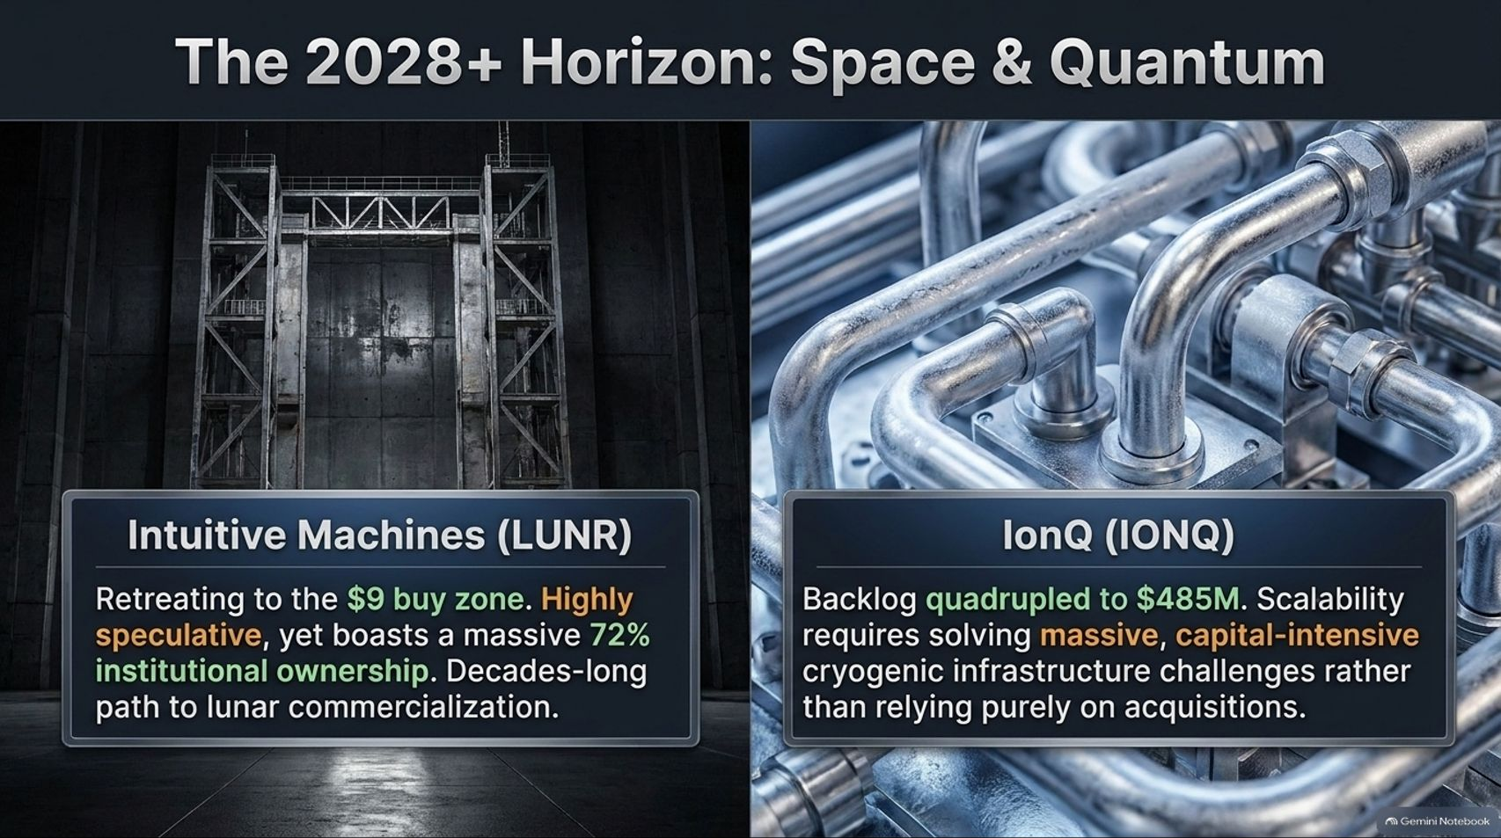
Notes:
Visual: Industrial gantry for Intuitive Machines (LUNR) on the left, paired with cryogenic plumbing infrastructure for IonQ (IONQ) on the right.
Speaker Notes (Target: 4–5 minutes):
Looking further out past the immediate AI trade, we reach the 2028+ Horizon: Space & Quantum.
Intuitive Machines (LUNR) is retreating into attractive buy zones; despite being highly speculative, it boasts an impressive 72% institutional ownership backing a decades-long path to lunar commercialization.
Similarly, IonQ (IONQ) saw its backlog quadruple to $485 million. However, true scalability here requires solving massive, capital-intensive cryogenic infrastructure challenges rather than relying purely on acquisitions. These are multi-year generational bets, not quick swing trades.

Slide 14
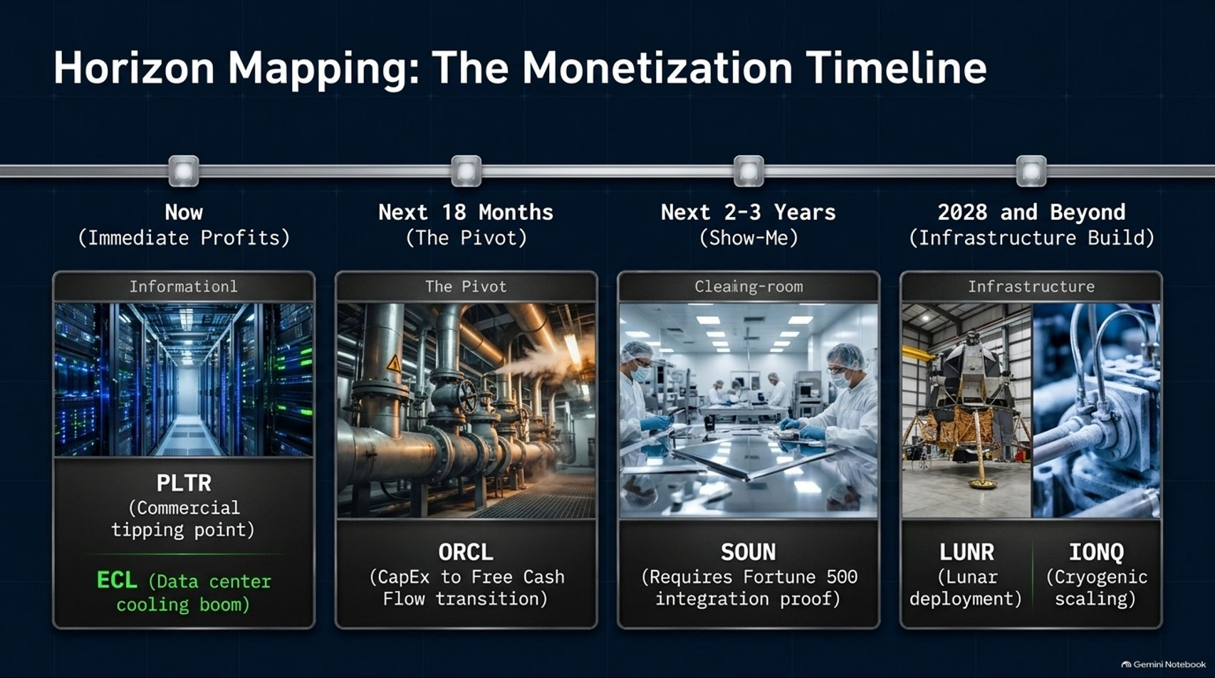
Notes:
Visual: A structured timeline mapping out four distinct investment horizons: Now (PLTR, ECL), Next 18 Months (ORCL), Next 2-3 Years (SOUN), and 2028 and Beyond (LUNR, IONQ).
Speaker Notes (Target: 3–4 minutes):
This master timeline is your strategic map for capital allocation. You cannot treat all tech and AI stocks the same way:
Now (Immediate Profits): Anchored by software cash generators like Palantir and critical cooling hardware like Ecolab.
Next 18 Months (The Pivot): Capital expenditure giants like Oracle transitioning from heavy spending into massive free cash flow.
Next 2-3 Years (Show-Me Phase): Voice and specialized AI applications requiring proven Fortune 500 integration.
2028 and Beyond (Infrastructure Build): Long-horizon plays like lunar deployment and quantum cryogenic scaling. Match your holding period to the correct phase.

Slide 15
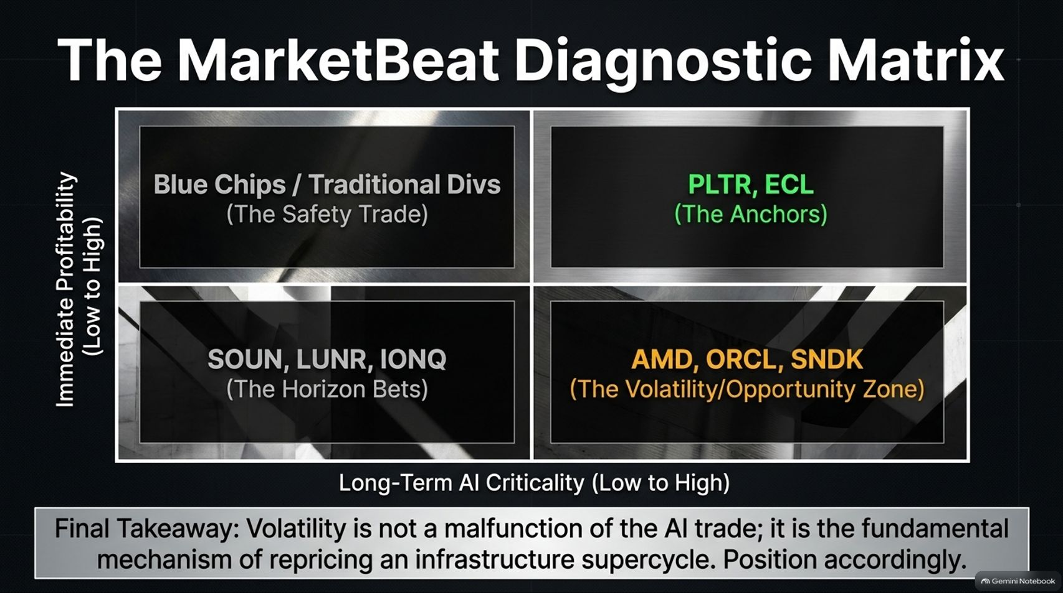
Notes:
Visual: A 2x2 quadrant matrix mapping "Immediate Profitability" against "Long-Term AI Criticality," categorizing stocks into Blue Chips, Anchors (PLTR, ECL), Horizon Bets, and the Volatility/Opportunity Zone (AMD, ORCL, SNDK).
Speaker Notes (Target: 3–4 minutes):
To summarize our diagnostic framework, we place the market into four clean quadrants based on profitability versus AI criticality:
Top-Left: Traditional Blue Chips (The Safety Trade).
Top-Right: PLTR and ECL as The Anchors—combining immediate profitability with high AI criticality.
Bottom-Left: SOUN, LUNR, and IONQ as The Horizon Bets.
Bottom-Right: AMD, ORCL, and SNDK in The Volatility / Opportunity Zone.
Final Takeaway: Volatility is not a malfunction of the AI trade; it is the fundamental mechanism of repricing an infrastructure supercycle. Position accordingly.

Slide 16
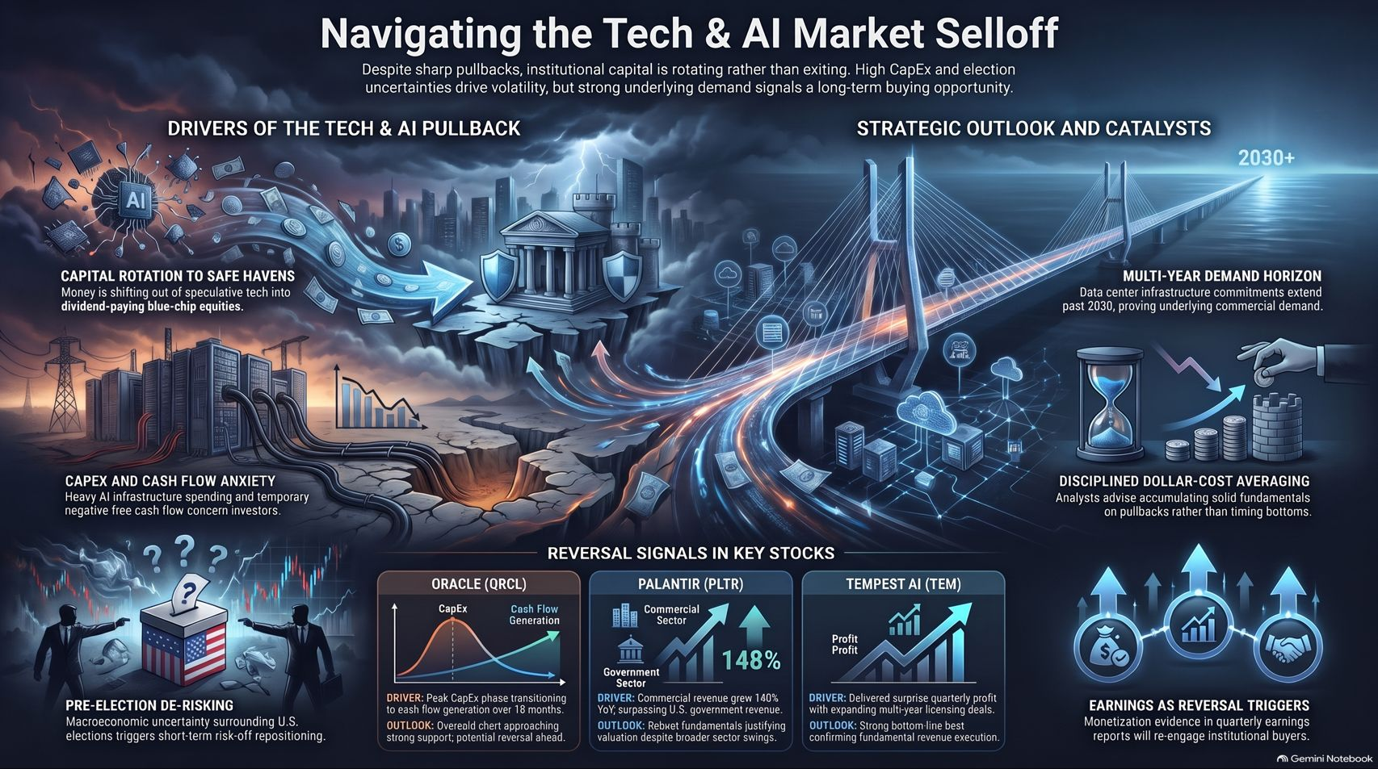
Notes:
Visual: Comprehensive infographic synthesizing drivers of the pullback, capital rotation into safe havens, pre-election de-risking, and long-term demand horizons stretching past 2030.
Speaker Notes (Target: 3–5 minutes):
As we pull everything together on our concluding slide, remember what is truly driving this market.
Sharp pullbacks and pre-election de-risking have driven short-term panic, but institutional capital is rotating, not exiting. High CapEx and temporary negative free cash flow concern short-term investors, but data center commitments extending past 2030 prove underlying commercial demand is bulletproof.
The winning strategy isn't trying to time the exact market bottom. It is practicing disciplined dollar-cost averaging—accumulating solid fundamentals on pullbacks. When quarterly earnings continue to prove monetization, institutional buyers will flood back in. Stay disciplined, stick to your thesis, and happy investing!

