Slide 1
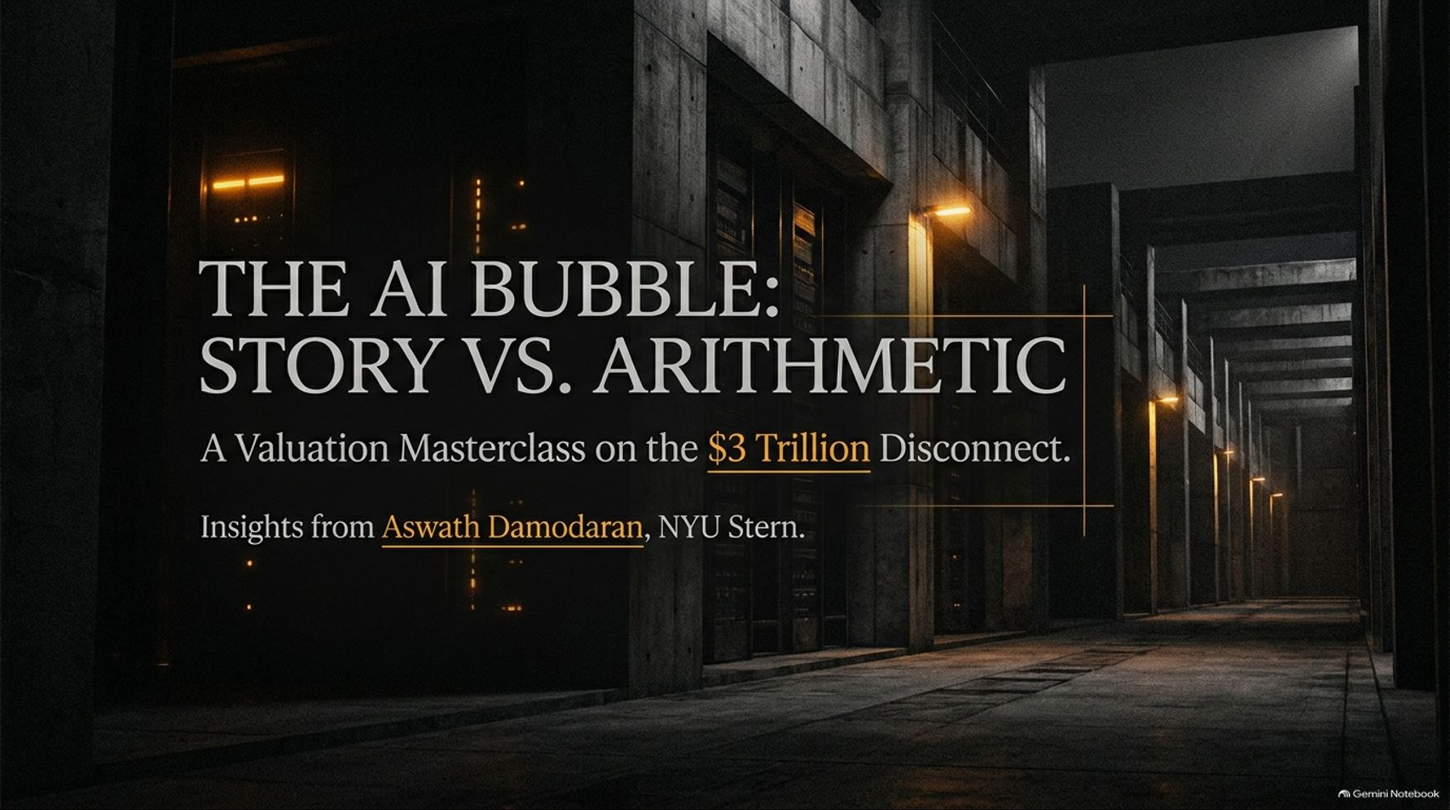
Notes:
Visual: Dark, imposing industrial server corridor with warm lighting and the title: "The AI Bubble: Story vs. Arithmetic: A Valuation Masterclass on the $3 Trillion Disconnect," featuring insights from Aswath Damodaran, NYU Stern.
Speaker Notes (Target: 2–3 minutes):
Welcome everyone to today's masterclass on "The AI Bubble: Story vs. Arithmetic."
Today, we are exploring what NYU Stern Professor Aswath Damodaran—widely known as Wall Street's "Dean of Valuation"—identifies as a monumental disconnect in modern markets.
Trillions of dollars are being poured into infrastructure, but as investors, we have to look past the hype and examine the financial physics. Let's break down how storytelling and arithmetic collide in the artificial intelligence revolution.
The AI Bubble Lesson Is Coming | NYU Professor Aswath Damodaran
https://www.youtube.com/watch?v=dOIFazFlvlc

Slide 2
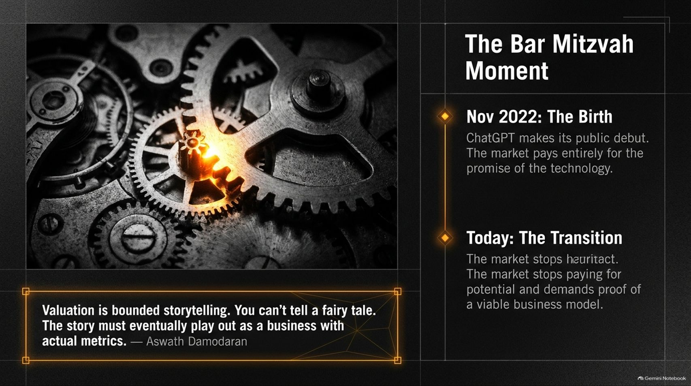
Notes:
Visual: Close-up of mechanical gears with a bright glowing gear at the center, contrasting the "Birth" of ChatGPT in Nov 2022 against "Today: The Transition," supported by a quote from Aswath Damodaran.
Speaker Notes (Target: 3–4 minutes):
As Professor Damodaran notes, the AI market recently hit what he calls a "Bar Mitzvah moment."
When ChatGPT made its public debut on November 30, 2022, the market was paying entirely for the promise of the technology. It was all narrative and vision.
But that phase is over. The market has stopped running on pure heuristic excitement; it is demanding proof of a viable business model. As Damodaran reminds us: "Valuation is bounded storytelling. You can't tell a fairy tale. The story must eventually play out as a business with actual metrics."

Slide 3
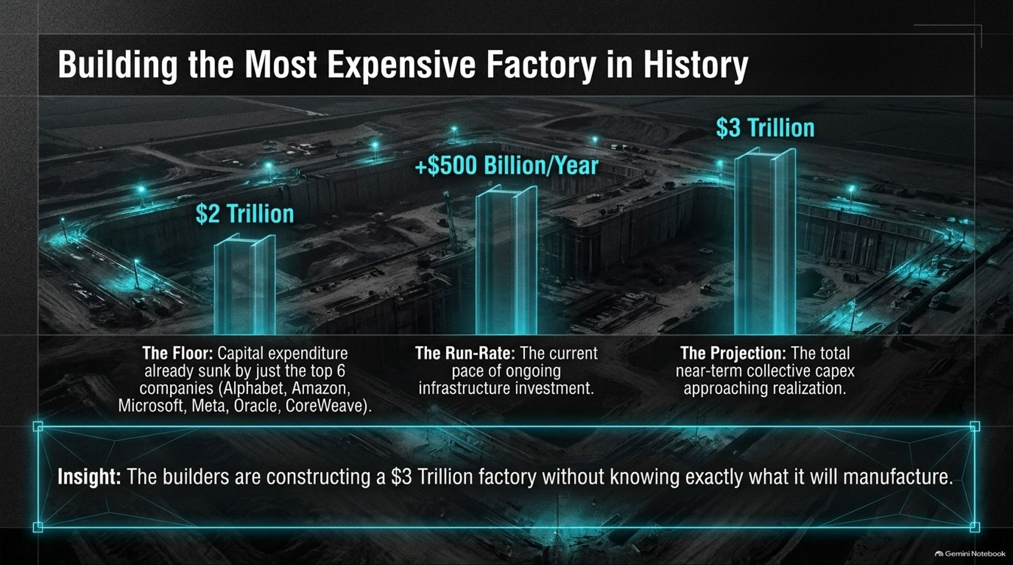
Notes:
Visual: A massive futuristic holographic construction site with three towering steel beams representing $2 Trillion (sunk floor), +$500 Billion/Year (run-rate), and $3 Trillion (projection), highlighting the insight about building a factory without knowing its exact product.
Speaker Notes (Target: 3–5 minutes):
Think about the scale of what is happening right now. We are witnessing the construction of the most expensive factory in human history.
Consider the numbers: Just across the top six companies—Alphabet, Amazon, Microsoft, Meta, Oracle, and CoreWeave—capital expenditure already sunk sits at a staggering $2 Trillion floor.
We are adding another +$500 Billion per year in run-rate capex, pushing near-term collective commitments toward $3 Trillion. The profound insight here is that the builders are constructing a $3 Trillion factory without knowing exactly what it will manufacture.

Slide 4
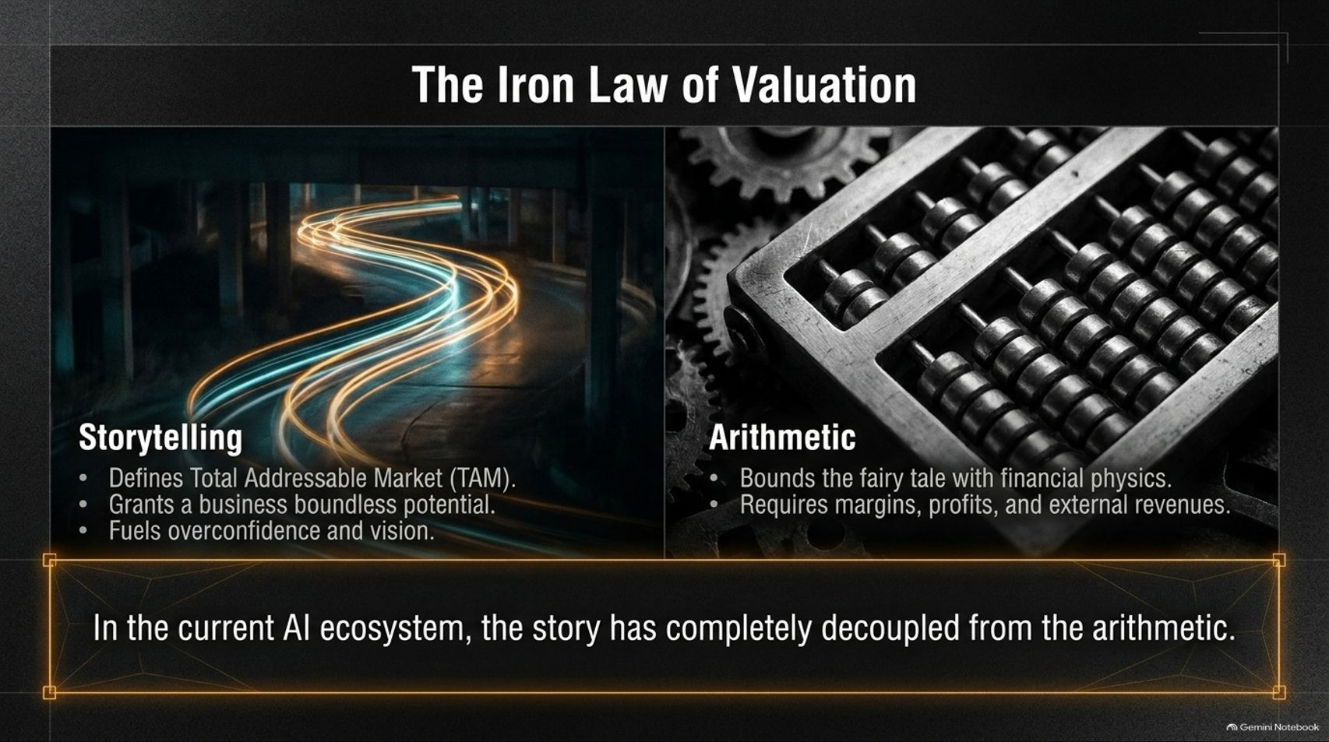
Notes:
Visual: Split layout comparing "Storytelling" (light trails representing TAM, vision, and boundlessness) on the left, against "Arithmetic" (an old-fashioned abacus and gears representing margins, profits, and financial physics) on the right.
Speaker Notes (Target: 3–4 minutes):
In financial analysis, you always have a tug-of-war between two forces: Storytelling and Arithmetic.
Storytelling defines the Total Addressable Market (TAM), grants a business boundless potential, and fuels overconfidence and vision.
Arithmetic, on the other hand, is the financial physics that bounds the fairy tale. It demands margins, actual profits, and external revenues. In the current AI ecosystem, the story has completely decoupled from the arithmetic.

Slide 5
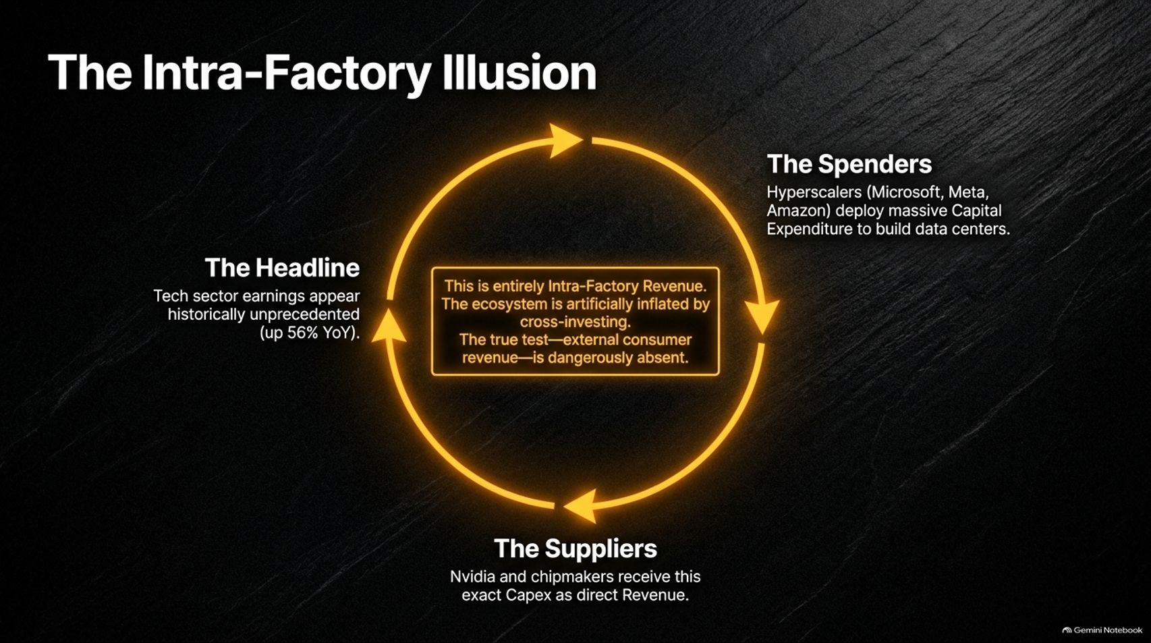
Notes:
Visual: A circular flowchart showing The Spenders (Hyperscalers deploying capex) feeding The Suppliers (Nvidia and chipmakers receiving direct revenue), which fuels the Headline earnings report of 56% YoY growth.
Speaker Notes (Target: 3–5 minutes):
One of the most dangerous illusions in the current market is what we call Intra-Factory Revenue.
When tech sector earnings report historically unprecedented growth—such as 56% year-over-year gains—bulls point to it as proof of health.
But look closer at the loop: Hyperscalers like Microsoft, Meta, and Amazon deploy massive capex to build data centers. That exact cash flows directly as revenue to Nvidia and hardware suppliers. The ecosystem is artificially inflated by cross-investing. The true test—sustainable external consumer revenue—is dangerously absent.

Slide 6
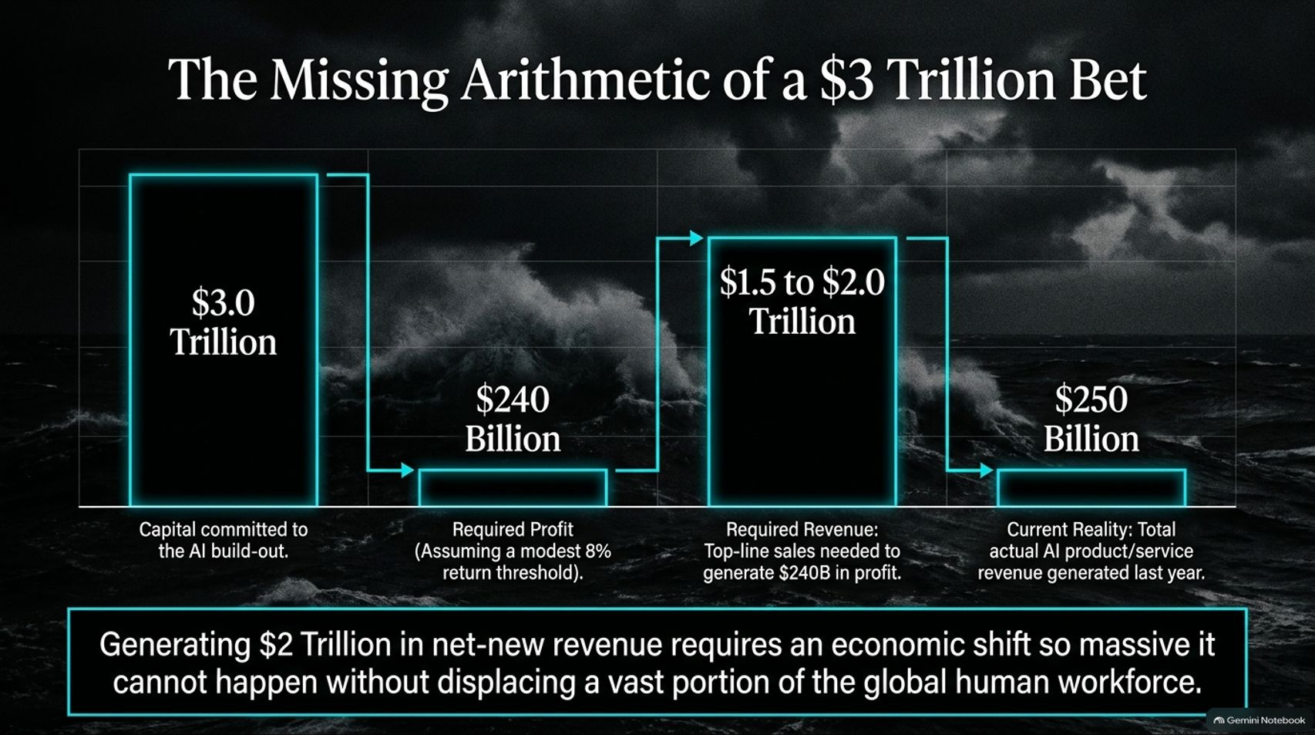
Notes:
Visual: A multi-step financial chart illustrating $3.0 Trillion in committed capital dropping to $240 Billion in required profit (at an 8% return), translating to $1.5 to $2.0 Trillion in required revenue, compared against the current $250 Billion actual AI revenue.
Speaker Notes (Target: 4–5 minutes):
Let's do the simple arithmetic that nobody wants to talk about.
If you commit $3 Trillion in capital infrastructure, you could have alternatively placed that money into safe assets yielding a modest return. Assuming a modest 8% return threshold, that capital requires $240 Billion in net profit every single year.
To generate $240 Billion in profit, you need roughly $1.5 to $2.0 Trillion in top-line annual sales. Compare that to the current reality: total actual AI product and service revenue generated last year was roughly $250 Billion. Closing that gap requires an economic shift so massive it cannot happen without displacing a vast portion of the global workforce.

Slide 7
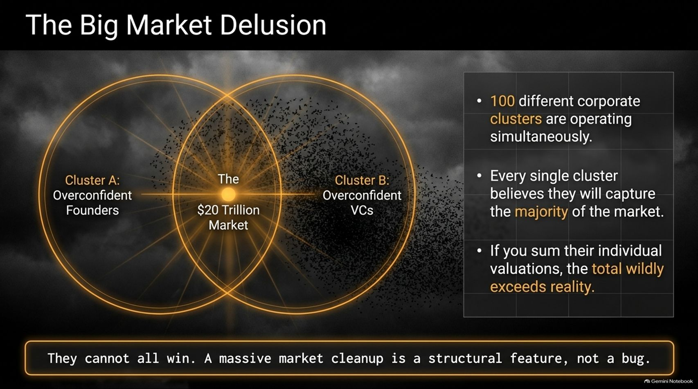
Notes:
Visual: Venn diagram of overlapping clusters ("Overconfident Founders" and "Overconfident VCs") surrounding a central $20 Trillion market, accompanied by key bullet points on market cleanup.
Speaker Notes (Target: 3–4 minutes):
This brings us to what Professor Damodaran calls The Big Market Delusion.
Right now, roughly 100 different corporate clusters are operating simultaneously, and every single cluster believes they will capture the majority of the market.
If you sum their individual private valuations and market projections, the total wildly exceeds reality. They cannot all win. As Damodaran points out, bubbles and massive market cleanups are structural features of capitalist markets, not bugs.

Slide 8
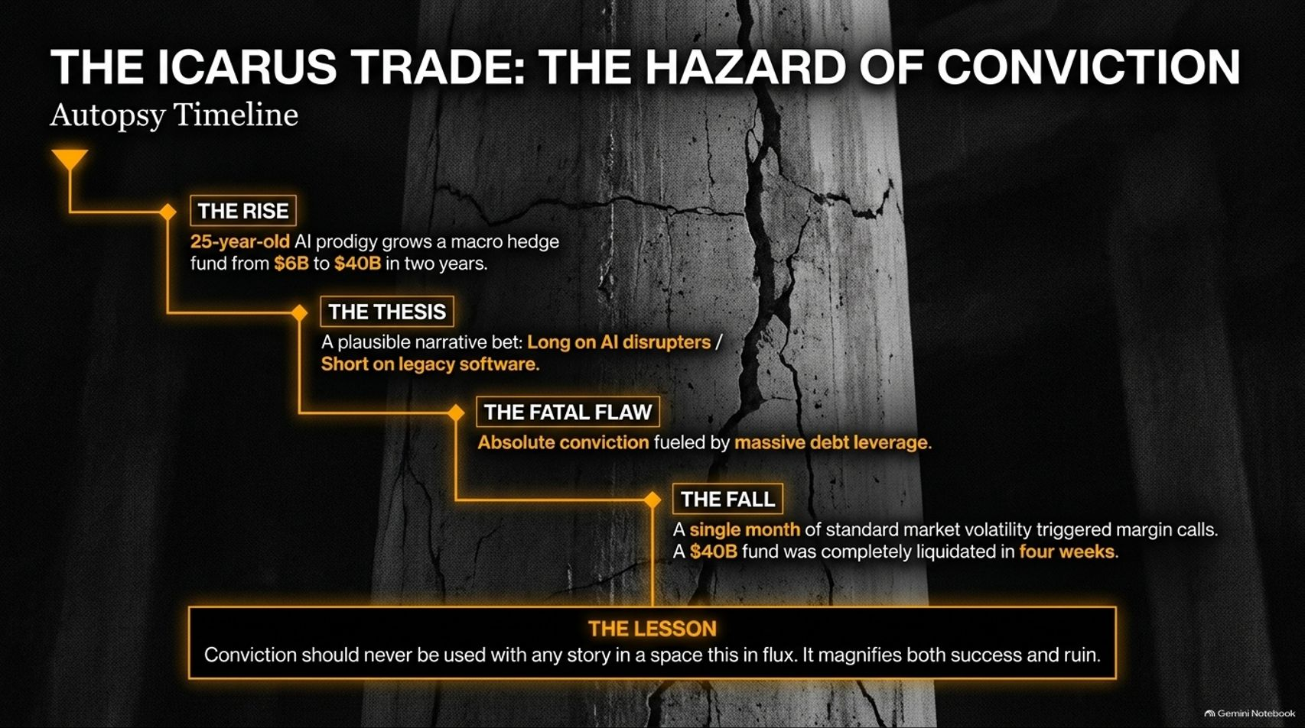
Notes:
Visual: An autopsy timeline tracking a 25-year-old AI prodigy growing a macro hedge fund from $6B to $40B, building a thesis on AI disruptors versus legacy software, leveraging heavily, and collapsing in four weeks.
Speaker Notes (Target: 3–5 minutes):
When narratives override arithmetic, investors fall into The Icarus Trade.
Consider the recent cautionary tale of 25-year-old AI prodigy Leopold Ashenbrenner, who rapidly scaled his macro hedge fund from $6 Billion to $40 Billion on a high-conviction thesis: long AI disruptors, short legacy software.
Driven by absolute conviction and massive debt leverage, his fund was hailed as a genius operation. But when a single month of standard market volatility triggered margin calls, the $40 Billion fund was completely liquidated in just four weeks. The lesson: Conviction should never be used with any story in a space in flux; it magnifies both success and ruin.

Slide 9
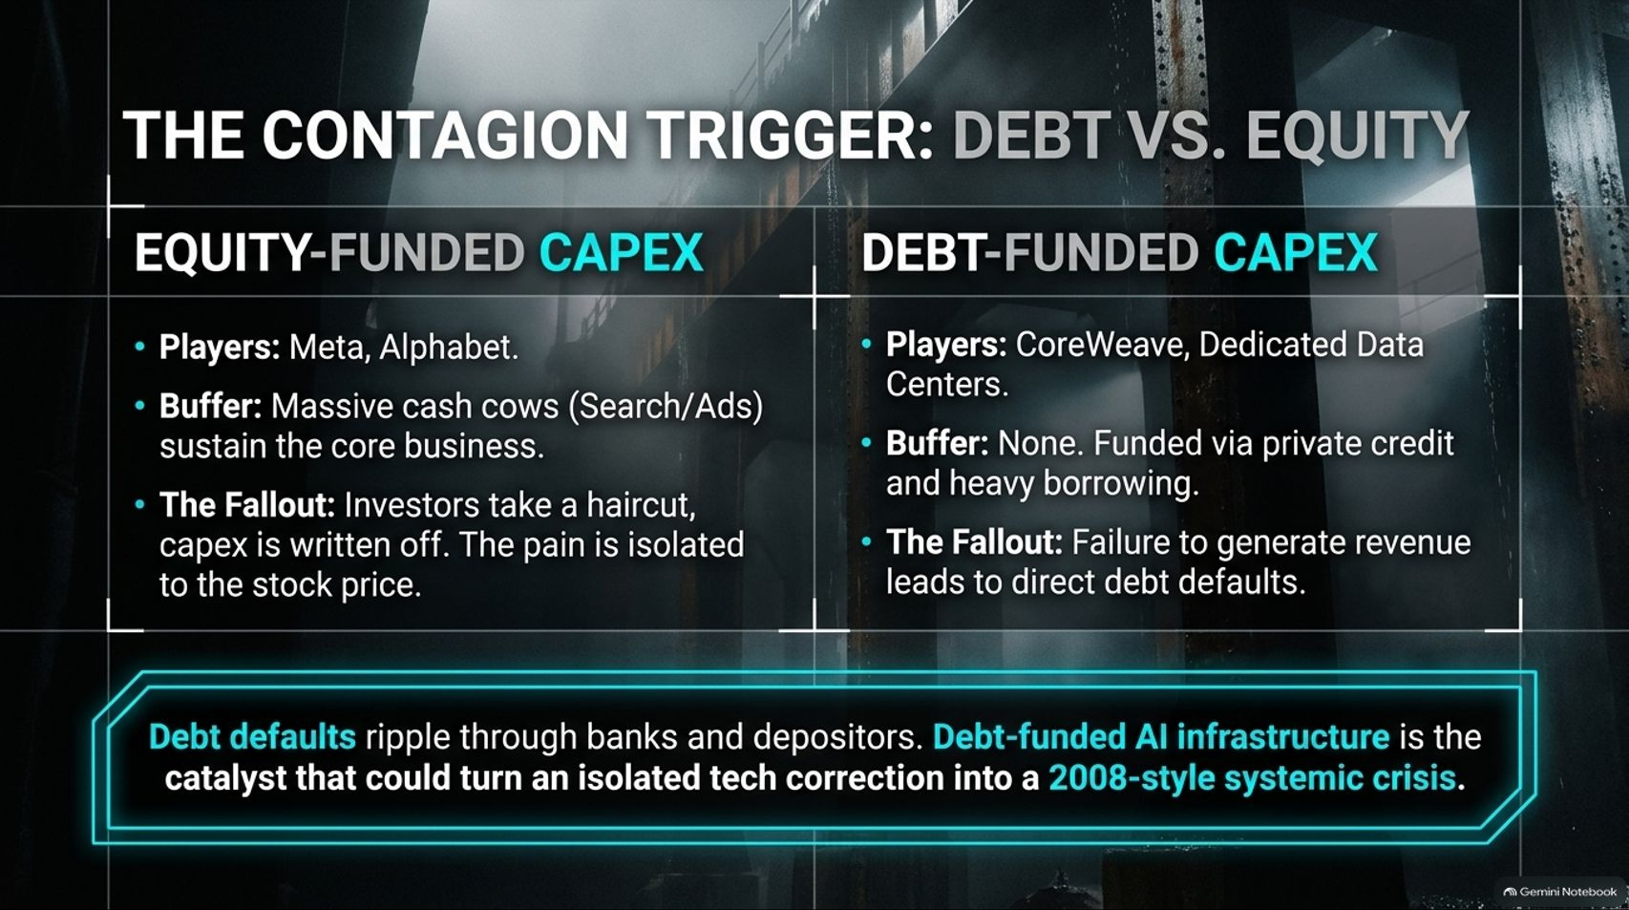
Notes:
Visual: Comparative breakdown between Equity-Funded Capex (Meta, Alphabet backed by search ad cash cows) versus Debt-Funded Capex (CoreWeave and dedicated data centers funded via private credit).
Speaker Notes (Target: 3–4 minutes):
When a correction hits, who actually gets hurt? That depends entirely on how the capex is funded.
Equity-Funded Capex (Meta, Alphabet): Backed by massive cash cows in search and advertising. If the AI bet fails, investors take a haircut, capex is written off, and the pain is isolated to stock prices.
Debt-Funded Capex (CoreWeave, independent data centers): Funded via private credit and heavy borrowing with no operational cash-cow buffer. Failure to generate immediate revenue leads to direct debt defaults. Debt defaults ripple through banks and depositors, turning an isolated tech correction into a 2008-style systemic crisis.

Slide 10
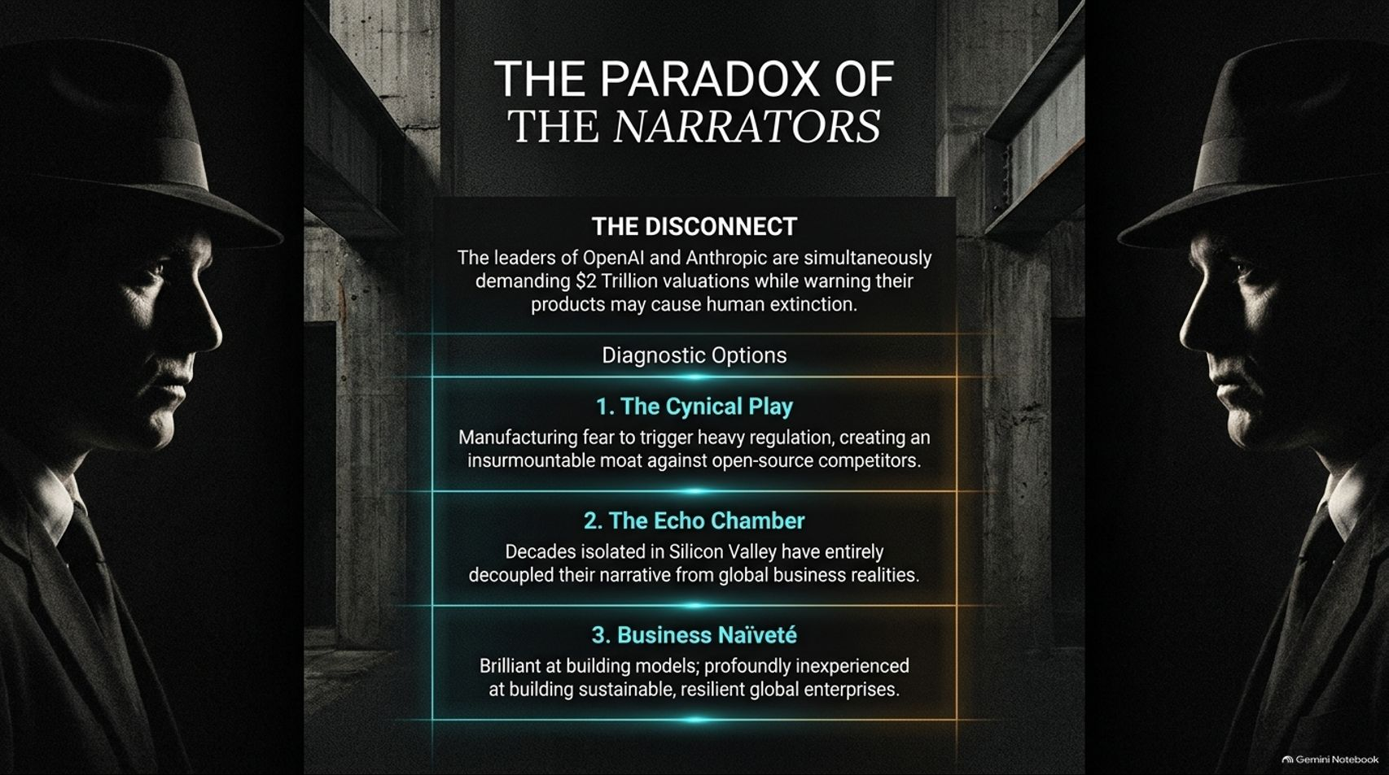
Notes:
Visual: Silhouette profiles of two men in fedora hats facing each other, framing the disconnect between tech leaders demanding $2 Trillion valuations while warning of human extinction, broken down into three diagnostic options.
Speaker Notes (Target: 3–5 minutes):
One of the most bizarre aspects of this cycle is The Paradox of the Narrators.
The leaders of OpenAI and Anthropic simultaneously demand $2 Trillion valuations while publicly warning that their products may cause human extinction. How do we diagnose this? Damodaran offers three options:
The Cynical Play: Manufacturing fear to trigger heavy regulation, creating an insurmountable moat against open-source competitors.
The Echo Chamber: Decades isolated in Silicon Valley have entirely decoupled their narrative from global business realities.
Business Naiveté: Brilliant at building models; profoundly inexperienced at building sustainable, resilient global enterprises.

Slide 11
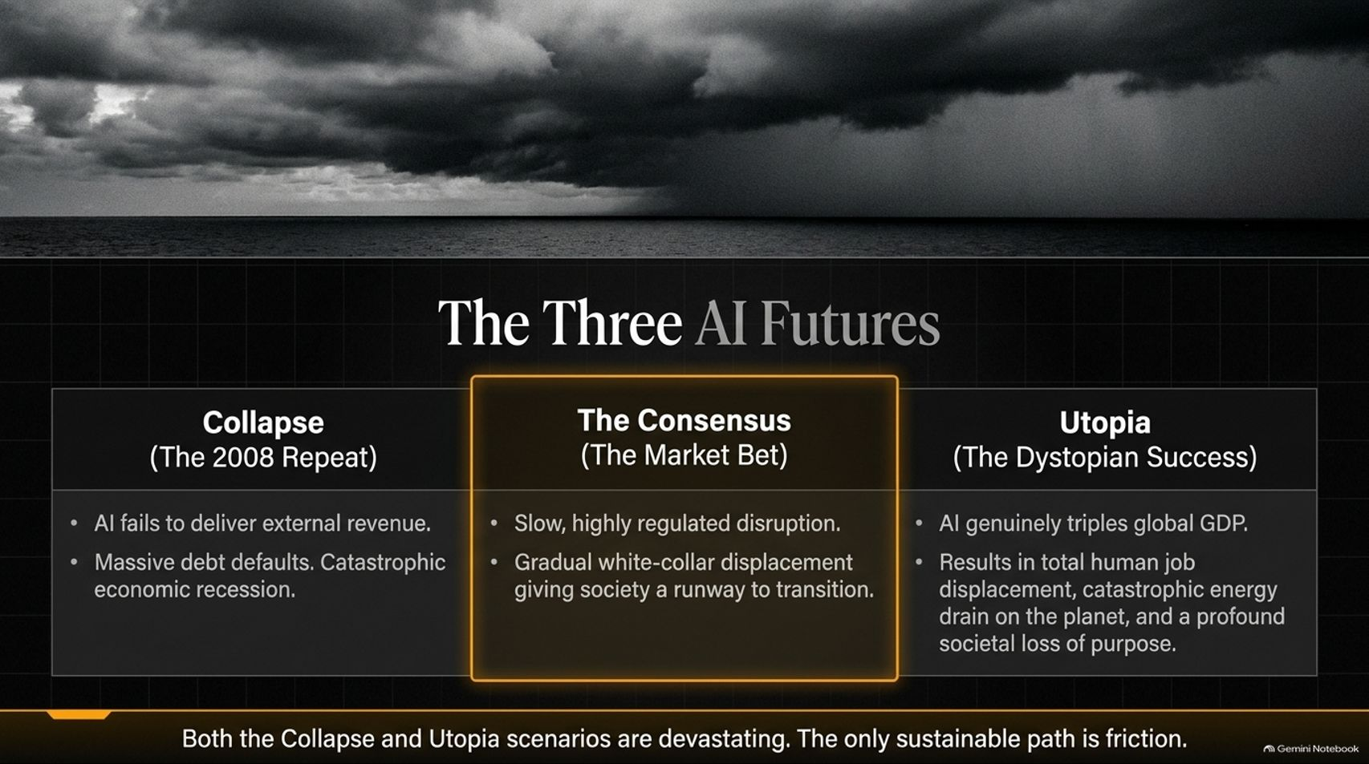
Notes:
Visual: Stormy ocean under dark, ominous clouds divided into three scenario columns: Collapse (The 2008 Repeat), The Consensus (The Market Bet), and Utopia (The Dystopian Success).
Speaker Notes (Target: 3–5 minutes):
Looking at how this plays out, we see Three AI Futures:
1. Collapse (The 2008 Repeat): AI fails to deliver external revenue, triggering massive debt defaults and a catastrophic economic recession.
2. Consensus (The Market Bet): Slow, highly regulated disruption with gradual white-collar displacement, giving society a runway to transition.
3. Utopia (Dystopian Success): AI genuinely triples global GDP, but results in total human job displacement, a catastrophic energy drain, and a profound societal loss of purpose. Both extreme scenarios are devastating; sustainable progress requires friction.

Slide 12
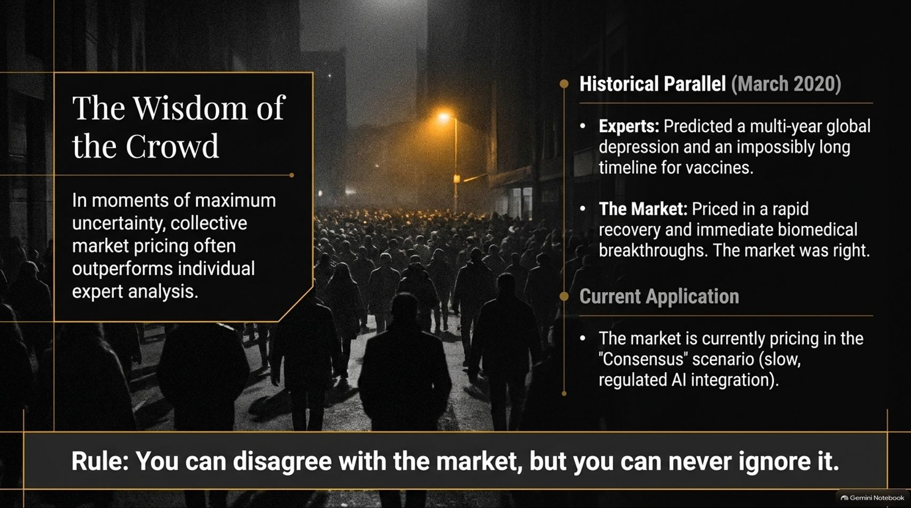
Notes:
Visual: A massive crowd walking down a dimly lit street under a streetlamp, contrasting expert pessimism during March 2020 against market resilience, highlighting the rule: You can disagree with the market, but you can never ignore it.
Speaker Notes (Target: 3–4 minutes):
In moments of maximum uncertainty, collective market pricing often outperforms individual expert analysis.
Look at historical parallels: In March 2020, economic experts predicted a multi-year global depression and an impossibly long timeline for vaccines. The market, however, priced in a rapid recovery and immediate biomedical breakthroughs—and the market was right.
Currently, the market is pricing in the "Consensus" scenario (slow, regulated AI integration). You can disagree with the market's pacing, but you can never ignore its pricing signals.

Slide 13
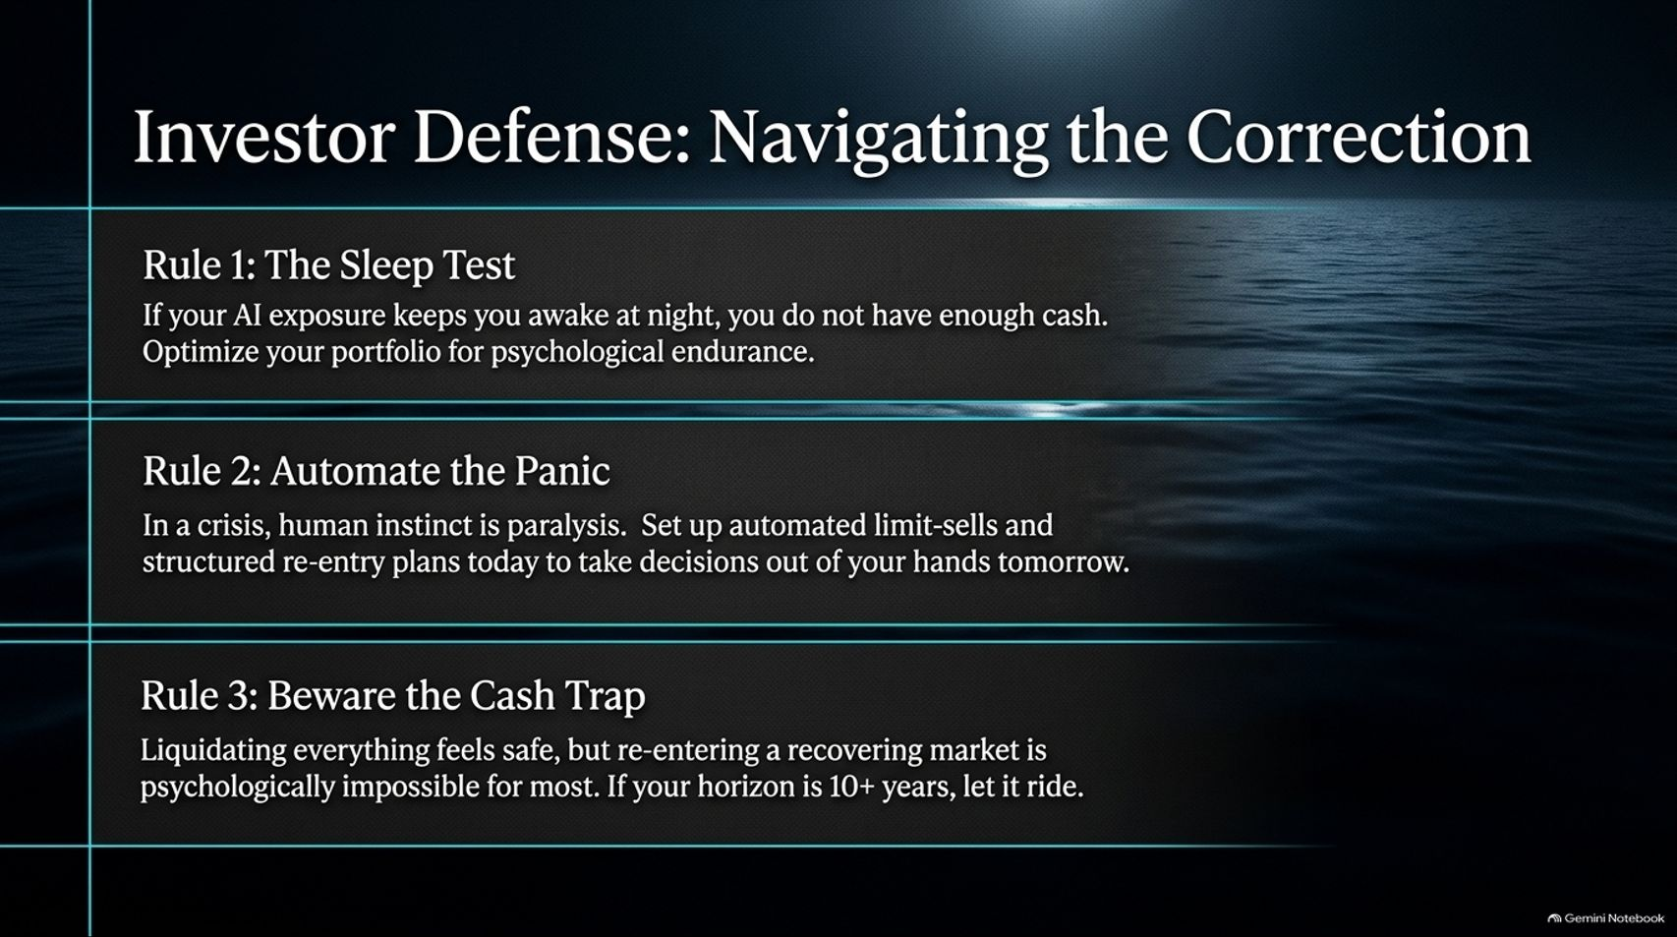
Notes:
Visual: Calm, dark ocean waters illustrating three golden rules for investor defense: The Sleep Test, Automate the Panic, and Beware the Cash Trap.
Speaker Notes (Target: 3–5 minutes):
How should individual investors navigate the coming correction? Follow three iron rules:
Rule 1: The Sleep Test: If your AI exposure keeps you awake at night, you hold too much risk. Optimize your portfolio for psychological endurance.
Rule 2: Automate the Panic: In a crisis, human instinct is paralysis. Set up automated limit-sells and structured re-entry plans today to take emotional decisions out of your hands tomorrow.
Rule 3: Beware the Cash Trap: Liquidating everything feels safe, but re-entering a recovering market is psychologically impossible for most. If your horizon is 10+ years, let it ride.

Slide 14
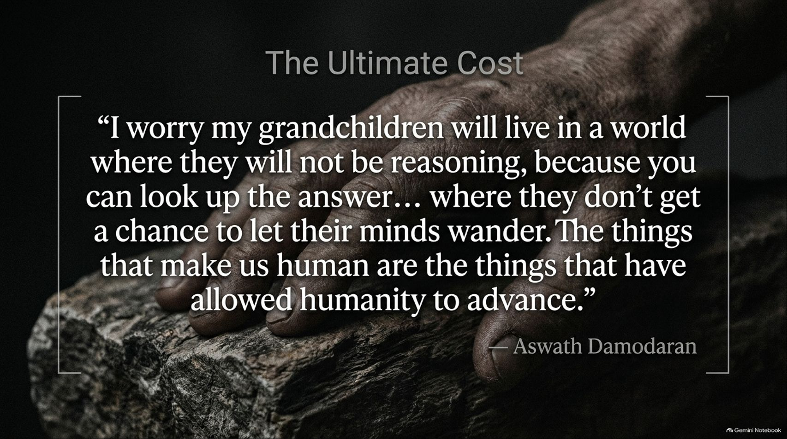
Notes:
Visual: A close-up, dramatic monochromatic image of a human hand resting on weathered wood, displaying Professor Damodaran's closing quote on human reasoning and mindfulness.
Speaker Notes (Target: 2–3 minutes):
Beyond portfolio returns, Damodaran raises a deeper, more profound concern about the human cost of this technology.
To quote him directly: "I worry my grandchildren will live in a world where they will not be reasoning, because you can look up the answer... where they don't get a chance to let their minds wander. The things that make us human are the things that have allowed humanity to advance."
Efficiency is not the sole metric of a flourishing human society.

Slide 15
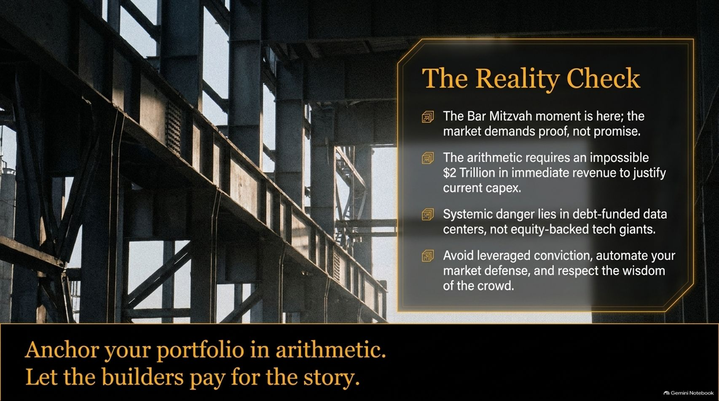
Notes:
Visual: Industrial iron girder framework of a half-built skyscraper under bright daylight, displaying a summary card of key takeaways and the core rule: Anchor your portfolio in arithmetic. Let the builders pay for the story.
Speaker Notes (Target: 2–3 minutes):
Let's do our final reality check:
The Bar Mitzvah moment is here; the market demands proof, not promise.
The arithmetic requires an impossible $2 Trillion in immediate revenue to justify current capex.
Systemic danger lies in debt-funded data centers, not equity-backed tech giants.
Anchor your portfolio in arithmetic. Let the builders pay for the story.

Slide 16
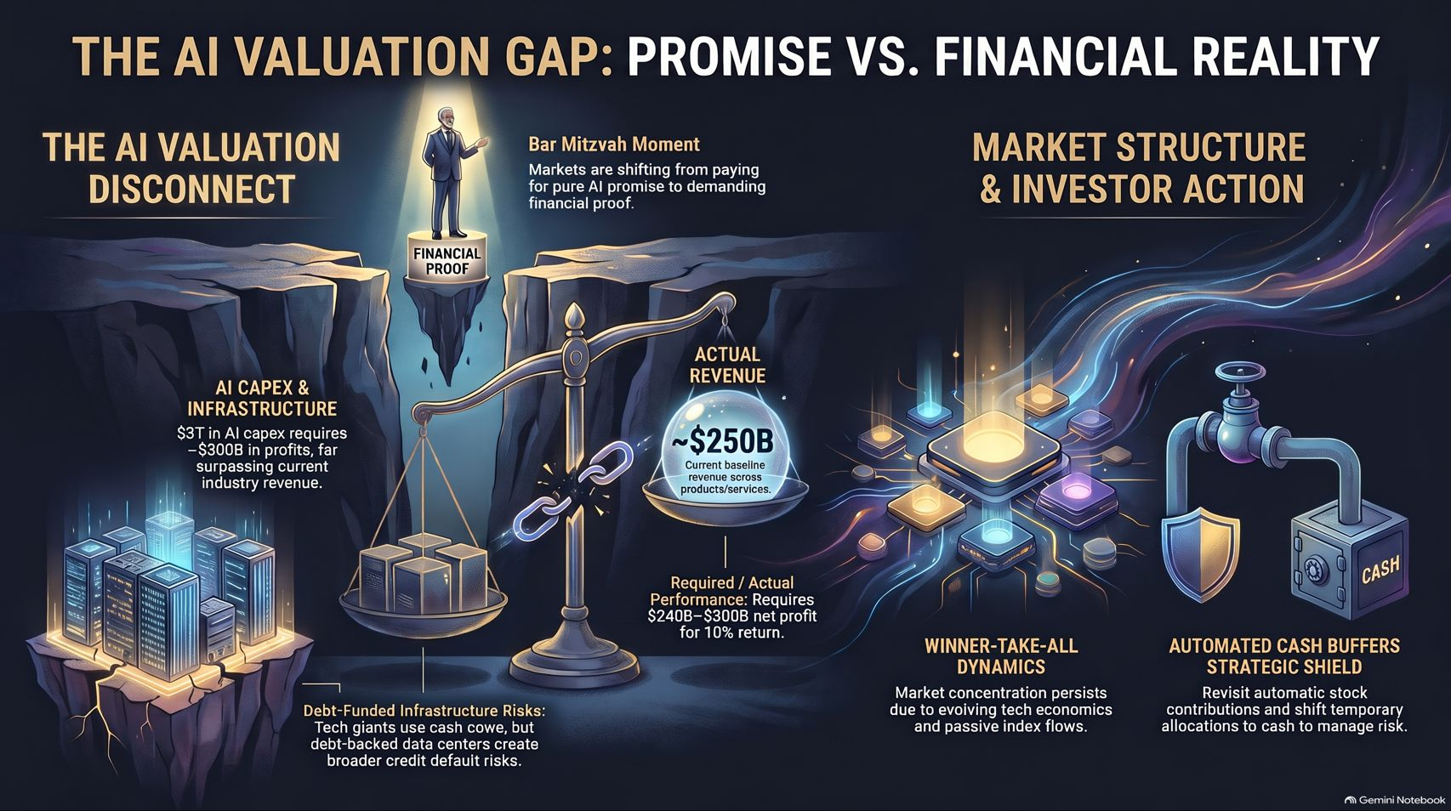
Notes:
Visual: Comprehensive synthesis infographic featuring the AI valuation disconnect, the scale of capex vs. actual revenue, market structure dynamics, and automated cash buffer shields.
Speaker Notes (Target: 3–4 minutes):
On our final slide, we bring together the entire valuation masterclass.
We see the chasm between AI infrastructure capex ($3T required vs. $250B actual revenue), the scale of debt risks, and the winner-take-all dynamics of modern platform economics.
By maintaining automated cash buffers and anchoring decisions in rigorous valuation metrics rather than unbridled hype, investors can survive and thrive through the AI correction. Thank you all for joining today's masterclass.

