Slide 1

Notes:
Slide Title: Building Beyond the Frontier
Core Theme: A strategic playbook for software architecture, rapid iteration, and capturing vertical markets in the AI era. Based on the insights of HubSpot CTO Dharmesh Shah.
Speaker Notes (Estimated Delivery Time: 2–3 Minutes):
"Welcome, everyone. Today we are exploring a strategic playbook for building software beyond the frontier in the AI era. As we look at the current market, there is a lot of noise about what artificial intelligence means for software companies. But instead of falling into the trap of nihilism or believing that SaaS is dead, we are going to examine how builders, founders, and incumbent leaders can navigate this landscape.
This framework is heavily inspired by the insights of Dharmesh Shah, co-founder and CTO of HubSpot, who has spent over 30 years building commercial software. Throughout this presentation, we will break down why the traditional paths are crowded, how higher abstractions shorten learning loops, and why the rise of the hyper-vertical, one-person enterprise represents the single greatest opportunity of our lifetime."
Where Startups Can Win Beyond OpenAI and Anthropic | HubSpot’s Dharmesh Shah
https://www.youtube.com/watch?v=s4lXP9IuHjk

Slide 2
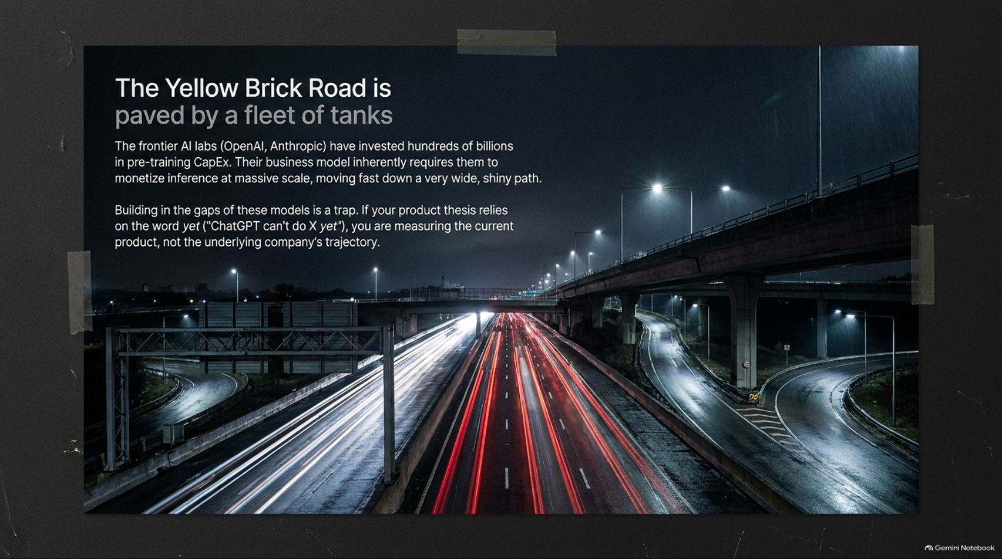
Notes:
Slide Title: The Yellow Brick Road is paved by a fleet of tanks
Core Theme: Frontier AI labs investing heavily in pre-training CapEx and chasing massive inference scale. Building directly in their immediate path is a dangerous trap if your thesis relies on "yet."
Speaker Notes (Estimated Delivery Time: 3–4 Minutes):
"Let's start with a foundational premise: The Yellow Brick Road is paved by a fleet of tanks.
Look at what the frontier AI labs like OpenAI and Anthropic are doing. They have invested hundreds of billions of dollars into pre-training capital expenditure. Their business model inherently requires them to monetize inference at massive scale, moving down a very wide, shiny, highly-praised path toward the Emerald City.
But here is where founders often make a critical mistake. If your product thesis relies on the word 'yet'—such as saying 'ChatGPT can't do X yet'—you are making a fatal error. You are measuring the current product features instead of looking at the underlying trajectory of the company. If an AI lab's ambition points toward your feature set, they will barrel right through you. Therefore, building directly in the gaps of these models without a defensible moat is a trap. You have to step off the highway."

Slide 3
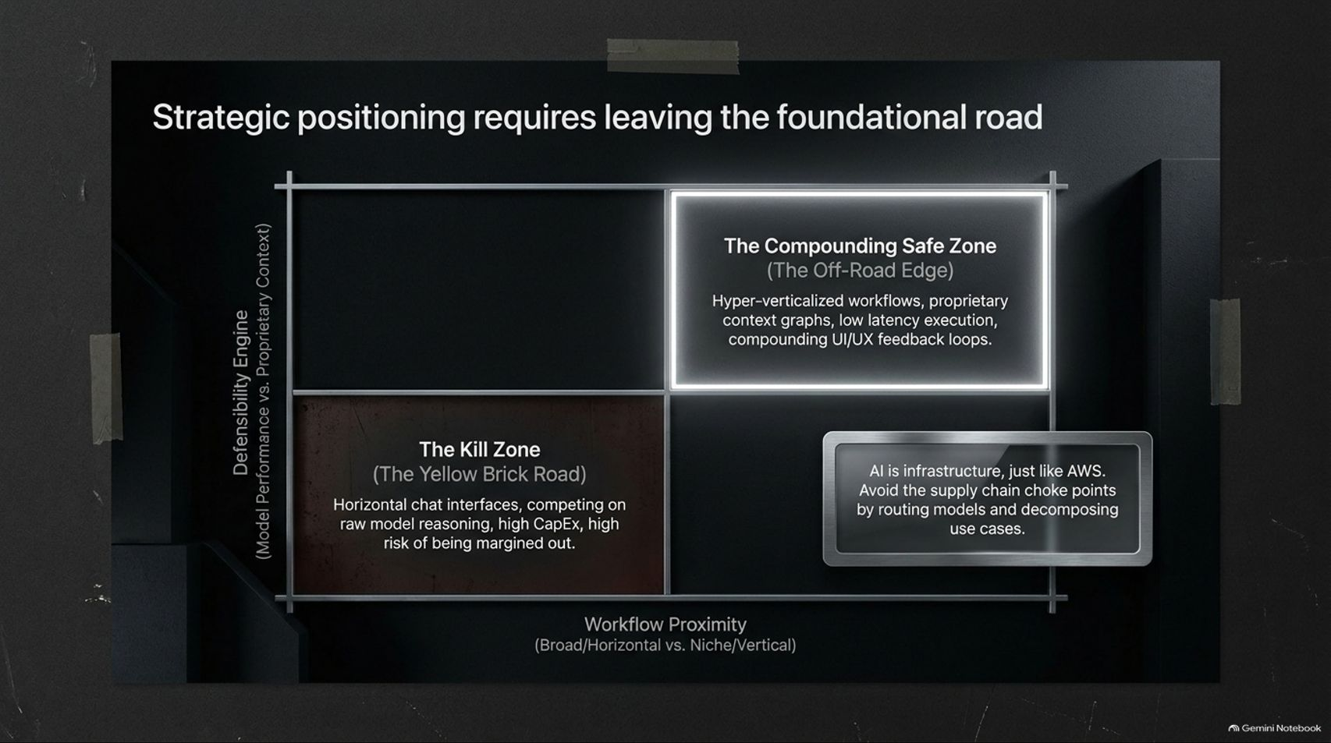
Notes:
Slide Title: Strategic positioning requires leaving the foundational road
Core Theme: Navigating the matrix between Defensibility Engine and Workflow Proximity. Avoiding the Kill Zone and moving into the Compounding Safe Zone.
Speaker Notes (Estimated Delivery Time: 3–5 Minutes):
"Strategic positioning requires leaving the foundational road entirely. If we map this out on a strategic matrix where the vertical axis represents our Defensibility Engine (model performance versus proprietary context) and the horizontal axis represents Workflow Proximity (broad/horizontal vs. niche/vertical), we can clearly identify where companies survive and where they perish.
Down in the bottom-left quadrant lies The Kill Zone—the Yellow Brick Road. This is where companies build horizontal chat interfaces, competing directly on raw model reasoning with massive CapEx requirements and a high risk of being margined out.
To survive and compound, you must move to the top-right: The Compounding Safe Zone (The Off-Road Edge). Here, you focus on hyper-verticalized workflows, proprietary context graphs, low-latency execution, and compounding UI/UX feedback loops. AI is infrastructure, just like AWS was fifteen years ago. Avoid the supply chain choke points by routing models, decomposing use cases, and owning the domain workflow."

Slide 4
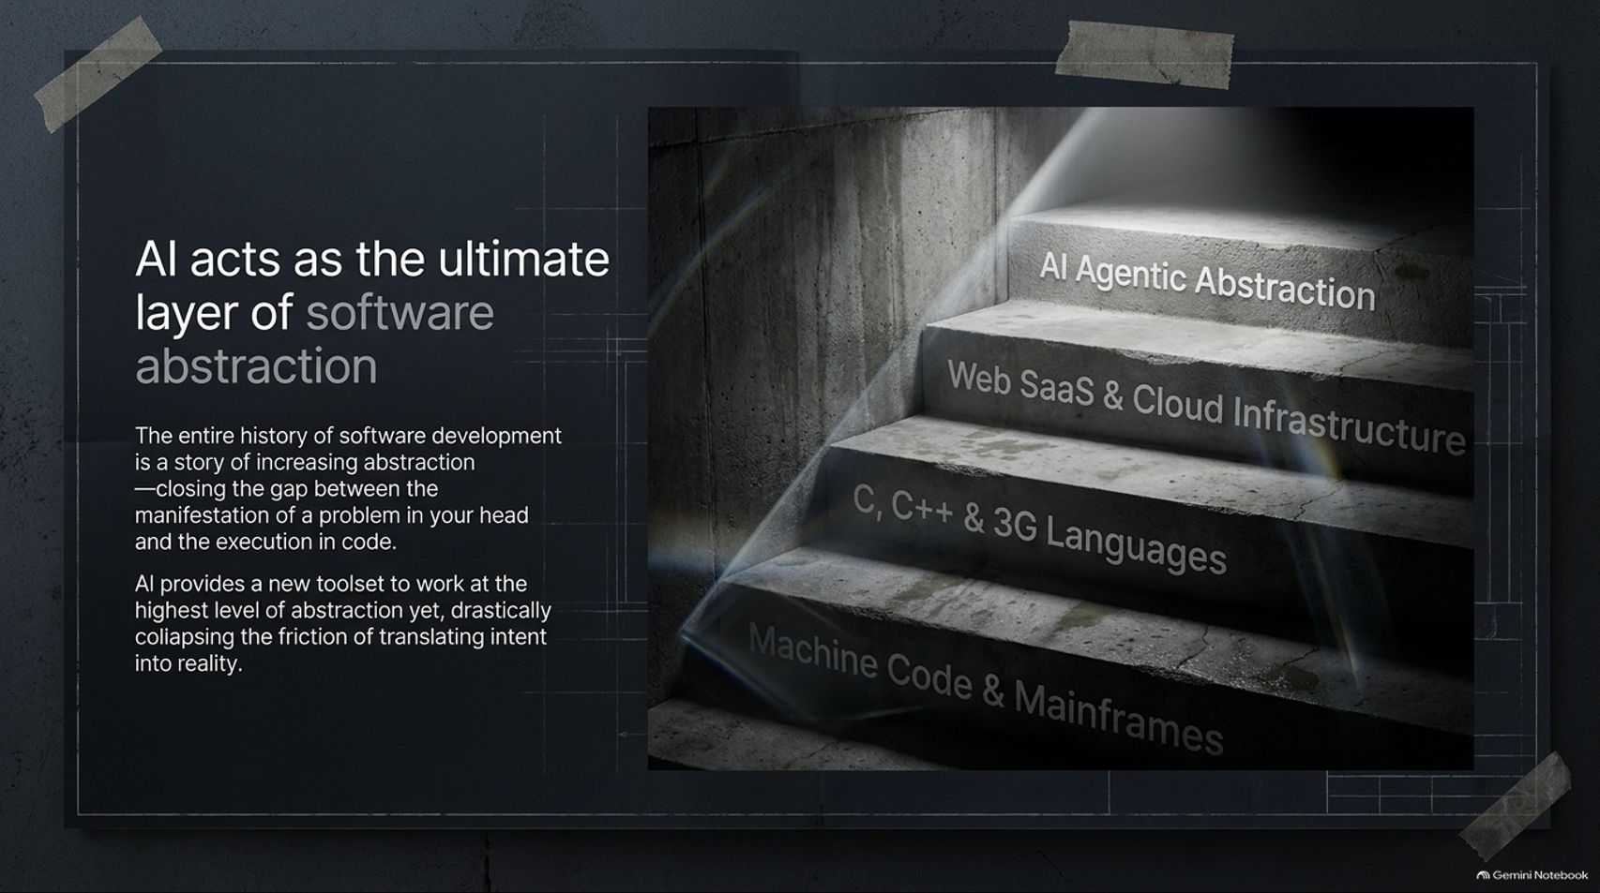
Notes:
Slide Title: AI acts as the ultimate layer of software abstraction
Core Theme: The history of software is a story of increasing abstraction. AI collapses the friction of translating intent into reality.
Speaker Notes (Estimated Delivery Time: 3–4 Minutes):
"If we zoom out and look at software development through a historical lens, the entire story of software is a story of increasing abstraction. It is about closing the gap between the manifestation of a problem in your head and the execution of code.
When Dharmesh Shah started building software, developers worked with machine code and mainframes. Then we climbed the ladder: through C and C++, 3GLs, and 4GLs, up into web SaaS and cloud infrastructure. Today, AI Agentic Abstraction sits at the absolute pinnacle of that staircase.
AI provides a brand-new toolset to work at the highest level of abstraction yet achieved. It drastically collapses the friction of translating human intent into working reality, expanding the scope of who can be a builder and allowing technical creators to operate at unprecedented velocity."

Slide 5
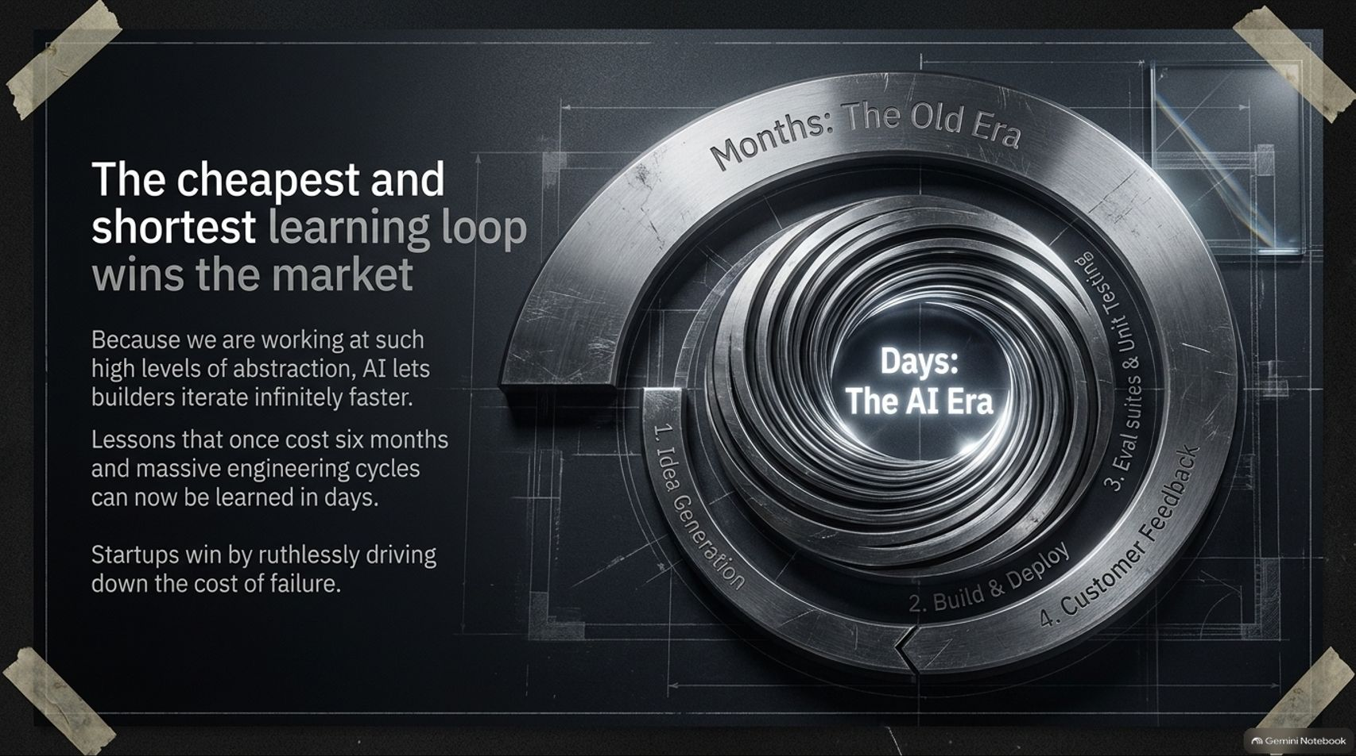
Notes:
Slide Title: The cheapest and shortest learning loop wins the market
Core Theme: Operating at high levels of abstraction lets builders iterate infinitely faster. Turning months of engineering cycles into days of learning.
Speaker Notes (Estimated Delivery Time: 3–5 Minutes):
"In the AI era, the cheapest and shortest learning loop wins the market. Because we are working at such high levels of abstraction, AI lets builders iterate infinitely faster.
Lessons that once cost six months of engineering cycles, complex architectural diagrams, and massive resource allocation can now be learned in days. The old era was measured in months of slow idea generation, monolithic builds, and heavy testing suites. The AI era compresses that entire spiral—idea generation, deployment, eval suites, and customer feedback—into rapid, continuous cycles.
Startups and agile teams win by ruthlessly driving down the cost of failure. If you can test an idea cheaply and get it in front of real users immediately, you eliminate wasted capital and find product-market fit before anyone else."

Slide 6
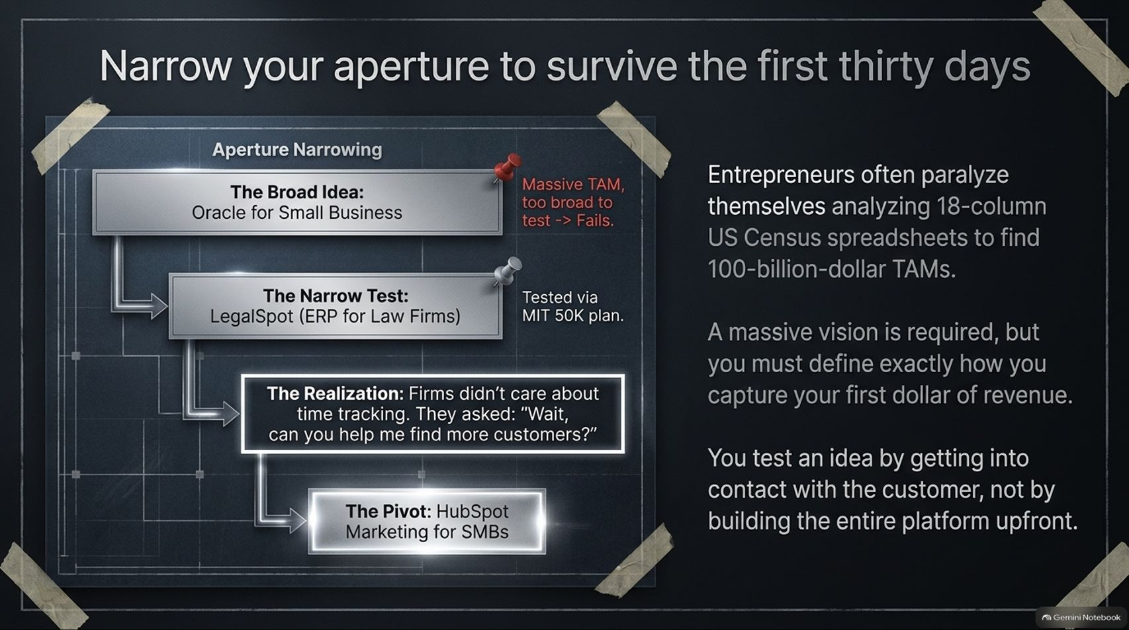
Notes:
Slide Title: Narrow your aperture to survive the first thirty days
Core Theme: Avoid paralyzing yourself with 18-column US Census spreadsheets. Define exactly how you capture your first dollar of revenue.
Speaker Notes (Estimated Delivery Time: 4–5 Minutes):
"Entrepreneurs often paralyze themselves in the early days by analyzing 18-column US Census spreadsheets, trying to prove a 100-billion-dollar Total Addressable Market (TAM). While a massive vision is mandatory, you must narrow your aperture to survive the first thirty days.
Look at HubSpot’s own origin story: they started with a broad idea—an Oracle for Small Business. Recognizing that was too broad, they narrowed the test to LegalSpot (an ERP for law firms) and entered the MIT 50K competition. But when they got into contact with real customers, they discovered a vital truth: law firms didn't care about time tracking. They asked, 'Wait, can you help us find more customers?'
That realization led directly to the pivot into marketing software for small and medium businesses. You test an idea by getting into contact with the customer and capturing your first dollar of revenue, not by building an entire enterprise platform upfront."

Slide 7
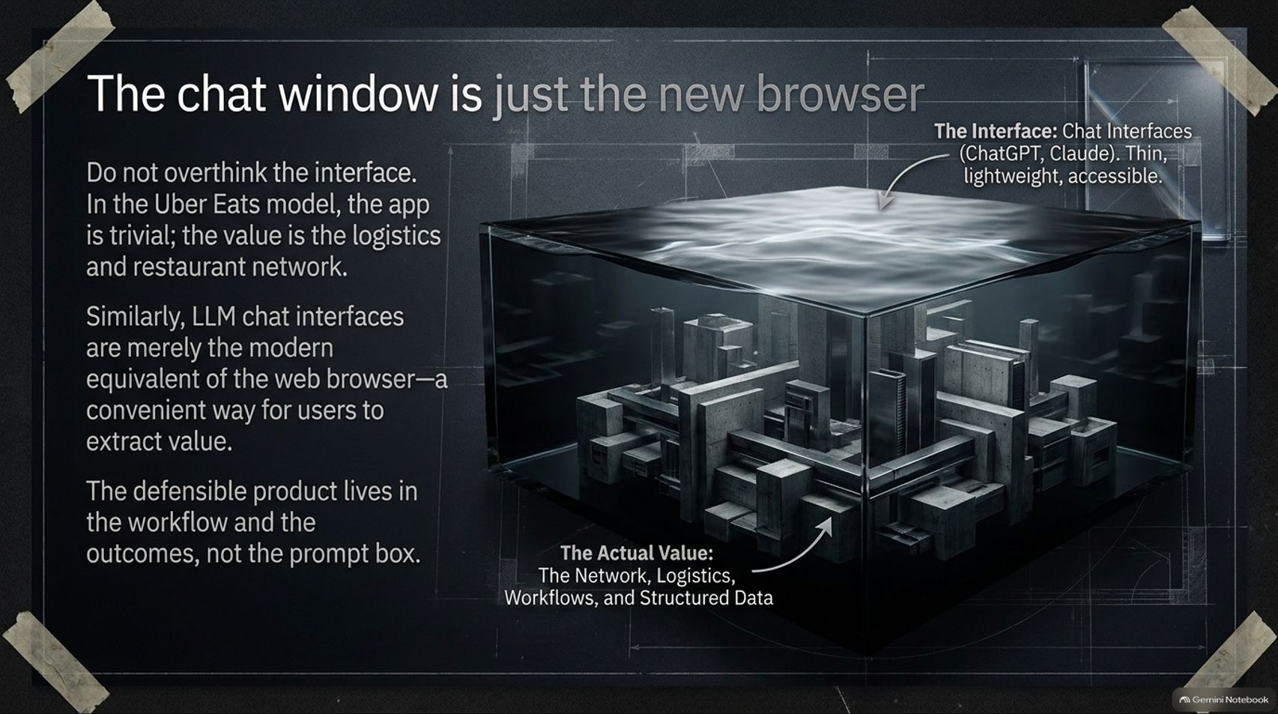
Notes:
Slide Title: The chat window is just the new browser
Core Theme: Do not overthink the interface. LLM chat interfaces are merely modern web browsers; defensible value lives in workflows and structured data.
Speaker Notes (Estimated Delivery Time: 4–6 Minutes):
"One of the most profound realizations in modern software architecture is that the chat window is just the new browser.
Do not overthink the interface. Look at the Uber Eats model: the consumer-facing app is trivial; the real value is the logistics, restaurant network, and driver fleet underlying it. Similarly, LLM chat interfaces like ChatGPT or Claude are merely the modern equivalent of Netscape or Internet Explorer—they are convenient, lightweight access points for users to extract value.
The defensible product does not live in the prompt box; it lives deep in the workflow, the structured data, the network connections, and the domain-specific business logic. The browser didn't capture all software value in the web era, and chat windows won't capture all value in the AI era."

Slide 8
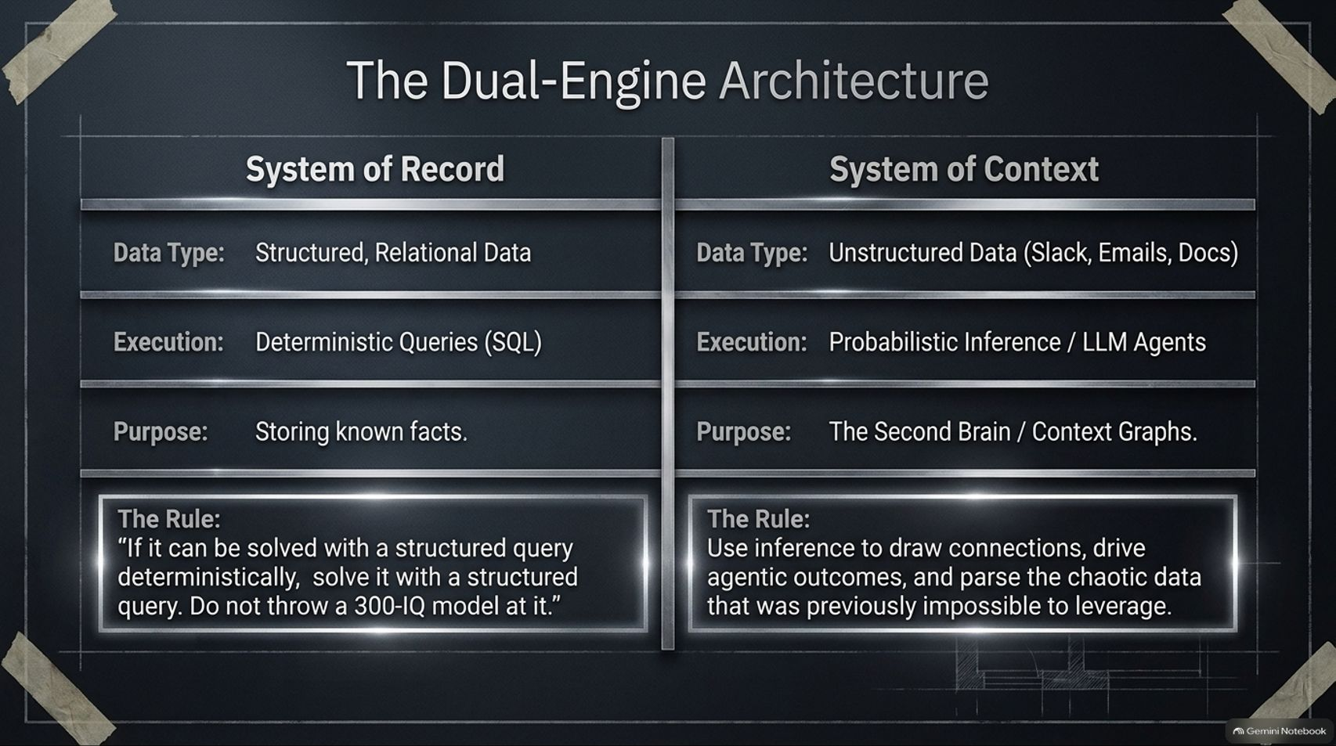
Notes:
Slide Title: The Dual-Engine Architecture
Core Theme: Balancing Systems of Record (structured SQL data) with Systems of Context (probabilistic LLM agents and context graphs).
Speaker Notes (Estimated Delivery Time: 4–5 Minutes):
"To build modern AI-native applications, you need a Dual-Engine Architecture that bridges structured certainty with unstructured intelligence.
On the left side is your System of Record: structured, relational data executed via deterministic queries (SQL), dedicated to storing known facts. On the right side is your System of Context: unstructured data streams from Slack, emails, and documents parsed via probabilistic inference and LLM agents acting as a 'second brain'.
Here is the golden rule of this architecture: If a problem can be solved with a structured query deterministically, solve it with a structured query. Do not throw a 300-IQ model at it. Use inference to draw connections and parse chaotic data, but keep your core facts grounded in deterministic databases."

Slide 9
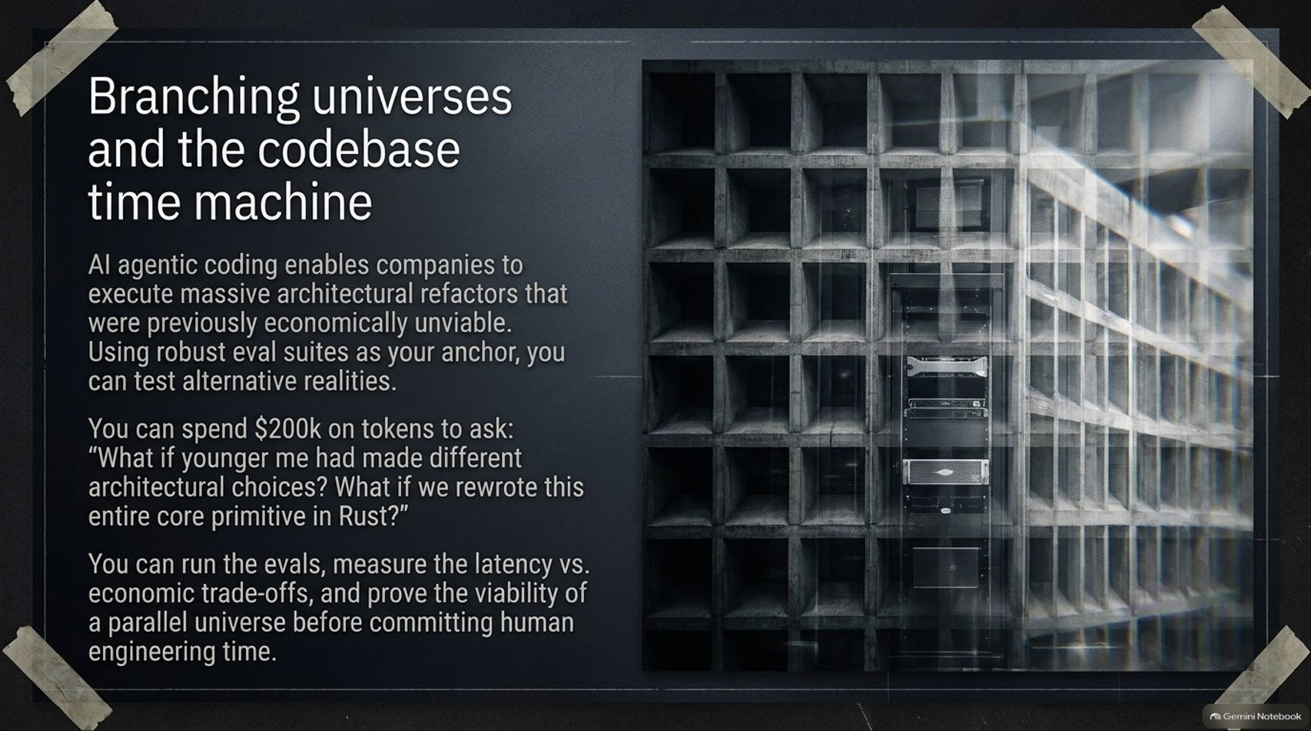
Notes:
Slide Title: Branching universes and the codebase time machine
Core Theme: AI agentic coding enables massive architectural refactors, running evals on alternative realities before committing human engineering time.
Speaker Notes (Estimated Delivery Time: 3–5 Minutes):
"AI agentic coding has unlocked something previously unimaginable: branching universes and a codebase time machine.
Historically, major architectural refactors were economically unviable. Today, using robust evaluation suites as your anchor, you can test alternative realities. Imagine spending $200,000 on tokens to ask: 'What if younger me had made different architectural choices? What if we rewrote this entire core primitive in Rust?'
You can run the evals, measure the latency versus economic trade-offs, and prove the viability of a parallel universe before committing a single hour of human engineering time. Incumbents and agile startups alike can simulate massive codebase evolutions instantly."

Slide 10
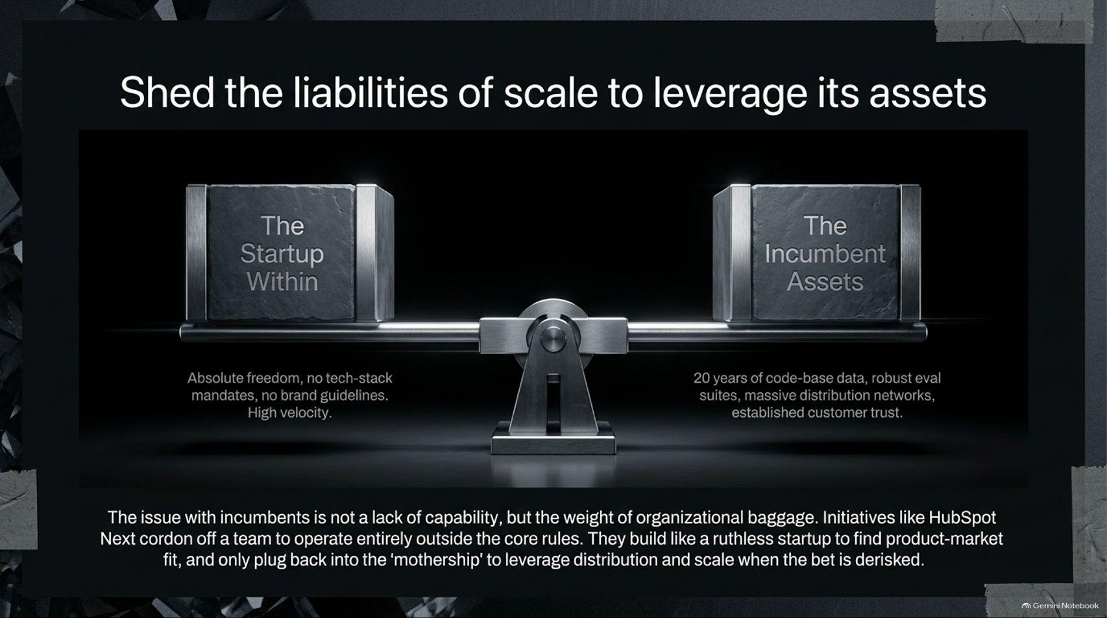
Notes:
Slide Title: Shed the liabilities of scale to leverage its assets
Core Theme: Overcoming organizational baggage by running internal startup labs (like HubSpot Next) that operate outside core rules before plugging back into the mothership.
Speaker Notes (Estimated Delivery Time: 3–4 Minutes):
"The primary issue with established software incumbents is not a lack of technical capability, but rather the heavy weight of organizational baggage.
To solve this, companies must shed the liabilities of scale while leveraging its assets. Initiatives like HubSpot Next cordon off an elite team to operate entirely outside corporate tech-stack mandates and brand guidelines. They build like ruthless startups to find product-market fit with absolute freedom.
Once the bet is fully derisked, they plug back into the mothership to leverage massive distribution networks, robust evaluation suites, and established customer trust. You get the speed of a startup combined with the unfair distribution advantages of an incumbent."

Slide 11
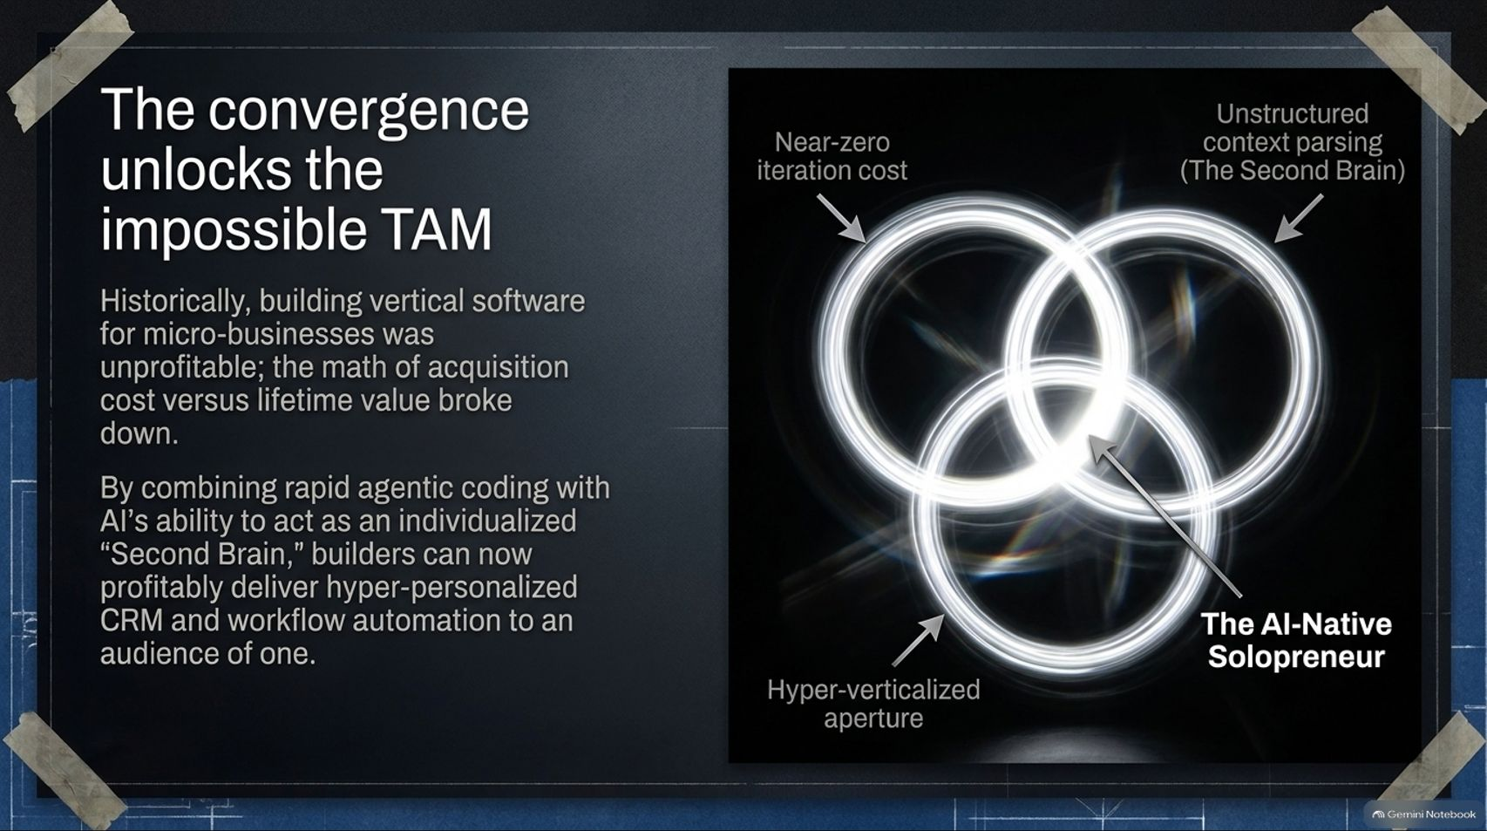
Notes:
Slide Title: The convergence unlocks the impossible TAM
Core Theme: Combining near-zero iteration cost, unstructured context parsing, and hyper-verticalized apertures to deliver personalized software to an audience of one.
Speaker Notes (Estimated Delivery Time: 3–5 Minutes):
"Historically, building vertical software for micro-businesses was economically unprofitable because the math of customer acquisition cost versus lifetime value simply broke down.
However, the convergence of three forces unlocks the Impossible TAM:
Near-zero iteration cost driven by AI coding agents.
Unstructured context parsing acting as an individualized 'Second Brain'.
Hyper-verticalized apertures targeting micro-niches.
By combining these elements, AI-native solopreneurs and modern builders can profitably deliver hyper-personalized CRM and workflow automation to an audience of one."

Slide 12
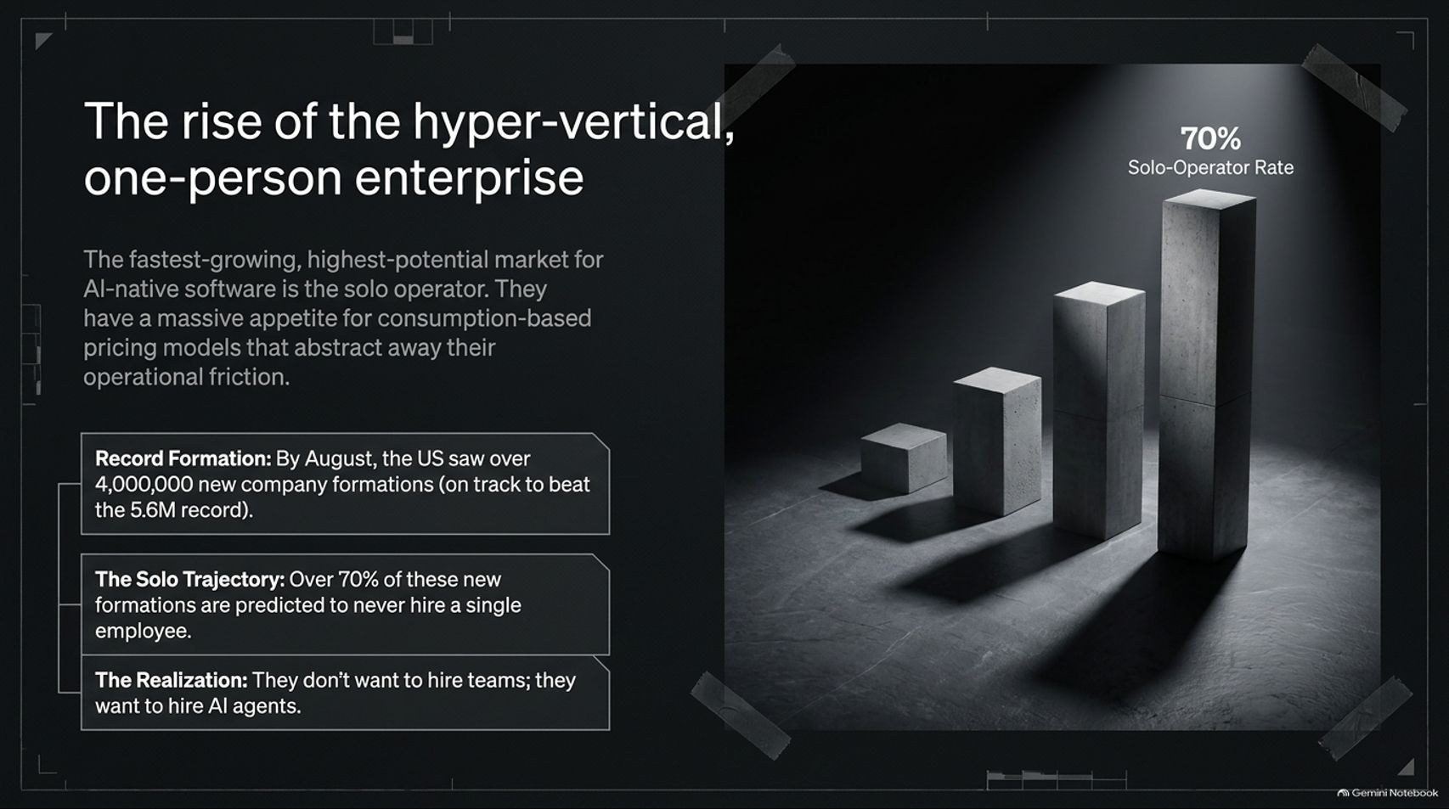
Notes:
Slide Title: The rise of the hyper-vertical, one-person enterprise
Core Theme: Over 70% of new business formations are solo operators who do not want to hire human teams—they want to hire AI agents.
Speaker Notes (Estimated Delivery Time: 3–5 Minutes):
"The fastest-growing, highest-potential market for AI-native software is no longer the Fortune 500—it is the solo operator. They have a massive appetite for consumption-based pricing models that abstract away operational friction.
Look at the macroeconomic data: new business formations in the United States have shattered records, with millions of new companies registered annually. More importantly, over 70% of these new formations are predicted to never hire a single human employee.
Why? Because founders don't want to manage human teams anymore; they want to hire and orchestrate fleets of AI agents. This represents a massive, untapped market requiring lightweight, consumption-priced software solutions."

Slide 13
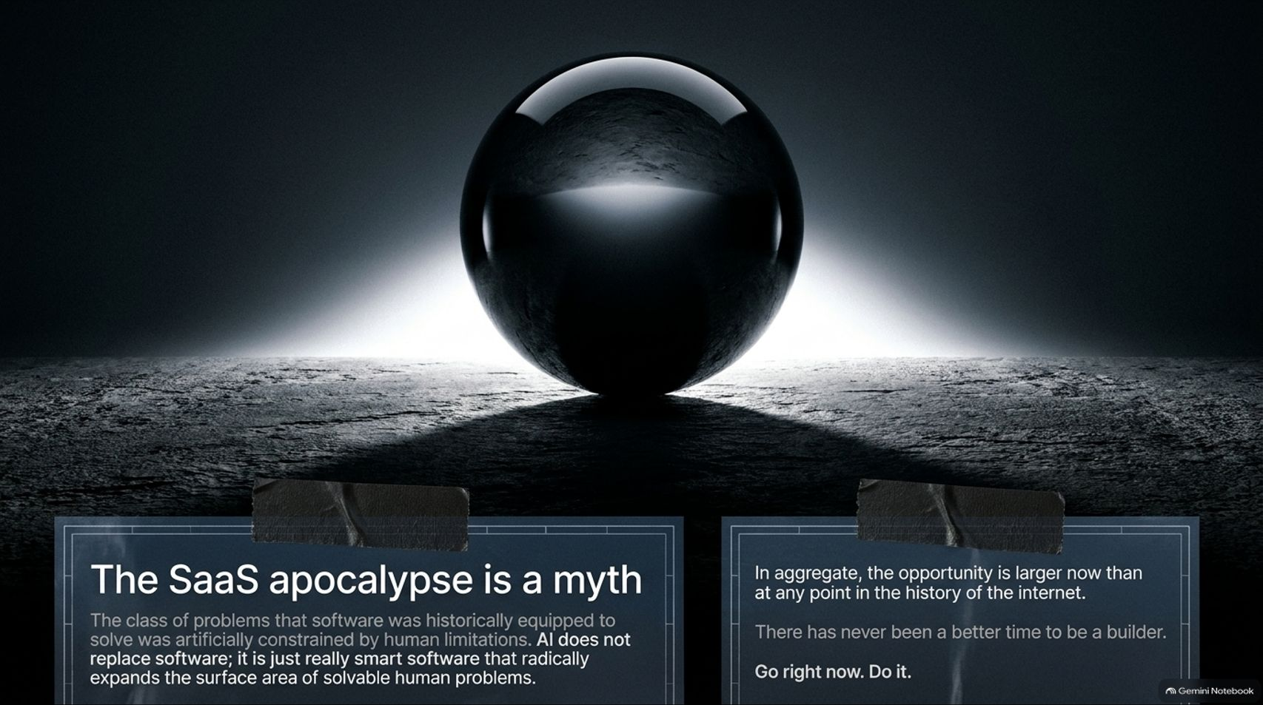
Notes:
Slide Title: The SaaS apocalypse is a myth
Core Theme: AI does not replace software; it is smart software that expands the surface area of solvable human problems. The aggregate opportunity is larger than ever.
Speaker Notes (Estimated Delivery Time: 3–5 Minutes):
"Let's put to rest the widespread narrative that we are living through a 'SaaS apocalypse.' The SaaS apocalypse is a complete myth.
The class of problems that software was historically equipped to solve was artificially constrained by human limitations. AI does not replace software; it is simply really smart software that radically expands the surface area of solvable human problems.
Just as the internet created entirely new software categories on the P&L that didn't exist before, AI opens up a vast new frontier of workflows. In aggregate, the market opportunity is larger today than at any point in the history of the internet. There has never been a better time to be a builder. Go right now. Do it."

Slide 14
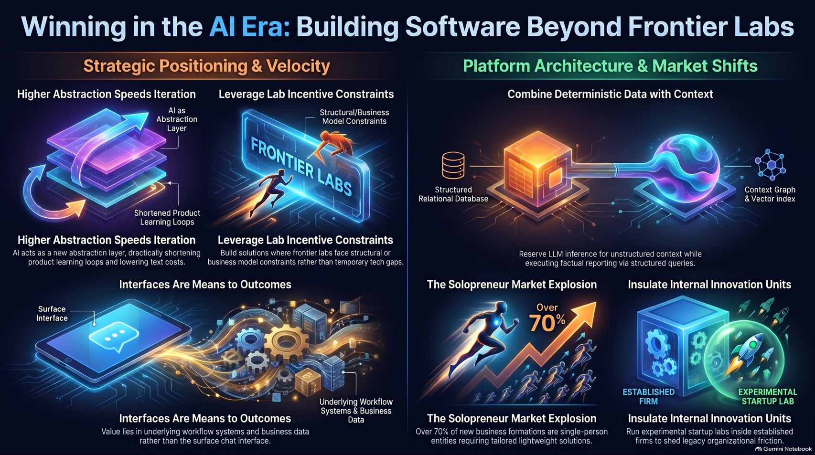
Notes:
Slide Title: Winning in the AI Era: Building Software Beyond Frontier Labs
Core Theme: Comprehensive summary uniting strategic positioning, dual-engine architectures, hyper-vertical solopreneurs, and agile internal innovation units.
Speaker Notes (Estimated Delivery Time: 3–5 Minutes):
"As we conclude our playbook, let's review the core pillars of Winning in the AI Era:
Strategic Positioning & Velocity: Leverage higher abstraction speeds to shorten product learning loops, build outside the structural constraints of frontier labs, and treat chat interfaces merely as access means to underlying workflow value.
Platform Architecture & Market Shifts: Combine deterministic relational databases with context graphs, capitalize on the explosion of 70%+ solopreneur enterprises, and insulate internal startup incubation units to shed organizational friction.
The tools are ready, the abstraction layers are built, and the market demand is limitless. Thank you, and let's go build beyond the frontier."

