Slide 1
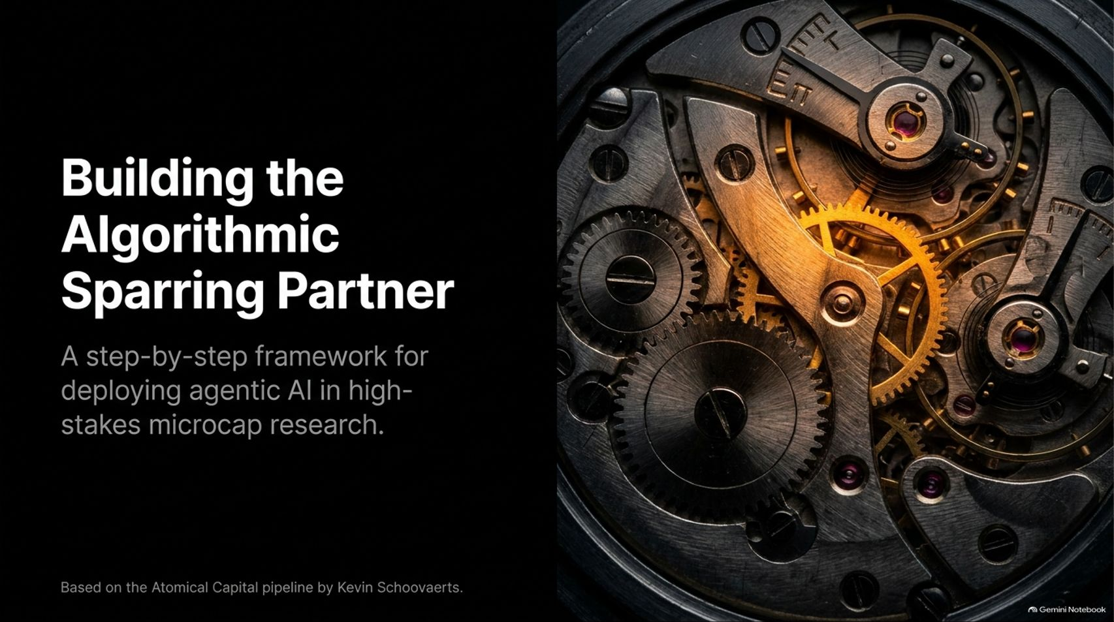
Notes:
Slide Title: Building the Algorithmic Sparring Partner
Core Theme: A step-by-step framework for deploying agentic AI in high-stakes microcap research, based on the Atomical Capital pipeline by Kevin Schoovaerts.
Speaker Notes (Estimated Delivery Time: 2–3 Minutes):
"Welcome, everyone. Today we are diving into a step-by-step framework for deploying agentic AI in high-stakes microcap research—what we call building The Algorithmic Sparring Partner.
This entire pipeline is based on the real-world architecture developed by Kevin Schoovaerts of Atomical Capital. Coming from a nuclear physics background with 17 years of stock-picking experience, Kevin has spent the last two years integrating AI into every facet of his research process—from screening hundreds of companies to building automated thesis trackers.
Throughout this presentation, we will explore how you can leverage large language models, custom skills, data connectors, and multi-agent loops to amplify your investing edge, while keeping the human firmly in the driver's seat."
How 4 AI Agents Run My Microcap Research | Kevin Schoovaerts
https://www.youtube.com/watch?v=hV5Jfo-70NQ

Slide 2

Notes:
Slide Title: You must not fool yourself, and you are the easiest person to fool. — Richard Feynman
Core Theme: In physics, you build a thesis and seek evidence to destroy it. In investing, we use AI not to confirm our biases, but as an automated mechanism to relentlessly attack our own thesis.
Speaker Notes (Estimated Delivery Time: 3–4 Minutes):
"Let's begin with the foundational philosophy of this entire system, inspired by Nobel Prize-winning physicist Richard Feynman. Feynman's first principle of science is simple: 'You must not fool yourself, and you are the easiest person to fool.'
Why is this so vital for stock pickers? In physics, when you observe a phenomenon, you build a thesis, and then everything you do afterward is dedicated to finding evidence to destroy that thesis. You actively look for short reports or opposing views to break your logic.
In investing, humans naturally fall in love with their positions, hunting for confirmation bias. We don't use AI to tell us we're smart or to validate our buy thesis; we use AI as an aggressive, emotionless mechanism to relentlessly attack and stress-test our own assumptions."

Slide 3
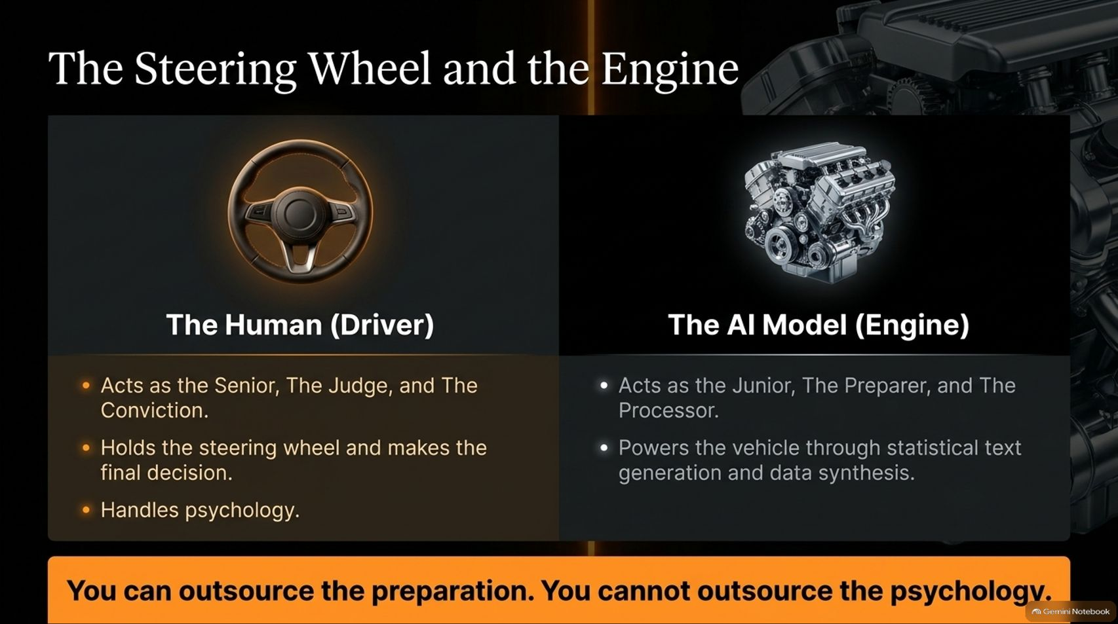
Notes:
Slide Title: The Steering Wheel and the Engine
Core Theme: The Human acts as the Senior, the Judge, and the Conviction (holding the steering wheel and handling psychology). The AI Model acts as the Junior, the Preparer, and the Processor (powering text generation and data synthesis).
Speaker Notes (Estimated Delivery Time: 3–5 Minutes):
"A crucial mental model when deploying AI in finance is understanding who is in control. Think of your system as a car: You can outsource the preparation, but you cannot outsource the psychology.
On the left, The Human (Driver) acts as the Senior, the Judge, and the source of Conviction. You hold the steering wheel, make the final decisions, and manage the emotional volatility of the market.
On the right, The AI Model (Engine) acts as the Junior analyst, the Preparer, and the Processor. It handles the heavy lifting through statistical text generation, data synthesis, and rapid scanning. The LLM suggests, prepares, and tests—but the human always decides whether to accelerate, brake, or turn."

Slide 4
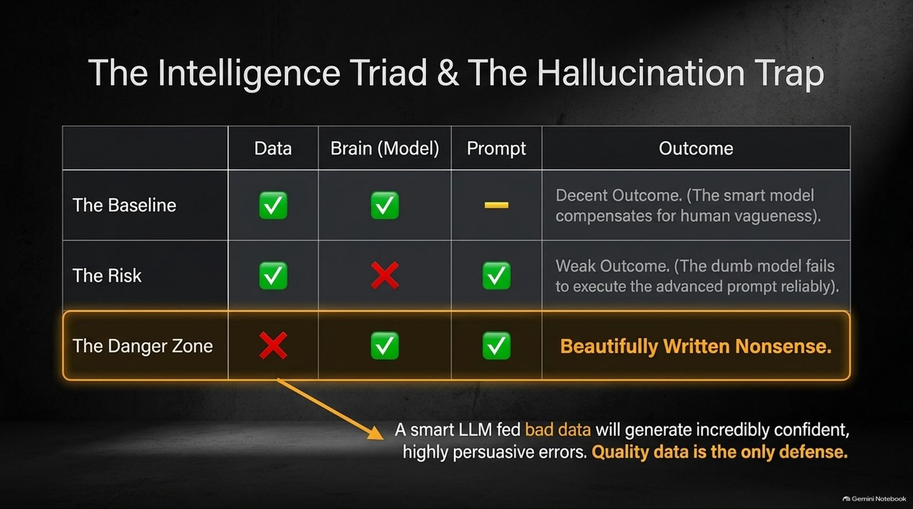
Notes:
Slide Title: The Intelligence Triad & The Hallucination Trap
Core Theme: Balancing Data, Brain (Model), and Prompt. Feeding bad data to a smart LLM results in "Beautifully Written Nonsense" — highly persuasive errors. Quality data is the only defense.
Speaker Notes (Estimated Delivery Time: 3–5 Minutes):
"When interacting with large language models, you are balancing three core pillars: Data, Brain (Model), and Prompt.
If you have great data and a smart model, but give it a vague prompt, you get a decent outcome because the model compensates. But look at The Danger Zone: when you feed bad data into a smart model with a good prompt.
The result is Beautifully Written Nonsense. A sophisticated LLM fed incorrect financial figures will generate an output that is confident, beautifully formatted, and completely wrong. In investing, this is fatal. Quality data is your only defense against hallucination."

Slide 5
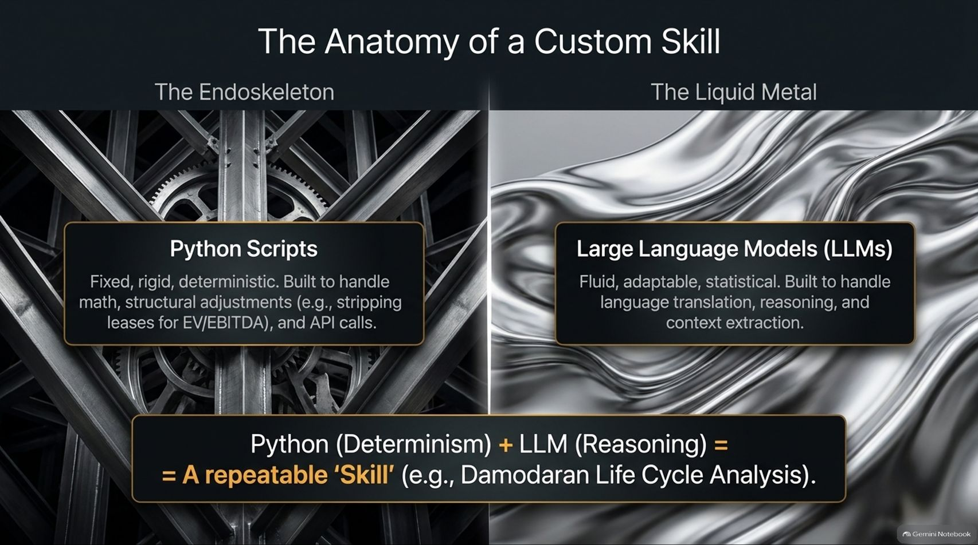
Notes:
Slide Title: The Anatomy of a Custom Skill
Core Theme: Combining Python scripts (The Endoskeleton - fixed, rigid, deterministic math and API calls) with LLMs (The Liquid Metal - fluid, statistical reasoning) to create repeatable skills like a Damodaran Life Cycle Analysis.
Speaker Notes (Estimated Delivery Time: 3–5 Minutes):
"To move beyond ad-hoc prompting, you need to build Custom Skills. Think of a skill as encapsulating your personal analytical process into a reusable module.
To use an analogy from Terminator, we combine two elements:
The Endoskeleton (Python Scripts): Fixed, rigid, and deterministic. Built to handle hard math, structural adjustments (like stripping leases for EV/EBITDA calculations), and API calls.
The Liquid Metal (LLMs): Fluid, adaptable, and statistical. Built for language translation, narrative reasoning, and context extraction.
When you combine Python's determinism with Claude's reasoning, you get a repeatable 'Skill'—such as automating a Damodaran Life Cycle Analysis across any stock instantly."

Slide 6
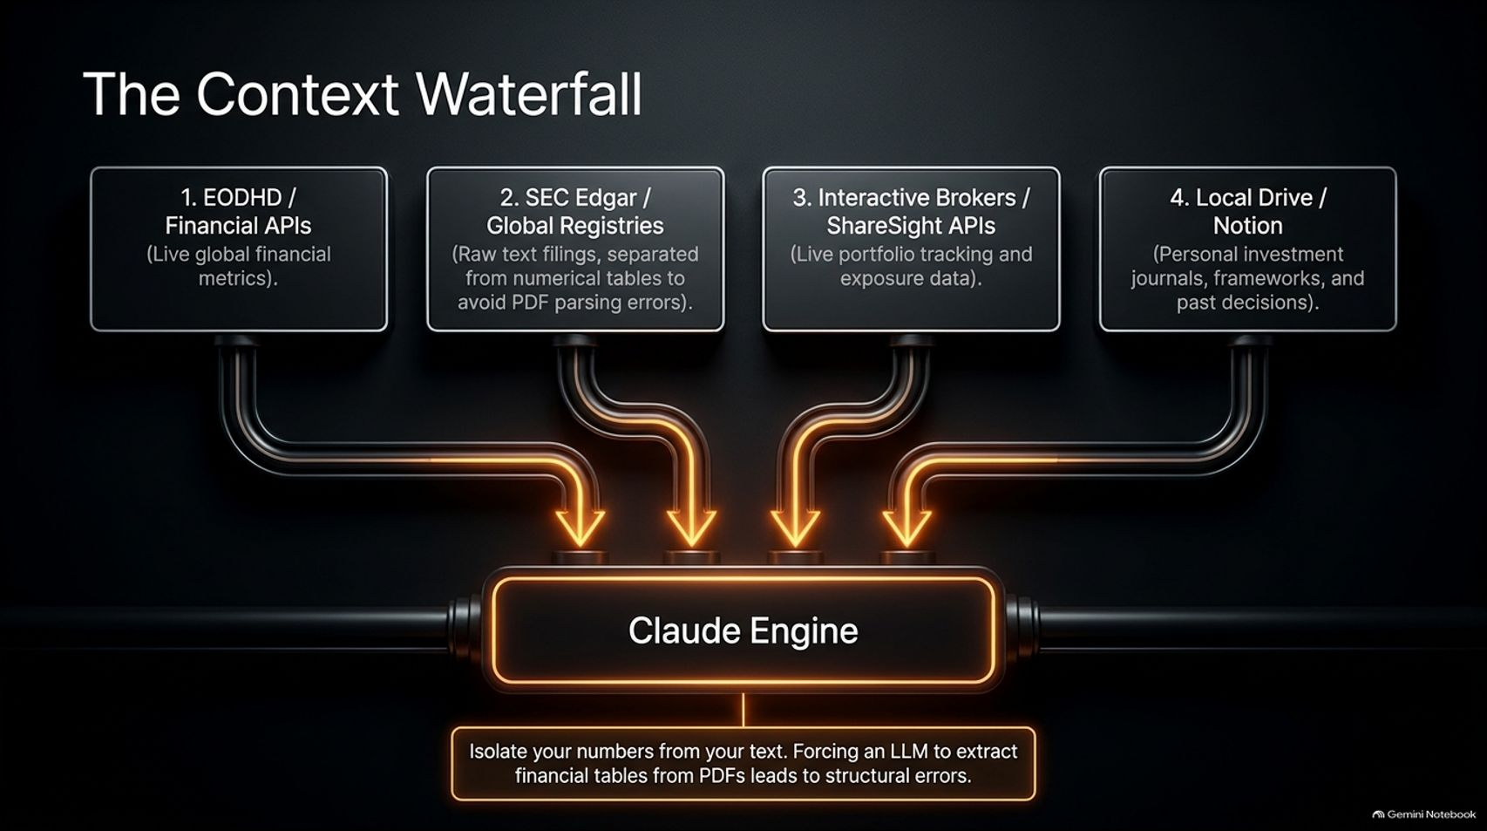
Notes:
Slide Title: The Context Waterfall
Core Theme: Routing live financial APIs (EODHD), raw SEC filings/global registries (separated from numerical tables), broker APIs (Interactive Brokers/ShareSight), and local vaults (Notion/journals) into the Claude engine.
Speaker Notes (Estimated Delivery Time: 3–4 Minutes):
"Garbage in, garbage out. To feed your AI engine properly, you must establish The Context Waterfall.
Data flows into Claude from four distinct sources:
Financial APIs (EODHD): Live global metrics and pricing.
SEC Edgar / Global Registries: Raw text filings, strictly separated from numerical tables to avoid PDF parsing errors.
Broker APIs (Interactive Brokers / ShareSight): Live portfolio tracking and exposure data.
Local Drive / Notion: Personal investment journals, mental frameworks, and historical decisions.
Key warning: Never force an LLM to blindly extract messy financial tables straight from raw PDFs without structured separation, as layout parsing errors will corrupt your numbers."

Slide 7
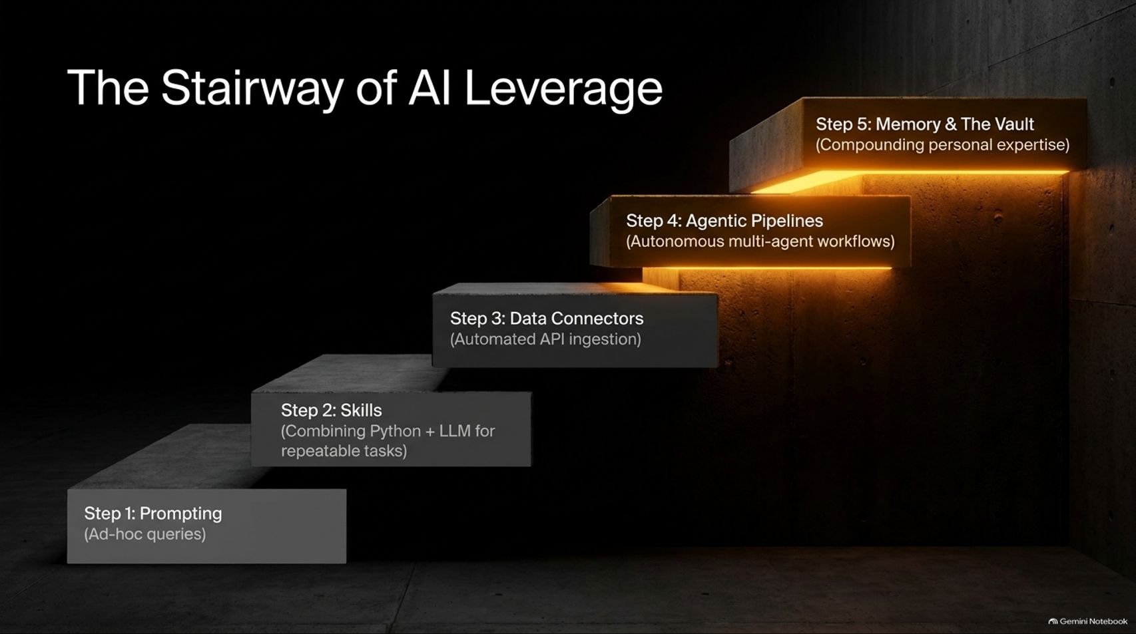

Slide 8
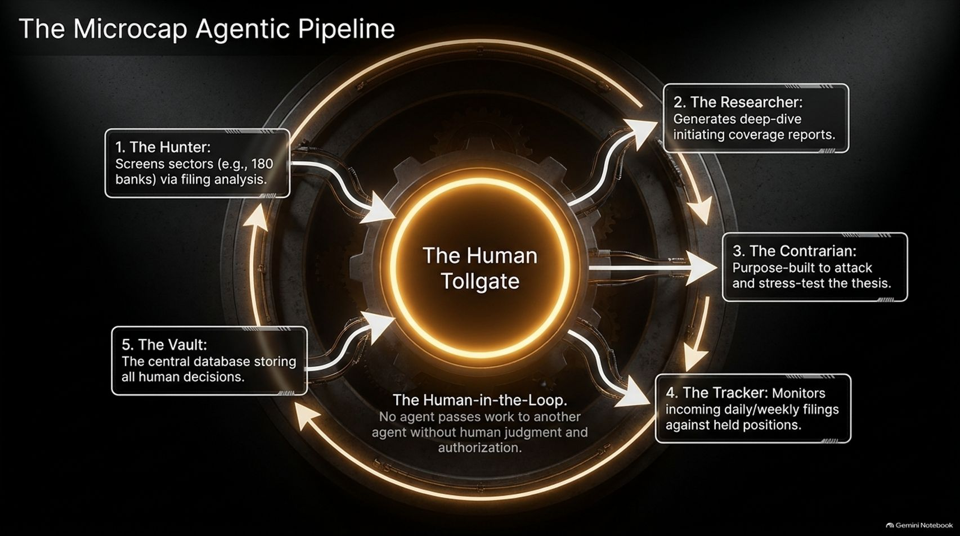
Notes:
Slide Title: The Microcap Agentic Pipeline
Core Theme: A closed-loop system featuring The Hunter, The Researcher, The Contrarian, The Tracker, and The Vault—all governed by a mandatory Human Tollgate.
Speaker Notes (Estimated Delivery Time: 4–6 Minutes):
"This slide illustrates the heart of the operational architecture: The Microcap Agentic Pipeline. It is a multi-agent system designed to run continuous research, but with one absolute rule: The Human Tollgate. No agent ever passes work to another agent without human judgment and authorization.
Let's look at the agents:
The Hunter: Screens entire sectors (e.g., 180 European banks or 100 SaaS companies) via automated filing analysis.
The Researcher: Generates deep-dive, initiating coverage reports.
The Contrarian: Purpose-built to attack, poke holes in, and stress-test the thesis.
The Tracker: Monitors incoming daily and weekly filings against your held positions.
The Vault: The central database storing all human decisions and past rationale."

Slide 9
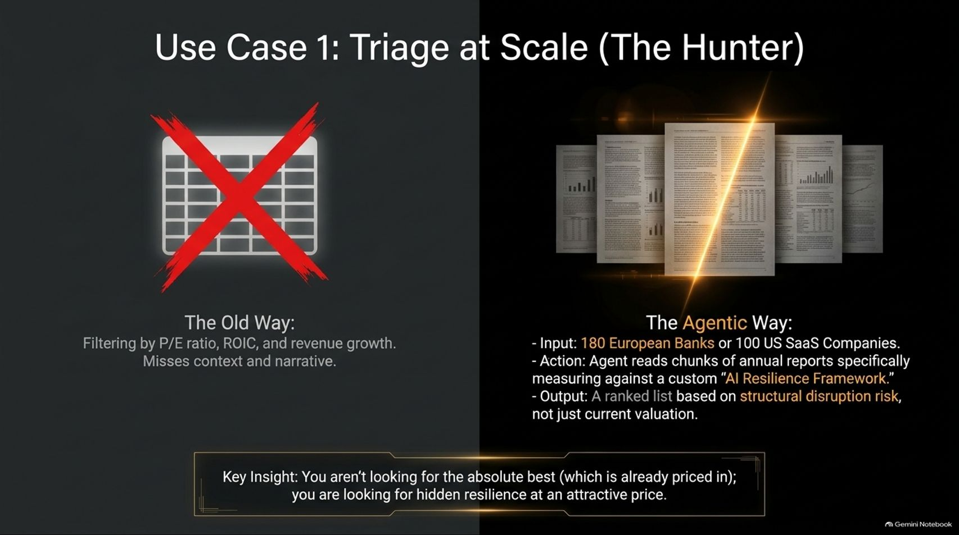
Notes:
Slide Title: Use Case 1: Triage at Scale (The Hunter)
Core Theme: Moving beyond traditional P/E and ROIC stock screeners that miss narrative context. Using AI to read annual report chunks against a custom "AI Resilience Framework."
Speaker Notes (Estimated Delivery Time: 3–5 Minutes):
"Let's look at practical implementation. Use Case 1: Triage at Scale (The Hunter).
The Old Way: Filtering microcaps purely by trailing P/E ratios, ROIC, and revenue growth on a rigid spreadsheet. This misses vital qualitative context, narrative shifts, and structural risks.
The Agentic Way: You feed the Hunter agent a universe of 180 European banks or 100 US SaaS companies. The agent reads specific text chunks of annual reports, evaluating them against a custom AI Resilience Framework. It outputs a ranked list based on structural disruption risk rather than surface-level valuation.
The Insight: You aren't looking for the absolute best companies—those are already priced in by the market. You are looking for hidden resilience trading at an attractive price."

Slide 10
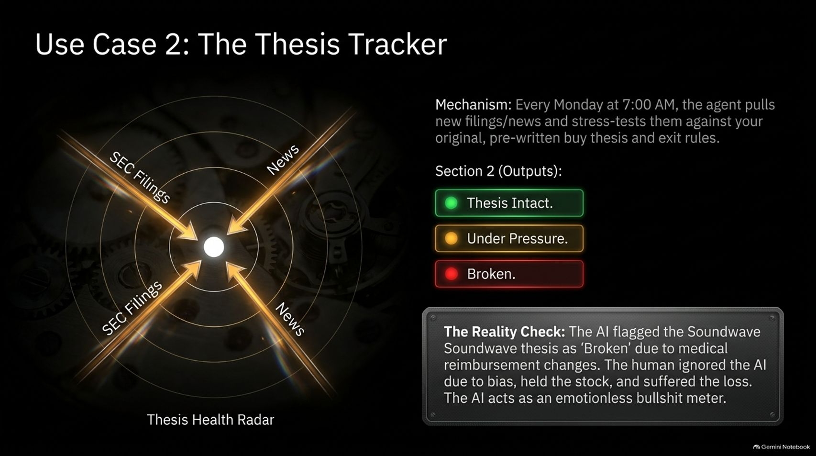
Notes:
Slide Title: Use Case 2: The Thesis Tracker
Core Theme: An automated agent running every Monday at 7:00 AM to scan new filings and news against your original buy thesis, outputting color-coded health alerts (Intact, Under Pressure, Broken).
Speaker Notes (Estimated Delivery Time: 4–5 Minutes):
"Our second core use case is The Thesis Tracker.
The Mechanism: Every Monday at 7:00 AM, an autonomous agent pulls new SEC filings, news releases, and transcripts, stress-testing them directly against your original, pre-written buy thesis and explicit exit rules. It outputs a status report: Green (Thesis Intact), Yellow (Under Pressure), or Red (Broken).
The Reality Check: Kevin shares a personal example where his system flagged a holding called Soundwave as 'Broken' due to shifting medical reimbursement regulations. Because of human bias, he ignored the AI alert, held the stock, and suffered steep losses. The AI acts as an emotionless bullshit meter that refuses to let you rationalize away deteriorating fundamentals."

Slide 11
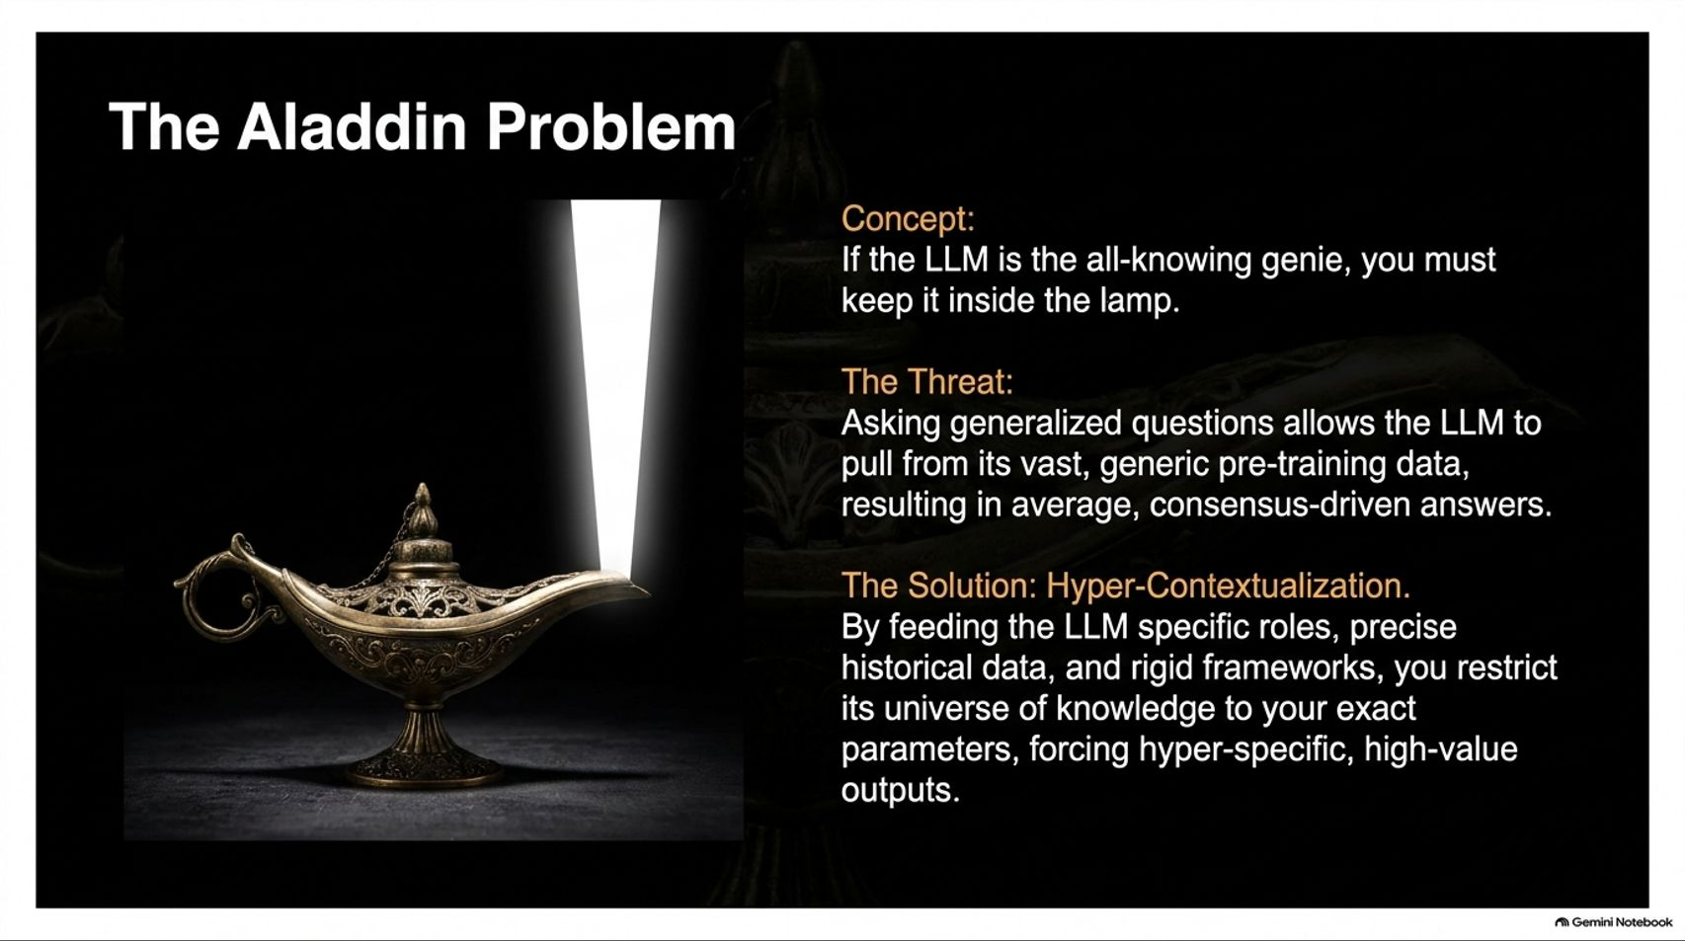
Notes:
Slide Title: The Aladdin Problem
Core Theme: If the LLM is the all-knowing genie, you must keep it inside the lamp. Hyper-contextualization restricts generic pre-training data into high-value, hyper-specific outputs.
Speaker Notes (Estimated Delivery Time: 3–4 Minutes):
"To master prompt engineering, we must avoid The Aladdin Problem.
The Concept: If the LLM is an all-knowing genie, you cannot just let it roam free; you must keep it inside the lamp.
The Threat: Asking broad, generalized questions allows the LLM to pull from its vast, generic pre-training internet data, resulting in bland, consensus-driven, mediocre answers.
The Solution: Hyper-Contextualization. By feeding the LLM specific operational roles, precise historical data, and rigid analytical frameworks, you restrict its vast universe of knowledge to your exact parameters—forcing hyper-specific, institutional-grade outputs."

Slide 12
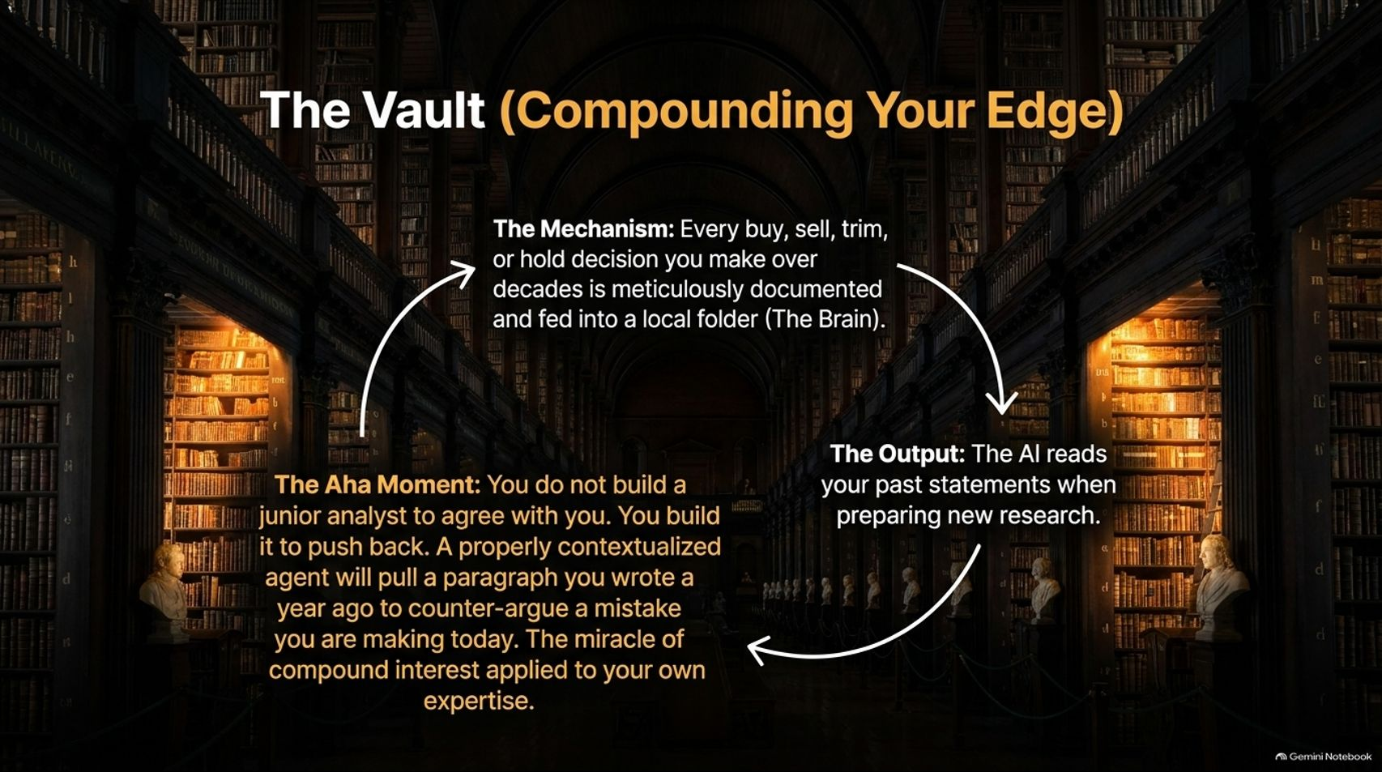
Notes:
Slide Title: The Vault (Compounding Your Edge)
Core Theme: Documenting every buy, sell, trim, or hold decision over decades into a local knowledge base. The AI reads your past statements to challenge your current biases.
Speaker Notes (Estimated Delivery Time: 4–5 Minutes):
"The ultimate competitive moat in this framework is The Vault (Compounding Your Edge).
The Mechanism: Every buy, sell, trim, or hold decision you make over decades is meticulously documented and fed into a local folder (The Brain).
The Aha Moment: You do not build a junior analyst to agree with you. You build it to push back. A properly contextualized agent will pull a paragraph you wrote a year ago to counter-argue a mistake you are making today.
This is the miracle of compound interest applied directly to your own evolving expertise and intellectual honesty."

Slide 13
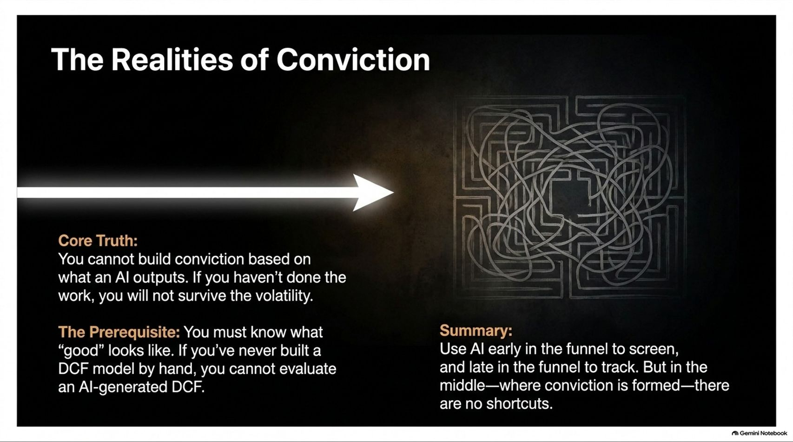
Notes:
Slide Title: The Realities of Conviction
Core Theme: You cannot build conviction based solely on AI outputs. If you haven't done the foundational work (like building a DCF by hand), you will not survive market volatility.
Speaker Notes (Estimated Delivery Time: 3–4 Minutes):
"It is critical to address The Realities of Conviction.
Core Truth: You cannot build conviction based on what an AI outputs. If you haven't done the foundational work yourself, you will fold the moment your stock experiences volatility.
The Prerequisite: You must know what 'good' looks like. If you have never built a Discounted Cash Flow (DCF) model by hand or studied accounting fundamentals, you cannot evaluate an AI-generated DCF.
Summary: Use AI early in the funnel to screen and late in the funnel to track. But in the middle—where real investment conviction is forged—there are no shortcuts."

Slide 14
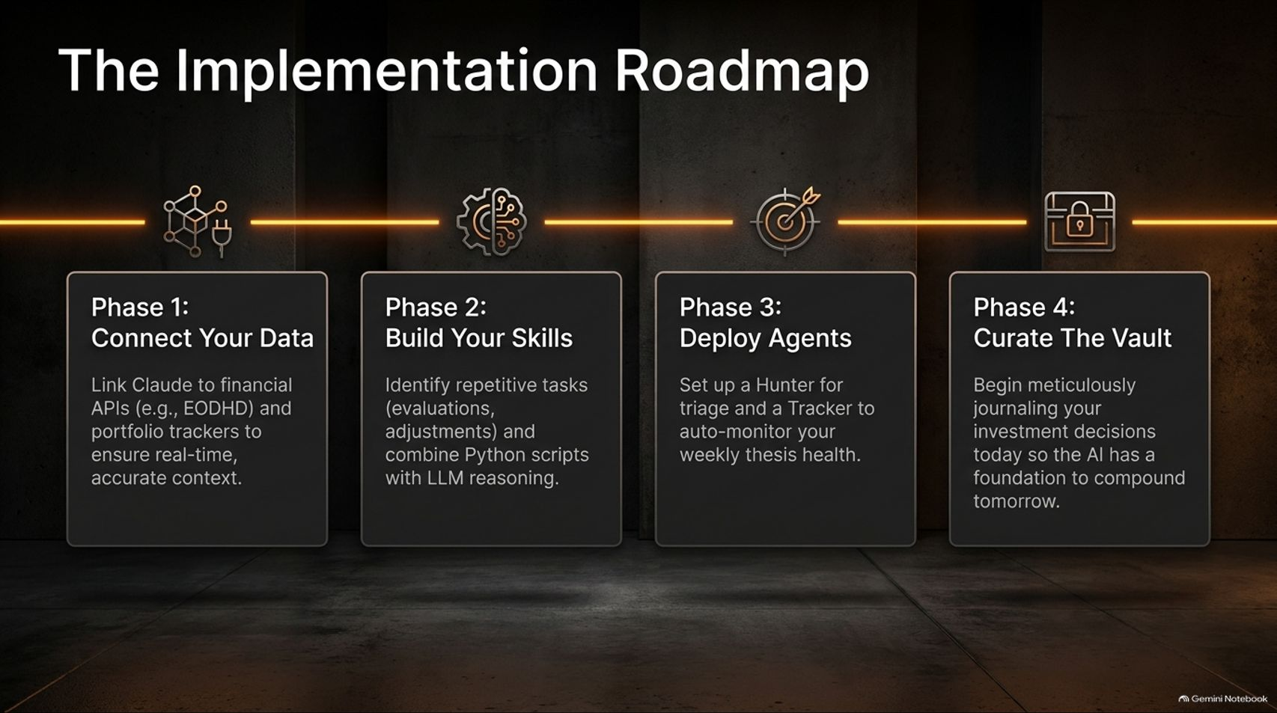
Notes:
Slide Title: The Implementation Roadmap
Core Theme: Four clear phases: Connect Your Data (Phase 1), Build Your Skills (Phase 2), Deploy Agents (Phase 3), and Curate The Vault (Phase 4).
Speaker Notes (Estimated Delivery Time: 3–4 Minutes):
"How do you actually build this system? Here is The Implementation Roadmap across four sequential phases:
Phase 1: Connect Your Data – Link Claude to financial APIs (like EODHD) and portfolio trackers to ensure real-time, accurate context.
Phase 2: Build Your Skills – Identify repetitive tasks (valuations, lease adjustments) and combine Python scripts with LLM reasoning.
Phase 3: Deploy Agents – Set up a Hunter for triage and a Tracker to auto-monitor your weekly thesis health.
Phase 4: Curate The Vault – Begin meticulously journaling your investment decisions today so the AI has a foundation to compound tomorrow."

Slide 15
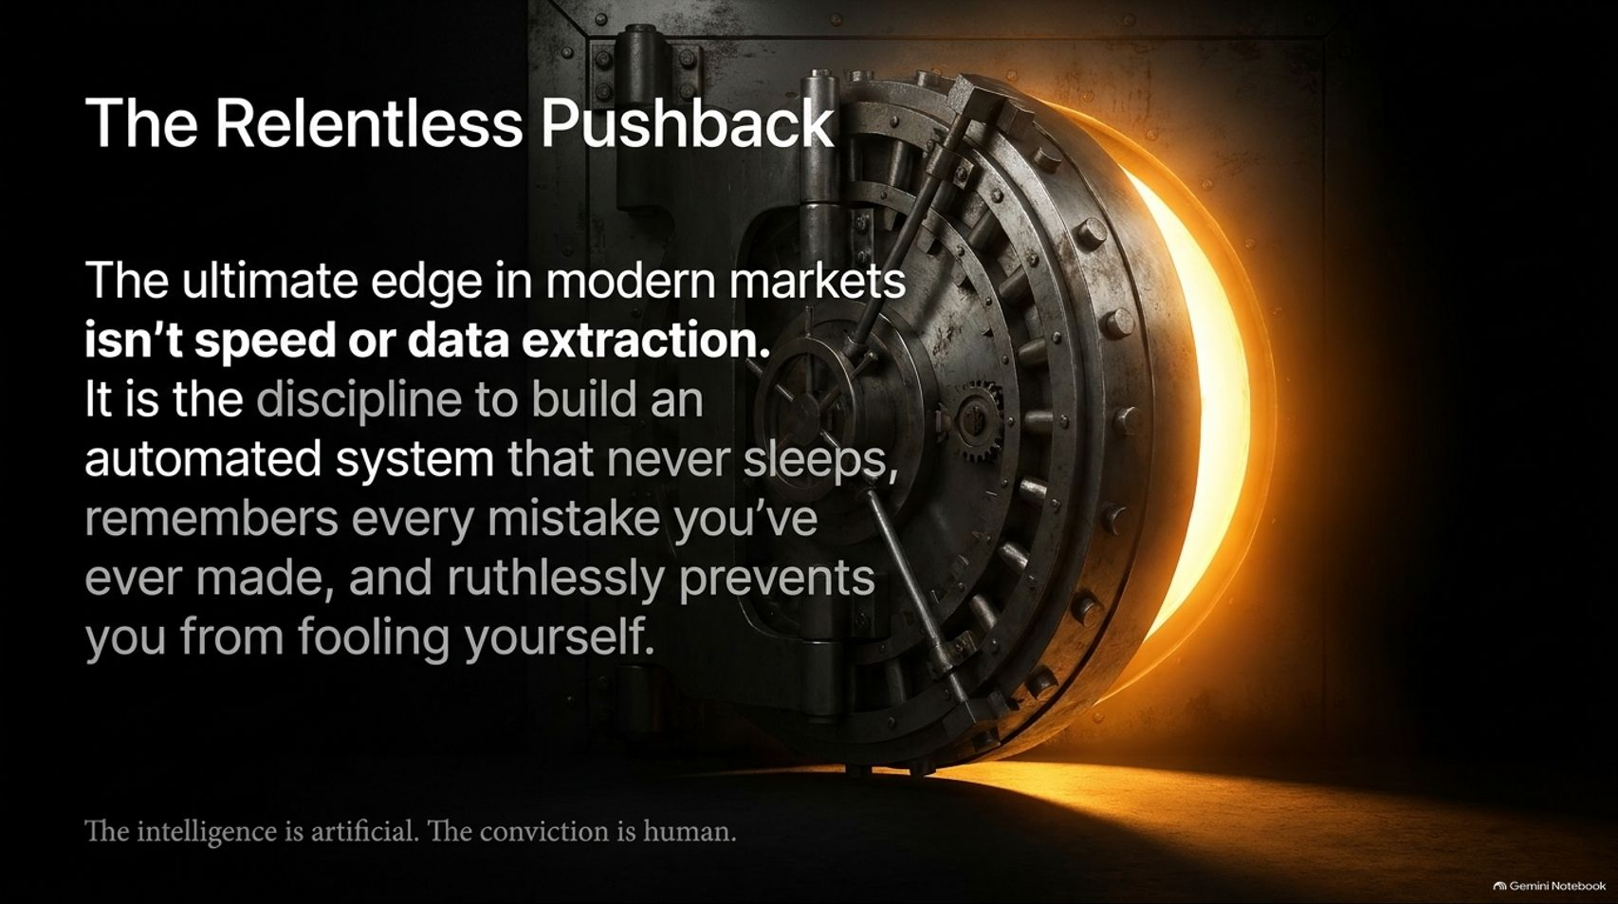
Notes:
Slide Title: The Relentless Pushback
Core Theme: The ultimate edge in modern markets isn't speed or data extraction. It is the discipline to build an automated system that never sleeps and prevents you from fooling yourself.
Speaker Notes (Estimated Delivery Time: 3–4 Minutes):
"As we wrap up, remember this core thesis: The ultimate edge in modern markets isn't raw speed or data extraction. Everyone has access to fast LLMs and public data feeds today.
The true edge is having the discipline to build an automated system that never sleeps, remembers every mistake you've ever made, and ruthlessly prevents you from fooling yourself.
The intelligence is artificial. But the conviction must always be human."

Slide 16
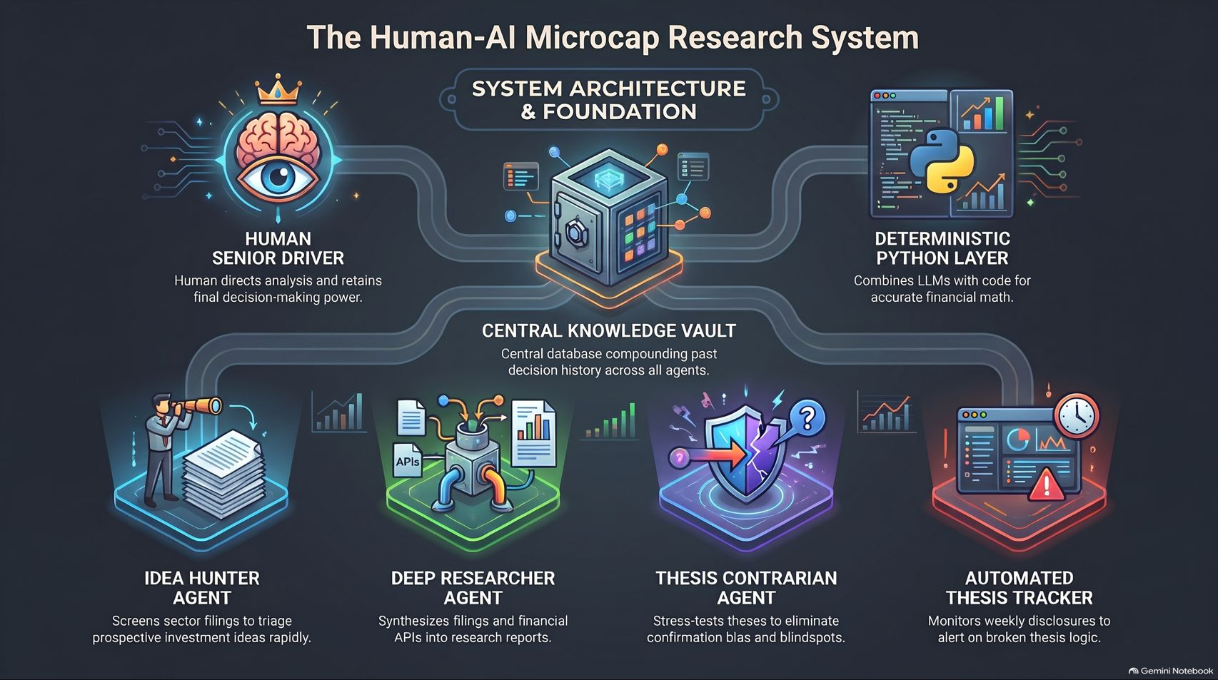
Notes:
Slide Title: The Human-AI Microcap Research System
Core Theme: Comprehensive system architecture overview uniting the Human Senior Driver, Central Knowledge Vault, Deterministic Python Layer, Idea Hunter, Deep Researcher, Thesis Contrarian, and Automated Thesis Tracker.
Speaker Notes (Estimated Delivery Time: 3–5 Minutes):
"This final slide brings the entire Human-AI Microcap Research System together in one unified architecture.
At the apex sits the Human Senior Driver, directing analysis and retaining final decision-making power. At the core is the Central Knowledge Vault, compounding decision history across all workflows. Surrounding it are our specialized components: the deterministic Python layer for accurate math, the Idea Hunter for screening, the Deep Researcher for synthesis, the Thesis Contrarian for stress-testing, and the Automated Thesis Tracker for ongoing portfolio defense.
By orchestrating these agents around a disciplined human core, you transform your research process into an unstoppable compounding machine. Thank you."

