Slide 1
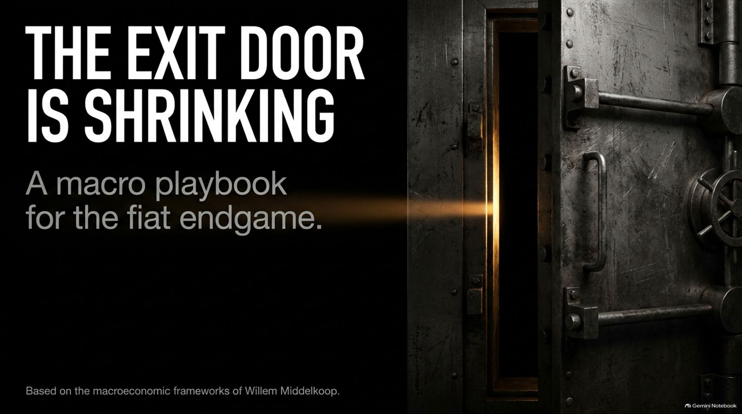
Notes:
Lab Made Gold and the End of the Dollar Standard /w Willem Middelkoop
https://www.youtube.com/watch?v=agm-IxIFXrE

Slide 2
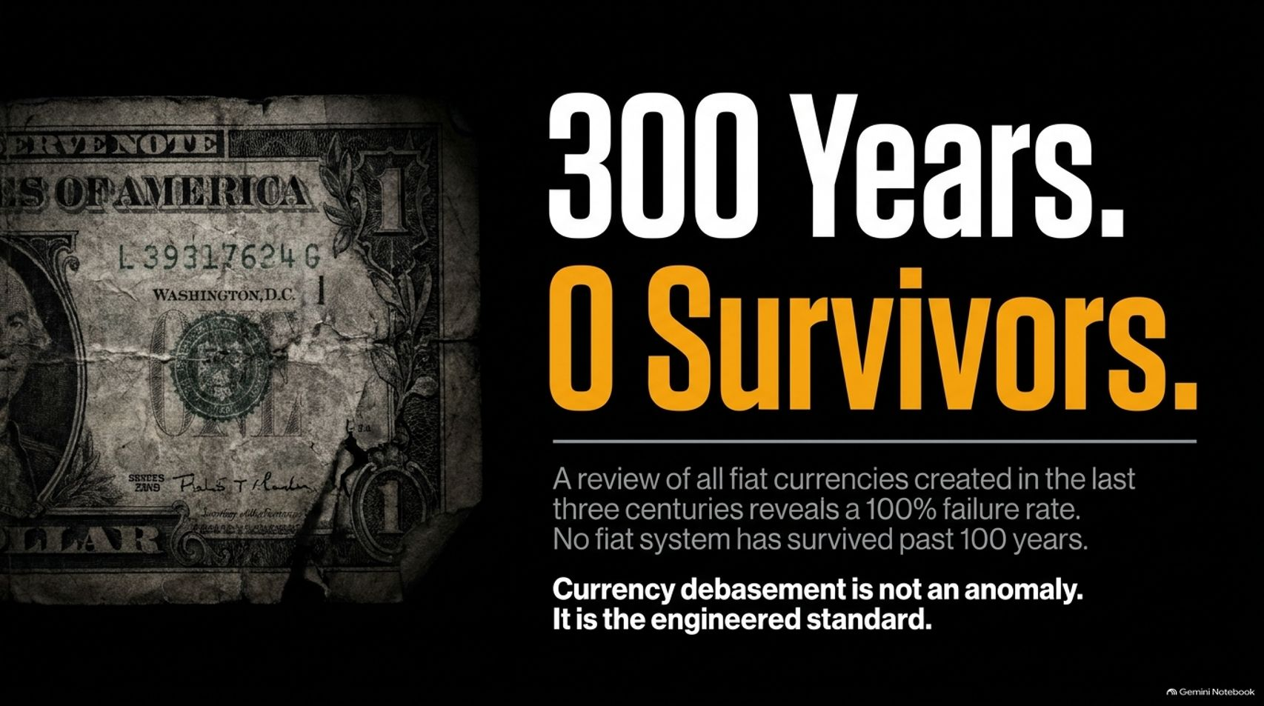
Notes:
Slide Title: 300 Years. 0 Survivors.
Core Theme: A review of all fiat currencies created in the last three centuries reveals a 100% failure rate. Currency debasement is not an anomaly; it is the engineered standard.
Speaker Notes (Estimated Delivery Time: 3–4 Minutes):
"Let's start with a sobering historical truth: 300 Years. Zero Survivors.
If you review every single fiat currency created over the last three centuries, the historical failure rate is precisely 100%. Not a single fiat system in modern history has survived past 100 years. As Willem Middelkoop documents in the appendix of The Big Reset, currency debasement is not an unexpected market glitch or a temporary policy error—it is the engineered standard of central banking.
Every fiat experiment eventually collapses under the weight of exponential debt expansion. Understanding this 100% failure rate is the mandatory first step for anyone trying to preserve generational wealth."

Slide 3
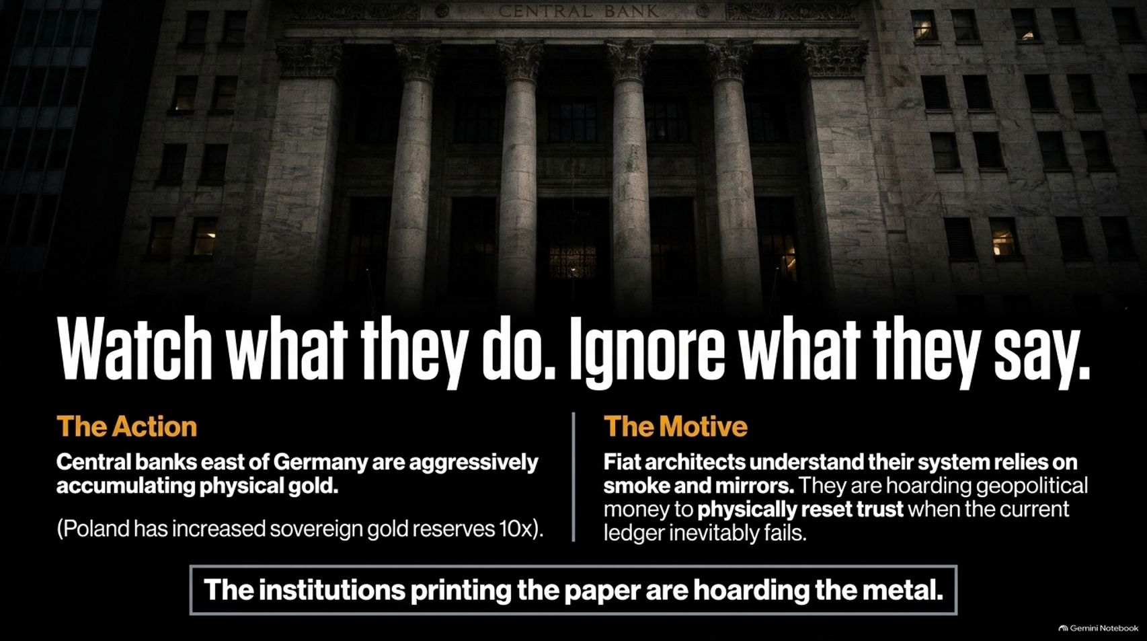
Notes:
Slide Title: Watch what they do. Ignore what they say.
Core Theme: Central banks east of Germany are aggressively accumulating physical gold (e.g., Poland increasing reserves 10x). Fiat architects are hoarding geopolitical money to physically reset trust when the ledger fails.
Speaker Notes (Estimated Delivery Time: 4–5 Minutes):
"When analyzing monetary policy, there is a golden rule: Watch what they do, and ignore what they say.
Central bankers and fiat architects do a lot of public posturing, but behind closed doors, they act with absolute pragmatism. Central banks east of Germany—led by nations like Poland, which has increased its sovereign gold reserves tenfold—are aggressively accumulating physical gold.
Why? Because fiat architects know their system relies entirely on smoke and mirrors. They know fiat money always fails. They are hoarding physical, geopolitical money so they can physically reset trust on their balance sheets when the current digital ledger inevitably fractures. The institutions printing the paper are hoarding the metal."

Slide 4
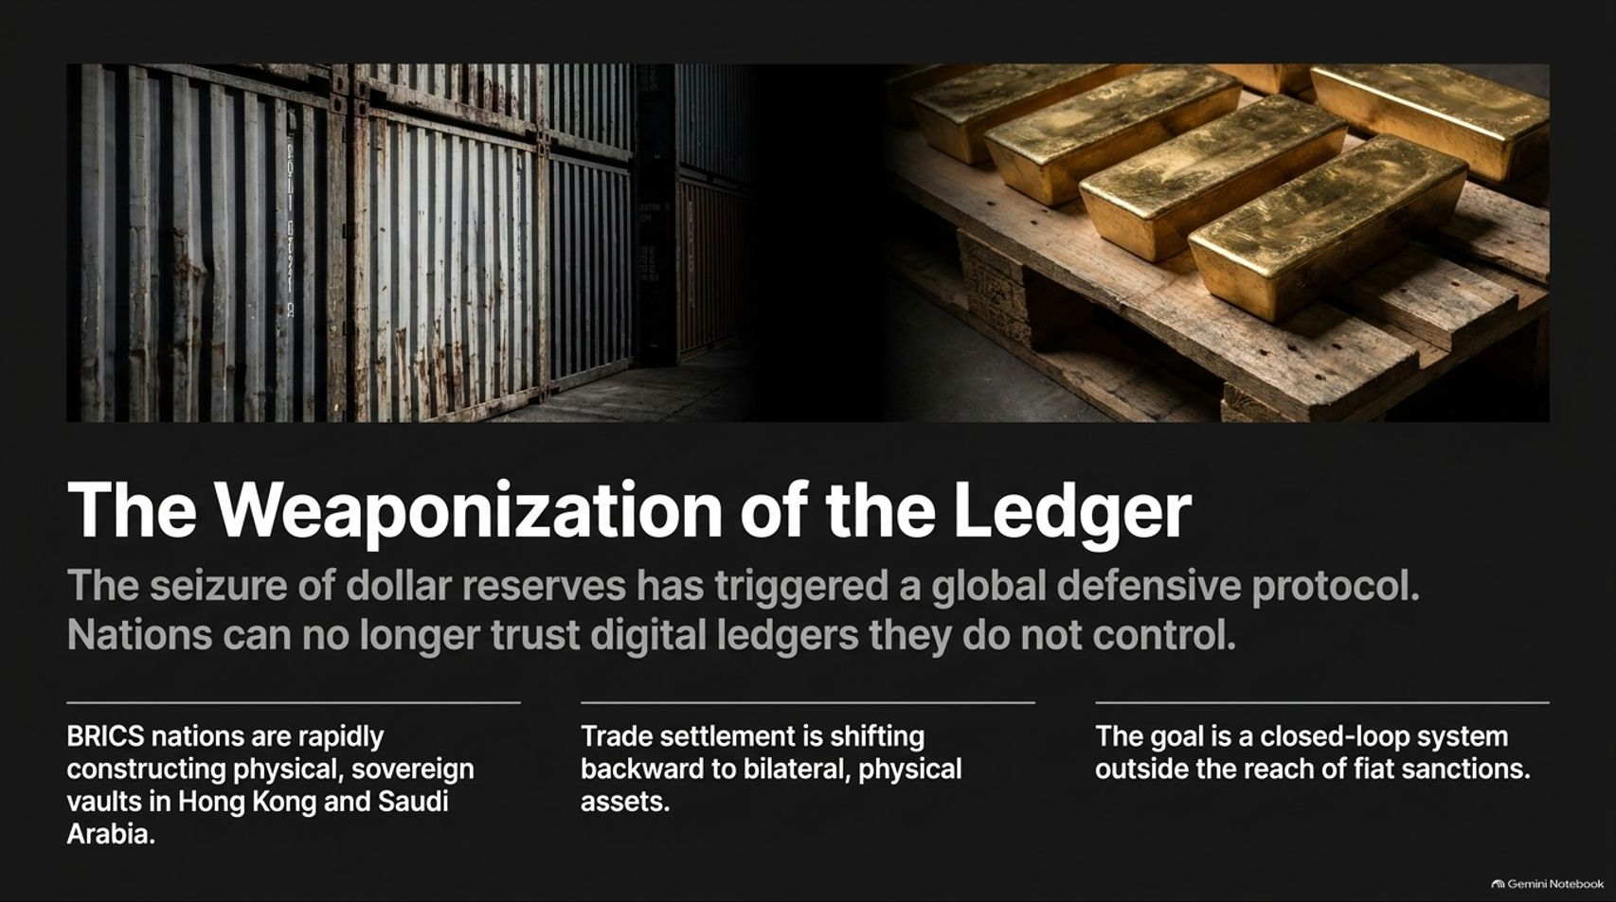
Notes:
Slide Title: The Weaponization of the Ledger
Core Theme: The seizure of dollar reserves has triggered a global defensive protocol. BRICS nations are constructing physical vaults in Hong Kong and Saudi Arabia to settle trade outside fiat sanctions.
Speaker Notes (Estimated Delivery Time: 4–5 Minutes):
"The weaponization of the US dollar and global payment ledgers has triggered an irreversible defensive protocol among sovereign nations. When foreign exchange reserves can be frozen or seized overnight at the stroke of a pen, countries realize they can no longer trust digital ledgers they do not control.
As a result, BRICS nations are rapidly constructing physical, sovereign vaults in strategic financial hubs like Hong Kong and Saudi Arabia. Global trade settlement is shifting backward away from fiat rails toward bilateral, physical hard assets. The ultimate goal for these sovereign powers is a closed-loop settlement system operating entirely outside the reach of Western fiat sanctions."

Slide 5
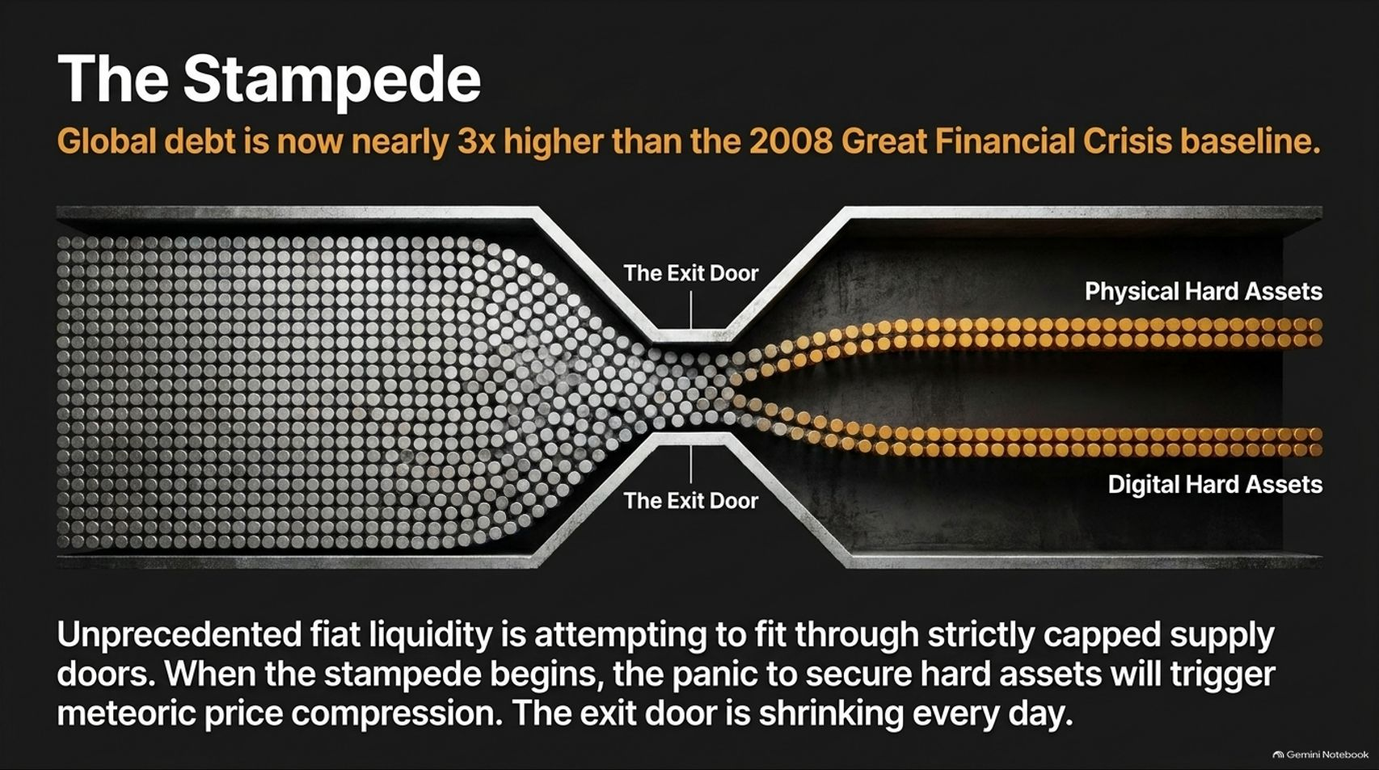
Notes:
Slide Title: The Stampede
Core Theme: Global debt is nearly 3x higher than the 2008 GFC baseline. Unprecedented fiat liquidity is attempting to fit through strictly capped supply doors into physical and digital hard assets.
Speaker Notes (Estimated Delivery Time: 4–6 Minutes):
"This brings us to The Stampede. Global debt today is nearly three times higher than the baseline we witnessed during the 2008 Great Financial Crisis.
Visualize a massive volume of fiat liquidity—representing trillions of units of newly printed currency—funneling toward a tiny exit door. That exit door is strictly capped by the physical supply of gold and the cryptographic code of Bitcoin.
When the stampede truly begins, the panic to secure hard assets will trigger meteoric price compression. People will rush to trade depreciating paper claims for scarce physical and digital assets. The exit door is shrinking every single day."

Slide 6
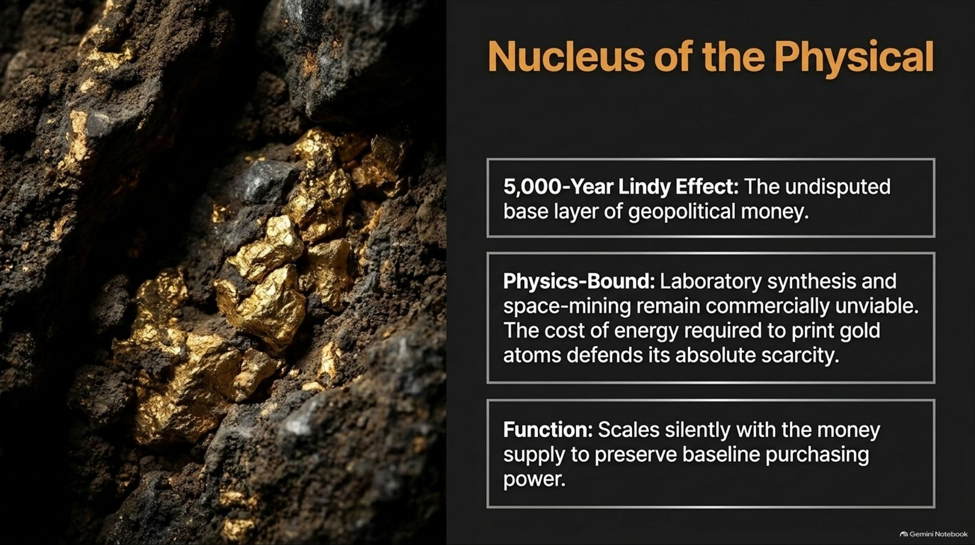
Notes:
Slide Title: Nucleus of the Physical
Core Theme: Gold’s 5,000-year Lindy Effect. Physics-bound scarcity (space mining and lab synthesis remain commercially unviable). Gold scales silently with money supply to preserve baseline purchasing power.
Speaker Notes (Estimated Delivery Time: 3–5 Minutes):
"At the foundation of the physical hard asset universe sits gold—the Nucleus of the Physical.
Gold boasts a 5,000-year Lindy Effect, making it the undisputed base layer of geopolitical money. Furthermore, it is strictly bound by the laws of physics. Despite sci-fi theories about space mining or laboratory synthesis, producing gold requires immense energy, defending its absolute scarcity.
Gold is not an investment designed to make you rich overnight; its core function is to scale silently with expanding money supplies over decades to preserve your baseline purchasing power."

Slide 7
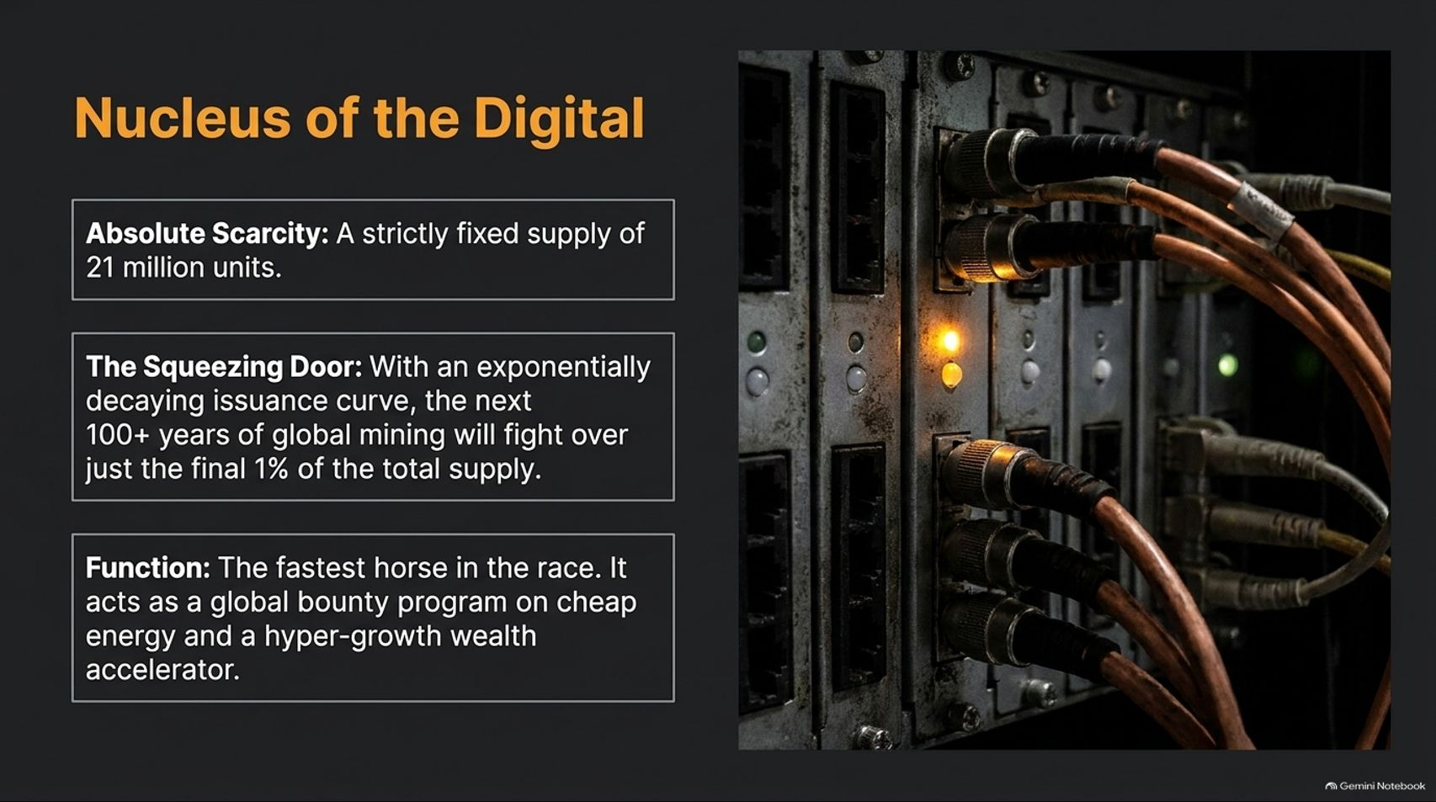
Notes:
Slide Title: Nucleus of the Digital
Core Theme: Bitcoin's absolute scarcity (strictly fixed 21 million units) and exponentially decaying issuance curve. It acts as a global bounty program on cheap energy and a hyper-growth wealth accelerator.
Speaker Notes (Estimated Delivery Time: 4–5 Minutes):
"Just as gold is the nucleus of the physical world, Bitcoin is the Nucleus of the Digital.
Bitcoin introduces absolute scarcity: a strictly fixed supply cap of 21 million units that can never be inflated by government decree. Thanks to its exponentially decaying issuance curve, the next century of global mining will fight over just the final 1% of total supply.
Bitcoin acts as the fastest horse in the race. It functions simultaneously as a global bounty program incentivizing the development of cheap, stranded energy and as a hyper-growth wealth accelerator for those escaping fiat debasement."

Slide 8
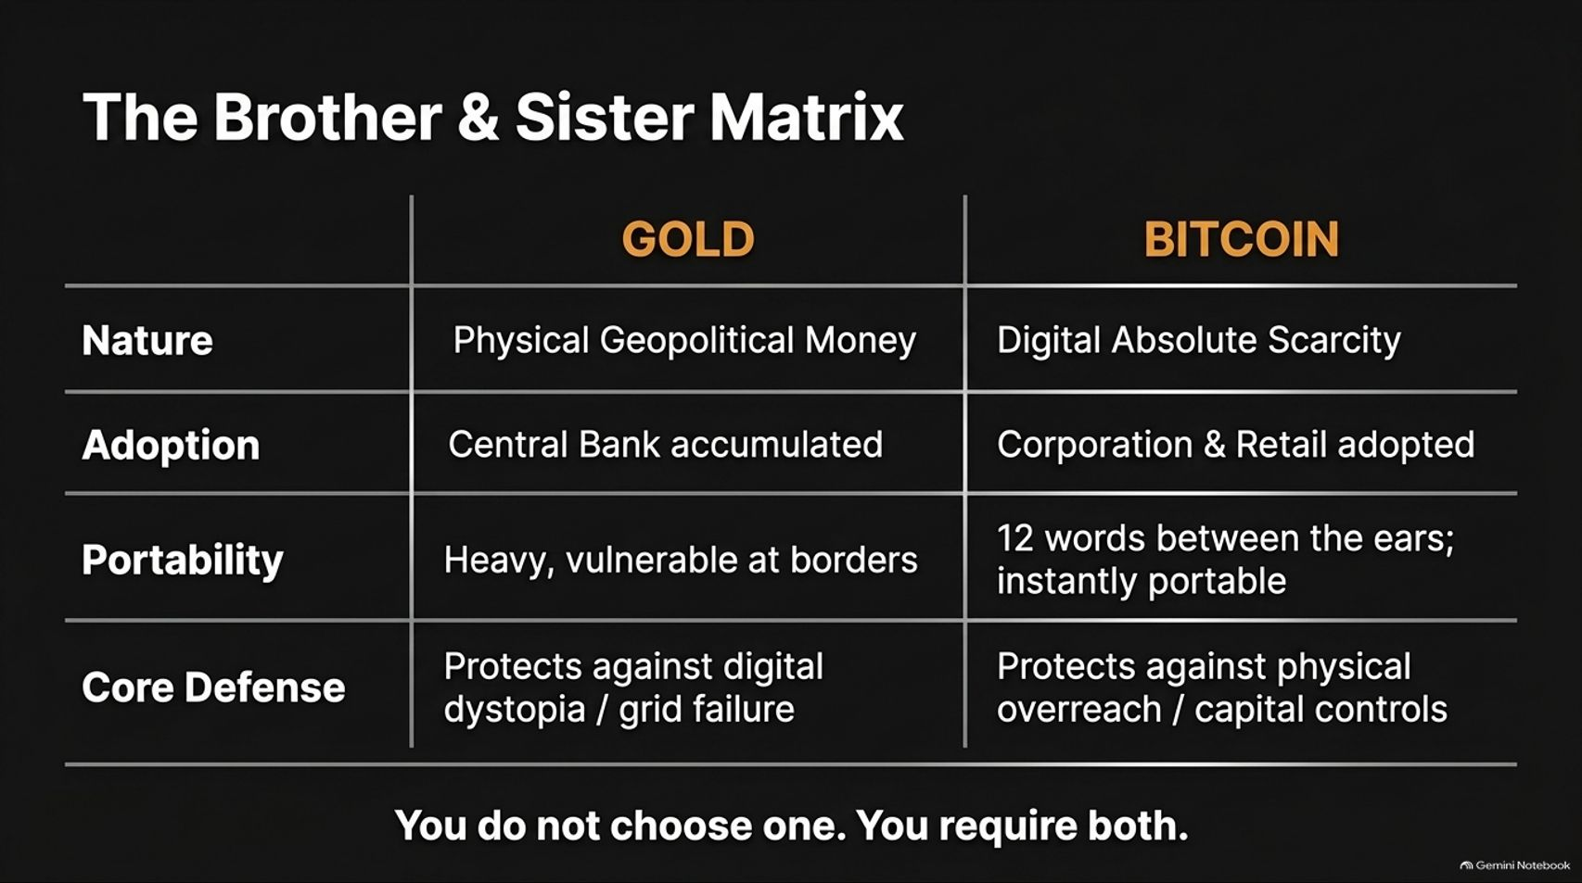
Notes:
Slide Title: The Brother & Sister Matrix
Core Theme: Comparing Gold (physical geopolitical money, central bank accumulated, heavy, protects against digital grid failure) and Bitcoin (digital absolute scarcity, corporate/retail adopted, 12 words, protects against physical overreach). You require both.
Speaker Notes (Estimated Delivery Time: 3–5 Minutes):
"Too often, commentators pit gold bugs against Bitcoiners in a pointless tribal war. But in reality, Gold and Bitcoin are brothers and sisters. You do not choose one; you require both.
Gold is physical geopolitical money accumulated by central banks. It is heavy and vulnerable at borders, but it serves as your ultimate defense against digital dystopian grid failure.
Bitcoin is digital absolute scarcity adopted by corporations and retail. It can be memorized as 12 words between your ears and moved instantly across borders, serving as your ultimate defense against physical overreach and capital controls.
Together, they cover every threat vector of the fiat endgame."

Slide 9

Notes:
Slide Title: The Threat of the Border: “Optionality is the key to pragmatic freedom.”
Core Theme: Hard assets mean nothing if seized at a checkpoint. True capital mobility requires an asset that cannot be physically printed and cannot be physically detained.
Speaker Notes (Estimated Delivery Time: 3–5 Minutes):
"History teaches us a harsh lesson: Hard assets mean nothing if they can be seized at a checkpoint.
In times of severe geopolitical upheaval, authoritarian regimes routinely confiscate private wealth, check luggage at borders, and impose draconian capital controls. As Willem Middelkoop emphasizes, optionality is the key to pragmatic freedom.
True capital mobility requires assets that transcend physical borders—assets that cannot be physically printed by central banks and cannot be physically detained by border guards. This is where the portability of digital bearer assets becomes a matter of personal survival."

Slide 10
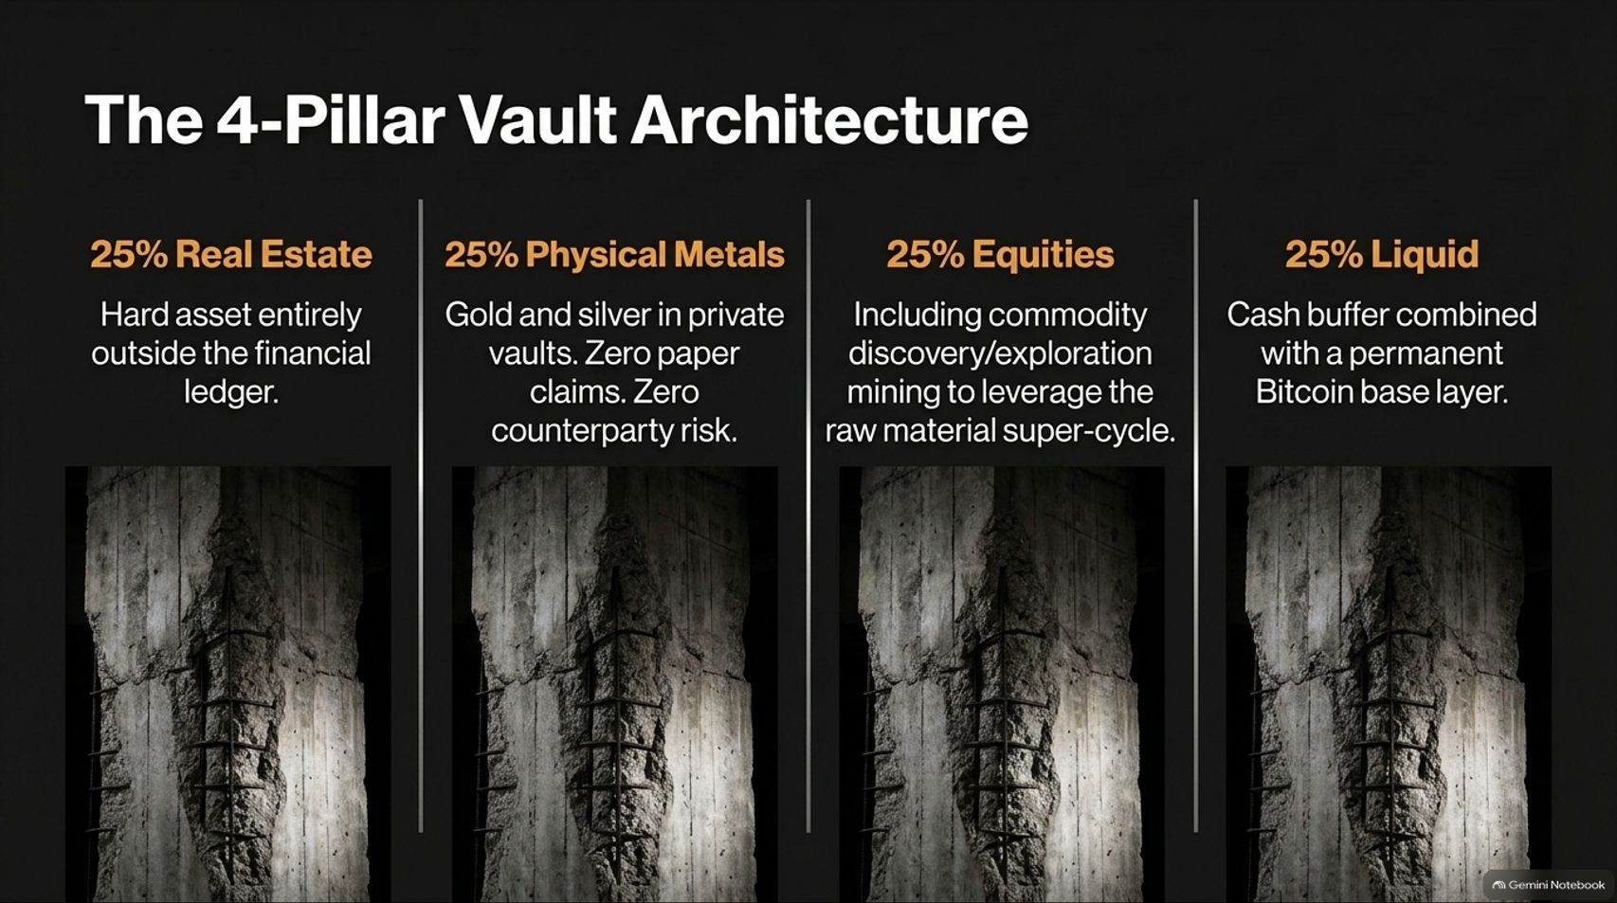
Notes:
Slide Title: The 4-Pillar Vault Architecture
Core Theme: A balanced allocation: 25% Real Estate (outside the financial ledger), 25% Physical Metals (in private vaults with zero counterparty risk), 25% Equities (leveraging the raw material super-cycle), and 25% Liquid (cash buffer + Bitcoin base layer).
Speaker Notes (Estimated Delivery Time: 4–6 Minutes):
"How do we structure a resilient portfolio for the fiat endgame? We implement The 4-Pillar Vault Architecture, dividing your net worth into four balanced quadrants:
25% Real Estate: Tangible hard assets entirely outside the traditional digital banking ledger.
25% Physical Metals: Gold and silver stored securely in private vaults outside the banking system, with zero paper claims and zero counterparty risk.
25% Equities: Productive assets, including commodity discovery and exploration mining companies, designed to leverage the coming raw material super-cycle.
25% Liquid: A disciplined cash buffer combined with a permanent Bitcoin base layer for hyper-growth and instant mobility."

Slide 11
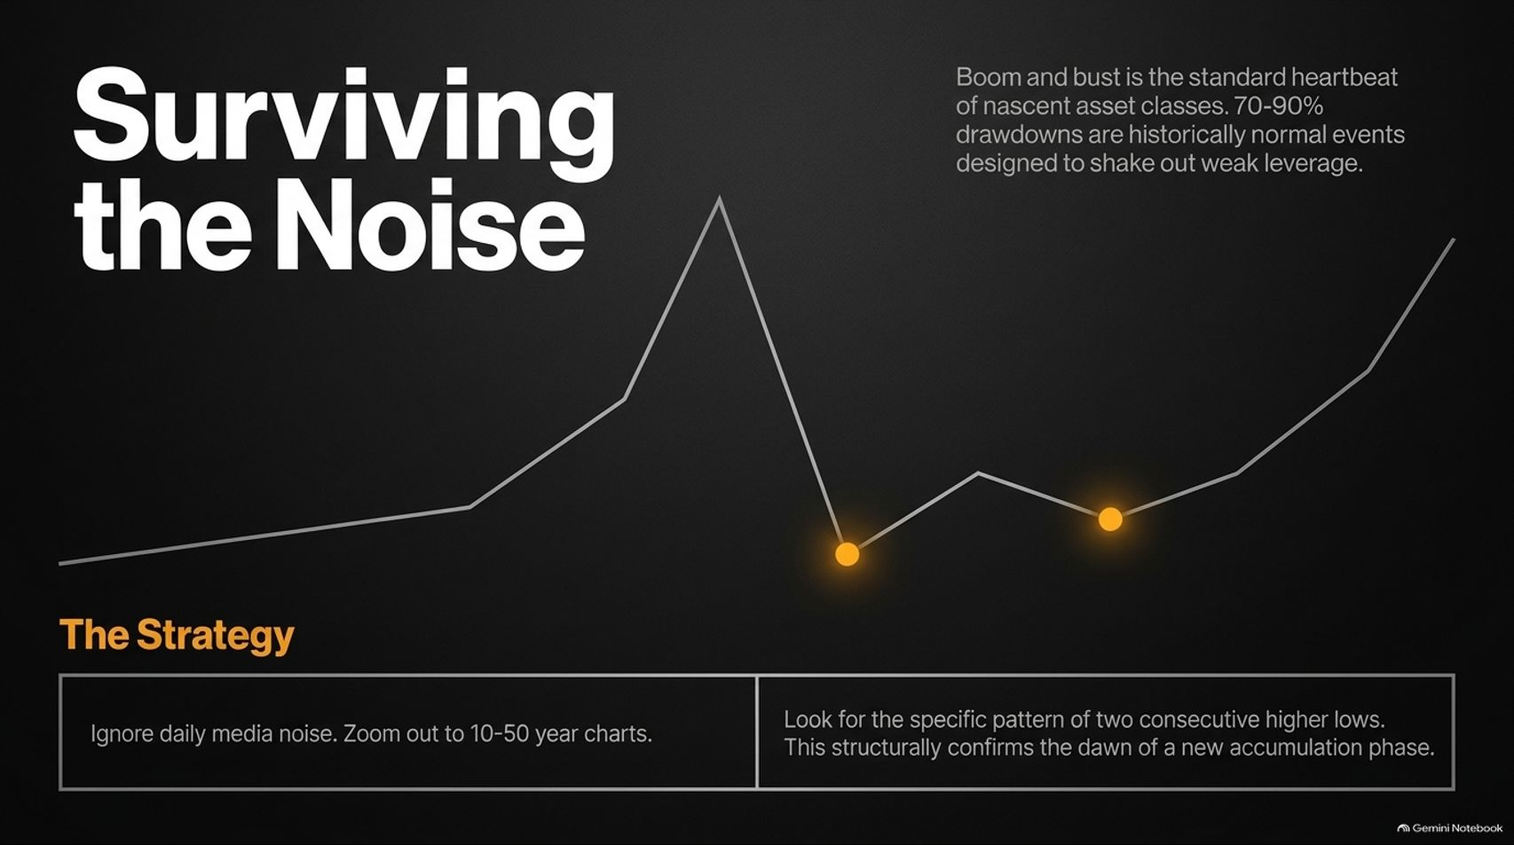
Notes:
Slide Title: Surviving the Noise
Core Theme: Boom and bust is the heartbeat of nascent asset classes. 70-90% drawdowns are normal events designed to shake out weak leverage. Zoom out to 10–50 year charts and look for consecutive higher lows.
Speaker Notes (Estimated Delivery Time: 3–5 Minutes):
"When investing in hard assets and nascent monetary networks, volatility is the price of admission. Boom and bust is the standard heartbeat of new asset classes.
History shows that brutal 70% to 90% drawdowns are completely normal cyclical events designed to shake out weak leverage. To survive the psychological warfare of daily financial media, you must zoom out to 10- to 50-year macro charts.
Look for the structural pattern of two consecutive higher lows. That simple technical confirmation signals the dawn of a new accumulation phase."

Slide 12
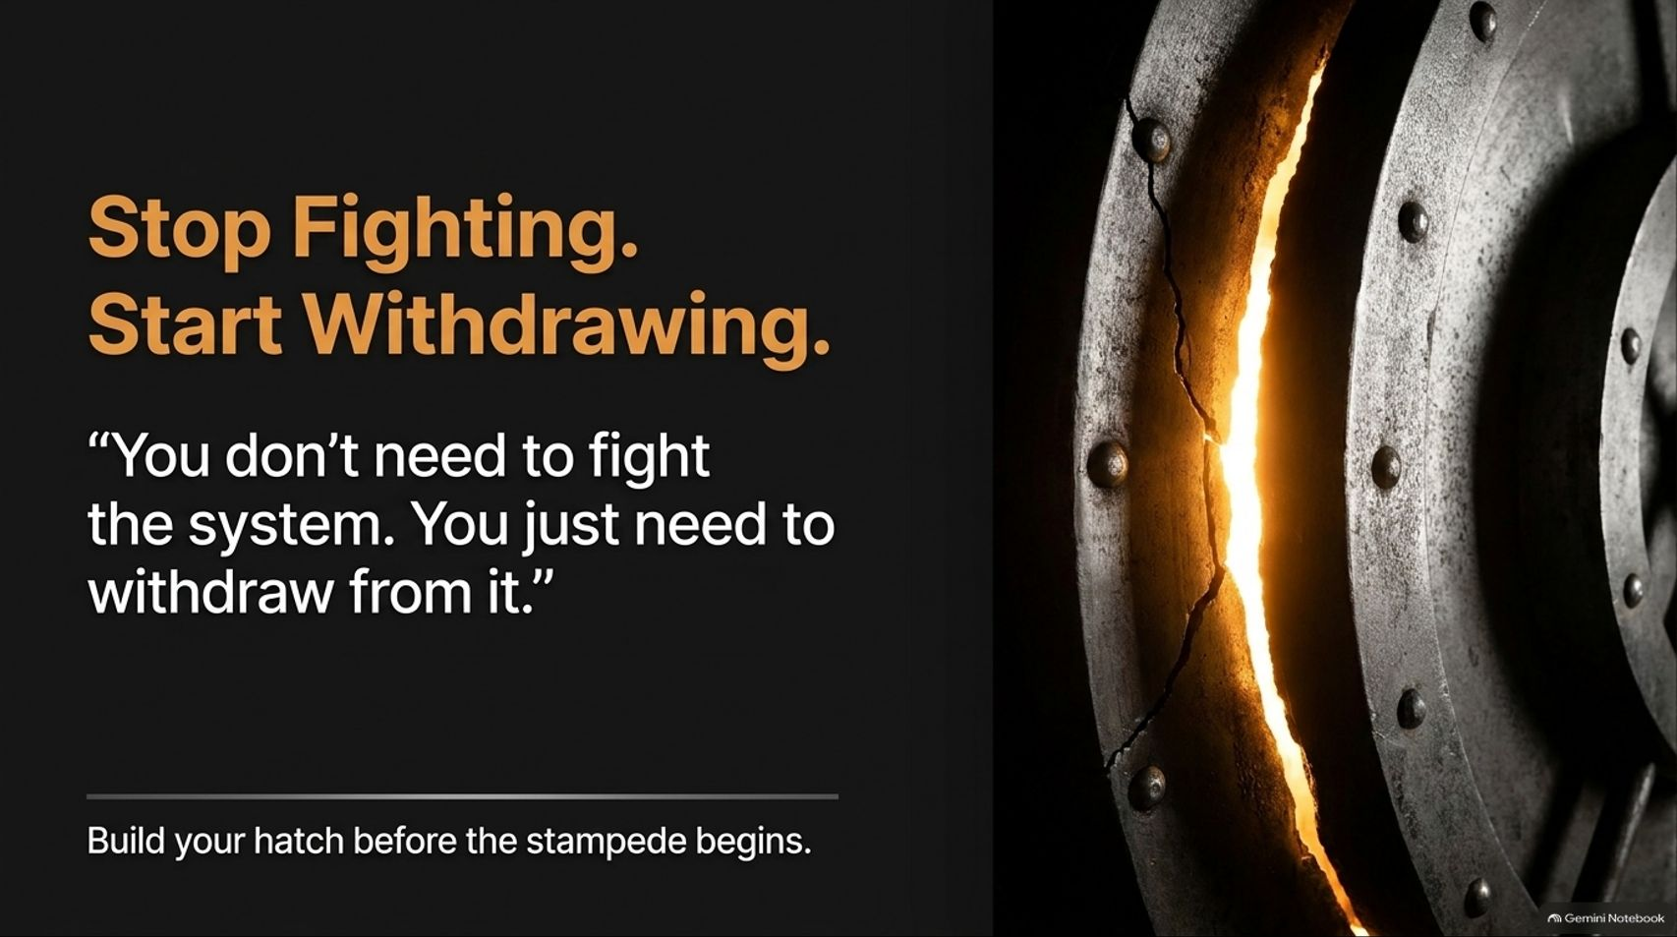
Notes:
Slide Title: Stop Fighting. Start Withdrawing.
Core Theme: “You don't need to fight the system. You just need to withdraw from it.” Build your hatch before the stampede begins.
Speaker Notes (Estimated Delivery Time: 3–4 Minutes):
"A vital philosophical takeaway from Willem Middelkoop’s framework is this: You don't need to fight the system. You just need to withdraw from it.
Trying to reform bloated, debt-saturated fiat institutions is a waste of energy. Instead of fighting political corruption, focus your energy on personal sovereignty. Build your financial hatch, accumulate unprintable hard assets, and detach your livelihood from failing monetary rails.
Build your escape hatch today, before the stampede begins."

Slide 13
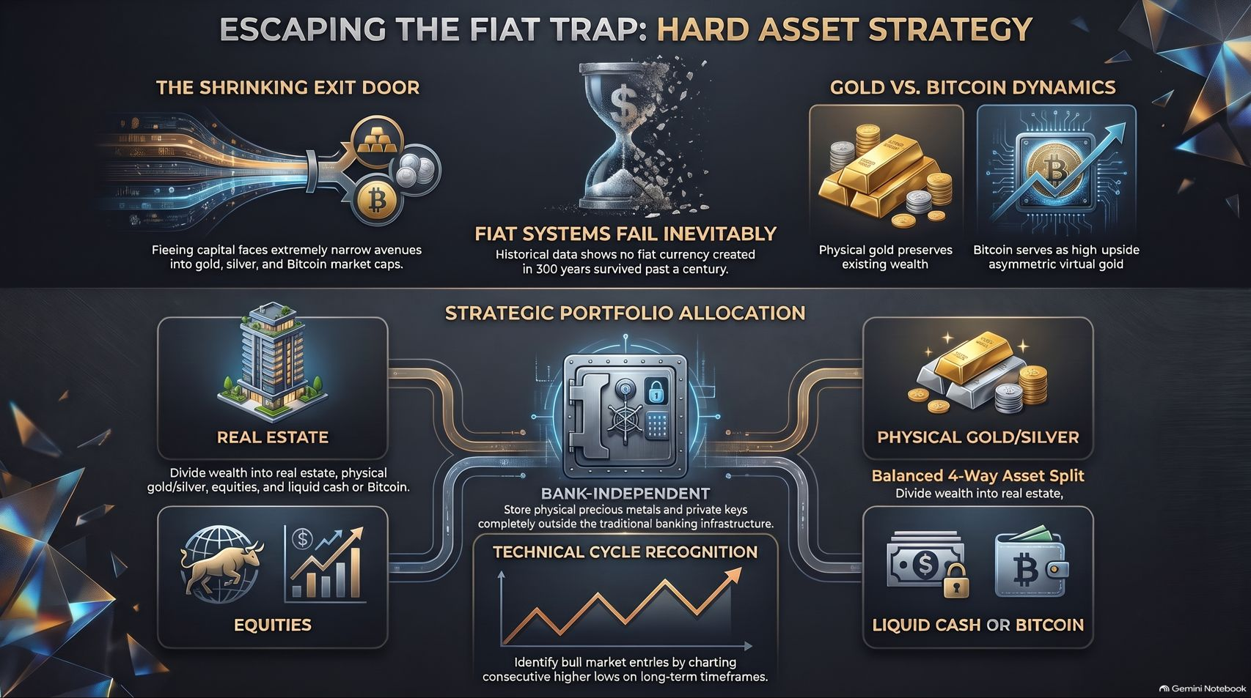
Notes:
Slide Title: Escaping the Fiat Trap: Hard Asset Strategy
Core Theme: Comprehensive summary uniting the shrinking exit door, inevitable fiat failure, gold vs. bitcoin dynamics, and the 4-pillar portfolio allocation.
Speaker Notes (Estimated Delivery Time: 3–5 Minutes):
"As we conclude our playbook, let's review our master blueprint for Escaping the Fiat Trap:
Recognize the Reality: Fiat systems fail 100% of the time, and the exit doors into hard assets are rapidly narrowing.
Deploy the Brother & Sister Matrix: Combine physical gold for geopolitical baseline preservation with Bitcoin as an asymmetric digital wealth accelerator.
Execute the 4-Pillar Allocation: Balance your wealth across real estate, private physical metals, commodity equities, and liquid Bitcoin.
Stay agile, maintain absolute optionality, and withdraw from the fragile legacy ledger. Thank you."

