Slide 1
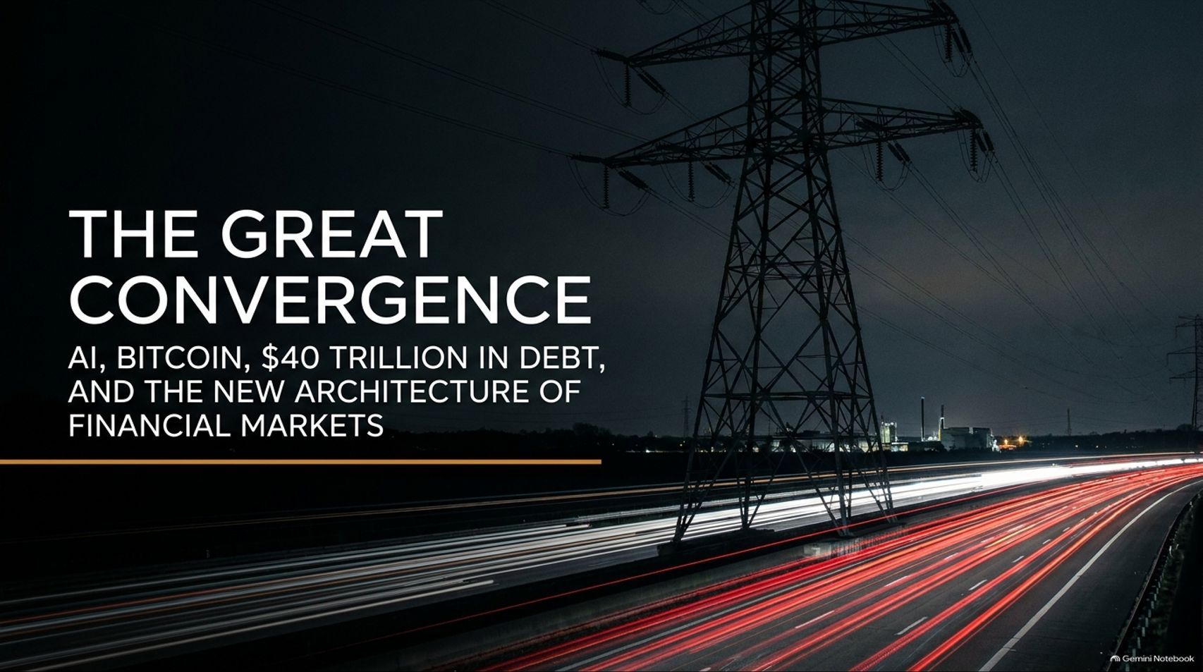
Notes:
Slide Title: The Great Convergence
Core Theme: AI, Bitcoin, $40 Trillion in debt, and the new architecture of financial markets.
Speaker Notes (Estimated Delivery Time: 2–3 Minutes):
"Welcome, everyone. Today we are exploring one of the most defining macroeconomic and technological transitions in modern history: The Great Convergence.
We are witnessing the simultaneous collision of three massive, unstoppable forces: exponential AI growth, the decentralized resilience of the Bitcoin standard, and a staggering $40 trillion sovereign debt load. As Tilman Holloway, CEO of Arch Public, discusses in his latest insights, these colliding forces are not just isolated trends—they are permanently rewriting the rules of energy infrastructure, digital security, and financial alpha. Over the next few minutes, we will break down how these vectors intersect and how modern investors can navigate this high-volatility landscape."
Bitcoin, AI & $40 Trillion in Debt: What Happens Next?
https://www.youtube.com/watch?v=wO4A4TR0dw0

Slide 2
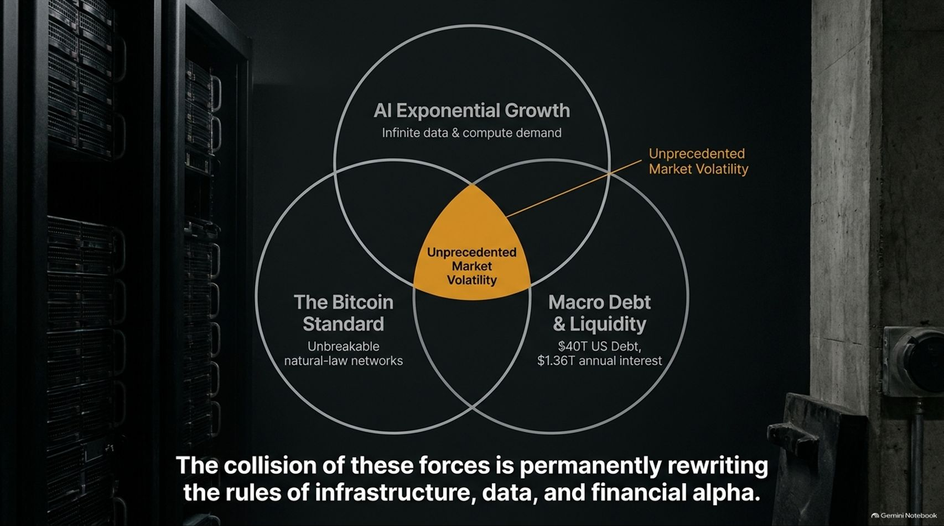
Notes:
Slide Title: The Three Forces of the Great Convergence
Core Theme: AI Exponential Growth (infinite data & compute demand), Macro Debt & Liquidity ($40T US debt, $1.36T annual interest), and The Bitcoin Standard (unbreakable natural-law networks). Their collision creates unprecedented market volatility.
Speaker Notes (Estimated Delivery Time: 3–4 Minutes):
"To understand where financial markets are heading, we must examine the intersection of three concentric circles.
First, we have AI Exponential Growth, driving infinite demand for data and compute. Second, we have Macro Debt & Liquidity, characterized by $40 trillion in US national debt and $1.36 trillion in annual interest payments. Third, we have The Bitcoin Standard, representing unbreakable, natural-law cryptographic networks.
Right at the center where these three forces collide lies Unprecedented Market Volatility. This collision is permanently rewriting the rules of physical infrastructure, data security, and wealth generation."

Slide 3
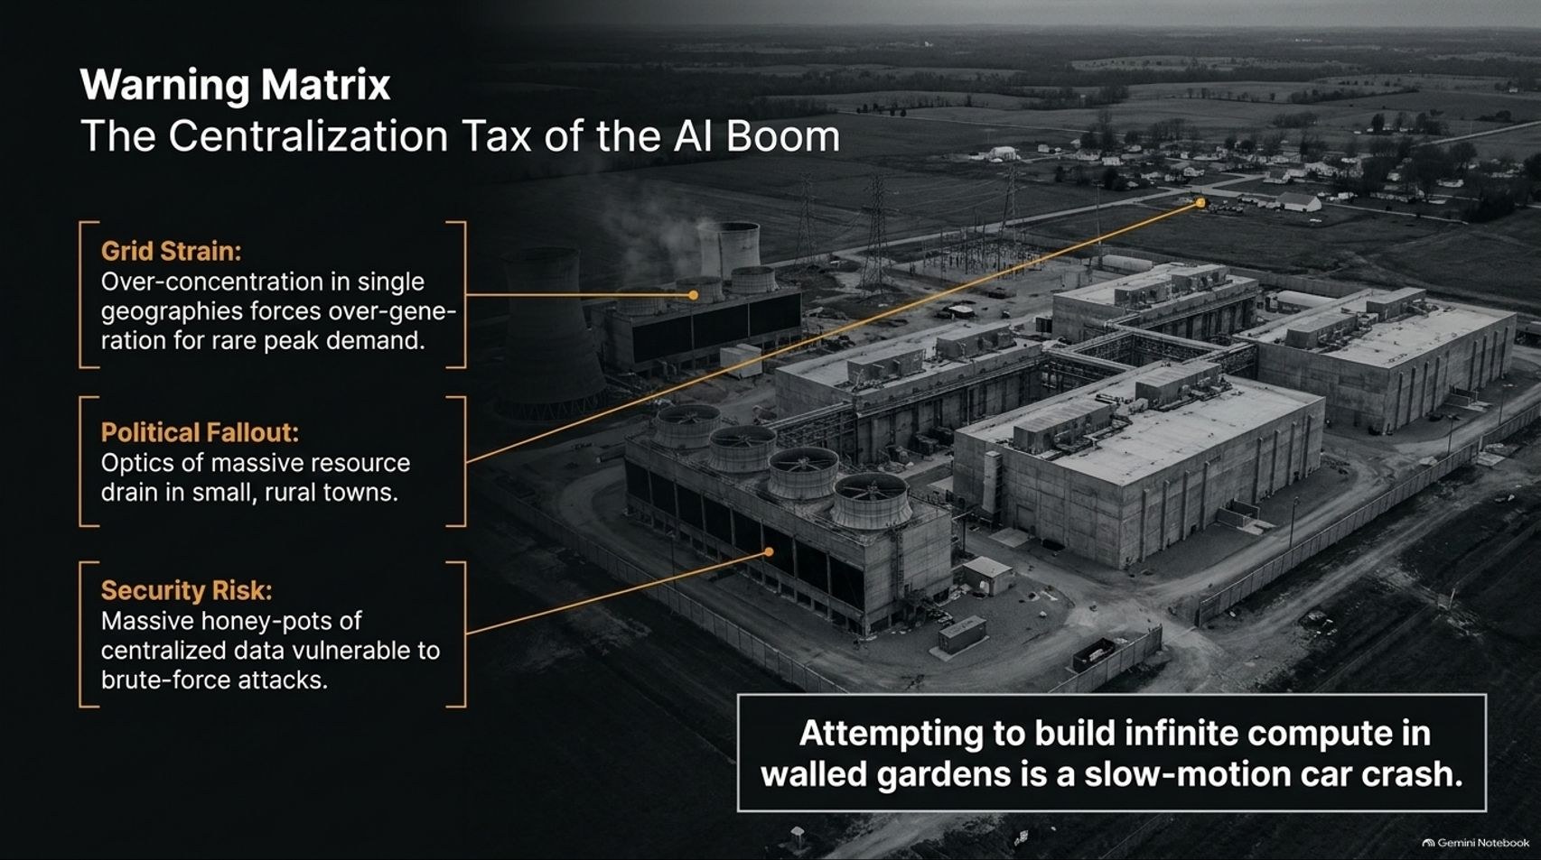
Notes:
Slide Title: Warning Matrix: The Centralization Tax of the AI Boom
Core Theme: Grid strain from over-concentration, political fallout in small rural towns, and security risks from massive centralized data honeypots. Attempting to build infinite compute in walled gardens is a slow-motion car crash.
Speaker Notes (Estimated Delivery Time: 3–5 Minutes):
"As the artificial intelligence industry scales, it is currently marching down a dangerous path of centralization—what we call The Centralization Tax of the AI Boom.
When tech giants attempt to build massive mega-facilities and data centers concentrated in single geographic locations, it triggers severe consequences:
Grid Strain: Over-concentration forces local utilities to over-generate power continuously just to prepare for rare peak demands.
Political Fallout: The optics of a massive resource drain in small, rural towns create intense friction and community backlash.
Security Risk: Centralized mega-facilities create massive honeypots of sensitive data that remain highly vulnerable to brute-force attacks.
As Tilman Holloway points out, attempting to build infinite compute inside isolated walled gardens is a slow-motion car crash."

Slide 4
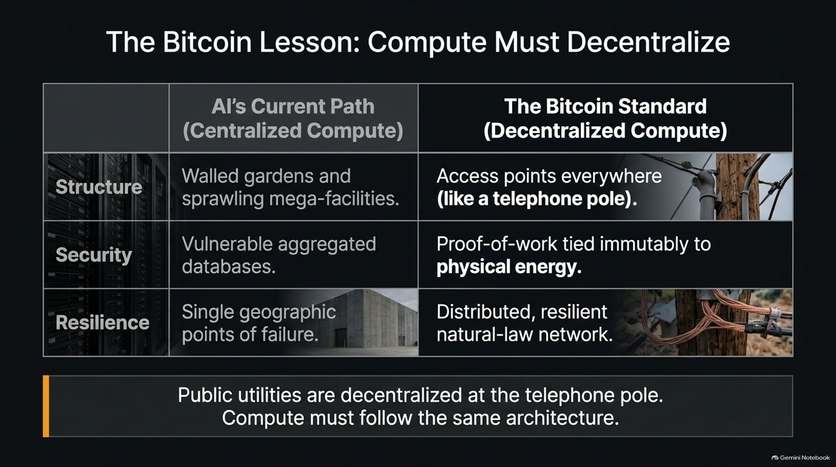
Notes:
Slide Title: The Bitcoin Lesson: Compute Must Decentralize
Core Theme: Comparing centralized AI compute (walled gardens, vulnerable databases, single points of failure) with decentralized compute inspired by Bitcoin (access points everywhere like telephone poles, proof-of-work tied to physical energy, distributed natural-law networks).
Speaker Notes (Estimated Delivery Time: 4–5 Minutes):
"The AI industry has a lot to learn from the path that Bitcoin and crypto forged before it. Specifically, compute must decentralize.
Look at the structural contrast:
AI’s Current Path (Centralized Compute): Relies on sprawling mega-facilities, vulnerable aggregated databases, and single geographic points of failure.
The Bitcoin Standard (Decentralized Compute): Features access points everywhere—much like public utilities decentralized at the telephone pole—with proof-of-work tied immutably to physical energy across a resilient natural-law network.
Just as public electrical utilities are distributed across thousands of local nodes, compute infrastructure must follow the exact same decentralized architecture to survive."

Slide 5
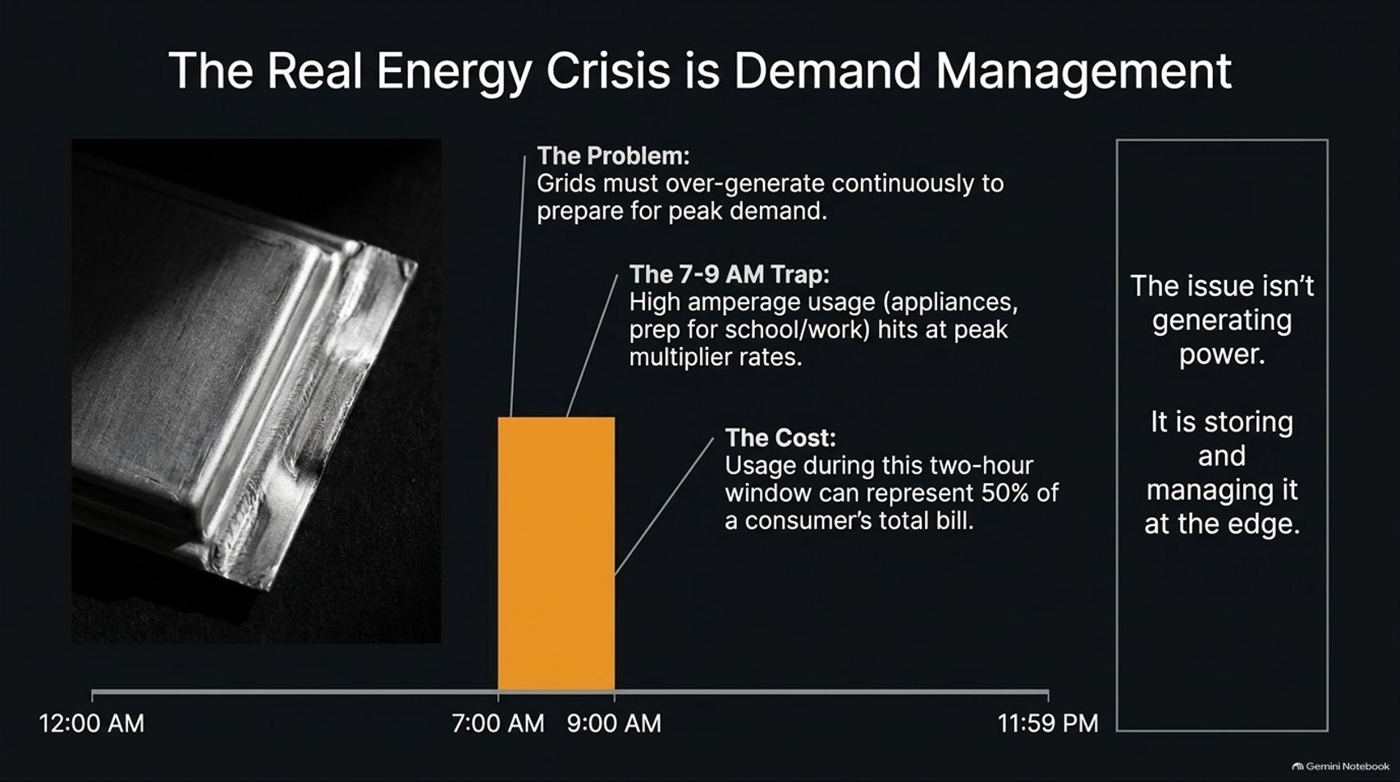
Notes:
Slide Title: The Real Energy Crisis is Demand Management
Core Theme: Grids must over-generate continuously for peak demand (like the 7-9 AM school/work rush representing 50% of bills). The issue isn't generating power; it's storing and managing it at the edge.
Speaker Notes (Estimated Delivery Time: 3–5 Minutes):
"When people discuss the energy crisis surrounding AI and modern grids, they usually focus on power generation. But as Tilman Holloway emphasizes, the real energy crisis is demand management.
Power grids are forced to over-generate continuously simply to prepare for rare peak demand spikes. Consider the 7-9 AM Trap: when every household wakes up, turns on appliances, and prepares for school or work, high amperage usage hits during peak multiplier rates. Usage during this single two-hour window can represent up to 50% of a consumer's total monthly utility bill.
The core problem isn't a lack of generating capacity; it is our inability to store and manage power intelligently at the edge."

Slide 6
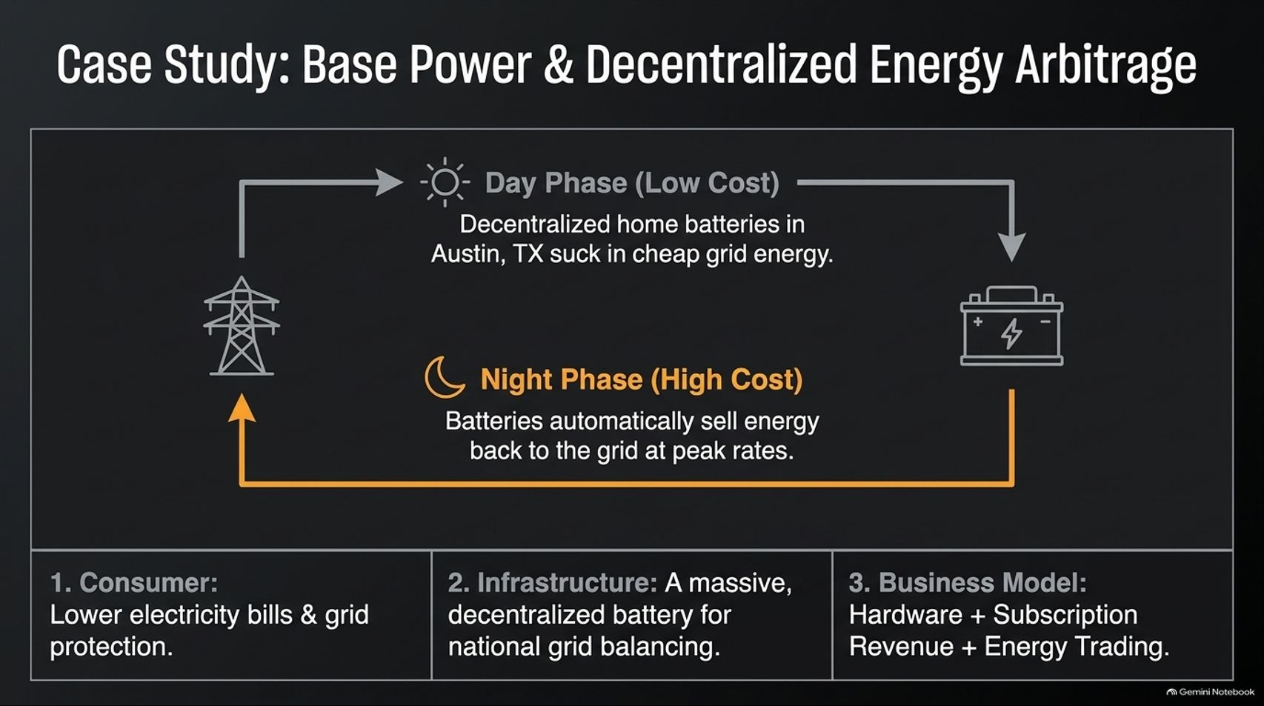

Slide 7
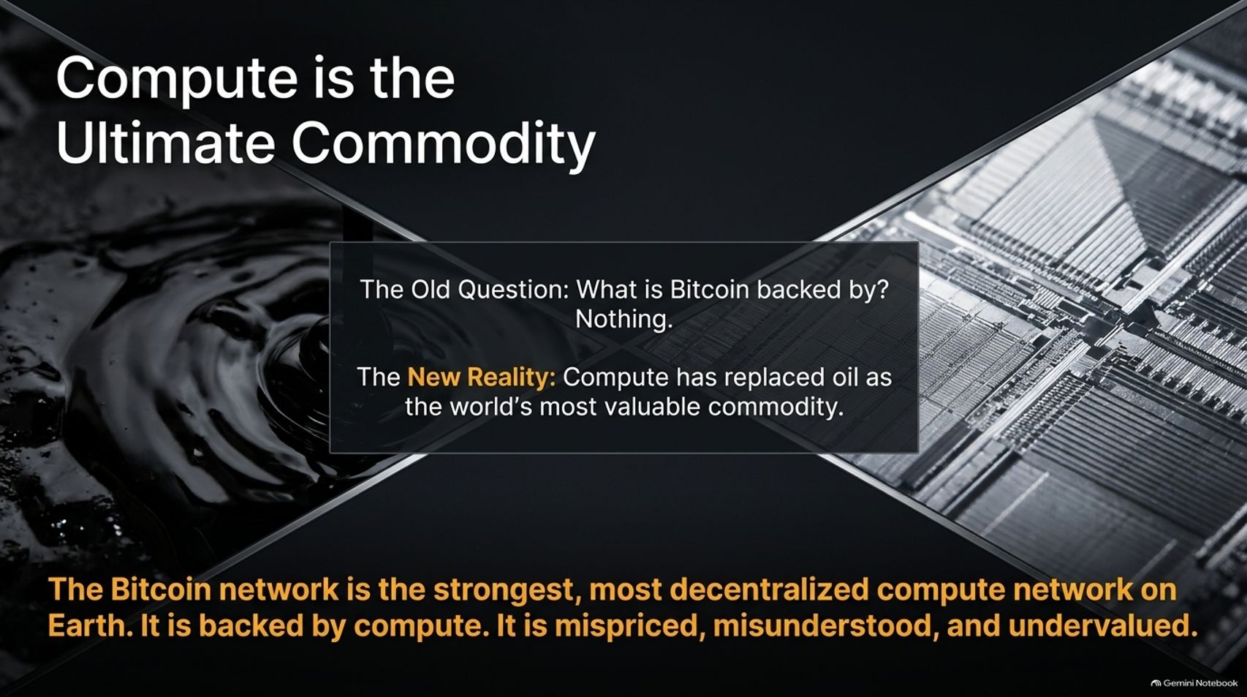
Notes:
Slide Title: Compute is the Ultimate Commodity
Core Theme: Moving past the old question ("What is Bitcoin backed by?"). Compute has replaced oil as the world's most valuable commodity, and Bitcoin is backed by the strongest decentralized compute network on Earth.
Speaker Notes (Estimated Delivery Time: 3–5 Minutes):
"For years, critics asked the old question: 'What is Bitcoin backed by? Nothing.'
But we have entered a new reality: Compute has replaced oil as the world's most valuable commodity. The Bitcoin network is the strongest, most secure, and most decentralized compute network on the planet. It is backed directly by verifiable compute and physical energy consumption.
Because traditional analysts failed to recognize compute as the ultimate backing layer, Bitcoin has historically been deeply mispriced, misunderstood, and undervalued by legacy financial institutions."

Slide 8
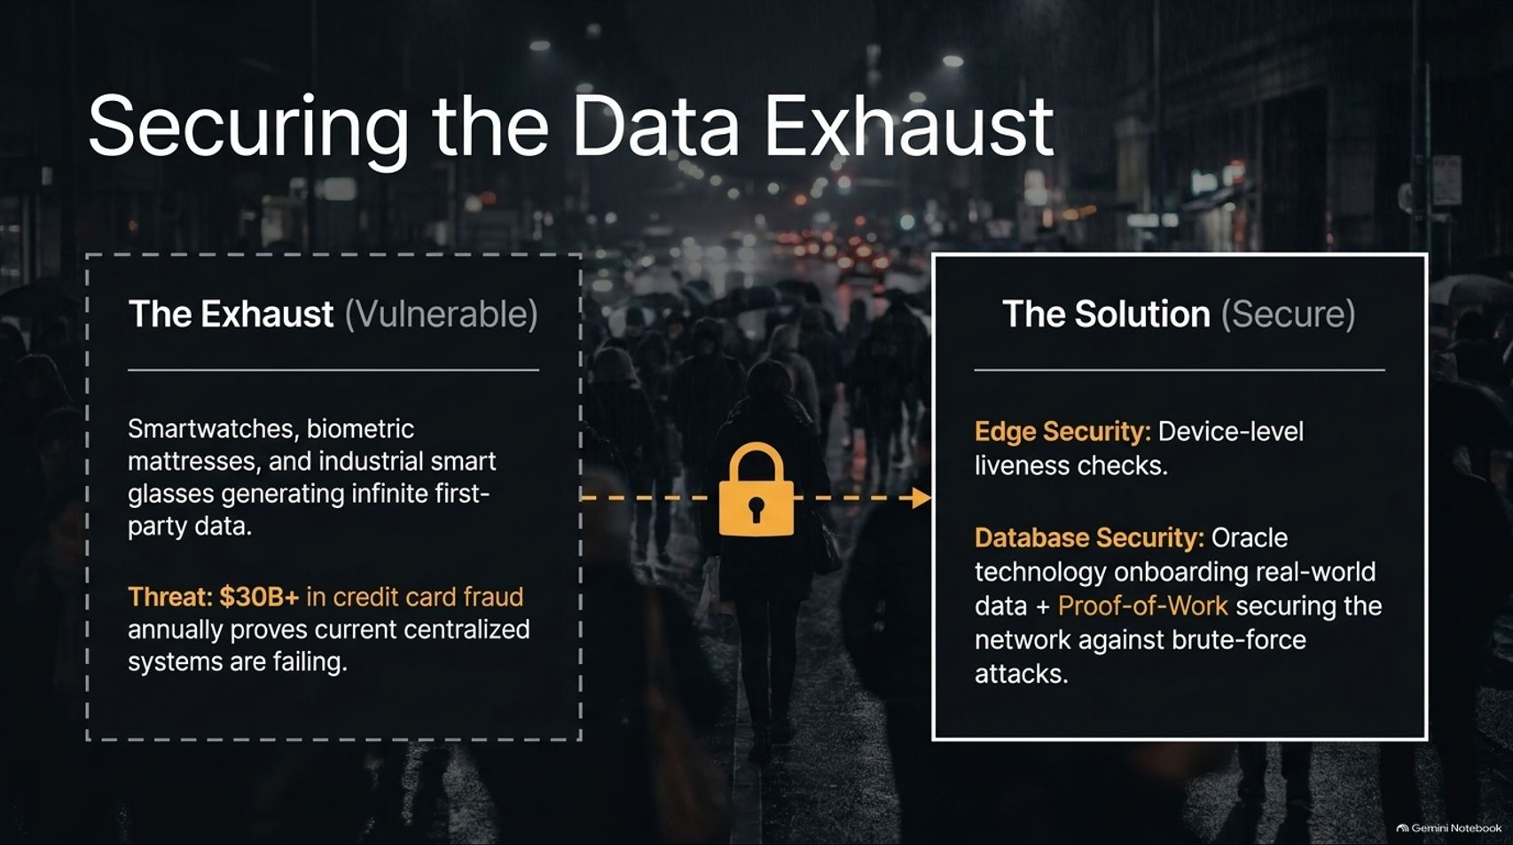
Notes:
Slide Title: Securing the Data Exhaust
Core Theme: Smartwatches, biometric mattresses, and smart glasses generate infinite first-party data. Securing this exhaust requires edge security (liveness checks) and database security (oracles + proof-of-work).
Speaker Notes (Estimated Delivery Time: 4–5 Minutes):
"Every aspect of our daily lives now generates a massive stream of data exhaust—from smartwatches tracking our heart rate to biometric mattresses monitoring sleep cycles and industrial smart glasses capturing worker workflows.
While this first-party data fuels AI innovation, it also presents a massive threat. With over $30 billion in credit card and identity fraud occurring annually, current centralized databases are proving entirely inadequate.
To secure this data, we require a two-layered defense:
Edge Security: Device-level liveness checks verifying human presence and identity at the point of creation.
Database Security: Oracle technology onboarding real-world data securely, combined with Proof-of-Work blockchains to secure networks against brute-force attacks."

Slide 9
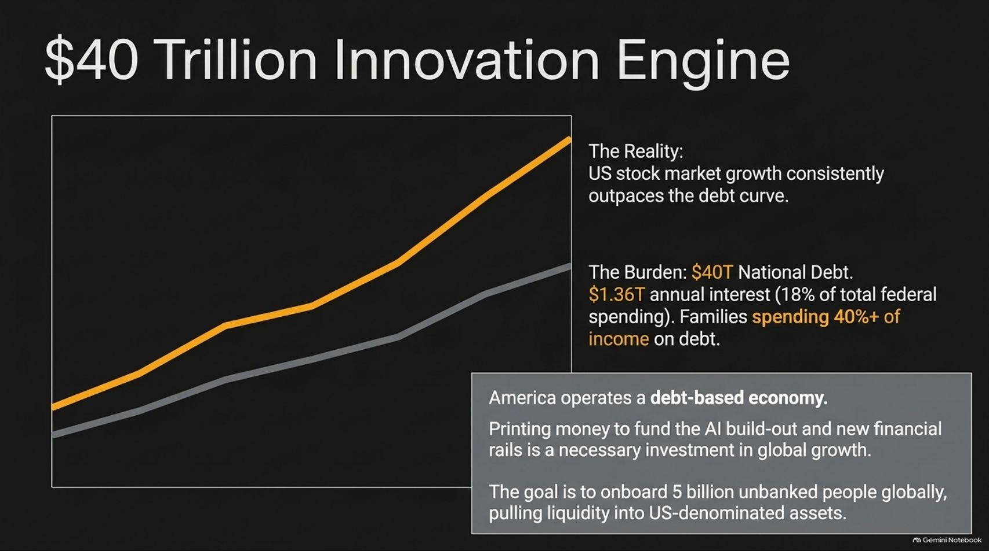
Notes:
Slide Title: $40 Trillion Innovation Engine
Core Theme: US stock market growth consistently outperforms the debt curve. America operates a debt-based consumer economy where printing money to fund AI and new financial rails is an investment in global growth and onboarding 5 billion unbanked people.
Speaker Notes (Estimated Delivery Time: 4–5 Minutes):
"When evaluating the US national debt—sitting at $40 trillion with $1.36 trillion in annual interest (consuming roughly 18% of federal spending)—critics often point to unsustainability. However, historical data reveals a crucial counter-reality: US stock market growth consistently outperforms the national debt curve.
America operates a dynamic, debt-based consumer economy. Deploying capital and expanding monetary rails to fund the AI infrastructure build-out is a necessary investment in future global growth. The ultimate strategic goal is to onboard up to 5 billion unbanked and unbitcoined individuals globally, pulling their liquidity directly into US-denominated assets and stablecoins."

Slide 10
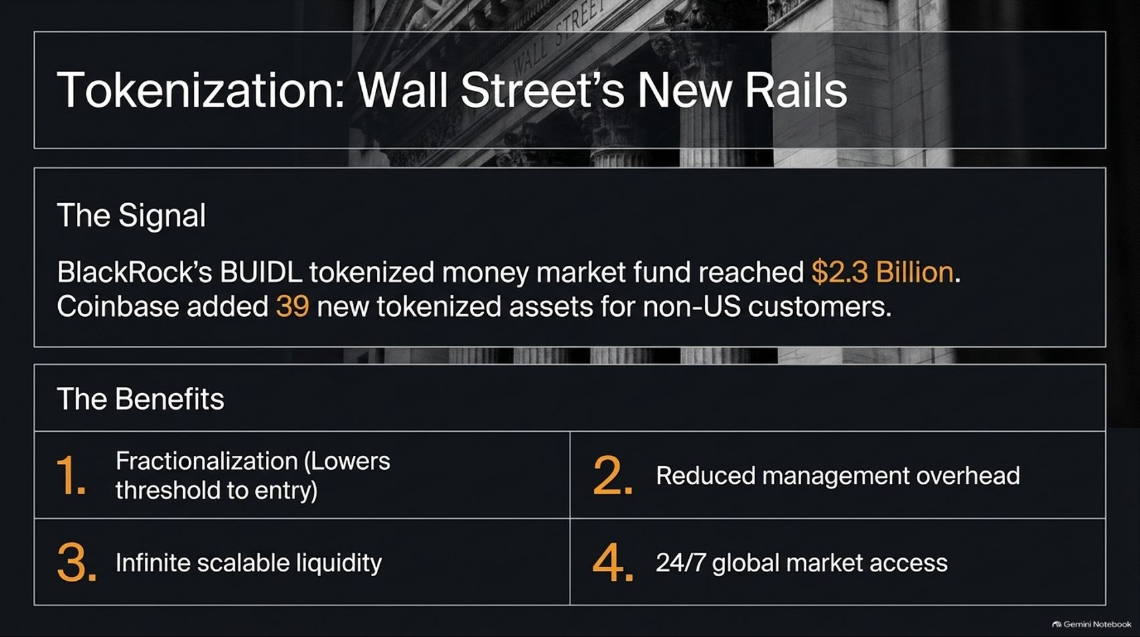
Notes:
Slide Title: Tokenization: Wall Street's New Rails
Core Theme: BlackRock’s BUIDL tokenized money market fund reached $2.3 Billion, and Coinbase added 39 tokenized assets. Benefits include fractionalization, reduced overhead, infinite scalable liquidity, and 24/7 global market access.
Speaker Notes (Estimated Delivery Time: 3–5 Minutes):
"Traditional finance is no longer ignoring digital assets; Wall Street is actively building new rails through tokenization.
The market signals are undeniable: BlackRock’s BUIDL tokenized money market fund recently surged to $2.3 billion, while major platforms like Coinbase continue rapidly expanding tokenized asset offerings for global customers.
The structural benefits of tokenized financial rails are profound:
Fractionalization: Lowers barriers to entry for global investors.
Reduced Management Overhead: Eliminates legacy intermediary friction.
Infinite Scalable Liquidity: Connects pools of capital instantly.
24/7 Global Market Access: Operates continuously without traditional closing bells."

Slide 11
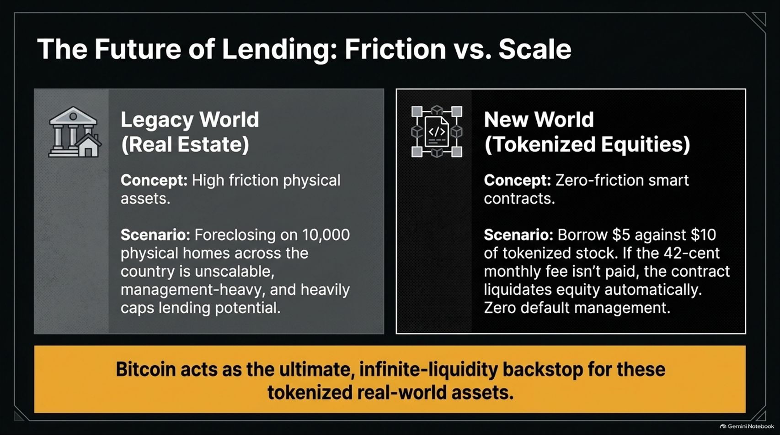
Notes:
Slide Title: The Future of Lending: Friction vs. Scale
Core Theme: Legacy real estate lending is high-friction and unscalable (foreclosing on 10,000 homes is management-heavy). Tokenized equities and smart contracts enable automated, zero-friction micro-lending where defaults are managed automatically. Bitcoin acts as the ultimate liquidity backstop.
Speaker Notes (Estimated Delivery Time: 4–5 Minutes):
"Tokenization is fundamentally transforming the future of lending by eliminating friction.
In the Legacy World of real estate, lending is encumbered by physical friction. Foreclosing on thousands of physical homes across the country is unscalable, management-heavy, and heavily restricts lending potential.
In the New World of tokenized equities and smart contracts, lending operates with zero friction. For example, a user can borrow against tokenized stock; if a monthly fee or margin requirement isn't met, the smart contract liquidates equity automatically with zero default management overhead. Ultimately, Bitcoin acts as the ultimate, infinite-liquidity backstop for these tokenized real-world assets."

Slide 12
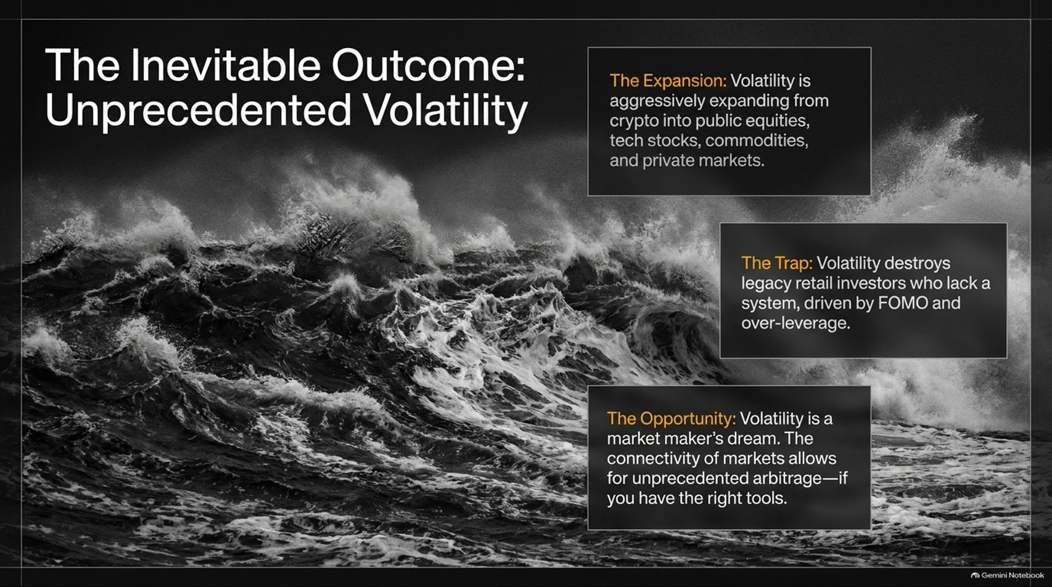
Notes:
Slide Title: The Inevitable Outcome: Unprecedented Volatility
Core Theme: Volatility is expanding from crypto into public equities, tech stocks, commodities, and private markets. It traps overleveraged retail investors but serves as a market maker's dream for cross-market arbitrage.
Speaker Notes (Estimated Delivery Time: 3–4 Minutes):
"As all these financial and technological systems converge, unprecedented market volatility is the inevitable outcome.
This volatility is no longer confined to cryptocurrency markets; it is actively expanding into public equities, mega-cap tech stocks, commodities, and private markets.
For legacy retail investors driven by FOMO and over-leverage, this volatility is a destructive trap. However, for sophisticated participants equipped with the right tools, volatility is a market maker's dream—enabling unprecedented cross-market arbitrage across highly connected global exchanges."

Slide 13
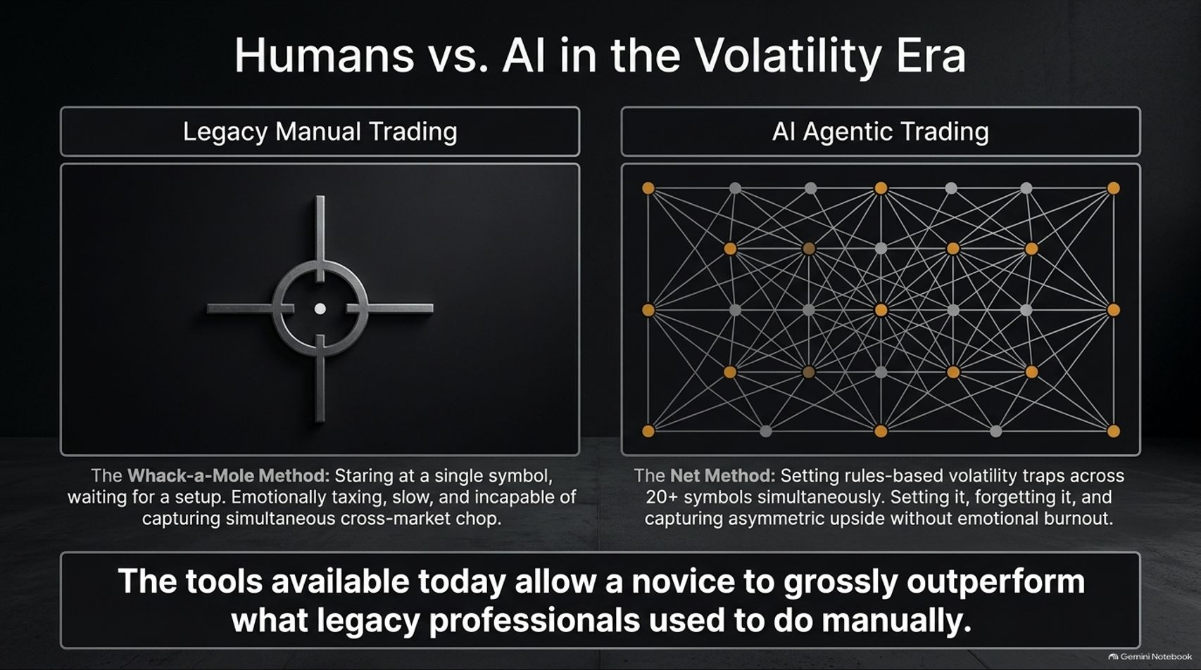
Notes:
Slide Title: Humans vs. AI in the Volatility Era
Core Theme: Legacy manual trading relies on the exhausting "Whack-a-Mole" method (staring at one symbol). AI agentic trading utilizes the "Net Method" (setting rules-based volatility traps across 20+ symbols simultaneously). Modern tools allow novices to outperform legacy professionals.
Speaker Notes (Estimated Delivery Time: 3–5 Minutes):
"In this new high-volatility era, human traders face a stark bottleneck. Legacy manual trading relies on what we call the Whack-a-Mole Method—staring exhaustively at a single trading symbol, waiting for a setup, suffering from emotional burnout, and missing simultaneous cross-market chop.
In contrast, AI Agentic Trading utilizes the Net Method—deploying automated rules-based volatility traps across 20 or more symbols simultaneously. You set it, forget it, and capture asymmetric upside without emotional fatigue. As Tilman Holloway notes, the tools available today allow a disciplined novice using automated systems to grossly outperform what legacy professionals used to do manually."

Slide 14
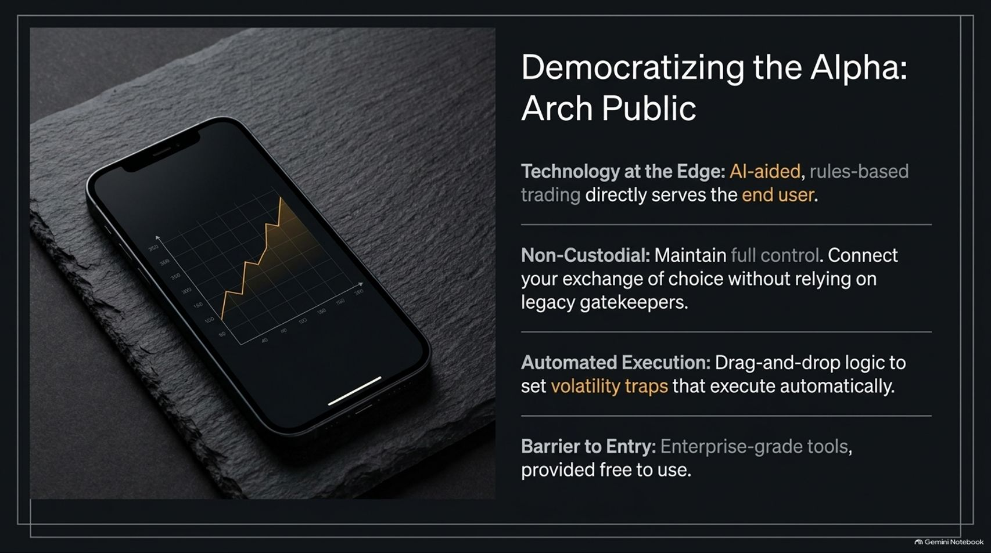
Notes:
Slide Title: Democratizing the Alpha: Arch Public
Core Theme: Bringing AI-aided, rules-based trading directly to the end user. Non-custodial connectivity, drag-and-drop automated execution, and enterprise-grade tools provided free to use.
Speaker Notes (Estimated Delivery Time: 3–4 Minutes):
"Platforms like Arch Public are actively democratizing financial alpha by bringing institutional-grade technology directly to the everyday investor.
Key pillars of this democratization include:
Technology at the Edge: AI-aided, rules-based trading tools built directly for end users.
Non-Custodial Control: Users maintain full custody by connecting their exchange of choice without relying on legacy gatekeepers.
Automated Execution: Drag-and-drop logic allows users to set volatility traps that execute autonomously.
Zero Barrier to Entry: Providing enterprise-grade trading tools completely free to use.
By removing intermediaries, users gain direct control over their financial futures."

Slide 15
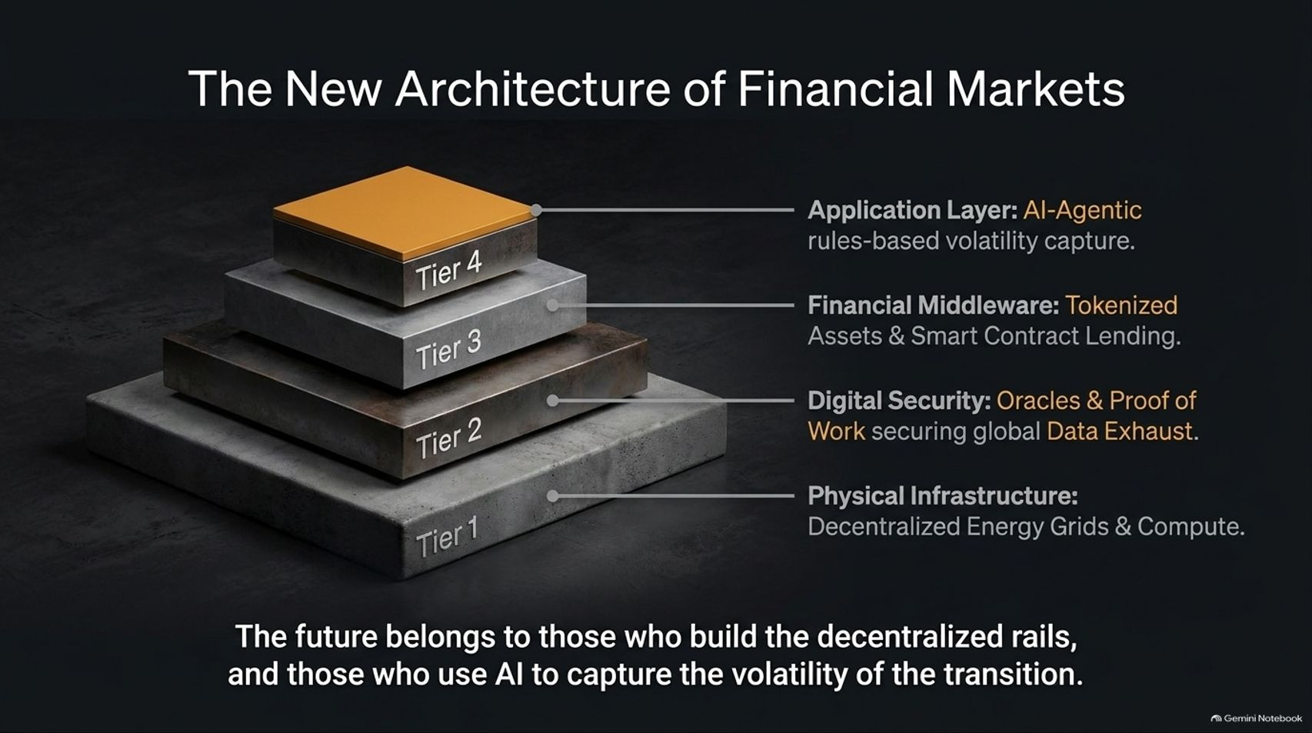
Notes:
Slide Title: The New Architecture of Financial Markets
Core Theme: A four-tier stack: Physical Infrastructure (Tier 1: Decentralized energy grids & compute), Digital Security (Tier 2: Oracles & Proof of Work securing data exhaust), Financial Middleware (Tier 3: Tokenized assets & smart contract lending), and Application Layer (Tier 4: AI-agentic rules-based volatility capture).
Speaker Notes (Estimated Delivery Time: 4–5 Minutes):
"If we look at how the future is being constructed, we can visualize The New Architecture of Financial Markets as a robust four-tier stack:
Tier 1 (Physical Infrastructure): Decentralized energy grids and distributed compute nodes powering the AI revolution.
Tier 2 (Digital Security): Oracles and Proof-of-Work networks securing global data exhaust against brute-force attacks.
Tier 3 (Financial Middleware): Tokenized real-world assets and automated smart contract lending rails.
Tier 4 (Application Layer): AI-agentic, rules-based volatility capture serving end users directly.
The future belongs to those who build these decentralized rails and use AI to capture the volatility of the transition."

Slide 16
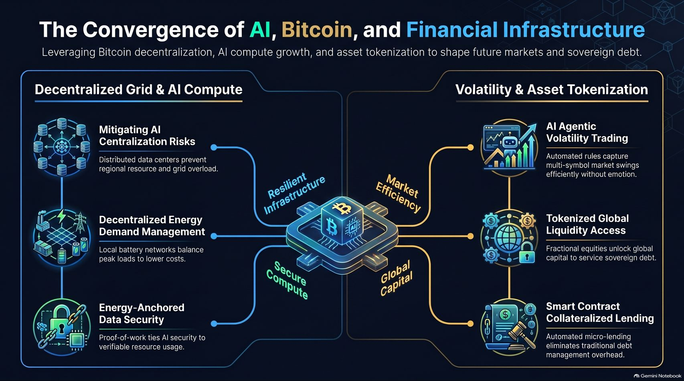
Notes:
Slide Title: The Convergence of AI, Bitcoin, and Financial Infrastructure
Core Theme: Final comprehensive summary uniting resilient infrastructure (decentralized data centers, energy demand management, energy-anchored security) with market efficiency and global capital access through Bitcoin as the anchor.
Speaker Notes (Estimated Delivery Time: 3–5 Minutes):
"As we conclude our journey through The Great Convergence, let's review the master blueprint connecting AI, Bitcoin, and global financial infrastructure:
Resilient Infrastructure: Mitigating centralization risks via distributed data centers, balancing peak loads with decentralized battery networks, and anchoring data security to Proof-of-Work energy.
Market Efficiency & Global Capital: Deploying AI agentic volatility trading, unlocking global liquidity access through fractional tokenized assets, and eliminating administrative overhead via smart contract micro-lending.
At the very center of this architecture sits Bitcoin—serving as the unbreakable, decentralized anchor for secure compute and sovereign financial freedom. Thank you."

