Slide 1

Notes:
Slide Title: The Tectonic Market
Core Theme: Why structural fragility is building toward a crisis beneath a calm surface, featuring insights from Cem Karsan and Noel Smith of Kai Asset Management.
Speaker Notes (Estimated Delivery Time: 2–3 Minutes):
"Welcome, everyone. Today we are examining one of the most complex structural setups in modern financial history: The Tectonic Market.
On the surface, broad equity indices often reflect deceptive calm, moving in tight upward drifts. But beneath that surface, immense potential energy and violent single-stock rotations are building up.
As Cem Karsan and Noel Smith, co-CIOs of Kai Asset Management, discuss in their macro framework, we are operating in a market defined by deep structural fragility. Over the next few minutes, we will break down why this latent energy is accumulating, how options flows pin the index, and how institutional allocators can navigate the coming tectonic release."
Why Market Fragility is Building into a Crisis in 2027 | Cem Karsan & Noel Smith
https://www.youtube.com/watch?v=VUIv4gAsYqA

Slide 2

Notes:
Slide Title: The Paradox of the Sumo Market
Core Theme: Broad indices reflect low volatility and upward drift, but beneath the surface lies immense potential energy. As Cem Karsan notes, we are in a "sumo market" where everything is held together by structural flows until the last sand pile triggers a massive tail event.
Speaker Notes (Estimated Delivery Time: 3–4 Minutes):
"To understand our current environment, we must recognize the paradox of what Cem Karsan calls the Sumo Market.
On the surface, broad equity indices reflect historically low volatility, moving in a tight, upward drift. However, beneath the hood, immense potential energy and violent single-stock rotations are accumulating.
To quote Cem Karsan directly: 'It’s two tectonic plates. Even though things aren’t moving, there’s immense potential pressure building under the hood... we are in a sumo market where all it takes is that last sand pile to trigger a massive tail event.' The absence of movement does not mean the absence of risk; it simply means pressure is compounding."

Slide 3
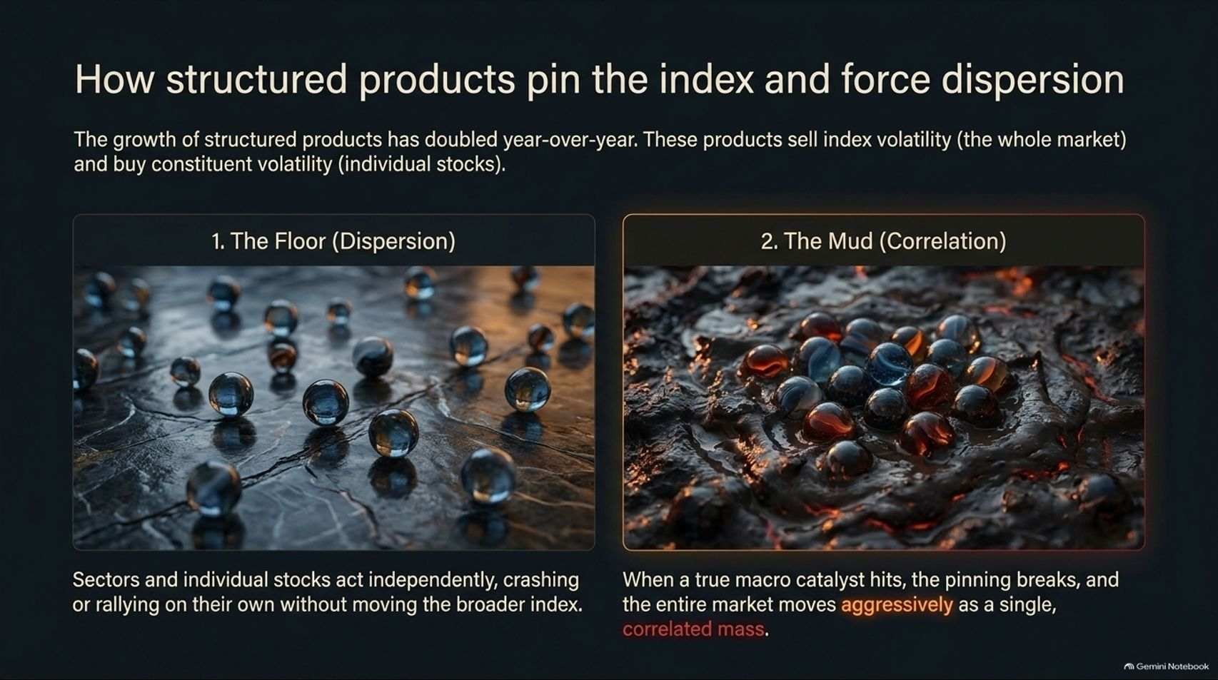
Notes:
Slide Title: How structured products pin the index and force dispersion
Core Theme: Structured products sell index volatility (the whole market) and buy constituent volatility (individual stocks). This creates a "Floor" of dispersion where sectors act independently, while macroeconomic pressure builds a "Mud" of high correlation when pinning breaks.
Speaker Notes (Estimated Delivery Time: 3–5 Minutes):
"What is holding this sumo market together? Structured products. The growth of structured products has doubled year-over-year. These products operate by selling index volatility—suppressing the broad market—while buying constituent volatility across individual stocks.
This dynamic creates two distinct realities:
The Floor (Dispersion): Sectors and individual stocks act independently, crashing or rallying on their own without moving the broader index.
The Mud (Correlation): When a true macro catalyst hits, the pinning breaks, and the entire market moves aggressively as a single, correlated mass.
This structural carry trade has been profitable, but it stores up massive latent energy for the left tail."

Slide 4
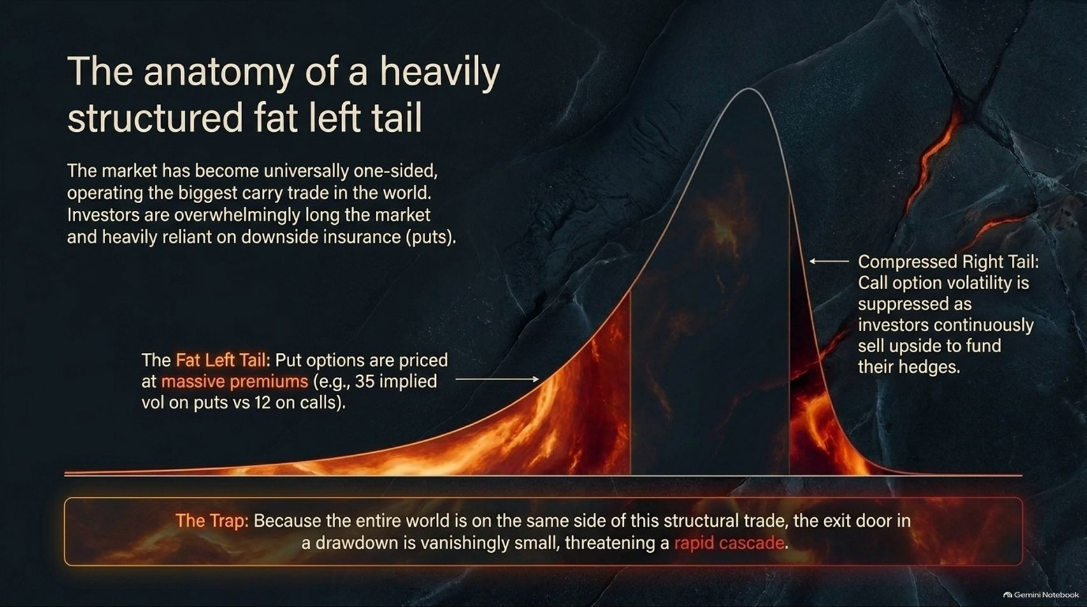
Notes:
Slide Title: The anatomy of a heavily structured fat left tail
Core Theme: The market is universally one-sided, operating the biggest carry trade in the world. Put options are priced at massive premiums (e.g., 35 implied vol vs. 12 on calls), creating a dangerous trap where the exit door during a drawdown is vanishingly small.
Speaker Notes (Estimated Delivery Time: 4–5 Minutes):
"When we examine the options surface, we see the anatomy of a heavily structured fat left tail.
The market has become universally one-sided, operating what is effectively the largest carry trade in the world. Investors are overwhelmingly long the market and heavily reliant on downside insurance via put options.
Consequently, put options are priced at massive premiums—for example, trading at 35 implied volatility compared to just 12 on calls. Because the entire world is on the same side of this structural trade, the exit door in a drawdown is vanishingly small, threatening a rapid, cascading liquidity crunch."

Slide 5
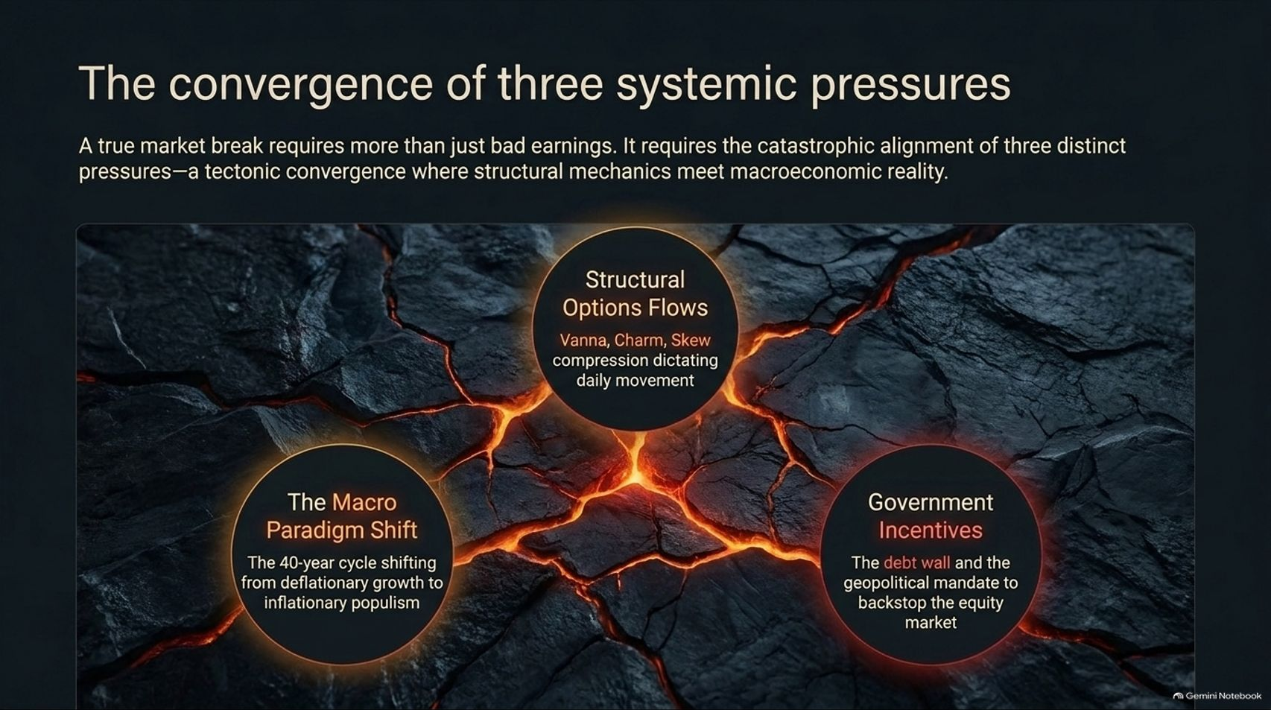
Notes:
Slide Title: The convergence of three systemic pressures
Core Theme: A true market break requires the catastrophic alignment of three distinct forces: Structural Options Flows (Vanna, Charm, Skew), The Macro Paradigm Shift (deflationary growth to inflationary populism), and Government Incentives (the debt wall and the equity backstop mandate).
Speaker Notes (Estimated Delivery Time: 3–5 Minutes):
"A true market break requires more than just bad earnings. It requires the catastrophic alignment of three distinct pressures—a tectonic convergence where structural mechanics meet macroeconomic reality:
Structural Options Flows: Vanna, charm, and skew compression dictating daily price movement.
The Macro Paradigm Shift: The 40-year cycle shifting decisively from deflationary growth to inflationary populism.
Government Incentives: The immovable debt wall and the geopolitical mandate for authorities to backstop the equity market."

Slide 6
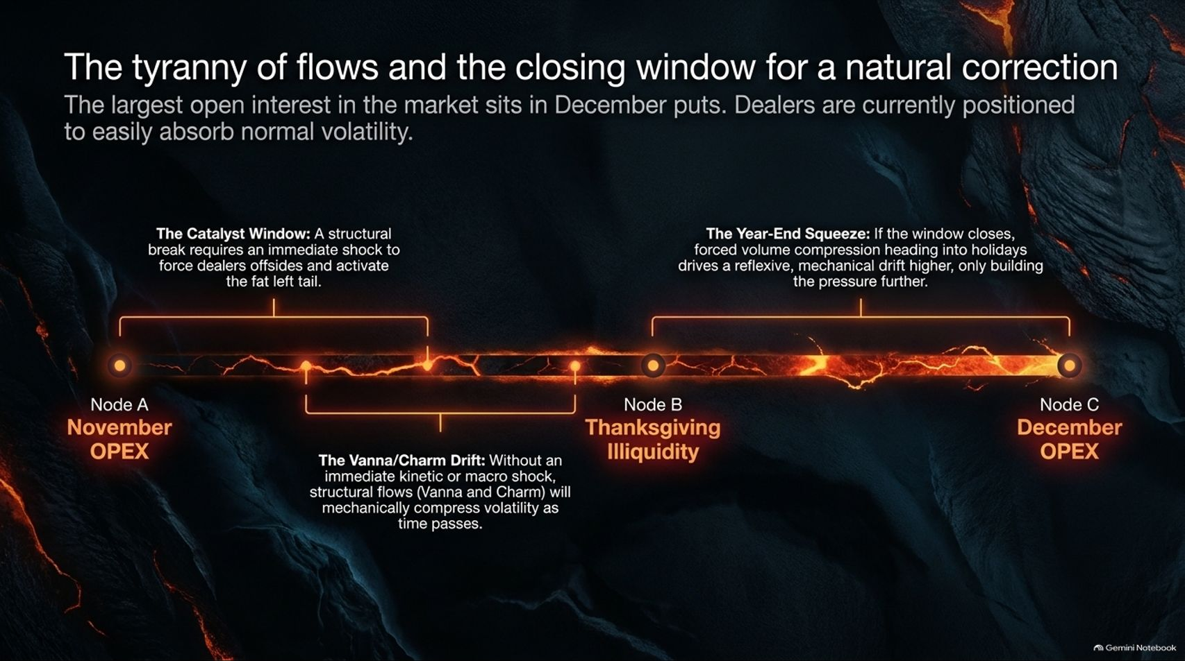

Slide 7
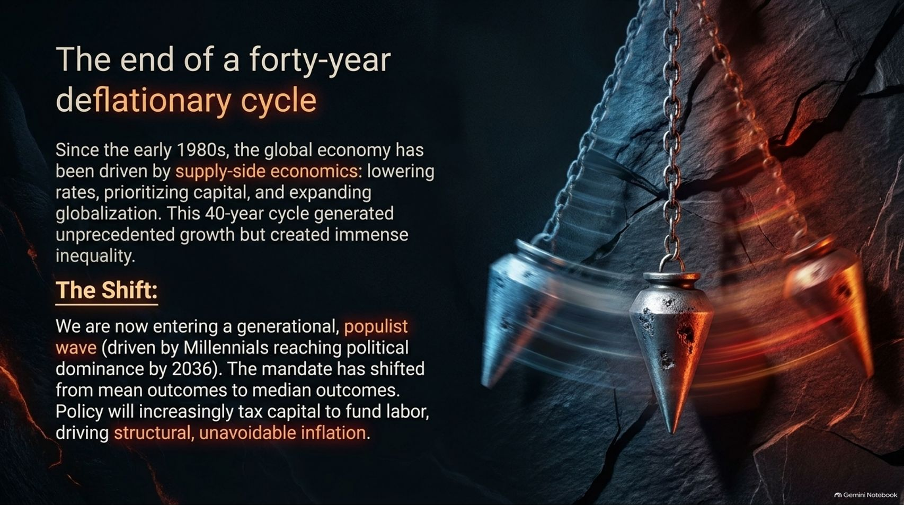
Notes:
Slide Title: The end of a forty-year deflationary cycle
Core Theme: Since the early 1980s, supply-side economics prioritized capital and globalization, creating growth but immense inequality. We are entering a generational populist wave where policy taxes capital to fund labor, driving structural inflation.
Speaker Notes (Estimated Delivery Time: 4–5 Minutes):
"To understand the macro forces at play, we must recognize the end of a forty-year deflationary cycle.
Since the early 1980s, the global economy has been driven by supply-side economics: lowering interest rates, prioritizing capital, and expanding globalization. While this 40-year cycle generated unprecedented technological growth, it also created immense wealth inequality.
We are now entering a generational, populist wave—accelerated by Millennials reaching political dominance. The political mandate has fundamentally shifted from mean outcomes to median outcomes. Policy will increasingly tax capital to fund labor, driving structural, unavoidable inflation."

Slide 8
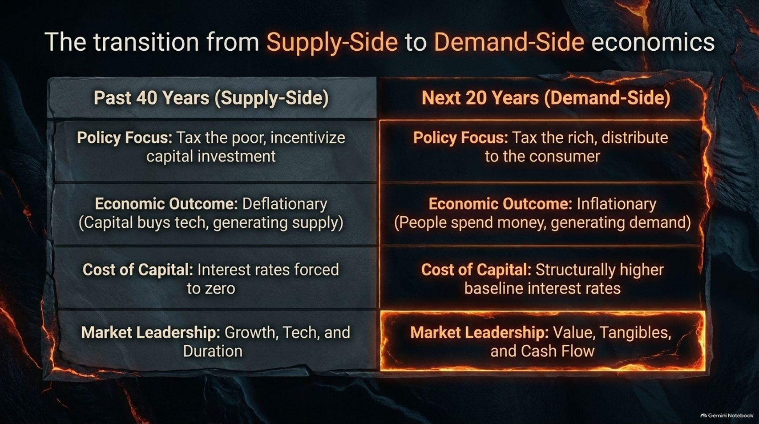
Notes:
Slide Title: The transition from Supply-Side to Demand-Side Economics
Core Theme: Comparing the past 40 years (tax the poor, zero rates, growth/tech leadership) with the next 20 years (tax the rich, distribute to consumers, structurally higher baseline interest rates, value/tangibles leadership).
Speaker Notes (Estimated Delivery Time: 4–5 Minutes):
"This table outlines the profound transition from Supply-Side to Demand-Side economics:
Policy Focus: Shifting from taxing the poor and incentivizing capital investment to taxing the rich and distributing purchasing power directly to consumers.
Economic Outcome: Moving from deflationary capital-generated supply to inflationary consumer-generated demand.
Cost of Capital: Transitioning from interest rates forced to zero to structurally higher baseline interest rates.
Market Leadership: Shifting away from growth, tech, and duration toward Value, Tangibles, and Cash Flow."

Slide 9
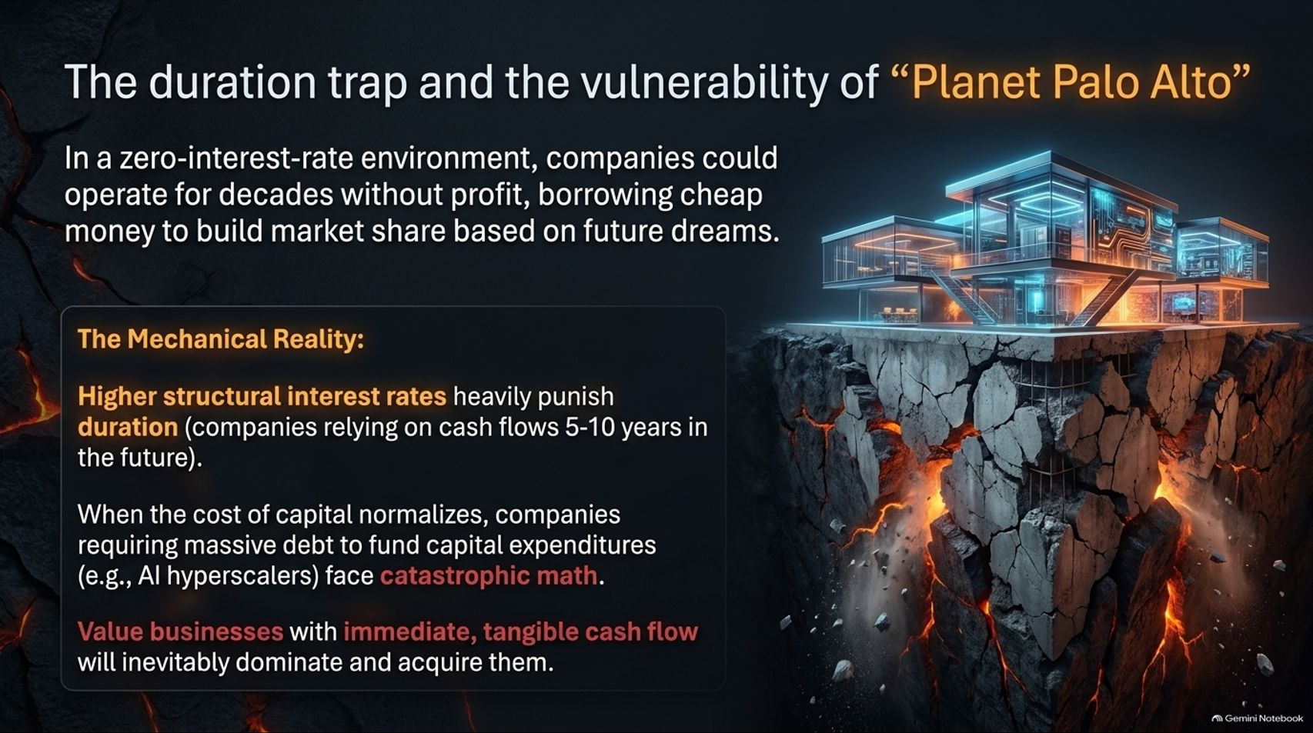
Notes:
Slide Title: The duration trap and the vulnerability of "Planet Palo Alto"
Core Theme: In a zero-interest-rate environment, companies operated for decades without profit. Higher structural interest rates punish duration and capital-intensive business models (like AI hyperscalers), making value businesses with immediate cash flow dominant.
Speaker Notes (Estimated Delivery Time: 4–5 Minutes):
"In a zero-interest-rate environment, companies could operate for decades without profit, borrowing cheap money to build market share based on future dreams—a phenomenon we call 'Planet Palo Alto'.
But higher structural interest rates heavily punish duration—meaning companies relying on cash flows 5 to 10 years in the future face catastrophic math. When the cost of capital normalizes, companies requiring massive debt to fund capital expenditures, such as AI hyperscalers, face severe pressure. Value businesses with immediate, tangible cash flow will inevitably dominate and acquire them."

Slide 10
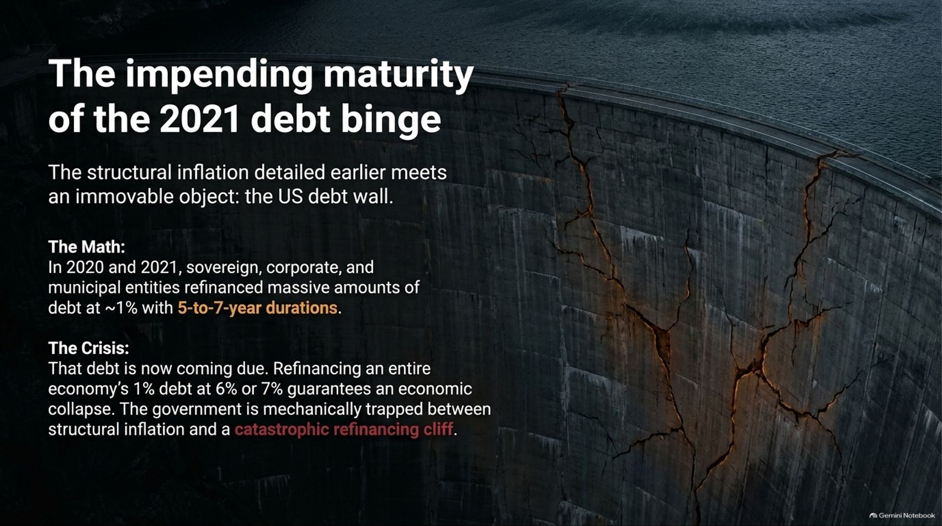
Notes:
Slide Title: The impending maturity of the 2021 debt binge
Core Theme: Sovereign, corporate, and municipal entities refinanced massive debt at ~1% in 2020-2021 with 5-to-7-year durations. Refinancing that debt at 6% or 7% guarantees economic collapse, trapping the government between inflation and a refinancing cliff.
Speaker Notes (Estimated Delivery Time: 4–5 Minutes):
"Structural inflation now meets an immovable object: the US debt wall.
In 2020 and 2021, sovereign, corporate, and municipal entities refinanced massive amounts of debt at roughly 1% interest with 5-to-7-year durations. That debt is now coming due.
Refinancing an entire economy's 1% debt stack at 6% or 7% guarantees severe economic dislocation. The government is mechanically trapped between structural inflation and a catastrophic refinancing cliff."

Slide 11
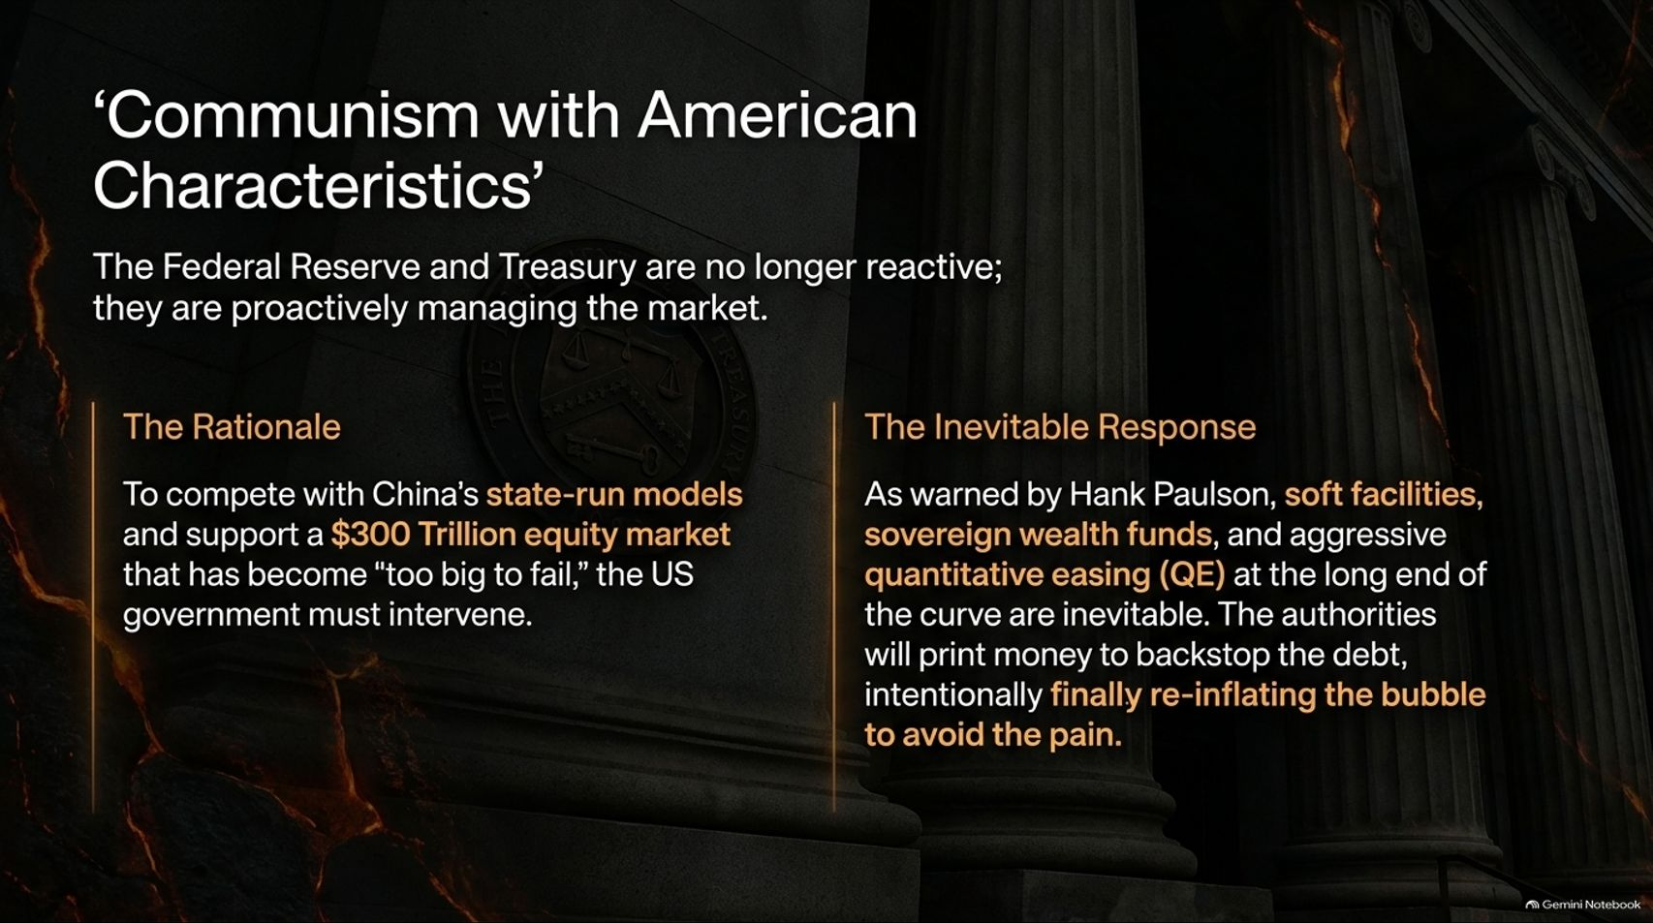
Notes:
Slide Title: ‘Communism with American Characteristics’
Core Theme: The Fed and Treasury are proactively managing the market. To compete with China and support a $300 Trillion equity market that is "too big to fail," authorities are forced to deploy soft facilities, sovereign wealth funds, and aggressive QE to re-inflate the bubble.
Speaker Notes (Estimated Delivery Time: 4–5 Minutes):
"Faced with this debt wall, the Federal Reserve and Treasury are no longer reactive; they are proactively managing the market.
To compete with China’s state-run models and support a $300 trillion equity market that has become 'too big to fail,' the US government must intervene. As warned by figures like Hank Paulson regarding a coming Treasury crisis, soft facilities, sovereign wealth funds, and aggressive quantitative easing (QE) at the long end of the curve are inevitable. Authorities will print money to backstop the debt, intentionally re-inflating the bubble to avoid systemic collapse."

Slide 12
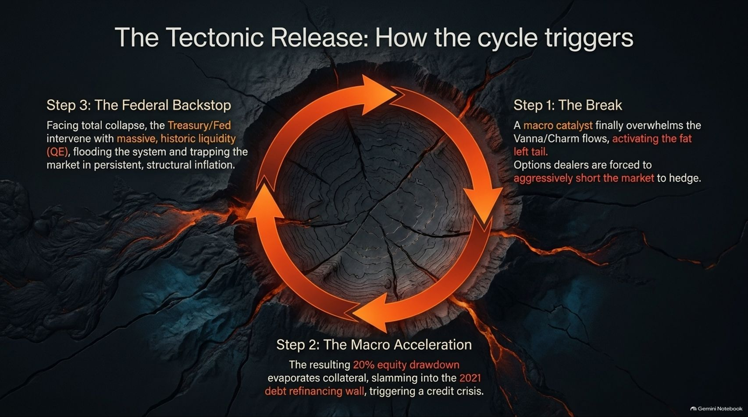
Notes:
Slide Title: The Tectonic Release: How the cycle triggers
Core Theme: Step 1: A macro catalyst overwhelms Vanna/Charm flows, activating the fat left tail. Step 2: A 20% equity drawdown evaporates collateral, slamming into the 2021 debt refinancing wall. Step 3: The Treasury/Fed intervene with massive QE, trapping the market in persistent structural inflation.
Speaker Notes (Estimated Delivery Time: 4–5 Minutes):
"Let's trace how this tectonic cycle triggers in practice:
Step 1 (The Break): A macro catalyst finally overwhelms Vanna and Charm flows, activating the fat left tail and forcing options dealers to aggressively short the market to hedge.
Step 2 (The Macro Acceleration): The resulting 20% equity drawdown evaporates collateral, slamming directly into the 2021 debt refinancing wall and triggering a credit crisis.
Step 3 (The Federal Backstop): Facing total collapse, the Treasury and Fed intervene with massive, historic liquidity (QE), flooding the system and permanently trapping the market in persistent structural inflation."

Slide 13
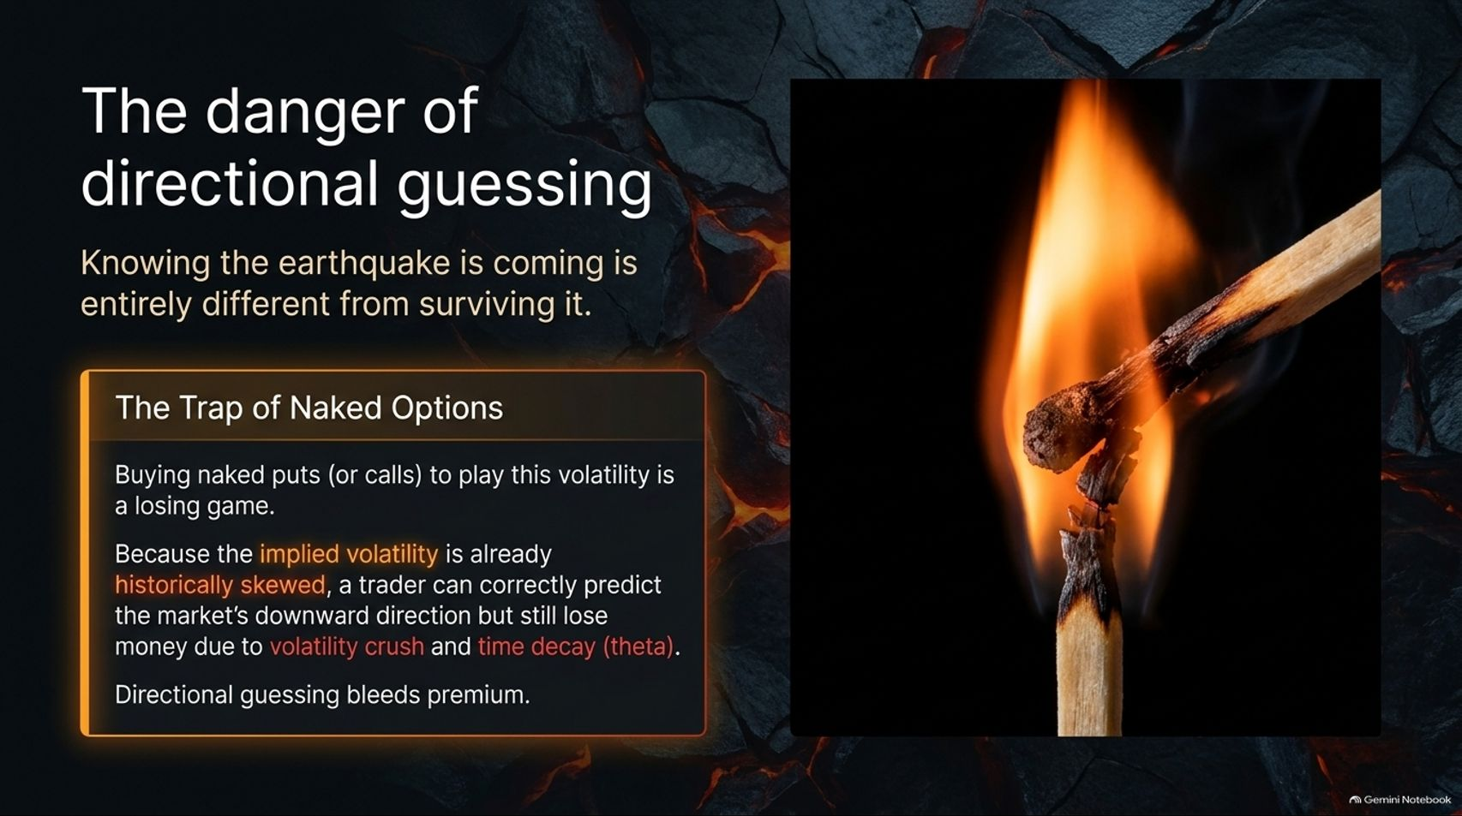

Slide 14
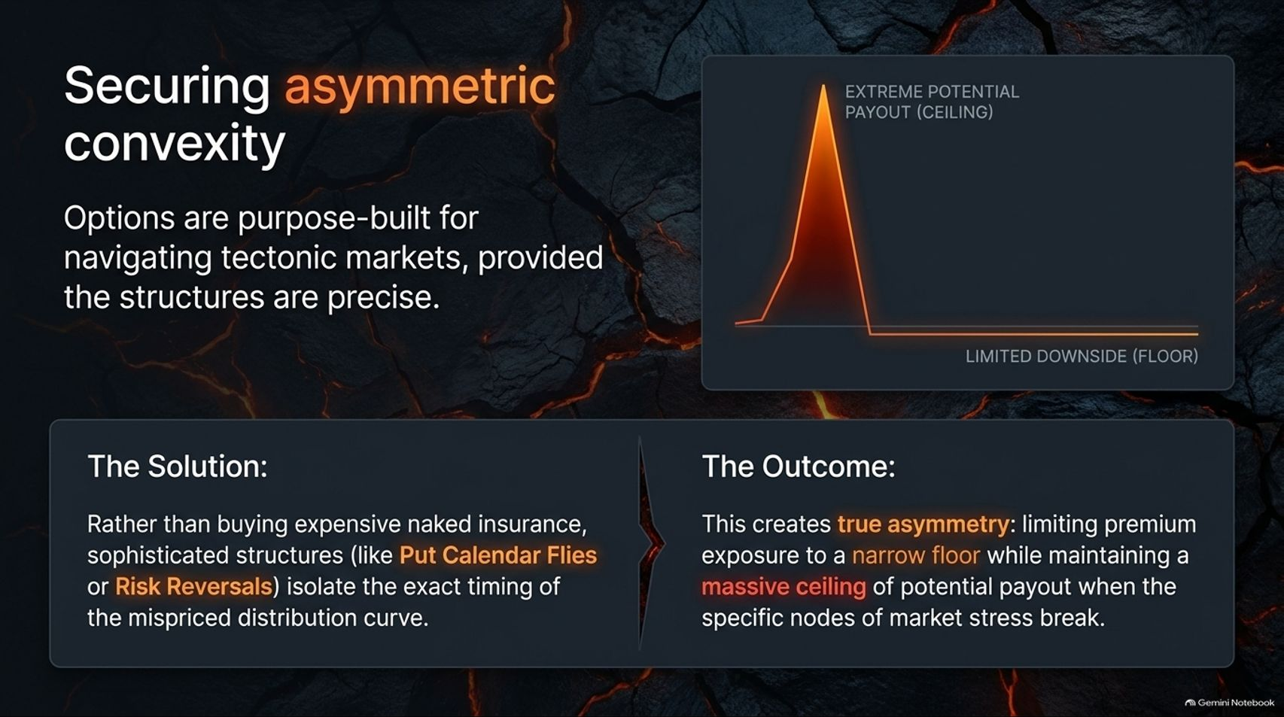

Slide 15
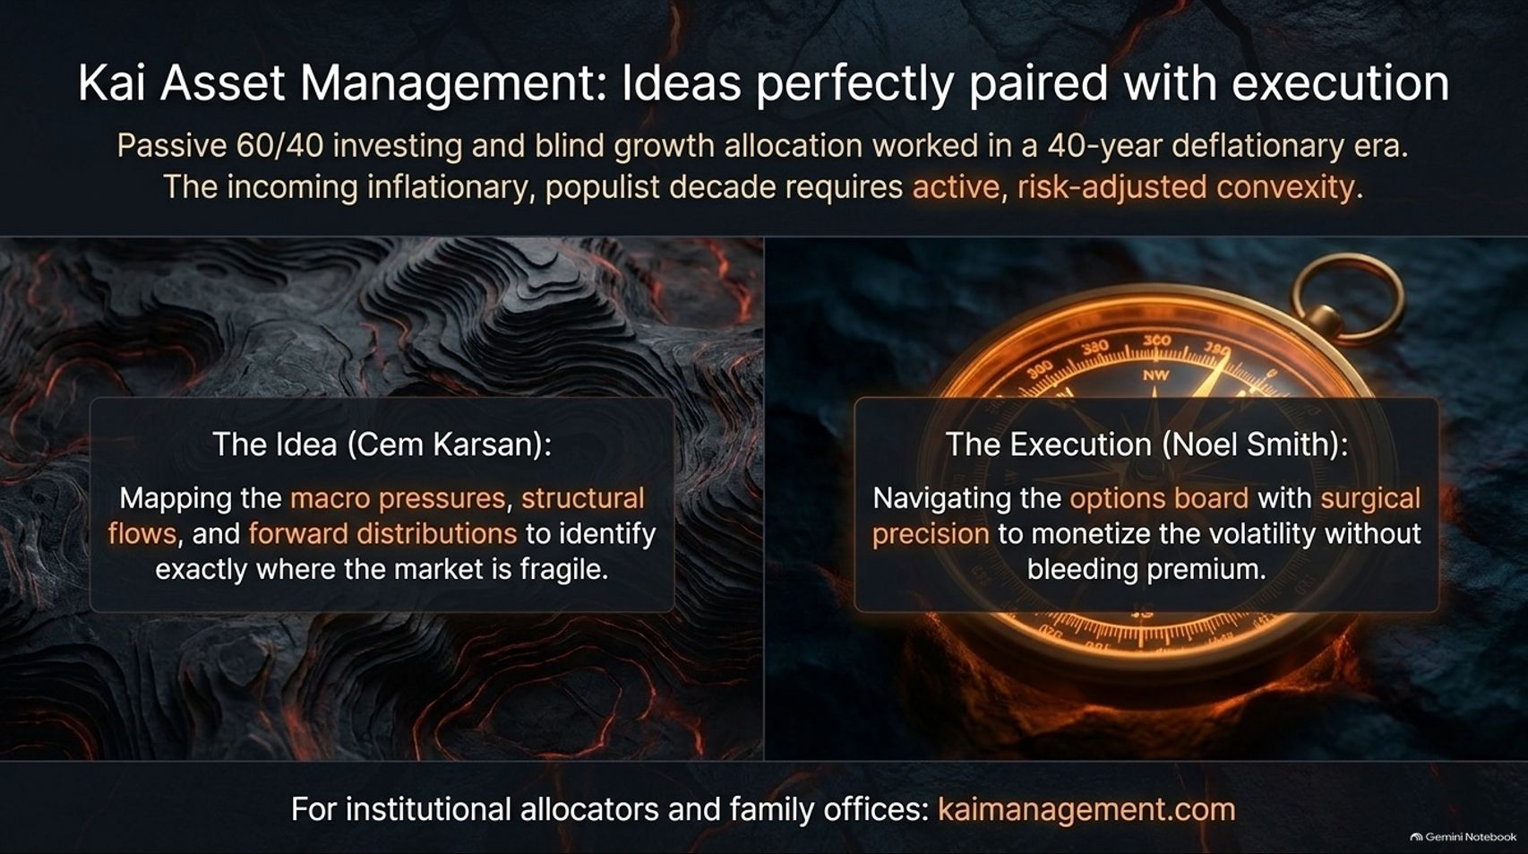
Notes:
Slide Title: Kai Asset Management: Ideas perfectly paired with execution
Core Theme: Passive 60/40 investing worked in a 40-year deflationary era; the incoming inflationary populist decade requires active, risk-adjusted convexity. Cem Karsan maps the macro pressures, while Noel Smith navigates the options board with surgical precision.
Speaker Notes (Estimated Delivery Time: 3–4 Minutes):
"Passive 60/40 investing and blind growth allocation worked brilliantly in a 40-year deflationary era. But the incoming inflationary, populist decade requires active, risk-adjusted convexity.
At Kai Asset Management, ideas are perfectly paired with execution:
The Idea (Cem Karsan): Mapping macro pressures, structural flows, and forward distributions to identify exactly where the market is fragile.
The Execution (Noel Smith): Navigating the options board with surgical precision to monetize volatility without bleeding premium."

Slide 16
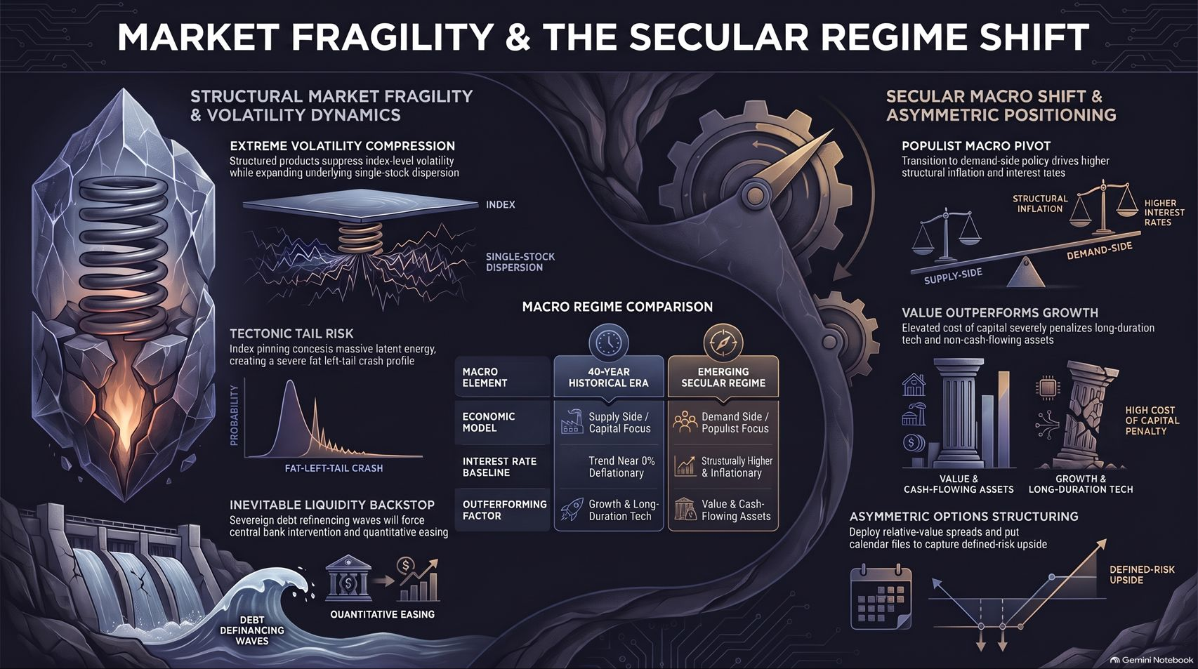
Notes:
Slide Title: Market Fragility & The Secular Regime Shift
Core Theme: Comprehensive summary uniting structural market fragility & volatility dynamics (extreme vol compression, fat-left-tail crash risk, liquidity backstops) with the secular macro shift (populist pivot, value outperforming growth, asymmetric options structuring).
Speaker Notes (Estimated Delivery Time: 4–5 Minutes):
"As we conclude our master review, this final slide summarizes Market Fragility & The Secular Regime Shift:
Structural Fragility: Extreme volatility compression via structured products is masking massive latent energy, setting up a severe fat-left-tail crash profile that will ultimately force central bank liquidity backstops.
Secular Macro Shift: The pivot toward demand-side populist economics guarantees structurally higher interest rates and inflation, severely penalizing long-duration tech while causing value and tangible cash-flowing assets to outperform.
Asymmetric Structuring: Deploying relative-value spreads and put calendar flies allows investors to capture defined-risk upside in an increasingly volatile world. Thank you."

