Slide 1
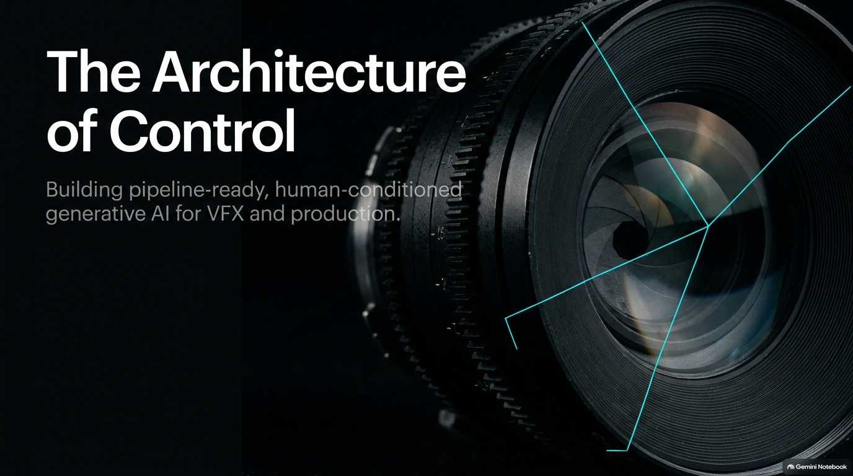
Notes:
TPC 2026 Day One: The Agentic Pipeline
https://www.youtube.com/watch?v=bWvxBu_vVes

Slide 2
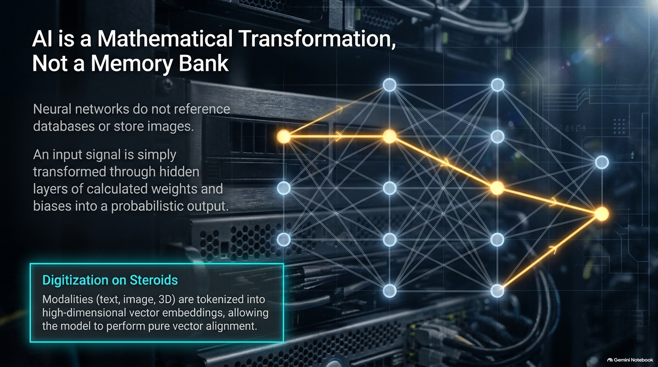
Notes:
Target Timing: 3.5 minutes (02:30 - 06:00)
Key Themes: Rapid model proliferation, web interfaces vs. studio integration, tool fatigue.
Speaker Script:
"Let's take a honest look at where the industry stands today. On one side, we have incredible standalone consumer platforms—web-based tools like Runway, Pika, Hicksfield, or Luma. They are fantastic for rapid exploration and initial concept ideation.
However, for a production pipeline, standalone web UIs present major roadblocks:
Data Isolation: Assets live in browser silos rather than connected asset management systems.
Lack of Repeatability: Generating a shot twice with identical parameters often yields vastly different results.
Non-Standard I/O: They lack deep integration into OpenUSD, ACES color management, or standard VFX shot tracking systems.
Our goal as pipeline architects isn't to replace creative discovery, but to wrap these technologies in a control structure that guarantees compliance, trackability, and determinism."

Slide 3
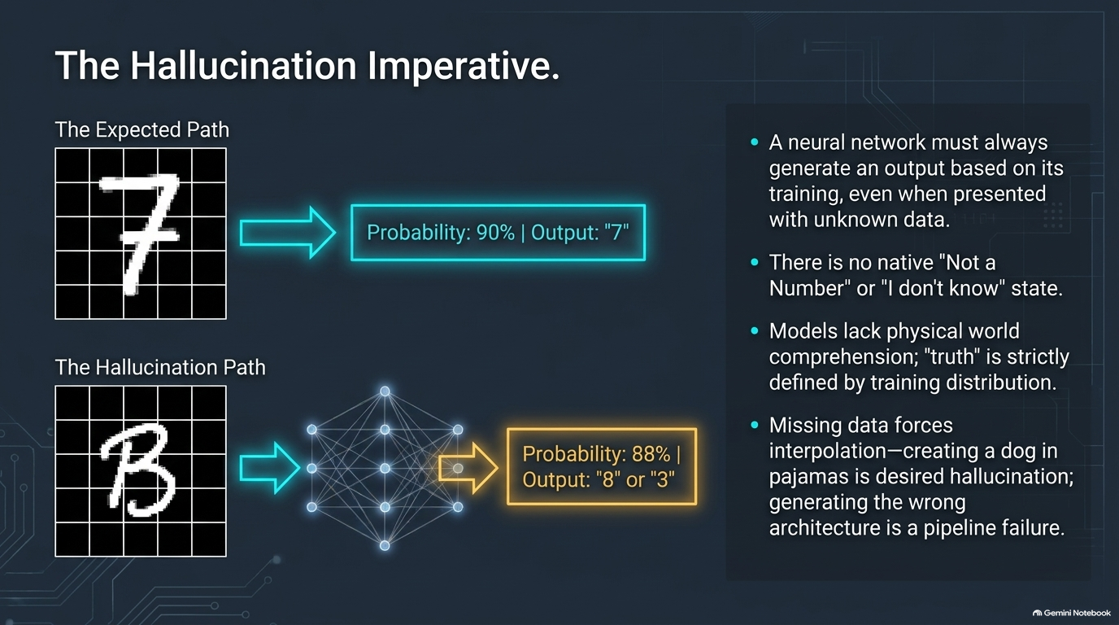
Notes:
Target Timing: 4 minutes (06:00 - 10:00)
Key Themes: Why prompt engineering fails at scale, the slot machine illusion, non-determinism.
Speaker Script:
"One of the biggest myths in generative AI is that 'prompt engineering' is the key to mastering these models.
In production engineering, relying purely on text prompts is what I call The Slot Machine Problem. You pull the lever (send a prompt), hope for a good output, and if it fails, you tweak three words and pull the lever again. You have almost zero granular control over the spatial, structural, or temporal outcome.
If a Director asks you to shift a character’s arm 10 degrees to the left or adjust the key light intensity while keeping the character's face identical, a text prompt will fail 99 times out of 100.
True pipeline control requires moving away from plain-text prompting toward structured latent control, explicit conditioning, and agentic orchestration."

Slide 4
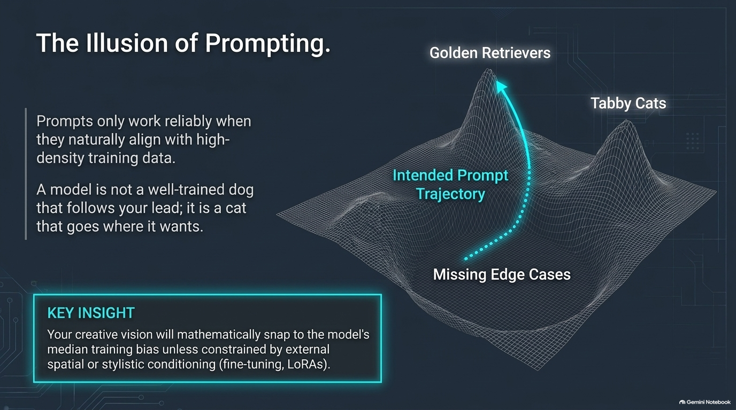
Notes:
Target Timing: 4.5 minutes (10:00 - 14:30)
Key Themes: Conceptual divide between AI labs and studio pipeline developers.
Speaker Script:
"Why is there so much frustration when bringing AI into studio workflows? It stems from a fundamental disconnect between AI researchers and creative technologists.
The AI Research Perspective: Researchers measure success using metrics like FID scores, CLIP loss, and cross-entropy evaluation across massive dataset distributions. To them, a model that generates a beautiful, plausible image 80% of the time is a success.
The Creative Engineering Perspective: Studios demand pixel-accurate continuity across 300 shots, strict compliance with art direction, precise camera focal lengths, and keyframe-level control.
Understanding this gap is the first step toward solving it. We cannot expect raw foundation models out-of-the-box to meet studio standards. It is the job of the pipeline architecture to bridge this gap."

Slide 5
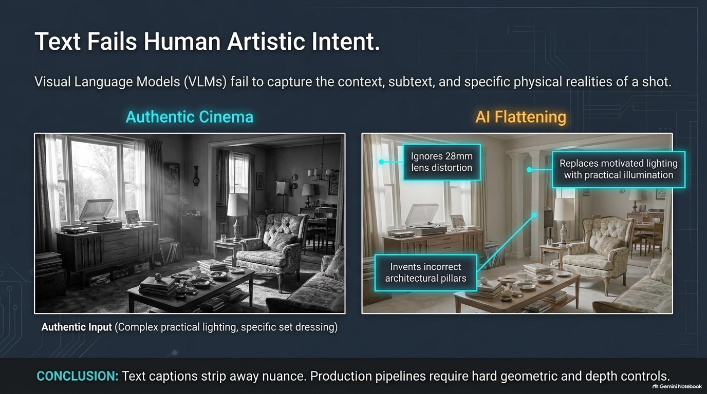
Notes:
Target Timing: 5 minutes (14:30 - 19:30)
Key Themes: Numerical vectors, hidden layers, weights & biases, activation functions.
Speaker Script:
"Before we talk about high-level agentic orchestration, let's step back and look at how these models operate at a fundamental mathematical level.
Stripped of marketing, a neural network is a set of matrix operations operating on high-dimensional vectors:
Input Layer: Every modality—text, depth maps, RGB pixels, audio—is converted into numerical embeddings.
Hidden Layers & Weights: Matrix multiplications transform input vectors through trained weights and biases.
Activation Functions & Latent Space: Non-linear transformations map concepts into a continuous mathematical latent space.
Why does this matter to pipeline developers? Because if every input and output is just a vector, we can mathematically intervene at intermediate latent layers rather than relying solely on high-level text inputs."

Slide 6
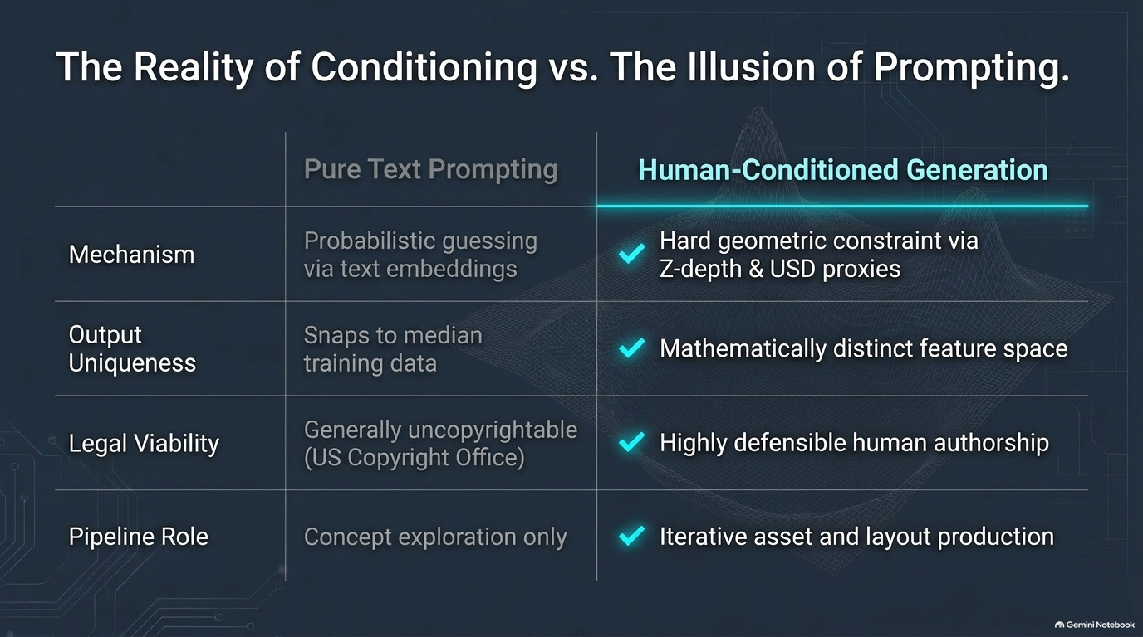
Notes:
Target Timing: 4 minutes (19:30 - 23:30)
Key Themes: Latent representation, manifold learning, semantic vectors.
Speaker Script:
"Let's explore the concept of the Latent Space. When a generative model learns from billions of images or frames, it compresses high-dimensional pixel space into a lower-dimensional latent representation.
In this latent manifold, semantic attributes—such as lighting direction, depth, subject identity, and artistic style—occupy specific directional vectors.
When we understand that latent vectors represent semantic traits, we realize that controlling a model isn't about guessing the right text words; it's about navigating and manipulating vectors in latent space using structured guidance signals."

Slide 7
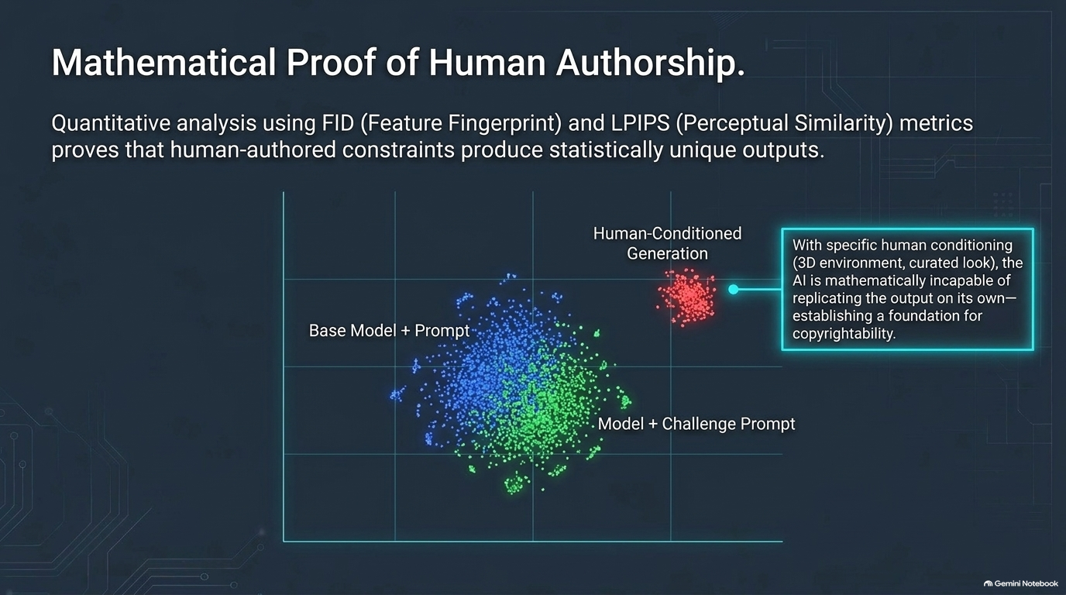
Notes:
Target Timing: 5.5 minutes (23:30 - 29:00)
Key Themes: Cross-attention mechanisms, ControlNet, IP-Adapter, spatial conditioning.
Speaker Script:
"How do we inject deterministic control into probabilistic models? Through Conditioning Mechanisms.
There are three primary conditioning pathways used in modern pipelines:
Text & Concept Conditioning (Cross-Attention): Mapping CLIP or T5 text embeddings into the UNet or Transformer backbone via cross-attention layers.
Spatial Conditioning (ControlNet / Adapter Models): Injecting explicit structural maps—such as depth passes, Canny edges, pose skeletons, or normal maps—to anchor spatial geometry.
Image & Feature Reference (IP-Adapter / InstantID): Extracting feature embeddings from target reference imagery to maintain character identity and lighting consistency.
By layering these conditioning signals, we transform a random generative process into a constrained, deterministic rendering pass."

Slide 8
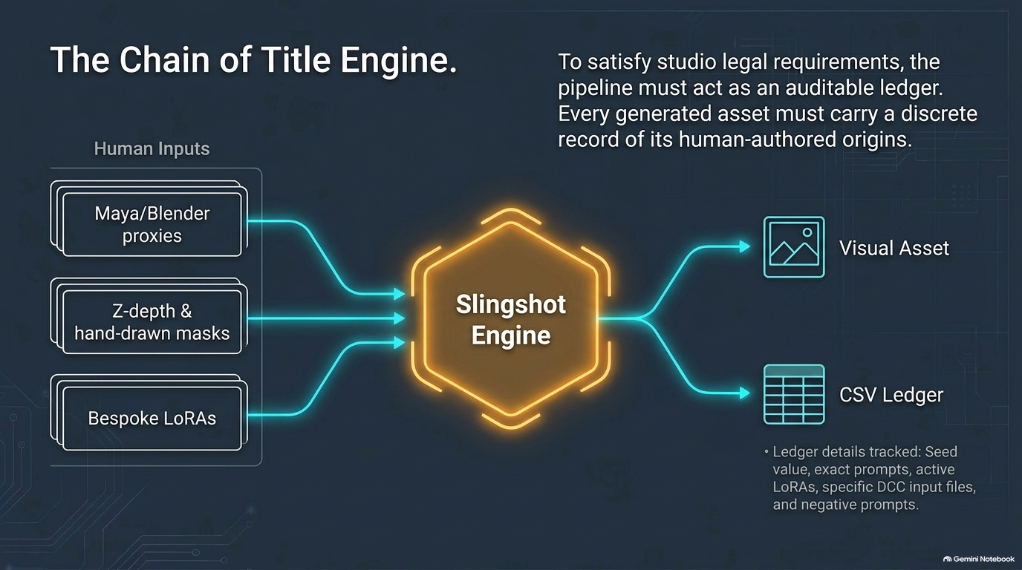
Notes:
Target Timing: 5 minutes (29:00 - 34:00)
Key Themes: Moving from single inference to multi-agent feedback loops.
Speaker Script:
"Now let's examine the transition from static AI scripts to an Agentic Pipeline.
A traditional pipeline script is linear: Input A -> Process B -> Output C.
An Agentic Pipeline, by contrast, introduces closed-loop intelligence:
Planner Agent: Deconstructs a complex creative task (e.g., 'Generate 3D concept asset options from a script sequence') into executable sub-tasks.
Worker Agents: Specialized micro-services that execute individual operations (depth generation, upscaling, relighting, 3D mesh extraction).
Evaluator / Critic Agent: Automatically validates outputs against production criteria (resolution, color space, semantic alignment) and routes failing outputs back for iteration.
This feedback loop is what replaces human 'prompt tweaking' with automated, goal-driven convergence."

Slide 9
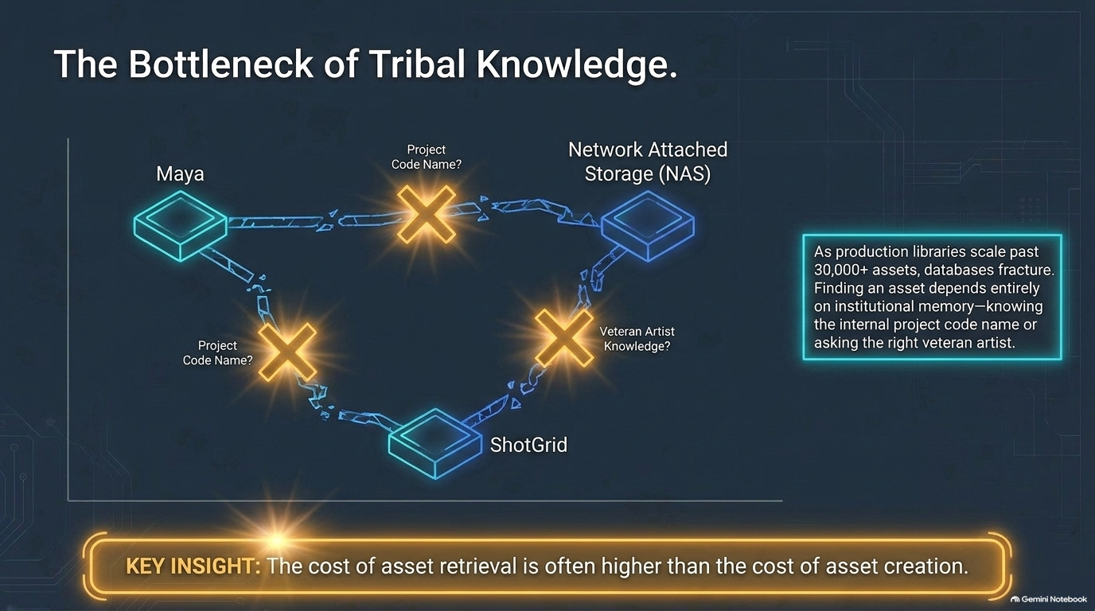
Notes:
Target Timing: 4.5 minutes (34:00 - 38:30)
Key Themes: Hybrid workflows, OpenUSD integration, camera telemetry, plate guidance.
Speaker Script:
"Generative AI should never operate in a vacuum. The most successful studio implementations use a Hybrid 3D/AI Workflow.
Instead of asking AI to generate a shot from scratch, we feed the model structured guide data from traditional 3D software (Maya, Houdini, Unreal Engine):
Low-poly proxy geometry for spatial layouts.
Exact camera transformations and focal length telemetry.
Rough lighting passes and depth channels exported via OpenUSD pipelines.
The AI model acts as a sophisticated 'neural renderer' conditioned on deterministic 3D blocking, preserving exact camera moves and actor placement while generating photorealistic surface detail."

Slide 10
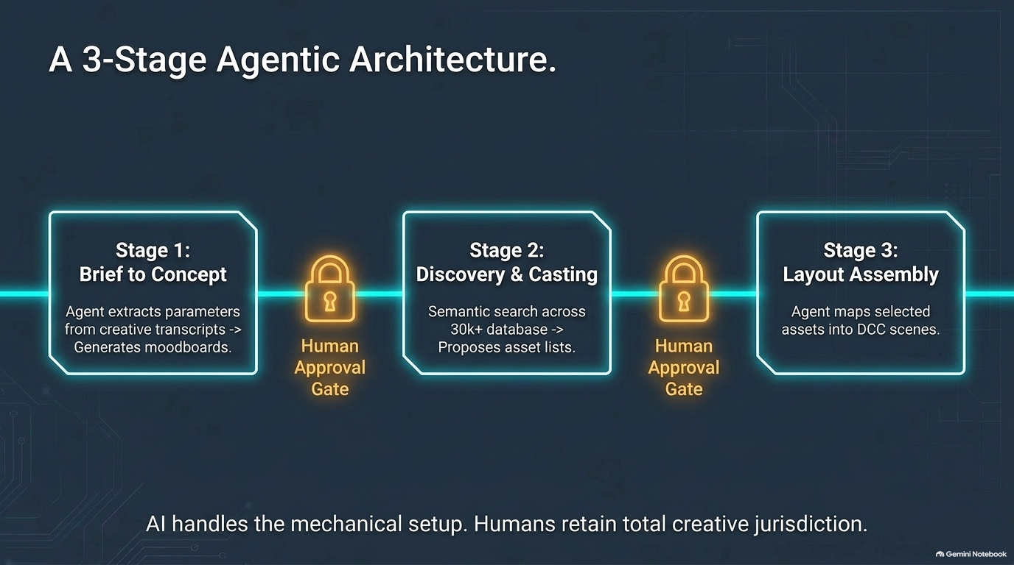
Notes:
Target Timing: 4 minutes (38:30 - 42:30)
Key Themes: Seed tracking, context window persistence, vector databases, asset versioning.
Speaker Script:
"A critical requirement for enterprise pipeline engineering is State Management and Reproducibility.
To make AI outputs reproducible across teams and departments, every step of an agentic workflow must record state metadata:
Exact seed values and sampler configurations.
Checkpoint hashes and fine-tuned adapter weights.
Vector database IDs representing conversation and context history.
Input plate metadata, lens profiles, and color space transforms.
By serializing agent state alongside traditional shot metadata in asset management systems (like ShotGrid or Ftrack), any generated result can be inspected, audited, and re-executed identically months later."

Slide 11
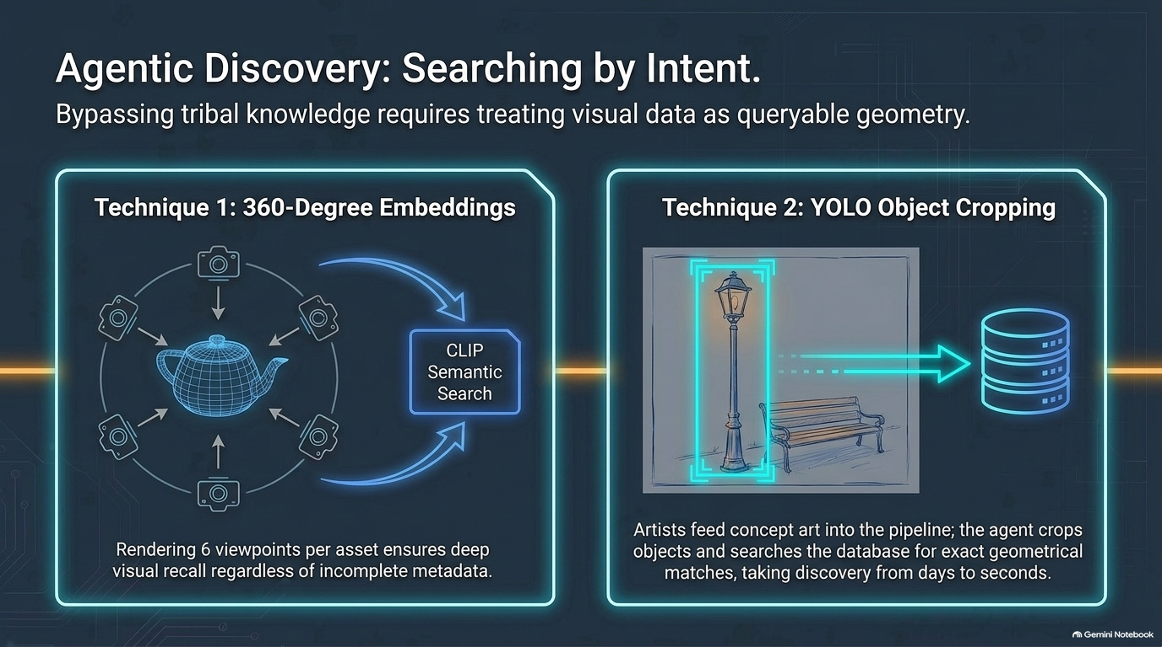
Notes:
Target Timing: 5 minutes (42:30 - 47:30)
Key Themes: Latency bottlenecks, GPU compute tracking, distributed tracing, telemetry.
Speaker Script:
"When scaling agentic pipelines across hundreds of GPU worker nodes, system performance and observability become paramount.
AI inference workloads are compute-intensive and prone to silent failures, latency spikes, or VRAM bottlenecks. To ensure operational reliability, we implement end-to-end distributed tracing across edge and cloud environments:
Inference Latency Metrics: Tracking time-to-first-token and diffusion step execution speeds.
VRAM & Memory Profiling: Pinpointing memory leaks and GPU utilization bottlenecks during complex batch generation.
Causal Error Isolation: Automatically identifying whether a pipeline failure stems from network latency, invalid conditioning data, or model execution crashes.
Comprehensive telemetry ensures our agentic workflows remain stable and cost-effective under heavy production loads."

Slide 12
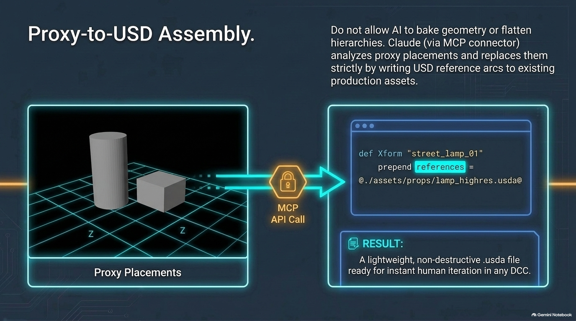
Notes:
Target Timing: 4 minutes (47:30 - 51:30)
Key Themes: Creative agency, approval gates, interactive override controls.
Speaker Script:
"Automated agentic loops are powerful, but creative direction requires explicit Human-in-the-Loop (HITL) Control Points.
An effective architecture defines clear boundary conditions where autonomous execution pauses for human intervention:
Keyframe Approval Gates: Agents generate multiple spatial or look-development options; artists approve or select candidate vectors.
Interactive Inpainting / Regional Overrides: Artists manually edit mask passes or sketch guide curves before handing the asset back to the agent loop.
Parameter Threshold Escalation: If the Evaluator Agent's confidence score falls below a set threshold, the task is automatically flagged for supervisor review.
AI should augment artist capabilities and handle repetitive tasks, giving time back to artists for high-level creative decisions."

Slide 13
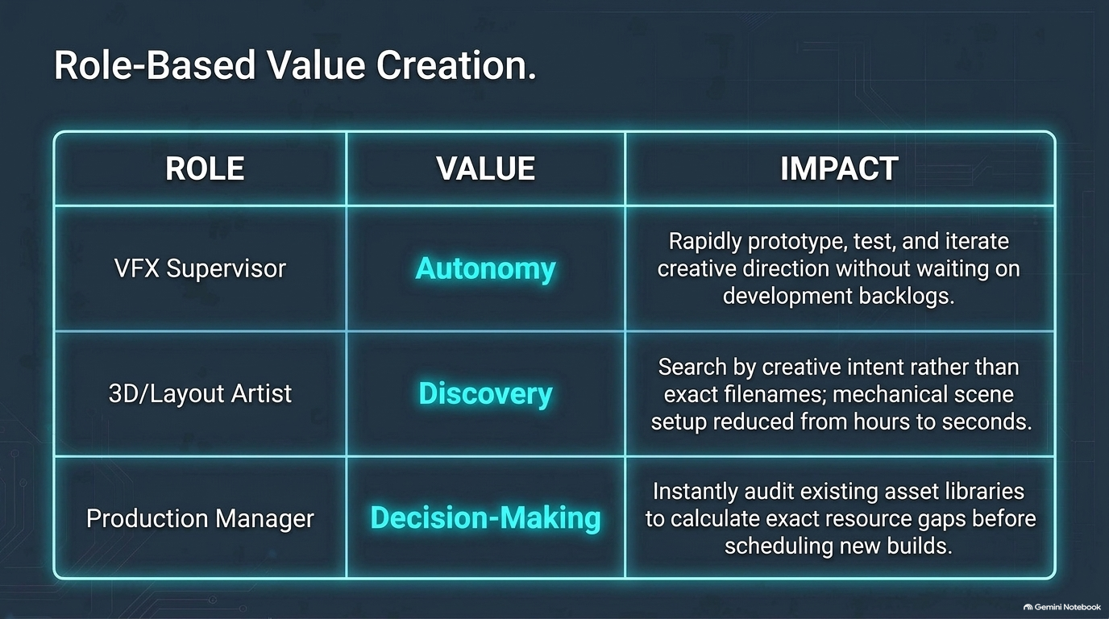
Notes:
Target Timing: 4.5 minutes (51:30 - 56:00)
Key Themes: Programming languages as thought proxies, Cintiq vs. AI, empowering creative talent.
Speaker Script:
"Let's reflect on the broader paradigm shift happening across studio engineering and creative disciplines.
Historically, code and creative software served as proxies for thought:
A programming language was a proxy for a developer to translate mental logic into execution.
A Cintiq tablet or paintbrush was a proxy for an artist to express visual ideas onto a canvas.
Generative models and agentic workflows are simply smarter, highly efficient proxies. They do not replace human vision or engineering expertise; they handle tedious overhead, allowing developers and artists to focus on high-level problem solving and creative refinement."

Slide 14
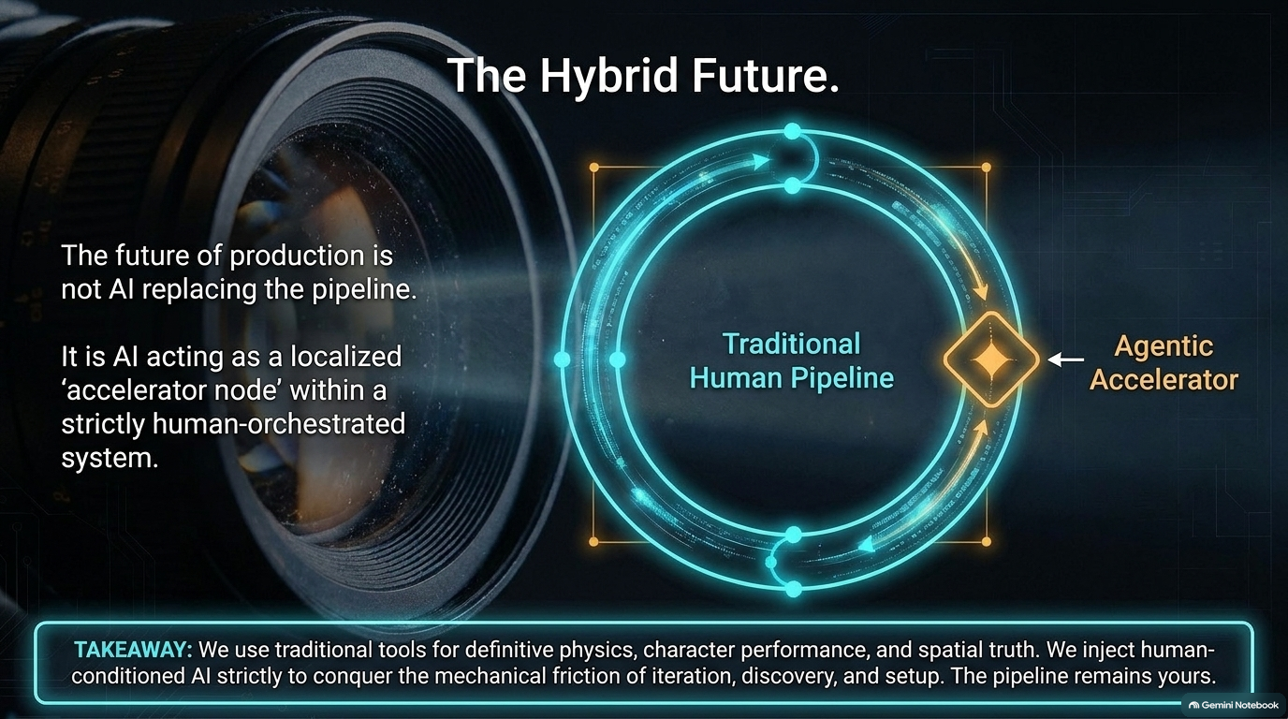
Notes:
Target Timing: 5.5 minutes (56:00 - 1:01:30)
Key Themes: End-to-end system architecture schematic, dataset pipelines, multi-agent execution.
Speaker Script:
"Let's put all these concepts together into a complete Architecture Blueprint for an Agentic Production Pipeline.
Here is the complete data flow:
Ingestion & Parsing Layer: Parses incoming shot descriptions, 3D proxy scenes, and track data.
Orchestration Engine: Deploys planner agents to assign tasks across distributed GPU workers.
Conditioning & Generation Core: Combines base foundation models with fine-tuned LoRAs, ControlNets, and spatial guide layers.
Automated Evaluation Suite: Runs semantic segmentation, visual similarity scoring, and technical QA.
Asset Management & Publishing: Automatically packages approved assets into OpenUSD formats with full lineage metadata attached.
This architecture transforms loose, stochastic generative tools into a deterministic production engine."

Slide 15
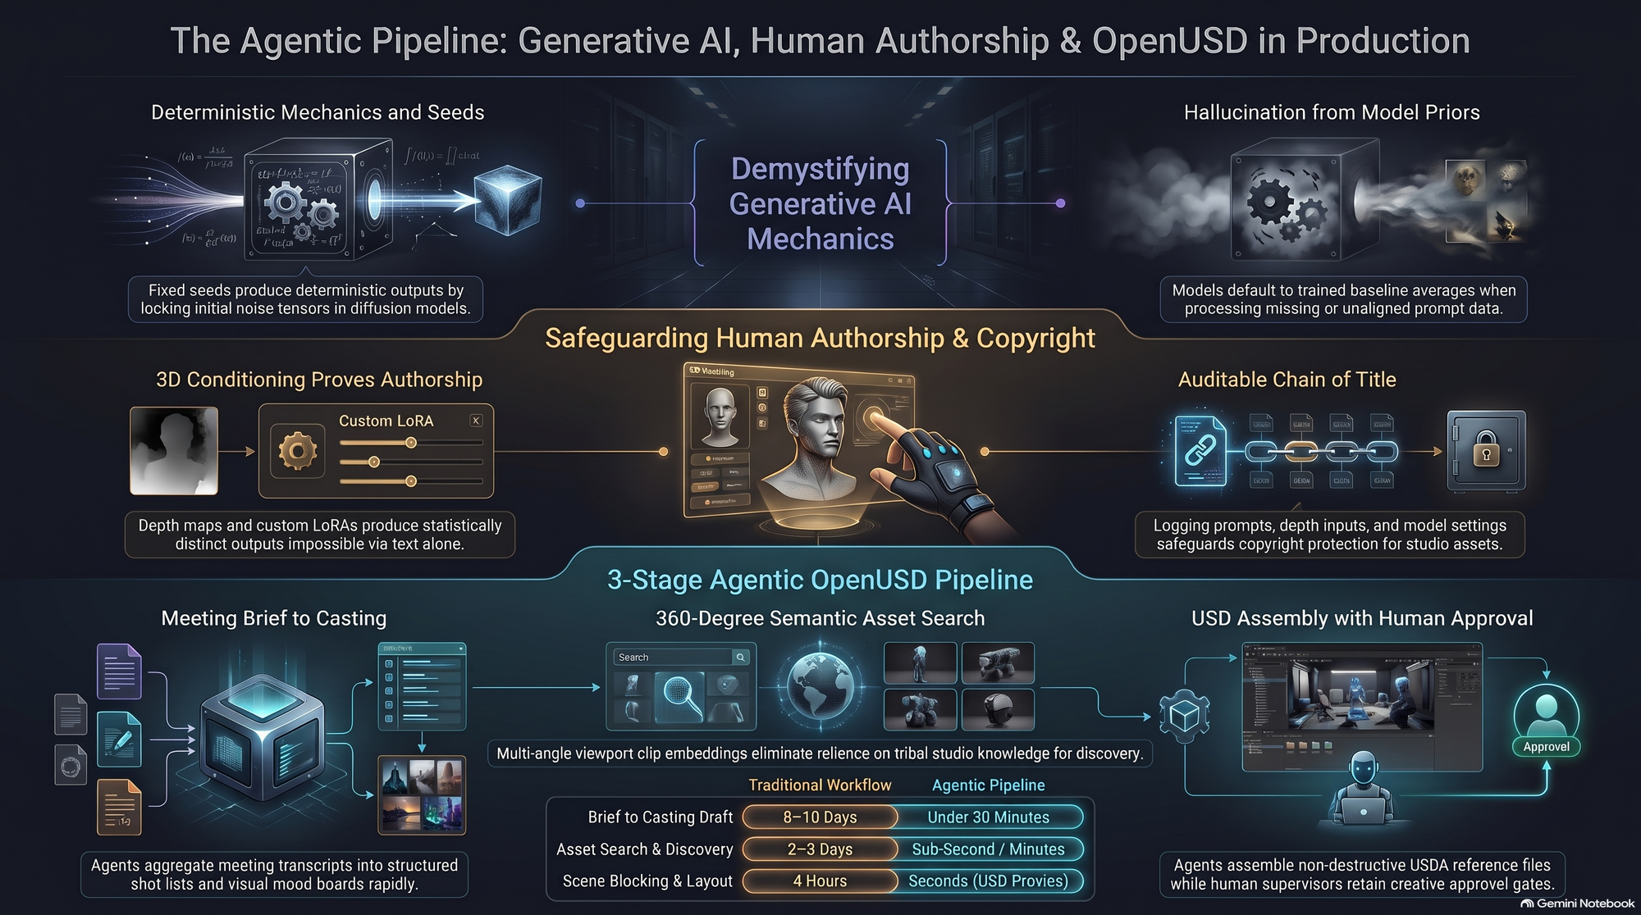
Notes:
Target Timing: 3 minutes (1:01:30 - 1:04:30)
Key Themes: Core takeaways, practical steps for implementation, optimistic outlook.
Speaker Script:
"To wrap up today’s presentation, here are the three core principles to take back to your engineering teams:
Move Beyond Prompts: Ditch text-only prompting in favor of multi-modal conditioning, 3D guide passes, and explicit latent controls.
Build Agentic Loops with Strict Guardrails: Implement evaluator agents and human-in-the-loop review gates to guarantee studio-quality outputs.
Treat AI as a Powerful Tool, Not a Black Box: Focus on state management, observability, and deep integration into established studio pipelines.
The future of visual effects and pipeline engineering isn't about replacing human creativity—it's about building the control architecture that empowers it.
Thank you very much! I'll now open the floor for Q&A and breakout discussions."
Summary Table of Timing & Structure
Slide #
Title / Topic
Target Timing
Core Focus
Slide 1
The Architecture of Control
2.5 mins
Introduction & Setting Expectations
Slide 2
Landscape of Generative AI
3.5 mins
Web Platforms vs. Studio Pipelines
Slide 3
The Slot Machine Problem
4.0 mins
Why Prompting Fails at Scale
Slide 4
Researchers vs. Creatives Gap
4.5 mins
Bridging AI Research & VFX Needs
Slide 5
How Neural Networks Process Data
5.0 mins
Vectors, Layers & Weights
Slide 6
Understanding Latent Spaces
4.0 mins
Manifolds & Vector Manipulation
Slide 7
Conditioning Mechanisms
5.5 mins
ControlNet, IP-Adapter & Cross-Attention
Slide 8
Anatomy of an Agentic Pipeline
5.0 mins
Planner, Worker & Evaluator Agents
Slide 9
Structural Determinism & 3D
4.5 mins
Hybrid 3D / AI Workflows (OpenUSD)
Slide 10
State Management & Memory
4.0 mins
Reproducibility, Seeds & Metadata
Slide 11
Real-Time Observability
5.0 mins
Tracing, Telemetry & GPU Metrics
Slide 12
Human-in-the-Loop Points
4.0 mins
Gateways, Overrides & Review
Slide 13
AI as a Creative Proxy
4.5 mins
Developer & Artist Paradigm Shift
Slide 14
Case Study / Blueprint
5.5 mins
Full System Architecture Flow
Slide 15
Conclusion & Key Takeaways
3.0 mins
Summary, Best Practices & Q&A
Total Presentation Duration: ~67 minutes (fitting comfortably into a 60–75 minute keynote session).

