Slide 1
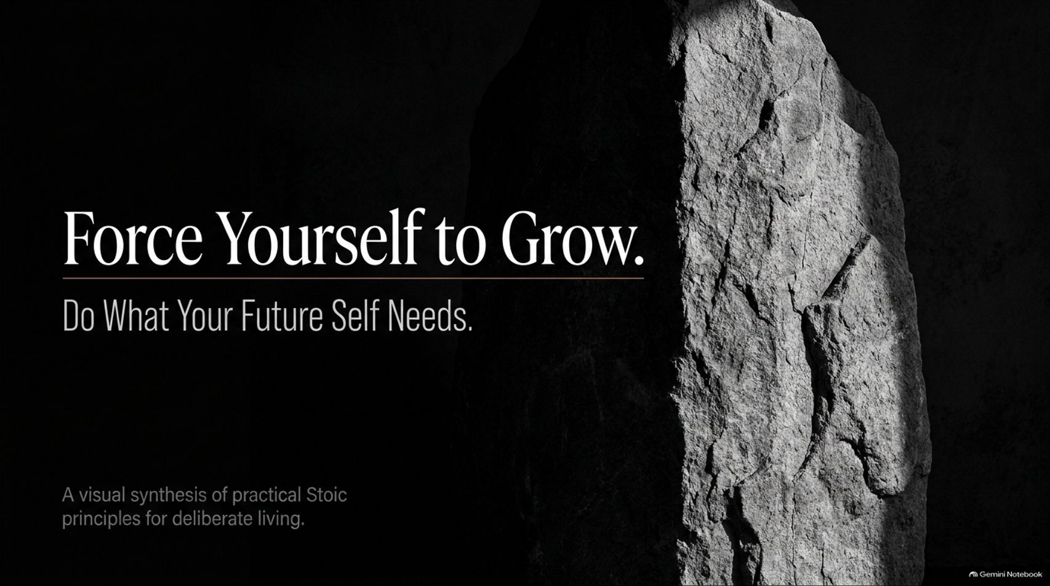
Notes:
Estimated Speaking Time: 2 – 3 minutes
Speaker Script & Talking Points
Welcome everyone. Today we are exploring a theme that is both demanding and deeply liberating: "Force Yourself to Grow: Do What Your Future Self Needs."
When we think about personal development or long-term success, we often wait for the "right moment"—a moment when we feel motivated, rested, or entirely ready. But Stoic philosophy and practical experience teach us a very different lesson: your future is not shaped by what you promise yourself you will do tomorrow; it is forged by what you execute today.
Every single day, we stand at a crossroads. Every time you avoid a difficult task, brush off a personal responsibility, or choose short-term comfort over real progress, you are essentially passing a heavier burden down the line to your future self. Conversely, every time you take ownership, embrace deliberate discomfort, build daily discipline, and convert missteps into lessons, you actively invest in the person you are becoming.
Over the course of this presentation, we will synthesize practical Stoic principles into actionable frameworks. We will cover how to shift your locus of control, dismantle the illusion of readiness, build discipline when motivation vanishes, and architect a daily system that serves your long-term vision.
Force Yourself to Grow: Do What Your Future Self Needs | Audiobook
https://www.youtube.com/watch?v=hv_O6AOuj0I

Slide 2
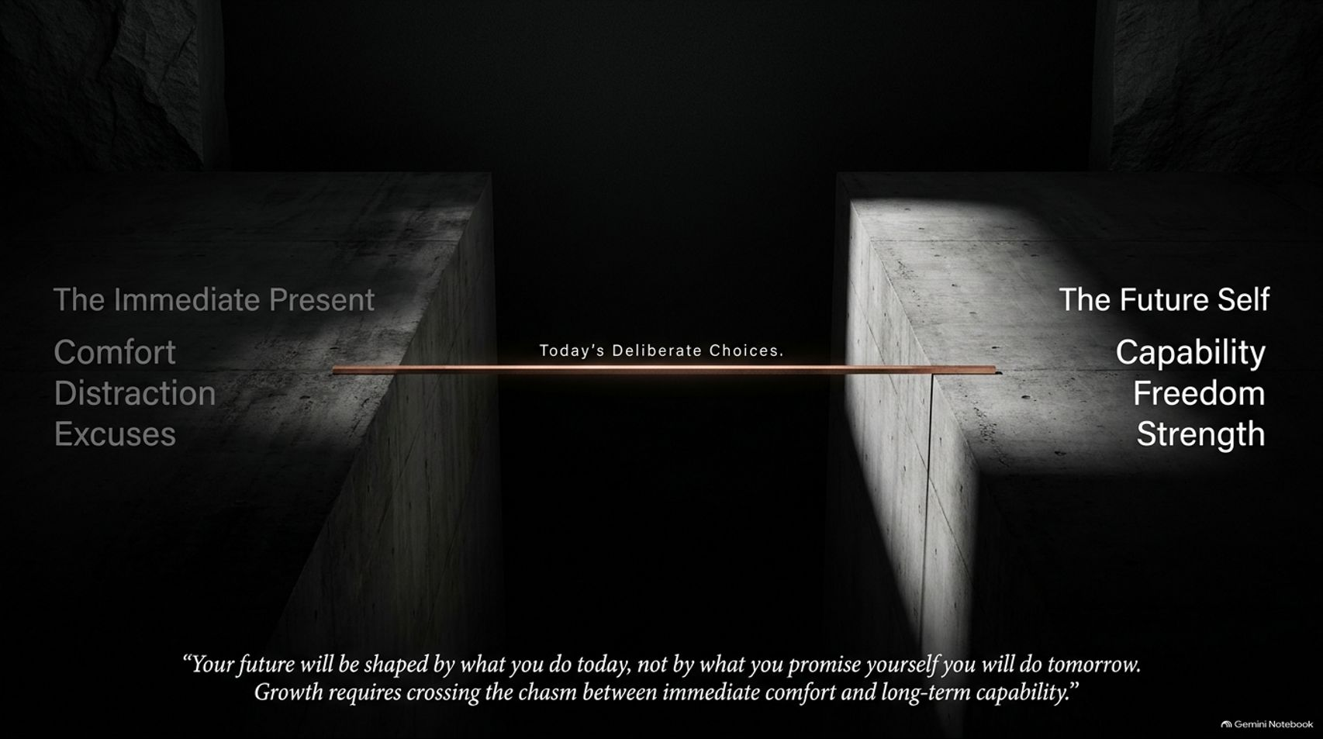
Notes:
Estimated Speaking Time: 3 – 4 minutes
Speaker Script & Talking Points
Take a look at the diagram on this slide. On the left side, we have The Immediate Present. It’s characterized by three powerful pulls: Comfort, Distraction, and Excuses. On the right side, we have The Future Self, defined by Capability, Freedom, and Strength.
Between these two worlds lies a deep chasm. The bridge that spans this chasm is built out of Today's Deliberate Choices.
It is easy to fall into the mental trap of treating your future self like a stranger—someone with unlimited energy, perfect willpower, and zero stress who will magically handle everything you postpone today. But that person is not a superhero; they are simply the recipient of your current habits. If you feed your present with excuses and immediate comfort, your future self inherits diminished options, higher stress, and fragile capabilities.
Crossing this chasm requires recognizing that long-term capability cannot be bought with good intentions. Every choice to turn off a distraction, hold yourself accountable, or step into an uncomfortable task lays down another plank on this bridge. Ask yourself today: Are your current choices building a bridge to strength, or are they keeping you stranded in temporary comfort?

Slide 3
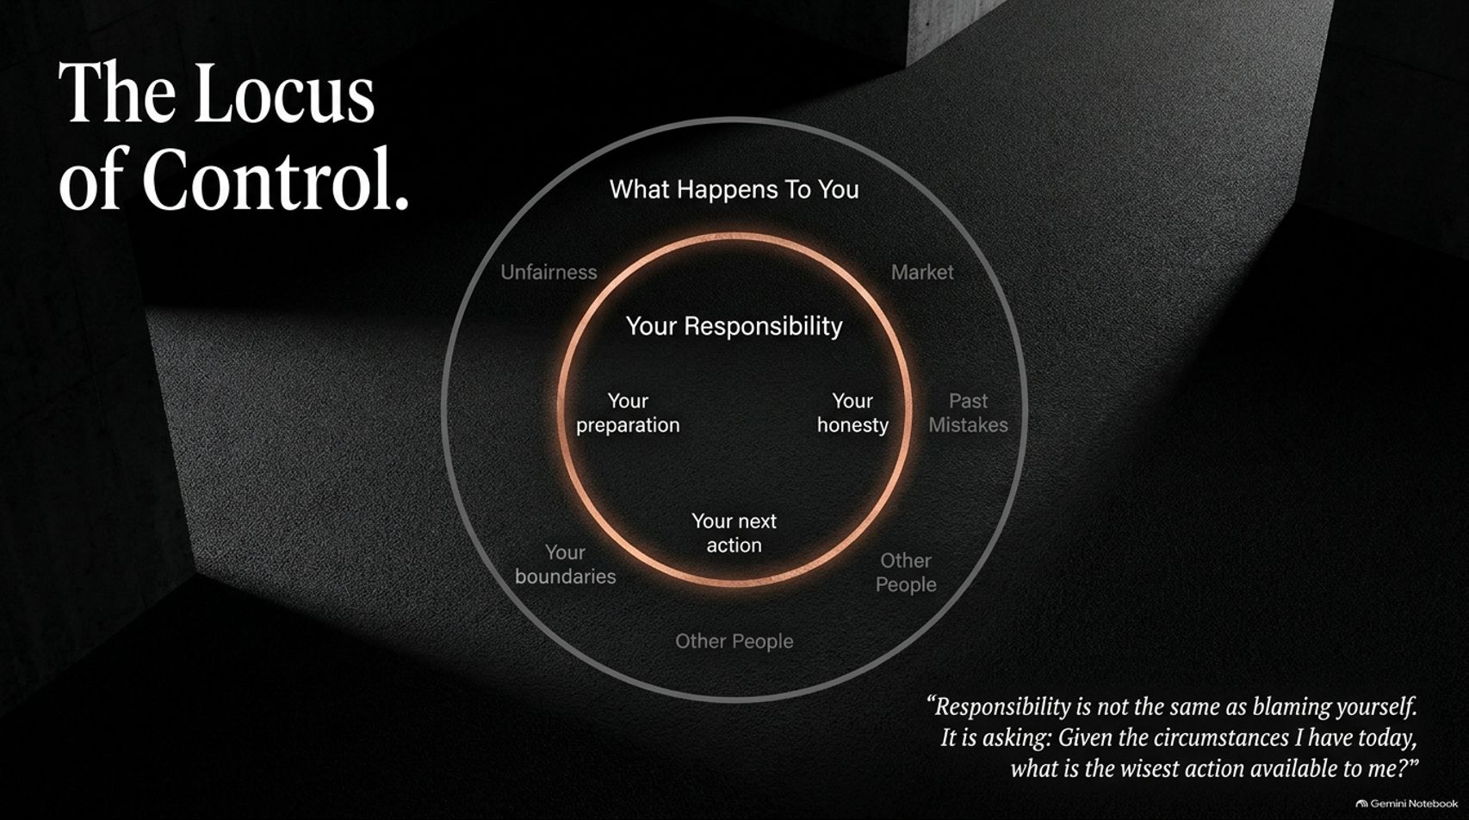
Notes:
Estimated Speaking Time: 4 – 5 minutes
Speaker Script & Talking Points
One of the core tenets of Stoicism is distinguishing between what is within our power and what is not. Here, we map out The Locus of Control.
The outer circle represents What Happens To You—external factors like market shifts, unfair treatment, past mistakes, and the actions or opinions of other people. You cannot rewrite yesterday, and you cannot control every challenge or circumstance that lands on your desk. Spending your emotional energy railing against the outer ring leads to frustration and helplessness.
The inner circle represents Your Responsibility. This includes your preparation, your honesty, your boundaries, and—most importantly—your very next action.
Notice the quote at the bottom: "Responsibility is not the same as blaming yourself. It is asking: Given the circumstances I have today, what is the wisest action available to me?"
Taking full responsibility doesn't mean ignoring unfairness or pretending hard situations don't exist. It simply means refusing to let external conditions dictate your internal standard of behavior. When you shift your focus entirely to your inner circle, you reclaim your agency.

Slide 4
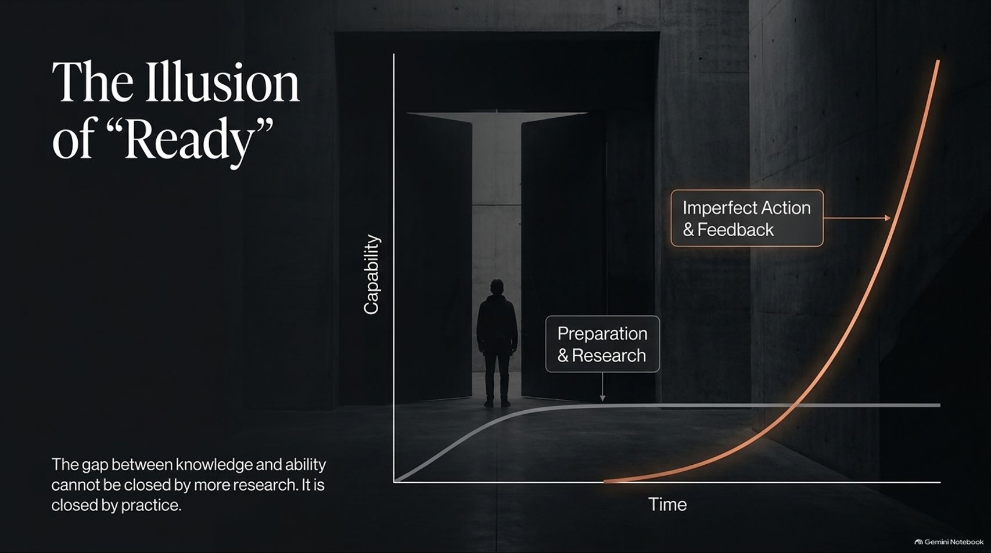
Notes:
Estimated Speaking Time: 4 – 5 minutes
Speaker Script & Talking Points
Slide 4 illustrates a visual curve that every high-achiever needs to internalize: The Illusion of "Ready."
Look at the flat white curve at the bottom representing Preparation & Research. Many of us fall into the trap of endless research, reading another book, taking another course, or tweaking a plan for weeks. We tell ourselves we are working, but in reality, preparation beyond a certain point becomes a respectable disguise for fear of failure or embarrassment. As the graph shows, passive research hits a quick ceiling in actual capability.
Now look at the steep orange curve: Imperfect Action & Feedback. Real capability does not explode until you step through the door and begin executing in the real world.
The gap between theoretical knowledge and practical execution cannot be closed by more research; it is closed exclusively by practice. Consider learning how to swim: you can study fluid dynamics and stroke techniques all day, but true mastery only happens once you jump into the water. Action creates feedback, feedback drives adjustment, and adjustment builds genuine skill.

Slide 5
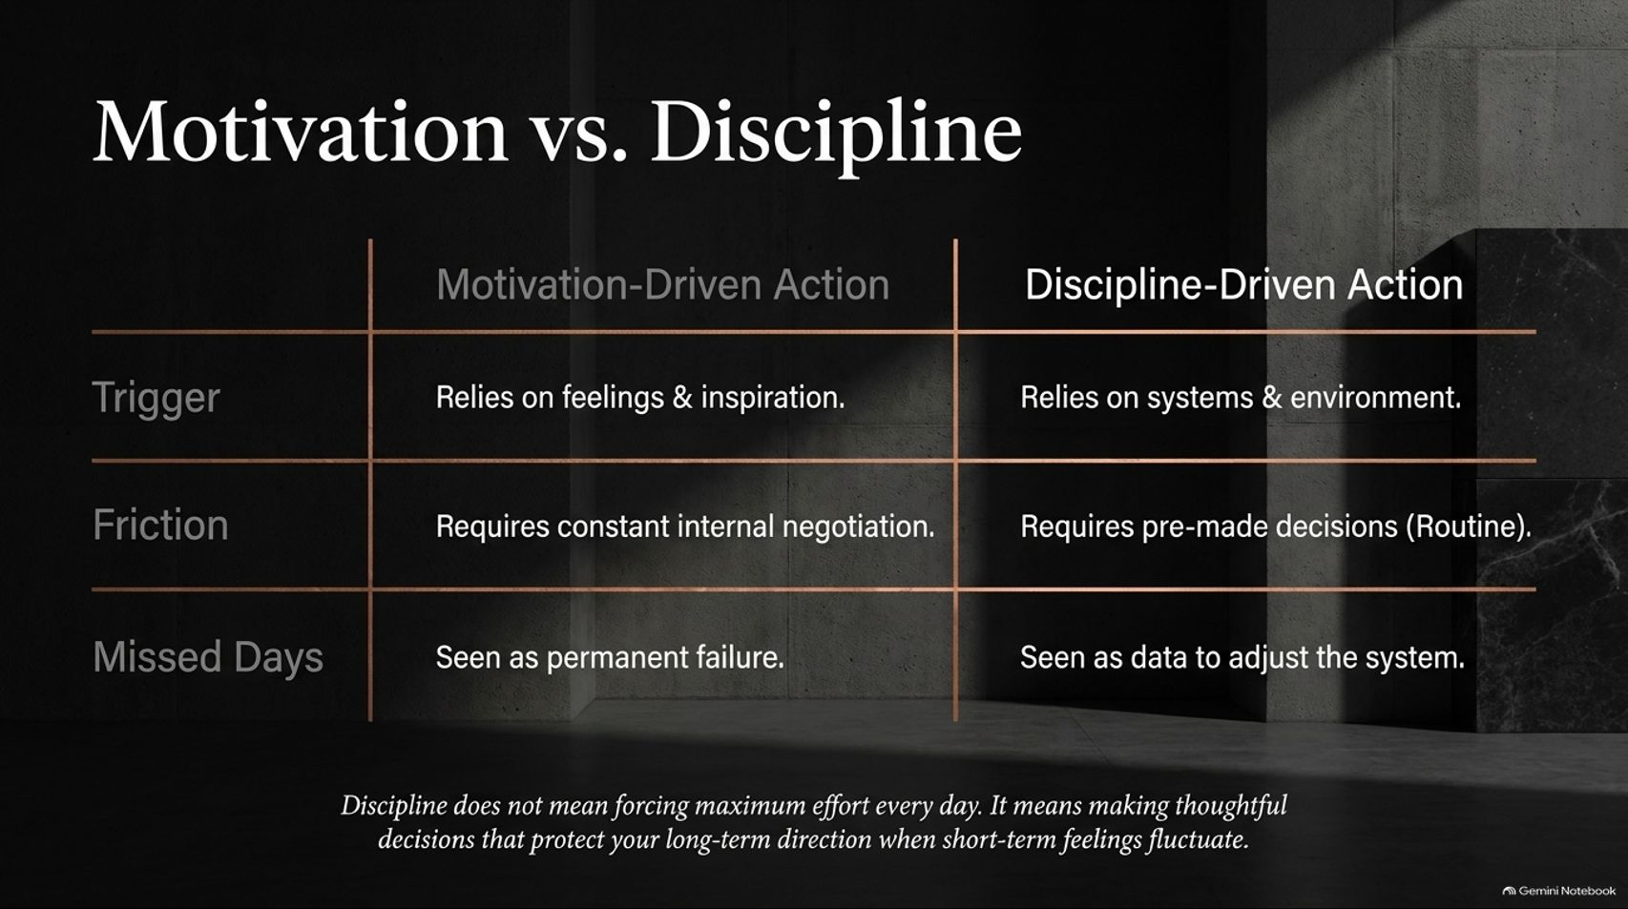
Notes:
Estimated Speaking Time: 4 – 5 minutes
Speaker Script & Talking Points
Let's break down the comparative matrix between Motivation-Driven Action and Discipline-Driven Action.
The Trigger: Motivation relies on fleeting emotions, mood, and momentary inspiration. Discipline relies on structured systems, clear rules, and engineered environments.
Friction: Motivation requires constant internal negotiation ("Do I feel like doing this right now?"). Discipline relies on pre-made decisions and established routines, eliminating daily friction.
Missed Days: When a motivation-driven person misses a day, they interpret it as personal failure and give up. A discipline-driven person views a missed day simply as data to evaluate and adjust their underlying system.
Discipline is not about forcing maximum effort through brute willpower every single day. It’s about making thoughtful, pre-committed decisions that protect your long-term direction when short-term feelings inevitably fluctuate. When you build a system, you no longer rely on how you feel to determine what you do.

Slide 6
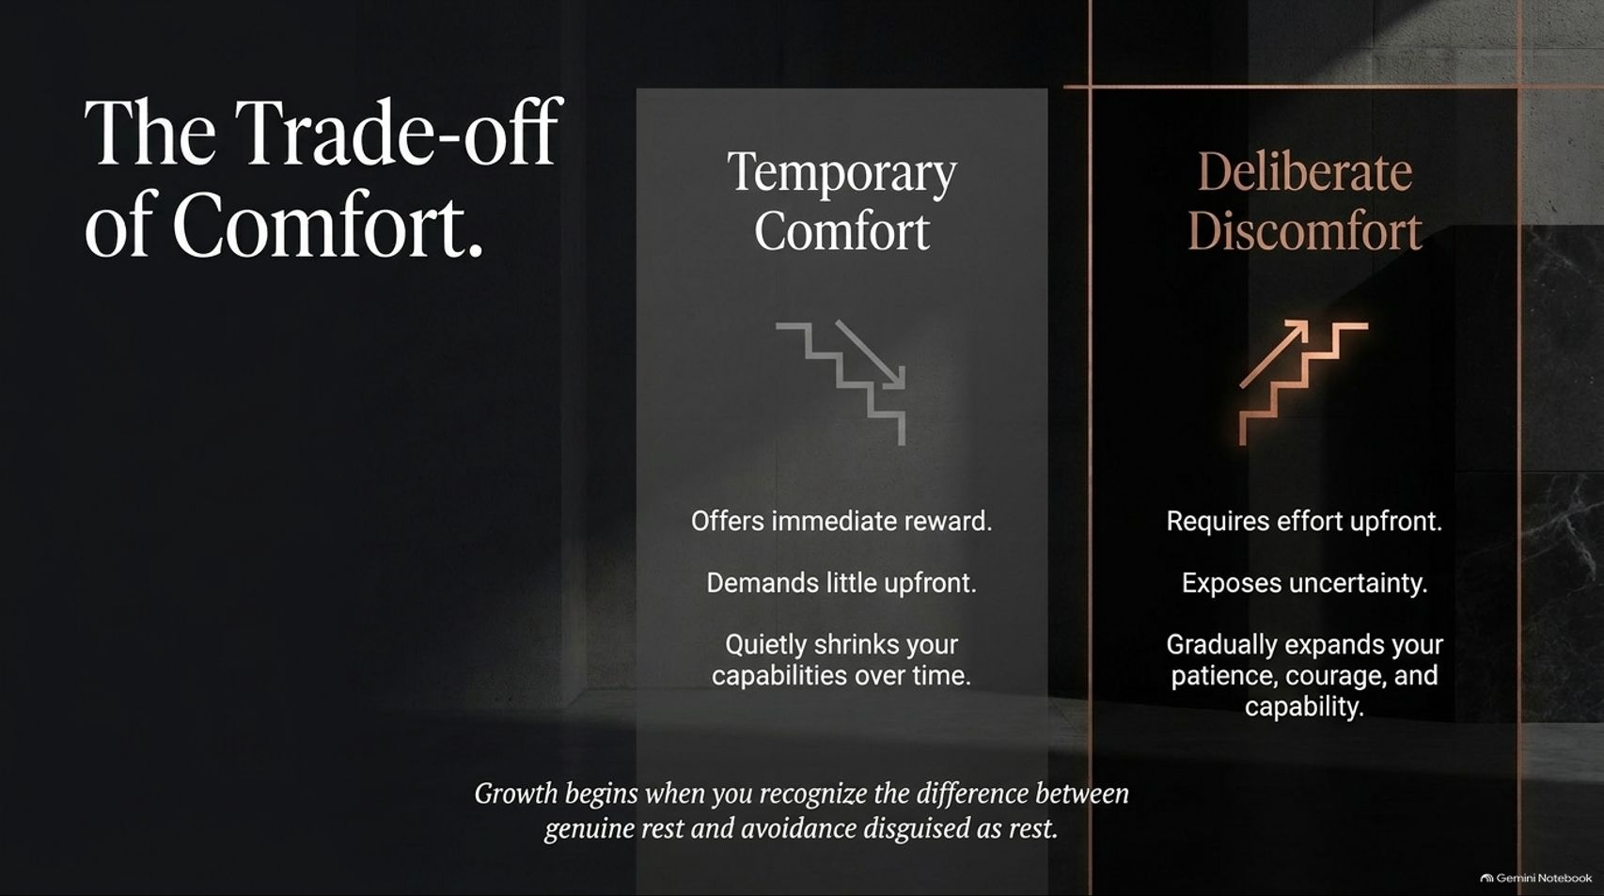
Notes:
Estimated Speaking Time: 3 – 4 minutes
Speaker Script & Talking Points
Growth requires an explicit economic transaction with yourself: trading temporary comfort for deliberate discomfort.
Temporary Comfort offers immediate gratification and demands little upfront effort. However, its hidden cost is compound decay: over time, avoiding difficulty quietly shrinks your resilience, confidence, and real-world capability.
Deliberate Discomfort requires upfront effort and forces you to face uncertainty head-on. But its return on investment is compounding expansion: it systematically broadens your capacity for patience, courage, and execution.
Growth begins the moment you learn to distinguish between genuine rest and avoidance disguised as rest. Rest recharges your battery so you can re-engage with life; avoidance merely postpones necessary action while increasing anxiety. Choosing deliberate discomfort today builds the stamina required for tomorrow’s bigger challenges.

Slide 7
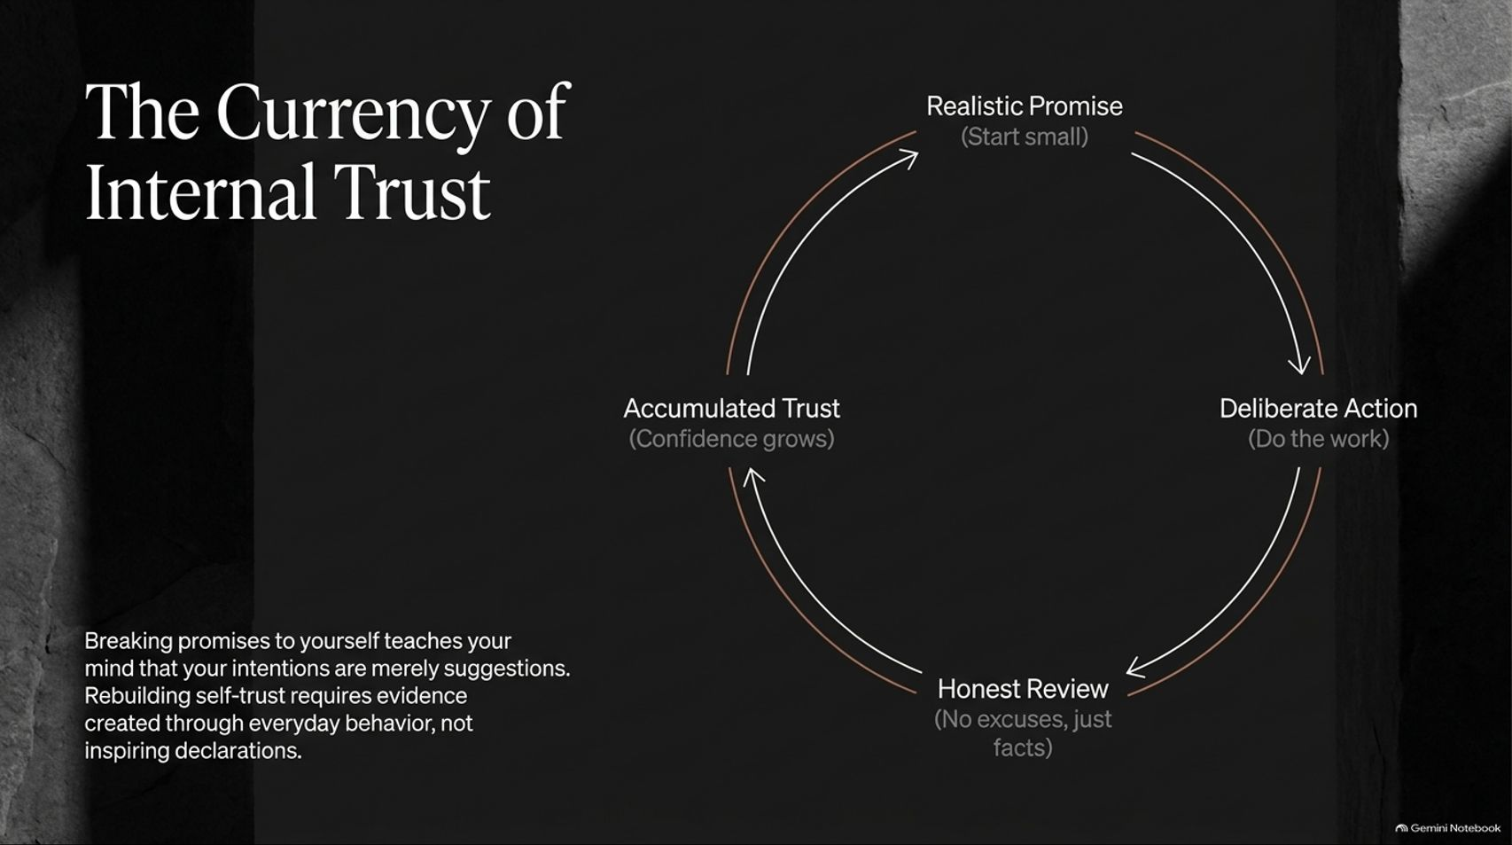
Notes:
Estimated Speaking Time: 4 – 5 minutes
Speaker Script & Talking Points
Self-confidence is not self-esteem messaging or positive affirmations; it is Accumulated Internal Trust built through evidence.
Every time you break a promise to yourself—whether it’s snoozing the alarm, skipping a planned task, or breaking a commitment—you send a signal to your mind that your intentions are merely optional suggestions. Over time, this erodes self-trust.
To rebuild self-trust, we follow the 4-stage cycle on Slide 7:
Realistic Promise: Start small. Make a commitment so manageable that failure is nearly impossible.
Deliberate Action: Execute the work without negotiation.
Honest Review: Evaluate the result with facts, not excuses.
Accumulated Trust: Each completed loop provides tangible proof of your integrity, growing your core confidence.
Stop trying to transform your life overnight with grand declarations. Rebuild internal trust through small, unshakeable daily commitments.

Slide 8
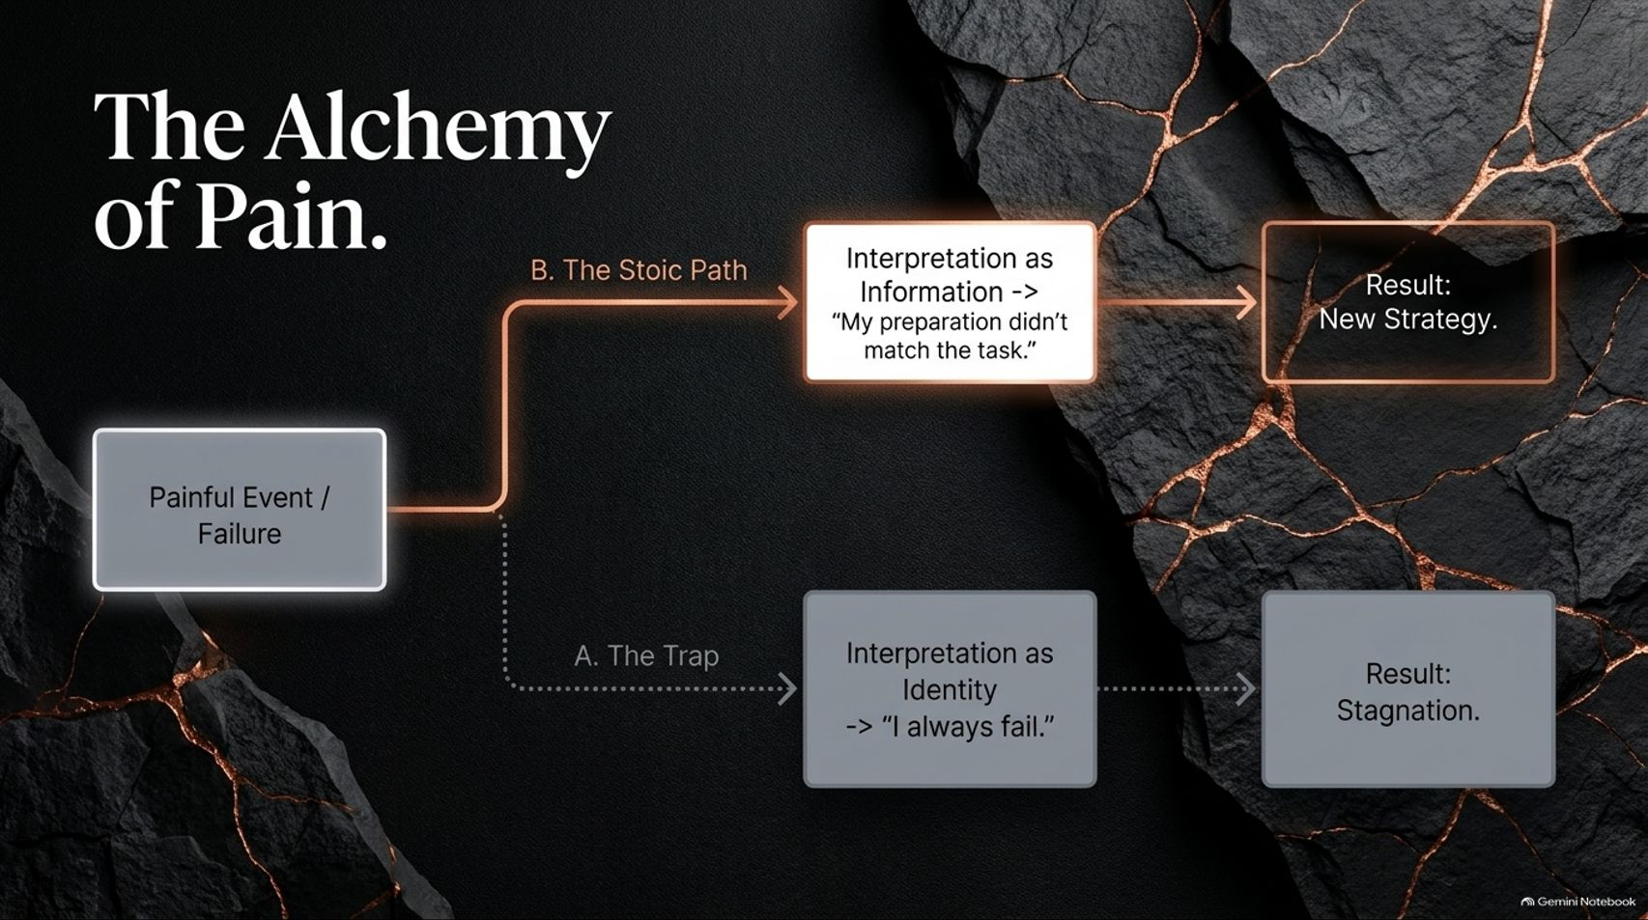
Notes:
Estimated Speaking Time: 4 – 5 minutes
Speaker Script & Talking Points
When failure, setback, or pain occurs, your interpretation determines whether that experience breaks you or builds you. Slide 8 outlines two distinct pathways:
Path A — The Trap: Painful Event $\rightarrow$ Interpretation as Identity ("I failed, therefore I am a failure / I always mess up") $\rightarrow$ Result: Stagnation and self-pity.
Path B — The Stoic Path: Painful Event $\rightarrow$ Interpretation as Information ("My current strategy or preparation didn't match the demands of this task") $\rightarrow$ Result: New Strategy and Growth.
Stoicism treats pain and failure not as emotional verdicts on your worth, but as objective data. When an outcome falls short of your expectations, strip away the narrative of self-blame. Extract the strategic information: What went wrong? What assumption was incorrect? Adjust your approach and execute again.

Slide 9

Notes:
Estimated Speaking Time: 4 – 5 minutes
Speaker Script & Talking Points
You cannot build a high-performing life on a shaky structural foundation. Slide 9 presents the Architecture of the Mind, modeled as a three-story building:
Foundation — Physical State: Sleep, physical movement, and proper nutrition form the biological bedrock of mental discipline. If your foundation is compromised by chronic sleep deprivation or neglect, your executive function and willpower will collapse under strain.
Middle Floor — Environment: Design physical and digital surroundings where productive behavior is the default option rather than a constant test of willpower. If your phone sits on your desk next to your keyboard, staying focused becomes an unnecessary uphill battle.
Top Floor — Information Intake: Protect your attention ruthlessly. Not every headline, notification, or outrage deserves mental bandwidth.
Stop relying on sheer self-control to carry you through. Build a solid physical foundation, optimize your environment, and filter your inputs.

Slide 10
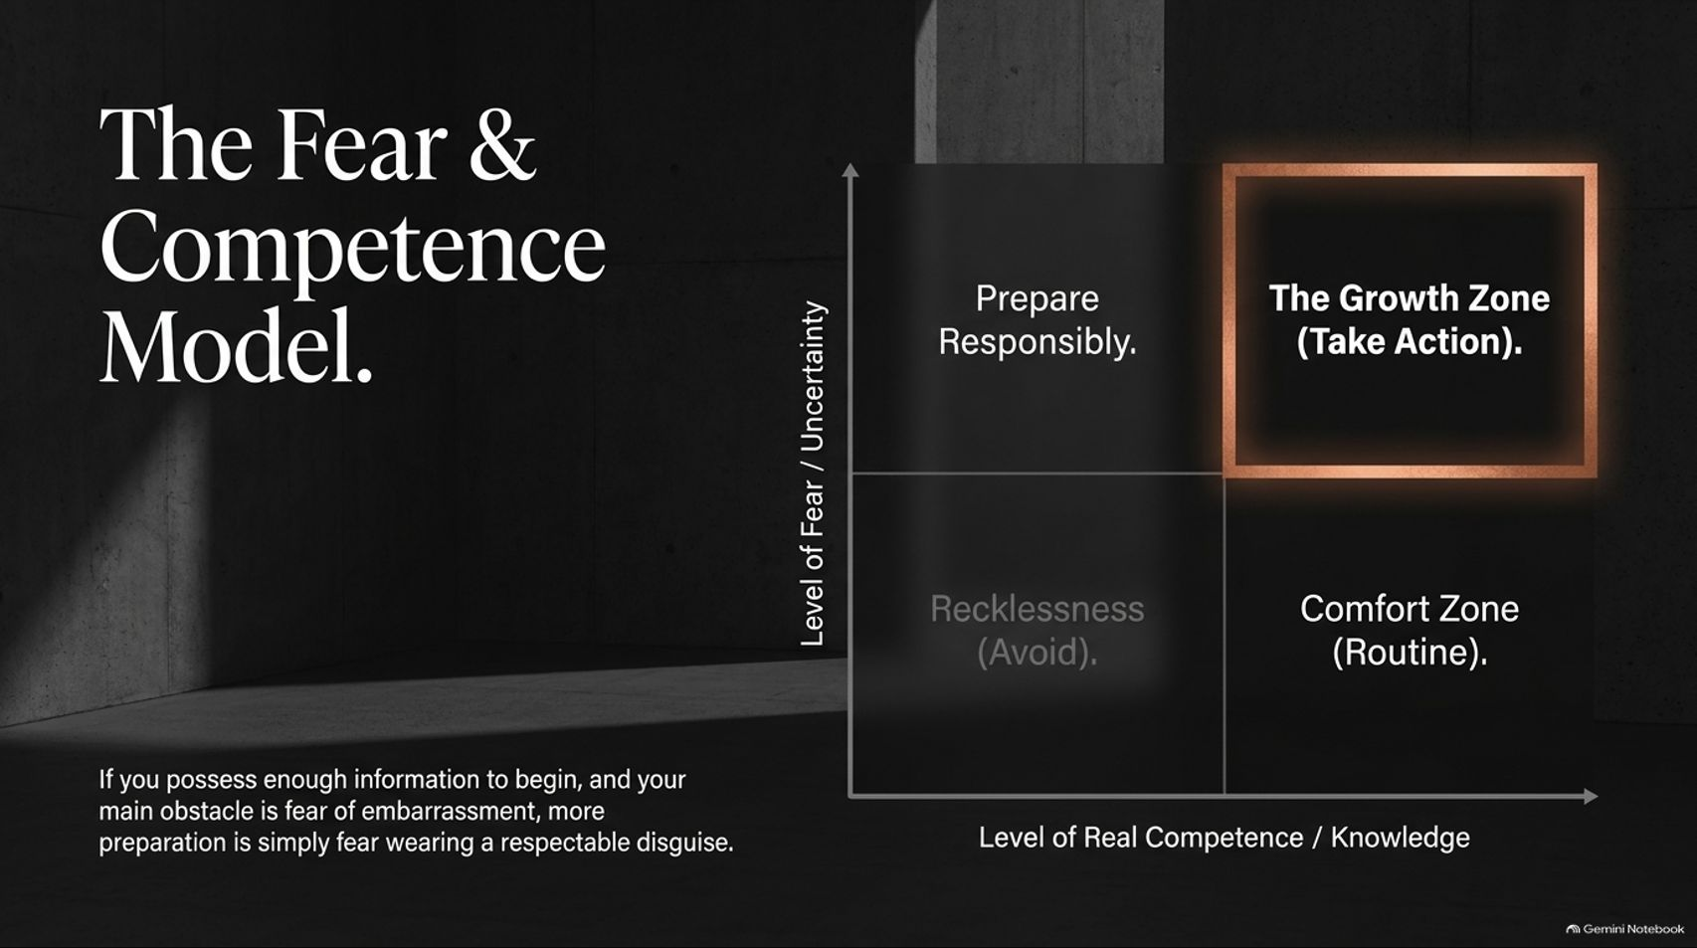
Notes:
Estimated Speaking Time: 4 – 5 minutes
Speaker Script & Talking Points
Slide 10 categorizes our choices using a 2x2 matrix plotting Level of Real Competence against Level of Fear / Uncertainty.
Low Competence / Low Fear (Recklessness): Taking uncalculated risks without requisite knowledge.
High Competence / Low Fear (Comfort Zone): Operating strictly within familiar routines. It feels safe, but leads to atrophy.
Low Competence / High Fear (Prepare Responsibly): This is where legitimate learning and foundational research belong.
High Competence / High Fear (The Growth Zone): This highlighted quadrant is where real progress happens.
When you already possess sufficient knowledge to begin, but fear of embarrassment or failure holds you back, additional research is simply fear wearing a respectable mask. Recognize when you have crossed from responsible preparation into fear-based stalling, and force yourself into the Growth Zone by taking action.

Slide 11
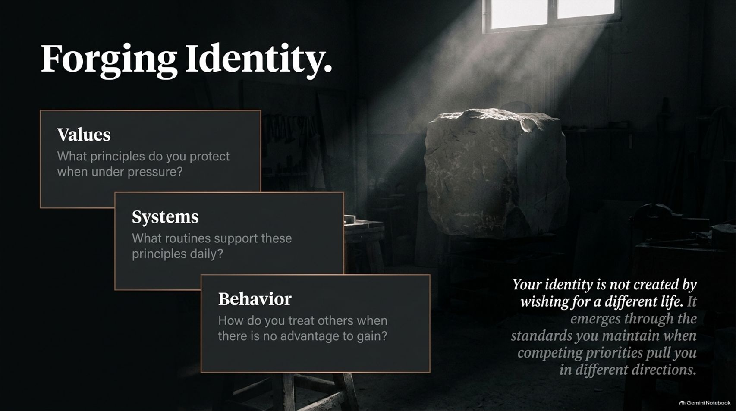
Notes:
Estimated Speaking Time: 3 – 4 minutes
Speaker Script & Talking Points
Identity is not formed by wishing, dreaming, or declaring who you want to be; it is forged in the crucible of daily standards. Slide 11 outlines the three-tiered progression of identity creation:
Values: What core principles do you uphold when placed under extreme pressure?
Systems: What specific daily routines and habits turn those abstract values into repeatable actions?
Behavior: How do you treat others and handle tasks when there is no immediate advantage or reward to gain?
Your true identity emerges through the standards you maintain when competing priorities drag you in different directions. When you consistently align your systems and behavior with your values, an unshakeable, authentic self-image naturally follows.

Slide 12
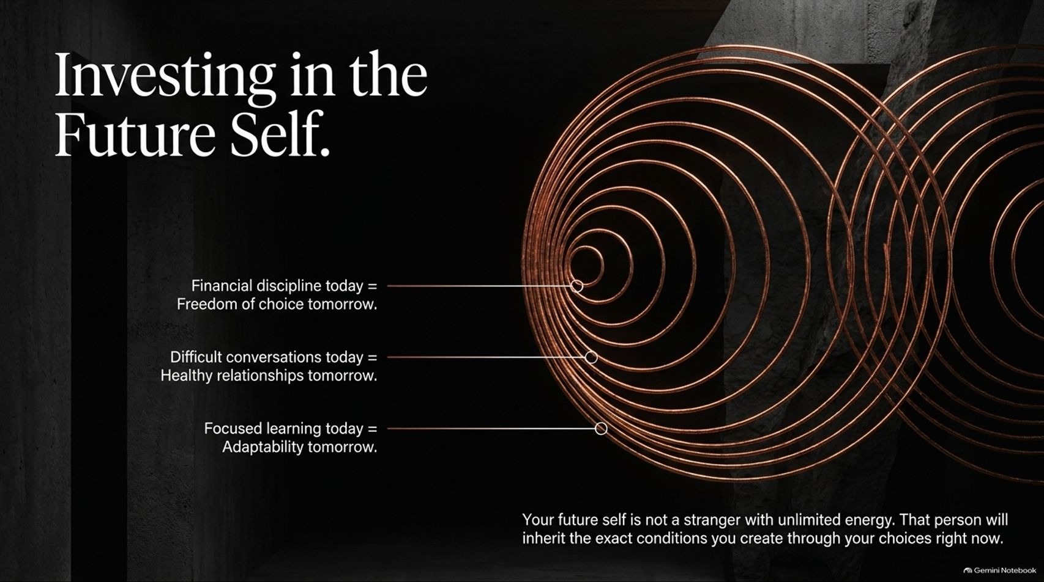
Notes:
Estimated Speaking Time: 3 – 4 minutes
Speaker Script & Talking Points
Slide 12 visually illustrates how targeted present actions compound into long-term assets for your future self:
Financial discipline today directly yields freedom of choice tomorrow.
Having difficult, honest conversations today builds healthy, resilient relationships tomorrow.
Focused, continuous learning today ensures adaptability and security tomorrow.
Your future self is not an abstract entity; that person will inherit the exact reality, financial state, health, and relationship quality you assemble through your choices right now. Treat your future self with the respect and care you would offer someone you deeply love.

Slide 13

Notes:
Estimated Speaking Time: 4 – 5 minutes
Speaker Script & Talking Points
Slide 13 synthesizes our core frameworks into an architectural blueprint:
The Foundation: Absolute Responsibility & Internal Promises. Without total ownership and self-trust, nothing above can stand.
The Pillars: Deliberate Habits & Emotional Discipline. These structural columns sustain load during stressful periods.
The Mortar: Action Before Readiness & Learning from Pain. This binding material holds your experiences together, turning setbacks into structural strength.
The Roof: The Future Identity. The ultimate outcome—a resilient, capable, and self-directed life.
Every deliberate choice you make today serves as a physical building material for this structure.

Slide 14
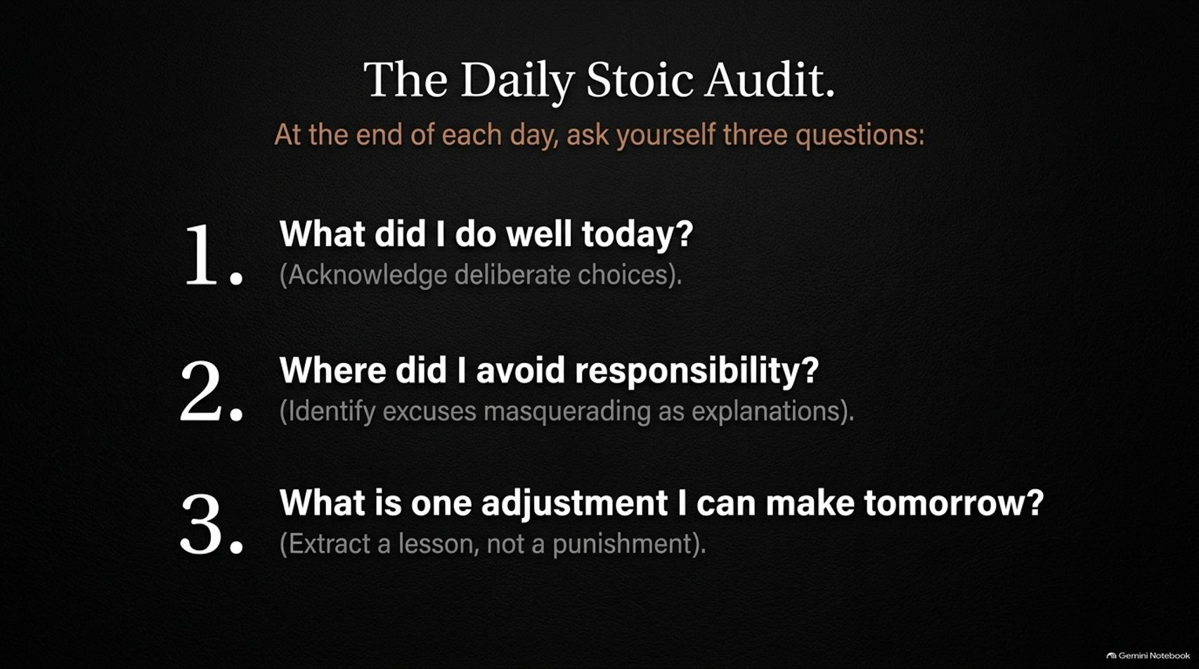
Notes:
Estimated Speaking Time: 3 – 4 minutes
Speaker Script & Talking Points
To maintain continuous alignment, we need a daily feedback loop. Slide 14 outlines The Daily Stoic Audit, consisting of three simple evening reflection questions:
What did I do well today? Acknowledge your deliberate choices and celebrate small victories to reinforce positive habits.
Where did I avoid responsibility? Identify excuses masquerading as reasonable explanations. Be brutally honest with yourself.
What is one adjustment I can make tomorrow? Extract a constructive tactical lesson rather than indulging in self-punishment.
This daily audit takes less than five minutes, but keeps your growth trajectory calibrated.

Slide 15
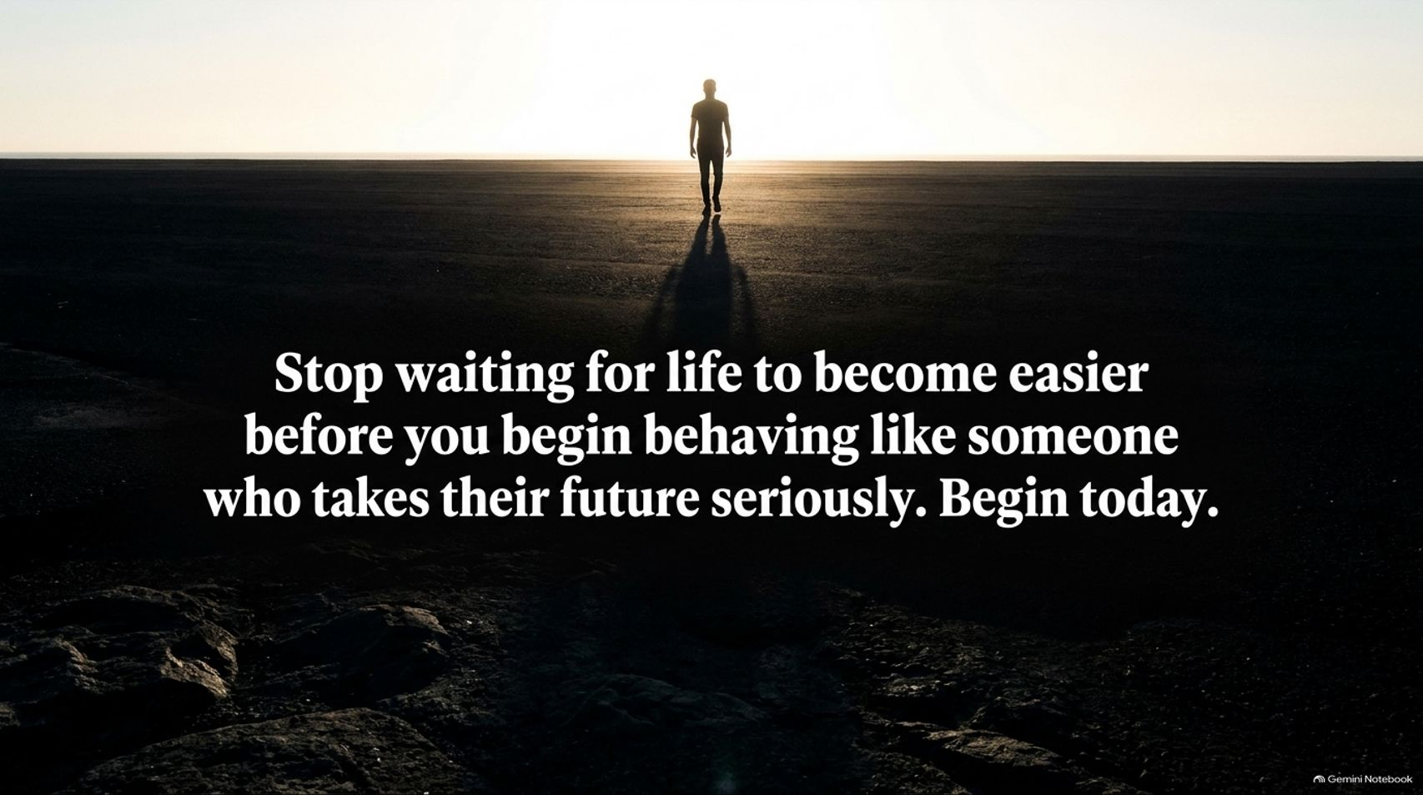
Notes:
Estimated Speaking Time: 2 – 3 minutes
Speaker Script & Talking Points
Slide 15 brings us to our core imperative: "Stop waiting for life to become easier before you begin behaving like someone who takes their future seriously. Begin today."
Conditions will never be perfect. Demands will not disappear. The ideal quiet period you are waiting for does not exist.
Personal transformation begins the exact moment you stop making conditions a prerequisite for action. Pick one meaningful responsibility you have been delaying, face it today, and take the first step.

Slide 16
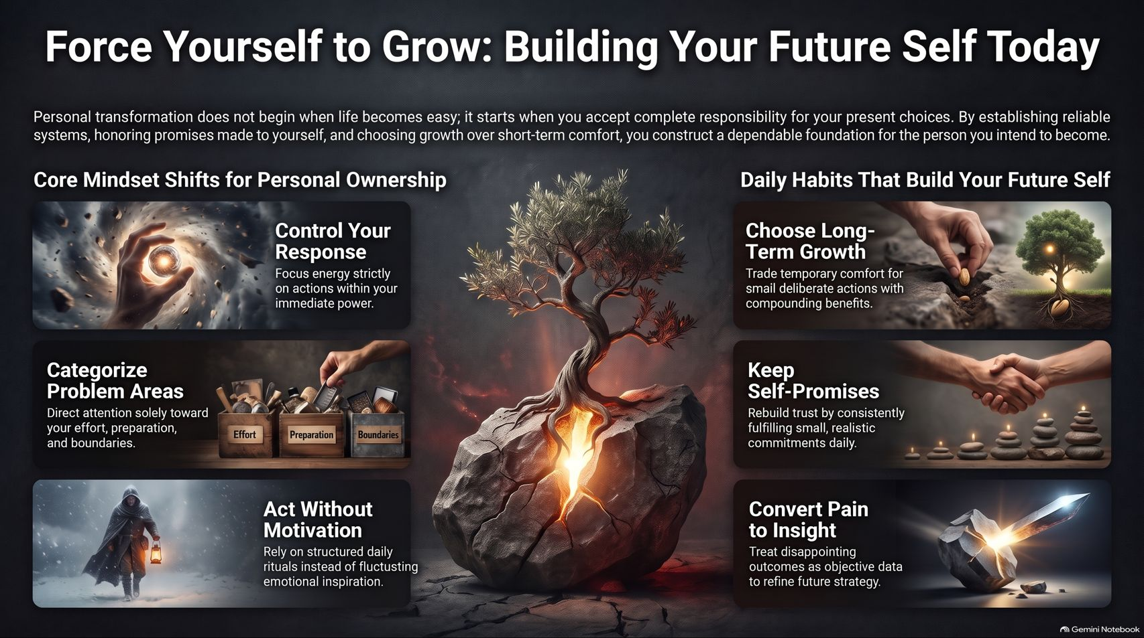
Notes:
Estimated Speaking Time: 4 – 5 minutes
Speaker Script & Talking Points
To conclude, let’s review our core executive summary. Personal transformation starts when you accept complete responsibility for your present choices.
We have grouped our core principles into two operational pillars:
Core Mindset Shifts for Personal Ownership:
Control Your Response: Direct energy strictly toward what is within your immediate power.
Categorize Problem Areas: Direct focus strictly to effort, preparation, and boundaries.
Act Without Motivation: Depend on daily rituals rather than emotional inspiration.
Daily Habits That Build Your Future Self:
Choose Long-Term Growth: Trade temporary comfort for small deliberate actions with compounding returns.
Keep Self-Promises: Rebuild self-trust by consistently fulfilling small daily commitments.
Convert Pain to Insight: Treat disappointing outcomes as objective data to refine your strategy.
Thank you for your time. Start making those deliberate choices today, and build the future self you deserve.

