Slide 1
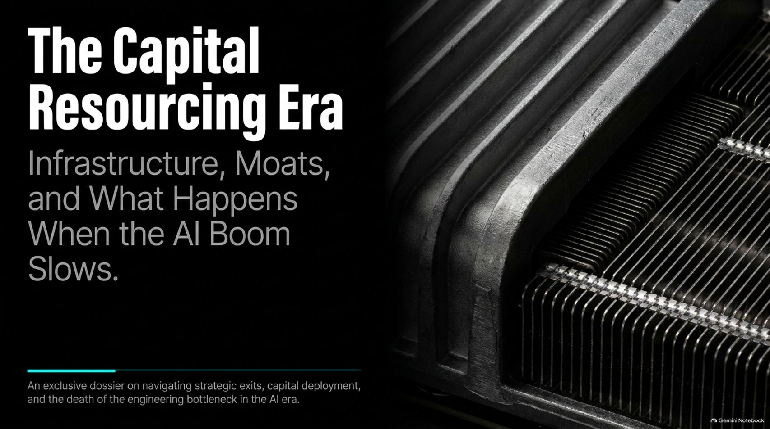
Notes:
Estimated Speaking Time: 2 – 3 minutes
Speaker Script & Talking Points
Welcome everyone. Today we are examining an exclusive dossier on navigating strategic exits, capital deployment, and the death of the engineering bottleneck in the AI era.
For the past several decades, technology has operated under the constraints of human software engineering. Today, we have entered The Capital Resourcing Era. As discussed in recent insights on how modern venture and technology markets operate, we are no longer limited by how fast human engineers can write code; we are limited by our own creativity and the physical deployment of capital.
Over the next 14 slides, we will unpack the shift from engineering bottlenecks to capital engines, analyze the four mindsets of tech investing, dissect the true shape of moats, and look ahead at what happens when the current AI growth curve encounters saturation.
What Happens When the AI Boom Slows Down
https://www.youtube.com/watch?v=XZxDawMm4lU

Slide 2
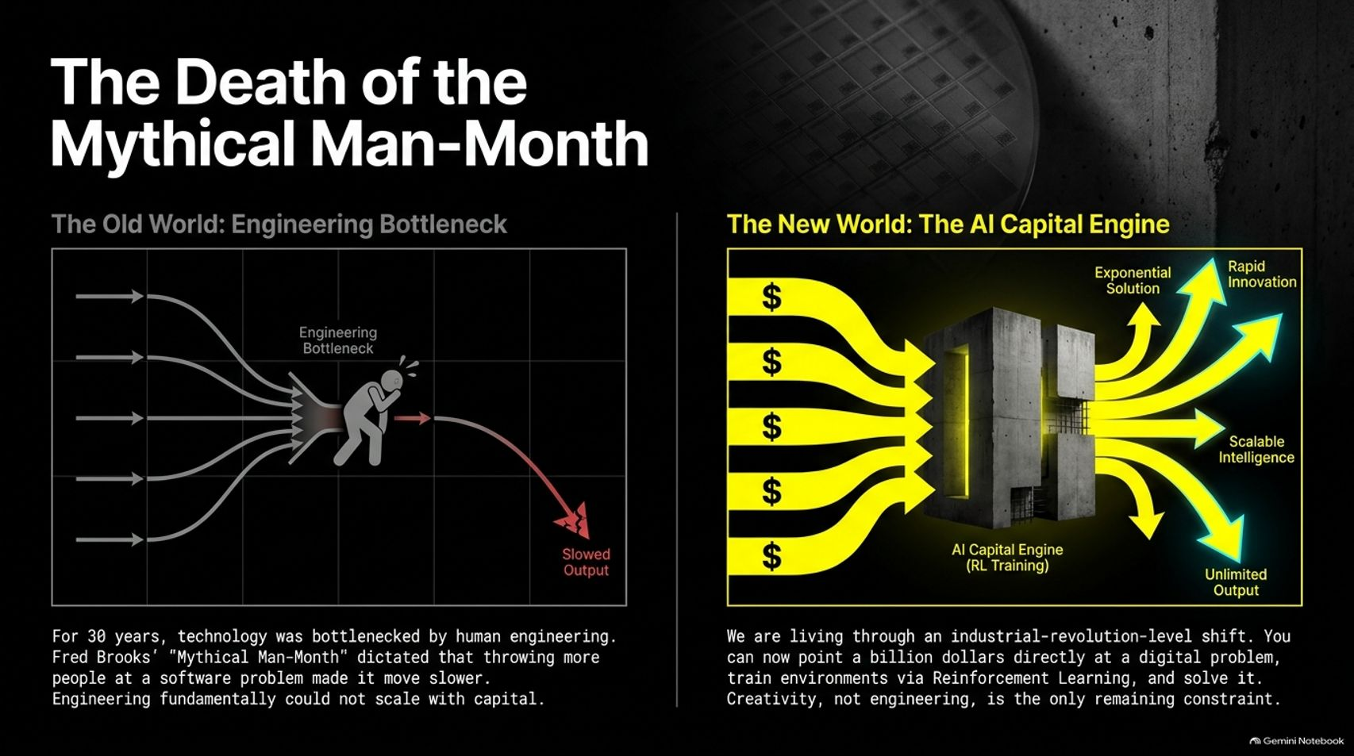
Notes:
Estimated Speaking Time: 4 – 5 minutes
Speaker Script & Talking Points
Slide 2 tackles a foundational principle of computer science: The Death of the Mythical Man-Month.
The Old World (Engineering Bottleneck): For 30 years, technology was bottlenecked by human engineering. Fred Brooks’ famous observation in The Mythical Man-Month dictated that throwing more people at a software problem made it move slower because communication overhead scaled non-linearly. Engineering fundamentally could not scale with capital.
The New World (The AI Capital Engine): We are living through an industrial-revolution-level shift. Today, you can point a billion dollars directly at a digital problem, train environments via Reinforcement Learning, and solve it.
As noted in our discussions with leading infrastructure investors, anything that can be simulated can be solved with compute and capital. Creativity, not engineering, is now the only remaining constraint.

Slide 3
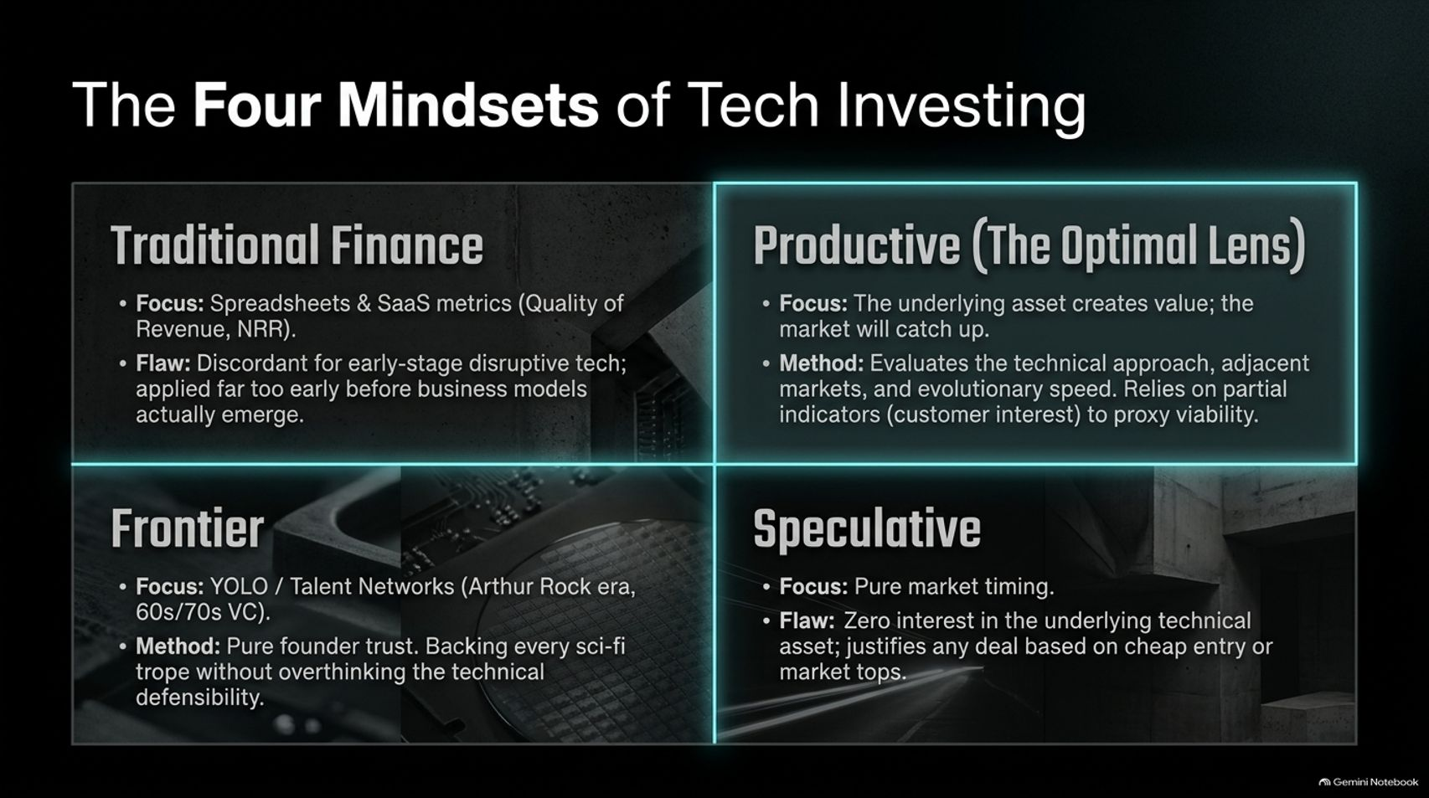
Notes:
Estimated Speaking Time: 4 – 5 minutes
Speaker Script & Talking Points
When evaluating early-stage disruptive technology, investors often bring conflicting frameworks to the table. Slide 3 categorizes these into The Four Mindsets of Tech Investing:
Traditional Finance: Focuses on spreadsheets, SaaS metrics, and Net Revenue Retention (NRR). The Flaw: It is highly discordant for early-stage disruptive tech, applied far too early before viable business models have even emerged.
Productive (The Optimal Lens): Focuses on the underlying technical asset creating value, trusting that the market will eventually catch up. It evaluates technical approaches, adjacent markets, and evolutionary speed using partial indicators.
Frontier: Focuses on pure founder trust and talent networks (reminiscent of 60s/70s VC). It backs visionary sci-fi concepts without overthinking technical defensibility.
Speculative: Focuses purely on market timing and quick liquidity, with zero interest in the underlying technical asset.
Knowing which lens you are looking through is vital to avoid cognitive dissonance in boardrooms.

Slide 4
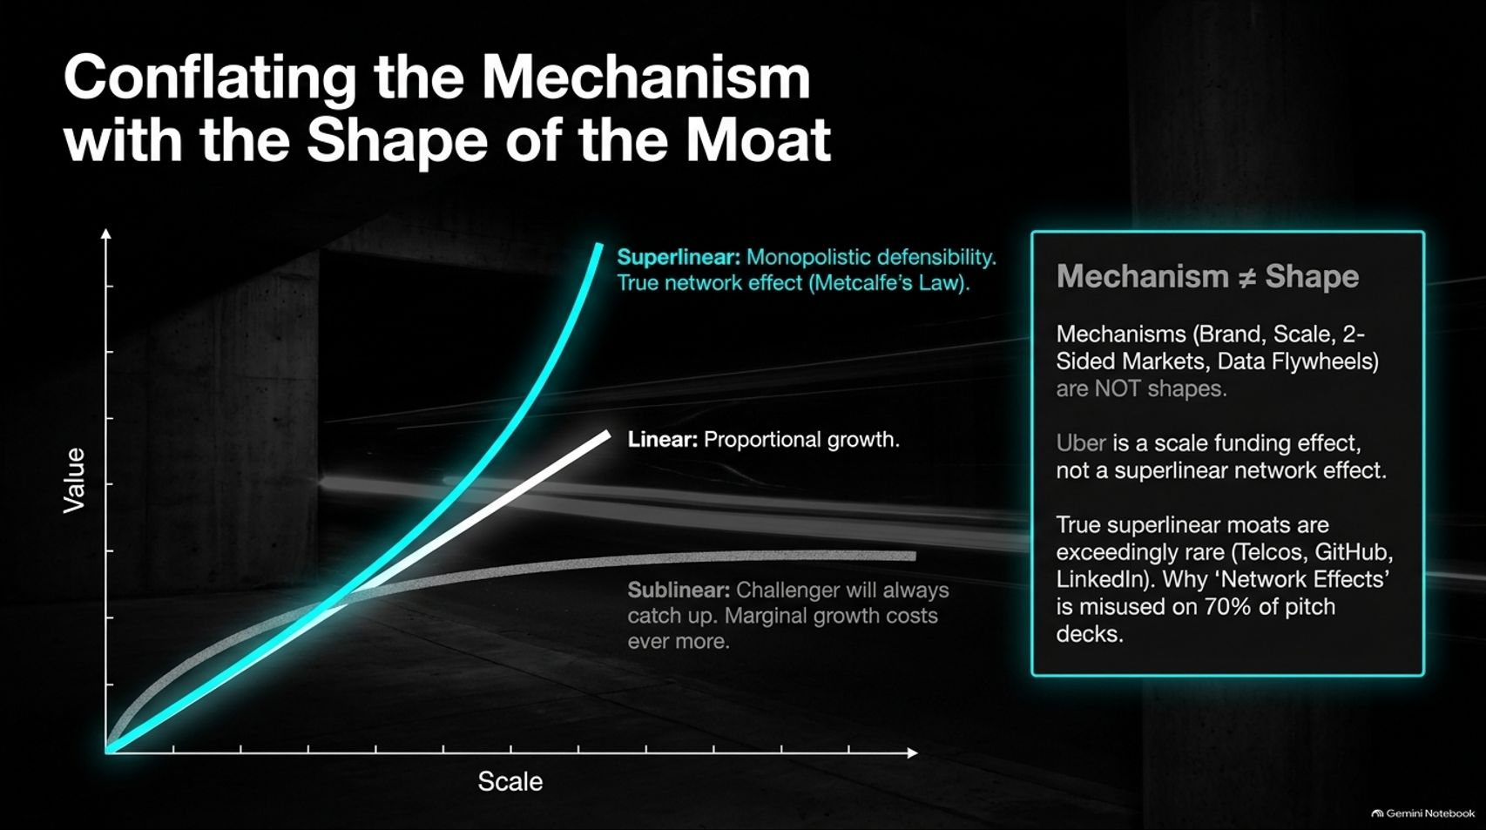
Notes:
Estimated Speaking Time: 4 – 5 minutes
Speaker Script & Talking Points
One of the most common points of confusion in pitch decks is the casual misuse of the term "network effects". Slide 4 clarifies why Mechanism $\neq$ Shape.
Mechanisms (such as brand, scale, two-sided markets, or data flywheels) are not the shape of the moat. For example, Uber is a scale funding effect, not a superlinear network effect.
The Shapes of Defensibility:
Superlinear (Metcalfe’s Law): Exceedingly rare (e.g., Telcos, GitHub, LinkedIn), where value grows exponentially with scale. True network effects create natural monopolies.
Linear: Proportional growth where challengers can easily keep pace.
Sublinear: Marginal growth costs ever more, meaning competitors will inevitably catch up.
The word "network effects" is misused on roughly 70% of pitch decks because teams confuse the business mechanism with mathematical superlinear defensibility.

Slide 5
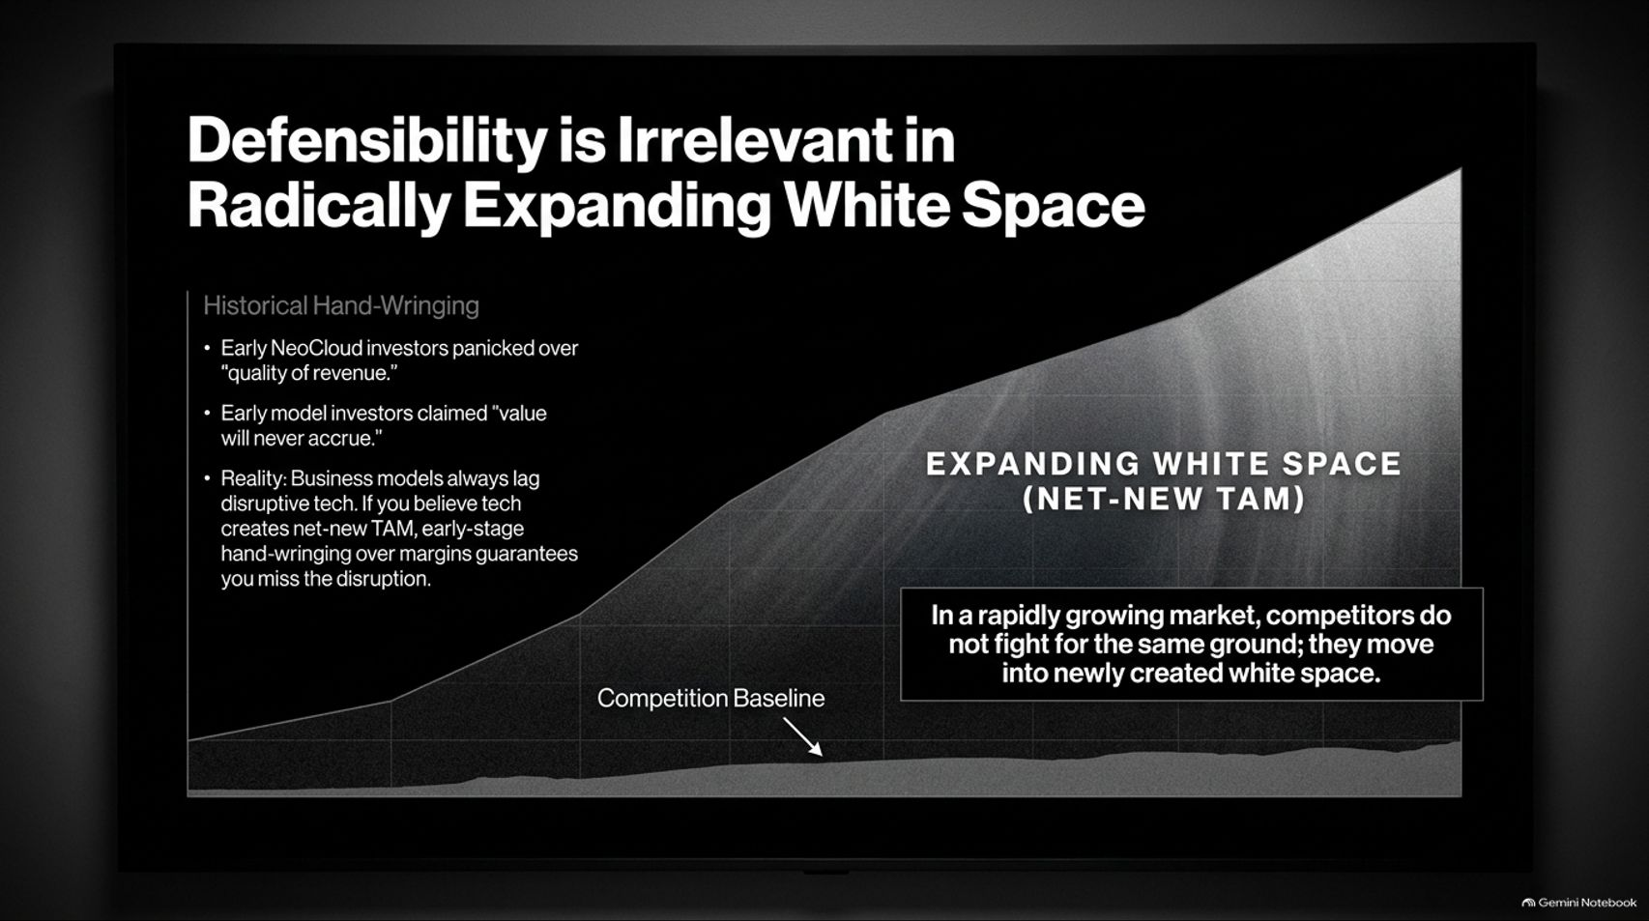
Notes:
Estimated Speaking Time: 4 – 5 minutes
Speaker Script & Talking Points
Why do early-stage investors spend so much time hand-wringing over defensibility? Slide 5 demonstrates that Defensibility is Irrelevant in Radically Expanding White Space.
Historical Hand-Wringing: Early investors panicked over the "quality of revenue" for NeoClouds, claiming value would never accrue.
The Reality: Business models always lag disruptive technology. If you believe a technology creates net-new Total Addressable Market (TAM), early-stage hand-wringing over operating margins guarantees you will miss the disruption entirely.
In a rapidly growing market, competitors do not fight for the same stagnant ground; they expand outward into newly created white space. TAM creation trumps static defensibility in the early days of a paradigm shift.

Slide 6
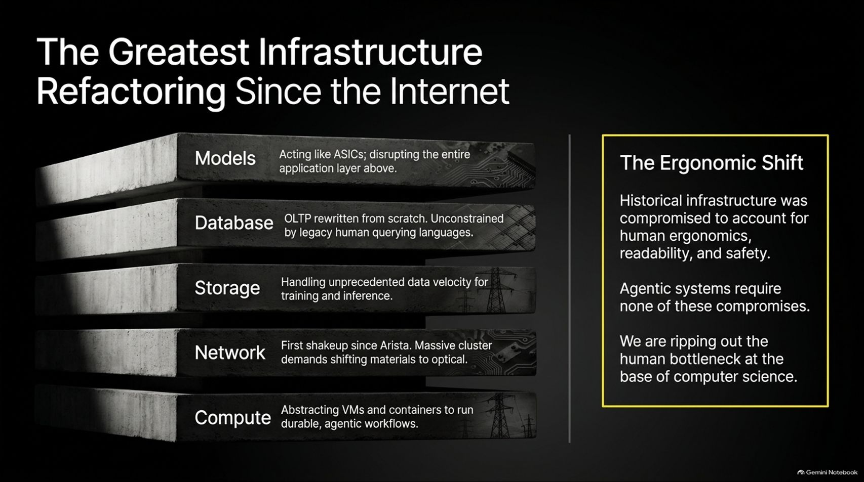
Notes:
Estimated Speaking Time: 4 – 5 minutes
Speaker Script & Talking Points
Slide 6 breaks down The Greatest Infrastructure Refactoring Since the Internet, examining how AI is rewriting every layer of the computer science stack:
Compute: Abstracting VMs and containers to run durable, agentic workflows.
Network: Massive cluster demands are shifting physical materials to optical networks for the first time since Arista.
Storage: Handling unprecedented data velocity for training and inference.
Database: OLTP (Transaction Databases) being rewritten from scratch, unconstrained by legacy human-centric query languages.
Models: Acting like ASICs, disrupting the entire application layer above them.
The Ergonomic Shift: Historical infrastructure was compromised to account for human ergonomics and readability. Agentic systems require none of these compromises, removing the human bottleneck at the base of computer science.

Slide 7
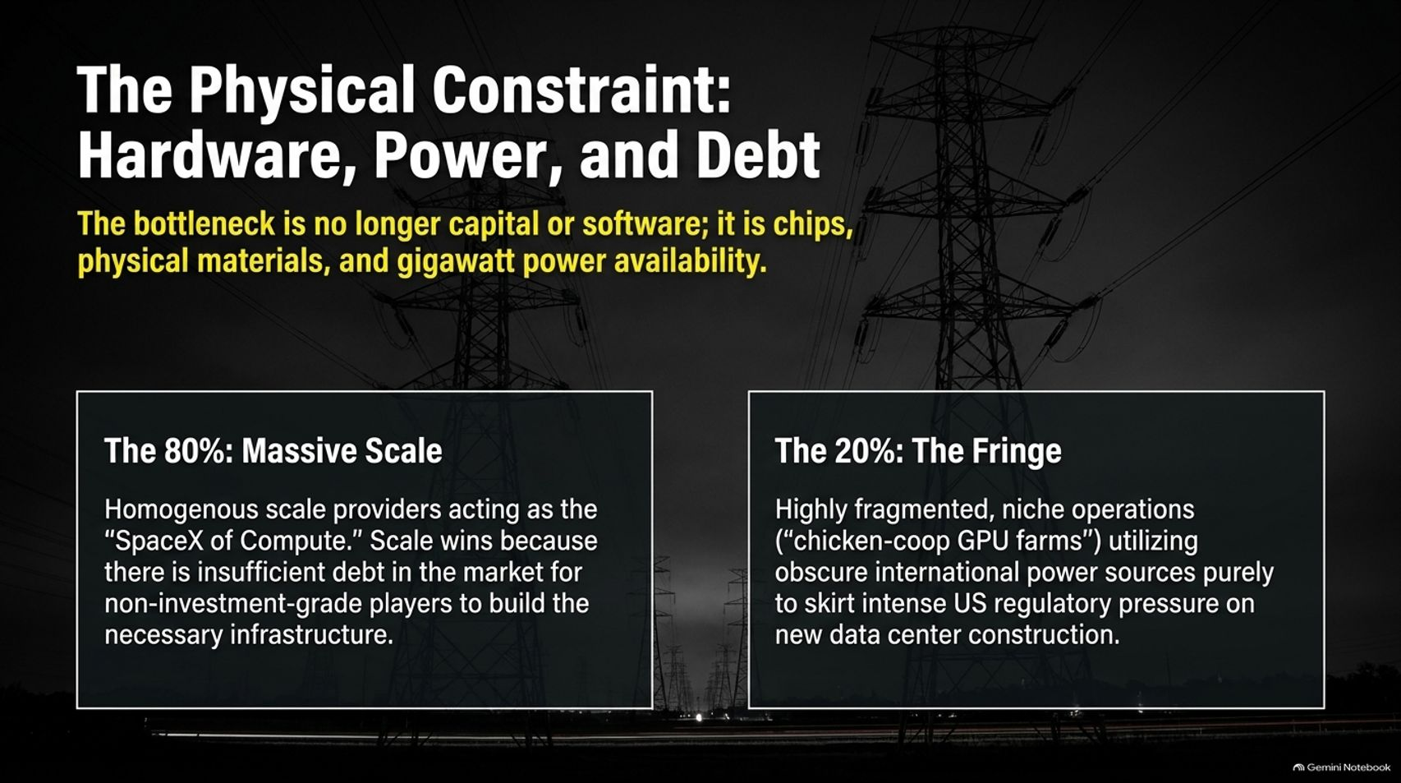
Notes:
Estimated Speaking Time: 4 – 5 minutes
Speaker Script & Talking Points
While capital and software are increasingly abundant, Slide 7 reminds us of The Physical Constraint: Hardware, Power, and Debt.
The 80% (Massive Scale): Homogenous scale providers acting as the "SpaceX of Compute." Scale wins because there is insufficient debt in the market for non-investment-grade players to build multi-gigawatt infrastructure.
The 20% (The Fringe): Highly fragmented, niche operations ("chicken-coop GPU farms") utilizing obscure international power sources purely to skirt intense regulatory pressure on new domestic data center construction.
The bottleneck is no longer code; it is silicon wafers, physical materials, and gigawatt power availability.

Slide 8
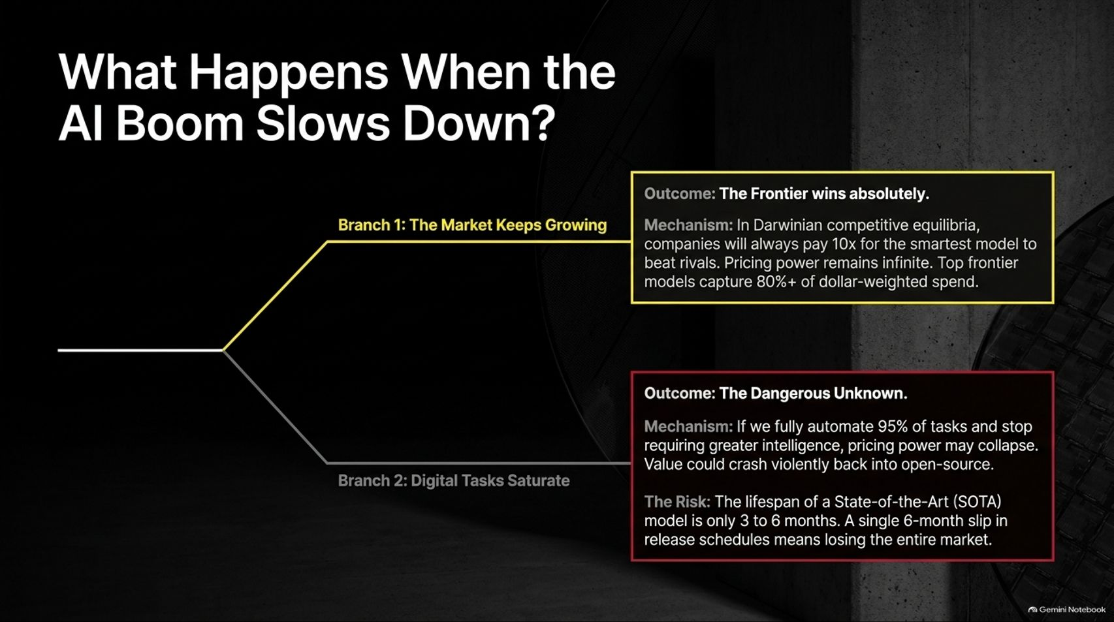
Notes:
Estimated Speaking Time: 4 – 5 minutes
Speaker Script & Talking Points
As we look to the future, Slide 8 maps out two potential branching scenarios for What Happens When the AI Boom Slows Down?
Branch 1: The Market Keeps Growing (The Frontier Wins Absolutely): In Darwinian competitive equilibria, companies will always pay 10x for the smartest model to beat rivals. Top frontier models capture 80%+ of dollar-weighted spend because pricing power remains infinite.
Branch 2: Digital Tasks Saturate (The Dangerous Unknown): If we fully automate 95% of tasks and stop requiring greater intelligence, pricing power could collapse, and value could crash back into open source.
The Risk: The lifespan of a State-of-the-Art (SOTA) model is only 3 to 6 months. A single 3-month slip in release schedules means losing the entire market.

Slide 9
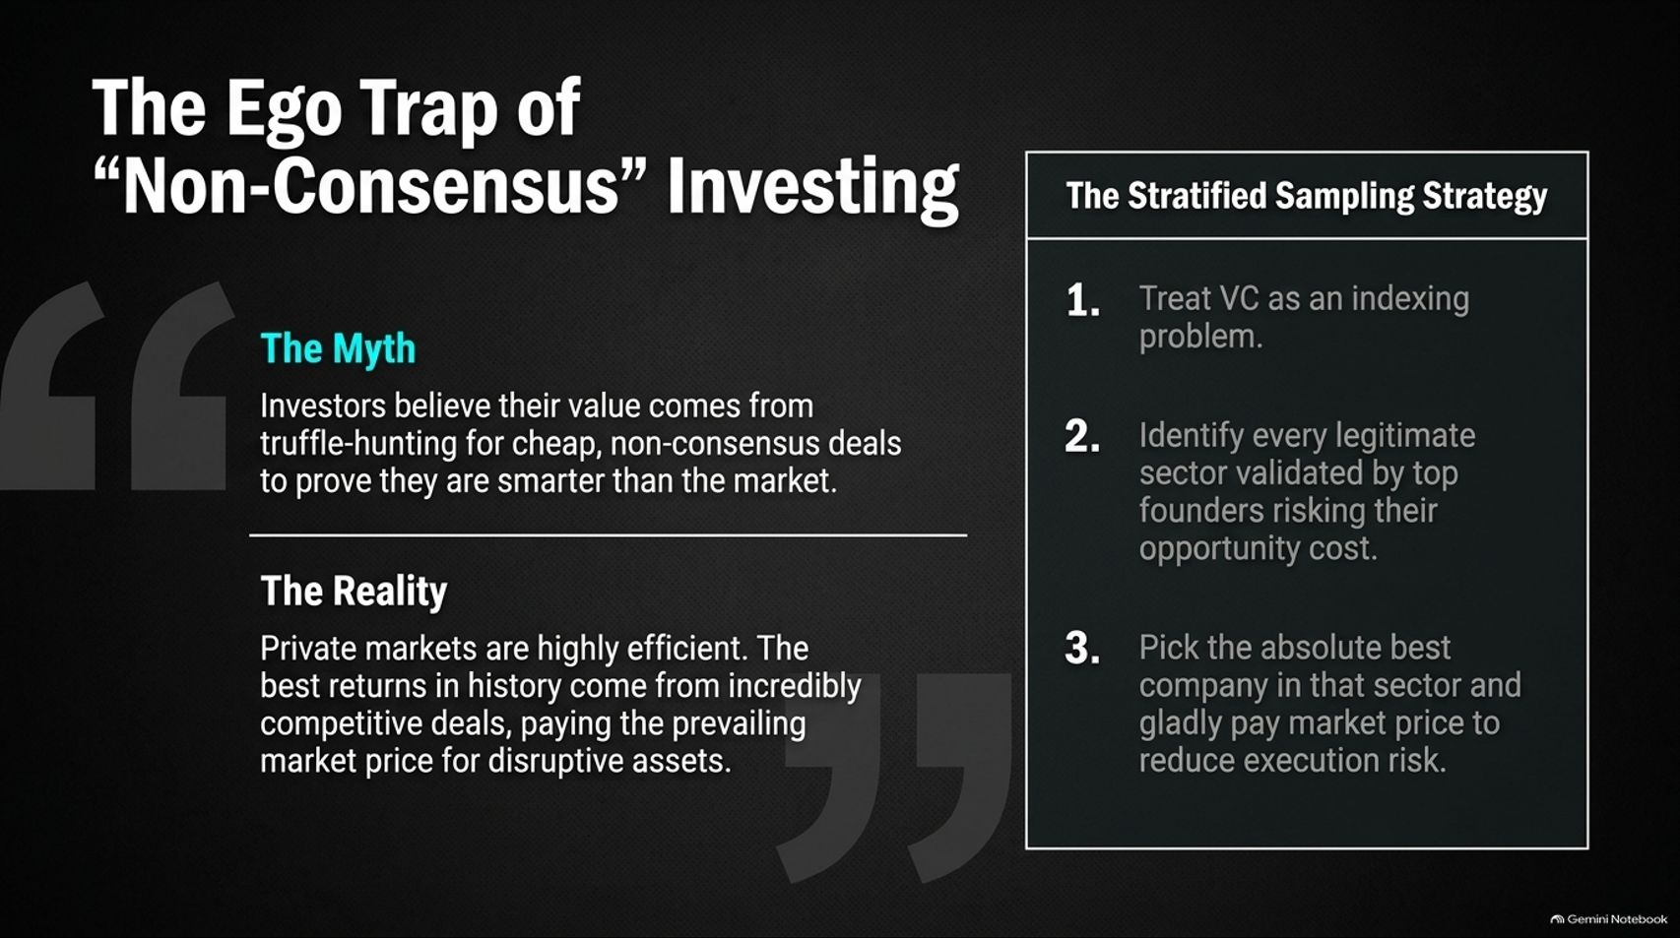
Notes:
Estimated Speaking Time: 4 – 5 minutes
Speaker Script & Talking Points
Slide 9 challenges a cherished venture capital myth: The Ego Trap of "Non-Consensus" Investing.
The Myth: Investors believe their primary value comes from truffle-hunting for cheap, non-consensus deals to prove they are smarter than the market.
The Reality: Private markets are highly efficient. The best historical returns come from intensely competitive deals where you pay prevailing market prices for disruptive assets rather than waiting for a hidden discount.
The Stratified Sampling Strategy:
Treat venture investing as an indexing problem across sectors.
Identify every legitimate sector validated by top founders risking their opportunity cost.
Pick the absolute best company in that sector and gladly pay market price to reduce execution risk.

Slide 10
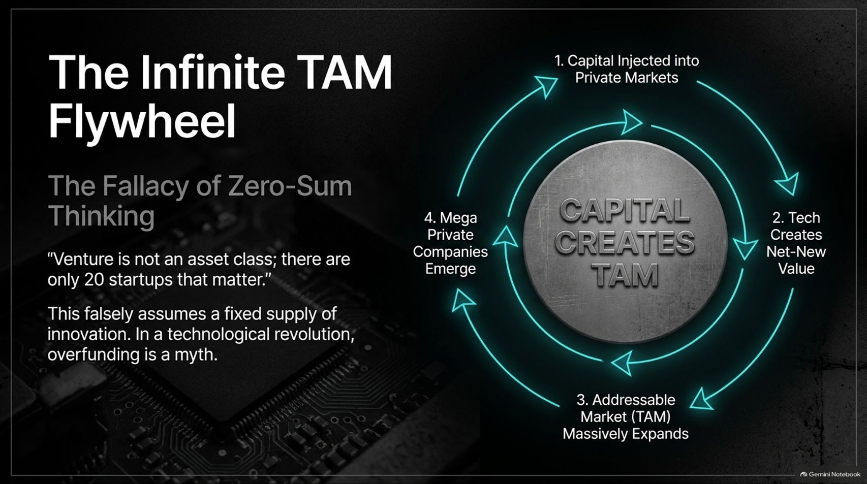
Notes:
Estimated Speaking Time: 4 – 5 minutes
Speaker Script & Talking Points
Slide 10 dismantles zero-sum thinking with The Infinite TAM Flywheel.
Many veteran investors argue that venture capital is overfunded, assuming a fixed supply of innovation ("there are only 20 startups that matter"). This is a fallacy.
The Flywheel of Capital Creation:
Capital is injected into private markets.
Technology creates net-new value.
The Addressable Market (TAM) massively expands.
Mega private companies emerge, generating a larger ecosystem.
In a technological revolution, overfunding is a myth because capital actively expands the boundaries of the investable universe.

Slide 11
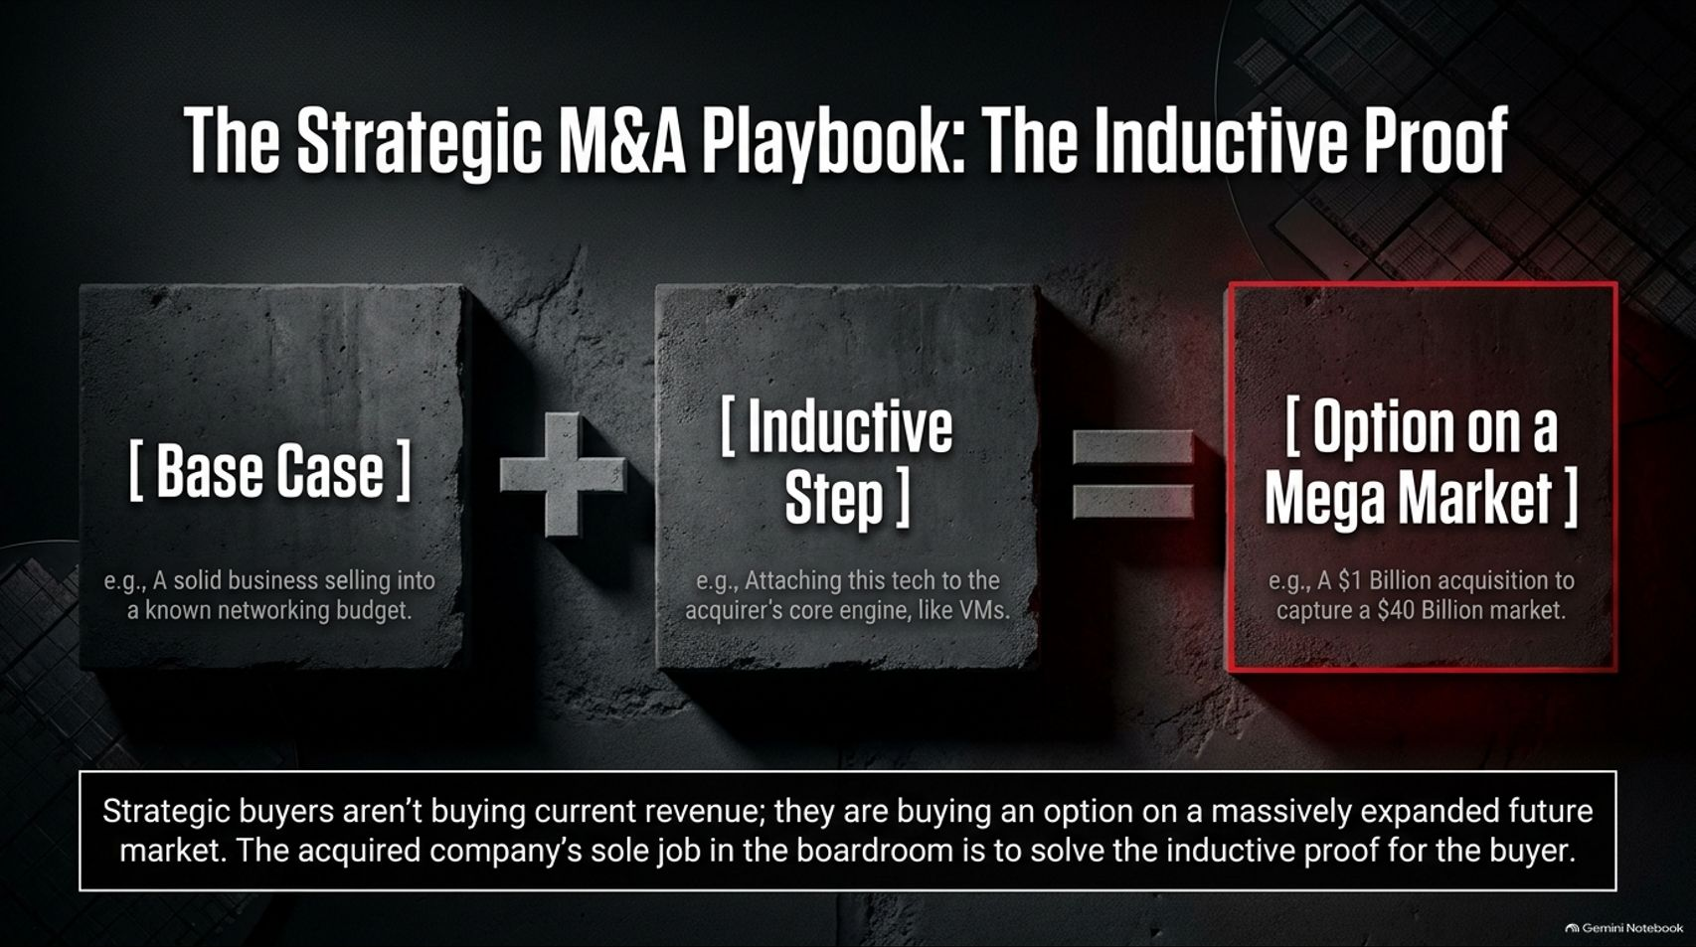
Notes:
Estimated Speaking Time: 4 – 5 minutes
Speaker Script & Talking Points
Slide 11 outlines how major technology acquisitions actually succeed: The Strategic M&A Playbook.
[Base Case]: A solid business selling into a known, existing budget (e.g., networking or storage).
[Inductive Step]: Attaching innovative technology to the acquirer's core engine (e.g., integrating new software into virtual machines).
= [Option on a Mega Market]: E.g., a $1 billion acquisition executed to capture a $40 billion expanding market.
Strategic buyers aren't buying past revenue; they are buying an option on a massively expanded future market. The acquired company's job in the boardroom is to solve the inductive proof for the buyer.

Slide 12
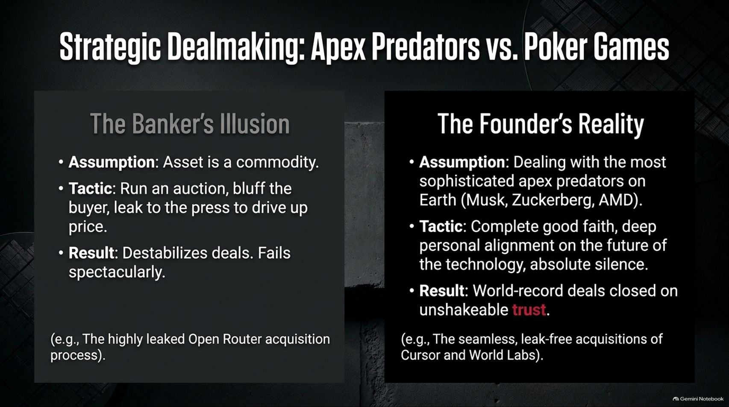
Notes:
Estimated Speaking Time: 4 – 5 minutes
Speaker Script & Talking Points
Slide 12 contrasts two opposing styles of corporate dealmaking: Apex Predators vs. Poker Games.
The Banker’s Illusion: Assumes the asset is a generic commodity. Tactics include running artificial auctions, bluffing buyers, and leaking to the press to drive up price. Result: Destabilizes deals and fails spectacularly with sophisticated buyers.
The Founder’s Reality: Recognizes you are dealing with the most sophisticated apex predators on Earth (e.g., Musk, Zuckerberg, AMD). Tactics require complete good faith, deep personal alignment on the future of technology, and absolute silence. Result: World-record deals closed on unshakeable trust (exemplified by leak-free acquisitions like Cursor and World Labs).

Slide 13
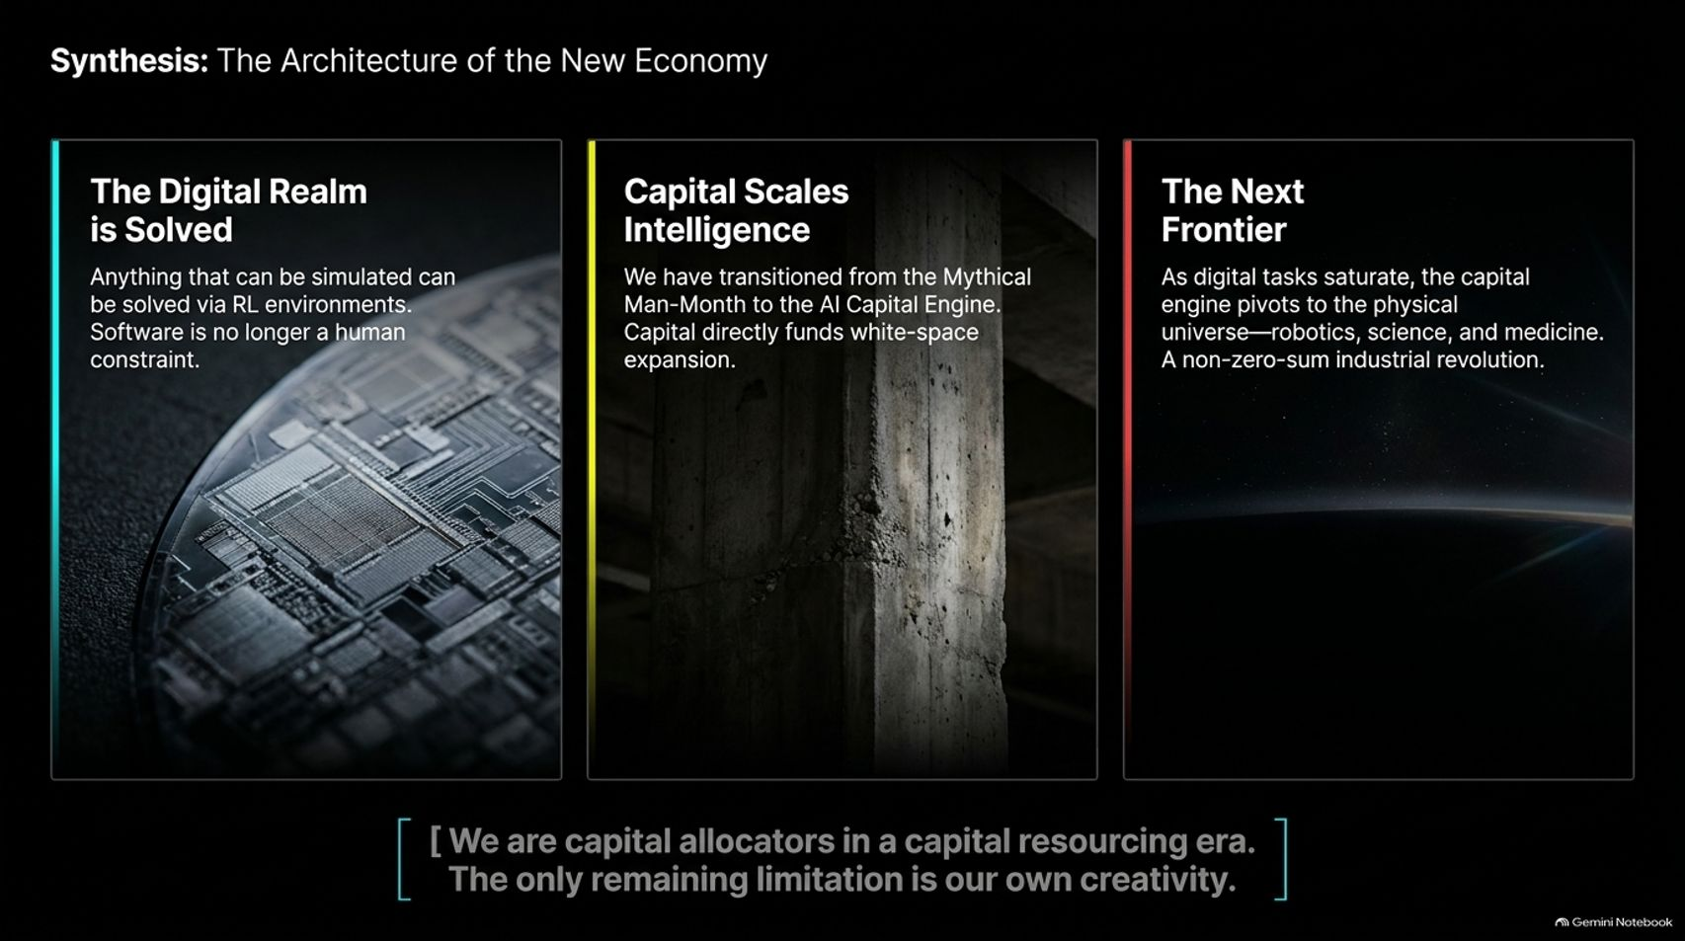
Notes:
Estimated Speaking Time: 4 – 5 minutes
Speaker Script & Talking Points
Slide 13 provides the macro synthesis of our changing world:
The Digital Realm is Solved: Anything that can be simulated can be solved via Reinforcement Learning environments. Software is no longer a human constraint.
Capital Scales Intelligence: We have transitioned from the Mythical Man-Month to the AI Capital Engine, where capital directly funds white-space expansion.
The Next Frontier: As digital tasks saturate, the capital engine pivots outward into the physical universe—robotics, science, and medicine in a non-zero-sum industrial revolution.
"[We are capital allocators in a capital resourcing era. The only remaining limitation is our own creativity.]"

Slide 14
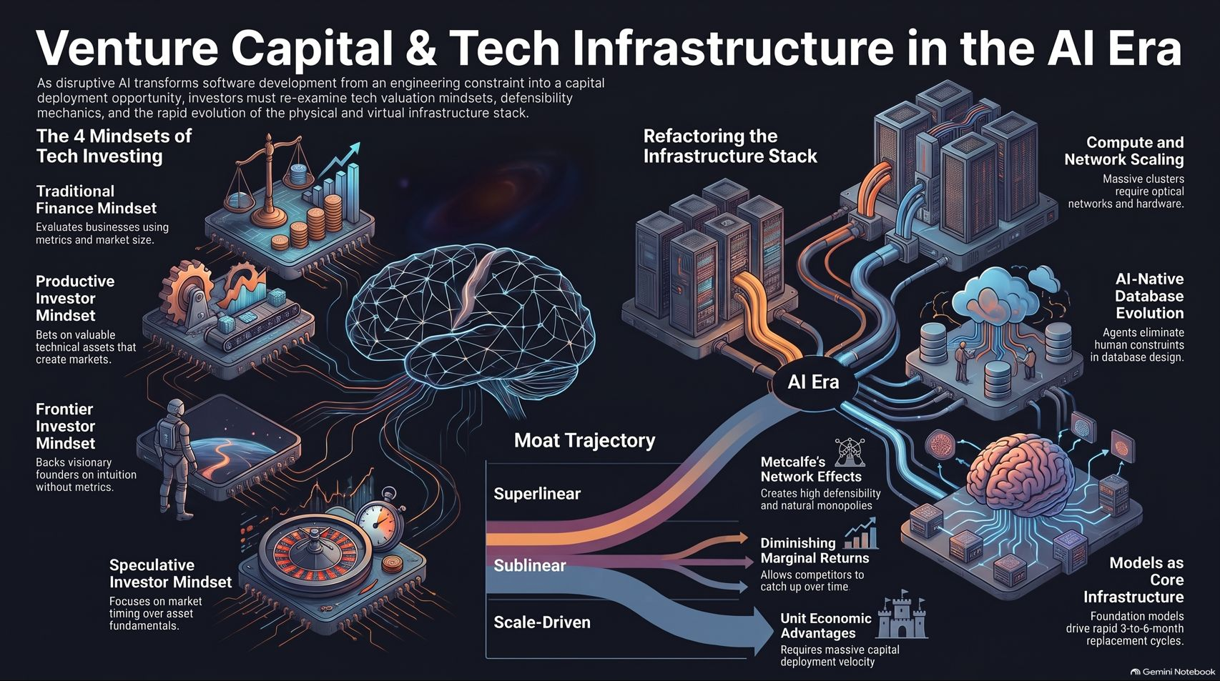
Notes:
Estimated Speaking Time: 4 – 5 minutes
Speaker Script & Talking Points
To conclude our dossier (Slide 14):
As disruptive AI transforms software development from an engineering bottleneck into a capital deployment opportunity, investors must re-examine their valuation mindsets, defensibility metrics, and infrastructure stacks.
Whether evaluating the refactored infrastructure layers, navigating superlinear versus sublinear moats, or managing strategic M&A through trust rather than auctions, the rules of the game have fundamentally changed.
We are capital allocators shaping a new industrial era. Thank you.

