Slide 1
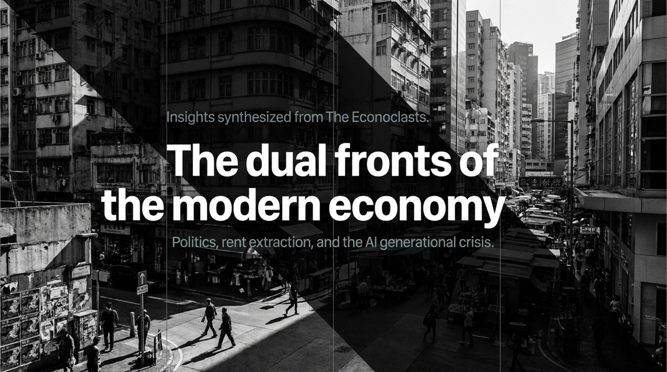
Notes:
Estimated Delivery Time: 4 – 6 minutes
Speaker Notes:
Let's synthesize our entire journey across these dual fronts of the modern economy:
On Class Politics & Rent Extraction: We saw that since 1989, over 75% of stock market gains reflect diverted worker income and central bank liquidity rather than organic growth. True counter-strategies—like Brazil's PIX handling 80 billion transactions—prove that public digital infrastructure can dismantle private financial plunder.
On AI Labor & Global Divergence: Western tech models use AI primarily for white-collar service reduction and youth hiring freezes, exposing a productivity delusion where use value outpaces exchange value. In contrast, alternative models integrate open-source AI with physical manufacturing and robotics.
Ultimately, overcoming this generational crisis requires rejecting political fatalism, building public digital commons, and demanding productive technology that empowers the workforce rather than locking them out. Thank you.
AI’s silent jobs crisis is here - Yanis Varoufakis & Wolfgang Munchau | The Econoclasts
https://www.youtube.com/watch?v=4a5RSWh1p34

Slide 2
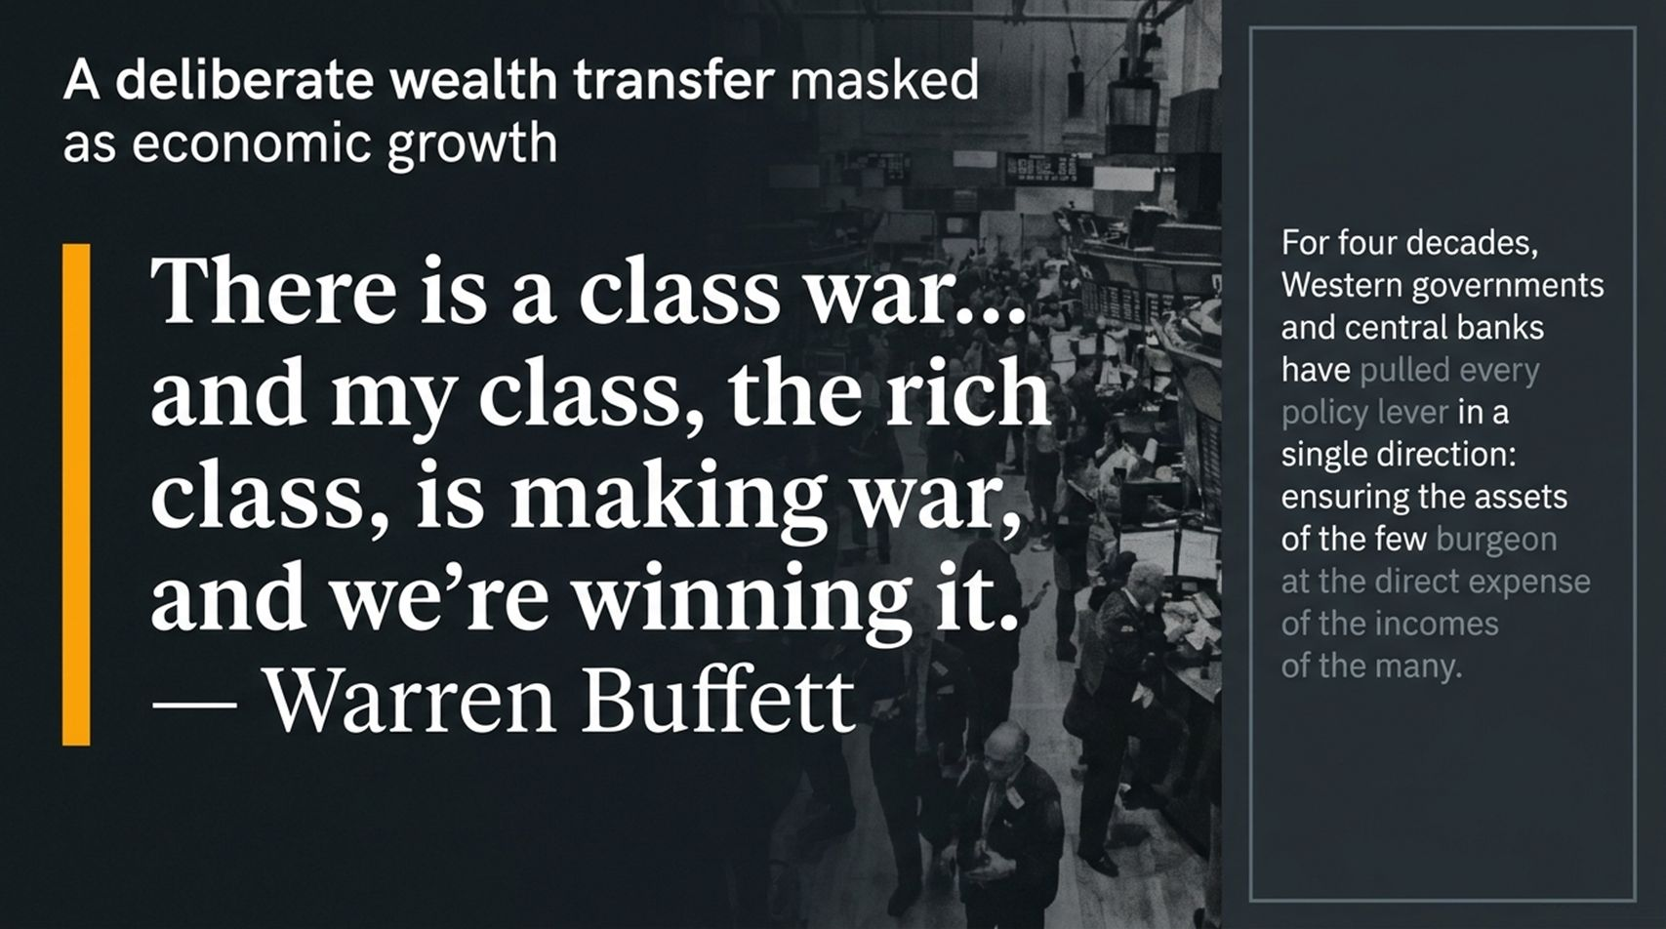
Notes:
Estimated Delivery Time: 3 – 4 minutes
Speaker Notes:
Let's start with a stark reality check. As Warren Buffett famously admitted: “There’s class warfare, all right, but it’s my class, the rich class, that’s making war, and we’re winning it”.
For nearly four decades, Western governments and central banks have pulled every policy lever in a single direction. Whenever financial crises hit, the state rushes in with liquidity and bailouts, ensuring that the assets of the very few surge at the direct expense of the wages and purchasing power of the many.
Economists often talk about growth as if it lifts all boats equally. But as we will see on the next slide, the data reveals that what has been marketed as "growth" is actually a systemic, engineered wealth transfer from workers to capital owners.

Slide 3
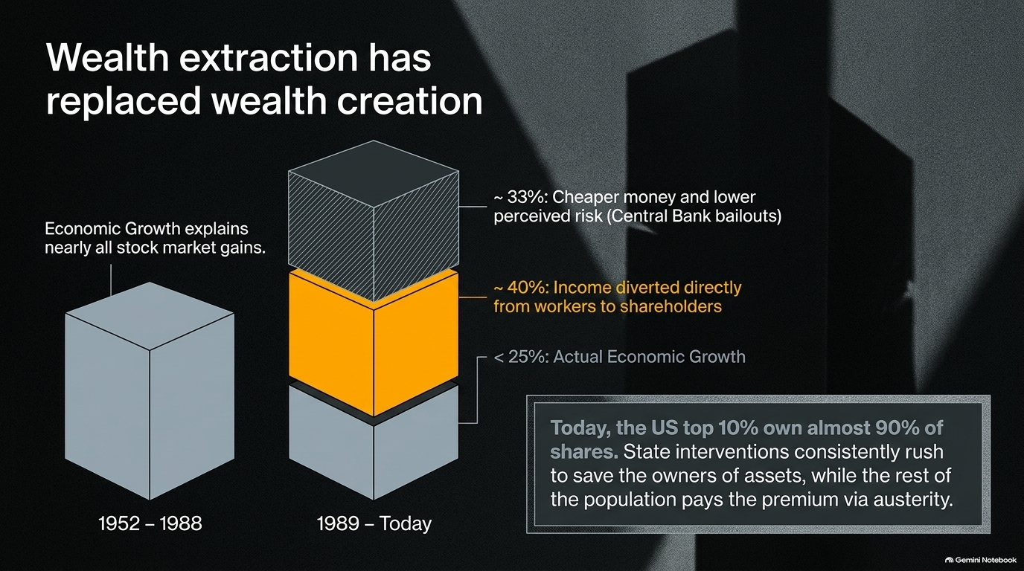
Notes:
Estimated Delivery Time: 3 – 5 minutes
Speaker Notes:
Look closely at this structural breakdown of stock market gains. Between 1952 and 1988, nearly all stock market gains could be explained by actual underlying economic growth.
But look at the regime shift from 1989 to today. Actual economic growth accounts for less than 25% of market gains. Where did the rest go? Roughly 40% represents income diverted directly from workers to shareholders, and about 33% comes from cheaper money and systemic risk suppression via central bank bailouts.
Today, the top 10% in the US own almost 90% of all shares. When Adam Parker discusses market cycles and capital allocation in his analysis, he notes how capital access remains heavily skewed toward those holding existing assets. State interventions consistently rescue asset holders while the rest of the population pays the premium through quiet austerity.

Slide 4
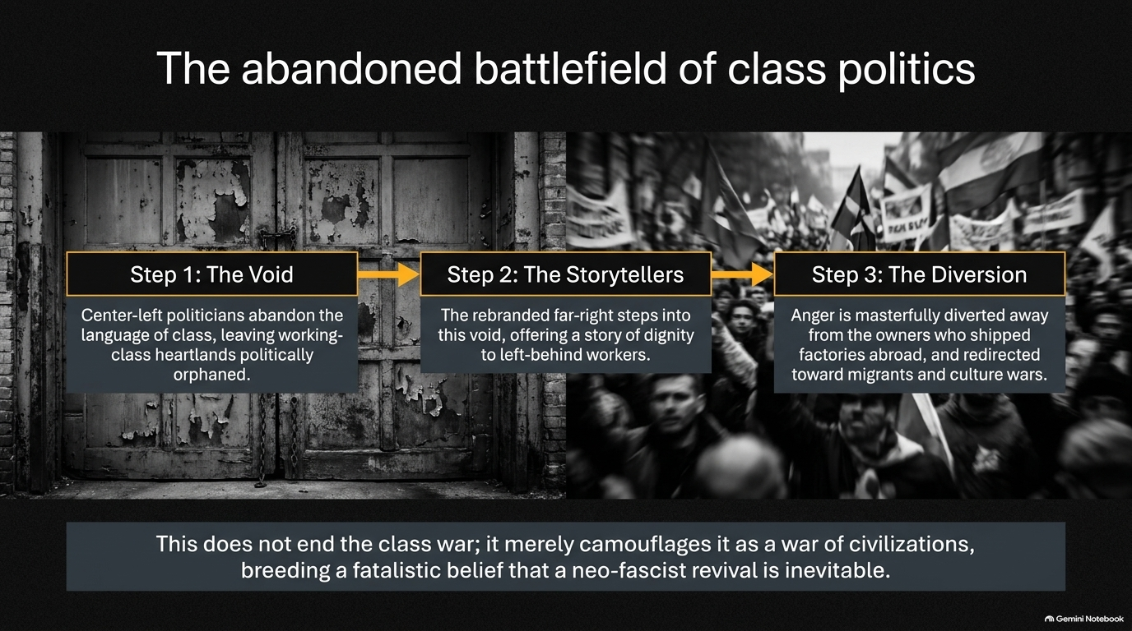
Notes:
Estimated Delivery Time: 3 – 5 minutes
Speaker Notes:
How did this massive economic shift go unchecked politically? It happened because of a three-step abandonment of working-class politics.
Step 1: The Void. Center-left politicians largely abandoned the language of class, adopting technocratic management and leaving working-class heartlands politically orphaned.
Step 2: The Storytellers. Into this political void stepped a rebranded far-right, offering a toxic brand of dignity and grievance to left-behind workers.
Step 3: The Diversion. Public anger is masterfully deflected away from the corporate owners who shipped factories abroad and suppressed wages, and redirected downward toward migrants and culture wars.
This doesn't end the class war; it merely camouflages it as a war of civilizations, breeding a fatalistic belief that a neo-fascist revival is inevitable. But as our next case study shows, this cycle can be broken.

Slide 5
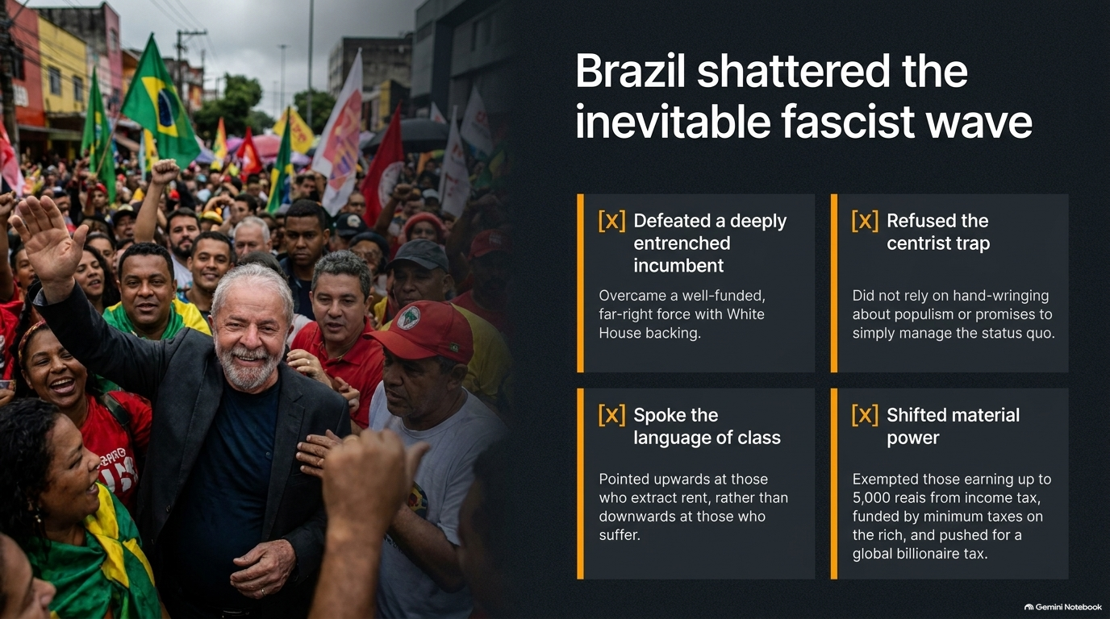
Notes:
Estimated Delivery Time: 4 – 6 minutes
Speaker Notes:
Brazil recently provided a masterclass in how to counter this wave. Lula’s movement shattered the narrative that far-right populism is unstoppable through four decisive choices:
First, they defeated a deeply entrenched incumbent backed by powerful external forces.
Second, they refused the centrist trap—they didn't rely on hand-wringing about populism or hollow promises to manage a broken status quo.
Third, they spoke the language of class, explicitly pointing upwards at rent extractors rather than downwards at vulnerable people.
Fourth, they shifted material power. They exempted workers earning up to 5,000 reais from income tax, funded it through minimum taxes on the rich, and pushed aggressively for a global billionaire tax. This proves that material redistribution is the ultimate antidote to political extremism.

Slide 6
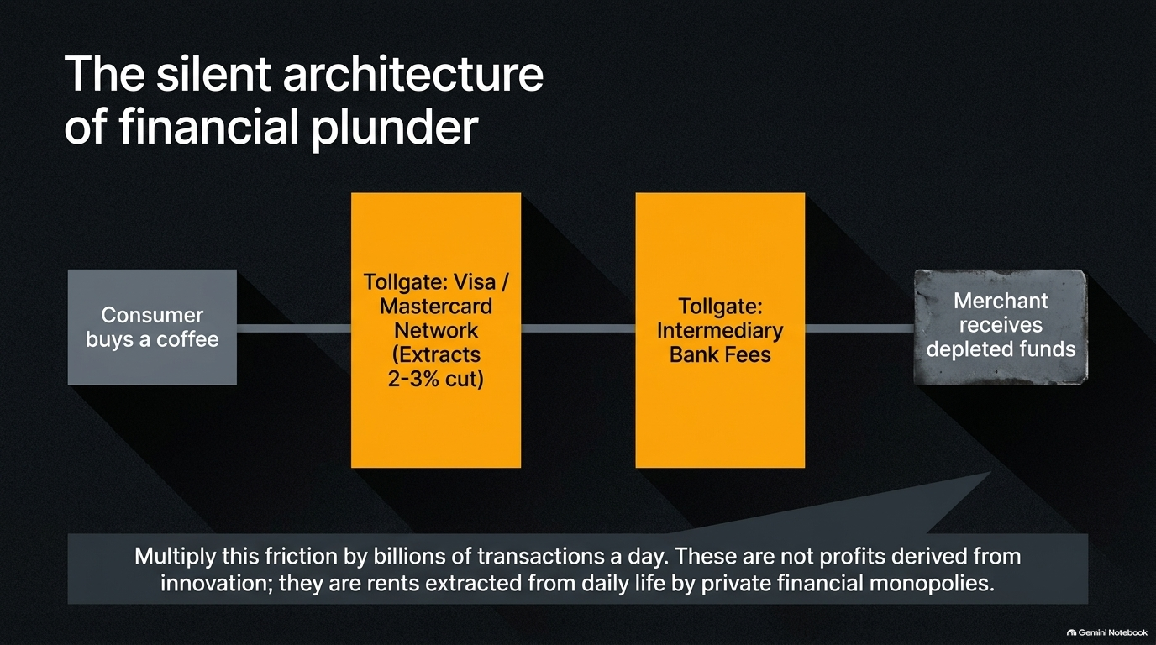
Notes:
Estimated Delivery Time: 3 – 4 minutes
Speaker Notes:
Let's look at how extraction operates at the micro-level of daily life: the private financial tollgates.
Consider something as simple as a consumer buying a morning coffee. Between the consumer and the merchant sits a private card network—like Visa or Mastercard—extracting a mandatory 2% to 3% cut, followed by intermediary bank and processing fees. The merchant receives depleted funds.
Multiply this friction across billions of daily transactions. These are not profits derived from technological innovation or service enhancement; they are pure economic rents extracted from everyday life by private financial monopolies.

Slide 7
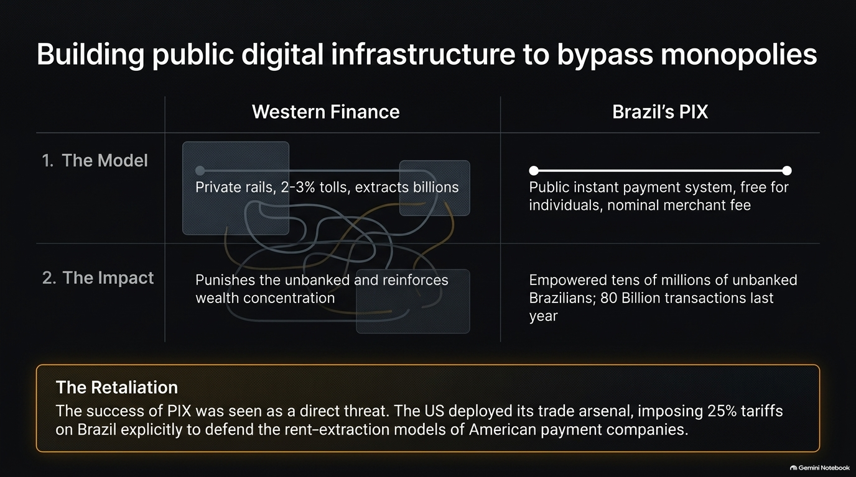
Notes:
Estimated Delivery Time: 3 – 5 minutes
Speaker Notes:
Is this financial extraction inevitable? Brazil proves it isn't.
Under Western finance, private payment rails impose 2-3% tolls, extracting billions and punishing the unbanked. In contrast, Brazil built PIX—a public instant payment system that is entirely free for individuals and charges only nominal merchant fees.
PIX empowered tens of millions of unbanked Brazilians, handling over 80 billion transactions last year. But public infrastructure threatens private plunder. The US response? Pure retaliation—deploying trade pressure and tariffs explicitly to defend the rent-extraction models of American financial giants.

Slide 8
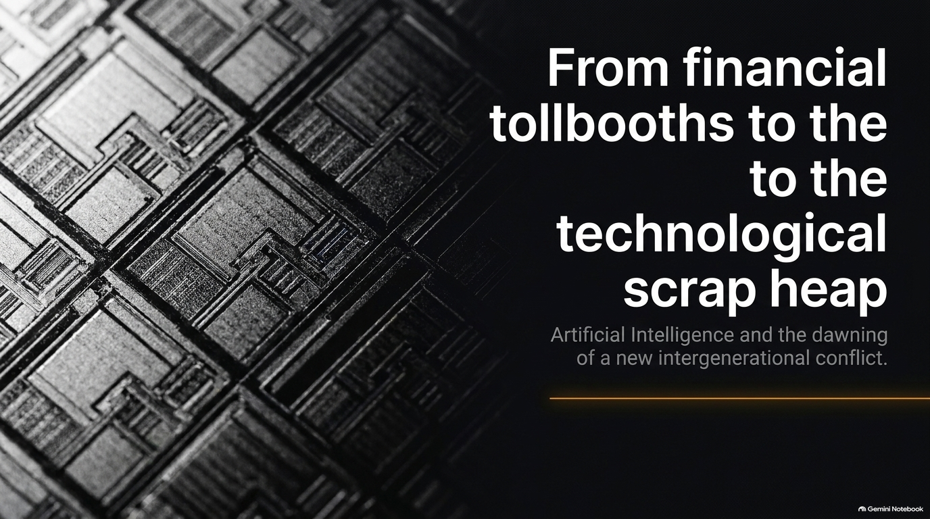
Notes:
Estimated Delivery Time: 2 – 3 minutes
Speaker Notes:
As financial extraction faces pushback, capital is pivoting to a massive new frontier: Artificial Intelligence.
But we must look past the Silicon Valley marketing hype. While AI is framed as the ultimate engine of human progress, its deployment under current Western market structures risks turning into a technological scrap heap for labor.
In the upcoming slides, we will examine how AI is reshaping the labor market, why its productivity numbers are currently a delusion, and how diverging global blueprints in the West and China are leading to entirely different social outcomes.

Slide 9
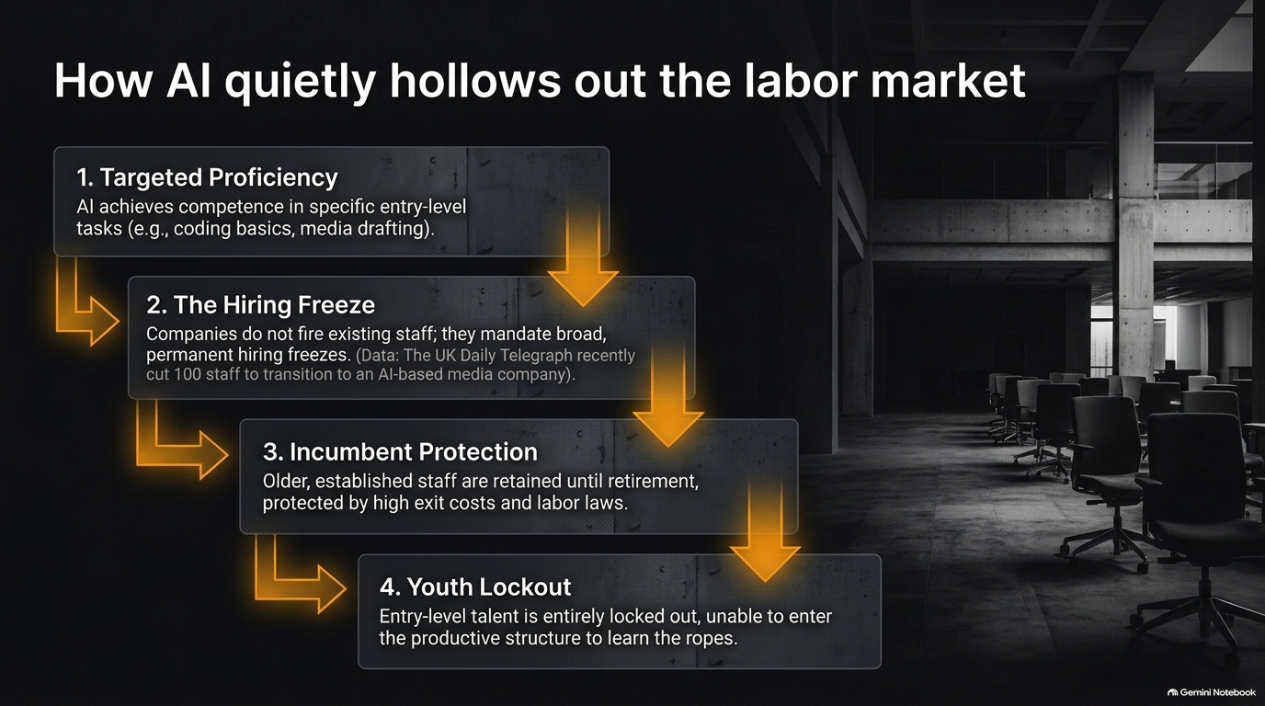
Notes:
Estimated Delivery Time: 4 – 6 minutes
Speaker Notes:
How is AI impacting work? It doesn't happen overnight with dramatic mass layoffs; it happens through a quiet, structural hollowing out.
Step 1: Targeted Proficiency. AI rapidly achieves competence in specific entry-level tasks like coding basics, legal document review, and media drafting.
Step 2: The Hiring Freeze. Instead of firing existing senior staff, companies mandate broad, permanent hiring freezes. For instance, media outlets and tech firms routinely cut staff and transition to automated workflows.
Step 3: Incumbent Protection. Older, established staff are retained until retirement, shielded by high exit costs and labor laws.
Step 4: Youth Lockout. The tragic result is that entry-level talent is entirely locked out, unable to enter the productive structure to learn the ropes and build careers.

Slide 10
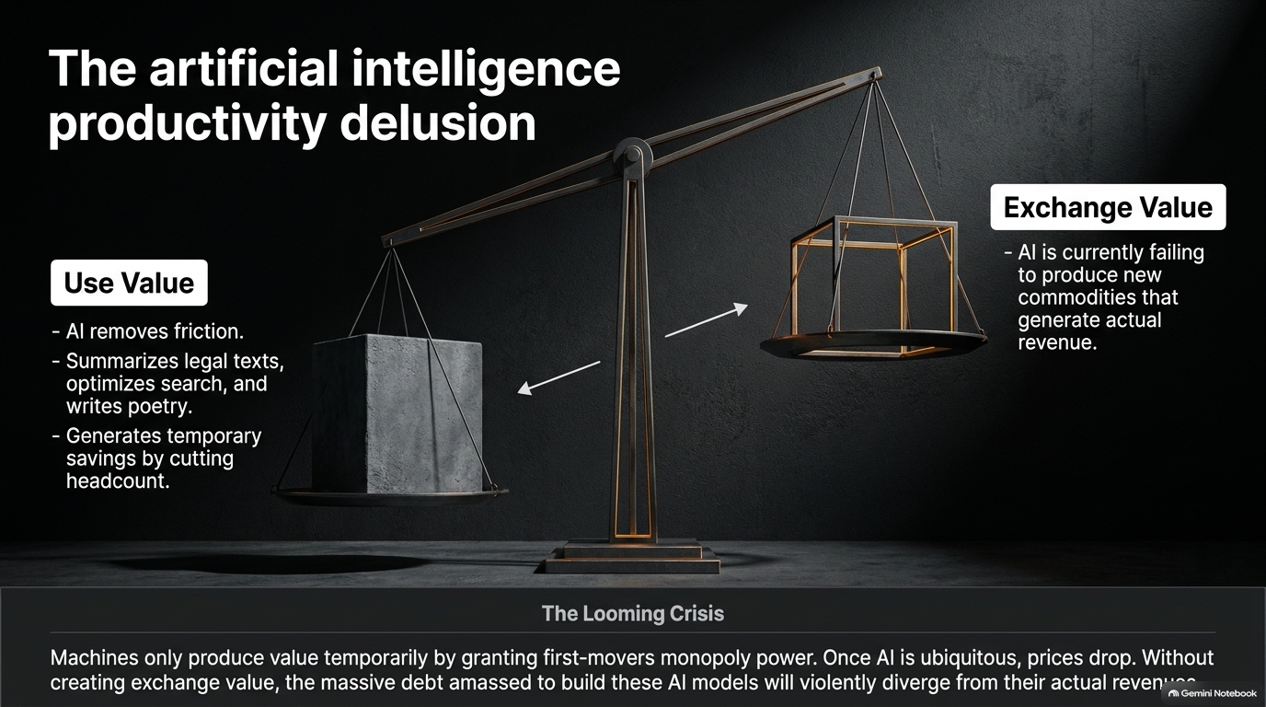
Notes:
Estimated Delivery Time: 4 – 5 minutes
Speaker Notes:
We need to examine the massive gap between Use Value and Exchange Value in the current AI boom.
On the Use Value side, AI is undeniable: it removes friction, summarizes legal texts, optimizes search, writes poetry, and generates temporary corporate savings by cutting headcount.
But on the Exchange Value side, AI is currently failing to produce new mass commodities that generate sustainable organic revenue. As Adam Parker notes in his market analysis, while capital expenditures by hyperscalers are astronomical, tangible earnings realization across corporate sectors is lagging.
The looming crisis is clear: machines only produce temporary value by granting first-movers monopoly power. Once AI becomes ubiquitous, prices plummet. Without true exchange value, the massive debt amassed to build these models will violently diverge from actual revenues.

Slide 11
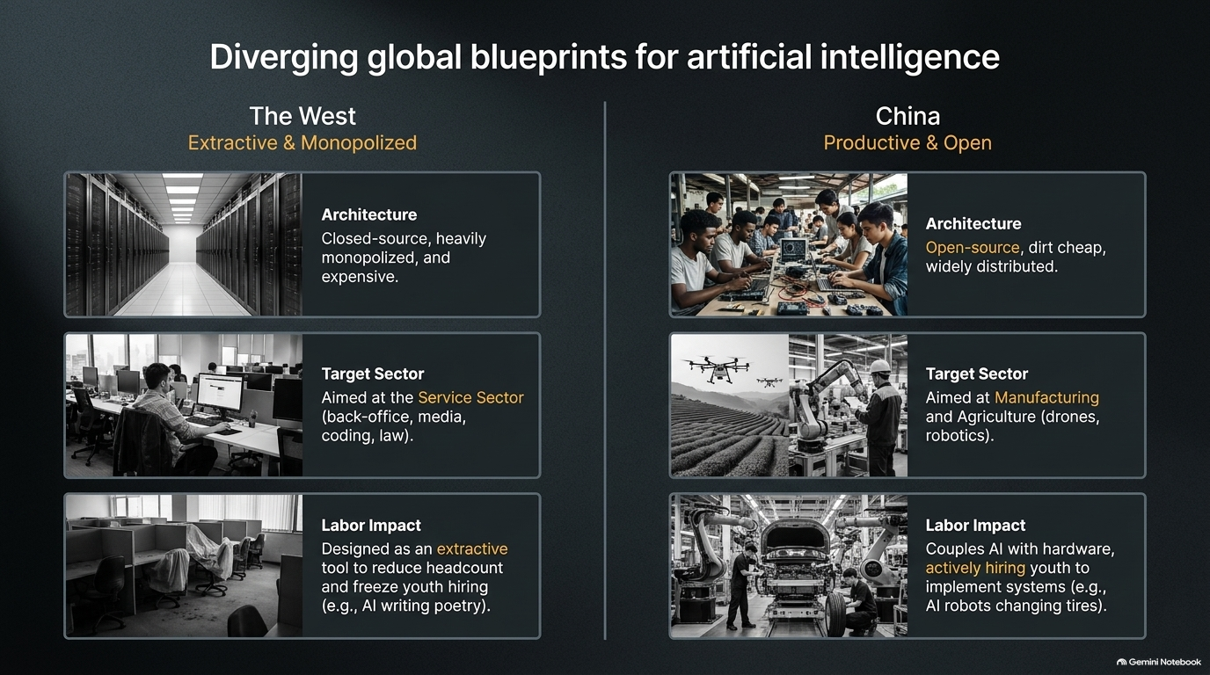
Notes:
Estimated Delivery Time: 4 – 6 minutes
Speaker Notes:
Look at how differently the West and China are approaching AI architecture and labor.
The West (Extractive & Monopolized): Built on closed-source, heavily monopolized, and expensive architecture. It targets the service sector—back offices, media, coding, and law—acting as an extractive tool to freeze youth hiring and reduce white-collar headcount.
China (Productive & Open): Built on open-source, low-cost, widely distributed systems. Its primary target sector is physical manufacturing and agriculture, deploying drones, automation, and industrial robotics. Crucially, its labor impact couples AI with physical hardware, actively hiring youth to implement tech-driven production systems.

Slide 12
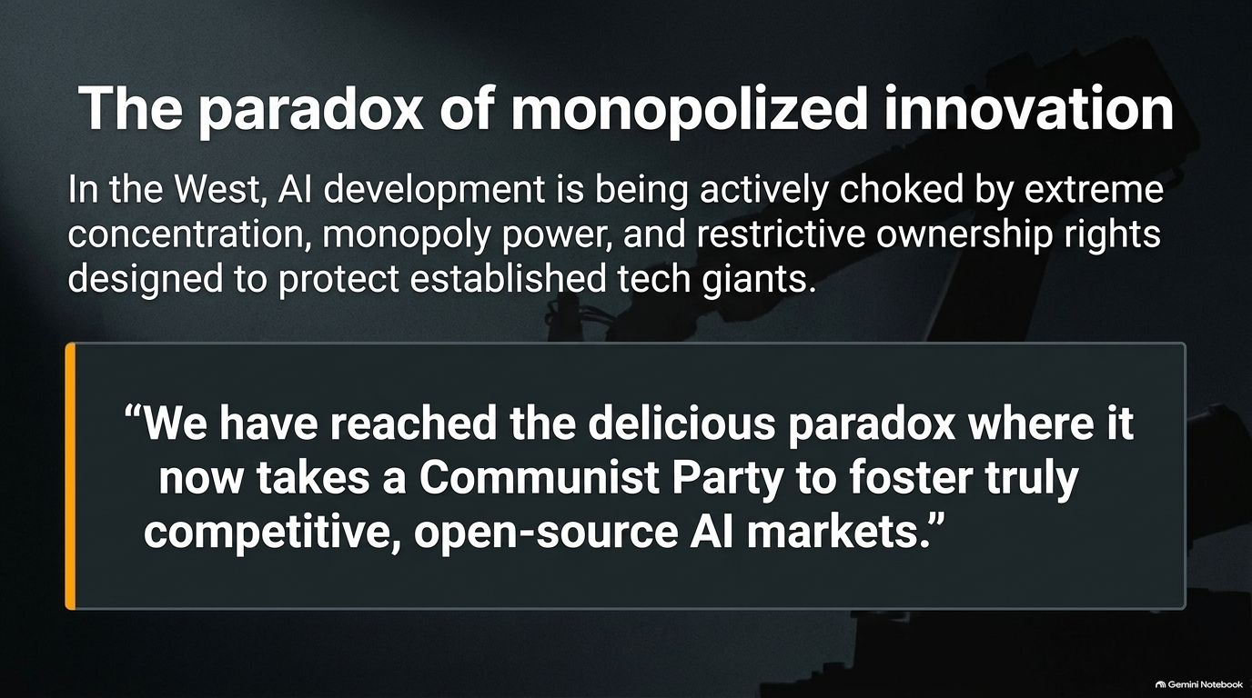
Notes:
Estimated Delivery Time: 3 – 4 minutes
Speaker Notes:
This brings us to a delicious and sobering paradox of modern capitalism.
In the West, AI development is being actively choked by extreme corporate concentration, monopoly power, and restrictive intellectual property rights designed solely to protect established tech giants.
As the quote on this slide highlights: “We have reached the delicious paradox where it now takes a Communist Party to foster truly competitive, open-source AI markets”. When Western markets rely purely on monopoly rents, state-backed open ecosystems end up driving actual technical democratization.

Slide 13
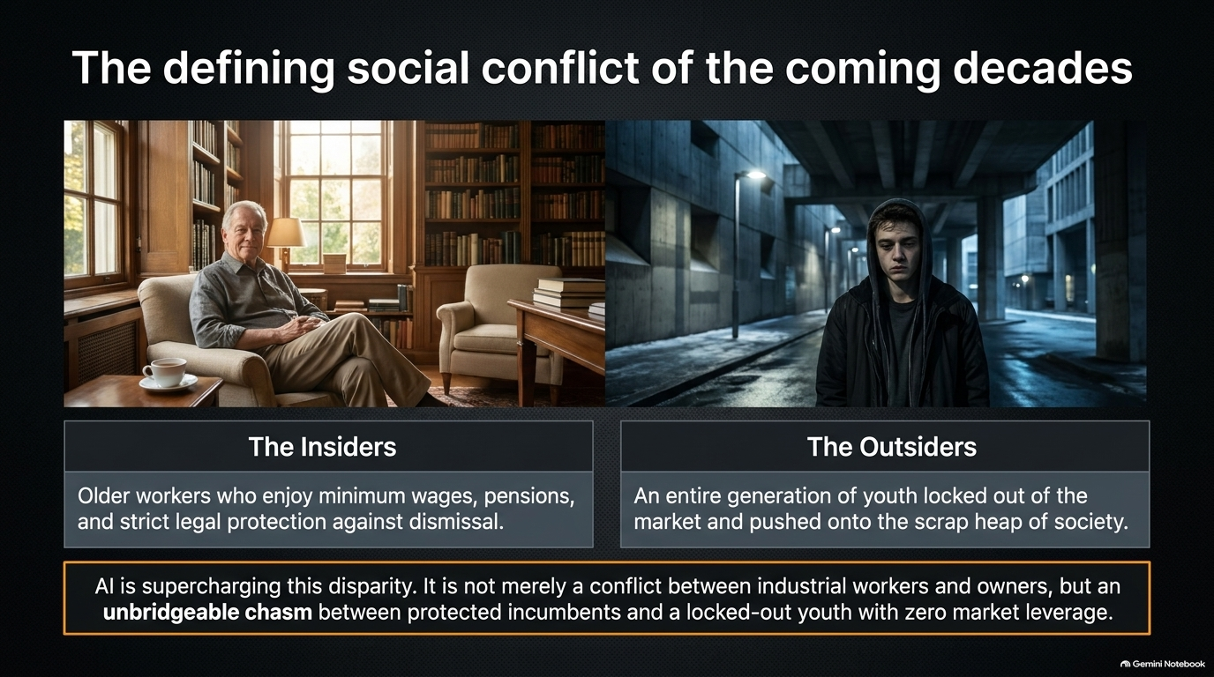
Notes:
Estimated Delivery Time: 4 – 5 minutes
Speaker Notes:
The ultimate social fracture of the coming decades will not just be traditional industrial workers versus owners. It is an unbridgeable chasm between The Insiders and The Outsiders.
The Insiders: Older workers who enjoy minimum wages, pensions, home equity, and strict legal protections against dismissal.
The Outsiders: An entire generation of youth locked out of the market, facing hiring freezes, and pushed onto the societal scrap heap with zero market leverage.
AI is supercharging this disparity, turning generational inequality into a structural permanent divide.

Slide 14
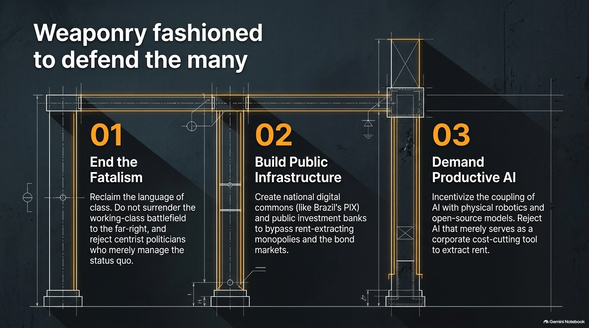
Notes:
Estimated Delivery Time: 3 – 5 minutes
Speaker Notes:
How do we fight back? We need to build three structural pillars to defend the many:
01. End the Fatalism: Reclaim the language of class. Do not surrender the working-class battlefield to the far-right, and reject centrist politicians who merely manage the status quo.
02. Build Public Infrastructure: Create national digital commons—like Brazil’s PIX—and public investment banks to bypass rent-extracting monopolies and bond markets.
03. Demand Productive AI: Incentivize the coupling of AI with physical robotics and open-source models. Reject AI that serves merely as a corporate cost-cutting tool for rent extraction.

Slide 15
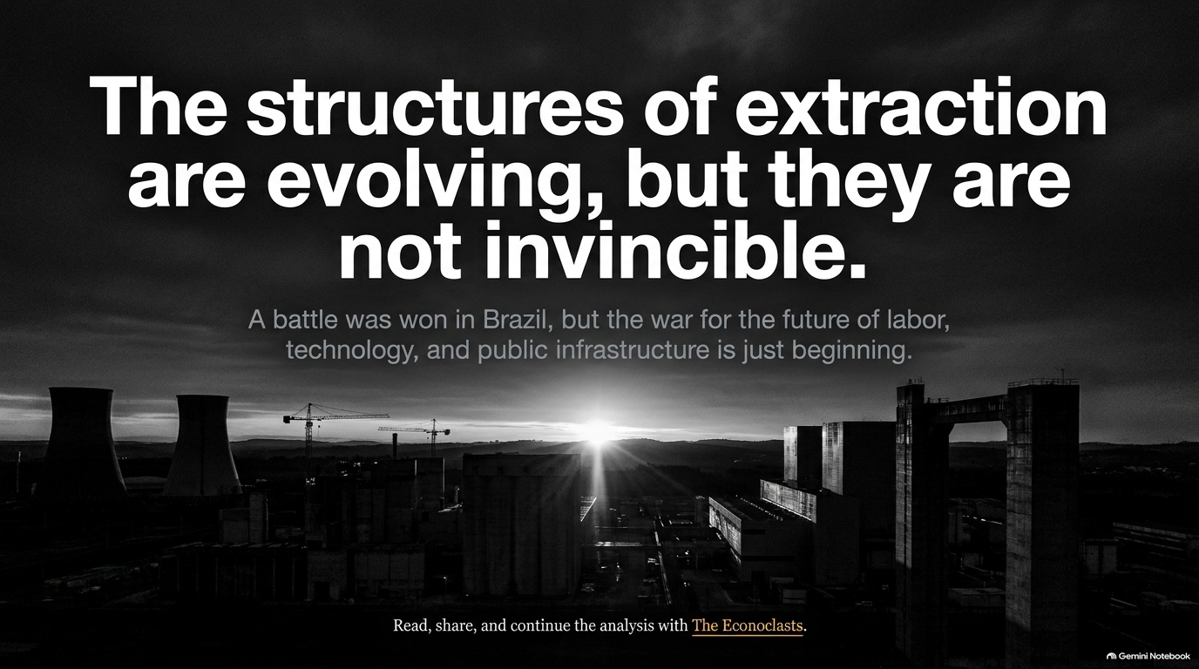
Notes:
Estimated Delivery Time: 2 – 3 minutes
Speaker Notes:
As we conclude, remember this: the structures of extraction are constantly evolving, but they are not invincible.
A battle was won in Brazil, proving that public-interest economics can triumph over private tolls. But the war for the future of labor, technology, and public infrastructure is just beginning.
We have the tools, the data, and the analytical frameworks to reshape our economy. It’s time to use them.

Slide 16
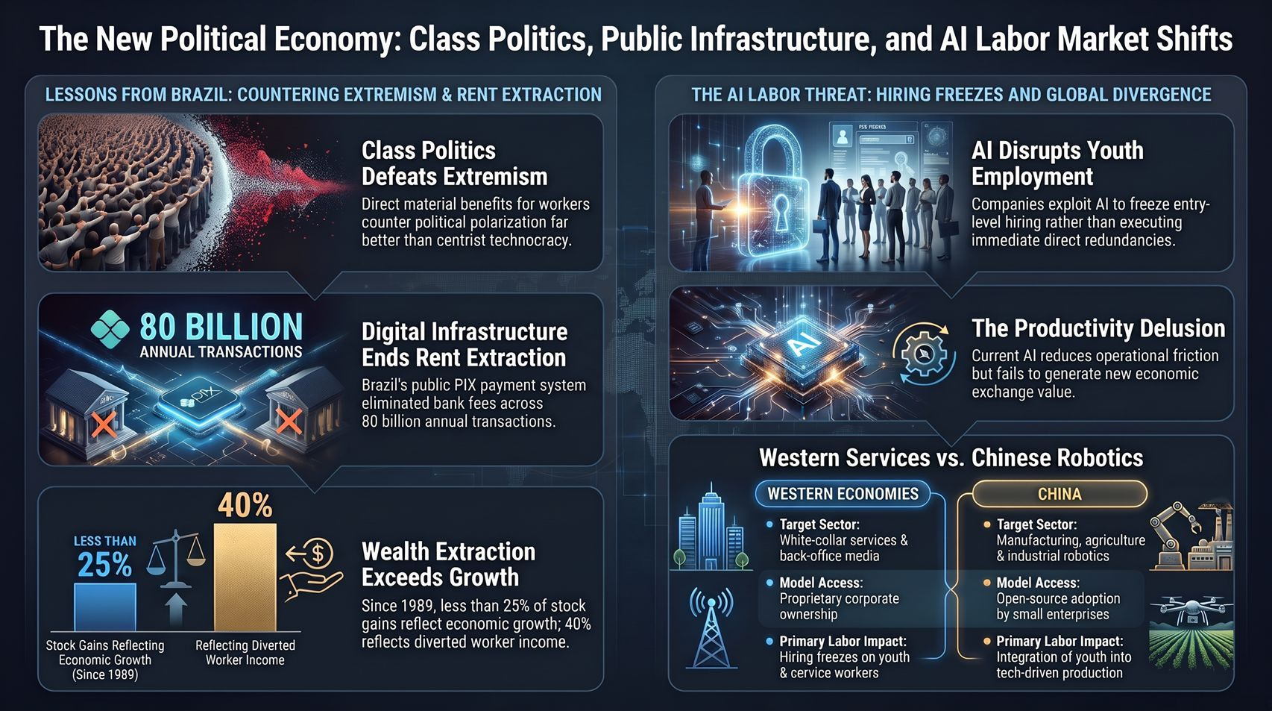
Notes:
Estimated Delivery Time: 4 – 6 minutes
Speaker Notes:
Let's synthesize our entire journey across these dual fronts of the modern economy:
On Class Politics & Rent Extraction: We saw that since 1989, over 75% of stock market gains reflect diverted worker income and central bank liquidity rather than organic growth. True counter-strategies—like Brazil's PIX handling 80 billion transactions—prove that public digital infrastructure can dismantle private financial plunder.
On AI Labor & Global Divergence: Western tech models use AI primarily for white-collar service reduction and youth hiring freezes, exposing a productivity delusion where use value outpaces exchange value. In contrast, alternative models integrate open-source AI with physical manufacturing and robotics.
Ultimately, overcoming this generational crisis requires rejecting political fatalism, building public digital commons, and demanding productive technology that empowers the workforce rather than locking them out. Thank you.

