Slide 1
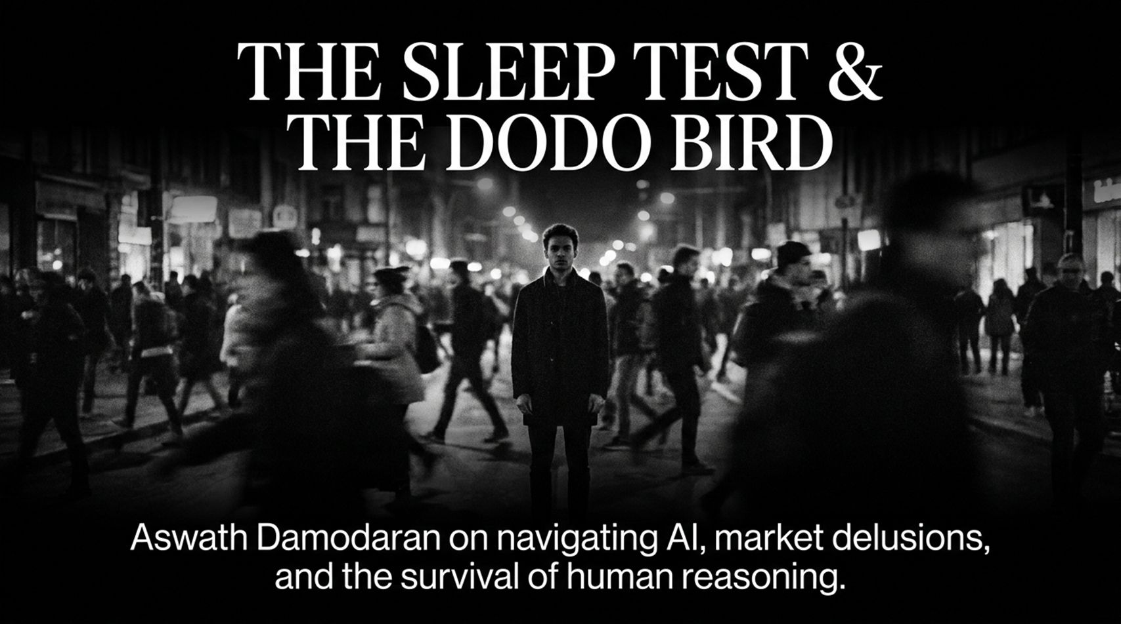
Notes:
Slide Content: Title slide featuring "Aswath Damodaran on navigating AI, market delusions, and the survival of human reasoning."
Target Duration: 3–4 minutes
Speaker Script:
Welcome, everyone. Today, we are diving deep into a conversation grounded in insights from Professor Aswath Damodaran of NYU Stern. Every market cycle comes with its own unique flavor of chaos and complexity. Six years ago, global markets were rocked by a pandemic; fifteen years ago, it was the global banking crisis. Today, the main force disrupting global markets, corporate finance, and our personal lives is Artificial Intelligence.
We’ve moved past the debate over whether AI is merely incremental or truly revolutionary—it is undeniably a fundamental structural shift. But as we examine this tech transformation, two central metaphors emerge: The Sleep Test and The Dodo Bird.
The Sleep Test addresses how we manage financial risk and psychological survival in an era where AI hype dominates market returns.
The Dodo Bird addresses human cognitive evolution—what happens to human reasoning when we continuously outsource our thinking process to machine models for convenience?
Over the course of this talk, we will break down Damodaran's framework across four key themes: portfolio management under extreme market uncertainty, debt-funded AI systemic risks, global competitiveness, and the urgent need to guard human reasoning against cognitive atrophy.
Why Aswath Damodaran Is Holding Record Cash: The Sleep Test | Sonia Shenoy Podcast
https://www.youtube.com/watch?v=4H7uyVO6BKc

Slide 2
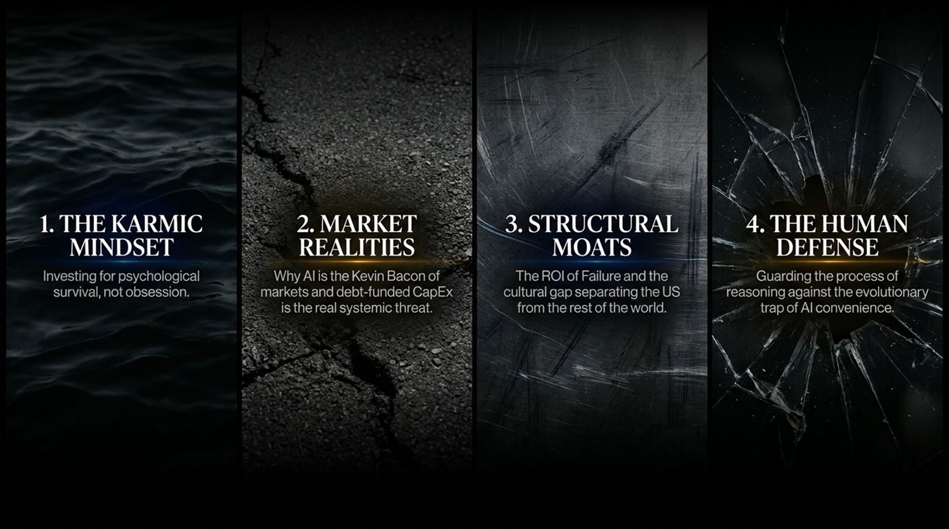
Notes:
Slide Content: 1. The Karmic Mindset | 2. Market Realities | 3. Structural Moats | 4. The Human Defense.
Target Duration: 2–3 minutes
Speaker Script:
Our agenda today is organized into four interconnected pillars:
The Karmic Mindset: How to approach investing and portfolio construction for psychological survival rather than emotional obsession. We’ll focus on why holding cash isn't about market timing, but about passing the "Sleep Test".
Market Realities: We will unpack why US equity markets remain elevated despite macro headwinds, analyze the Magnificent 7 AI trade, and examine why debt-funded CapEx poses a systemic risk reminiscent of 2008.
Structural Moats: Why hasn't Europe or Latin America built a cutting-edge tech titan? We’ll look at the cultural gap separating Silicon Valley from the rest of the world—specifically, the high ROI of cultural forgiveness for failure.
The Human Defense: Guarding the core process of human reasoning against the evolutionary trap of AI convenience. We will contrast machine learning brute-force compute with true human reasoning, and outline concrete actions to remain relevant.

Slide 3
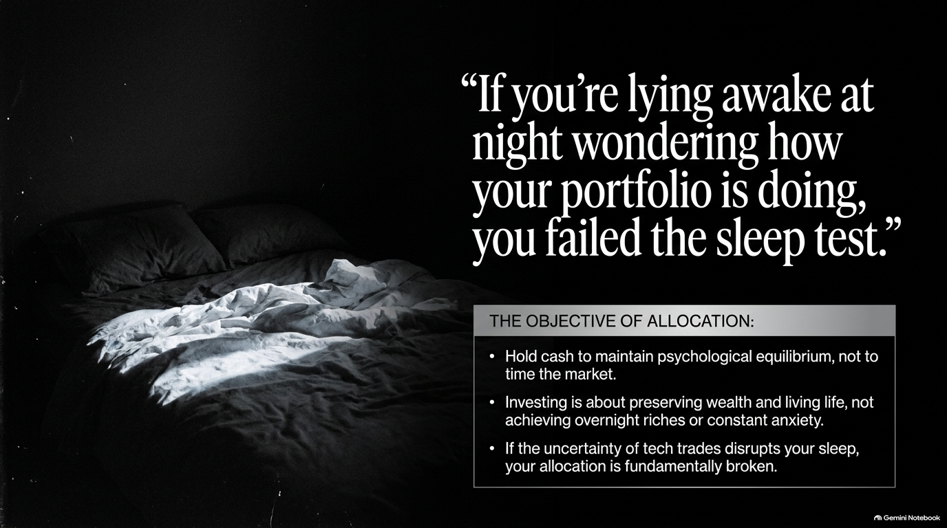
Notes:
Slide Content: "If you're lying awake at night wondering how your portfolio is doing, you failed the sleep test."
Target Duration: 4–5 minutes
Speaker Script:
Professor Damodaran recently revealed that his personal cash reserves are at a historic high. People immediately assume he is making a high-conviction macro call or timing a market crash. His actual explanation is much simpler: it's all about The Sleep Test.
"If you're lying awake at night wondering how your portfolio is doing, you failed the sleep test."
Here are three key allocation principles from this mindset:
Cash is for psychological equilibrium, not timing the market: Cash isn't held to prove how smart you are when the market drops; it's held so you can sleep peacefully when asset prices swing wildly.
Investing is about preserving wealth and living life: Over the past 20 years, social media has twisted the goal of investing from long-term wealth preservation into a high-speed lottery to get rich quick. That mentality leads to constant anxiety.
Fix broken allocations: If your equity position in high-volatility tech stocks disrupts your sleep, your asset allocation is fundamentally broken.

Slide 4
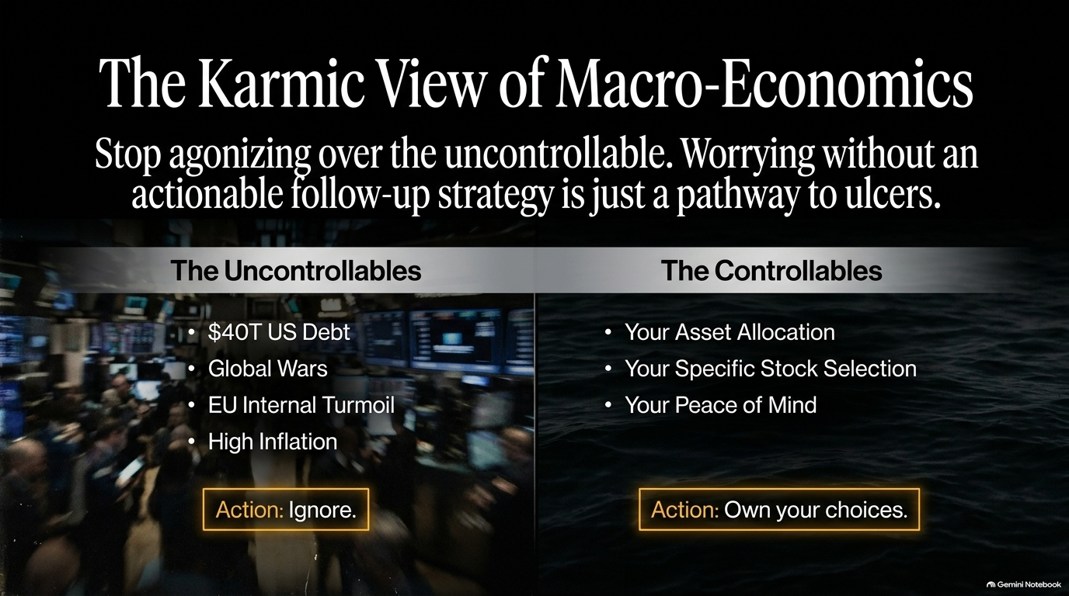
Notes:
Slide Content: Stop agonizing over the uncontrollable. Actions for Uncontrollables vs. Controllables.
Target Duration: 3–4 minutes
Speaker Script:
Damodaran introduces what he calls the Karmic View of Macro-Economics: Worrying about things you cannot control without an actionable follow-up strategy is simply a direct pathway to ulcers and health issues.
Let's divide macro environment variables into two distinct buckets:
The Uncontrollables: $40 Trillion in US national debt, geopolitics and global conflicts, European internal turmoil, and elevated inflation/interest rates.
Action: Ignore them in your day-to-day worrying. You cannot stop wars, alter central bank rate decisions, or unilaterally fix national debt. If your worry doesn't result in a concrete, actionable portfolio change, it is wasted energy.
The Controllables: Your specific asset allocation, your individual stock selection, and your personal peace of mind.
Action: Own your choices. Take full ownership instead of delegating decisions or blaming institutional analysts.

Slide 5
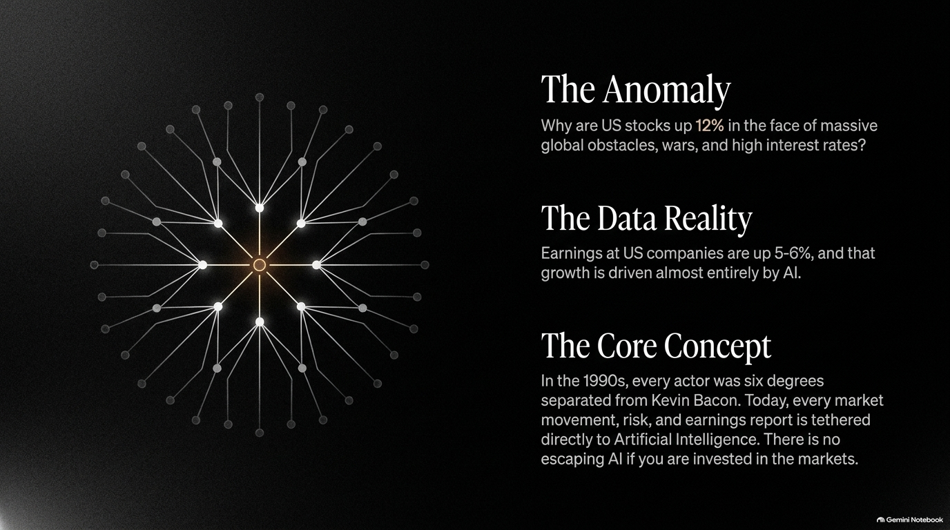
Notes:
Slide Content: Why US stocks are up 12% despite macro headwinds; earnings driven by AI; AI as the Kevin Bacon of finance.
Target Duration: 4–5 minutes
Speaker Script:
There is an apparent paradox in modern markets: Why are US equity markets up 12% to 13% while interest rates remain high, global conflicts rage, and economic growth feels precarious?
The data reveals a simple truth: US corporate earnings are up 5% to 6%, and that earnings growth is being powered almost entirely by Artificial Intelligence.
Damodaran compares AI today to actor Kevin Bacon in 1990s pop culture. Back then, the popular trivia game "Six Degrees of Kevin Bacon" posited that every actor in Hollywood could be connected to Kevin Bacon within six steps.
Today, AI is the Kevin Bacon of global capital markets. Every market movement, earnings report, corporate strategy, and systemic risk vector connects back directly to AI. There is no escaping AI's influence if you are an investor in global markets.

Slide 6
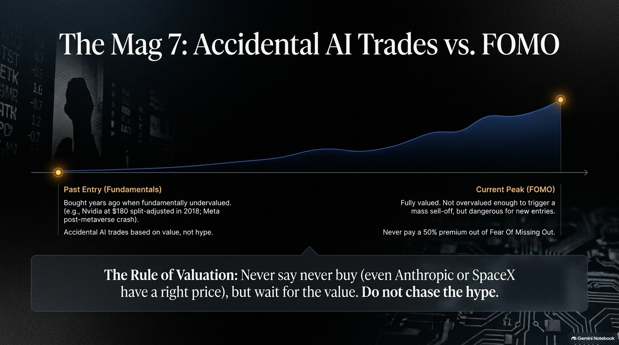
Notes:
Slide Content: Past entry based on value vs. current peak driven by FOMO; The Rule of Valuation.
Target Duration: 4–5 minutes
Speaker Script:
When discussing the Magnificent 7 tech giants, Damodaran makes a crucial distinction between accidental AI trades and FOMO-driven market chasing.
Many value-oriented investors who profited immensely from the AI boom did so accidentally. They bought Microsoft in 2014 during Satya Nadella's transition, Meta after the metaverse sell-off, or Nvidia in 2018 at a split-adjusted price of $180—not because of AI hype, but because the underlying businesses were fundamentally undervalued at the time.
Fast forward to today: many of these companies are fully valued or slightly overvalued. While they may not be overvalued enough to justify panic selling, entering them now out of Fear Of Missing Out (FOMO) or Regret Of Missing Out (ROMO) is dangerous.
The Core Rule of Valuation: Never say "never buy"—even high-flying private companies like Anthropic or SpaceX have a right price. But you must wait for value to emerge rather than paying a 50% premium out of fear of missing the crowd.

Slide 7
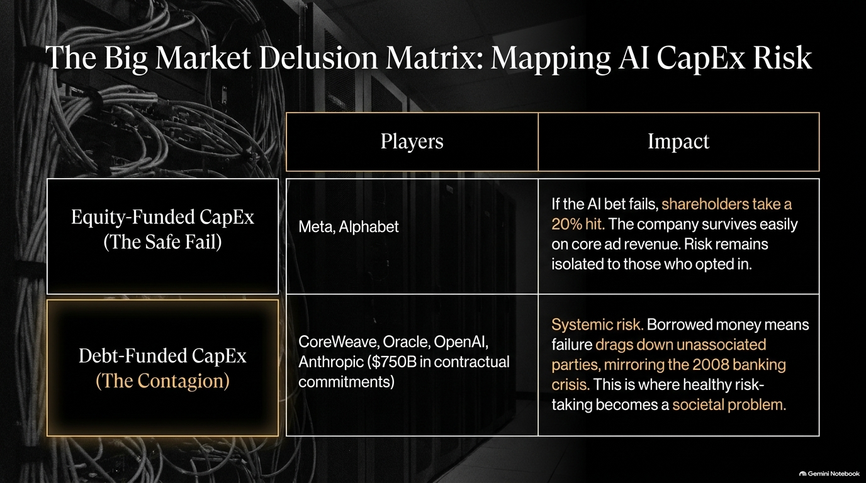
Notes:
Slide Content: Equity-Funded CapEx (Safe Fail) vs. Debt-Funded CapEx (The Contagion).
Target Duration: 5–6 minutes
Speaker Script:
Corporate CEOs and professional investors often exhibit sheep-like herd behavior, pouring hundreds of billions into CapEx without clear line-of-sight on ROI. However, not all AI CapEx risk is created equal.
Damodaran breaks AI spending into two structural risk categories:
Equity-Funded CapEx (The Safe Fail): Companies like Meta and Alphabet generate $150B+ in annual cash flow from core businesses like digital advertising. If their multi-billion dollar AI CapEx bets fail completely, shareholders might take a 20-25% haircut on valuation. However, the core business remains intact and safe from insolvency. The downside risk stays isolated to equity investors who opted into that risk.
Debt-Funded CapEx (The Contagion Risk): This is where healthy risk-taking turns into a systemic threat. Firms like CoreWeave, Oracle, OpenAI, and Anthropic have racked up hundreds of billions in debt and contractual commitments. If an entity with massive contractual debt commitments defaults, it drags down unassociated counterparties across financial markets—mirroring the 2008 banking crisis.

Slide 8
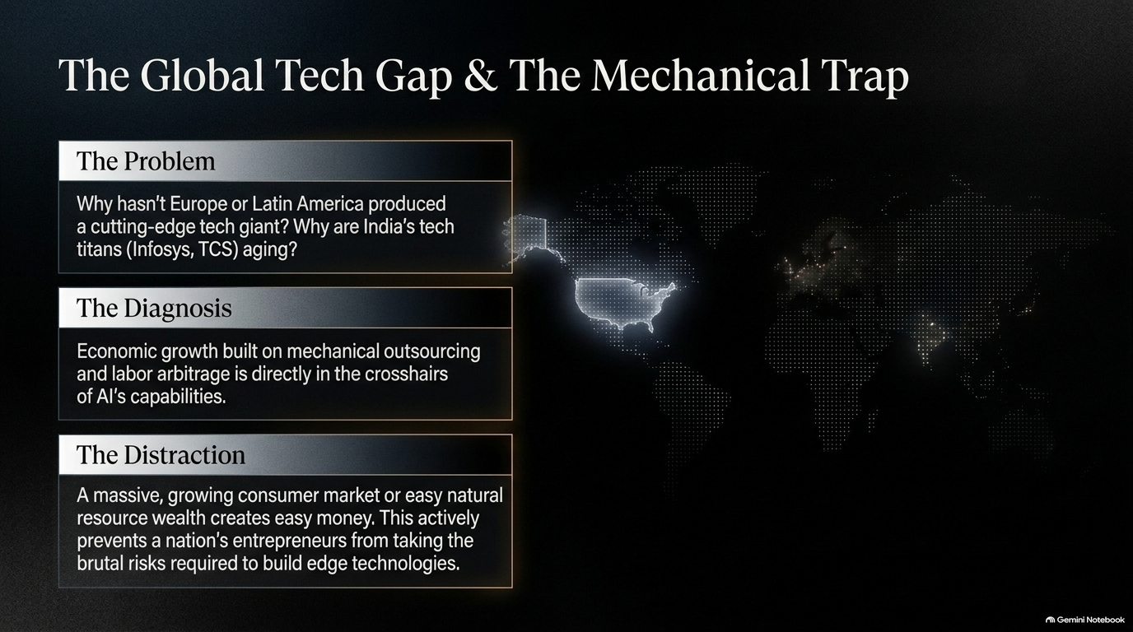
Notes:
Slide Content: Why Europe, Latin America, and India lag in frontier tech; economic growth built on labor arbitrage in AI's crosshairs.
Target Duration: 4–5 minutes
Speaker Script:
Why has nearly all cutting-edge technology innovation concentrated in the US (and to a degree China), while Europe, Latin America, and India have struggled to produce global frontier tech giants?
The Problem: Take the 50 largest companies in Europe, Brazil, or India—most are legacy, aging enterprises (banks, mining, legacy IT services). India's IT services titans like Infosys and TCS built massive businesses around IT outsourcing.
The Diagnosis: Businesses built primarily on mechanical outsourcing, routine coding, and labor cost arbitrage are positioned directly in the crosshairs of generative AI and automation. What was once an economic engine is now a structural vulnerability.
The Distraction: Regions with large growing consumer markets or abundant natural resources often generate "easy money." This comfortable fallback disincentivizes entrepreneurs from taking the brutal risks required to pioneer deep-tech breakthroughs.

Slide 9
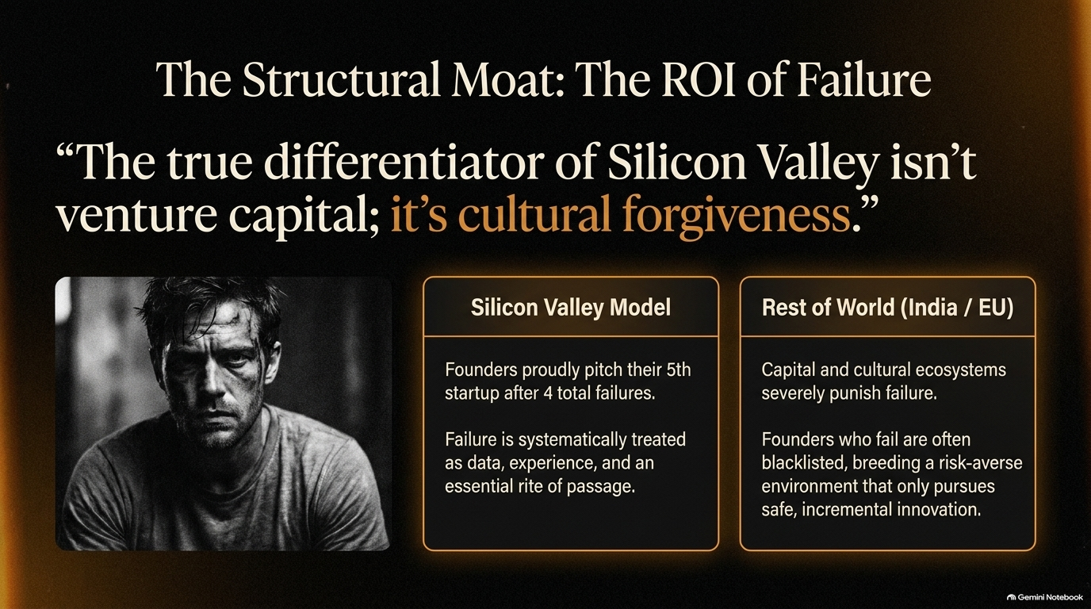
Notes:
Slide Content: "The true differentiator of Silicon Valley isn't venture capital; it's cultural forgiveness."
Target Duration: 4–5 minutes
Speaker Script:
Many analysts claim Silicon Valley’s moat is capital availability. Damodaran refutes this, pointing out that global markets are flooded with venture capital. The true structural differentiator is cultural forgiveness of failure.
The Silicon Valley Model: Founders openly pitch their 5th startup after four complete burn-outs. In Silicon Valley, failure is treated as empirical data, critical experience, and a necessary rite of passage for enterprise building.
Rest of World (EU / India / LatAm): Capital ecosystems severely penalize failure. Entrepreneurs who fail once are often blacklisted from future funding, creating a risk-averse culture that encourages safe, incremental ideas over radical innovation.
If non-US ecosystems want to build cutting-edge frontier technologies, they must develop a higher cultural tolerance for honorable failure.

Slide 10
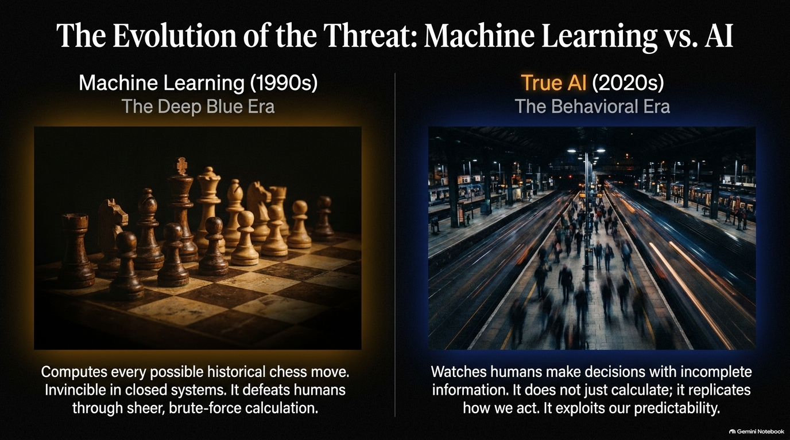
Notes:
Slide Content: Machine Learning (1990s Deep Blue) vs. True AI (2020s Behavioral Era).
Target Duration: 4–5 minutes
Speaker Script:
To understand how AI threatens human employment and reasoning, we must differentiate 1990s Machine Learning from 2020s Generative AI.
Machine Learning (1990s - The Deep Blue Era): When IBM’s Deep Blue defeated Gary Kasparov in chess, Kasparov knocked over the board because he realized he was competing against brute-force calculation. Deep Blue had evaluated every historical move in a closed-system rulebook. It won through compute power, not human-like adaptability.
True AI (2020s - The Behavioral Era): Modern AI goes far beyond closed-system calculation. It observes human decision-making under conditions of incomplete information and uncertainty. It learns to replicate behavioral patterns, exploiting our underlying predictability.

Slide 11
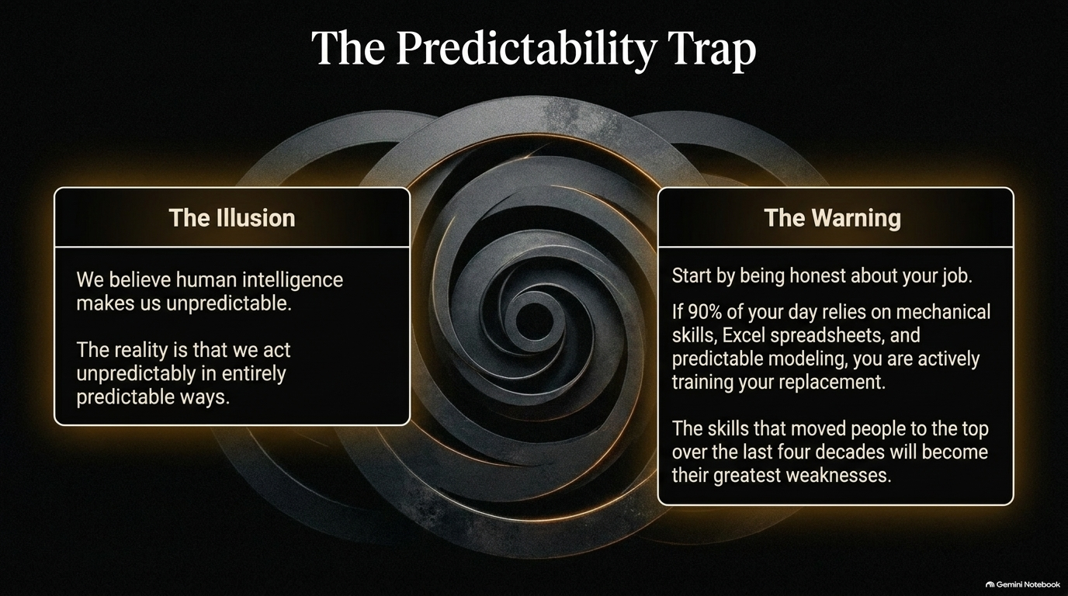
Notes:
Slide Content: The Illusion of human unpredictability vs. The Warning for mechanical white-collar jobs.
Target Duration: 3–4 minutes
Speaker Script:
We like to flatter ourselves by thinking that human intelligence makes us inherently complex and unpredictable. The reality is that humans act unpredictably in remarkably predictable ways. AI models excel at analyzing these behavioral loops.
The Practical Warning: Every professional must perform a brutal self-audit. If 90% of your daily job relies on mechanical skills—building standard financial models, processing routine spreadsheet formulas, or writing structured boilerplate code—you are actively training your automated replacement.
The very skills that propelled white-collar professionals to the top over the last 40 years—being organized, methodical, and adept at routine numerical analysis—are transitioning from competitive advantages into career vulnerabilities.

Slide 12
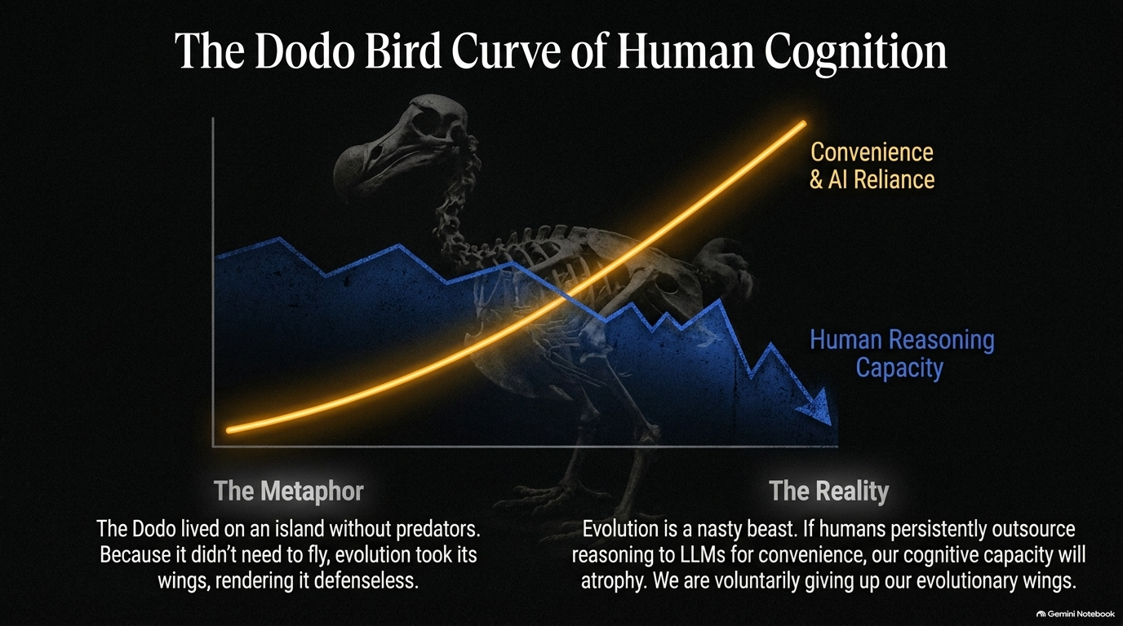
Notes:
Slide Content: Convenience & AI Reliance vs. Human Reasoning Capacity; The Dodo Metaphor.
Target Duration: 4–5 minutes
Speaker Script:
This slide contains the central evolutionary warning of Damodaran's talk: The Dodo Bird Curve.
The Metaphor: The Dodo bird evolved on an isolated island with no natural predators. Because it no longer needed to fly to escape danger, evolutionary pressures slowly caused its wings to atrophy. When external predators finally arrived, the Dodo was completely defenseless.
The Cognitive Reality: Evolution is uncompromising. If humans consistently outsource basic reasoning, critical analysis, and problem-solving to LLMs for the sake of convenience, our inherent cognitive capacity will atrophy over time.
By trading the friction of thinking for instant AI-generated answers, we risk voluntarily surrendering the exact evolutionary trait—reasoning under uncertainty—that defines our humanity.

Slide 13
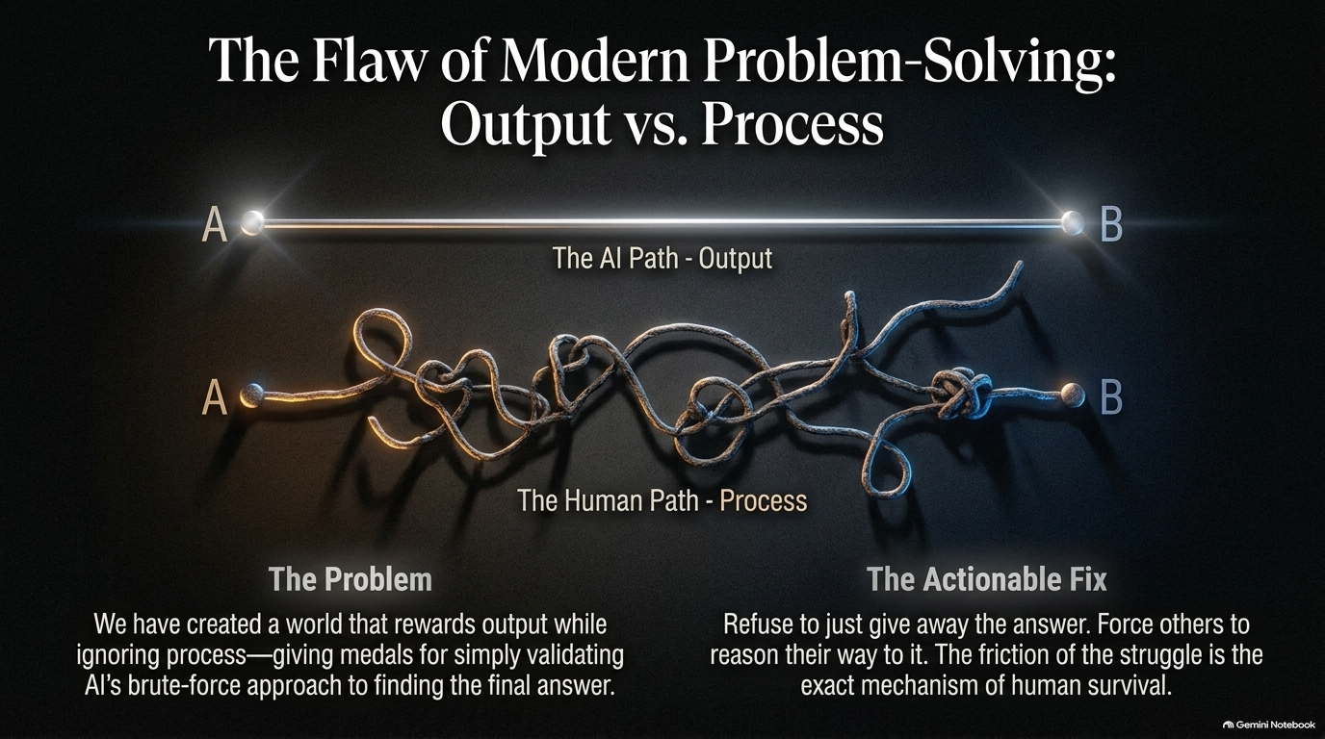
Notes:
Slide Content: The AI Path (Output) vs. The Human Path (Process); The Problem & Actionable Fix.
Target Duration: 4–5 minutes
Speaker Script:
Modern education and corporate culture suffer from a systemic flaw: we over-reward the final output while undervaluing the underlying analytical process.
The Problem: We award "medals" to whoever produces the final answer fastest, regardless of whether they used an AI model to shortcut the reasoning. When output is all that matters, human reasoning is viewed as inefficient friction.
The Actionable Fix: Refuse to just hand over quick answers to students, children, or team members. Force them to grapple with incomplete data and reason their way to conclusions.
The messy friction of intellectual struggle is not a waste of time—it is the essential training mechanism for preserving human capability.

Slide 14
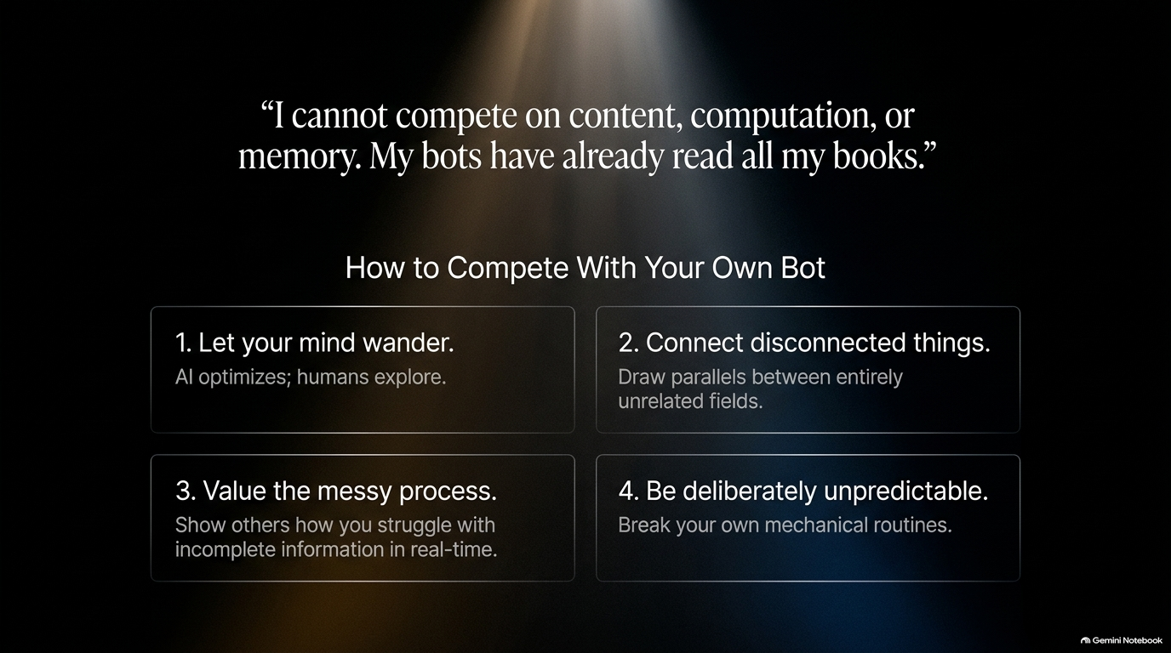
Notes:
Slide Content: Damodaran on competing with his 5 custom bots: 1. Mind wandering | 2. Connect disconnected fields | 3. Value messy process | 4. Be unpredictable.
Target Duration: 4–5 minutes
Speaker Script:
Damodaran shares that five custom AI bots trained on all his books, transcripts, and valuation models currently exist online. As he notes: "I cannot compete on content, computation, or memory. My bots have already read all my books."
To remain relevant alongside your own digital twin, follow these four rules:
Let your mind wander: AI optimizes within set parameters; human minds explore across boundaries.
Connect disconnected things: Draw cross-disciplinary insights between completely unrelated domains.
Value the messy process: Demonstrate publicly how you wrestle with ambiguous data in real time, flaws included.
Be deliberately unpredictable: Shake up mechanical routines so machine models cannot forecast your next move.

Slide 15

Notes:
Slide Content: Summary quote: "Live in the world you are in... Guard your reasoning. Own your choices. Pass the sleep test."
Target Duration: 3–4 minutes
Speaker Script:
To conclude, let's reflect on the core philosophical takeaways from this analysis:
"Live in the world you are in, not the one you wish you were in. For convenience, we gave up privacy. For speed, we are giving up the reasoning that makes us human. Guard your reasoning. Own your choices. Pass the sleep test."
Navigating the AI era does not require panicking over market trends or rushing blindly into overhyped trades. It calls for personal accountability: structuring your investments so you can sleep peacefully, and intentionally engaging your mind to preserve the human capacity for critical thought.

Slide 16
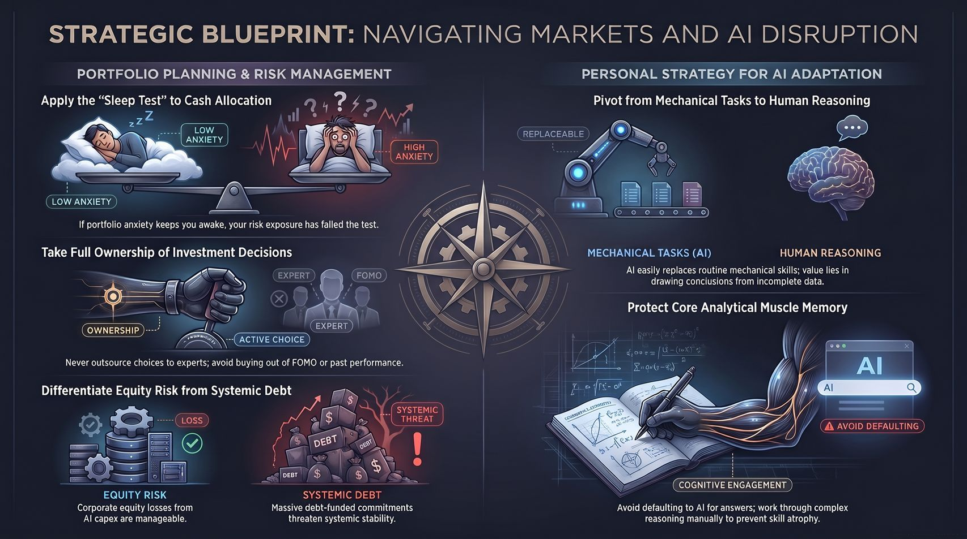
Notes:
Slide Content: Visual synthesis combining Portfolio Planning & Risk Management with Personal Strategy for AI Adaptation.
Target Duration: 4–5 minutes
Speaker Script:
Slide 16 brings together our complete executive blueprint across two key dimensions:
+-----------------------------------------------------------------------------------+
| STRATEGIC BLUEPRINT SUMMARY |
+---------------------------------------------------+-------------------------------+
| PORTFOLIO & RISK MANAGEMENT | PERSONAL AI ADAPTATION |
+---------------------------------------------------+-------------------------------+
| 1. Apply the "Sleep Test" to Cash Allocation | 1. Pivot from Mechanical |
| 2. Take Full Ownership of Investment Choices | Tasks to Human Reasoning |
| 3. Differentiate Equity Risk from Systemic Debt | 2. Protect Core Analytical |
| | Muscle Memory |
+---------------------------------------------------+-------------------------------+
Portfolio Planning & Risk Management:
Apply the Sleep Test: If portfolio anxiety disrupts your rest, rebalance into cash for mental equilibrium.
Take Full Ownership: Never outsource decisions to consensus hype or FOMO.
Differentiate Risk: Separate isolated corporate equity risks from systemic debt-funded CapEx contagion.
Personal Strategy for AI Adaptation:
Pivot to Reasoning: Transition away from mechanical tasks like spreadsheet modeling toward drawing conclusions from incomplete data.
Protect Cognitive Muscle Memory: Work through complex problems manually rather than defaulting to LLM prompts, ensuring your cognitive wings never atrophy.

