Slide 1
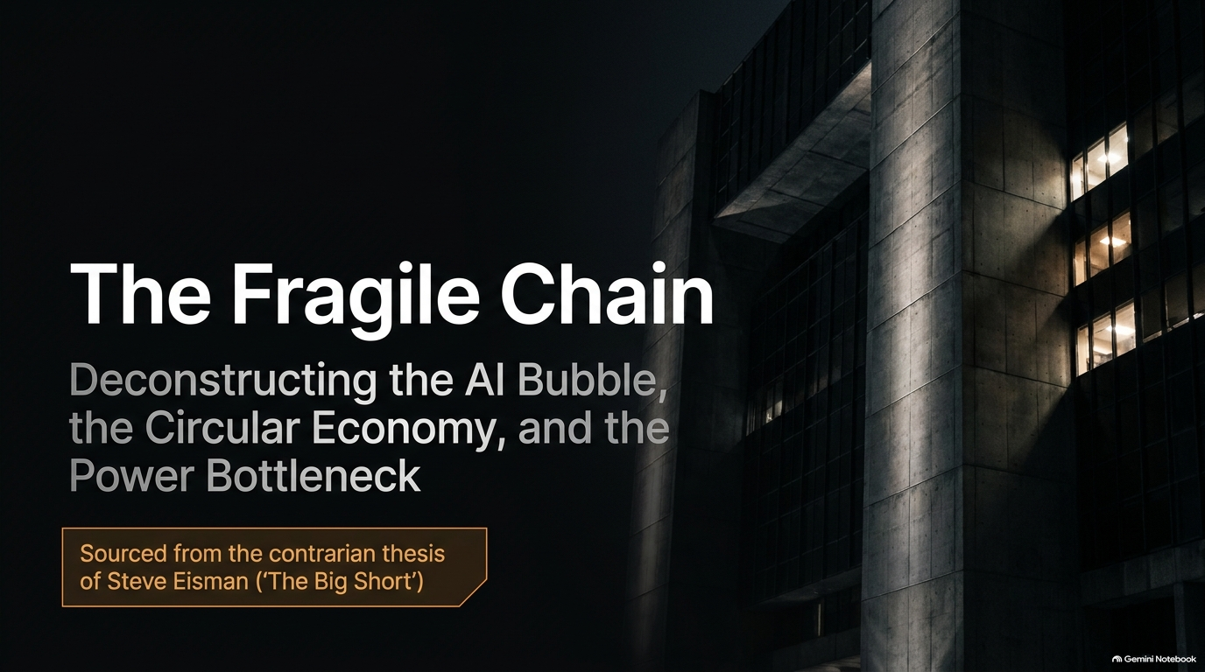
Notes:
Duration: 2 – 3 minutes
Speaker Notes:
"Welcome, everyone, to today's session: The Fragile AI Chain. Today, we are going to deconstruct the current AI boom not just through the lens of technological optimism, but by examining the cold, hard financial mechanics underneath. We’ll look at why so much of the current multi-hundred-billion-dollar enterprise rests on a remarkably narrow foundation of extreme concentration risks, circular financing, and structural dependencies. As we unpack this presentation, keep one fundamental question in mind: what happens to the entire edifice if the primary demand engine wobbles? Let's dive in."
'Big Short' Investor Explains How the AI Bubble Will Burst
https://www.youtube.com/watch?v=Zw0I7kb6zg4

Slide 2
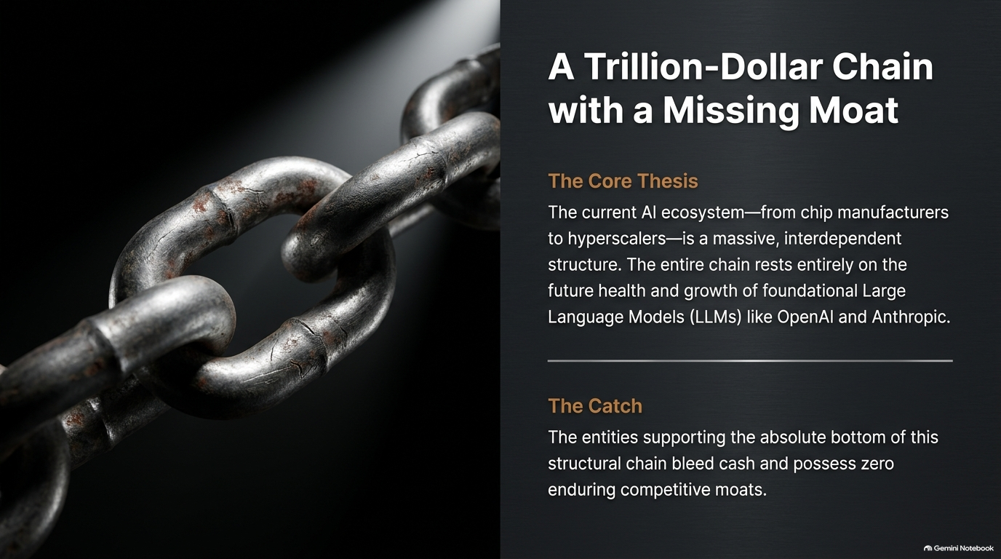
Notes:
Duration: 3 – 5 minutes
Speaker Notes:
"When you take a step back and examine the tech landscape today, the concentration risks are truly awe-inspiring. Imagine analyzing an established software company: if it has thousands of diverse customers, that’s a resilient business. But if it turns out the company relies on only two customers for the vast majority of its revenue, you’d immediately recognize it as high-risk—because if anything happens to either of those two clients, the company is in severe jeopardy.
This exact dynamic is playing out across the entire AI ecosystem right now. The entire chain—stretching all the way from Nvidia down through the hyperscalers and straight to foundational model developers like Anthropic and OpenAI—rests entirely on the financial health and rapid growth of just a couple of pre-profit entities. If those entities stumble, the shockwaves will ripple upward instantly."

Slide 3
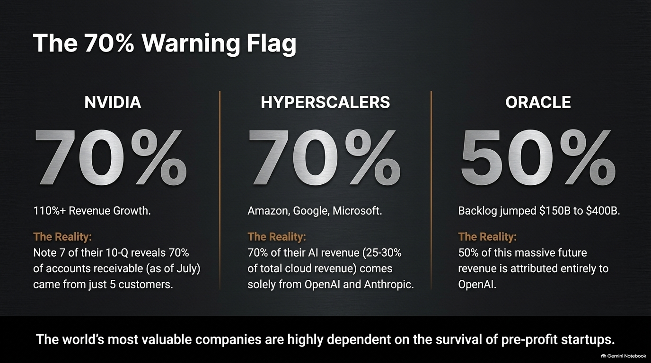
Notes:
Duration: 3 – 5 minutes
Speaker Notes:
"Let's start at the very top of the hardware stack with Nvidia. God bless them—they are an incredible company delivering staggering revenue growth above 100% year-over-year. On the surface, it looks unstoppable.
However, if you dig past the headline numbers into Nvidia's 10-Q filing—specifically looking at Note 7—you’ll find a critical warning flag: roughly 70% of Nvidia's accounts receivable came from just five customers. While not an immediate death knell, it highlights an immense dependency. Nvidia is selling massive volumes of GPUs, but those purchases are heavily concentrated among a handful of hyperscale giants who are financing aggressive build-outs."

Slide 4
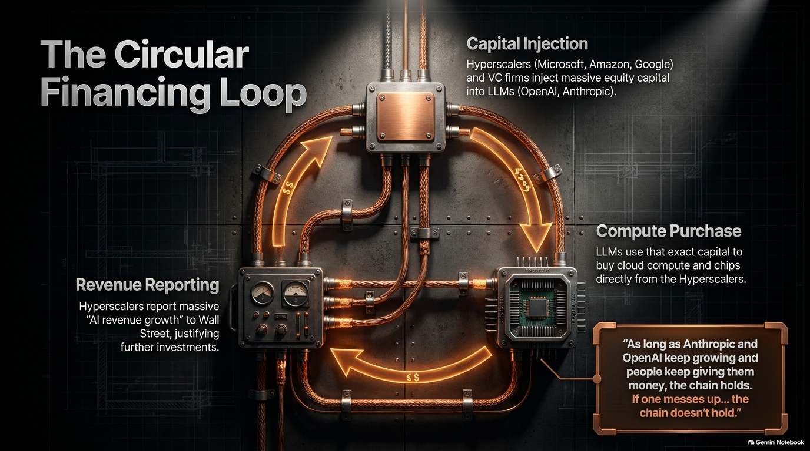
Notes:
Duration: 4 – 6 minutes
Speaker Notes:
"Now, let's look one step down at the hyperscalers: Microsoft, Amazon, Google, Meta, and Oracle. These massive enterprises are spending hundreds of billions of dollars building out data centers and buying Nvidia chips. But where is their AI revenue coming from?
Studies and disclosures show that an extraordinary share—roughly 70% of the hyperscalers' AI revenue, equating to 25% to 30% of their total cloud revenue—comes solely from Anthropic and OpenAI.
Take Oracle as a prime example: when examining their RPO (Remaining Performance Obligation, essentially a measure of future contract backlog), we saw numbers explode into hundreds of billions. Yet, independent analysis revealed that nearly 50% of Oracle's massive RPO backlog was tied directly to OpenAI—a company currently burning billions of dollars every quarter. Fifty percent of a giant enterprise's future commitments resting on a single pre-profit startup."

Slide 5
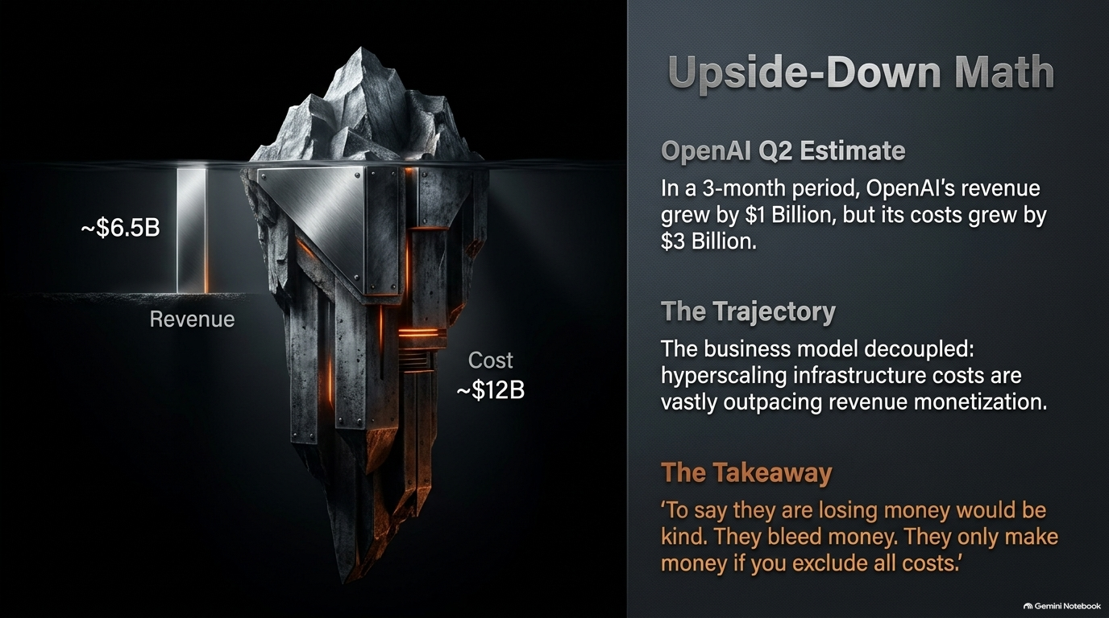
Notes:
Duration: 3 – 5 minutes
Speaker Notes:
"At the very bottom of the chain sit the frontier model builders: OpenAI and Anthropic. To say these companies 'lose money' is putting it mildly—they bleed cash.
Look at the math: during recent reporting periods, OpenAI's revenue might go up by a billion dollars, but its costs go up by three billion dollars. That is an upside-down business model where scaling revenue currently accelerates cash burn. Anthropic has shown strong revenue momentum, growing over 100% in short windows, but both remain heavily pre-profit. If these primary demand drivers fail to achieve sustainable profitability or face a funding squeeze, the commitments made to the hyperscalers will stall, reversing the entire capital expenditure cycle upward through the chain."

Slide 6
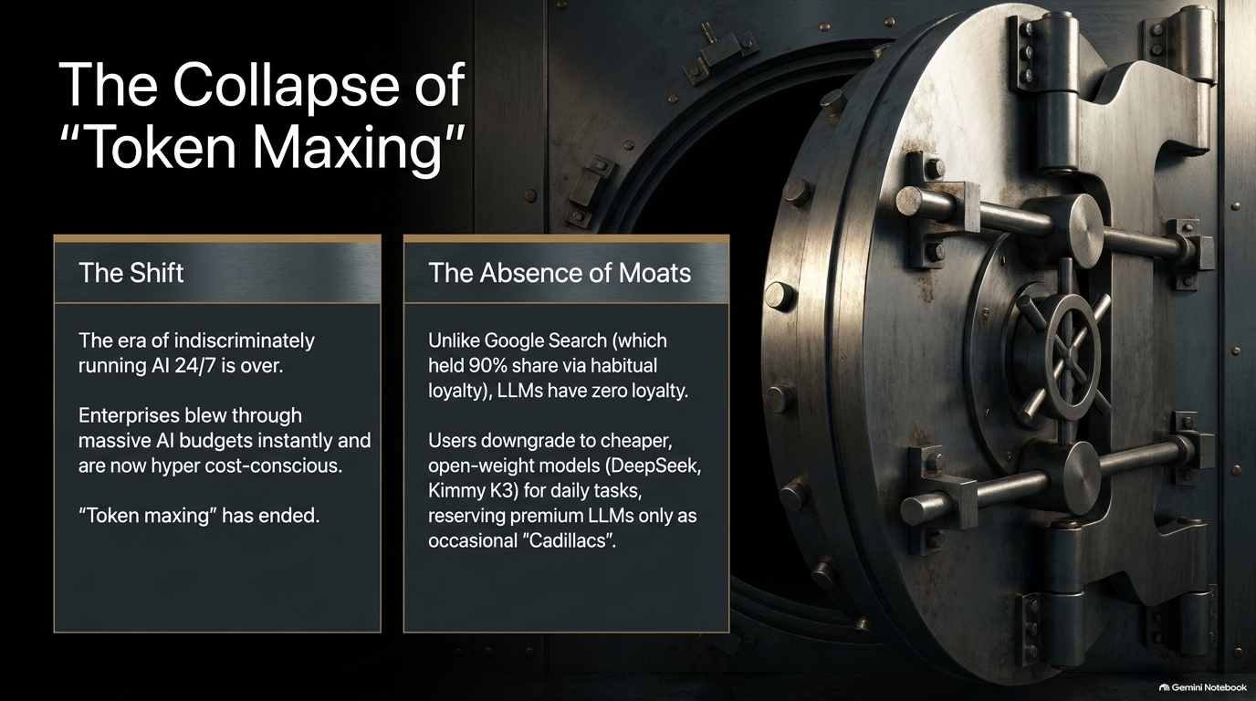
Notes:
Duration: 3 – 5 minutes
Speaker Notes:
"This brings us to a crucial question: where is all this money coming from? Initially, many assumed it was purely traditional venture capital. In reality, a massive portion of the capital fueling OpenAI and Anthropic comes directly from the hyperscalers and hardware makers themselves—Amazon, Google, Microsoft, Nvidia, and strategic partners like SoftBank taking massive equity stakes and pumping capital in.
It has the distinct feel of circularity: cash or commitments flow from hyperscalers to AI labs, which in turn use those funds to buy compute and cloud capacity from those exact same hyperscalers. As long as the music plays, valuations soar, and capital keeps flowing, the chain holds. But it relies entirely on unbroken growth and external confidence."

Slide 7
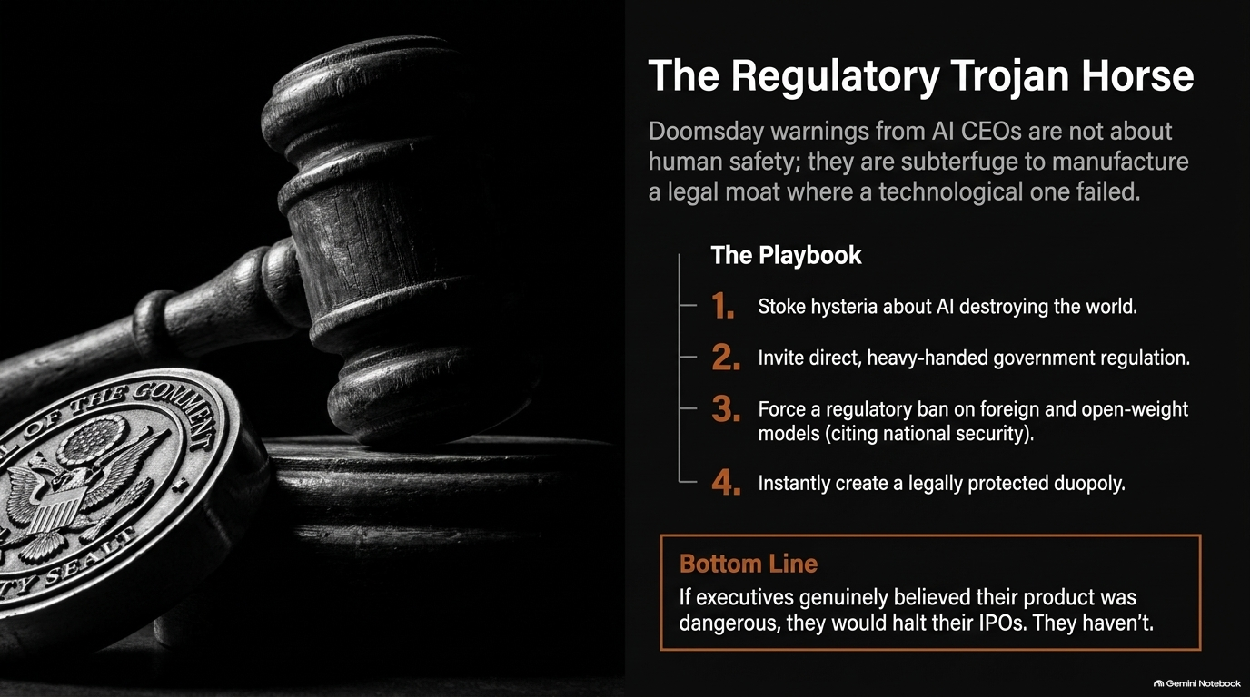
Notes:
Duration: 3 – 5 minutes
Speaker Notes:
"Beyond concentration and financing, we must examine the business model risk at the application layer: specifically, the end of 'token maxing.'
For a long time, companies told software engineers to use AI 24/7 across every workflow, whether necessary or not. Meanwhile, foundational model providers heavily undercharged for tokens to capture market share. Eventually, reality caught up: providers had to raise token prices to reflect true costs.
Enterprise clients suddenly realized their AI bills were skyrocketing—some burning through quarterly budgets in weeks or spending hundreds of thousands before noticing. Corporate buyers immediately became cost-conscious. 'Token maxing' evaporated overnight, replaced by rigorous optimization and a shift toward open-weight models."

Slide 8
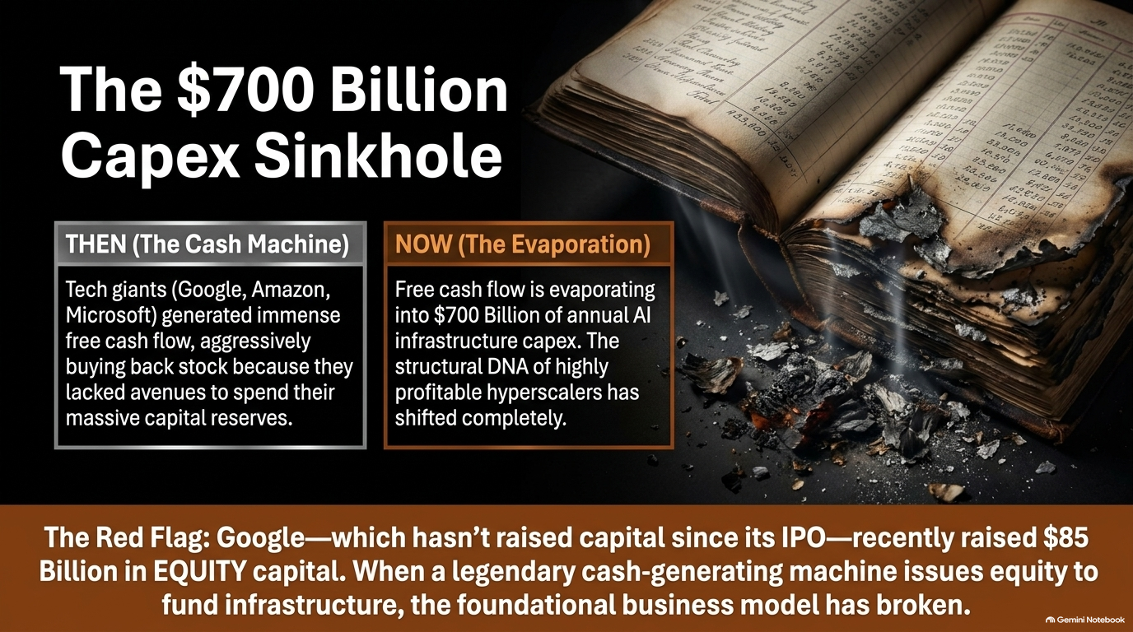
Notes:
Duration: 3 – 5 minutes
Speaker Notes:
"This highlights one of the most glaring vulnerabilities in the AI software layer: there are no moats in large language models.
Think of traditional corporate moats—like Google’s historical search dominance or deeply embedded enterprise software like Salesforce or ServiceNow, where switching costs are brutal because the software is woven into the operational fabric of the business.
In contrast, LLMs suffer from a complete lack of customer loyalty. If a developer or enterprise is using Claude today, but tomorrow an open-weight model from China—like DeepSeek or Kimi K3—or a rival model performs better and costs less, they switch instantly. There is no structural lock-in at the raw model layer."

Slide 9
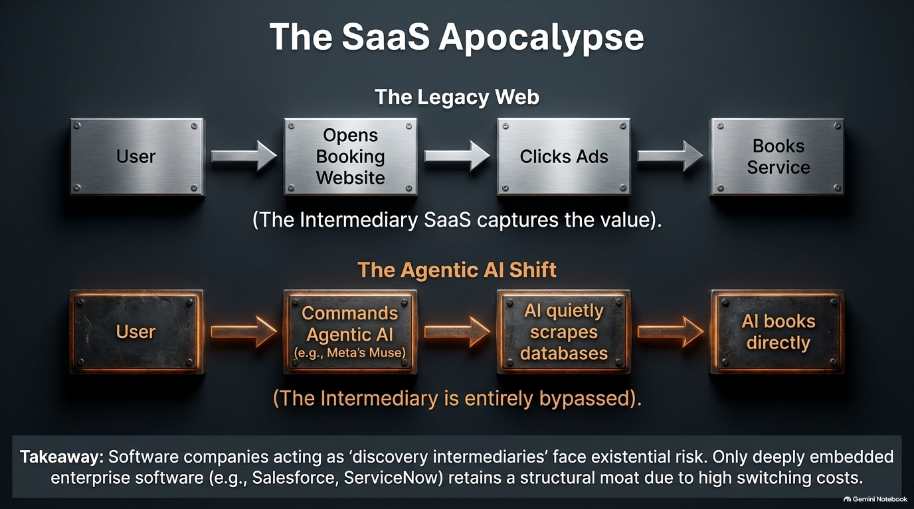
Notes:
Duration: 3 – 5 minutes
Speaker Notes:
"Given the lack of moats, intense competition, and the rise of powerful, low-cost open-weight alternatives, how do leading labs react? Some market observers argue that industry leaders are manufacturing a narrative of existential risk and societal danger.
By sounding alarm bells about artificial general intelligence safety, they hope to encourage governments to step in with heavy regulation. The underlying strategy? Use compliance hurdles, liability frameworks, and restrictions on open-weight or foreign models to artificially construct the legal moats that technology alone cannot provide, effectively cementing a government-protected duopoly."

Slide 10
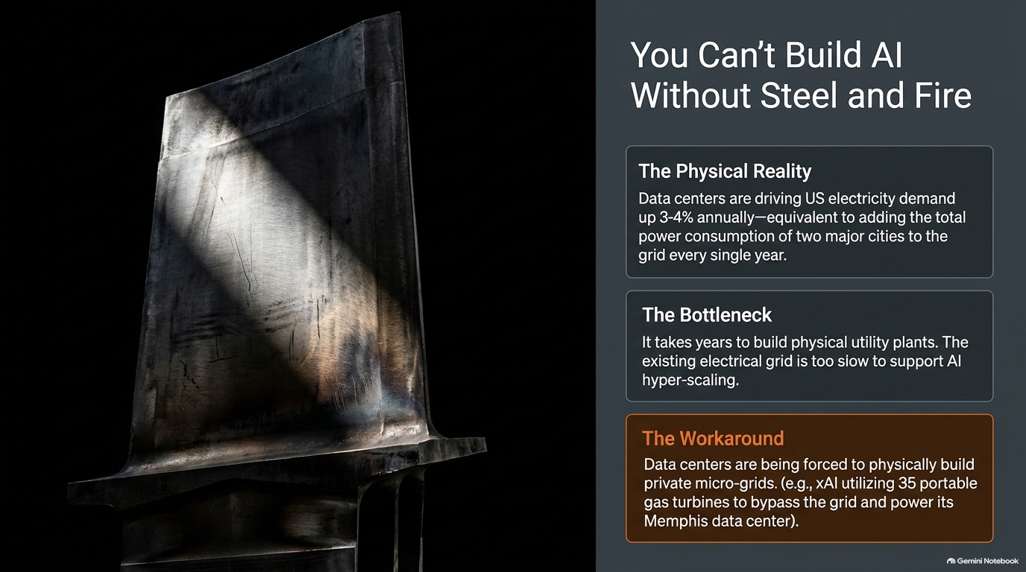
Notes:
Duration: 3 – 5 minutes
Speaker Notes:
"Let's examine how this capital intensity affects the hyperscalers themselves. Historically, tech giants like Google, Microsoft, and Amazon were cash flow powerhouses—so flush with cash that their primary dilemma was figuring out how much stock to buy back.
Today, driven by hundreds of billions in annual AI infrastructure capex, free cash flow has compressed dramatically, and in some cases turned negative. Google even raised tens of billions in equity capital—a seismic shift for a tech titan that hadn’t tapped equity markets since its IPO. The financial burden of funding the AI infrastructure build-out is testing the balance sheets of even the most dominant corporations."

Slide 11
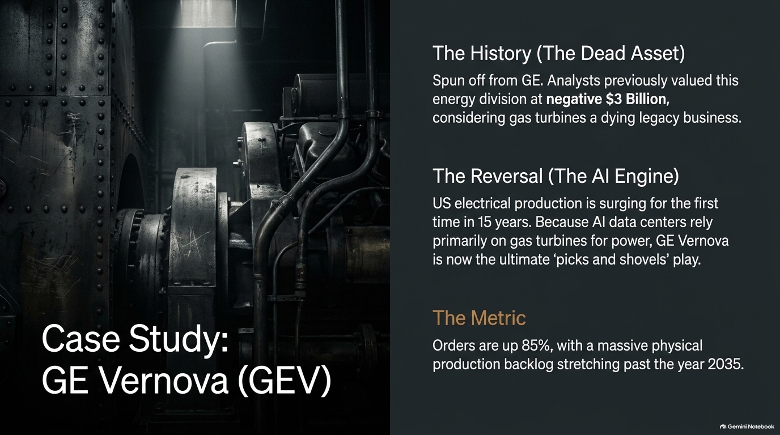
Notes:
Duration: 3 – 5 minutes
Speaker Notes:
"Investors like Michael Burry have raised critical accounting questions regarding hardware depreciation. Hyperscalers extended their GPU depreciation schedules from 3-4 years out to 5-6 years, artificially boosting reported profitability through lower annual depreciation expense.
Furthermore, critics argue that next-generation chips render older hardware obsolete faster than accounting schedules imply. However, the counter-argument is practical: right now, aggregate demand for compute is so intense that even older-generation chips remain in high demand. The real risk isn't depreciation schedules; it's whether end-user monetization collapses."

Slide 12
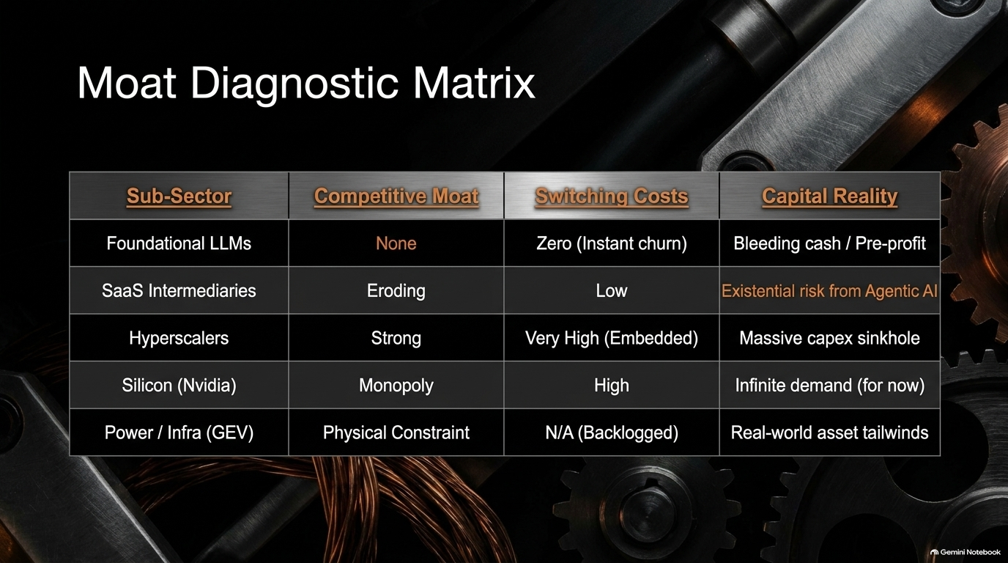
Notes:
Duration: 3 – 5 minutes
Speaker Notes:
"As Elon Musk famously noted, while China faces a chip problem, the United States faces a power problem. Building data centers is constrained by physical energy infrastructure, which takes years to plan, approve, and construct.
US electricity demand is projected to grow by 3% to 4% annually—equivalent to adding multiple major metropolitan areas to the grid. Because local power grids cannot keep pace, hyperscalers are increasingly forced to seek dedicated solutions, from on-site industrial gas turbines to nuclear power purchase agreements."

Slide 13
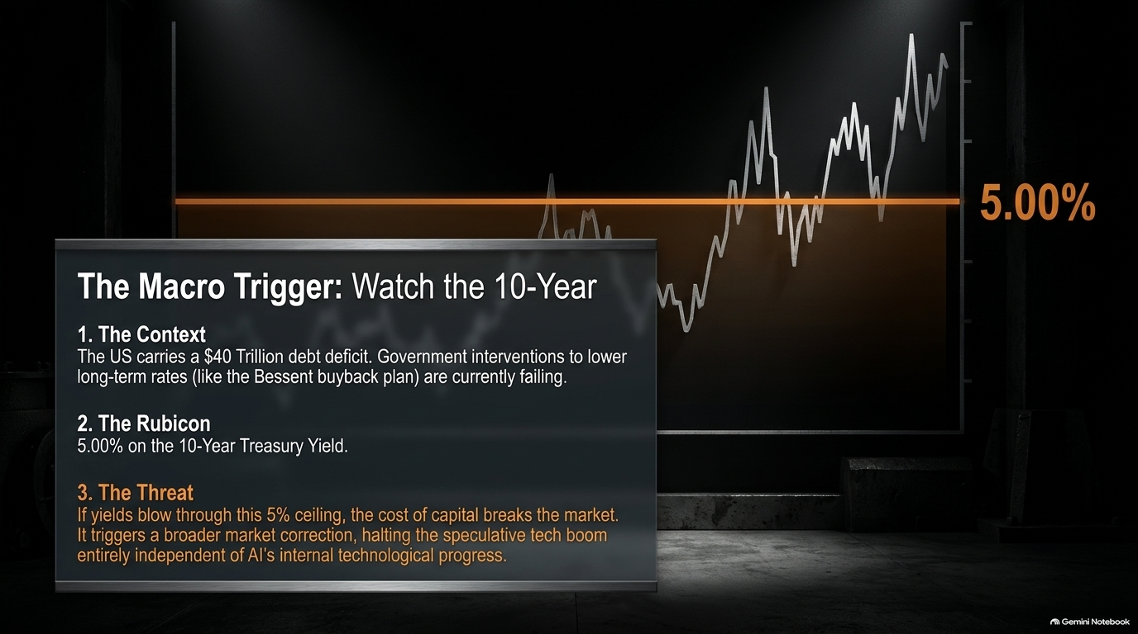
Notes:
Duration: 3 – 5 minutes
Speaker Notes:
"This energy bottleneck turns traditional industrial equipment makers into frontline beneficiaries of the AI boom. Companies like GE Vernova—which manufactures heavy-duty gas turbines structurally identical to aerospace jet engines—are seeing unprecedented demand.
With order backlogs stretching out years into the future, electrical equipment providers, grid infrastructure specialists, and electrification companies (such as Eaton) represent the classic 'picks and shovels' play on AI, benefiting from the massive physical infrastructure build-out regardless of which software model wins."

Slide 14
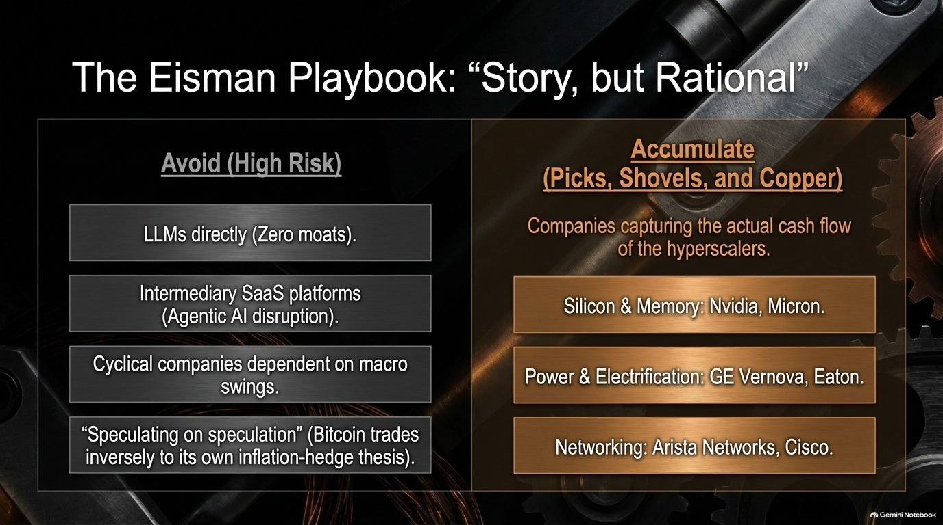
Notes:
Duration: 3 – 5 minutes
Speaker Notes:
"So how should sophisticated investors and strategists navigate this landscape?
High Risk / Avoid: Raw foundational model plays (LLMs) due to the absence of moats, and consumer/travel applications vulnerable to Agentic AI disruption (where AI agents bypass traditional booking platforms entirely).
Prudent Plays (Picks & Shovels): Companies capturing the capex cash flow directly—such as advanced hardware providers, semiconductor component makers (Micron), network infrastructure (Arista Networks, Cisco), and electrification leaders (GE Vernova, Eaton)."

Slide 15
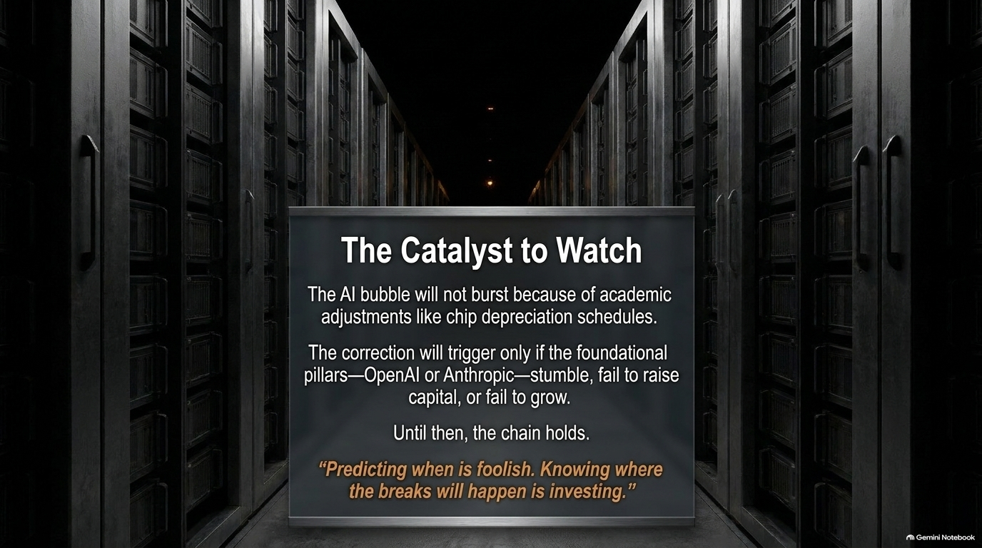
Notes:
Duration: 3 – 5 minutes
Speaker Notes:
"We must also view the AI narrative within the broader macroeconomic context. With US national debt surpassing $40 trillion and annual interest expenses exceeding $1.2 trillion, macroeconomic sensitivity is heightened.
Long-term yields—particularly the 10-year Treasury yield—act as the primary barometer for financial market health. Historically, when yields push past 5%, valuation multiples across high-growth technology sectors face severe downward pressure. The cost of capital is no longer zero, meaning speculative tech must eventually prove real return on investment."

Slide 16
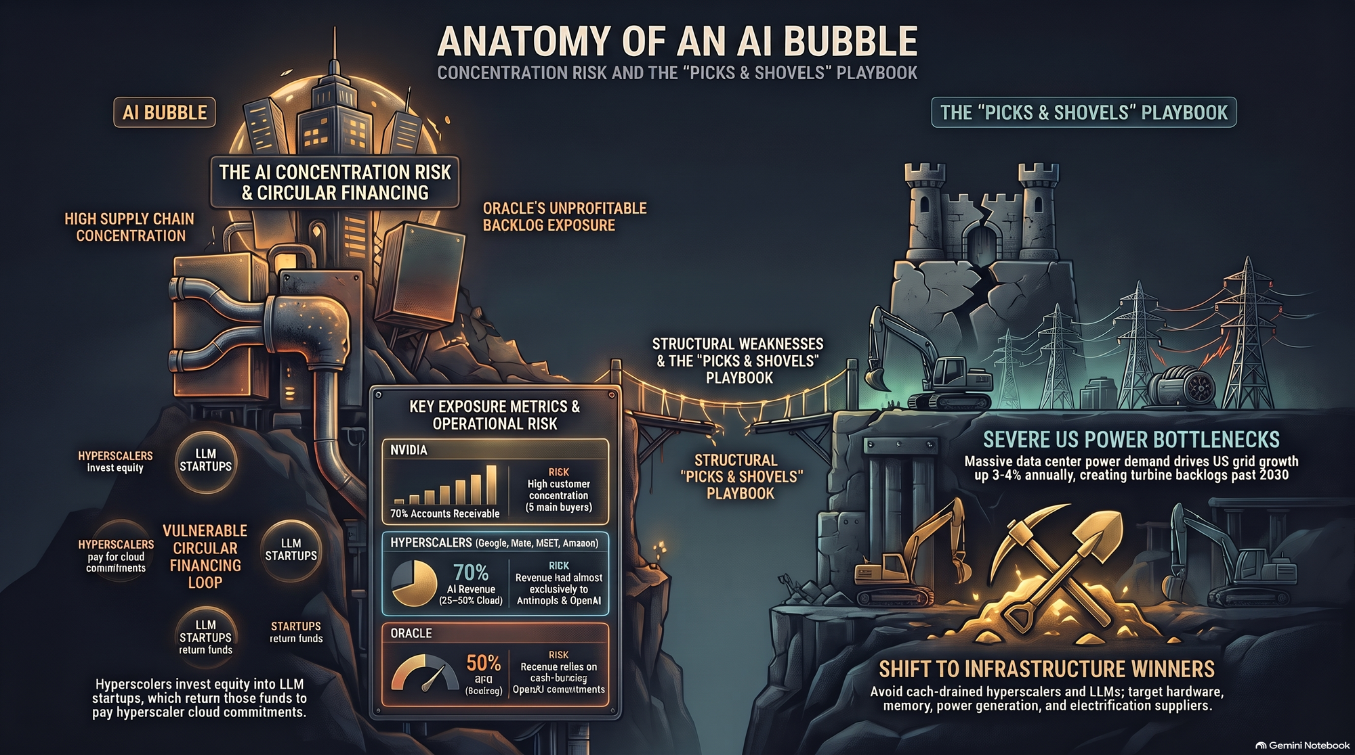
Notes:
Duration: 3 – 4 minutes
Speaker Notes:
"In conclusion, The Fragile AI Chain reminds us that technological revolutions do not move in straight lines. While the long-term potential of artificial intelligence is profound, the current financial architecture is burdened by extreme concentration risk, circular financing loops, unmasked cash burn at the foundational layer, and staggering energy demands.
Whether the bubble experiences a sharp correction or successfully transitions into mature enterprise utility, navigating this era requires distinguishing between speculative hype and durable, cash-generating infrastructure. Thank you for your time, and I look forward to your questions."

