Slide 1
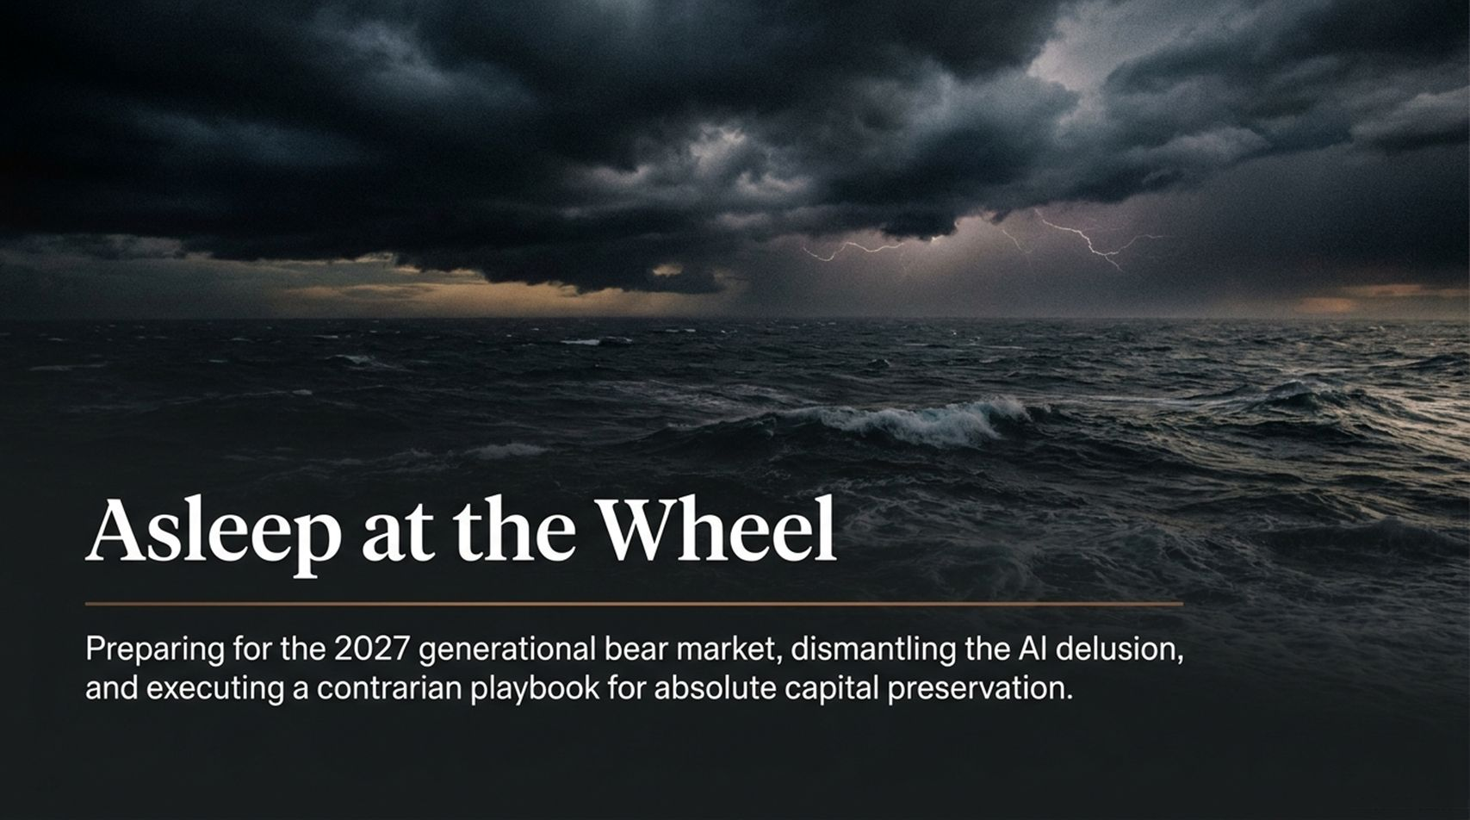
Notes:
Slide Text: Asleep at the Wheel: Preparing for the 2027 generational bear market, dismantling the AI delusion, and executing a contrarian playbook for absolute capital preservation.
Estimated Speaking Duration: 3 – 4 minutes
Speaker Notes:
Opening Hook & Setting the Tone: "Welcome, everyone. Thank you for taking the time to join us today. When we titled this presentation Asleep at the Wheel, we didn't choose those words lightly. We are living through an era of profound collective complacency. Everywhere you look, investors, retirees, and institutions are driving full speed ahead into a brick wall, eyes wide shut, completely convinced that the good times will never end.
The Core Thesis: "Our objective today is stark, clear, and uncompromising. We are looking directly ahead at 2027—the convergence point of a generational bear market. We are going to dissect why the current artificial intelligence mania is an absolute carbon copy of the 1999 fiber-optic bubble, why the Federal Reserve has run out of bullets, and most importantly, what you need to do right now to protect everything you've spent a lifetime building."
Transition to Action: "This isn’t about fear-mongering; it’s about math, history, and physical reality. Let’s look at the convergence happening right now."
Ted Oakley: A Generational Bear Market Is Coming
https://www.youtube.com/watch?v=nwHXD6YLX_I

Slide 2
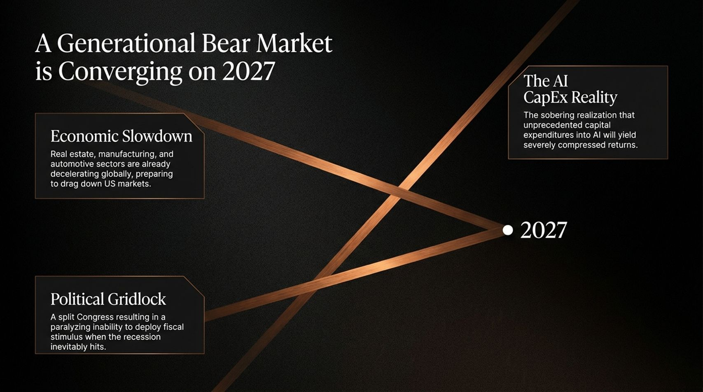
Notes:
Slide Text: Economic Slowdown, Political Gridlock, The AI CapEx Reality leading to 2027.
Estimated Speaking Duration: 4 – 5 minutes
Speaker Notes:
The Macro Convergence: "Take a close look at this slide. Bear markets of this magnitude don't happen in a vacuum; they happen when multiple systemic pressures collide at a single point in time. For us at Oxbow Advisers, that point is 2027.
Pillar One – The Economic Slowdown: "First, look at the real economy. Real estate, manufacturing, and the automotive sectors are already decelerating globally. This is not a sudden cliff; it’s a slow-motion train wreck that is preparing to drag down U.S. markets.
Pillar Two – Political Gridlock: "Second, consider Washington. We are hurtling toward a split Congress. When the next recession hits, Congress will suffer from a paralyzing inability to deploy fiscal stimulus. The political machinery is too broken, too polarized, and too deep in debt to write another trillion-dollar check.
Pillar Three – The AI CapEx Reality: "And finally, the epicenter of the bubble: the AI CapEx reality. Corporate America is waking up to the sobering realization that pouring hundreds of billions of dollars into capital expenditures for AI will yield severely compressed, deeply disappointing returns. When these three forces converge in 2027, the fallout will redefine wealth management for a generation."

Slide 3
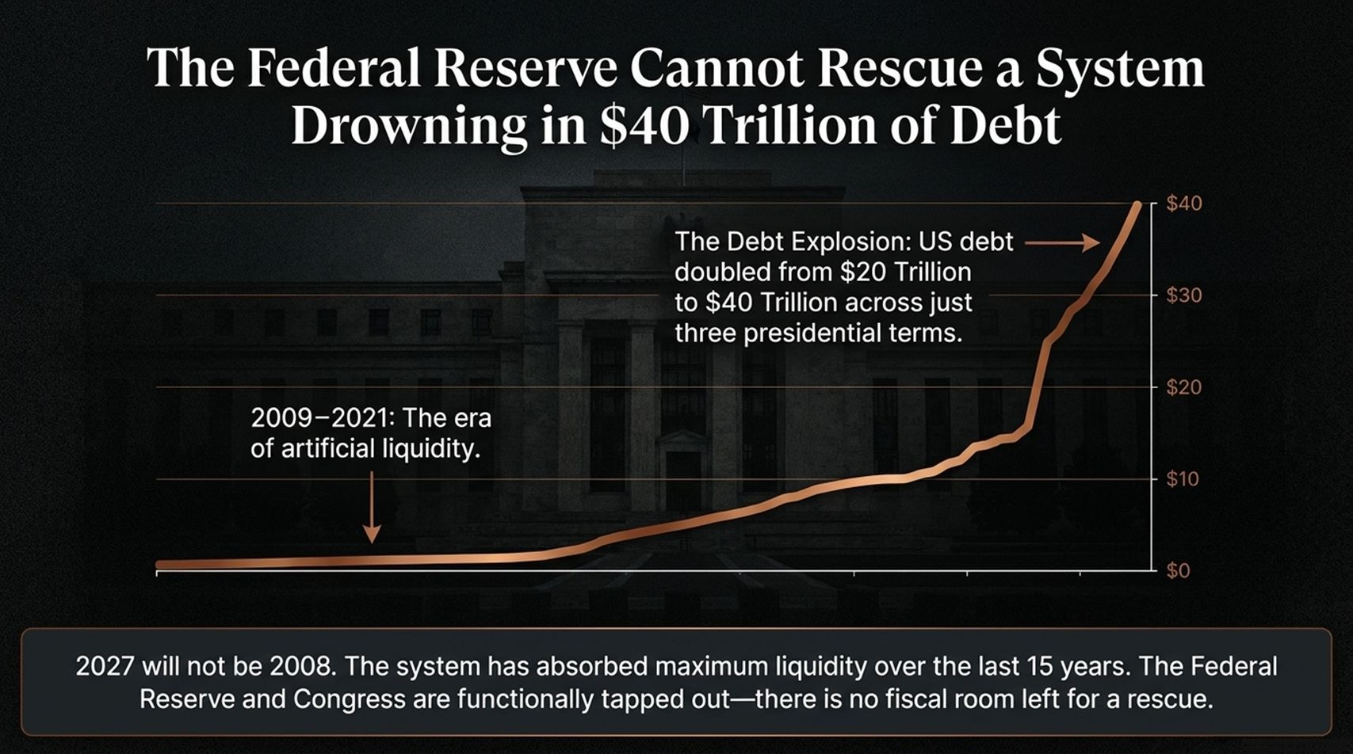
Notes:
Slide Text: The Debt Explosion: US debt doubled from $20 Trillion to $40 Trillion across just three presidential terms. 2009–2021: The era of artificial liquidity. 2027 will not be 2008...
Estimated Speaking Duration: 4 – 6 minutes
Speaker Notes:
Dispelling the Fed Put: "One of the most dangerous myths on Wall Street is the belief in the 'Fed Put'—the idea that whenever the market stumbles, the Federal Reserve will magically step in, lower interest rates, print money, and rescue investors. I am here to tell you that 2027 will not be 2008. Why? Because the patient has overdosed on the medicine.
The 15-Year Liquidity Binge: "Between 2009 and 2021, we lived through an unprecedented era of artificial liquidity. Central banks and governments flooded the system with cheap money. Look at this chart: U.S. national debt exploded from $20 trillion to $40 trillion across just three presidential terms—spanning two administrations.
Tapped Out: "The system has absorbed the maximum possible amount of liquidity over the last 15 years. The Federal Reserve and Congress are functionally tapped out. There is zero fiscal room left for a rescue package. If you are counting on the government to bail out your portfolio when stocks drop 50%, you are betting your retirement on an empty vault."

Slide 4
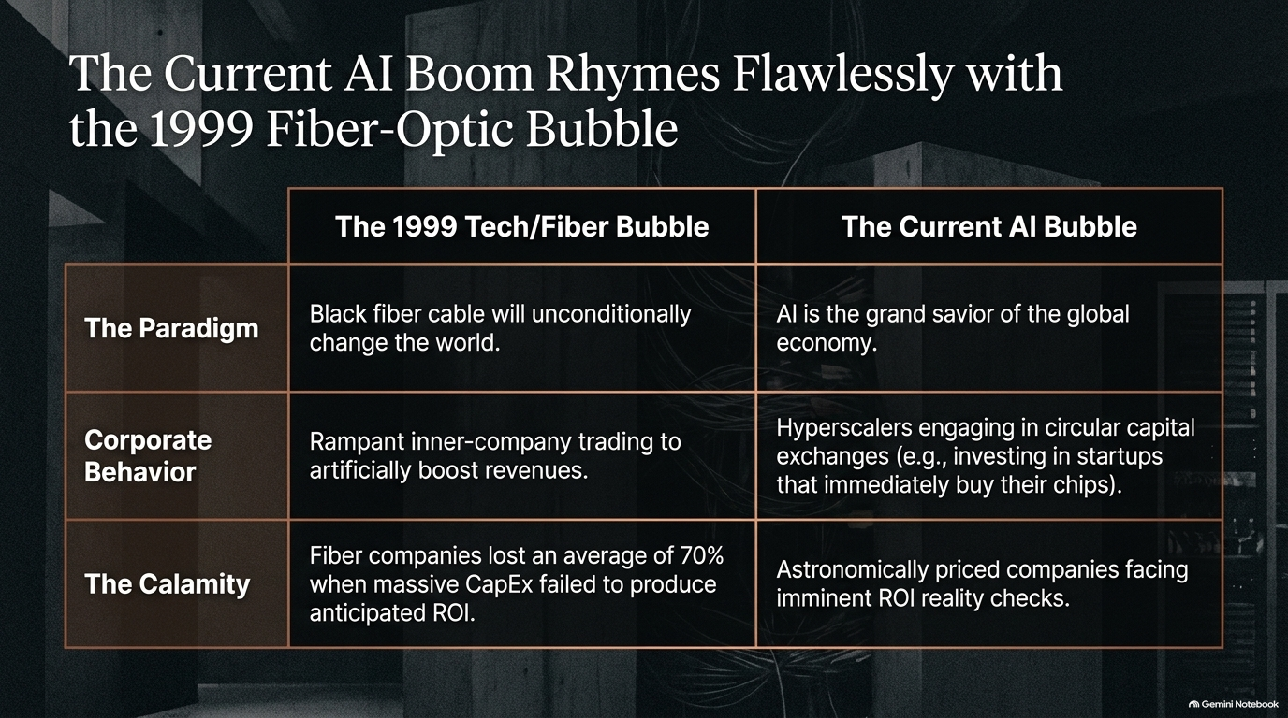
Notes:
Slide Text: The Paradigm, Corporate Behavior, The Calamity comparing 1999 Tech/Fiber Bubble vs. The Current AI Bubble.
Estimated Speaking Duration: 4 – 5 minutes
Speaker Notes:
History Rhymes: "Mark Twain famously said that history doesn't repeat itself, but it often rhymes. Take a look at this comparison table. It should send a chill down your spine.
The Paradigm Parallel: "Back in 1999, the paradigm was black fiber-optic cable. Wall Street told us that laying miles of glass underground would unconditionally change the world—and they were right! Fiber did change the world. But today’s paradigm is AI as the 'grand savior' of the global economy. The technology is real, but the valuations are pure delusion.
Corporate Behavior & Inner-Company Trading: "Look at the corporate behavior. In 1999, we saw rampant inner-company trading to artificially boost revenues. Today? Hyperscalers are engaging in circular capital exchanges—investing billions into private AI startups that immediately turn around and use that exact cash to buy chips from the parent company. It’s circular financing.
The Calamity: "And how did it end for fiber companies? They lost an average of 70% of their value when massive capital expenditures failed to produce anticipated returns. AI is heading straight toward the exact same reckoning."

Slide 5
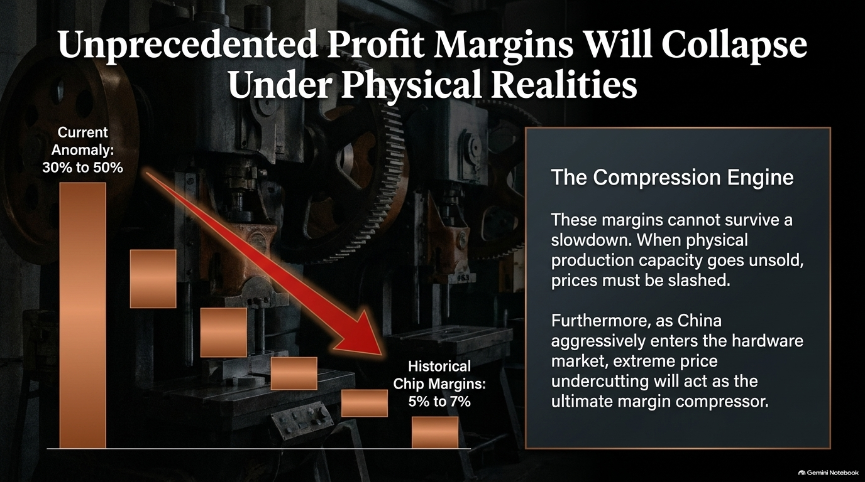
Notes:
Slide Text: Current Anomaly: 30% to 50% vs. Historical Chip Margins: 5% to 7%. The Compression Engine and China's market entry.
Estimated Speaking Duration: 4 – 5 minutes
Speaker Notes:
The Margin Anomaly: "Let's talk about corporate profit margins, because this is where the rubber meets the road. Right now, semiconductor and tech hardware manufacturers are printing operating margins between 30% and 50%. That is an extraordinary historical anomaly. Historically, chip margins hover between 5% and 7%.
The Compression Engine: "These margins cannot survive an economic slowdown. When physical production capacity goes unsold, economic gravity takes over: prices must be slashed.
The China Factor: "Furthermore, look at global competition. As China aggressively enters the hardware and semiconductor market, extreme price undercutting will act as the ultimate margin compressor. When margins collapse from 50% back down to historical norms, earnings estimates will get blown to pieces."

Slide 6
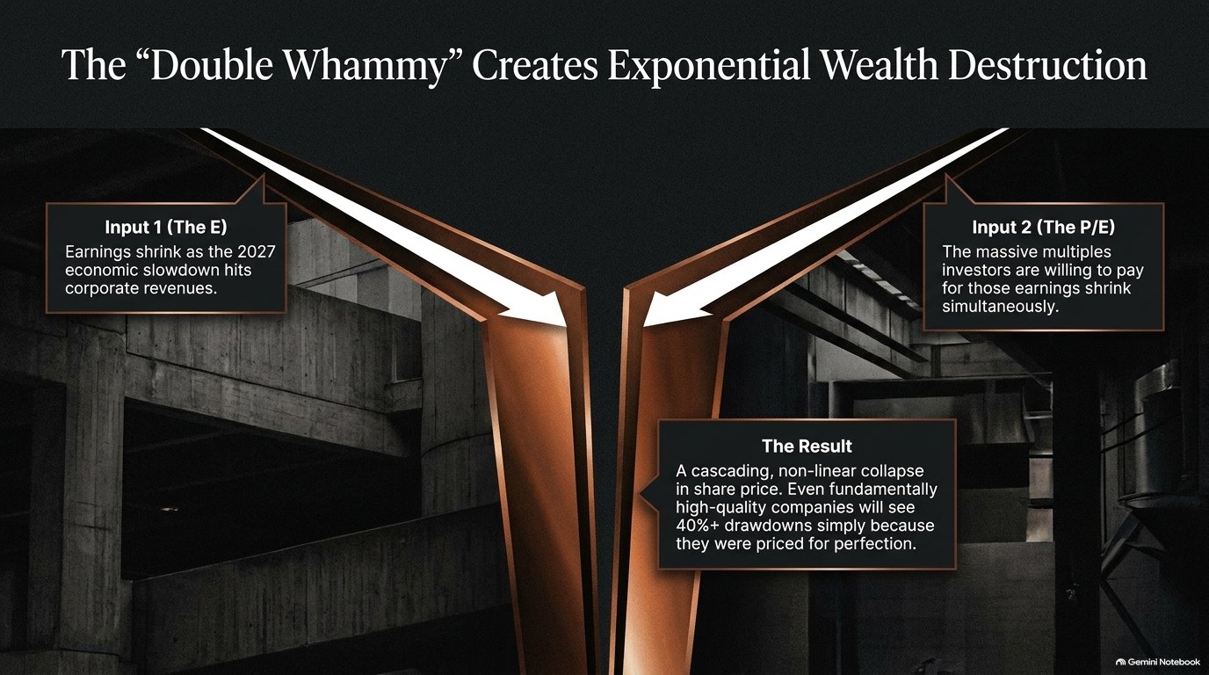
Notes:
Slide Text: Input 1 (The E): Earnings shrink as 2027 economic slowdown hits corporate revenues. Input 2 (The P/E): Massive multiples shrink simultaneously. Result: 40%+ drawdowns.
Estimated Speaking Duration: 3 – 5 minutes
Speaker Notes:
The Mechanics of a Crash: "When investors ask me how a stock market crash actually unfolds, I point them to the concept of the 'Double Whammy'. People often look at price-to-earnings (P/E) multiples today and say, 'Well, valuations aren't quite as high as they were at the absolute peak in March 2000.' That might be true on trailing earnings. But here is what they miss.
Input 1 & Input 2: "In 2027, you are going to get hit by two distinct inputs simultaneously. First, Input 1: Earnings (the 'E') will shrink as the economic slowdown hits corporate revenues. Second, Input 2: The massive P/E multiples that investors are currently willing to pay for those earnings will shrink at the exact same time.
The Cascading Result: "When earnings drop and multiples contract concurrently, you don’t get a linear decline—you get a cascading, non-linear collapse. Even fundamentally high-quality companies will experience 40% to 50% drawdowns simply because they were priced for absolute perfection."

Slide 7
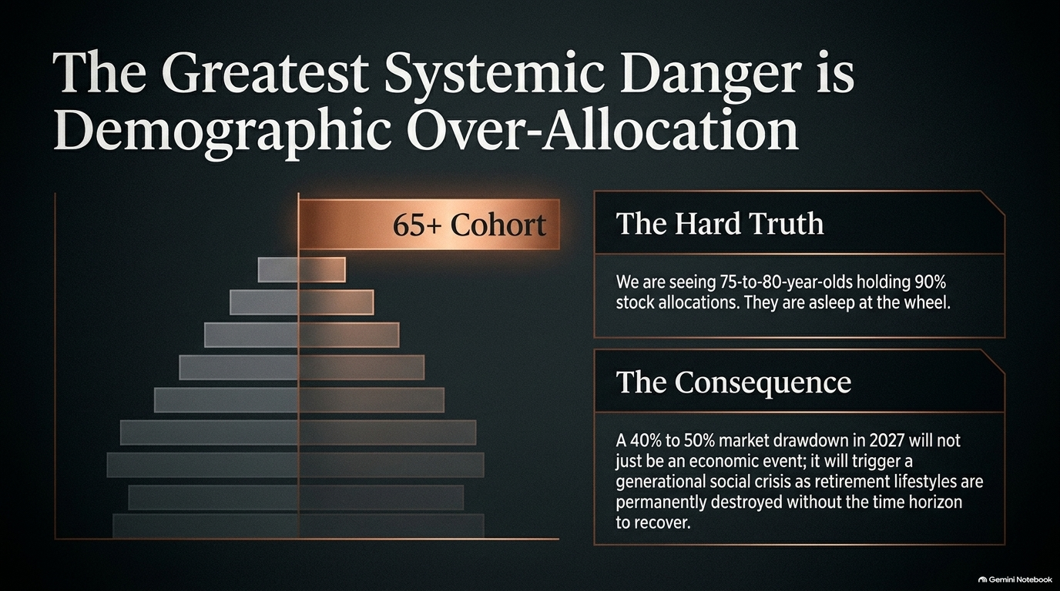
Notes:
Slide Text: 65+ Cohort: 75-to-80-year-olds holding 90% stock allocations. The consequence: permanent lifestyle destruction.
Estimated Speaking Duration: 4 – 5 minutes
Speaker Notes:
A Looming Social Crisis: "This slide highlights what I consider to be the most tragic systemic danger in the entire financial system today: demographic over-allocation. In our new book, Asleep at the Wheel: You Have Too Much Stock For Your Age, we address this head-on.
The Hard Truth: "We have clients walking into our offices—75, 80 years old—holding 90% of their net worth in common stocks. Think about the sheer recklessness of that. These are people who spent their entire lives working, and they are sitting on maximum equity risk at the absolute twilight of their accumulation phase.
The Consequence: "When a 40% to 50% market drawdown hits in 2027, it won’t just be an economic event. It will trigger a generational social crisis. Retirement lifestyles will be permanently destroyed because retirees simply do not have the time horizon left to recover. And the psychological shock rolls downhill to their children, who suddenly face the burden of supporting aging parents."

Slide 8

Notes:
Slide Text: The Wall Street Fallacy: celebrating "relative outperformance". The Contrarian Rule: Absolute liquidity and cash preservation.
Estimated Speaking Duration: 3 – 5 minutes
Speaker Notes:
The Wall Street Con Game: "We need to talk about how the financial advisory industry gaslights investors. What do standard advisors tell you after a major market crash? They pat you on the back and celebrate 'relative outperformance'. They look you in the eye and say, 'Be happy! The S&P 500 crashed 50%, but your portfolio only lost 30%!'
Exposing the Fallacy: "Think about how absurd that is. Telling someone who just lost nearly a third of their life savings to celebrate because someone else lost half is a con game.
The Contrarian Rule: "Relative performance is entirely irrelevant when your wealth is permanently impaired. In a generational bear market, you cannot pay your grocery bills with 'relative outperformance.' The only mathematically sound defense is absolute liquidity and capital preservation. Our job is not to lose less than a collapsing market; our job is to protect your principal so you emerge from the storm completely intact."

Slide 9
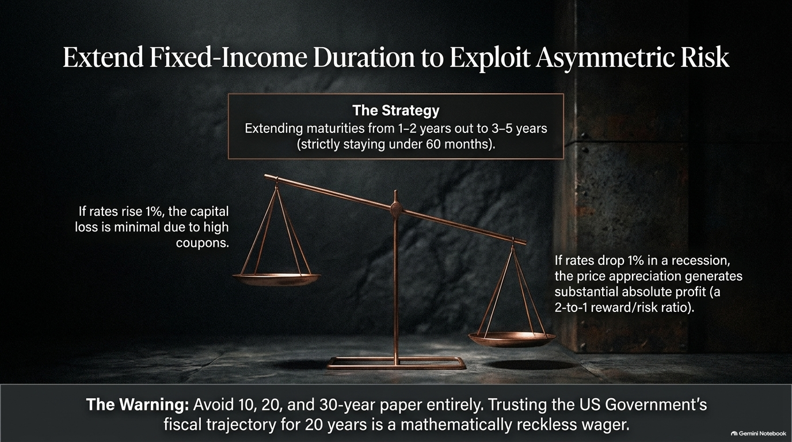
Notes:
Slide Text: Extending maturities from 1-2 years out to 3-5 years (strictly under 60 months). Avoiding 10, 20, and 30-year paper.
Estimated Speaking Duration: 4 – 5 minutes
Speaker Notes:
Navigating the Yield Curve: "Now let's talk about portfolio strategy and fixed income. For the last couple of years, we kept our cash and fixed-income maturities very short—under 24 months. But with interest rates where they are today, we have quietly and strategically extended our duration out to 3, 4, and up to 5 years—strictly staying under 60 months.
The Asymmetric Trade: "This creates a beautiful asymmetric risk profile. If interest rates rise another 1%, our capital loss is minimal because we are anchored by high coupons. But if rates drop 1% during an economic recession, the price appreciation on those 3-to-5-year bonds generates substantial absolute profits—a fantastic 2-to-1 reward-to-risk ratio.
The 20-Year Warning: "Notice what we are avoiding: 10, 20, and 30-year government paper. Trusting the U.S. government's fiscal trajectory and locking up your money for 20 years in the face of $40 trillion in debt is a mathematically reckless wager."

Slide 10

Notes:
Slide Text: Energy makes up <4% of S&P 500 vs. historical peak of 30% in early 1980s. Major producers profitable at $70/barrel.
Estimated Speaking Duration: 4 – 5 minutes
Speaker Notes:
The Contrarian Bet on Energy: "While Wall Street is obsessed with overcrowded tech stocks, we positioned our portfolios heavily in energy years ago. Let’s look at the numbers. Today, energy makes up less than 4% of the S&P 500. Contrast that with the early 1980s, when energy peaked at over 30% of the entire index.
Robust Profitability: "People assume oil needs to be at $120 a barrel for energy companies to thrive. Major producers like Petrobras print massive, enviable profits even at $70 a barrel. They sell at ultra-low P/E multiples and pay rich, reliable cash dividends.
The Catalyst: "Because the energy sector is so tiny relative to its history, a mere 5% capital rotation out of bloated AI stocks and into fossil fuels will trigger a violent, upward repricing of energy equities."

Slide 11
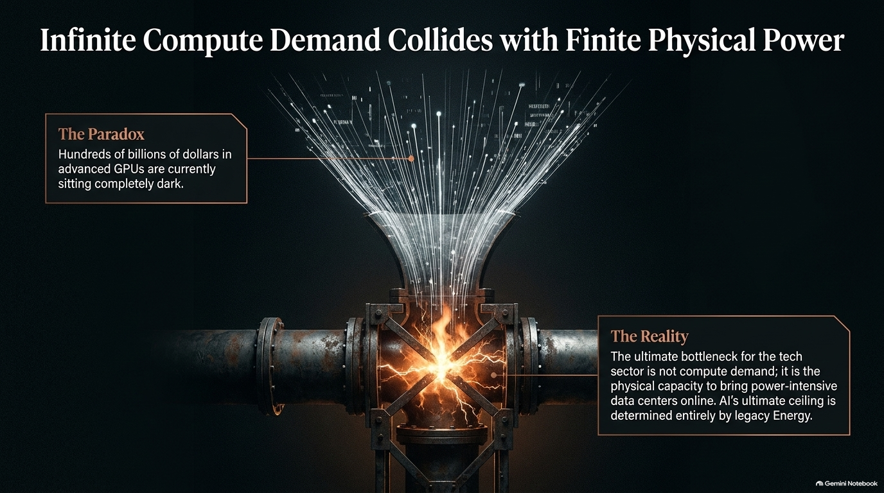
Notes:
Slide Text: The Paradox: Hundreds of billions in advanced GPUs sitting dark. The Ultimate Bottleneck: Legacy energy and power-intensive data centers.
Estimated Speaking Duration: 4 – 5 minutes
Speaker Notes:
The Great AI Power Bottleneck: "Let's address the great contradiction in the AI narrative. Everyone talks about insatiable compute demand. But what is the reality on the ground? Reuters reported that major tech giants have hundreds of billions of dollars worth of advanced H100 GPUs sitting completely dark in warehouses.
Why Are They Dark? "Why aren't they turned on? Because they don't have enough electricity!
The Physical Ceiling: "The ultimate bottleneck for the tech sector is not silicon chip design; it is the physical, engineering capacity to bring power-intensive data centers online. AI's ultimate growth ceiling is determined entirely by legacy energy. That is why traditional energy infrastructure remains an indispensable cornerstone of our thesis."

Slide 12

Notes:
Slide Text: The Hidden Cost: Middle East oil shipping costs spiked from $5 to $35/barrel. The Tactical Exit strategy.
Estimated Speaking Duration: 3 – 5 minutes
Speaker Notes:
Friction in the Supply Chain: "We must also remain clear-eyed about global risks. Geopolitical frictions, conflicts, and skyrocketing marine insurance premiums have fundamentally altered physical supply chains.
The Cost Spike: "Consider this: due to regional conflicts and vessel rerouting, the cost to ship a single barrel of oil out of the Middle East has spiked from $5 historically to roughly $35 a barrel.
Active Management & The Exit Plan: "Energy has been a stellar performer, but we manage it with active discipline. When the 2027 economic slowdown inevitably dampens consumer demand, we are fully prepared to aggressively trim and lighten our energy exposure. We don't marry assets; we manage risk."

Slide 13
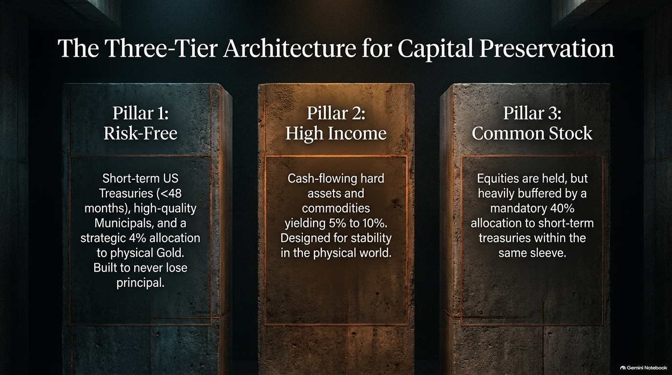
Notes:
Slide Text: Pillar 1: Risk-Free (Short Treasuries, Municipals, 4% Gold). Pillar 2: High Income (Cash-flowing assets yielding 5-10%). Pillar 3: Common Stock (Equities heavily buffered by 40% treasuries).
Estimated Speaking Duration: 4 – 5 minutes
Speaker Notes:
Our Blueprint for Safety: "How do we structure our client portfolios at Oxbow Advisers to weather this entire storm? We utilize a disciplined Three-Tier Architecture.
Pillar 1 – Risk-Free: "Pillar One consists of short-term U.S. Treasuries under 48 months, high-quality municipal bonds, and a strategic 4% allocation to physical gold. This sleeve is engineered to never lose principal.
Pillar 2 – High Income: "Pillar Two is our High Income portfolio. We target cash-flowing hard assets and commodities yielding 5% to 10%. This provides exceptional, tangible cash flow that doesn't rely on Wall Street fairy tales.
Pillar 3 – Common Stock: "Pillar Three is our Common Stock sleeve. Yes, we own equities—but they are heavily buffered by a mandatory 40% allocation to short-term treasuries right inside the same portfolio. This ensures that even our equity exposure is protected against catastrophic downside."

Slide 14
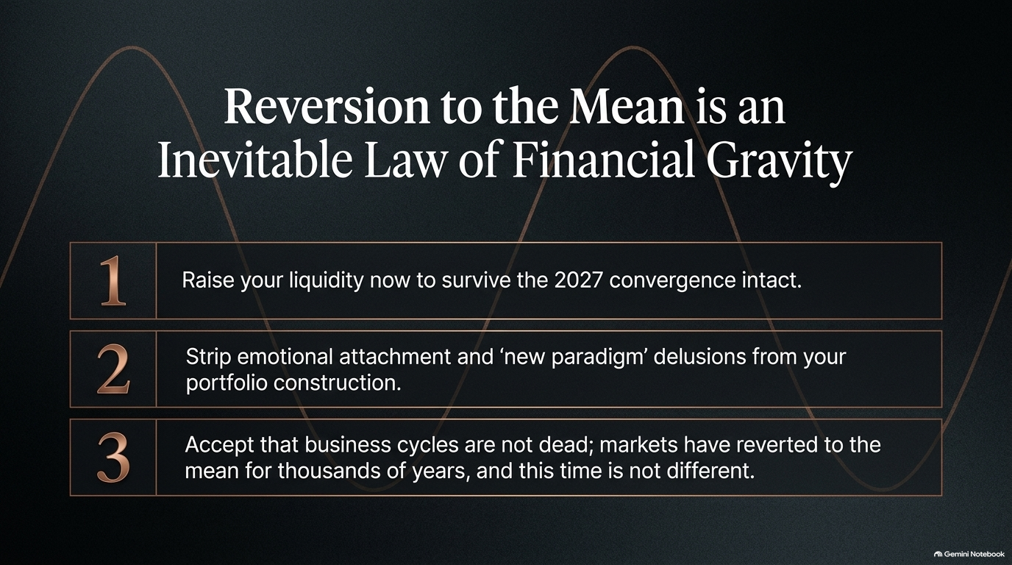
Notes:
Slide Text: 1. Raise liquidity now. 2. Strip emotional attachment and 'new paradigm' delusions. 3. Accept that business cycles are not dead.
Estimated Speaking Duration: 3 – 5 minutes
Speaker Notes:
The Law of Financial Gravity: "As we bring this home, remember the most fundamental law in all of finance: Reversion to the Mean. You can listen to analysts talk about a 'new paradigm' all day long; they told me the exact same thing in late 1999.
The Three Commandments:
Raise your liquidity now so you survive the 2027 convergence with your financial life intact.
Strip emotional attachment and 'new paradigm' delusions out of your portfolio construction.
Accept reality: business cycles are not dead. Markets have reverted to the mean for thousands of years, and 2027 will be no different."

Slide 15

Notes:
Slide Text: OxbowAdvisers.com, upcoming book Asleep at the Wheel, The Promise: No chatbots, speak directly with experts in the trenches.
Estimated Speaking Duration: 2 – 4 minutes
Speaker Notes:
Our Commitment to You: "At Oxbow Advisers, we don't hide behind smoke and mirrors. We operate with absolute transparency. You can visit our website at OxbowAdvisers.com to view our exact holdings and strategies.
Our Book & Promise: "Look for our upcoming January book release, Asleep at the Wheel: You Have Too Much Stock For Your Age. And here is our absolute promise to you: when you call our firm, you will never talk to a chatbot or an automated script. You will speak directly with seasoned portfolio managers who are managing capital in the trenches every single day."

Slide 16
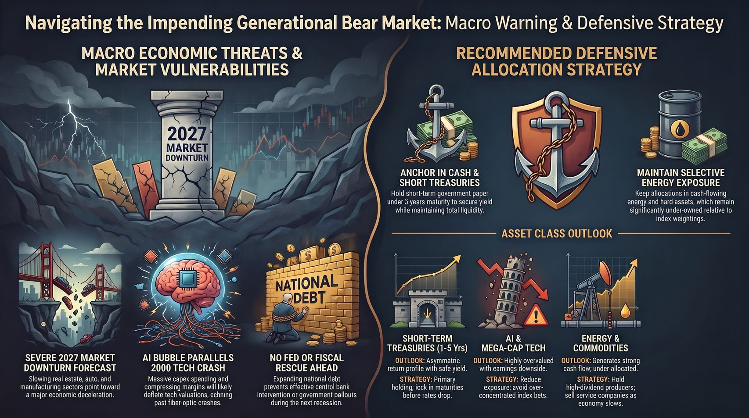
Notes:
Slide Text: Macro Economic Threats & Market Vulnerabilities vs. Recommended Defensive Allocation Strategy.
Estimated Speaking Duration: 3 – 4 minutes
Speaker Notes:
Summary & Call to Action: "Let’s summarize our roadmap on this final slide. On the left, the vulnerabilities are locked in: a 2027 market downturn, AI bubble parallels to 2000, and a tapped-out federal government with $40 trillion in debt. On the right, the solution is clear: anchor your wealth in cash and short-term treasuries (under 60 months), maintain selective energy exposure, and eliminate over-concentrated index risk.
Final Thought: "Don't be caught asleep at the wheel. Take control of your financial destiny today, protect your principal, and position your portfolio for the opportunities that will emerge on the other side of the storm. Thank you very much."

