Slide 1

Notes:
Why hasn't Amazon cut its engineers yet? - AI Engineering by Chip Huyen
https://www.youtube.com/watch?v=WRCE4w9BMGI

Slide 2
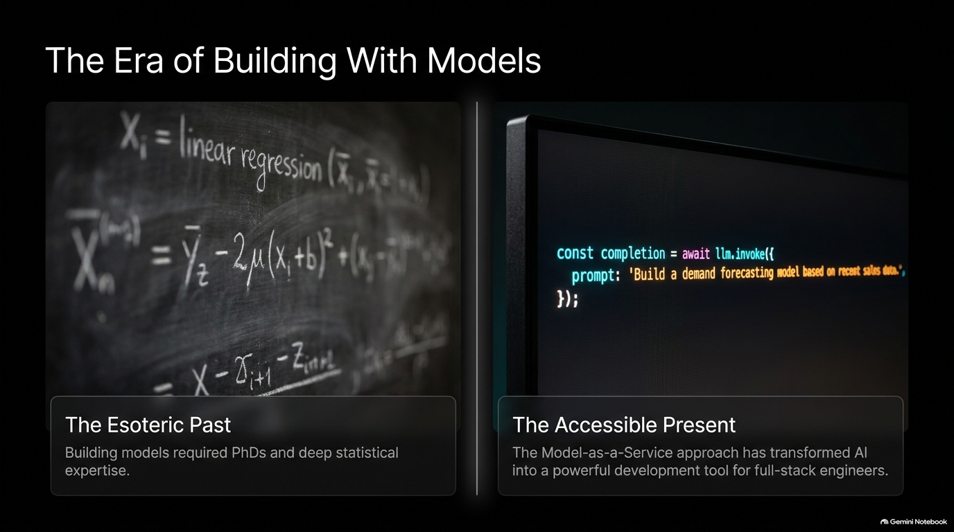

Slide 3
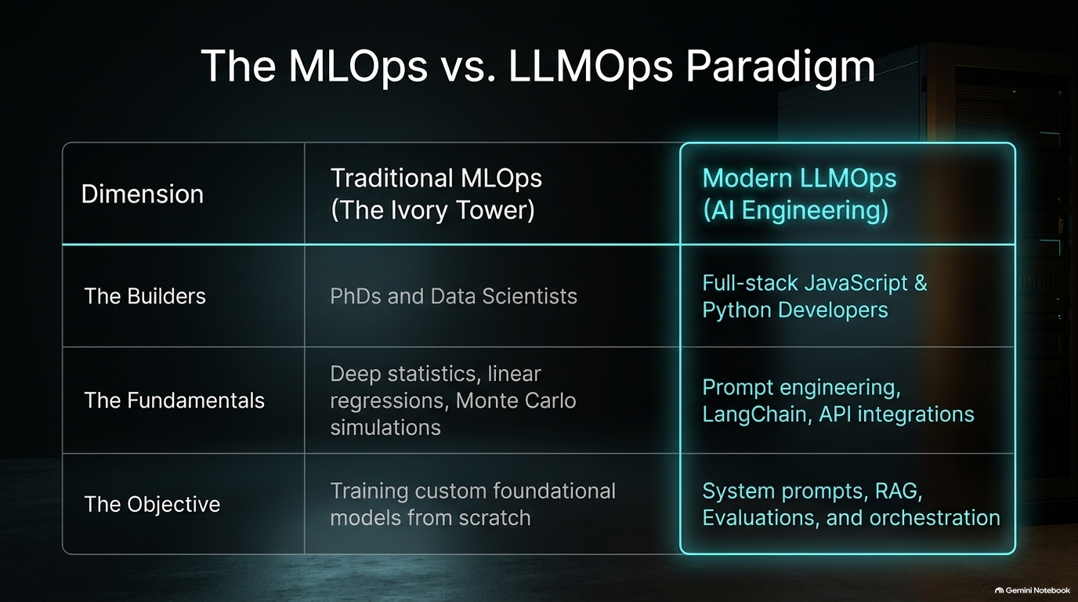

Slide 4
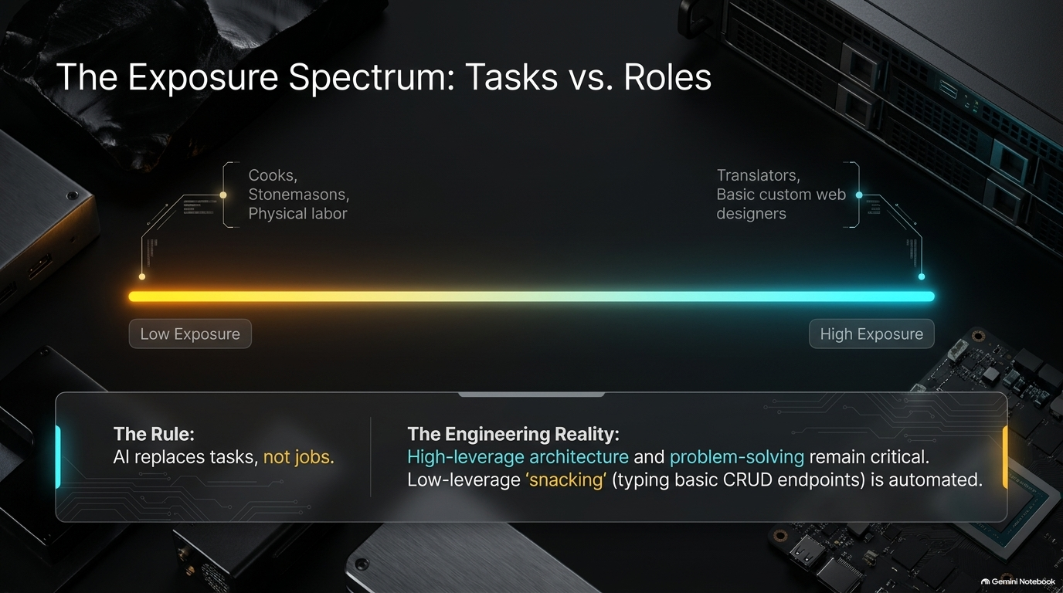

Slide 5
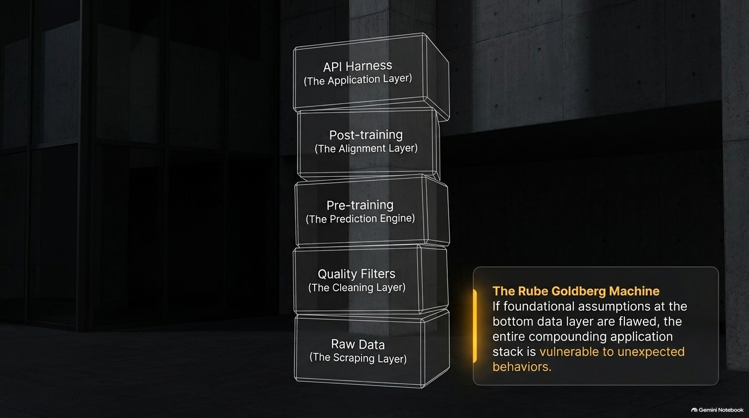

Slide 6


Slide 7
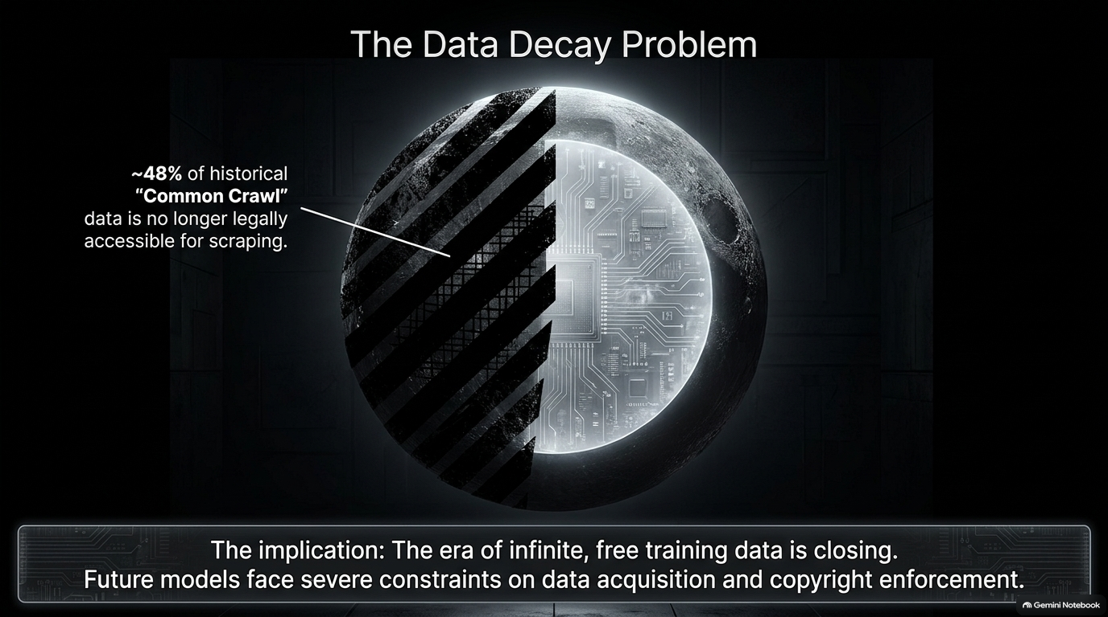

Slide 8
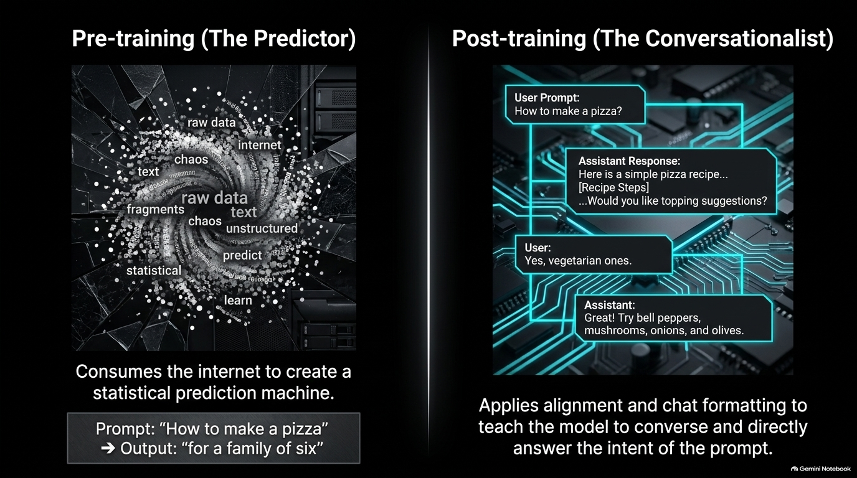

Slide 9


Slide 10
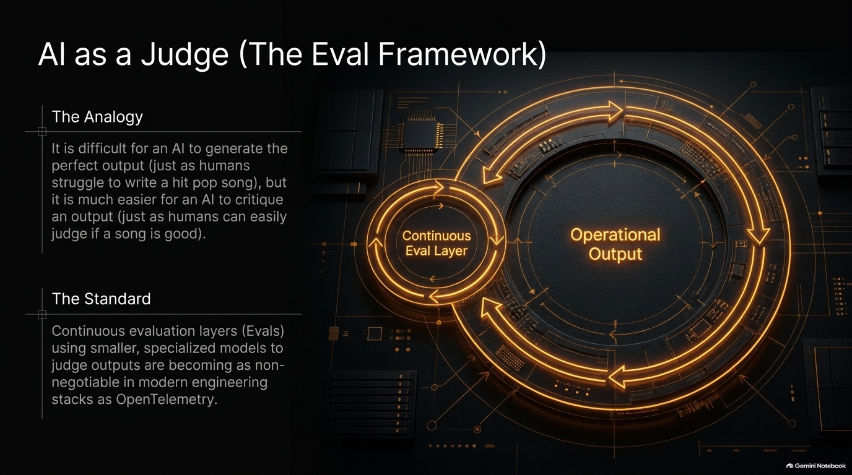

Slide 11
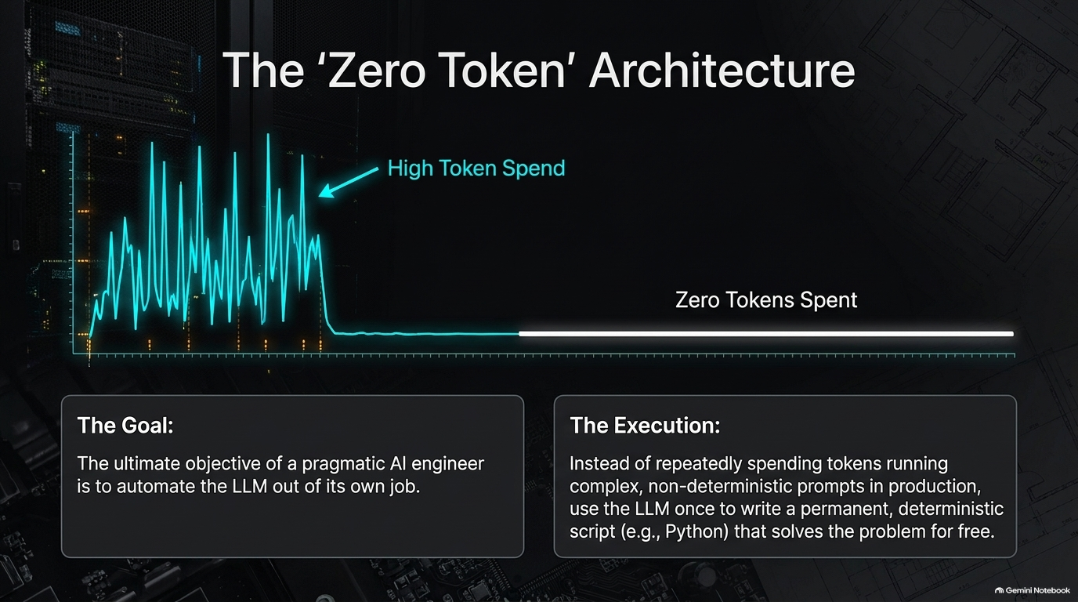

Slide 12
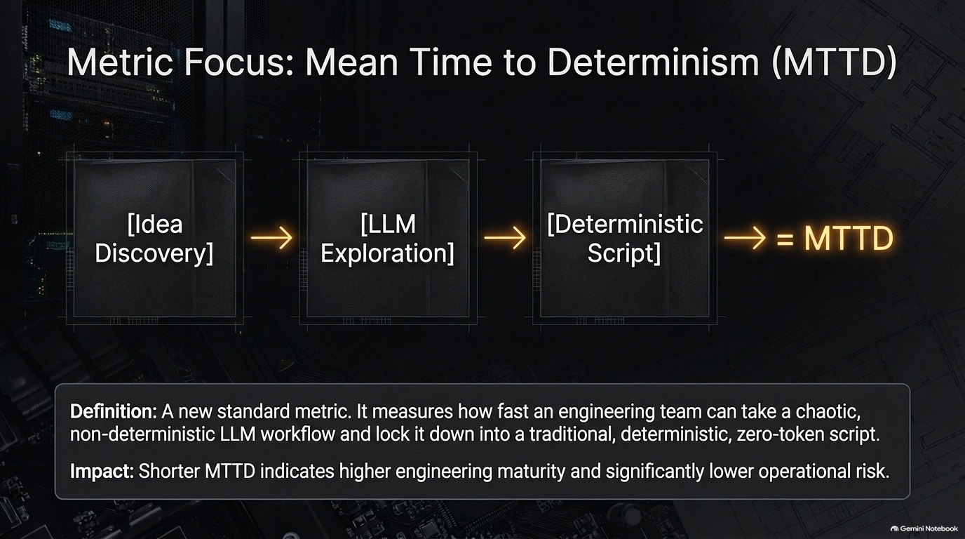

Slide 13


Slide 14
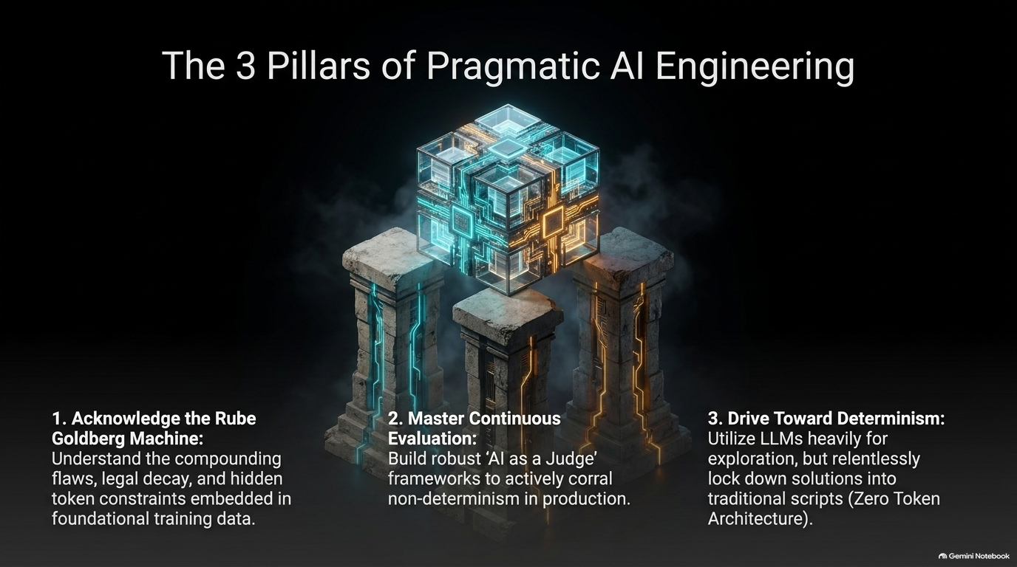

Slide 15


Slide 16
