Slide 1
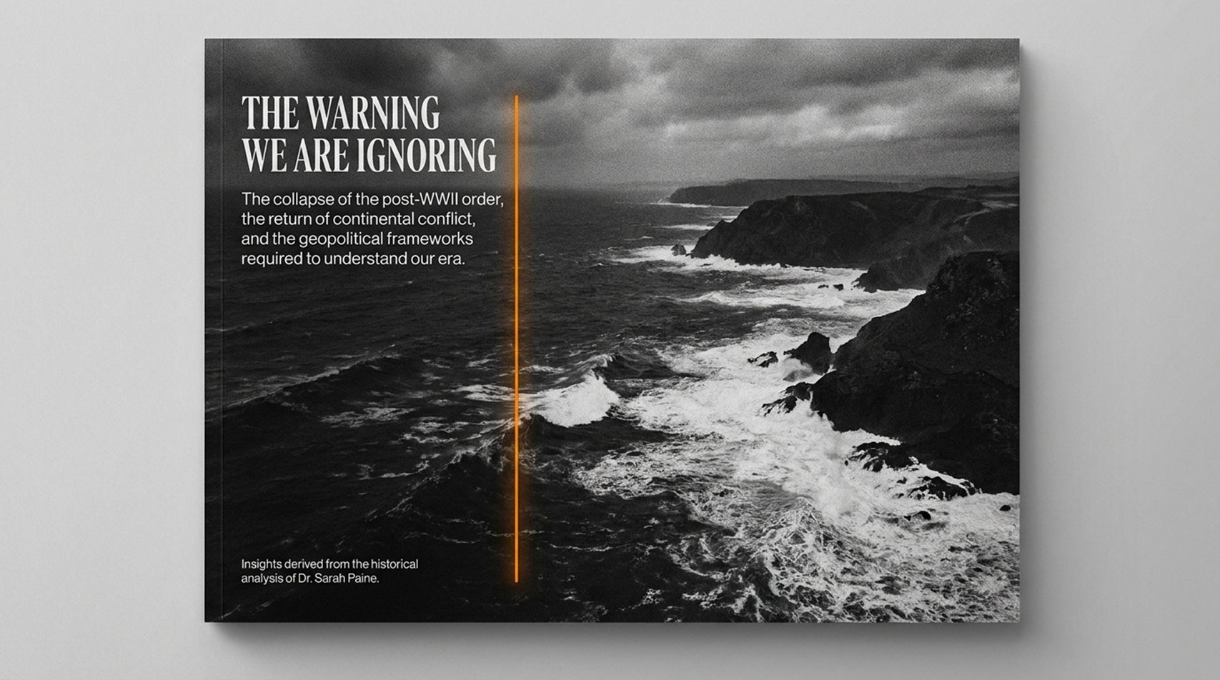
Notes:
Estimated Pacing: 2 – 3 minutes
Key YouTube Reference: [00:00:00] – [00:04:16]
Speaker Script & Notes
"Welcome, everyone. Today we are exploring the foundational security and economic dilemma of the 21st century: The Clash of World Orders.
As Dr. Sarah Paine points out, history does not start in a vacuum; it is a continuum. Right now, we feel as though a logjam has busted and we are barreling toward systemic global instability. But to understand the current conflicts—from Europe to the Middle East—we must look beyond daily headlines and examine the structural forces beneath them.
Over the next 14 sections, we will break down how geopolitical power is organized, why major powers make critical strategic blunders, and how middle powers and non-state actors are reframing the global architecture."
WW3 Threat Expert: The Warning We Are Ignoring, The Only Way Out Is THIS! | Dr Sarah Paine
https://www.youtube.com/watch?v=3kuNW8hRc2U

Slide 2
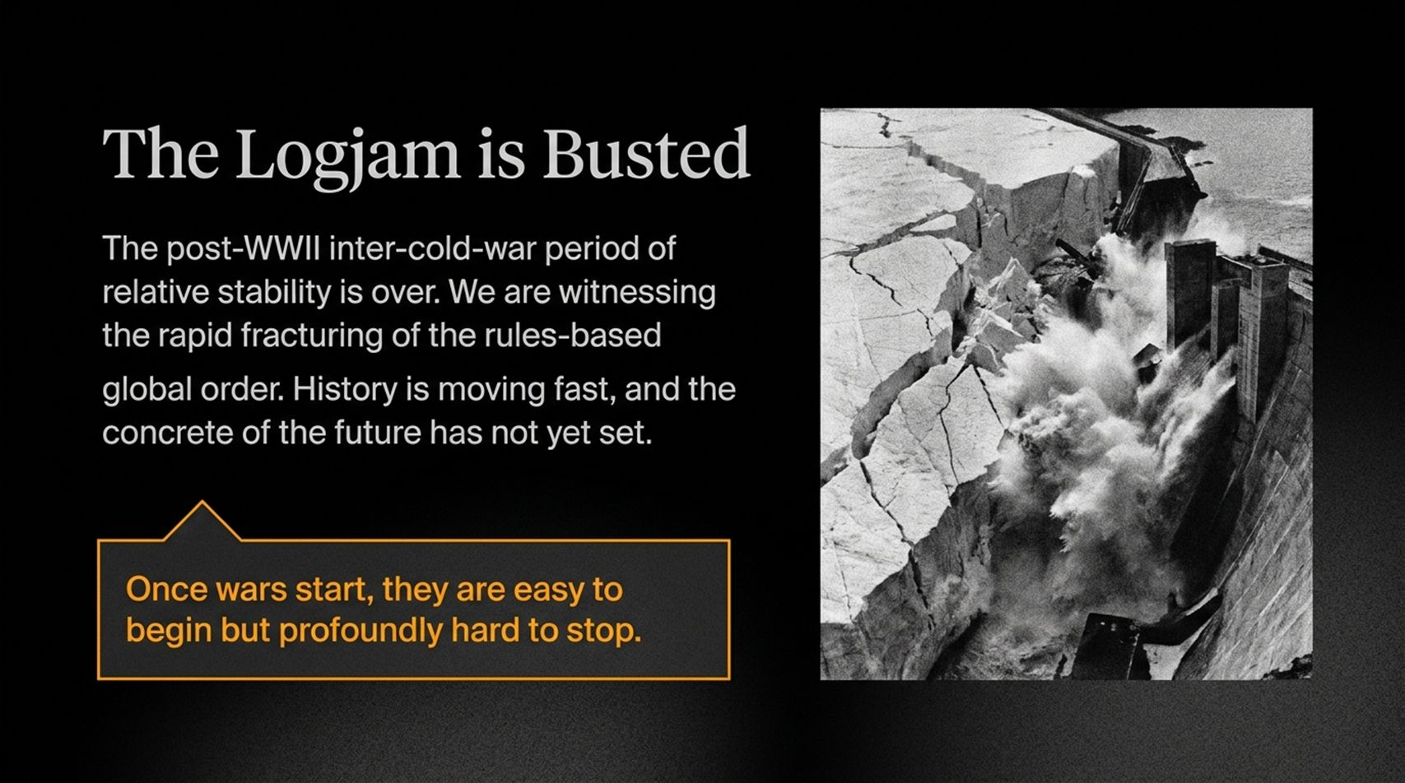
Notes:
Estimated Pacing: 4 – 5 minutes
Key YouTube Reference: [00:02:43] – [00:04:16]
Speaker Script & Notes
"To analyze global power, Dr. Paine introduces two contrasting strategic paradigms: the Continentalist Order and the Maritime Order.
Continentalist Powers: Historically and modernly, land is their currency of power. Their strategy is defined by seizing territory, expanding physical borders, and creating contiguous spheres of influence. The fundamental flaw is that taking territory burns wealth rather than compounding it.
Maritime Powers: Developed post-Industrial Revolution, maritime powers use industry, rule of law, and global commerce to compound wealth. Instead of conquering neighbors, they build universal rules—such as open sea lanes, interoperable financial systems, and secure property rights.
When a Continentalist power attempts to kick over the chessboard, it threatens the entire rules-based ecosystem that underpins global prosperity."

Slide 3
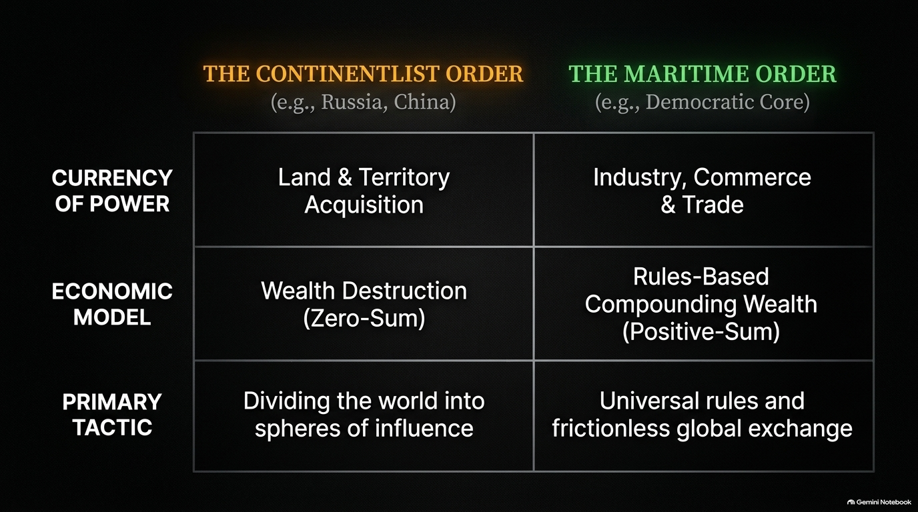
Notes:
Estimated Pacing: 3 – 4 minutes
Key YouTube Reference: [00:05:06] – [00:06:58]
Speaker Script & Notes
"When evaluating foreign policy, we must distinguish between Positive Objectives and Negative Objectives.
Positive Objectives: Making a specific event happen—e.g., capturing a leader or capturing a target area. They are easily verifiable.
Negative Objectives: Preventing a bad outcome from occurring—e.g., deterring foreign invasion, maintaining infrastructure, or averting world war.
The core challenge of governance is that governments rarely get credit for negative objectives because when they succeed, nothing happens. Deterrence is an unprovable metric. However, failing at negative objectives leads to catastrophe."

Slide 4
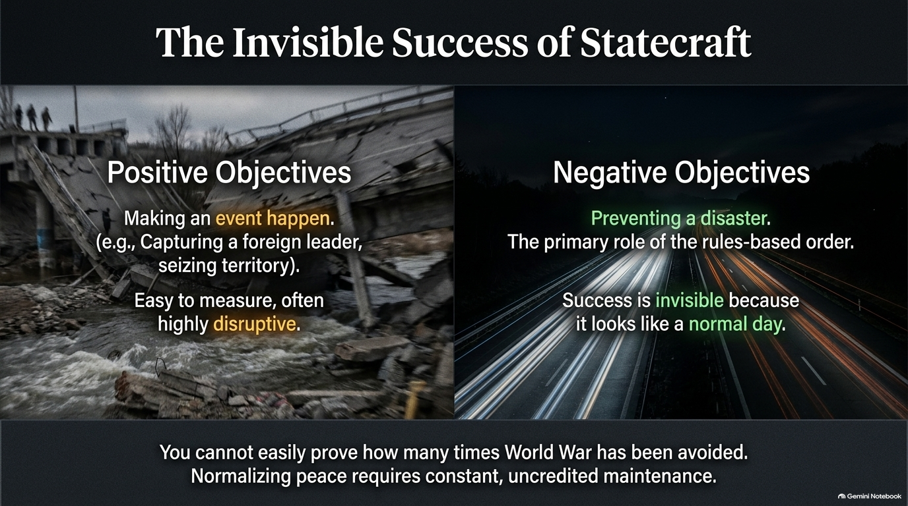
Notes:
Estimated Pacing: 4 – 5 minutes
Key YouTube Reference: [00:12:25] – [00:15:20]
Speaker Script & Notes
"A primary cause of imperial collapse is mistaking an unmanageable Situation for a solvable Problem.
A Problem can be solved directly with available resources.
A Situation cannot be 'solved' through direct force without causing self-destruction; it must be managed over time.
For example, during the Cold War, the U.S. managed the Soviet existential threat through containment, deterrence, and alliance growth rather than direct invasion. Pursuing unfeasible, grand objectives leads directly to strategic overextension."

Slide 5
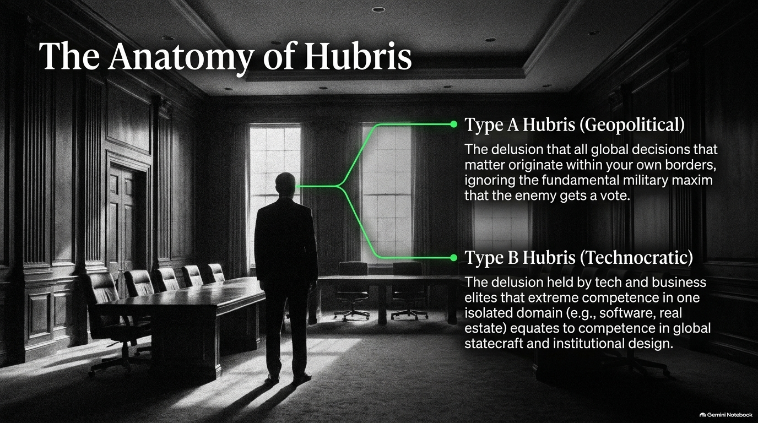
Notes:
Estimated Pacing: 4 – 5 minutes
Key YouTube Reference: [00:07:05] – [00:10:46]
Speaker Script & Notes
"Why do major powers launch disastrous conflicts? It stems from flawed Net Assessment and strategic hubris.
Effective military strategy requires evaluating four quadrants:
My strengths
My weaknesses
Adversary's strengths
Adversary's weaknesses (plus third-party reactions).
Failures occur when decision-makers practice Type A Hubris (believing all important decisions happen domestically) or Type B Hubris (assuming expertise in one domain transfers to military strategy). When leaders surround themselves with 'yes-men' and eliminate divergent views, pivotal errors become inevitable."

Slide 6
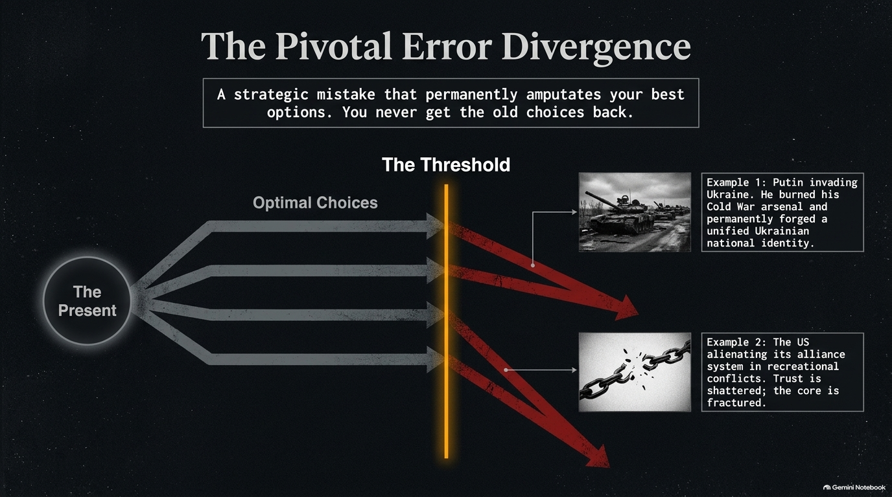
Notes:
Estimated Pacing: 3 – 4 minutes
Key YouTube Reference: [00:15:43] – [00:17:15]
Speaker Script & Notes
"A Pivotal Error is an action that permanently alters the strategic landscape. Once committed:
The favorable options available prior to the error disappear forever.
The actor is forced to choose between progressively worse alternatives.
Russia's full-scale invasion of Ukraine represents a classic pivotal error. Instead of destabilizing Ukraine quietly, it solidified Ukrainian national identity, burned through Russia's Cold War hardware reserves, and galvanized NATO expansion."

Slide 7
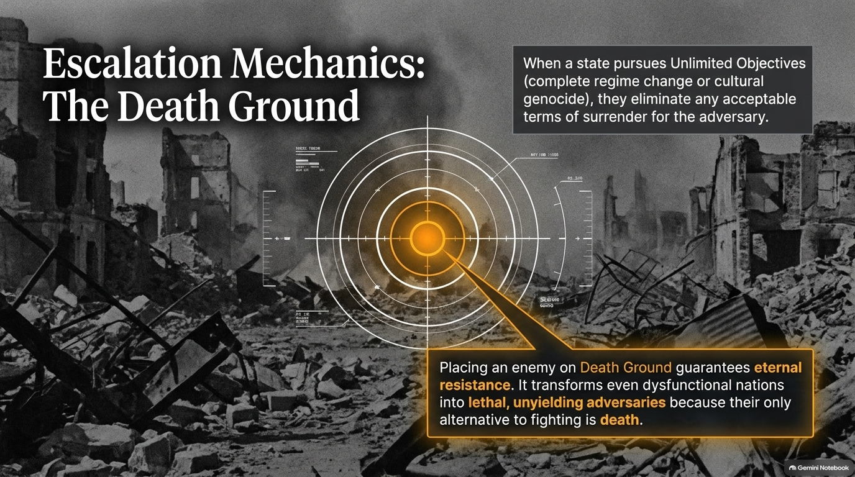
Notes:
Estimated Pacing: 4 – 5 minutes
Key YouTube Reference: [00:17:15] – [00:18:24]
Speaker Script & Notes
"The global system relies on norms, much like traffic rules. There are never enough police officers to enforce order if everyone decides to ignore the rules at once.
When major powers begin violating foundational norms—such as peaceful transfers of power, international borders, or treaty commitments—the broader rules-based system degrades into transactional anarchy."

Slide 8
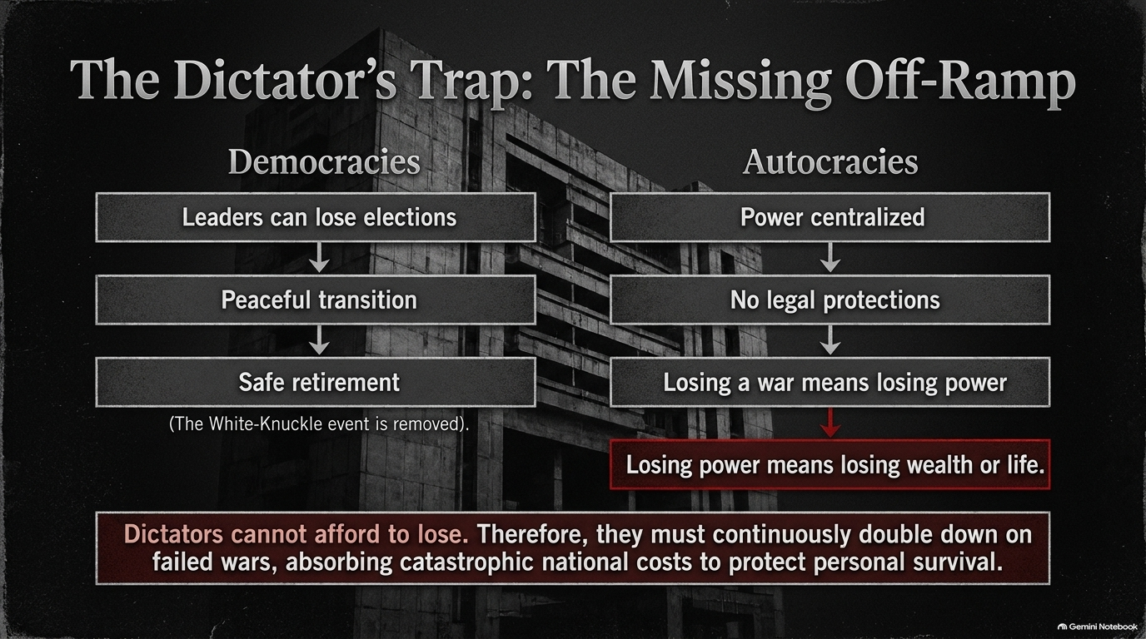
Notes:
Estimated Pacing: 4 – 5 minutes
Key YouTube Reference: [00:18:24] – [00:19:52]
Speaker Script & Notes
"As great powers become unpredictable or aggressive, a key realignment occurs: Middle Power Coalition Building.
Nations outside the traditional superpower alignment—such as the Nordic-Baltic blocs, Canada, and European middle powers—are rapidly building new security arrangements, space ports, and autonomous financial systems to hedge against global volatility."

Slide 9
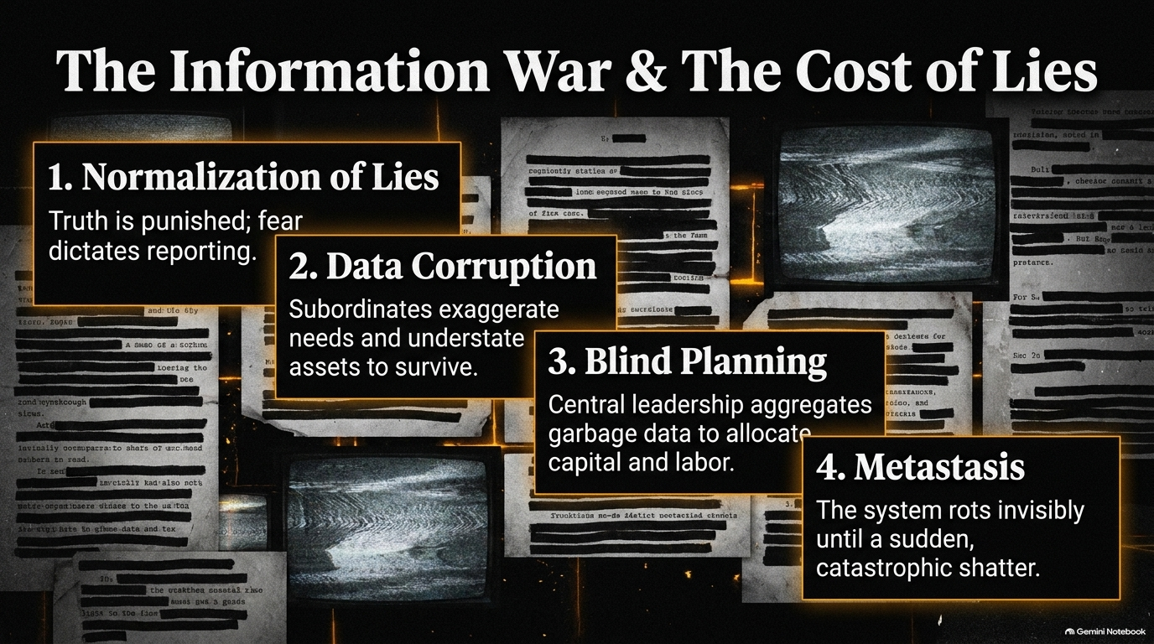
Notes:
Estimated Pacing: 3 – 4 minutes
Key YouTube Reference: [00:36:08] – [00:37:27]
Speaker Script & Notes
"Economic statecraft acts as a form of strategic chemotherapy.
Sanctions depress adversary economic growth over decades while keeping allied wealth compounding.
Direct Warfare immediately torches capital and destabilizes global markets.
Even small differentials in economic growth compound significantly over 20 to 50 years, making steady economic containment far more effective than abrupt military action."

Slide 10
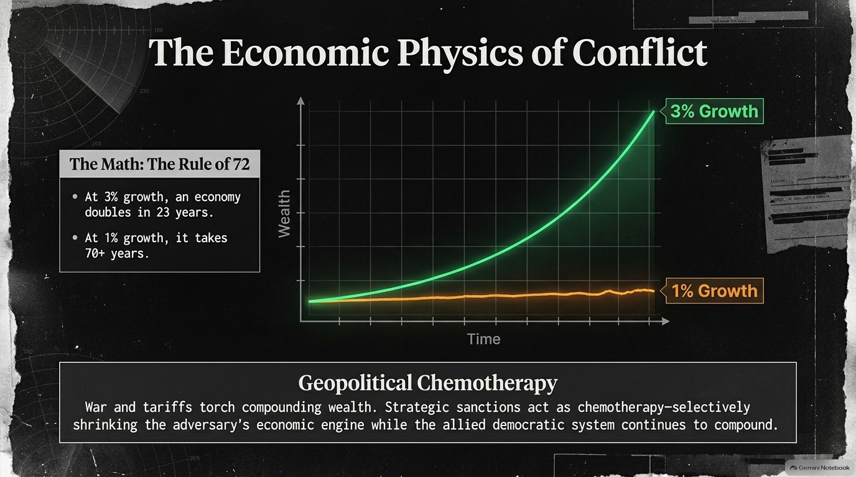
Notes:
Estimated Pacing: 4 – 5 minutes
Key YouTube Reference: [00:21:20] – [00:25:21]
Speaker Script & Notes
"Warfare sits on a spectrum ranging from Limited Objectives (border adjustments, diplomatic concessions) to Unlimited Objectives (regime change, territorial erasure, or genocide).
When an aggressor pursues unlimited objectives, it places the defender on Death Ground. On death ground, the defending population has no choice but to fight to the end, turning even a smaller or weaker nation into a formidable adversary."

Slide 11
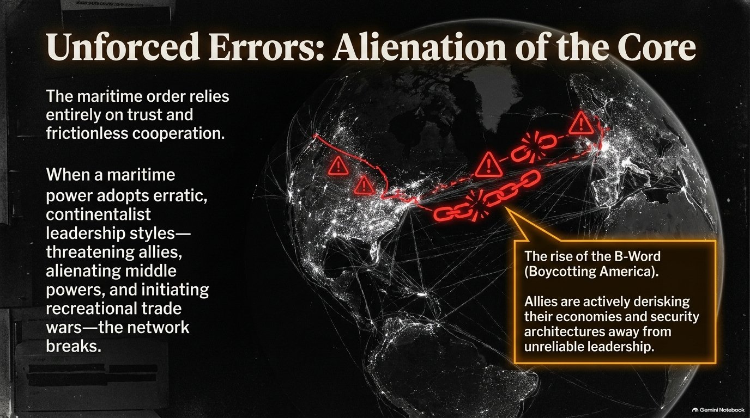
Notes:
Estimated Pacing: 3 – 4 minutes
Key YouTube Reference: [00:37:51] – [00:39:24], [01:32:53] – [01:34:20]
Speaker Script & Notes
"Autocratic regimes face an inherent structural flaw: The Retirement Problem.
In democratic systems, elections allow for leadership change without bloodshed. In personalized dictatorships, stepping down often means imprisonment or death. As a result, authoritarian leaders double down on failing strategies, leaving no institutional mechanism for peaceful succession when they die or fall."

Slide 12
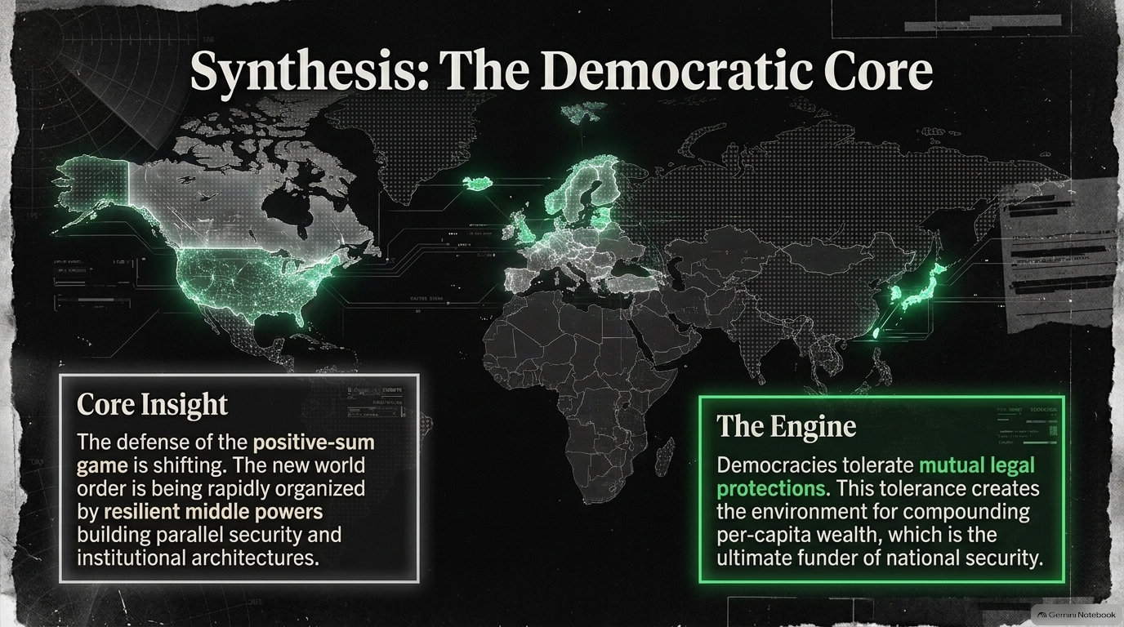
Notes:
Estimated Pacing: 4 – 5 minutes
Key YouTube Reference: [00:40:09] – [00:41:04], [01:29:40] – [01:30:28]
Speaker Script & Notes
"Every dollar spent on prolonged territorial wars carries a massive Opportunity Cost.
Resources diverted into high-risk war efforts drain domestic infrastructure, healthcare, education, and civilian R&D. Over time, state-directed defense spending creates artificial short-term GDP figures while eroding long-term technological competitiveness."

Slide 13
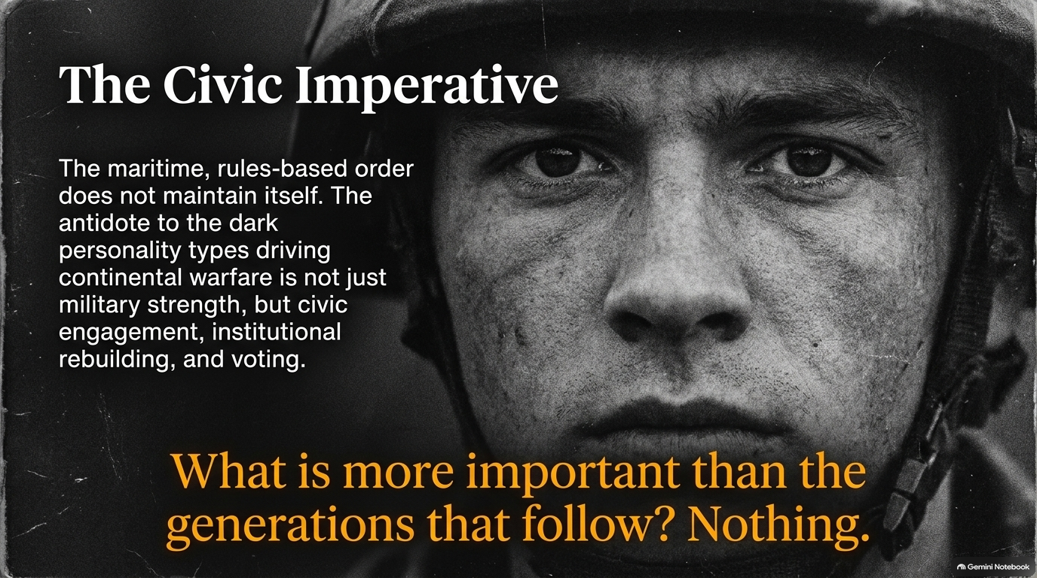
Notes:
Estimated Pacing: 4 – 5 minutes
Key YouTube Reference: [01:13:45] – [01:16:33]
Speaker Script & Notes
"To dissect organizational or military strategy, we must maintain clarity across three distinct levels:
Tactical: Specific tools, units, and localized engagements.
Operational: Campaigns and maneuvers designed to win specific battles.
Strategic: The overarching purpose of the conflict.
A fatal error occurs when leaders excel operationally or tactically while pursuing self-defeating grand strategies."

Slide 14
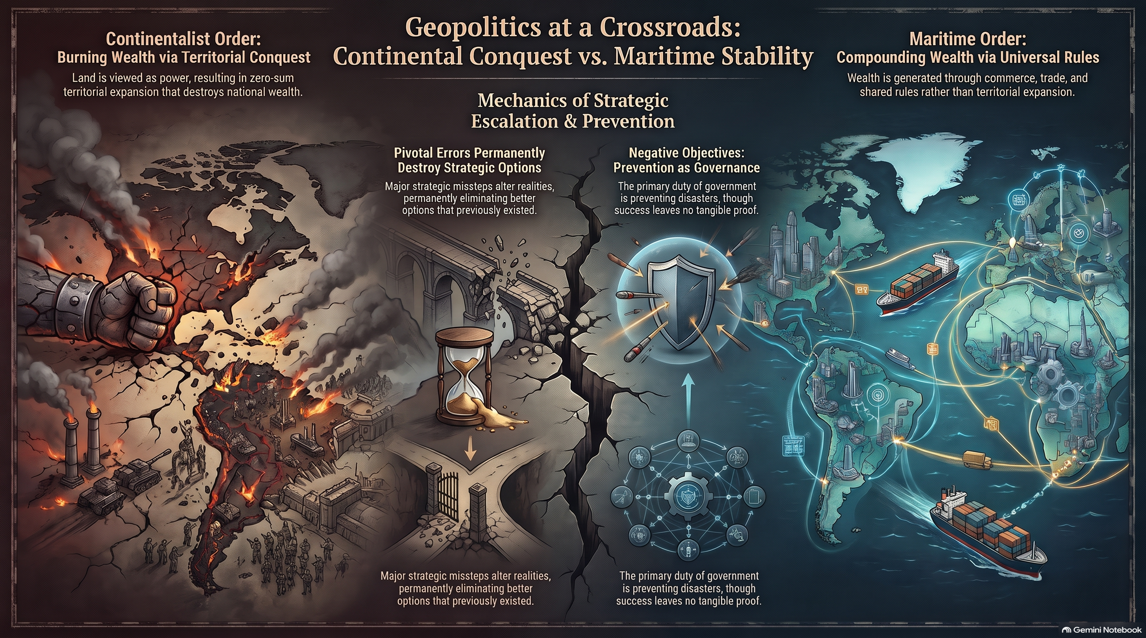
Notes:
Estimated Pacing: 3 – 4 minutes
Key YouTube Reference: [01:36:02] – [01:41:18]
Speaker Script & Notes
"As we look ahead, the preserving element of global security lies in reinforcing positive-sum institutions.
Wars destroy wealth rapidly.
Maritime trade, open standards, civil norms, and democratic rule of law compound human potential.
Safeguarding stability requires active civic participation, clear moral commitments, and building institutional frameworks built for long-term resilience."
Presentation Timing Overview
Slide Range
Theme / Focus Area
Estimated Time
Slides 1 – 4
Geopolitical Frameworks & Objectives
13 – 17 mins
Slides 5 – 8
Strategic Blunders, Norms & Middle Powers
15 – 19 mins
Slides 9 – 11
Economic Warfare & Autocratic Vulnerabilities
10 – 13 mins
Slides 12 – 14
Opportunity Costs, Levels of Strategy & Conclusion
11 – 14 mins
Total
Full Deck Presentation
49 – 63 mins

