Slide 1
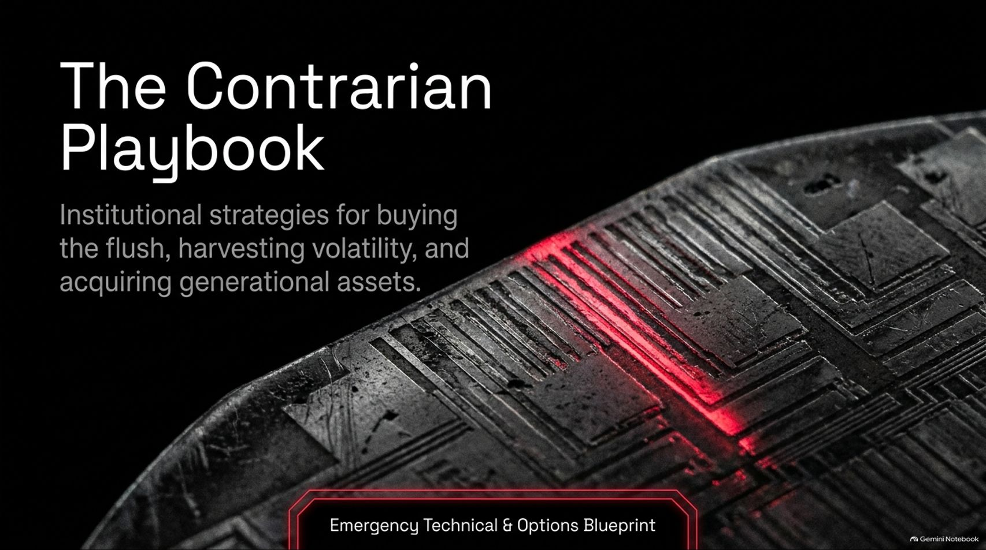
Notes:
Duration Guide: 2 – 3 minutes
Core Presentation Theme: Welcome the audience to the emergency briefing. Introduce the core premise: during periods of intense market panic and political flushes, institutional contrarians do not panic—they harvest volatility, buy the technical washouts, and acquire generational assets at a discount.
Speaker Notes:
"Welcome everyone to this emergency market briefing: 'The Contrarian Playbook: Institutional strategies for buying the flush, harvesting volatility, and acquiring generational assets'."
"Right now, the market is experiencing intense carnage—a massive 40% tech sector drawdown driven by political fear surrounding data center policy."
"Drawing on insights from market experts Josh, Larry Jones, and Trading with Ashley, today we are going to break down why this sell-off is a mechanical fear response rather than a structural failure. We will show you exactly how to separate political noise from corporate fundamentals, harvest elevated volatility, and position your portfolio for the upcoming recovery. Let’s dive in."
Emergency Technical Analysis 🚨 Buying Strategy
https://www.youtube.com/watch?v=0h_e1D6Cm6A

Slide 2
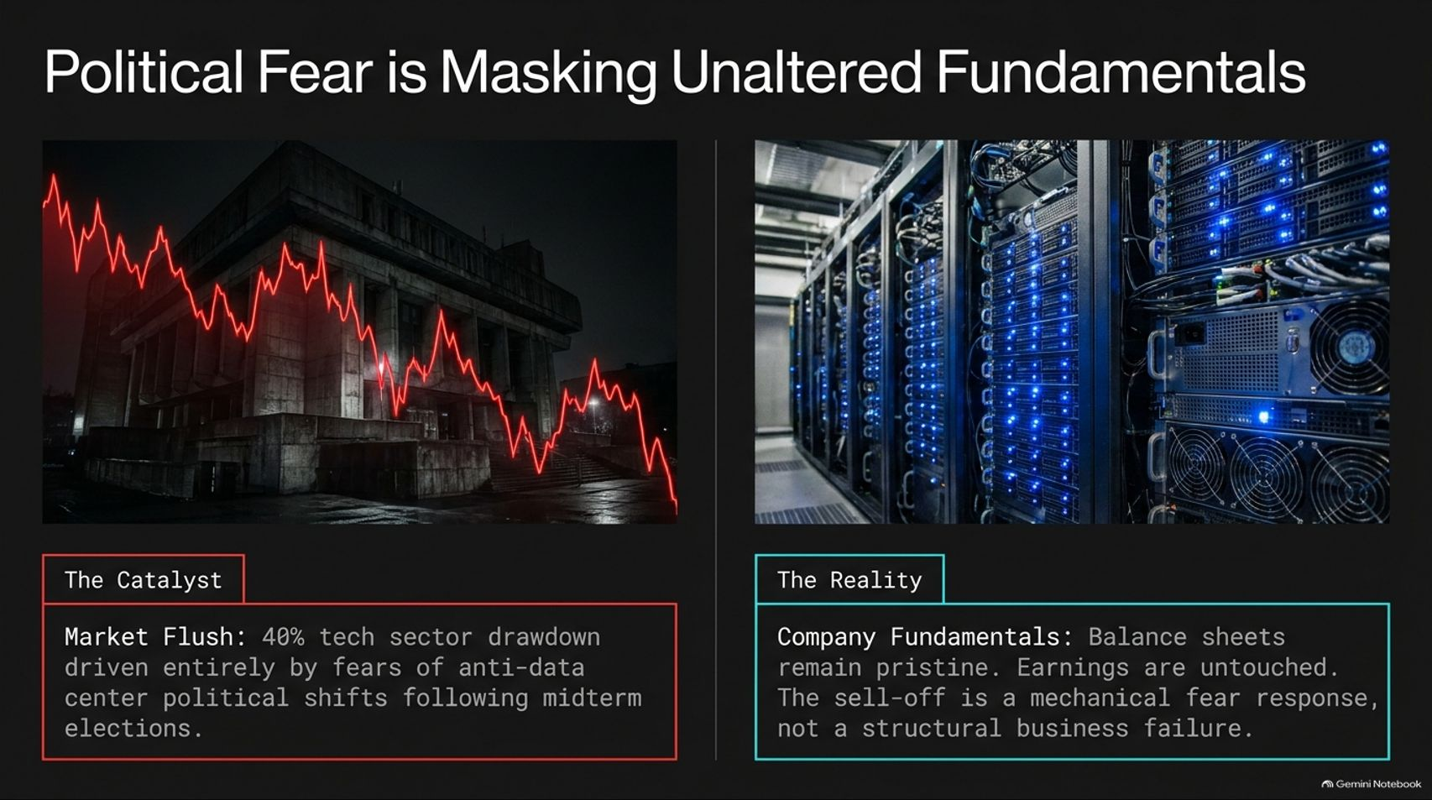
Notes:
Duration Guide: 3 – 5 minutes
Core Presentation Theme: Contrast the catalyst (a 40% tech sector flush driven by midterm political fears over data centers) with the underlying reality (pristine balance sheets, untouched earnings, and a mechanical fear response).
Speaker Notes:
"Let's start by identifying what is actually driving this market collapse. The Catalyst: A brutal 40% drawdown across tech, triggered almost entirely by political anxiety following the midterm elections. Markets panicked over concerns that newly empowered political factions would crack down on data center buildouts."
"The Reality: Company fundamentals remain entirely untouched. Balance sheets are pristine, earnings are exceptional, and cash flows are robust."
"As Larry Jones noted during the emergency broadcast, 'It's carnage in the street, but nothing is wrong with these companies. This sell-off is a mechanical fear response, not a structural business failure'."

Slide 3
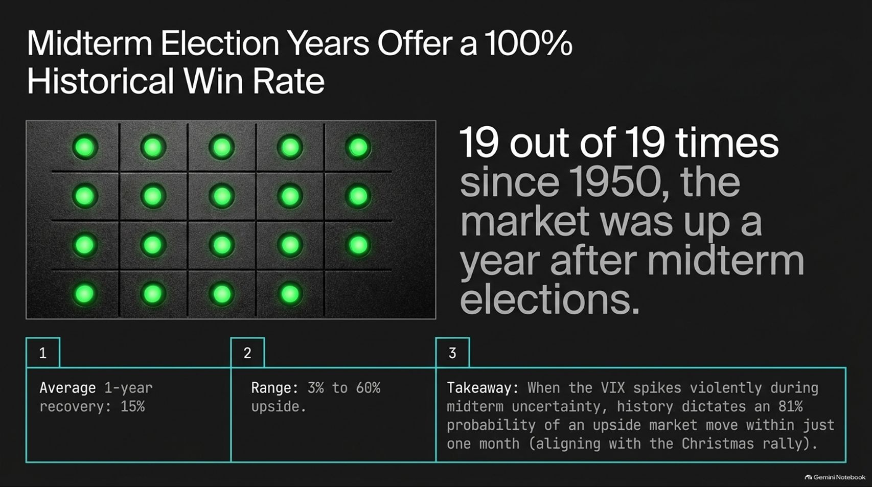
Notes:
Duration Guide: 4 – 5 minutes
Core Presentation Theme: Highlight the staggering statistical edge of midterm election years: 19 out of 19 times since 1950, the market was higher one year later, with an 81% probability of an upside move within one month.
Speaker Notes:
"When retail investors panic, historians and statisticians look at the data. Look at the powerful statistic on screen: 19 out of 19 times since 1950, the market was higher one year after midterm elections. That is a 100% historical win rate."
"The average 1-year recovery is 15%, with a historical upside range spanning 3% to 60%."
"Furthermore, when the VIX spikes violently during midterm uncertainty, history dictates an 81% probability of an explosive upside market move within just one month—aligning perfectly with the seasonal Christmas rally. Fear creates opportunity."

Slide 4
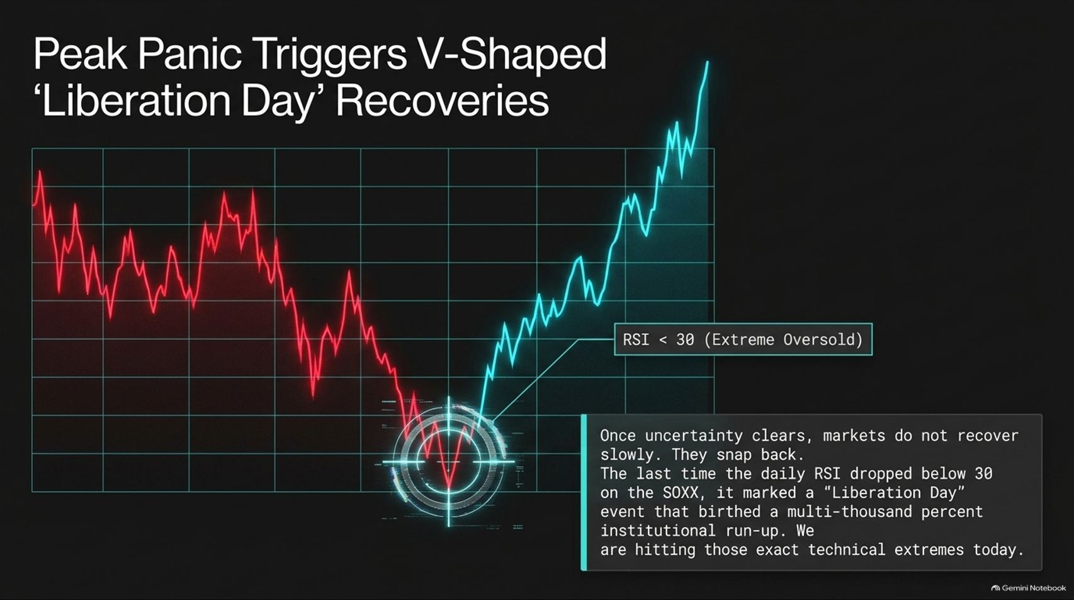
Notes:
Duration Guide: 4 – 5 minutes
Core Presentation Theme: Analyze historical technical extremes (daily RSI dropping below 30 on semiconductor ETFs like SOXX) and how peak panic during "Liberation Day" events always gives way to explosive V-shaped recoveries.
Speaker Notes:
"Once uncertainty clears, markets do not recover slowly—they snap back violently in V-shaped recoveries."
"Look at the technical setup: When extreme selling pushes the daily RSI below 30 into deeply oversold territory, it mirrors past historical turning points."
"As Josh highlighted in the emergency briefing, the last time the daily RSI dropped below 30 on the semiconductor sector (SOXX), it marked a 'Liberation Day' event that birthed a multi-thousand percent institutional run-up. We are hitting those exact technical extremes right now."

Slide 5
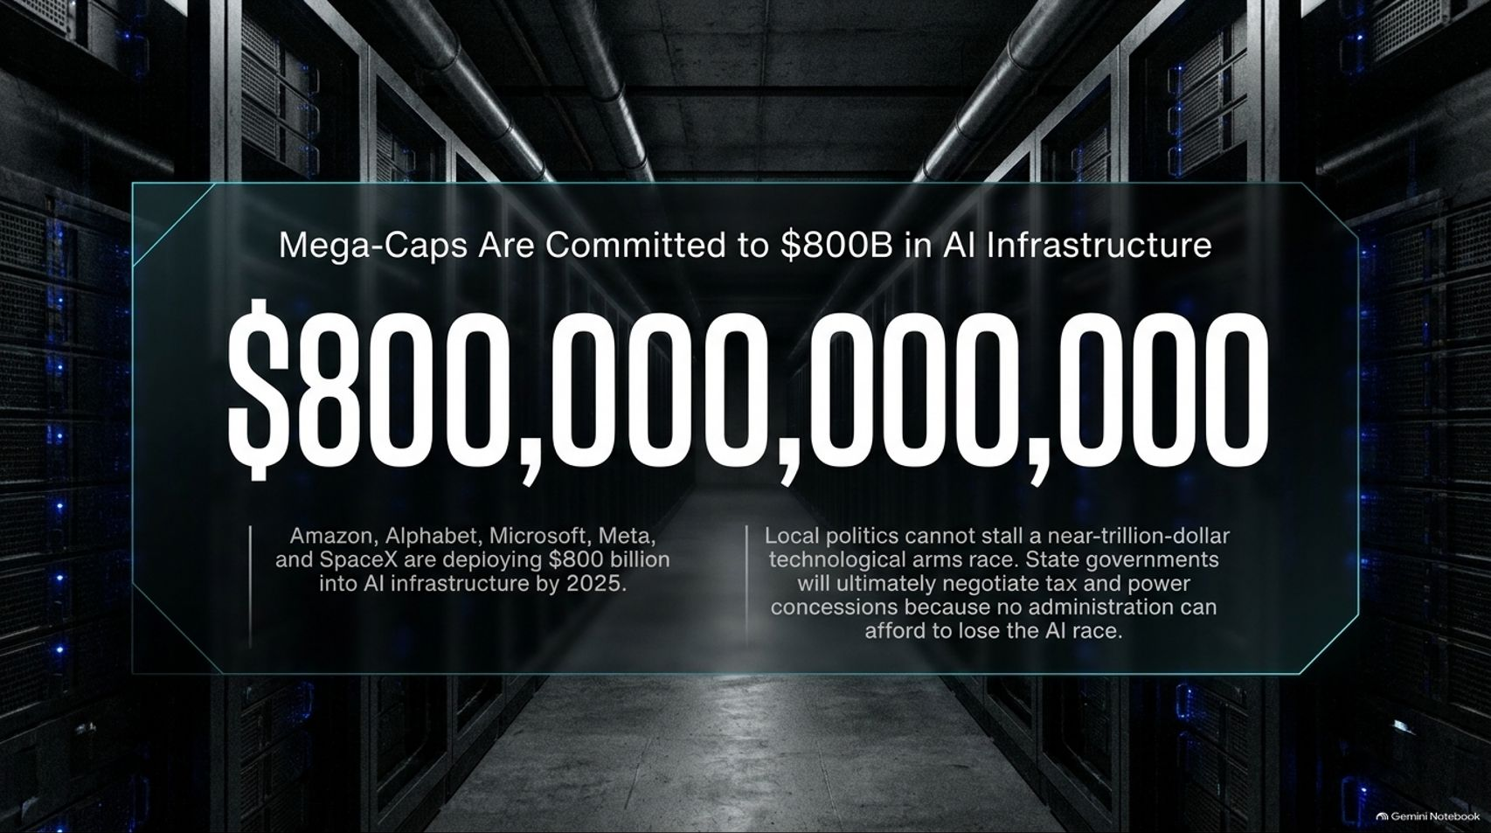
Notes:
Duration Guide: 4 – 5 minutes
Core Presentation Theme: Prove that local politics cannot derail a near-trillion-dollar technological arms race, with Amazon, Alphabet, Microsoft, Meta, and SpaceX deploying $800B into AI infrastructure by 2025.
Speaker Notes:
"Why can local political noise not kill the AI trade? Because the sheer capital commitment is too massive."
"Amazon, Alphabet, Microsoft, Meta, and SpaceX are actively deploying $800 billion into AI and data center infrastructure."
"Local politics cannot stall a near-trillion-dollar technological arms race. State governments will ultimately negotiate tax and power concessions because no administration can afford to lose the global AI race. Once the political theater settles, the capital deployment resumes at full speed."

Slide 6
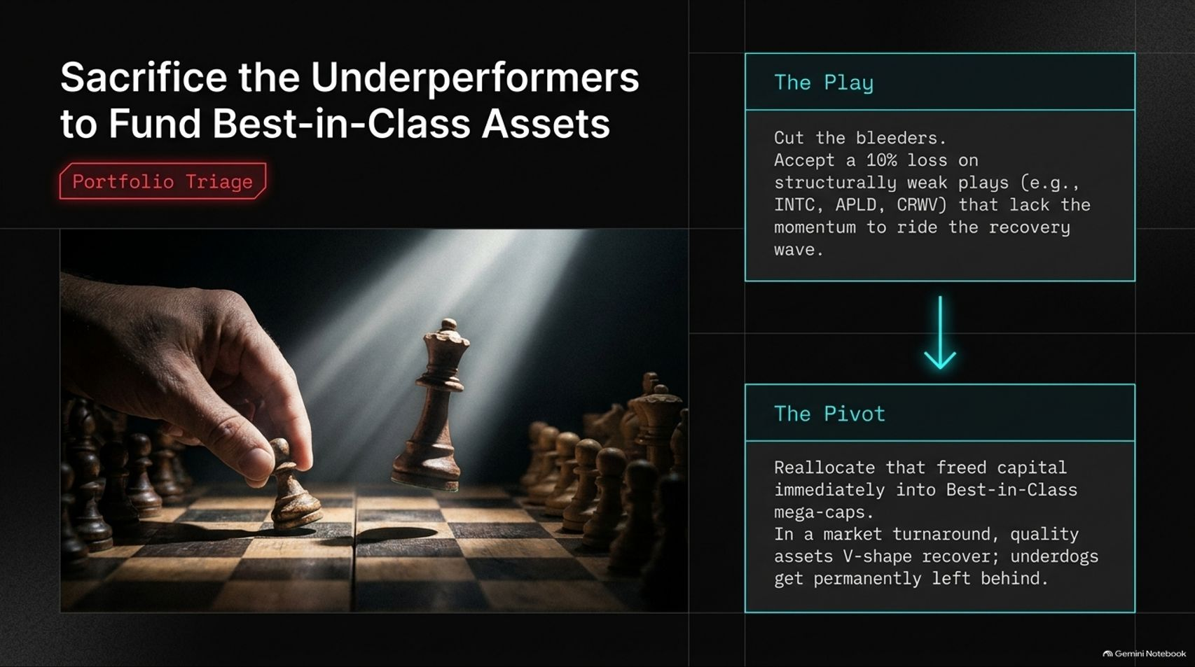
Notes:
Duration Guide: 4 – 5 minutes
Core Presentation Theme: Outline portfolio triage: accept small losses on structurally weak underperforming plays (e.g., INTC, APLD, CRWV) and pivot that freed capital immediately into best-in-class mega-caps.
Speaker Notes:
"In a severe market flush, portfolio triage is mandatory. You must act like a grandmaster playing chess."
"The Play: Cut the bleeders. Accept a 10% loss on structurally weak speculative plays (such as INTC, APLD, or CRWV) that lack the fundamental momentum to lead the recovery wave."
"The Pivot: Reallocate that freed capital immediately into Best-in-Class mega-caps. In a market turnaround, quality assets V-shape recover aggressively, while underperforming speculative underdogs get permanently left behind."

Slide 7
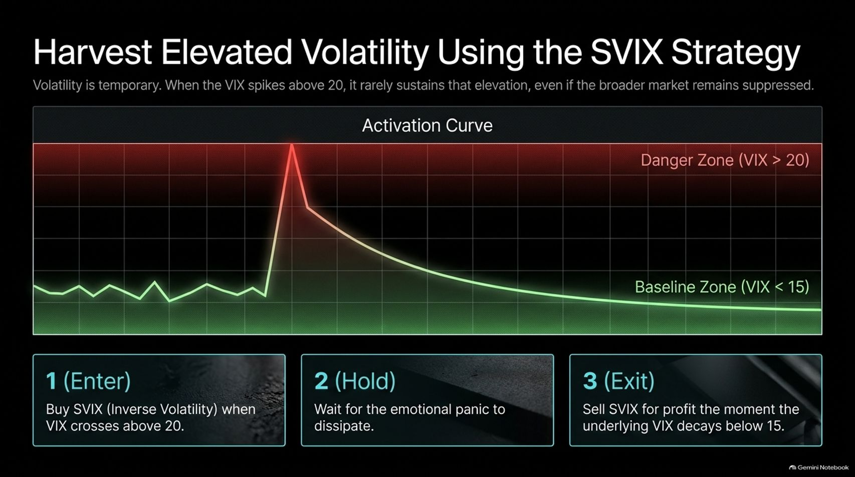
Notes:
Duration Guide: 4 – 5 minutes
Core Presentation Theme: Detail Trading with Ashley's proven volatility-harvesting strategy: buying the inverse volatility ETF (SVIX) when the VIX spikes above 20, and selling for profit once the VIX decays back below 15.
Speaker Notes:
"Volatility is temporary. When fear peaks and the VIX spikes above 20, it rarely sustains that elevation, even if the broader market remains suppressed."
"1. Enter: Buy the inverse volatility product (SVIX) when the VIX crosses above 20."
"2. Hold: Wait for the emotional panic to dissipate."
"3. Exit: Sell SVIX for profit the moment the underlying VIX decays back below 15. As Trading with Ashley emphasized, this is one of the most reliable swing-trading strategies for monetizing elevated market fear."

Slide 8
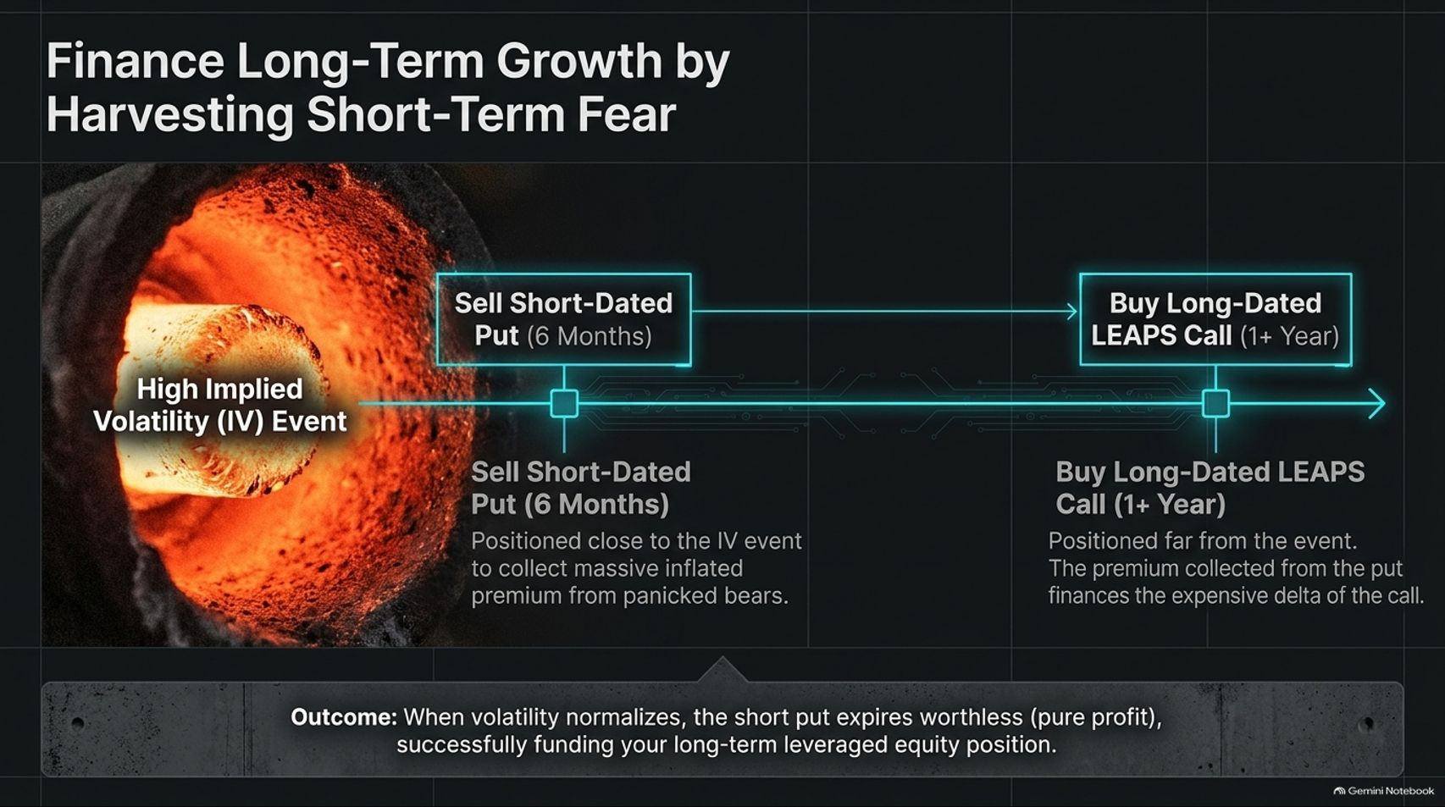
Notes:
Duration Guide: 4 – 5 minutes
Core Presentation Theme: Explain the advanced options collar strategy: selling short-dated 6-month puts during high IV events to collect massive inflated premiums, using that cash to finance long-dated LEAPS calls (1+ year out).
Speaker Notes:
"How do you finance long-term growth during high-fear events without breaking the bank? By using options structure."
"When implied volatility (IV) spikes, option premiums become heavily inflated."
"Sell Short-Dated Puts (6 Months): Positioned close to the IV event to collect massive premium from panicked bears."
"Buy Long-Dated LEAPS Calls (1+ Year): Positioned far out in time, financed entirely by the put premium collected."
"Outcome: When volatility normalizes, the short put expires worthless (pure profit), successfully funding your long-term leveraged equity position."

Slide 9
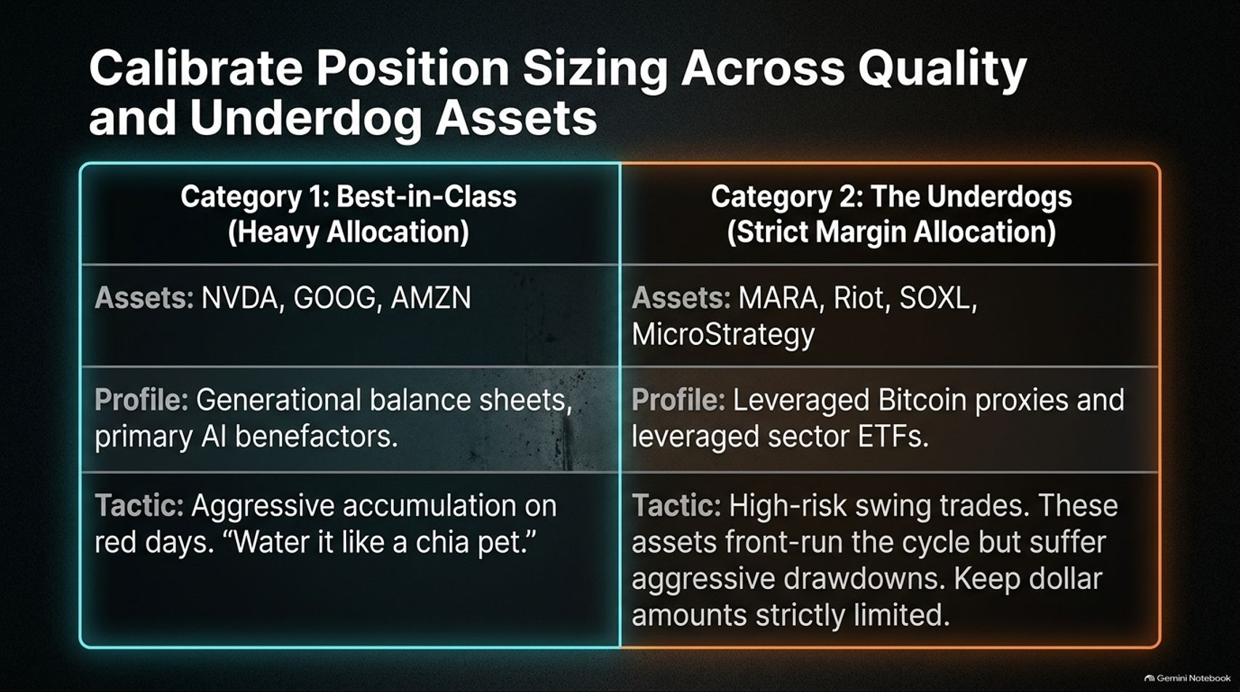
Notes:
Duration Guide: 4 – 5 minutes
Core Presentation Theme: Differentiate portfolio allocations: heavy accumulation on red days for Best-in-Class anchors (NVDA, GOOG, AMZN), versus strict margin and dollar limits for high-risk underdog swing trades (MARA, SOXL, MSTR).
Speaker Notes:
"Position sizing is everything during a washout. We divide assets into two distinct categories."
"Category 1: Best-in-Class (Heavy Allocation): Assets like NVDA, GOOG, and AMZN. They feature generational balance sheets and primary AI tailwinds. The tactic is aggressive accumulation on red days—'water it like a chia pet'."
"Category 2: The Underdogs (Strict Margin Allocation): Assets like MARA, Riot, SOXL, and MicroStrategy. These are leveraged Bitcoin proxies and sector ETFs. While they front-run the cycle, they suffer brutal drawdowns. Keep dollar allocations strictly limited."

Slide 10
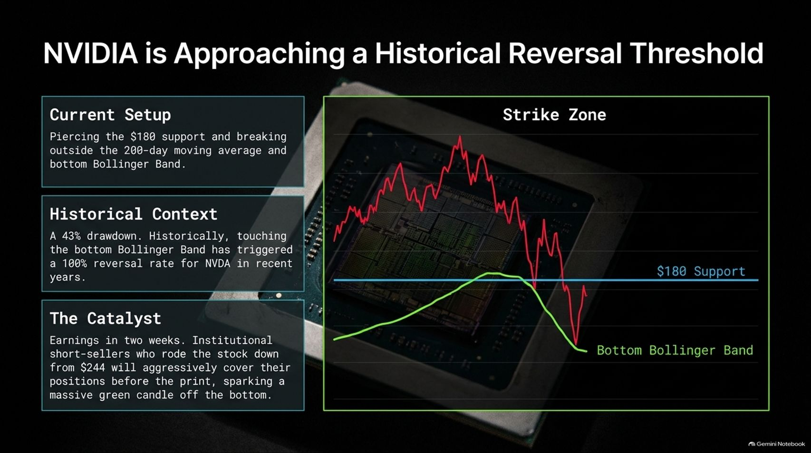
Notes:
Duration Guide: 4 – 5 minutes
Core Presentation Theme: Analyze NVDA's technical setup: piercing $180 support, breaking outside the 200-day moving average and bottom Bollinger Band, and setting up for an institutional short-covering squeeze ahead of earnings.
Speaker Notes:
"Let's look at the crown jewel of AI: NVIDIA."
"Current Setup: NVDA is testing the $180 support level, piercing outside the 200-day moving average and bottom Bollinger Band following a 43% drawdown."
"Historical Context: Historically, touching the bottom Bollinger Band triggers a 100% reversal rate for NVDA in recent years."
"The Catalyst: Earnings arrive in two weeks. Institutional short-sellers who rode the stock down from $244 will aggressively cover their positions before the print, sparking a massive green recovery candle off the bottom."

Slide 11
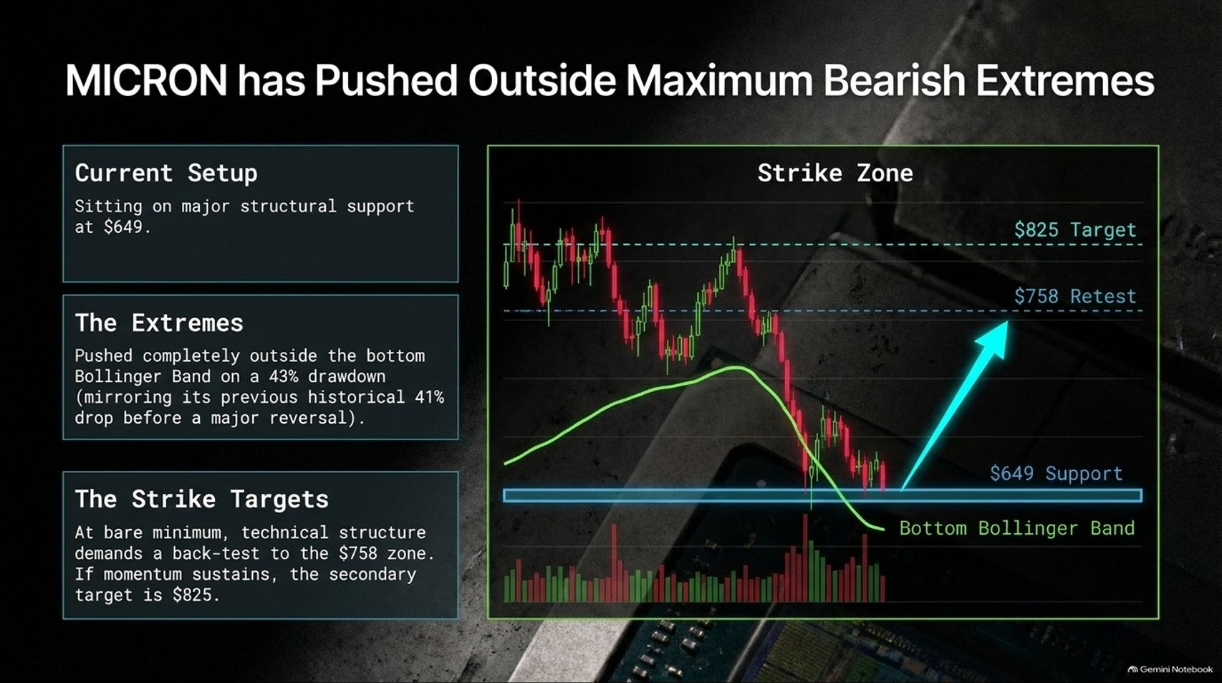
Notes:
Duration Guide: 4 – 5 minutes
Core Presentation Theme: Examine Micron (MU) sitting on major structural support at $649, trading outside the bottom Bollinger Band on a 43% drawdown, with a primary retracement target of $758 and secondary target at $825.
Speaker Notes:
"Turning to memory leader Micron (MU):"
"Current Setup: MU is sitting directly on major structural support at $649."
"The Extremes: Price has pushed completely outside the bottom Bollinger Band on a 43% drawdown, mirroring its previous historical 40%+ drop before a major reversal."
"The Strike Targets: At bare minimum, technical structure demands a back-test to the $758 zone. If momentum sustains post-earnings, the secondary target extends to $825."

Slide 12
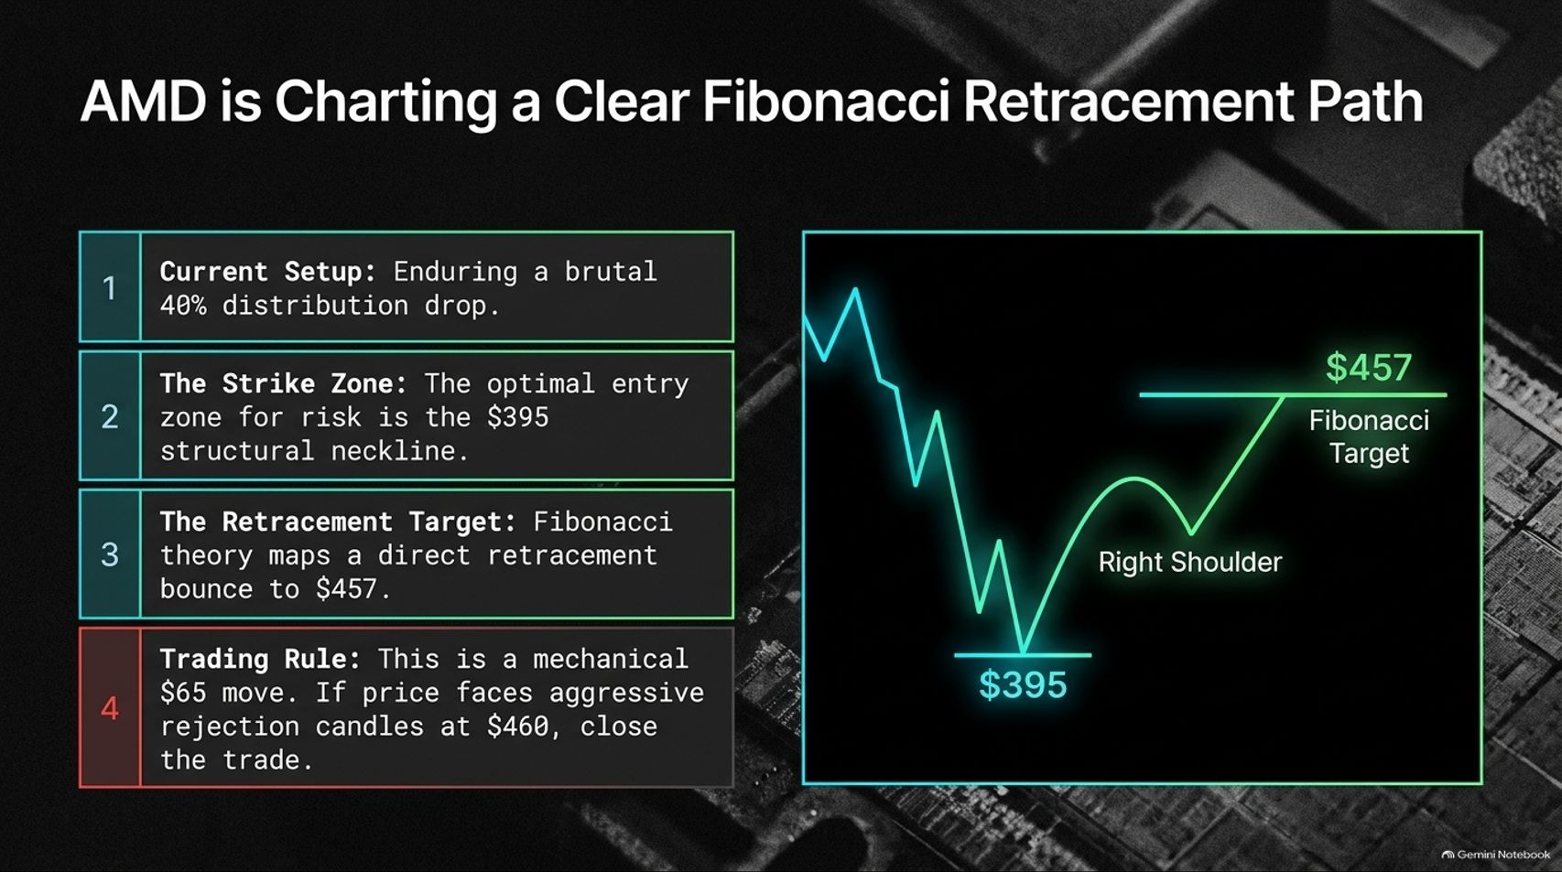
Notes:
Duration Guide: 4 – 5 minutes
Core Presentation Theme: Map AMD's technical recovery path: enduring a 40% distribution drop to the $395 structural neckline, with Fibonacci theory mapping a direct retrenchment bounce to $457.
Speaker Notes:
"Advanced Micro Devices (AMD) is presenting a textbook technical trade."
"1. Current Setup: Enduring a brutal 40% distribution drop."
"2. The Strike Zone: The optimal entry zone for risk is the $395 structural neckline."
"3. The Retracement Target: Fibonacci theory maps a direct retracement bounce to $457."
"4. Trading Rule: This is a mechanical $65 move. Set strict risk parameters—if price faces aggressive rejection candles at $460, close the trade."

Slide 13
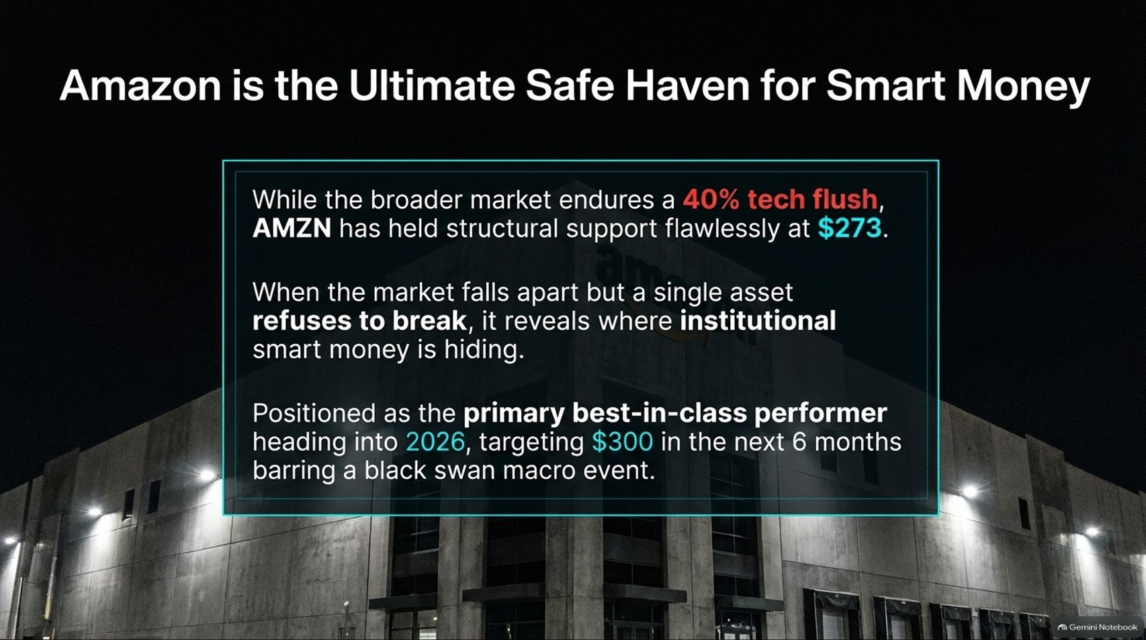
Notes:
Duration Guide: 4 – 5 minutes
Core Presentation Theme: Highlight Amazon (AMZN) outperforming the broader tech flush by flawlessly holding structural support at $273, proving institutional smart money accumulation and targeting $300 in the next 6 months.
Speaker Notes:
"While the broader tech sector endured a punishing 40% flush, Amazon (AMZN) proved why it is the ultimate safe haven."
"AMZN has held structural support flawlessly at $273. When the market falls apart but a single tier-1 asset refuses to break, it reveals where institutional smart money is hiding."
"Positioned as a primary best-in-class performer heading into 2026, AMZN is targeting $300 in the next 6 months barring a black swan macro event."

Slide 14
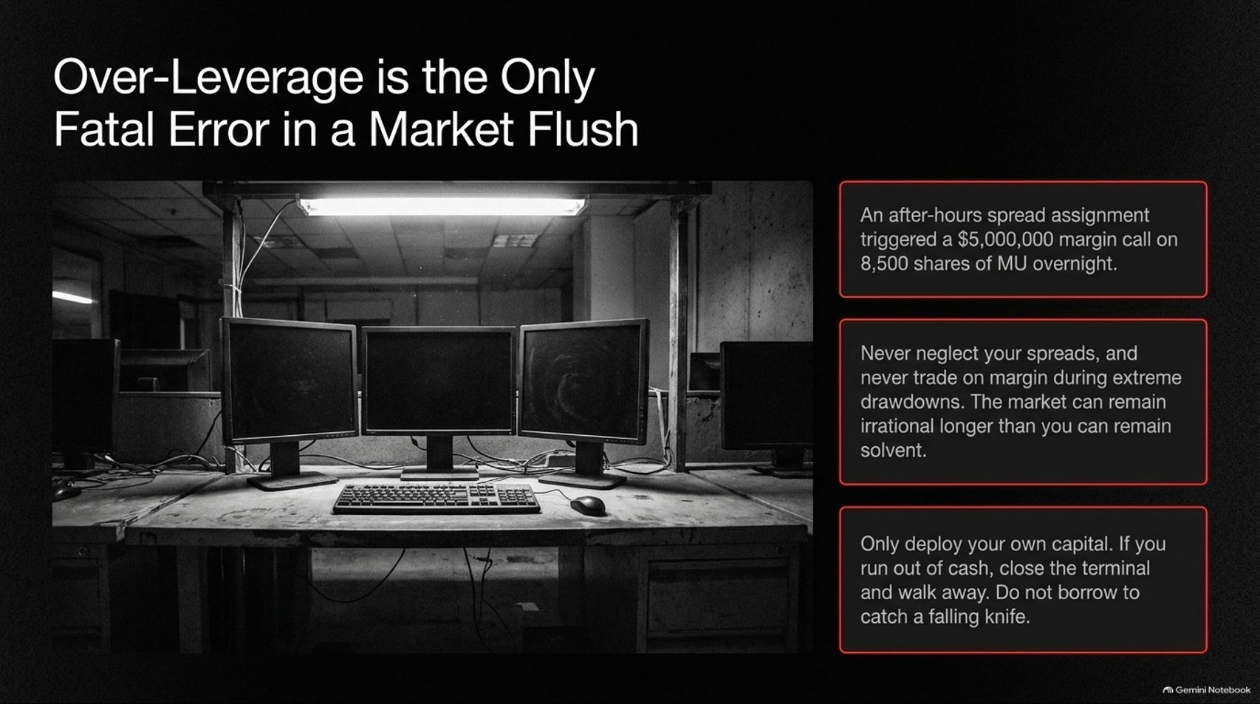
Notes:
Duration Guide: 4 – 5 minutes
Core Presentation Theme: Issue a vital risk-management warning against margin trading during extreme drawdowns, referencing real-world lessons on spread assignments and the golden rule: never borrow to catch a falling knife.
Speaker Notes:
"As Trading with Ashley candidly shared during the broadcast regarding her harrowing $5 million after-hours margin call on MU options, over-leverage is the only fatal error in a market flush."
"Never neglect your spreads, and never trade on margin during extreme market drawdowns. As the old saying goes, the market can remain irrational longer than you can remain solvent."
"Only deploy your own capital. If you run out of cash, close the terminal, step away, and take a breath. Do not borrow to catch a falling knife."

Slide 15
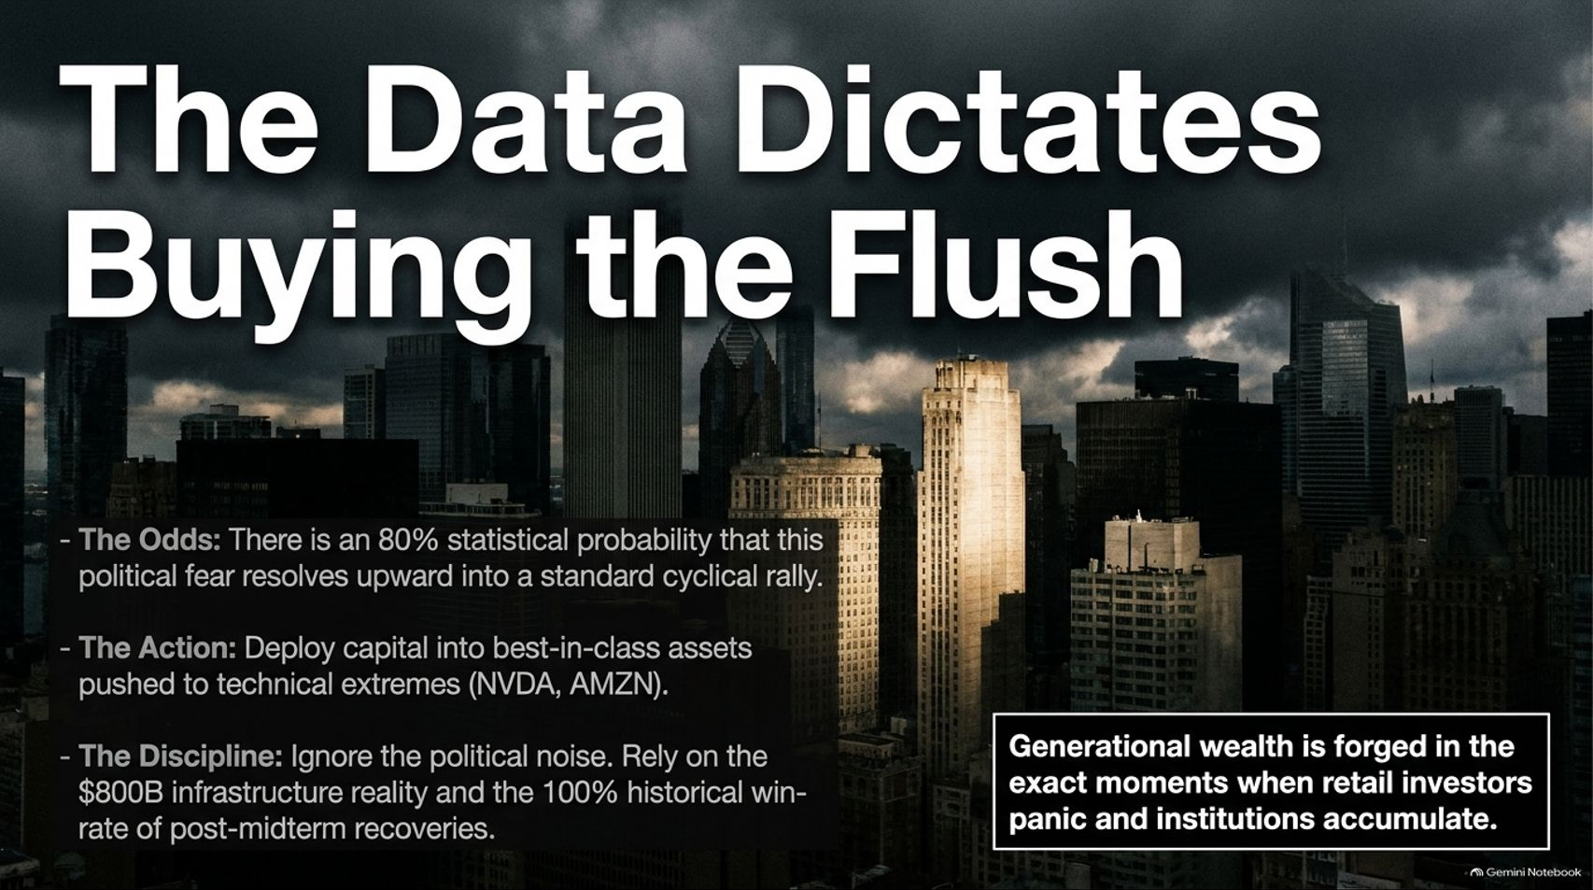
Notes:
Duration Guide: 4 – 5 minutes
Core Presentation Theme: Synthesize the core thesis: an 80% statistical probability that political fear resolves upward, backed by the $800B infrastructure reality and a 100% historical post-midterm win rate.
Speaker Notes:
"Let's synthesize the data dictating our contrarian playbook:"
"The Odds: There is an 80% statistical probability that this political data center fear resolves upward into a standard cyclical rally."
"The Action: Deploy capital into best-in-class assets pushed to extreme technical lows (NVDA, AMZN, MU)."
"The Discipline: Ignore the political noise. Rely on the $800B infrastructure reality and the 100% historical win-rate of post-midterm recoveries."
"Remember: Generational wealth is forged in the exact moments when retail investors panic and institutions accumulate."

Slide 16
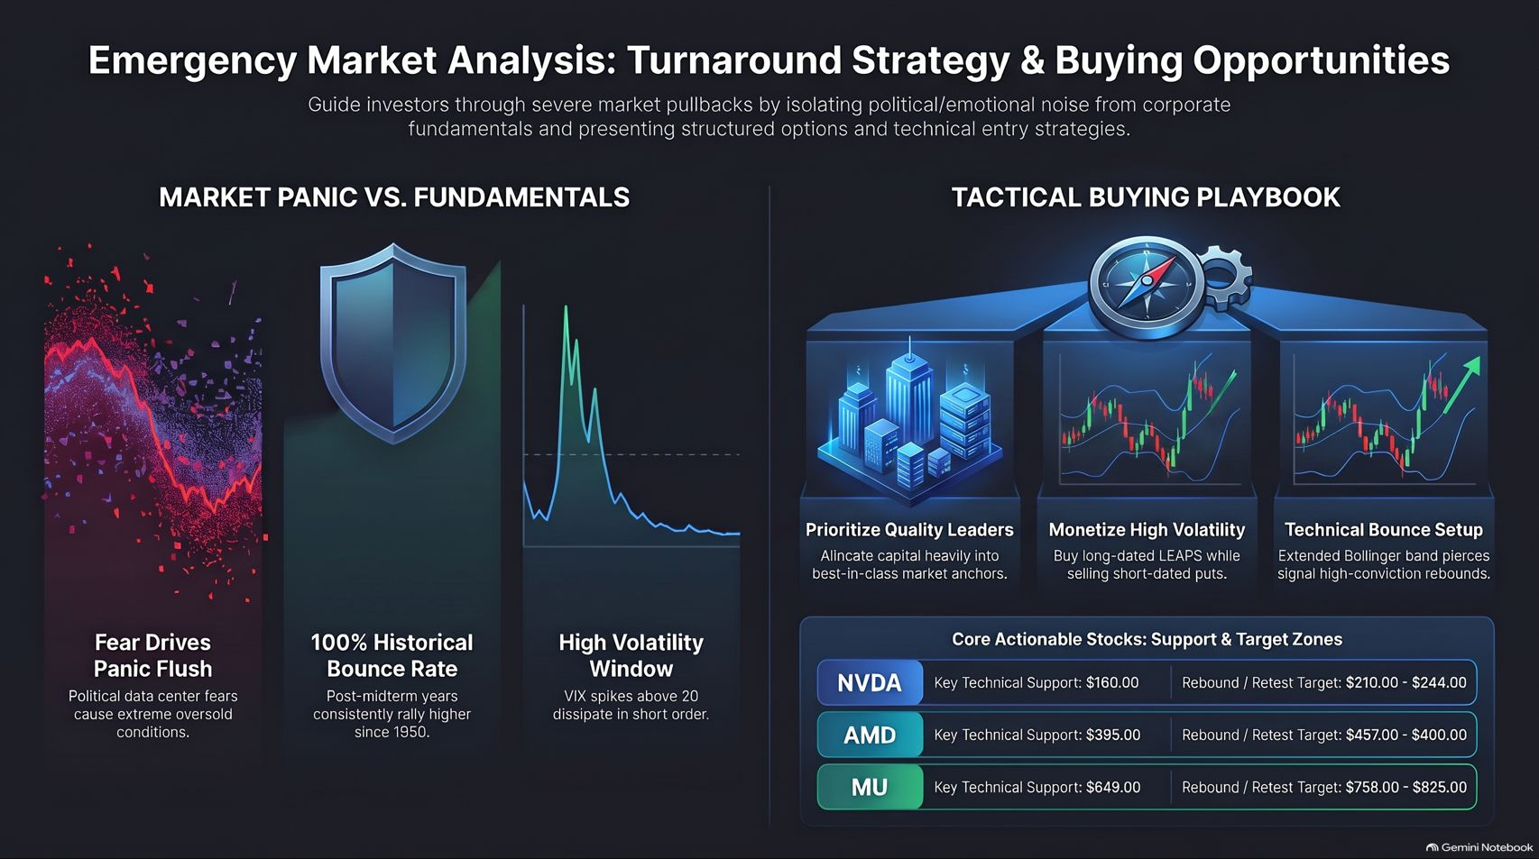
Notes:
Duration Guide: 3 – 5 minutes
Core Presentation Theme: Provide a comprehensive visual reference summary connecting market panic vs. fundamentals, tactical options/volatility strategies, and core actionable support/target zones for NVDA, AMD, and MU.
Speaker Notes:
"Let's use this final summary slide as your ultimate reference sheet for navigating the contrarian playbook."
"On the left, remember the core disconnect: fear drives panic flushes, but history dictates a 100% bounce rate following midterm years as VIX volatility spikes above 20 and quickly dissipates."
"On the right, execute your tactical playbook: prioritize quality leaders, monetize high volatility via SVIX or LEAPS collars, and target key technical support zones ($160 for NVDA, $395 for AMD, $649 for MU)."
"Stay disciplined, manage your leverage, and buy the flush. Thank you for watching!"

