Slide 1
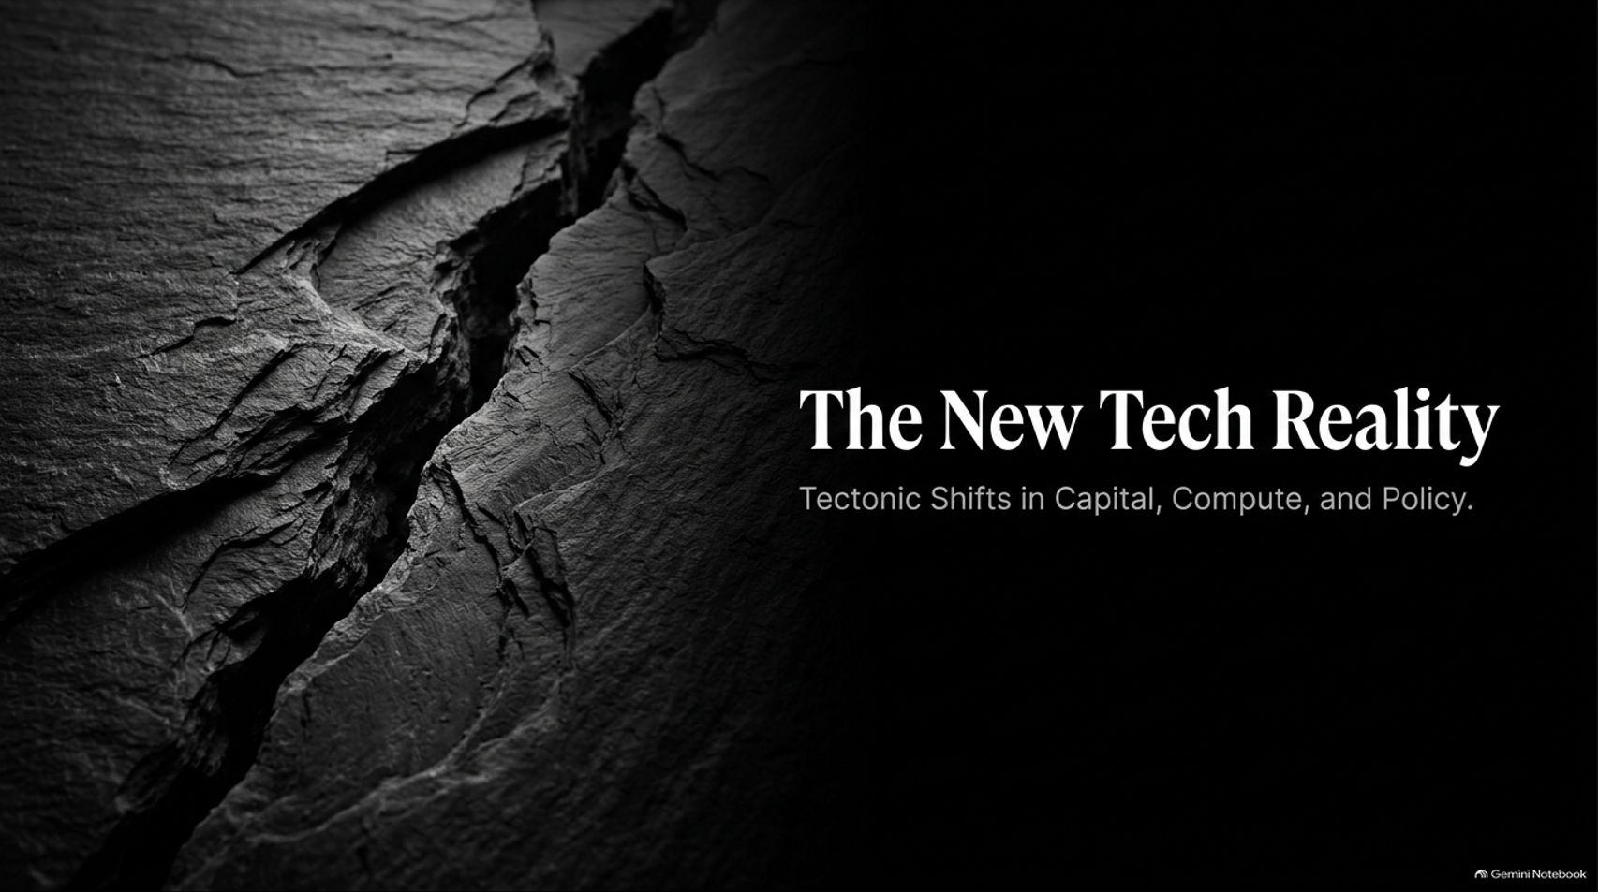
Notes:
Duration Guide: 2 – 3 minutes
Core Presentation Theme: Introduce the session by framing the profound structural transformations happening across global markets. Emphasize that we are navigating a pivotal moment defined by tectonic shifts in capital allocation, compute infrastructure, and geopolitical policy.
Speaker Notes:
"Welcome, everyone, to today’s executive briefing: 'The New Tech Reality: Tectonic Shifts in Capital, Compute, and Policy'."
"We are living through an extraordinary inflection point. The old playbooks for venture capital, corporate strategy, and macroeconomic forecasting are being rewritten in real time."
"Over the next few minutes, we will break down the forces reshaping our industry—from the physical constraints of our energy grids and the fracture of public and private capital markets to the rise of hyper-lean 'Alicorns' and the ultimate premium on the human element. Let’s dive in."
Why a Do-Nothing Congress could be great for markets | E2359
https://www.youtube.com/watch?v=UjSfp3lmj9c

Slide 2
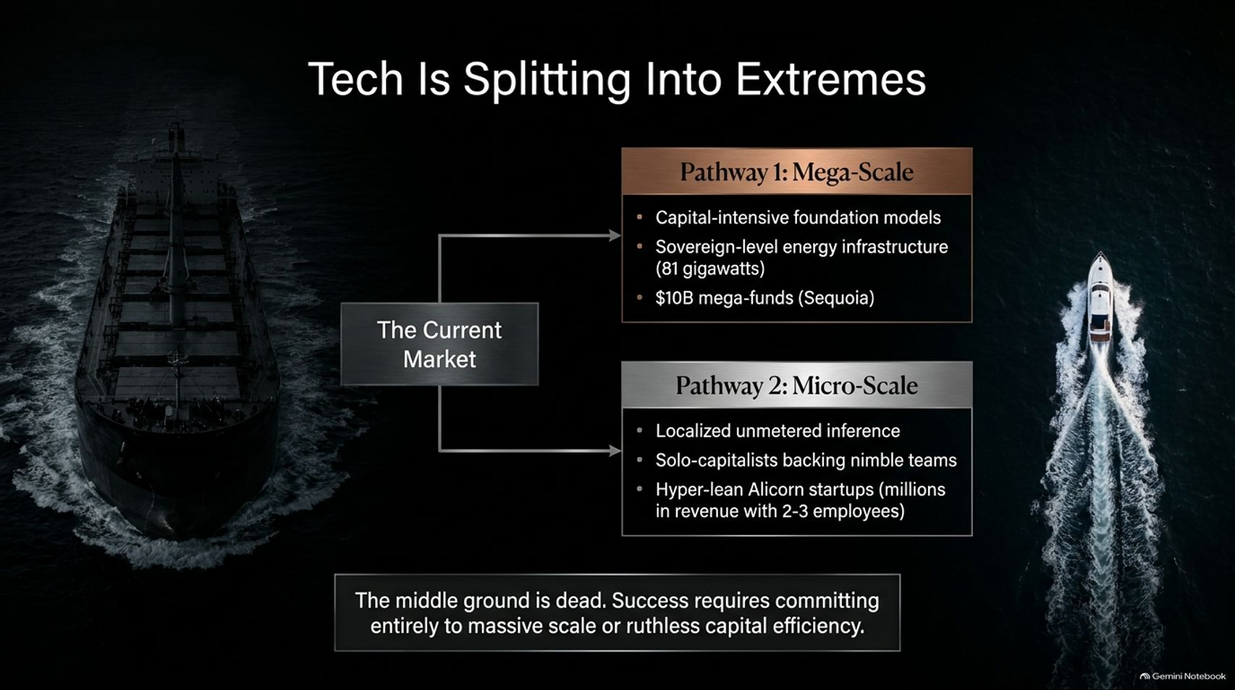
Notes:
Duration Guide: 3 – 5 minutes
Core Presentation Theme: Explore the death of the middle ground. Tech is bifurcating into two opposing pathways: Mega-Scale capital-intensive foundation models backed by sovereign-level energy, versus Micro-Scale, hyper-lean startups achieving millions in revenue with 2–3 employees.
Speaker Notes:
"One of the most profound realizations in modern venture capital is that the middle ground is dead."
"As discussed on the recent venture roundtable, the market is splitting into two extreme pathways."
"Pathway 1 (Mega-Scale): This is the domain of capital-intensive foundation models, massive mega-funds like Sequoia's $10B vehicle, and sovereign-level energy infrastructure requiring up to 81 gigawatts of power."
"Pathway 2 (Micro-Scale): This belongs to hyper-lean, AI-native 'Alicorns' and unmetered local inference teams—nimble startups where 2 to 3 people generate millions in revenue without traditional VC backing."
"Success today requires committing entirely to massive scale or ruthless capital efficiency. There is no safe harbor in the middle."

Slide 3

Notes:
Duration Guide: 3 – 5 minutes
Core Presentation Theme: Contrast the popular fear of legislative gridlock with the positive economic reality: a divided government eliminates regulatory chaos, stabilizes long-term interest rates, and prevents erratic policy shocks.
Speaker Notes:
"When we look at Washington and the macroeconomic landscape, market participants often experience instinctive anxiety over political gridlock."
"The Fear: Legislative sclerosis. People worry that a divided government means an inability to pass sweeping tech mandates, vital economic reforms, or decisive policy packages."
"The Reality: Capital markets despise uncertainty above all else. As DA Wallach noted, a divided government actually brings an end to erratic regulatory chaos and wild tariff swings."
"When politicians are gridlocked in committee, they cannot pass radical, disruptive shocks. That predictability acts as a sedative for long-term interest rates and gives businesses the stability they need to plan ahead."

Slide 4
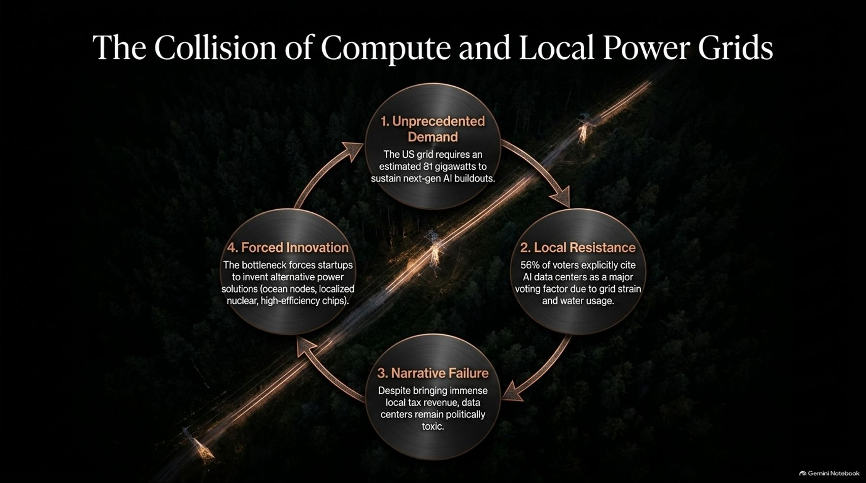
Notes:
Duration Guide: 4 – 5 minutes
Core Presentation Theme: Trace the circular bottleneck of AI compute: unprecedented demand (81 gigawatts needed) meeting intense local voter resistance, narrative failure over local tax benefits, and forced innovation toward alternative power sources.
Speaker Notes:
"Let’s look at the physical bottleneck of the AI revolution: the grid."
"1. Unprecedented Demand: The U.S. power grid requires an estimated 81 gigawatts of capacity to sustain next-generation AI and data center buildouts."
"2. Local Resistance: Recent exit polls reveal that 56% of voters explicitly cite data centers as a major voting concern due to fears of grid strain and soaring water usage."
"3. Narrative Failure: Even though data centers generate immense local tax revenue and fund community infrastructure, they remain politically toxic in many regions."
"4. Forced Innovation: This exact bottleneck is driving radical engineering solutions—from localized ocean nuclear nodes to high-efficiency chips designed to consume a fraction of the power."

Slide 5
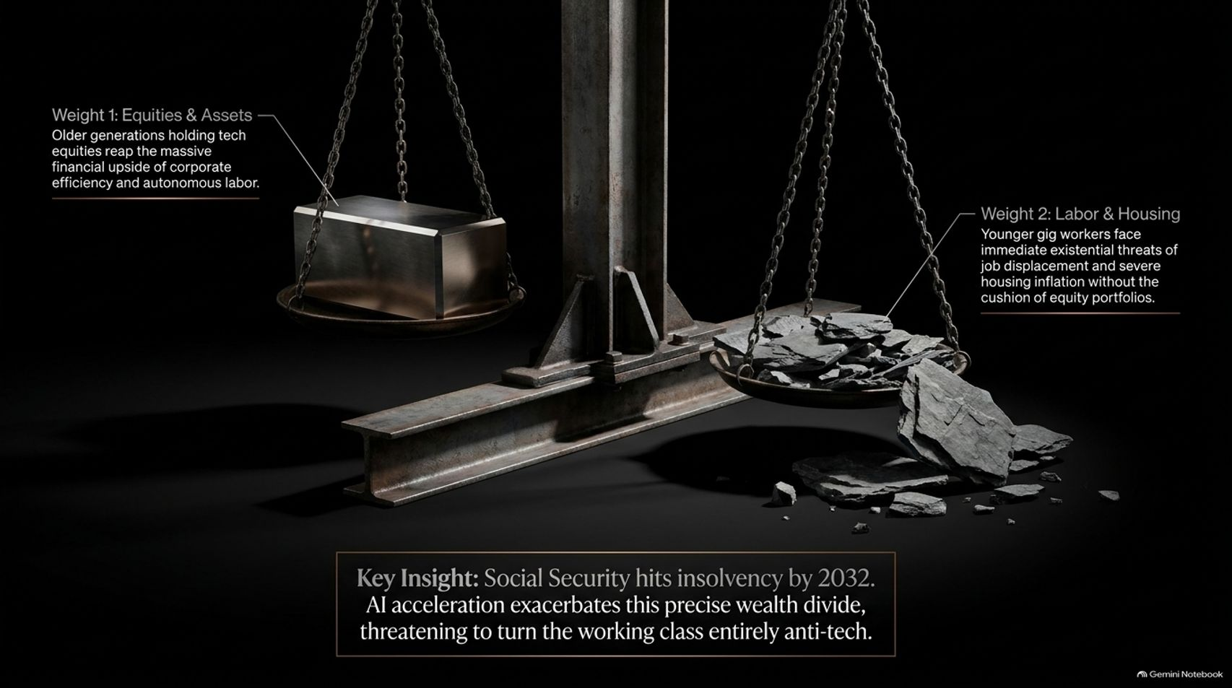
Notes:
Duration Guide: 4 – 5 minutes
Core Presentation Theme: Examine the growing intergenerational war: older generations holding tech equities reaping massive financial windfalls, while younger workers face housing inflation and job displacement without portfolio cushions.
Speaker Notes:
"Beneath the surface of technological acceleration lies a deeper societal tension—what some analysts call the intergenerational winter."
"Weight 1 (Equities & Assets): Older generations holding legacy tech equities and real estate reap the massive financial upside of corporate efficiency and autonomous labor."
"Weight 2 (Labor & Housing): Younger gig workers face immediate existential anxieties regarding job displacement and severe housing inflation, lacking the cushioning effect of large equity portfolios."
"With Social Security heading toward insolvency by 2032, AI acceleration risks exacerbating this wealth divide. If we fail to address it, we risk turning the working class entirely anti-tech."

Slide 6
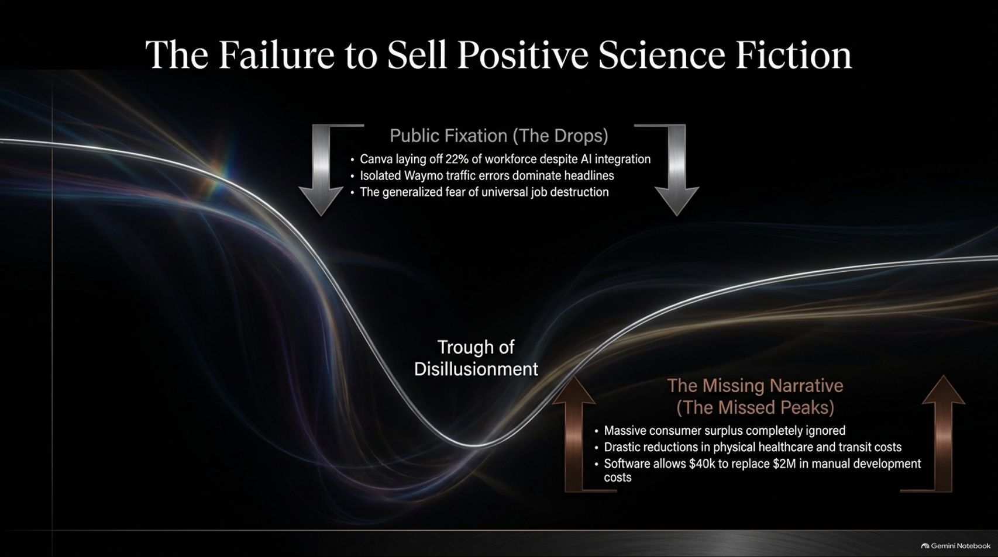
Notes:
Duration Guide: 4 – 5 minutes
Core Presentation Theme: Contrast public fixations on negative headlines (corporate layoffs, Waymo errors, job destruction) with the ignored massive consumer surplus, healthcare savings, and dramatic development cost reductions.
Speaker Notes:
"Why is public sentiment turning sour on technology? Because our cultural narrative is trapped in the Trough of Disillusionment."
"Public Fixation (The Drops): Headlines focus relentlessly on negative data points—such as Canva cutting 22% of its workforce despite AI integration, isolated autonomous driving errors, and generalized fears of universal job destruction."
"The Missing Narrative (The Missed Peaks): What gets ignored is the staggering consumer surplus being created. Software tools now allow a $40k API budget to replace what once required a $2M manual development cycle."
"We are seeing drastic reductions in administrative overhead, yet we are failing to tell a positive, aspirational science-fiction story that shows everyday people how AI directly improves their quality of life."

Slide 7
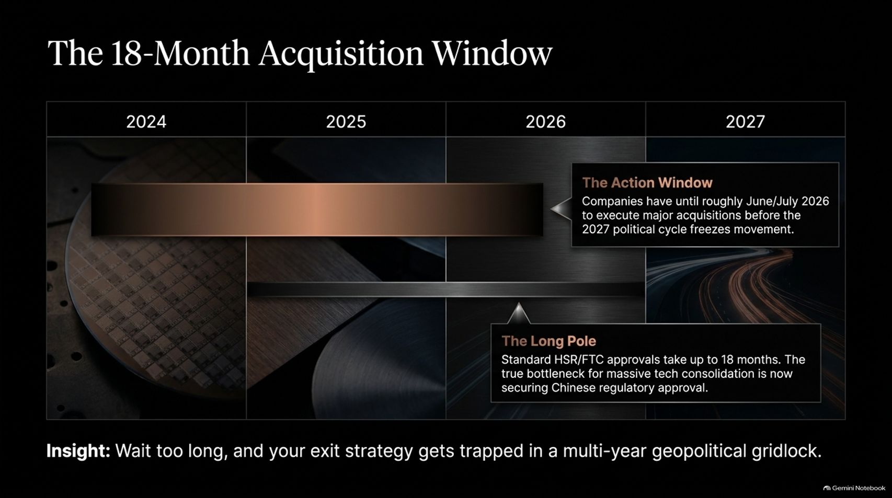

Slide 8
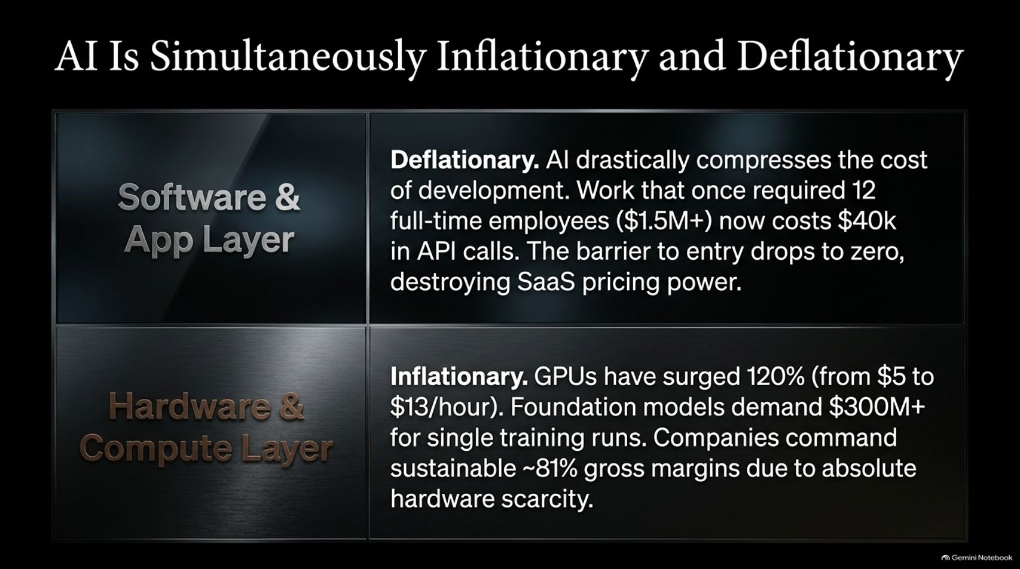
Notes:
Duration Guide: 4 – 5 minutes
Core Presentation Theme: Detail the dual economic nature of AI: deflationary at the software layer (compressing development costs from $1.5M to $40k and destroying SaaS pricing power) and inflationary at the hardware layer (GPU costs surging 120%, 81% gross margins).
Speaker Notes:
"One of the most fascinating paradoxes of the current tech economy is that AI is simultaneously inflationary and deflationary."
"Software & App Layer (Deflationary): AI drastically compresses development costs. Work that once required 12 full-time engineers ($1.5M+) now costs $40k in API calls. The barrier to entry drops to zero, putting intense downward pressure on traditional SaaS pricing power."
"Hardware & Compute Layer (Inflationary): Conversely, state-of-the-art GPUs have surged 120% in hourly cost, and single training runs demand $300M+. Due to absolute hardware scarcity, foundation model providers currently command sustainable ~81% gross margins."

Slide 9
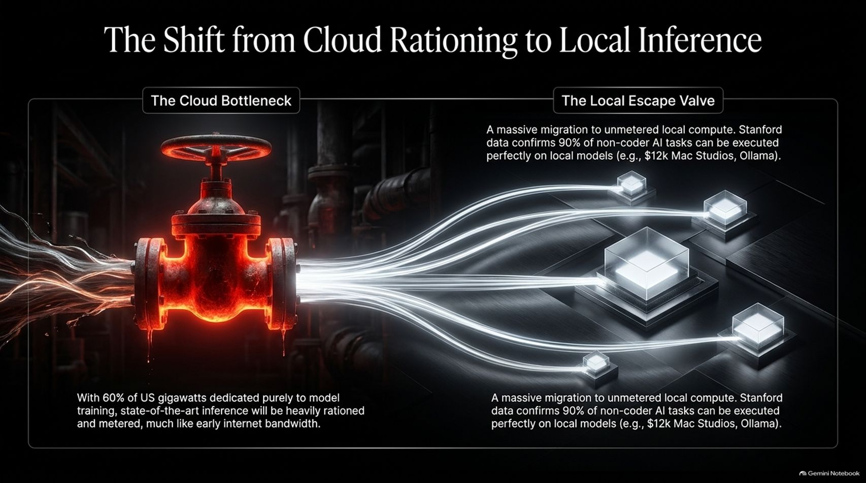
Notes:
Duration Guide: 4 – 5 minutes
Core Presentation Theme: Contrast cloud bottlenecks (with 60% of US gigawatts dedicated to model training, state-of-the-art cloud inference will be heavily rationed) with the local escape valve (unmetered local compute like Mac Studios and Ollama executing 90% of non-coder tasks).
Speaker Notes:
"As data center power demands skyrocket, we are witnessing a major structural shift from centralized cloud bottlenecks to local inference."
"The Cloud Bottleneck: With approximately 60% of U.S. gigawatts dedicated purely to model training, state-of-the-art cloud inference will inevitably face rationing and metering—much like early internet bandwidth."
"The Local Escape Valve: To bypass this, developers and enterprises are staging a massive migration to unmetered local compute. As Stanford data confirms, roughly 90% of non-coder AI tasks can be executed perfectly on local hardware setups, such as high-end Mac Studios running Ollama."

Slide 10
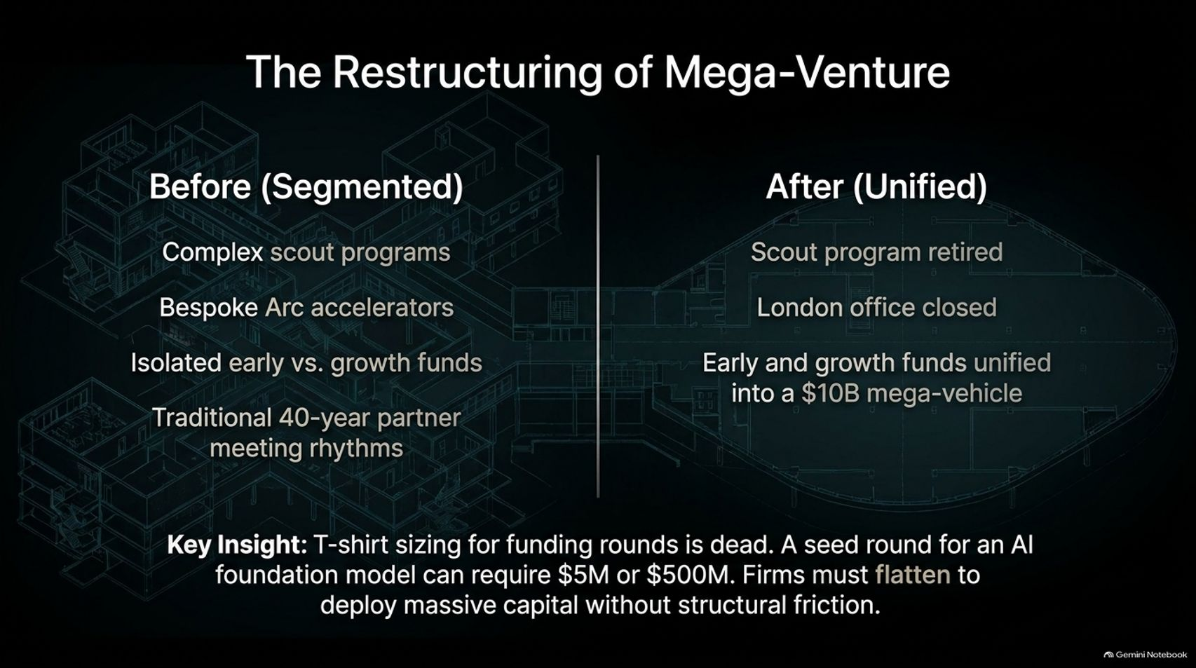
Notes:
Duration Guide: 3 – 5 minutes
Core Presentation Theme: Examine how legendary venture firms are flattening their structures—retiring scout programs, closing overseas offices, and unifying early and growth funds into $10B mega-vehicles to eliminate structural friction.
Speaker Notes:
"Venture capital institutions are undergoing their own radical restructuring."
"Before (Segmented): Traditional firms operated with complex scout programs, bespoke accelerator batches, isolated early-stage versus growth funds, and rigid 40-year partner meeting rhythms."
"After (Unified): Today's reality demands agility. Major firms are retiring legacy scout networks, consolidating international outposts, and merging early and growth pools into massive $10B mega-vehicles."
"Key Insight: Traditional t-shirt sizing for funding rounds is dead. When a seed-stage foundation model can require $5M or $500M upfront, venture firms must flatten to deploy massive capital without internal friction."

Slide 11
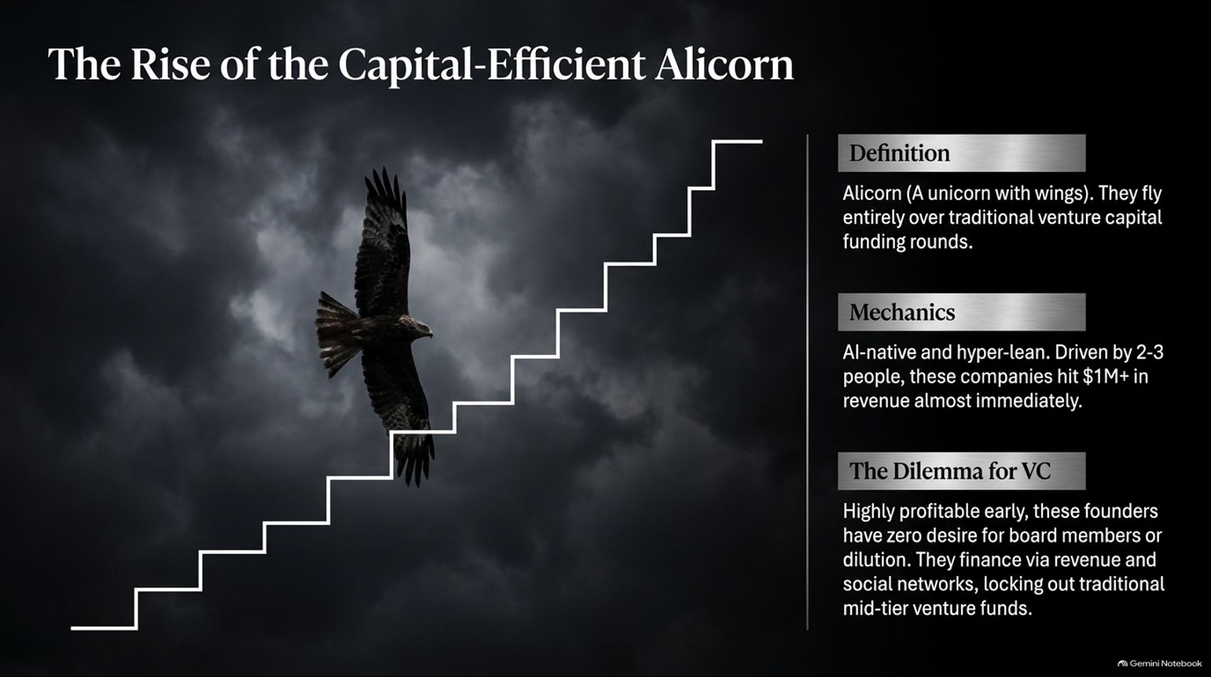
Notes:
Duration Guide: 3 – 5 minutes
Core Presentation Theme: Define the "Alicorn" (a unicorn with wings): AI-native, hyper-lean startups run by 2–3 people that achieve $1M+ in revenue almost immediately, flying entirely over traditional venture capital funding rounds.
Speaker Notes:
"Meet the newest dominant species in the startup ecosystem: the Alicorn—a unicorn with wings."
"Definition: Alicorns fly entirely over traditional venture capital funding rounds. They don't need a massive Series A or B to prove product-market fit."
"Mechanics: Driven by AI-native, hyper-lean teams of just 2 to 3 people, these companies hit $1M+ in annual recurring revenue almost immediately."
"The Dilemma for VC: Highly profitable from day one, these founders have zero desire for board dilution or external meddling. They finance their growth through customer revenue and digital networks, locking out traditional mid-tier venture funds."

Slide 12
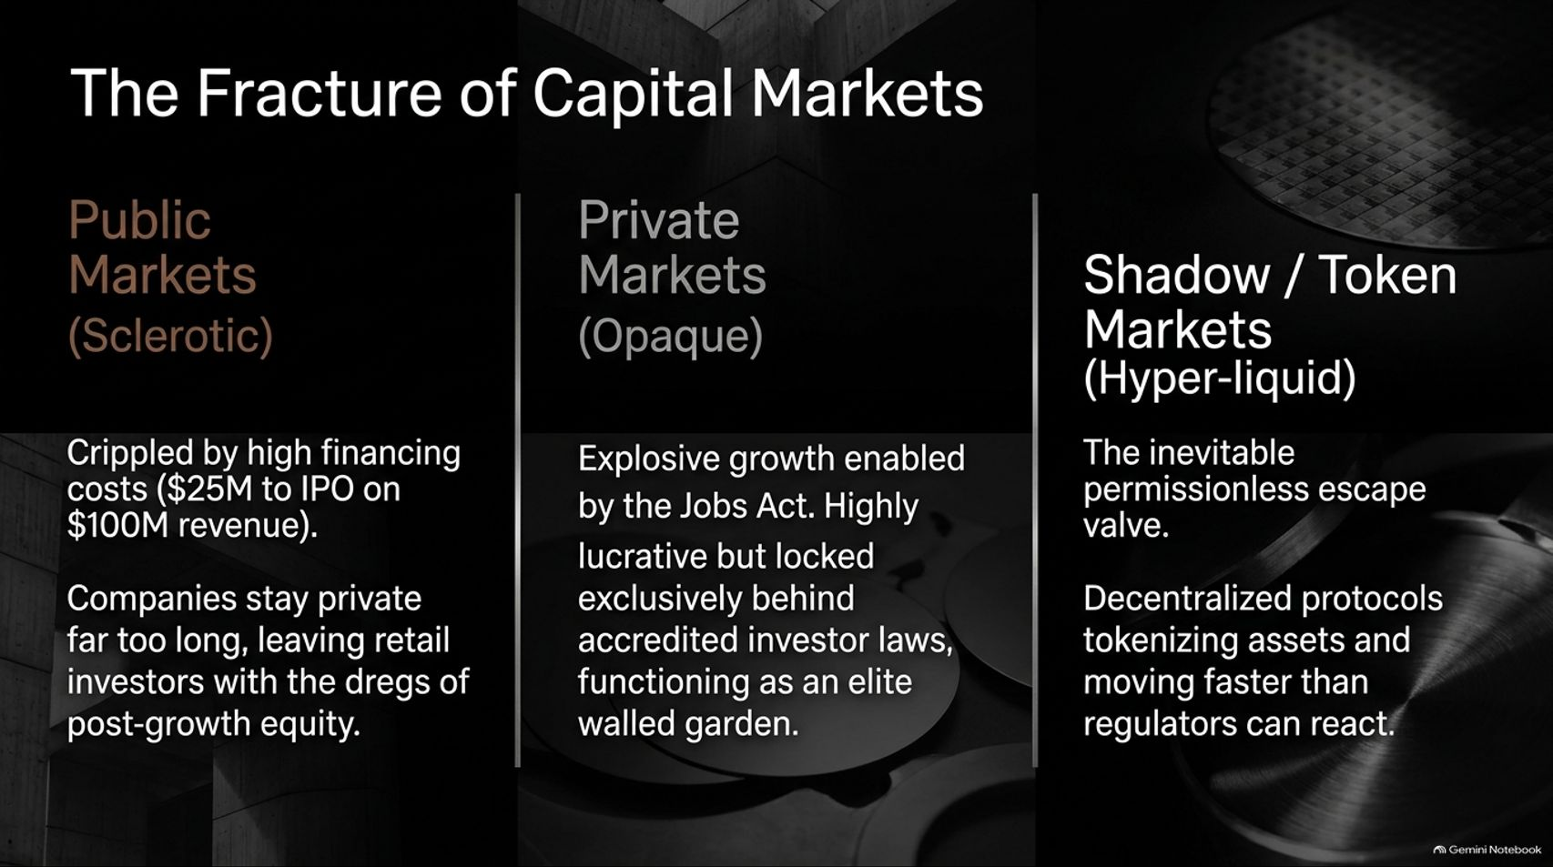
Notes:
Duration Guide: 4 – 5 minutes
Core Presentation Theme: Analyze the three-way fracture of global capital markets: public markets (sclerotic and high-cost), private markets (opaque, lucrative, and locked behind accredited investor walls), and shadow/token markets (hyper-liquid, permissionless escape valves).
Speaker Notes:
"Capital markets have fractured into three distinct realms, each operating under completely different rules."
"Public Markets (Sclerotic): Crippled by high regulatory and compliance costs ($25M to IPO on $100M revenue). Companies stay private far too long, leaving retail investors with the dregs of post-growth equity."
"Private Markets (Opaque): Enabled by the Jobs Act, private markets offer explosive growth but remain locked exclusively behind accredited investor laws—functioning as an elite walled garden."
"Shadow / Token Markets (Hyper-liquid): The inevitable permissionless escape valve. Decentralized protocols and tokenized assets are moving faster than traditional regulators can react, offering global liquidity 24/7."

Slide 13
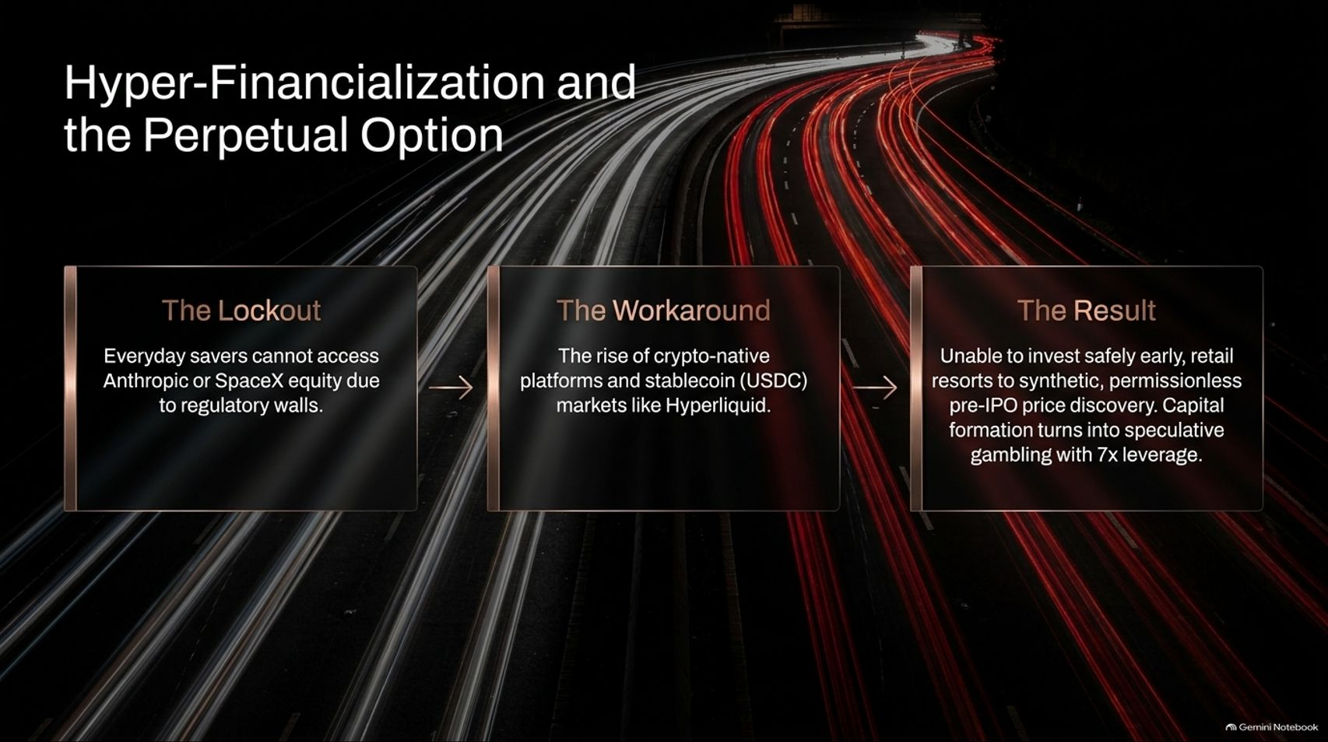
Notes:
Duration Guide: 4 – 5 minutes
Core Presentation Theme: Trace the path from retail lockout (unable to buy Anthropic or SpaceX equity due to regulatory walls) to crypto-native workarounds (stablecoins, Hyperliquid) and the resulting speculative surge with high leverage.
Speaker Notes:
"When everyday savers are legally locked out of early-stage wealth creation, hyper-financialization steps in to fill the vacuum."
"The Lockout: Everyday retail savers cannot access equity in generational giants like Anthropic or SpaceX due to restrictive regulatory walls."
"The Workaround: This has fueled the explosive rise of crypto-native platforms, stablecoin liquidity, and decentralized perpetual markets like Hyperliquid."
"The Result: Unable to invest safely early, retail capital resorts to synthetic, permissionless price discovery. Without proper access, capital formation frequently curdles into speculative trading with high leverage."

Slide 14
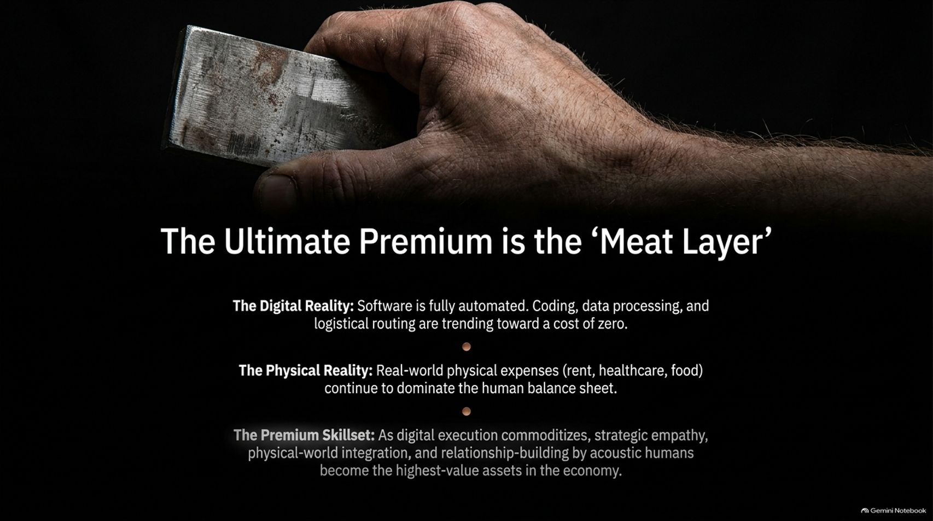
Notes:
Duration Guide: 3 – 5 minutes
Core Presentation Theme: Contrast the deflationary digital reality (where software, coding, and data processing trend toward zero) with the physical reality (rent, healthcare, food), establishing that strategic empathy and acoustic human relationship-building are the ultimate high-value skillsets.
Speaker Notes:
"As digital automation advances, we are reminded that not everything can be reduced to ones and zeros."
"The Digital Reality: Software execution, coding, data processing, and logistical routing are rapidly trending toward a cost of zero."
"The Physical Reality: Real-world expenses—housing, healthcare, education, and food—continue to dominate the human balance sheet."
"The Premium Skillset: As digital execution commoditizes, human traits become our highest-value assets. Strategic empathy, physical-world integration, and genuine relationship-building by 'acoustic humans' will command the ultimate economic premium."

Slide 15
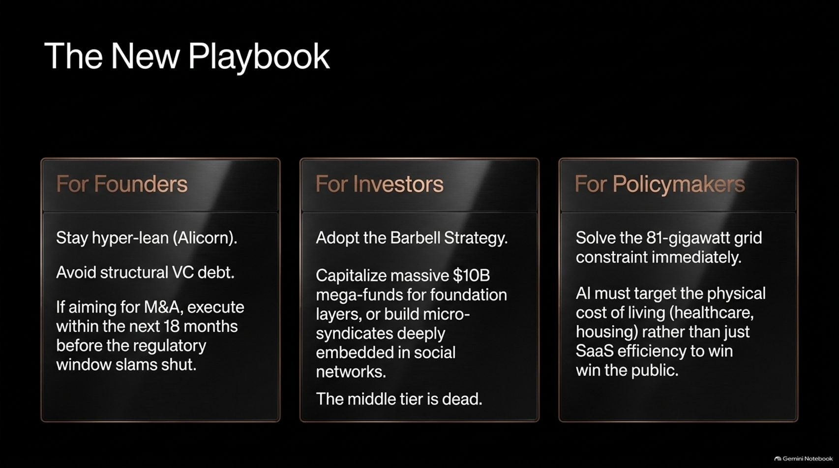
Notes:
Duration Guide: 4 – 5 minutes
Core Presentation Theme: Summarize actionable strategies for founders (stay lean, avoid VC debt, execute M&A before the window closes), investors (adopt a barbell strategy, back $10B mega-funds or micro-syndicates), and policymakers (solve the 81-gigawatt grid constraint and lower the physical cost of living).
Speaker Notes:
"How do we operate in this new tech reality? Here is our strategic playbook across three key constituents:"
"For Founders: Stay hyper-lean like an Alicorn. Avoid structural venture debt. If your goal is M&A, execute within the next 18 months before the regulatory window slams shut."
"For Investors: Adopt a strict barbell strategy. Either back massive $10B mega-funds playing the infrastructure layer, or build micro-syndicates deeply embedded in founder social networks. The middle tier is officially dead."
"For Policymakers: Solve the 81-gigawatt grid constraint immediately. If tech is to win public support, AI must actively target the physical cost of living—lowering healthcare and housing expenses—rather than just driving enterprise software efficiency."

Slide 16
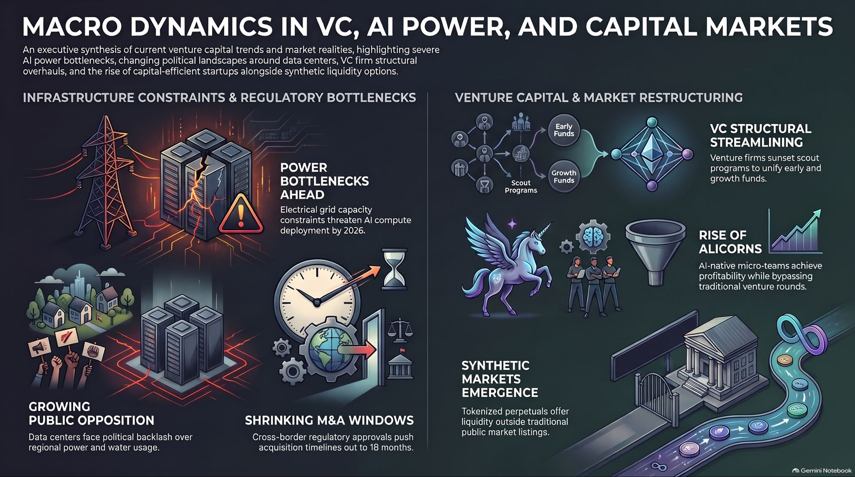
Notes:
Duration Guide: 3 – 5 minutes
Core Presentation Theme: Provide a visual reference summary of the entire presentation deck, synthesizing infrastructure constraints, regulatory bottlenecks, venture capital restructuring, and the emergence of synthetic and tokenized markets.
Speaker Notes:
"Let’s use this final summary slide as your executive reference sheet for navigating the current macroeconomic landscape."
"On the left, keep a close eye on infrastructure constraints: power bottlenecks threatening AI compute by 2026, growing public pushback over data centers, and shrinking 18-month M&A windows."
"On the right, recognize the structural changes in finance: venture firms streamlining their fund architectures, the unstoppable rise of capital-efficient Alicorns, and the emergence of tokenized perpetual markets offering liquidity outside traditional public exchanges."
"The rules of the game have changed. Adapt your playbook, embrace capital efficiency, and focus on where real-world value is created. Thank you for your time."

