Slide 1
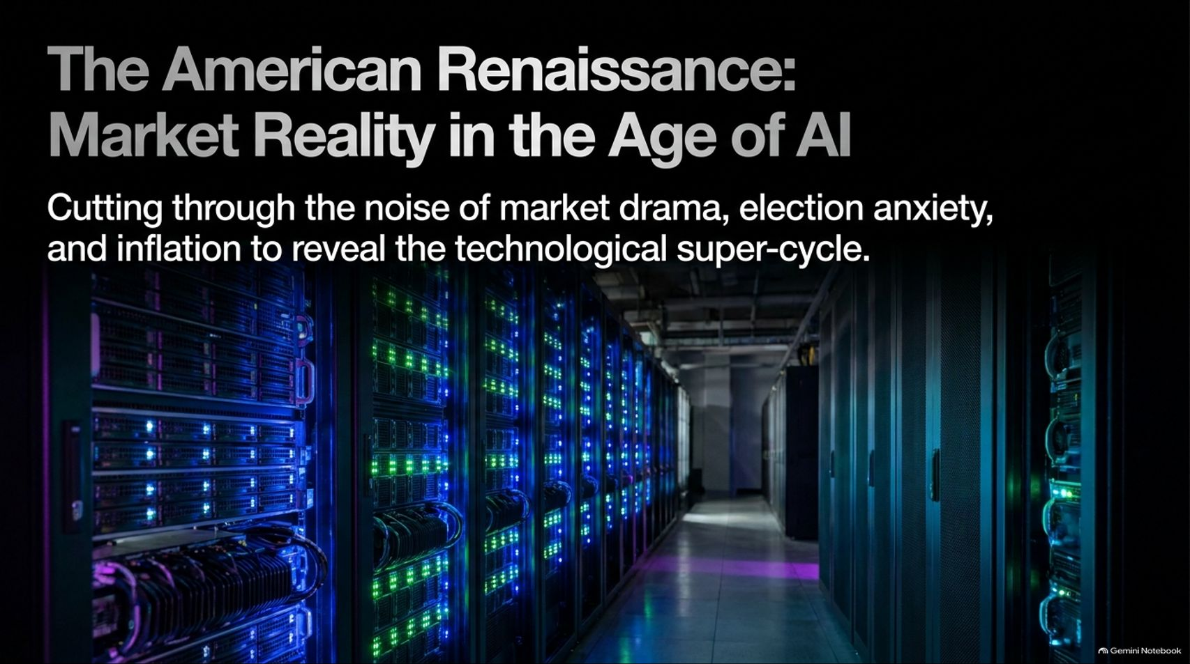
Notes:
Visual: Dark background featuring a title slide titled "The American Renaissance: Market Reality in the Age of AI" with the subtitle: "Cutting through the noise of market drama, election anxiety, and inflation to reveal the technological super-cycle," and a glowing server room graphic.
Estimated Speaking Time: 2 – 3 minutes
Speaker Notes:
"Welcome everyone to our macro and market review. Today, we are cutting through the noise of short-term market drama, election anxiety, and persistent inflation narratives to examine the structural reality of the technological supercycle.
Over the past few weeks, investors have faced immense volatility, headlines screaming about regulatory pushback, and anxiety surrounding political shifts. But when you step back from the emotional day-to-day fluctuations, a profound macro trend is taking shape: an American Renaissance driven by artificial intelligence, robotics, and energy deflation. Over the next 16 slides, we are going to dissect the data, examine the credit markets, analyze Wright’s Law cost curves, and demonstrate why the broader economy is entering an era of unprecedented productivity and abundance. Let’s begin by putting everything in proper perspective."
Cathie Wood: Did The Market Overreact To The Election? | In The Know
https://www.youtube.com/watch?v=Pk3XgEYGBWQ

Slide 2
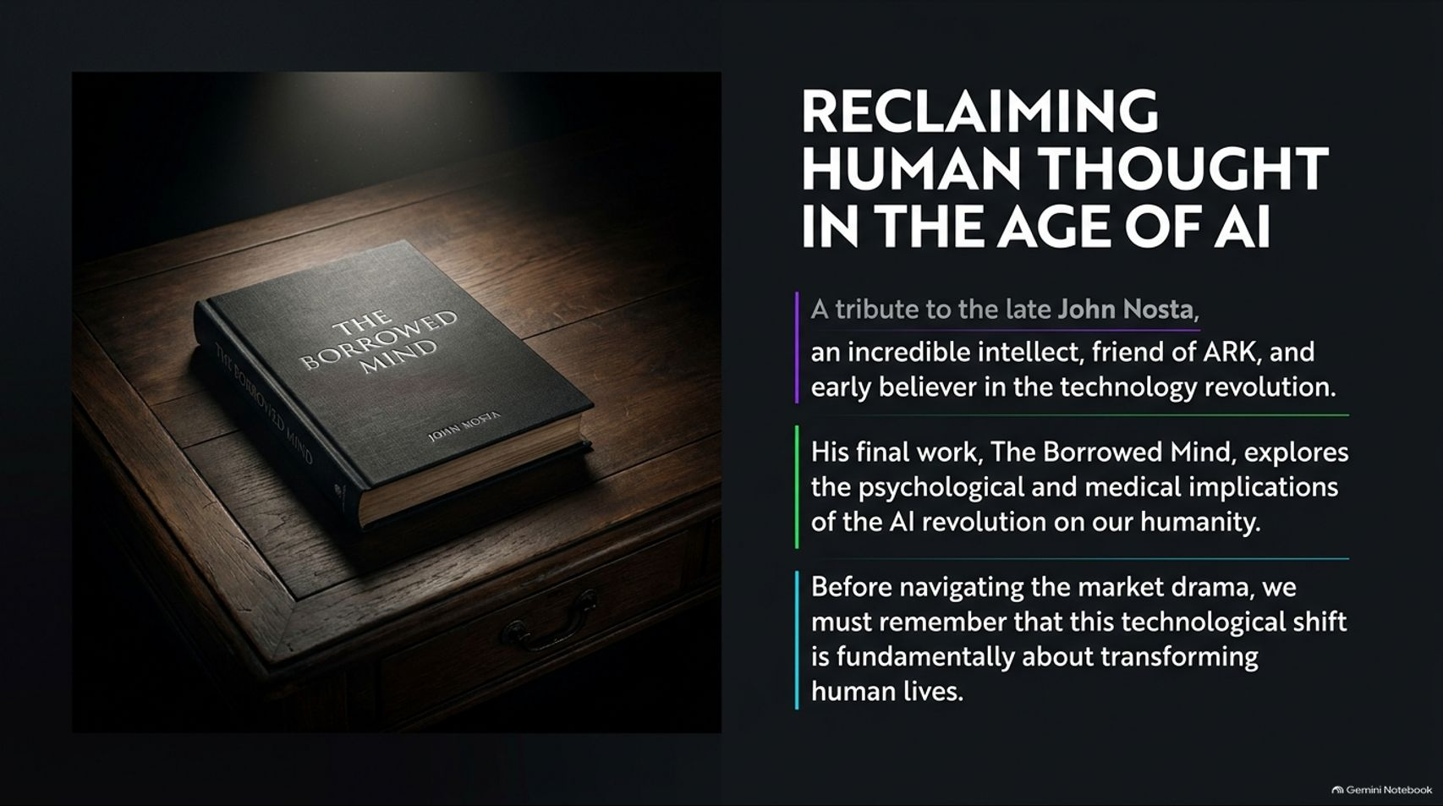
Notes:
Visual: A dark wooden desk featuring a book titled The Borrowed Mind by John Nosta, accompanied by bullet points honoring the late John Nosta, his final work on the psychological and medical implications of AI, and the fundamental human focus of this technological shift.
Estimated Speaking Time: 3 – 5 minutes
Speaker Notes:
"Before we dive into market charts and economic metrics, we must pause to honor a dear friend of ARK, the late John Nosta, who passed away recently. John was an incredible intellect, a dedicated family man, and an early believer in our firm when very few shared our vision back in 2014.
Right before his passing, John published his final book, The Borrowed Mind: Reclaiming Human Thought in the Age of AI. Drawing from his deep background in medicine and psychology, John explored the profound psychological and medical implications of the AI revolution on our humanity. His work serves as an essential reminder that beneath all the financial data, capital expenditures, and market drama, this technological shift is fundamentally about transforming human lives and empowering human thought. We strongly encourage everyone to support John’s family by reading his final contribution."

Slide 3
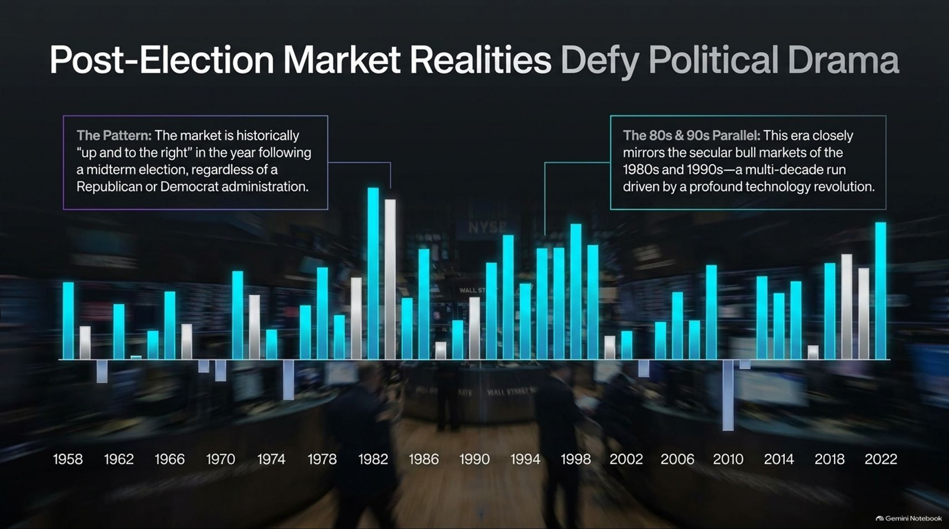
Notes:
Visual: A historical bar chart tracking stock market performance following midterm elections from 1958 to 2022, highlighting the consistent 'up and to the right' pattern regardless of political party and drawing parallels to the secular bull markets of the 1980s and 1990s.
Estimated Speaking Time: 3 – 5 minutes
Speaker Notes:
"Let’s turn to the market impact of the recent midterm elections. The vertical line on our historical chart illustrates a very consistent pattern: in the year following a midterm election, the stock market has historically trended up and to the right, regardless of whether a Republican or Democratic administration took office.
Why does this happen? Because prior to midterms, investors experience acute angst and uncertainty, often leading to significant turnover in the incumbent party. Once the election passes, that uncertainty clears. Furthermore, we view this era as closely mirroring the secular bull markets of the 1980s and 1990s—a multi-decade economic expansion driven by a profound technology revolution. Past performance is prologue, and historical trends indicate strong recovery ahead."

Slide 4
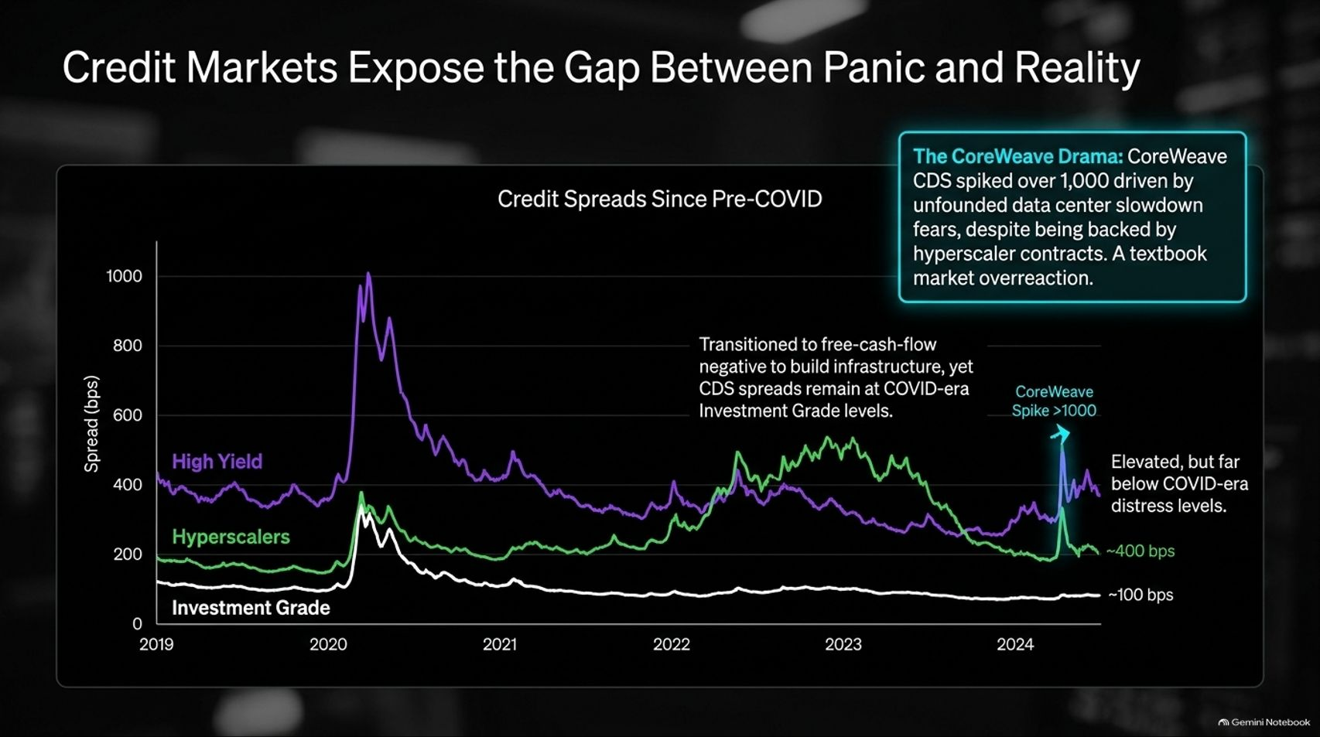
Notes:
Visual: A multi-line credit spread chart from pre-COVID to 2024 comparing High Yield, Hyperscalers, and Investment Grade credit default swaps (CDS), highlighting the CoreWeave CDS spike above 1,000 bps due to unfounded data center slowdown fears.
Estimated Speaking Time: 3 – 5 minutes
Speaker Notes:
"To understand whether recent market drops signal systemic danger, we must look at the credit markets, where panic often diverges from reality.
Look at the credit default swap (CDS) chart on screen. During the COVID shock, high-yield spreads experienced a massive heart attack, spiking near 1,000 basis points. While recent market drama caused a slight elevation in hyperscaler credit spreads—bringing them roughly in line with COVID-era investment grade levels—they remain far below true financial distress.
Notice the CoreWeave spike: CoreWeave CDS spreads surged over 1,000 basis points driven by unfounded fears of a data center slowdown. However, because their contracts are fully backed by hyperscaler commitments, this represents a textbook market overreaction."

Slide 5
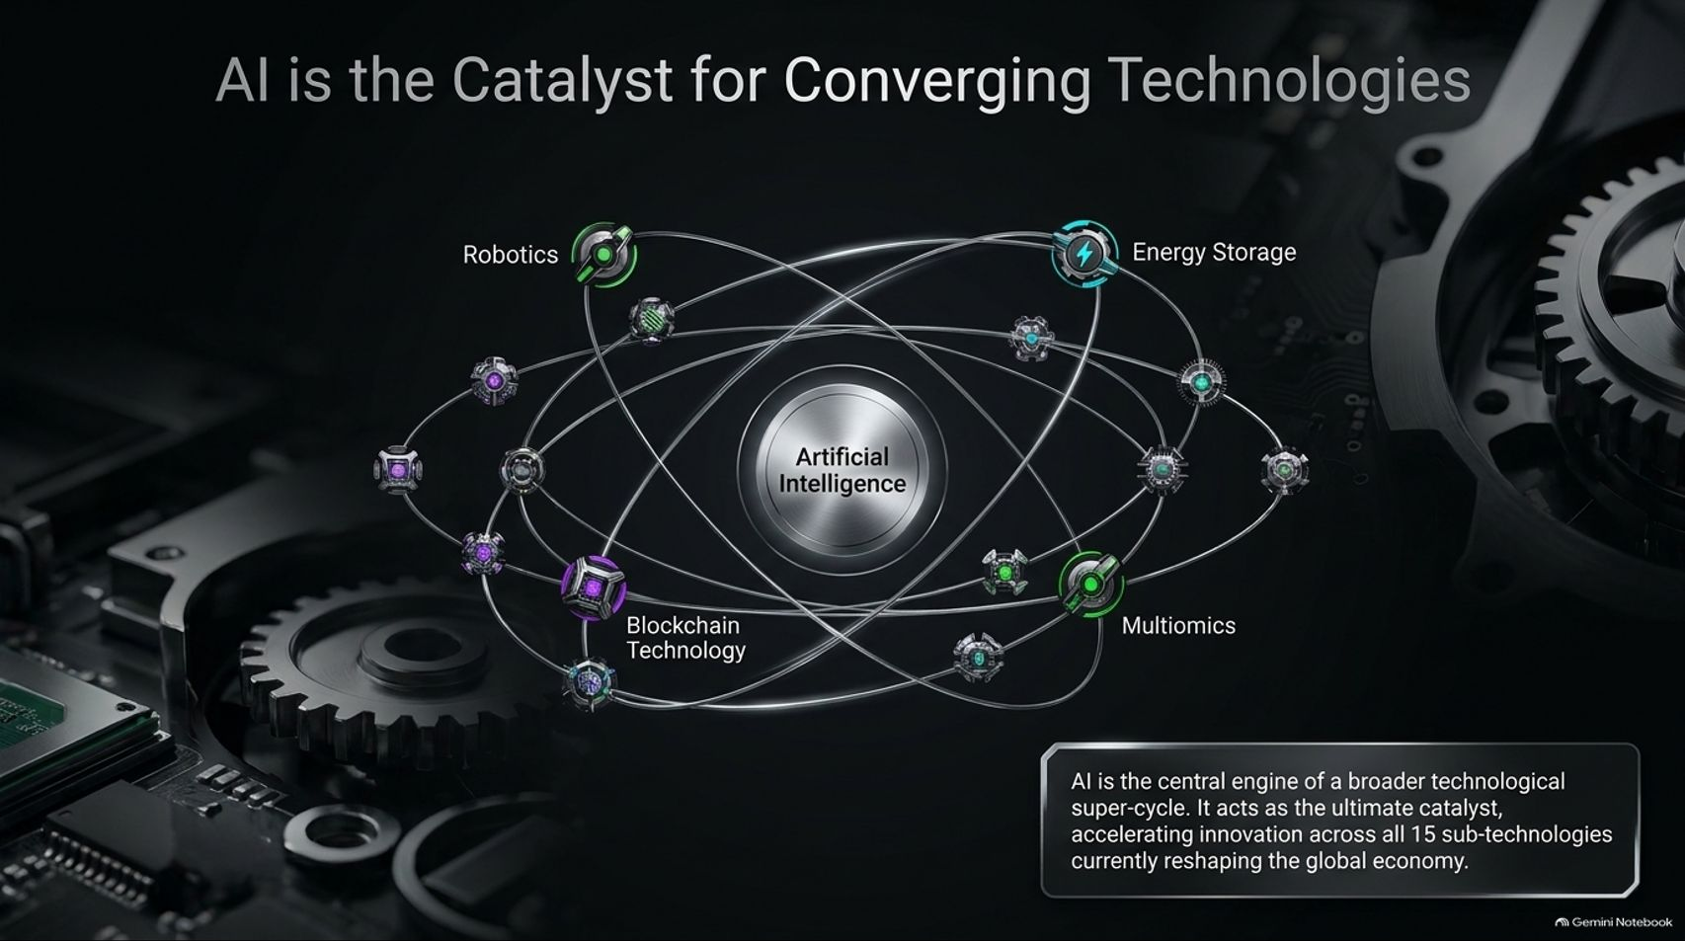
Notes:
Visual: A cosmic orbital diagram featuring Artificial Intelligence at the center, surrounded by interconnected technology platforms including Robotics, Energy Storage, Blockchain Technology, and Multiomics.
Estimated Speaking Time: 3 – 4 minutes
Speaker Notes:
"At the core of this entire structural transformation is Artificial Intelligence. AI is not an isolated software trend; it is the ultimate economic catalyst.
As illustrated by our orbital model, AI acts as the central engine accelerating innovation across all 15 sub-technologies currently reshaping the global economy. It directly feeds into and supercharges robotics, next-generation energy storage, decentralized blockchain technology, and multiomics healthcare revolutions. When you combine artificial intelligence with physical automation and energy breakthroughs, you ignite a multi-trillion-dollar technological supercycle."

Slide 6
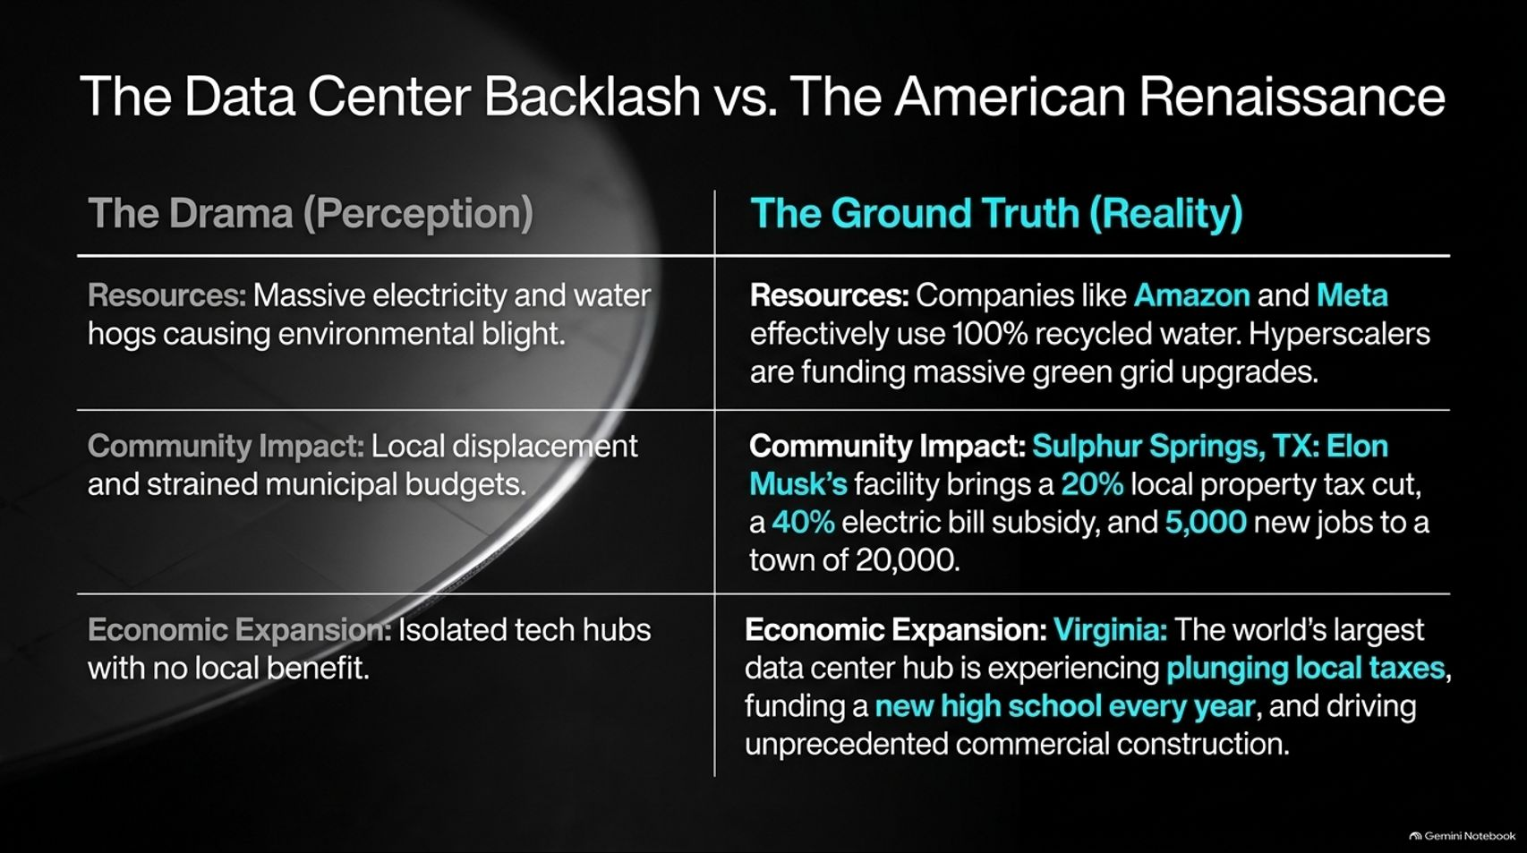
Notes:
Visual: A two-column comparison table contrasting 'The Drama (Perception)'—massive electricity/water hogs, municipal budget strain, and isolated tech hubs—against 'The Ground Truth (Reality)'—100% recycled water use, massive local tax cuts, electric bill subsidies, and school funding.
Estimated Speaking Time: 4 – 5 minutes
Speaker Notes:
"One of the most heavily debated topics in recent months has been the rapid expansion of data centers. Public perception has been clouded by negative headlines claiming massive environmental blight and municipal strain. But let's look at the actual ground truth.
Resources: Major hyperscalers like Amazon and Meta effectively utilize 100% recycled water systems and are directly funding massive green grid upgrades.
Community Impact: In Sulphur Springs, Texas, Elon Musk’s facility brought a 20% local property tax cut, a 40% electric bill subsidy, and 5,000 new jobs to a town of 20,000. In Virginia—the world's largest data center hub—plunging local taxes are funding a brand-new high school every year alongside unprecedented commercial construction.
Data centers are not community drains; they are the physical foundation of the American Renaissance."

Slide 7
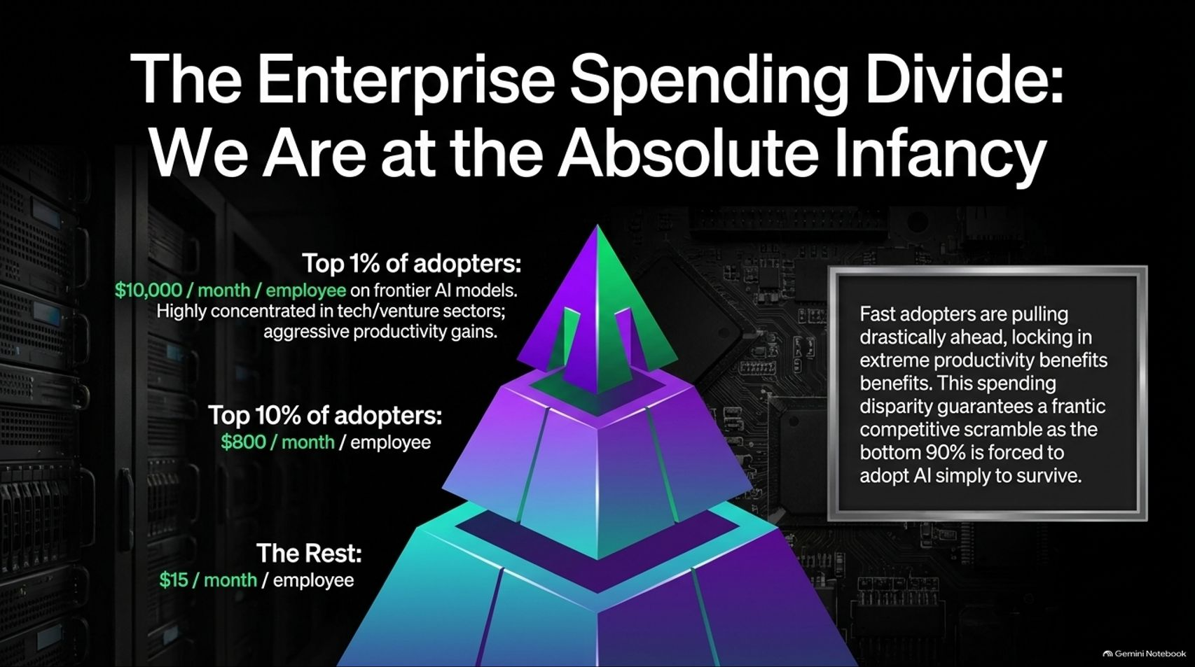
Notes:
Visual: A tiered pyramid chart illustrating enterprise spending on frontier AI models per employee: Top 1% ($10,000/month), Top 10% ($800/month), and The Rest ($15/month).
Estimated Speaking Time: 3 – 5 minutes
Speaker Notes:
"How are enterprises actually adopting AI? Data from fintech leader Ramp reveals a striking enterprise spending divide.
Look at the adoption pyramid on screen:
Top 1% of Adopters: Spending nearly $10,000 per month per employee on frontier AI models, heavily concentrated in tech and venture sectors capturing aggressive productivity gains.
Top 10% of Adopters: Spending around $800 per month per employee.
The Rest (Bottom 90%): Spending a mere $15 per month per employee.
This proves we are at the absolute infancy of this cycle. Fast adopters are pulling drastically ahead and locking in extreme productivity advantages. This spending disparity guarantees a frantic competitive scramble as the bottom 90% is forced to adopt AI simply to survive."

Slide 8
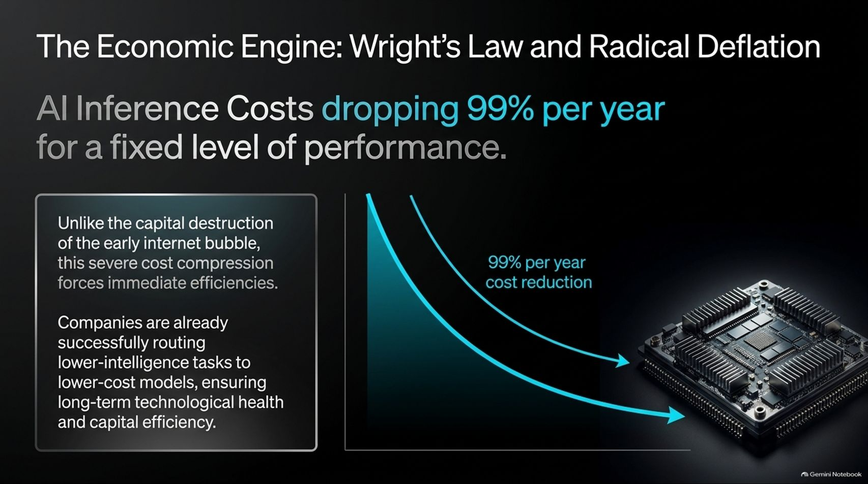
Notes:
Visual: An exponential decay curve illustrating AI inference costs dropping 99% per year for a fixed level of performance, contrasted with bullet points on capital efficiency and intelligent workload routing.
Estimated Speaking Time: 4 – 5 minutes
Speaker Notes:
"Unlike the destructive capital speculation of the early internet bubble, the AI supercycle is governed by a powerful economic engine: Wright’s Law and Radical Deflation.
As shown on this curve, AI inference costs are dropping 99% per year for a fixed level of performance. Every time cumulative compute production doubles, costs drop predictably. This severe cost compression forces immediate operational efficiencies. Companies are already successfully routing lower-intelligence tasks to lower-cost models, ensuring long-term technological health and capital efficiency. Deflation in technology is not a sign of weakness; it is the ultimate driver of mass adoption."

Slide 9
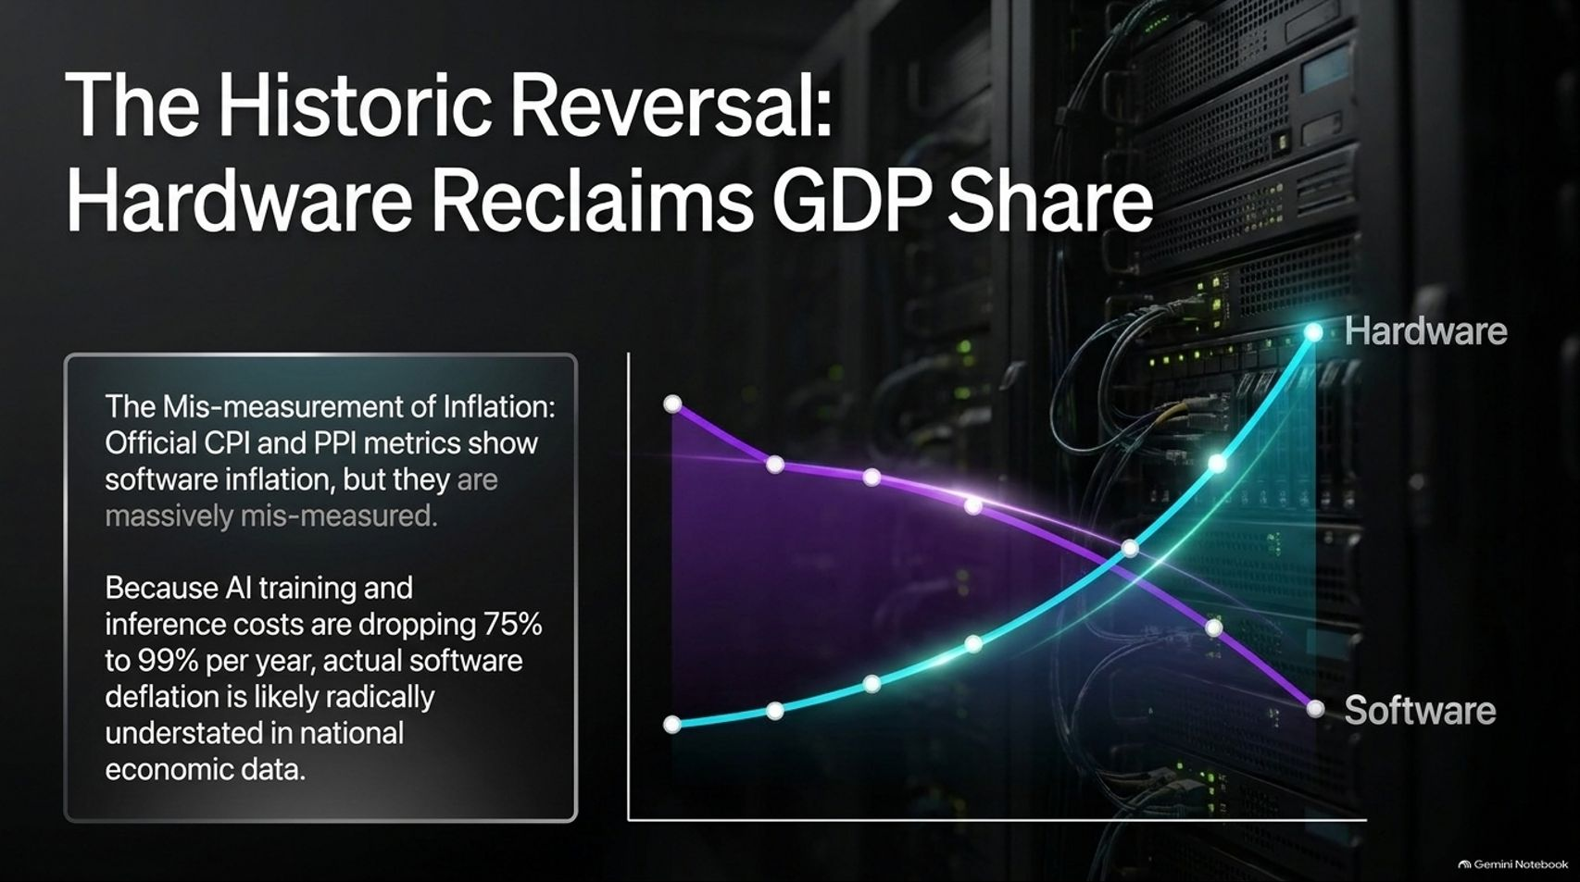
Notes:
Visual: A dual-curve chart showing software and hardware contributions to GDP over decades, highlighting the mismeasurement of inflation in official CPI/PPI metrics and the massive understatement of actual software deflation.
Estimated Speaking Time: 3 – 5 minutes
Speaker Notes:
"We are currently witnessing a historic reversal in national economic accounts: Hardware is rapidly reclaiming its share of GDP.
Official CPI and PPI metrics attempt to measure software and hardware inflation, but they are massively mis-measured. Because AI training and inference costs are dropping 75% to 99% per year, actual software deflation is radically understated in national economic data. While infrastructure and hardware investments surge to build out data centers and power grids, software productivity is scaling exponentially without triggering traditional inflationary bottlenecks."

Slide 10
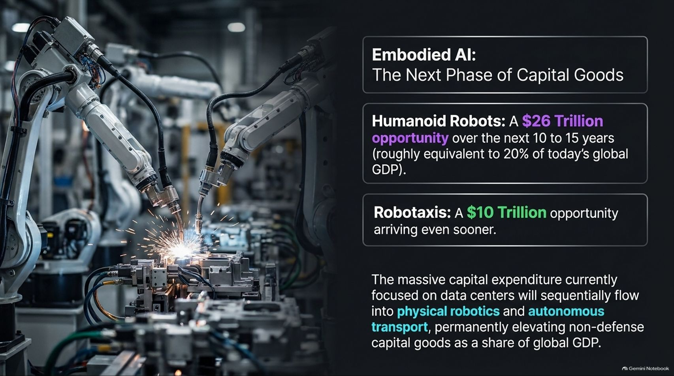
Notes:
Visual: Industrial robotic arms welding on a manufacturing floor, paired with stat callouts for Humanoid Robots ($26 Trillion opportunity over 10-15 years, ~20% of global GDP) and Robotaxis ($10 Trillion opportunity).
Estimated Speaking Time: 4 – 5 minutes
Speaker Notes:
"Data centers represent just the first wave of physical AI integration. The next phase is Embodied AI.
Look at the staggering market sizing on screen:
Humanoid Robots: Represent a $26 Trillion opportunity over the next 10 to 15 years—roughly equivalent to 20% of today's global GDP.
Robotaxis: Represent an imminent $10 Trillion opportunity arriving even sooner.
The massive capital expenditure currently concentrated on data centers will sequentially flow into physical robotics and autonomous transport, permanently elevating non-defense capital goods as a dominant share of global GDP."

Slide 11
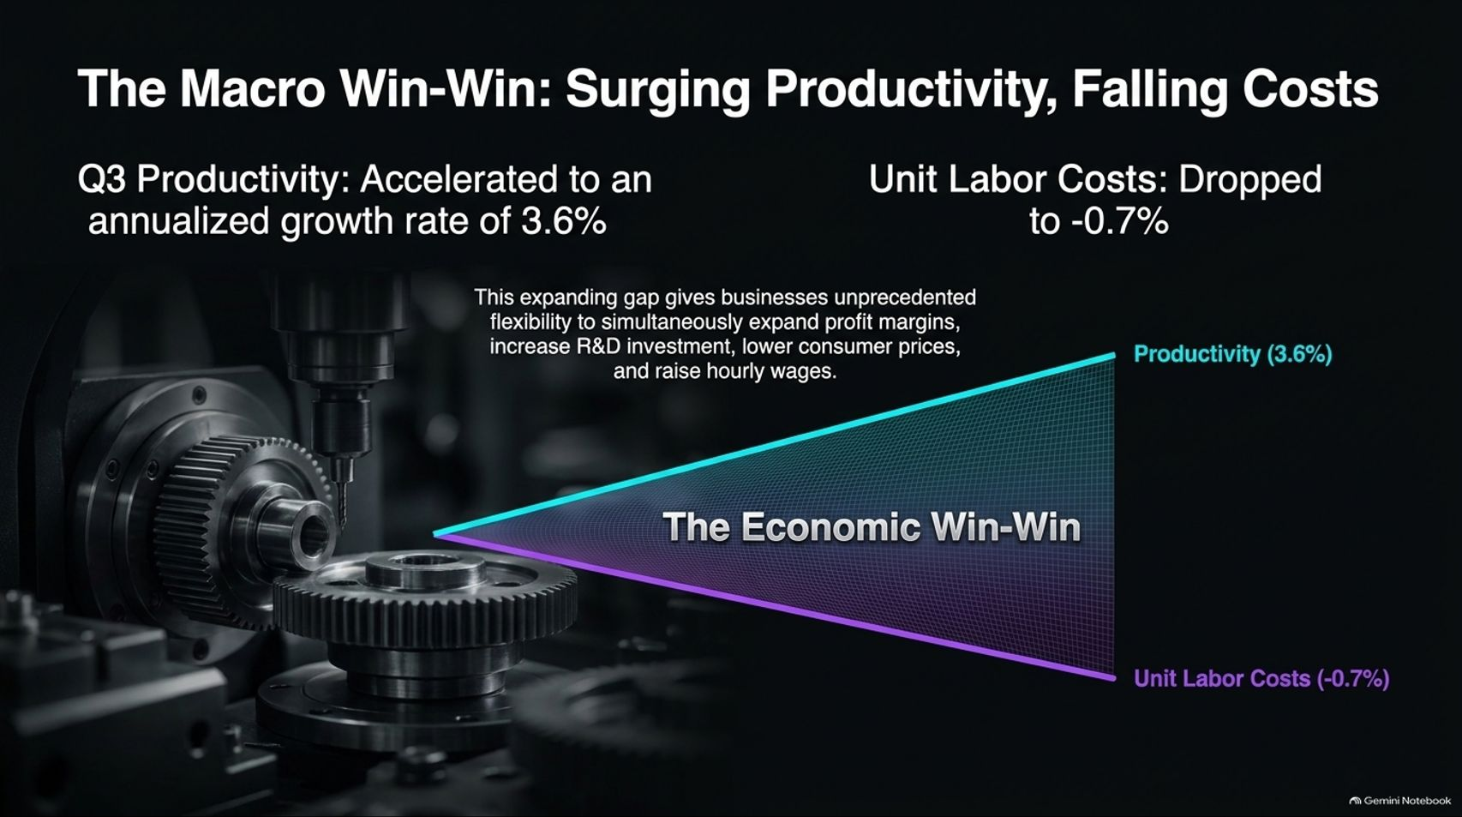
Notes:
Visual: A converging economic wedge diagram highlighting Q3 annualized productivity growth accelerating to 3.6% against unit labor costs dropping to -0.7%, creating an expanding margin and wage flexibility gap.
Estimated Speaking Time: 3 – 5 minutes
Speaker Notes:
"Recent macroeconomic data confirms the ultimate economic win-win: Surging Productivity and Falling Unit Labor Costs.
In the latest reporting period, annualized productivity growth accelerated to 3.6%, while unit labor costs dropped to -0.7%. This expanding wedge gives businesses unprecedented flexibility to simultaneously expand profit margins, increase R&D investment, lower consumer prices, and raise hourly wages. When technology drives productivity past labor cost growth, everyone wins—businesses become more profitable, and consumers enjoy deflationary price drops."

Slide 12
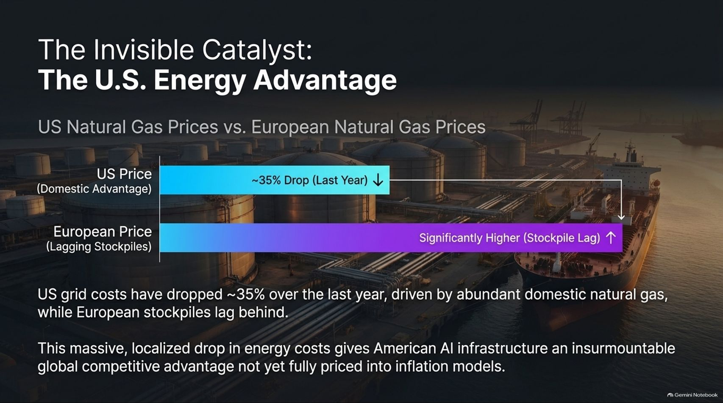
Notes:
Visual: A terminal storage facility background with a comparative bar chart showing U.S. natural gas prices dropping ~35% over the last year compared to significantly higher European prices due to stockpile lags.
Estimated Speaking Time: 3 – 5 minutes
Speaker Notes:
"A critical hidden catalyst powering the American AI supercycle is our unrivaled domestic energy advantage.
Look at the natural gas price comparison on screen. Driven by abundant domestic production and export scaling, U.S. grid feedstock costs have dropped roughly 35% over the last year, while European stockpiles lag behind with significantly higher costs. This massive, localized drop in energy costs gives American AI infrastructure an insurmountable global competitive advantage that traditional inflation models have yet to fully price in."

Slide 13
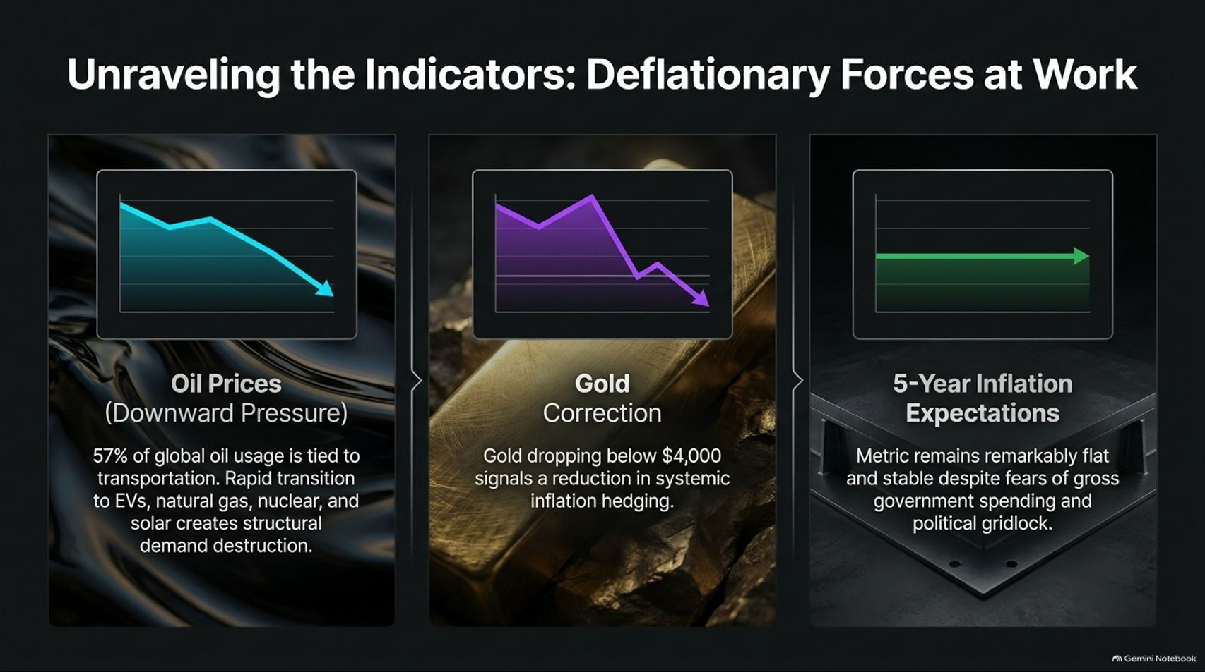
Notes:
Visual: Three financial indicator trend cards showing Oil Prices under downward pressure (57% tied to transportation transitions), a Gold Correction below $4,000, and remarkably flat 5-Year Inflation Expectations.
Estimated Speaking Time: 3 – 5 minutes
Speaker Notes:
"When we examine broader market indicators, the prevailing macroeconomic force is unmistakably deflationary:
Oil Prices: Facing continuous downward pressure because 57% of global oil usage is tied to transportation, which is rapidly transitioning to EVs, natural gas, nuclear, and solar.
Gold Correction: Dropping below $4,000, signaling a clear reduction in systemic inflation hedging among investors.
Inflation Expectations: The 5-year forward inflation expectation metric remains remarkably flat and stable, completely defying fears of runaway government spending."

Slide 14

Notes:
Visual: A gold bar resting beside a digital wireframe cube, highlighting the dramatic drop in the correlation between Bitcoin and gold down to 0.1 since 2019.
Estimated Speaking Time: 3 – 4 minutes
Speaker Notes:
"In the digital asset realm, we are witnessing a fascinating structural divergence. The correlation between Bitcoin and traditional gold has plummeted to 0.1 since 2019.
Bitcoin is no longer trading as a mere proxy for physical gold. While gold corrects downward as macro inflation risks subside, Bitcoin continues an independent, upward trajectory driven by unique network adoption fundamentals, institutional integration, and its role as pristine digital collateral."

Slide 15
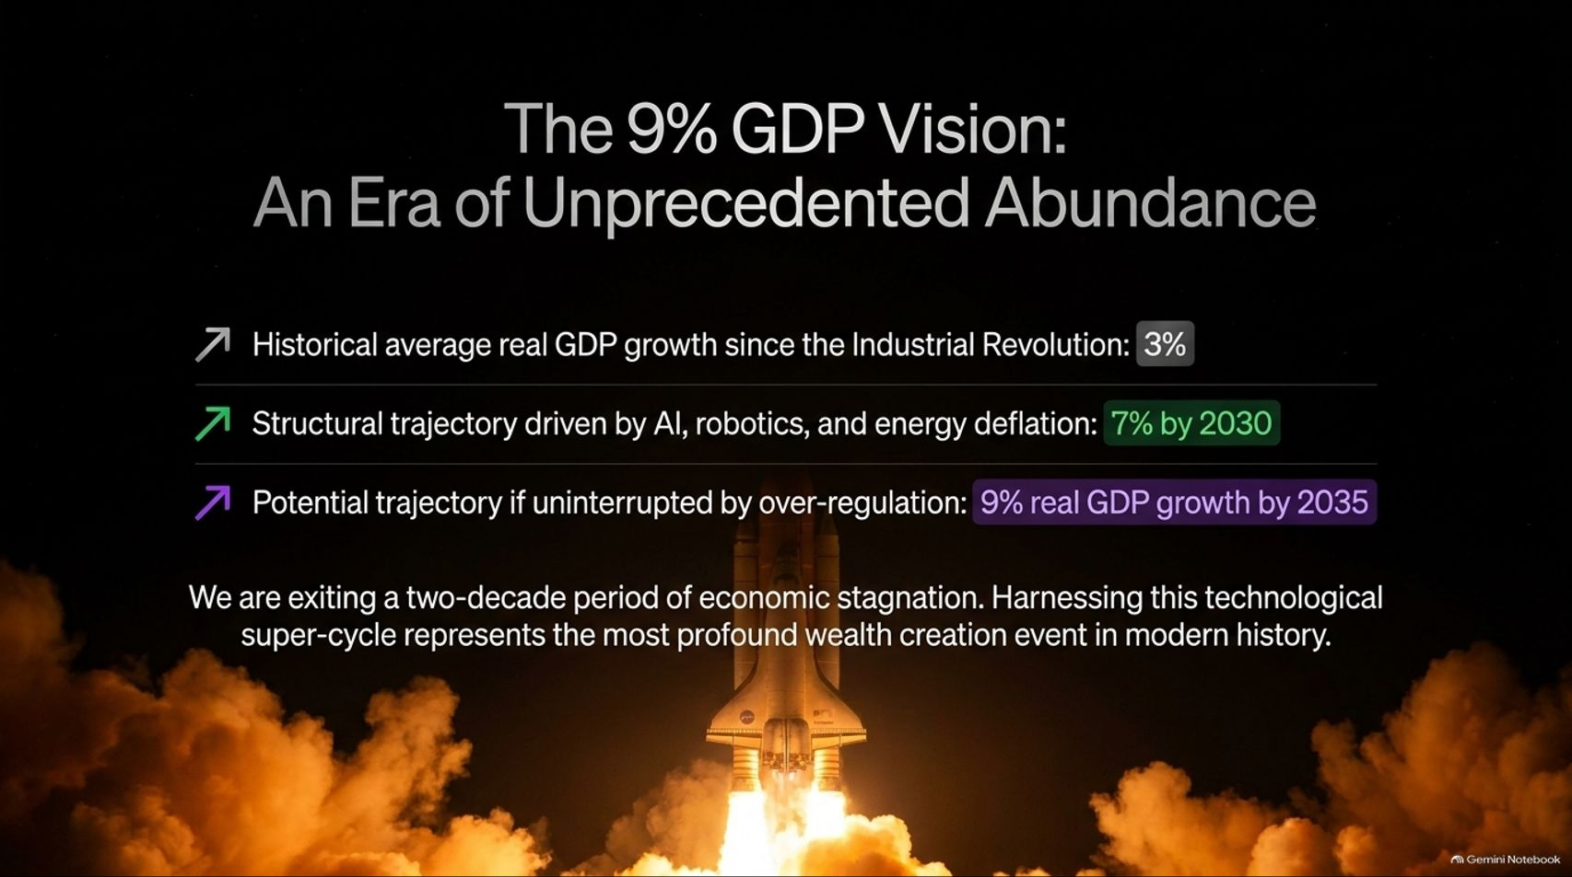
Notes:
Visual: A space shuttle launching into the stars, contrasting historical real GDP growth (3%) against the structural trajectory driven by AI and robotics (7% by 2030) and the potential uninhibited trajectory (9% real GDP growth by 2035).
Estimated Speaking Time: 3 – 5 minutes
Speaker Notes:
"This brings us to our overarching macro vision: The 9% GDP Era of Unprecedented Abundance.
For generations, real GDP growth has averaged roughly 3% since the Industrial Revolution. However, driven by the compounding convergence of AI, robotics, and energy deflation, our structural trajectory points toward 7% real GDP growth by 2030, and potentially 9% by 2035 if left uninterrupted by over-regulation. We are exiting a two-decade period of economic stagnation; harnessing this technological supercycle represents the most profound wealth creation event in modern history."

Slide 16
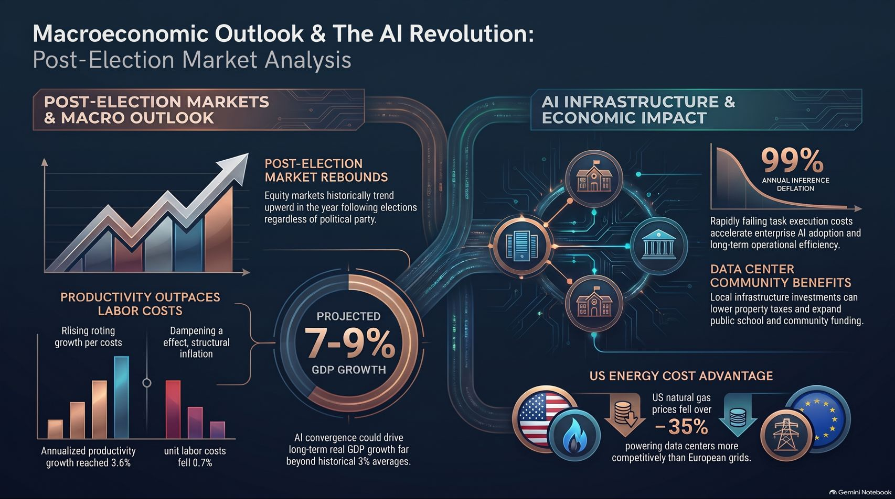
Notes:
Visual: A comprehensive master synthesis dashboard integrating post-election market rebounds, productivity outpacing labor costs, projected 7-9% GDP growth, 99% annual inference deflation, data center community benefits, and U.S. natural gas cost advantages.
Estimated Speaking Time: 3 – 5 minutes
Speaker Notes:
"We conclude our presentation with this comprehensive master synthesis dashboard: Macroeconomic Outlook & The AI Revolution.
Every data point we have examined today points to the same inescapable conclusion: post-election market volatility is noise; the technological supercycle is signal. With productivity outpacing labor costs, inference costs deflating by 99% annually, U.S. energy advantages securing our power grids, and embodied robotics unlocking a $26 trillion horizon, the macroeconomic foundation has never been stronger. By staying focused on real innovation and riding this structural wave, we step confidently into an era of unprecedented economic abundance. Thank you."

