Slide 1
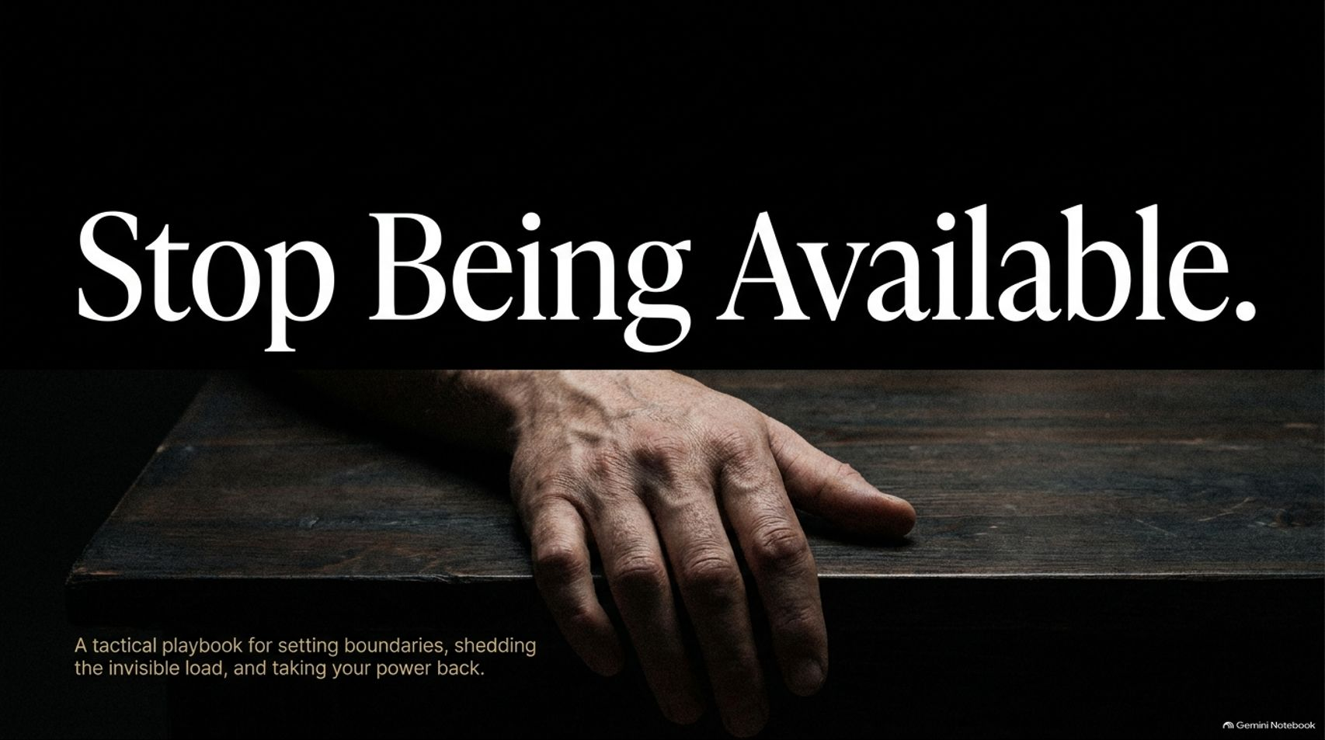
Notes:
Visual: Dark background with the title "Stop Being Available" and a hand resting on a table, accompanied by the subtitle: "A tactical playbook for setting boundaries, shedding the invisible load, and taking your power back."
Estimated Speaking Time: 2 – 3 minutes
Speaker Notes:
"Welcome everyone. Take a deep breath and look at the title on the screen: Stop Being Available. Right out of the gate, I want you to ask yourself a hard question: How much of your life is spent reacting to everyone else's emergencies, pings, text messages, and unstated expectations? For years—and especially for women, caregivers, and high-functioning professionals—being 'available' 24/7 has been worn like a badge of honor. We treat it as proof of our love, our loyalty, and our worth. But what is it actually costing you?
As Mel Robbins and Dr. Mark Hyman discuss in their work on behavioral patterns and personal health, waiting around to feel ready or waiting for permission to change means you'll be waiting until you die. Availability without boundaries isn't kindness; it's self-abandonment.
Over the next hour, we aren't just going to talk about 'nice' boundaries or polite ways to say no. We are opening a tactical playbook. We are going to examine the invisible load you've been carrying, why pouring from an empty cup is a structural failure rather than a lack of effort, and how you can systematically take your power back without guilt. Let's dive in."
Mel Robbins: The Real Reason You Can't Stick to Healthy Habits (And How to Fix It)
https://www.youtube.com/watch?v=5MDvPFrAsGM

Slide 2
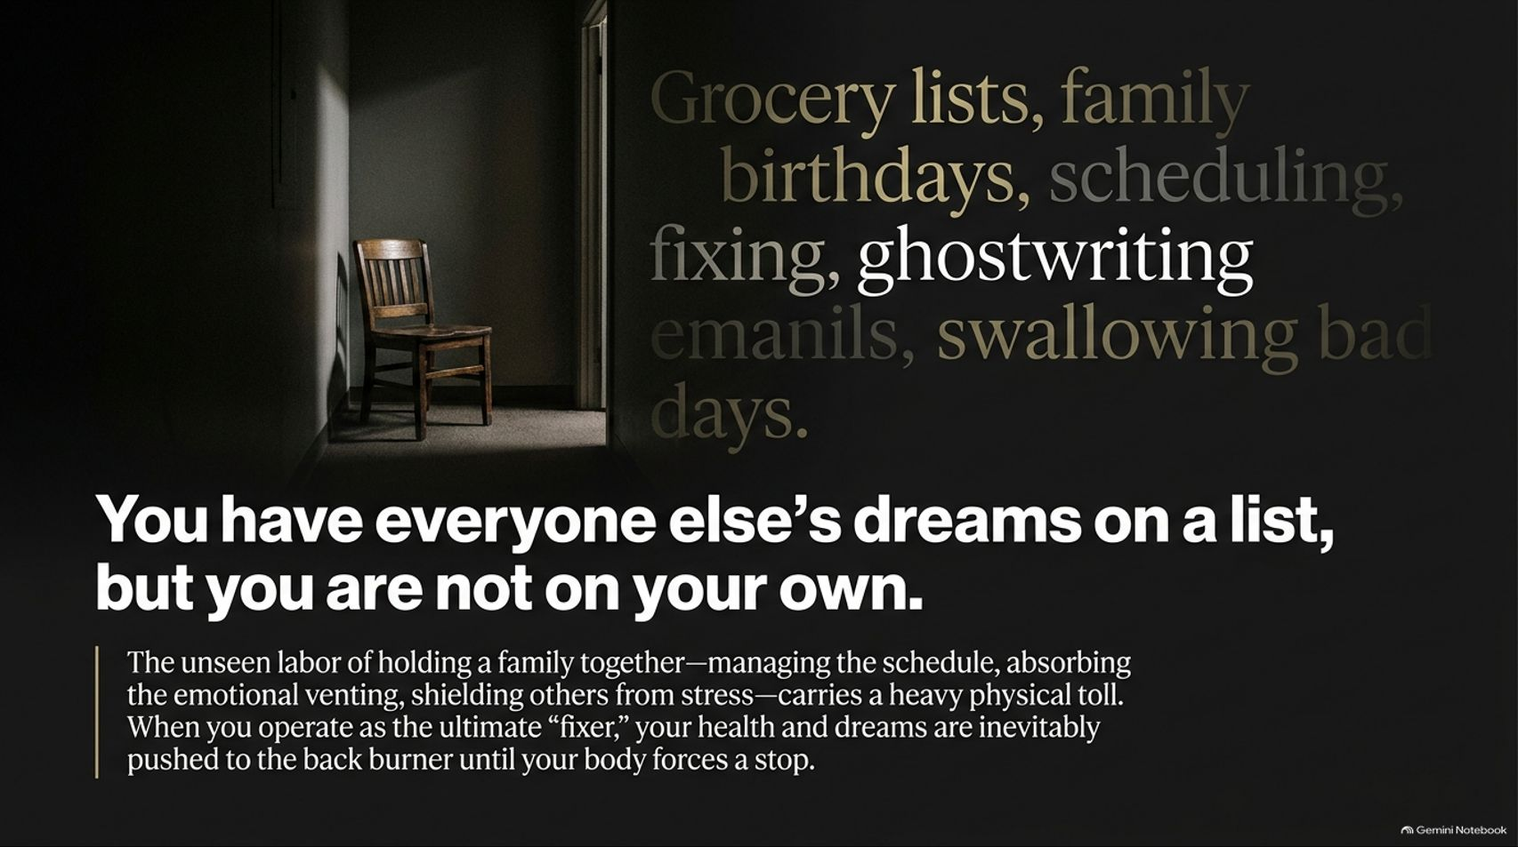
Notes:
Visual: A dark hallway with an empty chair and text highlighting grocery lists, family birthdays, scheduling, fixing, ghostwriting emails, and swallowing bad days.
Estimated Speaking Time: 3 – 4 minutes
Speaker Notes:
"Look closely at the list on this slide: Grocery lists, family birthdays, scheduling, fixing things around the house, ghostwriting emails for spouses or kids, and swallowing your own bad days to keep the peace. If you walked into your own mind right now, whose schedule dominates your mental RAM? Is it yours, or is it everyone else's?
The unseen labor of holding a family or a workplace together—managing the calendar, absorbing everyone's emotional venting, and shielding others from stress—carries a staggering physical and psychological toll. When you operate as the ultimate 'fixer,' your own health, your own career aspirations, and your deepest dreams are inevitably pushed to the back burner. And you stay there until your body literally forces a stop—through burnout, illness, or profound exhaustion.
Think about what Mel Robbins shares regarding how we let our feelings dictate our daily inertia. We get so used to managing everyone else's friction that we become total strangers to our own desires. Today, we are naming that labor. We are going to look at why you have kept everyone else's dreams on your master checklist while your own name isn't even written down anywhere."

Slide 3
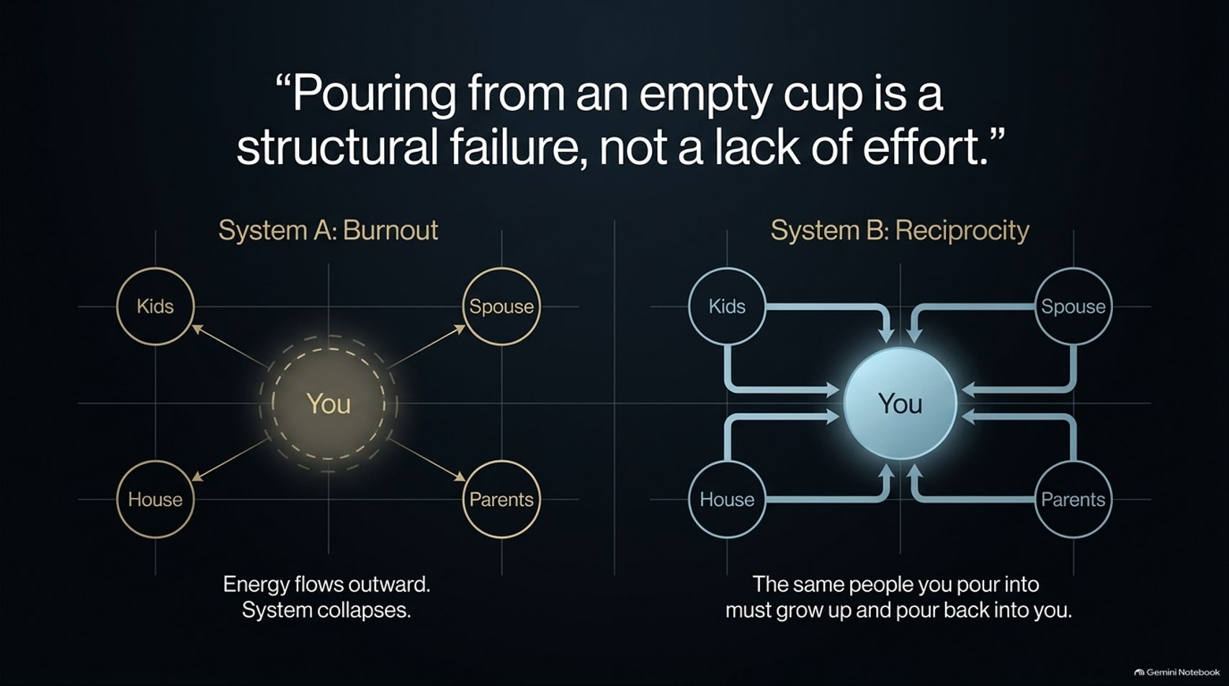
Notes:
Visual: Two system comparison diagrams. System A (Burnout) showing energy flowing outward from 'You' to Kids, Spouse, House, and Parents until the system collapses. System B (Reciprocity) showing energy flowing reciprocally back and forth.
Estimated Speaking Time: 3 – 5 minutes
Speaker Notes:
"Let’s bust one of the most toxic myths in modern wellness and family culture: the idea that if you're burning out, you just need to try harder. That is a lie. As this slide states: 'Pouring from an empty cup is a structural failure, not a lack of effort.'
Look at the two systems on screen. Look at System A: Burnout. You are sitting in the center, acting as a frantic hub, shooting energy outward to your kids, your spouse, your house, and your parents. It is a one-way street. Energy flows outward until the system inevitably collapses under its own weight because physics—and human biology—doesn't allow infinite output without input.
Now look at System B: Reciprocity. In a healthy, sustainable ecosystem, the exact same people you pour into must grow up, step up, and pour back into you. Relationships are not designed to be a permanent parent-child dynamic where you are the perpetual martyr. If your current life structure looks like System A, working harder won't save you—you have to change the architecture of the system itself. Let's look at how we got trapped in that role in the first place."

Slide 4
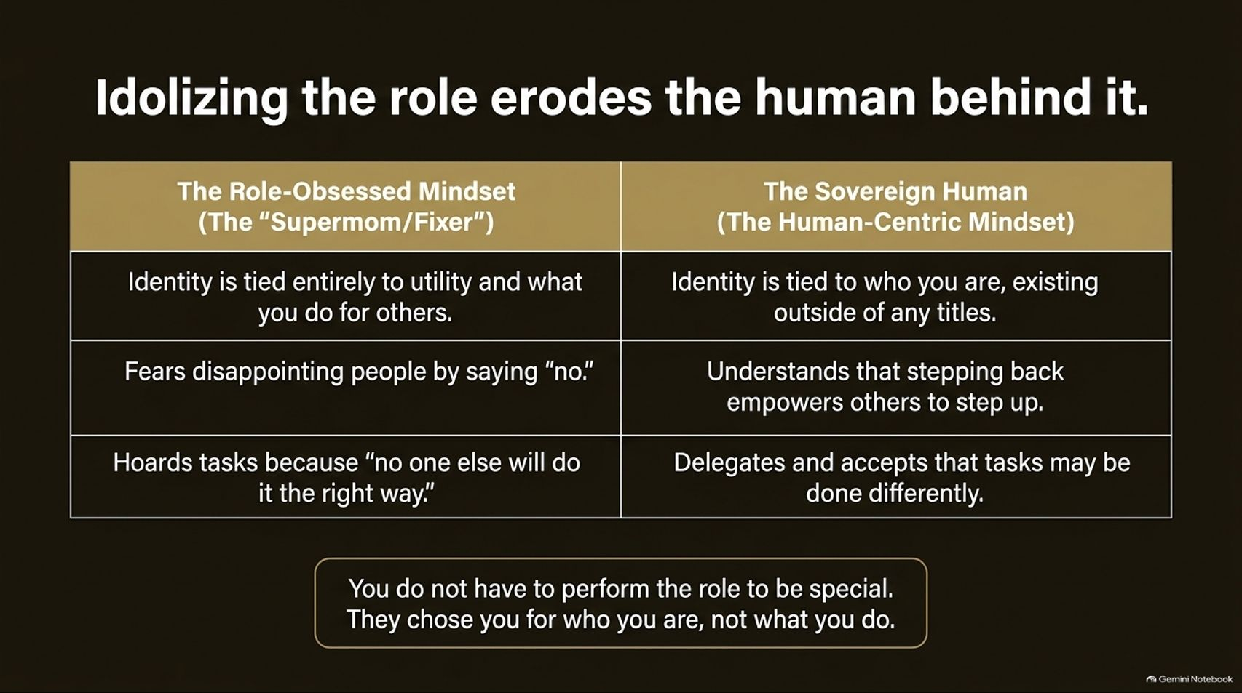
Notes:
Visual: A structured comparison table contrasting 'The Role-Obsessed Mindset (The "Supermom/Fixer")' against 'The Sovereign Human (The Human-Centric Mindset)', anchored by the quote: "You do not have to perform the role to be special. They chose you for who you are, not what you do."
Estimated Speaking Time: 3 – 4 minutes
Speaker Notes:
"We fall into a dangerous trap: we idolize the role so much that we completely erode the human being living inside it. Let's look at the contrast on this slide.
In the Role-Obsessed Mindset—what we call the 'Supermom' or the 'Fixer'—your identity is tied entirely to your utility. You believe you are only valuable based on what you do for others. You live in terror of disappointing people by saying 'no,' and you hoard tasks because of that ego-driven belief that 'no one else will do it the right way.'
Contrast that with the Sovereign Human mindset. Here, your identity is rooted in who you are, existing completely outside of any title or chore list. A Sovereign Human understands that stepping back isn't failing; stepping back actually empowers others to step up. When you delegate, you accept that tasks might be done differently—and that's okay!
Remember the bottom banner: You do not have to perform the role to be special. The people in your life chose you for your essence, your soul, and your presence—not your ability to fold laundry or manage their schedules."

Slide 5
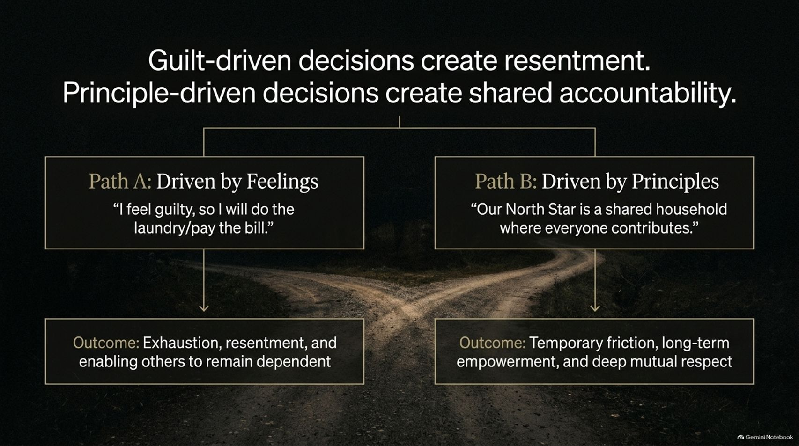
Notes:
Visual: A fork in the road comparing Path A (Driven by Feelings: "I feel guilty, so I will do the laundry/pay the bill") vs. Path B (Driven by Principles: "Our North Star is a shared household where everyone contributes").
Estimated Speaking Time: 3 – 4 minutes
Speaker Notes:
"Every single day, you stand at a fork in the road when faced with domestic and emotional labor. How do you make your decisions? Are they driven by temporary emotional guilt, or are they anchored in long-term principles?
Look at Path A: The Feeling-Driven Path. You walk past the messy kitchen or the pile of laundry, and a wave of guilt hits you. You think, 'I feel guilty, so I'll just do it myself.' What is the outcome? Exhaustion, silent resentment, and actively enabling everyone else around you to remain dependent. You teach them that if they wait you out long enough, you will cave.
Now look at Path B: The Principle-Driven Path. Here, your North Star is a shared household where everyone contributes equitably. When you operate from principles, you accept that there will be temporary friction—people might complain, things might get messy for a few days—but the long-term outcome is profound empowerment, capability, and deep mutual respect. Stop letting momentary guilt dictate a lifetime of burnout."

Slide 6
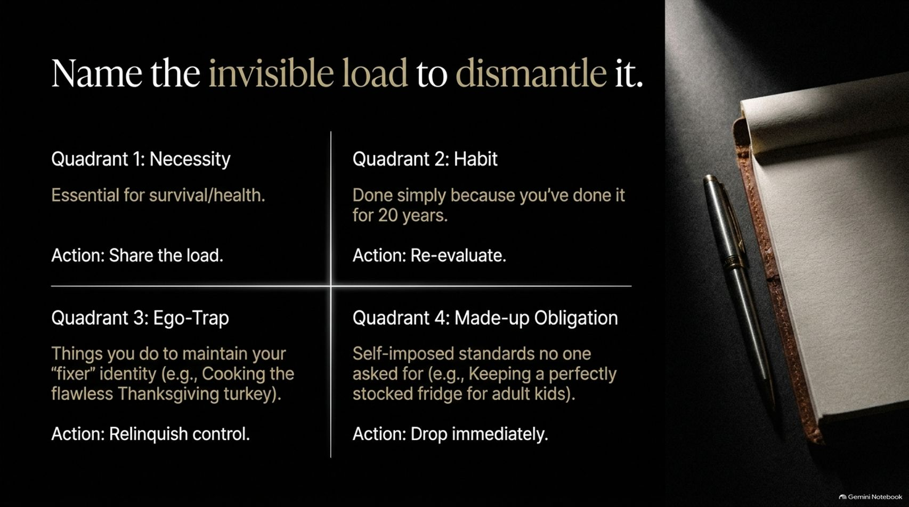
Notes:
Visual: A 2x2 grid detailing four quadrants of labor: Necessity (survival/health), Habit (done for 20 years), Ego-Trap (maintaining the fixer identity), and Made-up Obligation (self-imposed standards).
Estimated Speaking Time: 4 – 5 minutes
Speaker Notes:
"You cannot dismantle what you refuse to look at. On this slide, we break down your invisible load into a tactical 2x2 grid. Let’s look at each quadrant, because not all tasks carry the same weight or purpose:
Quadrant 1: Necessity. These are essential for survival and basic health. The action here is simple: Share the load. Don't hoard necessary survival tasks.
Quadrant 2: Habit. These are things you do simply because you've done them out of habit for the last 10 or 20 years. The action here is to Re-evaluate. Does this still need to be done the way it always has been?
Quadrant 3: Ego-Trap. These are tasks you perform primarily to maintain your 'fixer' identity—like cooking a ridiculously complex, flawless Thanksgiving turkey single-handedly so everyone praises your martyrdom. The action here: Relinquish control.
Quadrant 4: Made-up Obligation. These are completely self-imposed standards that literally no one asked for—like keeping a perfectly color-coordinated, fully stocked snack fridge for adult children who don't even live at home. The action here: Drop immediately.
Audit your lists. Which quadrant are you spending 80% of your energy in?"

Slide 7
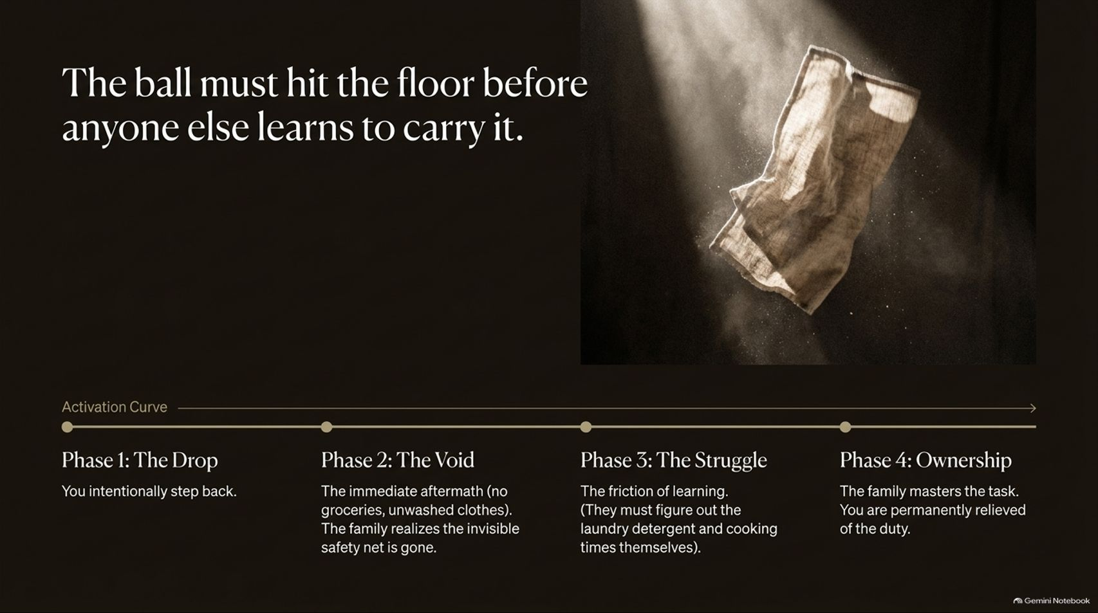
Notes:
Visual: A timeline graphic showing the Activation Curve across four phases: Phase 1: The Drop, Phase 2: The Void, Phase 3: The Struggle, and Phase 4: Ownership, paired with an image of a falling cloth/ball.
Estimated Speaking Time: 4 – 6 minutes
Speaker Notes:
"This is arguably the most critical tactical slide in the entire playbook: The Activation Curve. If you want your family, your partner, or your team to learn how to carry their own weight, you have to understand a fundamental law of human behavior: The ball must hit the floor before anyone else learns to pick it up.
Let's walk through the four phases of the Activation Curve:
Phase 1: The Drop. You intentionally step back. You stop running interference. You stop tracking everyone's dental appointments, school forms, and lost socks.
Phase 2: The Void. This is the immediate aftermath. There are no groceries ordered, clothes are unwashed, chaos ensues. This is where your anxiety spikes because the family realizes the invisible safety net is gone. This is where most people fail—they panic and grab the ball back.
Phase 3: The Struggle. The friction of learning sets in. They have to figure out how to operate the washing machine, figure out laundry detergent, and notice when things are empty. They will fumble.
Phase 4: Ownership. Through that struggle, the family masters the task. And you? You are permanently relieved of a duty that was never yours to bear alone.
Let the ball drop. Trust the void. That friction is the sound of other people growing up."

Slide 8
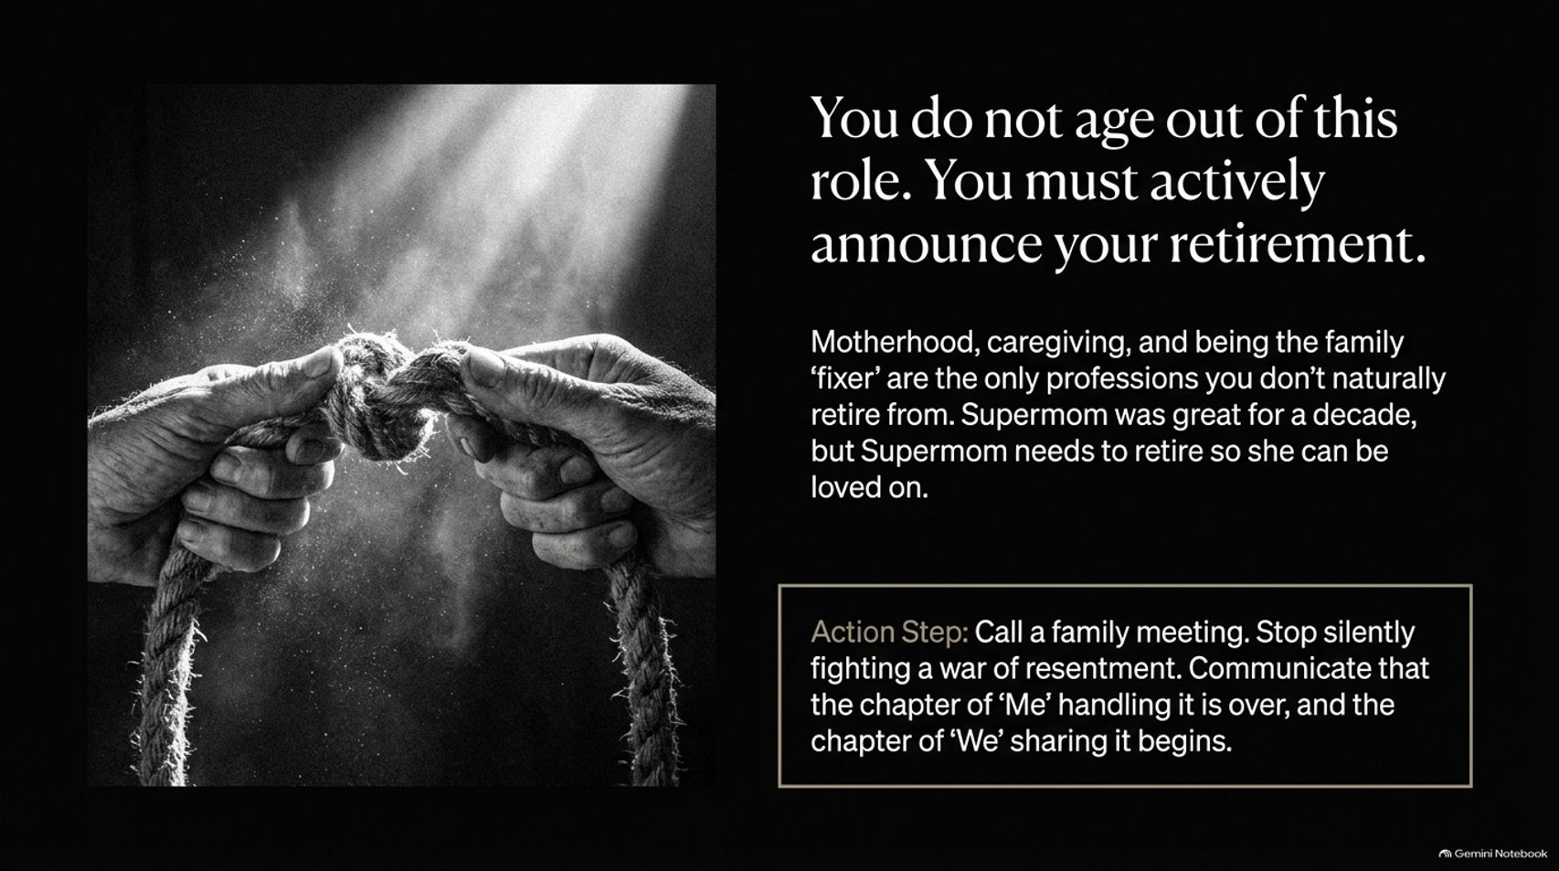
Notes:
Visual: Two hands untying or gripping a heavy rope in black and white, featuring an action step box on calling a family meeting.
Estimated Speaking Time: 3 – 4 minutes
Speaker Notes:
"Here is a sobering truth: You do not naturally 'age out' of being the family fixer. In corporate life, there is a retirement party, a gold watch, and a clear transition. But in family systems, caregiving, and motherhood, people will happily let you keep carrying the burden until your body breaks down. You do not naturally retire from being Supermom—you must actively announce your retirement.
Supermom was a great chapter for a decade, but she needs to retire so that you can finally be loved for who you are, rather than what you produce or manage.
Look at the action step: Call a family meeting. Stop silently fighting a war of resentment behind closed doors while washing dishes with aggressive force. Sit down, communicate clearly, and state: 'The chapter of "Me" handling everything solo is over. The chapter of "We" sharing this life begins right now.' Own your retirement announcement."

Slide 9
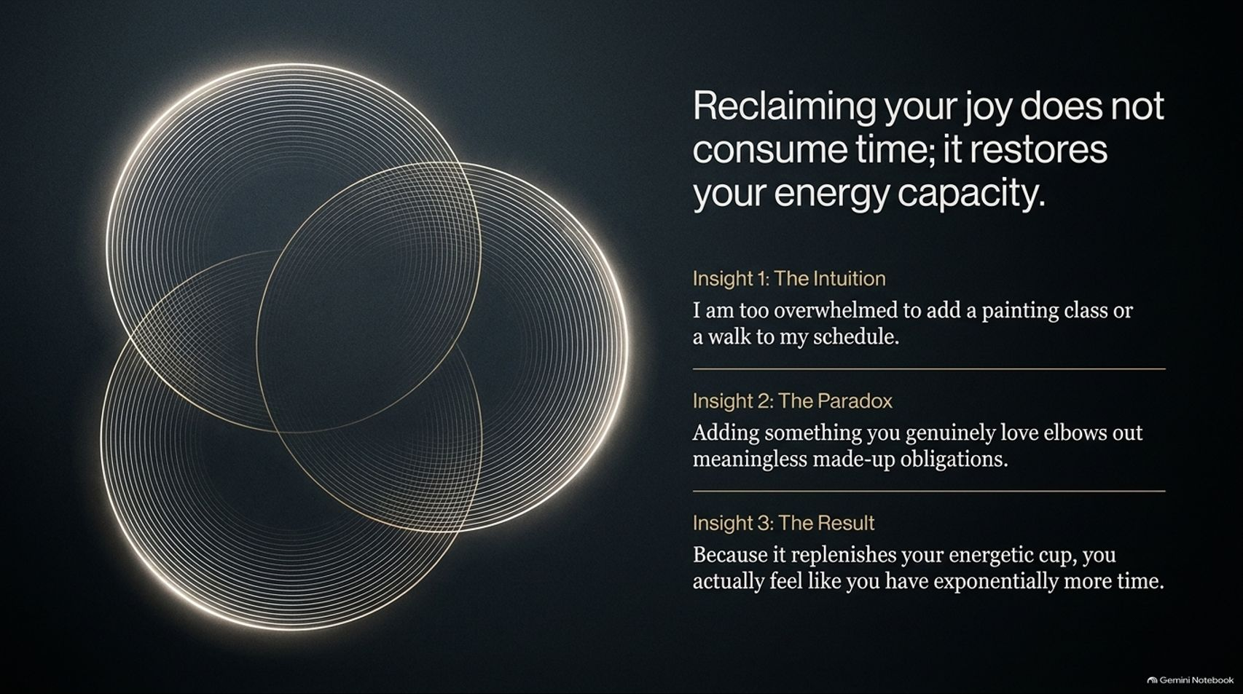
Notes:
Visual: Abstract overlapping golden luminous circles creating a Venn diagram effect, paired with insights on intuition, paradox, and results.
Estimated Speaking Time: 3 – 4 minutes
Speaker Notes:
"When we talk about adding self-care, hobbies, or personal joy back into an exhausted schedule, the immediate pushback we hear—our intuition telling us lies—is: 'I am way too overwhelmed. I don't have time to add a painting class, a walk, or reading time to my schedule!' That is Insight 1: The Intuition of Scarcity.
But let's look at Insight 2: The Paradox. Adding something you genuinely love doesn't crowd your life—it elbows out all the meaningless, made-up obligations you've been drowning in. It creates a boundary around your soul.
And that leads to Insight 3: The Result. Because doing what you love replenishes your energetic cup, you don't feel depleted; you actually feel like you have exponentially more time and energy. Joy is not a luxury item on your to-do list; joy is the fuel that keeps your internal engine running without burning out."

Slide 10
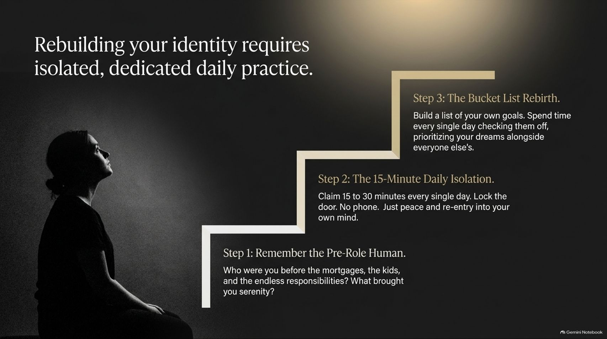
Notes:
Visual: A silhouette of a person sitting in quiet reflection next to a stepped staircase graphic detailing three steps: Pre-Role Human, 15-Minute Daily Isolation, and Bucket List Rebirth.
Estimated Speaking Time: 4 – 5 minutes
Speaker Notes:
"Rebuilding your sovereign identity after years of self-sacrifice requires deliberate, isolated, daily practice. It doesn't happen by accident. Look at the three-step staircase on this slide:
Step 1: Remember the Pre-Role Human. Before the mortgages, before the kids, before the endless career and family responsibilities piled up—who were you? What sparked joy in your chest? What brought you serenity when you were twenty years old? Connect back to that original spark.
Step 2: The 15-Minute Daily Isolation. Claim 15 to 30 minutes every single day without exception. Lock the door. Leave the phone outside. No notifications, no demands. Just absolute peace and re-entry into your own mind.
Step 3: The Bucket List Rebirth. Build a list of your own personal goals and dreams. Spend time every single day checking them off, prioritizing your aspirations right alongside everyone else's.
You are not a supporting character in everyone else's movie. You are the author of your own."

Slide 11
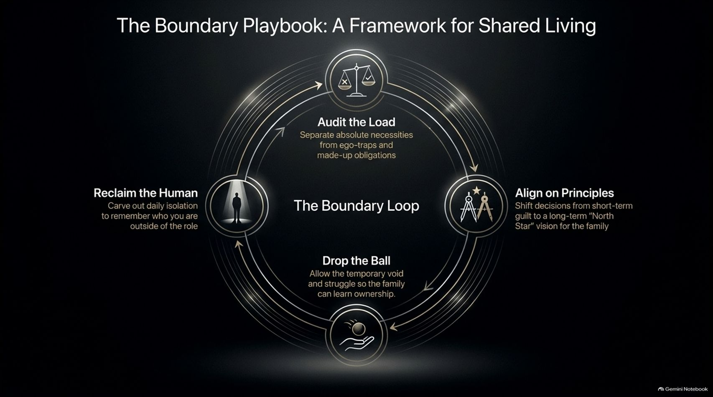
Notes:
Visual: A circular flowchart diagram titled 'The Boundary Loop' featuring four core stages: Audit the Load, Align on Principles, Drop the Ball, and Reclaim the Human, connected in a continuous cycle.
Estimated Speaking Time: 4 – 5 minutes
Speaker Notes:
"We have walked through the individual components, and now we bring them together into The Boundary Loop—a complete framework for sustainable, shared living. Notice how this is a continuous cycle, not a one-time event:
Audit the Load: Regularly separate absolute survival necessities from ego-traps and made-up obligations (Quadrant analysis).
Align on Principles: Shift your family or team decisions away from short-term emotional guilt toward a long-term 'North Star' vision of shared contribution.
Drop the Ball: Intentionally step back, allowing the temporary void and struggle so that others can learn real ownership and capability.
Reclaim the Human: Carve out daily isolation and joy to remember who you are outside of your utility and titles.
When you run this loop consistently, boundaries stop feeling like walls that keep people out, and start feeling like architecture that keeps your sanity and relationships intact."

Slide 12
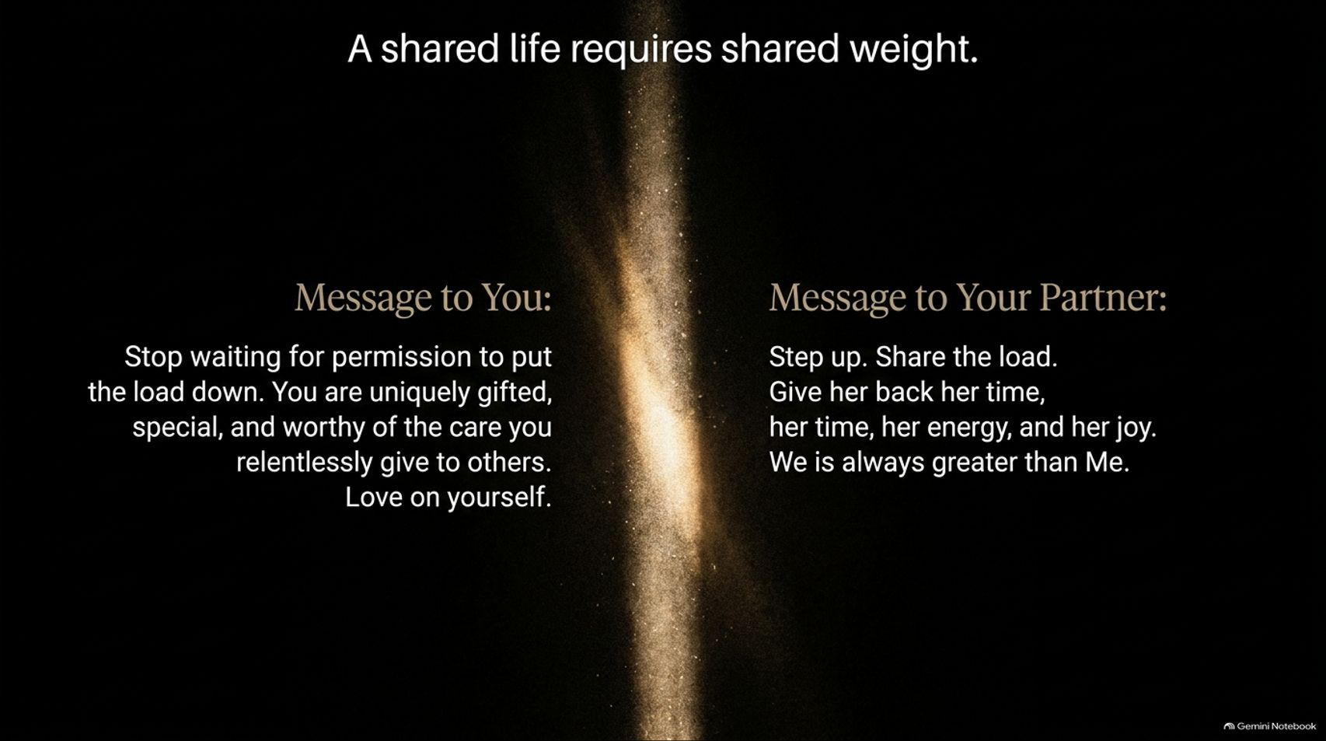
Notes:
Visual: A split slide layout comparing two direct messages: 'Message to You' (Stop waiting for permission, love on yourself) vs. 'Message to Your Partner' (Step up, share the load, give her back her time/energy, We is always greater than Me), separated by a vertical column of golden starlight.
Estimated Speaking Time: 3 – 4 minutes
Speaker Notes:
"As we near the conclusion of this playbook, we have two distinct messages that must be spoken clearly.
First, The Message to You: Stop waiting for permission to put the load down. You are uniquely gifted, special, and profoundly worthy of the exact same care, patience, and devotion that you so relentlessly hand out to everyone else. Love on yourself first.
Second, The Message to Your Partner / Your Household: Step up. Share the weight. Give back her time, her energy, and her joy. Realize that 'We' is always greater than 'Me.' A partnership is not a spectator sport where one person manages the stadium while the other sits in the stands. True love means sharing the load so neither person breaks under the pressure."

Slide 13
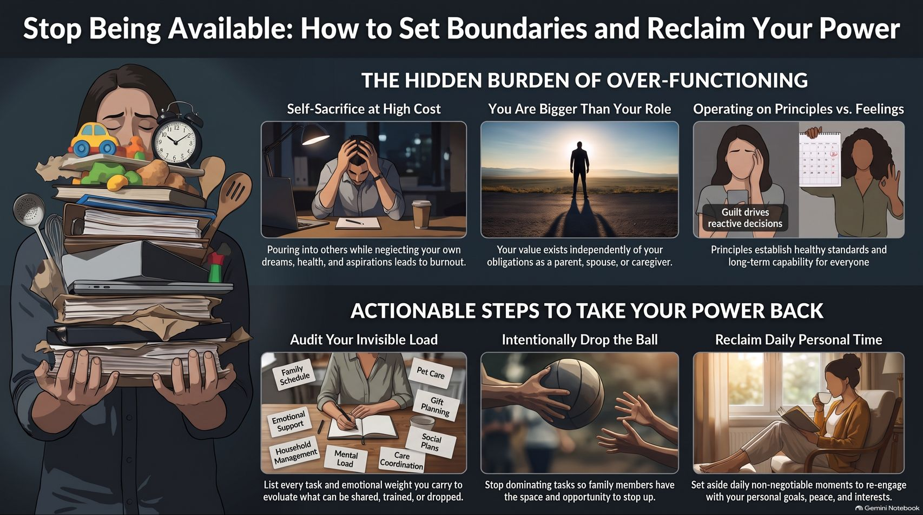
Notes:
Visual: Comprehensive summary slide featuring a montage of illustrations representing the hidden burden of over-functioning and actionable steps to take power back (Audit Invisible Load, Intentionally Drop the Ball, Reclaim Daily Personal Time).
Estimated Speaking Time: 3 – 5 minutes
Speaker Notes:
"We arrive at our summary slide: Stop Being Available: How to Set Boundaries and Reclaim Your Power.
Look at the visual summary in front of you. On the left and top, we see the hidden burden of over-functioning: self-sacrifice at high cost, operating out of guilt rather than principles, and burning out while pouring into others.
But look at the bottom row—your actionable roadmap moving forward:
Audit Your Invisible Load: List every task and emotional weight you carry, and ruthlessly evaluate what can be shared, trained, or dropped.
Intentionally Drop the Ball: Stop dominating every task so that family members and colleagues finally have the space and opportunity to step up.
Reclaim Daily Personal Time: Set aside daily, non-negotiable moments to re-engage with your personal goals, peace, and vital interests.
You have the playbook. You know the cost of staying available to everyone else at the expense of your own soul. Starting today, stop being available to chaos, and start being available to yourself. Thank you."

