Slide 1

Notes:
Visual: A close-up cinematic shot of a heavy 1 kilogram 999.9 fine gold bar, centered with a futuristic holographic HUD interface overlay reading: "The Bullion Bubble Backfires: The Tectonic Shift from Paper Suppression to Physical Price Discovery."
Estimated Speaking Time: 2 – 3 minutes
Speaker Notes:
"Welcome everyone to today's special briefing. Today, we are breaking down a historic, structural watershed moment in global finance—one that we have been tracking closely as the paper suppression paradigm finally collides with unrelenting physical reality.
As you can see on our title slide, we are witnessing The Bullion Bubble Backfires. For decades, the global pricing of precious metals has been anchored to fractional, paper-dominated exchanges like the COMEX and LBMA, where synthetic contracts and unallocated claims outnumber physical bullion by orders of magnitude. But that era of engineered price suppression is officially coming to a violent end.
Today, we are going to examine the exact mechanics of this market dislocation, the role of central bank interventions, the strategic positioning of the U.S. Exchange Stabilization Fund under Scott Bessent and Judy Shelton, and the upcoming catalyst in Hong Kong that is set to rewrite global price discovery forever. Let's dive straight into the mechanics of the trap."
Bessent’s Bullion Bubble Backfires - LFTV Ep 297
https://www.youtube.com/watch?v=LwPLKSWaGNs

Slide 2
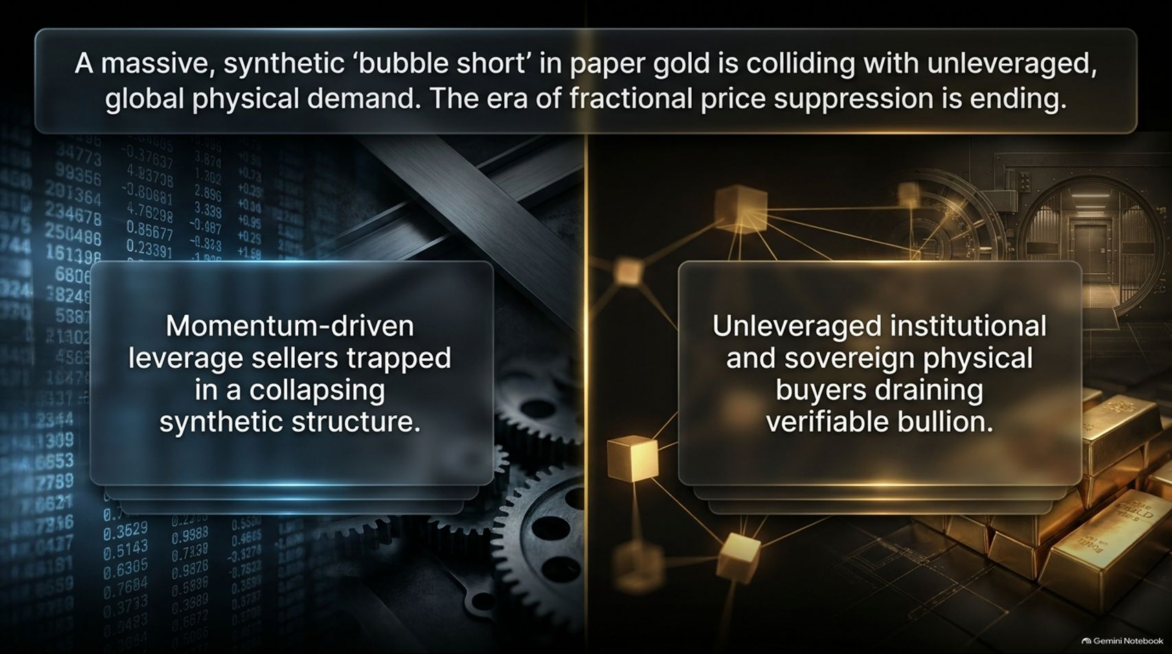
Notes:
Visual: A split-screen comparison. On the left, a dense digital trading terminal with tumbling red numbers and gears representing synthetic short positions; on the right, a glowing gold vault and interconnected blockchain-style nodes representing institutional physical demand.
Estimated Speaking Time: 3 – 5 minutes
Speaker Notes:
"To understand why the gold and silver markets are behaving the way they are right now, we have to look at the core conflict driving the entire financial system: A massive, synthetic 'bubble short' in paper gold is colliding with unaligned, unleveraged, global physical demand.
On the left side of your screen, you see the momentum-driven leverage sellers—speculators and institutional funds trapped inside a collapsing synthetic structure. They have relied on percentage-based margin requirements to double down on short positions into a declining market, effectively painting the tape and driving artificial price drops.
But look at the right side of the screen. Unleveraged institutional buyers, sovereign central banks, and industrial accumulators across Asia, India, and the Middle East are quietly draining verifiable, high-grade bullion at a rate of over $1 billion a week. The gap between what is traded on paper and what actually exists in physical vaults has stretched beyond its breaking point. The era of fractional price suppression is ending."

Slide 3

Notes:
Visual: A heavy golden nautical anchor resting against a dark background, with its primary anchor chain snapped cleanly in half under immense tension, accompanied by structured bullet panels.
Estimated Speaking Time: 4 – 5 minutes
Speaker Notes:
"Let’s examine the exact anatomy of this market dislocation. As illustrated by our snapped anchor on screen, the traditional link between paper pricing and physical reality has broken.
Look at what is happening across the major delivery hubs:
First, institutional physical buyers are aggressively demanding T+1 physical delivery, completely bypassing the old rules of delayed settlement.
Second, fast-market leverage sellers who thought they were playing a safe paper game are suddenly being called in by prime brokers to stand and deliver physical bullion that they simply do not own.
Third, cash settlement is no longer sufficient. Counterparties are rejecting paper credits because the systemic demand for real, unencumbered collateral is shattering the paper loop.
When the market demands physical metal and the shorts only have paper promises, the entire synthetic anchor snaps."

Slide 4
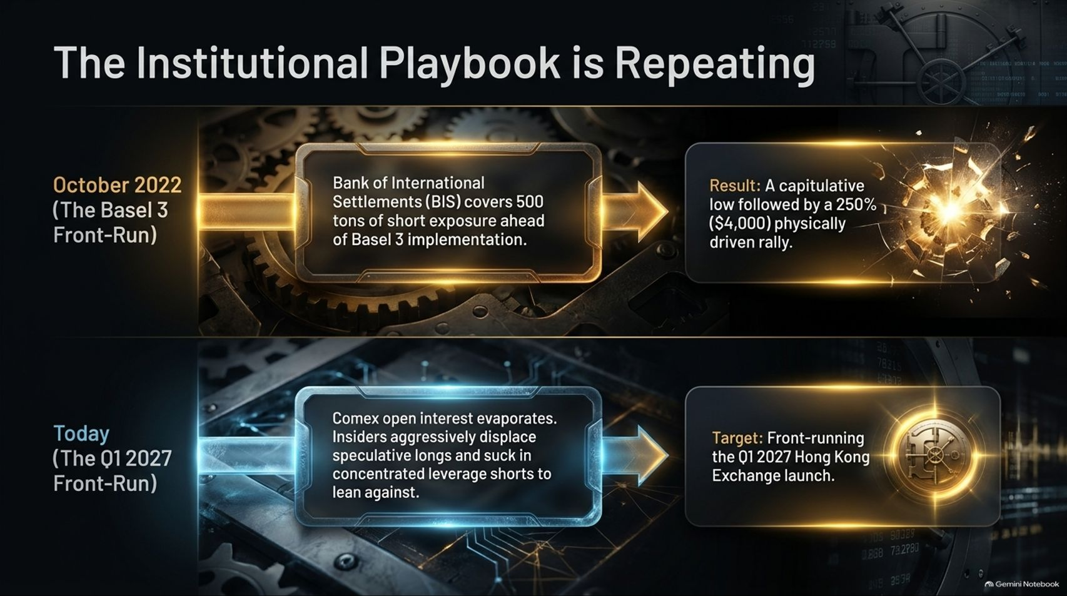
Notes:
Visual: A two-part timeline comparing October 2022 (Basel 3 Front-Run) on top with Today (The Q1 2027 Front-Run) on the bottom, utilizing glowing gold arrows and vault target icons.
Estimated Speaking Time: 4 – 6 minutes
Speaker Notes:
"History doesn't just rhyme in the precious metals market; it repeats with astonishing precision. Look at the institutional playbook mapped out on this slide.
Back in October 2022, right ahead of the official Basel 3 implementation, the Bank of International Settlements (BIS)—often referred to as the central bank of central banks—quietly covered and squared the remaining 500 tons of their accumulated short gold exposure. What was the result? A capitulative low followed by a breathtaking 250%, $4,000 physically driven rally.
Look at where we are today. COMEX open interest is evaporating as insiders aggressively displace speculative longs and suck in concentrated leverage shorts to lean against. Why? Because they are front-running the massive structural pivot launching in the first quarter of 2027. The insiders are positioning themselves ahead of the storm; the retail speculators are once again being led right into the slaughterhouse."

Slide 5
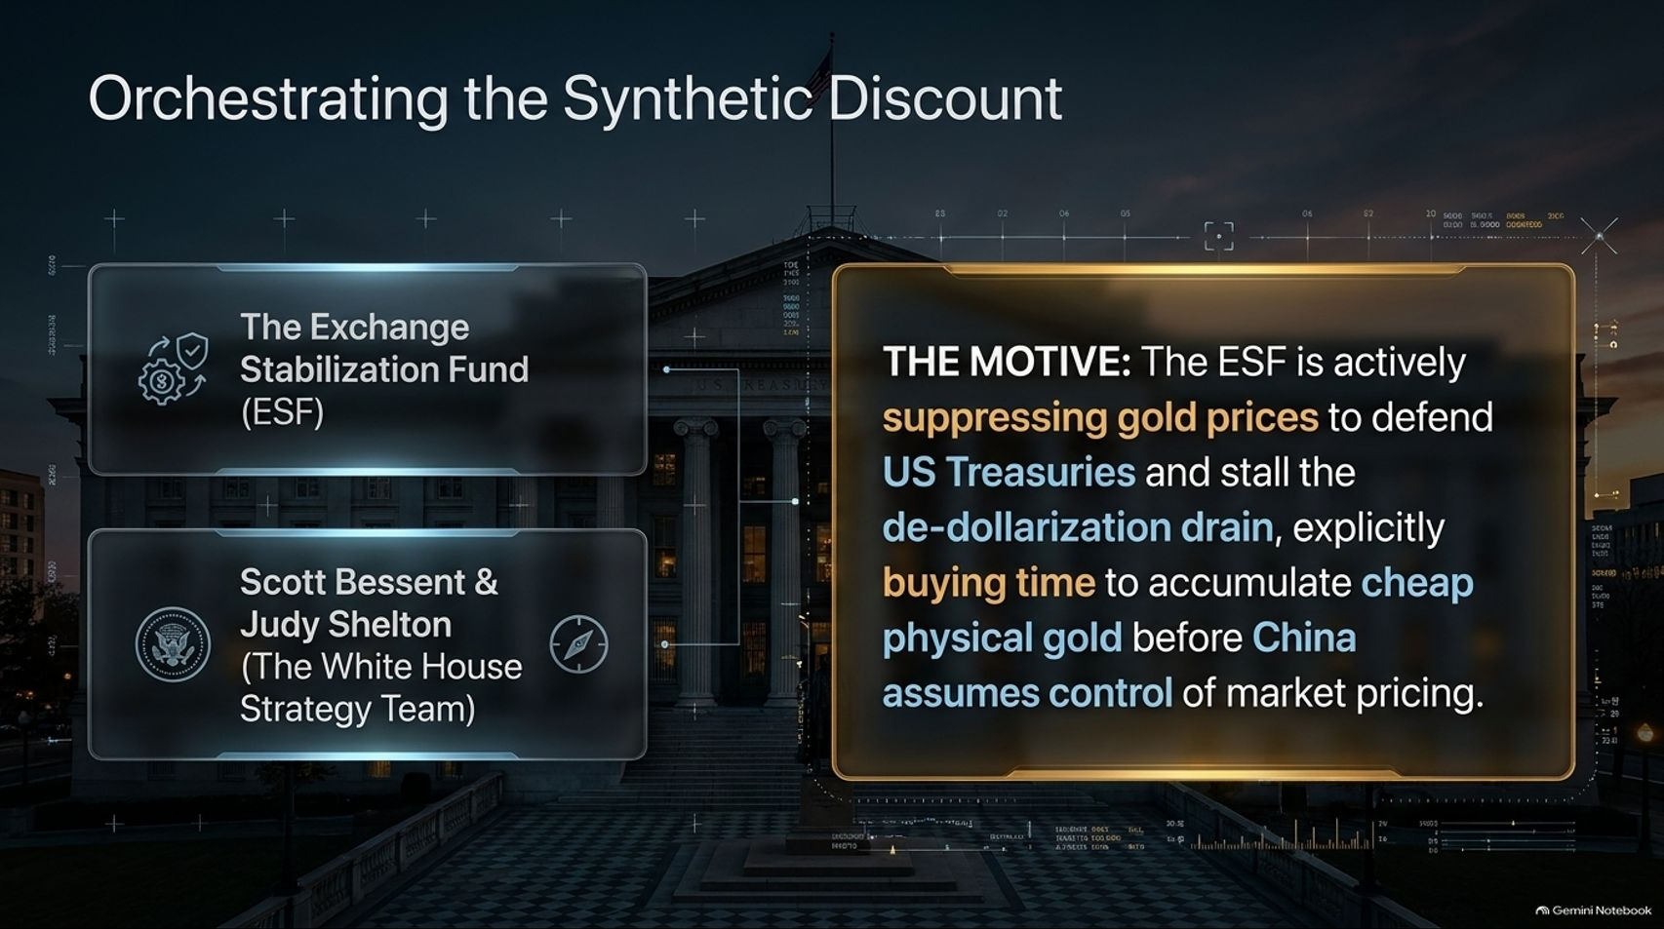
Notes:
Visual: The majestic neoclassical facade of the U.S. Treasury building in Washington D.C., overlaid with futuristic HUD readouts, linking the Exchange Stabilization Fund (ESF) to a golden strategy module.
Estimated Speaking Time: 4 – 5 minutes
Speaker Notes:
"Who is actually driving these counterintuitive, aggressive sell-offs in gold and silver? To answer that, we have to look at Washington, the U.S. Exchange Stabilization Fund (ESF), and the White House strategy team featuring Scott Bessent and Judy Shelton.
What is the motive? The ESF is actively suppressing gold prices to defend U.S. Treasuries and stall the relentless drain of de-dollarization.
By executing aggressive paper suppression, the Treasury strategy team is explicitly buying time to accumulate cheap physical gold in the over-the-counter (OTC) market before China and its sovereign partners assume absolute control of global market pricing. They are weaponizing paper derivatives to artificially deflate the price of gold, creating a rigged discount so they can quietly vacuum up physical bullion before the music stops."

Slide 6
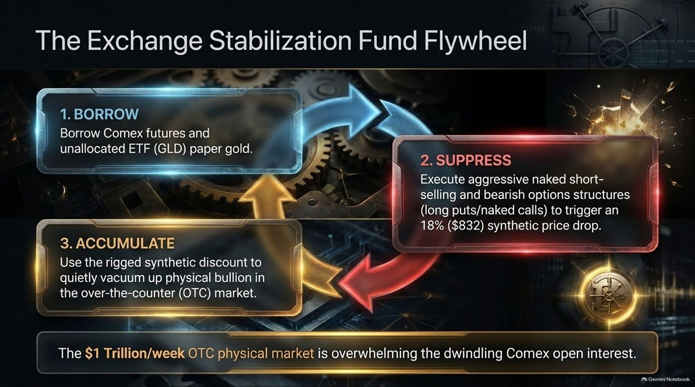
Notes:
Visual: A circular 3-step economic flywheel graphic detailing the mechanics of 1. Borrow, 2. Suppress, and 3. Accumulate, surrounded by industrial gears and vault imagery.
Estimated Speaking Time: 4 – 5 minutes
Speaker Notes:
"Let’s break down the exact operational mechanics of the Exchange Stabilization Fund Flywheel as illustrated on screen:
Step 1 (Borrow): The interventionists borrow COMEX futures and unallocated ETF paper gold—such as unallocated shares from the GLD—creating massive phantom supply.
Step 2 (Suppress): They execute aggressive naked short-selling and bearish options structures, combining long puts and naked calls to engineer a steep, synthetic price drop—such as the recent 18% ($832) drop.
Step 3 (Accumulate): They use this rigged synthetic discount to quietly vacuum up physical bullion in the over-the-counter (OTC) market.
The $1 trillion-a-week OTC physical market is rapidly overwhelming dwindling COMEX open interest. This flywheel cannot spin forever; the physical demand is simply too immense."

Slide 7
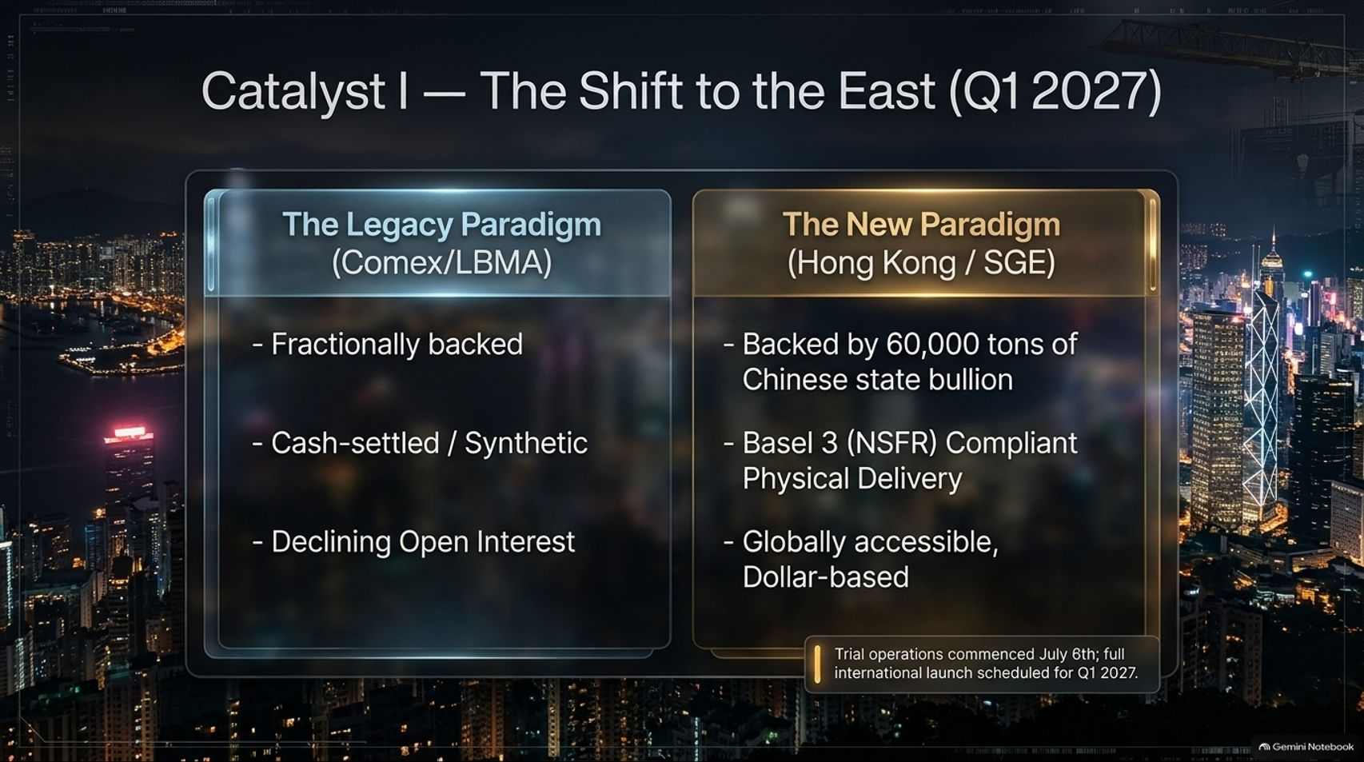
Notes:
Visual: A split comparison table contrasting the Legacy Paradigm (Comex/LBMA) against the New Paradigm (Hong Kong/SGE), set against a glowing nighttime skyline of Hong Kong.
Estimated Speaking Time: 4 – 5 minutes
Speaker Notes:
"This brings us to Catalyst I: The Great Shift to the East, culminating in the full international launch in the first quarter of 2027.
Let's look at the paradigm shift on your screen:
The Legacy Western Paradigm (COMEX/LBMA): Fractionally backed, entirely cash-settled and synthetic, characterized by declining open interest and toxic paper exposure.
The New Eastern Paradigm (Hong Kong / SGE): Backed by over 60,000 tons of Chinese state and sovereign bullion, fully Basel 3 (NSFR) compliant with mandatory physical delivery, and globally accessible while remaining dollar-linked during its rollout.
Trial operations commenced on July 6th, and the full international rollout in Q1 2027 represents the definitive migration of global price discovery from paper illusion to physical reality."

Slide 8

Notes:
Visual: A global map centered on the prime meridians, featuring glowing golden trade routes connecting New York and London to major hubs in the Middle East, India, and Asia.
Estimated Speaking Time: 4 – 5 minutes
Speaker Notes:
"Take a close look at this global map. The physical re-allocation of wealth is accelerating at an unprecedented scale.
The Macro Trigger: With over $40 trillion in U.S. national debt requiring servicing at structurally higher interest rates, sovereign de-dollarization is no longer a theoretical debate—it is an economic survival necessity.
The Physical Reality: Persistent, massive kilobar buying from Indian, Asian, and Saudi institutional buyers is aggressively tightening global refinery capacity and completely breaking paper correlations.
Gold is flowing decisively from West to East. Vaults in New York and London are being systematically drained to feed the insatiable demand of sovereign buyers who refuse to hold unbacked paper IOUs."

Slide 9
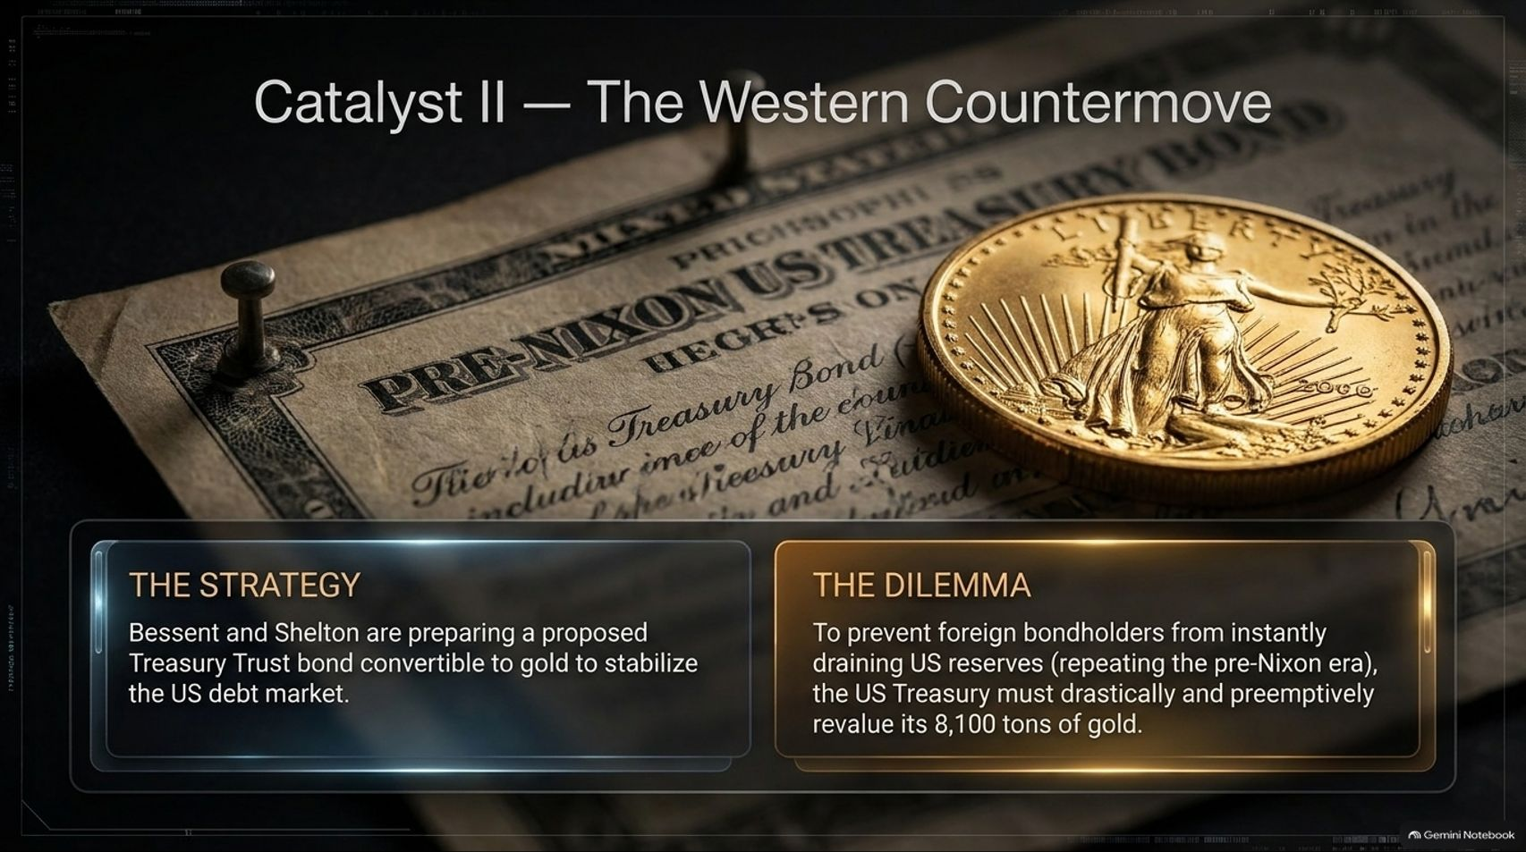
Notes:
Visual: A historical pre-Nixon U.S. Treasury Bond document pinned down beside a gleaming American Gold Eagle bullion coin.
Estimated Speaking Time: 4 – 5 minutes
Speaker Notes:
"Now let's examine Catalyst II: The Western Countermove. As the U.S. debt burden spirals out of control, the Treasury strategy team—including Scott Bessent and Judy Shelton—is actively preparing a proposed Treasury Trust bond convertible to gold to stabilize the collapsing U.S. debt market.
But this strategy creates a massive dilemma: To prevent foreign bondholders from instantly draining remaining U.S. gold reserves—repeating the exact fatal flaw of the pre-Nixon era—the U.S. Treasury must drastically and preemptively revalue its official 8,100 tons of gold.
If foreign creditors are offered a gold-backed instrument, the math requires the underlying gold to be repriced to match outstanding liabilities. Front-running this mathematical inevitability is the true, hidden purpose of the current institutional accumulation ahead of Q1 2027."

Slide 10
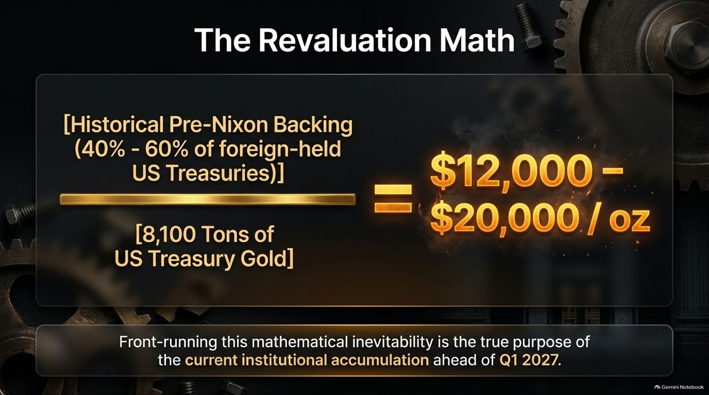
Notes:
Visual: A clean mathematical equation framed in glowing gold, dividing historical pre-Nixon backing ratios against 8,100 tons of U.S. Treasury gold, resulting in a valuation target of $12,000 to $20,000 per ounce.
Estimated Speaking Time: 4 – 5 minutes
Speaker Notes:
"Let’s look at the raw revaluation math on screen. Historically, sound money backing required covering between 40% and 60% of foreign-held U.S. Treasuries.
When you take that historical backing ratio and divide it across the U.S. Treasury’s official reserve of 8,100 tons of gold, the resulting valuation is staggering: $12,000 to $20,000 per ounce.
This is not speculative fantasy; it is the strict mathematical outcome required to stabilize a $40 trillion sovereign debt structure if the West introduces a gold-backed Treasury bond. Front-running this structural repricing is why central banks and insiders are aggressively accumulating physical metal right now, ignoring the artificial paper price dips on the COMEX."

Slide 11

Notes:
Visual: A high-contrast industrial pressure gauge needle pegged deep into the red 'Critical' zone, with digital readouts showing 110% system stress and >95% margin call probability.
Estimated Speaking Time: 4 – 5 minutes
Speaker Notes:
"Let’s analyze the extreme vulnerability of the paper bubble short right now. Look at our pressure gauge on screen: system stress is sitting at 110%, and the probability of cascading margin calls is over 95%.
Mechanics of the Trap: Momentum speculators have doubled down, utilizing lower percentage-based margin requirements to short into a declining market.
The Catalyst: As unleveraged physical demand steadily pushes the spot price up, exponential margin calls are triggered. Put options are deep in the money, and there are virtually no calls left to cash in below $4,000.
The Outcome: The market is sitting on a tinderbox. We are on the verge of a catastrophic, forced short-covering event that will obliterate leveraged paper shorts."

Slide 12

Notes:
Visual: A high-temperature industrial crucible pouring molten, glowing liquid silver into a casting mold, accompanied by structured insight panels.
Estimated Speaking Time: 4 – 5 minutes
Speaker Notes:
"Everything we have detailed regarding gold applies with even greater explosive force to silver.
Core Insight: Silver is currently experiencing an identical speculative 'bubble short' structure. Speculators have been trapped on the wrong side of the ledger by aggressive paper shorting.
Market Reality: Despite silver not holding official Basel 3 Tier-1 bank asset status, relentless institutional and industrial demand—driven by solar, electronics, and sovereign hoarding—is rapidly draining physical supplies worldwide.
This structural deficit guarantees a massive upward price realignment in silver that will run parallel to, and in percentage terms exceed, the breakout in gold."

Slide 13

Notes:
Visual: A massive, multi-ton steel bank vault door swung open, revealing rows of secure safe deposit boxes and modern high-tech refining equipment inside.
Estimated Speaking Time: 4 – 5 minutes
Speaker Notes:
"The migration of the physical value chain is no longer theoretical—it is happening on the ground in real-time.
The Proof: Valcambi—one of the world’s premier Swiss refiners—is establishing its first-ever refinery outside of Switzerland directly in Hong Kong.
The Synthesis: A complete, self-sustaining ecosystem is being forged. We are seeing Swiss refining capacity, London-style OTC volume, and U.S.-style futures infrastructure being consolidated into a single Asian hub anchored entirely to verifiable, physical bullion.
Major refiners are voting with their capital, positioning themselves directly where the physical demand and sovereign custody requirements reside."

Slide 14
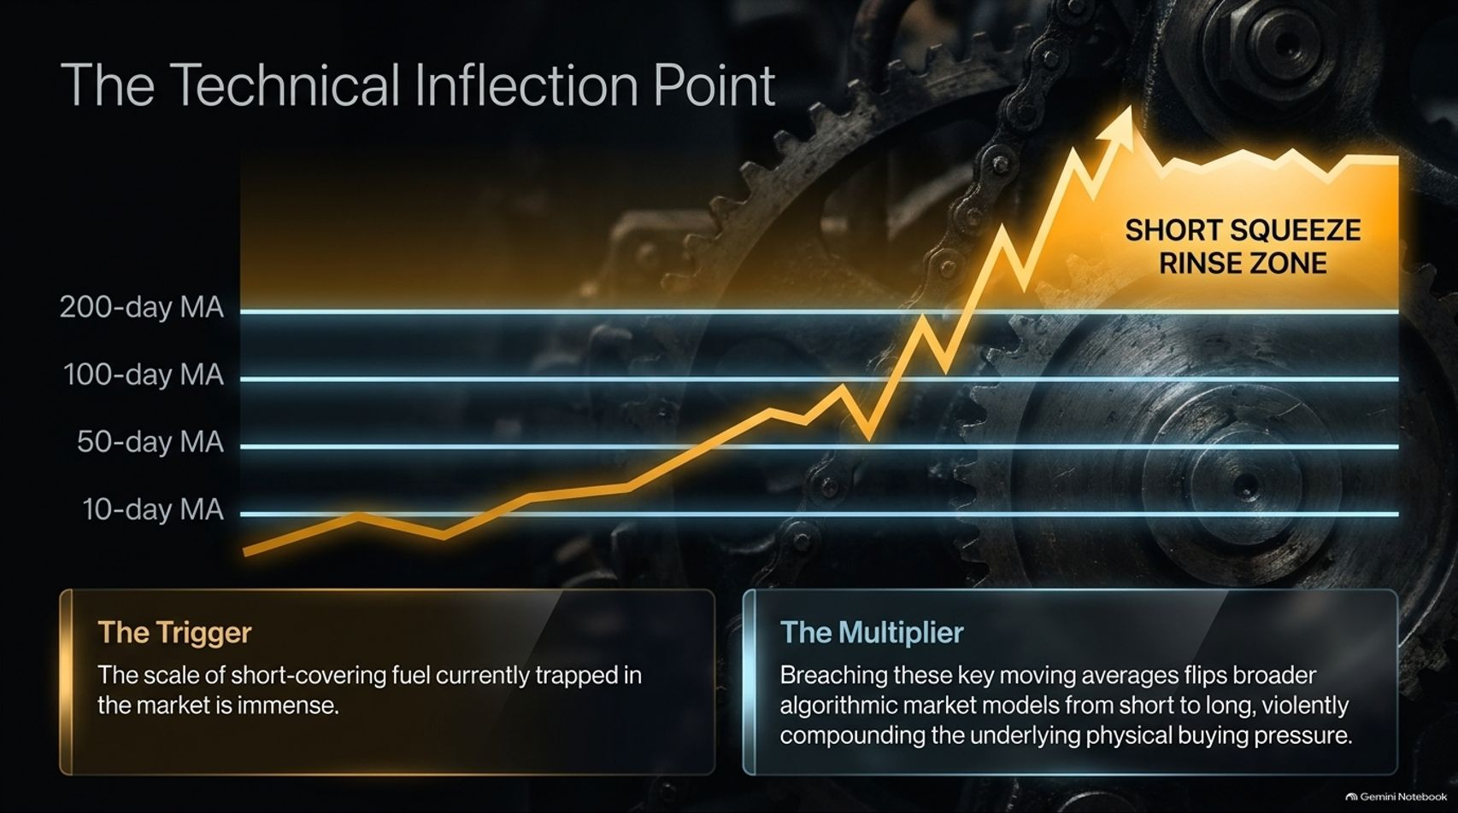
Notes:
Visual: A technical chart featuring moving average lines (10-day, 50-day, 100-day, and 200-day MA) being pierced by a sharp golden price breakout entering the 'Short Squeeze Rinse Zone'.
Estimated Speaking Time: 4 – 5 minutes
Speaker Notes:
"Let’s look at the technical inflection point currently unfolding on the charts.
The Trigger: The scale of short-covering fuel currently trapped in the market is immense. Speculators who thought they could cap the market have run out of open interest.
The Multiplier: As spot prices breach key moving averages—the 10-day, 50-day, 100-day, and 200-day MAs—broader algorithmic market models are forced to flip violently from short to long.
This technical transition creates a compounding multiplier effect, supercharging the underlying physical buying pressure and launching the market directly into the Short Squeeze Rinse Zone."

Slide 15
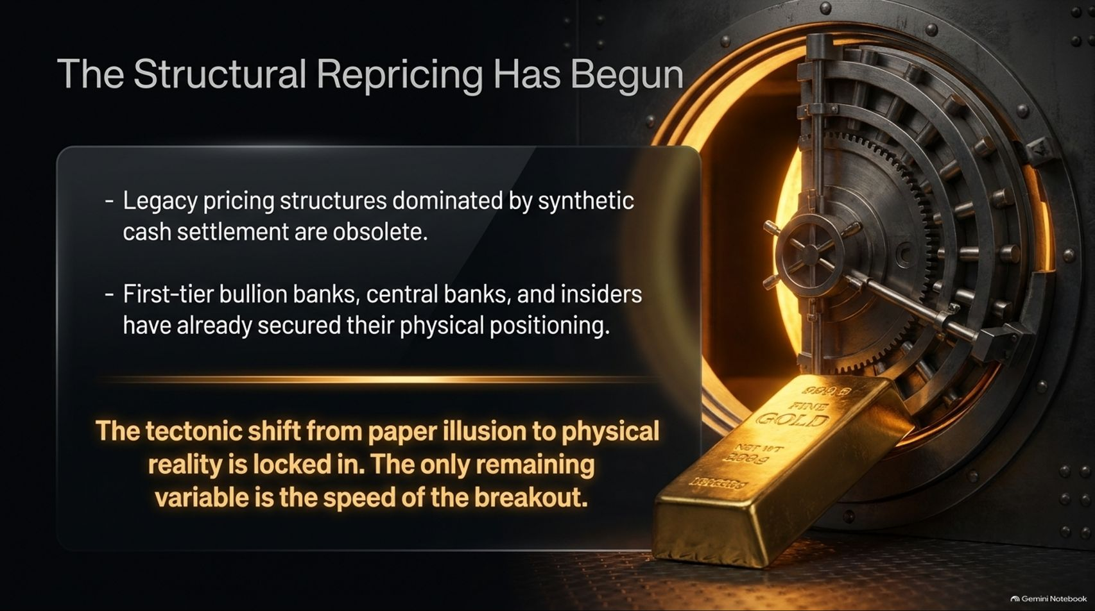
Notes:
Visual: A golden vault door framing a pristine bar of fine gold, accompanied by summary conclusion bullet points on the obsolescence of legacy pricing.
Estimated Speaking Time: 4 – 5 minutes
Speaker Notes:
"As we synthesize the data across all our metrics, the conclusion is inescapable: The structural repricing has begun.
Legacy pricing structures dominated by synthetic cash settlement and unallocated paper promises are officially obsolete.
First-tier bullion banks, central banks, and well-connected insiders have already secured their physical positioning.
The tectonic shift from paper illusion to physical reality is locked in. The paper suppression model is broken beyond repair, and the only remaining variable is the sheer speed of the ultimate breakout."

Slide 16

Notes:
Visual: A comprehensive executive summary slide featuring a classic judicial scale balancing Paper Market Suppression on the left against Physical Market Reality on the right, surrounded by all core catalysts, ESF interventions, and revaluation milestones.
Estimated Speaking Time: 4 – 6 minutes
Speaker Notes:
"We conclude our presentation with this master synthesis dashboard, balancing the crumbling paper suppression trap against the unyielding force of physical market reality.
On the left, we see the overextended speculative shorts, the official ESF interventions, and the synthetic 18% price drops designed to buy time for the Treasury. On the right, we see the true anchors: the Q1 2027 Hong Kong physical exchange launch, the mathematical inevitability of U.S. Treasury gold revaluation to $12,000–$20,000/oz, and record sovereign physical accumulation.
The paper trap has officially backfired on its creators. As we head deeper into gold season, the transition from synthetic paper claims to verifiable physical ownership is complete. Make sure your positioning reflects reality before the final doors of the paper vault lock shut. Thank you."

