Slide 1
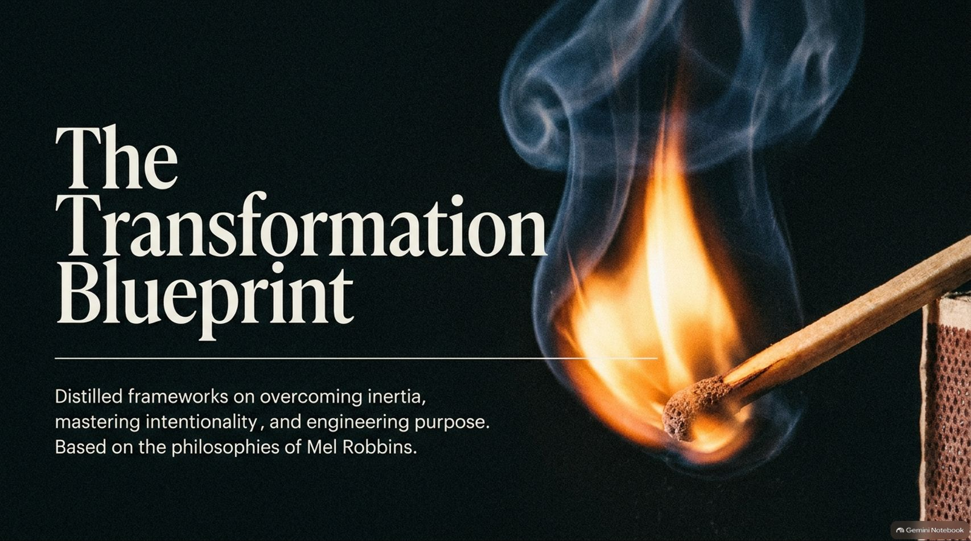
Notes:
Visual: Dark background featuring a close-up of a match stick igniting into a bright, curling flame, accompanied by title text: "The Transformation Blueprint: Distilled frameworks on overcoming inertia, mastering intentionality, and engineering purpose. Based on the philosophies of Mel Robbins."
Estimated Speaking Time: 2 – 3 minutes
Speaker Notes:
"Welcome everyone. Today, we are walking through The Transformation Blueprint—a comprehensive operational guide for personal evolution built on the distilled philosophies of Mel Robbins.
As pictured on our opening slide, transformation is rarely a massive, dramatic event; it begins with a single, immediate spark of intentional movement. So many of us spend years feeling stuck, overthinking our choices, and waiting for motivation or permission that is never going to come. Over the next 13 slides, we are going to deconstruct the mechanics of self-sabotage, examine the '5-Second Rule' override, analyze relational boundaries like 'Let Them,' and explore how true purpose is created through action. Let's begin by looking at where your current choices are taking you."
How To Make The Next 10 Years The Best Years Of Your Life | Mel Robbins | FO584 Raj Shamani
https://www.youtube.com/watch?v=RR2bORcvzKs

Slide 2
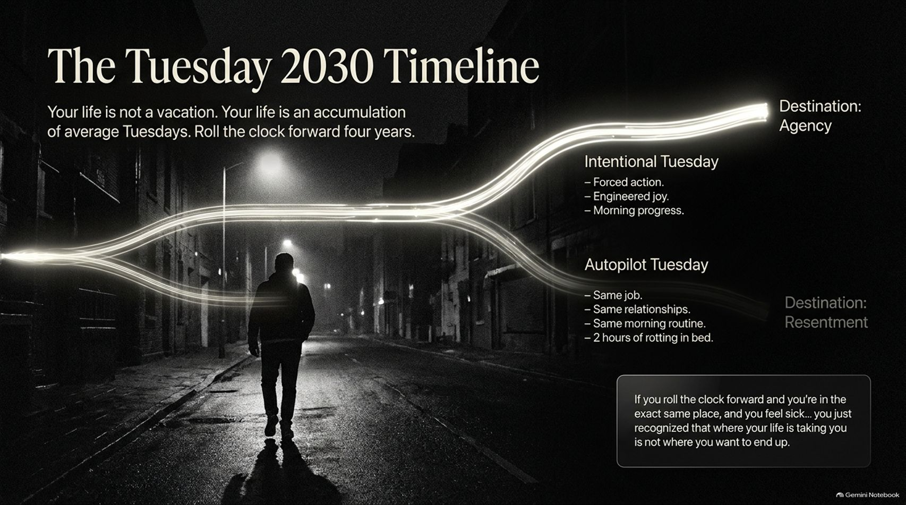
Notes:
Visual: A black-and-white night scene of a person walking down an empty street, flanked by two diverging light paths: Intentional Tuesday (leading to Destination: Agency) and Autopilot Tuesday (leading to Destination: Resentment), with a callout note on assessing where your current trajectory is leading.
Estimated Speaking Time: 3 – 5 minutes
Speaker Notes:
"Let me start with a fundamental truth from Mel Robbins: Your life is not a vacation. Your life is an accumulation of average Tuesdays.
Look at the diverging timelines on this slide. If we roll the clock forward four years to a Tuesday in 2030, you will arrive at one of two destinations:
Autopilot Tuesday (Destination: Resentment): You wake up in the exact same job, stuck in the exact same relational dynamics, dragging through the same morning routine, spending two hours laying in bed rotting on your phone. If you imagine that scenario right now and feel a pit in your stomach, you’ve just realized your current trajectory is taking you somewhere you don't want to end up.
Intentional Tuesday (Destination: Agency): You take control today. You force immediate action, engineer daily moments of joy, and make progress on what matters before the world demands your attention.
The choices you make on an ordinary Tuesday determine which timeline becomes your reality."

Slide 3
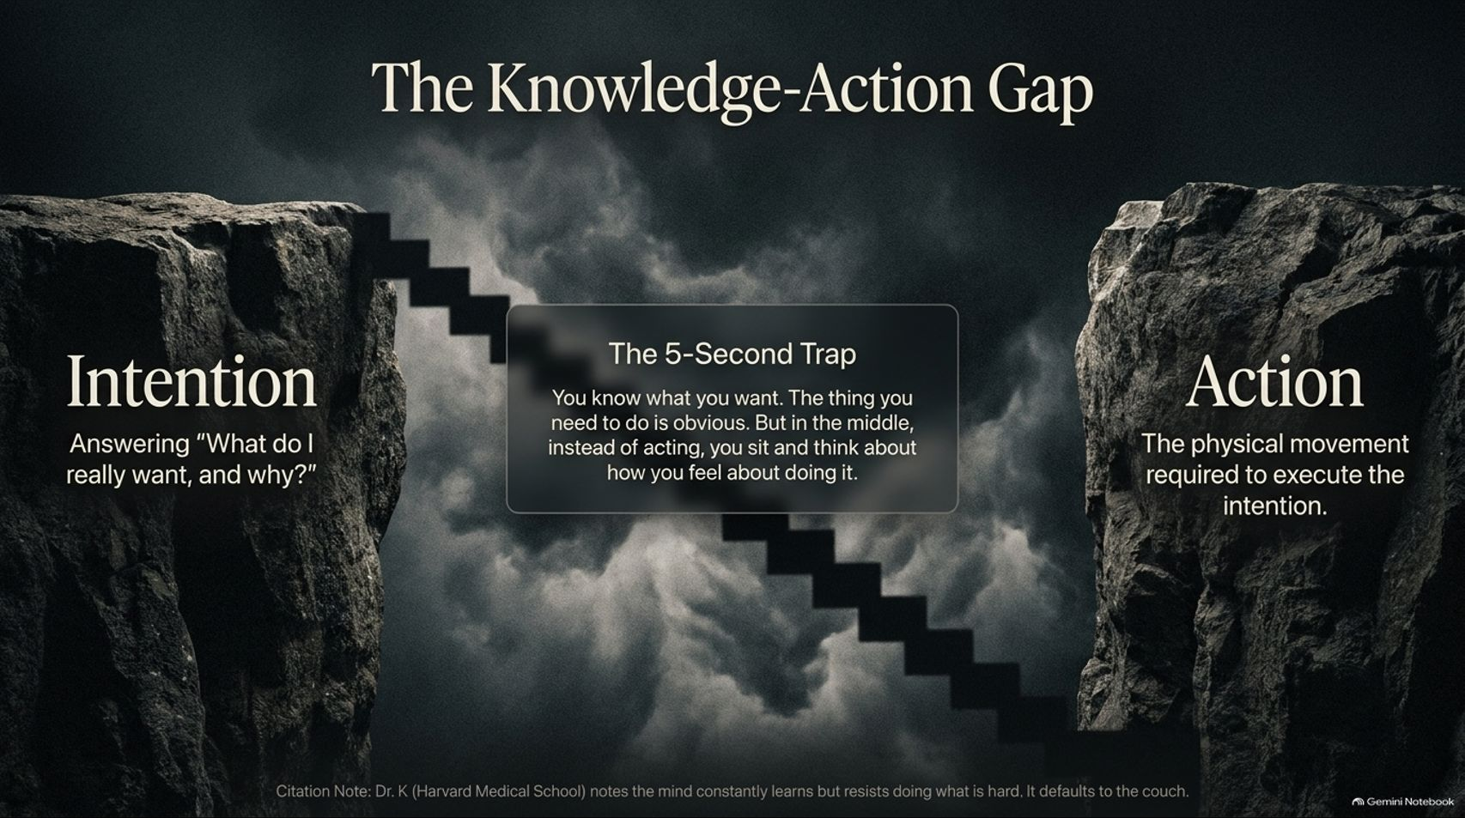
Notes:
Visual: A cliff chasm connected by a broken, suspended staircase. On the left cliff sits Intention (Answering "What do I really want, and why?"); on the right cliff sits Action (Physical movement required to execute); in the middle gap sits The 5-Second Trap. Includes a citation note referencing Dr. K (Harvard Medical School) on cognitive resistance.
Estimated Speaking Time: 4 – 5 minutes
Speaker Notes:
"Almost everyone knows what they should do to improve their lives—exercise, apply for the job, manage emotions, save money, or leave toxic situations. Yet millions remain stuck. Why? Because of The Knowledge-Action Gap.
Look at the chasm on screen. On one side, you have Intention—clarifying what you want. On the other side, you have Action—the physical movement required to get there.
Right in the middle sits The 5-Second Trap. When it's time to act, instead of taking immediate physical action, you pause and hesitate. You sit and think about how you feel about taking the action. As Dr. K from Harvard Medical School notes, your brain is designed to learn, but it inherently resists hard, unfamiliar tasks and defaults to the easy option—the couch. The moment you let your feelings negotiate with your intentions, you lose."

Slide 4
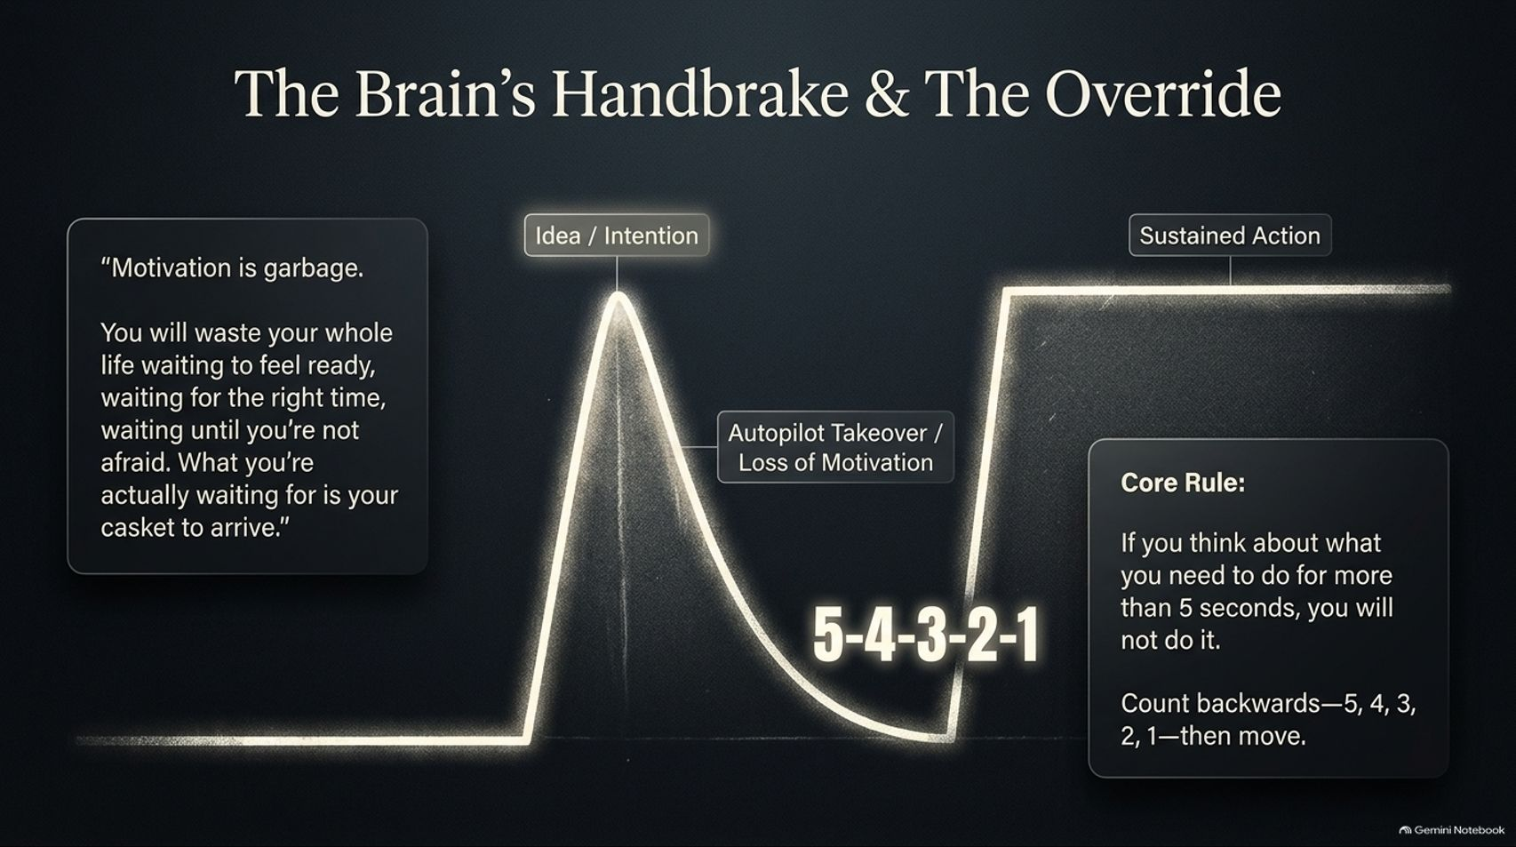
Notes:
Visual: A line graph tracking a surge from 'Idea / Intention', plunging into an 'Autopilot Takeover / Loss of Motivation' valley, and forcefully overriding upward to 'Sustained Action' via a bold 5-4-3-2-1 callout box containing Mel Robbins' quote on motivation.
Estimated Speaking Time: 4 – 5 minutes
Speaker Notes:
"Mel Robbins famously states: 'Motivation is garbage. You will waste your whole life waiting to feel ready, waiting for the right time... What you're actually waiting for is your casket to arrive.'
Look at the neurological mechanism plotted on this chart:
You get an Idea or Intention.
Within 5 seconds, your brain’s survival mechanism pulls the handbrake, plunging you into Autopilot Takeover where fear, doubt, and emotional resistance talk you out of it.
The Core Rule Override (5-4-3-2-1): The moment you recognize hesitation, you count backward out loud or in your head—5, 4, 3, 2, 1—and physically move.
Counting backward requires deliberate prefrontal cortex focus, interrupting the brain's default autopilot loop and driving physical movement before your brain can convince you to quit."

Slide 5
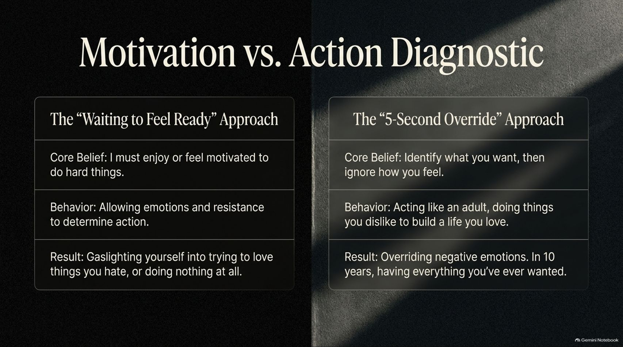
Notes:
Visual: A two-column comparison table contrasting The "Waiting to Feel Ready" Approach against The "5-Second Override" Approach, highlighting Core Belief, Behavior, and Result.
Estimated Speaking Time: 3 – 5 minutes
Speaker Notes:
"Let's compare these two operational approaches side-by-side:
The 'Waiting to Feel Ready' Approach: Operates on the false belief that you must feel motivated or enjoy a task before doing it. This behavior lets temporary emotions dictate your actions, resulting in gaslighting yourself into trying to love things you hate—or doing nothing at all.
The '5-Second Override' Approach: Operates on the mature belief that you identify what you want, and then intentionally ignore how you feel in the moment. You act like an adult, executing uncomfortable tasks so you can build a life you love.
Newsflash: If you simply forced yourself to do the hard things you don't feel like doing, in 10 years you would have everything you've ever wanted."

Slide 6
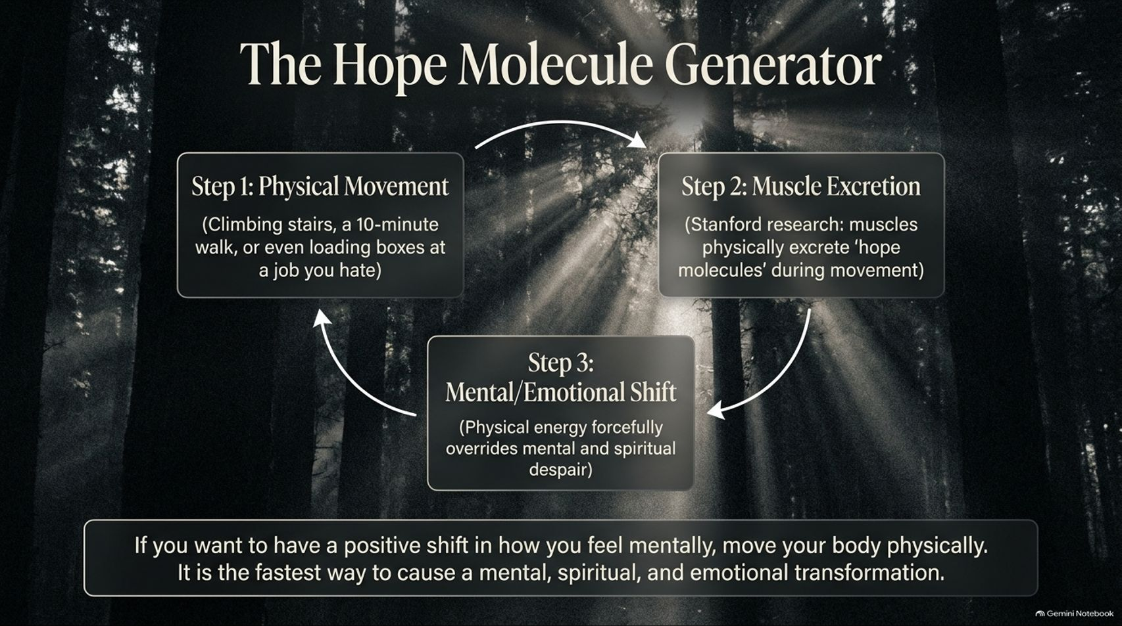
Notes:
Visual: A circular 3-step cycle overlaying a sunlit forest: Step 1: Physical Movement $\rightarrow$ Step 2: Muscle Excretion (Stanford research on 'hope molecules') $\rightarrow$ Step 3: Mental/Emotional Shift, anchored by a bottom summary card on physical movement.
Estimated Speaking Time: 3 – 4 minutes
Speaker Notes:
"When you are stuck in a dark chapter—facing financial hardship, loss, or deep discouragement—trying to 'think' your way into a better mood rarely works. You must use your physical body to alter your mental state.
Look at The Hope Molecule Generator framework on screen:
Step 1 (Physical Movement): Whether it's climbing stairs, taking a 10-minute walk, or lifting boxes at a job you dislike.
Step 2 (Muscle Excretion): Stanford research cited by Dr. Kelly McGonigal demonstrates that contracting your muscles physically secretes biochemicals called 'hope molecules' into your bloodstream.
Step 3 (Mental/Emotional Shift): This surge of physical energy directly overrides mental despair, creating an upward spiral of resilience.
Physical movement is the single fastest way to induce a mental, spiritual, and emotional transformation."

Slide 7
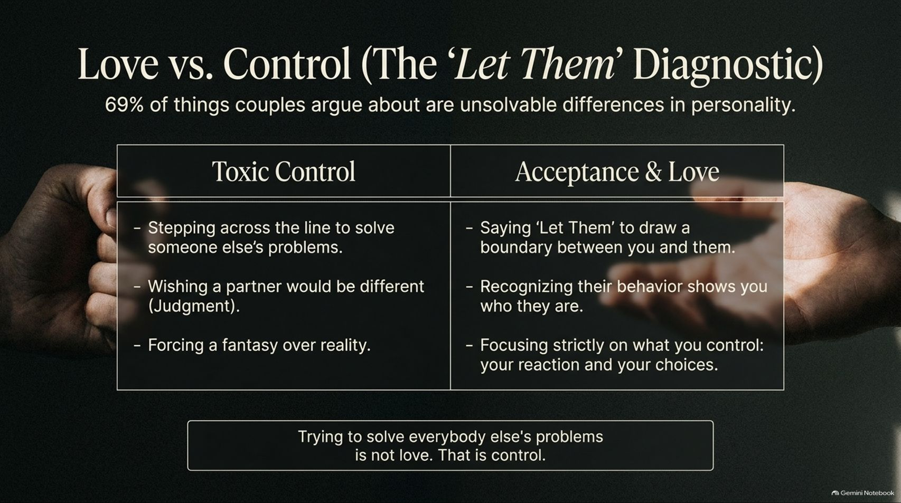
Notes:
Visual: Two hands in high contrast—one clenched in a tight fist (Toxic Control), the other reaching open (Acceptance & Love)—above a comparison table detailing boundary management, with a Gottman statistic callout (69% unsolvable differences).
Estimated Speaking Time: 4 – 5 minutes
Speaker Notes:
"Relationships are often ruined by a fundamental misunderstanding of love versus control. As research from the Gottman Institute reveals, 69% of things couples argue about are unsolvable differences in personality.
Look at our diagnostic table:
Toxic Control: Stepping across the line to solve someone else's problems, wishing a partner were different, and forcing your personal fantasy over reality. Trying to control others isn't love; it's anxiety and judgment.
Acceptance & Love: Utilizing the 'Let Them' framework. Saying 'Let Them' draws a healthy emotional boundary. It recognizes that people show you who they are, letting you focus strictly on what you control: your reactions, your choices, and your standards."

Slide 8
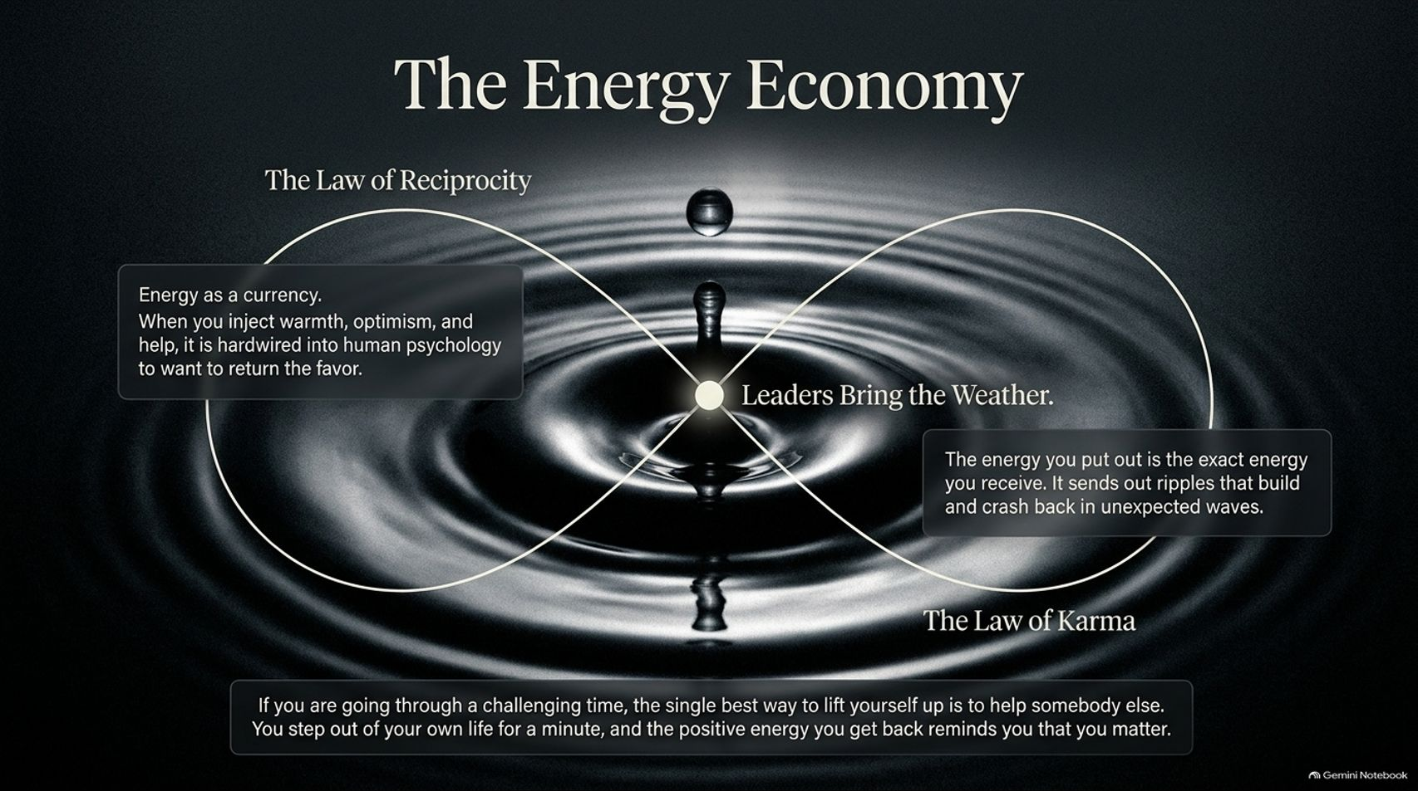
Notes:
Visual: A fluid infinity loop diagram set against water ripples from a single droplet. Nodes highlight 'The Law of Reciprocity', 'The Law of Karma', and a central anchor: "Leaders Bring the Weather."
Estimated Speaking Time: 3 – 5 minutes
Speaker Notes:
"Your personal energy is your most valuable currency. As shown on this slide, every human being acts as a leader because your behavior directly influences the emotional weather of those around you.
Consider two underlying psychological laws:
The Law of Reciprocity: When you bring warmth, optimism, and genuine support to others, human psychology naturally hardwires them to want to return the favor.
The Law of Karma: The energy you project into the world builds ripples that eventually return in unexpected waves.
If you are going through a painful period, the fastest way to lift yourself out of discouragement is to help someone else. Stepping out of your own head to serve others proves your value and restores your own sense of purpose."

Slide 9
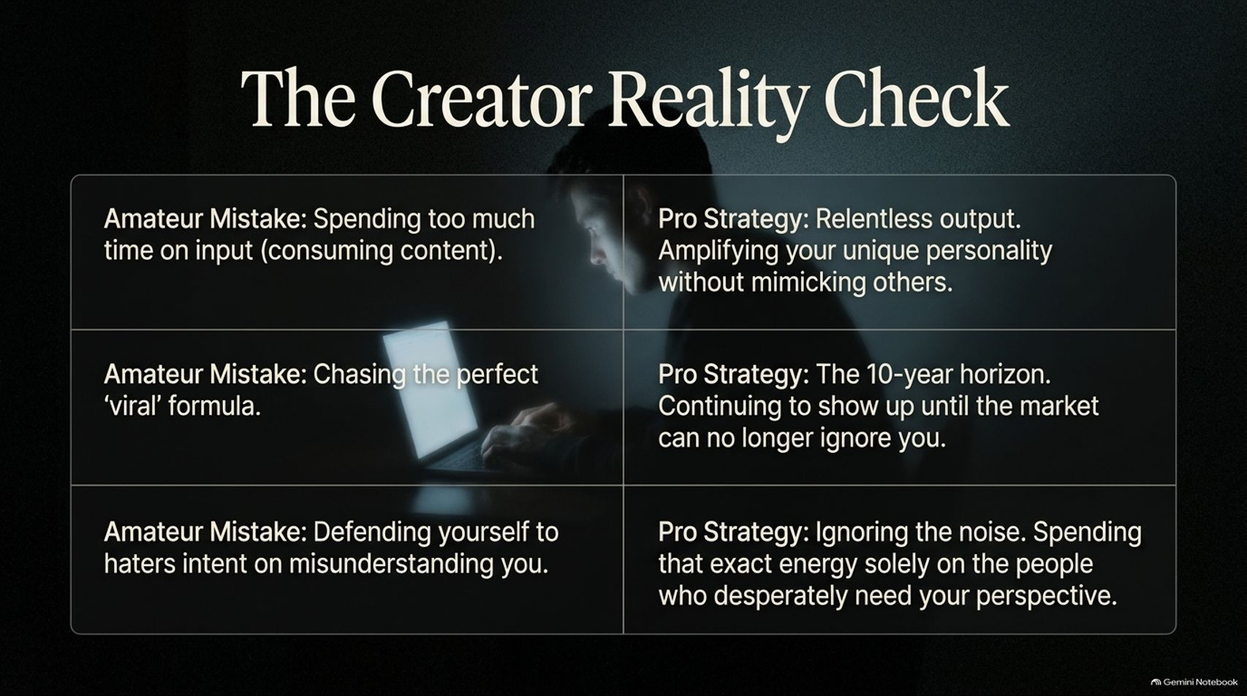
Notes:
Visual: A 3-row grid contrasting 'Amateur Mistakes' on the left against 'Pro Strategies' on the right, set beside a silhouette of a person working at a glowing laptop in the dark.
Estimated Speaking Time: 4 – 5 minutes
Speaker Notes:
"For modern creators, entrepreneurs, and professionals, building an impactful platform requires avoiding common traps. Look at our three strategic contrasts:
Input vs. Output: Amateurs spend far too much time consuming other people's content. Pros focus on relentless output, amplifying their unique voice without mimicking competitors.
Formulas vs. Horizons: Amateurs chase temporary viral hacks. Pros adopt a 10-year horizon, consistently showing up until the market can no longer ignore them.
Haters vs. Needers: Amateurs waste critical energy defending themselves to critics intent on misunderstanding them. Pros apply 'Let Them', ignoring the noise to focus exclusively on the specific people who desperately need their message."

Slide 10
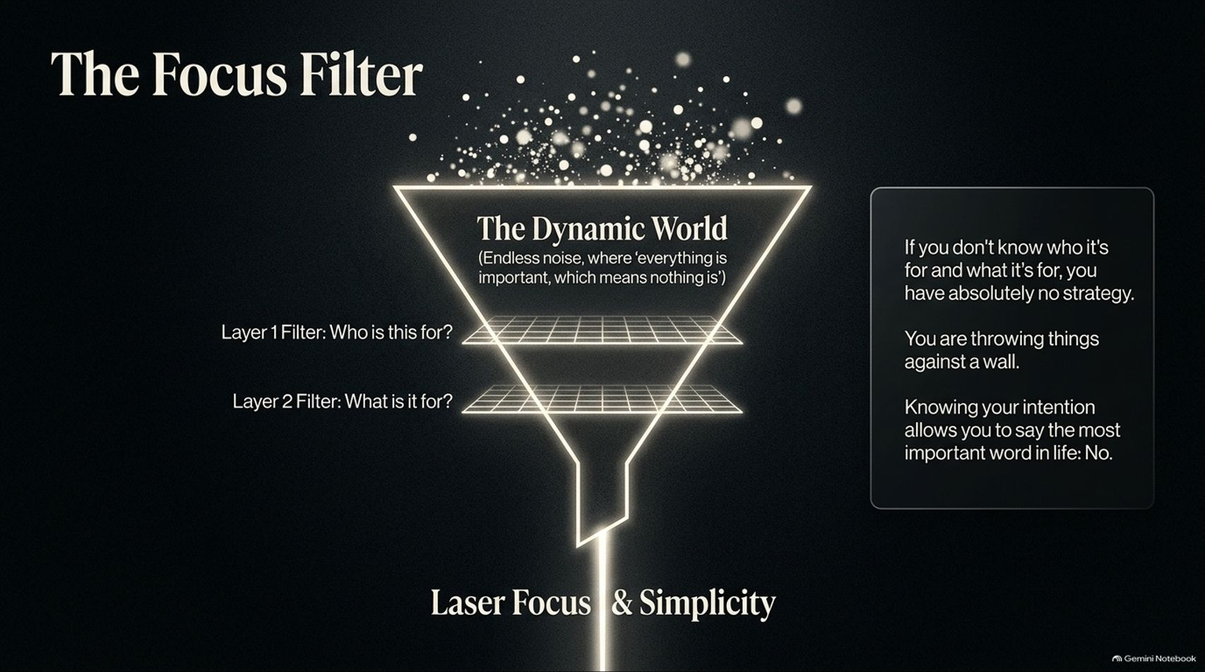
Notes:
Visual: A glowing funnel graphic filtering chaotic data particles from 'The Dynamic World' down through two horizontal grid filters (Layer 1: Who is this for? Layer 2: What is it for?) into 'Laser Focus & Simplicity'.
Estimated Speaking Time: 3 – 5 minutes
Speaker Notes:
"We live in a dynamic world where information is limitless, which means if everything is important, nothing is. The defining competitive skill today is laser focus and absolute simplicity.
As Seth Godin teaches, every successful effort must pass through The Focus Filter by answering two fundamental questions:
Layer 1 Filter: Who is this for?
Layer 2 Filter: What is it for?
If you cannot clearly answer who it's for and what it's for, you don't have a strategy—you are throwing things against the wall. Knowing your core intention gives you the clarity and courage to say the most powerful word in life: 'No.'"

Slide 11
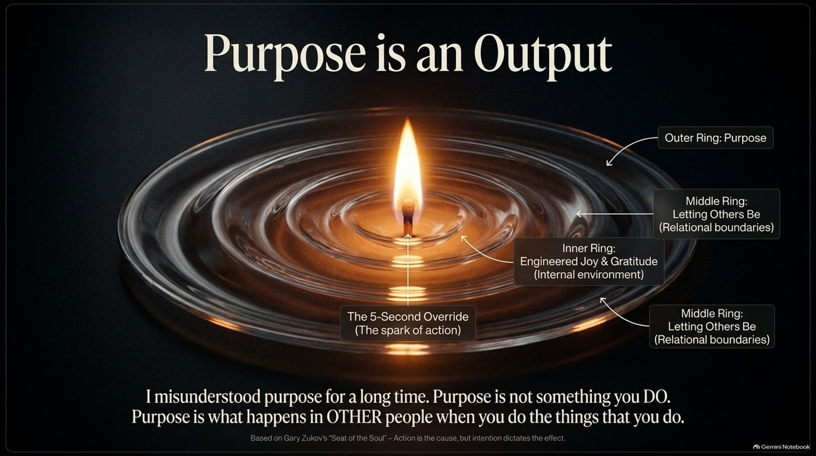
Notes:
Visual: Concentric glass ripple rings expanding outward from a lit match flame at the center. Annotations label the center (The 5-Second Override), inner ring (Engineered Joy & Gratitude), middle ring (Letting Others Be), and outer ring (Purpose).
Estimated Speaking Time: 4 – 5 minutes
Speaker Notes:
"There is a massive cultural misunderstanding about purpose. Many people spend decades searching for their purpose as if it's an object hidden under a rock.
Look at the ripple framework on screen. Drawing from Gary Zukov’s The Seat of the Soul, Purpose is not something you DO. Purpose is what happens in OTHER people when you do the things that you do.
The Center Spark: The 5-Second Override ignites action.
Inner & Middle Rings: Creating internal gratitude and honoring relational boundaries (Letting Others Be).
The Outer Ring: The ripple effect on others—how you make people feel, encourage them, and lift them up. Purpose is the outward impact of your daily intentions."

Slide 12
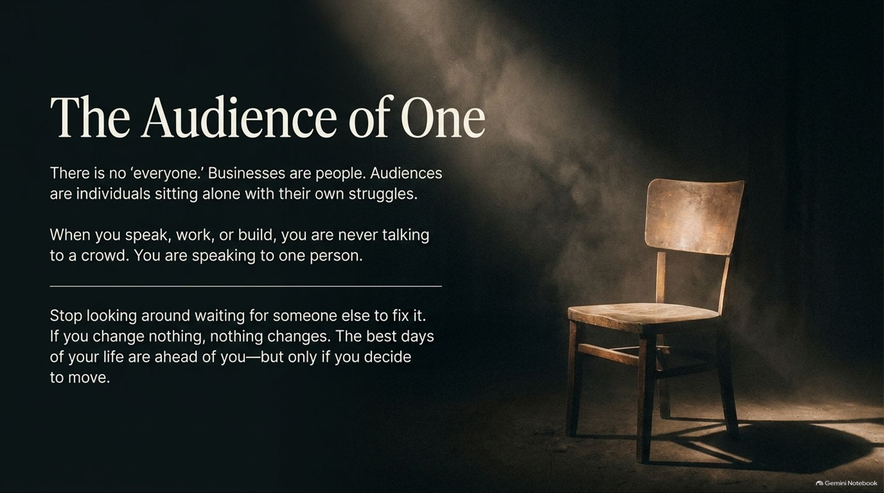
Notes:
Visual: A single wooden chair illuminated by a dramatic spotlight cutting through a dark room, paired with core text on speaking directly to an individual.
Estimated Speaking Time: 3 – 5 minutes
Speaker Notes:
"Whether you are presenting to a boardroom of 500 executives, writing a book, or talking to your team, remember this: There is no 'everyone.'
Audiences are not monolithic crowds; they are individual human beings sitting alone with their own private struggles, fears, and hopes. Great communicators never address a crowd; they speak directly to an Audience of One.
Stop looking around waiting for someone else to step up and fix your life. If you change nothing, nothing changes. The best days of your life are ahead of you—but only if you decide to count down 5-4-3-2-1 and move."

Slide 13
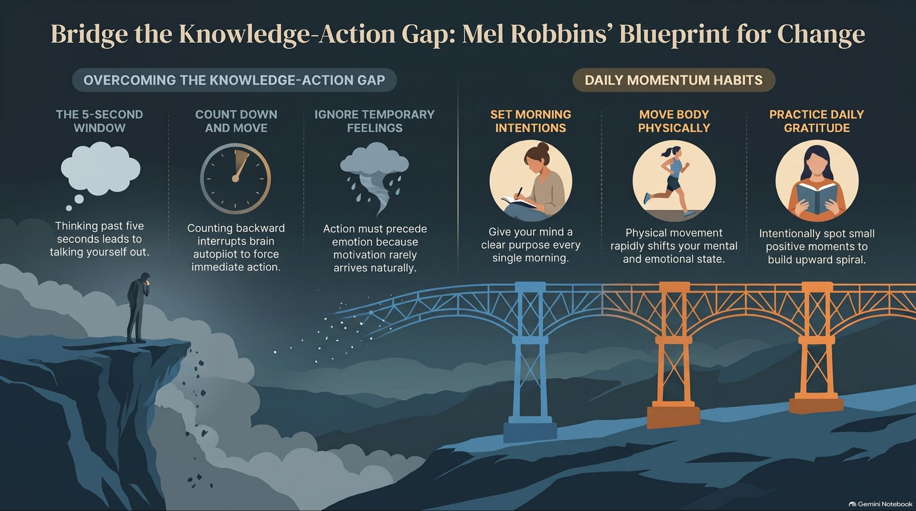
Notes:
Visual: An infographic bridging a dark cliff (Overcoming the Knowledge-Action Gap: 5-Second Window, Count Down and Move, Ignore Temporary Feelings) across to a bright platform (Daily Momentum Habits: Set Morning Intentions, Move Body Physically, Practice Daily Gratitude).
Estimated Speaking Time: 4 – 6 minutes
Speaker Notes:
"We conclude our presentation deck with this master summary blueprint: Bridging the Knowledge-Action Gap.
Look across the structure on screen:
Overcoming the Gap: Recognize the 5-second hesitation window, count down 5-4-3-2-1 to override autopilot, and execute physical movement while ignoring temporary emotional resistance.
Daily Momentum Habits:
Set Morning Intentions: Give your mind a clear job every morning (e.g., 'Today is going to be a good day because I'm going to make something good happen').
Move Your Body Physically: Trigger hope molecules to elevate your mental and emotional state.
Practice Daily Gratitude: Intentionally spot small positive moments to build a sustained upward spiral.
Transformation isn't magical; it's mechanical. You are always just one decision away from a completely different life. Thank you."

