Slide 1
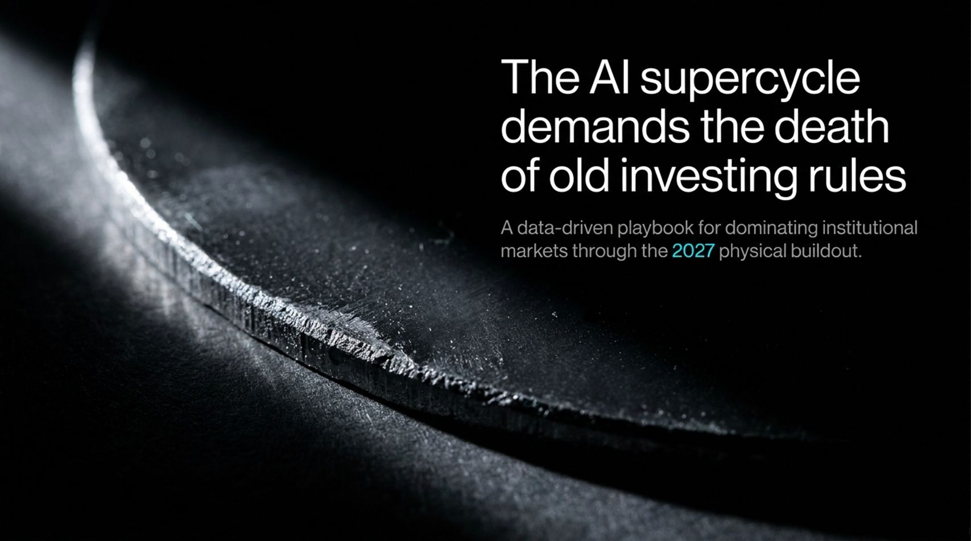
Notes:
Visual & Theme: Introduction to the 2027 physical buildout and the breakdown of legacy Wall Street guidelines.
Speaker Notes (2–3 minutes):
Good morning, everyone. Welcome to our deep-dive session on navigating institutional markets through the 2027 physical infrastructure buildout.
The central premise of today's deck is provocative yet backed by rigorous data: The AI supercycle demands the death of old investing rules.
For decades, traditional portfolio managers relied on legacy playbooks—mean reversion, buying low-quality value traps, chasing long 10-year passive compounders, and treating high-beta cycles like standard commodity shocks.
As we sit here today, those rules are no longer just obsolete; they are value-destructive. We are entering an 8-to-12-year structural capital spending regime driven by artificial intelligence, robotics, and energy infrastructure.
Over the next 16 slides, we are going to break down why the old rules failed, how market concentration has rewritten portfolio math, and where you need to deploy capital over the next 24 months to capture massive asymmetric upside. Let's dive in.
Parker: The AI stocks set to DOMINATE 2027
https://www.youtube.com/watch?v=AyMTWKoW80w

Slide 2
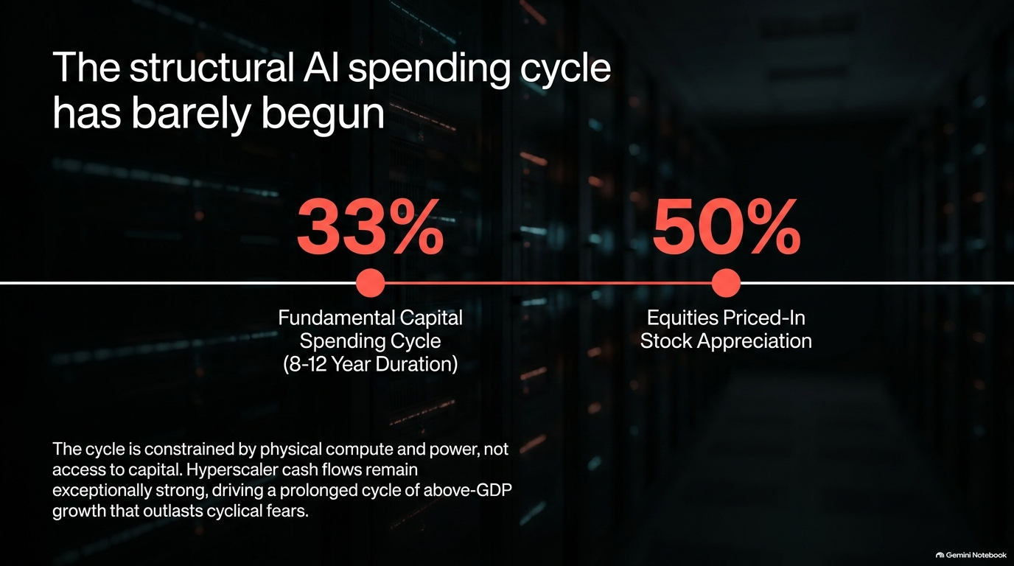
Notes:
Visual & Theme: Key milestones comparing fundamental capital spending (33%) vs. equity price-in appreciation (50%).
Speaker Notes (3–4 minutes):
Let's address the elephant in the room: Are we in a bubble, and are we late to the trade? The data emphatically answers: No, the structural AI spending cycle has barely begun.
When we look at cumulative total capital spending across the ecosystem—dating back to Nvidia’s major sales revision in May 2023—we estimate we are only 33% of the way through an 8-to-12-year capital expenditure cycle.
Equities have certainly run hard—pricing in roughly 50% of anticipated stock appreciation—but they are nowhere near as overextended as the skeptics claim.
Why? Because this cycle is constrained by physical compute and power availability, not access to capital. Hyperscaler cash flows remain exceptionally robust, and borrowing capacity across tech giants and infrastructure players is unprecedented.
This is driving a prolonged multi-year cycle of above-GDP growth that will comfortably outlast short-term cyclical fears.

Slide 3

Notes:
Visual & Theme: Highlighting the memory complex, Micron’s projected $320B free cash flow, and the reality of a new regime.
Speaker Notes (3–5 minutes):
Let's look at semiconductors and, specifically, the memory complex—arguably the most misunderstood asset class on Wall Street today.
Traditional investors keep slapping irrelevant historical cycles onto a completely new regime. They call it cyclical and wait for a crash. But let's look at the actual numbers: Micron is projecting an unprecedented $320 billion in free cash flow over an eight-quarter stretch on a roughly $1 trillion market cap company.
Think about the operating margins and factory yields—producing tens of billions in quarterly revenue at over 80% gross margins while demand outstrips supply for several quarters.
If you missed out because you thought "it's just a cyclical memory stock," you missed one of the greatest security upcycles in human history. The magnitude of this structural shortage completely dwarfs historical precedents, and exposure here remains a core high-beta engine.

Slide 4
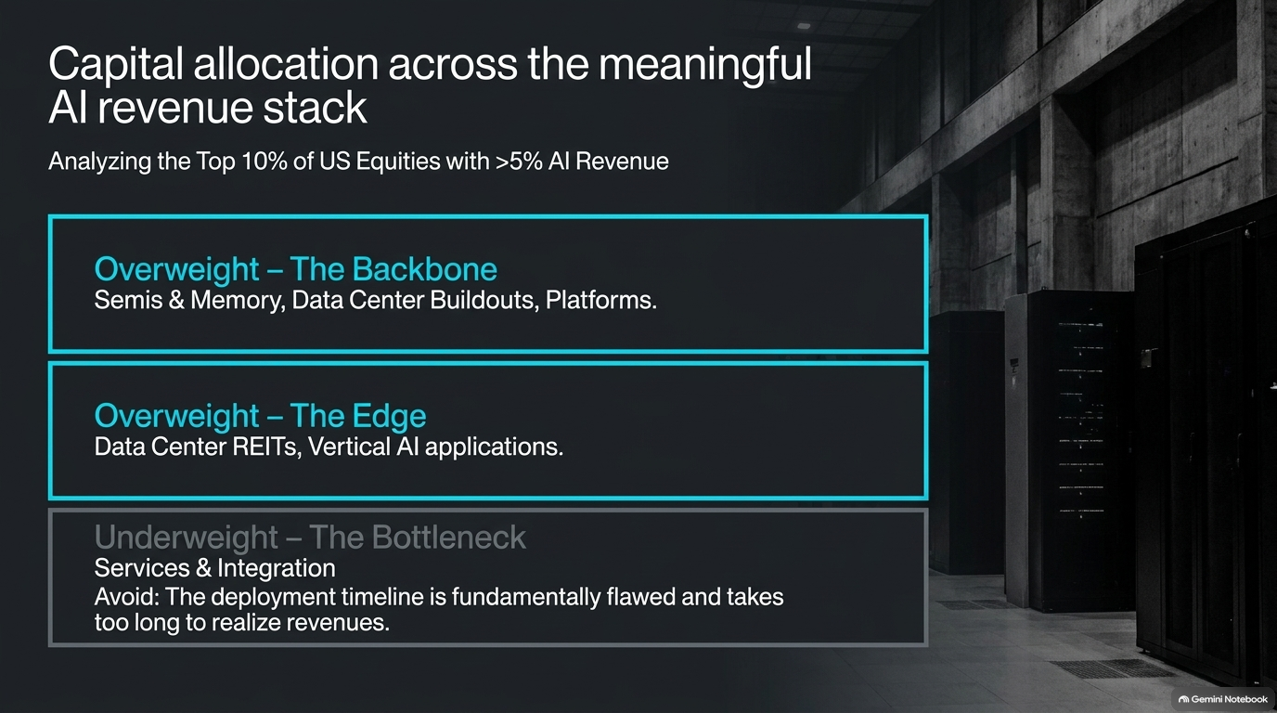
Notes:
Visual & Theme: Categorizing the top 10% of US equities with >5% AI revenue into Overweight (Backbone, Edge) and Underweight (Bottlenecks/Services).
Speaker Notes (3–4 minutes):
Not all AI exposure is created equal. When we analyze the top 10% of US equities boasting greater than 5% meaningful AI revenue, we have to slice the stack strategically.
We maintain a decisive Overweight on The Backbone: Semiconductors, memory, data center buildouts, and core compute platforms. This is where the hard demand sits.
We also maintain an Overweight on The Edge: Data center REITs and vertical AI applications that monetize downstream efficiency.
Conversely, we are explicitly Underweight on The Bottleneck—specifically Services and Integration (such as legacy IT consulting like Accenture). Why? Because their deployment timeline is structurally flawed, revenue realization takes too long, and corporate clients are prioritizing infrastructure over human-heavy integration. Do not buy generic tech ETFs blindly; you must isolate the true revenue drivers.

Slide 5
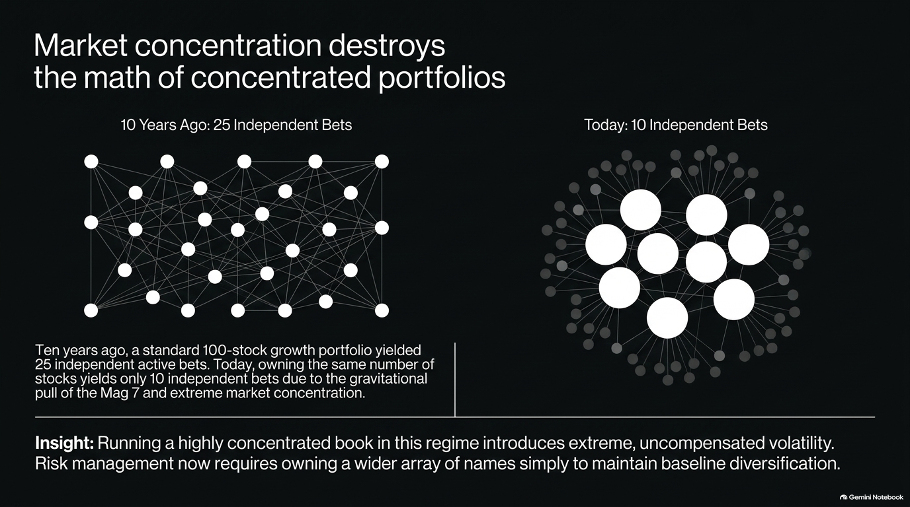
Notes:
Visual & Theme: Comparing network webs of 25 independent bets (10 years ago) versus 10 independent bets today under the gravitational pull of the Magnificent 7.
Speaker Notes (3–5 minutes):
Let's talk about portfolio construction and the myth of running a tight, concentrated book.
Ten years ago, owning a 100-stock growth portfolio yielded roughly 25 independent active bets. Today, due to the extreme gravitational pull of the Magnificent 7 and massive market concentration, that same portfolio yields only 10 independent bets.
If you run a heavily concentrated book in this market regime, you are introducing extreme, uncompensated volatility.
Institutional risk management can no longer afford to ignore index concentration. To maintain baseline diversification and capture secular trends without blowing up your book, portfolio managers must own a wider array of names than historical norms dictate.

Slide 6
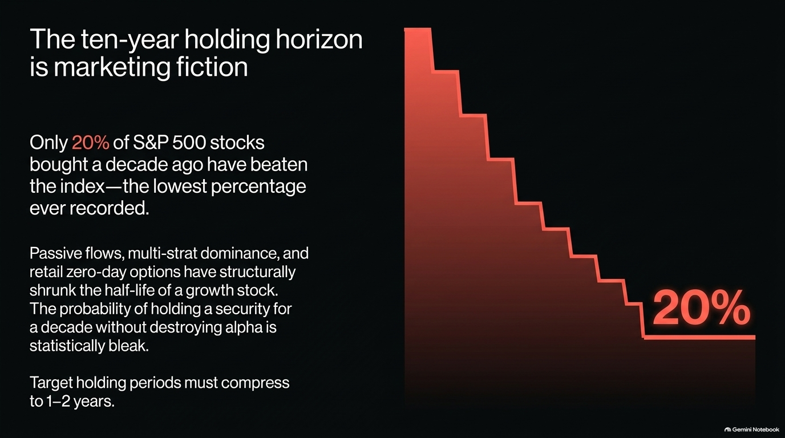
Notes:
Visual & Theme: Only 20% of S&P 500 stocks bought a decade ago have beaten the index—the lowest percentage ever recorded.
Speaker Notes (3–4 minutes):
Here is another uncomfortable truth for legacy long-term investors: The ten-year holding horizon is marketing fiction.
Only 20% of S&P 500 stocks bought a decade ago have beaten the index. That is the lowest percentage ever recorded in financial history.
Between passive indexing flows, multi-strategy fund dominance, and retail zero-day options (0DTE), the half-life of a growth stock has structurally compressed.
The probability of blindly buying a security and holding it for ten years without destroying your alpha is statistically bleak. If you are maintaining a 9% annual turnover strategy while the world evolves at lightspeed, your thesis is likely outdated.
Target holding periods in this new regime must compress to an active 1-to-2-year window.

Slide 7
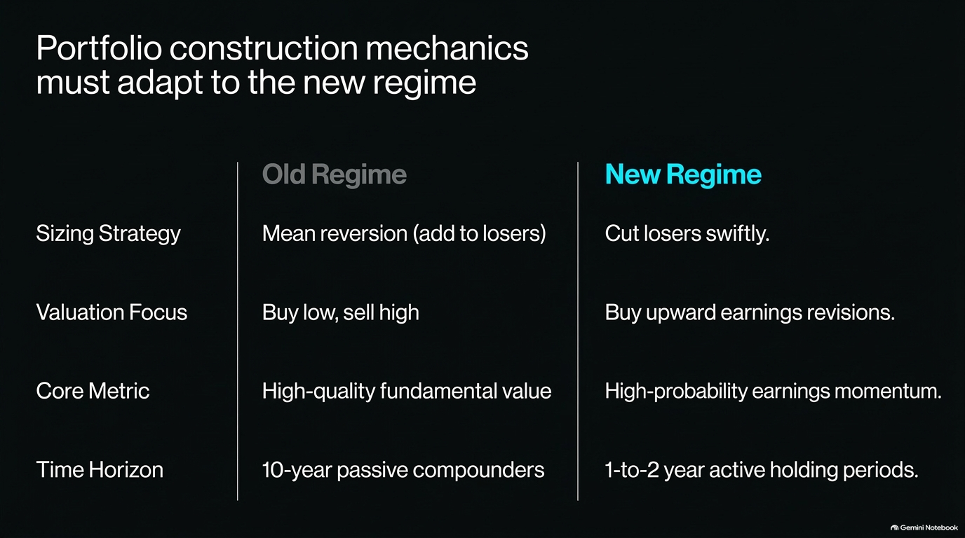
Notes:
Visual & Theme: A clear comparison table contrasting the Old Regime vs. New Regime across Sizing Strategy, Valuation Focus, Core Metric, and Time Horizon.
Speaker Notes (3–5 minutes):
This table summarizes the core paradigm shift. If you try to run your portfolio using old-world rules, you will underperform.
Sizing Strategy: In the old regime, we practiced mean reversion and added to losers. In the new regime, you must cut losers swiftly.
Valuation Focus: The old rule was "buy low, sell high." Today, that has been replaced by "buy upward earnings revisions."
Core Metric: We have moved away from static high-quality fundamental value toward high-probability earnings momentum.
Time Horizon: We are dropping 10-year passive compounders in favor of 1-to-2-year active holding periods. Embracing these mechanics is essential for generating institutional alpha today.

Slide 8
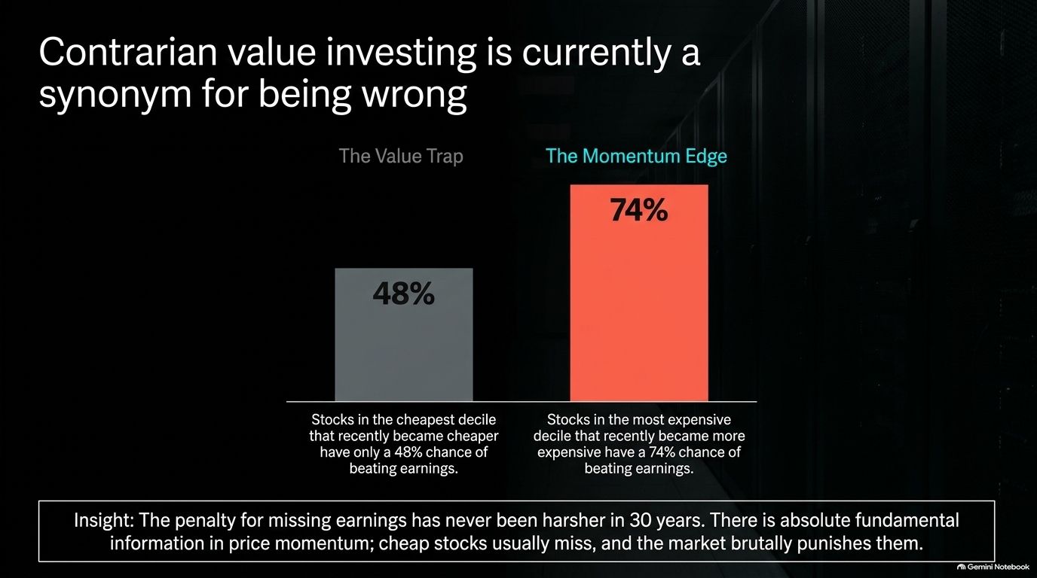
Notes:
Visual & Theme: Comparing the Value Trap (48% chance of beating earnings for cheap deciles) vs. The Momentum Edge (74% chance for expensive deciles).
Speaker Notes (3–5 minutes):
Let's talk about the danger of being a "contrarian value investor." In today's market, contrarian value investing is a direct synonym for being wrong.
Look at the data: Stocks in the cheapest valuation decile that recently became cheaper have only a 48% chance of beating earnings.
On the flip side, stocks in the most expensive decile that recently became more expensive carry a 74% chance of beating earnings.
Why? Because the penalty for missing earnings has never been harsher in the last 30 years. Cheap stocks usually miss because their fundamentals are deteriorating, and the market brutally punishes them. Price momentum carries fundamental information; stop buying cheap value traps.

Slide 9
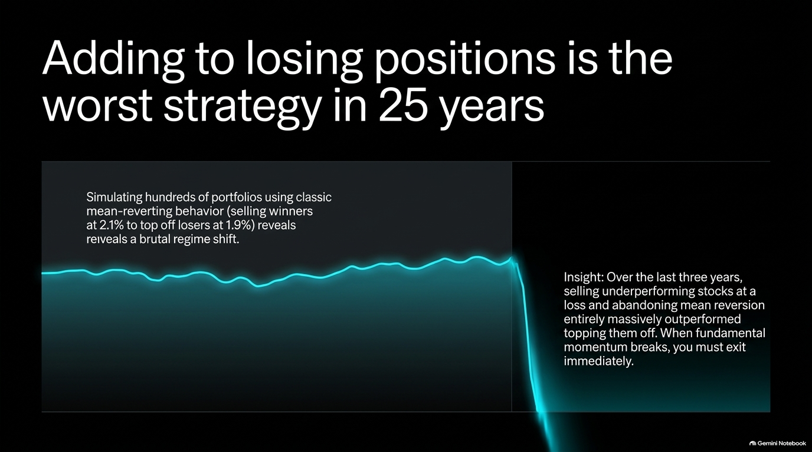
Notes:
Visual & Theme: Simulating mean-reverting behavior versus momentum execution, demonstrating that cutting underperforming assets immediately outperforms.
Speaker Notes (3–4 minutes):
Building on our point about valuations, let's examine sizing discipline: Adding to losing positions is the worst strategy executed in the last 25 years.
When we simulate hundreds of portfolios utilizing classic mean-reverting behavior—such as trimming winners to top off losers that drifted down—the performance chart drops off a cliff.
Over the last three years, selling underperforming stocks at a loss and abandoning mean reversion entirely has massively outperformed.
When fundamental momentum breaks in an asset, you must exit immediately rather than averaging down. Capital preservation requires letting your winners run and ruthlessly purging broken theses.

Slide 10
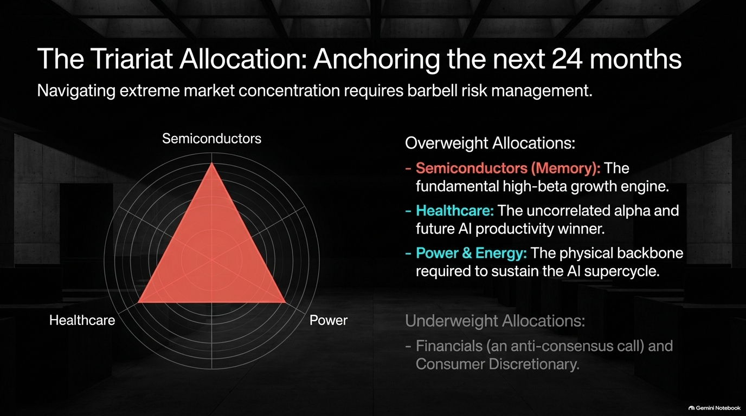
Notes:
Visual & Theme: Radar chart illustrating the Triariat barbell allocation framework across Semiconductors, Healthcare, and Power & Energy.
Speaker Notes (3–5 minutes):
Navigating extreme market concentration requires an aggressive barbell risk management strategy—what we call The Triariat Allocation.
We recommend overweighting three core pillars to anchor your book for the next 24 months:
Semiconductors & Memory: The fundamental high-beta growth engine powering the entire digital buildout.
Healthcare: The ultimate uncorrelated alpha and future AI productivity winner that hedges tech beta.
Power & Energy: The physical infrastructure backbone required to sustain the AI supercycle.
Conversely, we remain strictly Underweight on Financials (an anti-consensus call) and Consumer Discretionary.

Slide 11
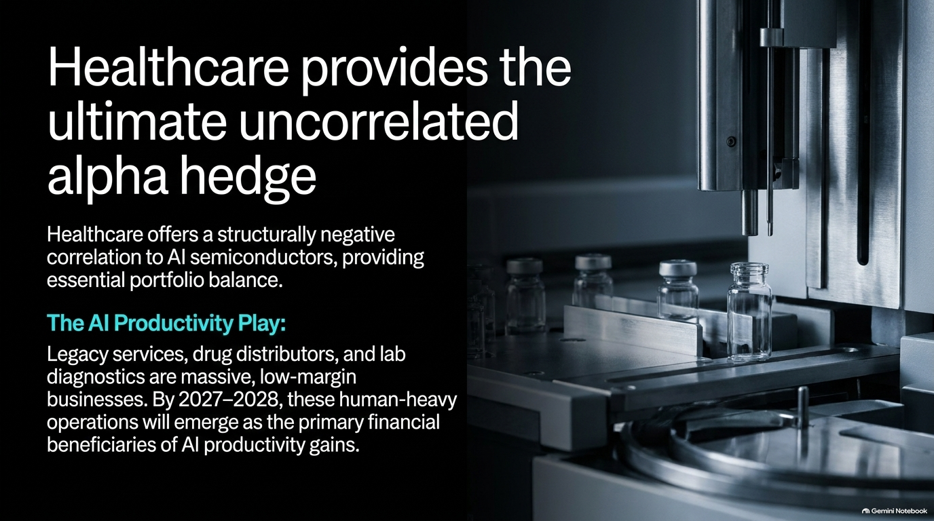
Notes:
Visual & Theme: Pharmaceutical manufacturing lines, highlighting healthcare's negative correlation to AI semis and its role as a productivity play.
Speaker Notes (3–4 minutes):
Let's zoom in on Healthcare because it forms the cornerstone of our risk-hedging strategy.
Healthcare offers a structurally negative correlation to AI semiconductors, providing essential portfolio balance when high-beta tech experiences pullbacks.
Beyond risk mitigation, it is an exceptional alpha play. Legacy services, drug distributors, and lab diagnostics are massive, human-heavy, low-margin businesses.
As we approach 2027–2028, these operations will emerge as the primary financial beneficiaries of corporate AI productivity gains, streamlining labor and expanding margins dramatically.

Slide 12

Notes:
Visual & Theme: An intersecting X-chart showing Demographics (aging population) and Pharmacology (GLP-1s, precision diagnostics) disrupting legacy staples.
Speaker Notes (3–5 minutes):
The secular longevity trade is permanently altering consumer habits and crushing legacy business models.
Five of the 14 fastest-growing categories in the entire equity market are in healthcare—specifically precision diagnostics and cancer therapeutics.
Simultaneously, the deployment of GLP-1 weight loss therapeutics—transitioning rapidly from injectables to mass-volume oral pills—is creating a structural headwind for legacy alcohol, snacking, and consumer staples companies.
If your portfolio is weighted toward traditional packaged foods and sugary beverages without accounting for the longevity shift, you are holding structural short positions disguised as safe havens.

Slide 13

Notes:
Visual & Theme: High-voltage electrical transmission towers and industrial power plants representing physical constraints and independent power producers (IPPs).
Speaker Notes (3–4 minutes):
You cannot talk about digital compute without addressing physical reality: The digital supercycle requires an industrial energy backbone.
The ultimate limitations of the AI buildout are not software algorithms; they are compute and power. Independent Power Producers (IPPs) and traditional energy stalwarts provide a vital dual advantage.
They offer completely non-correlated growth relative to tech, exhibit strong fundamental upward earnings revisions, and carry a statistically low probability of missing near-term earnings. Securing power assets is securing the literal fuel of the AI revolution.

Slide 14
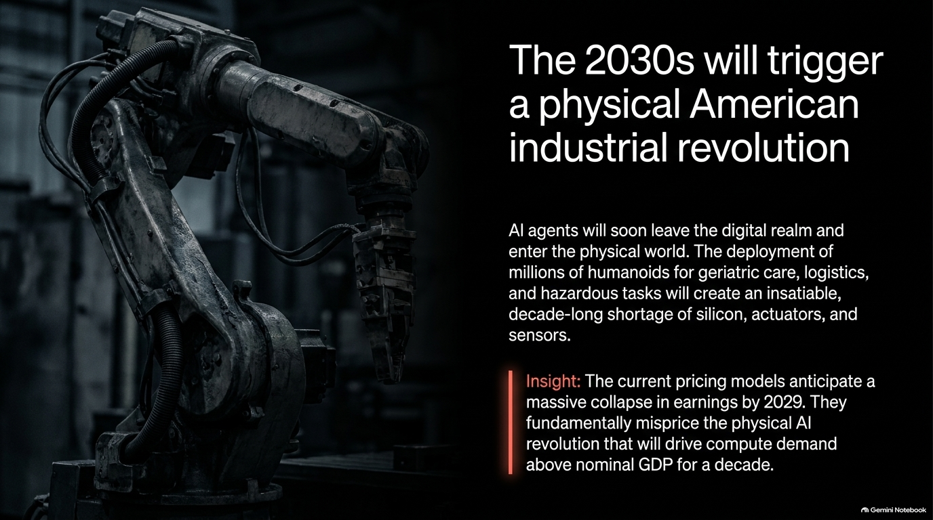
Notes:
Visual & Theme: Robotic industrial machinery arm, illustrating the transition of AI agents into physical humanoids and automated logistics.
Speaker Notes (3–5 minutes):
Looking ahead to the next decade, the narrative expands beyond server racks. The 2030s will trigger a physical American industrial revolution.
AI agents will soon leave the digital realm and enter the physical world. The commercial deployment of millions of humanoids for geriatric care, hazardous industrial tasks, and advanced logistics will create an insatiable, decade-long shortage of silicon, precision actuators, and sensors.
Current market pricing models foolishly anticipate a massive collapse in corporate earnings by 2029, completely mispricing the physical AI revolution that will drive industrial compute demand above nominal GDP for a decade.

Slide 15
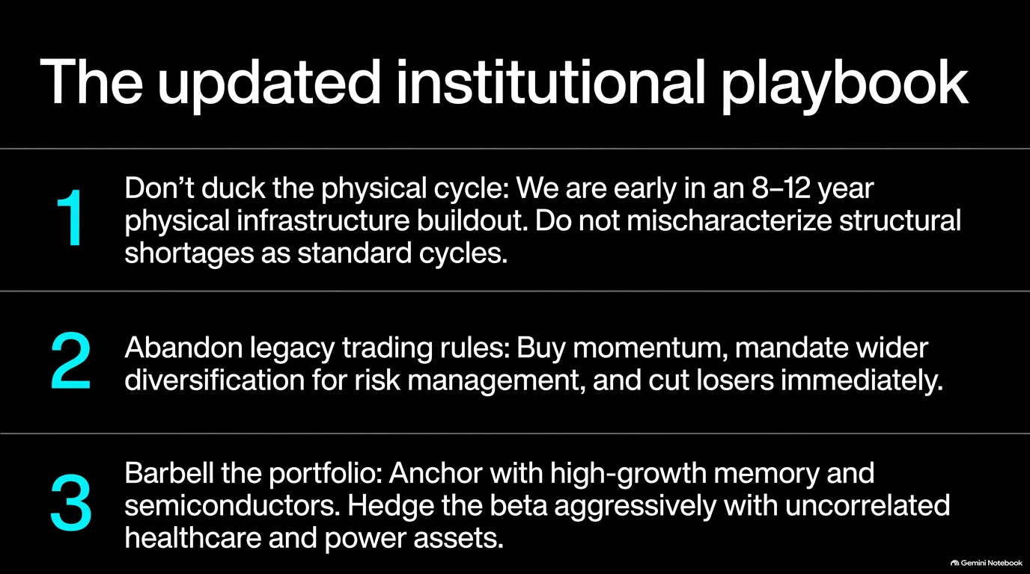
Notes:
Visual & Theme: Summary list of the three core institutional rules: 1) Don't duck the physical cycle, 2) Abandon legacy trading rules, 3) Barbell the portfolio.
Speaker Notes (3–4 minutes):
Let's synthesize everything into our updated institutional playbook across three non-negotiable pillars:
Don't duck the physical cycle: We are early in an 8–12-year physical infrastructure buildout. Never mischaracterize structural shortages as standard cyclical downturns.
Abandon legacy trading rules: Buy momentum, mandate wider portfolio diversification for robust risk management, and cut losers immediately.
Barbell the portfolio: Anchor your growth with memory and high-beta semiconductors while aggressively hedging beta with uncorrelated healthcare and power assets.

Slide 16
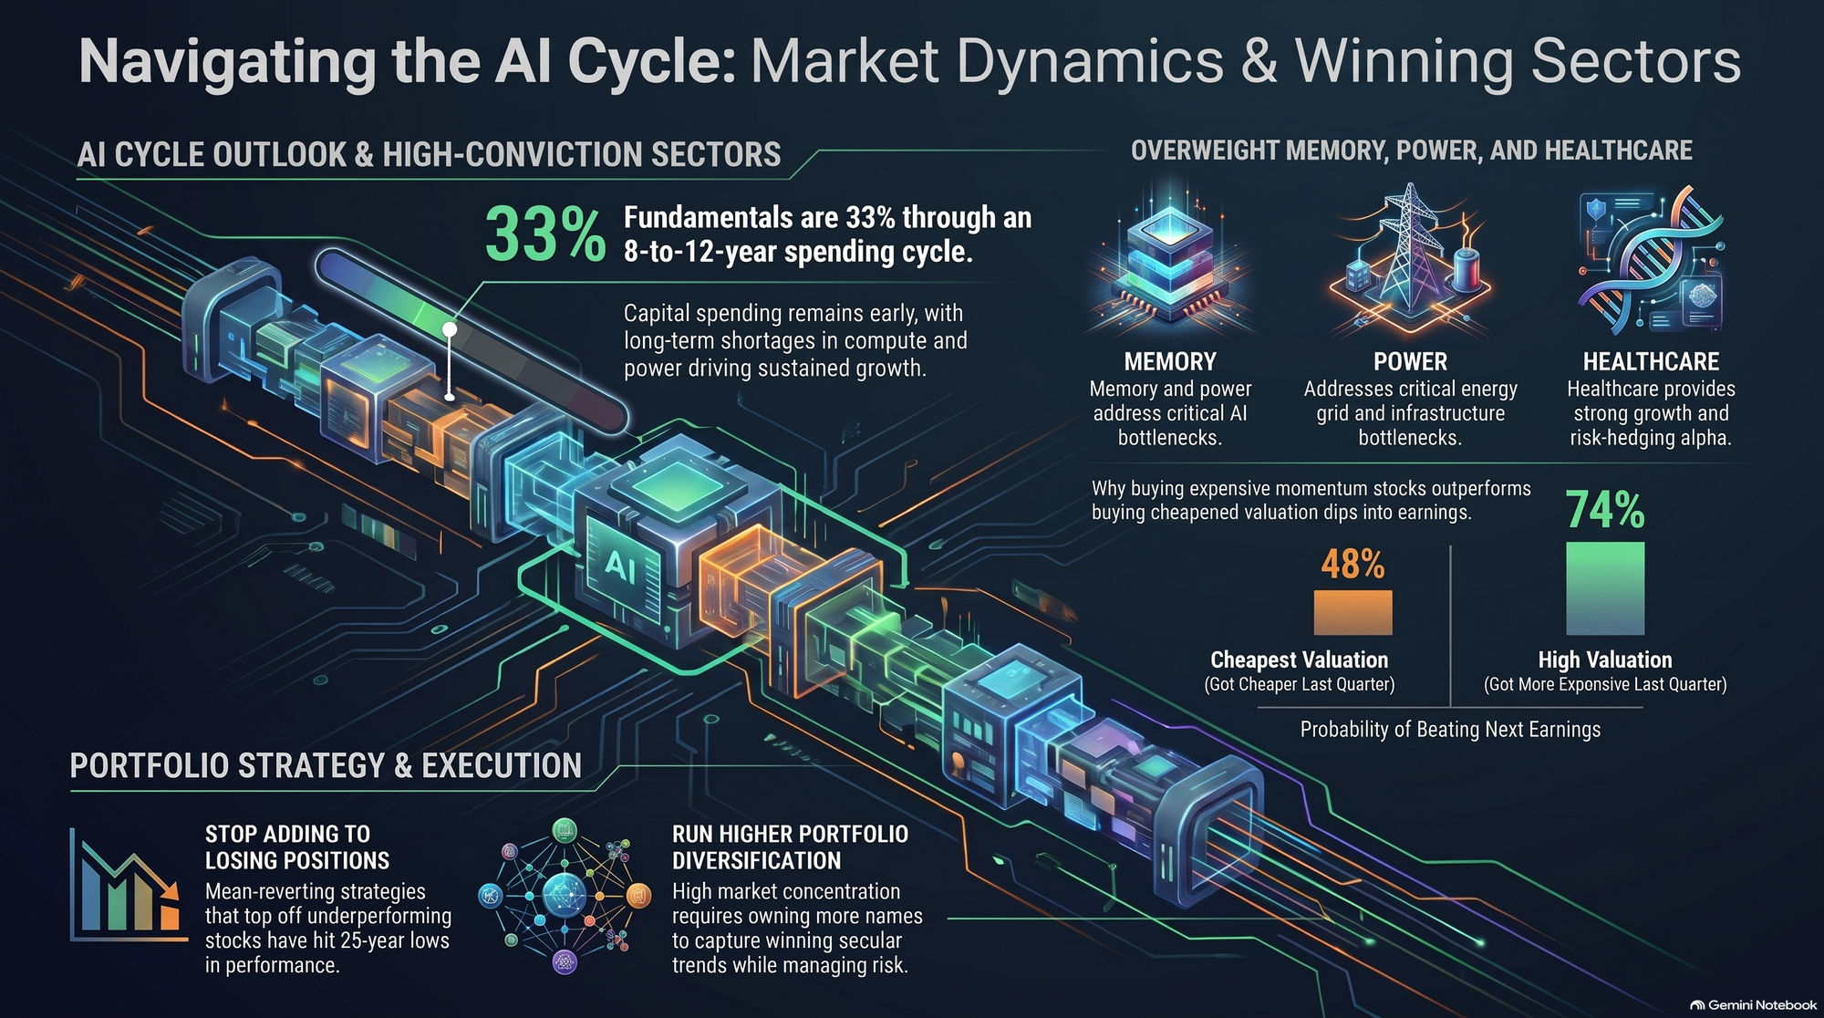
Notes:
Visual & Theme: Comprehensive summary graphic uniting all key themes: the 33% cycle timeline, memory/power/healthcare pillars, valuation momentum stats (48% vs 74%), and portfolio strategy.
Speaker Notes (3–5 minutes):
We leave you with this comprehensive roadmap summarizing the entire deck.
Remember: We are only 33% through a generational 10-year capital spending supercycle. The winners are clearly defined: Memory, Power, and Healthcare.
Stop fighting price momentum with losing value traps; remember that expensive stocks with rising earnings revisions boast a 74% probability of beating earnings, compared to just 48% for cheap, deteriorating value plays.
Stop adding to losing positions, expand your diversification to navigate extreme market concentration, and position your institutional book for the multi-year physical buildout ahead. Thank you for your time, and let's open the floor for questions.

