Slide 1

Notes:
Visual Reference: [Anatomy_of_a_Stock.pptx, Slide 1]
Target Delivery Time: 2 – 3 minutes
Speaker Notes:
"Welcome, everyone. Today we are exploring the Anatomy of a Stock: How the Pros Extract Value from an Irrational Market."
"When most retail investors look at the stock market, they see a flashing ticker tape of numbers, green and red bars, and endless spreadsheets. But professional analysts and veteran portfolio managers view the market entirely differently. They look at it as an ecosystem filled with living, breathing business organisms."
"Over the course of this presentation, we are going to dissect what it truly takes to evaluate a stock, steer clear of common Wall Street traps, and build generational wealth by partnering with durable businesses."
Joseph Foresi: Anatomy of a Stock: How the Pros Really Analyze a Stock. Moats, Models, and Mgmts
https://www.youtube.com/watch?v=Jvbrsy3tZRM

Slide 2
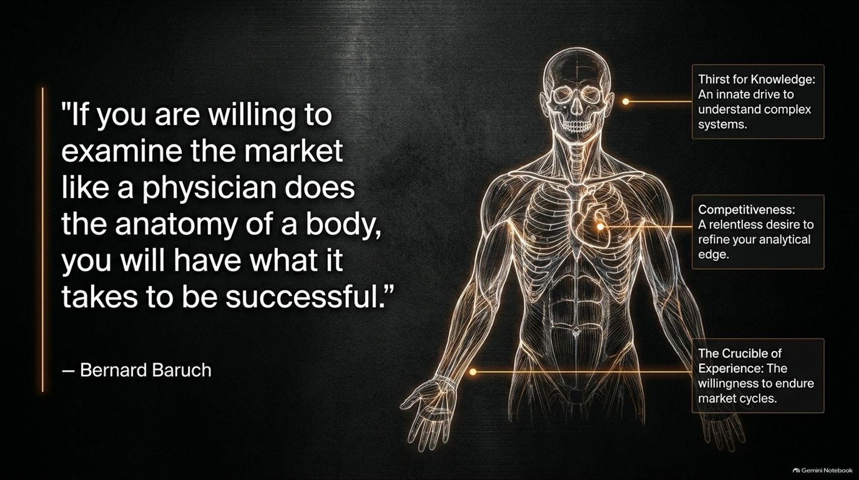
Notes:
Visual Reference: [Anatomy_of_a_Stock.pptx, Slide 2]
Target Delivery Time: 3 – 4 minutes
Speaker Notes:
"Let’s start with a foundational quote from legendary Wall Street financier Bernard Baruch: 'If you are willing to examine the market like a physician does the anatomy of a body, you will have what it takes to be successful.'"
"Baruch wasn't exaggerating; he was issuing a serious warning. The bar for successful investing is exceptionally high. Just as a surgeon cannot guess how a human body works, an investor cannot casually pick stocks based on tips or headlines and expect long-term success."
"This requires three core human attributes highlighted here:
Thirst for Knowledge: An innate, unrelenting drive to understand complex systems. Investing is not a 9-to-5 job that ends when the market closes; it requires continuous curiosity.
Competitiveness: A desire to constantly refine your analytical edge and out-think the crowd.
The Crucible of Experience: The willingness to endure market cycles. You cannot shortcut experience; you have to live through the market's ups and downs to truly understand risk."

Slide 3
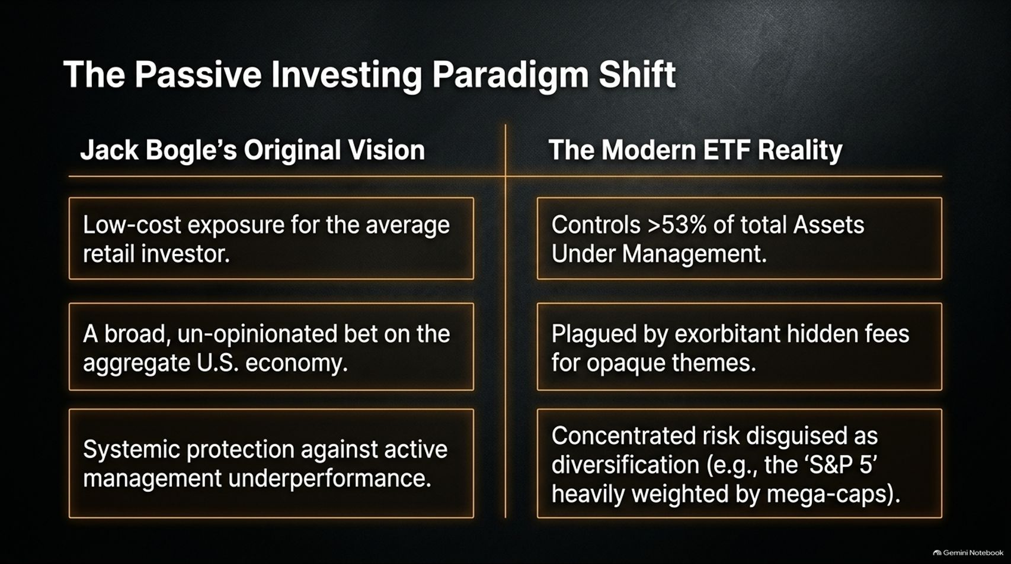
Notes:
Visual Reference: [Anatomy_of_a_Stock.pptx, Slide 3]
Target Delivery Time: 4 – 5 minutes
Speaker Notes:
"Let's talk about the modern landscape. Jack Bogle’s original vision for passive investing and index funds was a stroke of genius. It was designed to give average retail investors low-cost exposure to the aggregate U.S. economy, providing systemic protection against active management underperformance."
"However, fast forward to today, and we are experiencing a massive paradigm shift. Passive Exchange-Traded Funds (ETFs) now control over 53% of total Assets Under Management (AUM)."
"While Bogle’s original intent was noble and low-cost, the modern ETF reality has mutated:
Many modern ETFs are plagued by exorbitant hidden fees for opaque themes.
They often introduce concentrated risk disguised as diversification. For example, indexes like the S&P 500 are heavily weighted by just a handful of mega-cap tech stocks, meaning you aren't necessarily buying 500 equally weighted businesses anymore."
"As active fundamentalists, we must recognize that passive investing is a powerful tool, but blind indexing carries its own structural risks."

Slide 4
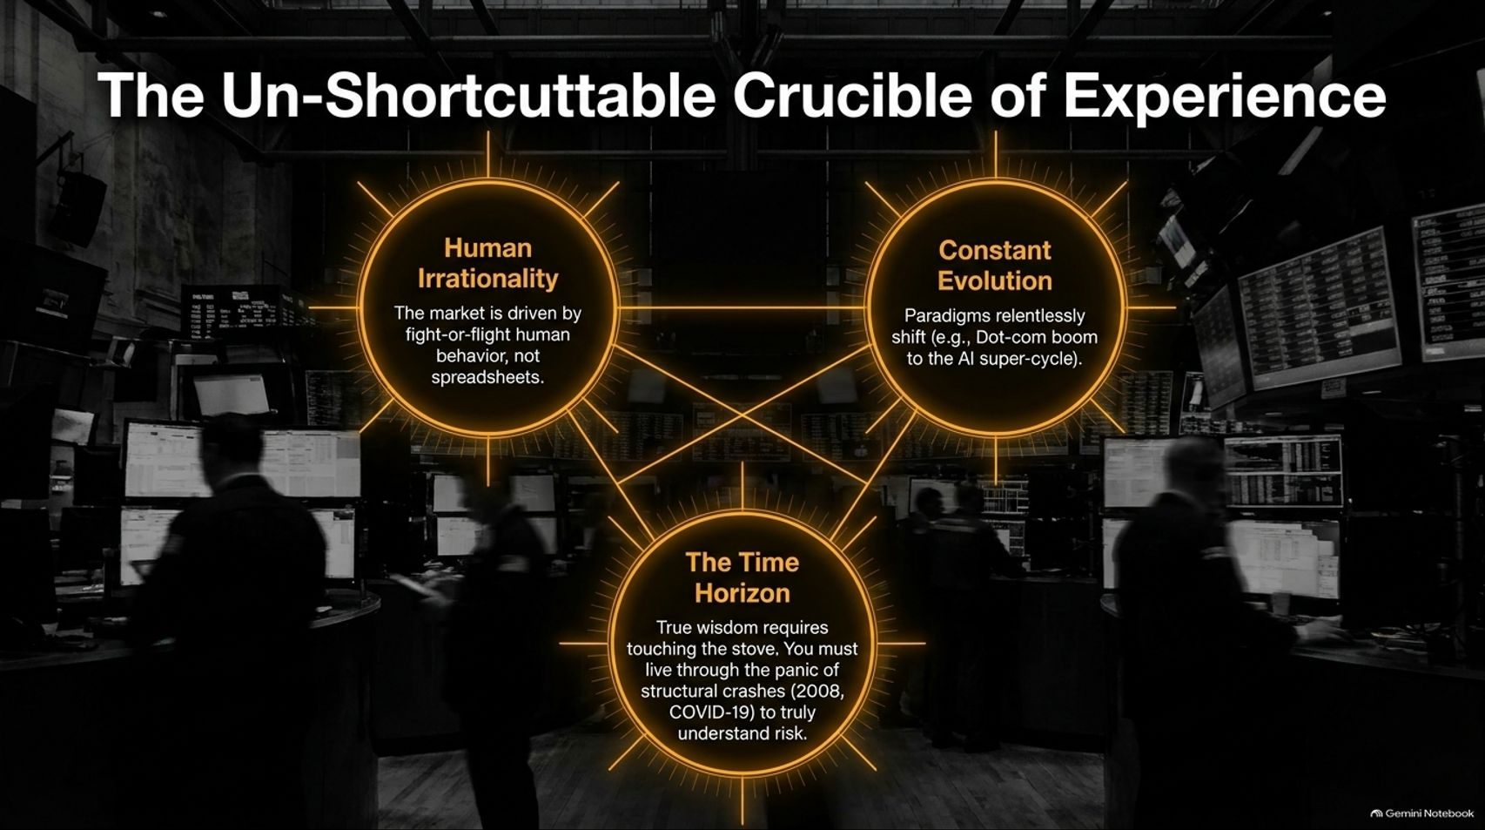
Notes:
Visual Reference: [Anatomy_of_a_Stock.pptx, Slide 4]
Target Delivery Time: 3 – 4 minutes
Speaker Notes:
"Why is beating the market so difficult? Why can't you just read a textbook and master it in three years? Because of the Un-Shortcuttable Crucible of Experience."
"As Joseph Foresi notes in his discussions on market veterans, wisdom in this industry requires 'touching the stove.' You have to live through structural crashes—like the 2008 Global Financial Crisis or the March 2020 COVID-19 panic—to truly understand risk."
"The market is driven by two un-modelable forces:
Human Irrationality: Markets are driven by deep-seated human fight-or-flight behaviors, panic, and greed, not clean spreadsheets.
Constant Evolution: Economic paradigms shift relentlessly, moving from historical events like the Dot-com boom all the way to modern AI super-cycles."
"Time horizon is your ultimate filter. True wisdom only comes from surviving these cycles firsthand."

Slide 5

Notes:
Visual Reference: [Anatomy_of_a_Stock.pptx, Slide 5]
Target Delivery Time: 4 – 5 minutes
Speaker Notes:
"Let’s keep our core insight front and center: Buying a stock means buying a piece of a living business that does not know you own it."
"Fundamental value has evolved drastically over the past century:
1930s (The Graham Trauma): Born directly out of the devastating 1929 crash. Benjamin Graham pioneered a deeply conservative, static search for liquidation value, tangible assets, and deep balance sheet safety. If a stock wasn't trading below its net-net asset value, he wouldn't touch it.
Modern Era (The Buffett/Munger Evolution): Warren Buffett and Charlie Munger revolutionized this approach. They shifted the paradigm from looking backward at liquidation value to looking forward at compounding growth potential and long-term economic moats."
"In today’s economy, a business isn't just a collection of hard assets; it's an engine capable of compounding free cash flows over decades."

Slide 6

Notes:
Visual Reference: [Anatomy_of_a_Stock.pptx, Slide 6]
Target Delivery Time: 4 – 6 minutes
Speaker Notes:
"How do professional analysts systematically evaluate a stock? We use a structured Five-Factor Diagnostic Framework."
"Think of this pentagon as your diagnostic checklist before deploying capital into any business:
Competitive Advantage: Identifying the structural Moat. What is the company's 'special sauce'?
Catalyst: The fundamental driver of growth. Is it expanding operating margins, taking market share, or capturing a secular trend?
Valuation: The art of pricing future cash flows. Finding the intersection between price and intrinsic worth.
Quality of Management: Evaluating the stewards of capital. Are they trustworthy partners or corporate politicians?
Market Psychology: Respecting the irrationality of the crowd and supply/demand dynamics."
"If a potential investment fails even one of these core diagnostic checks, pause and walk away."

Slide 7

Notes:
Visual Reference: [Anatomy_of_a_Stock.pptx, Slide 7]
Target Delivery Time: 4 – 5 minutes
Speaker Notes:
"Let's dive deeper into the first two pillars: Advantage and Catalyst."
"First, Competitive Advantage: If a company cannot define its special sauce or structural moat in one succinct sentence, walk away. Look for genuine structural barriers—such as deep customer loyalty, powerful network effects, or massive operational scale."
"Second, Catalyst: Revenue growth alone is not enough. You must look beneath the surface for improving operational models, deliberate market share capture, or optimized capital allocation structures. A true catalyst creates long-term momentum that independent spreadsheets can easily spot if you know where to look."

Slide 8
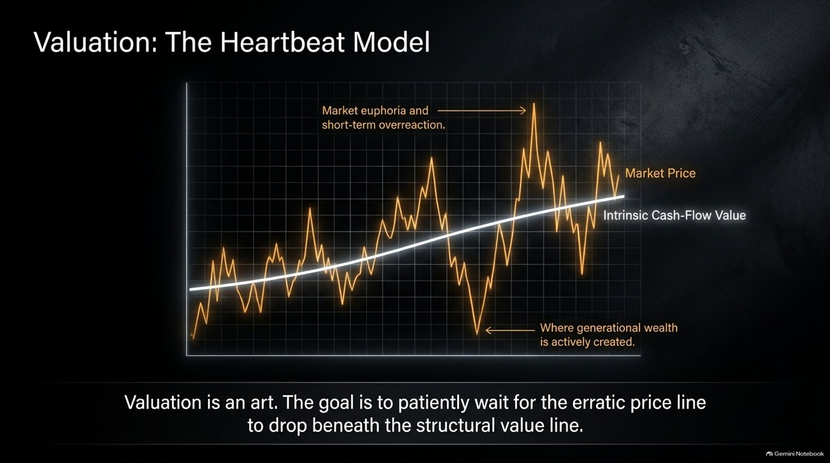
Notes:
Visual Reference: [Anatomy_of_a_Stock.pptx, Slide 8]
Target Delivery Time: 4 – 5 minutes
Speaker Notes:
"Next is Valuation: The Heartbeat Model."
"Notice how this graph is structured. The white line represents the Intrinsic Cash-Flow Value of the business, steadily compounding upward over time. Meanwhile, the volatile orange line represents the erratic Market Price."
"The market price fluctuates violently around intrinsic value due to human emotion:
Spikes represent Market euphoria and short-term overreaction.
Plunges represent moments of deep panic and capitulation.
"As Joe Foresi emphasizes, valuation is an art, not an exact science. The ultimate goal of the investor is to patiently wait for that erratic price line to drop beneath the structural intrinsic value line. That disconnect is precisely where generational wealth is actively created."

Slide 9

Notes:
Visual Reference: [Anatomy_of_a_Stock.pptx, Slide 9]
Target Delivery Time: 4 – 5 minutes
Speaker Notes:
"Factors 4 and 5 bring us into the realm of human behavior: Management and Psychology."
"Factor 4: Management (The Smell Test): Are executive leaders true stewards of capital, or are they just corporate politicians managing for the next quarterly earnings call? If your instinct detects a lack of alignment, walk away."
"As Joe Foresi noted from personal experience, if you meet a CEO and your gut tells you, 'I wouldn't leave my wallet with this gentleman,' no spreadsheet on earth can save you from a bad outcome."
"Factor 5: Psychology (The Crowd): You can have your math 100% correct in your financial model and still lose money if you completely ignore supply/demand curves, market timing, and human panic."

Slide 10
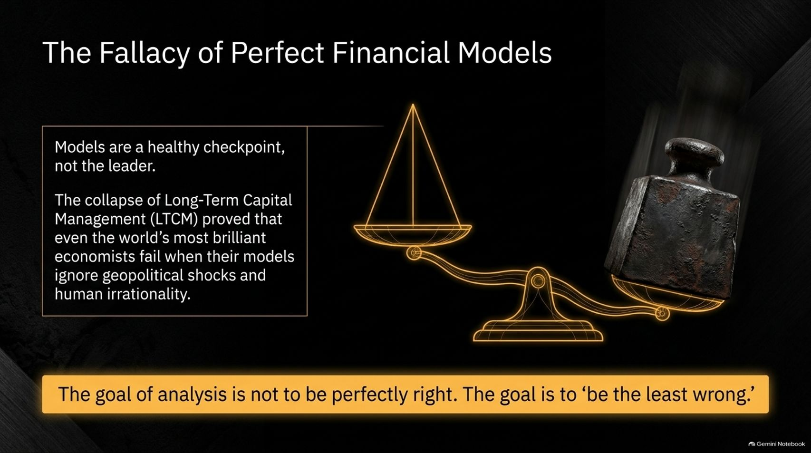
Notes:
Visual Reference: [Anatomy_of_a_Stock.pptx, Slide 10]
Target Delivery Time: 3 – 4 minutes
Speaker Notes:
"This brings us to a vital truth: The Fallacy of Perfect Financial Models."
"Models are a healthy checkpoint, not the leader. Building a model forces you to deeply engage with the business mechanics, but you must never let the model dictate your investment decisions."
"Consider the historical collapse of Long-Term Capital Management (LTCM). It proved conclusively that even a fund staffed by the world's most brilliant Nobel laureate economists will fail catastrophically when their models ignore geopolitical shocks, unexpected debt defaults, and human irrationality."
"The ultimate takeaway? The goal of analysis is not to be perfectly right. The goal is to 'be the least wrong.'"

Slide 11
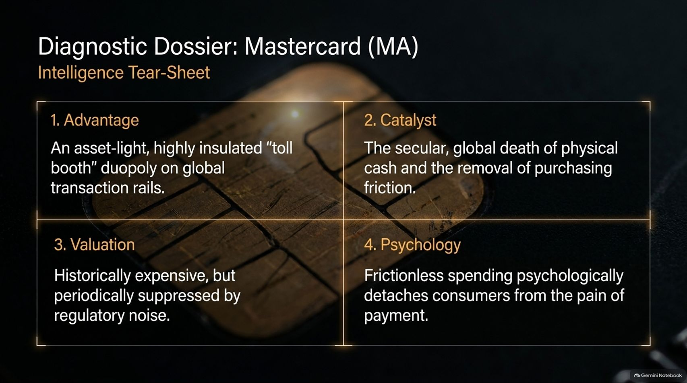
Notes:
Visual Reference: [Anatomy_of_a_Stock.pptx, Slide 11]
Target Delivery Time: 4 – 5 minutes
Speaker Notes:
"Let's apply our diagnostic framework to a real-world case study: Mastercard (MA)."
"Let's run through the tear-sheet:
Advantage: An asset-light, highly insulated 'toll booth' duopoly controlling global transaction rails alongside Visa.
Catalyst: The secular, global death of physical cash and the continuous removal of purchasing friction.
Valuation: Historically expensive, but periodically suppressed by regulatory noise or antitrust investigations.
Psychology: Frictionless spending psychology psychologically detaches consumers from the pain of payment."
"Mastercard represents a masterclass in durable business design—though, as a time-capsule warning, investors must always remain alert to future technological or regulatory disruptions."

Slide 12

Notes:
Visual Reference: [Anatomy_of_a_Stock.pptx, Slide 12]
Target Delivery Time: 3 – 4 minutes
Speaker Notes:
"What makes a business model like Mastercard truly bulletproof? It comes down to The Invisible Moat: Trust."
"Think about the sheer psychology of swiping a piece of plastic in a foreign city and walking out with valuable goods. That transaction relies entirely on an invisible phenomenon: absolute trust."
"Trust is earned slowly, compounds massively over decades, and acts as the ultimate un-modeled competitive advantage."
"Conversely, when management breaks trust, the spreadsheet no longer matters. If executive leadership lacks integrity, all the financial modeling in the world won't protect your capital."

Slide 13

Notes:
Visual Reference: [Anatomy_of_a_Stock.pptx, Slide 13]
Target Delivery Time: 4 – 5 minutes
Speaker Notes:
"Markets operate in extreme cycles, swinging between two distinct psychological extremes:"
"The Top: Nobody ever knows precisely when the market top arrives. Because trying to time the peak is a fool's errand, your only true insurance policy is the rigorous fundamental quality of the businesses you hold."
"The Bottom: Terrifying, but crystal clear. Market bottoms are marked by panic, circuit breakers, and liquidity crises (such as 2008 or COVID-19). These are the rare, fleeting moments when market price entirely detaches from intrinsic value, creating generational buying opportunities for disciplined investors."

Slide 14
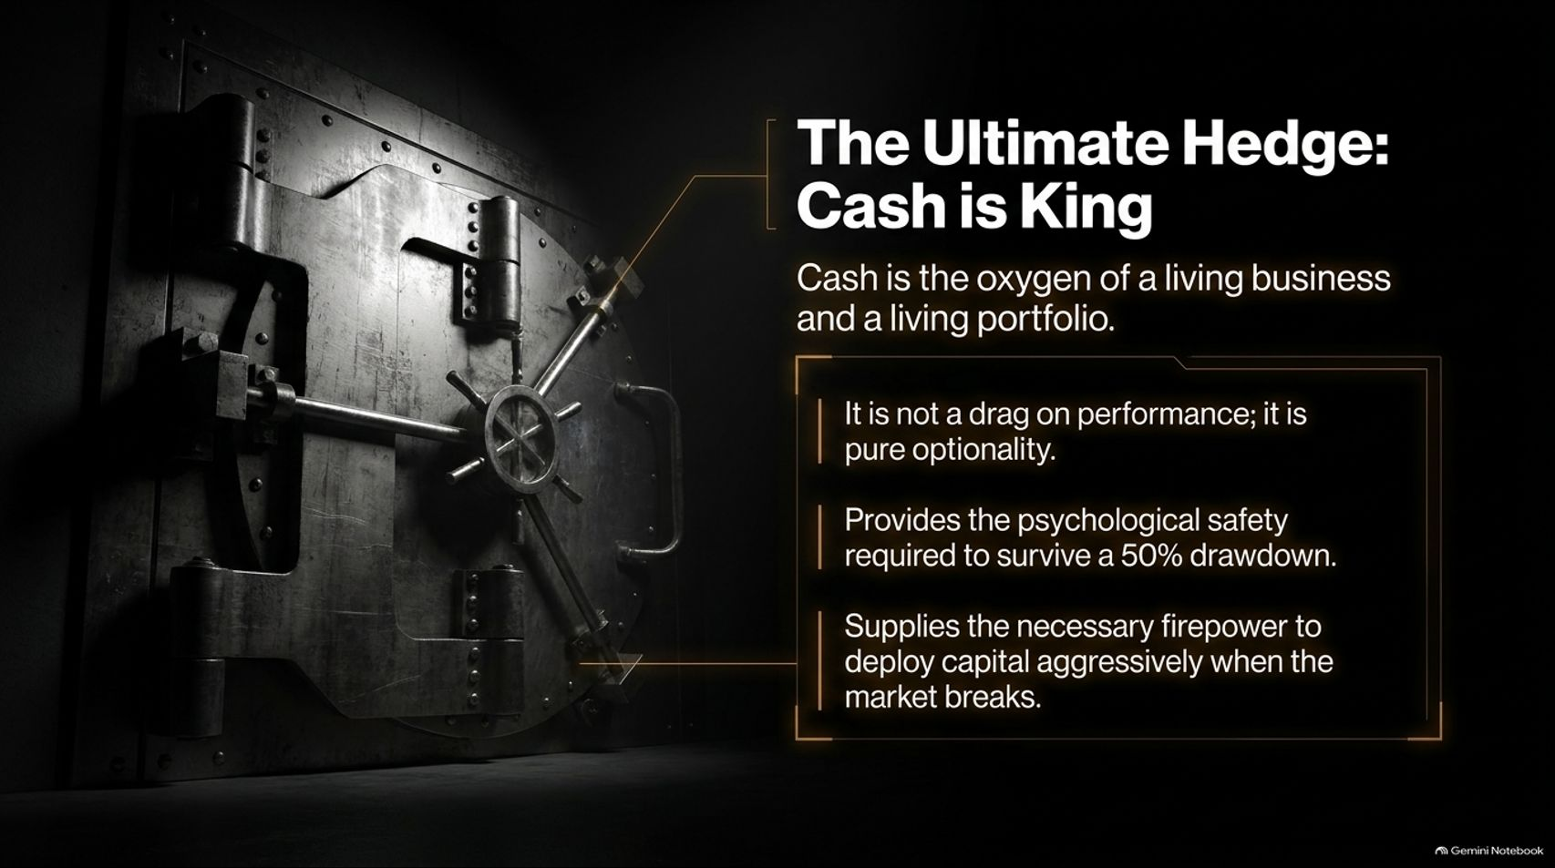
Notes:
Visual Reference: [Anatomy_of_a_Stock.pptx, Slide 14]
Target Delivery Time: 4 – 5 minutes
Speaker Notes:
"If there is one golden rule to take away from Joseph Foresi and decades of market wisdom, it is this: The Ultimate Hedge: Cash is King."
"Cash is the oxygen of both a living business and a personal investment portfolio. Far too many investors view cash reserves as a performance drag. In reality:
Cash is pure optionality.
It provides the essential psychological safety required to survive a brutal 50% market drawdown without panicking.
It supplies the necessary financial firepower to deploy capital aggressively when the market breaks."
"Well-capitalized businesses—and well-capitalized investors—always survive and thrive because they hold cash reserves when others are forced to sell."

Slide 15

Notes:
Visual Reference: [Anatomy_of_a_Stock.pptx, Slide 15]
Target Delivery Time: 3 – 4 minutes
Speaker Notes:
"Let's step back and look at The True Horizon of Wealth."
"Investing is a long-term architectural process, not a get-rich-quick scheme. Trying to judge an investment strategy in strict 12-month increments is a complete disservice to the power of compounding."
"As Joe Foresi reminds us, real wealth is generated by finding genuine joy in the process of identifying, valuing, and partnering with durable, high-quality businesses over decades, not days."

Slide 16
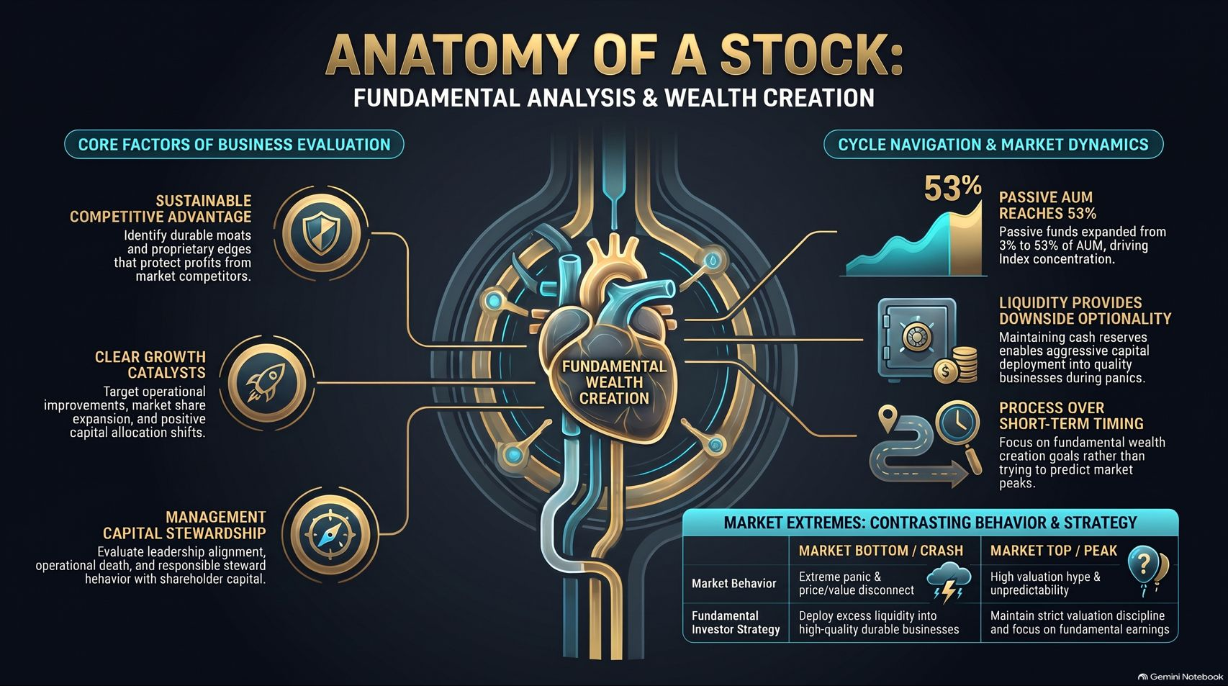
Notes:
Visual Reference: [Anatomy_of_a_Stock.pptx, Slide 16]
Target Delivery Time: 4 – 5 minutes
Speaker Notes:
"To wrap up our masterclass, this summary slide encapsulates everything we've covered:"
"On the left, our Core Factors of Evaluation: Sustainable Competitive Advantage, Clear Growth Catalysts, and Management Capital Stewardship."
"On the right, our Cycle Navigation & Market Dynamics: Recognizing the 53% passive AUM reality, maintaining liquidity for downside optionality, and prioritizing analytical process over short-term market timing."
"Finally, remember our contrast matrix: At market bottoms, embrace panic and deploy liquidity into quality; at market peaks, maintain strict valuation discipline and focus on fundamental earnings."
"Thank you for joining this exploration into the anatomy of a stock. Master the process, protect your downside with cash, and think in decades."

