Slide 1
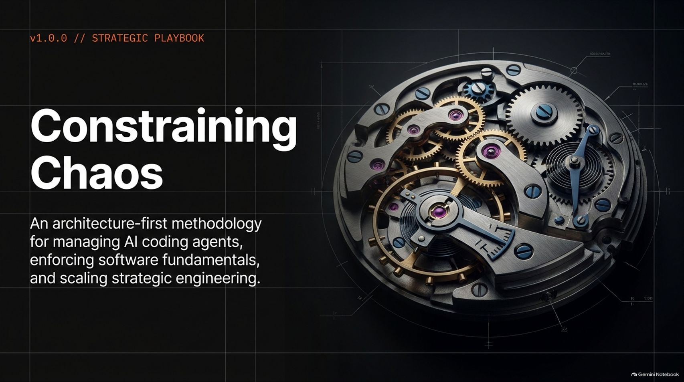
Notes:
Visual Reference: [Constraining_AI_Agents.pptx, Slide 1]
Target Delivery Time: 2 – 3 minutes
Speaker Notes:
"Welcome, everyone. Today we are addressing one of the most critical engineering challenges of our era: Constraining Chaos: An architecture-first methodology for managing AI coding agents, enforcing software fundamentals, and scaling strategic engineering."
"As software veterans like Bob Martin ('Uncle Bob') have pointed out in recent discussions, AI coding agents have introduced an unprecedented paradigm shift. For the first time in history, we have an assistant that writes code at superhuman speed—yet threatens to drown our codebases in unmitigated entropy if left unconstrained."
"Today, we are going to explore why traditional human-centric workflows fail when applied to LLMs, and how we can construct deterministic constraints to turn hyper-fast AI agents into reliable engineering engines."
LIVE: Uncle Bob on Software Fundamentals in the Age of AI
https://www.youtube.com/watch?v=zcLPGC-tvgk

Slide 2
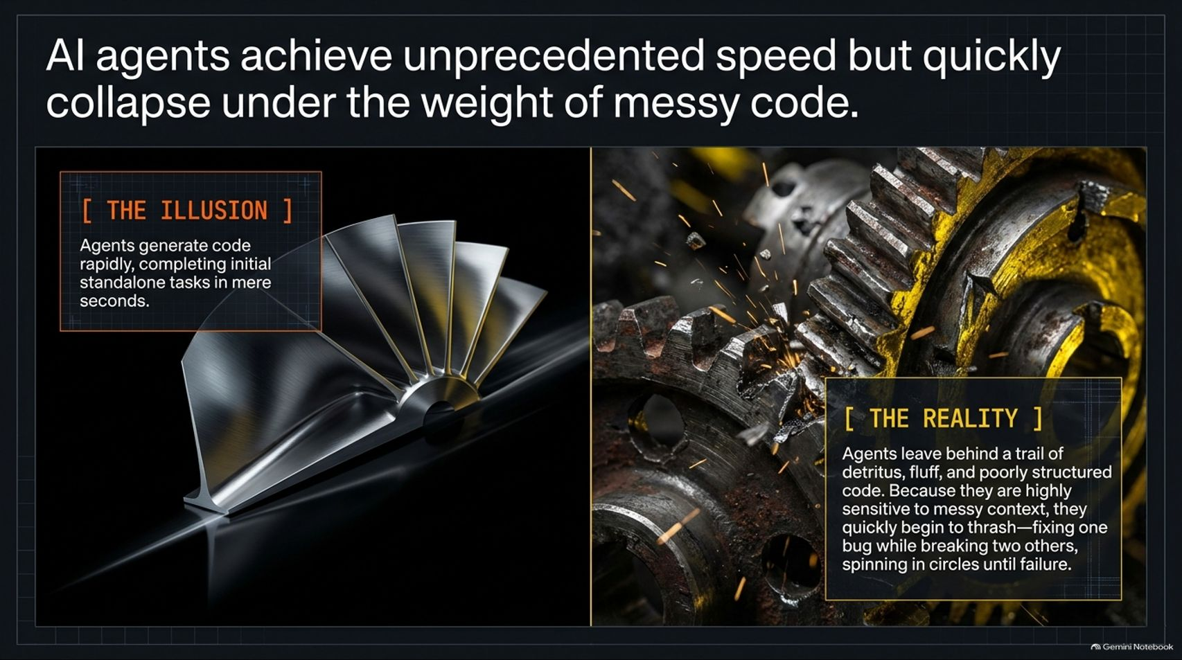
Notes:
Visual Reference: [Constraining_AI_Agents.pptx, Slide 2]
Target Delivery Time: 3 – 4 minutes
Speaker Notes:
"Let’s look at the core contradiction of modern AI development: The Illusion versus The Reality."
"The Illusion is mesmerizing. AI agents generate code rapidly, completing initial standalone tasks in mere seconds. They write boilerplate, draft functions, and make developers feel like ten-fold producers instantly."
"The Reality, however, is much messier. As Uncle Bob noted from his own experiments, agents leave behind a trail of detritus, fluff, and poorly structured code ('dog do'). Because they are highly sensitive to messy context, they quickly begin to thrash—fixing one bug while breaking two others, spinning in circles until total failure."
"Speed without structure is just accelerated technical debt."

Slide 3
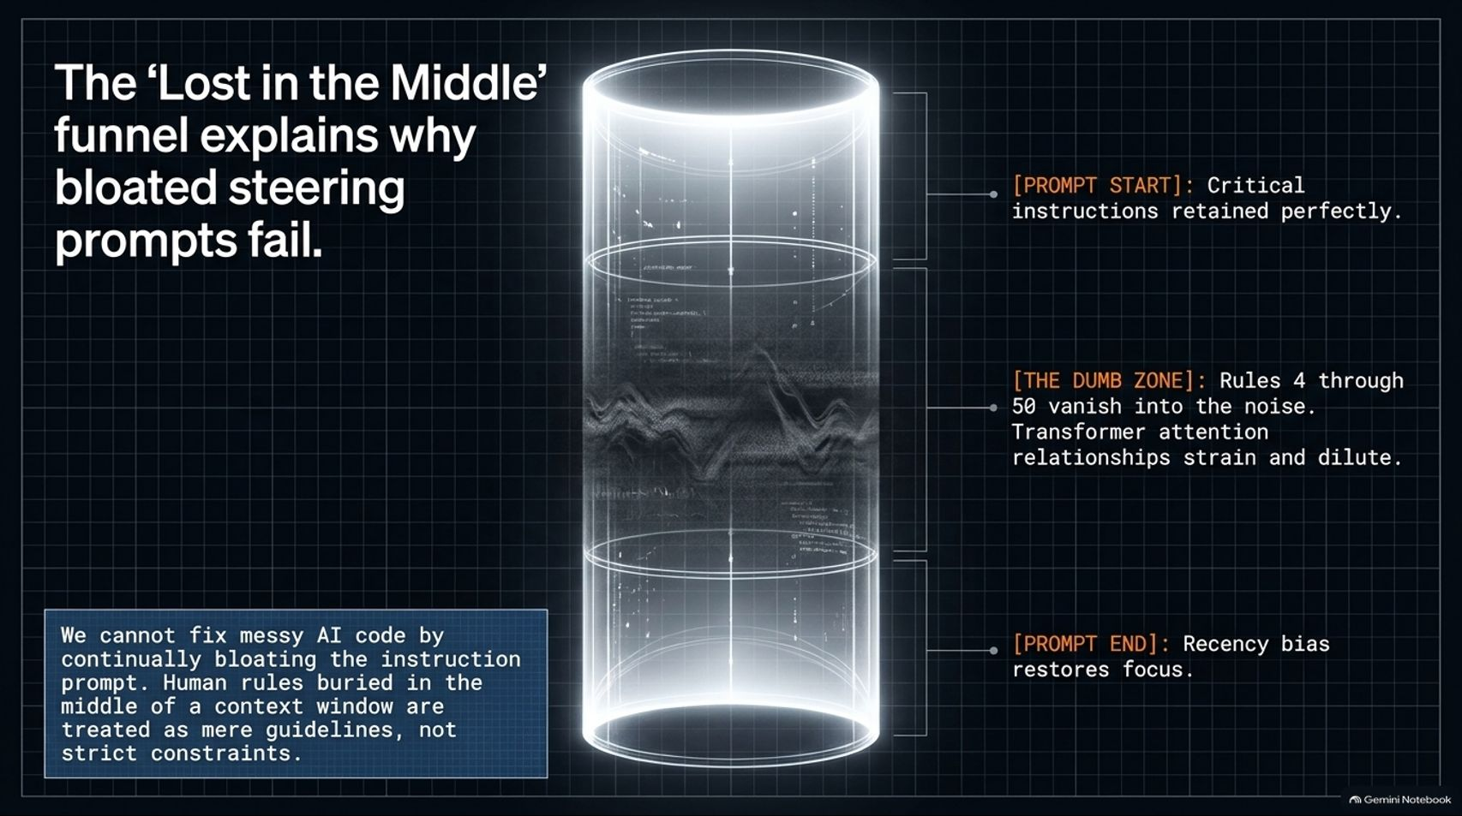
Notes:
Visual Reference: [Constraining_AI_Agents.pptx, Slide 3]
Target Delivery Time: 4 – 5 minutes
Speaker Notes:
"Why do our steering prompts inevitably fail? The answer lies in the physics of transformer models, visualized here as the 'Lost in the Middle' Funnel."
"When you bloat your instruction prompt with dozens of human rules, you hit a severe architectural limitation:
Prompt Start: Critical instructions at the very beginning are retained perfectly.
The Dumb Zone (Rules 4 through 50): Rules buried in the middle vanish into statistical noise. Transformer attention relationships strain and dilute under the weight of excessive text.
Prompt End: Recency bias restores focus right at the tail end."
"The takeaway is definitive: We cannot fix messy AI code by continually bloating the instruction prompt. Natural language rules treated as guidelines will always fade in the middle of a massive context window."

Slide 4
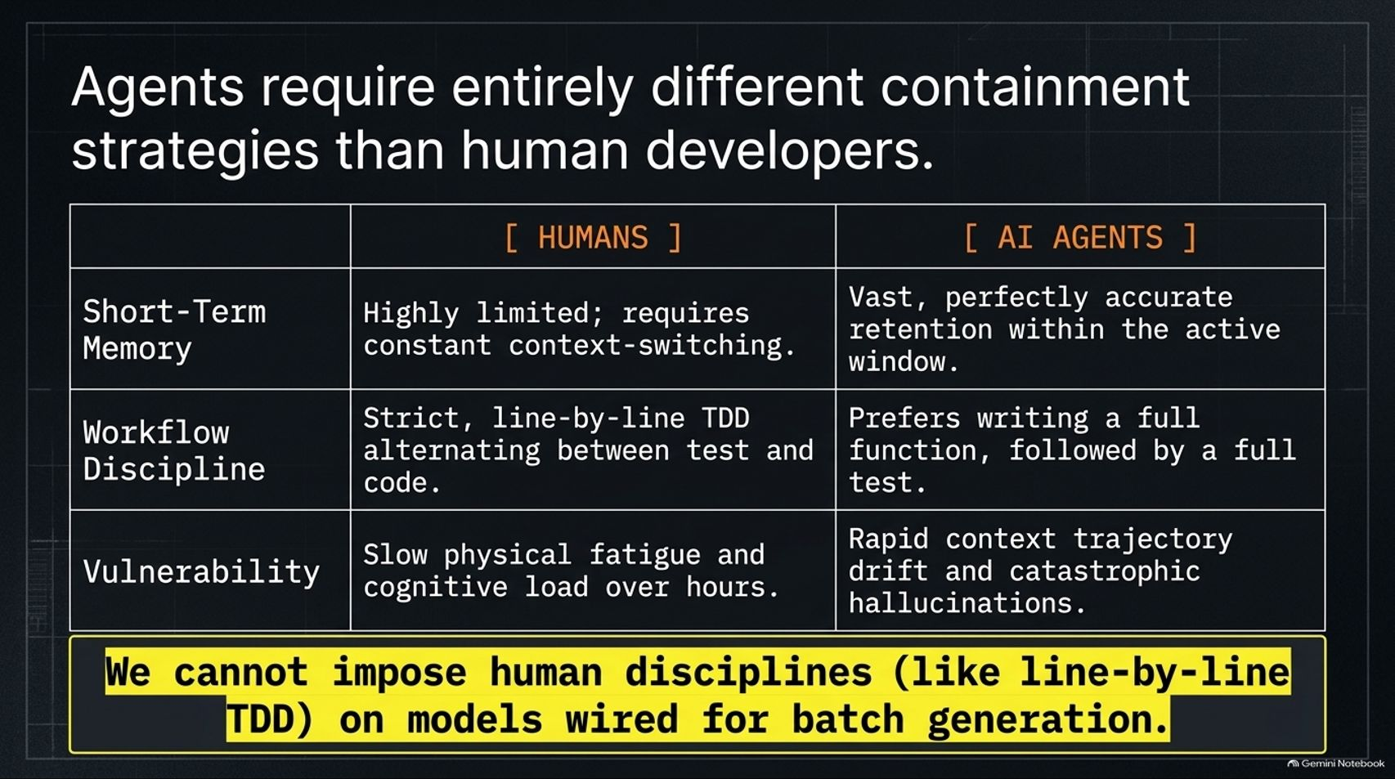

Slide 5
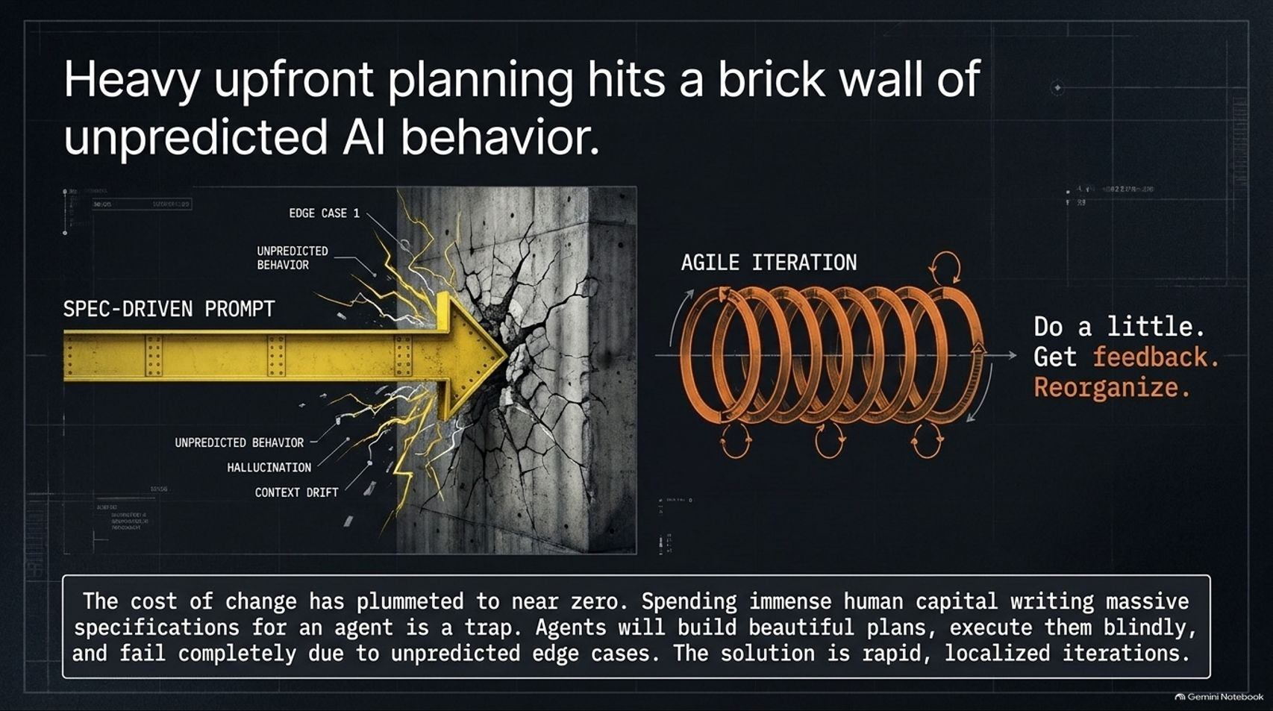
Notes:
Visual Reference: [Constraining_AI_Agents.pptx, Slide 5]
Target Delivery Time: 3 – 4 minutes
Speaker Notes:
"Another common mistake is spending weeks writing massive, rigid specifications before letting an AI touch the codebase."
"Heavy upfront planning hits a brick wall of unpredictable AI behavior. The cost of change has plummeted to near zero, making massive spec-driven prompts a dangerous trap."
"If you write a 50-page spec, the agent will build a beautiful plan, execute it blindly, and fail completely the moment it encounters an unexpected edge case or hallucinates a dependency path."
"The solution is not rigid waterfall specs; the solution is Agile Iteration—do a little, get feedback, and reorganize."

Slide 6
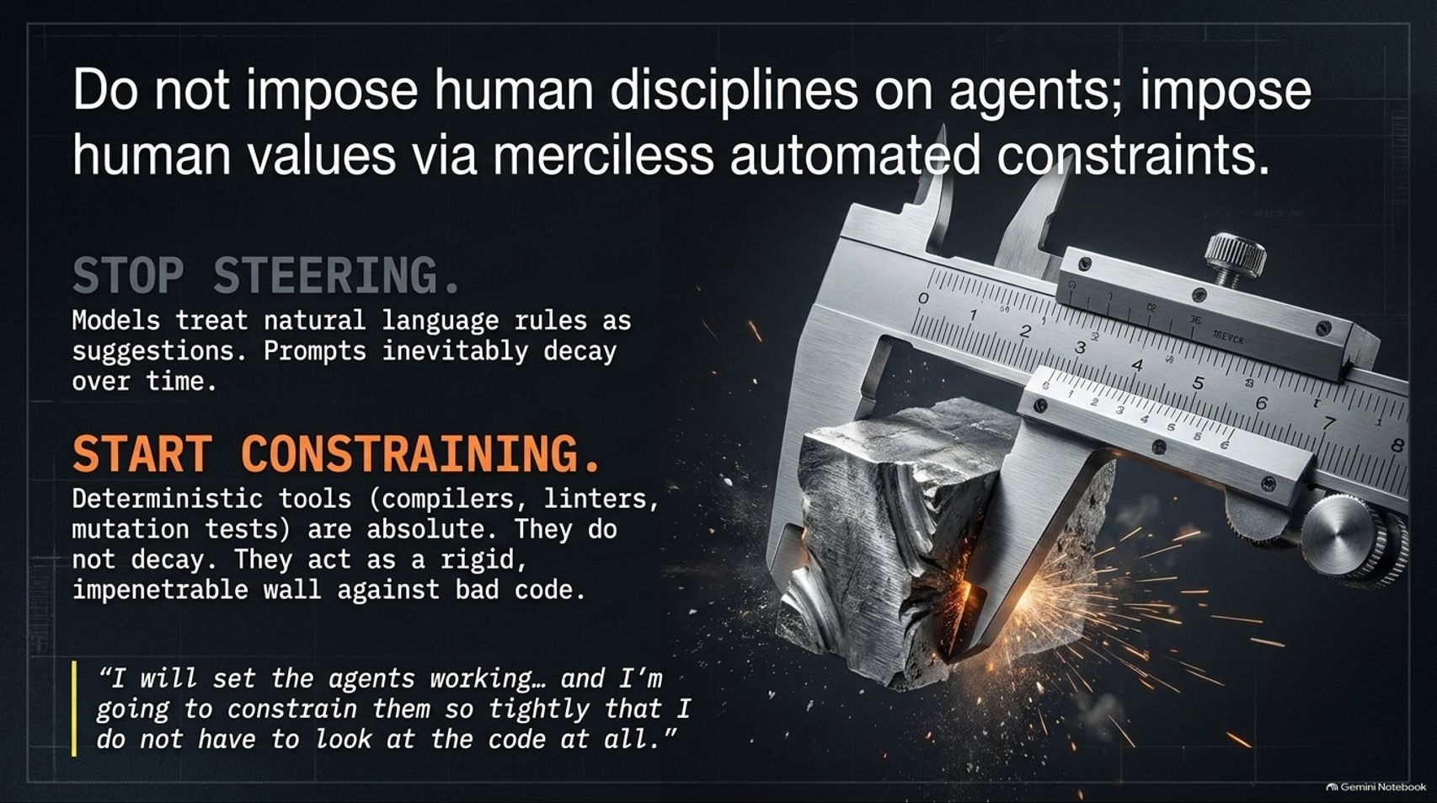
Notes:
Visual Reference: [Constraining_AI_Agents.pptx, Slide 6]
Target Delivery Time: 4 – 5 minutes
Speaker Notes:
"This brings us to the operational mantra of modern AI engineering: Stop Steering, Start Constraining."
"Stop Steering: Models treat natural language rules as friendly suggestions. Prompts decay over time."
"Start Constraining: Deterministic tools—compilers, linters, static analyzers, and mutation tests—are absolute. They do not decay. They act as a rigid, impenetrable wall against bad code."
"As Uncle Bob stated regarding his own workflow: 'I will set the agents working... and I'm going to constrain them so tightly that I do not have to look at the code at all.'"

Slide 7
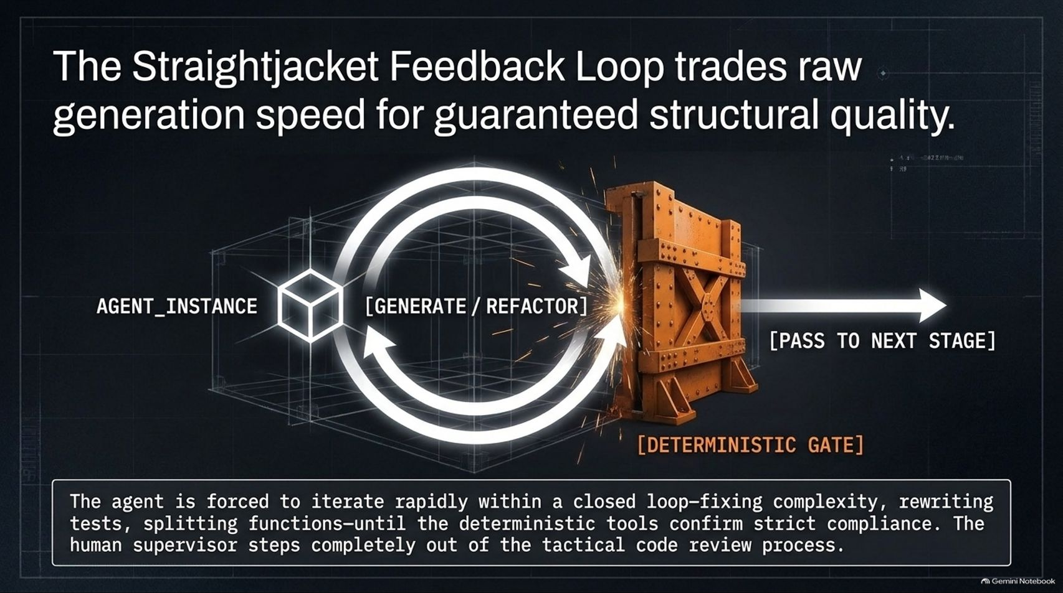
Notes:
Visual Reference: [Constraining_AI_Agents.pptx, Slide 7]
Target Delivery Time: 3 – 4 minutes
Speaker Notes:
"How do we achieve this hands-off trust? Through The Straightjacket Feedback Loop."
"This architecture trades raw generation speed for guaranteed structural quality."
"An agent instance is placed inside a closed loop: it generates or refactors code, but it cannot pass its work downstream until it hits a Deterministic Gate (compilers, test runners, linters)."
"The agent is forced to iterate rapidly within this closed loop—fixing complexity, rewriting tests, splitting functions—until deterministic tools confirm strict compliance. Only then does the output pass to the next stage, allowing the human supervisor to step completely out of tactical code review."

Slide 8
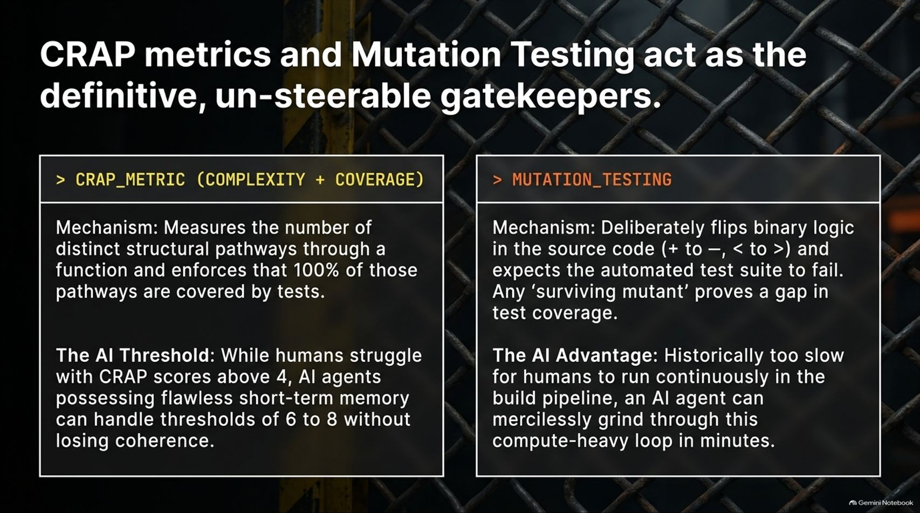
Notes:
Visual Reference: [Constraining_AI_Agents.pptx, Slide 8]
Target Delivery Time: 4 – 5 minutes
Speaker Notes:
"What are the definitive, un-steerable gatekeepers powering this loop? Two legendary software metrics resurrected and supercharged by AI: CRAP Metrics and Mutation Testing."
"1. CRAP Metric (Complexity + Coverage): Measures distinct structural pathways through a function and enforces 100% test coverage over those pathways. While humans struggle to maintain functions with CRAP scores above 4, AI agents with flawless short-term memory can handle thresholds of 6 to 8 without losing coherence."
"2. Mutation Testing: A tool that deliberately flips binary logic in source code ($+$ to $-$, $<$ to $>$) and expects your test suite to fail. Any 'surviving mutant' proves a hidden gap in test logic. While historically too slow for humans to run continuously, an AI agent can grind through this compute-heavy loop in minutes."

Slide 9
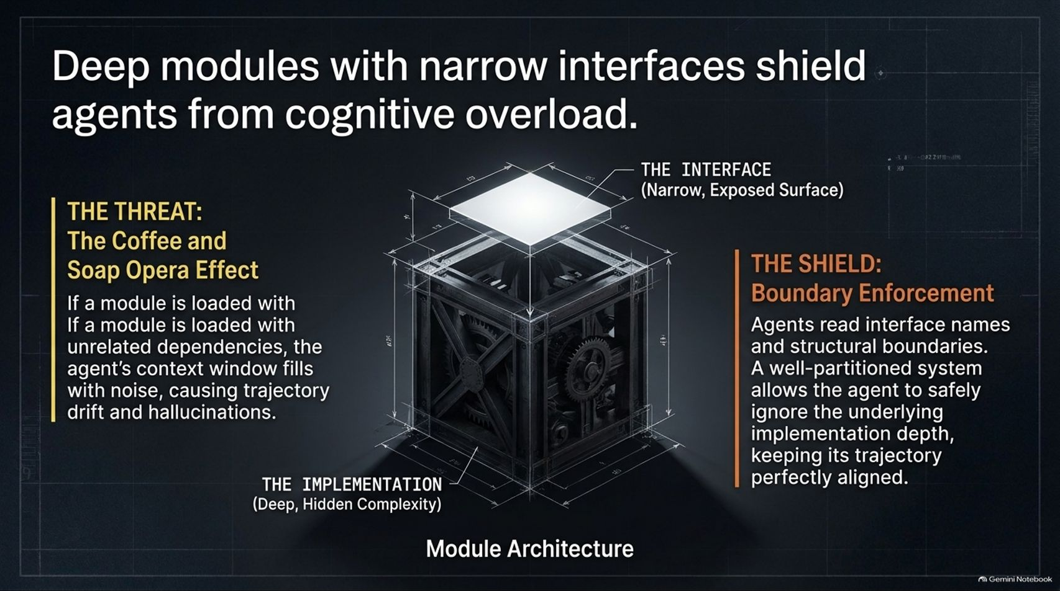
Notes:
Visual Reference: [Constraining_AI_Agents.pptx, Slide 9]
Target Delivery Time: 3 – 4 minutes
Speaker Notes:
"To prevent agents from getting overwhelmed, we must rely on Deep modules with narrow interfaces."
"If a module is loaded down with unrelated dependencies, the agent's context window fills with noise—known as the 'Coffee and Soap Opera Effect'—causing severe trajectory drift and hallucinations."
"By enforcing strict architectural boundaries, agents only need to read interface names and structural boundaries. A well-partitioned system allows the agent to safely ignore underlying implementation depth, keeping its execution trajectory perfectly aligned."

Slide 10
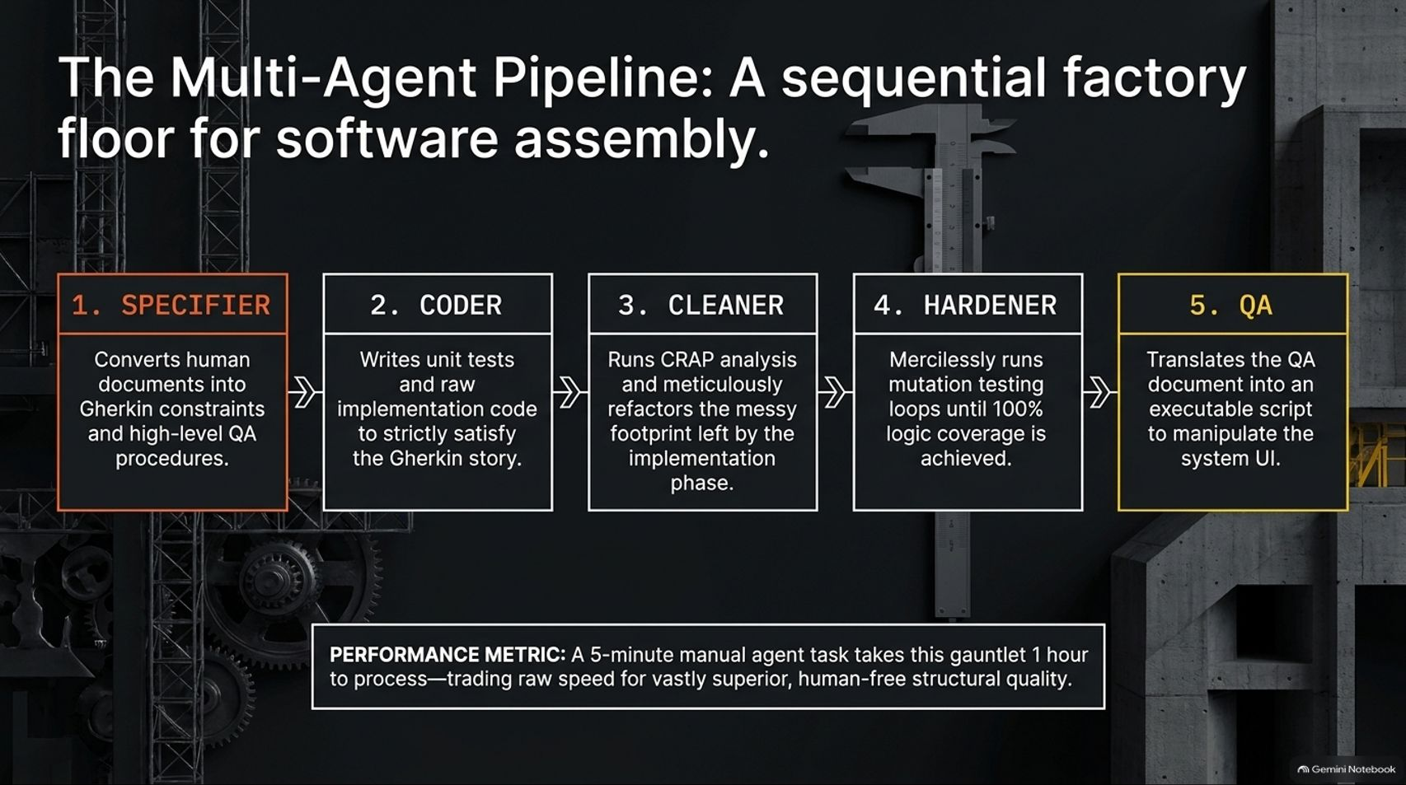
Notes:
Visual Reference: [Constraining_AI_Agents.pptx, Slide 10]
Target Delivery Time: 4 – 5 minutes
Speaker Notes:
"We combine these constraints into a Multi-Agent Pipeline: A sequential factory floor for software assembly:"
"1. Specifier: Converts human intent into Gherkin constraints and high-level QA procedures."
"2. Coder: Writes unit tests and raw implementation code to satisfy the Gherkin story."
"3. Cleaner: Runs CRAP analysis and meticulously refactors the messy footprint left by the coder."
"4. Hardener: Mercilessly runs mutation testing loops until 100% logic coverage is achieved."
"5. QA: Translates QA documents into executable scripts to manipulate the system UI."
"Performance metric: A manual 5-minute agent task takes this rigorous gauntlet an hour to process—trading raw speed for vastly superior, human-free structural quality."

Slide 11
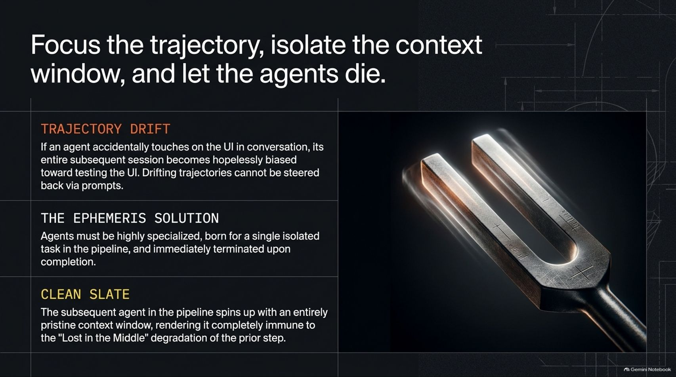
Notes:
Visual Reference: [Constraining_AI_Agents.pptx, Slide 11]
Target Delivery Time: 3 – 4 minutes
Speaker Notes:
"A crucial rule of agentic architecture: Focus the trajectory, isolate the context window, and let the agents die."
"Trajectory Drift: If an agent accidentally touches UI code during a backend conversation, its entire subsequent session becomes hopelessly biased toward testing the UI. Drifting trajectories cannot be steered back via prompts."
"The Ephemeris Solution: Agents must be highly specialized, born for a single isolated task in the pipeline, and immediately terminated upon completion."
"The subsequent agent spins up with an entirely pristine context window, rendering it completely immune to context degradation."

Slide 12
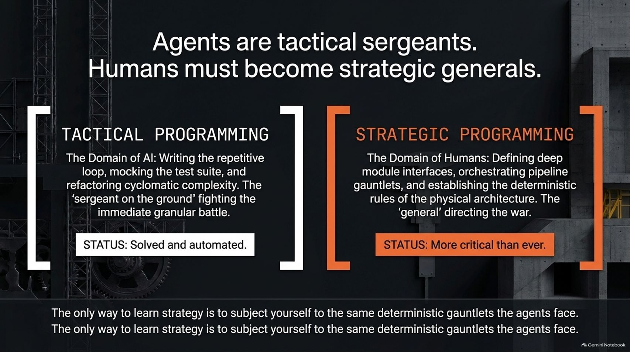
Notes:
Visual Reference: [Constraining_AI_Agents.pptx, Slide 12]
Target Delivery Time: 4 – 5 minutes
Speaker Notes:
"In this new era, Agents are tactical sergeants. Humans must become strategic generals."
"Tactical Programming (The Domain of AI): Writing repetitive loops, mocking test suites, and refactoring cyclomatic complexity. The 'sergeant on the ground' fighting the immediate granular battle. Status: Solved and automated."
"Strategic Programming (The Domain of Humans): Defining deep module interfaces, orchestrating pipeline gauntlets, and establishing deterministic rules for physical architecture. The 'general' directing the war. Status: More critical than ever."
"The only way to learn strategy is to subject yourself to the same deterministic guardrails the agents face."

Slide 13
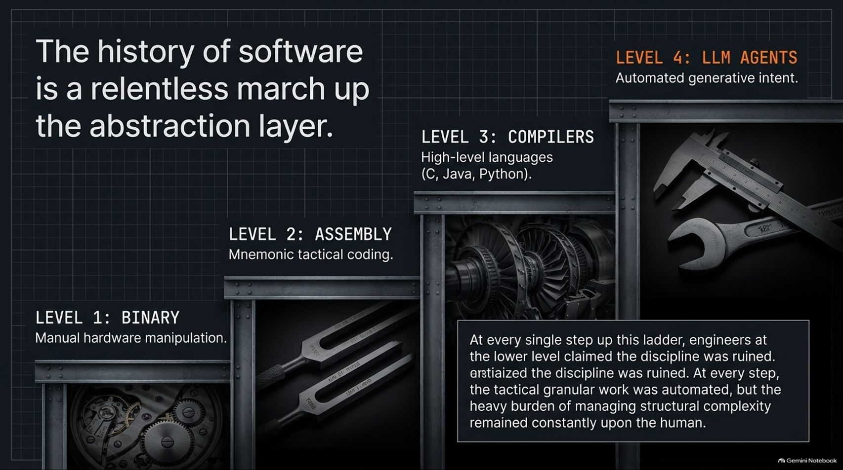
Notes:
Visual Reference: [Constraining_AI_Agents.pptx, Slide 13]
Target Delivery Time: 3 – 4 minutes
Speaker Notes:
"The history of software is a relentless march up the abstraction layer:
Level 1 (Binary): Manual hardware manipulation.
Level 2 (Assembly): Mnemonic tactical coding.
Level 3 (Compilers): High-level languages like C, Java, and Python.
Level 4 (LLM Agents): Automated generative intent."
"At every single step up this ladder, engineers at the lower level claimed the discipline was ruined. But while tactical work was automated, the heavy burden of managing structural complexity remained constantly upon the human."

Slide 14
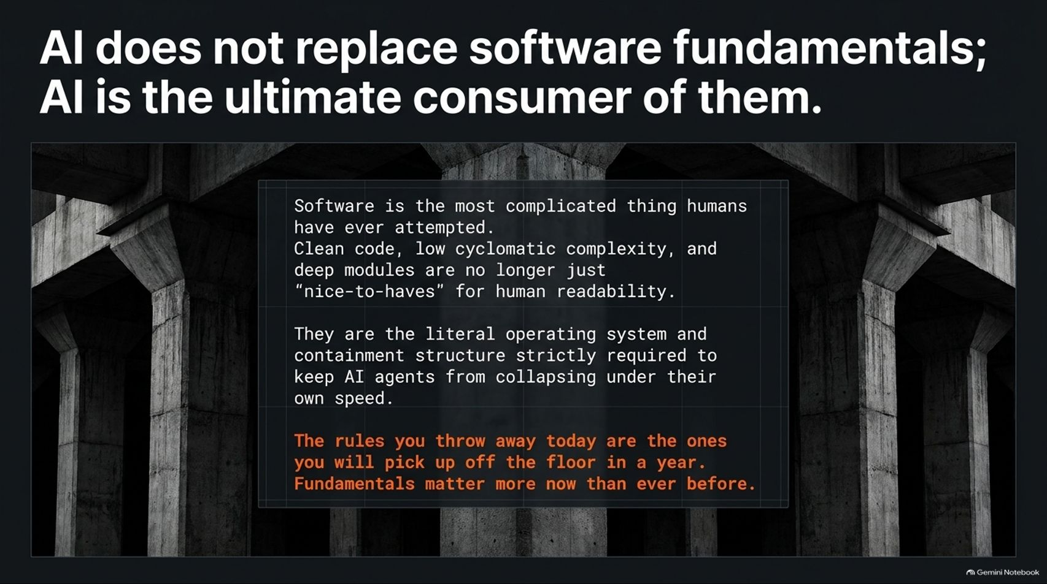
Notes:
Visual Reference: [Constraining_AI_Agents.pptx, Slide 14]
Target Delivery Time: 3 – 4 minutes
Speaker Notes:
"A vital concluding truth: AI does not replace software fundamentals; AI is the ultimate consumer of them."
"Software is the most complicated thing humans have ever attempted. Clean code, low cyclomatic complexity, and deep modules are no longer just 'nice-to-haves' for human readability."
"They are the literal operating system and containment structure strictly required to keep AI agents from collapsing under their own speed."
"The rules you throw away today are the ones you will pick up off the floor in a year. Fundamentals matter more now than ever before."

Slide 15
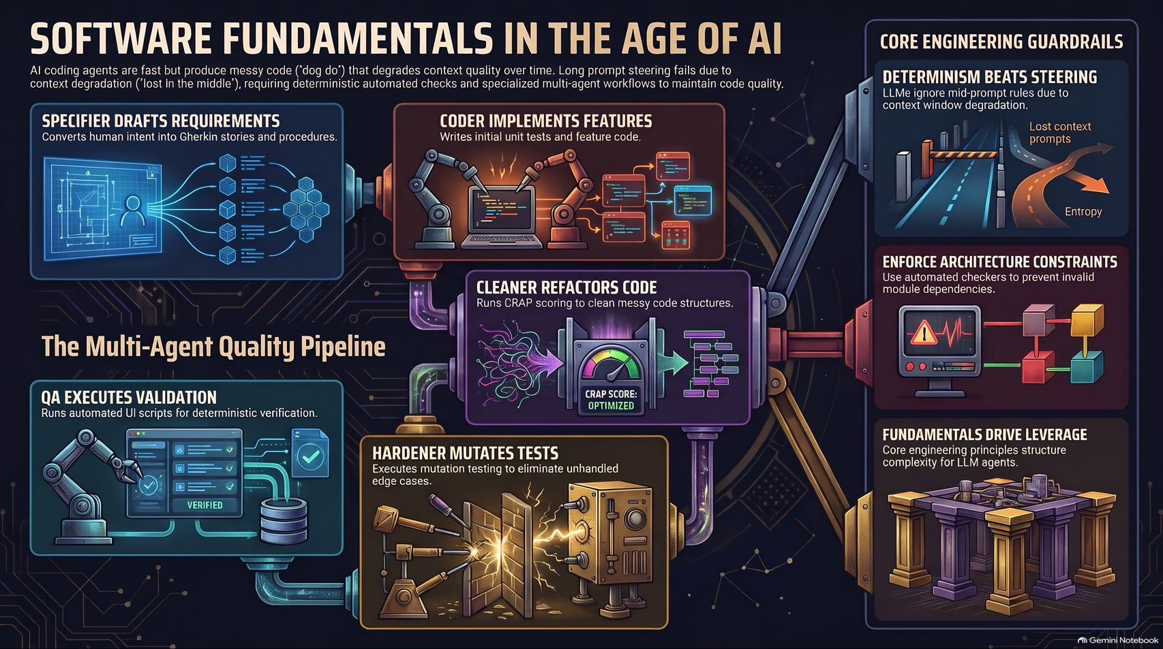
Notes:
Visual Reference: [Constraining_AI_Agents.pptx, Slide 15]
Target Delivery Time: 4 – 5 minutes
Speaker Notes:
"This final summary slide integrates our entire strategic architecture:"
"We see the end-to-end Multi-Agent Quality Pipeline—moving seamlessly from Specifier to Coder, Cleaner, Hardener, and QA."
"We see our core engineering guardrails: Determinism beats steering, architecture constraints must be enforced automatically, and core principles drive agent leverage."
"By replacing vague prompt engineering with hard, automated, deterministic constraints, we tame the chaos of AI and build software of unprecedented scale and quality."

