Slide 1
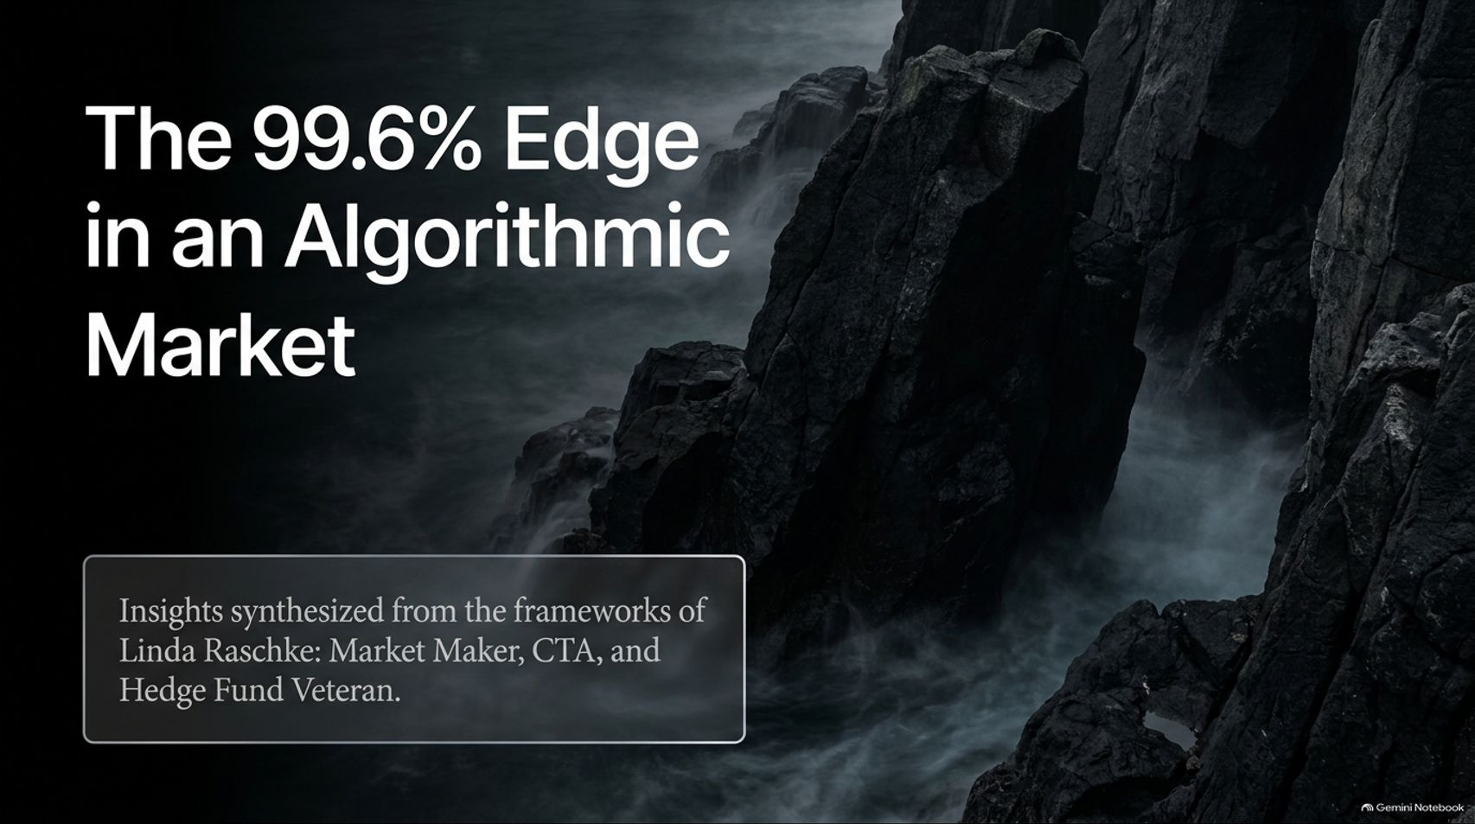
Notes:
Visual Reference: [The_Opportunistic_Edge.pptx, Slide 1]
Target Delivery Time: 2 – 3 minutes
Speaker Notes:
"Welcome, everyone. Today we are exploring The 99.6% Edge in an Algorithmic Market, drawing directly from the decades of market-making, CTA, and hedge fund wisdom of Linda Raschke."
"For decades, retail traders have tried to compete with institutional giants by staring at lagging indicators and guessing what order flow means. But as Linda Raschke—who ran a fund whose 5-year returns beat 99.7% of funds on the planet—has repeatedly pointed out, the game is no longer about fighting the algorithms."
"Today, we are going to unpack how to stop guessing, identify algorithmic footprints, and build an actuarial, process-driven approach to short-term trading."
The Woman Who Beat 99.6% Of Hedge Funds: I Know Where The Algorithms Strike. I Used To Run Them!
https://www.youtube.com/watch?v=caLSbXnkaj4

Slide 2
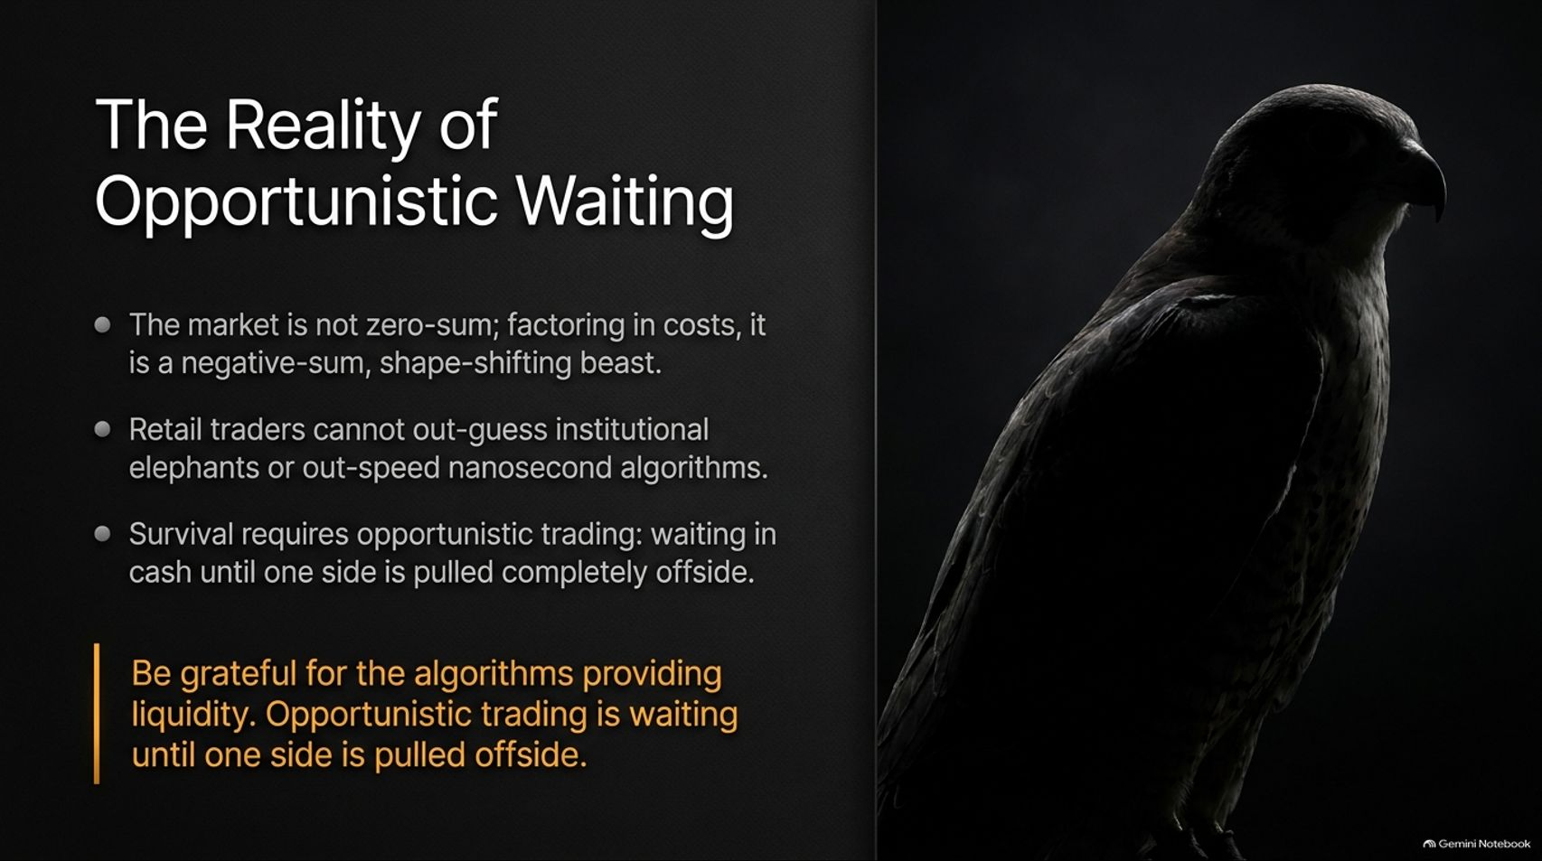
Notes:
Visual Reference: [The_Opportunistic_Edge.pptx, Slide 2]
Target Delivery Time: 3 – 4 minutes
Speaker Notes:
"Let’s start with a foundational hard truth: The market is not zero-sum; factoring in transaction costs, it is a negative-sum, shape-shifting beast."
"Retail traders cannot out-guess institutional elephants or out-speed nanosecond algorithms. Trying to fight high-frequency trading engines on their terms is a fool's errand."
"Instead, survival requires opportunistic trading: sitting patiently in cash until one side of the market is pulled completely offside."
"As the core takeaway states: Be grateful for the algorithms providing liquidity. Opportunistic trading is waiting until one side is pulled offside."

Slide 3
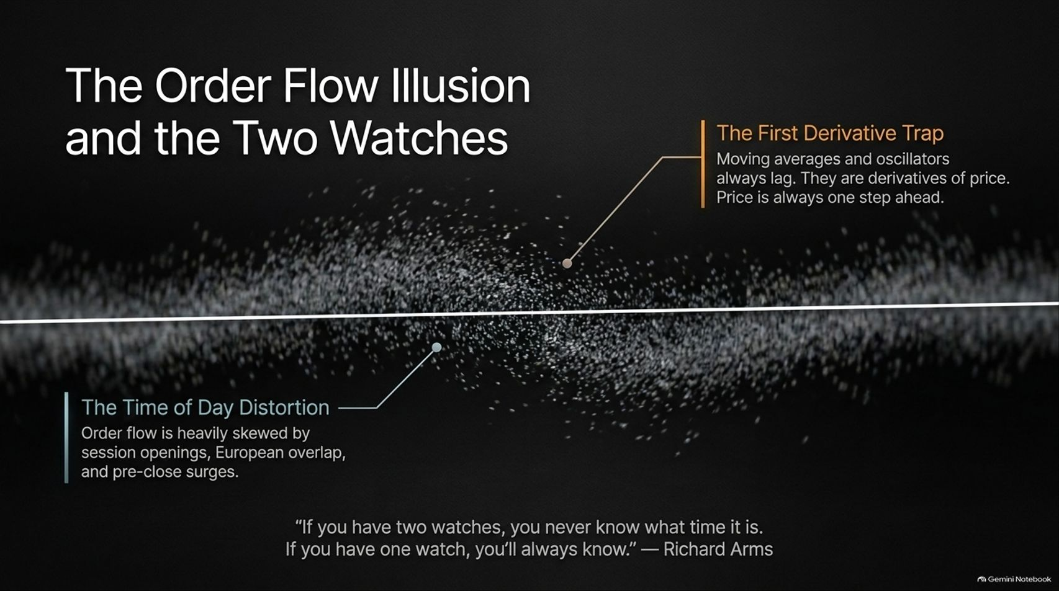
Notes:
Visual Reference: [The_Opportunistic_Edge.pptx, Slide 3]
Target Delivery Time: 4 – 5 minutes
Speaker Notes:
"Why do most retail trading strategies fail? First, because of The First Derivative Trap. Moving averages and oscillators always lag; they are derivatives of price, and price is always one step ahead."
"Second, The Time of Day Distortion: Order flow is heavily skewed by session openings, European overlaps, and pre-close surges."
"As legendary market technician Richard Arms famously said: 'If you have two watches, you never know what time it is. If you have one watch, you’ll always know.'"
"Traders drown themselves in noise by adding too many indicators. Stripping your charts down to essential structural boundaries is the only way to see true market mechanics."

Slide 4
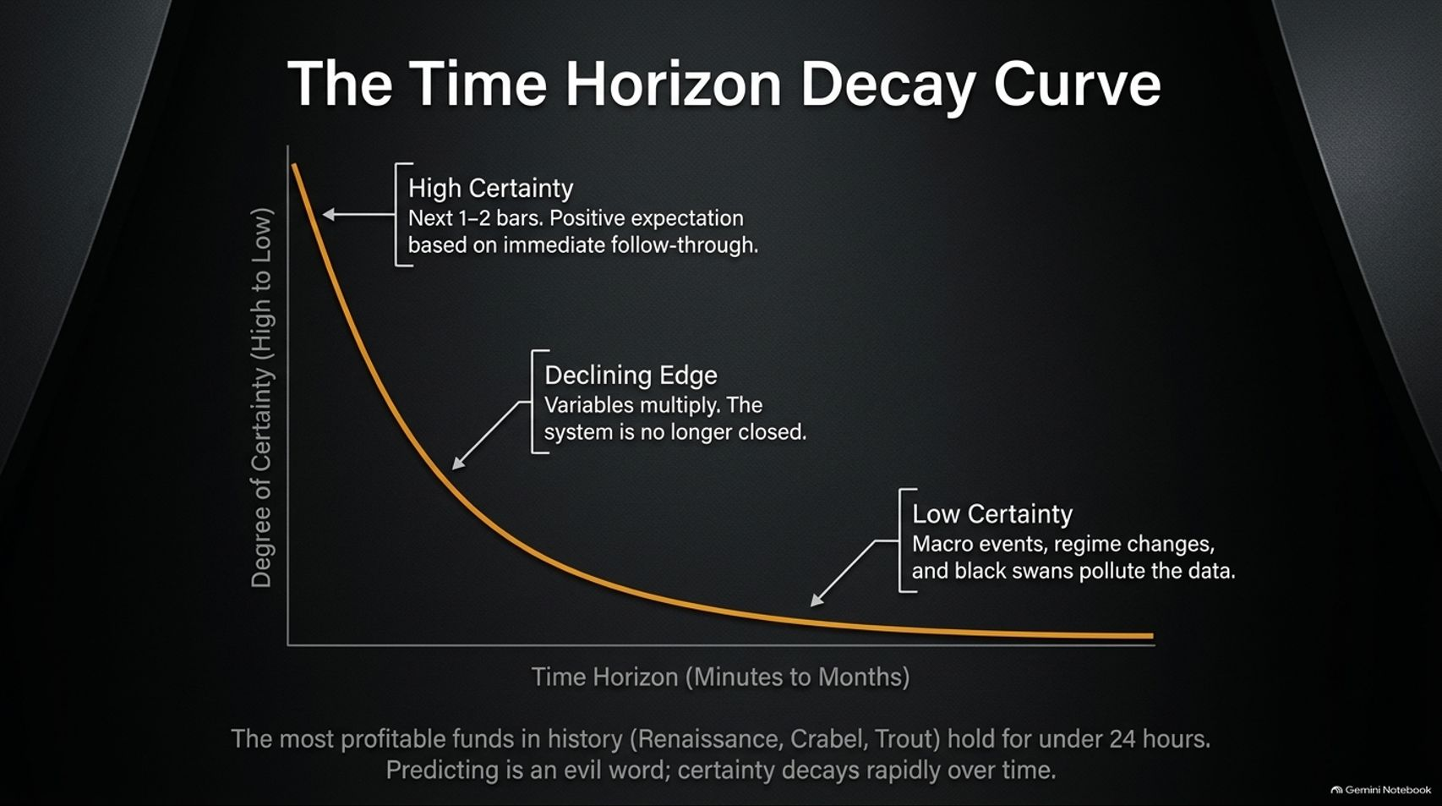
Notes:
Visual Reference: [The_Opportunistic_Edge.pptx, Slide 4]
Target Delivery Time: 4 – 5 minutes
Speaker Notes:
"Look closely at The Time Horizon Decay Curve."
"Degree of certainty starts exceptionally high on the immediate time horizon (the next 1–2 bars), where there is a positive expectation based on immediate follow-through."
"However, as the time horizon extends from minutes to months, variables multiply, the system is no longer closed, and macro events, regime changes, and black swans pollute the data."
"This explains why the most profitable short-term quantitative funds in history—such as Renaissance Technologies, Crabel, and Trout—maintain holding times of under 24 hours."
"Predicting is an evil word; certainty decays rapidly over time."

Slide 5
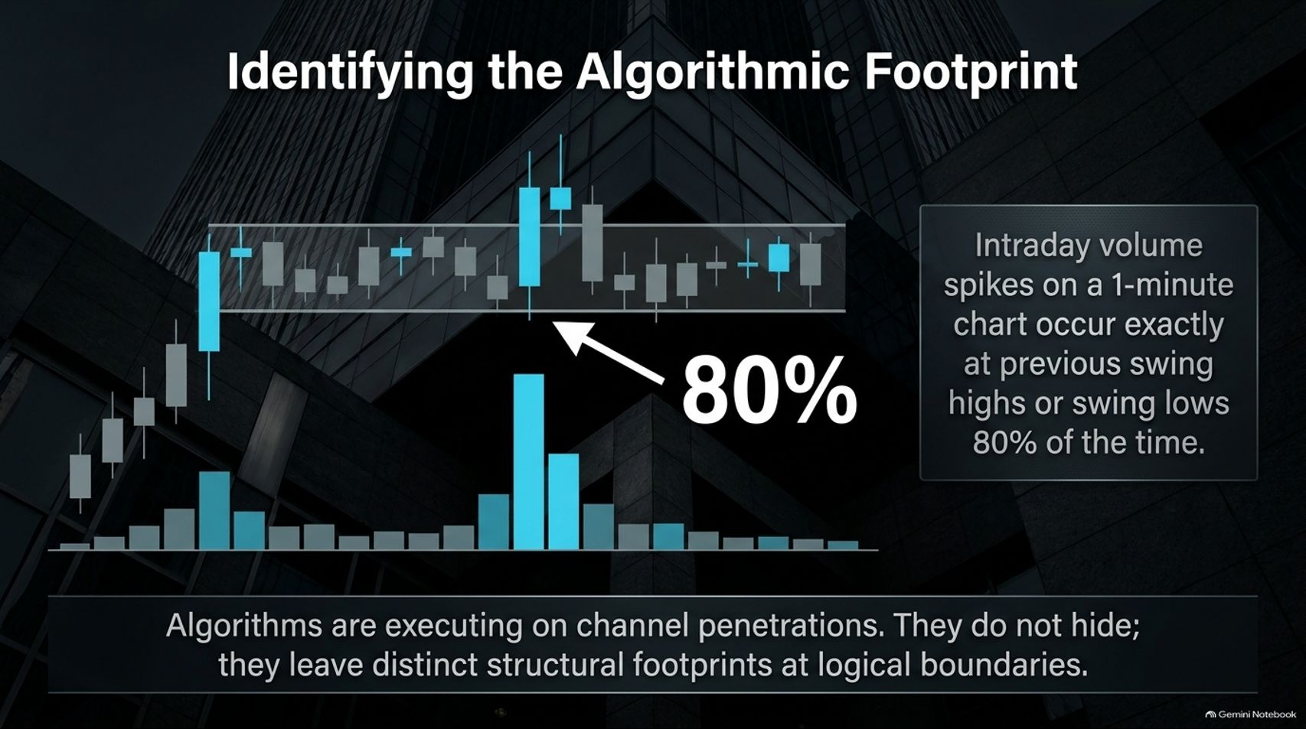
Notes:
Visual Reference: [The_Opportunistic_Edge.pptx, Slide 5]
Target Delivery Time: 4 – 5 minutes
Speaker Notes:
"Do algorithms hide? No. Algorithms are executing on channel penetrations. They leave distinct structural footprints at logical boundaries."
"Here is an actionable test you can run on your own charts: anytime you see an intraday volume spike on a 1-minute chart, go back and look where it occurred."
"80% of the time, intraday volume spikes occur exactly at previous swing highs or swing lows."
"This proves that breakout algorithms are actively triggering off channel highs and lows, pinging liquid orders and creating predictable, exploitable structural reactions."

Slide 6
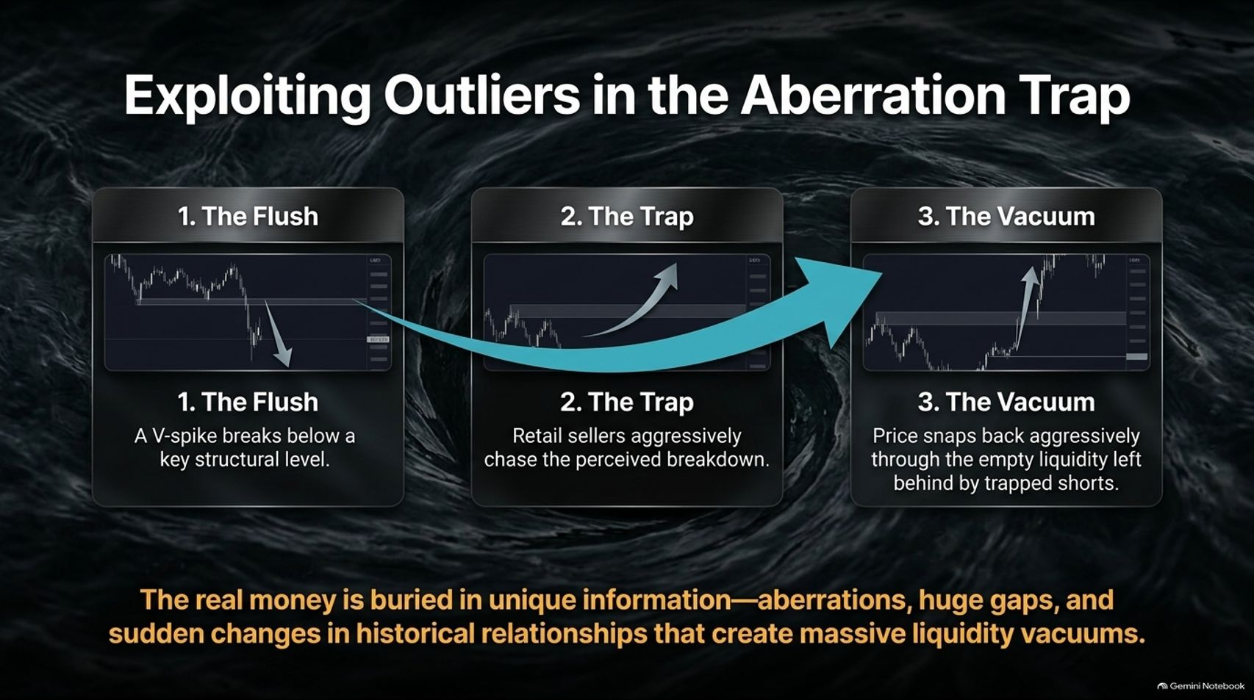
Notes:
Visual Reference: [The_Opportunistic_Edge.pptx, Slide 6]
Target Delivery Time: 4 – 5 minutes
Speaker Notes:
"The real money in trading is buried in unique information—aberrations, huge gaps, and sudden changes in historical relationships that create massive liquidity vacuums."
"We can visualize this through The Aberration Trap:
The Flush: A sharp V-spike breaks below a key structural level.
The Trap: Retail sellers aggressively chase the perceived breakdown, getting caught short.
The Vacuum: Price snaps back aggressively through the empty liquidity left behind by those trapped shorts."
"Mastering these structural aberrations yields far higher expectancy than chasing noisy mid-day price action."

Slide 7
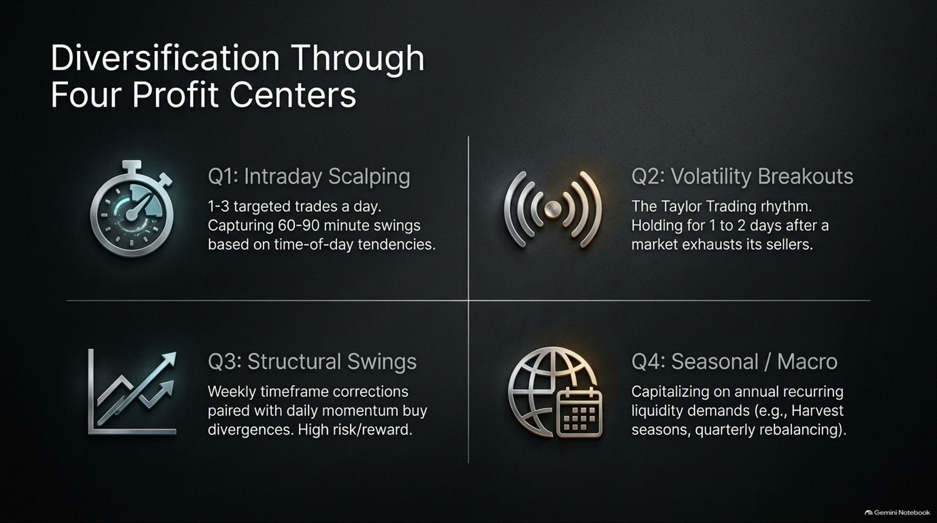
Notes:
Visual Reference: [The_Opportunistic_Edge.pptx, Slide 7]
Target Delivery Time: 4 – 5 minutes
Speaker Notes:
"To build a resilient trading operation, Linda Raschke divides performance into Four Distinct Profit Centers:
Q1: Intraday Scalping: 1–3 targeted trades a day, capturing 60–90 minute swings based on time-of-day tendencies.
Q2: Volatility Breakouts: Utilizing the Taylor Trading rhythm, holding for 1 to 2 days after a market exhausts its sellers.
Q3: Structural Swings: Weekly timeframe corrections paired with daily momentum buy divergences. High risk/reward.
Q4: Seasonal / Macro: Capitalizing on annual recurring liquidity demands, such as harvest seasons or quarterly rebalancing."
"Diversifying across these non-correlated profit centers stabilizes quarterly equity curves."

Slide 8
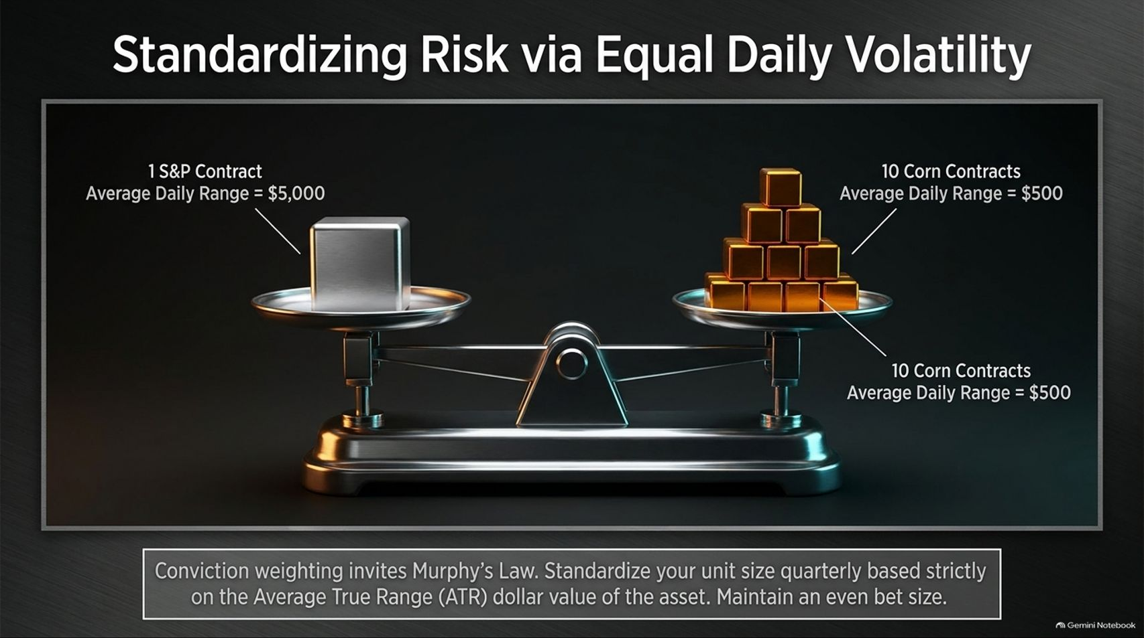
Notes:
Visual Reference: [The_Opportunistic_Edge.pptx, Slide 8]
Target Delivery Time: 4 – 5 minutes
Speaker Notes:
"A major amateur mistake is conviction weighting—sizing up on trades you feel strongly about, which directly invites Murphy’s Law."
"Instead, you must standardize your unit size quarterly based strictly on the Average True Range (ATR) dollar value of the asset."
"For example, if 1 S&P contract has an average daily range of $5,000, and 10 Corn contracts have an average daily range of $500 ($50/contract), you trade 10 corn contracts to equal the exact same daily volatility risk as 1 S&P contract."
"Maintain an even bet size across all markets."

Slide 9
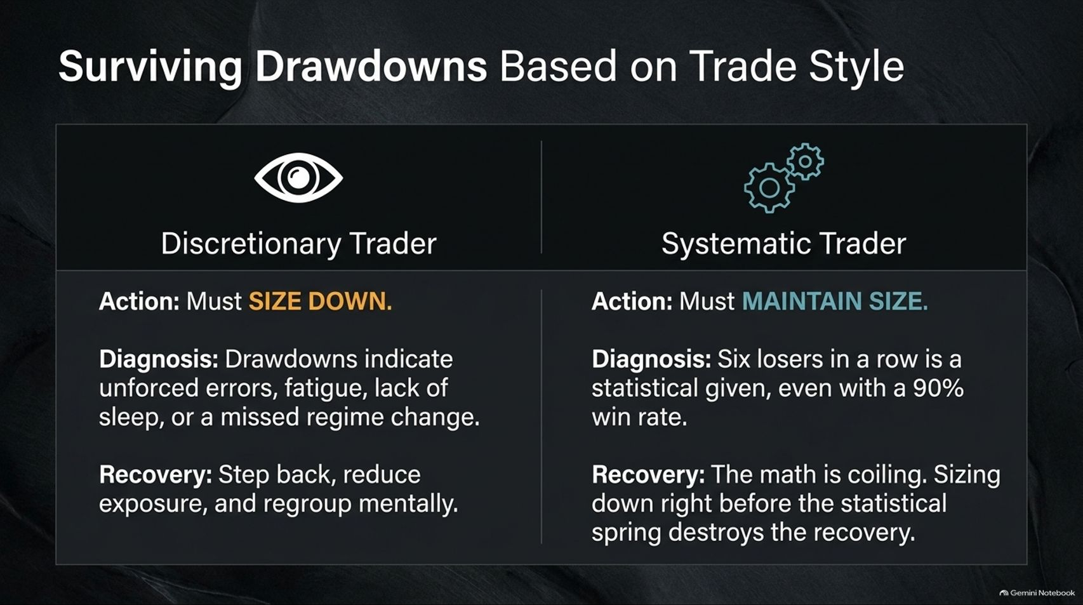
Notes:
Visual Reference: [The_Opportunistic_Edge.pptx, Slide 9]
Target Delivery Time: 4 – 5 minutes
Speaker Notes:
"How you handle drawdowns depends entirely on your trading methodology:"
"Discretionary Trader (Action: MUST SIZE DOWN): Drawdowns indicate unforced errors, fatigue, lack of sleep, or a missed regime change. You must step back, reduce exposure, and regroup mentally."
"Systematic Trader (Action: MUST MAINTAIN SIZE): Six losers in a row is a statistical given, even with a high win-rate system. Sizing down right before the statistical spring destroys your recovery."
"Know which style you are trading and never mix the two psychological rules."

Slide 10
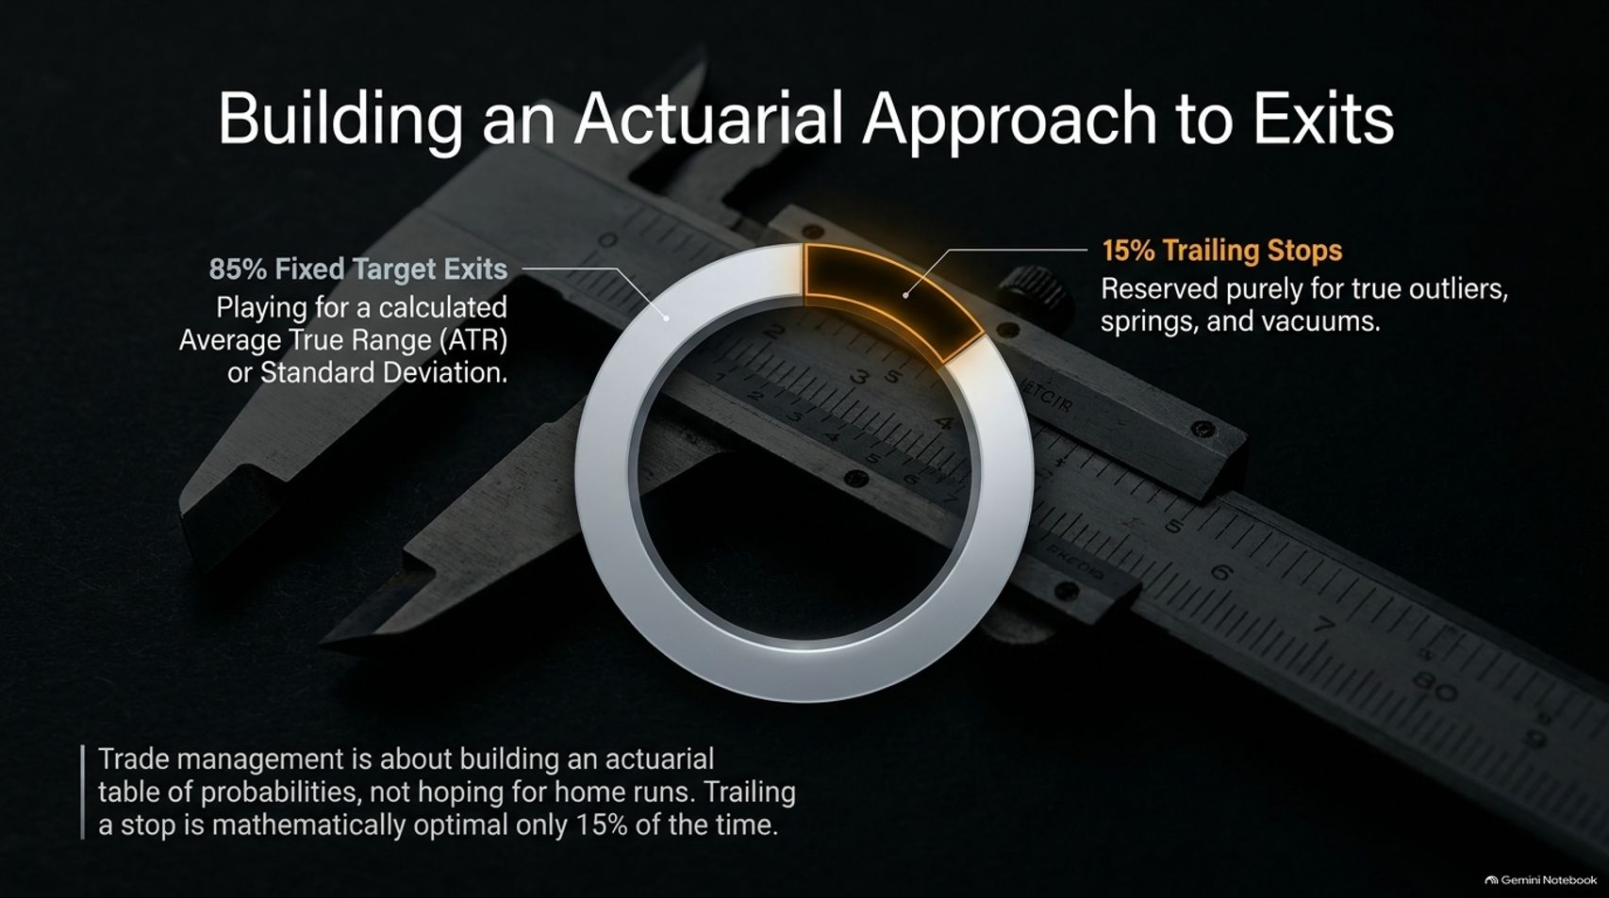

Slide 11
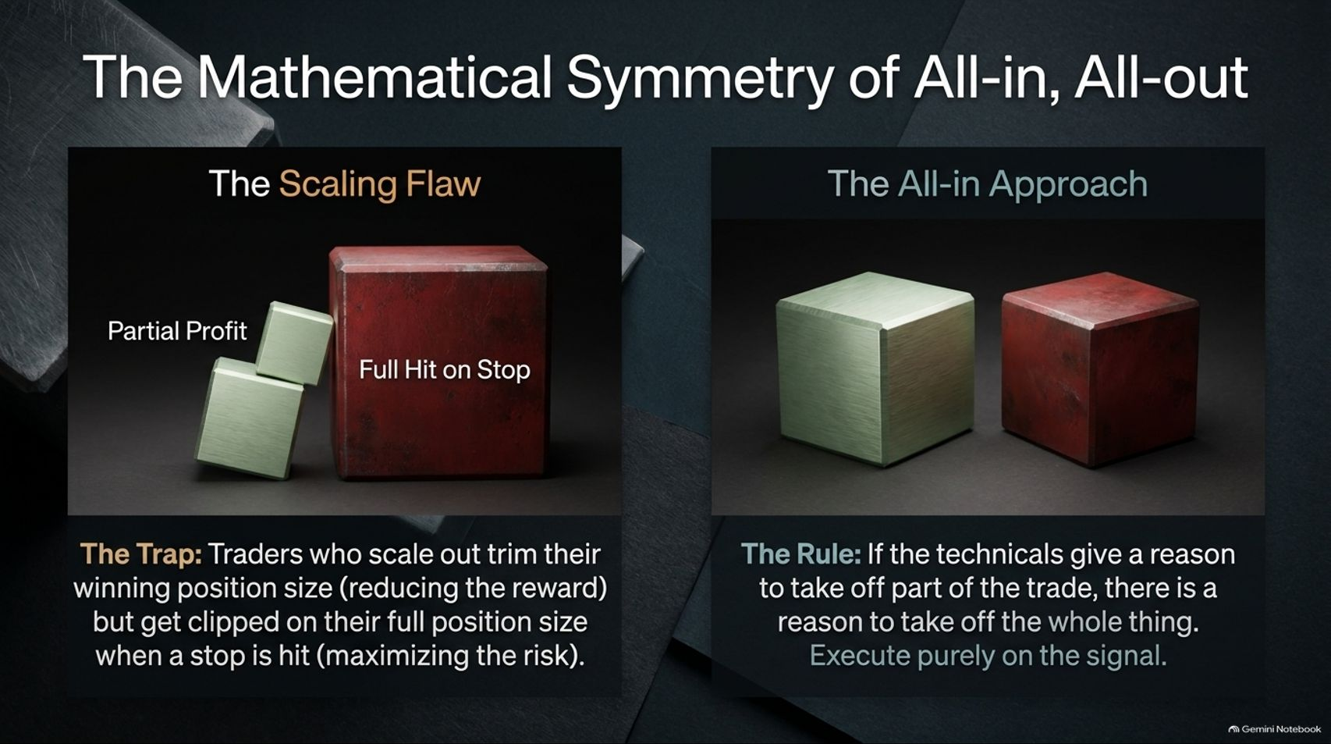
Notes:
Visual Reference: [The_Opportunistic_Edge.pptx, Slide 11]
Target Delivery Time: 3 – 4 minutes
Speaker Notes:
"Let's address The Scaling Flaw: Traders who scale out trim their winning position size (reducing their reward), but get clipped on their full position size when a stop is hit (maximizing their risk)."
"This asymmetry destroys long-term mathematical expectancy."
"The Rule: If the technicals give a reason to take off part of the trade, there is a reason to take off the whole thing. Execute purely on the signal."

Slide 12
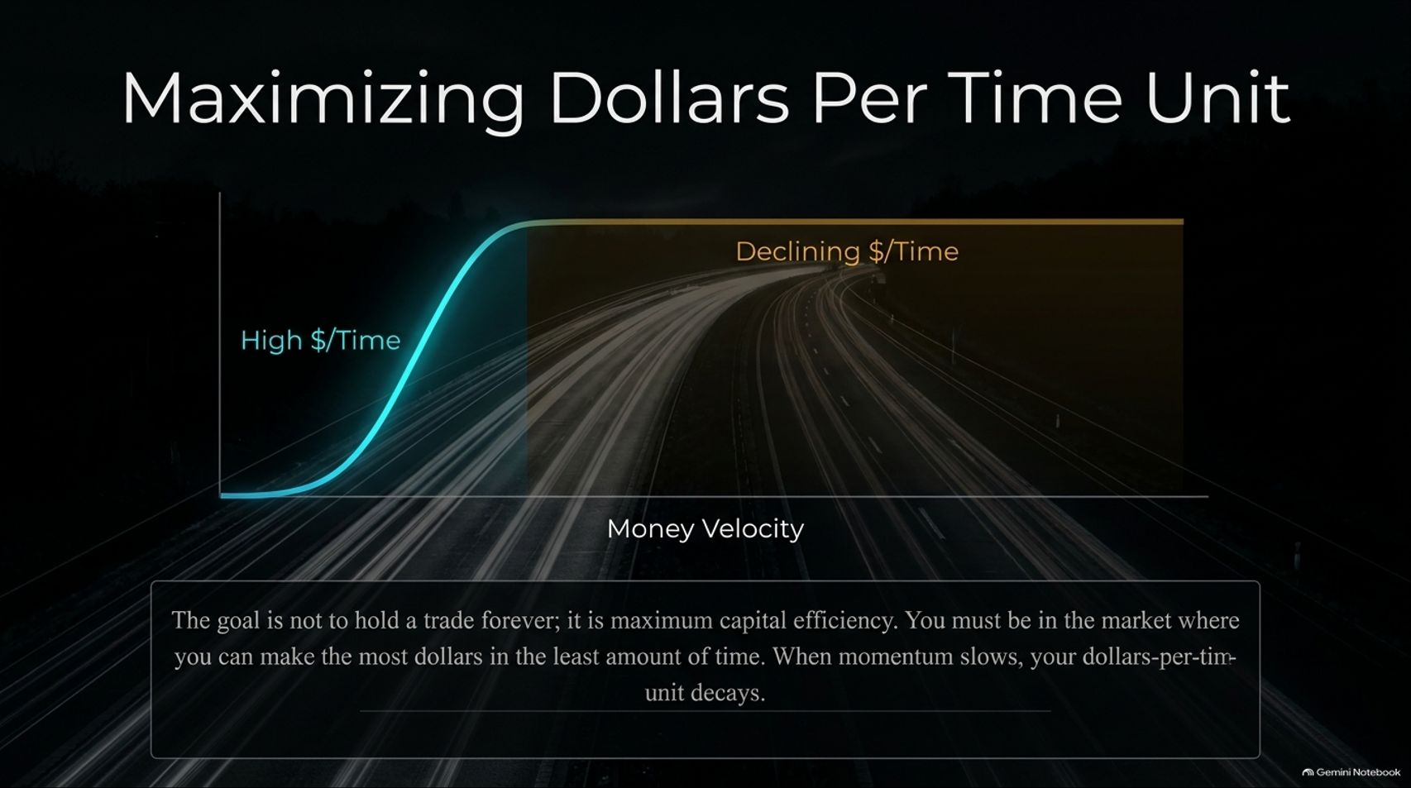
Notes:
Visual Reference: [The_Opportunistic_Edge.pptx, Slide 12]
Target Delivery Time: 3 – 4 minutes
Speaker Notes:
"The goal of professional trading is not to hold a trade forever; it is maximum capital efficiency."
"You must be in the market where you can make the most dollars in the least amount of time."
"When momentum slows and price action consolidates, your dollars-per-time-unit decays rapidly. Take your profit, free up your capital, and deploy it where velocity is high."

Slide 13
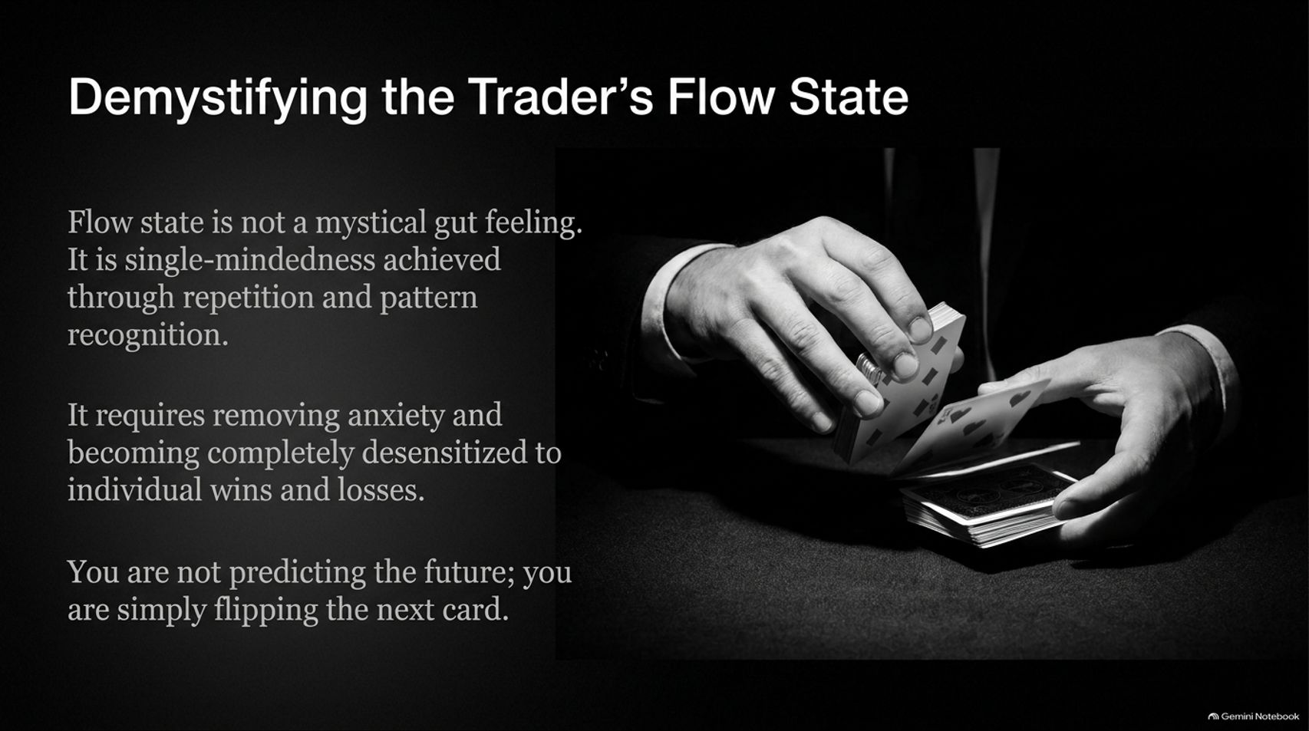
Notes:
Visual Reference: [The_Opportunistic_Edge.pptx, Slide 13]
Target Delivery Time: 3 – 4 minutes
Speaker Notes:
"Flow state is not a mystical gut feeling or a magical sixth sense. It is single-mindedness achieved through repetition and pattern recognition."
"True flow requires removing anxiety and becoming completely desensitized to individual wins and losses."
"You are not trying to predict the future; you are simply flipping the next card in a statistical deck."

Slide 14
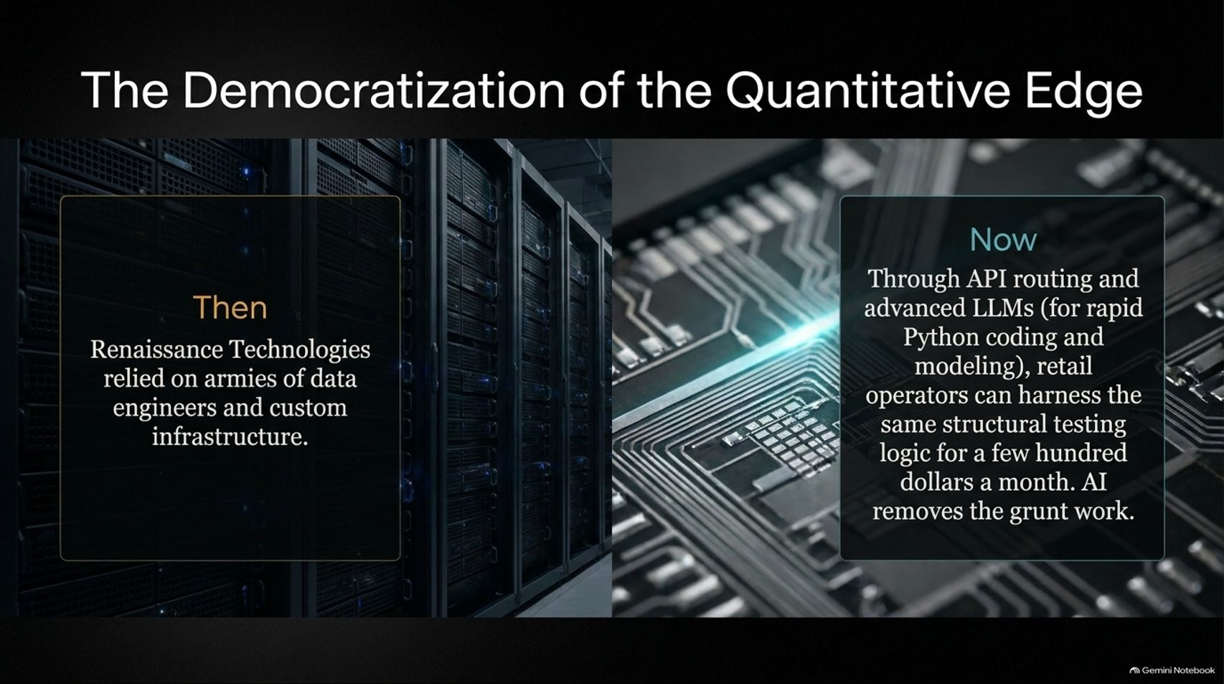
Notes:
Visual Reference: [The_Opportunistic_Edge.pptx, Slide 14]
Target Delivery Time: 4 – 5 minutes
Speaker Notes:
"In the past (Then), funds like Renaissance Technologies relied on armies of data engineers and custom infrastructure to maintain an edge."
"Today (Now), through API routing and advanced LLMs for rapid Python coding and modeling, retail operators can harness the exact same structural testing logic for a few hundred dollars a month."
"AI removes the grunt work, democratizing elite quantitative capabilities for independent traders."

Slide 15
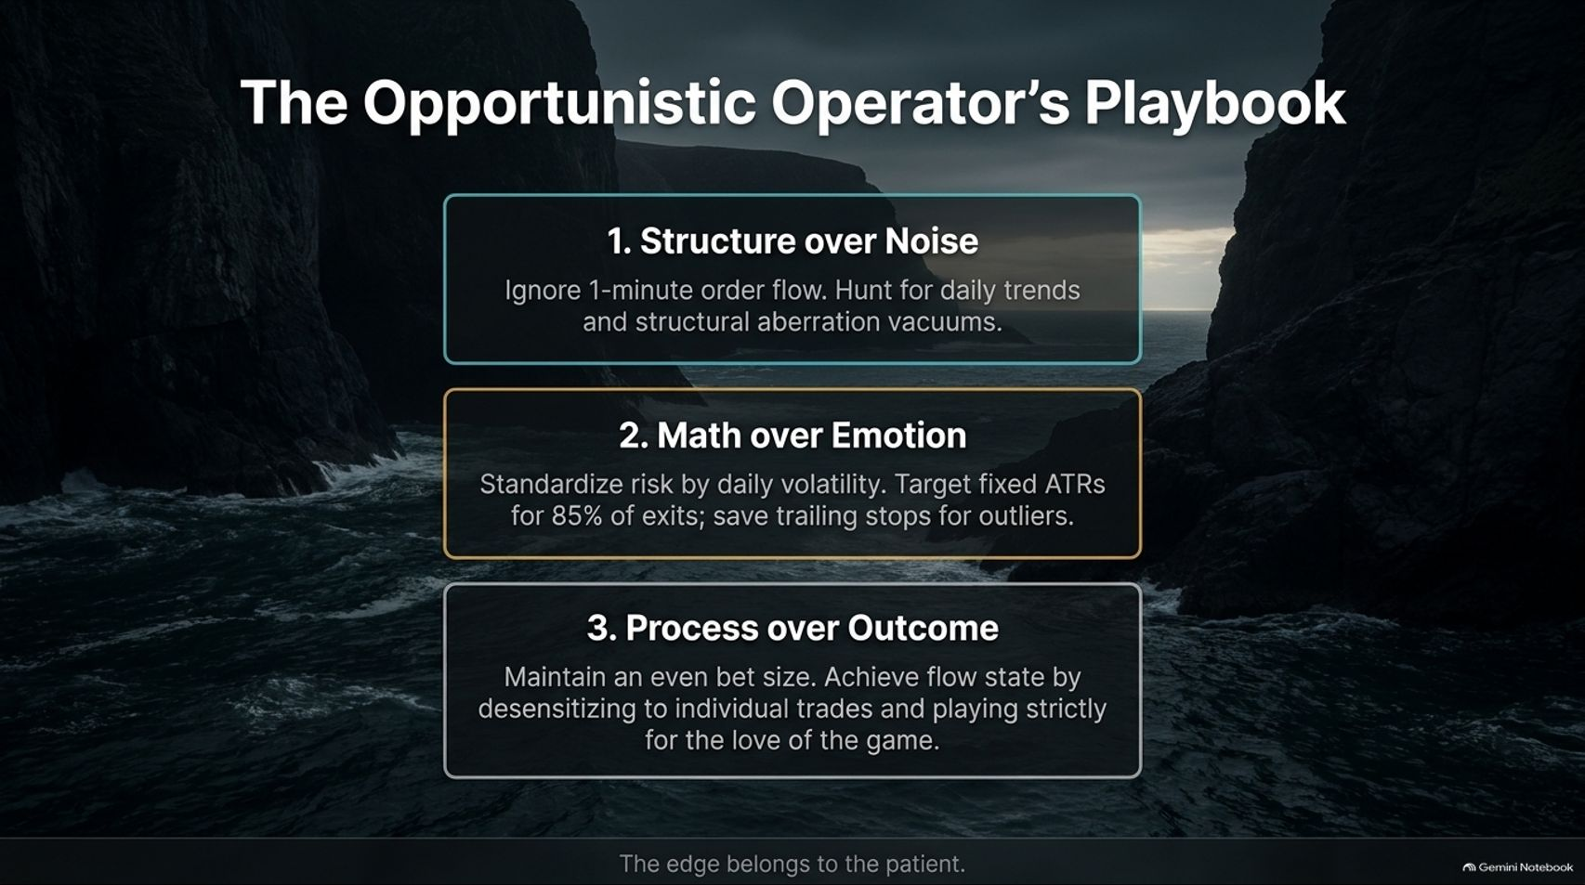
Notes:
Visual Reference: [The_Opportunistic_Edge.pptx, Slide 15]
Target Delivery Time: 4 – 5 minutes
Speaker Notes:
"To summarize our entire masterclass, let's review The Opportunistic Operator's Playbook:
Structure over Noise: Ignore 1-minute order flow. Hunt for daily trends and structural aberration vacuums.
Math over Emotion: Standardize risk by daily volatility. Target fixed ATRs for 85% of exits; save trailing stops for outliers.
Process over Outcome: Maintain an even bet size. Achieve flow state by desensitizing to individual trades and playing strictly for the love of the game."
"As the closing axiom reminds us: The edge belongs to the patient."

Slide 16
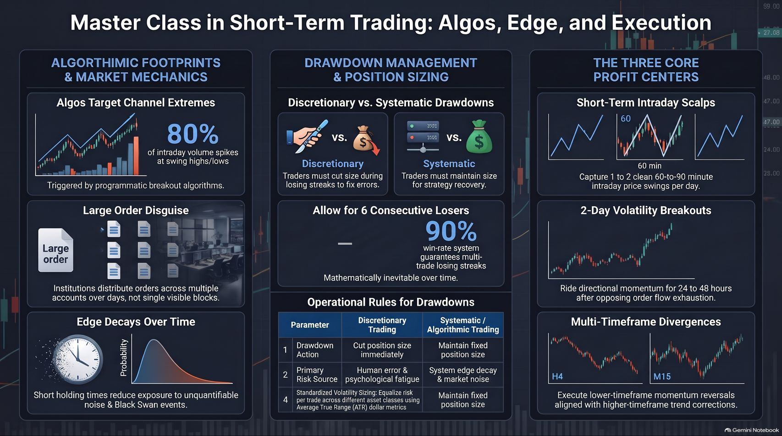
Notes:
Visual Reference: [The_Opportunistic_Edge.pptx, Slide 16]
Target Delivery Time: 4 – 5 minutes
Speaker Notes:
"This final summary dashboard consolidates our complete curriculum:"
"We've mapped out Algorithmic Footprints (understanding how algos trigger at 80% channel extremes), Drawdown Management (contrasting discretionary sizing down vs. systematic size maintenance), and The Three Core Profit Centers (scalps, breakouts, and multi-timeframe divergences)."
"Combine strict volatility sizing, actuarial exit planning, and operational discipline, and you possess a professional blueprint to thrive in any market environment."

