Slide 1
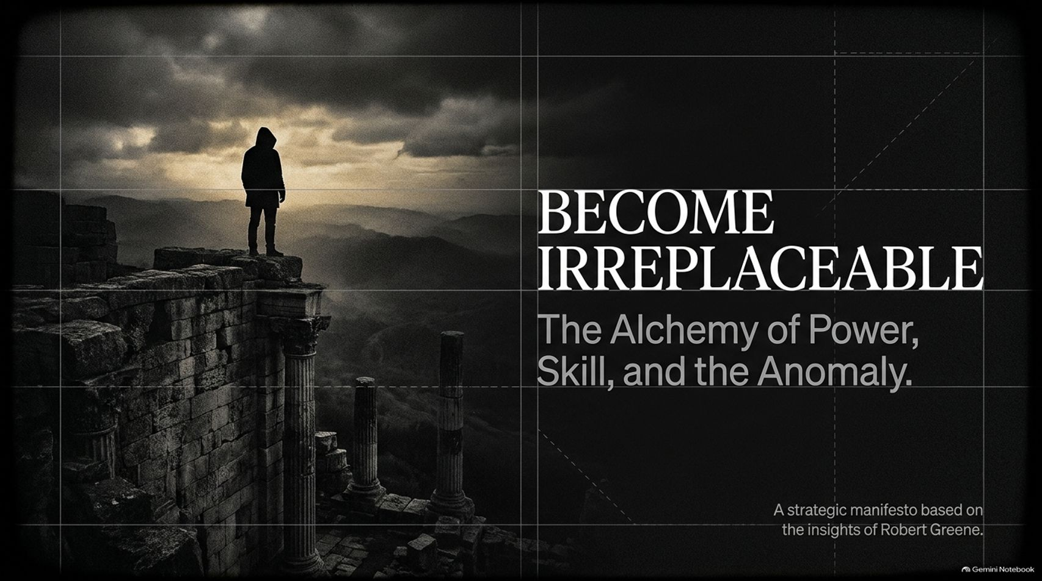
Notes:
Estimated Time: 2 – 3 minutes
Speaker Notes: Welcome, everyone. Today we are exploring a strategic manifesto drawn directly from the philosophies and life insights of Robert Greene.
In a world that constantly encourages standardisation and conformity, the most dangerous position you can occupy is being interchangeable. When you are interchangeable, you hold zero leverage. The title of this presentation, Become Irreplaceable, isn't just a motivational slogan; it is an imperative for survival in modern work, leadership, and personal mastery.
Over the course of this presentation, we will breakdown what we call the Alchemy of Power, Skill, and the Anomaly. We will move through five distinct phases:
The Wilderness: How disparate skills quietly lay the groundwork for mastery.
The Mindset of Power: Why practical wisdom (phronesis) and negative capability trump rigid certainty.
The Psychology of Reputation: How strategic optics and credibility dictate your influence long before you enter the room.
Embrace the Anomaly: Why your biological uniqueness and natural quirks are your greatest non-fungible asset.
The Pressure Principle: How necessity and deadlines unlock peak human capability.
By the end of this session, you will have a complete architectural blueprint for synthesizing these elements into a career and mind that cannot be manufactured, duplicated, or replaced. Let's begin.
Become So Valuable, Calm, Disciplined, and Rare That People Fear Losing Access to You- Robert Greene
https://www.youtube.com/watch?v=IdBKmMfYNzg

Slide 2
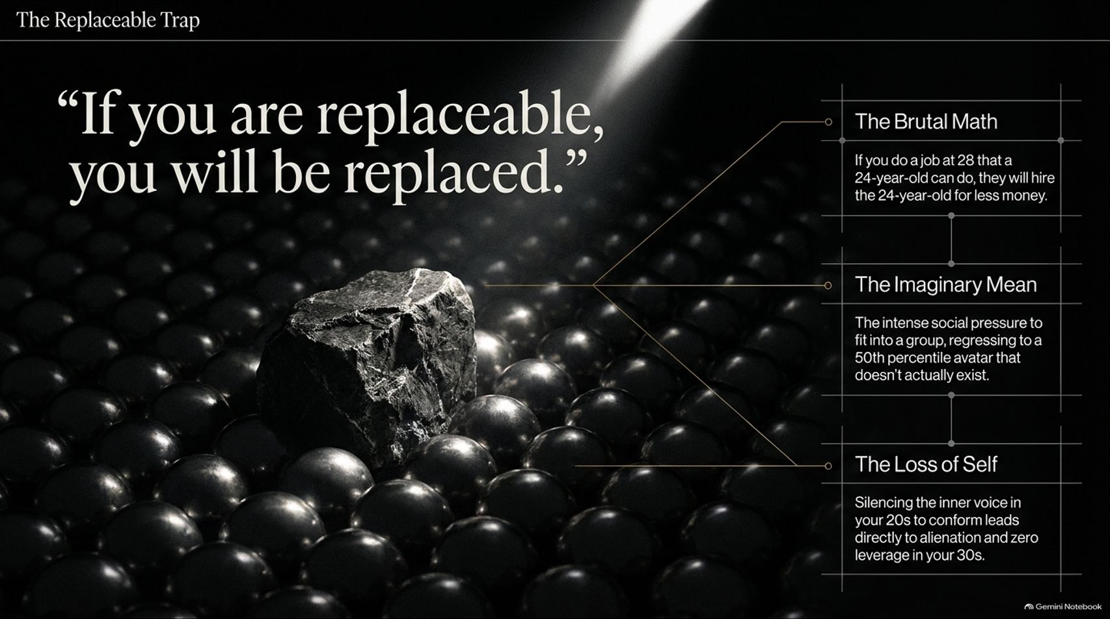
Notes:
Estimated Time: 3 – 5 minutes
Speaker Notes: Let’s start with a stark, uncomfortable truth: "If you are replaceable, you will be replaced."
Robert Greene points out the brutal economics of modern careers. If you are 28 years old performing a job with the exact same output, skill set, and template as a 24-year-old, the market will inevitably hire the 24-year-old for less money. The market does not reward loyalty to a commodity; it rewards rare, non-fungible value.
Why do so many capable people fall into this trap? It comes down to two psychological traps shown on this slide:
The Imaginary Mean: From adolescence through our 20s, we experience intense social pressure to conform. We edit out our unique tastes, suppress our odd inclinations, and attempt to fit into a group norm. We regress toward a 50th-percentile avatar—an imaginary average human that does not actually exist. While this average profile feels safe, it strips away everything distinct about you.
The Loss of Self: When you spend your 20s silencing your inner voice to fit in, you wake up in your 30s experiencing alienation. You no longer know what you truly like, what your genuine strengths are, or where your edge lies. You become standard corporate collateral with zero leverage.
To avoid being replaced, you must break away from the imaginary mean and understand how skills compound over time.

Slide 3
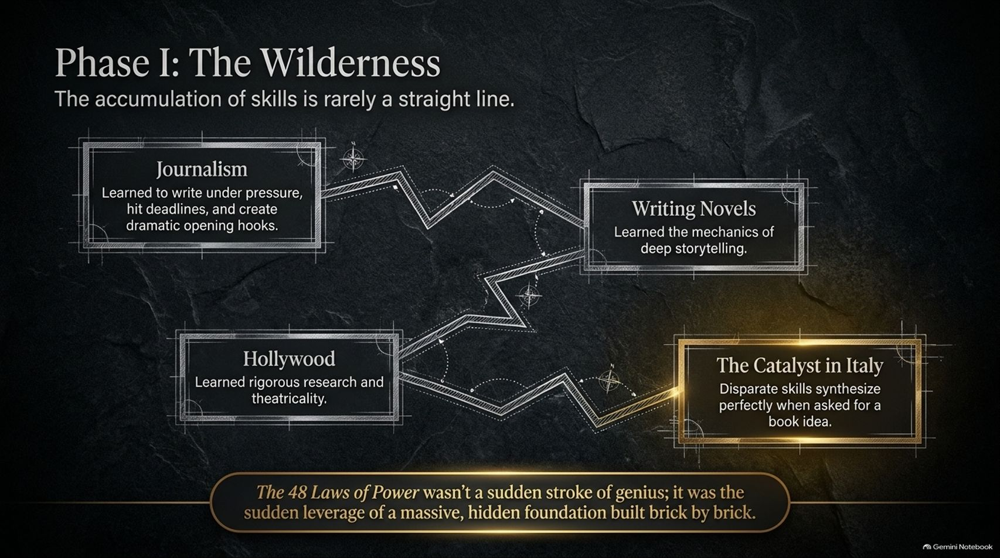
Notes:
Estimated Time: 4 – 6 minutes
Speaker Notes: Phase I of becoming irreplaceable is what Robert Greene calls "The Wilderness."
When you look at high achievers, we often fall for the illusion of instant genius. But skill acquisition is rarely a straight line. Greene reflects on his own journey: after college, he spent nearly two decades wandering through over 80 different jobs across Europe and Hollywood, feeling miserable and directionless for long stretches.
However, underneath that apparent chaos, brick by brick, he was accumulating a unique stack of skills:
Journalism: Taught him to write under strict deadlines, handle intense pressure, and craft dramatic opening hooks.
Writing Novels: Taught him the mechanics of deep storytelling and character development.
Hollywood Script Rewriting: Taught him rigorous research methods, theatrical pacing, and visual storytelling.
For 18 years, these skills seemed completely unrelated. But when he met a publisher in Italy who asked for a book idea, all those disparate streams synthesized instantly. He improvised the concept for The 48 Laws of Power.
The 48 Laws of Power was not a sudden stroke of lightning genius; it was the sudden leverage of a massive, hidden foundation built brick by brick over years in the wilderness. If you are currently in the wilderness, remember that no genuine skill acquired with seriousness is ever wasted.

Slide 4
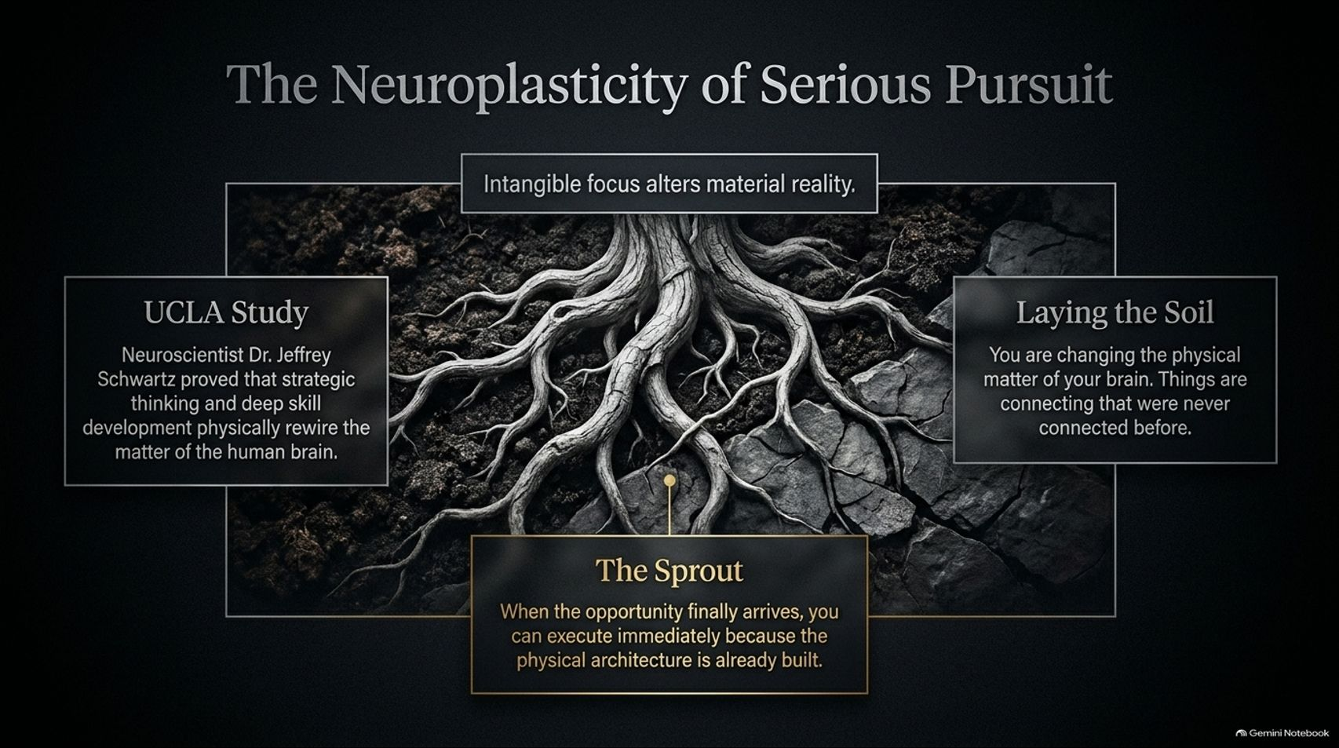
Notes:
Estimated Time: 3 – 5 minutes
Speaker Notes: There is a profound biological reason why deep focus in the wilderness works: intangible focus alters material reality.
In his upcoming book, Greene references research by UCLA neuroscientist Dr. Jeffrey Schwartz. Dr. Schwartz demonstrated that when individuals engage in intense strategic focus and cognitive re-framing, their physical brain structure alters. Non-material phenomena—like deliberate thoughts, focus, and persistent skill acquisition—physically rewire the physical matter of the human brain.
Consider the root metaphor on the slide:
Laying the Soil: When you dedicate yourself to mastering difficult disciplines, you are changing your neural architecture. Synapses fire and build pathways that never existed before. You are laying rich, fertile soil beneath the surface.
The Sprout: When the right market opportunity or life moment finally arrives, you execute instantly—not because of luck, but because the physical internal machinery has already been constructed.
Without skill, life remains a series of aimless circles and perpetual confusion. With rewired neural pathways, when an opportunity opens up, you shoot straight forward like a arrow.

Slide 5
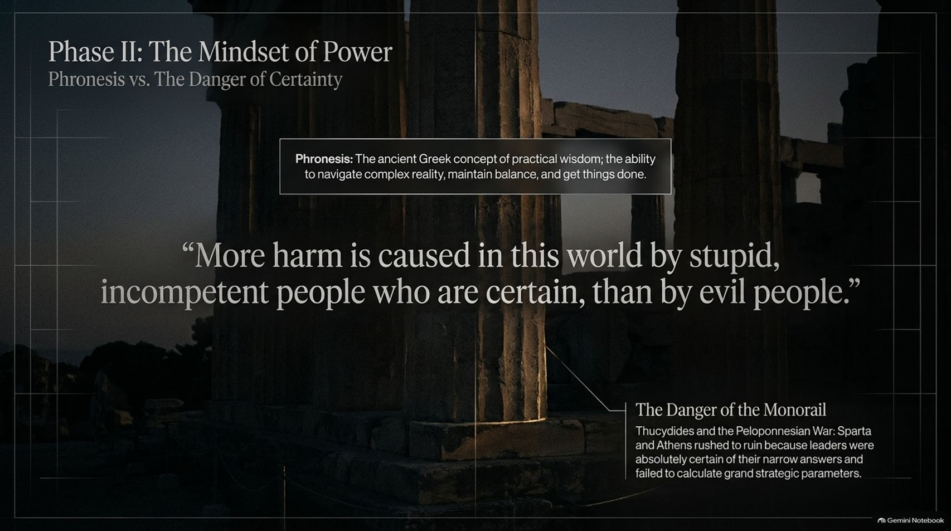
Notes:
Estimated Time: 4 – 5 minutes
Speaker Notes: Once you have accumulated skills, you must cultivate the right strategic mindset. Phase II focuses on Phronesis vs. The Danger of Certainty.
Phronesis is an ancient Greek concept translating to practical wisdom—the subtle ability to navigate complex human realities, maintain internal balance, and effectively get things done in the real world.
The antithesis of phronesis is absolute certainty. As Greene highlights from ancient philosophy: "More harm is caused in this world by stupid, incompetent people who are certain, than by evil people."
Look at The Danger of the Monorail: When people absorb external dogmas, they lock themselves onto a narrow cognitive track. They lose sight of the broad, nuanced landscape around them. Greene references Thucydides’ account of the Peloponnesian War between Athens and Sparta. Athenian leaders became so arrogantly certain of a quick victory in the Sicilian Expedition that they failed to calculate grand strategic risks, ultimately bringing about the collapse of Athenian democracy.
In leadership and strategy, dogmatic certainty breeds blind spots. Practical wisdom requires remaining adaptable, observant, and open to reality as it actually is.

Slide 6
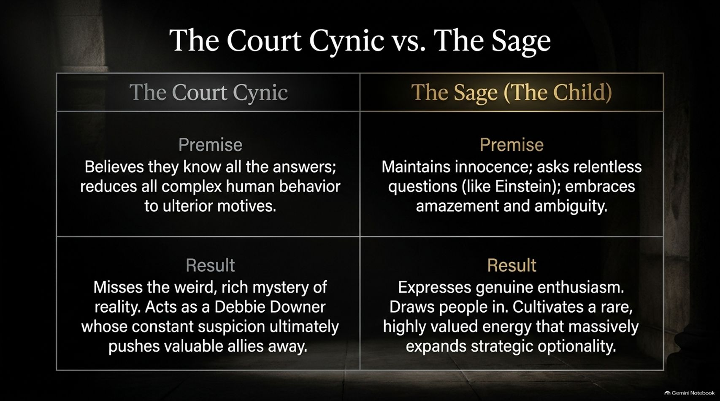
Notes:
Estimated Time: 3 – 5 minutes
Speaker Notes: To maintain practical wisdom, we must examine two contrasting worldviews: The Court Cynic vs. The Sage (The Child).
Let's contrast their premises and outcomes:
The Court Cynic:
Premise: Believes they already know everything. They reduce all complex human behavior, idealism, and art to cheap ulterior motives or power grabs.
Result: Cynicism collapses reality into a flat, single dimension. The cynic acts as a constant "Debbie Downer." While people might occasionally laugh at their sarcasm, long-term allies eventually push the cynic away because their energy is draining and toxic.
The Sage (The Child):
Premise: Retains childlike innocence, wonder, and relentless curiosity. Like Albert Einstein, who attributed his scientific discoveries to keeping a child's sense of wonder, the Sage embraces ambiguity and continually asks deep questions.
Result: Expresses genuine enthusiasm. High-value leaders and collaborators are naturally drawn to open, enthusiastic energy. Maintaining wonder expands your strategic options instead of narrowing them.

Slide 7
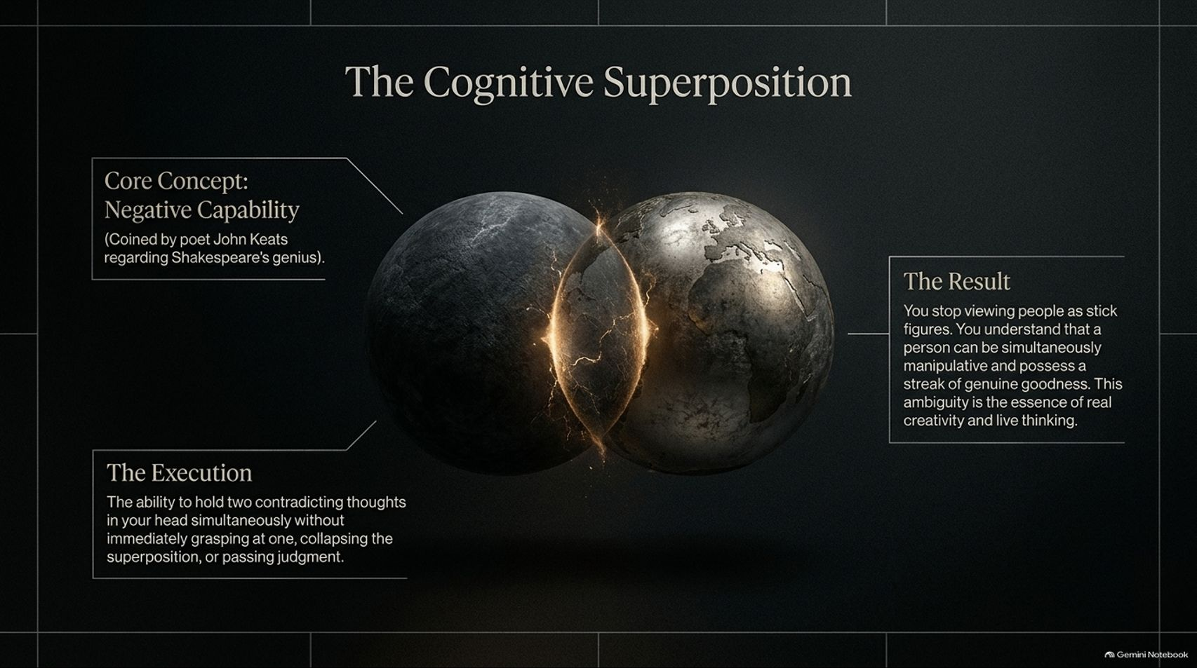
Notes:
Estimated Time: 4 – 5 minutes
Speaker Notes: How do we maintain childlike wonder while navigating complex tactical realities? We practice Cognitive Superposition.
This concept relies on what poet John Keats called Negative Capability—a term he coined to explain Shakespeare’s creative genius. Shakespeare created deeply human characters because he didn't view people as one-dimensional hero-or-villain stick figures. He could hold contradictory traits within a single character simultaneously.
The Execution: Negative capability is the rare capacity to hold two opposing thoughts or truths in your mind at the same time without impulsively reaching for a premature conclusion, collapsing the superposition, or passing immediate moral judgment.
The Result: You see people and strategic situations in full, rich detail. You understand that a person can be simultaneously manipulative in one domain while possessing genuine goodness in another.
Mastering cognitive superposition allows you to remain calm and objective amidst organizational politics and ambiguity.

Slide 8
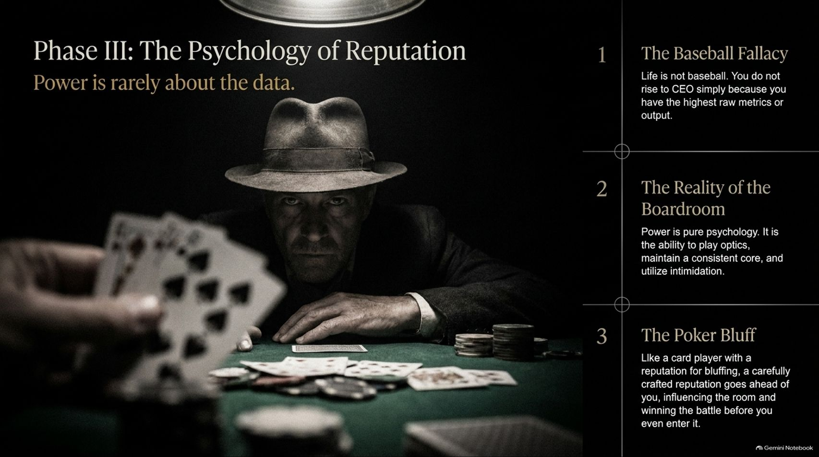
Notes:
Estimated Time: 4 – 6 minutes
Speaker Notes: Now we enter Phase III: The Psychology of Reputation.
A critical lesson from The 48 Laws of Power is that power is rarely about objective data alone—it is almost entirely psychological.
The Baseball Fallacy: Many professionals assume the corporate world operates like professional sports—that if you hit the highest batting average or produce the highest raw metrics, you will automatically be promoted to CEO. Life is not baseball.
The Reality of the Boardroom: Drawing from his experience on public corporate boards, Greene notes that promotions and executive power are driven by optics, psychological presence, and command. It is about how you project confidence, maintain a stable core, and manage executive perception.
The Poker Bluff: Think of poker. A player with a well-crafted reputation for calculated aggressiveness forces opponents to fold strong hands before the cards are even revealed.
Your reputation travels into the room ahead of you. It alters how others interpret your actions, shaping outcomes long before formal negotiations begin.

Slide 9
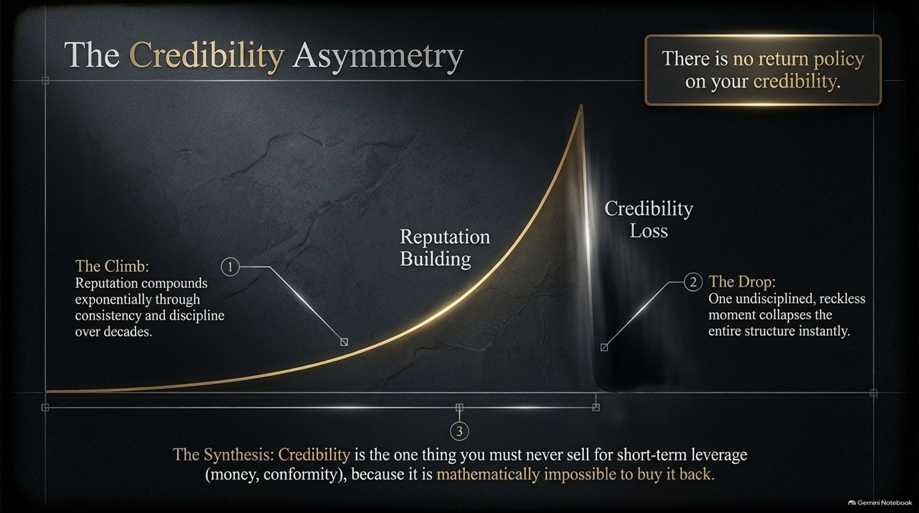
Notes:
Estimated Time: 3 – 5 minutes
Speaker Notes: While reputation can be leveraged for power, it is governed by a strict rule: The Credibility Asymmetry.
Look at the graph on this slide:
1. The Climb: Building a formidable, respected reputation takes decades of discipline, consistency, word-keeping, and high standards. It compounds slowly like exponential interest.
2. The Drop: A single moment of undisciplined greed, reckless social media posting, or ethical compromise can destroy decades of accumulated trust instantly.
3. The Synthesis: Credibility is the one asset you must never trade away for short-term financial gains or temporary social conformity.
As the slide explicitly notes: "There is no return policy on your credibility." Once lost, it is mathematically and psychologically almost impossible to buy back. Guard your core integrity fiercely.

Slide 10
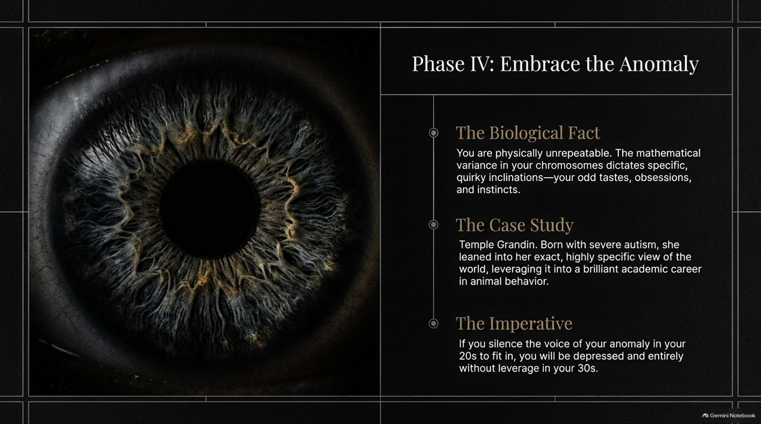
Notes:
Estimated Time: 4 – 6 minutes
Speaker Notes: In Phase IV, we unlock your ultimate competitive advantage: Embrace the Anomaly.
The Biological Fact: You are physically, genetically unrepeatable. The precise combination of chromosomal variations you received at birth has never existed before in human history and will never exist again. This biological blueprint dictates your natural inclinations, quirky obsessions, and unique tastes.
The Case Study (Temple Grandin): In Mastery, Greene highlights Temple Grandin, who was born with severe autism and was non-verbal in early childhood. Instead of trying to force herself into standard social patterns, she leaned into her unique visual cognitive style. She transformed her distinct perception into a world-leading career in animal behavior design and autism advocacy.
The Imperative: If you silence your internal anomaly during your 20s to fit in, you risk feeling unfulfilled and leverage-less in your 30s.
Your oddness is not a defect to be polished away; it is the raw material of your unique value.

Slide 11
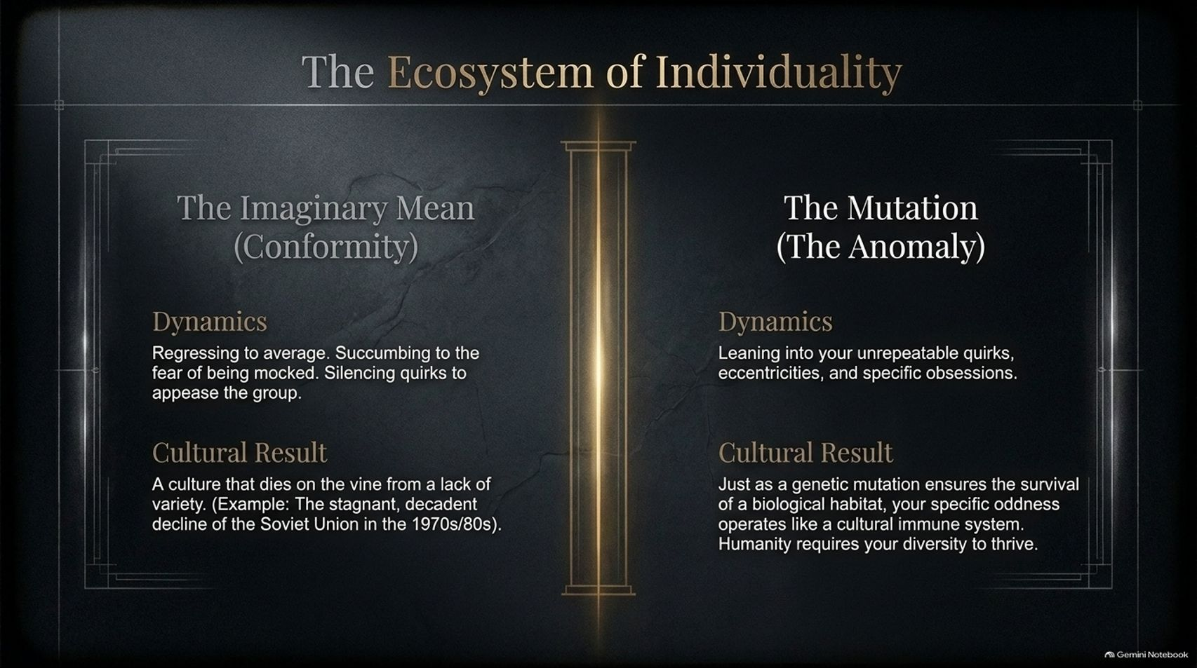
Notes:
Estimated Time: 3 – 5 minutes
Speaker Notes: Let's contrast how conformity and individual anomaly impact culture and organizations:
The Imaginary Mean (Conformity):
Dynamics: Succumbing to fear of social mockery, repressing personal eccentricities, and conforming to groupthink.
Cultural Result: Stagnation. Greene points to the Soviet Union during the 1970s and 80s—a system that suppressed individual variation and novelty, causing its culture and economy to stagnate and collapse.
The Mutation (The Anomaly):
Dynamics: Embracing your distinct quirks, specialized interests, and non-standard perspectives.
Cultural Result: Vitality and resilience. In biology, genetic diversity protects an ecosystem against changing environments. In human culture, individual oddities function as an immune system, bringing in new ideas, perspectives, and solutions.
Leaning into your authentic difference is both a career strategy and a contribution to organizational innovation.

Slide 12
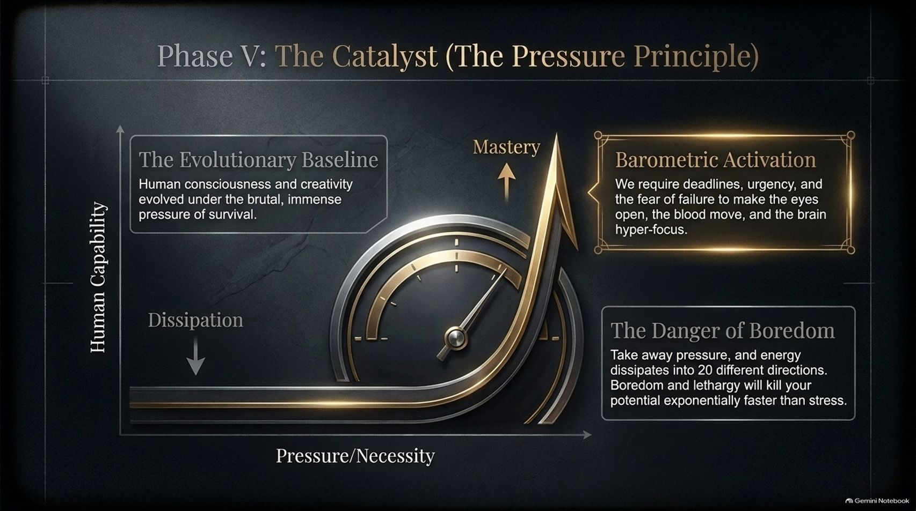
Notes:
Estimated Time: 4 – 5 minutes
Speaker Notes: Phase V introduces the engine that powers high achievement: The Pressure Principle.
Human capability follows a distinct curve when plotted against necessity and pressure:
The Evolutionary Baseline: Human intelligence, tool creation, and strategic thinking evolved under intense survival pressures. Our ancestors had to sharp-focus because failure meant immediate danger.
Barometric Activation: The human brain requires deadlines, urgency, and real stakes to operate at peak focus. Under targeted pressure, mental energy converges and execution accelerates.
The Danger of Boredom: When all pressure is removed, human energy dissipates in twenty different directions—leading to distraction, lethargy, and mindless scrolling. As Greene notes, boredom and lack of purpose dull potential far faster than acute stress.
Do not run from reasonable pressure; use it as a catalyst to unlock your best work.

Slide 13
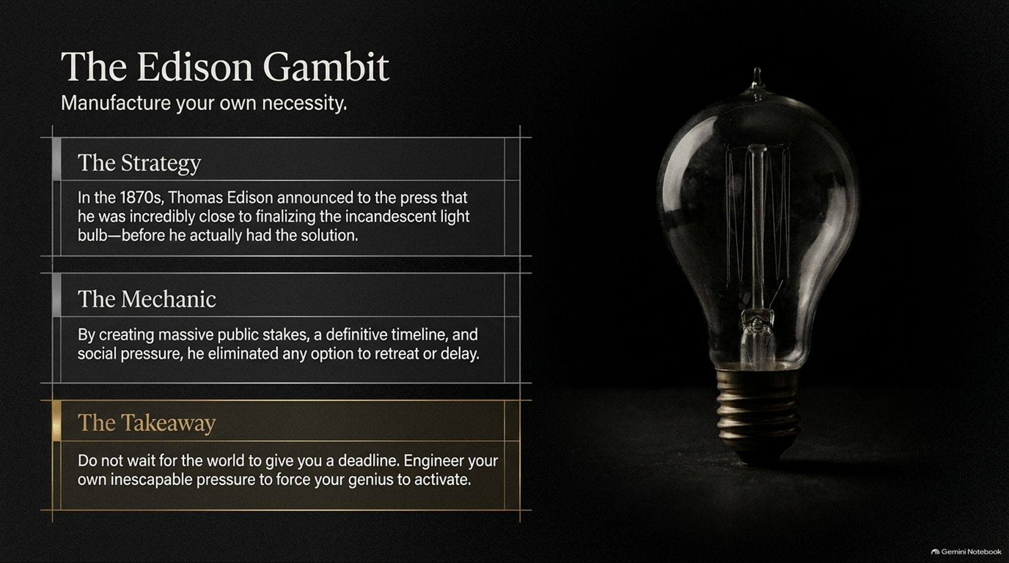
Notes:
Estimated Time: 3 – 5 minutes
Speaker Notes: How do you leverage the Pressure Principle when external circumstances are quiet? You apply The Edison Gambit—manufacturing your own necessity.
The Strategy: In the late 1870s, Thomas Edison publicly announced to the press that he had successfully invented a commercially viable incandescent light bulb—even though he had not yet solved the key technical hurdles.
The Mechanic: By staking his public reputation, securing investor eyes, and setting a firm timeline, Edison deliberately eliminated any option to delay or retreat. The self-imposed pressure forced his team at Menlo Park to work relentlessly until they achieved the breakthrough.
The Takeaway: Do not wait for external deadlines to fall into your lap. Set firm public commitments, tight delivery dates, and clear stakes to activate your focus and drive projects across the finish line.

Slide 14
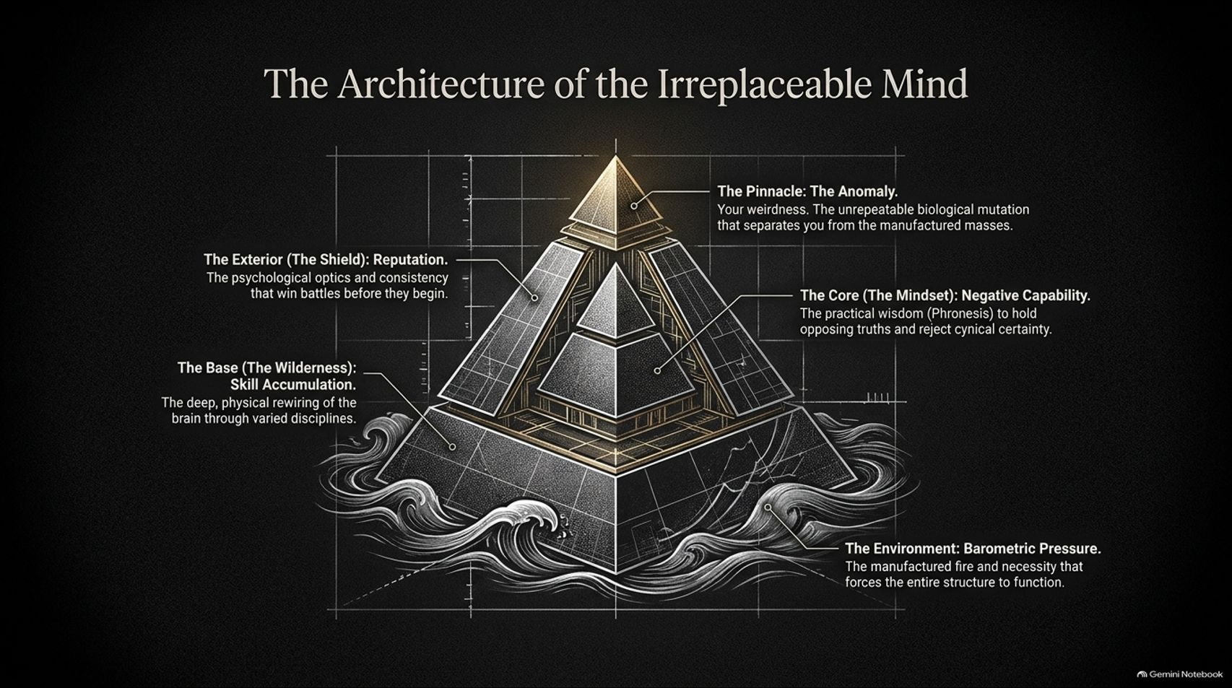
Notes:
Estimated Time: 4 – 6 minutes
Speaker Notes: Here, we bring all five phases together into a unified structural model: The Architecture of the Irreplaceable Mind.
Visualise this pyramid structure:
The Base (The Wilderness): Deep, multi-disciplinary skill accumulation that physically rewires your neural architecture over time.
The Core (The Mindset): Practical wisdom (phronesis) combined with Negative Capability—the mental flexibility to navigate real-world complexity without falling into rigid dogmatism.
The Exterior (The Shield): A carefully managed reputation and unshakeable credibility that command respect before you enter the room.
The Pinnacle (The Anomaly): Your unique biological perspective and authentic quirks that make your work non-fungible.
The Environment (Barometric Pressure): Self-imposed deadlines and accountability that energise the entire structure.
When these five elements align, you build a career, perspective, and skill set that cannot be easily replicated.

Slide 15
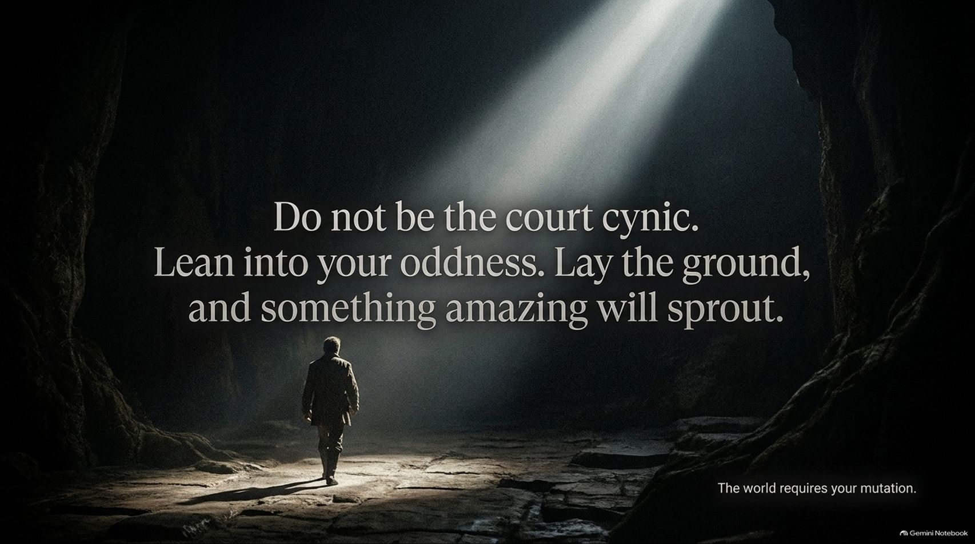
Notes:
Estimated Time: 2 – 4 minutes
Speaker Notes: To summarize our core manifesto: "Do not be the court cynic. Lean into your oddness. Lay the ground, and something amazing will sprout."
Avoid the trap of cynical certainty. Do not suppress your natural interests just to fit into an imaginary average. Dedicate yourself to serious skill accumulation, protect your credibility, set clear deadlines, and give your unique talents room to grow.
The market and the world do not need another copy of an existing template. As noted at the bottom right of the slide: The world requires your mutation.

Slide 16
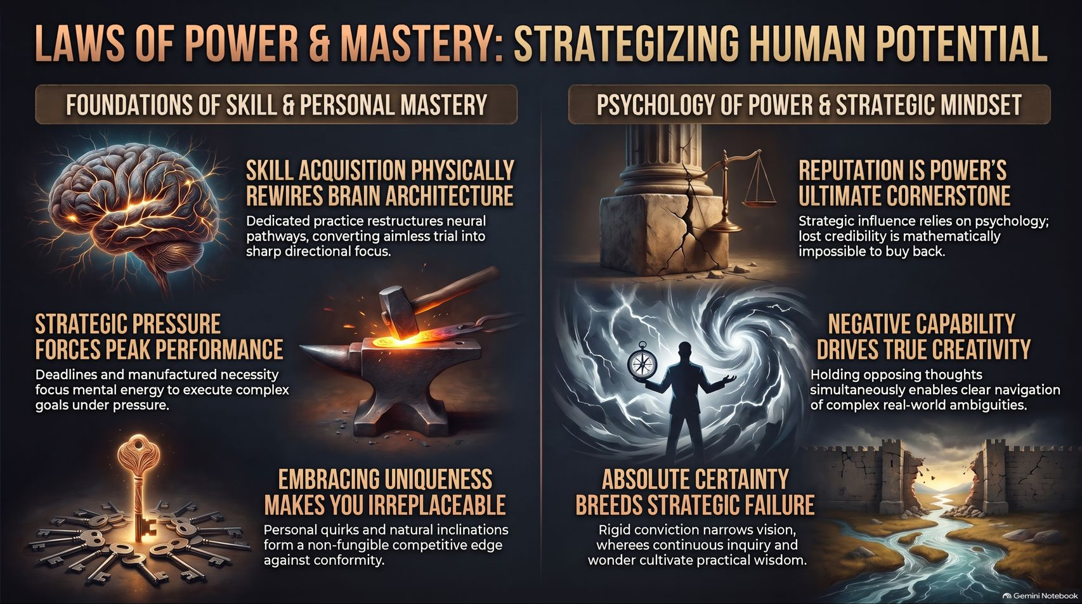
Notes:
Estimated Time: 4 – 6 minutes
Speaker Notes: To close our session, this reference card synthesises the core laws governing skill acquisition, strategy, and personal mastery:
Left Side: Foundations of Skill & Personal Mastery
Skill Acquisition Physically Rewires Brain Architecture: Dedicated, deliberate practice restructures neural pathways, turning aimless trial into sharp directional focus.
Strategic Pressure Forces Peak Performance: Manufactured deadlines focus mental energy to execute complex goals under pressure.
Embracing Uniqueness Makes You Irreplaceable: Personal quirks and natural inclinations form a non-fungible competitive edge against conformity.
Right Side: Psychology of Power & Strategic Mindset
Reputation is Power's Ultimate Cornerstone: Influence relies on psychology; lost credibility is mathematically impossible to buy back.
Negative Capability Drives True Creativity: Holding opposing thoughts simultaneously enables clear navigation of real-world ambiguities.
Absolute Certainty Breeds Strategic Failure: Rigid conviction narrows vision, whereas continuous inquiry and wonder cultivate practical wisdom.
Thank you for your time. Focus on building your foundation, lean into your anomaly, and make yourself irreplaceable.

