Slide 1
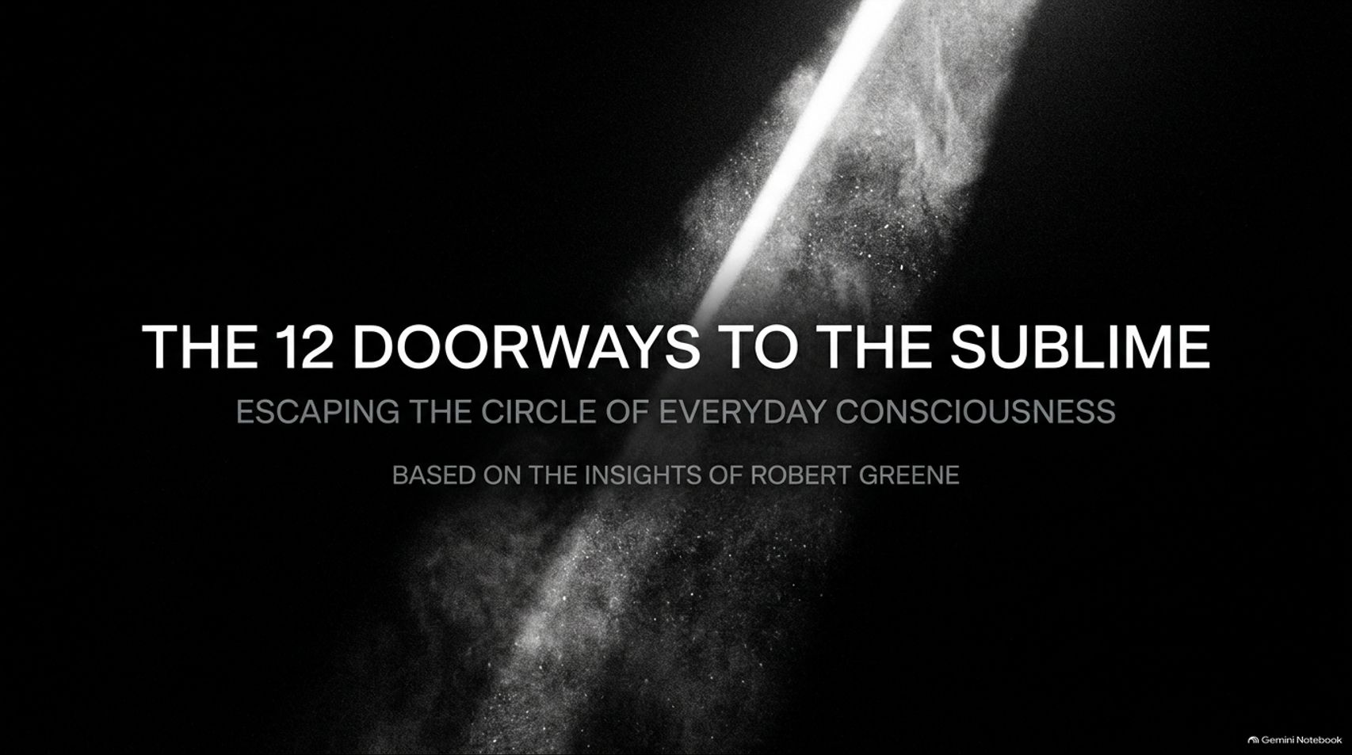
Notes:
Estimated Time: 2 – 3 minutes
Speaker Notes: Welcome, everyone. Today we embark on a profound exploration into what Robert Greene terms "The Sublime".
In our modern, high-speed civilization, most of us move through life in a state of hypnotic routine. We take our existence for granted, locked within a narrow cognitive loop of survival, stress, and cultural conditioning. The sublime represents those rare, electric moments where we shatter that everyday filter and touch reality in its unmediated, awe-inspiring, and terrifying entirety.
Over the next 16 slides, we will unpack the 12 gateways to the sublime across macro, micro, collective, and edge realms. We will examine how a near-fatal stroke forced Robert Greene to discover the Amazon rainforest right in his own backyard, and how you, too, can awaken to the sheer strangeness and miracle of being alive. Let's step through the first doorway.
Why Your Life Feels Smaller Than It Should (& How To Expand It) | Robert Greene
https://www.youtube.com/watch?v=x6LnZKiZWRA

Slide 2
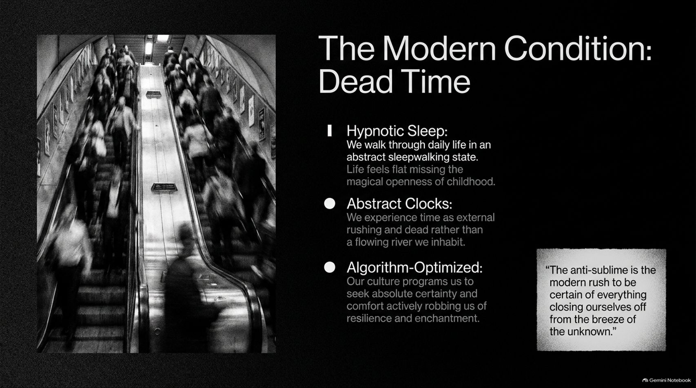
Notes:
Estimated Time: 3 – 5 minutes
Speaker Notes: Let us examine the baseline condition of modern life: Dead Time.
Robert Greene notes that we live much of our lives in a state of hypnotic sleep, walking through daily routines in an abstract sleepwalking state. Life feels flat, missing the magical, unmediated openness we experienced as children.
This condition manifests through three major symptoms:
Hypnotic Sleep: We go through the motions without true presence, detached from the vibrant reality around us.
Abstract Clocks: We experience time externally as rushing deadlines and dead ticking, rather than as a flowing river that we inhabit.
Algorithm-Optimized Culture: Modern culture and algorithms program us to seek absolute certainty and frictionless comfort, actively robbing us of resilience, depth, and enchantment.
As the quote on the slide emphasizes: "The anti-sublime is the modern rush to be certain of everything, closing ourselves off from the breeze of the unknown." To reclaim our humanity, we must break free from this mechanical slumber.

Slide 3
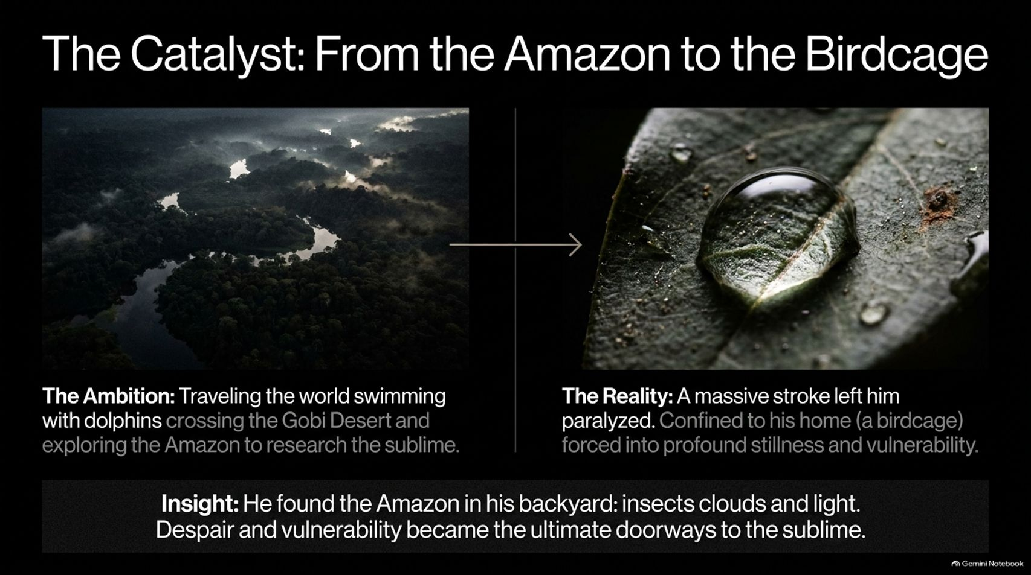
Notes:
Estimated Time: 4 – 6 minutes
Speaker Notes: Every profound philosophy is forged through lived experience. For Robert Greene, the genesis of his book on the sublime came through a radical, life-altering catalyst.
For over twenty years, Greene dreamed of writing a book on the sublime, imagining his research taking him across the globe—swimming with dolphins, crossing the Gobi Desert, and exploring the depths of the Amazon.
Then, reality intervened. While driving in Los Angeles with his girlfriend, a massive stroke struck suddenly. A blood clot in his right neck completely cut off blood flow to his brain. Had the ambulance arrived just 30 seconds later, he would have been dead or permanently brain-dead.
Instead, he survived, but the aftermath left him partially paralyzed on his left side, confined to his home—a literal "birdcage" where he could barely walk from room to room. Yet, in that extreme vulnerability and stillness, sitting in his backyard, a profound insight struck him: He found the Amazon right in his own backyard. Through observing insects, shifting clouds, and changing light, he realized that despair and vulnerability can become the ultimate doorways to the sublime.

Slide 4
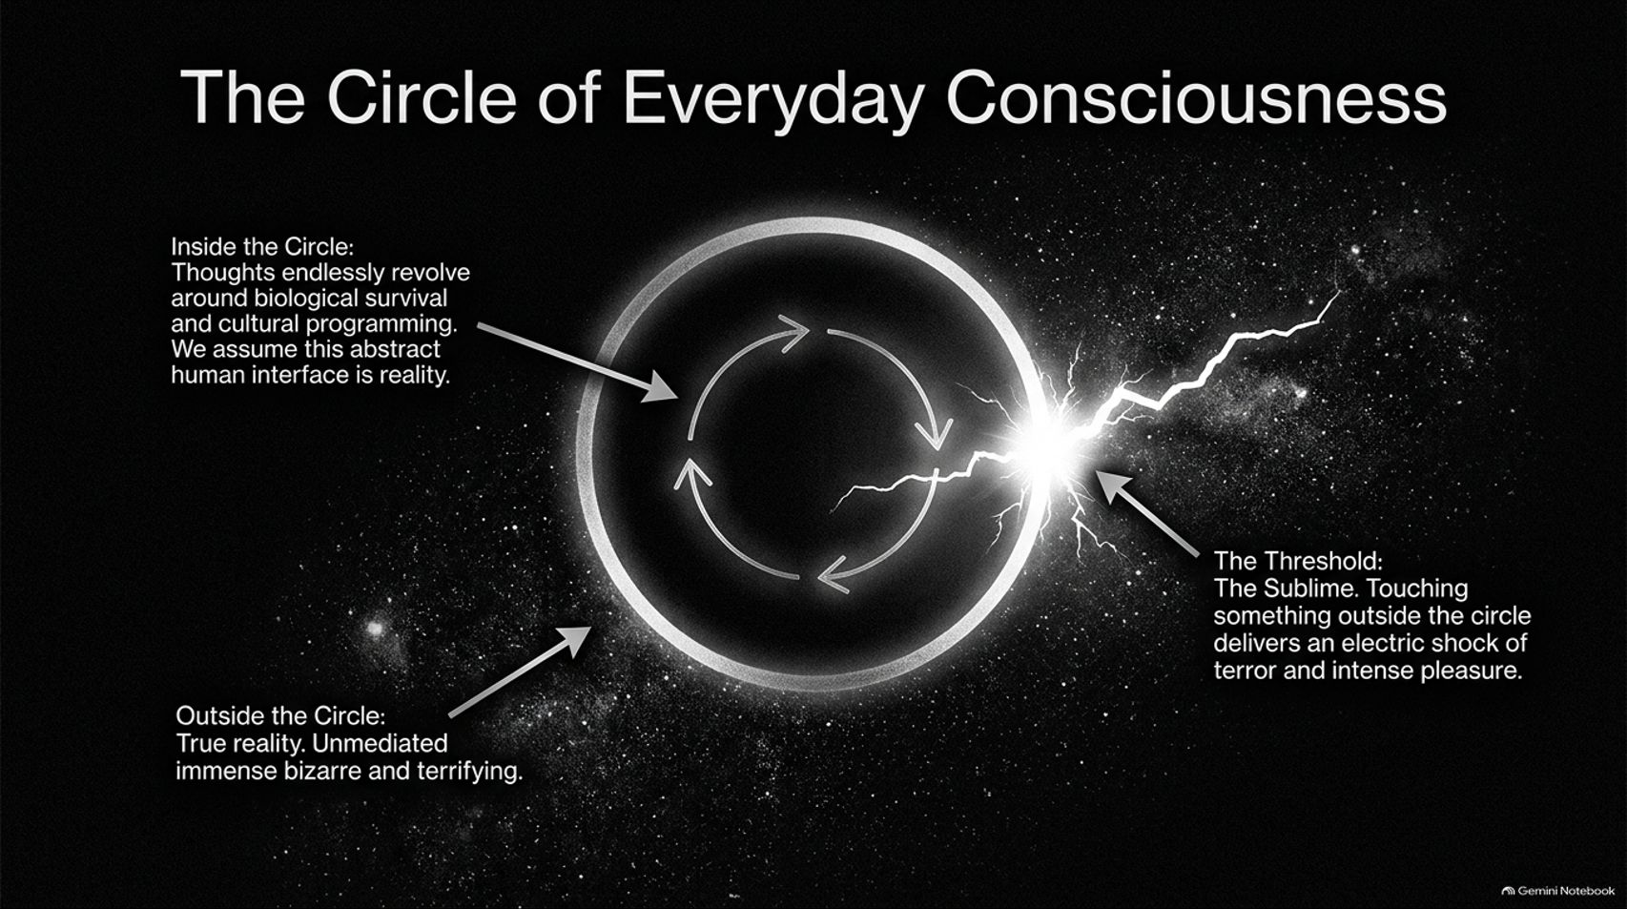
Notes:
Estimated Time: 3 – 5 minutes
Speaker Notes: To understand how we experience reality, Greene visualizes human consciousness as a Circle of Everyday Consciousness.
Inside the Circle: Our thoughts endlessly revolve around biological survival, ego protection, and cultural programming. We assume this narrow, abstract human interface is the entirety of objective reality.
Outside the Circle: True reality exists unmediated—immense, bizarre, complex, and terrifying.
The Threshold (The Sublime): Touching something outside the routine circle delivers an electric shock of simultaneous terror and intense pleasure.
The sublime is not a comfortable emotion; it is an overwhelming jolt that dissolves our ego defenses and reconnects us with the vast, pre-existing universe.

Slide 5
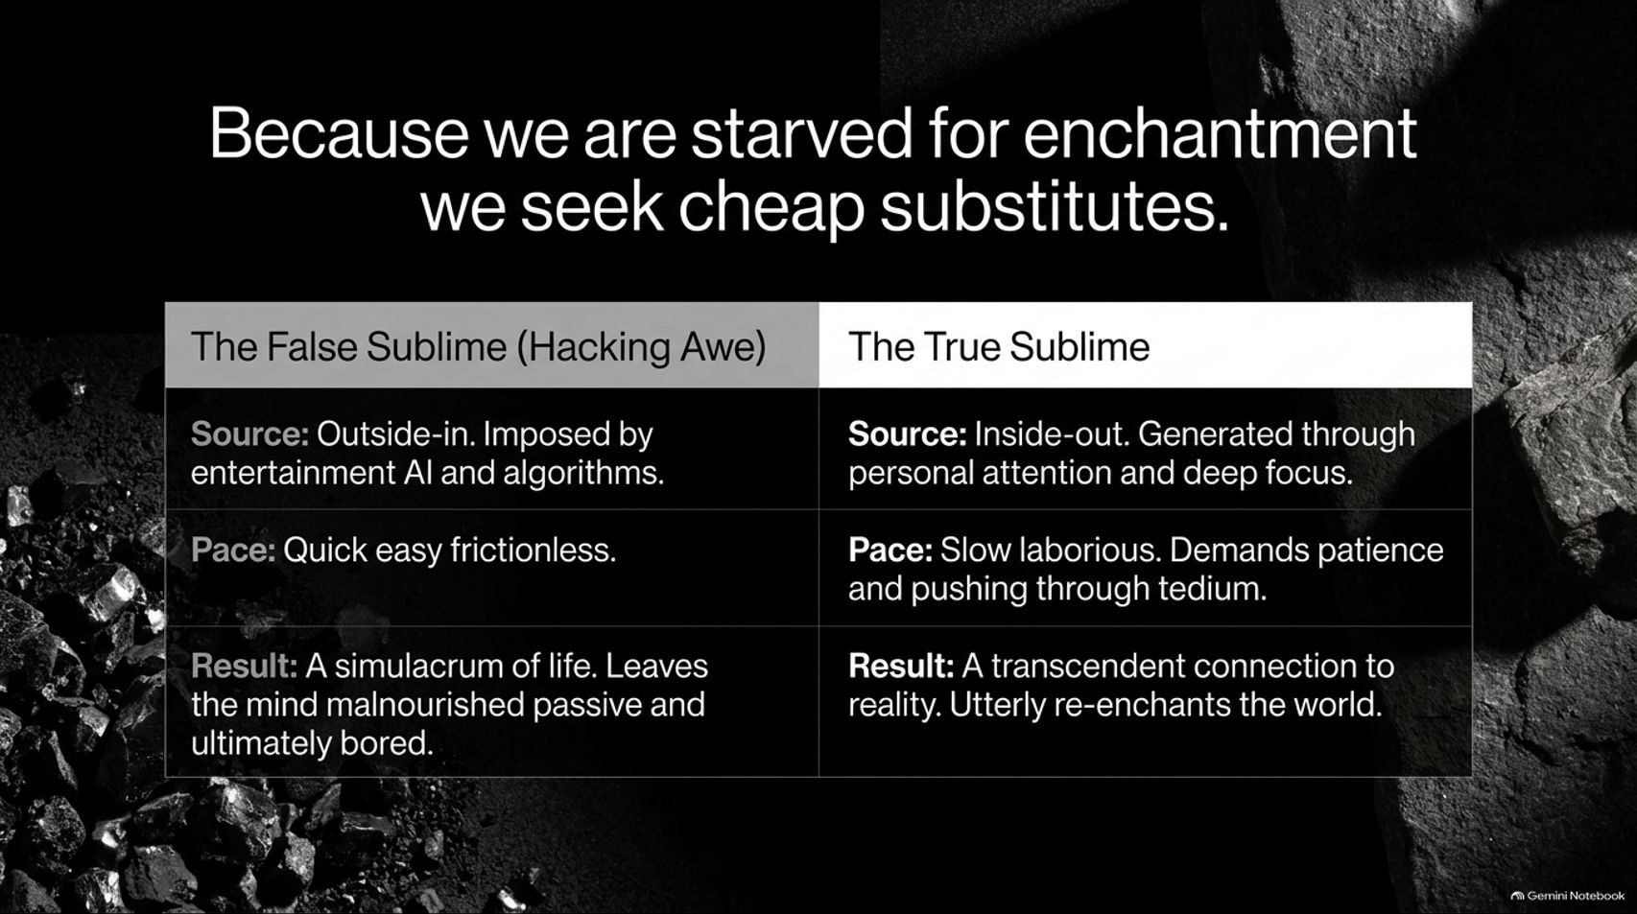
Notes:
Estimated Time: 3 – 5 minutes
Speaker Notes: Because modern society suffocates our access to the true sublime, humans become starved for enchantment. When starved, we desperately seek cheap substitutes. Let's contrast the false sublime with the true sublime:
The False Sublime (Hacking Awe):
Source: Outside-in, artificially imposed by entertainment, social media algorithms, and digital stimuli.
Pace: Quick, easy, and frictionless.
Result: A simulacrum of life that leaves the mind malnourished, passive, and ultimately chronically bored.
The True Sublime:
Source: Inside-out, generated through personal attention, deep focus, and patient contemplation.
Pace: Slow, laborious, and demanding patience through initial tedium.
Result: A transcendent connection to reality that completely re-enchants the world.
True awe cannot be downloaded or streamed; it must be earned through deliberate presence.

Slide 6
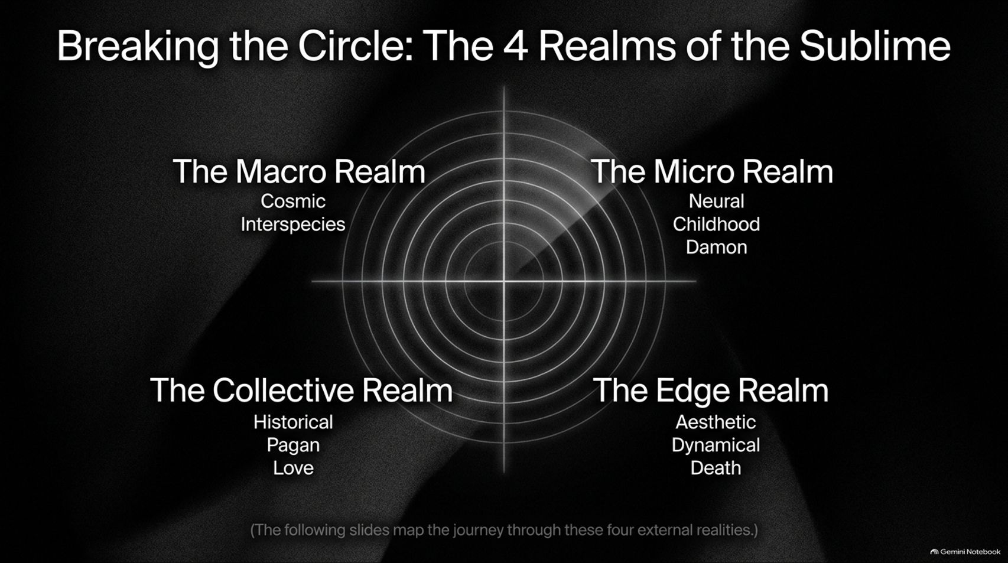
Notes:
Estimated Time: 3 – 5 minutes
Speaker Notes: To systematically break out of the circle of everyday consciousness, Greene maps out The 4 Realms of the Sublime. These four external realities serve as our navigational framework:
The Macro Realm: Expands our perception outward through the Cosmic (space and time) and Interspecies awareness.
The Micro Realm: Looks inward and downward through Neural architecture, Childhood memory, and our inner daemon.
The Collective Realm: Connects us horizontally through History, Pagan ecstasy, and transformative Love.
The Edge Realm: Confronts our limits through Aesthetic shock, Dynamical physical adversity, and the ultimate doorway of Death.
Over the upcoming slides, we will unpack each of these realms to discover how they shatter our mental filters.

Slide 7
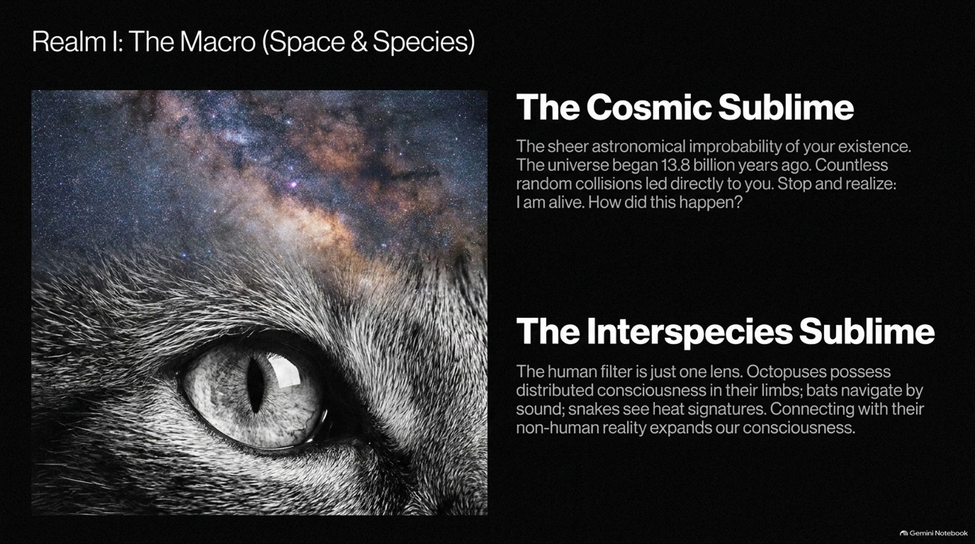
Notes:
Estimated Time: 4 – 5 minutes
Speaker Notes: We begin our journey with Realm I: The Macro, encompassing space and species.
The Cosmic Sublime: Consider the sheer astronomical improbability of your existence. The universe began 13.8 billion years ago. Countless random cosmic and biological collisions over 70,000 generations of ancestors had to fall into place precisely as they did for you to draw breath today. Stopping to realize “I am alive. How did this happen?” induces a stunning cosmic shock.
The Interspecies Sublime: Our human perceptual filter is only one lens among many. Octopuses possess distributed consciousness in their limbs; bats navigate entirely by sound; snakes perceive heat signatures. Connecting with the non-human reality of animals expands our consciousness beyond the narrow confines of the human ego.

Slide 8
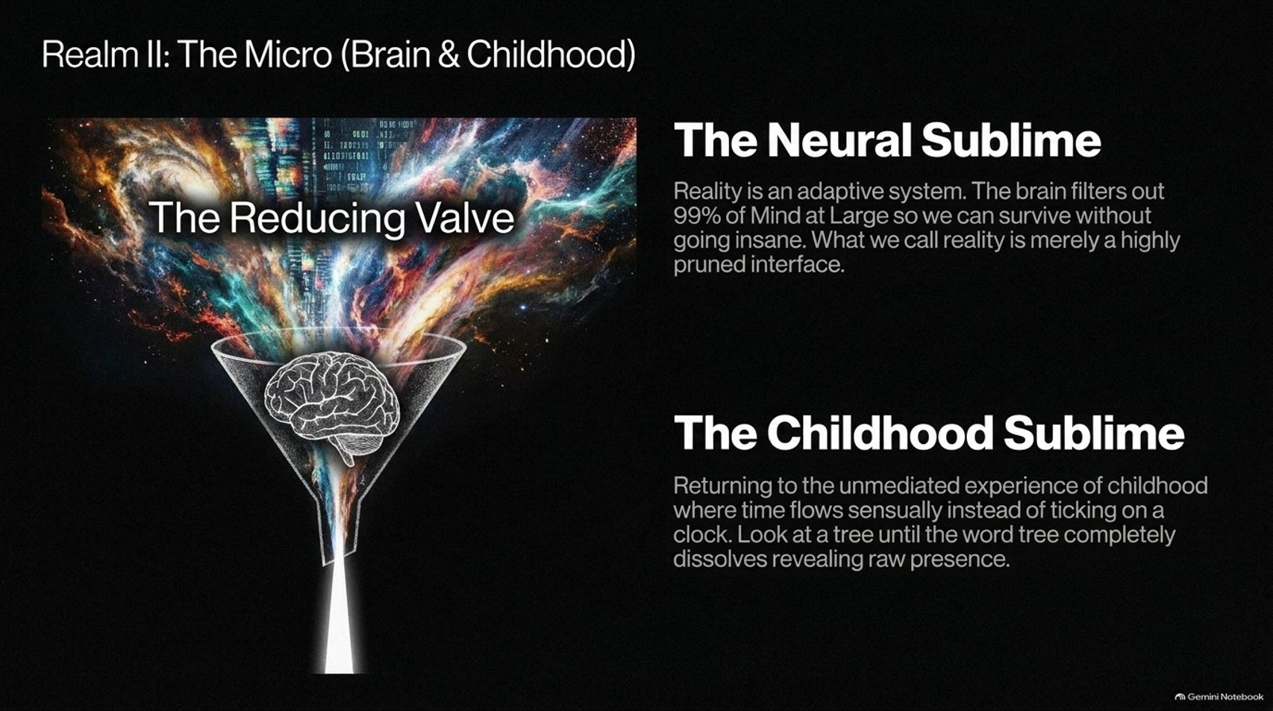
Notes:
Estimated Time: 4 – 5 minutes
Speaker Notes: Moving inward, Realm II explores The Micro: Brain and Childhood.
The Reducing Valve: As philosopher Aldous Huxley noted, human consciousness acts as a reducing valve. The brain filters out 99% of "Mind at Large" so we can function without going insane. What we call normal reality is merely a highly pruned, utilitarian interface.
The Childhood Sublime: Remember how the world felt when you were a child. Time flowed sensuously rather than ticking mechanically on a clock. If you look intently at an ordinary tree until the verbal label "tree" completely dissolves in your mind, the conceptual grid falls away, revealing raw, vibrating presence.

Slide 9
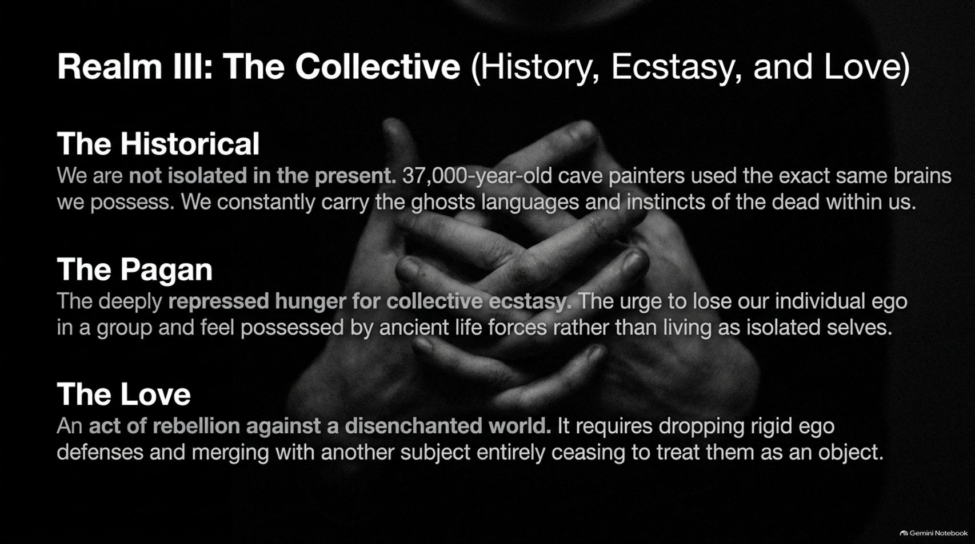
Notes:
Estimated Time: 4 – 5 minutes
Speaker Notes: Realm III bridges our individual isolation into The Collective.
The Historical Sublime: We are never truly isolated in the present moment. The artists who painted cave walls 37,000 years ago possessed the exact same brain hardware we have today. We carry the ghosts, languages, and instincts of the dead whispering within our cultural DNA.
The Pagan & The Love: Humans harbor a deeply repressed hunger for collective ecstasy—the urge to drop ego defenses and feel possessed by ancient life forces. Similarly, true Love is an act of rebellion against a disenchanted world. It requires dropping rigid psychological armor and merging with another subject entirely, rather than treating them as an object for utility.

Slide 10
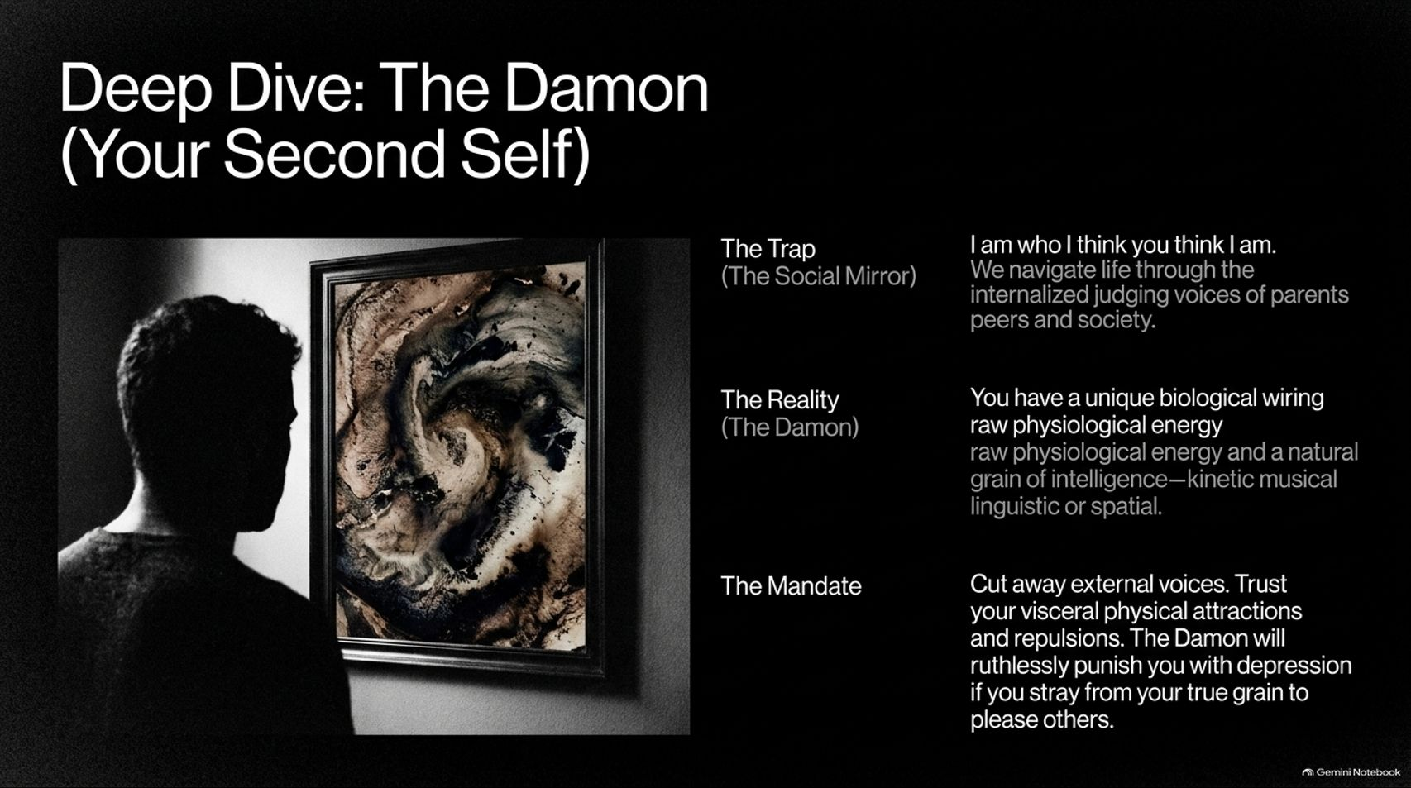
Notes:
Estimated Time: 4 – 6 minutes
Speaker Notes: Within the micro realm lies a vital psychological concept: The Daemon, or Your Second Self.
The Trap (The Social Mirror): Most people live trapped in the mindset of “I am who I think you think I am.” We navigate life through internalized, judging voices of parents, peers, and societal expectations.
The Reality (The Daemon): You possess a unique biological wiring—raw physiological energy and a natural grain of intelligence, whether kinetic, musical, linguistic, or spatial.
The Mandate: You must ruthlessly cut away external voices and trust your visceral physical attractions and repulsions. Greene warns that if you betray your unique grain to please others, your inner daemon will punish you with depression and listlessness.

Slide 11
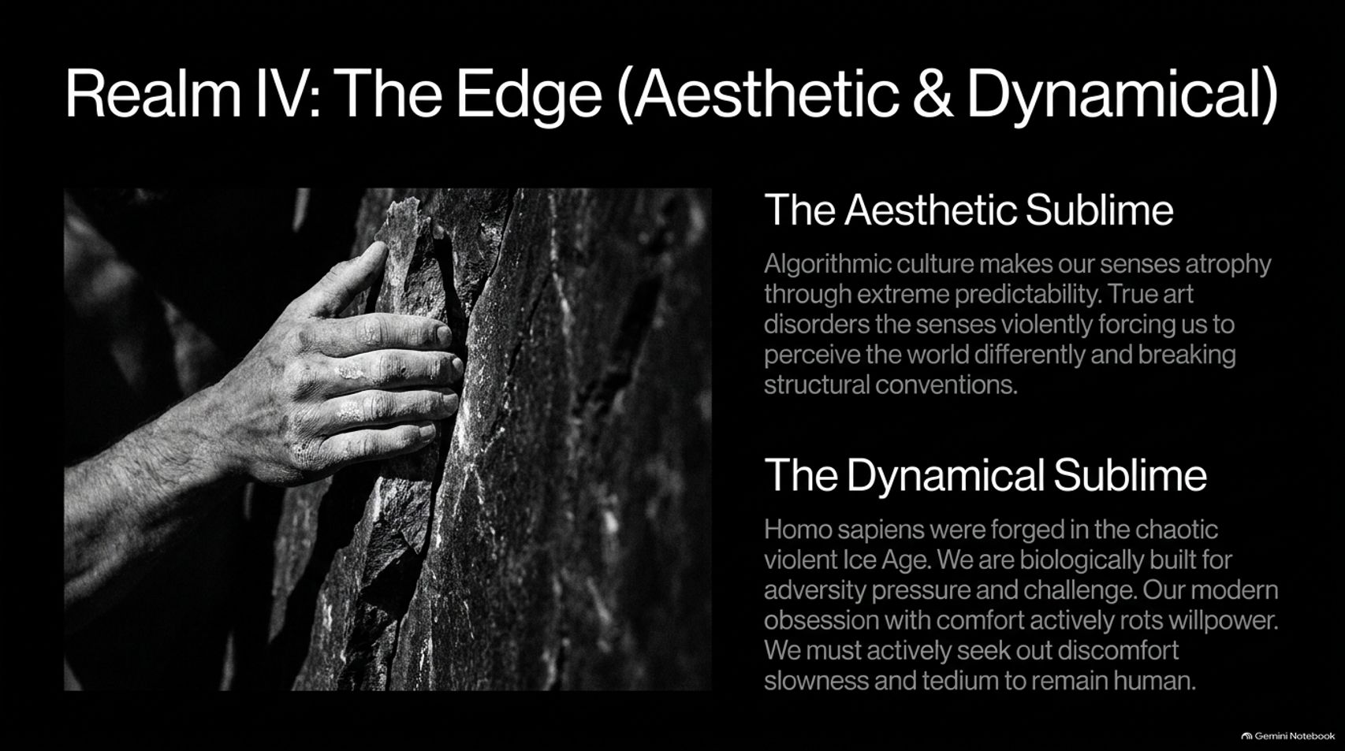
Notes:
Estimated Time: 4 – 5 minutes
Speaker Notes: We reach Realm IV: The Edge, focusing on aesthetic and dynamical shocks.
The Aesthetic Sublime: Algorithmic culture makes our senses atrophy through extreme predictability. True art disorders our senses violently, forcing us to perceive the world differently and breaking structural conventions.
The Dynamical Sublime: Homo sapiens were forged in the chaotic, violent crucible of the Ice Age. We are biologically built for adversity, pressure, and challenge. Our modern obsession with absolute comfort actively rots willpower and mental fortitude. To remain fully human, we must actively seek out discomfort, physical exertion, and slowness.

Slide 12
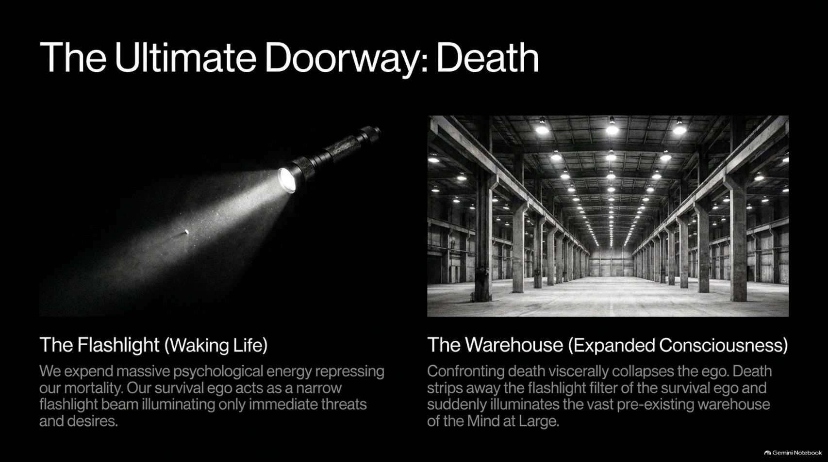
Notes:
Estimated Time: 4 – 6 minutes
Speaker Notes: Among all gateways, the most powerful and terrifying is The Ultimate Doorway: Death.
The Flashlight (Waking Life): Normally, we expend massive psychological energy repressing our mortality. Our survival ego acts as a narrow flashlight beam, illuminating only immediate threats, pleasures, and daily chores.
The Warehouse (Expanded Consciousness): When we confront death viscerally—whether through a near-death health crisis like Greene's stroke, or meditating on impermanence—the ego collapses. Death strips away the narrow flashlight filter, suddenly illuminating the vast, pre-existing warehouse of Mind at Large. Embracing impermanence cures us of petty grievances and wakes us up to life's profound intensity.

Slide 13
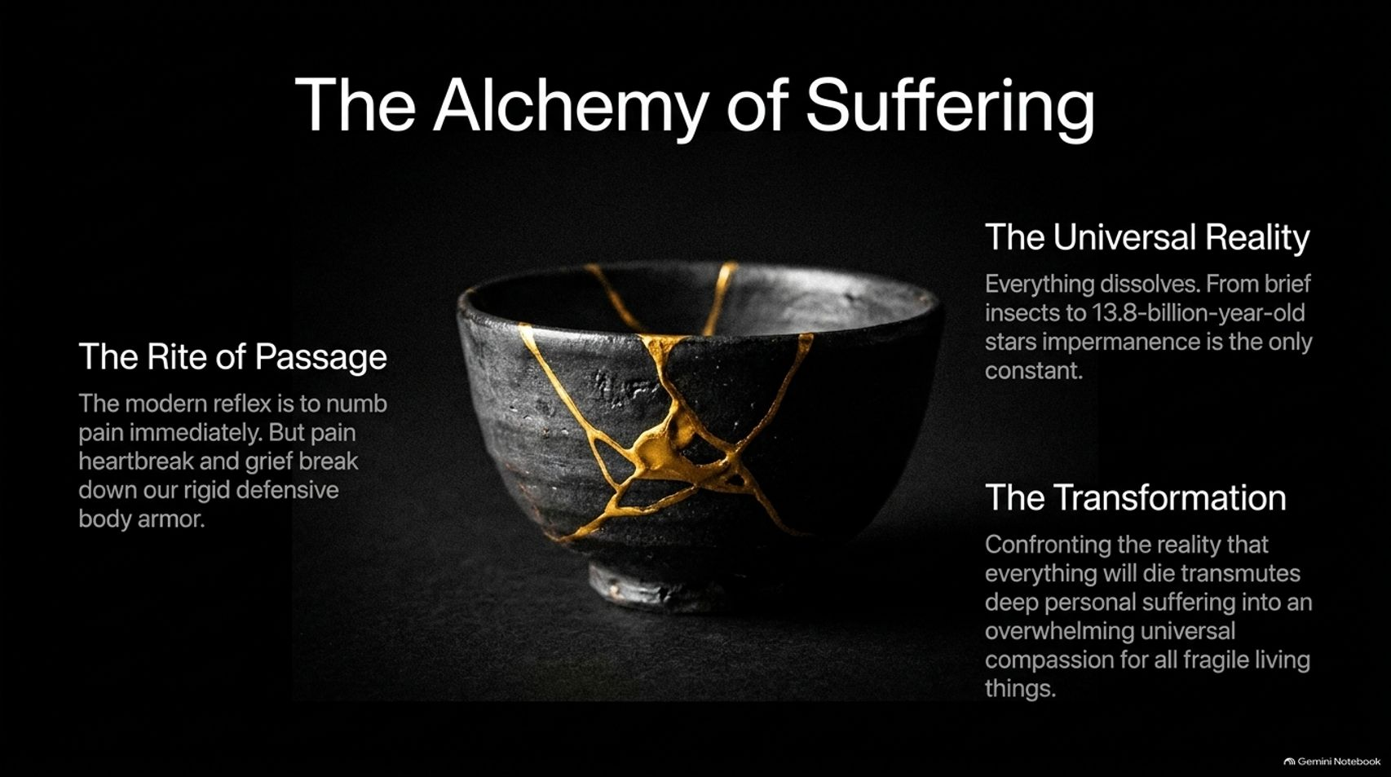
Notes:
Estimated Time: 3 – 5 minutes
Speaker Notes: Suffering and heartbreak, when properly processed, undergo a profound transformation known as The Alchemy of Suffering.
The Rite of Passage: The modern reflex is to numb emotional pain immediately with distractions. However, experiencing heartbreak and grief breaks down our rigid defensive body armor.
The Universal Reality & Transformation: Everything in nature dissolves; impermanence is the only constant from insects to ancient stars. When we confront the reality that everything will die, it transmutes deep personal suffering into an overwhelming, universal compassion for all fragile living things.

Slide 14
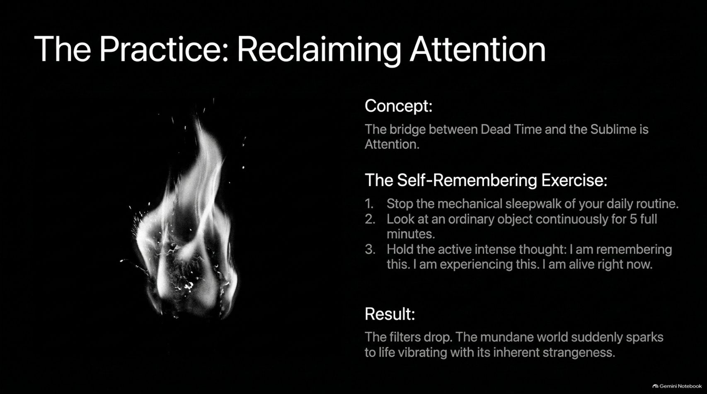
Notes:
Estimated Time: 3 – 5 minutes
Speaker Notes: Knowing the theory of the sublime is not enough; we must practice it. The bridge between Dead Time and the Sublime is Attention.
Here is a practical Self-Remembering Exercise you can practice daily:
Interrupt: Stop the mechanical sleepwalk of your daily routine.
Gaze: Look at an ordinary object in your environment continuously for 5 full minutes.
Affirm: Hold the active, intense thought: “I am remembering this. I am experiencing this. I am alive right now.”
Result: The mental filters drop. The mundane world suddenly sparks back to life, vibrating with its inherent strangeness and sacredness.

Slide 15
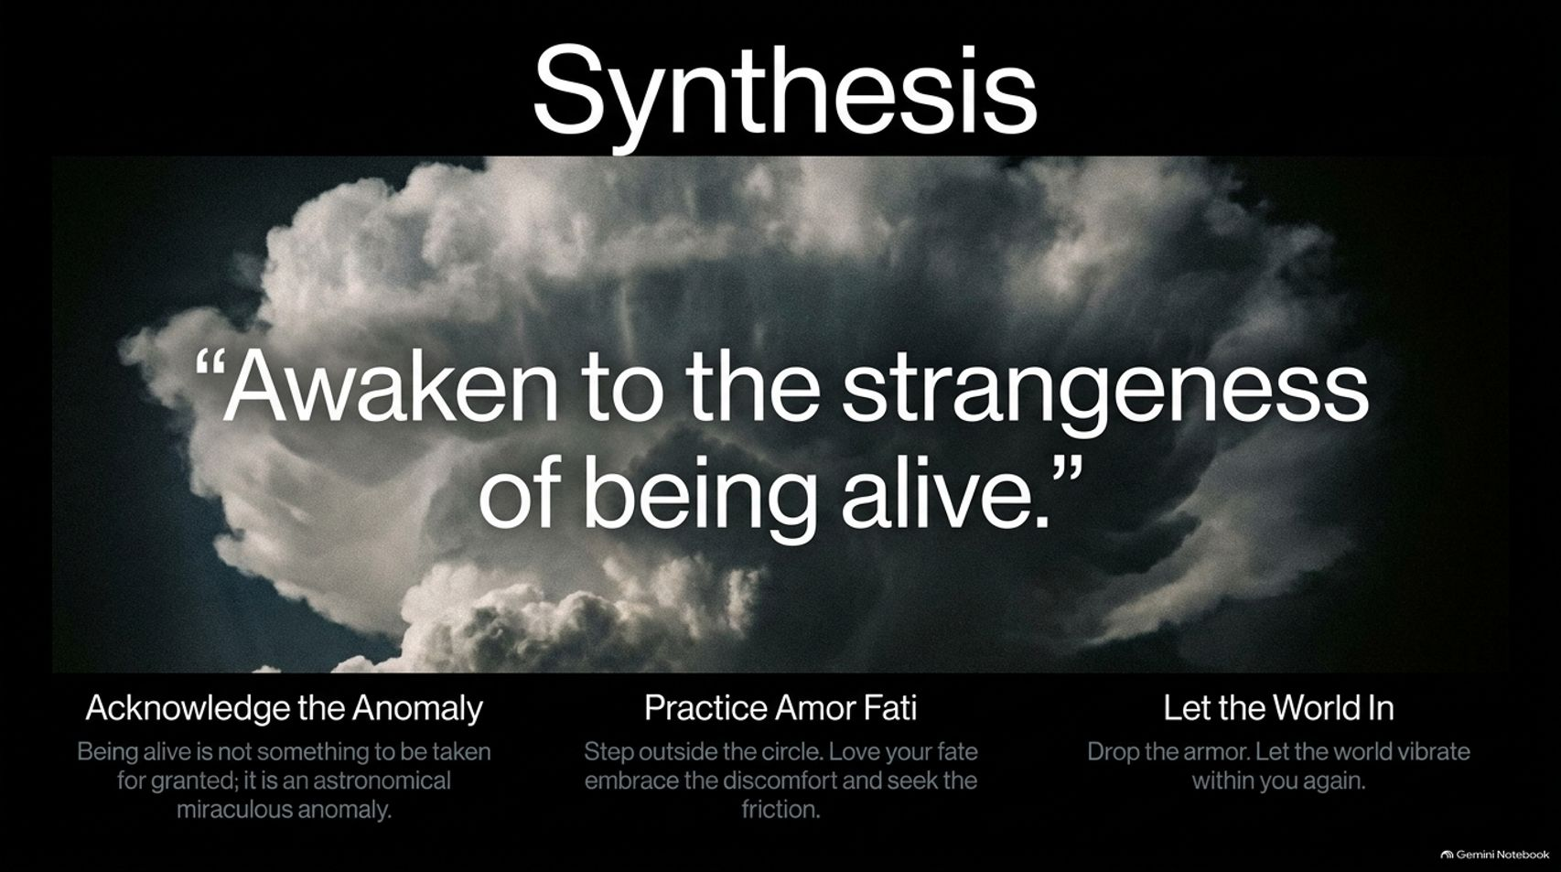
Notes:
Estimated Time: 3 – 4 minutes
Speaker Notes: As we synthesize our journey, we return to Robert Greene's core directive: "Awaken to the strangeness of being alive."
To embody this synthesis, remember three core pillars:
Acknowledge the Anomaly: Being alive is not something to take for granted; it is an astronomical, miraculous anomaly.
Practice Amor Fati: Step outside the circle, love your fate, embrace discomfort, and seek healthy friction.
Let the World In: Drop your psychological armor and let the world vibrate within you again.
Never let dead time rob you of your aliveness.

Slide 16
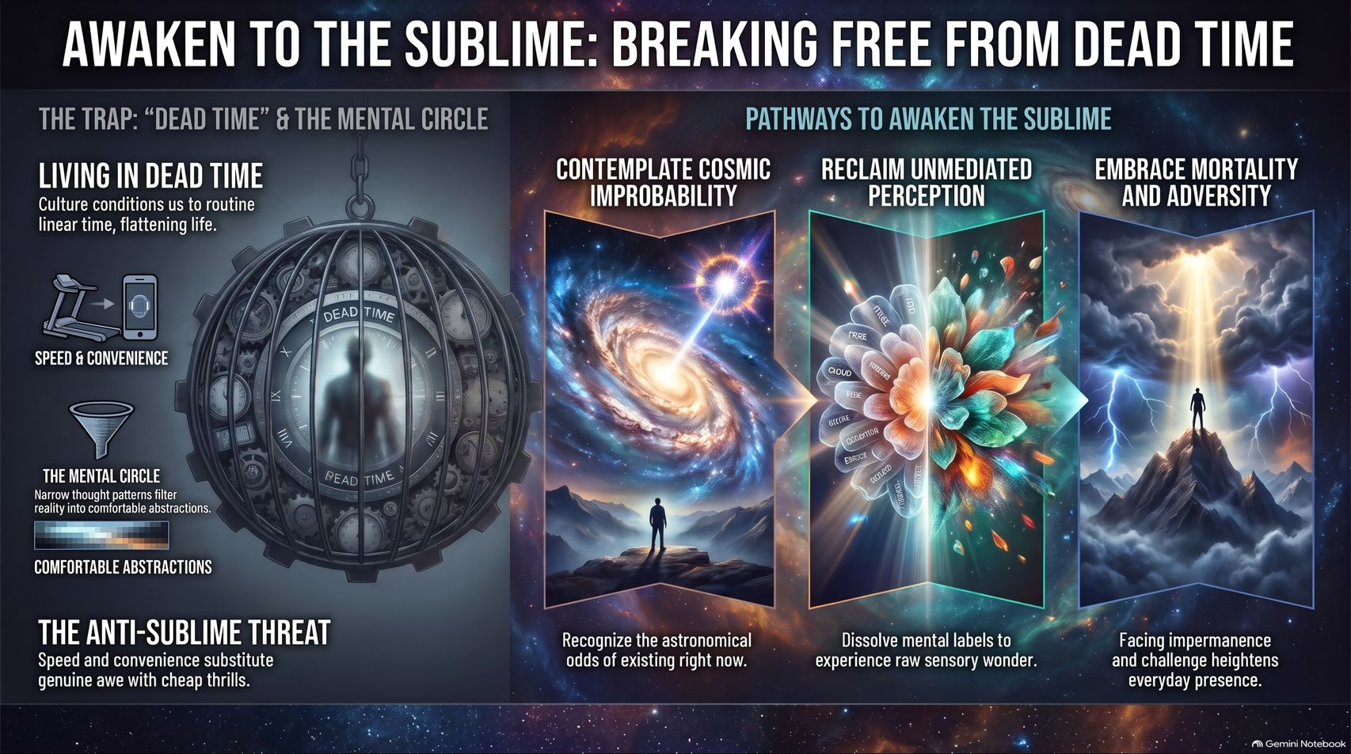
Notes:
Estimated Time: 4 – 6 minutes
Speaker Notes: To conclude our masterclass, this comprehensive framework summarizes our entire expedition:
The Trap ("Dead Time" & The Mental Circle): Culture conditions us into speed, convenience, and narrow mental abstractions that flatten life into automated numbness. Speed and convenience substitute genuine awe with cheap digital thrills.
Pathways to Awaken the Sublime:
Contemplate Cosmic Improbability: Recognize the staggering mathematical odds of existing right now across 13.8 billion years of history.
Reclaim Unmediated Perception: Actively dissolve mental labels and categories to experience raw sensory wonder.
Embrace Mortality and Adversity: Facing impermanence and physical challenge heightens everyday presence and restores our vital edge.
Thank you for walking through these 12 doorways. Step out of the circle, embrace the unknown, and awaken to the profound strangeness of being alive.

