Slide 1
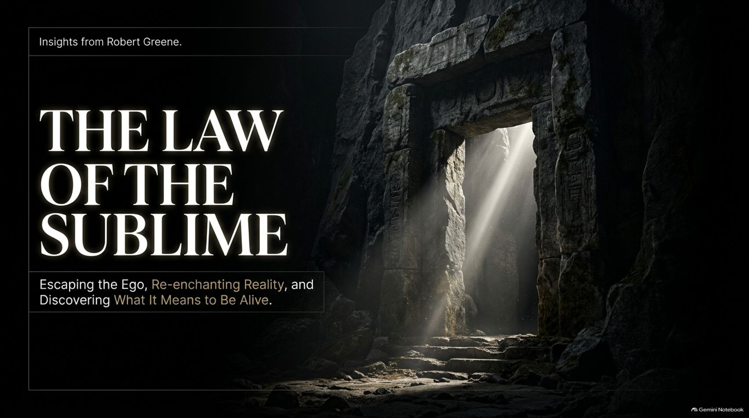
Notes:
Estimated Time: 2 – 3 minutes
Speaker Notes: Welcome, everyone. Today we are exploring a profound and urgent topic: The Law of the Sublime: Escaping the Ego, Re-enchanting Reality, and Discovering What It Means to Be Alive.
In our modern, algorithm-driven world, most of us wander through existence in a state of hypnotic routine. We are trapped inside a tight, invisible loop of daily anxieties, past regrets, and future deadlines. The sublime represents the threshold—the doorway out of this mental prison.
Over the next 16 slides, we will examine Robert Greene’s insights on how a near-death stroke radically reordered his perception of reality, how our adult brains filter out enchantment, and how we can systematically open the doors to the sublime across nature, art, love, and consciousness itself. Let us step across the threshold together.
Skip the Big Life Overhaul in 2027 & Do This Instead | Robert Greene
https://www.youtube.com/watch?v=eJKF7XcA3jY

Slide 2
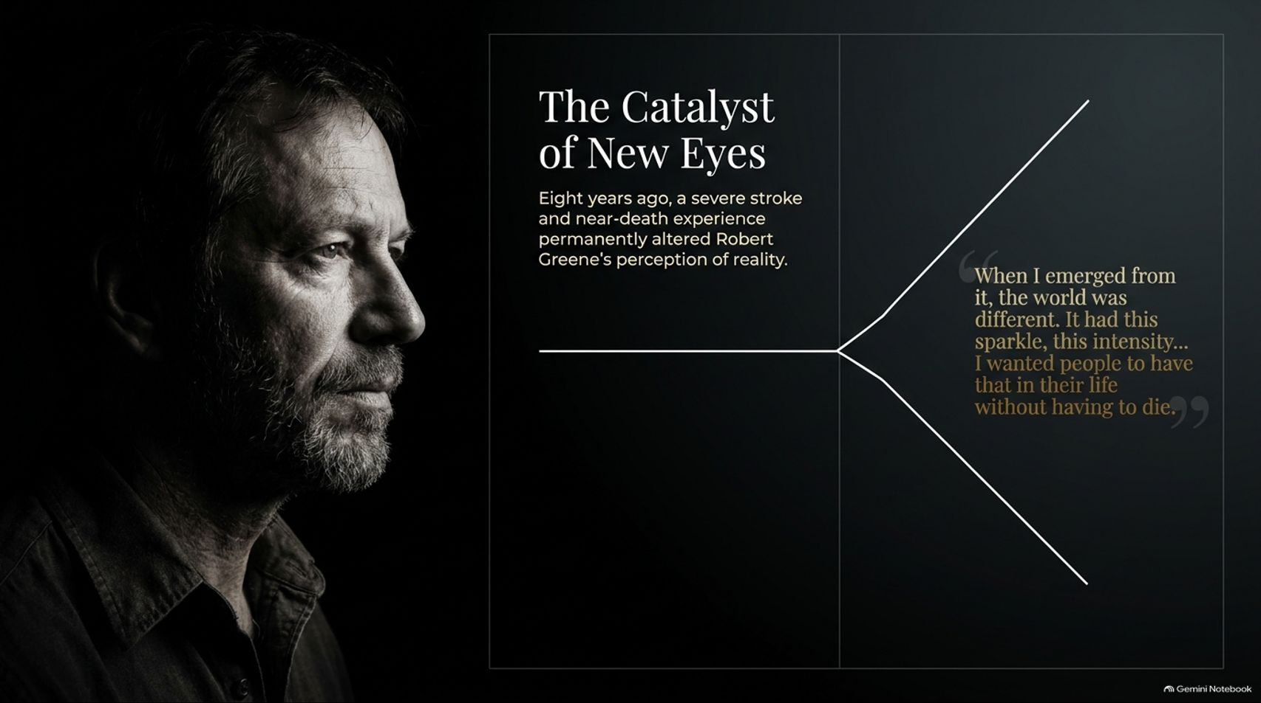

Slide 3
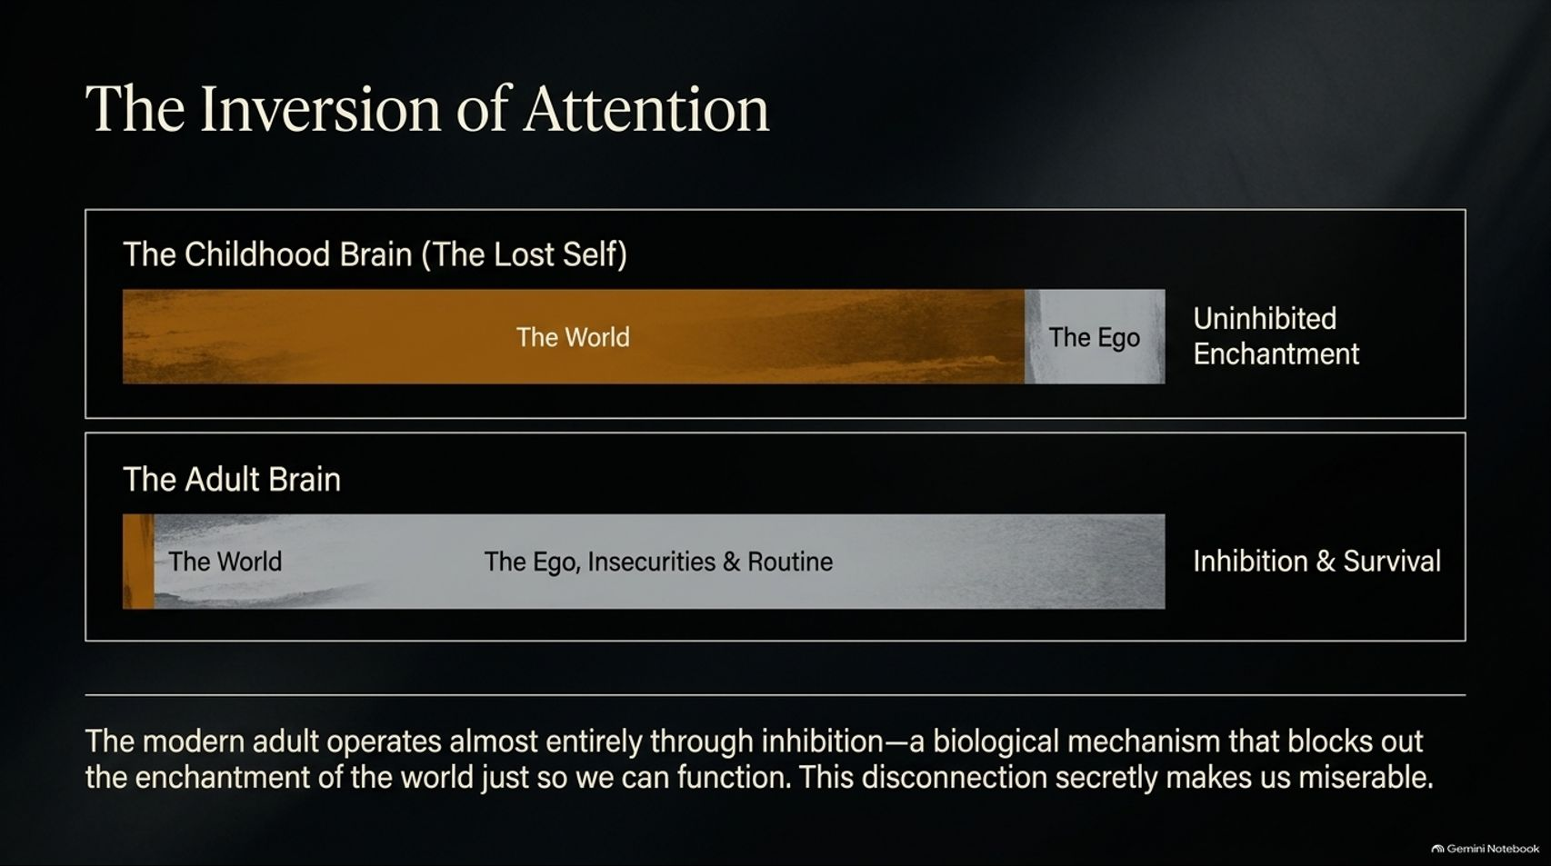
Notes:
Estimated Time: 4 – 5 minutes
Speaker Notes: Why do adults feel so chronically unfulfilled compared to children? The answer lies in The Inversion of Attention.
The Childhood Brain (The Lost Self): In childhood, our mental bandwidth is heavily weighted toward The World. Without a fully formed linguistic filter or rigid conceptual categories, children experience uninhibited enchantment. The ego takes up only a tiny fraction of mental space.
The Adult Brain: As we age, this ratio completely inverses. The adult brain devotes nearly its entire operating capacity to The Ego, Insecurities, & Routine.
As noted on this slide, the modern adult operates almost entirely through inhibition—a biological mechanism that filters out the magic of the world simply so we can navigate traffic, pay bills, and survive. This constant psychological self-censorship and inward focus is what secretly makes modern life feel so flat and miserable.

Slide 4
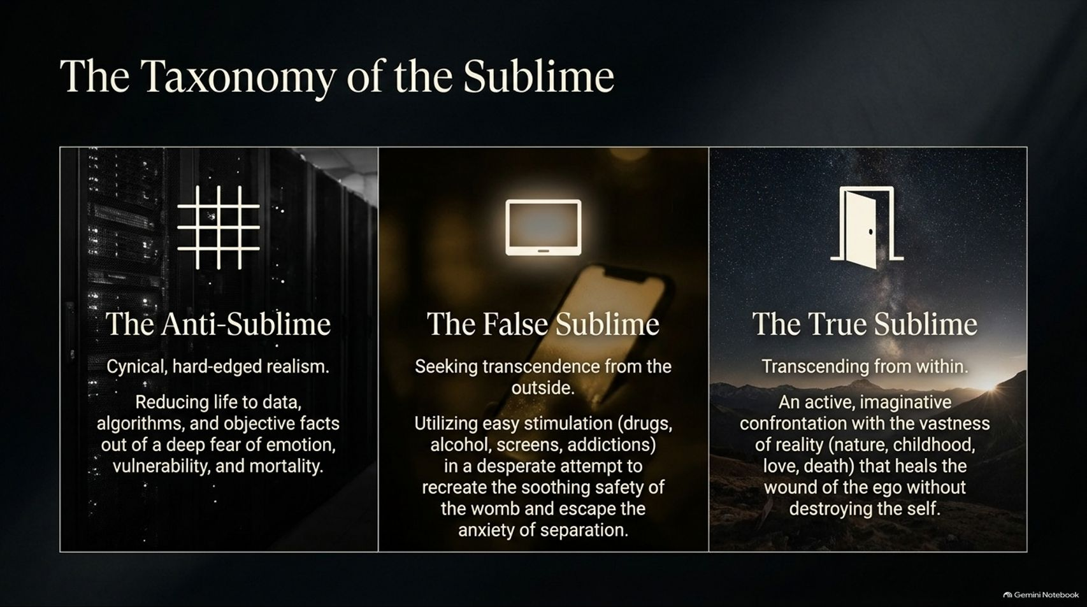
Notes:
Estimated Time: 4 – 6 minutes
Speaker Notes: To understand how we interact with reality, we must look at The Taxonomy of the Sublime, which breaks down into three distinct categories:
The Anti-Sublime: Rooted in cynical, hard-edged realism. This is the mindset that reduces human life entirely to cold data, algorithms, and objective facts out of a deep-seated fear of emotion, vulnerability, and mortality.
The False Sublime: Seeking transcendence from the outside through quick, frictionless fixes—such as drugs, alcohol, screen addictions, or endless digital stimulation. This is a desperate, artificial attempt to recreate the soothing safety of the womb and escape the anxiety of separation.
The True Sublime: Transcending from within. This involves an active, imaginative confrontation with the vastness of reality—through nature, childhood memory, love, or the contemplation of death—that heals the wound of the ego without destroying the self.

Slide 5
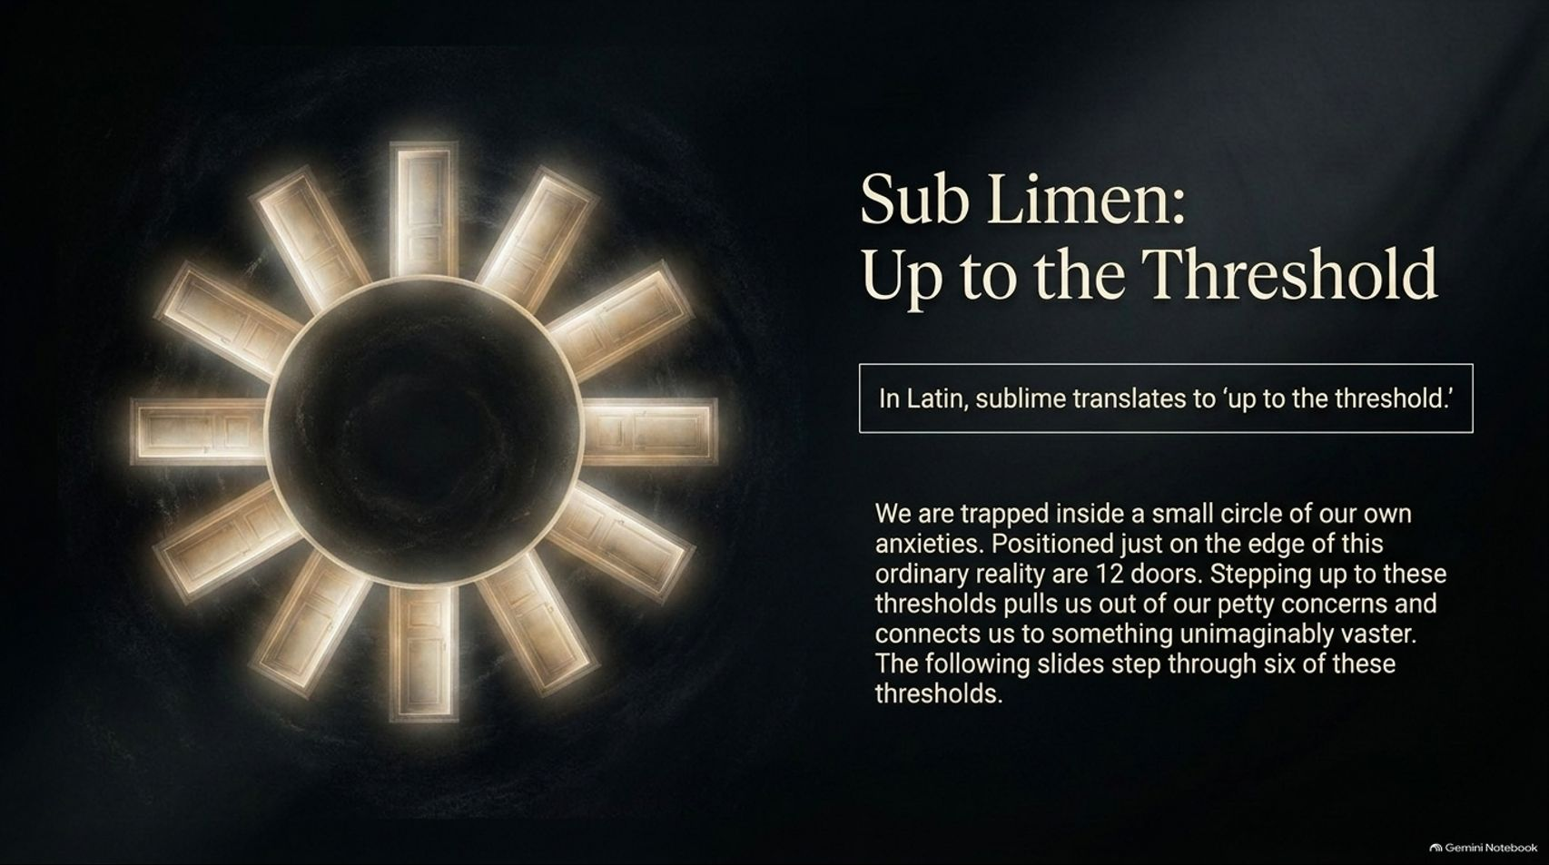
Notes:
Estimated Time: 3 – 5 minutes
Speaker Notes: Let's look at the etymology of the word itself. In Latin, sublimis translates to "up to the threshold" (sub meaning up to, limen meaning threshold).
Most of us are trapped inside a small, suffocating circle of our own daily anxieties and ego concerns. Positioned just on the outer edge of this ordinary reality are 12 metaphorical doors. Stepping up to these thresholds pulls us violently out of our petty grievances and connects us to something unimaginably vaster.
In the following slides, we will step through six of these primary doorways to examine how we can breach the circle of everyday consciousness.

Slide 6
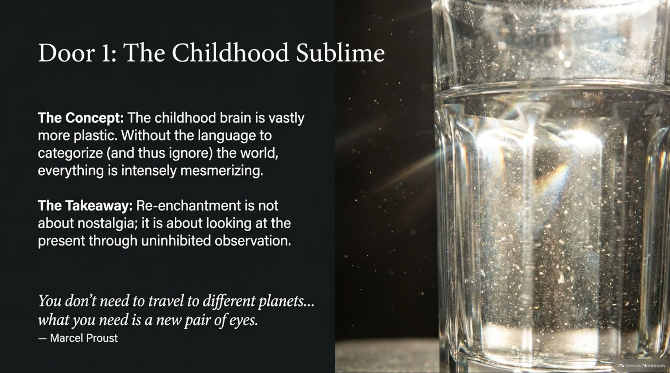
Notes:
Estimated Time: 3 – 5 minutes
Speaker Notes: Our first portal is Door 1: The Childhood Sublime.
The Concept: The childhood brain is vastly more plastic. Because children lack the developed adult vocabulary to immediately categorize—and thus dismiss or ignore—the world around them, everything they encounter is intensely mesmerizing.
The Takeaway: True re-enchantment is not about indulging in cheesy nostalgia or wishing you were young again; it is about learning to look at the present moment through uninhibited, beginner's observation.
As Marcel Proust famously wrote: "You don't need to travel to different planets... what you need is a new pair of eyes."

Slide 7
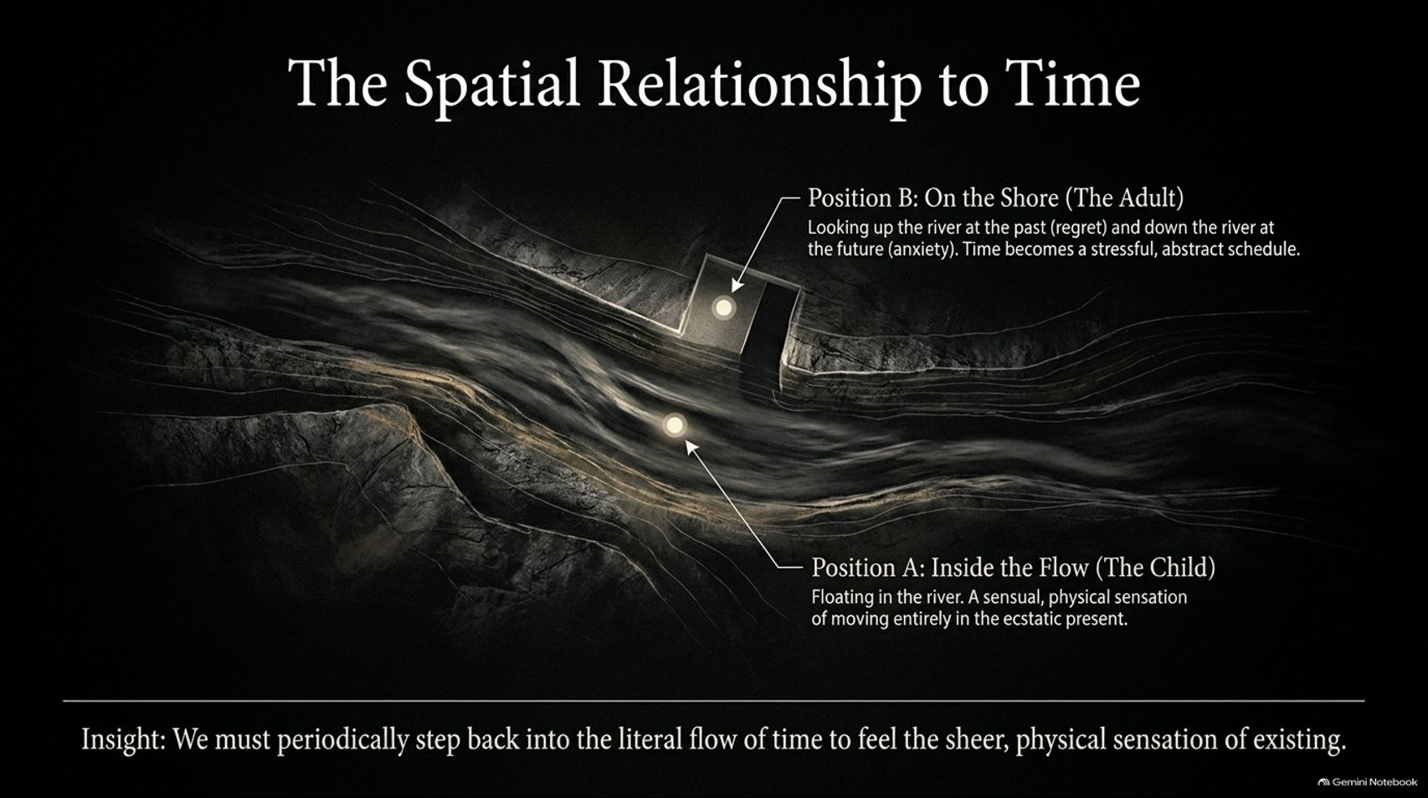
Notes:
Estimated Time: 4 – 5 minutes
Speaker Notes: How we experience time dictates whether we feel alive or trapped. This slide maps our spatial relationship to time into two distinct positions:
Position B: On the Shore (The Adult): Adults stand rigidly on the riverbank. Looking upstream, we obsess over past regrets; looking downstream, we panic over future deadlines and obligations. Time becomes a stressful, abstract schedule that boxes us in.
Position A: Inside the Flow (The Child): This is floating directly in the rushing river of the present. It is a sensual, physical sensation of moving entirely in the ecstatic now.
The Core Insight: We must periodically step off the dry shore of abstract scheduling and drop back into the literal flow of time to feel the sheer, physical sensation of existing.

Slide 8
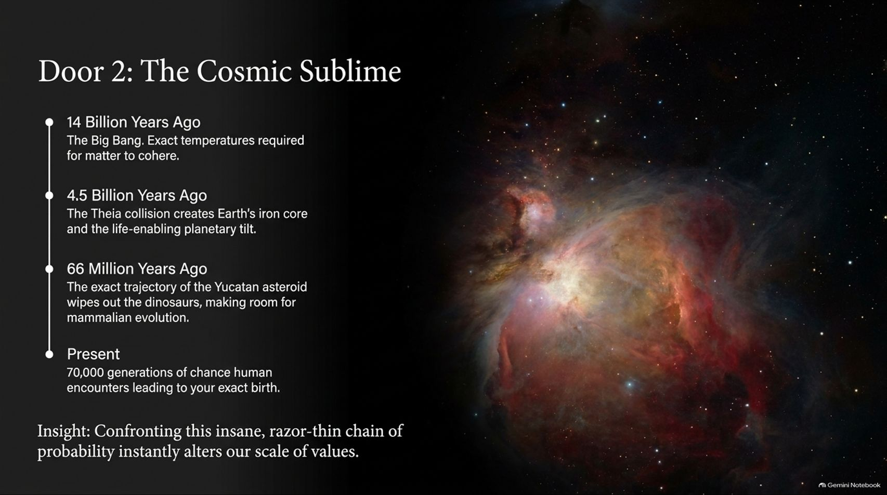
Notes:
Estimated Time: 4 – 6 minutes
Speaker Notes: Our second portal is Door 2: The Cosmic Sublime, which expands our perspective across deep time:
14 Billion Years Ago: The Big Bang sets exact temperatures required for matter to cohere.
4.5 Billion Years Ago: The Theia planetary collision creates Earth's iron core and our life-enabling planetary tilt.
66 Million Years Ago: The exact trajectory of the Yucatan asteroid wipes out the dinosaurs, clearing the evolutionary path for mammalian development.
Present Day: Over 70,000 generations of unbroken chance human encounters lead directly to your exact birth.
The Insight: Confronting this insane, razor-thin chain of probability instantly alters our scale of values. Daily trivial annoyances evaporate when viewed against a 14-billion-year cosmic backdrop.

Slide 9
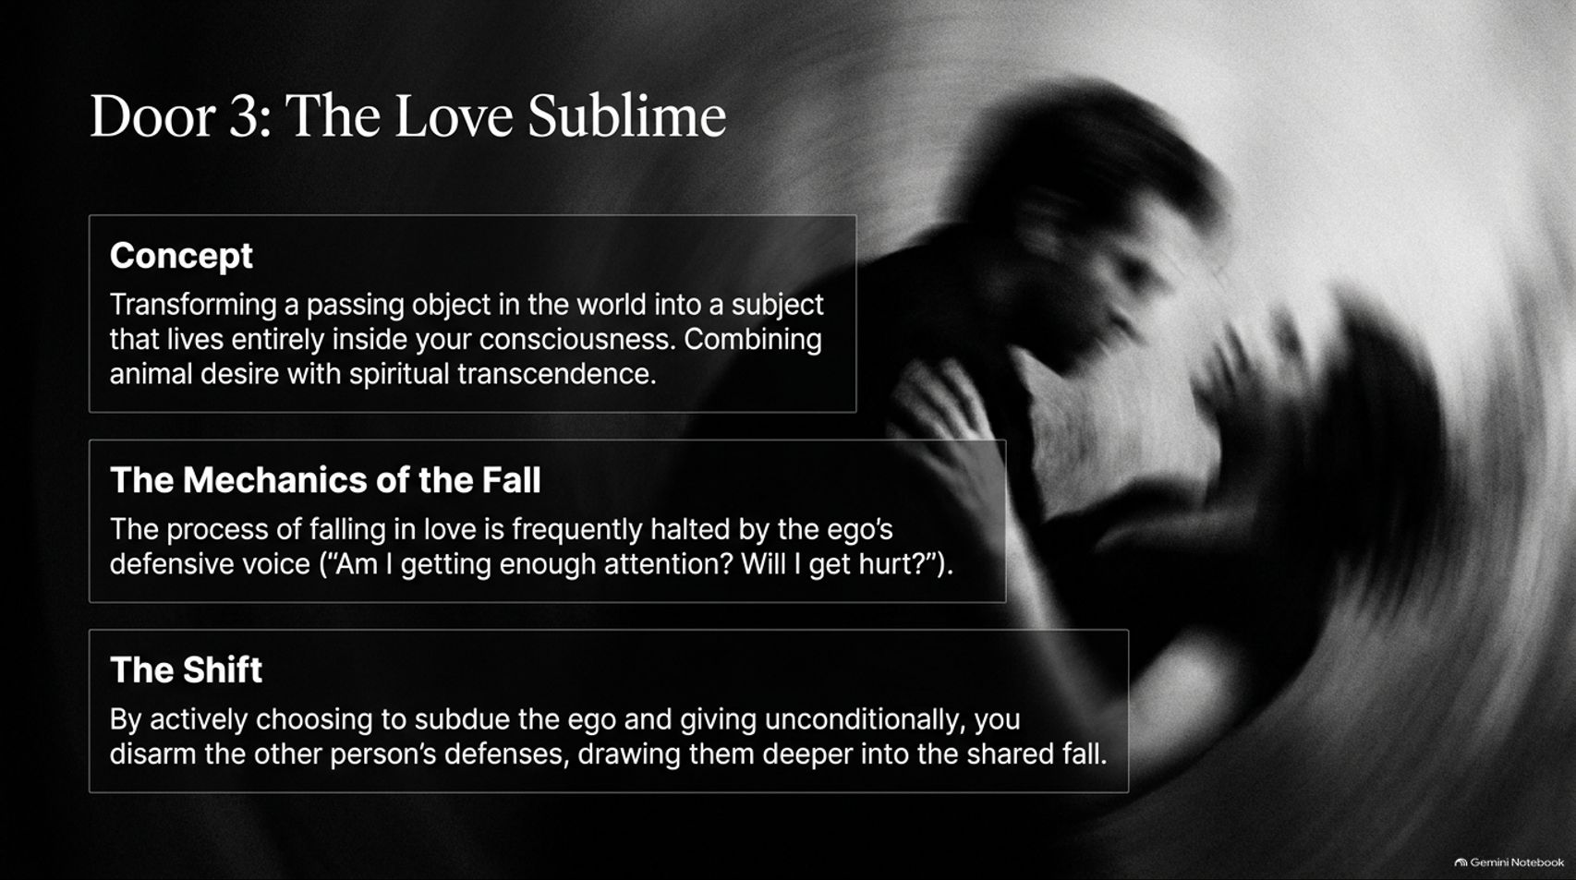
Notes:
Estimated Time: 3 – 5 minutes
Speaker Notes: Portal number three is Door 3: The Love Sublime.
The Concept: True love is the alchemy of transforming a passing object in the world into a subject that lives entirely inside your consciousness. It bridges raw animal desire with profound spiritual transcendence.
The Mechanics of the Fall: Why do so many relationships stall? Because the ego's defensive voice keeps asking: "Am I getting enough attention? Will I get hurt?" This self-protection kills intimacy.
The Shift: By actively choosing to subdue the ego and giving affection unconditionally, you disarm the other person's defensive armor, drawing them deeper into a shared, uninhibited emotional fall.

Slide 10
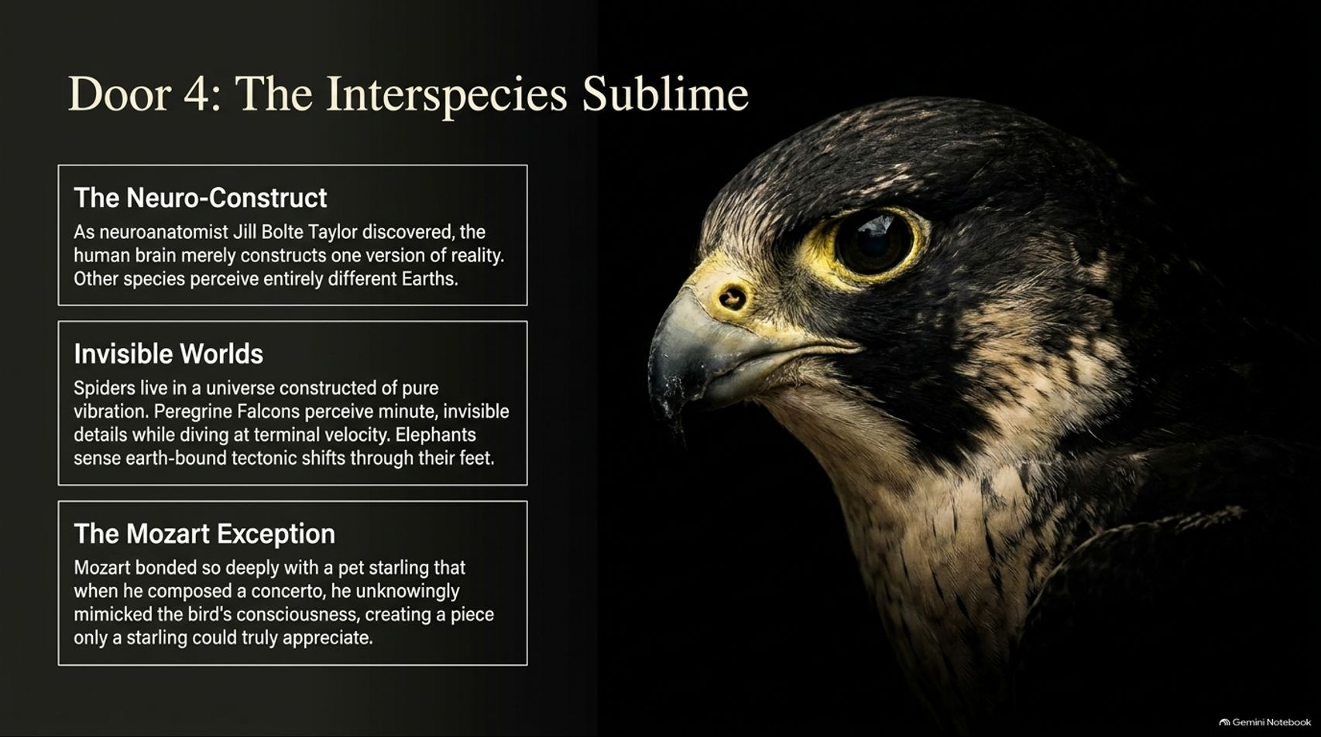
Notes:
Estimated Time: 4 – 5 minutes
Speaker Notes: Portal four opens us up to Door 4: The Interspecies Sublime.
The Neuro-Construct: As neuroanatomist Jill Bolte Taylor discovered, the human brain merely constructs one localized version of reality. Other species inhabit entirely different experiential Earths.
Invisible Worlds: Spiders experience a universe constructed entirely of pure physical vibration. Peregrine falcons perceive minute, invisible spatial details while diving at terminal velocity. Elephants sense earth-bound tectonic shifts through their footpads.
The Mozart Exception: Wolfgang Amadeus Mozart bonded so deeply with a pet starling that when he composed a concerto, he unknowingly mirrored the bird's vocal cadence, creating a musical passage only a starling could truly appreciate.

Slide 11
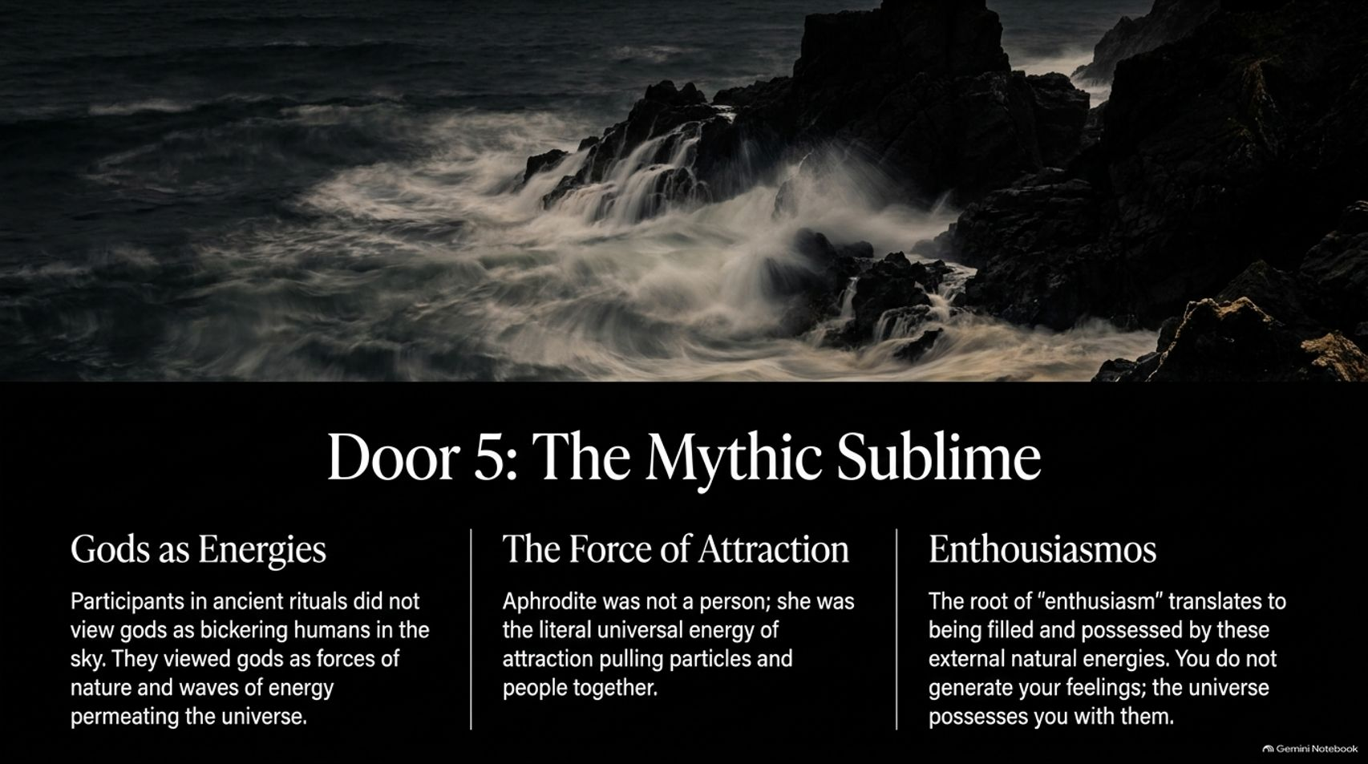
Notes:
Estimated Time: 3 – 5 minutes
Speaker Notes: Our fifth portal is Door 5: The Mythic Sublime.
Gods as Energies: Ancient peoples participating in sacred rituals did not view gods as petty, bickering humans sitting up in the sky. They viewed gods as primal forces of nature and massive waves of energy permeating the universe.
The Force of Attraction: Aphrodite was not viewed merely as a person; she represented the literal universal energy of attraction pulling particles, atoms, and people together.
Enthusiasmos: The root word of "enthusiasm" translates from Greek as being filled and possessed by these external natural energies. You do not generate your deepest inspirations out of nowhere; rather, the universe possesses you with them.

Slide 12
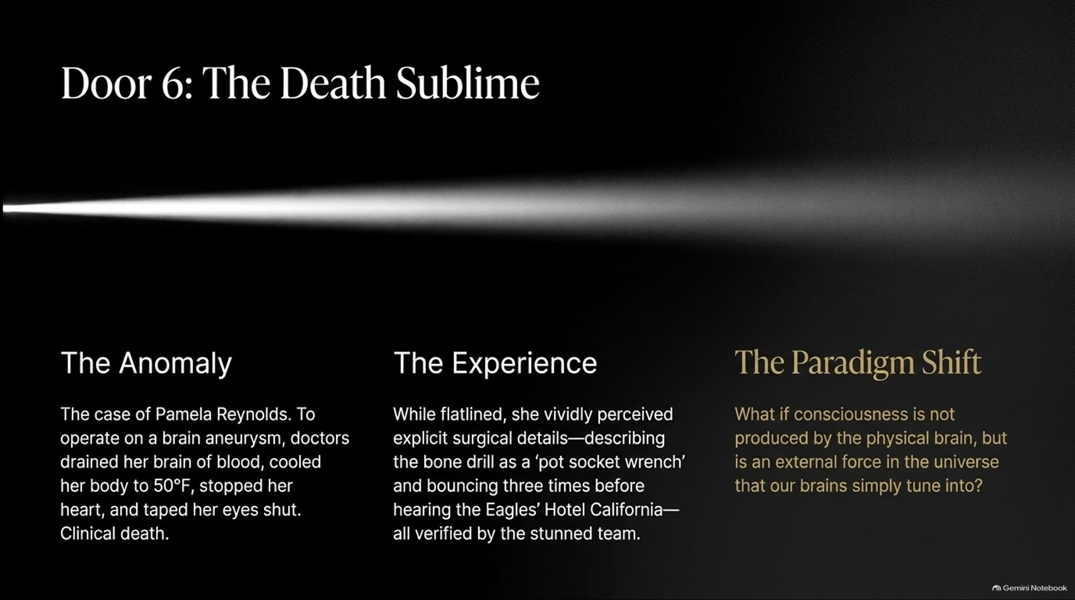
Notes:
Estimated Time: 4 – 6 minutes
Speaker Notes: Our final highlighted portal is Door 6: The Death Sublime, representing the most radical ego-shattering experience available to humans.
The Anomaly: Consider the famous medical case of Pamela Reynolds. To safely operate on a complex brain aneurysm, doctors cooled her body down to 50°F, drained all blood from her brain, stopped her heart, and taped her eyes shut—inducing complete clinical death.
The Experience: While flatlined, she vividly perceived explicit surgical details, later describing the bone drill as a "pot socket wrench" and recalling specific songs playing—all verified by the stunned surgical team.
The Paradigm Shift: This raises a profound question: What if consciousness is not strictly produced as a byproduct inside the physical brain, but is instead an external force in the universe that our brains simply tune into like a radio receiver?

Slide 13
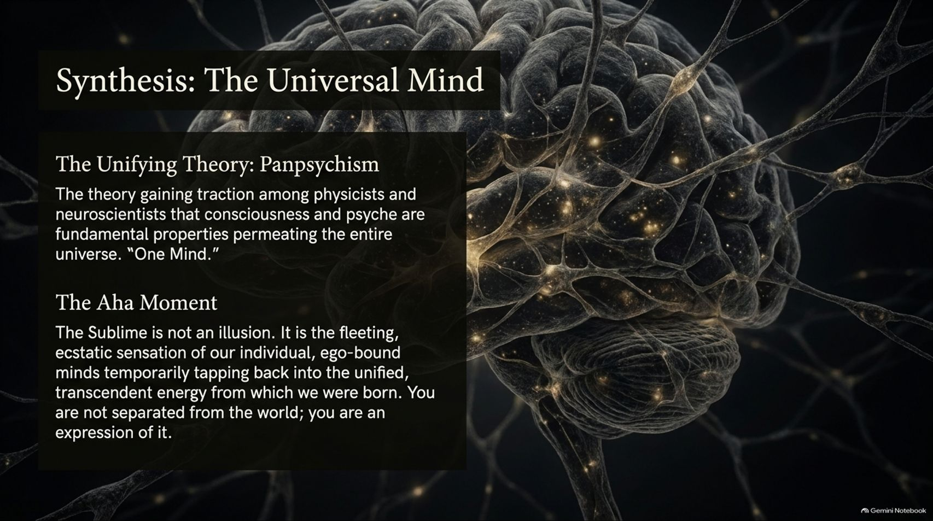
Notes:
Estimated Time: 4 – 5 minutes
Speaker Notes: When we synthesize these insights, we arrive at a powerful unifying framework: Panpsychism.
The Unifying Theory: Panpsychism is gaining serious traction among modern physicists and neuroscientists. It posits that consciousness and psyche are not late-stage biological accidents, but fundamental properties permeating the entire universe—what we might call One Mind.
The Aha Moment: The sublime is never an illusion. It is the fleeting, ecstatic sensation of our individual, ego-bound minds temporarily tapping back into the unified, transcendent energy from which we were born. You are not isolated and separated from the world; you are a direct, conscious expression of it.

Slide 14
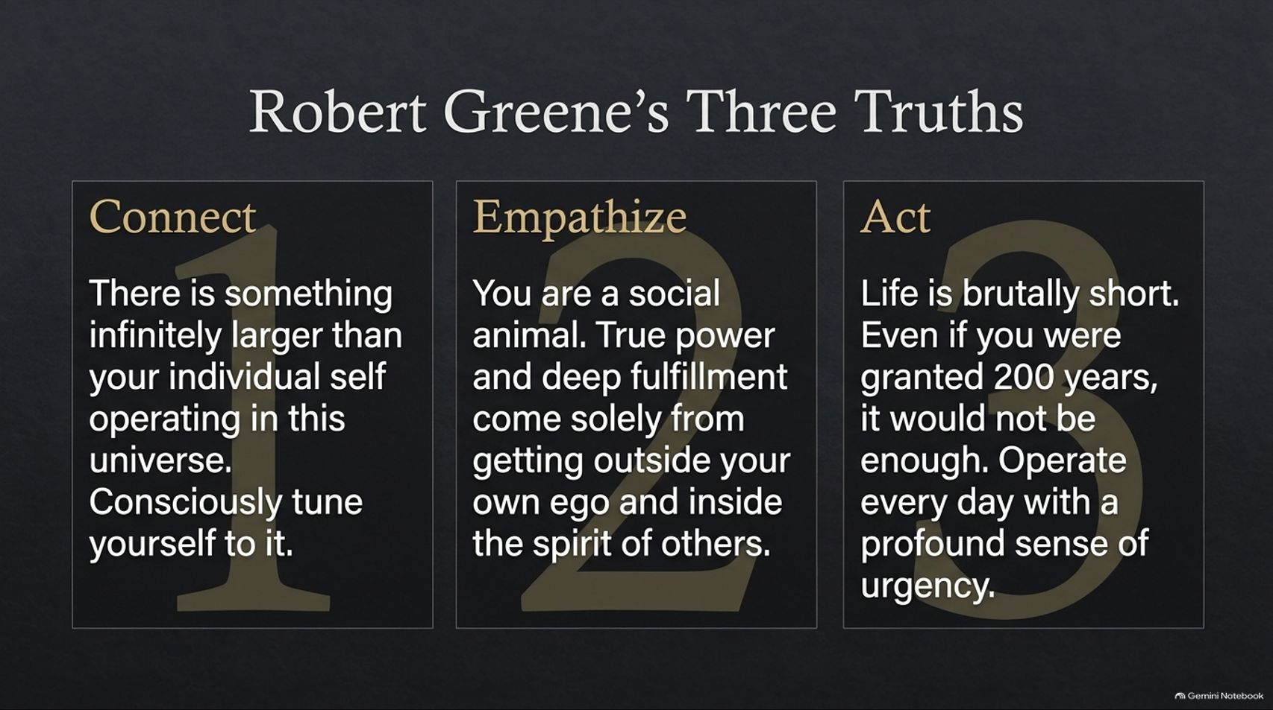
Notes:
Estimated Time: 3 – 5 minutes
Speaker Notes: To translate this philosophy into daily action, Robert Greene leaves us with Three Core Truths:
Connect: Recognize that there is something infinitely larger than your individual ego operating in this universe. Consciously tune yourself to it daily.
Empathize: You are fundamentally a social animal. True personal power and deep psychological fulfillment come solely from stepping outside your own ego and entering the emotional spirit of others.
Act: Life is brutally short. Even if you were granted 200 years on this earth, it would not be enough. Operate every single day with a profound sense of urgency and appreciation.

Slide 15
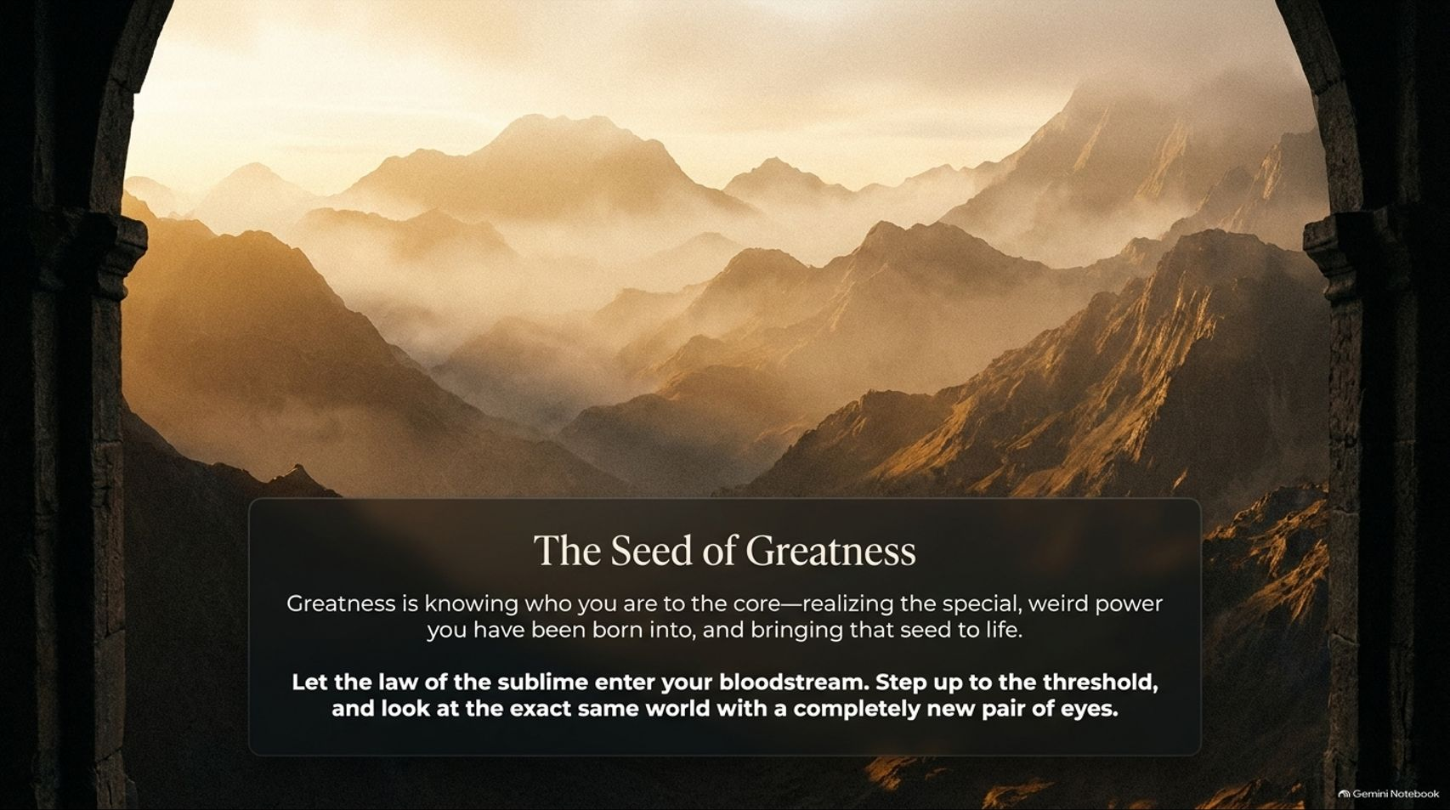
Notes:
Estimated Time: 2 – 4 minutes
Speaker Notes: As we approach our conclusion, we find The Seed of Greatness.
True greatness is not about copying external templates or chasing hollow status metrics. It is about knowing who you are to your absolute core—realizing the special, unrepeatable power you were born into, and bringing that unique seed to life.
Let the law of the sublime enter your bloodstream. Step up to the threshold, drop your defensive armor, and look at the exact same everyday world with a completely new pair of eyes.

Slide 16
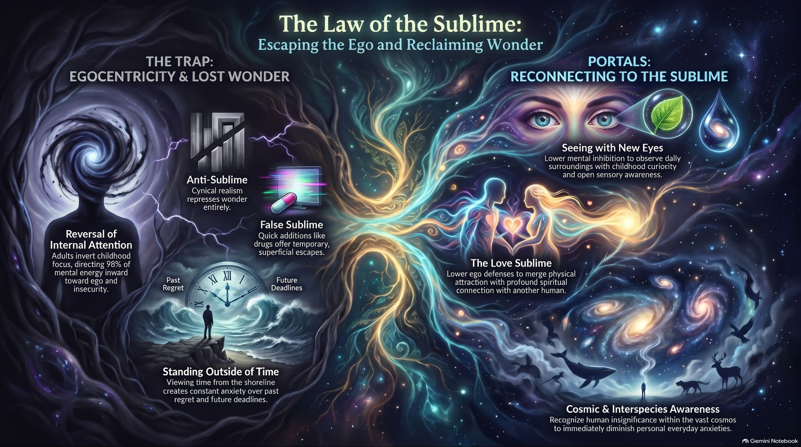
Notes:
Estimated Time: 4 – 6 minutes
Speaker Notes: To close our masterclass, this summary blueprint maps out our entire journey:
The Trap (Egocentricity & Lost Wonder): Adults invert childhood focus, directing 98% of mental energy inward toward ego defense, past regrets, and future deadlines. Both the Anti-Sublime (cynical realism) and the False Sublime (cheap digital addictions) trap us in numbness.
Portals (Reconnecting to the Sublime):
Seeing with New Eyes: Lowering mental inhibition to observe daily surroundings with childlike curiosity.
The Love Sublime: Lowering ego defenses to merge physical attraction with profound spiritual connection.
Cosmic & Interspecies Awareness: Recognizing human insignificance within the vast cosmos to immediately dissolve daily personal anxieties.
Thank you for walking through these doorways. Reclaim your wonder, escape your ego, and awaken to the sublime reality of being alive.
I Wrote This NEW Book to Change How You Live Your Life in 2027 | Robert Greene
This video provides an in-depth interview with Robert Greene discussing the core principles of his work on the sublime and consciousness.

