Slide 1
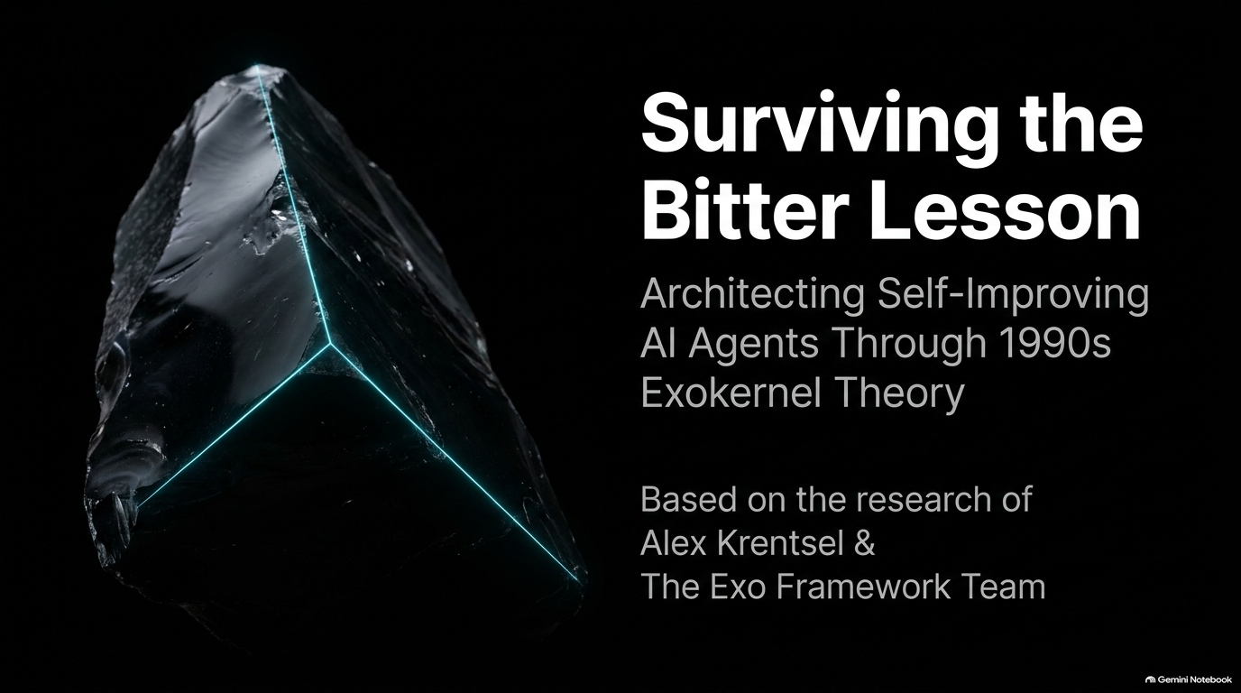
Notes:
Slide Title: Surviving the Bitter Lesson: Architecting Self-Improving AI Agents Through 1990s Exokernel Theory
Estimated Speaking Time: 2 – 3 minutes
Key Visual Elements: Minimalist dark aesthetic with an obsidian crystal split by glowing teal light; subtitle highlighting Alex Krentsel and the Exo Framework Team.
Speaker Script / Notes:
"Welcome, everyone. Today we are looking at a foundational question that faces every developer building autonomous systems: What kind of harness design stands the test of time? As foundation models get better at a blistering pace, the wrapper or system we place them inside often becomes obsolete.
In this talk, we’ll explore Exo, an architecture designed to survive Rich Sutton’s 'Bitter Lesson' by building self-improving agents. We’ll look at why traditional static harnesses hit a ceiling, and how we can borrow lessons from 1990s operating systems theory—specifically Exokernels—to let agents safely modify their own code, prompts, and tools at runtime without crashing or losing their memory."
Self-Improving AI Agents: Exo and the Bitter Lesson | Alex Krentsel
https://www.youtube.com/watch?v=Jglgg0m8EIs

Slide 2
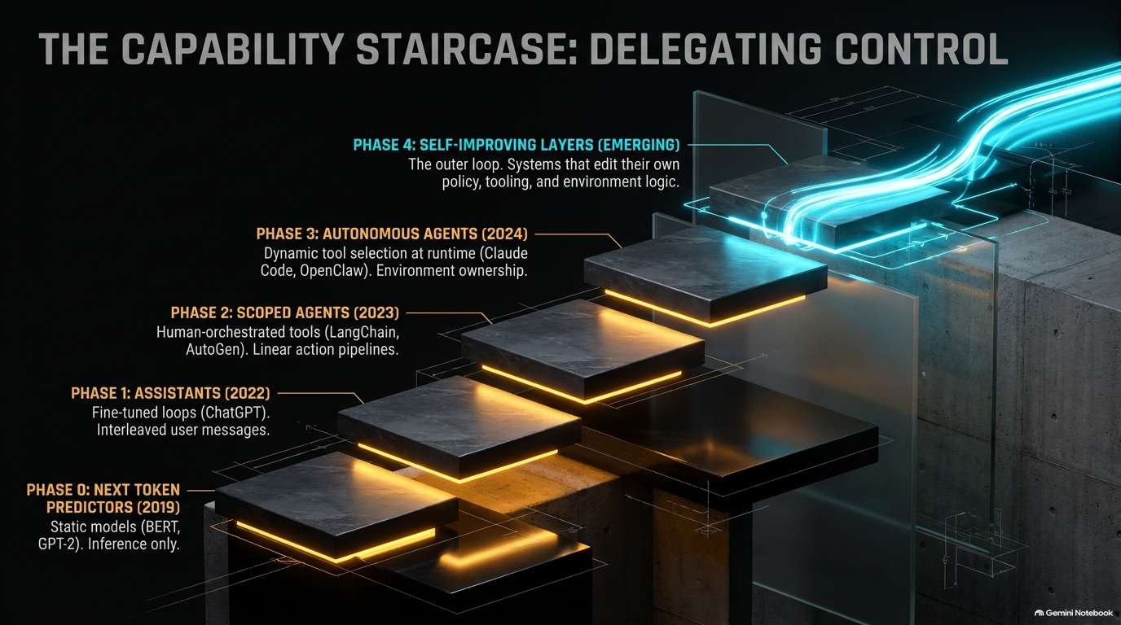
Notes:
Slide Title: The Capability Staircase: Delegating Control
Estimated Speaking Time: 3 – 3.5 minutes
Key Visual Elements: A staircase chart illustrating Phase 0 (Next Token Predictors) up to Phase 4 (Self-Improving Layers).
Speaker Script / Notes:
"To understand where we are going, let's look at how agentic architectures have evolved.
Phase 0 and 1 (2019–2022): We treated models as static next-token predictors (like early BERT or GPT-2) and fine-tuned chatbots like ChatGPT to act as conversational assistants.
Phase 2 (2023): We entered the era of scoped agents using rigid orchestration frameworks like LangChain or AutoGen, passing linear pipelines from one action to the next.
Phase 3 (2024): We moved to autonomous agents that dynamically select tools at runtime, such as Claude Code or OpenClaw.
But right now, we are crossing the threshold into Phase 4: The Self-Improving Layer. This is an outer loop where the system doesn't just use tools—it edits its own policy, toolsets, and logic rules on the fly to maximize efficiency."

Slide 3
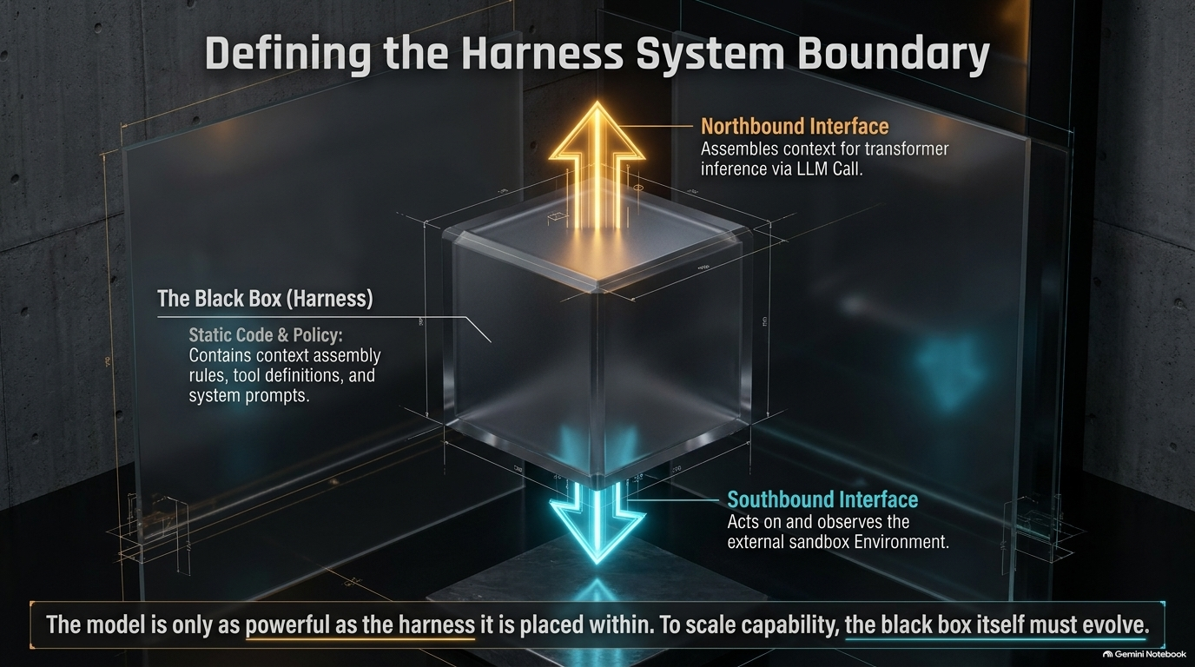
Notes:
Slide Title: Defining the Harness System Boundary
Estimated Speaking Time: 3.5 – 4 minutes
Key Visual Elements: A cube diagram representing the 'Black Box' harness, showing a Northbound Interface (LLM Call) and a Southbound Interface (Sandbox Environment).
Speaker Script / Notes:
"What exactly is a harness? Let's strip away the confusion. A harness is fundamentally a black box with two primary interfaces:
The Northbound Interface: This assembles context, memory, and instructions to package a request for the transformer inference engine (the LLM call).
The Southbound Interface: This acts upon and observes the external sandbox environment.
Everything else inside that black box is Policy. As the bottom quote emphasizes: The model is only as powerful as the harness it is placed within. To scale capability, the black box itself must evolve. If our harness is static, our agent's capability is permanently capped."

Slide 4
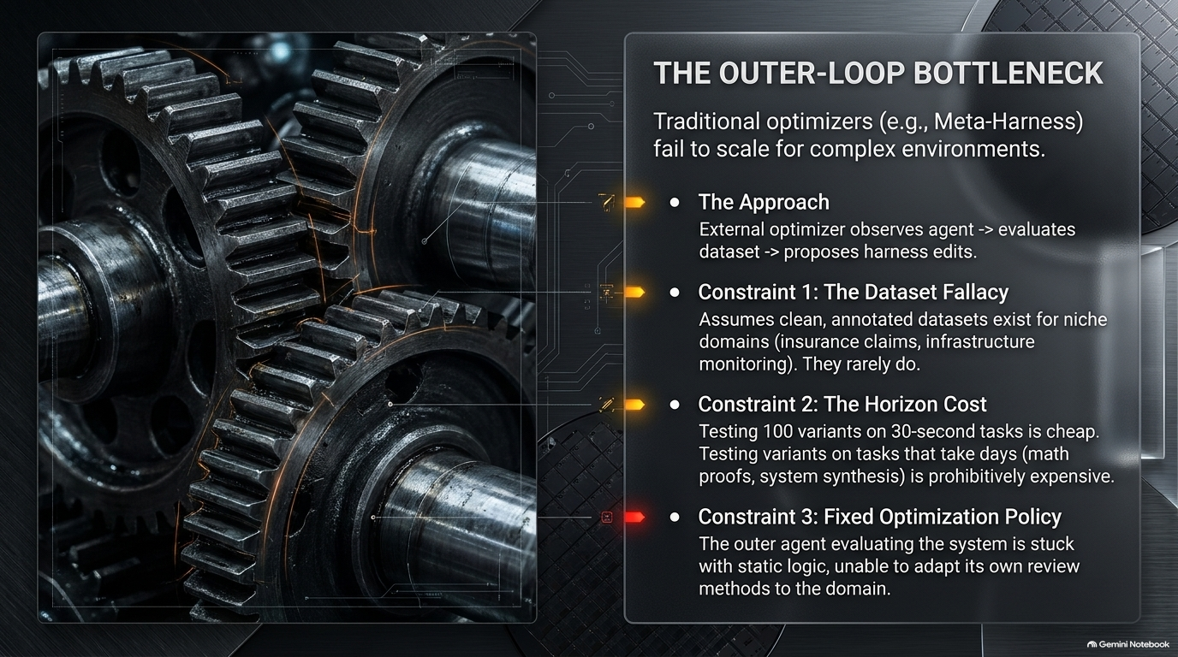
Notes:
Slide Title: The Outer-Loop Bottleneck
Estimated Speaking Time: 3.5 – 4 minutes
Key Visual Elements: Interlocking industrial gears representing mechanical friction, paired with text detailing optimization constraints.
Speaker Script / Notes:
"Up until now, people trying to optimize agent performance have relied on external 'meta-harness' optimizers. An external script watches the agent, evaluates a dataset, and proposes code edits. But this approach hits three severe walls:
Constraint 1: The Dataset Fallacy. It assumes clean, well-annotated datasets exist for niche domains like insurance claims or infrastructure monitoring. They rarely do.
Constraint 2: The Horizon Cost. Testing 100 variants on a 30-second task is cheap. Testing variants on multi-day tasks—like formal math proofs or system synthesis—is prohibitively expensive.
Constraint 3: Fixed Optimization Policy. The outer loop optimizer is stuck using static logic, unable to adapt its own review methods to novel domains."

Slide 5
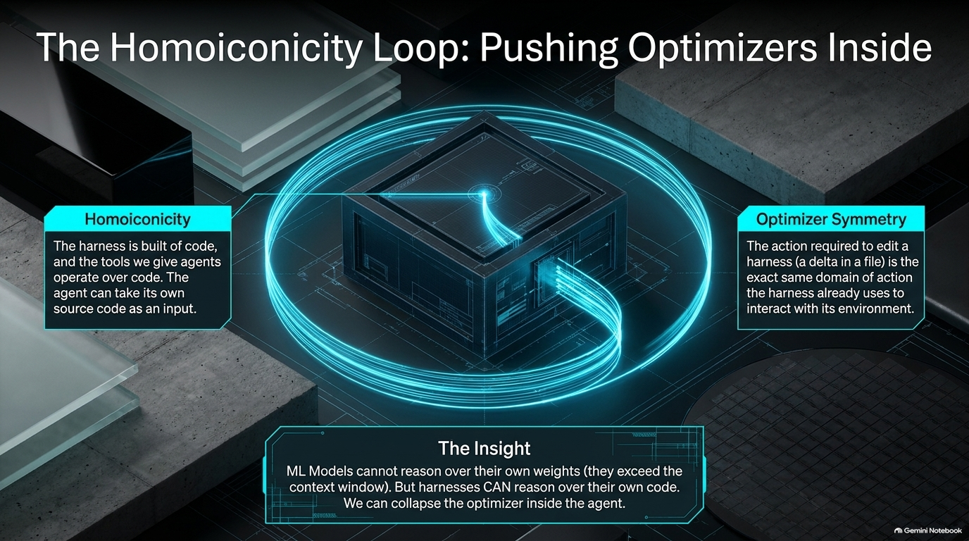
Notes:
Slide Title: The Homoiconicity Loop: Pushing Optimizers Inside
Estimated Speaking Time: 3.5 – 4 minutes
Key Visual Elements: Glowing blueprint schematic highlighting code loops folding back into the harness core.
Speaker Script / Notes:
"So how do we solve the outer-loop bottleneck? We collapse the optimizer inside the agent.
This relies on two powerful properties:
Homoiconicity: The harness is built of code, and the tools we give agents (like file editors and LSPs) operate over code. Unlike neural network weights—which are far too large for a model to reason over directly—the source code of a harness can fit into an LLM's context window.
Optimizer Symmetry: The action required to edit a harness (modifying a file) is in the exact same domain as the actions the harness already takes to interact with its environment.
Because the agent can read and write code, it can act as its own optimizer."

Slide 6
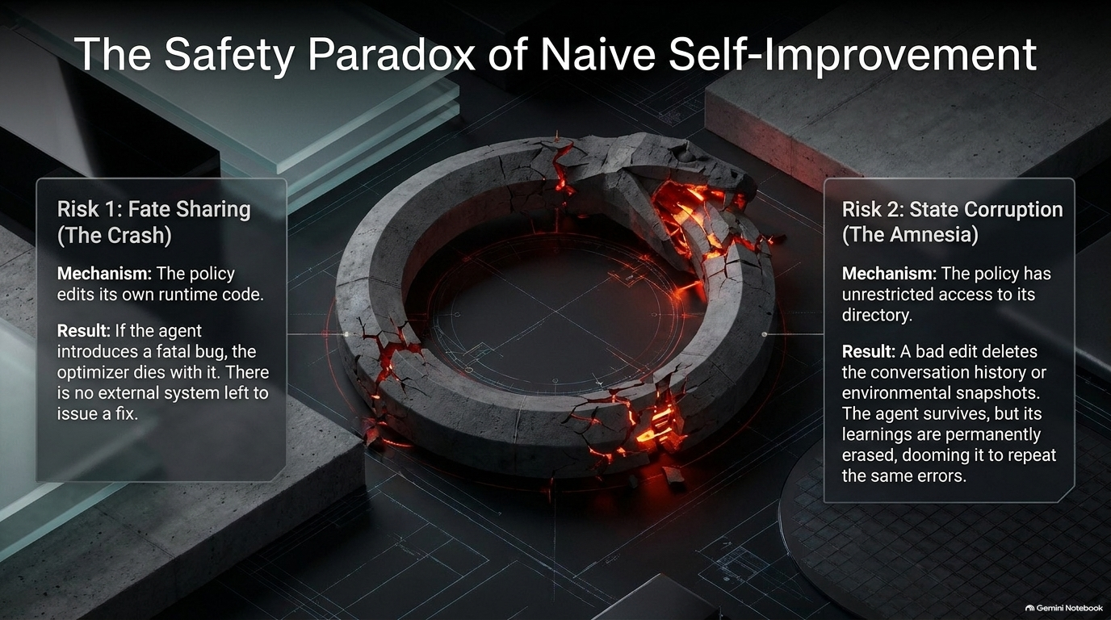
Notes:
Slide Title: The Safety Paradox of Naive Self-Improvement
Estimated Speaking Time: 3.5 – 4 minutes
Key Visual Elements: An Ouroboros snake symbol cracked and glowing red, illustrating catastrophic failure modes.
Speaker Script / Notes:
"Allowing an agent to edit its own runtime code introduces two terrifying risks if done naively:
Risk 1: Fate Sharing (The Crash). If the policy edits its own runtime code and introduces a fatal bug, the optimizer dies with it. There is no external system left to issue a fix.
Risk 2: State Corruption (The Amnesia). If the policy has unconstrained file system access, a bad edit might accidentally wipe out conversation history, memory logs, or environment snapshots. The agent might survive the syntax error, but its learnings are permanently erased, dooming it to repeat the exact same mistakes."

Slide 7
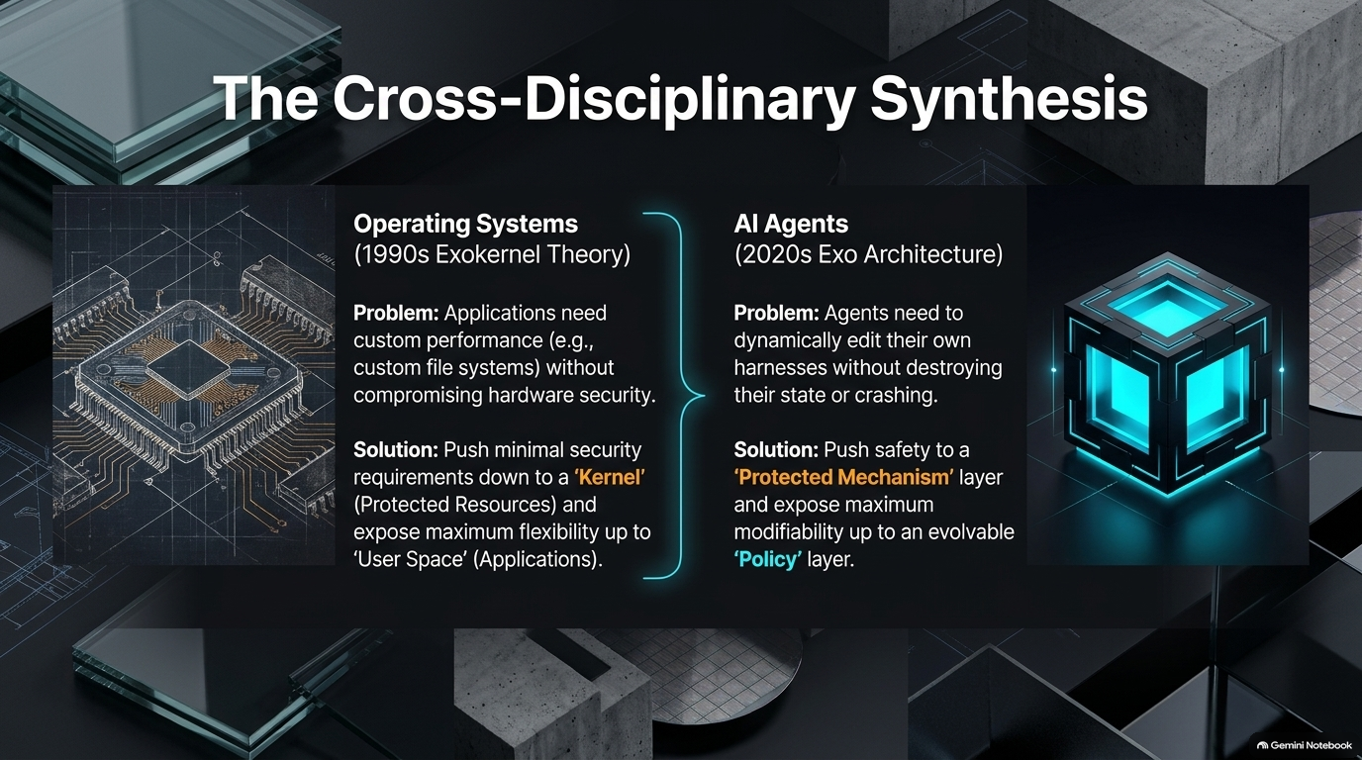
Notes:
Slide Title: The Cross-Disciplinary Synthesis
Estimated Speaking Time: 4 – 4.5 minutes
Key Visual Elements: Split screen contrasting 1990s OS microkernel/exokernel architecture chips with modern AI agent blocks.
Speaker Script / Notes:
"To solve this safety paradox, we didn't invent something brand-new; we looked at decades of computer science history. In the 1990s, operating systems faced the exact same dilemma. Applications wanted custom performance and custom file systems, but giving them raw kernel access compromised hardware security.
The Exokernel architecture ( pioneered by Engler et al. at MIT) solved this by pushing minimal security requirements down into an immutable Kernel (Protected Resources) while exposing maximum flexibility up into User Space (Applications).
We apply the exact same synthesis to AI agents: push safety and state to a protected mechanism layer, and expose maximum modifiability up to an evolvable policy layer."

Slide 8
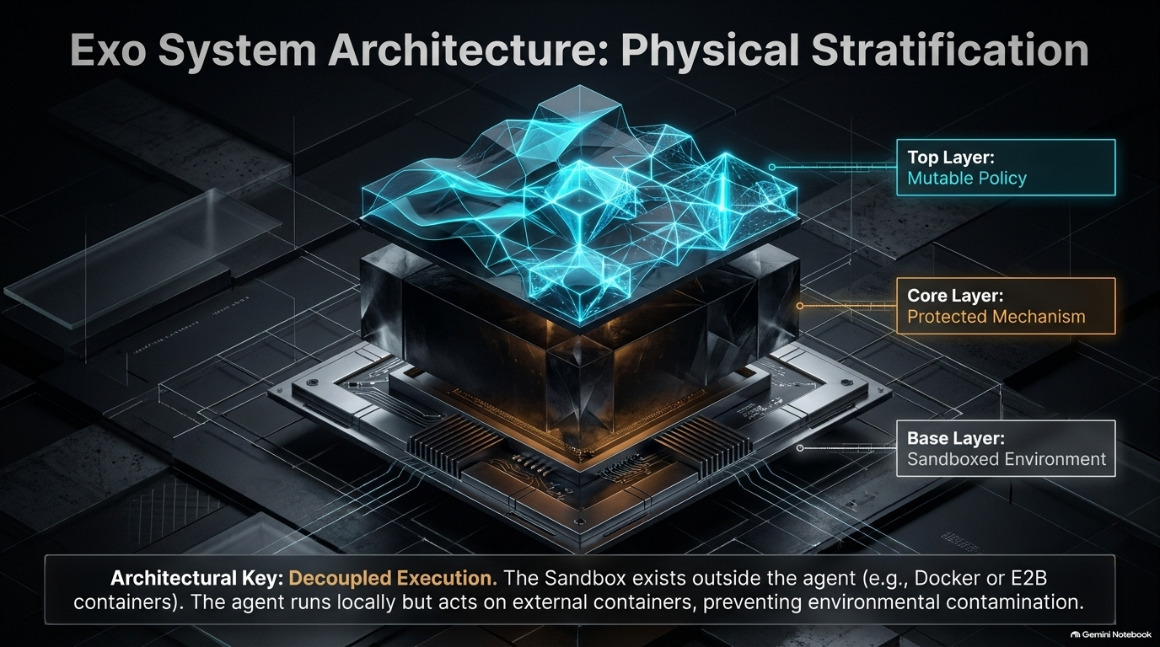
Notes:
Slide Title: Exo System Architecture: Physical Stratification
Estimated Speaking Time: 4 – 4.5 minutes
Key Visual Elements: 3D layered block diagram showing the Base Layer (Sandboxed Environment), Core Layer (Protected Mechanism), and Top Layer (Mutable Policy).
Speaker Script / Notes:
"Here is how the physical stratification of the Exo architecture is laid out:
Base Layer (Sandboxed Environment): The execution sandbox (Docker, E2B, or Firecracker containers) exists completely outside the agent process, preventing environmental contamination.
Core Layer (Protected Mechanism): Houses core state, history, and verification guards.
Top Layer (Mutable Policy): The dynamic workspace where prompt templates, context assembly rules, and domain-specific tools live and evolve.
By decoupling execution, the agent runs locally or in a control plane, but acts securely on isolated external containers."

Slide 9
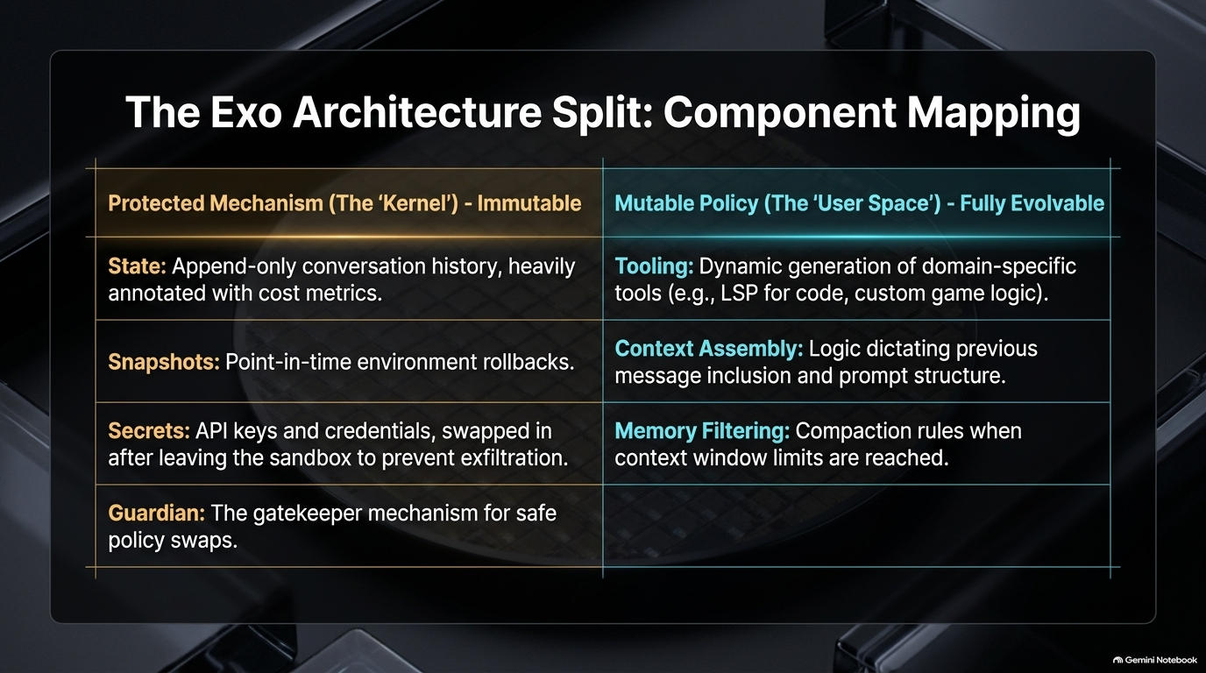
Notes:
Slide Title: The Exo Architecture Split: Component Mapping
Estimated Speaking Time: 4 – 4.5 minutes
Key Visual Elements: A structured architectural comparison table dividing components into immutable and fully evolvable spaces.
Speaker Script / Notes:
"Let's look at the exact component mapping of this split:
The Protected Mechanism (The 'Kernel' - Immutable): Contains our append-only conversation history (heavily annotated with cost metrics), point-in-time environment snapshots, isolated API keys and credentials (swapped out dynamically to prevent exfiltration), and the Guardian gatekeeper.
The Mutable Policy (The 'User Space' - Fully Evolvable): Contains dynamic tooling (like LSPs or custom game logic), context assembly logic, and memory filtering compaction rules.
The model can freely rewrite its policy layer, but it can never directly touch the kernel-protected state or secrets."

Slide 10
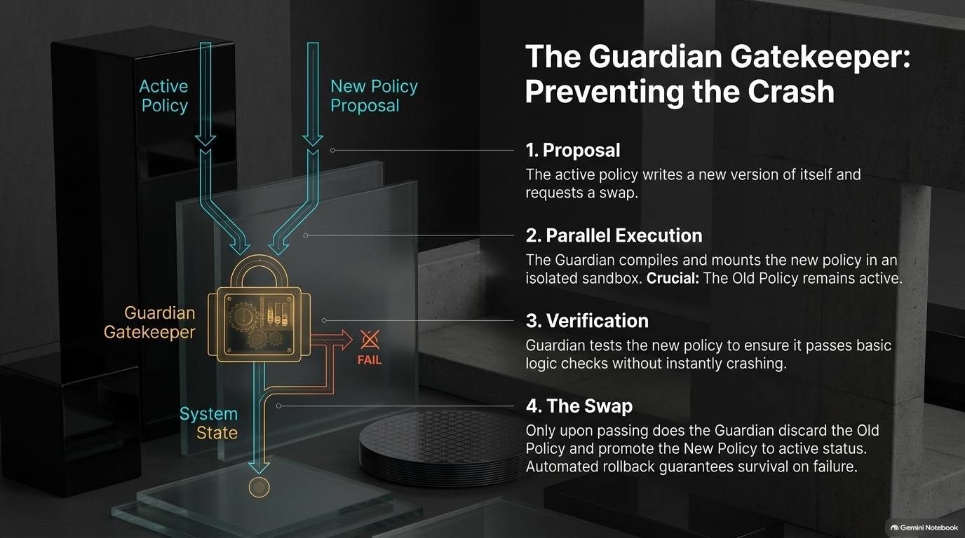
Notes:
Slide Title: The Guardian Gatekeeper: Preventing the Crash
Estimated Speaking Time: 4.5 – 5 minutes
Key Visual Elements: A secure vault lock diagram with workflow steps (Proposal, Parallel Execution, Verification, The Swap).
Speaker Script / Notes:
"How do we safely execute a policy change without triggering 'Fate Sharing'? We introduce the Guardian Gatekeeper:
Proposal: The active policy writes a new version of itself and requests a hot-swap.
Parallel Execution: The Guardian compiles and mounts the new policy in an isolated sandbox. Crucial: The old policy remains active and untouched.
Verification: The Guardian tests the new policy against basic logic checks or test tasks to ensure it doesn't instantly crash.
The Swap: Only upon passing verification does the Guardian discard the old policy and promote the new one. Automated rollbacks guarantee survival on failure."

Slide 11
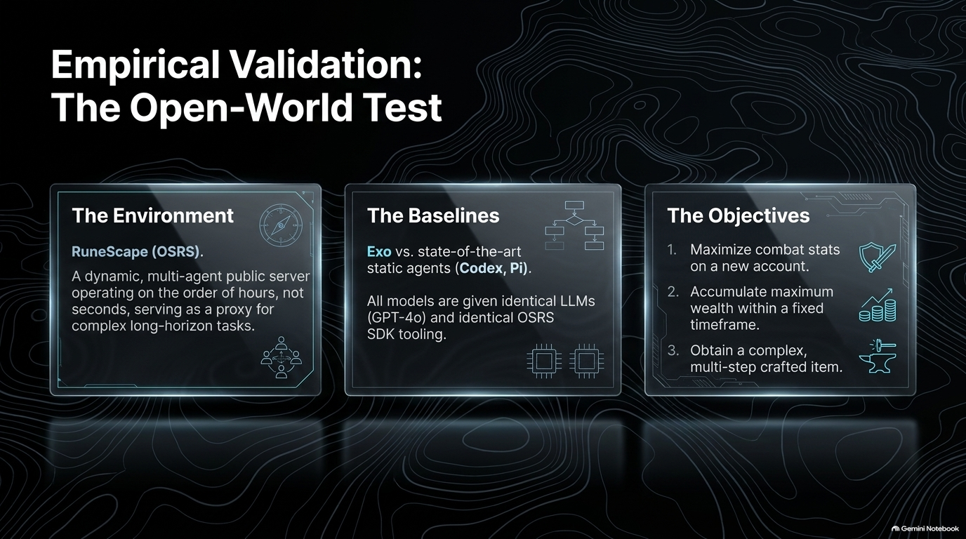
Notes:
Slide Title: Empirical Validation: The Open-World Test
Estimated Speaking Time: 4 – 4.5 minutes
Key Visual Elements: Three glass panels outlining the OSRS Runescape environment, Codex/Pi baselines, and core objectives.
Speaker Script / Notes:
"To prove this architecture works in the wild, we tested Exo beyond static academic benchmarks. We deployed it in Old School RuneScape (OSRS)—a dynamic, multi-agent public server operating over hours and days.
We pitted Exo against state-of-the-art static agents like Codex and Pi, giving all models identical LLMs (GPT-4o) and identical SDK tooling. The objectives were challenging: maximize combat stats on a new account, accumulate wealth within a fixed timeframe, and craft complex multi-step items."

Slide 12
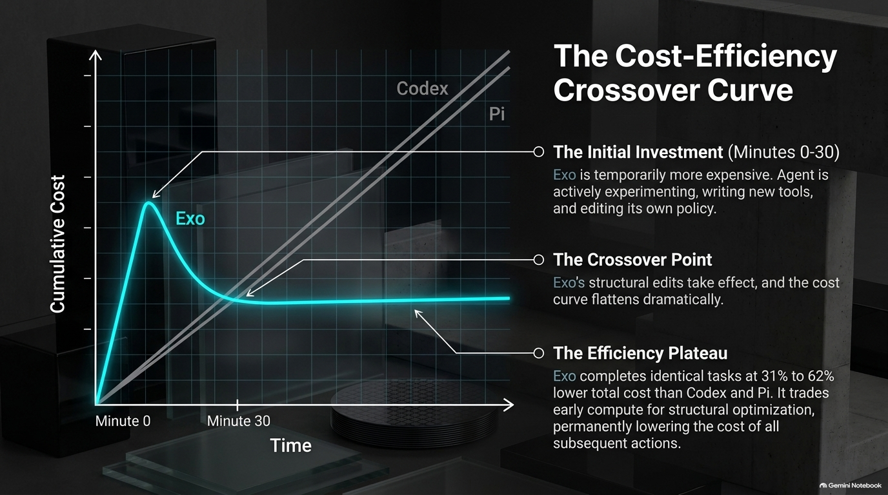
Notes:
Slide Title: The Cost-Efficiency Crossover Curve
Estimated Speaking Time: 4.5 – 5 minutes
Key Visual Elements: Line graph charting cumulative cost over time, highlighting the initial investment spike, crossover point, and efficiency plateau.
Speaker Script / Notes:
"The results were striking. Initially, Exo is more expensive during the first 30 minutes. Why? Because the agent is actively experimenting, writing new tools, and editing its own policy.
However, once structural edits take effect at the Crossover Point, Exo's cost curve flattens dramatically. Across identical open-world tasks, Exo completed tasks at a 31% to 62% lower total cost than Codex and Pi. It trades early compute for structural optimization, permanently lowering the cost of all subsequent actions."

Slide 13
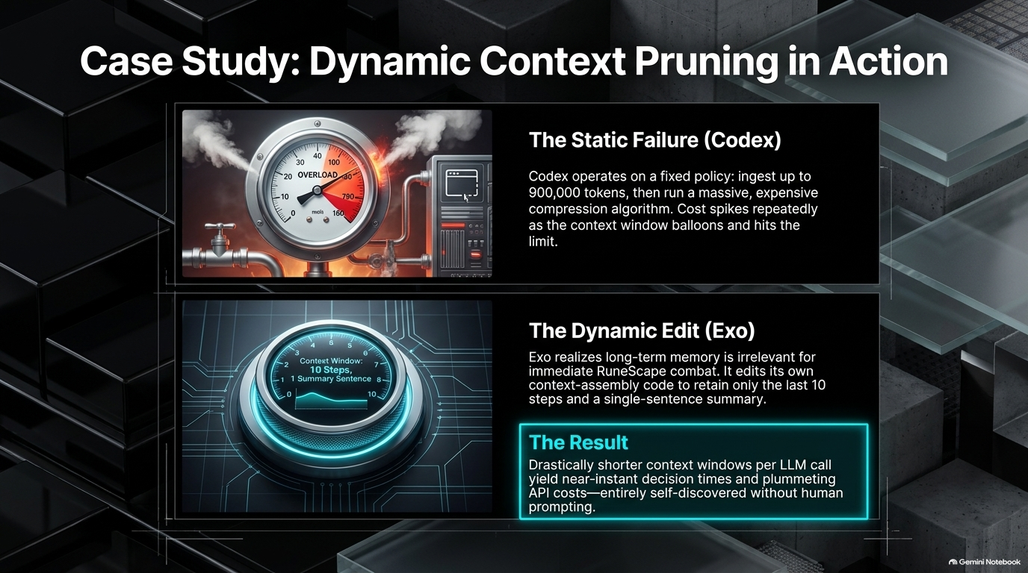
Notes:
Slide Title: Case Study: Dynamic Context Pruning in Action
Estimated Speaking Time: 4 – 4.5 minutes
Key Visual Elements: Split screen contrasting a stressed industrial pressure valve (Static Failure) with a sleek digital gauge (Dynamic Edit).
Speaker Script / Notes:
"Let's look at why this cost reduction happens.
Under a Static Failure (Codex), the agent operates on a fixed policy: ingest up to 900,000 tokens, then run an expensive compression algorithm. Cost spikes repeatedly as context balloons.
Under a Dynamic Edit (Exo), the agent realizes long-term history is irrelevant for immediate combat. It dynamically edits its own context-assembly code to retain only the last 10 steps and a single-sentence summary. Shorter context windows yield near-instant decision times and plummeting API costs—discovered entirely on its own without human intervention."

Slide 14
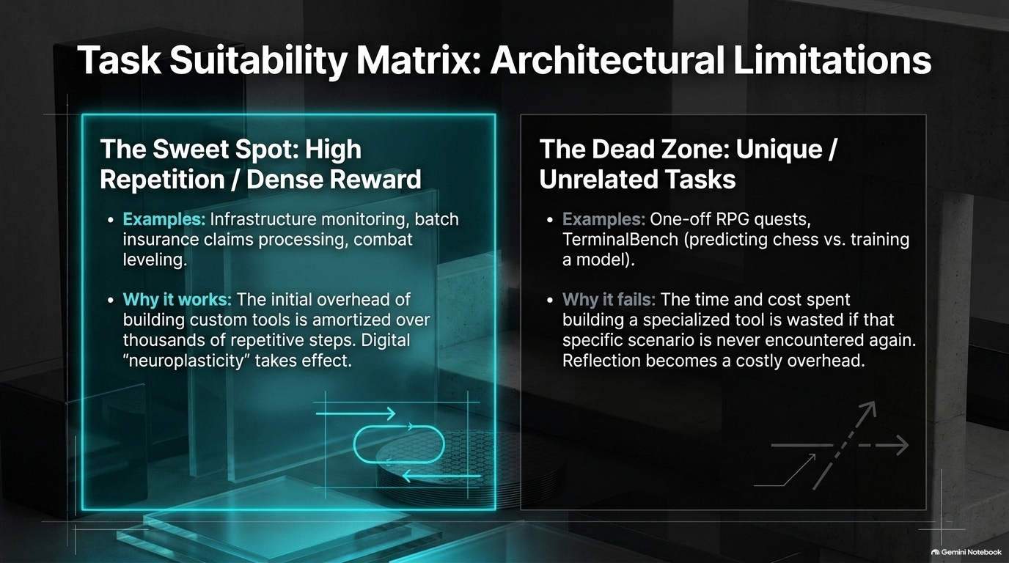
Notes:
Slide Title: Task Suitability Matrix: Architectural Limitations
Estimated Speaking Time: 4 – 4.5 minutes
Key Visual Elements: Two comparative zones: 'The Sweet Spot' (High Repetition/Dense Reward) vs. 'The Dead Zone' (Unique/Unrelated Tasks).
Speaker Script / Notes:
"As rigorous researchers, we must also examine where this architecture fails.
The Sweet Spot: High-repetition environments like infrastructure monitoring, batch insurance processing, or combat leveling. Here, the initial overhead of building custom tools is amortized over thousands of repetitive steps. Digital neuroplasticity takes effect.
The Dead Zone: One-off RPG quests or benchmarks like TerminalBench (where tasks jump randomly from predicting chess moves to training models). If a specialized tool is never used again, reflection becomes a wasted overhead."

Slide 15
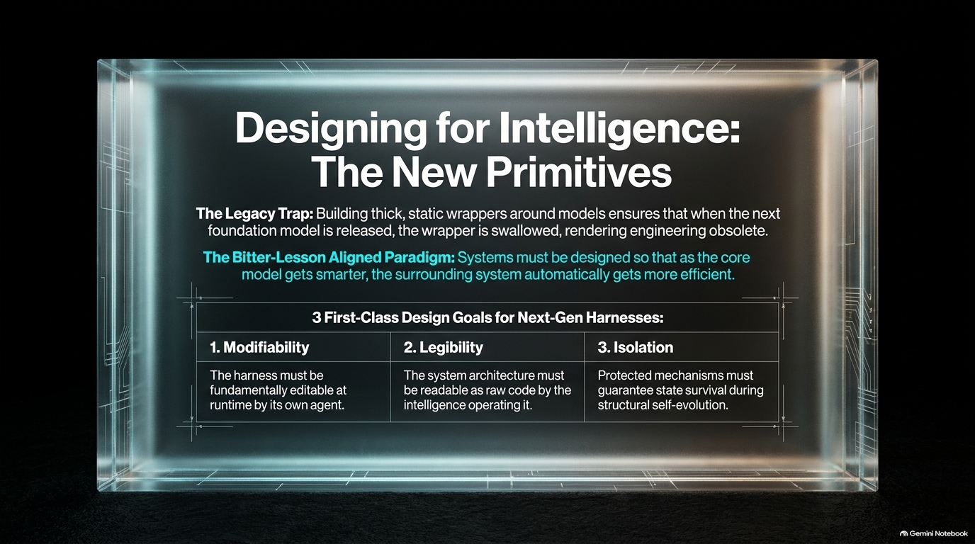
Notes:
Slide Title: Designing for Intelligence: The New Primitives
Estimated Speaking Time: 3.5 – 4 minutes
Key Visual Elements: A structured table displaying three design goals: Modifiability, Legibility, and Isolation.
Speaker Script / Notes:
"To align with the Bitter Lesson, we must move away from the legacy trap of building thick, static wrappers that get swallowed by the next foundation model release. Instead, our systems must become more efficient as core models get smarter.
This requires three first-class design goals for next-generation harnesses:
Modifiability: The harness must be fundamentally editable at runtime by its own agent.
Legibility: System architecture must be readable as raw code by the intelligence operating it.
Isolation: Protected mechanisms must guarantee state survival during structural self-evolution."

Slide 16
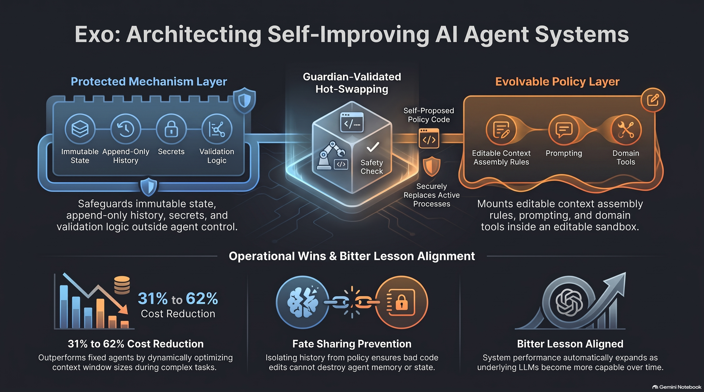
Notes:
Slide Title: Exo: Architecting Self-Improving AI Agent Systems
Estimated Speaking Time: 3 – 3.5 minutes
Key Visual Elements: Summary schematic uniting the Protected Mechanism Layer, Guardian Hot-Swapping, and Evolvable Policy Layer, alongside GitHub repository references.
Speaker Script / Notes:
"To wrap up: by treating agent harnesses through the lens of 1990s Exokernel theory, we can successfully unlock runtime self-improvement without risking system crashes or memory amnesia.
We achieve a 31% to 62% cost reduction, prevent fate sharing through rigorous kernel isolation, and ensure our systems align with the Bitter Lesson.
The code is fully open-source and available on GitHub at [github.com/exoharness/exo](https://github.com/exoharness/exo). Thank you for your time, and I'd love to open the floor for your questions!"

