Slide 1
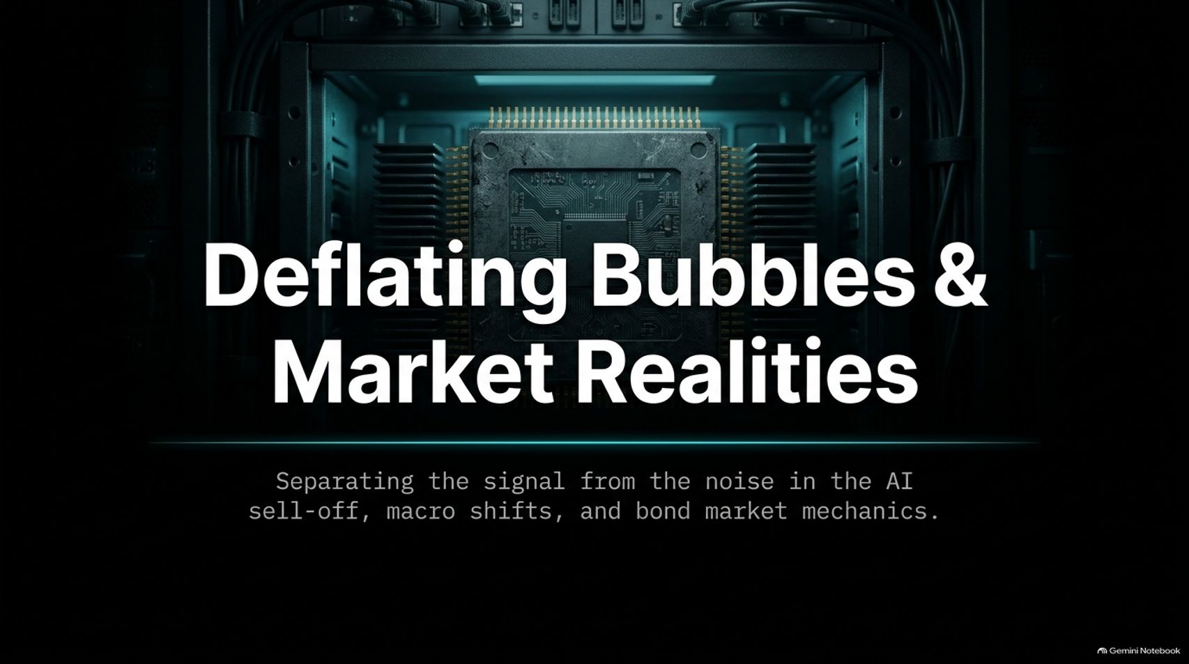
Notes:
Estimated Delivery Time: 2 – 3 minutes
Speaker Notes:
Welcome everyone, and thank you for joining. Today, we are tackling a critical theme that has dominated financial discussions: "Deflating Bubbles & Market Realities: Separating the signal from the noise in the AI sell-off, macro shifts, and bond market mechanics."
As we've seen recently, market panics tend to grab the headlines, especially when multi-trillion-dollar juggernauts like Nvidia experience sharp corrections. But as long-term investors, our job is to look past the media hysteria and examine the fundamental mechanics driving these asset classes.
Over the next few minutes, we will break down why concentrated tech narratives unravel, how broad global diversification protects your capital, and what macro shifts in bond yields and corporate debt actually mean for your portfolio strategy. Let’s dive in.
Is the AI Bubble Popping? Market Sell-off & Live Q&A
https://www.youtube.com/watch?v=SDd2xaXuhao

Slide 2
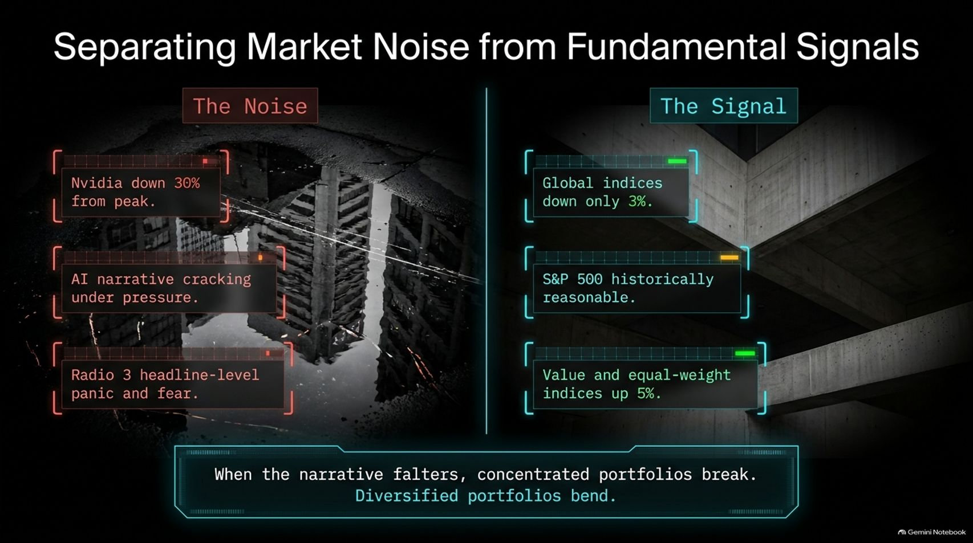
Notes:
Estimated Delivery Time: 3 – 4 minutes
Speaker Notes:
Let's start by distinguishing between what is mere market noise and what represents a true structural signal.
On the left side of the slide, we see "The Noise": headlines screaming that Nvidia has plummeted 30% from its peak, that the entire AI narrative is cracking under pressure, and panic spreading across general media channels—even making it into classical music broadcasts like Radio 3! As I often joke, when financial distress reaches the Radio 3 morning news reader, you know public anxiety is hitting a peak.
But look at the right side—"The Signal": Broad global indices are down a modest 3%, the S&P 500's forward valuation remains historically reasonable, and value or equal-weight indices are actually up 5%.
The underlying takeaway here is vital: When the narrative falters, concentrated portfolios break, but diversified portfolios merely bend. Understanding this distinction is the cornerstone of surviving market volatility.

Slide 3
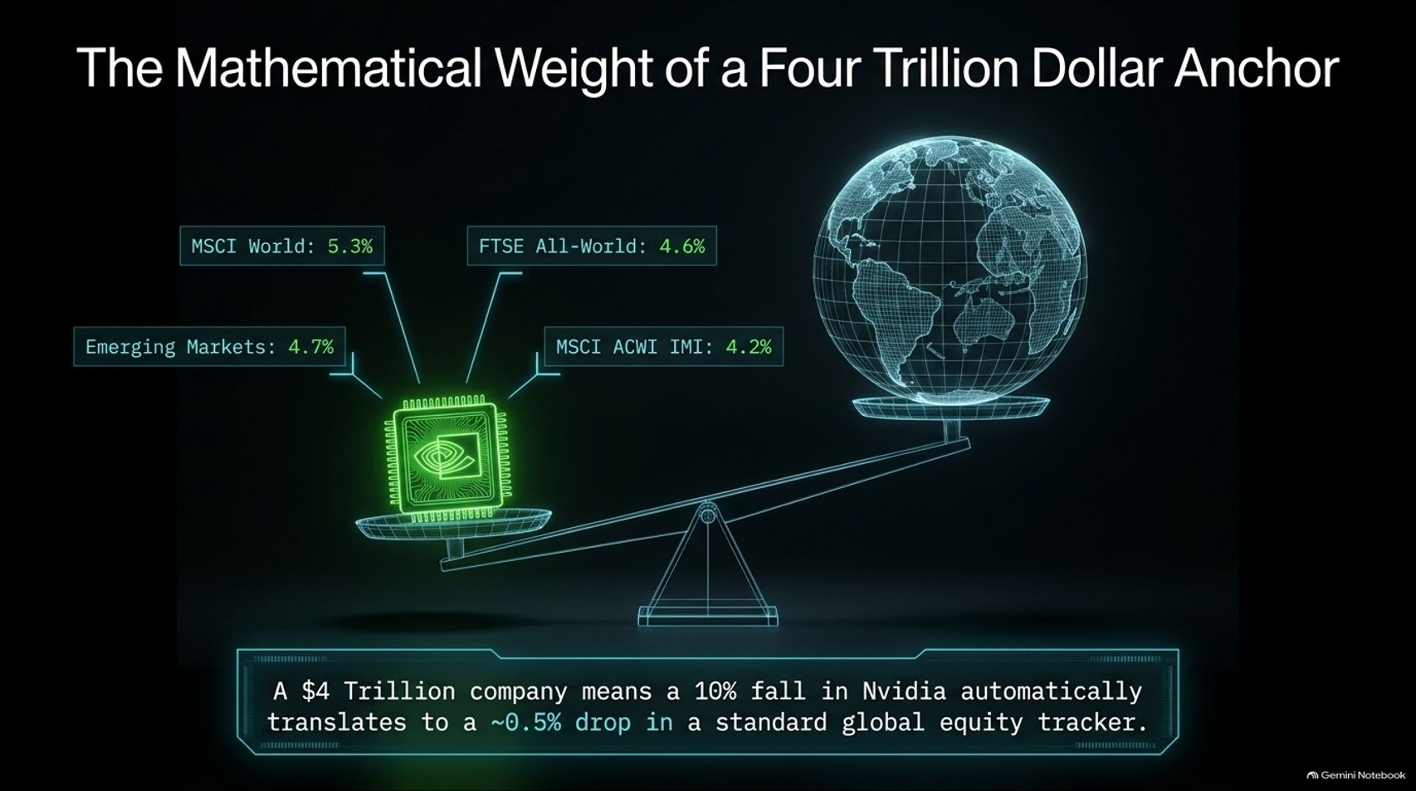
Notes:
Estimated Delivery Time: 3 – 5 minutes
Speaker Notes:
Why does Nvidia command so much attention? Because mathematically, it acts as a massive anchor for global equities.
If you hold a standard global index fund or a pension fund, chances are you own a substantial slug of Nvidia simply due to its immense market capitalization. As shown on the slide, Nvidia makes up 5.3% of the MSCI World Index, 4.7% of Emerging Markets, 4.6% of the FTSE All-World, and 4.2% of the MSCI ACWI IMI.
Because it represents between 4% and 5% of virtually every global equity benchmark, the math is inescapable: A 10% fall in Nvidia automatically translates to roughly a 0.5% drop in a standard global equity tracker.
While half a percent isn't catastrophic on its own, it explains why indiscretions or corrections in a single massive company can drag down passive indices and trigger broader market unease.

Slide 4
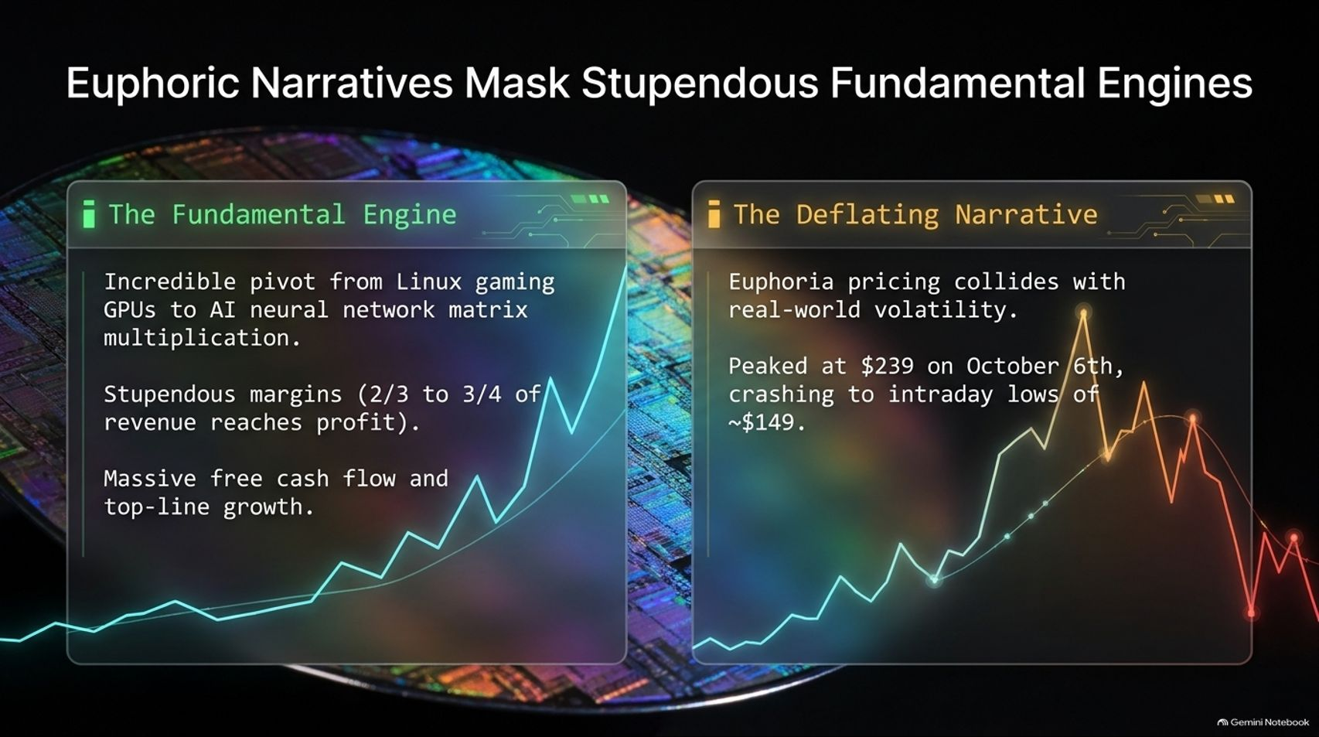
Notes:
Estimated Delivery Time: 4 – 5 minutes
Speaker Notes:
To understand Nvidia fairly, we must look at two conflicting realities: its fundamental business engine versus its deflating stock market narrative.
On one hand, The Fundamental Engine is nothing short of spectacular. I remember when Nvidia was primarily known as a niche GPU provider for Linux gaming desktops. Their pivot into AI neural network matrix multiplication was a masterclass in timing and engineering. Their operating margins are staggering—roughly two-thirds to three-quarters of every revenue dollar makes it straight to the bottom-line profit. Top-line growth and free cash flow generation have been nothing short of phenomenal.
On the other hand, we have The Deflating Narrative. Euphoria-driven pricing inevitably collides with real-world volatility. After peaking at $239 on October 6th, the stock suffered dramatic intraday crashes down toward $149 before attempting stabilization. Extraordinary fundamentals do not exempt a company from gravity when expectations reach perfection.

Slide 5
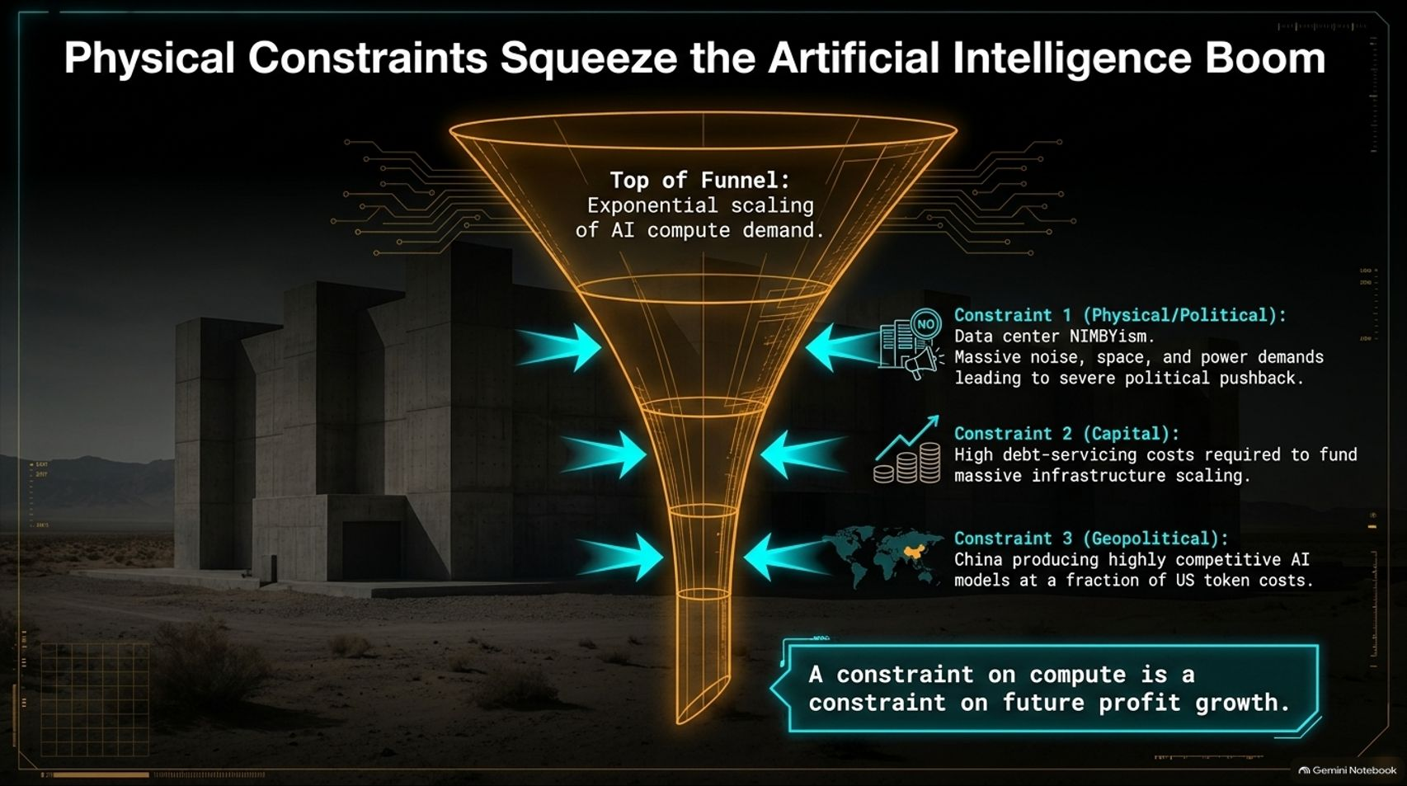
Notes:
Estimated Delivery Time: 4 – 6 minutes
Speaker Notes:
Why is the narrative deflating? Because the AI boom is running into hard physical, capital, and geopolitical constraints.
Imagine a funnel: at the top, we have exponential scaling of AI compute demand. But that demand is being squeezed by three major bottlenecks:
Physical and Political Constraints (Data Center NIMBYism): Massive noise, space, and power demands are triggering severe political pushback. As highlighted in recent reports, homeowners are suddenly finding their scenic backyard views blocked by noisy, hulking data center boxes.
Capital Constraints: Massive infrastructure scaling requires immense debt-servicing costs in a higher-rate environment.
Geopolitical Constraints: Competitors—particularly in China—are producing highly competitive AI models at a fraction of US token costs.
The core lesson: A constraint on compute is a direct constraint on future profit growth. Markets are finally pricing in these operational realities.

Slide 6
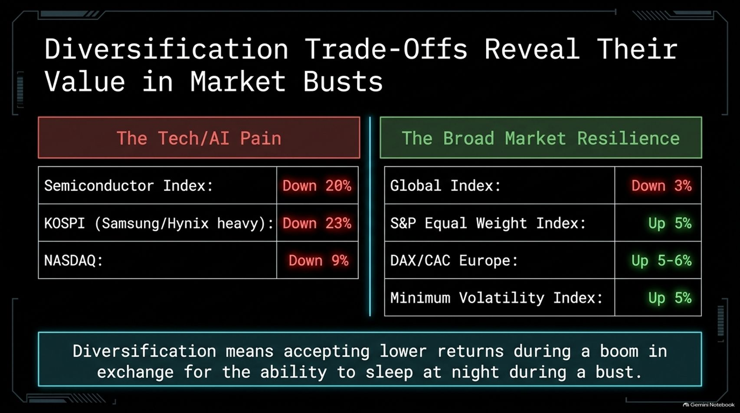
Notes:
Estimated Delivery Time: 3 – 4 minutes
Speaker Notes:
When tech and AI sectors experience severe pain, the true value of portfolio diversification becomes crystal clear.
Look at the divergence on this slide. In the tech sell-off, semiconductor indices dropped by 20% (and worse at their lows), South Korea's KOSPI—heavy on Samsung and SK Hynix hardware—slumped 23%, and the NASDAQ corrected by 9%.
Conversely, Broad Market Resilience shone brightly: global indices dipped only 3%, while the S&P Equal Weight Index, European indices (DAX/CAC), and Minimum Volatility strategies gained 5% to 6%.
As the adage goes: Diversification means accepting lower returns during a speculative boom in exchange for the ability to sleep at night during a market bust.

Slide 7
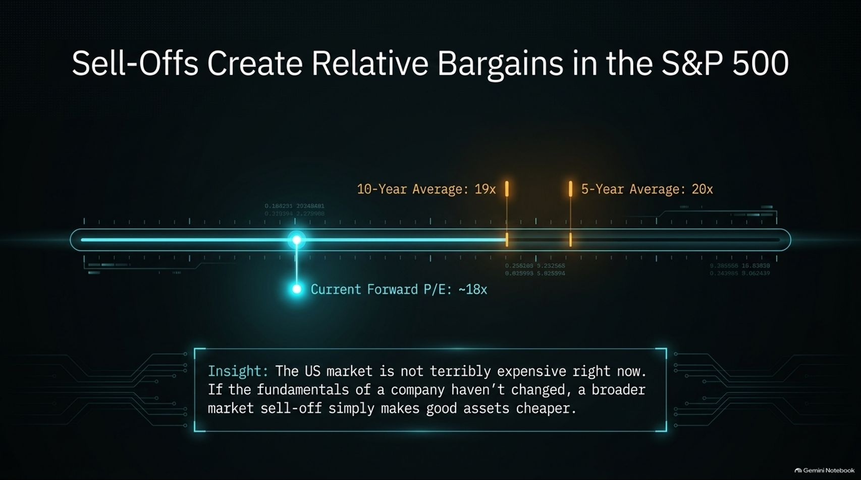
Notes:
Estimated Delivery Time: 3 – 4 minutes
Speaker Notes:
Market sell-offs naturally induce fear, but rational investors view them through the lens of valuation.
Looking at the S&P 500 forward P/E multiple timeline, we see that the index has pulled back from its highs. The 10-year average forward P/E sits around 19x, and the 5-year average is around 20x. Following the recent correction, the current forward P/E has compressed to approximately 18x.
This reveals a crucial insight: The US market is not terribly expensive right now. If the underlying fundamentals of quality companies haven't changed, a broader market sell-off simply makes good assets cheaper. Panic turns quality stocks into relative bargains.

Slide 8
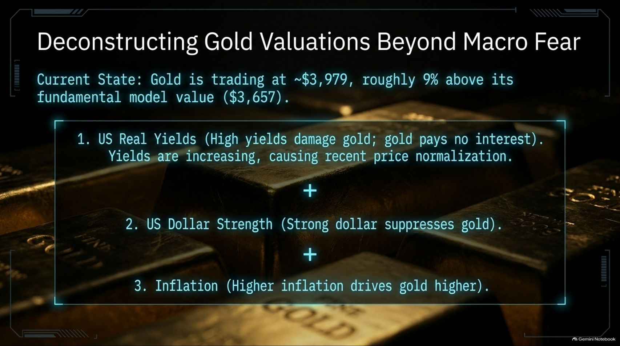

Slide 9
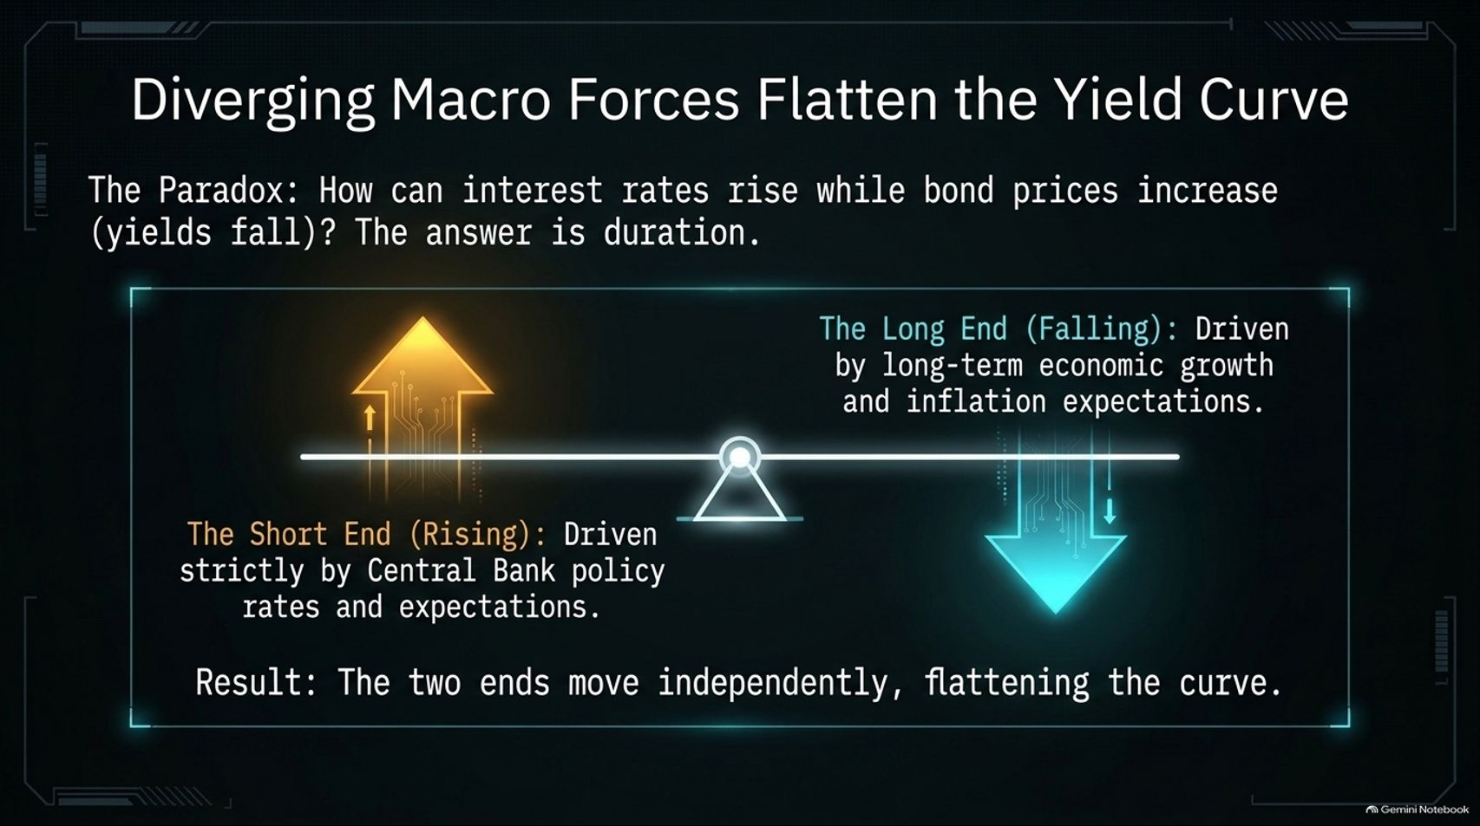
Notes:
Estimated Delivery Time: 4 – 6 minutes
Speaker Notes:
Let's address a common market paradox: How can interest rates rise while bond prices increase (yields fall)? The answer lies in duration and the shape of the yield curve.
The short end of the yield curve is driven strictly by Central Bank policy rates and near-term expectations. When central banks hike rates to fight inflation, short-term yields spike.
Meanwhile, the long end of the curve is driven by long-term economic growth and inflation expectations. When growth expectations cool, long-term yields fall, causing long-term bond prices to rise.
Because these two ends move independently, central bank tightening coupled with cooling long-term growth expectations results in a flattening yield curve. Always specify which maturity you are looking at—you cannot treat all bonds as a monolith.

Slide 10
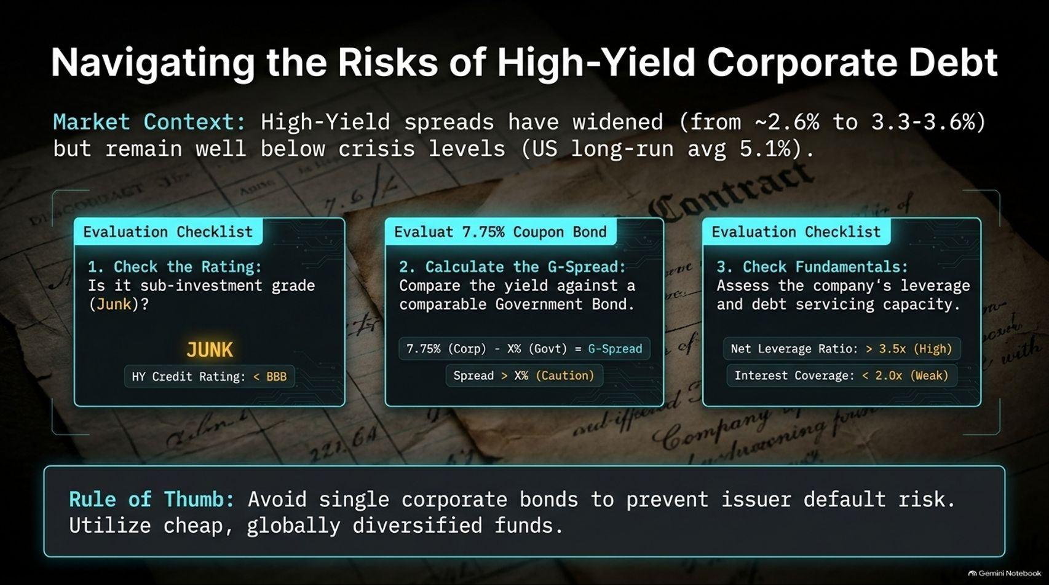
Notes:
Estimated Delivery Time: 4 – 5 minutes
Speaker Notes:
In a high-rate environment, investors often chase yield by looking at corporate bonds, but caution is warranted. High-yield credit spreads have widened from roughly 2.6% to between 3.3% and 3.6%, though they still remain well below historical crisis levels (such as the US long-run average of 5.1%).
When evaluating corporate debt, use a strict checklist:
Check the Rating: Is it sub-investment grade ("Junk" with a credit rating below BBB)?
Calculate the G-Spread: Compare the corporate bond's yield against a comparable government bond to determine if the spread adequately compensates for default risk.
Check Fundamentals: Assess the company's net leverage ratio (caution if > 3.5x) and interest coverage ratio (weakness if < 2.0x).
Rule of Thumb: Avoid single corporate bonds to prevent issuer default risk; instead, utilize low-cost, globally diversified funds to spread that credit risk across dozens of issuers.

Slide 11
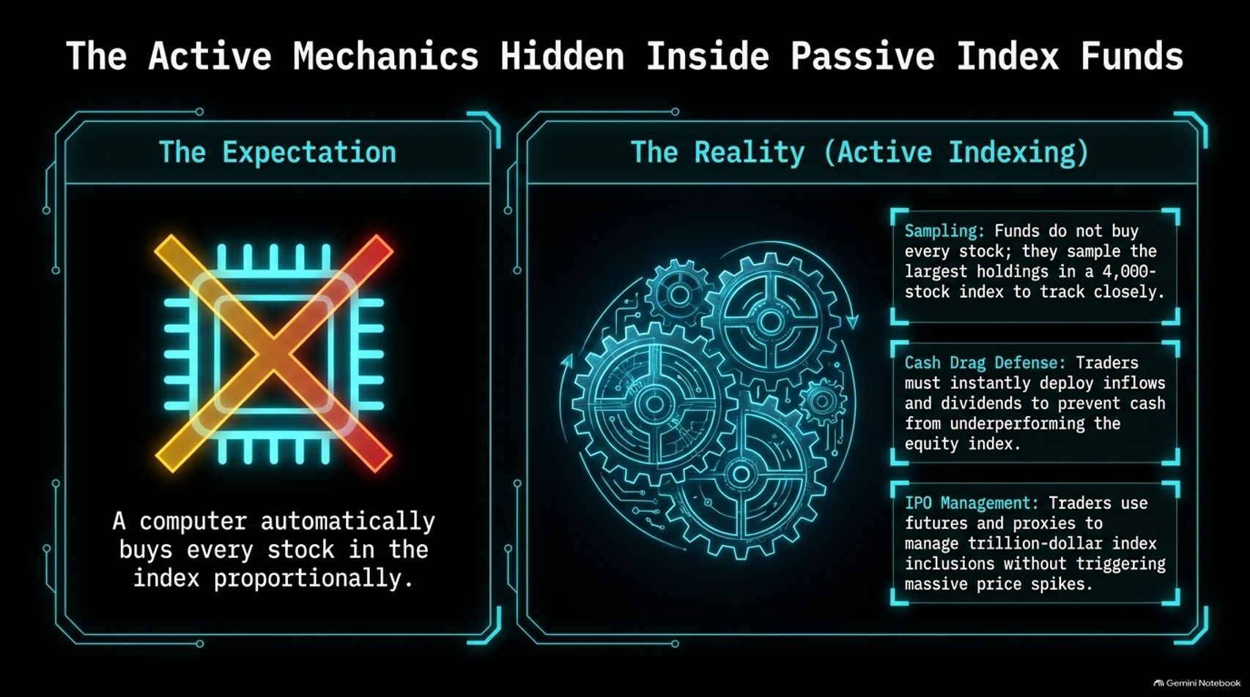
Notes:
Estimated Delivery Time: 3 – 5 minutes
Speaker Notes:
Many investors believe passive index funds are entirely automated—that a computer simply buys every stock in an index proportionally. As I discussed in my recent interview with senior Vanguard traders on the Many Happy Returns podcast, passive indexing is anything but passive.
In reality, managing large index funds requires active mechanics behind the scenes:
Sampling: Funds with thousands of underlying holdings do not buy every single small stock; they use sophisticated sampling of the largest holdings to track the index closely.
Cash Drag Defense: Portfolio managers must instantly deploy incoming cash inflows and dividends to prevent cash from dragging down performance.
IPO & Rebalance Management: Traders utilize futures, derivatives, and proxies to manage trillion-dollar index inclusions and corporate actions without triggering massive, wealth-destroying market price spikes.

Slide 12
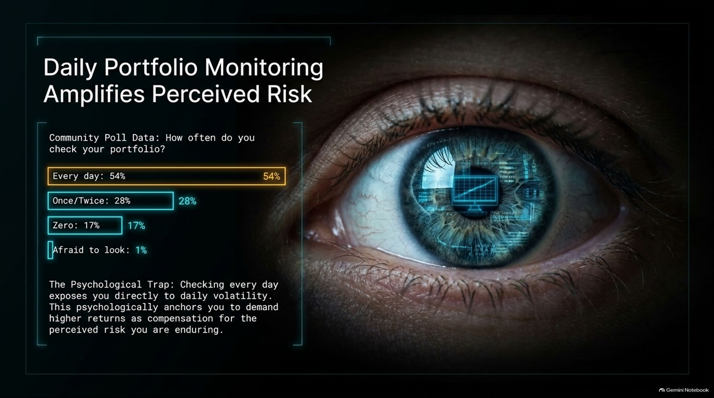
Notes:
Estimated Delivery Time: 3 – 4 minutes
Speaker Notes:
Let's look at the psychology of investing. In a recent community poll, we asked: How often do you check your portfolio?
The results were telling: 54% check every day, 28% check once or twice a week, 17% check zero times, and 1% are afraid to look. Even professional commentators admit to checking daily, though we know we shouldn't!
This exposes a major Psychological Trap: Checking your portfolio every day exposes you directly to random daily volatility. This constant exposure psychologically anchors you, causing you to demand higher expected returns as emotional compensation for the perceived risk you feel you are enduring. Checking less often is literally better for your mental health and your discipline.

Slide 13
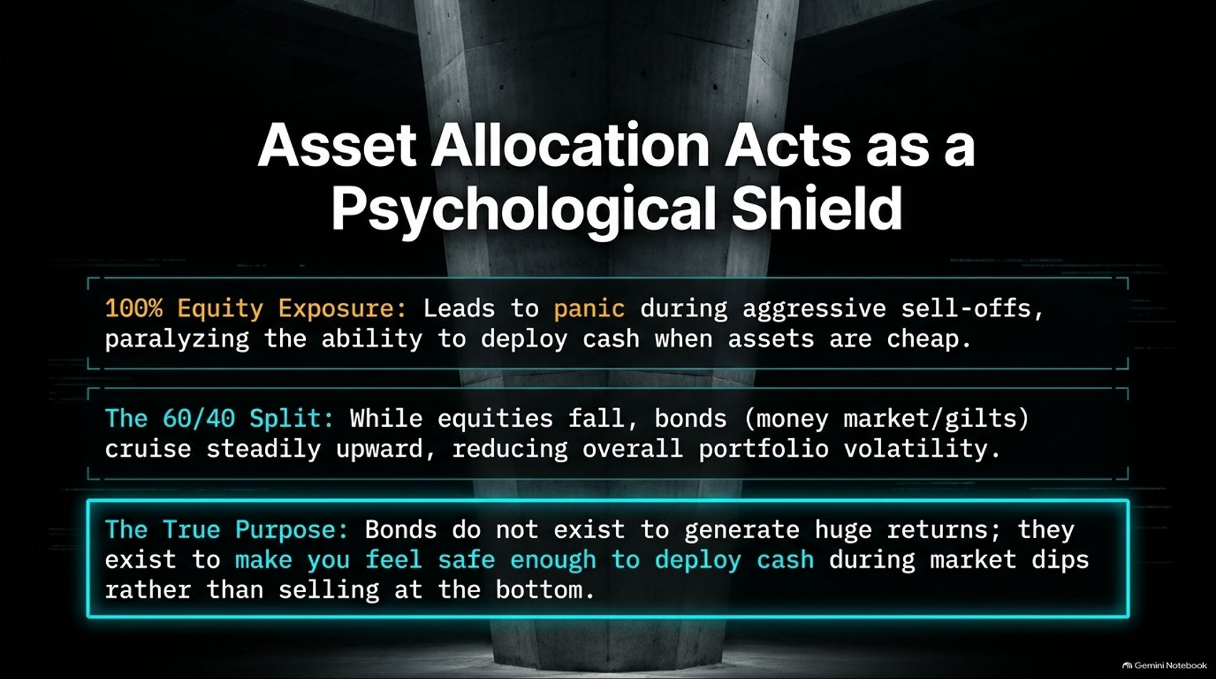
Notes:
Estimated Delivery Time: 3 – 5 minutes
Speaker Notes:
This brings us to the true purpose of asset allocation. If you maintain 100% equity exposure, aggressive market sell-offs trigger panic, paralyzing your ability to deploy cash when assets are cheap.
Conversely, a traditional 60/40 Split behaves differently. While equities experience drawdowns, high-quality bonds and money market instruments cruise steadily upward or hold their ground, dampening overall portfolio volatility.
What is the ultimate takeaway here? Bonds do not exist to generate huge speculative returns; they exist to make you feel safe enough to deploy cash during market dips rather than panic-selling at the bottom. Asset allocation is primarily a psychological shield.

Slide 14
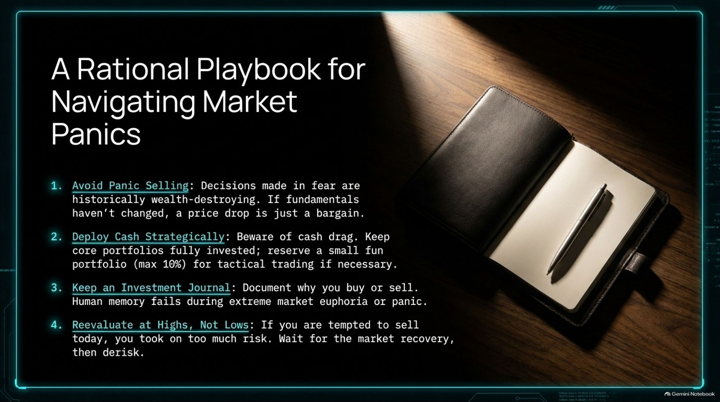
Notes:
Estimated Delivery Time: 3 – 4 minutes
Speaker Notes:
To wrap up our strategic framework, let’s review a rational playbook for navigating market panics:
Avoid Panic Selling: Decisions made in fear are historically wealth-destroying. If underlying business fundamentals haven't changed, a price drop is simply a sale.
Deploy Cash Strategically: Keep your core portfolio fully invested to avoid cash drag, reserving a small tactical allocation (maximum 10%) for opportunistic trading if desired.
Keep an Investment Journal: Document your rationale when buying or selling. Human memory fails under extreme market euphoria or panic.
Reevaluate at Highs, Not Lows: If market volatility makes you feel like selling today, it means you took on too much risk. Wait for the market to recover, then calmly derisk.

Slide 15
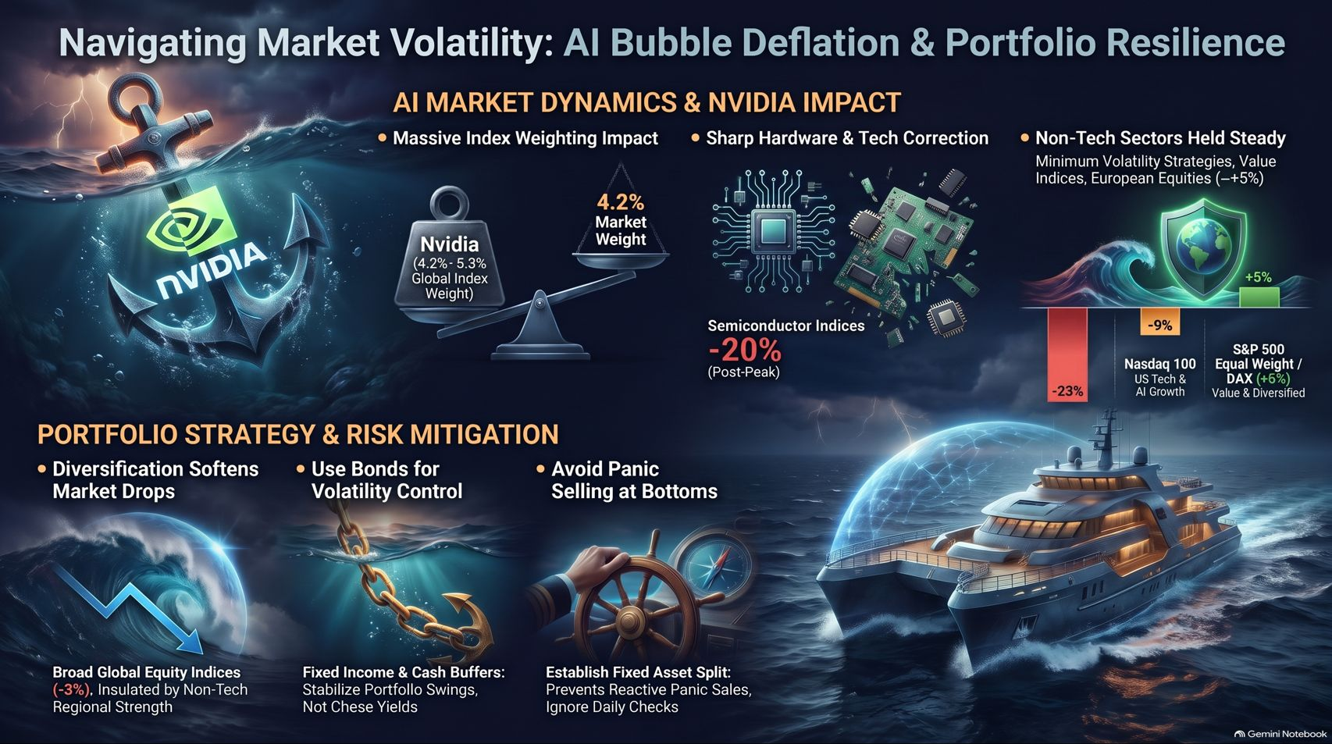
Notes:
Estimated Delivery Time: 3 – 5 minutes
Speaker Notes:
On our final slide, we synthesize our entire journey across AI market dynamics, macro forces, and portfolio resilience.
We've observed how Nvidia's massive 4% to 5% global index weighting creates a mathematical anchor during tech corrections, and how physical, capital, and geopolitical bottlenecks are deflating the hyper-optimistic AI narrative.
Yet, broader market metrics tell a balanced story: non-tech sectors, European equities, and minimum volatility strategies have held steady, proving that global diversification works.
By utilizing fixed income as a volatility stabilizer, maintaining disciplined asset splits, and refusing to sell into the teeth of a drawdown, we transform market noise into long-term opportunity. Keep calm, stay rational, and remember that market panics always blow over. Thank you!

