Slide 1
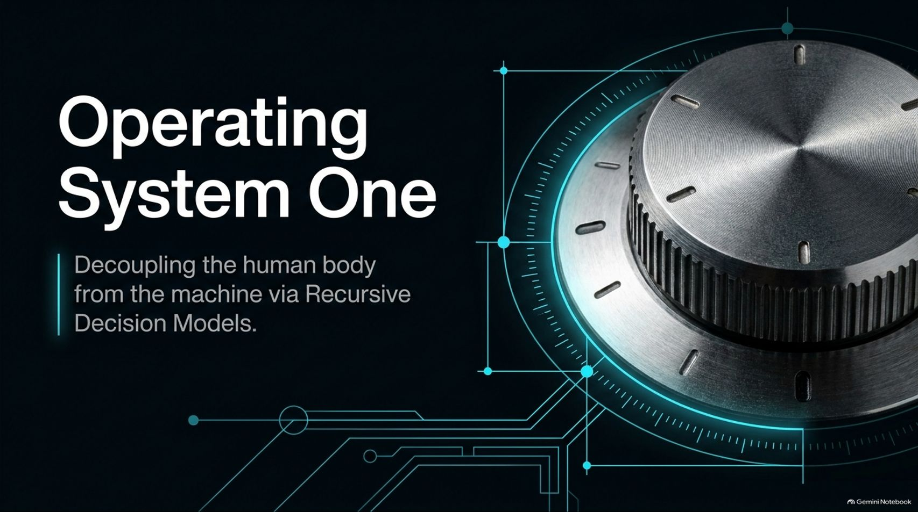
Notes:
Estimated Delivery Time: 2 – 3 minutes
Speaker Notes:
Welcome everyone. Today, we are exploring a paradigm shift in how we build AI systems and interact with our machines: "Operating System One: Decoupling the human body from the machine via Recursive Decision Models."
For decades, we have accepted a heavy physical and cognitive toll just to use computers—relying on mice, QWERTY keyboards, and slow generative text loops.
In this presentation, we are going to examine how breaking complex reasoning down into ultra-fast, microscopic decision models allows us to build agentic systems that are brutally fast, highly scalable, and fundamentally designed to let us control our computers without seeing or touching them. Let’s dive into the core architecture.
Your Agent Doesn't Need an LLM for Every Decision - Raymond Weitekamp, OpenProse
https://www.youtube.com/watch?v=hFNbPmzzcEs

Slide 2
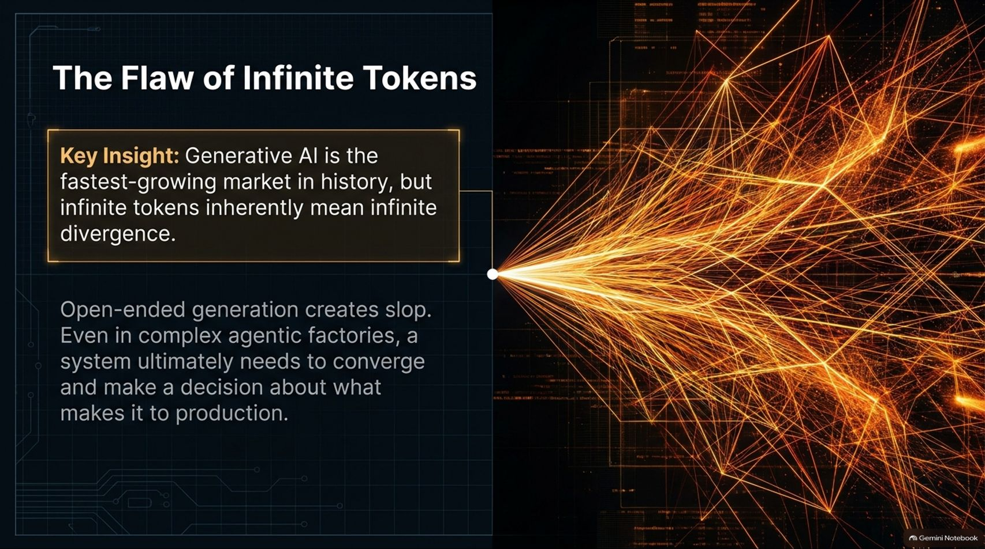
Notes:
Estimated Delivery Time: 3 – 4 minutes
Speaker Notes:
Let's start with a fundamental paradox in modern AI. Generative AI is the fastest-growing market in human history, but infinite tokens inherently mean infinite divergence.
Open-ended generation creates "slop." Even when you set up complex agentic code factories, a system ultimately needs to converge. It has to make a hard, definitive choice about what actually makes it into production.
As Raymond Weitekamp points out in our reference video, generative models can spit out endless freewheeling text, but without a mechanism for convergence, you get unbounded drift. We need an architectural counterpart to rein in that divergence.

Slide 3
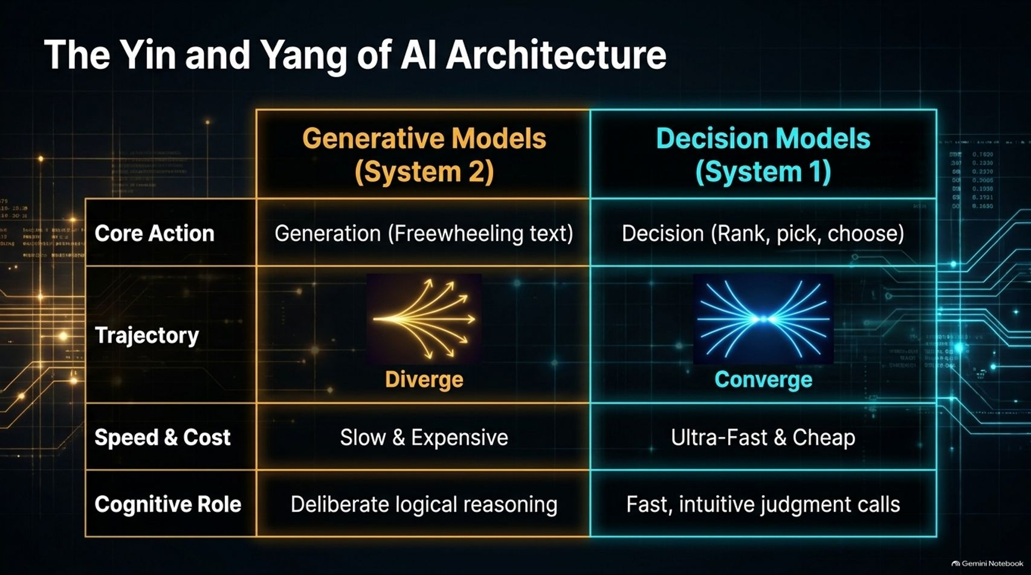
Notes:
Estimated Delivery Time: 3 – 5 minutes
Speaker Notes:
To solve this divergence, we have to look at the Yin and Yang of AI Architecture: balancing Generative Models (System 2) against Decision Models (System 1).
Think of Generative Models as System 2—they are slow, expensive, and designed for deliberate logical reasoning and open-ended text generation. Their trajectory is inherently divergent.
In direct contrast, Decision Models represent System 1—they are ultra-fast, cheap, and incapable of generating text. Their core action is to rank, pick, and choose among pre-enumerated options. Their trajectory is strictly convergent, handling fast, intuitive judgment calls. Pairing these two forces gives us a complete cognitive engine.

Slide 4
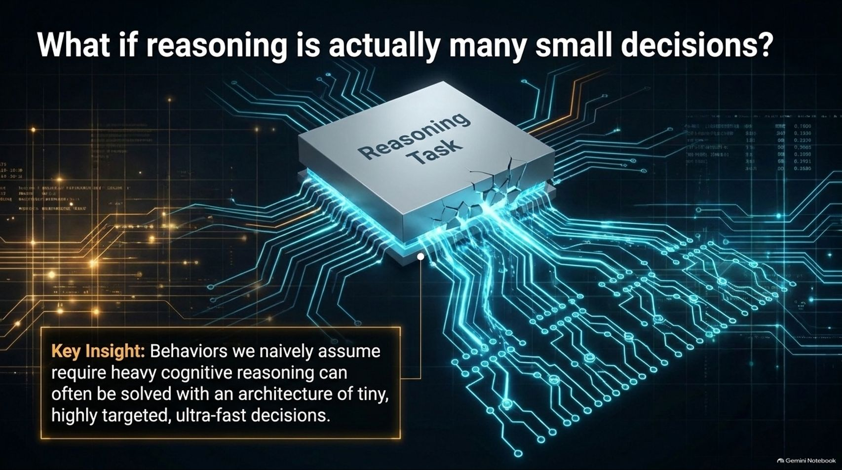
Notes:
Estimated Delivery Time: 3 – 4 minutes
Speaker Notes:
This brings us to a foundational question that drives this entire architecture: What if reasoning is actually many small decisions?
Naively, we assume that complex behaviors require heavy, expensive cognitive reasoning loops. But as we see in human psychology and advanced system design, many tasks we label as "reasoning" can actually be solved with an architecture of tiny, highly targeted, ultra-fast decisions.
By breaking a massive reasoning task down into a cascading network of microscopic choices, we bypass the latency and expense of massive LLM calls entirely.

Slide 5
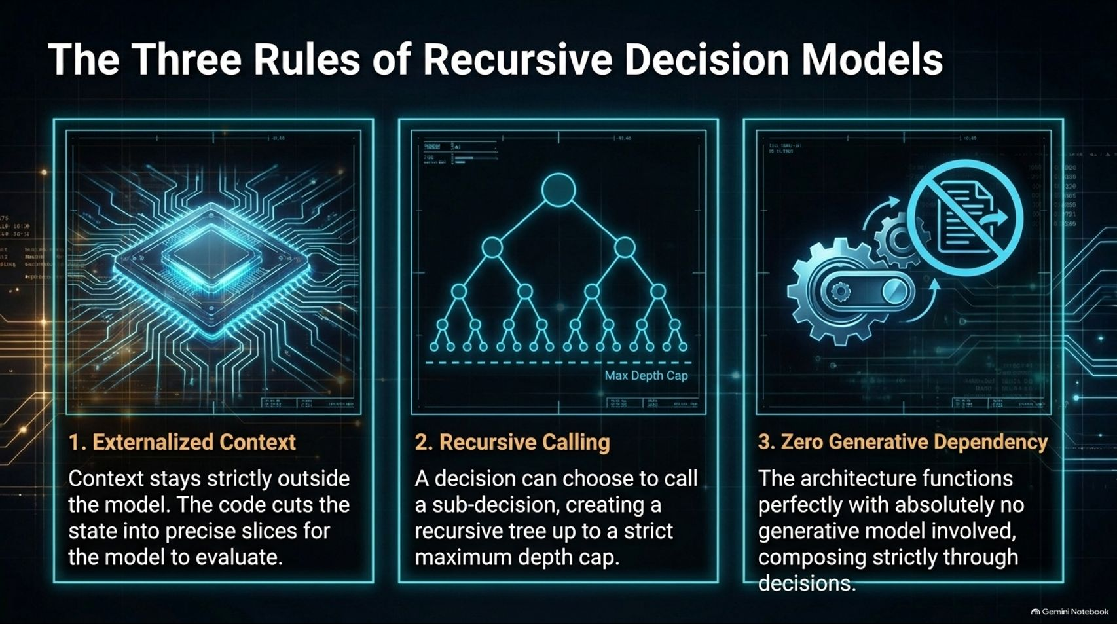
Notes:
Estimated Delivery Time: 4 – 6 minutes
Speaker Notes:
When building Recursive Decision Models (RDMs), we follow three strict foundational rules:
Externalized Context: Context stays strictly outside the model. Our code cuts the system state into precise, lightweight slices for the decision model to evaluate.
Recursive Calling: A decision can choose to call a sub-decision, building a recursive tree up to a strict maximum depth cap. This mirrors recursive language models while maintaining bounded execution.
Zero Generative Dependency: The architecture must function perfectly with absolutely no generative model involved. It composes strictly through decisions. If it can't work without generation, the architecture isn't pure.

Slide 6
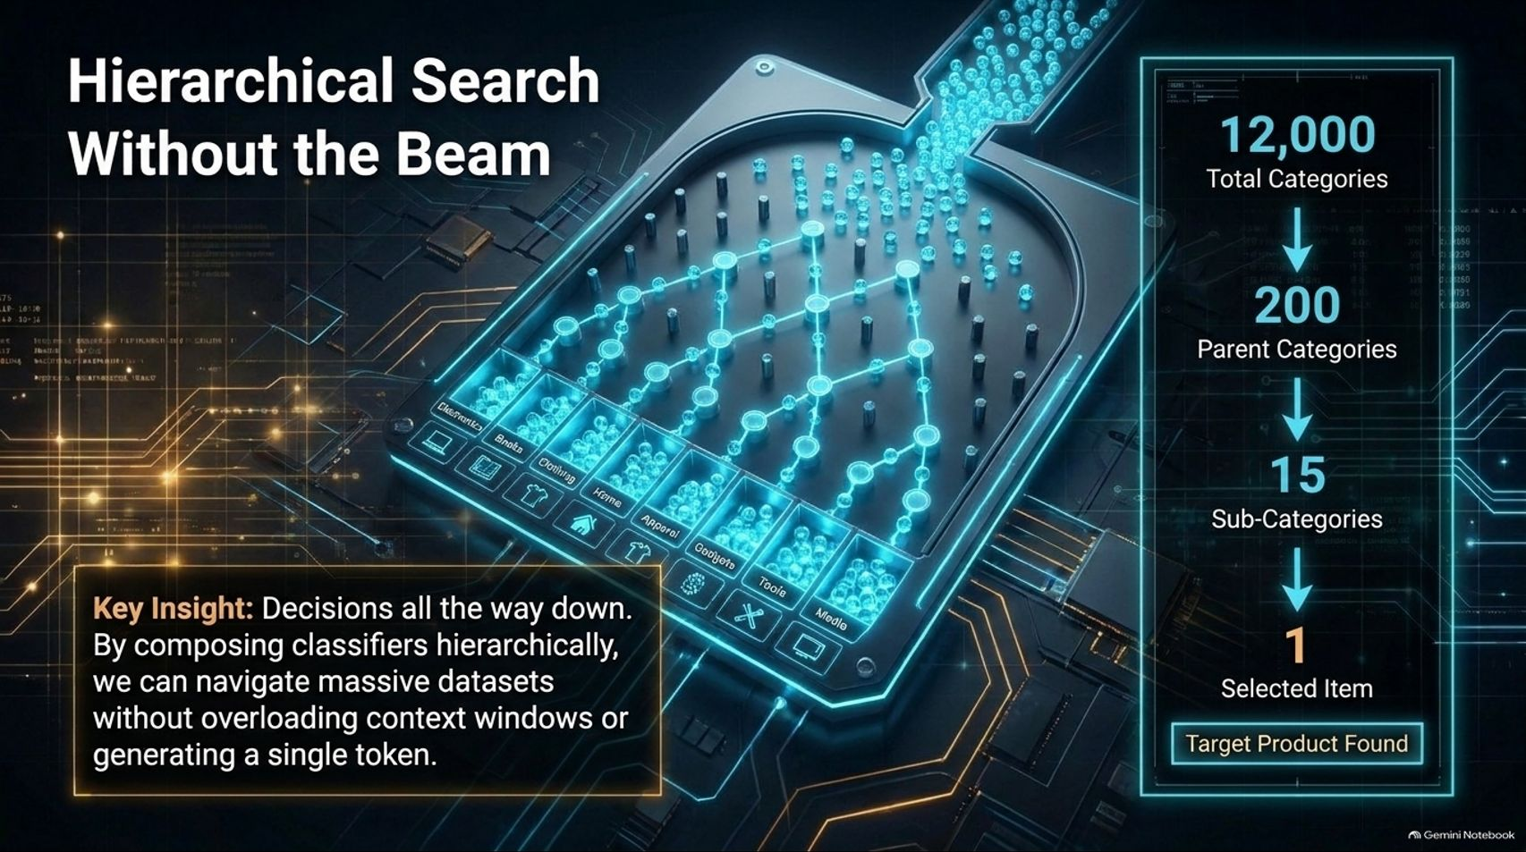
Notes:
Estimated Delivery Time: 3 – 5 minutes
Speaker Notes:
How do we navigate massive datasets without overloading context windows? Through Hierarchical Search Without the Beam.
Imagine trying to sort through 12,000 product categories. Instead of feeding everything into a massive prompt, we compose classifiers hierarchically.
As illustrated on the slide, the system funnels 12,000 total categories down to 200 parent categories, down to 15 sub-categories, and finally to 1 selected target item. By composing classifiers hierarchically, decisions guide us all the way down without generating a single token.

Slide 7
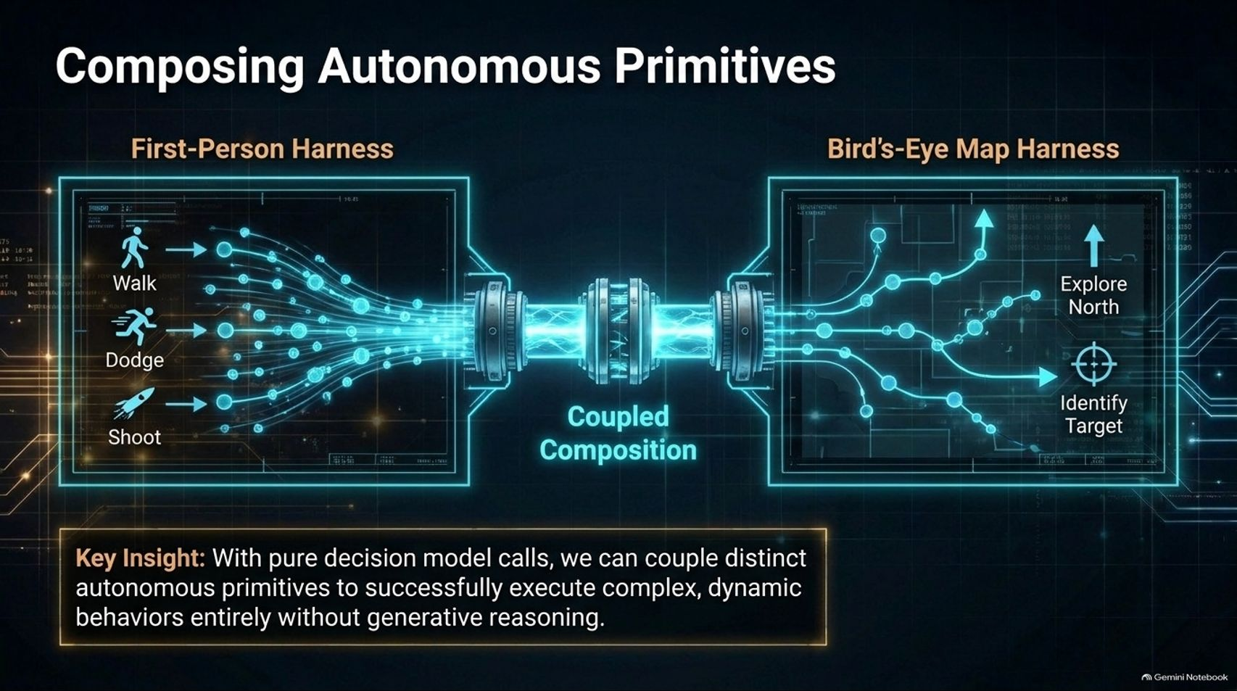
Notes:
Estimated Delivery Time: 3 – 5 minutes
Speaker Notes:
One of the most powerful features of pure decision models is the ability to compose autonomous primitives.
Look at the famous example of Jev playing Doom referenced in the talk. The system couples distinct autonomous harnesses: a First-Person Harness handling immediate survival actions (walk, dodge, shoot), and a Bird's-Eye Map Harness managing macro-navigation (explore north, identify target).
Through coupled composition of these distinct decision modules, the system executes complex, dynamic behaviors entirely without generative reasoning. It proves that complex agentic loops can be built from simple decision building blocks.

Slide 8
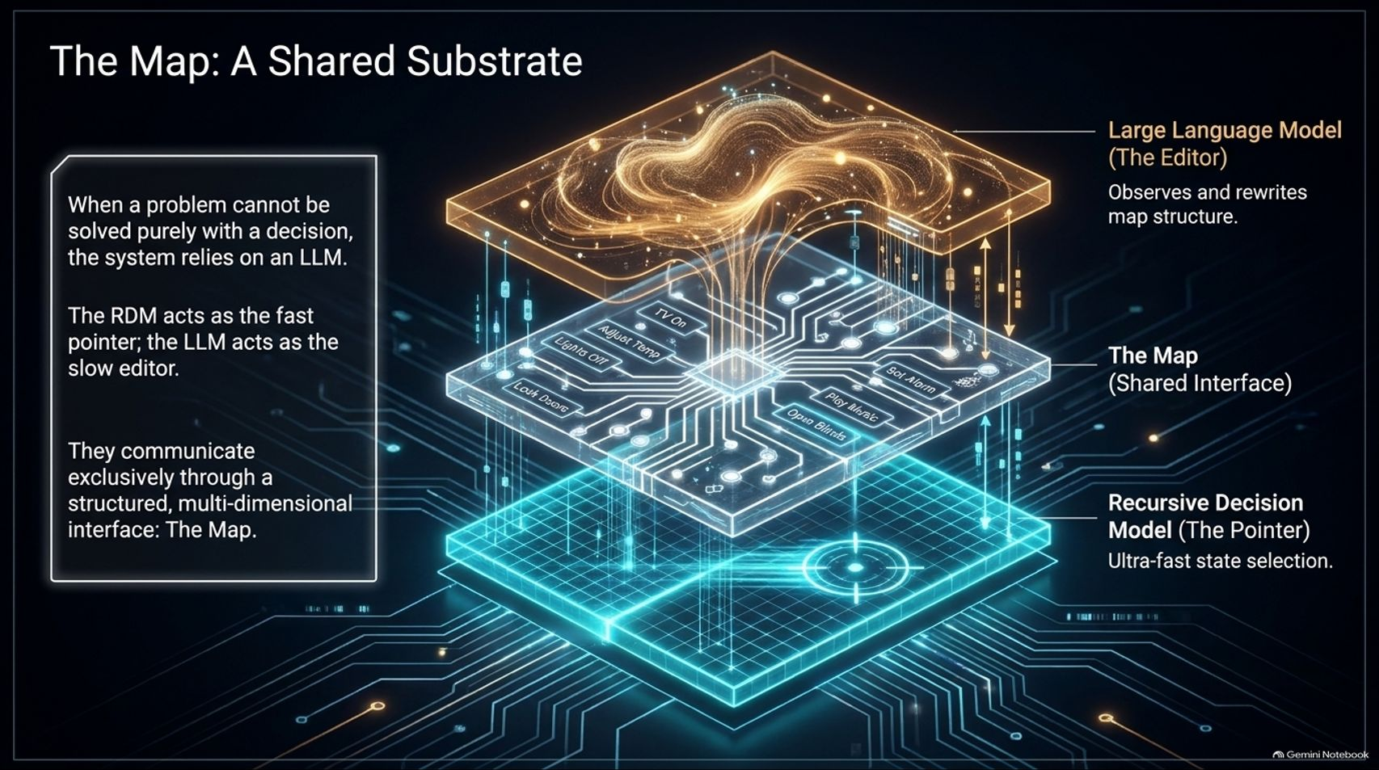
Notes:
Estimated Delivery Time: 4 – 6 minutes
Speaker Notes:
When a problem cannot be solved purely with a fast decision, the system relies on an LLM. But how do an ultra-fast decision model and an open-ended LLM communicate? Through The Map: A Shared Substrate.
In this architecture, the RDM acts as the fast pointer (handling ultra-fast state selection), while the LLM acts as the slow editor (observing and rewriting map structures).
They communicate exclusively through a structured, multi-dimensional interface called The Map, linking open-ended generative outputs to concrete, executable action pointers.

Slide 9
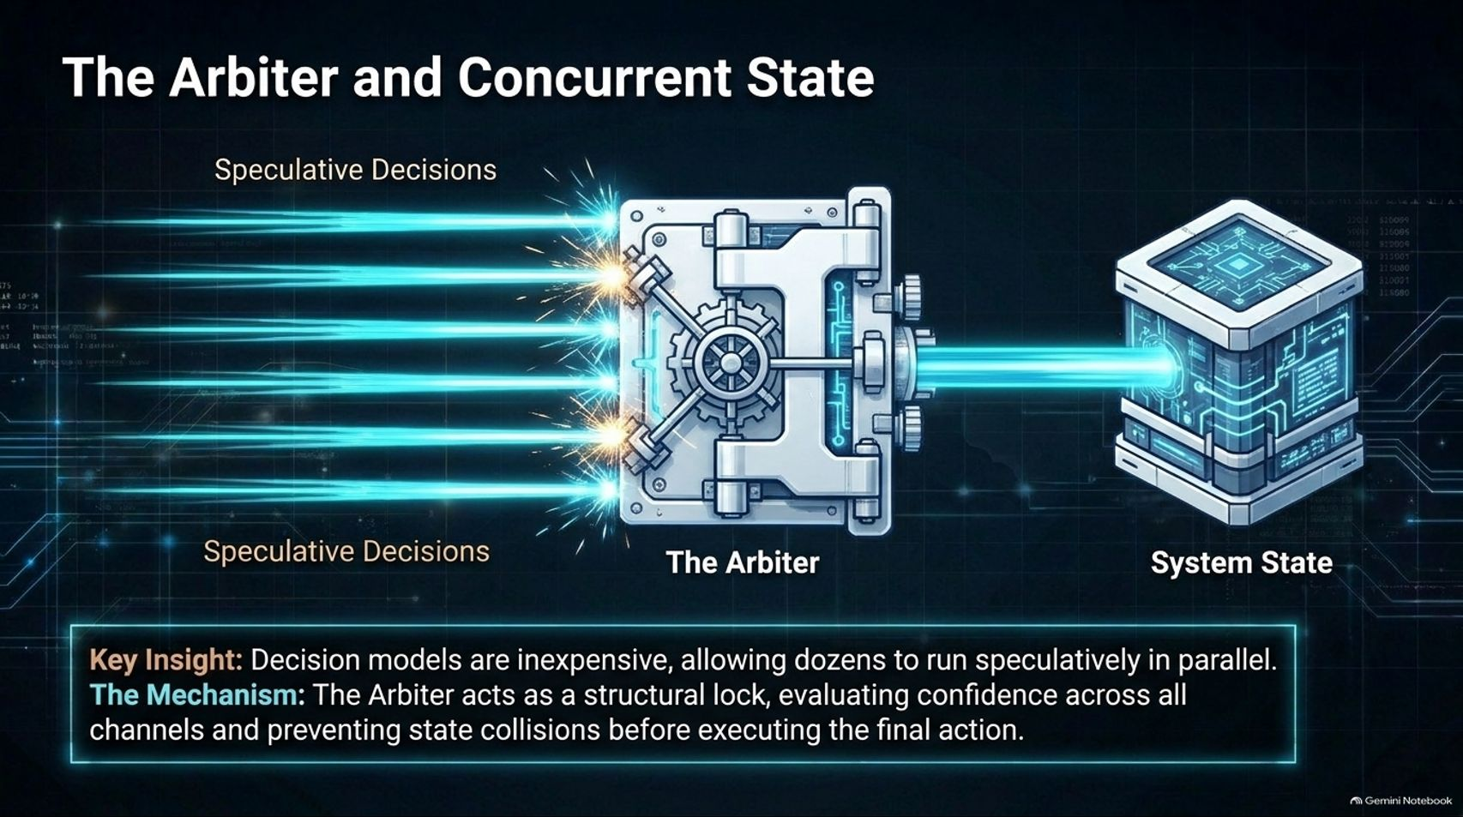
Notes:
Estimated Delivery Time: 3 – 5 minutes
Speaker Notes:
Because decision models are exceptionally inexpensive and fast, we can run dozens of them speculatively in parallel. But running parallel decisions introduces the risk of state collisions.
To solve this, we introduce The Arbiter. Acting like a structural lock in a CPU, the Arbiter evaluates confidence across all speculative decision channels, preventing state write collisions before executing the final system action.
It acts as a secure gatekeeper, allowing massive parallel exploration without corrupting the core system state.

Slide 10
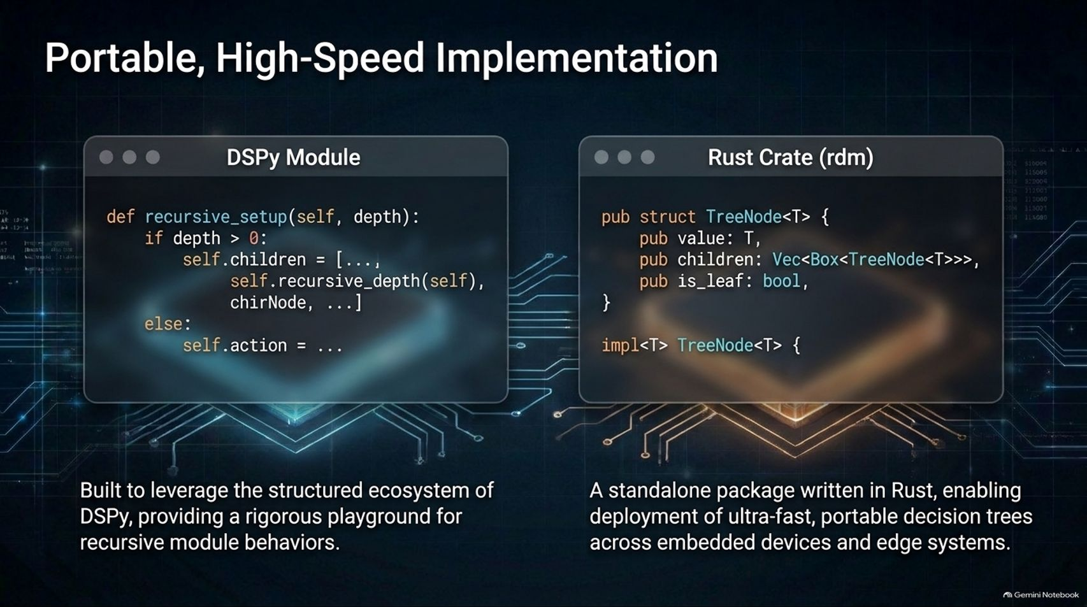
Notes:
Estimated Delivery Time: 3 – 4 minutes
Speaker Notes:
RDMs are not just theoretical concepts; they are backed by robust implementations.
As shown on the slide, we can build and test recursive module behaviors using a DSPy Module, leveraging the structured ecosystem of compound AI frameworks.
Furthermore, for production and edge deployment, we have a standalone package written in Rust (rdm). By defining tree nodes (TreeNode<T>) natively in Rust, we enable the deployment of ultra-fast, portable decision trees across embedded devices and edge systems with zero overhead.

Slide 11

Notes:
Estimated Delivery Time: 3 – 5 minutes
Speaker Notes:
Why are we building this? Because of The Physical Toll of Legacy Interfaces.
Traditional computer use couples our physical bodies directly to legacy hardware—mice, QWERTY keyboards, and touchscreens. This constant enmeshment causes unnecessary repetitive stress injuries, tech-neck, shoulder tension, and physical limitation.
As Raymond Weitekamp shares from personal experience dealing with grad school deadlines and ergonomic mice, working on computers shouldn't require physical punishment. We must decouple the body from the device.

Slide 12
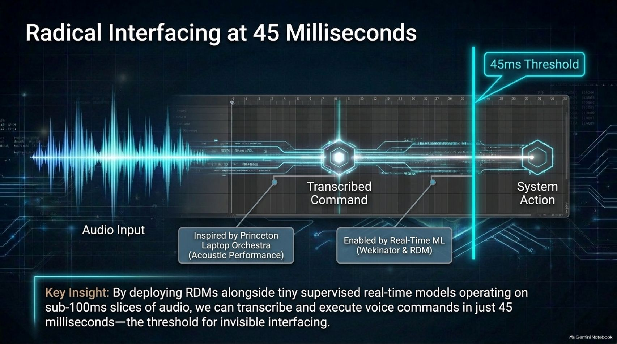
Notes:
Estimated Delivery Time: 4 – 6 minutes
Speaker Notes:
How do we achieve this decoupling? Through Radical Interfacing at 45 Milliseconds.
Drawing inspiration from real-time machine learning frameworks like the Wenator and acoustic performance in the Princeton Laptop Orchestra, we can deploy RDMs alongside tiny supervised models operating on sub-100ms slices of audio.
By combining real-time ML with recursive decision routing, the system can transcribe and execute voice commands in just 45 milliseconds—well beneath the threshold required for truly invisible, natural computer interfacing.

Slide 13
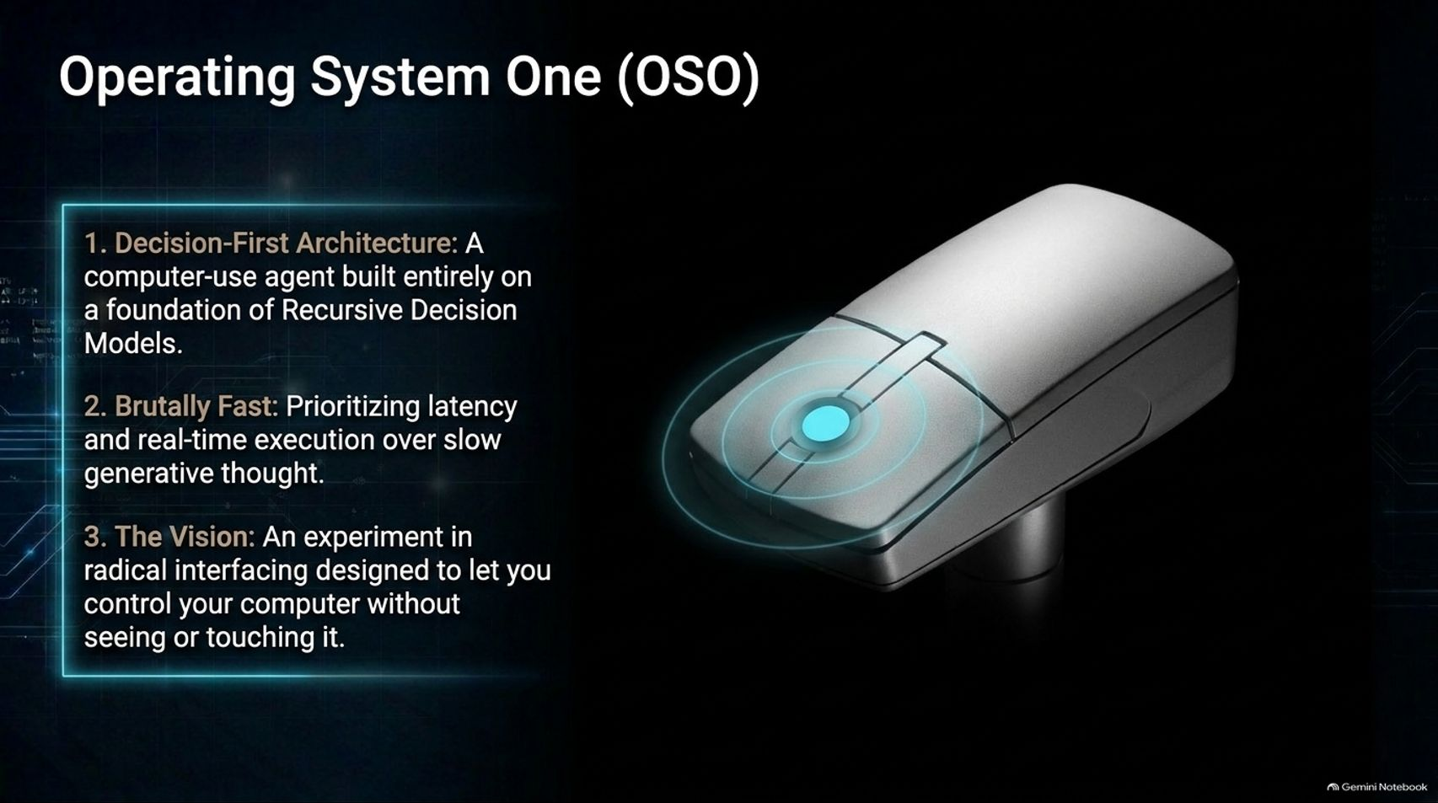
Notes:
Estimated Delivery Time: 3 – 4 minutes
Speaker Notes:
This brings us to Operating System One (OSO) (oso.computer), an experimental computer built on three core pillars:
Decision-First Architecture: A computer-use agent built entirely on a foundation of Recursive Decision Models.
Brutally Fast: Prioritizing sub-second latency and real-time execution over slow generative thought.
The Vision: An experiment in radical interfacing designed to let you control your computer without seeing or touching it.
Starting with voice input, OSO paves the way for a completely new relationship with our machines.

Slide 14

Notes:
Estimated Delivery Time: 2 – 3 minutes
Speaker Notes:
As we look to the future of AI engineering, the goal is clear: Decouple the body. Upgrade the machine.
We no longer have to be shackled to the physical limitations of keyboards and screens. By harnessing the power of Recursive Decision Models, System 1 decision routing, and ultra-low-latency interfacing, we can build AI systems that are faster, smarter, and physically liberating.
I invite you to join the waitlist and explore the architecture further at oso.computer. Thank you!

Slide 15
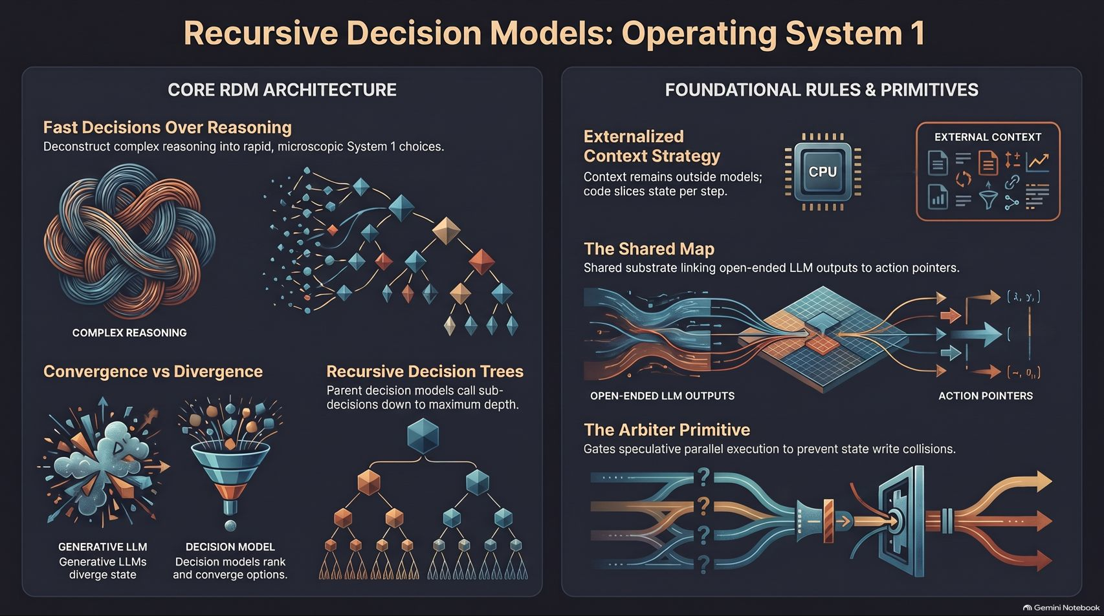
Notes:
Estimated Delivery Time: 3 – 5 minutes
Speaker Notes:
To summarize our entire architectural journey on this final overview slide:
On the left, we contrast complex reasoning with fast System 1 choices, showing how decision models converge where generative LLMs diverge.
On the right, we reinforce our core foundational rules: externalizing context into lightweight slices, utilizing the shared Map substrate to bridge LLMs and RDMs, and employing the Arbiter primitive to safely manage speculative parallel execution.
This is the blueprint for Operating System One—bridging fast decisions and deep reasoning into a unified, lightning-fast computing experience.

