Slide 1
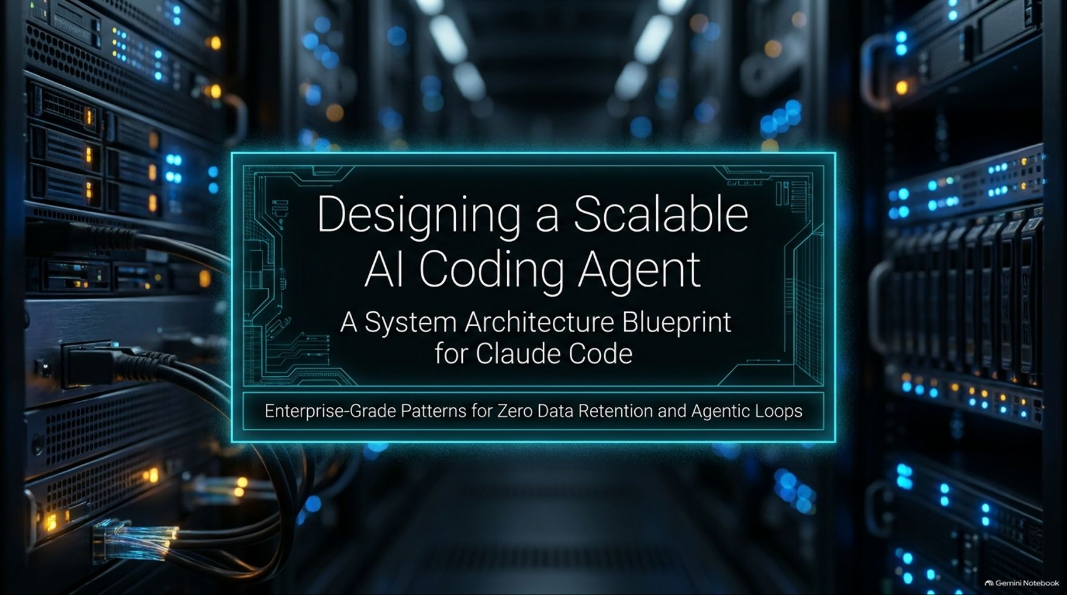
Notes:
AI System Design Mock Interview: Design Claude Code
https://www.youtube.com/watch?v=20pf1nnpXnM

Slide 2
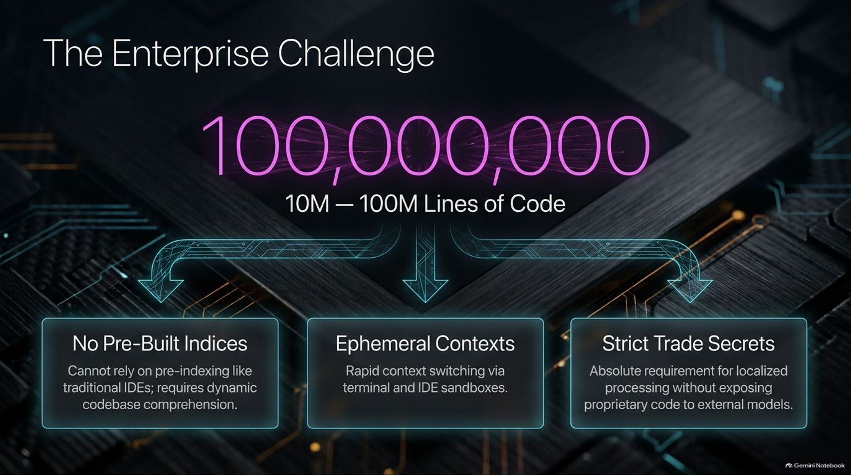
Notes:
Estimated Delivery Time: 3 – 5 minutes
Speaker Notes:
To understand why traditional tools fail here, we must look at The Enterprise Challenge. When developers use AI tools on massive corporate repositories containing 10 to 100 million lines of code, three major obstacles emerge:
No Pre-Built Indices: Unlike traditional IDEs that pre-index codebases into static vector databases ahead of time, terminal-based agents like Claude Code operate dynamically session-by-session. They cannot rely on pre-computed server-side indices.
Ephemeral Contexts: The system requires rapid context switching, handling terminal inputs, file edits, and IDE interactions on the fly.
Strict Trade Secrets: Enterprises demand absolute localization and privacy. Proprietary code and trade secrets cannot be exposed to external vector databases or stored on third-party inference servers.

Slide 3
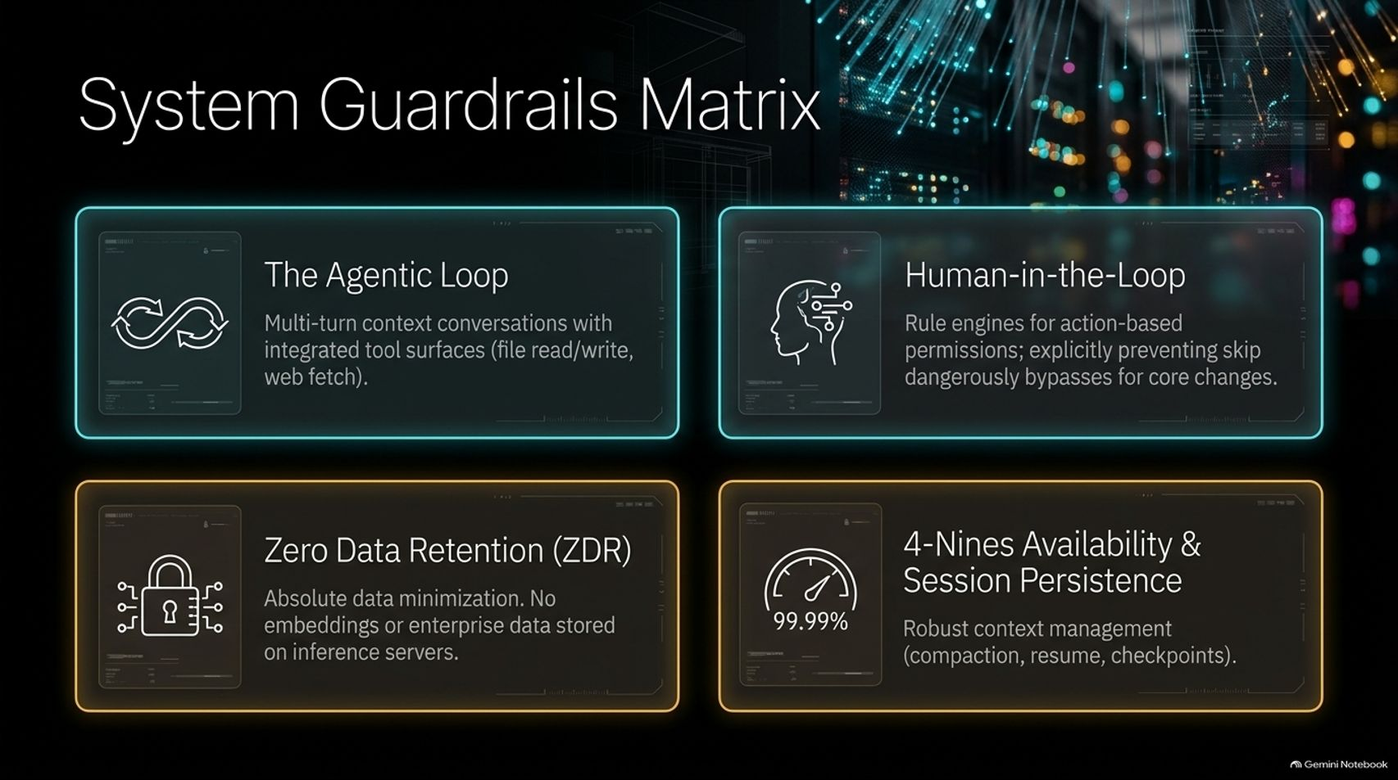
Notes:
Estimated Delivery Time: 3 – 4 minutes
Speaker Notes:
To conquer these enterprise challenges, our architecture is anchored by a robust System Guardrails Matrix comprising four fundamental pillars:
The Agentic Loop: Multi-turn context conversations integrated with powerful local and remote tool surfaces (file read/write/delete, web fetch).
Human-in-the-Loop: Strict rule engines and permission gates for action-based execution, explicitly preventing dangerous bypasses (like "skip dangerously") on core file changes.
Zero Data Retention (ZDR): Absolute data minimization ensuring no embeddings or enterprise source code are ever retained on remote inference servers.
4-Nines Availability & Session Persistence: Robust context management including automated compaction, session resumption, and historical checkpointing.

Slide 4
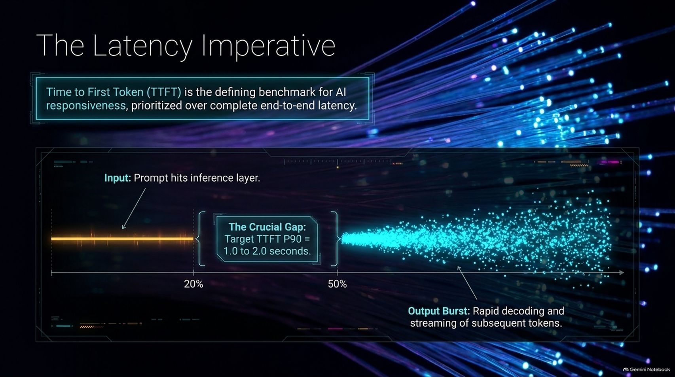
Notes:
Estimated Delivery Time: 3 – 4 minutes
Speaker Notes:
In standard web architectures, latency is measured by end-to-end request-response time. In AI systems, however, Time to First Token (TTFT) is the defining benchmark for responsiveness, prioritized over complete generation duration.
As illustrated on the slide timeline, when an input prompt hits the inference layer, the system undergoes prefill processing (consuming roughly 20% to 50% of the timeline).
The crucial operational gap is hitting our target TTFT P90 between 1.0 to 2.0 seconds. Once that first token clears, the system transitions into an rapid output burst, decoding and streaming subsequent tokens smoothly to the client.

Slide 5
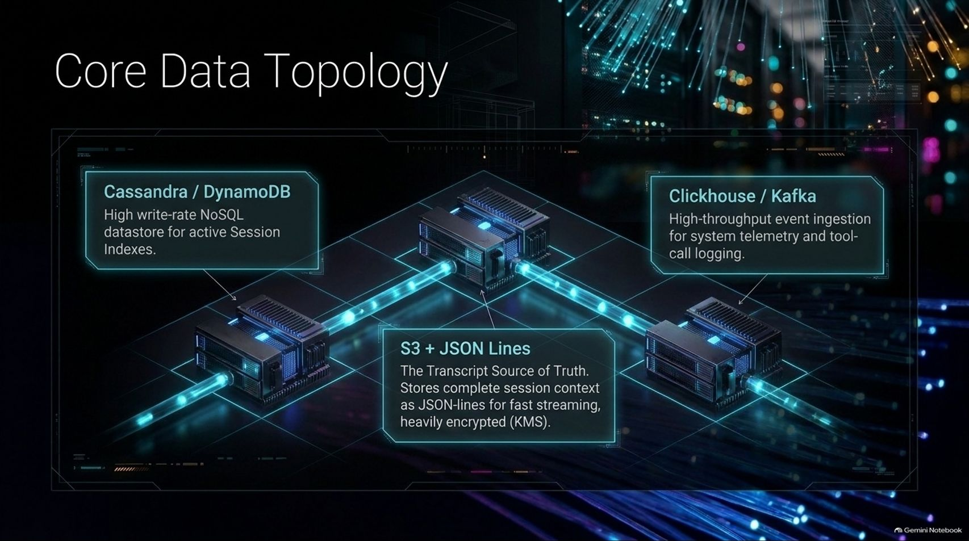
Notes:
Estimated Delivery Time: 4 – 5 minutes
Speaker Notes:
Let's examine the foundational data topology supporting this architecture:
Cassandra / DynamoDB: A high write-rate NoSQL datastore dedicated to managing active session indexes and quick state lookups.
S3 + JSON Lines: The transcript Source of Truth. We store complete session contexts as lightweight JSON-lines to enable fast streaming, heavily encrypted at rest using Key Management Services (KMS).
ClickHouse / Kafka: A high-throughput event ingestion pipeline capturing system telemetry, tool-call logging, and usage analytics.
This topology separates active session indexing from immutable transcript logging and real-time telemetry.

Slide 6
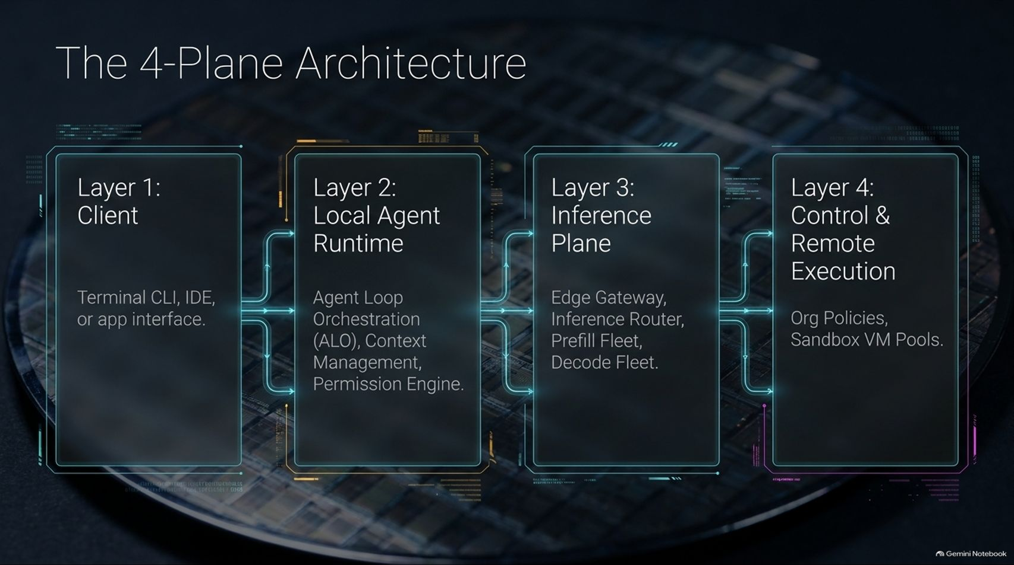
Notes:
Estimated Delivery Time: 4 – 6 minutes
Speaker Notes:
To organize this immense complexity, we divide our system into a clear 4-Plane Architecture:
Layer 1: Client: The developer's terminal CLI, IDE plugin, or application interface.
Layer 2: Local Agent Runtime: Handles Agent Loop Orchestration (ALO), local context management, prompt decision routing, and permission enforcement directly on the device.
Layer 3: Inference Plane: The cloud-based edge gateway, inference router, prefill fleet, and decode fleet responsible for LLM execution.
Layer 4: Control & Remote Execution: Enforces organization-level governance, access policies, and provisions ephemeral sandbox VM pools.

Slide 7
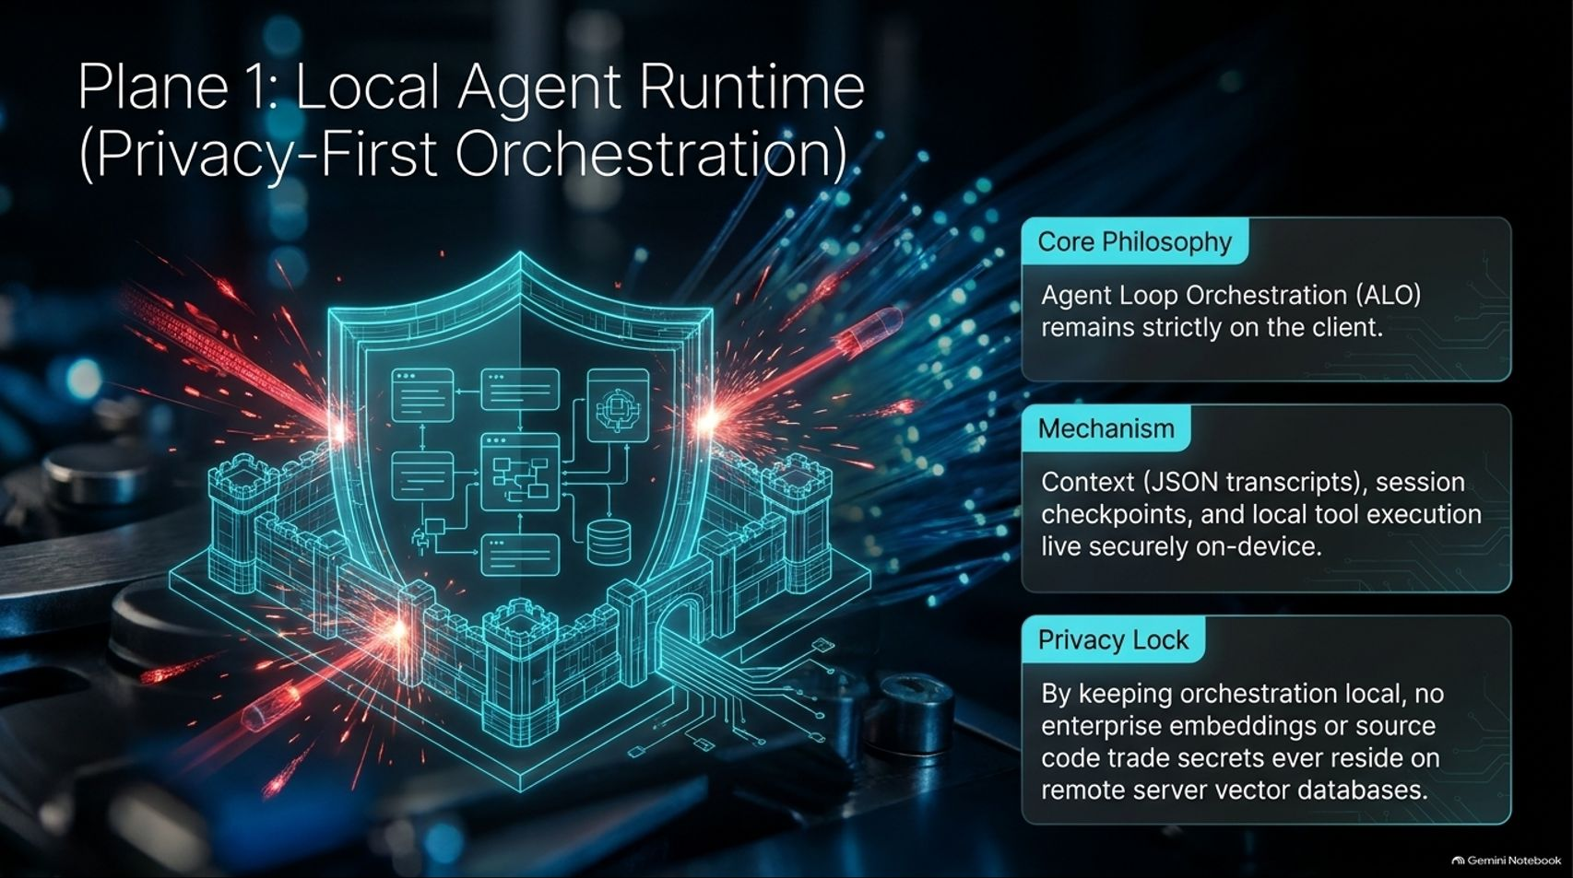
Notes:
Estimated Delivery Time: 3 – 5 minutes
Speaker Notes:
Let's zoom into Plane 1: The Local Agent Runtime. Its core philosophy is absolute privacy: Agent Loop Orchestration (ALO) remains strictly on the client device.
The mechanism is fully localized: session contexts (stored as JSON transcripts), session checkpoints, and local tool execution live securely on-device.
This establishes our Privacy Lock: Because orchestration happens locally, no enterprise code embeddings or trade secrets ever reside on remote server-side vector databases. Client-side execution is the ultimate shield for corporate intellectual property.

Slide 8
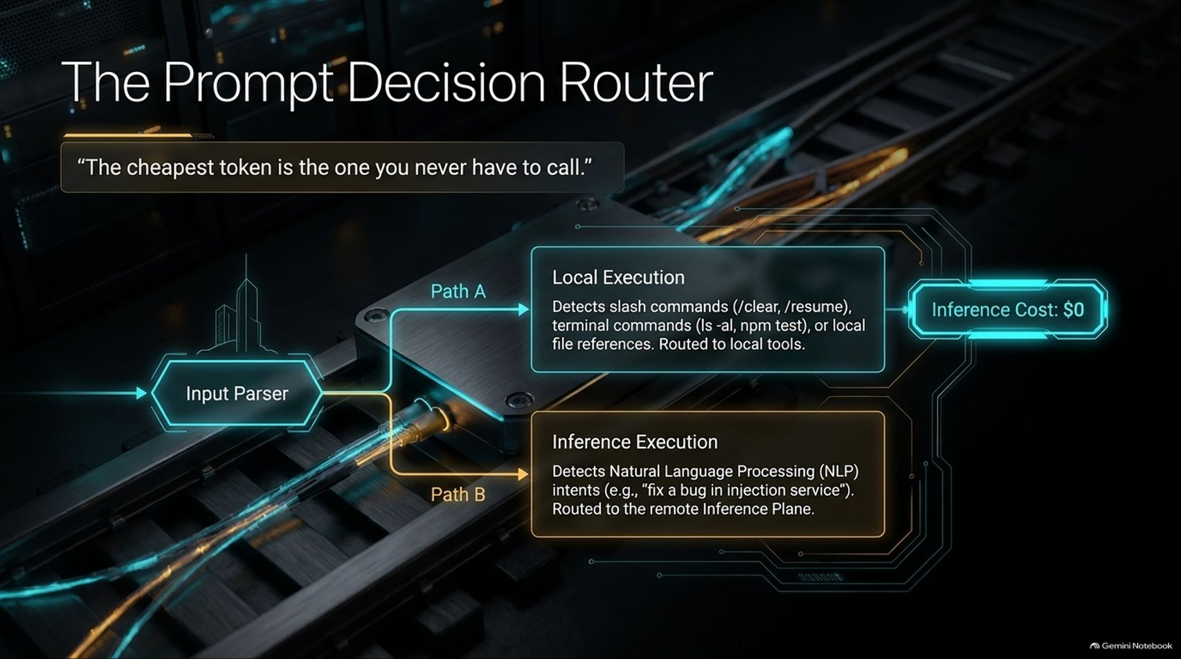
Notes:
Estimated Delivery Time: 3 – 5 minutes
Speaker Notes:
A critical optimization in our local runtime is The Prompt Decision Router. As the industry axiom states: “The cheapest token is the one you never have to call.”
When an input parser evaluates a developer's prompt, it splits execution into two distinct paths:
Path A (Local Execution - $0 Inference Cost): Detects slash commands (/clear, /resume), terminal commands (ls -al, npm test), or local file references (@file.py), routing them directly to local tools without hitting the cloud.
Path B (Inference Execution): Detects complex Natural Language Processing (NLP) intents (e.g., "fix a bug in injection service"), routing them securely to the remote Inference Plane.

Slide 9
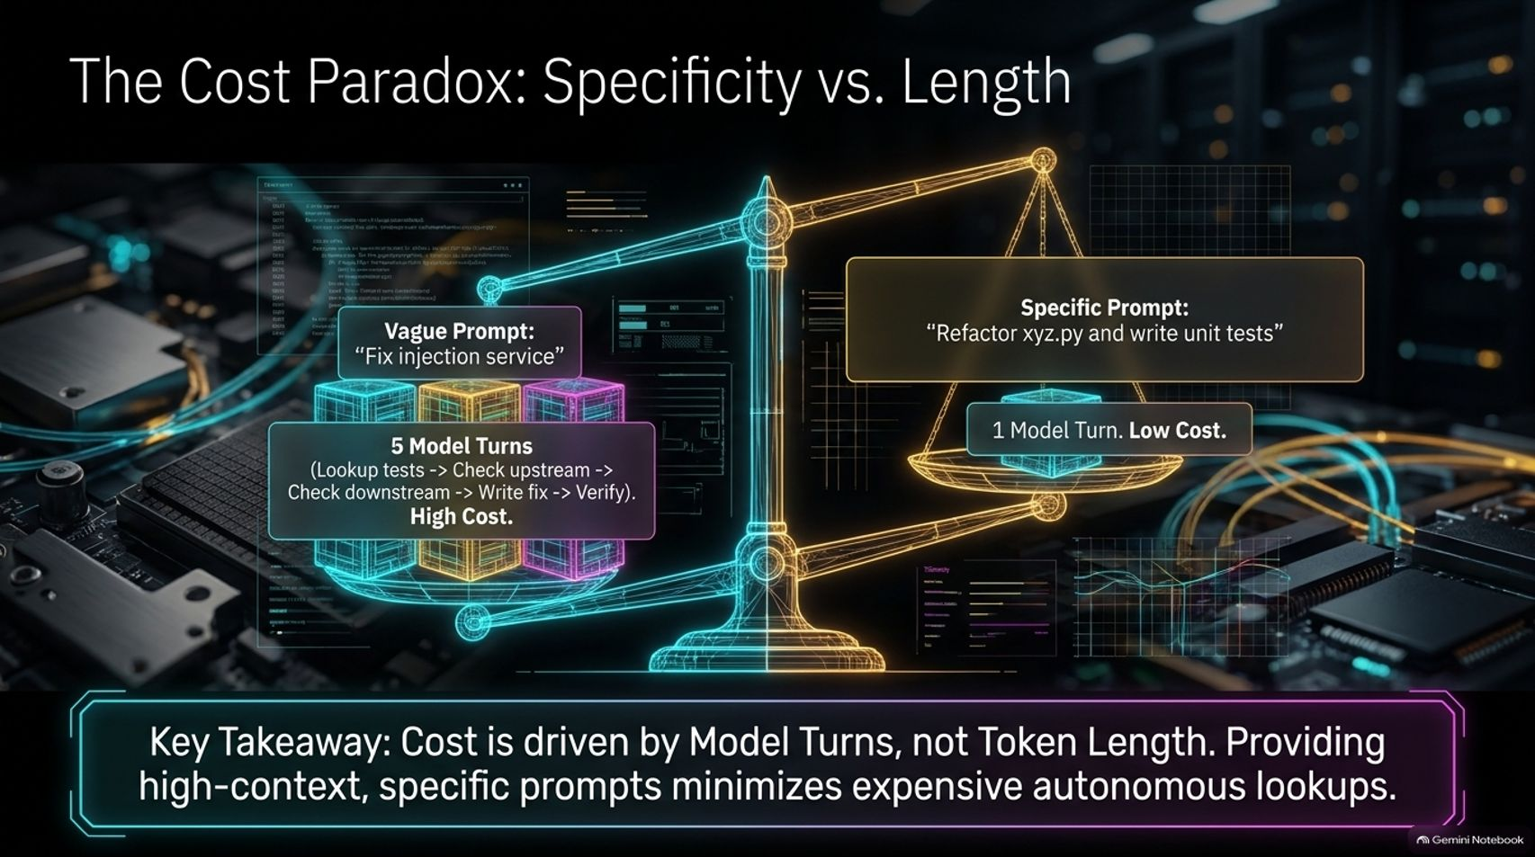
Notes:
Estimated Delivery Time: 4 – 5 minutes
Speaker Notes:
Many engineers fall into the trap of believing that prompt length dictates inference cost. In reality, we face The Cost Paradox: Specificity vs. Length.
Consider a vague prompt like "Fix injection service": The agent is forced into 5 expensive model turns—looking up tests, checking upstream services, verifying downstream logic, writing fixes, and self-correcting—resulting in high cost.
Conversely, a specific prompt like "Refactor xyz.py and write unit tests" requires only 1 model turn and low cost.
Key Takeaway: Cost is driven by Model Turns, not Token Length. Providing high-context, specific prompts minimizes expensive autonomous lookups.

Slide 10
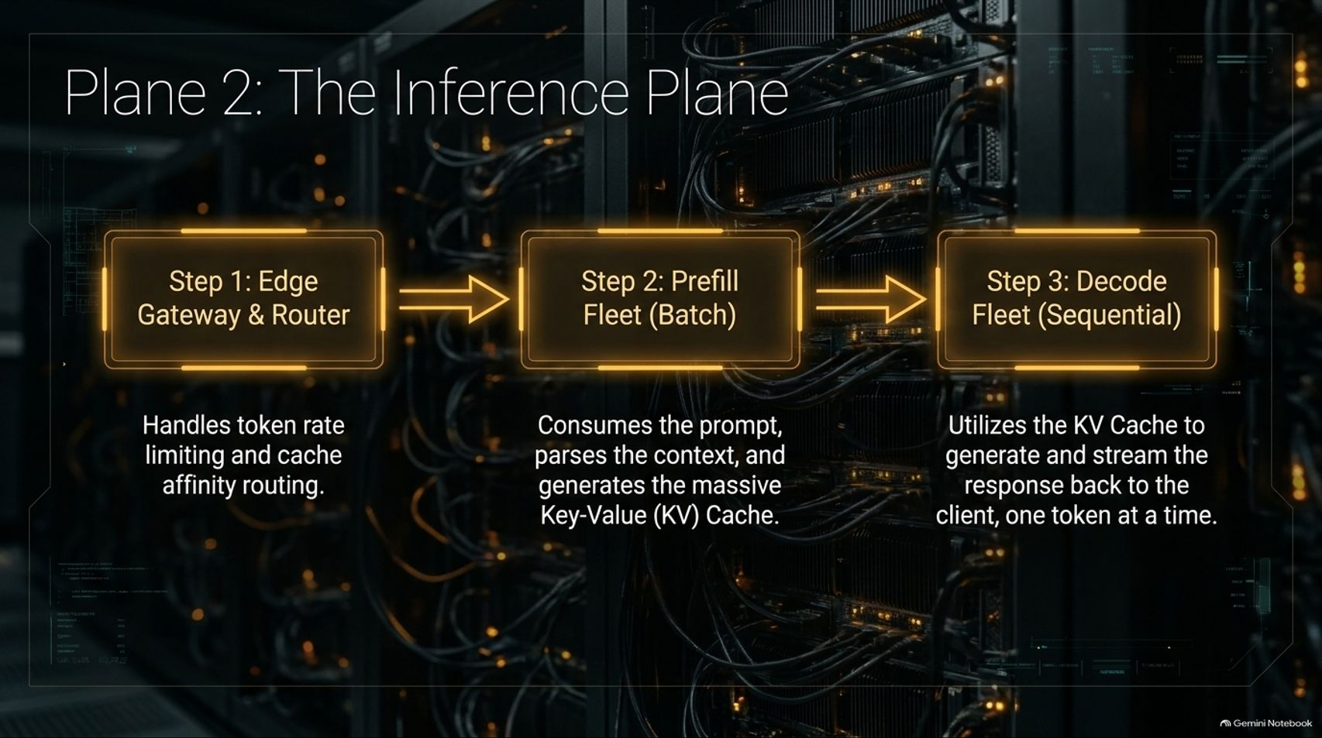
Notes:
Estimated Delivery Time: 4 – 6 minutes
Speaker Notes:
When a prompt does require cloud intelligence, it hits Plane 2: The Inference Plane, structured in three sequential steps:
Step 1: Edge Gateway & Router: Handles token rate limiting and cache affinity routing to direct requests to optimal GPU workers.
Step 2: Prefill Fleet (Batch): Consumes the prompt, parses the incoming context in parallel batches, and generates the massive Key-Value (KV) Cache.
Step 3: Decode Fleet (Sequential): Utilizes the KV Cache to generate and stream the response back to the client token-by-token sequentially.

Slide 11
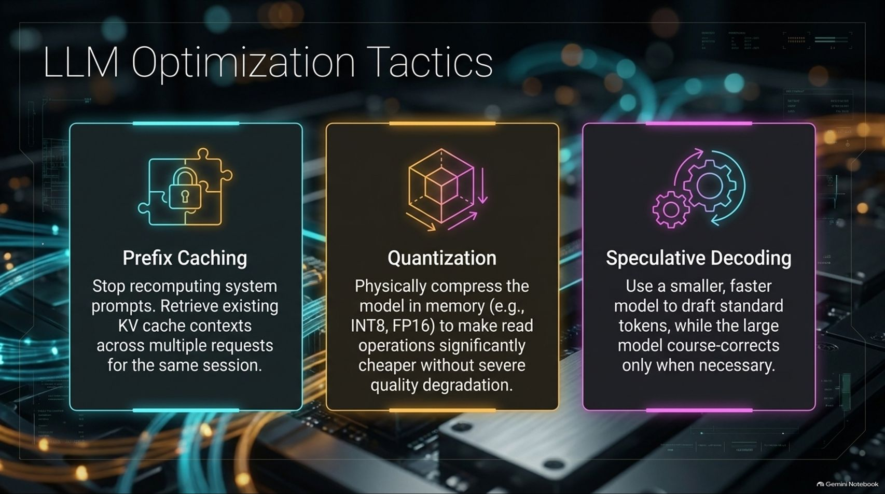

Slide 12
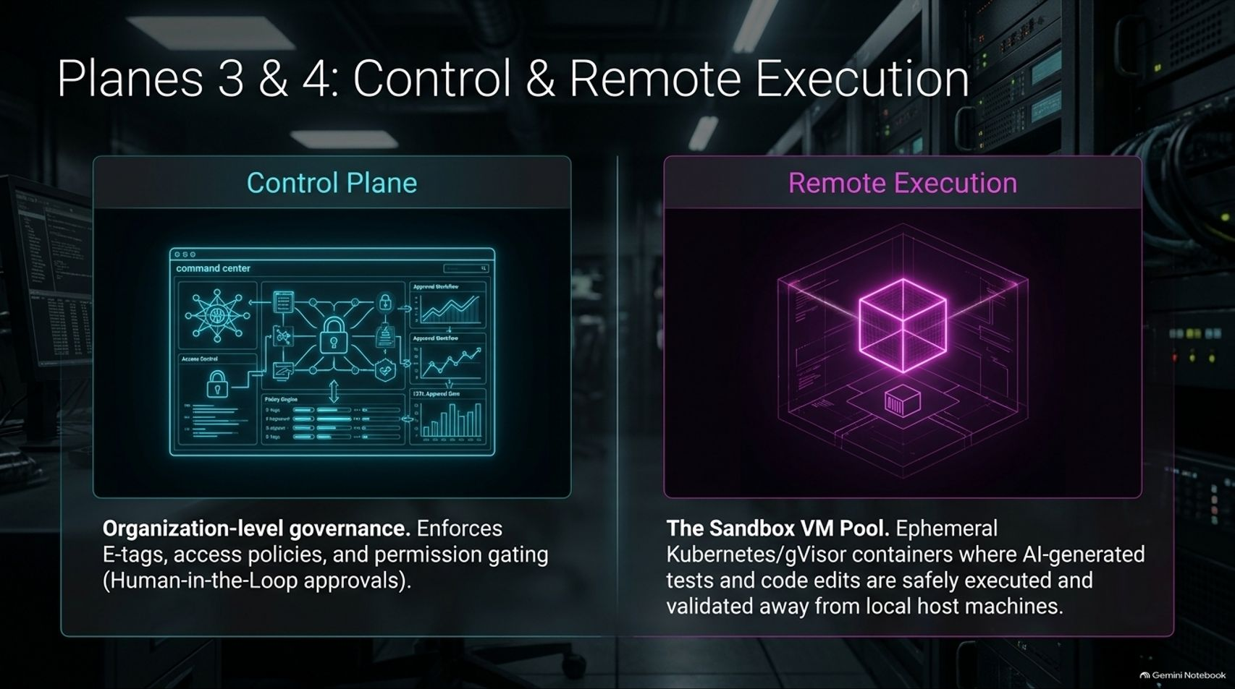
Notes:
Estimated Delivery Time: 4 – 5 minutes
Speaker Notes:
Next, let's examine Planes 3 & 4: Control & Remote Execution:
The Control Plane: Responsible for organization-level governance. It enforces E-tags for policies, access management, and permission gating (such as human-in-the-loop approvals for sensitive file modifications).
Remote Execution (The Sandbox VM Pool): Leverages ephemeral Kubernetes and gVisor isolated containers where AI-generated test suites, code edits, and shell execution loops run safely away from local host machines.

Slide 13
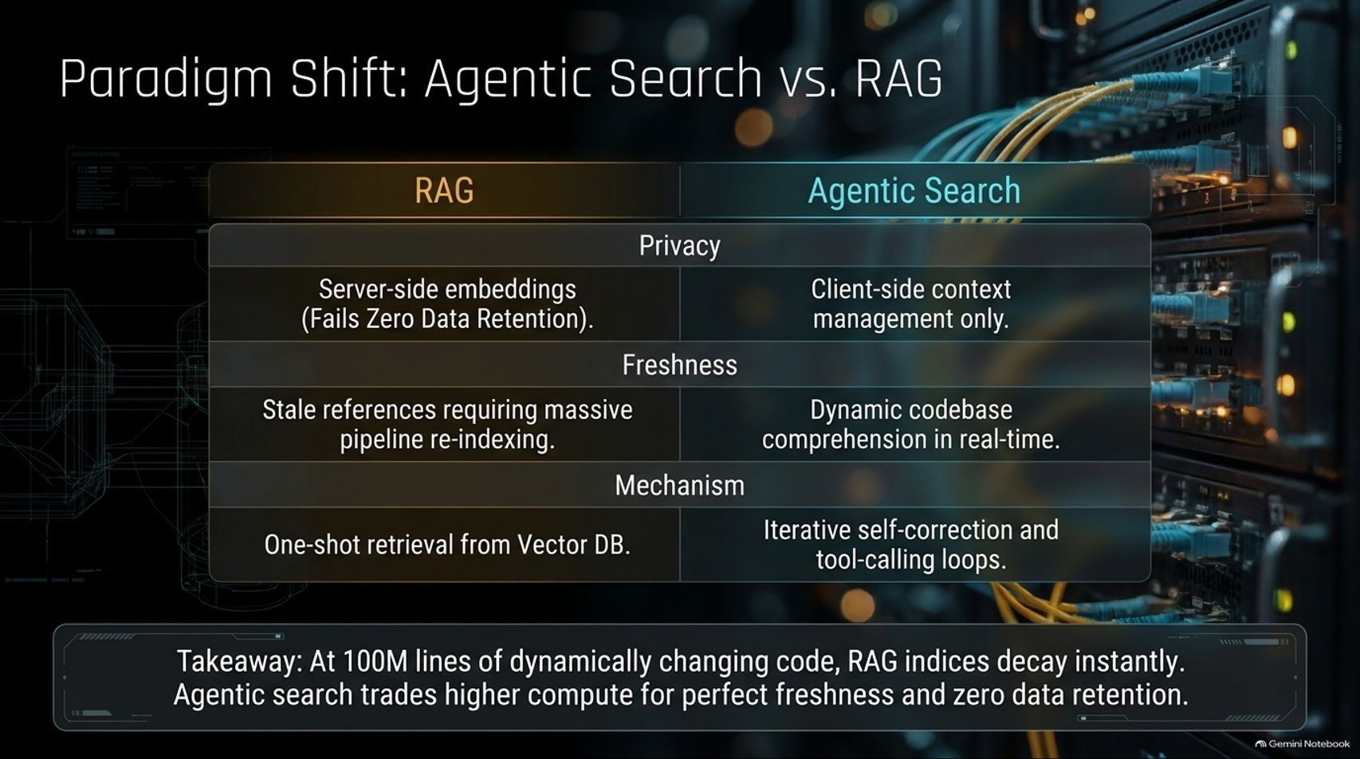
Notes:
Estimated Delivery Time: 4 – 6 minutes
Speaker Notes:
A foundational architectural choice in our design is abandoning traditional RAG in favor of Agentic Search:
Privacy: RAG relies on server-side embeddings, which breaks Zero Data Retention. Agentic Search keeps context management entirely client-side.
Freshness: In massive codebases, RAG indices decay instantly, requiring continuous pipeline re-indexing. Agentic Search achieves dynamic codebase comprehension in real-time.
Mechanism: RAG performs one-shot retrieval from a Vector DB; Agentic Search executes iterative self-correction and tool-calling loops.
Takeaway: At 100M lines of dynamically changing code, RAG fails; agentic search trades higher compute for perfect freshness and absolute privacy.

Slide 14
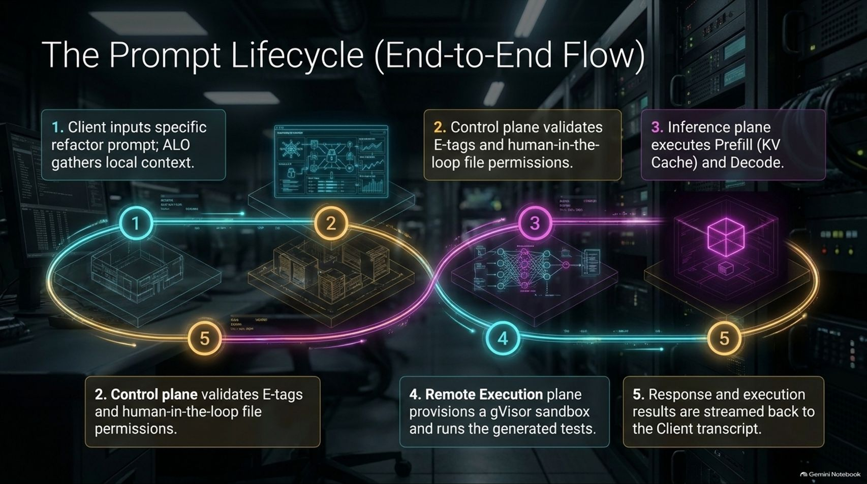
Notes:
Estimated Delivery Time: 4 – 5 minutes
Speaker Notes:
Let's trace The Prompt Lifecycle through our 5-step end-to-end flow:
Step 1: The client inputs a specific refactor prompt, and the ALO gathers local context.
Step 2: The control plane validates E-tags and human-in-the-loop file permissions.
Step 3: The inference plane executes the Prefill phase (building the KV Cache) and starts Decoding.
Step 4: The remote execution plane provisions a gVisor sandbox to run generated tests and code changes.
Step 5: Response data and execution results are streamed back directly to the client transcript.

Slide 15
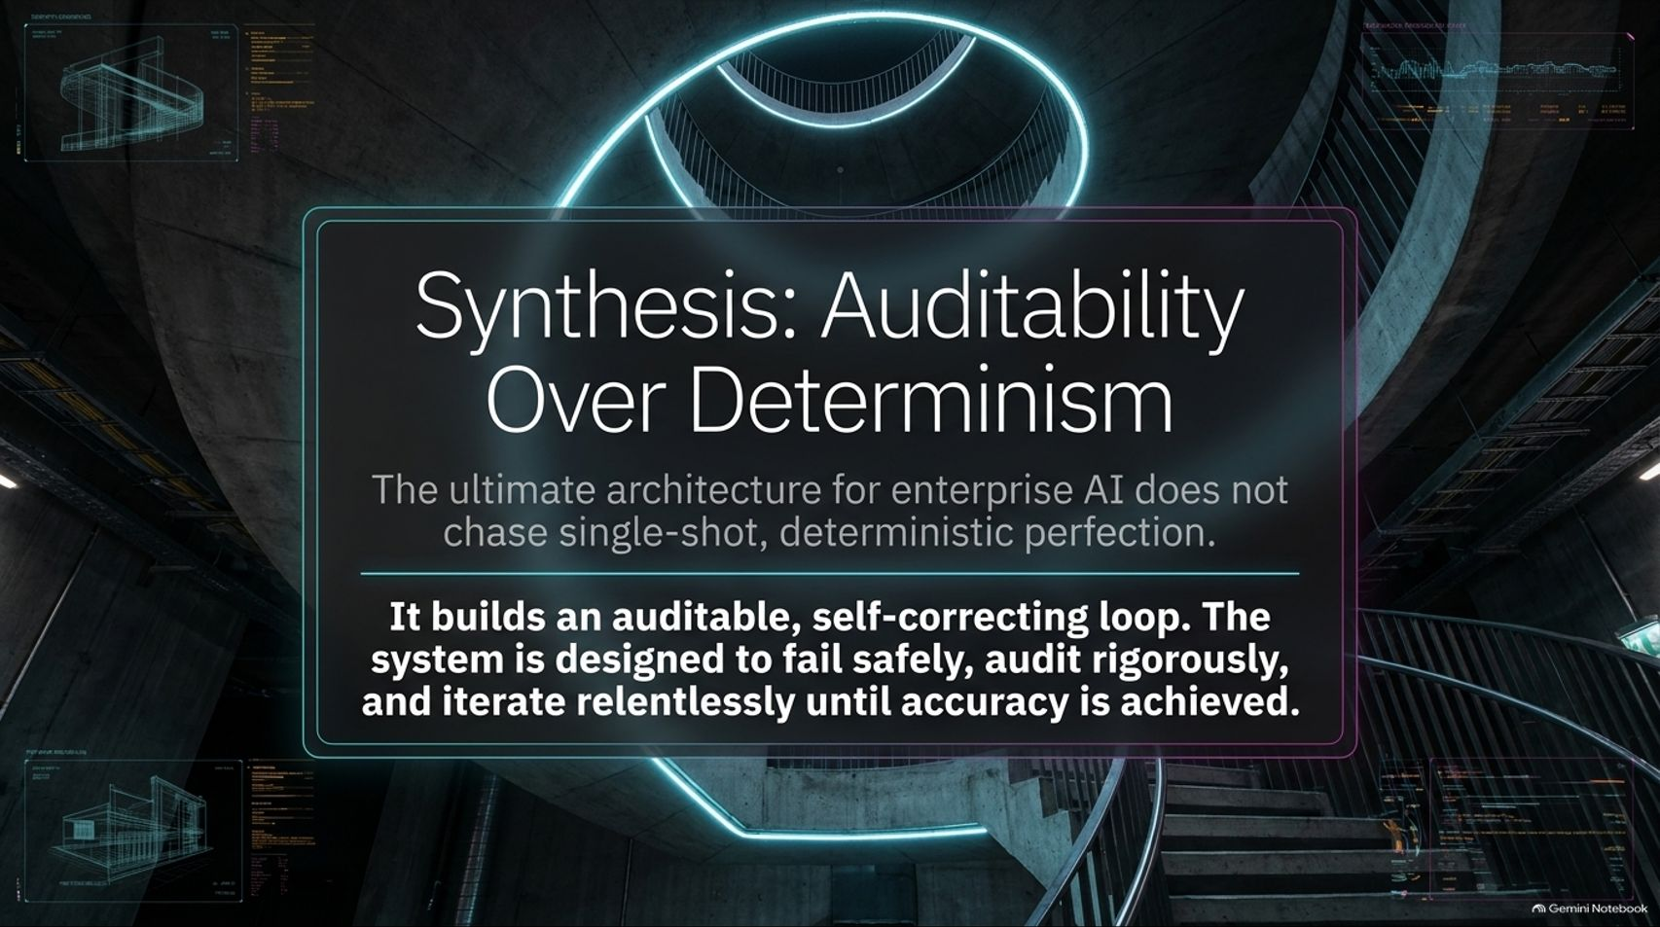
Notes:
Estimated Delivery Time: 3 – 4 minutes
Speaker Notes:
As we synthesize this entire architecture, we must embrace a key philosophy: Auditability Over Determinism.
The ultimate architecture for enterprise AI does not chase single-shot, deterministic perfection from an LLM.
Instead, it builds an auditable, self-correcting loop. The system is purposely designed to fail safely, audit rigorously through local tools and sandboxes, and iterate relentlessly until accuracy is achieved.

Slide 16
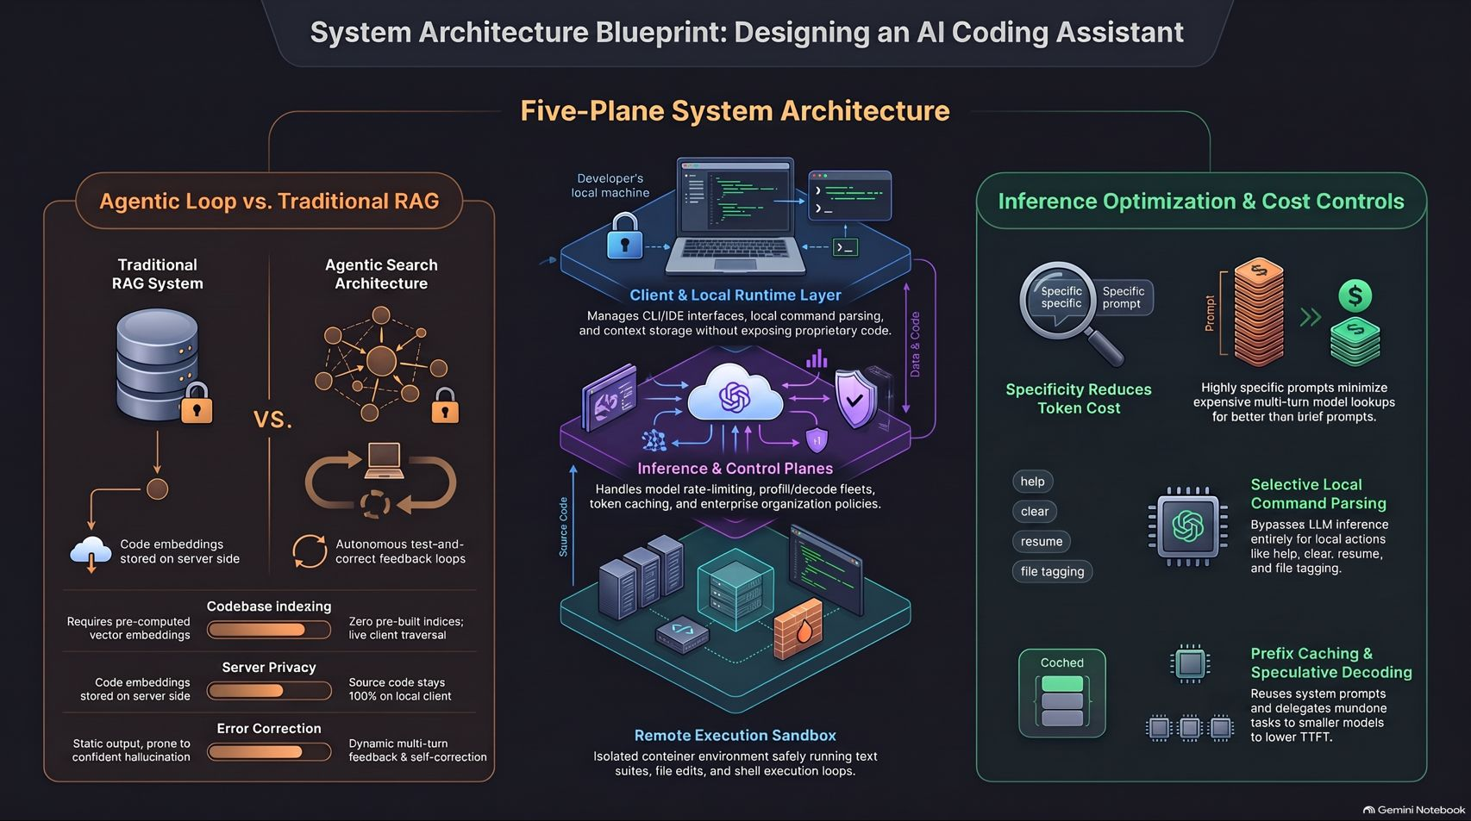
Notes:
Estimated Delivery Time: 3 – 5 minutes
Speaker Notes:
On our final overview slide, we bring together the entire Five-Plane System Architecture Blueprint:
We contrast the security and freshness of Agentic Search against stale server-side RAG systems.
We review the layered hierarchy from the developer's local runtime machine down to cloud inference routers and remote execution sandboxes.
And we highlight our cost controls—leveraging prompt specificity, selective local command parsing, prefix caching, and speculative decoding to maintain enterprise-grade efficiency.
This concludes our architectural deep dive into building scalable, secure AI coding agents. Thank you!

