Slide 1
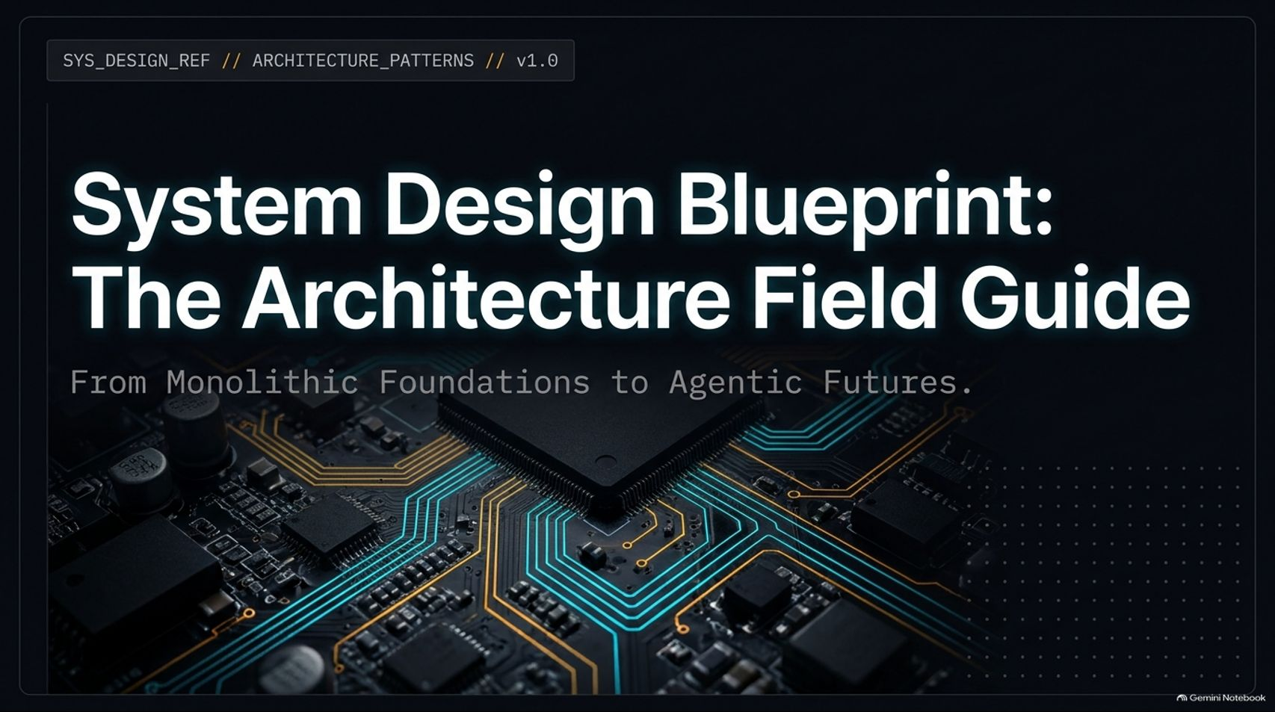
Notes:
Estimated Delivery Time: 2 – 3 minutes
Speaker Notes:
Welcome everyone, and thank you for joining. Today, we are diving into "System Design Blueprint: The Architecture Field Guide — From Monolithic Foundations to Agentic Futures."
With AI now generating a massive portion of production code, understanding high-level software architecture has become an essential skill—not just for principal architects, but even for mid-level engineers stepping into technical interviews. The more fluent you are in system boundaries and trade-offs, the more senior you will come across.
Over the course of this presentation, we will trace the complete evolution of software architecture—starting with classic MVC monoliths, moving through microservices, API gateways, event-driven topologies, and hexagonal domain boundaries, and culminating in modern AI-native patterns like Zero-Token Architecture and Agentic State Machines. Let's begin.
Every Software Architecture Pattern Explained (Micro-Frontends, BFF, API Gateway, Event Driven)
https://www.youtube.com/watch?v=2malNzTrMN0

Slide 2
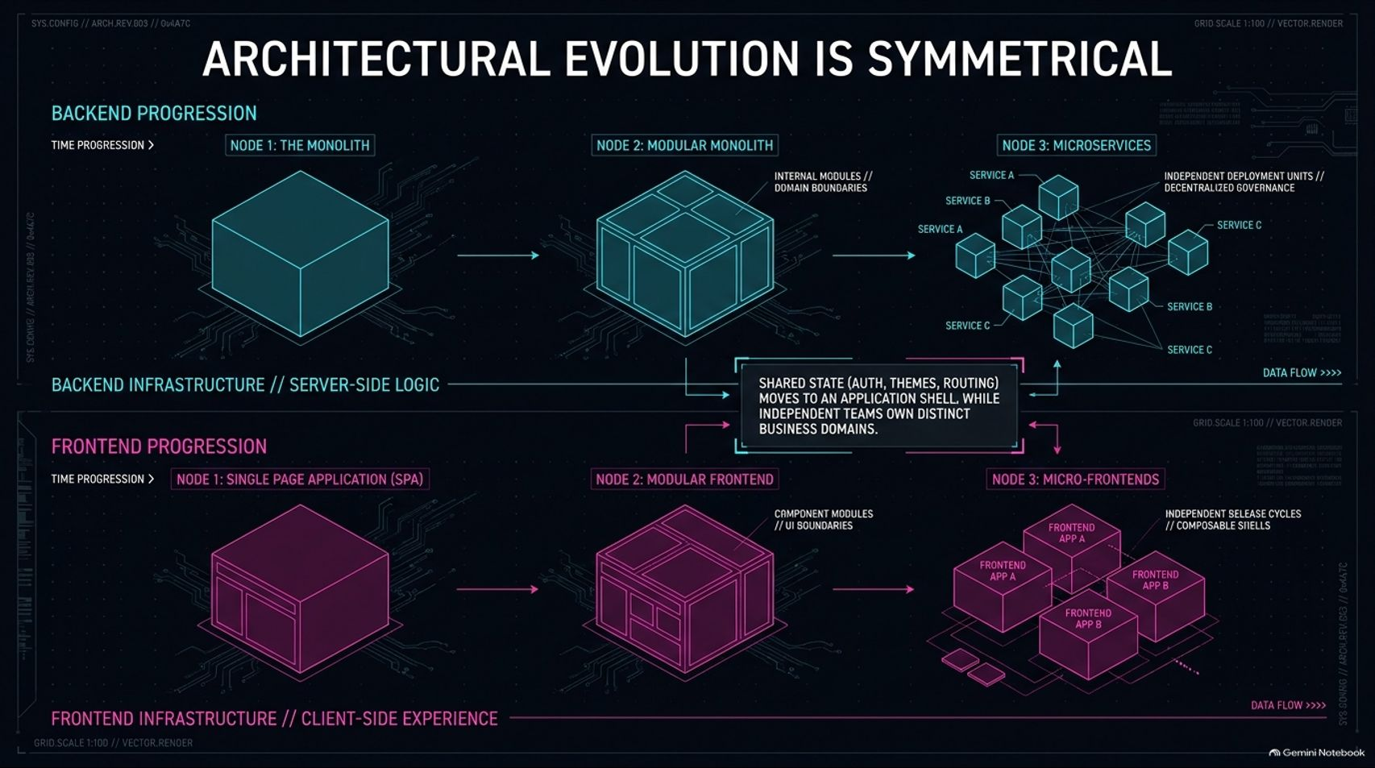
Notes:
Estimated Delivery Time: 3 – 5 minutes
Speaker Notes:
A fundamental insight often overlooked in system design is that architectural evolution is symmetrical across the stack.
Look at the Backend Progression on top: teams almost always start with a single, unified Monolith. As complexity grows, they refactor into a Modular Monolith with strict internal domain boundaries. Eventually, when scaling bottlenecks or team size demand independent deployment units and decentralized governance, they split into Microservices.
Now look at the Frontend Progression below: it mirrors the backend step-for-step. We start with a unified Single Page Application (SPA) (like React, Vue, or Angular), evolve into a Modular Frontend with reusable component libraries and UI boundaries, and ultimately scale into Micro-Frontends.
In micro-frontends, shared state—such as authentication, themes, and routing—moves into an application shell, while independent teams own and deploy distinct business domains on independent release cycles.

Slide 3
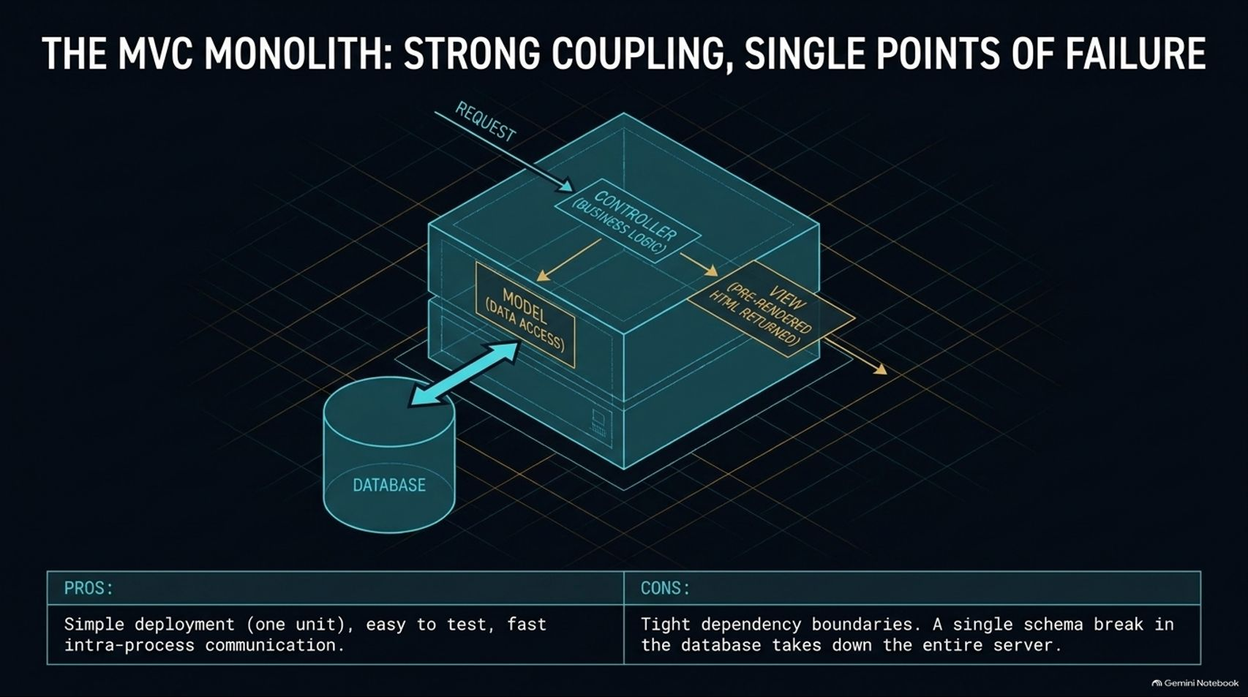
Notes:
Estimated Delivery Time: 3 – 4 minutes
Speaker Notes:
Let's examine our starting point: The MVC Monolith. In a classic two-tier setup—think Ruby on Rails, Django, or ASP.NET—the business logic and UI rendering live together on a single server, separated physically only from the database.
When an HTTP request arrives, the Controller executes business logic, queries the Model for database access, and compiles a pre-rendered HTML View to return to the client.
The Pros: Deployment is remarkably simple (just one artifact), local testing is straightforward, and intra-process communication is ultra-fast because everything happens in memory.
The Cons: You suffer from tight dependency boundaries. Because modules are stitched together, a single schema break in the shared database—or a fatal exception in one feature—can take down the entire server.

Slide 4
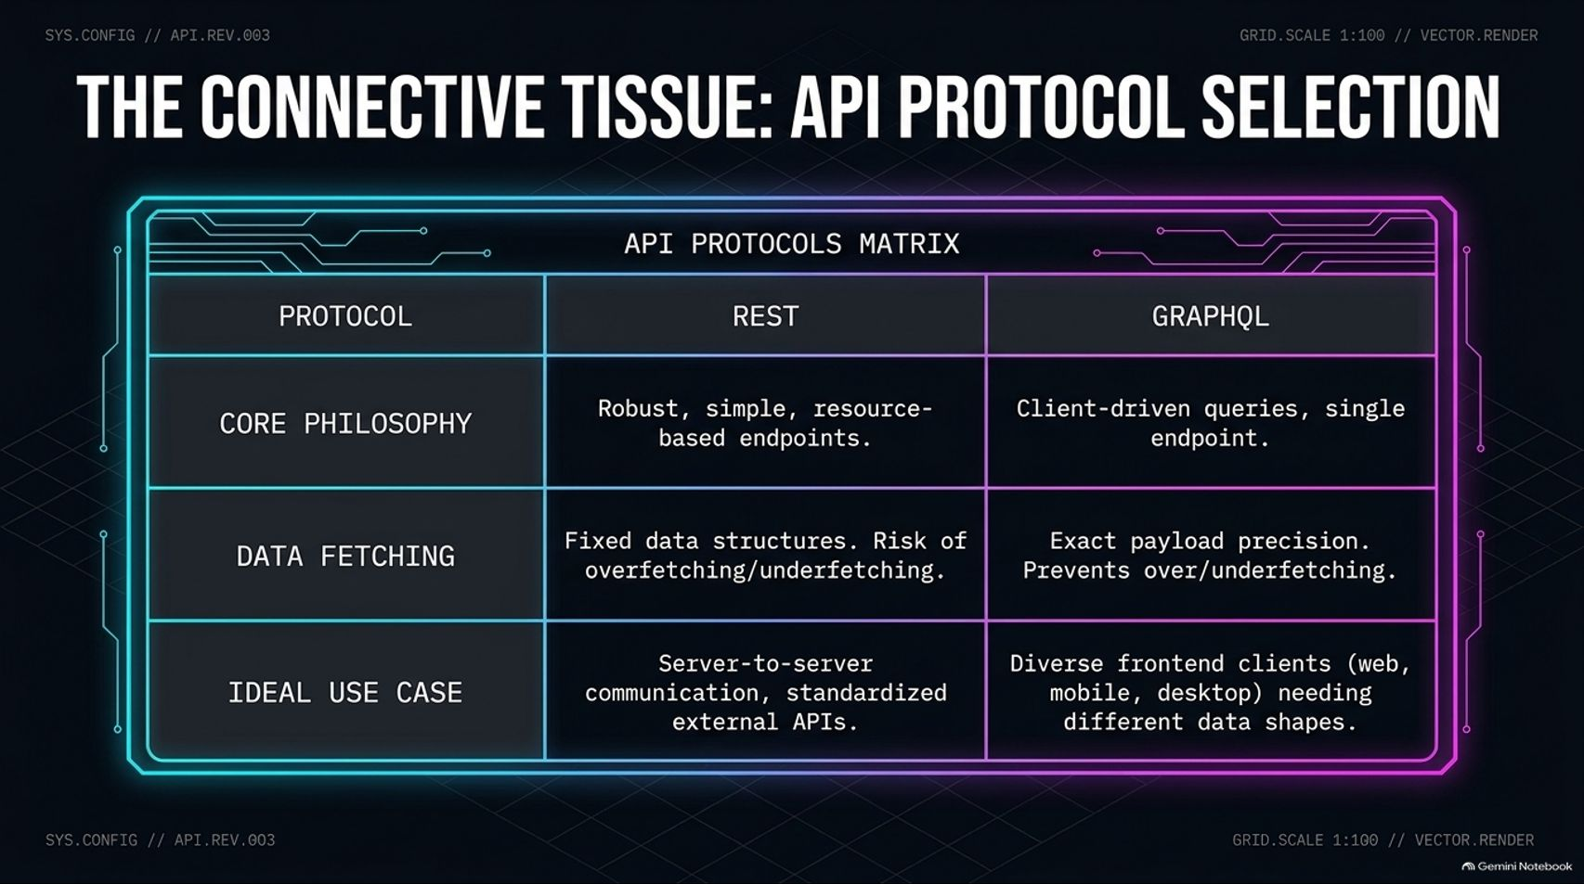
Notes:
Estimated Delivery Time: 3 – 5 minutes
Speaker Notes:
Once you decouple your frontend from your backend, your API becomes the connective tissue of your application. Choosing the right protocol between REST and GraphQL comes down to your client topology:
REST is built around robust, simple, resource-based endpoints. Because it returns fixed data structures, you risk overfetching unnecessary fields or underfetching (requiring multiple round-trips). However, it remains the gold standard for server-to-server communication and standardized external APIs.
GraphQL shifts control to the client via a single endpoint and client-driven queries. It provides exact payload precision, eliminating over- and underfetching. This makes it ideal when you support diverse frontend clients—web, mobile, and desktop—that each require vastly different data shapes.

Slide 5
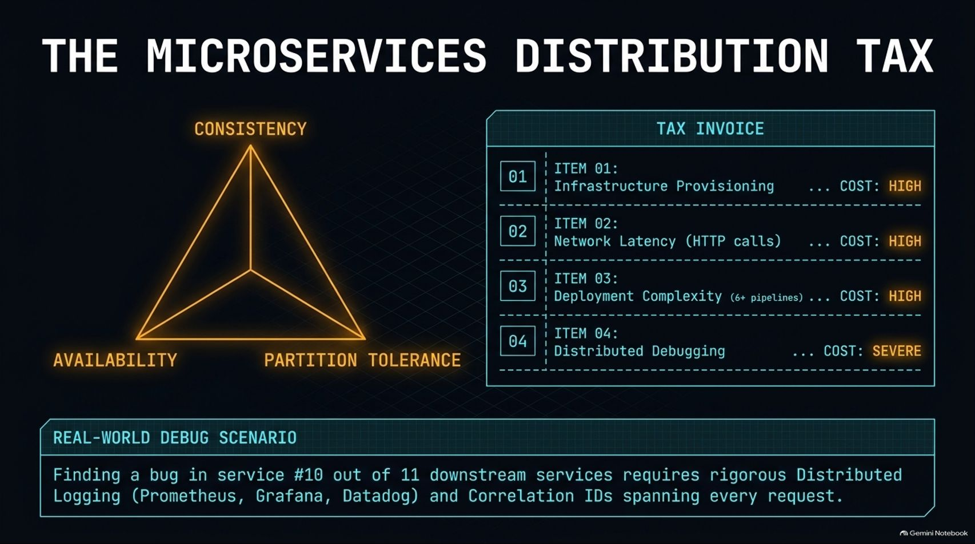
Notes:
Estimated Delivery Time: 4 – 6 minutes
Speaker Notes:
Splitting a modular monolith into isolated Microservices unlocks independent scaling, polyglot runtimes (e.g., Java for payments, Node.js for analytics), and fault isolation. However, distributing a system imposes a heavy Microservices Distribution Tax.
First, remember the CAP Theorem on the left: across a network partition, you must trade off between strong Consistency and Availability. Synchronous transactions spanning multiple microservices introduce serious latency.
Second, look at your Tax Invoice on the right:
Infrastructure Provisioning (High): You are now managing separate compute clusters and databases.
Network Latency (High): Fast in-memory function calls become slow HTTP network hops.
Deployment Complexity (High): You are maintaining 6+ separate CI/CD pipelines instead of one.
Distributed Debugging (Severe): Imagine tracking a bug in Service #10 out of 11 downstream services. Without centralized distributed logging (Prometheus, Grafana, Datadog) and unique Correlation IDs spanning every request, debugging becomes nearly impossible.

Slide 6
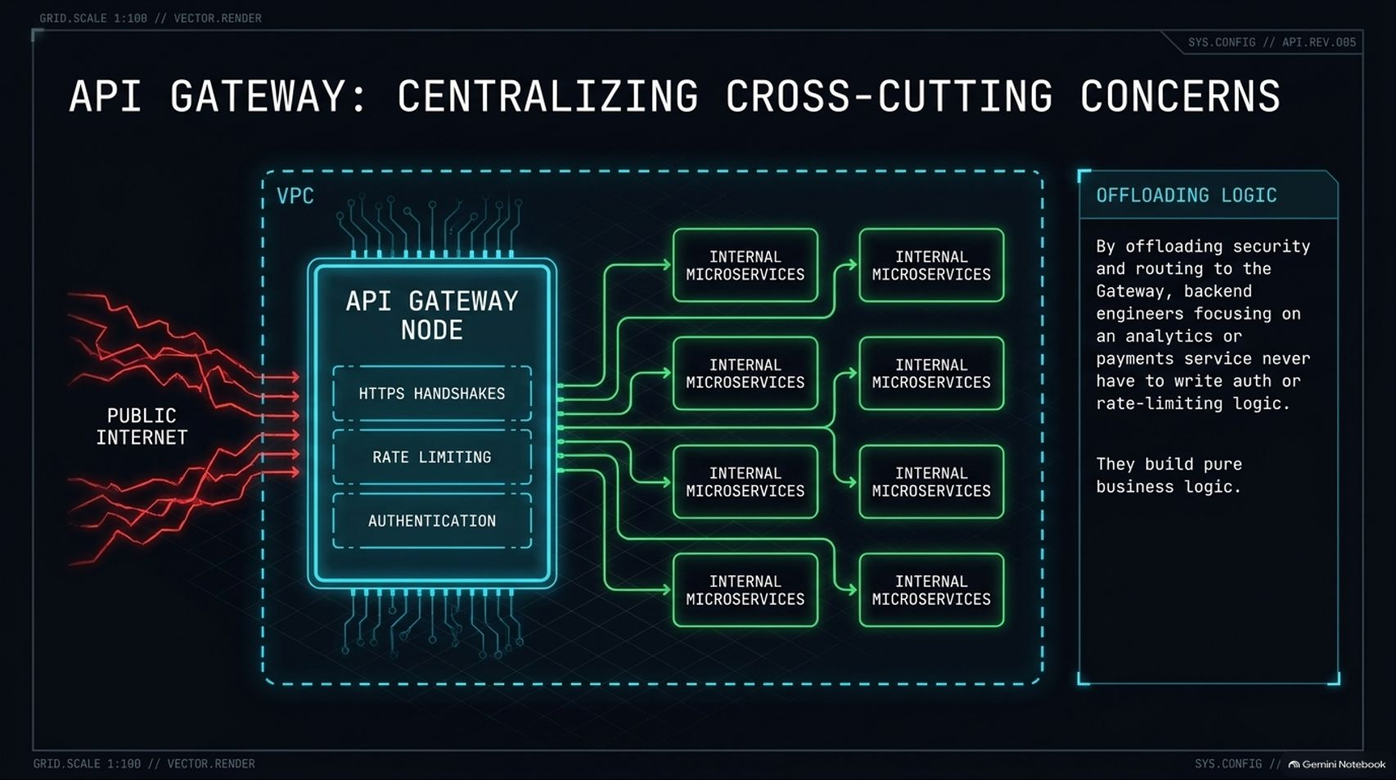
Notes:
Estimated Delivery Time: 3 – 5 minutes
Speaker Notes:
When you deploy dozens of microservices inside a Virtual Private Cloud (VPC), exposing every service directly to the public internet is a security and maintenance nightmare. The solution is an API Gateway.
The API Gateway acts as the single front door to your VPC. It centralizes cross-cutting concerns—terminating HTTPS handshakes, enforcing rate limiting to block DDoS attacks, and validating authentication tokens.
Once validated at the edge, traffic routes internally over fast, lightweight HTTP inside the protected VPC. By offloading security and routing to the gateway, backend engineers working on payments or analytics never have to write auth or rate-limiting boilerplate—they can focus purely on core business logic.

Slide 7
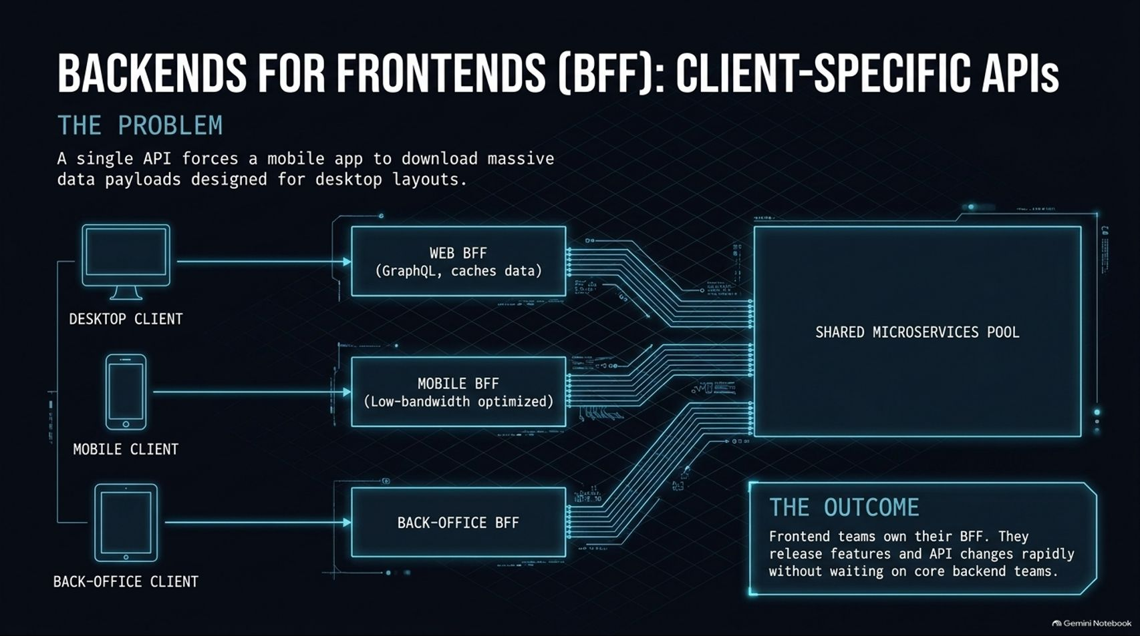
Notes:
Estimated Delivery Time: 3 – 5 minutes
Speaker Notes:
As your product expands across desktop web, mobile apps, and internal back-office portals, a single generic API becomes a bottleneck—forcing a mobile client on a slow cellular network to download massive JSON payloads designed for desktop layouts.
The Backends for Frontends (BFF) pattern solves this by placing a dedicated backend layer in front of your shared microservices pool for each client type: a Web BFF (often using GraphQL and caching), a Mobile BFF (low-bandwidth optimized), and a Back-Office BFF.
The Outcome: Frontend teams own their respective BFF. They can aggregate downstream calls and ship UI-driven API changes rapidly without blocking on core backend teams, trading a minor hop in network latency for massive gains in developer velocity.

Slide 8
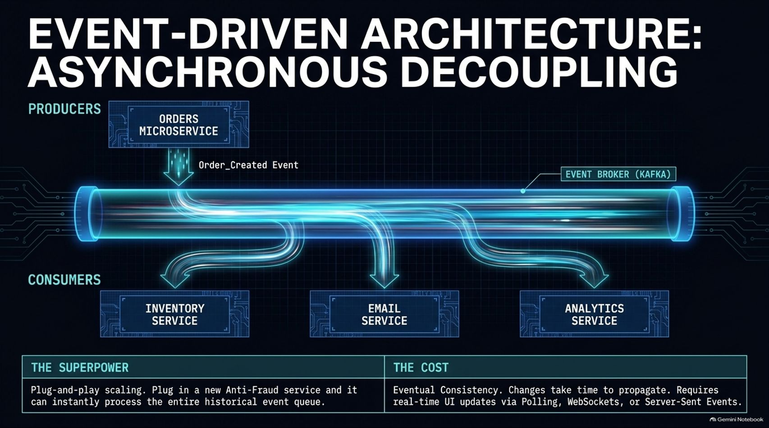
Notes:
Estimated Delivery Time: 4 – 6 minutes
Speaker Notes:
Even with gateways and BFFs, synchronous microservice chains eventually create tangled webs of dependencies. Event-Driven Architecture breaks this coupling using asynchronous producers, consumers, and an event broker like Apache Kafka.
When the Orders Microservice processes a checkout, it simply publishes an Order_Created event to the broker and moves on. Downstream consumers—the Inventory Service, Email Service, and Analytics Service—subscribe to that topic and react independently.
The Superpower: Plug-and-play scaling. You can plug in a brand-new Anti-Fraud service tomorrow, and because brokers like Kafka persist historical event logs, it can immediately replay and process historical data.
The Cost: You trade immediate consistency for Eventual Consistency. Data takes time to propagate through queues, meaning your UI must rely on real-time mechanisms like Polling, WebSockets, or Server-Sent Events to notify users when background tasks complete.

Slide 9
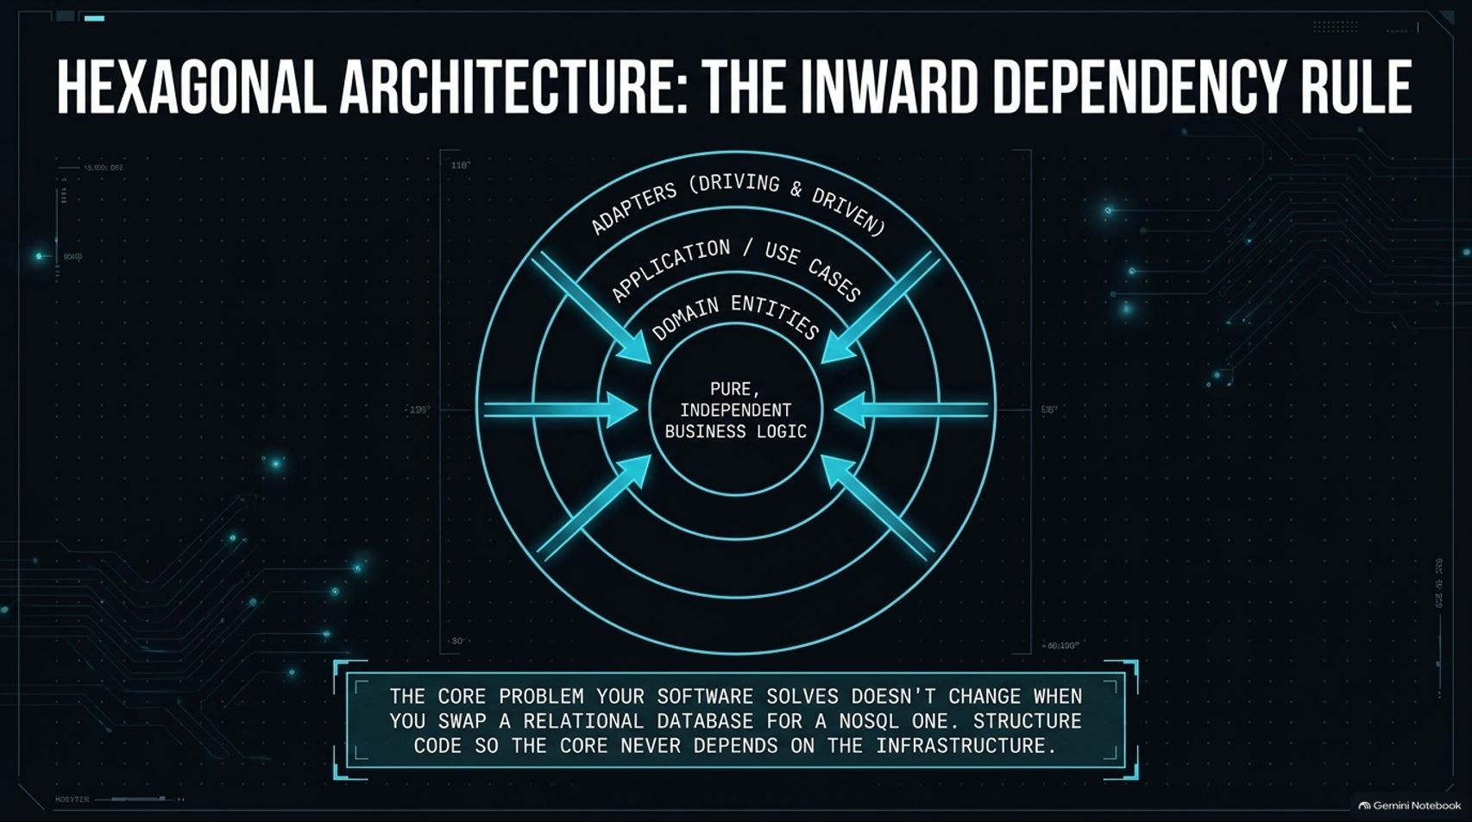
Notes:
Estimated Delivery Time: 3 – 5 minutes
Speaker Notes:
Inside individual services, traditional layered architectures often suffer from downward coupling—where business logic becomes tightly bound to specific database schemas or external frameworks. Hexagonal Architecture (alongside Onion and Clean Architecture) fixes this with a strict Inward Dependency Rule.
At the center sits your Pure, Independent Business Logic and Domain Entities. Surrounding that are Application Use Cases, and on the outer ring sit Adapters—both driving adapters (UI, GraphQL controllers, incoming events) and driven adapters (Postgres, NoSQL, external APIs).
Every dependency arrow points strictly inward. The core business problem your software solves doesn't change when you swap a relational database for a NoSQL store. By isolating the core from infrastructure, you can swap databases or add new API controllers without touching a single line of domain logic.

Slide 10
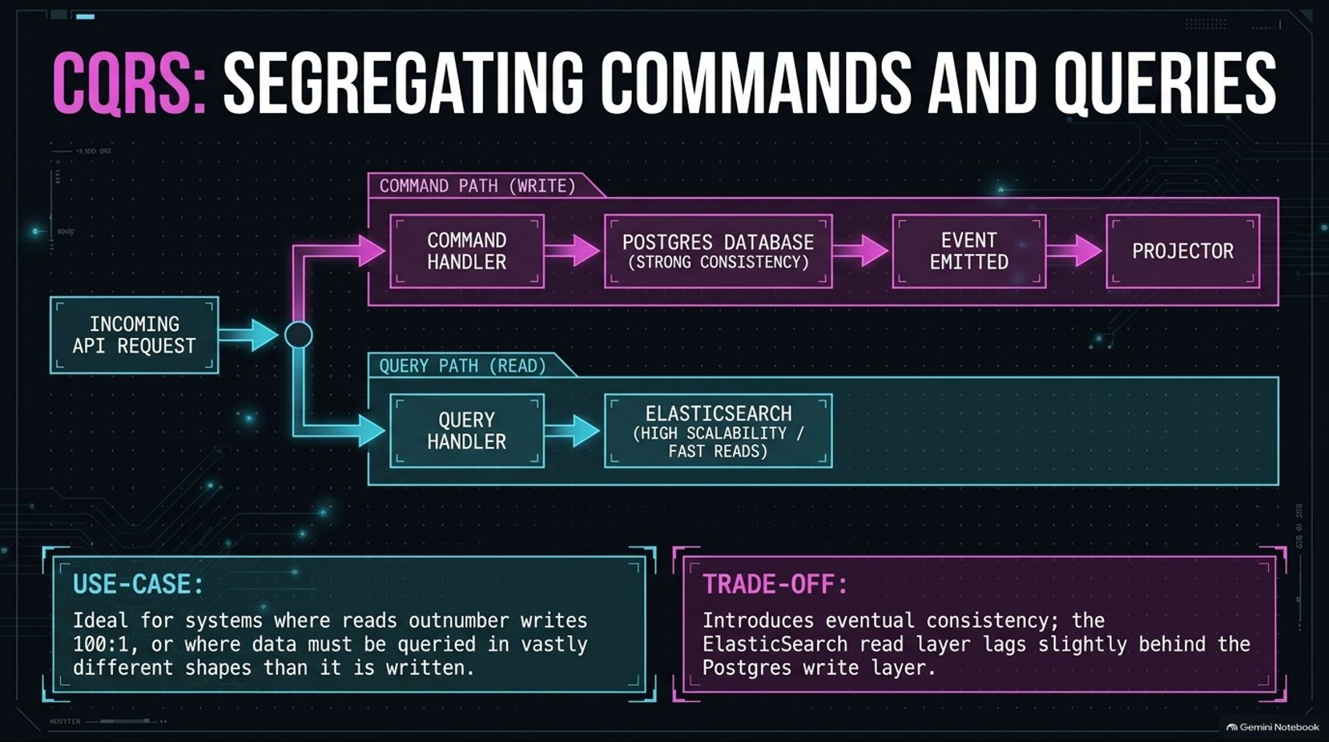
Notes:
Estimated Delivery Time: 3 – 5 minutes
Speaker Notes:
In high-scale systems, write operations and read operations often have completely different performance profiles. CQRS (Command Query Responsibility Segregation) splits your data pipeline into two distinct paths:
The Command Path (Write): Incoming mutations pass through a Command Handler into a strongly consistent database like Postgres, which then emits an event to a Projector.
The Query Path (Read): Read requests hit a Query Handler backed by a specialized, denormalized read store like Elasticsearch, built for ultra-fast queries and complex search shapes.
Use-Case & Trade-Off: CQRS is ideal when reads outnumber writes 100:1 or require vastly different data views. However, it introduces eventual consistency—there is a brief replication lag between a Postgres write and its visibility in Elasticsearch. Keep things simple until read/write asymmetry genuinely demands it.

Slide 11
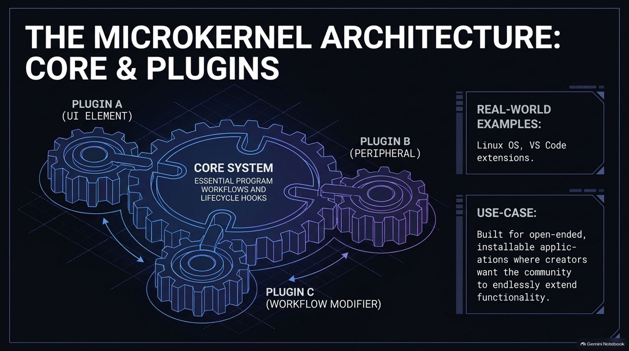

Slide 12
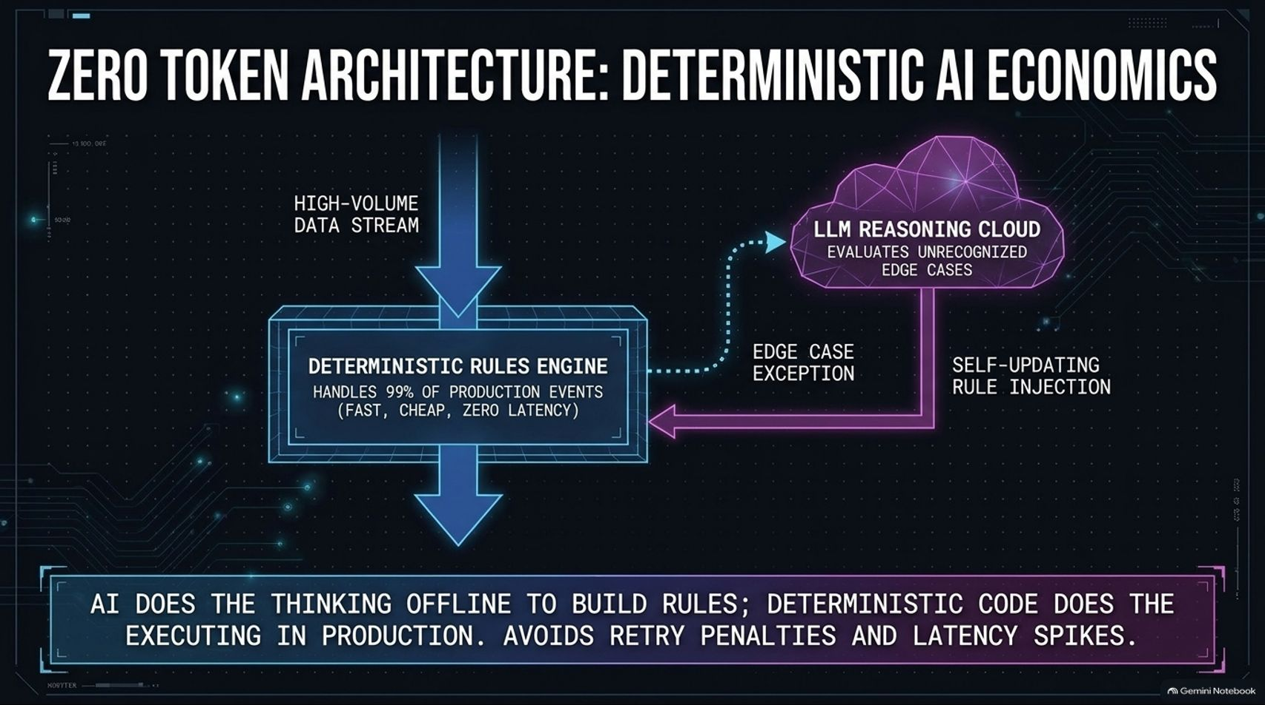
Notes:
Estimated Delivery Time: 4 – 6 minutes
Speaker Notes:
Now let's transition into AI-native system design, starting with Zero Token Architecture. Suppose you need to classify thousands of incoming e-commerce orders per minute. Sending every single event to a frontier LLM API is slow, expensive, and punishes you with double costs on retries.
Instead, we invert the model: a Deterministic Rules Engine sits directly in the high-volume production stream, handling 99% of routine events with near-zero latency and zero token cost.
Only when an unrecognized edge case exception occurs does the system route that event asynchronously to the LLM Reasoning Cloud. The LLM evaluates the anomaly and injects a new static rule back into the deterministic engine. In short: AI does the thinking offline to build rules; deterministic code does the executing in production.

Slide 13
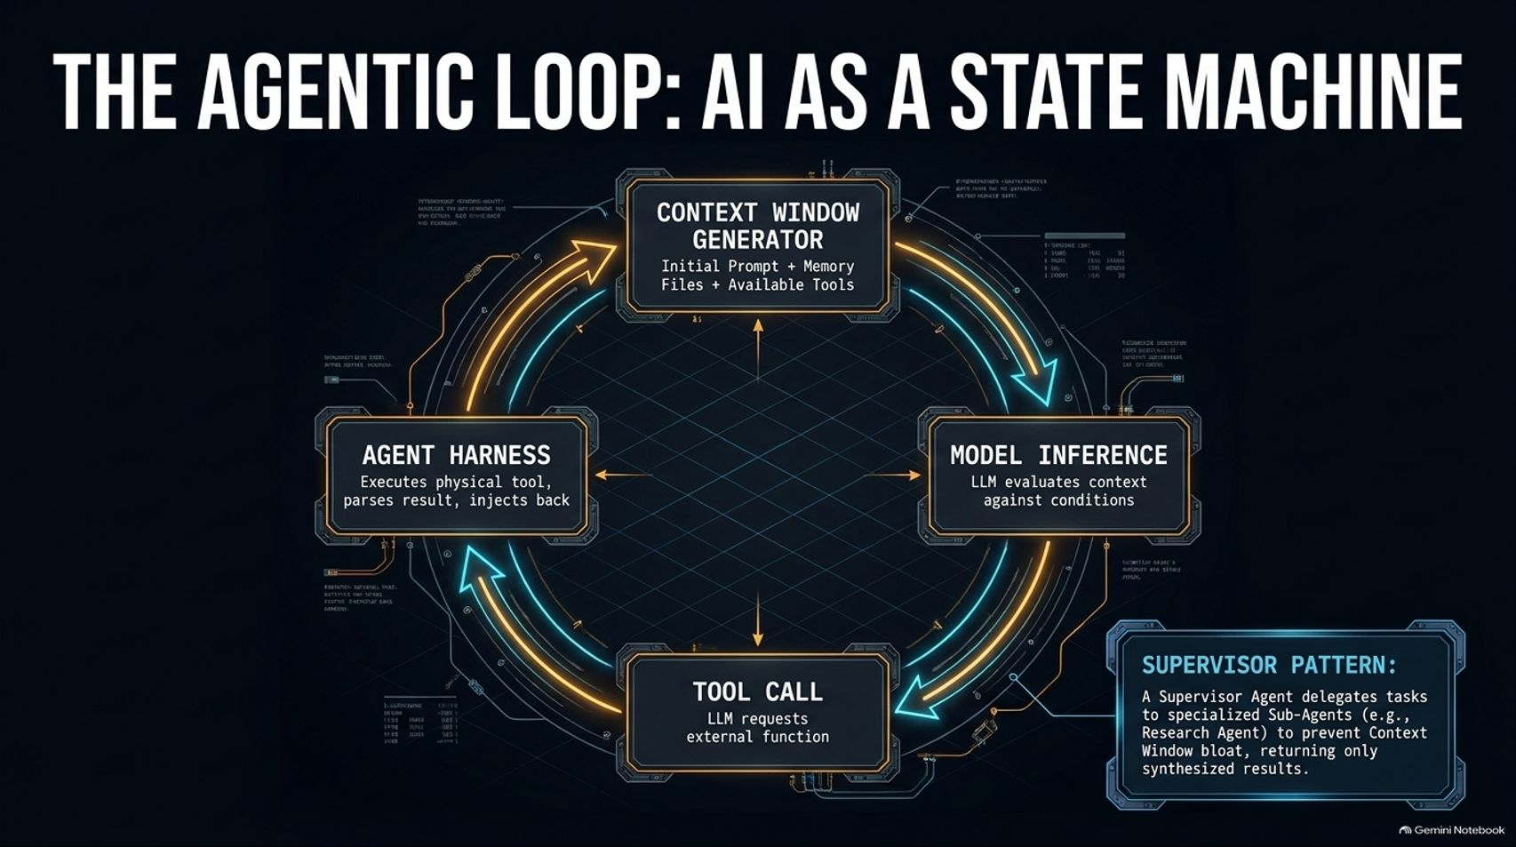
Notes:
Estimated Delivery Time: 4 – 6 minutes
Speaker Notes:
When tasks genuinely require dynamic reasoning—like autonomous coding assistants—we model the AI as an Agentic Loop, essentially a continuous while loop state machine:
Context Window Generator: Assembles the initial prompt, persistent memory files (CLAUDE.md, MEMORY.md), and available tool definitions.
Model Inference: The LLM evaluates the context against the goal condition.
Tool Call: Instead of finishing, the LLM outputs a structured request to invoke an external function (e.g., reading a file or running tests).
Agent Harness: Executes the physical tool locally, parses the output, injects it back into the context window, and loops until the condition is satisfied.
The Supervisor Pattern: To prevent a single agent's context window from bloating with raw search logs or web scrapes, a Supervisor Agent delegates specialized tasks to isolated Sub-Agents (like a Research Agent), receiving back only clean, synthesized results.

Slide 14
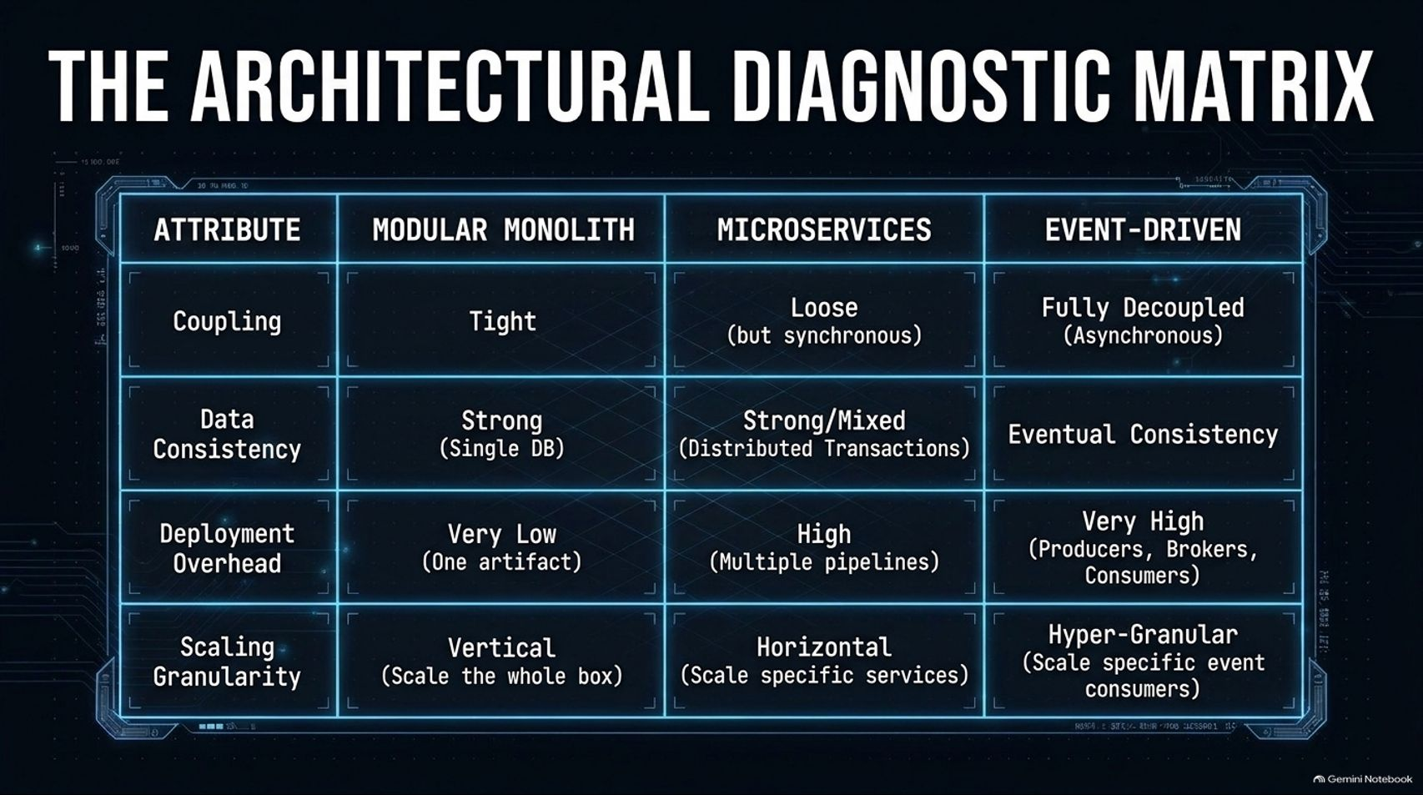
Notes:
Estimated Delivery Time: 3 – 4 minutes
Speaker Notes:
To help you compare our core backend paradigms side-by-side during design reviews or interviews, look at The Architectural Diagnostic Matrix:
Modular Monolith: Tight coupling, strong consistency in a single DB, very low deployment overhead (one artifact), and vertical scaling.
Microservices: Loose coupling (though often synchronous), mixed/distributed transactions, high deployment overhead across multiple pipelines, and horizontal service-level scaling.
Event-Driven Architecture: Fully decoupled asynchronous communication, eventual consistency, very high operational overhead (managing producers, brokers, and consumers), and hyper-granular scaling at the consumer level.

Slide 15
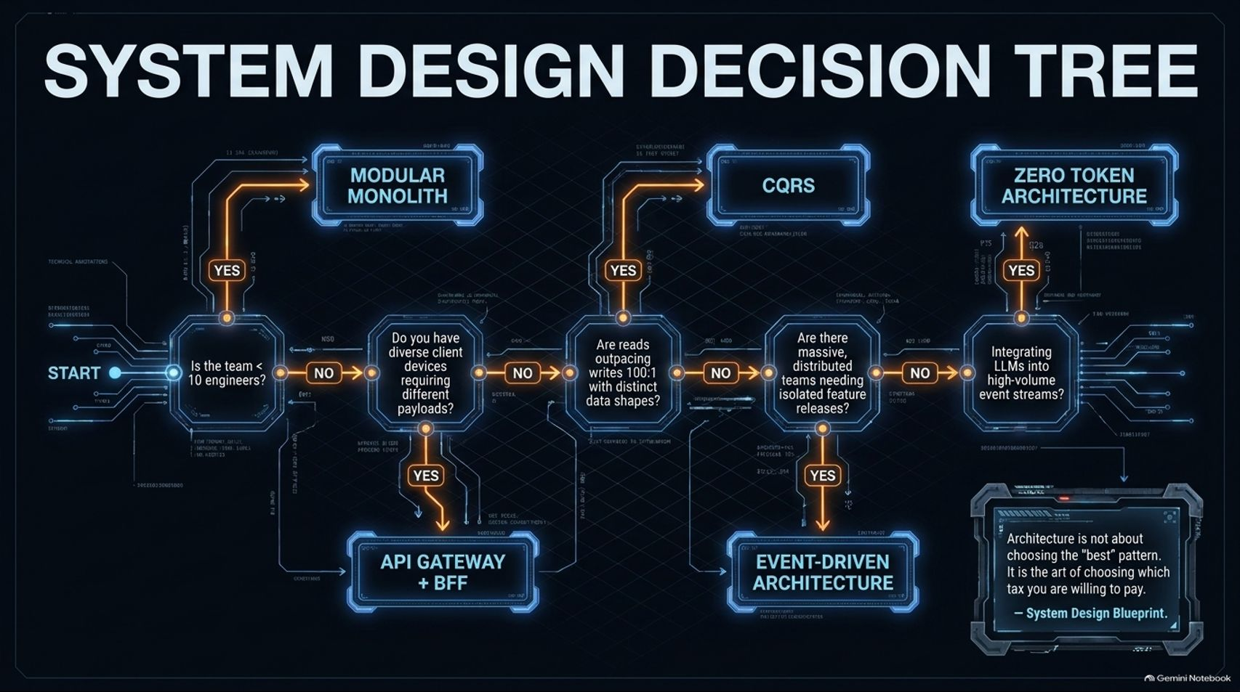
Notes:
Estimated Delivery Time: 3 – 5 minutes
Speaker Notes:
How do you choose the right pattern under pressure? Follow this System Design Decision Tree from left to right:
Is your team smaller than 10 engineers? If yes, stop immediately and build a Modular Monolith. Do not over-engineer.
Do you have diverse client devices needing different payloads? If yes, introduce an API Gateway + BFF.
Do reads outpace writes 100:1 with distinct query shapes? If yes, implement CQRS.
Do you have massive, distributed teams needing isolated feature releases? Move to Event-Driven Architecture.
Are you integrating LLMs into high-volume event streams? Apply Zero Token Architecture.
Remember the golden rule in the bottom right: Architecture is not about choosing the "best" pattern; it is the art of choosing which tax you are willing to pay.

Slide 16
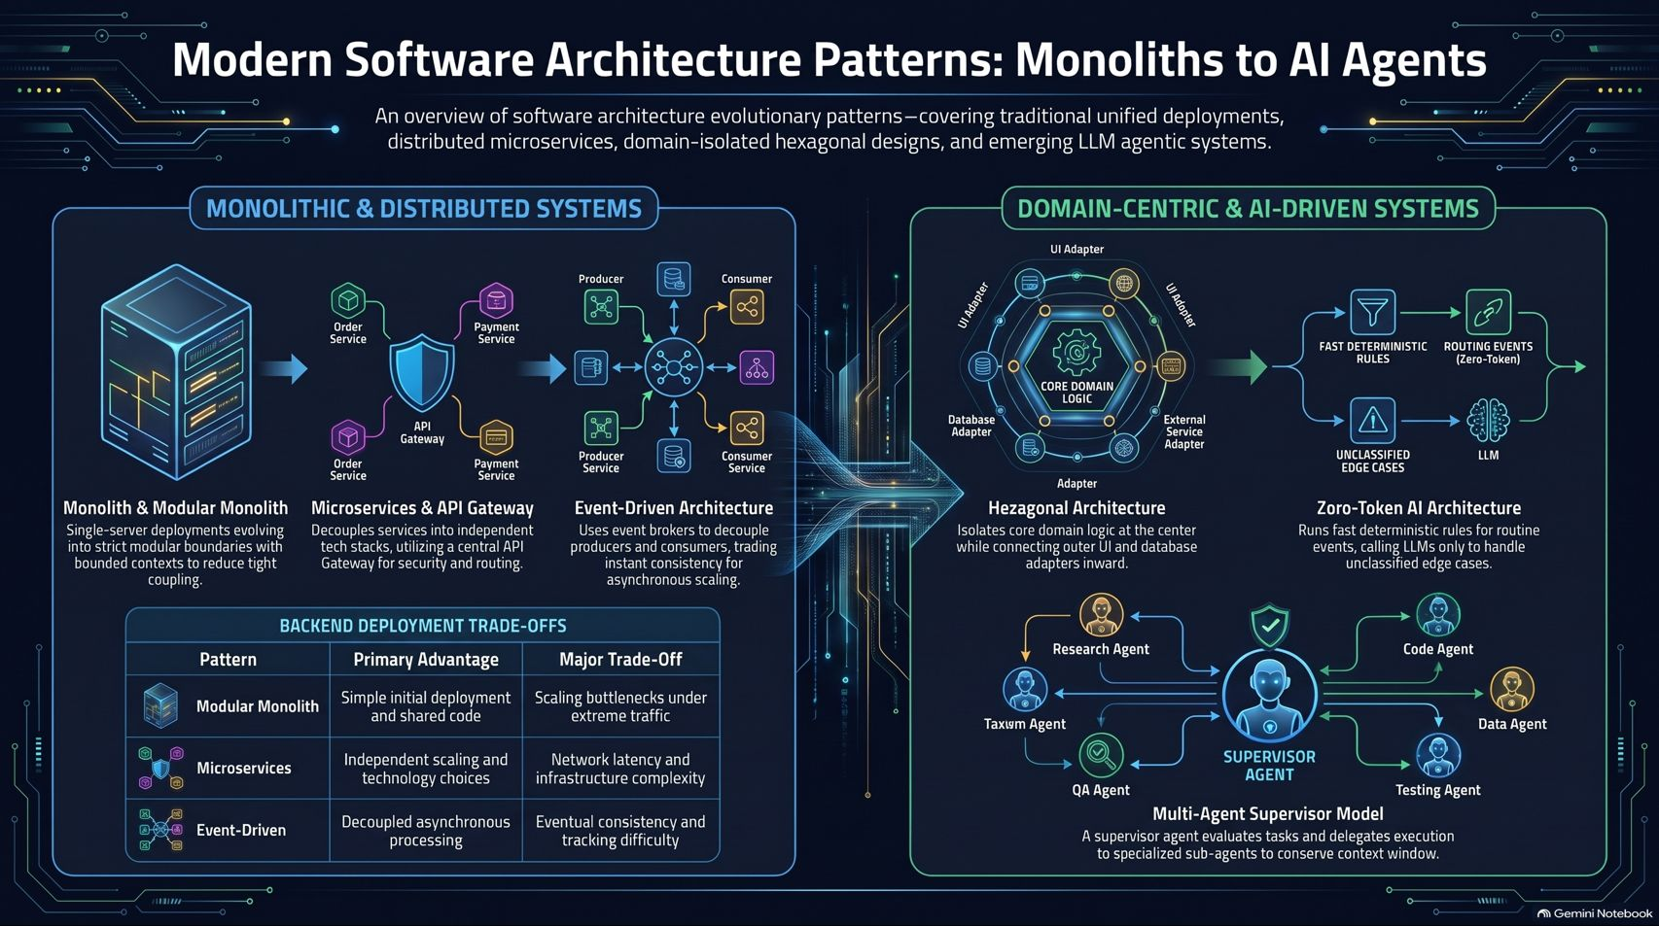
Notes:
Estimated Delivery Time: 3 – 5 minutes
Speaker Notes:
On our final summary poster, we view the entire architectural landscape at a glance.
On the left, under Monolithic & Distributed Systems, we see how applications scale outward—from single-server modular monoliths to API-gateway-protected microservices and asynchronous event brokers—alongside their core deployment trade-offs.
On the right, under Domain-Centric & AI-Driven Systems, we see how modern engineering protects core domain logic through Hexagonal adapters while taming AI latency and context limits through Zero-Token rules engines and Multi-Agent Supervisor models.
Master these building blocks and their trade-offs, and you will be equipped to design resilient, scalable systems for any era of software engineering. Thank you!

