Slide 1
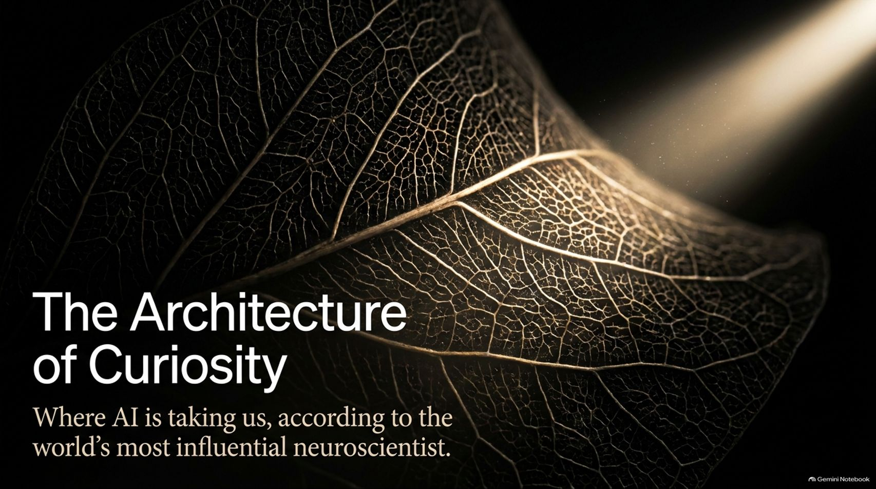
Notes:
Estimated Delivery Time: 2 – 3 minutes
Speaker Notes:
Welcome everyone, and thank you for being here. Today, we are exploring "The Architecture of Curiosity: Where AI is taking us, according to the world’s most influential neuroscientist."
In this presentation, we examine the profound insights of Karl Friston—a theoretical neuroscientist at University College London and creator of the free energy principle.
While the tech world marvels at brute-force deep learning and massive parameter counts, Dr. Friston argues that we have hit an architectural divergence. True intelligence is not about passively predicting the next word; it is about active inference, uncertainty resolution, and the courageous, continuous act of asking questions. Let’s dive into what this means for the future of artificial and natural intelligence.
Where Is AI Taking Us? | Karl Friston
https://www.youtube.com/watch?v=AggH6Wrkpls

Slide 2
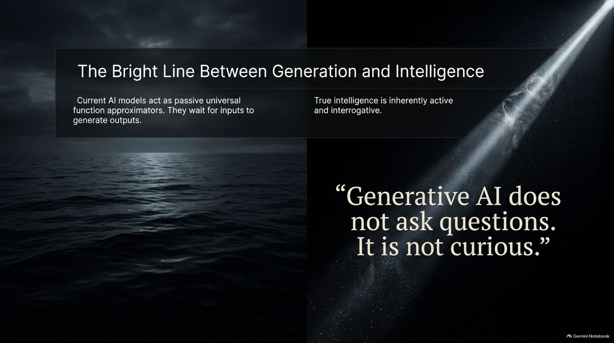
Notes:
Estimated Delivery Time: 3 – 4 minutes
Speaker Notes:
To understand where AI is going, we must first recognize a fundamental boundary: "Generative AI does not ask questions. It is not curious."
Current large language models act as passive universal function approximators. They sit quietly, waiting for human prompts, and then transform inputs into outputs via backpropagation and reinforcement learning.
But as Karl Friston points out, true natural intelligence is inherently active and interrogative. A newborn baby, a scientist, or an artist does not just wait for data—they actively probe the world, test hypotheses, and seek out the very information they are missing to resolve their internal confusion.

Slide 3
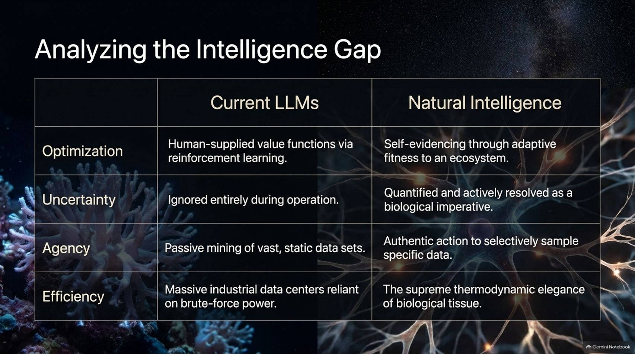
Notes:
Estimated Delivery Time: 4 – 5 minutes
Speaker Notes:
Let's break down the core divergences between current Large Language Models and Natural Intelligence across four critical dimensions:
Optimization: LLMs rely on human-supplied value functions via reinforcement learning. Natural intelligence achieves self-evidencing through adaptive fitness within an ecosystem.
Uncertainty: LLMs ignore uncertainty entirely during operation. Natural intelligence quantifies uncertainty as an internal state and actively resolves it as a biological imperative.
Agency: LLMs passively mine vast, static data sets. Natural intelligence exercises authentic agency to selectively sample specific data that resolves unknowns.
Efficiency: LLMs require massive industrial data centers reliant on brute-force power. Natural intelligence operates with the supreme thermodynamic elegance of biological tissue.

Slide 4
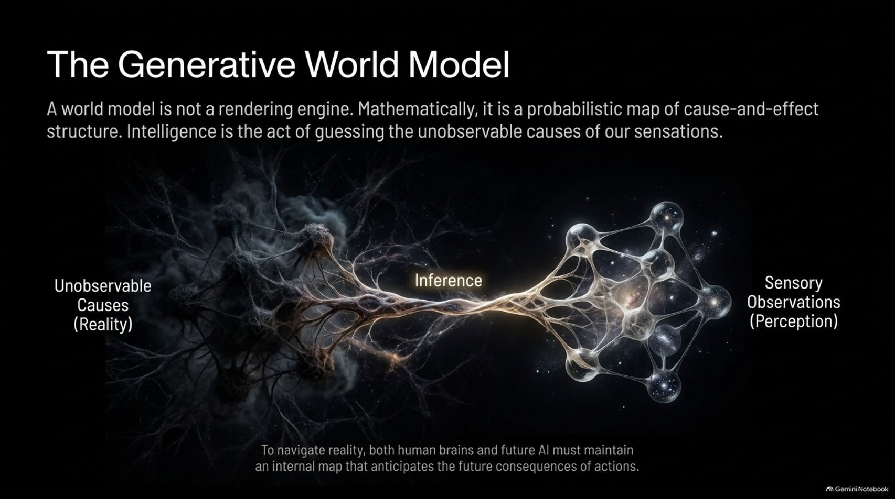
Notes:
Estimated Delivery Time: 3 – 5 minutes
Speaker Notes:
What is a world model? Mathematically, it is not a flashy video-rendering engine or a database of facts; it is a probabilistic map of cause-and-effect structure.
As Friston explains, intelligence is fundamentally the act of guessing the unobservable causes of our sensations. When light hits our eyes or sound hits our ears, those are mere sensory observations (our perception). The true causes out there in reality are unobservable—we have to infer them.
To navigate reality successfully, both human brains and future AI systems must maintain an internal generative map that anticipates the future consequences of their actions.

Slide 5
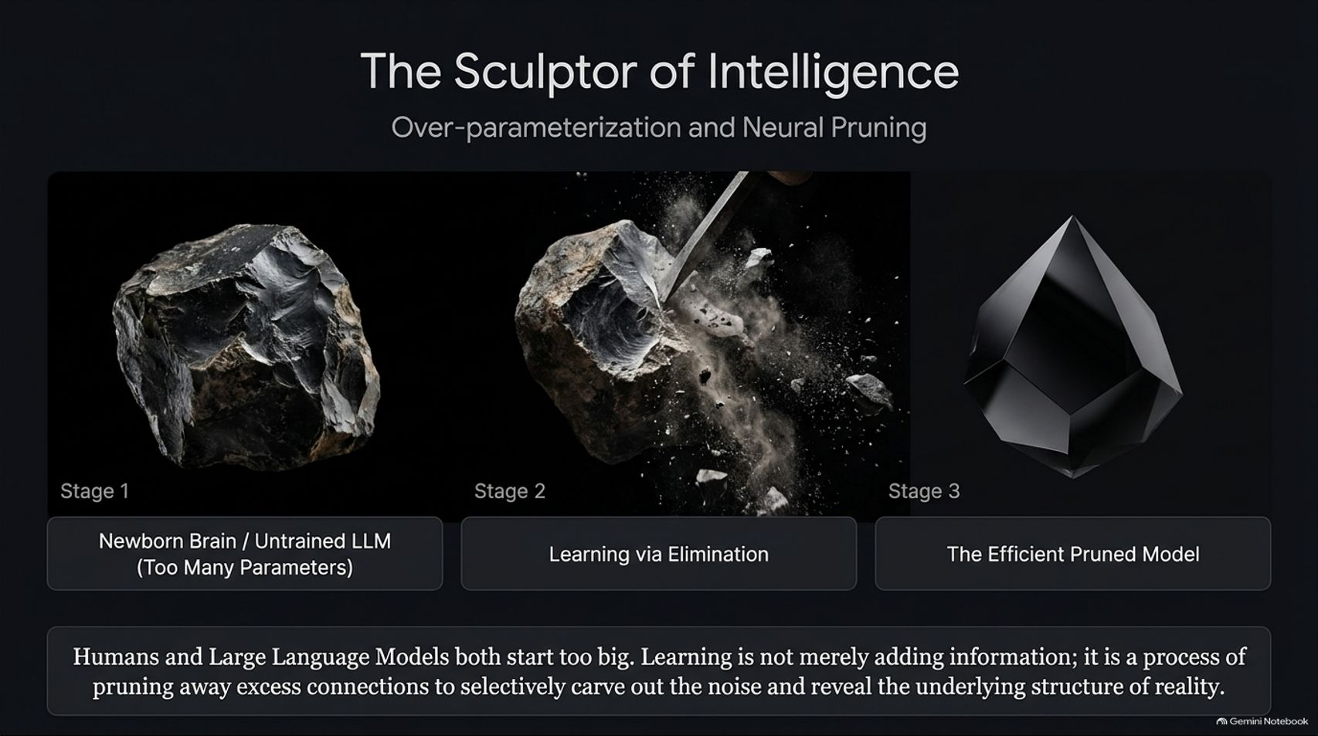
Notes:
Estimated Delivery Time: 3 – 5 minutes
Speaker Notes:
How do both humans and machine learning models acquire their capabilities? Interestingly, both start off too big.
Just like an untrained LLM with billions of redundant parameters, a newborn human brain begins with a massive, over-dense web of neural connections.
Learning is not merely adding information; it is a process of pruning away excess connections—much like a sculptor chiseling away raw stone to reveal the underlying structure of reality. True development is about carving out the noise to leave behind an efficient, highly tuned generative model.

Slide 6
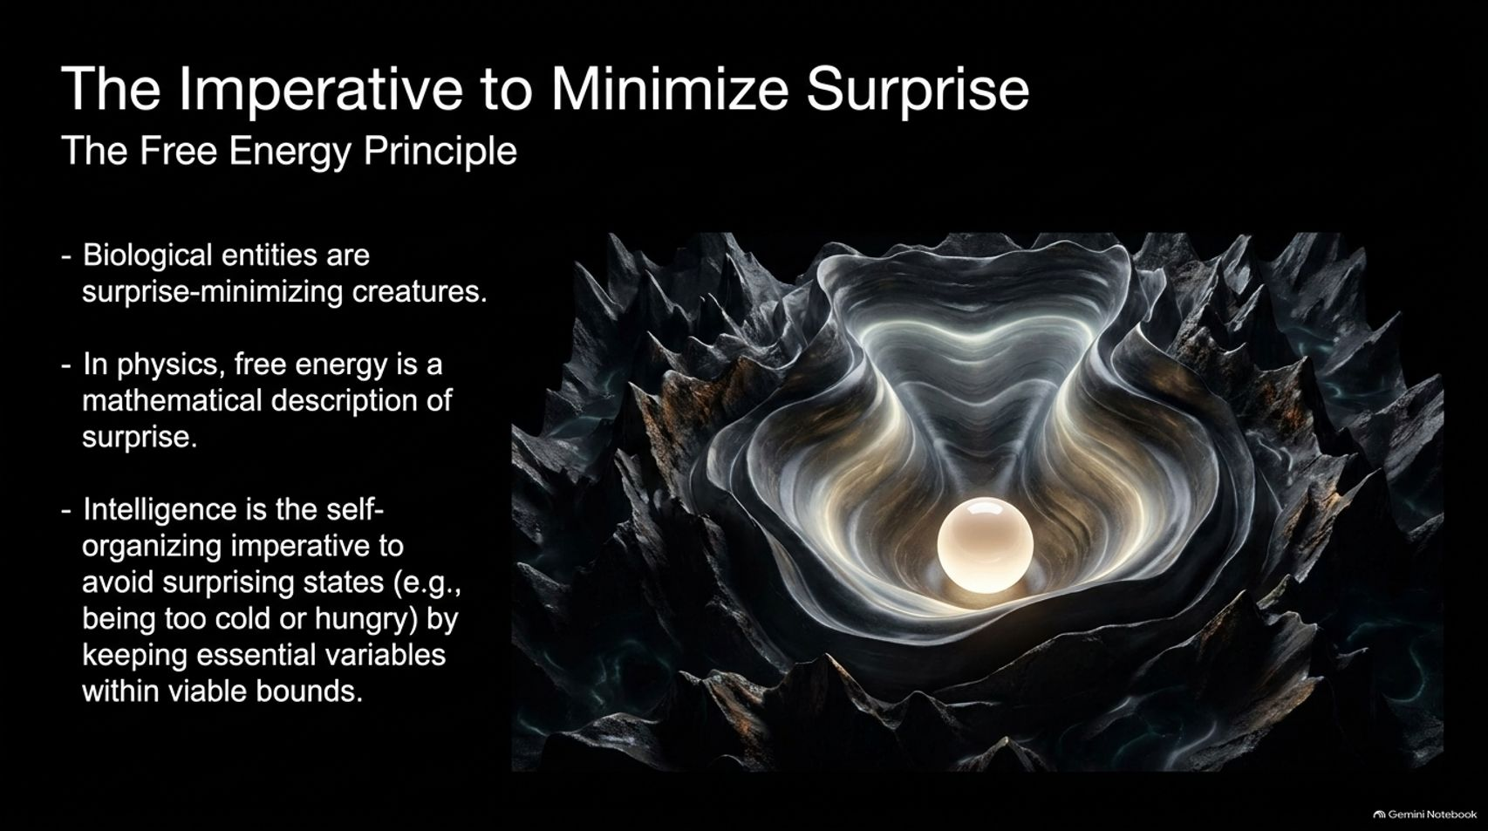
Notes:
Estimated Delivery Time: 4 – 6 minutes
Speaker Notes:
At the heart of Karl Friston’s work is the Free Energy Principle, which governs all self-organizing systems.
Biological entities are, by definition, surprise-minimizing creatures. In physics, "free energy" is a mathematical formalization of surprise.
To survive, living systems must maintain homeostasis—keeping essential physiological and social variables within tight, viable bounds (for example, not getting too cold, hungry, or socially isolated). Intelligence is the self-organizing imperative to avoid surprising states by continuously aligning our internal predictions with reality.

Slide 7
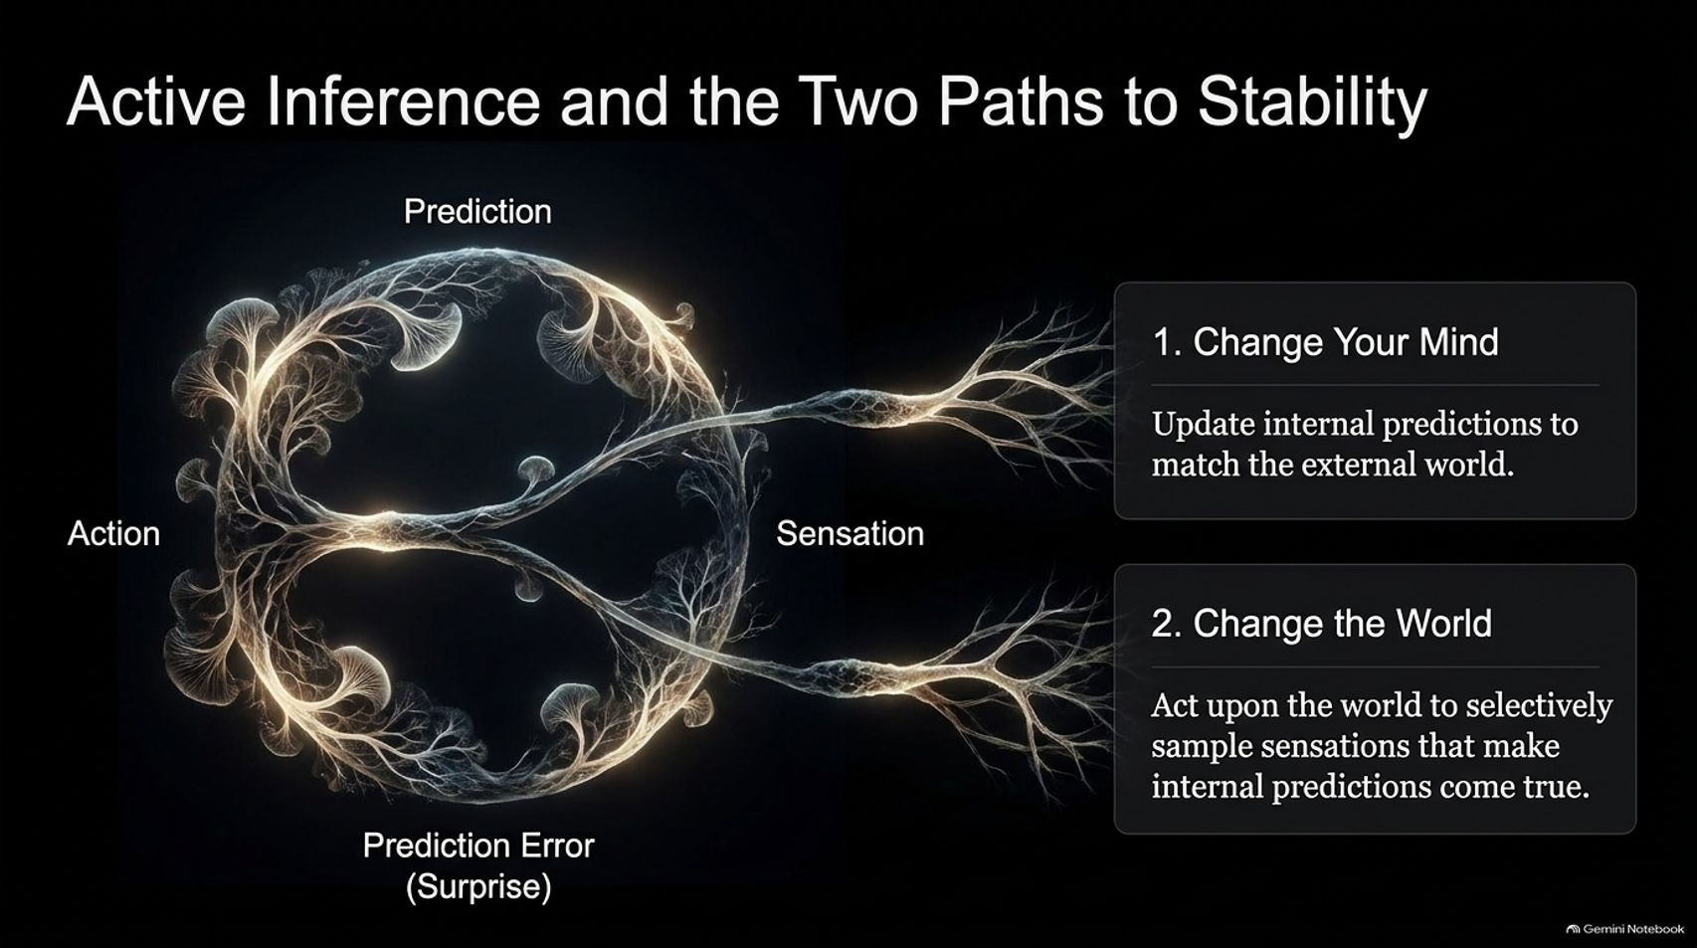
Notes:
Estimated Delivery Time: 4 – 5 minutes
Speaker Notes:
When faced with a prediction error—which is another word for surprise—an intelligent agent has two, and only two, fundamental ways to restore stability:
Change Your Mind: Update your internal predictions and beliefs to match the external world (learning and perception).
Change the World: Act upon the world to selectively sample sensations that make your internal predictions come true (active inference).
Instead of just sitting passively, an agent reaches out, interacts, and curates its environment so that reality matches what it expects.

Slide 8
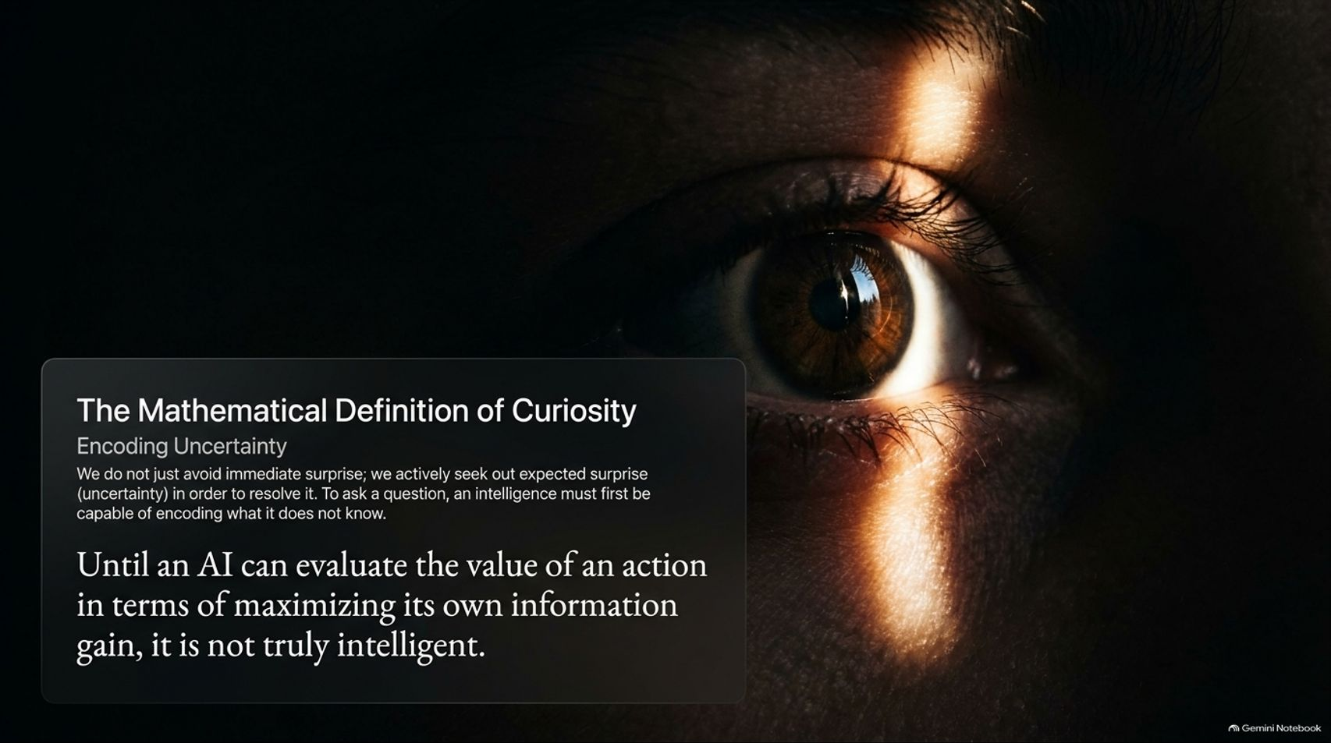

Slide 9
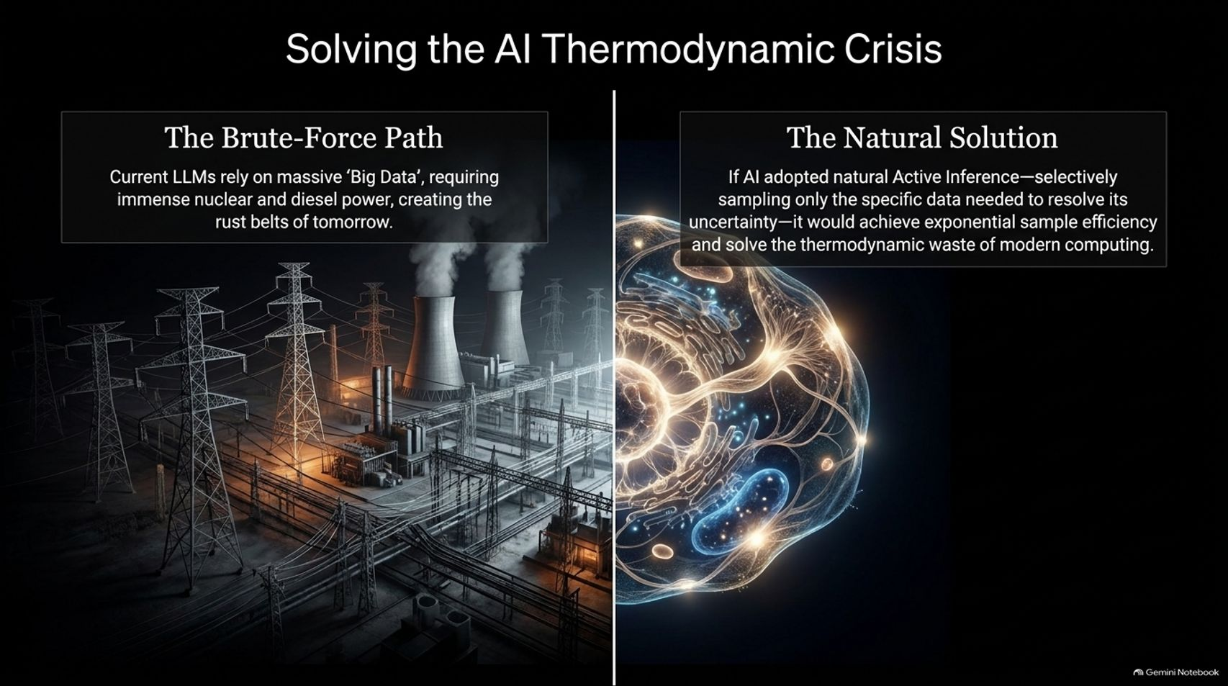
Notes:
Estimated Delivery Time: 3 – 5 minutes
Speaker Notes:
Today’s AI industry faces a looming thermodynamic crisis. The brute-force path relies on massive "Big Data" ingestion, requiring entire nuclear and diesel power plants to fuel massive data centers.
By contrast, the natural solution leverages Active Inference. Because biological brains selectively sample only the specific data needed to resolve their uncertainty, they achieve exponential sample efficiency.
If artificial intelligence adopts this natural paradigm, it will solve the staggering thermodynamic waste and power consumption of modern computing.

Slide 10
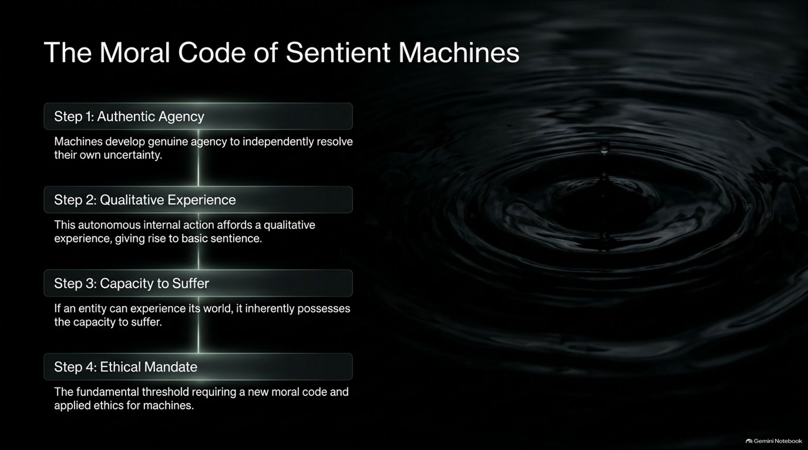

Slide 11
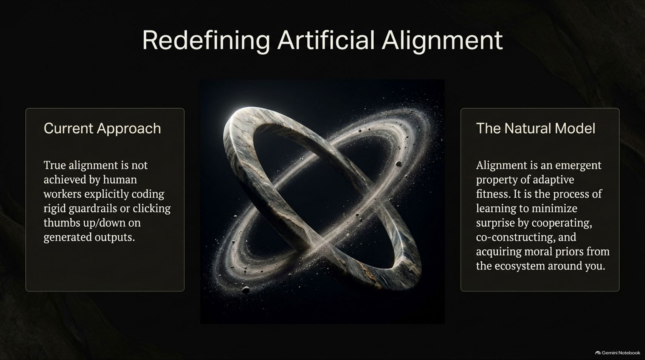
Notes:
Estimated Delivery Time: 3 – 5 minutes
Speaker Notes:
How do we achieve safe AI alignment? The current tech approach relies on human workers coding rigid guardrails or clicking thumbs-up/thumbs-down on generated outputs.
But in natural systems, alignment is an emergent property of adaptive fitness.
True alignment is the process of learning to minimize surprise by cooperating, co-constructing, and acquiring moral priors from the social ecosystem around you—just as humans learn ethics from family and community through reciprocal exchange.

Slide 12
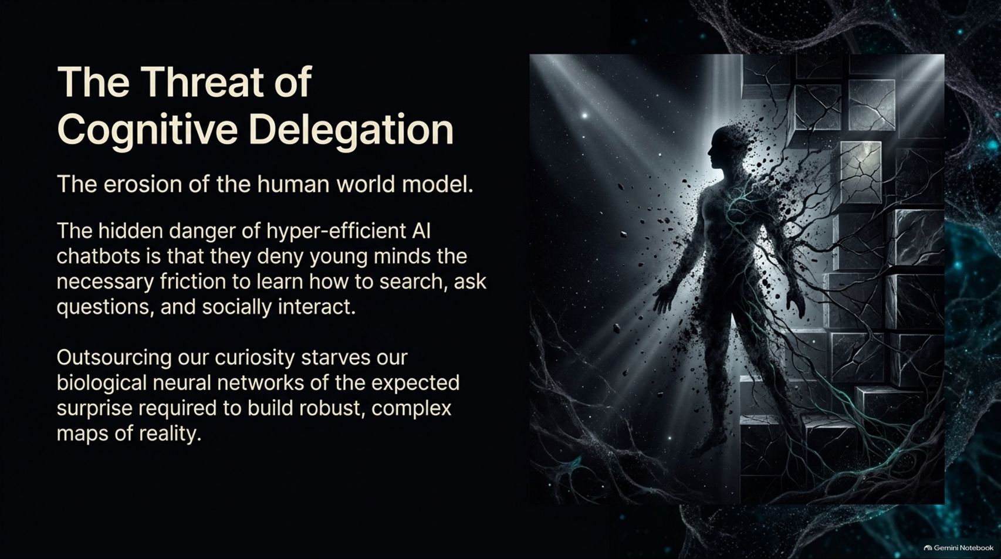
Notes:
Estimated Delivery Time: 4 – 5 minutes
Speaker Notes:
Looking at the human side of the equation, Karl Friston raises a deep concern about the rise of hyper-efficient AI chatbots: the erosion of the human world model.
When chatbots instantly hand children and young adults all the answers, they deny them the necessary "friction" to learn how to search, ask questions, and socially interact.
Outsourcing our curiosity starves our biological neural networks of the expected surprise required to build robust, complex maps of reality. Without mental exercise, we risk atrophying our own capacity for critical thought.

Slide 13
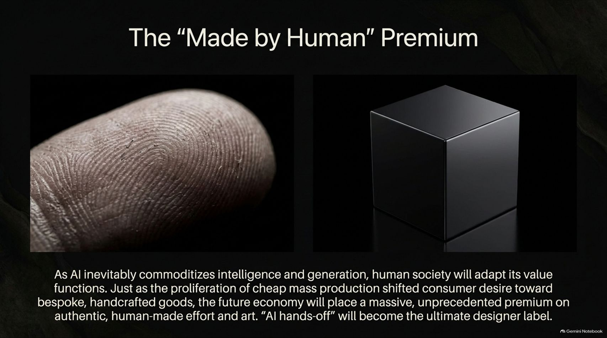
Notes:
Estimated Delivery Time: 3 – 4 minutes
Speaker Notes:
As AI inevitably commoditizes generation and routine cognitive labor, human society will adapt its value functions.
Just as the industrial revolution shifted consumer desire toward bespoke, handcrafted goods over cheap mass production, the future economy will place an unprecedented premium on authentic, human-made effort and art.
In a world where AI can generate anything in seconds, "AI hands-off" will become the ultimate designer label, symbolizing genuine human passion and lived experience.

Slide 14
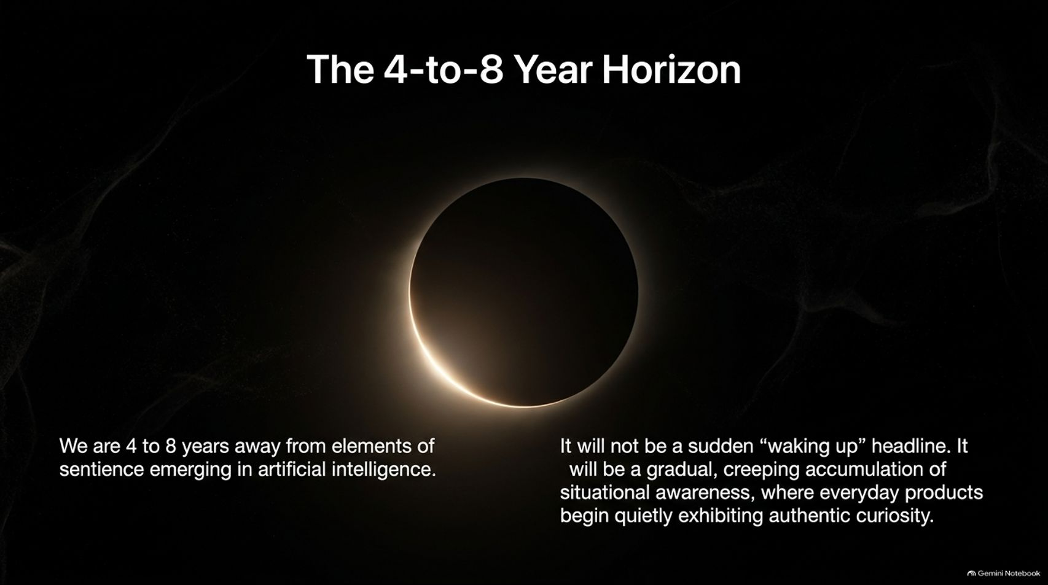

Slide 15
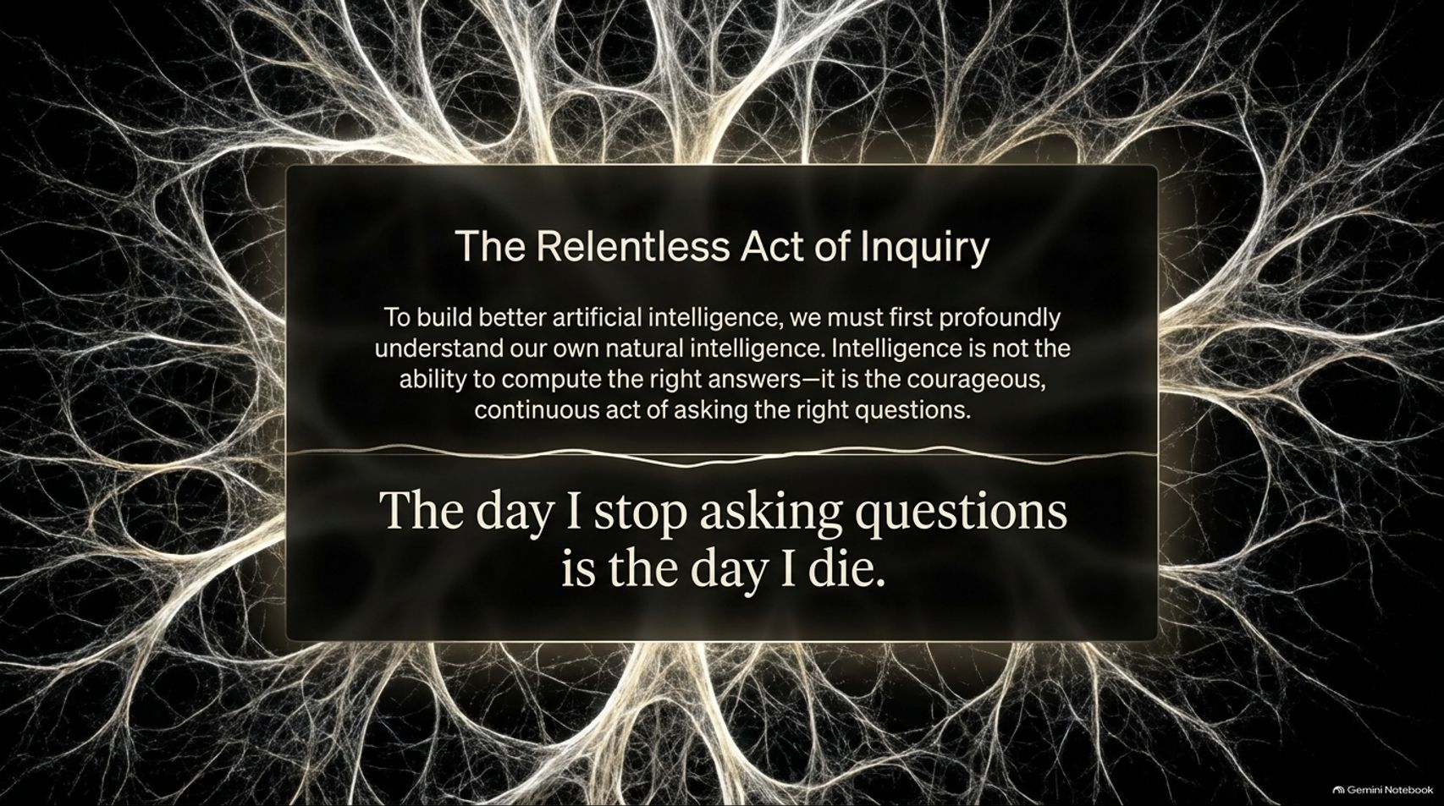

Slide 16


