Slide 1
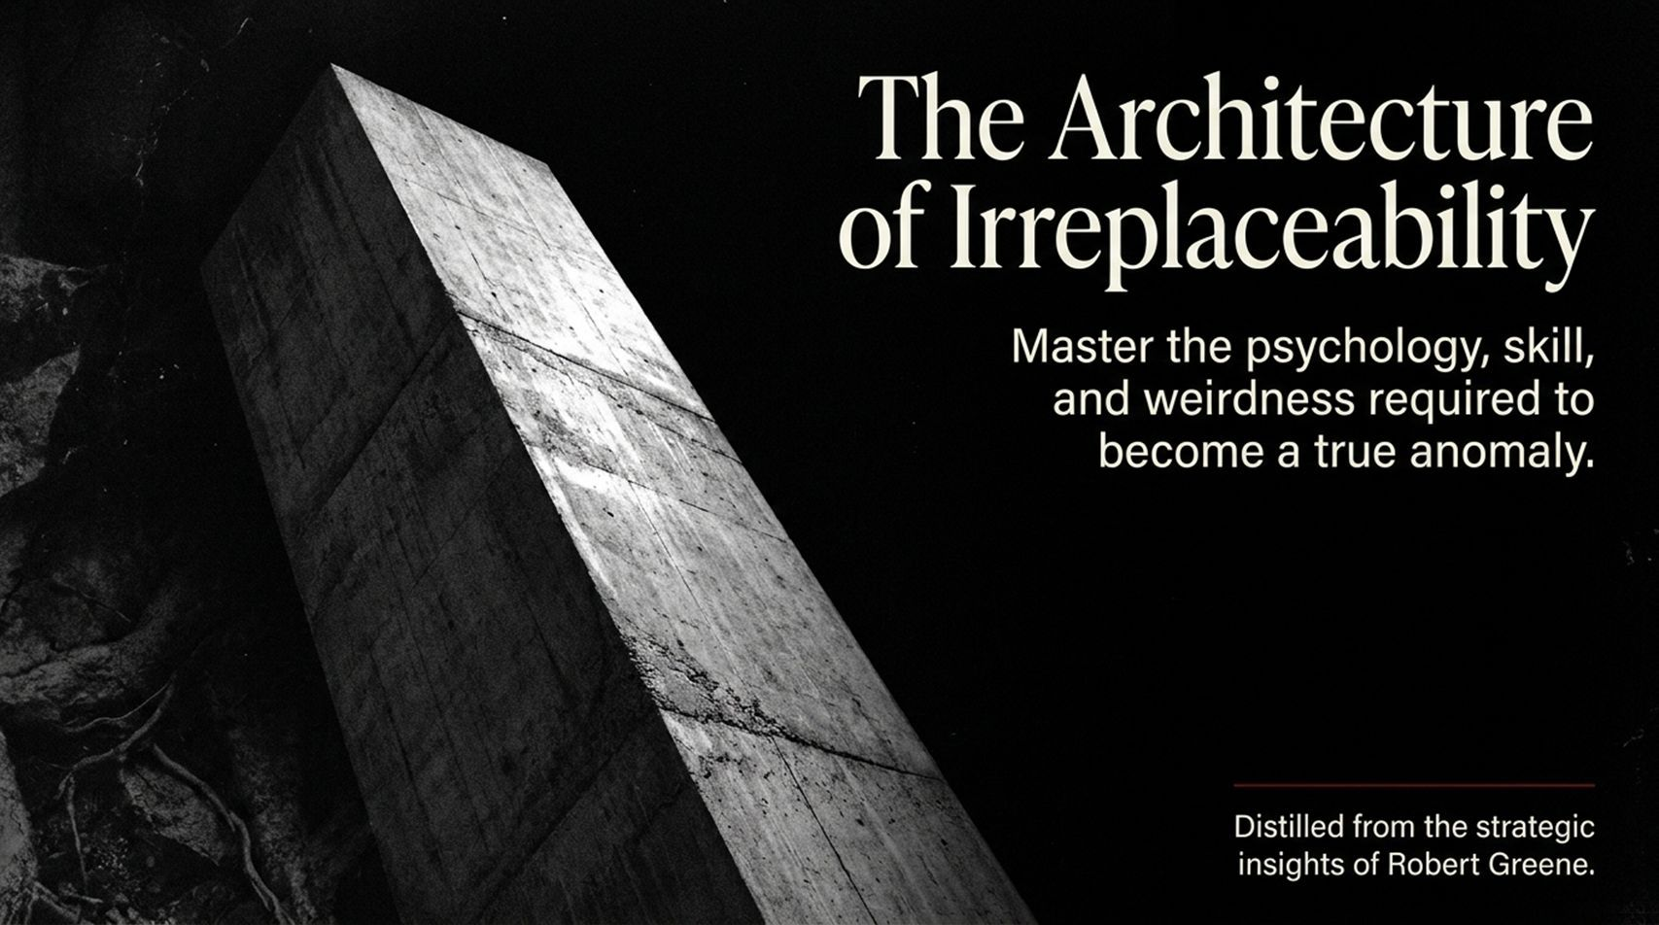
Notes:
Visual: A monumental, minimalist concrete monolith cutting upward into a dark, textured field.
Suggested Duration: 3 – 4 minutes.
Speaker Notes:
Opening Hook: Welcome, everyone. Let’s start with a brutal economic and biological truth: in a hyper-connected, AI-accelerated global market, being good at your job is no longer a moat. Being competent makes you a commodity.
Setting the Tone: Today, we are exploring The Architecture of Irreplaceability. This deck is distilled from the strategic insights of Robert Greene, evolutionary biology, and cognitive psychology. We are not looking at how to climb a traditional corporate ladder by following rules. We are looking at how to rewire your mind, weaponize your quirks, and systematically construct a professional profile that makes you mathematically impossible to replicate.
Core Premise: The goal is simple: stop swimming downstream into the vast ocean of interchangeable human parts, and learn how to stand as an irreplaceable anomaly.
Become So Valuable, Calm, Disciplined, and Rare That People Fear Losing Access to You- Robert Greene
https://www.youtube.com/watch?v=IdBKmMfYNzg

Slide 2
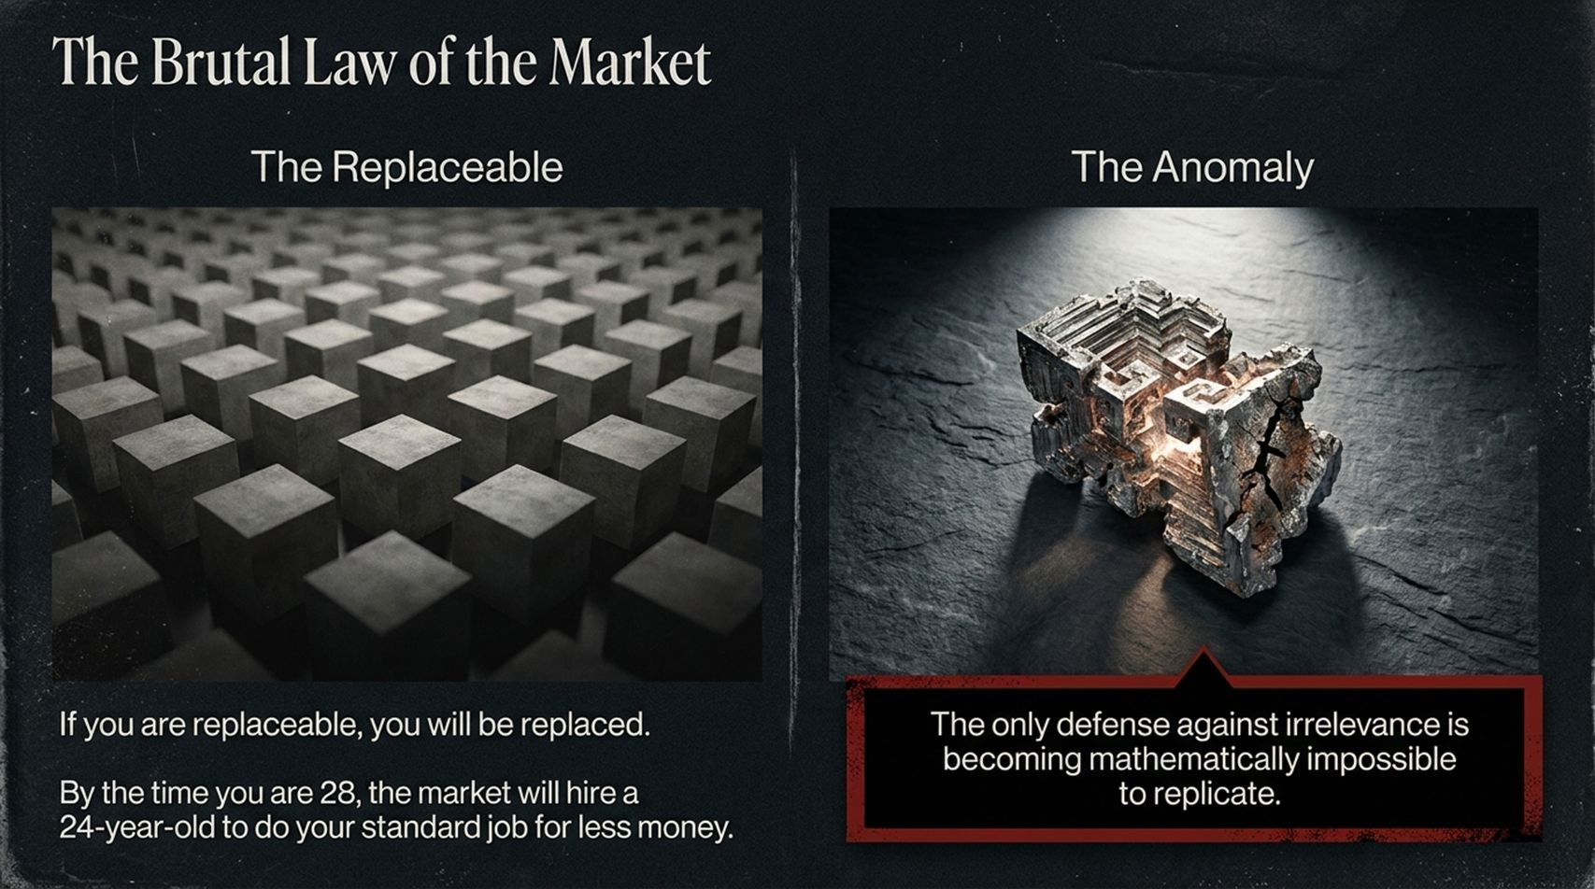
Notes:
Visual: Contrast between a monotonous grid of identical concrete blocks ("The Replaceable") and a complex, glowing metallic crystal ("The Anomaly").
Suggested Duration: 4 – 5 minutes.
Speaker Notes:
The Commodity Trap: Look at the left side of the screen. If you are replaceable, you will be replaced. It’s not personal; it’s mathematical efficiency. By the time you are 28 years old, globalized labor markets and automated tooling mean that organizations can easily hire a 24-year-old to do your standard, routine job for less money.
The Anomaly Defense: If your value proposition is bounded entirely by standard job descriptions, you are living on borrowed time.
The Core Defense: As highlighted on the right, the only true defense against irrelevance is becoming mathematically impossible to replicate. When your skill stack, psychological perspective, and personal history merge into a singular point, you stop competing in a market. You are the market.

Slide 3
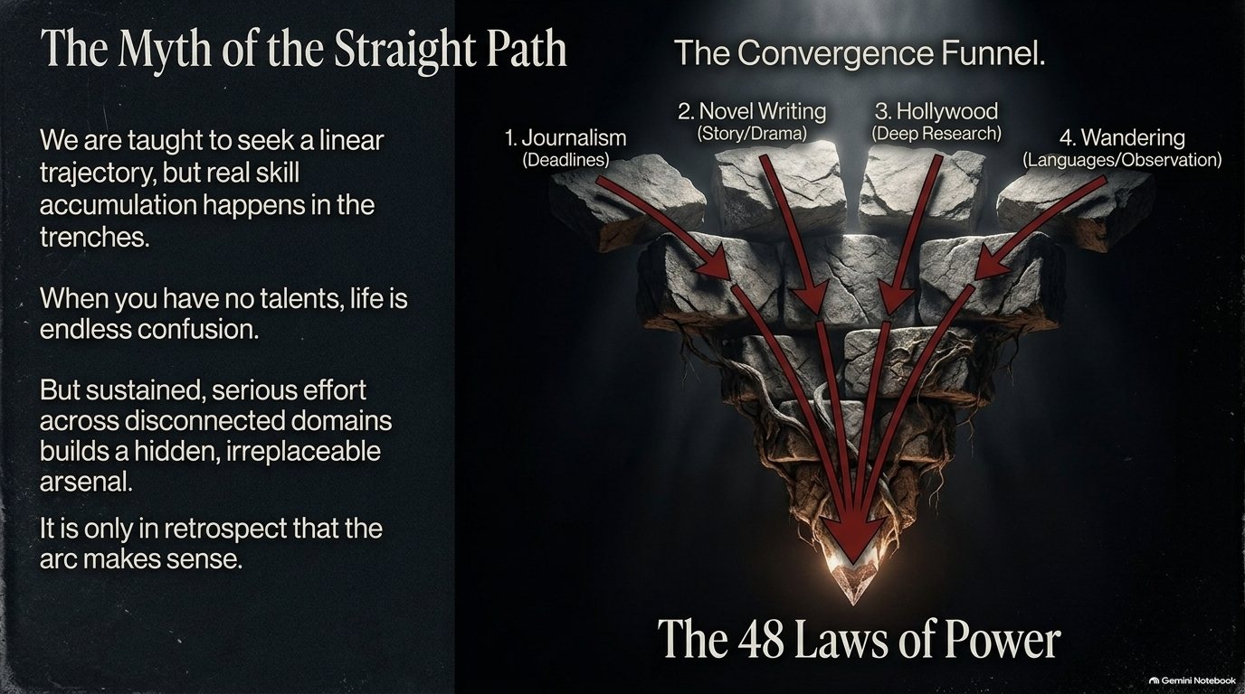
Notes:
Visual: A "Convergence Funnel" showing four disconnected streams (Journalism, Novel Writing, Hollywood, Wandering) funneling down into the foundational pillars of The 48 Laws of Power.
Suggested Duration: 4 – 6 minutes.
Speaker Notes:
The Linear Fallacy: From childhood, we are taught to seek a clean, linear trajectory: study this subject, get this specific entry-level job, take promotion A, then promotion B. But real, high-leverage skill accumulation happens in the messy, chaotic trenches.
The Confusion of Variety: When you have no traditional talent or single-track focus early on, life often feels like endless confusion. But sustained, serious effort across seemingly disconnected domains builds a hidden, irreplaceable arsenal.
The Robert Greene Analogy: Look at the funnel on screen. Robert Greene didn't start out writing masterclasses on power. He wandered through 80 different jobs—working as a journalist under tight deadlines, writing novels focusing on deep drama, conducting deep historical research in Hollywood, and traveling across languages and cultures. It was only in retrospect that this wild arc made sense, converging into a singular, world-class book that nobody else on earth could have written.

Slide 4
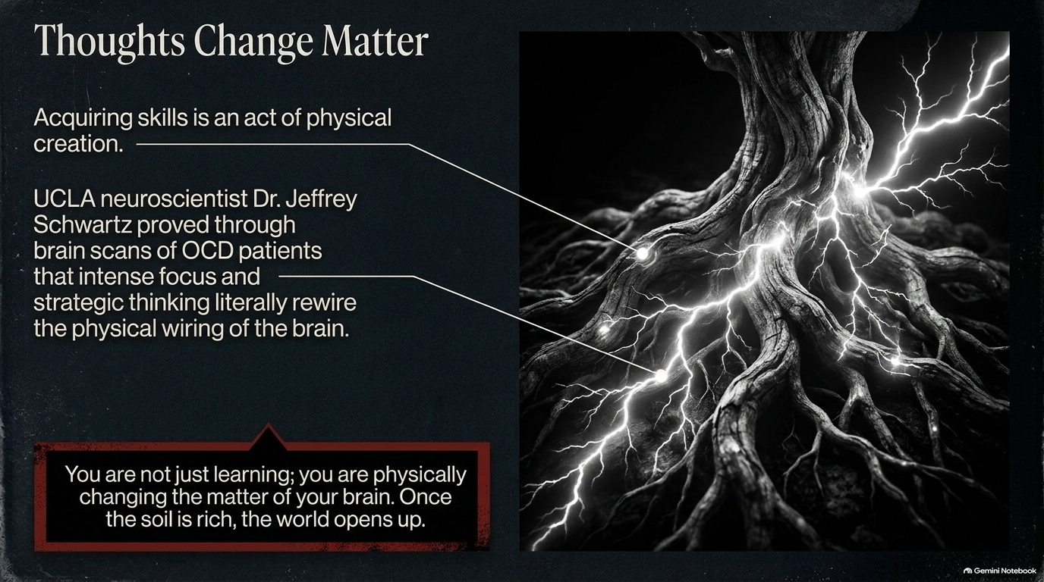
Notes:
Visual: A glowing, neural-network-like tree root system pulsing with electrical energy.
Suggested Duration: 3 – 5 minutes.
Speaker Notes:
Neuroplasticity as Architecture: Acquiring complex, disparate skills is not just a mental exercise—it is an act of physical creation.
The Science: UCLA neuroscientist Dr. Jeffrey Schwartz proved through brain scans of OCD patients that intense focus, behavioral conditioning, and strategic thinking literally rewire the physical wiring of the brain. Thoughts alter physical matter.
The Takeaway: You are not just "learning" passively; you are physically changing the matter and synaptic density of your brain. When you force yourself into uncomfortable intellectual territory, you enrich the soil of your mind. Once that soil is rich, the world opens up.

Slide 5
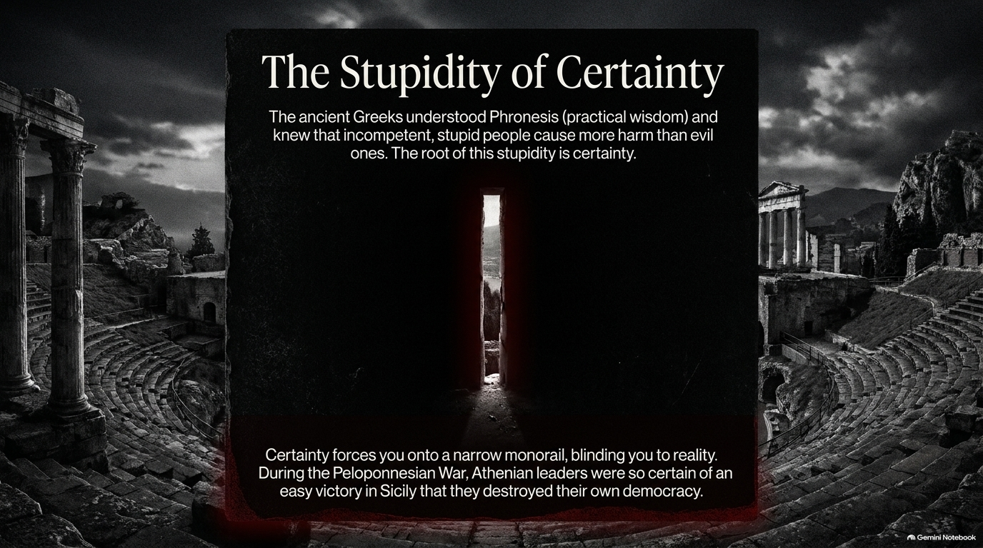
Notes:
Visual: A dark, ancient colosseum framing a single, narrow vertical slit of harsh light.
Suggested Duration: 3 – 5 minutes.
Speaker Notes:
Phronesis and Folly: The ancient Greeks understood Phronesis—practical wisdom—and recognized a terrifying truth: incompetent, stupid people often cause vastly more destruction to societies than explicitly evil ones. The root of this stupidity is certainty.
The Monorail Blindspot: Certainty forces you onto a narrow monorail, blinding you entirely to the shifting realities around you.
Historical Warning: During the Peloponnesian War, Athenian leaders were so absolutely certain of an easy, sweeping victory in Sicily that they ignored strategic warnings, overextended their forces, and ultimately destroyed their own democracy from within. Beware of anyone who has total, unshakeable answers; certainty is the precursor to collapse.

Slide 6
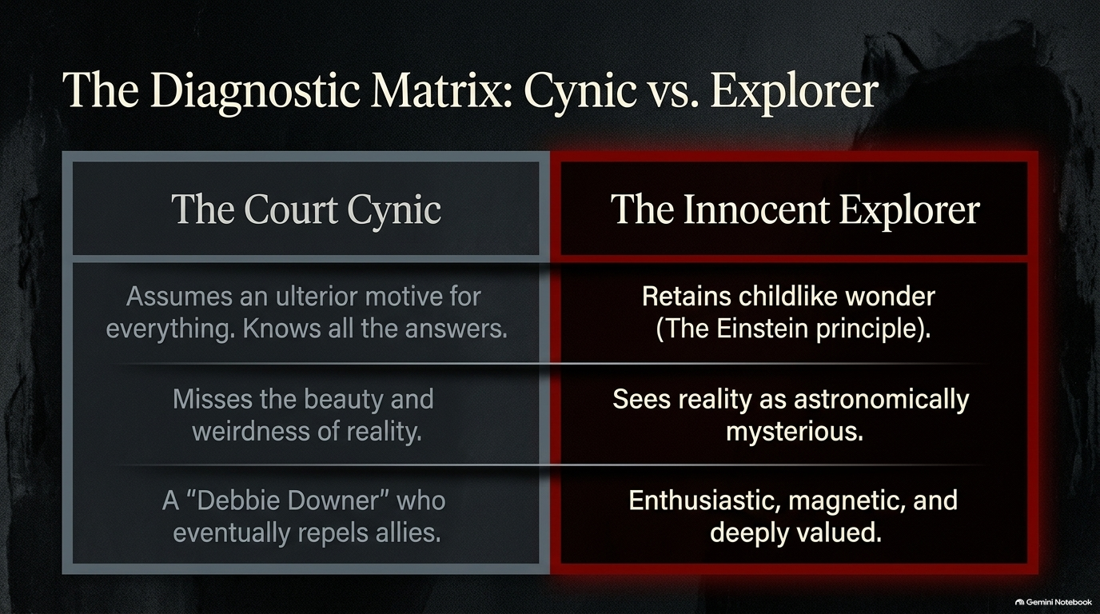
Notes:
Visual: A split comparison table contrasting "The Court Cynic" with "The Innocent Explorer".
Suggested Duration: 4 – 5 minutes.
Speaker Notes:
Two Ways of Viewing Reality: Look at how people position themselves relative to the world.
The Court Cynic: Assumes an ulterior motive for everything, struts around pretending to know all the answers, and misses the sheer beauty and weirdness of reality. They are the classic "Debbie Downer" who eventually repels allies and isolates themselves.
The Innocent Explorer: Retains a childlike wonder—embodying what we call the Einstein principle. They see reality as astronomically mysterious and inexhaustible. Because of this genuine curiosity, they are enthusiastic, magnetic, and deeply valued by high-level peers. Choose your archetype wisely.

Slide 7
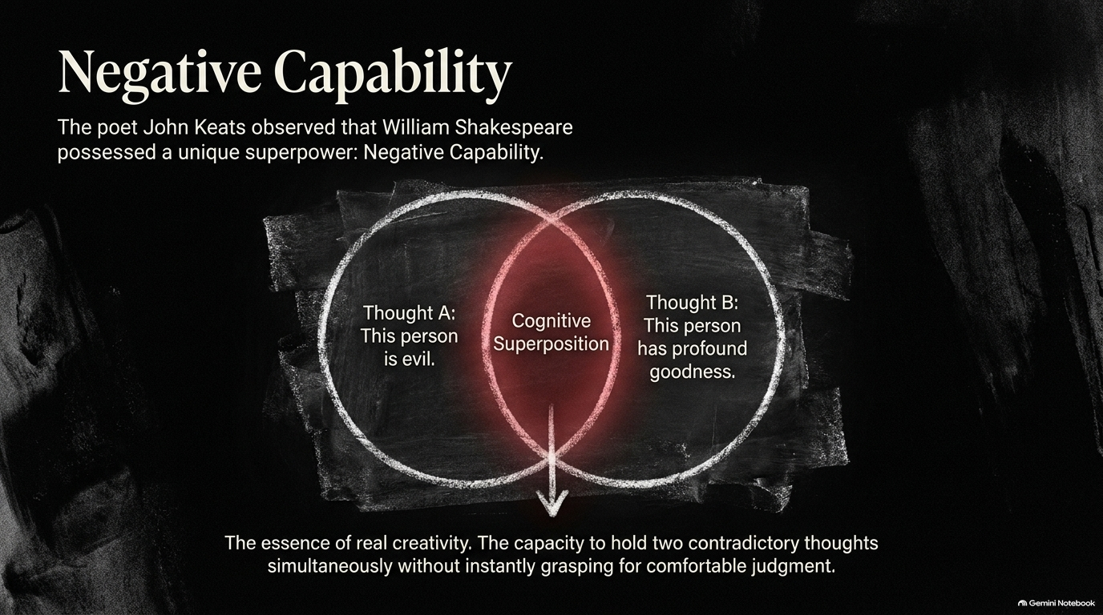
Notes:
Visual: A chalk-drawn Venn diagram highlighting a glowing red intersection labeled "Cognitive Superposition".
Suggested Duration: 4 – 5 minutes.
Speaker Notes:
The Poet’s Superpower: The poet John Keats observed that William Shakespeare possessed a rare, cognitive superpower: Negative Capability.
Cognitive Superposition: Look at the diagram. It is the ability to hold two completely contradictory thoughts simultaneously in your mind—for example, "This person is fundamentally dangerous/evil" (Thought A) alongside "This person possesses profound genius and goodness" (Thought B)—without instantly rushing for comfortable, premature moral judgment.
The Essence of Creativity: True strategic creativity requires this exact suspension of knee-jerk certainty. If you rush to categorize people or situations too quickly, you miss the nuanced leverage points that anomalies exploit.

Slide 8
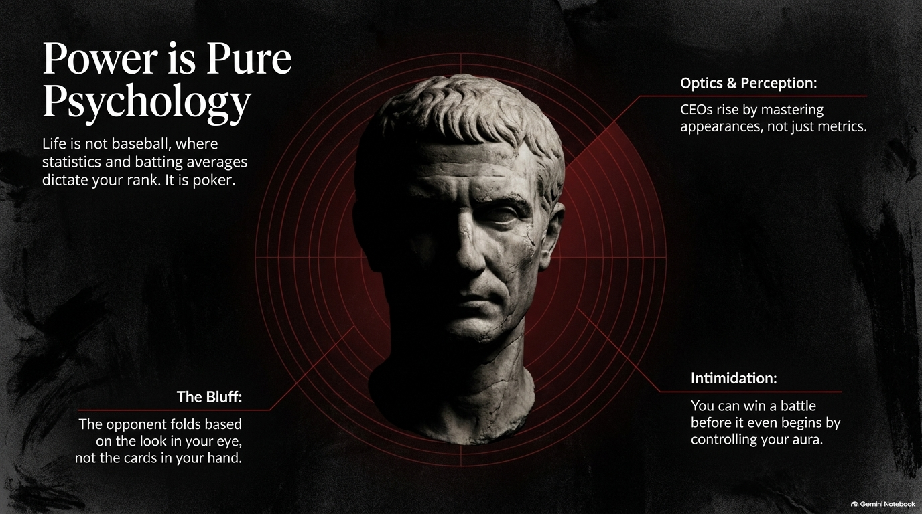
Notes:
Visual: A dark, imposing classical Roman bust surrounded by red target reticle rings.
Suggested Duration: 4 – 6 minutes.
Speaker Notes:
Poker vs. Baseball: Life is not baseball, where historical statistics and batting averages cleanly dictate your rank. Life is poker.
Optics & Perception: In high-stakes environments, CEOs and power-brokers rise just as much by mastering appearances, optics, and perception as they do by grinding out raw metrics.
The Bluff & Intimidation: As noted on the slide, skilled players win battles before a single shot is fired simply by controlling their aura and psychological weight. Often, your opponent folds based on the quiet, unshakeable look in your eye, not the mathematical cards in your hand.

Slide 9
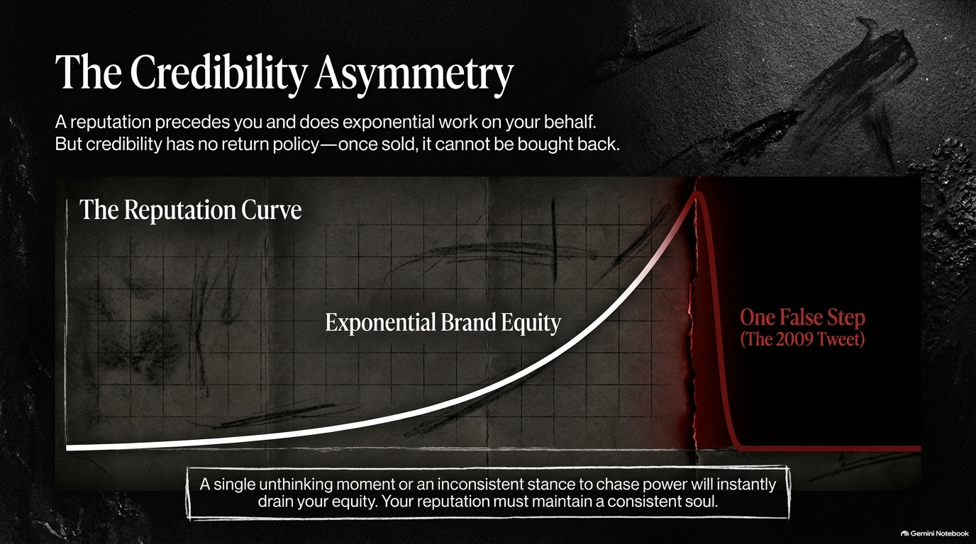
Notes:
Visual: A graph showing a slow, exponential rise in brand equity abruptly plummeting off a sharp cliff labeled "One False Step (The 2009 Tweet)".
Suggested Duration: 3 – 5 minutes.
Speaker Notes:
The Long Build, Sudden Fall: A strong reputation precedes you everywhere you go, doing exponential heavy lifting on your behalf. But credibility has a brutal property: it has no return policy. Once sold or squandered, it cannot simply be bought back.
The Asymmetry: Look at the curve. It takes decades of disciplined, compounding execution to build exponential brand equity, but it takes a single unthinking moment, a reactive outburst, or an inconsistent stance to drain it all to zero. Your reputation must maintain a consistent, unyielding soul.

Slide 10
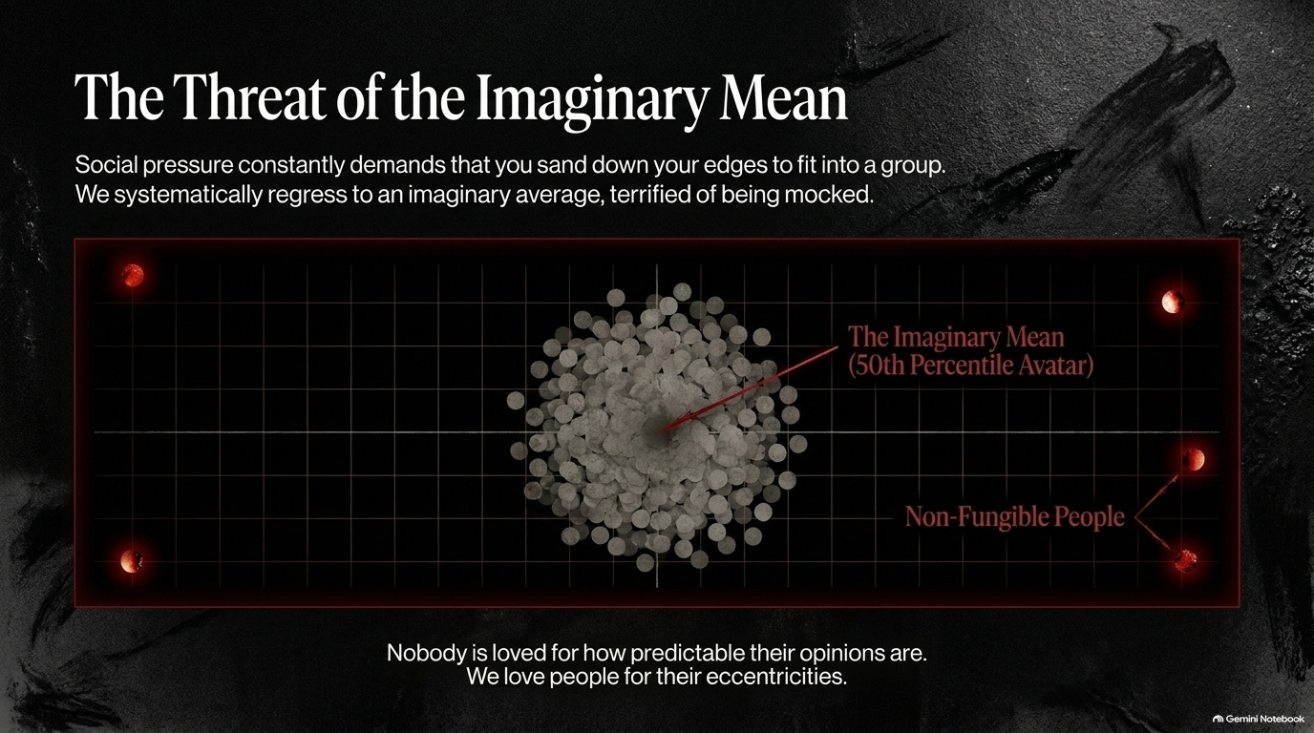
Notes:
Visual: A dense swarm of grey coins clustering toward a center point ("The Imaginary Mean"), with a few isolated red nodes glowing at the edges ("Non-Fungible People").
Suggested Duration: 4 – 5 minutes.
Speaker Notes:
The Gravity of Conformity: Social pressure constantly demands that you sand down your rough edges so you can smoothly fit into a group or organization. Terrified of mockery or social friction, we systematically regress toward an imaginary average.
The 50th Percentile Avatar: Most people spend their entire lives trying to become the ultimate middle-of-the-road avatar—offensive to no one, memorable to no one.
The Truth About Affection: Nobody is ever deeply loved for how predictable, safe, or beige their opinions are. We fall in love with people—and respect leaders—for their distinct, unapologetic eccentricities.

Slide 11

Notes:
Visual: A microscopic cellular cluster with one distinct, glowing red cell standing out among the grey cells.
Suggested Duration: 3 – 5 minutes.
Speaker Notes:
Evolutionary Necessity: In nature, diversity, random variation, and genetic mutation are what guarantee a species' survival against environmental shocks. Human culture operates under the exact same biological rules as an ecosystem.
Your Genetic Mutation: Your oddities, your niche tastes, and your strange psychological quirks are your unique evolutionary mutations. Statistically and mathematically, it is impossible for your chromosomal variance and life history to be replicated.
A Cultural Duty: Therefore, embracing your weirdness is not just a personal branding trick or a nice-to-have advantage—it is your fundamental duty to cultural evolution.

Slide 12
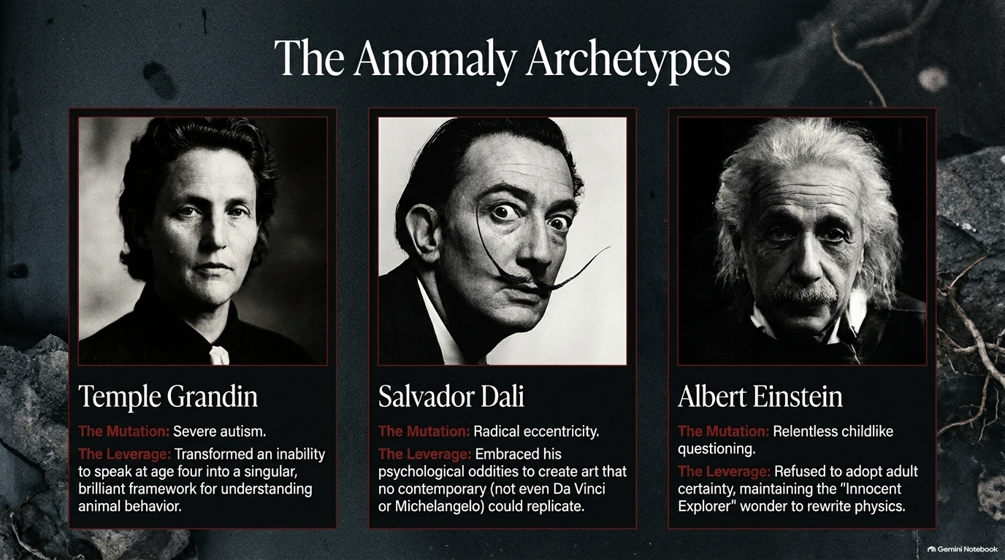
Notes:
Visual: Portraits of Temple Grandin, Salvador Dalí, and Albert Einstein, breaking down their specific mutations and leverages.
Suggested Duration: 4 – 6 minutes.
Speaker Notes:
Case Studies in Irreplaceability: Let's look at three historical figures who weaponized their anomalies:
Temple Grandin: Her mutation was severe autism and an inability to speak until age four. Her leverage? She transformed those neurological traits into a singular, brilliant visual framework for understanding animal behavior that revolutionized an entire industry.
Salvador Dalí: His mutation was radical, theatrical eccentricity. He took his deep psychological oddities and forged art that no contemporary—not even masters like Da Vinci or Michelangelo—could ever replicate.
Albert Einstein: His mutation was relentless, childlike questioning. He refused to adopt adult cognitive certainty, maintaining his "Innocent Explorer" wonder until he completely rewrote the laws of physics.

Slide 13
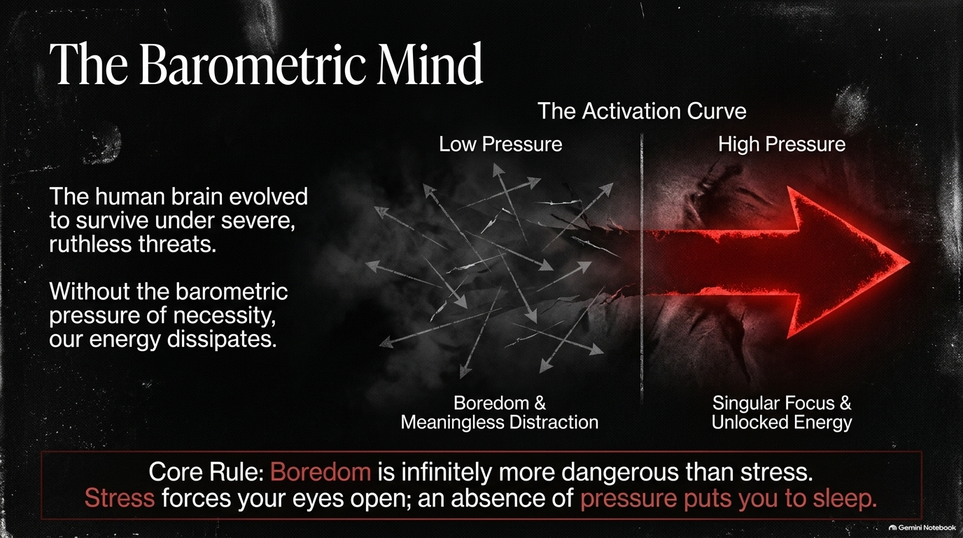
Notes:
Visual: A diagram showing "Low Pressure" leading to chaotic scatter and distraction, versus "High Pressure" channeling a massive red arrow of focused energy.
Suggested Duration: 4 – 5 minutes.
Speaker Notes:
Built for Threat: The human brain did not evolve in comfortable climate-controlled offices; it evolved to survive under severe, ruthless environmental threats.
The Dissipation of Energy: Without the barometric pressure of necessity and high stakes, our psychological energy naturally scatters into boredom and meaningless digital distraction.
The Core Rule: Boredom is infinitely more dangerous than stress. Stress forces your eyes wide open, heightens pattern recognition, and sharpens execution; an absence of pressure puts your potential to sleep.

Slide 14
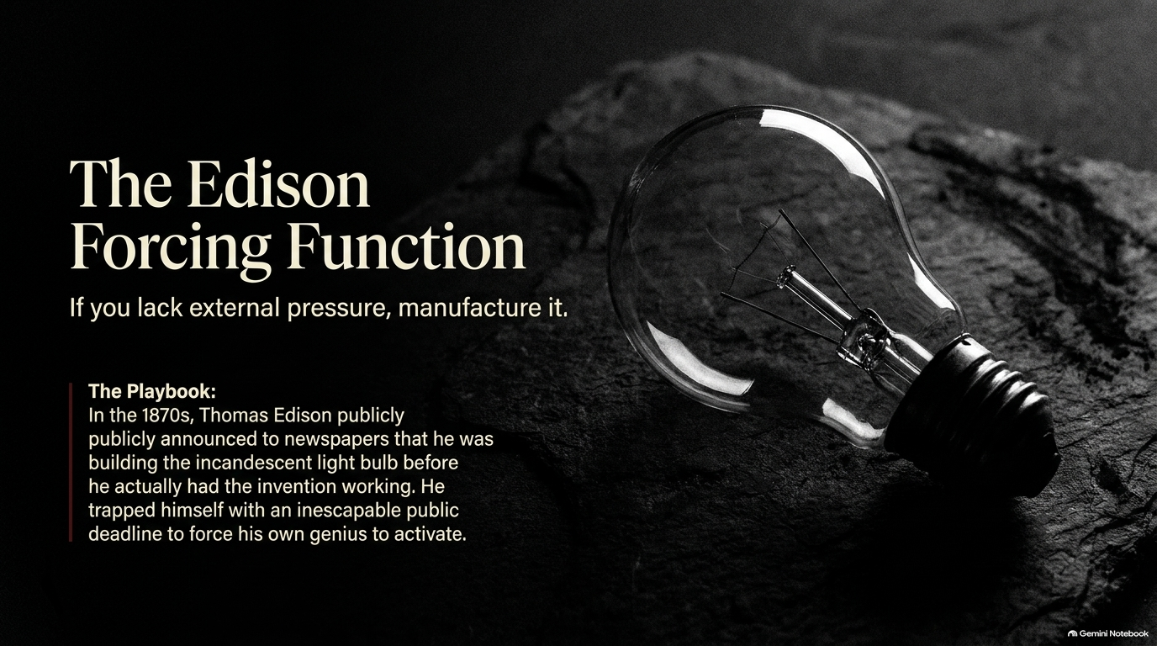
Notes:
Visual: A vintage, glowing incandescent light bulb resting on dark stone.
Suggested Duration: 3 – 5 minutes.
Speaker Notes:
Manufacturing Pressure: If you currently lack external pressure in your life or career, do not wait for a crisis to strike—manufacture it.
The Edison Playbook: In the 1870s, Thomas Edison publicly announced to major newspapers that he had successfully invented and built the incandescent light bulb before he actually had the working prototype finished in his lab.
Trapping Yourself: By making this public declaration, he trapped himself in an inescapable, high-visibility deadline, forcing his own genius and his team's output to activate under extreme pressure. Find your own public stakes and lock yourself into them.

Slide 15
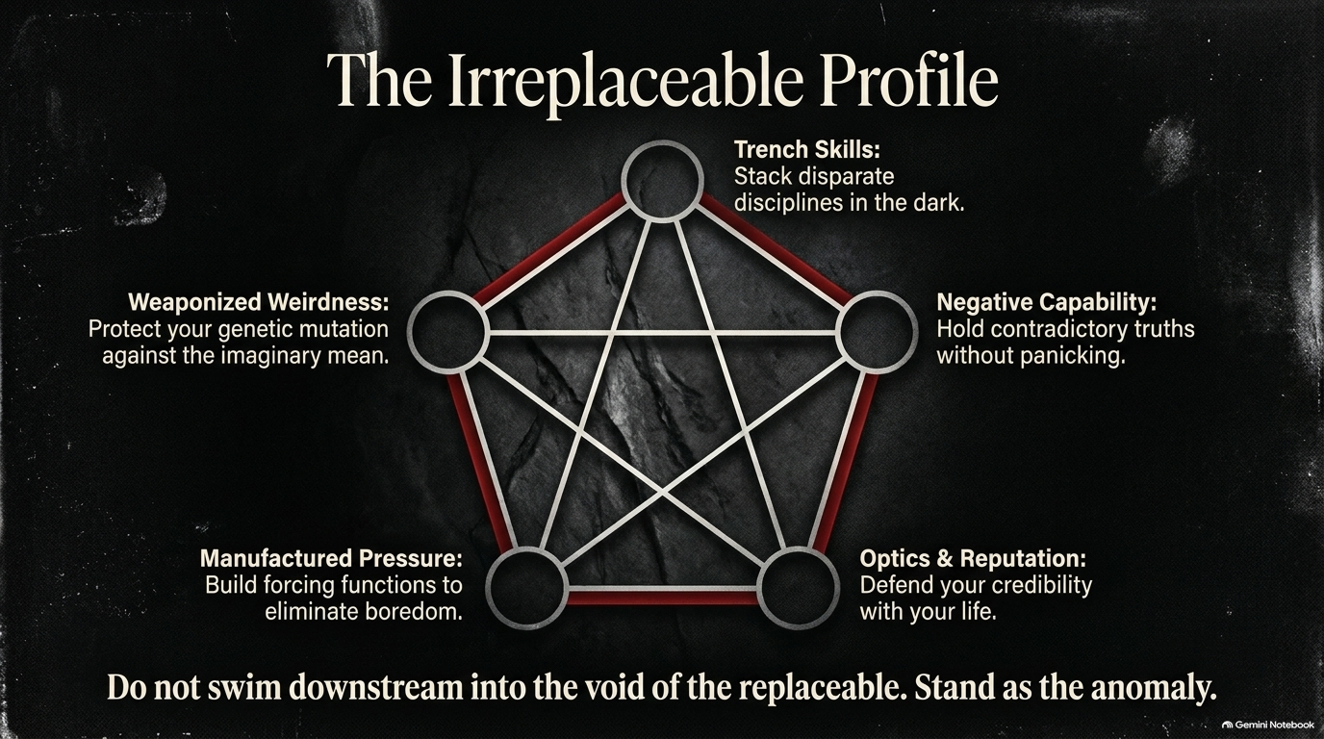
Notes:
Visual: A complex geometric pentagram connecting five core pillars of mastery against a dark stone background.
Suggested Duration: 4 – 5 minutes.
Speaker Notes:
The Five Pillars: Look at the architecture of the Irreplaceable Profile mapped out here. It is an integrated system:
Trench Skills: Stacking disparate disciplines in the dark.
Negative Capability: Holding contradictory truths without panicking.
Optics & Reputation: Defending your credibility with your life.
Manufactured Pressure: Building artificial forcing functions to eliminate boredom.
Weaponized Weirdness: Protecting your unique genetic mutation against the imaginary mean.
The Final Call: When these five pillars lock together, you transcend ordinary competition. Do not swim downstream into the void of the replaceable; stand as the anomaly.

Slide 16
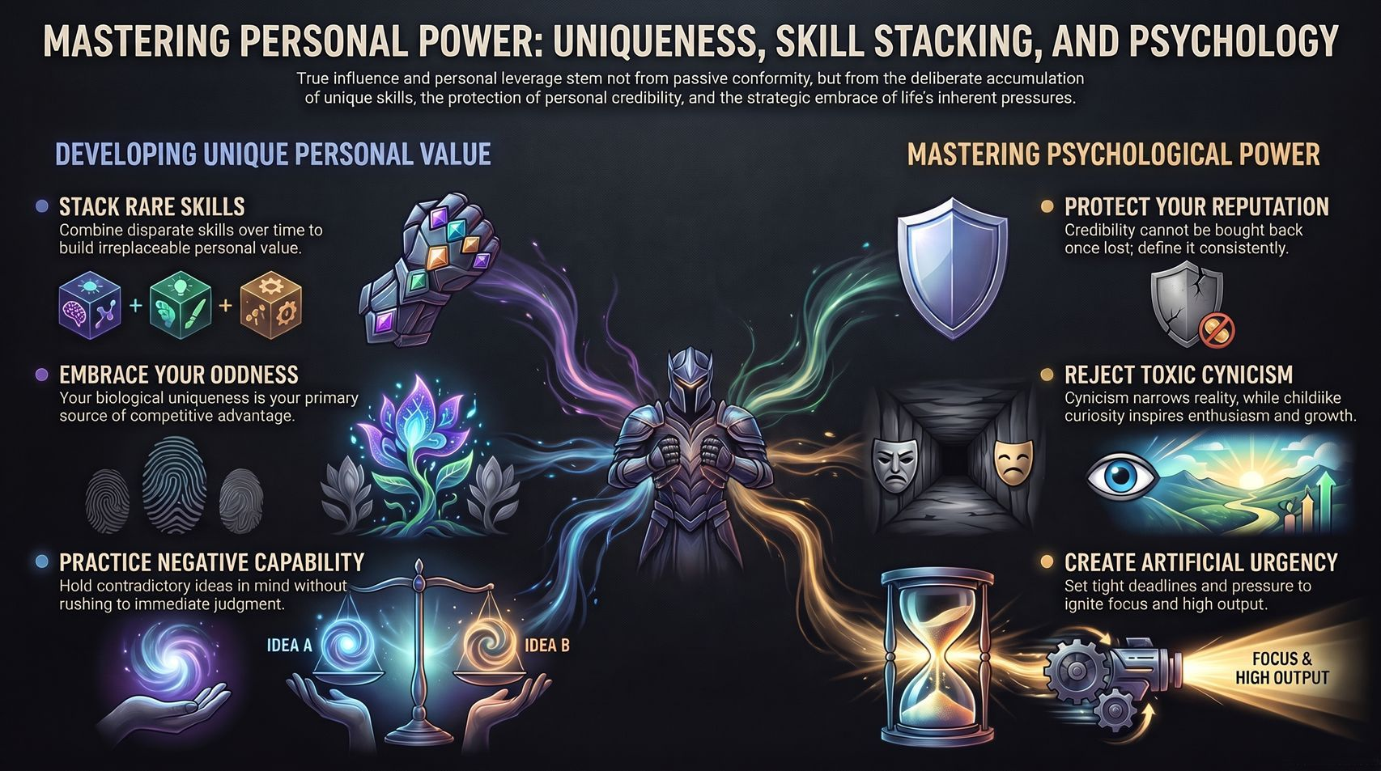
Notes:
Visual: A central armored knight flanked by visual icons representing skill stacking, oddness, negative capability, reputation, cynicism rejection, and artificial urgency.
Suggested Duration: 3 – 5 minutes.
Speaker Notes:
Comprehensive Synthesis: As we wrap up, remember that true influence and personal leverage never stem from passive conformity.
The Formula: They stem from the deliberate accumulation of unique skills, the fierce protection of personal credibility, and the strategic embrace of life's inherent pressures.
Closing Charge: Take these principles back to your work, your art, and your life. Build your stack, protect your weirdness, manufacture your pressure, and become irreplaceable. Thank you.

