Slide 1
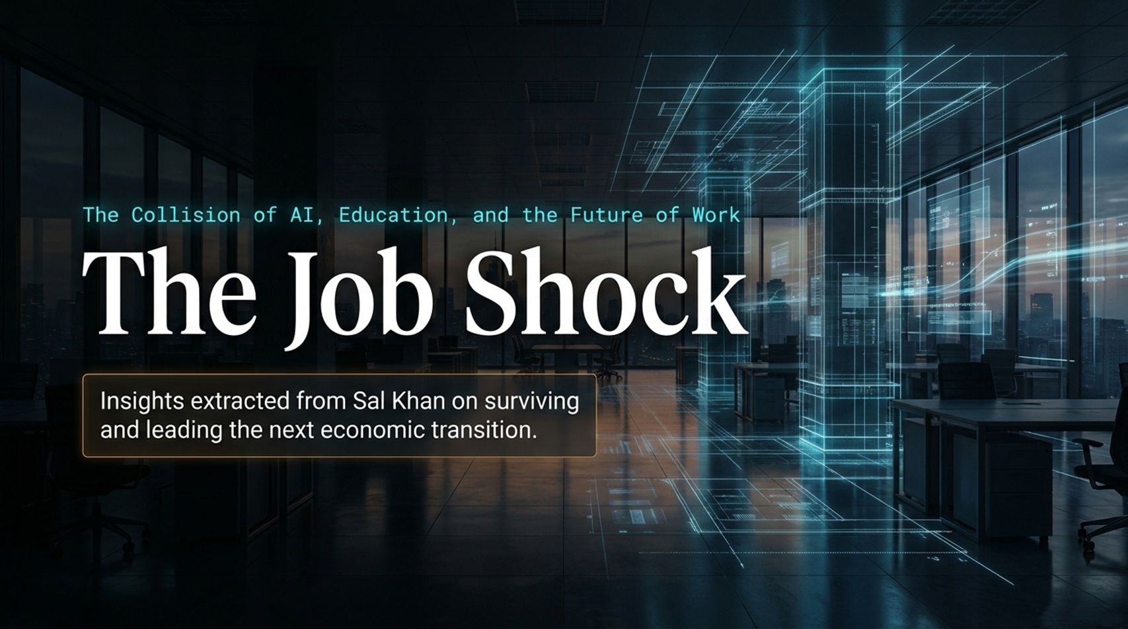
Notes:
Slide Title: The Job Shock
Subtitle/Context: The Collision of AI, Education, and the Future of Work | Insights extracted from Sal Khan on surviving and leading the next economic transition.
Target Pacing: 3 Minutes
Talking Points & Speaker Transcript
"Welcome everyone. Today, we are exploring The Job Shock—a comprehensive look at how artificial intelligence is transforming the collision point between technology, education, and the modern workforce.
When we examine the macro landscape, we aren't just talking about a minor technological upgrade or a faster software tool. As Sal Khan highlights in his analysis of workforce transformation, we are facing an economic shock that moves faster than any previous industrial revolution. The rules of career progression, higher education, and corporate productivity are being rewritten in real time.
Over the next 16 slides, we will deconstruct this transition. We'll look at the actual timeline of job dislocation, how traditional roles and tech silos are collapsing, how higher education is failing to keep pace, and—most importantly—the specific playbook you, your teams, and your organizations must adopt to not only survive, but thrive."
Audience Engagement & Transition
Engagement Prompt: "By a quick show of hands, how many of you feel your current professional skill set will look completely different three years from now?"
Transition: "Let’s look at the actual timeline of this disruption, because it’s much closer than most realize."
Khan Academy CEO: The Real AI Opportunity Is in Boring Industries | Sal Khan
https://www.youtube.com/watch?v=s-Iz-lLAhdg

Slide 2
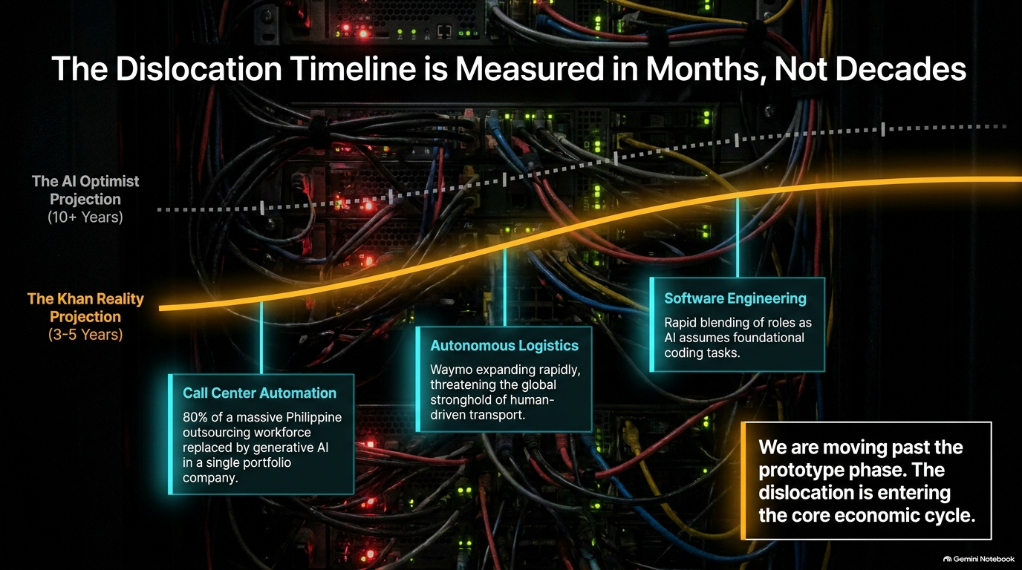
Notes:
Slide Title: The Dislocation Timeline is Measured in Months, Not Decades
Target Pacing: 4 Minutes
Talking Points & Speaker Transcript
"Slide 2 presents a stark reality check. For years, the 'AI Optimist Projection' suggested we had a decade or more to adapt to artificial general intelligence. That luxury of time has evaporated.
The Khan Reality Projection places major structural dislocation firmly in a 3- to 5-year window. Look at the data points already unfolding across the global economy:
Call Center Automation: We are seeing massive shifts where generative AI replaces significant portions of outsourced workforces in regions like the Philippines within single corporate portfolios.
Autonomous Logistics: Waymo and autonomous transport systems are scaling rapidly, threatening traditional human-driven transit and logistics.
Software Engineering: Coding is no longer insulated; AI models are increasingly assuming foundational coding tasks, compressing product development lifecycles.
As the slide highlights: We are moving past the prototype phase. The dislocation is entering the core economic cycle."
Audience Engagement & Transition
Transition: "If this is the macro timeline, where exactly does vulnerability lie across different job types? Let's check the Automation Vulnerability Curve."

Slide 3
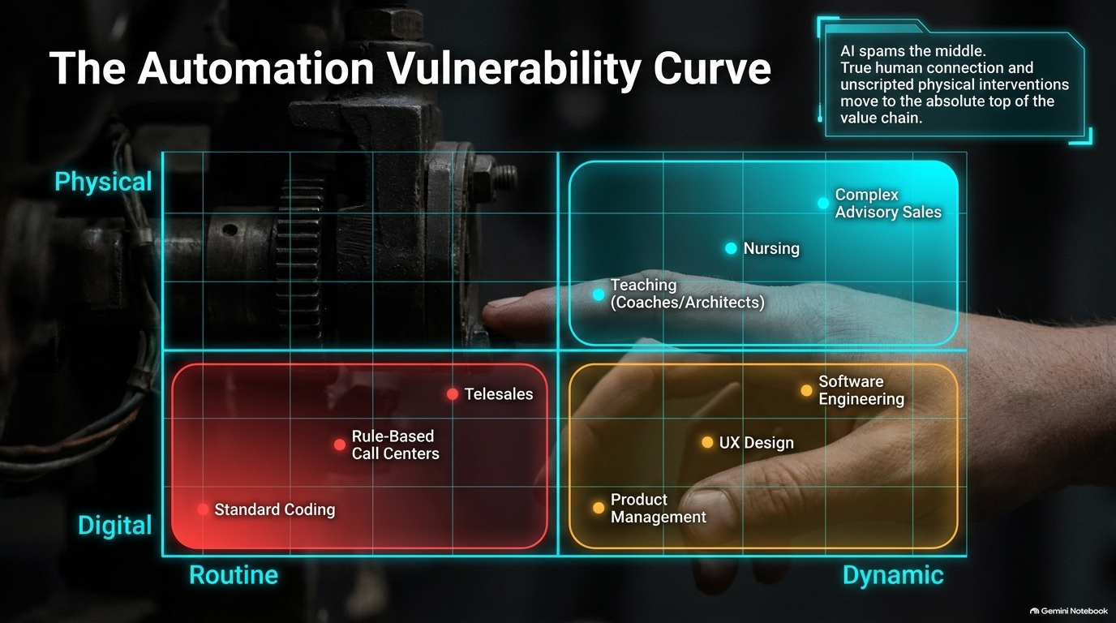
Notes:
Slide Title: The Automation Vulnerability Curve
Target Pacing: 4 Minutes
Talking Points & Speaker Transcript
"On Slide 3, we map out the Automation Vulnerability Curve across two axes: Routine vs. Dynamic, and Digital vs. Physical.
Notice where the greatest risk resides. The red zone in the bottom-left quadrant represents routine digital work—standard coding, rule-based call centers, and basic telesales. AI is aggressively automating the middle layers of the economy.
However, look at what sits safely at the top: complex advisory sales, nursing, and architectural teaching. True human connection, empathetic care, and unscripted physical or interpersonal interventions move to the absolute top of the value chain. Meanwhile, dynamic digital fields like product management, UX design, and advanced software engineering are shifting from manual creation to system orchestration."
Audience Engagement & Transition
Transition: "This shift is actively destroying traditional silos between tech disciplines. Let's look at how roles are collapsing."

Slide 4
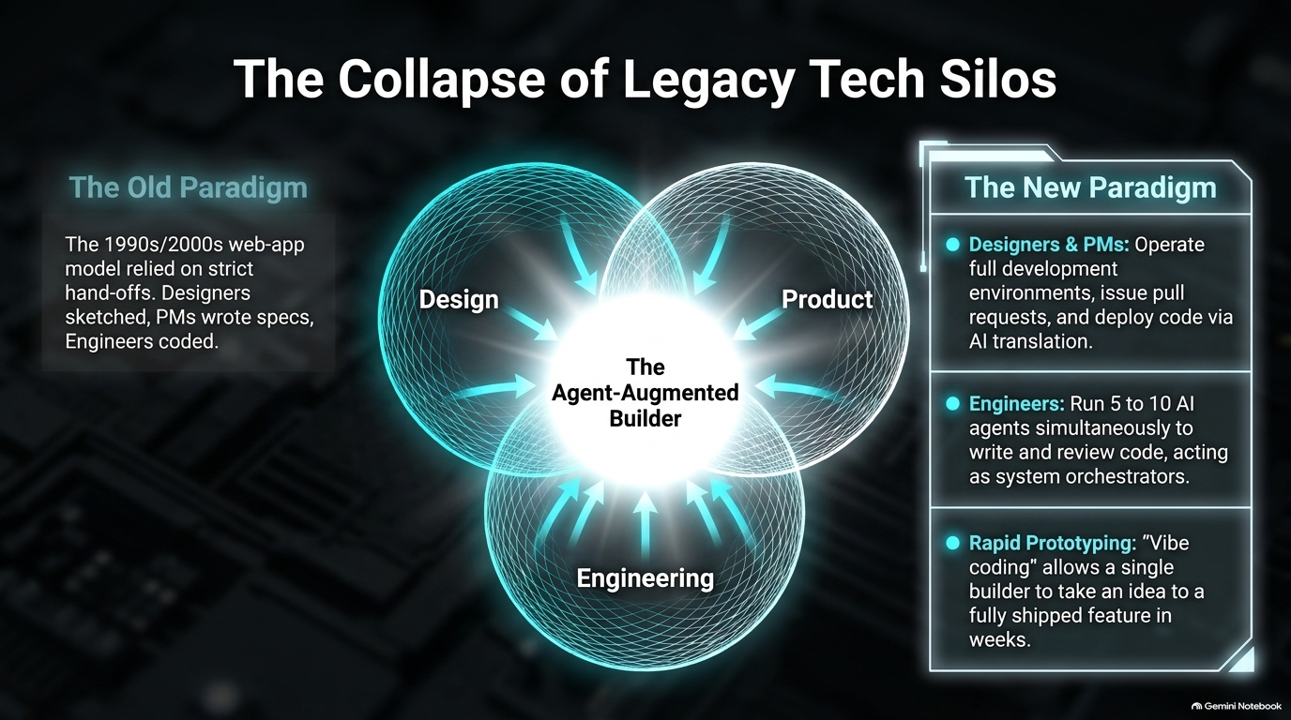
Notes:
Slide Title: The Collapse of Legacy Tech Silos
Target Pacing: 4 Minutes
Talking Points & Speaker Transcript
"Slide 4 illustrates how generative AI has demolished the old 1990s and 2000s web-app paradigm.
In the old model, we had strict hand-offs: designers sketched wireframes, product managers wrote specifications, and engineers spent weeks coding. Today, we have entered the era of The Agent-Augmented Builder:
Designers and PMs now operate across full development environments, issuing pull requests and deploying code directly via AI translation.
Engineers manage 5 to 10 AI agents simultaneously, shifting their primary job from writing syntax line-by-line to acting as system architects and reviewers.
Rapid Prototyping (Vibe Coding): A single builder can take an idea and turn it into a fully shipped feature in a matter of weeks."
Audience Engagement & Transition
Transition: "When you change the tooling, the unit economics of productivity change completely. Let's look at the math on Slide 5."

Slide 5
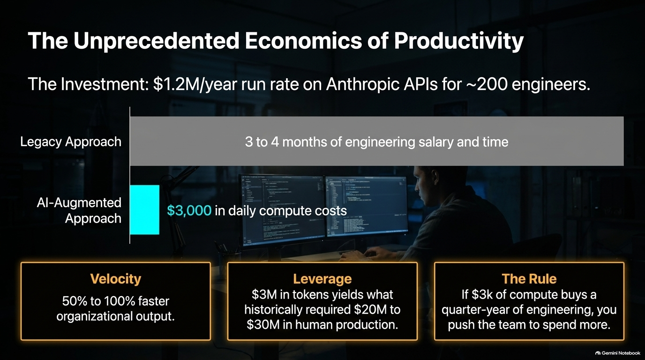
Notes:
Slide Title: The Unprecedented Economics of Productivity
Target Pacing: 5 Minutes
Talking Points & Speaker Transcript
"Slide 5 breaks down the raw economics of AI-driven engineering teams.
Consider a concrete enterprise investment: running a $1.2 million annual run rate on advanced APIs (such as Anthropic) for roughly 200 engineers.
Under the Legacy Approach, that amount of output consumed 3 to 4 months of heavy engineering salary and operational time.
Under the AI-Augmented Approach, compute costs drop to roughly $3,000 in daily compute to achieve staggering velocity gains.
Look at the core takeaways:
Velocity: Organizations see 50% to 100% faster organizational output.
Leverage: A fraction of historical spend yields what previously required tens of millions in human production.
The Rule: If a nominal compute investment buys a quarter-year of engineering output, leaders must aggressively push their teams to leverage more compute."
Audience Engagement & Transition
Transition: "This economic leverage isn't just for software teams; it transforms how leaders operate daily. Let's look at the AI Chief of Staff workflow."

Slide 6
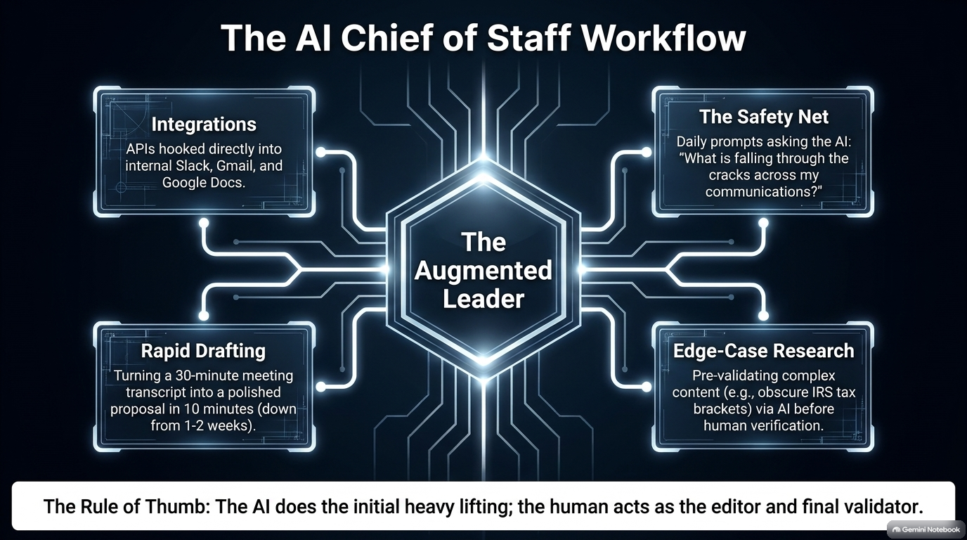
Notes:
Slide Title: The AI Chief of Staff Workflow
Target Pacing: 4 Minutes
Talking Points & Speaker Transcript
"On Slide 6, we look at how individual leaders amplify their capacity using an 'AI Chief of Staff' model.
Modern executives are utilizing four pillars of operational augmentation:
Integrations: APIs hooked directly into internal communication tools like Slack, Gmail, and Google Docs.
Rapid Drafting: Turning a 30-minute messy meeting transcript into a polished executive proposal in 10 minutes instead of 1 to 2 weeks.
Edge-Case Research: Pre-validating complex content—such as obscure tax brackets or regulatory compliance details—via AI before human verification.
The Safety Net: Running daily prompts like: 'What is falling through the cracks across my communications today?'
The core rule here is simple: The AI does the initial heavy lifting; the human acts as the editor and final validator."
Audience Engagement & Transition
Transition: "If workplace workflows are transforming this fast, why is formal education lagging so far behind? Let's examine the Higher Education Disconnect."

Slide 7
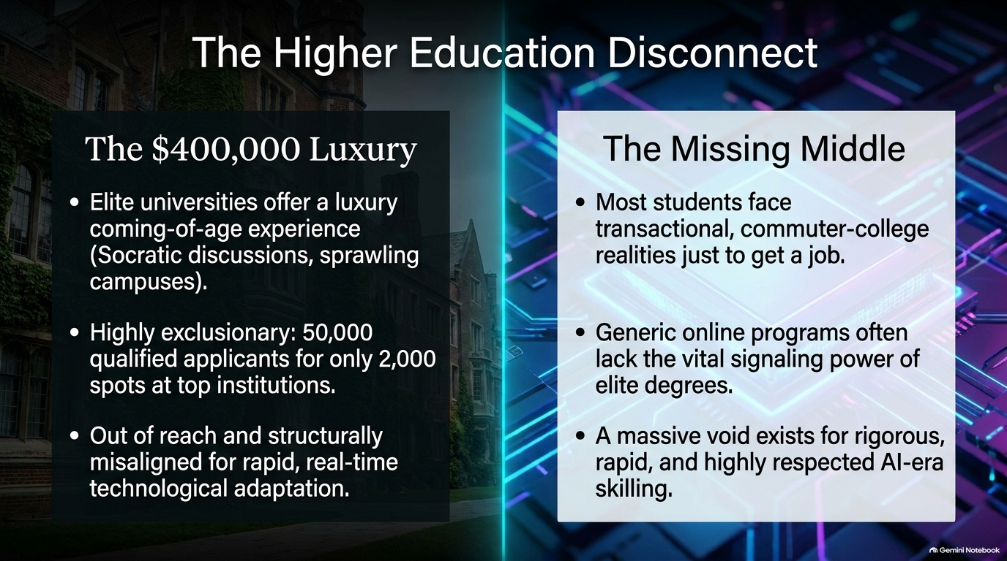
Notes:
Slide Title: The Higher Education Disconnect
Target Pacing: 5 Minutes
Talking Points & Speaker Transcript
"Slide 7 addresses a major friction point highlighted by Sal Khan: the widening gap between traditional universities and modern economic reality.
On one side, we have The $400,000 Luxury: elite universities offering a coming-of-age campus experience with Socratic discussions. But these institutions are highly exclusionary—accepting only 2,000 applicants out of 50,000—and are structurally too slow to adapt to real-time technological changes.
On the other side, The Missing Middle: most students face transactional commuter-college realities just to secure a job. Generic online programs often lack the signaling power of elite degrees. A massive void exists for rigorous, rapid, and highly respected AI-era skilling."
Audience Engagement & Transition
Transition: "How do we bridge this gap? By redesigning how credentials are earned. Let's look at Slide 8."

Slide 8
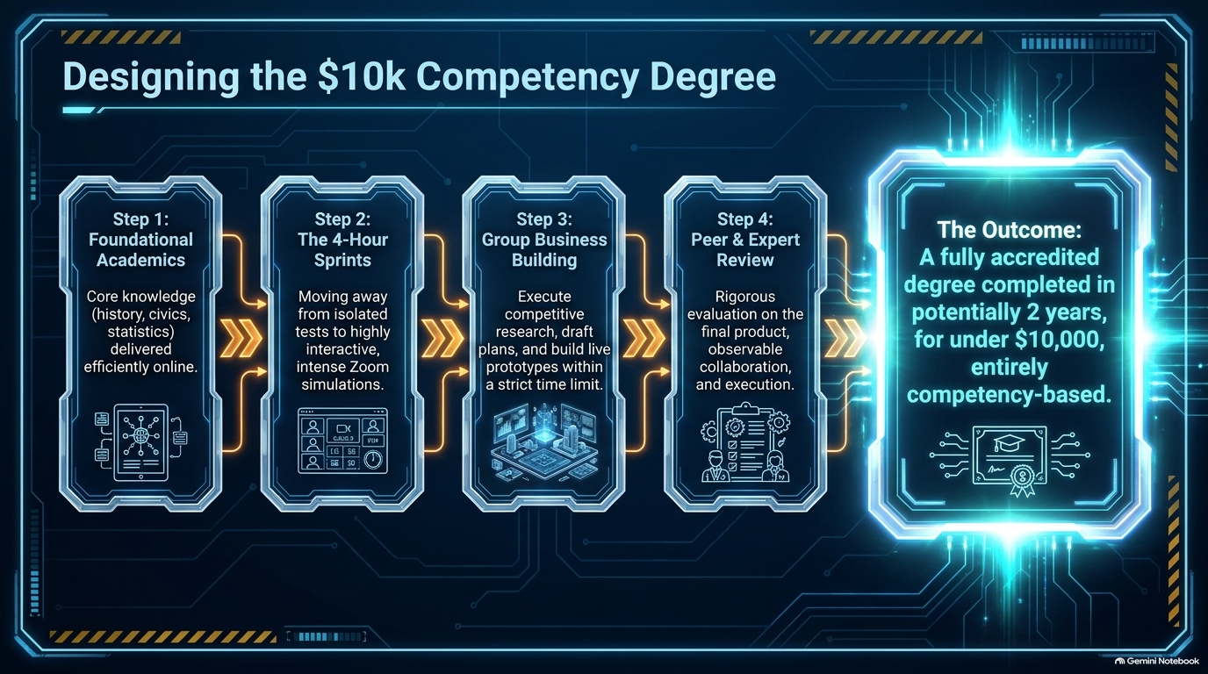
Notes:
Slide Title: Designing the $10k Competency Degree
Target Pacing: 4 Minutes
Talking Points & Speaker Transcript
"Slide 8 outlines the blueprint for a modern, accessible educational model: The $10k Competency Degree.
This four-step framework reimagines credentialing for the AI era:
Step 1: Foundational Academics: Delivering core knowledge like history, civics, and statistics efficiently online.
Step 2: The 4-Hour Sprints: Moving away from passive multiple-choice tests to highly interactive, intense Zoom simulations.
Step 3: Group Business Building: Executing competitive research, drafting business plans, and building live prototypes within strict time limits.
Step 4: Peer & Expert Review: Rigorous evaluation focused on the final product, observable collaboration, and actual execution.
The outcome? A fully accredited, entirely competency-based degree completed in roughly 2 years for under $10,000."
Audience Engagement & Transition
Transition: "In this new educational and professional model, what skills actually matter? Let's examine the Five Durable Human Skills."

Slide 9
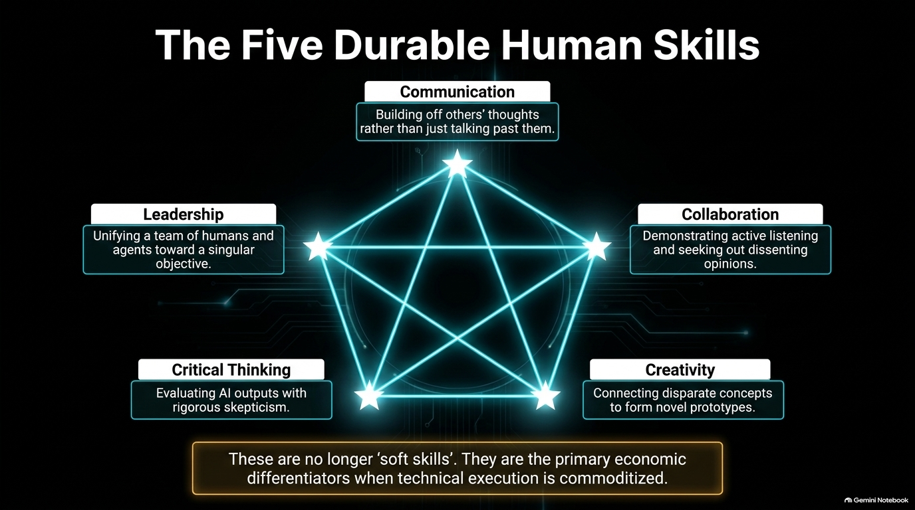
Notes:
Slide Title: The Five Durable Human Skills
Target Pacing: 5 Minutes
Talking Points & Speaker Transcript
"Slide 9 presents the pentagon of human capability. When routine technical execution is commoditized by AI, what separates top performers? Five durable human skills:
Communication: Building off others' thoughts rather than just talking past them.
Collaboration: Demonstrating active listening and actively seeking out dissenting opinions.
Creativity: Connecting disparate concepts to form novel prototypes.
Critical Thinking: Evaluating AI outputs with rigorous skepticism and checking for logical flaws.
Leadership: Unifying a team of humans and autonomous agents toward a singular objective.
As the bottom banner states: These are no longer 'soft skills.' They are the primary economic differentiators when technical execution is commoditized."
Audience Engagement & Transition
Transition: "This shifts how employers evaluate talent. Let's compare legacy hiring signals with modern AI-era portfolios."

Slide 10
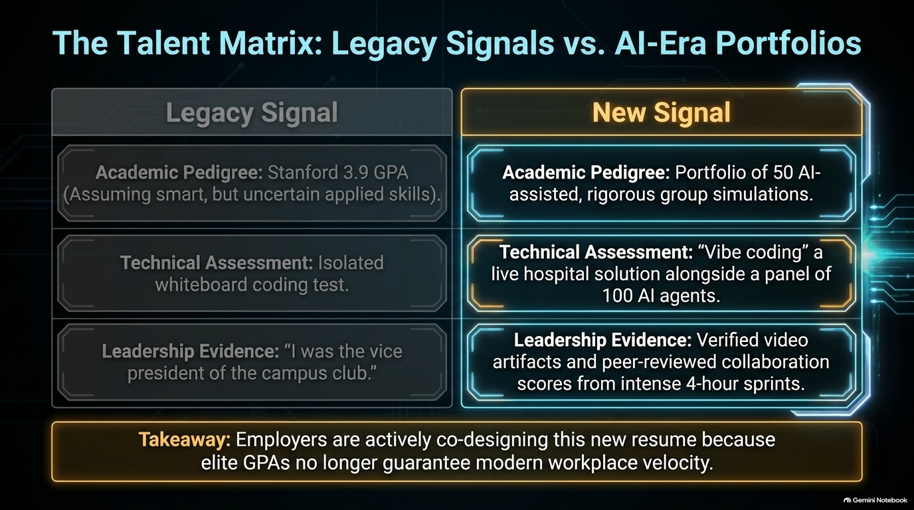
Notes:
Slide Title: The Talent Matrix: Legacy Signals vs. AI-Era Portfolios
Target Pacing: 4 Minutes
Talking Points & Speaker Transcript
"Slide 10 contrasts traditional hiring criteria with the new reality of talent evaluation.
Academic Pedigree: The legacy signal was a Stanford 3.9 GPA implying smarts; the new signal is a verified portfolio of 50 AI-assisted, rigorous group simulations.
Technical Assessment: Instead of an isolated whiteboard coding test, candidates now demonstrate 'vibe coding'—building a live solution alongside a panel of 100 AI agents.
Leadership Evidence: Moving from vague resume bullets like 'I was vice president of the campus club' to verified video artifacts and peer-reviewed collaboration scores from intense 4-hour sprints.
Employers are actively co-designing this new resume because elite GPAs no longer guarantee modern workplace velocity."
Audience Engagement & Transition
Transition: "With these frameworks in mind, how do individuals begin implementing this? Let's look at Strategy I."

Slide 11
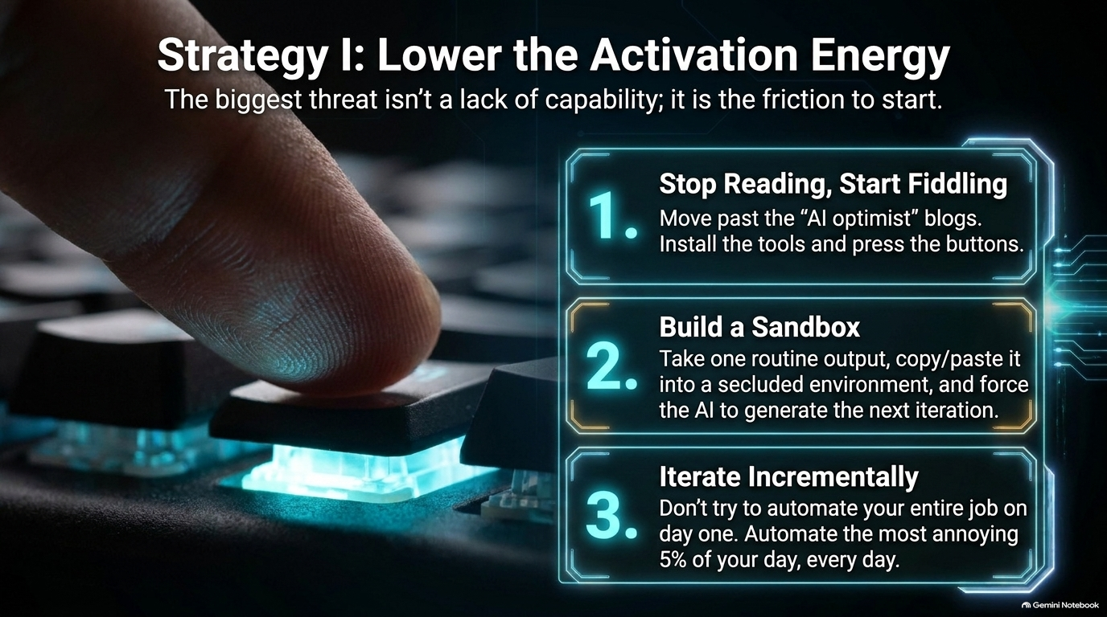
Notes:
Slide Title: Strategy I: Lower the Activation Energy
Target Pacing: 4 Minutes
Talking Points & Speaker Transcript
"Slide 11 focuses on overcoming personal and professional inertia. The biggest threat isn't a lack of capability; it is the friction to start.
Here is a three-step tactical approach to lower your activation energy:
Stop Reading, Start Fiddling: Move past theoretical blogs and optimization newsletters. Install the tools, open the playground, and start pressing buttons.
Build a Sandbox: Take one routine output from your daily work, copy and paste it into a secluded environment, and force the AI to generate successive iterations.
Iterate Incrementally: Do not try to automate your entire job on day one. Automate the most annoying 5% of your day, every single day."
Audience Engagement & Transition
Transition: "Beyond individual tasks, where are the massive market opportunities? Let's look at Strategy II."

Slide 12
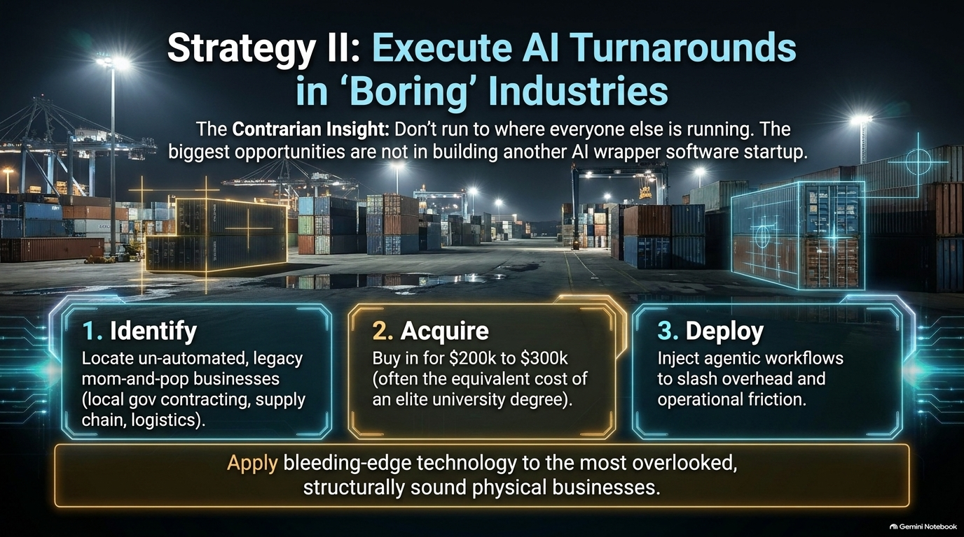
Notes:
Slide Title: Strategy II: Execute AI Turnarounds in 'Boring' Industries
Target Pacing: 5 Minutes
Talking Points & Speaker Transcript
"Slide 12 covers a powerful contrarian insight: Don't run to where everyone else is running. The biggest opportunities are not found in building another generic AI wrapper software startup.
Instead, look at traditional physical businesses:
1. Identify: Locate un-automated, legacy mom-and-pop businesses—such as local government contracting, supply chain logistics, and warehousing.
2. Acquire: Buy in for $200k to $300k, often the equivalent cost of funding an elite university degree.
3. Deploy: Inject agentic workflows to slash overhead and operational friction.
By applying bleeding-edge technology to overlooked, structurally sound physical businesses, you unlock massive, uncrowded economic value."
Audience Engagement & Transition
Transition: "Let's look at how you audit your day-to-day workflow in Strategy III."

Slide 13
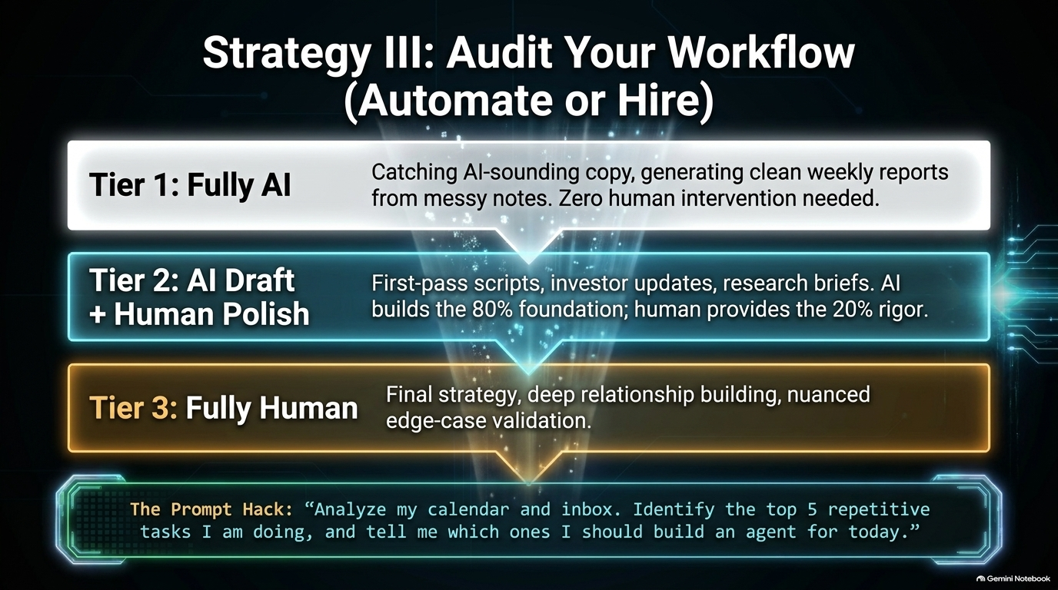
Notes:
Slide Title: Strategy III: Audit Your Workflow (Automate or Hire)
Target Pacing: 4 Minutes
Talking Points & Speaker Transcript
"Slide 13 provides a concrete tiering framework to audit your professional workload:
Tier 1: Fully AI: Catching AI-sounding copy, generating clean weekly reports from messy notes. Zero human intervention needed.
Tier 2: AI Draft + Human Polish: First-pass scripts, investor updates, research briefs. AI builds the 80% foundation; the human provides the 20% rigor.
Tier 3: Fully Human: Final strategy, deep relationship building, and nuanced edge-case validation.
Try this prompt hack today: 'Analyze my calendar and inbox. Identify the top 5 repetitive tasks I am doing, and tell me which ones I should build an agent for today.'"
Audience Engagement & Transition
Transition: "When all these technical capabilities and operational changes are in place, what is the ultimate human differentiator? Let's look at Slide 14."

Slide 14
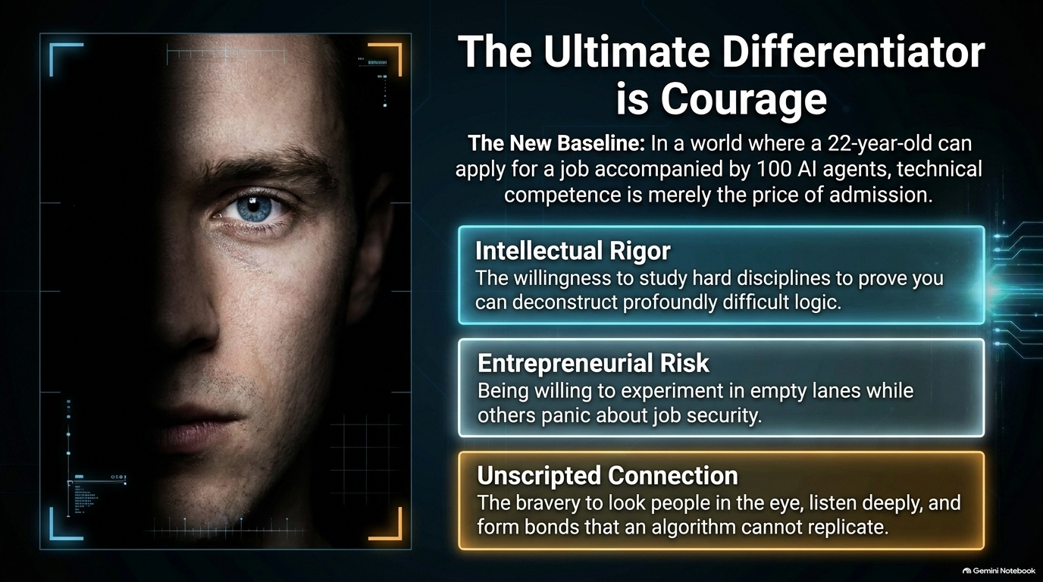
Notes:
Slide Title: The Ultimate Differentiator is Courage
Target Pacing: 4 Minutes
Talking Points & Speaker Transcript
"Slide 14 addresses the psychological core of this transition. In a world where a 22-year-old can apply for a job accompanied by 100 AI agents, technical competence is merely the price of admission.
The true differentiators are rooted in courage:
Intellectual Rigor: The willingness to study hard disciplines to prove you can deconstruct profoundly difficult logic.
Entrepreneurial Risk: Being willing to experiment in empty lanes while others panic about job security.
Unscripted Connection: The bravery to look people in the eye, listen deeply, and form bonds that an algorithm cannot replicate."
Audience Engagement & Transition
Transition: "Let's synthesize everything into our core transition framework on Slide 15."

Slide 15
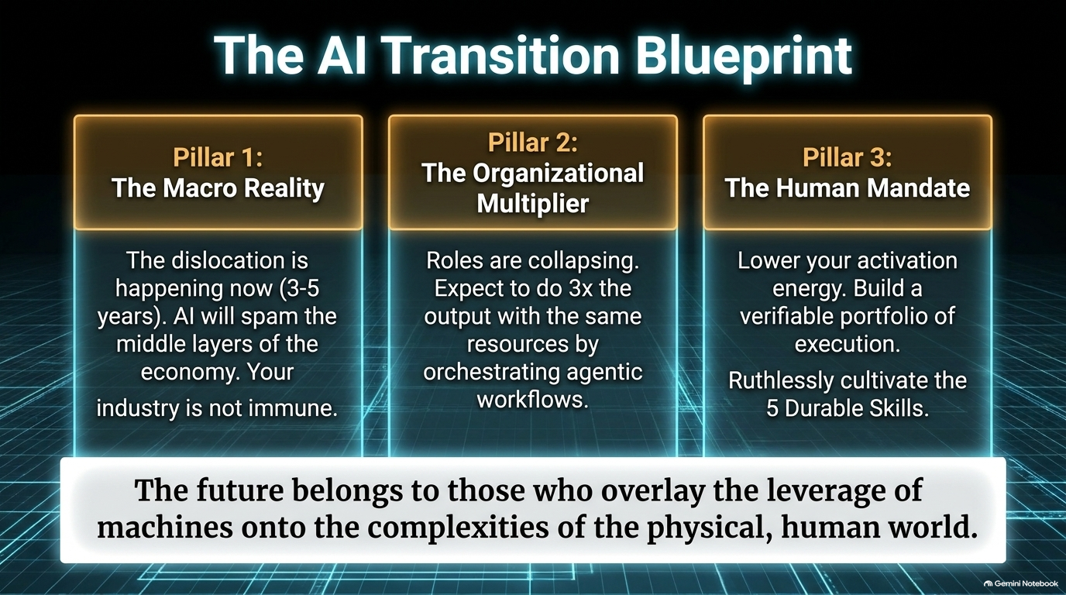
Notes:
Slide Title: The AI Transition Blueprint
Target Pacing: 4 Minutes
Talking Points & Speaker Transcript
"Slide 15 summarizes our entire blueprint across three core pillars:
Pillar 1: The Macro Reality: Recognize that dislocation is happening now (within a 3–5 year window). AI will impact the middle layers of the economy, and no industry is immune.
Pillar 2: The Organizational Multiplier: Roles are collapsing. Expect to generate 3x the output with the same resources by orchestrating agentic workflows.
Pillar 3: The Human Mandate: Lower your activation energy. Build a verifiable portfolio of execution and ruthlessly cultivate the 5 durable skills.
As our guiding thesis emphasizes: The future belongs to those who overlay the leverage of machines onto the complexities of the physical, human world."
Audience Engagement & Transition
Transition: "Let's review our complete visual and conceptual summary on our final slide."

Slide 16
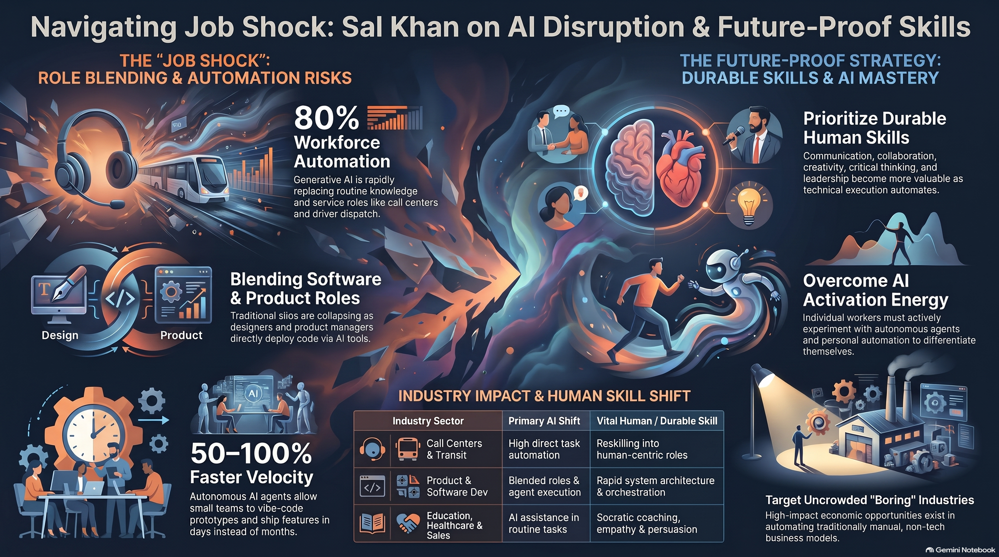
Notes:
Slide Title: Navigating Job Shock: Sal Khan on AI Disruption & Future-Proof Skills
Target Pacing: 5 Minutes
Talking Points & Speaker Transcript
"Our final slide brings together the full visual and conceptual tapestry of The Job Shock and our path forward.
From managing call center automation and blending product-engineering roles to targeting uncrowded 'boring' industries and mastering durable human skills, we have a complete roadmap.
Thank you for your engagement today. Let's open the floor to questions, discuss your specific operational challenges, and begin building your organization's AI workforce blueprint."

