Slide 1

Notes:
Visual: A cinematic, close-up shot of a person's eyes under dramatic golden lighting, framed by clean border lines.
Suggested Speaking Time: 2–3 minutes
Speaker Notes:
"Welcome, everyone. Today, we are going to look at a life-changing blueprint for overcoming depression, anger, resentment, and bitterness from a deeply biblical and psychological perspective. When we experience emotional turmoil, our instinct is to try and fix the emotion itself. But as we will discover, trying to fix a negative feeling without addressing what created it is like trying to fix the reflection in a mirror by wiping the glass instead of moving the object. Today's title says it all: Fix Your Frame, Fix Your Life. Who has a better blueprint for how human beings are supposed to feel and function than the One who created us to feel in the first place? Let’s dive into the architecture of the mind and learn how to reframe reality."
Overcoming Negative Emotions Step-By-Step
https://www.youtube.com/watch?v=FLgHy6pEhpE

Slide 2
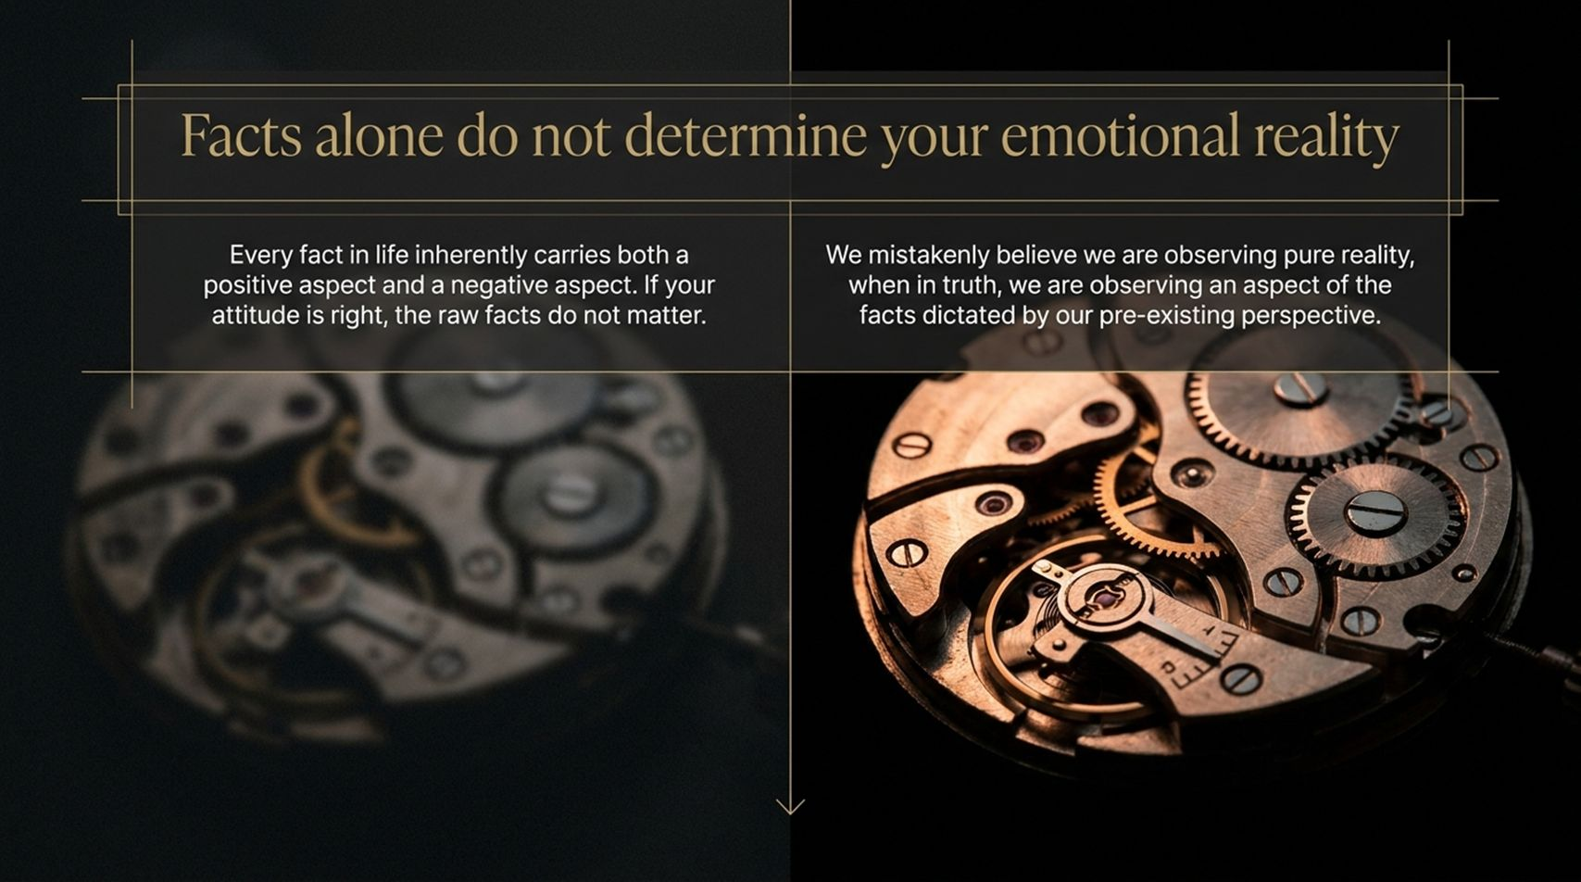
Notes:
Visual: A split-screen layout showcasing intricate watch gears, comparing how attitudes dictate the significance of raw facts.
Suggested Speaking Time: 3–4 minutes
Speaker Notes:
"Let's start with a foundational statement that might challenge how you've viewed life: Facts alone do not determine your emotional reality. Many of us mistakenly believe we are objective observers of pure reality, walking around saying, 'I'm just dealing with the facts!' But in truth, every single fact in life carries both a positive aspect and a negative aspect. If your perspective is right, the raw facts don't dictate your misery. We are never observing a naked fact; we are observing an aspect of that fact dictated by our pre-existing mental frame. Two people can experience the exact same event—whether it's financial loss, a career setback, or a physical trial—and walk away with entirely different emotional realities. Why? Because the facts didn't change; the frame changed."

Slide 3
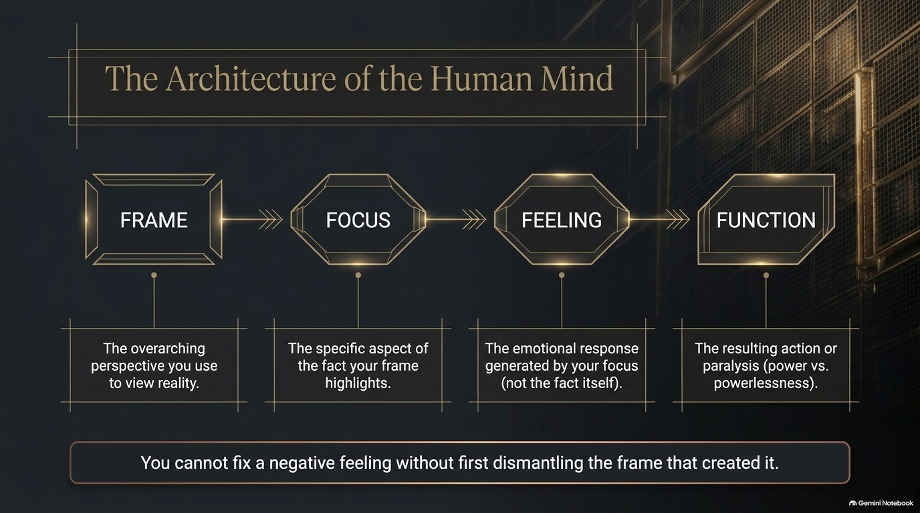
Notes:
Visual: A 4-stage sequential flowchart diagram moving from Frame to Focus, Feeling, and Function.
Suggested Speaking Time: 4–5 minutes
Speaker Notes:
"To understand why we struggle with negative emotions, we have to look at the architecture of the human mind. It operates as a strict sequence:
1. Frame: The overarching perspective or lens you use to view reality.
2. Focus: The specific aspect of the fact that your frame highlights.
3. Feeling: The emotional response generated by your focus—not by the fact itself.
4. Function: The resulting action or paralysis (power versus powerlessness). Look at the core rule at the bottom: You cannot fix a negative feeling without first dismantling the frame that created it. If you are living in depression or anger, stop fighting the feeling; examine the frame."

Slide 4
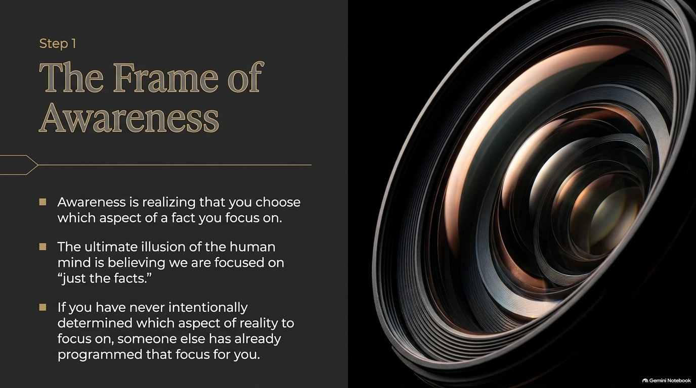
Notes:
Visual: A sophisticated camera lens aperture graphic illustrating depth and focus.
Suggested Speaking Time: 3–4 minutes
Speaker Notes:
"Step 1 on our journey is mastering The Frame of Awareness. Awareness is the sudden realization that you actively choose which aspect of a fact you focus on. The ultimate illusion of the human mind is believing that we are just 'focused on the facts'. But remember: every fact has a positive and a negative side. If you have never intentionally determined which aspect of reality to focus on, someone or something else—culture, media, past trauma—has already programmed that focus for you. Awareness means stepping back and asking yourself, 'What frame am I currently looking through?' Until you become aware of your frame, you are a prisoner to your perspective."

Slide 5
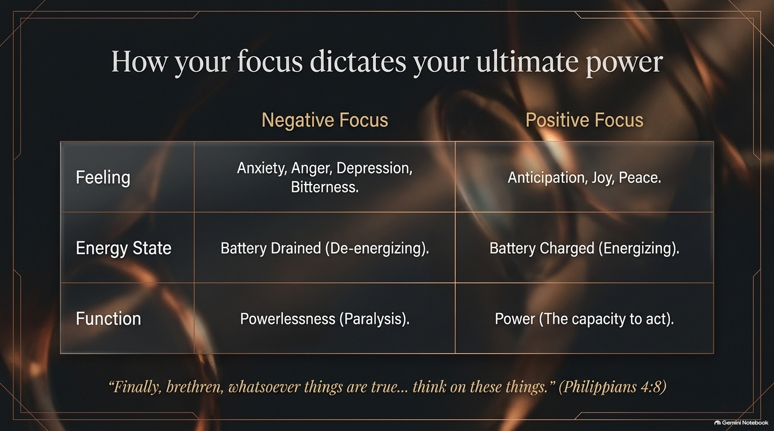
Notes:
Visual: A comprehensive comparison table contrasting 'Negative Focus' (anxiety, de-energizing, powerlessness) with 'Positive Focus' (anticipation, energizing, power), anchored by Philippians 4:8.
Suggested Speaking Time: 4–5 minutes
Speaker Notes:
"Look closely at how your focus dictates your ultimate power. When you maintain a Negative Focus, your feelings skew toward anxiety, anger, depression, and bitterness. What does that do to your energy state? It drains your battery completely, leaving you de-energized. And your function? Powerlessness and paralysis. But when you shift to a Positive Focus, your feelings transform into anticipation, joy, and peace. Your energy state becomes charged, and your function shifts to true power—the capacity to act. As the Apostle Paul wrote in Philippians 4:8: 'Finally, brethren, whatsoever things are true... whatsoever things are lovely... think on these things.' God didn't give us this command to torture us; He gave it to us because He knows that what we focus on determines our power."

Slide 6
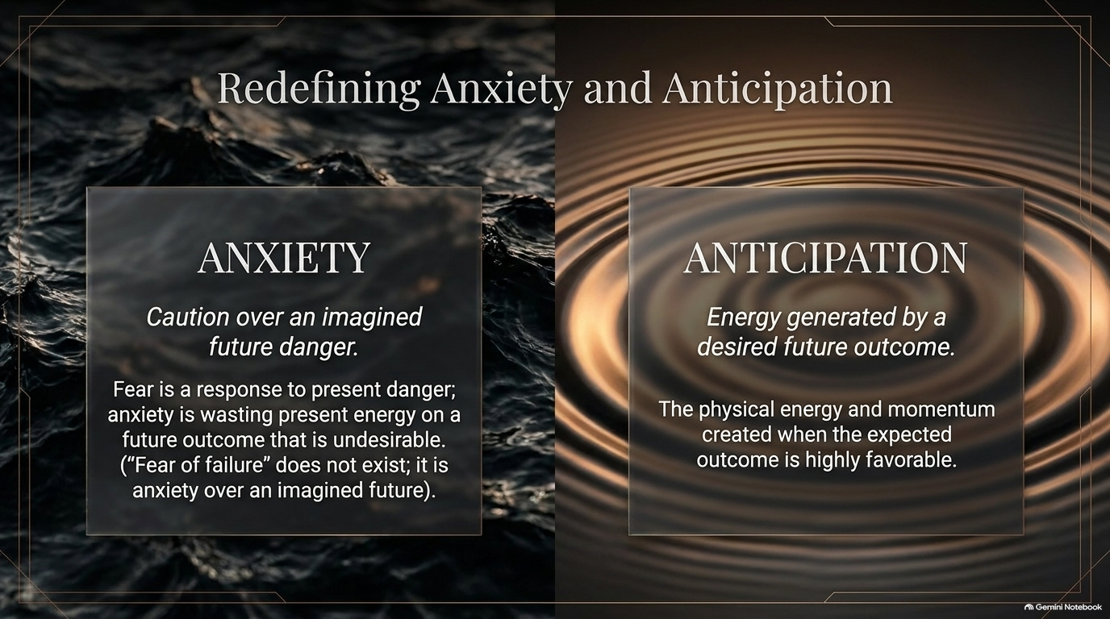
Notes:
Visual: A split-screen graphic contrasting a turbulent, dark ocean wave ('Anxiety') with a smooth, golden water ripple ('Anticipation').
Suggested Speaking Time: 4–5 minutes
Speaker Notes:
"Let's redefine two major emotional states: Anxiety and Anticipation. People often say things like, 'I have a fear of failure' or 'I have a fear of rejection.' But biblically and psychologically, 'fear of failure' does not actually exist. True fear is caution over a real, present, physical danger. Anxiety, on the other hand, is wasting present energy on an imagined future danger—caution over an undesirable future outcome. You are literally attacking yourself with anxiety (an anxiety attack). Conversely, Anticipation is the physical energy and momentum generated when the expected future outcome is highly favorable. Anxiety drains your present strength for a lie about tomorrow; anticipation fuels your present strength with a promise about tomorrow."

Slide 7
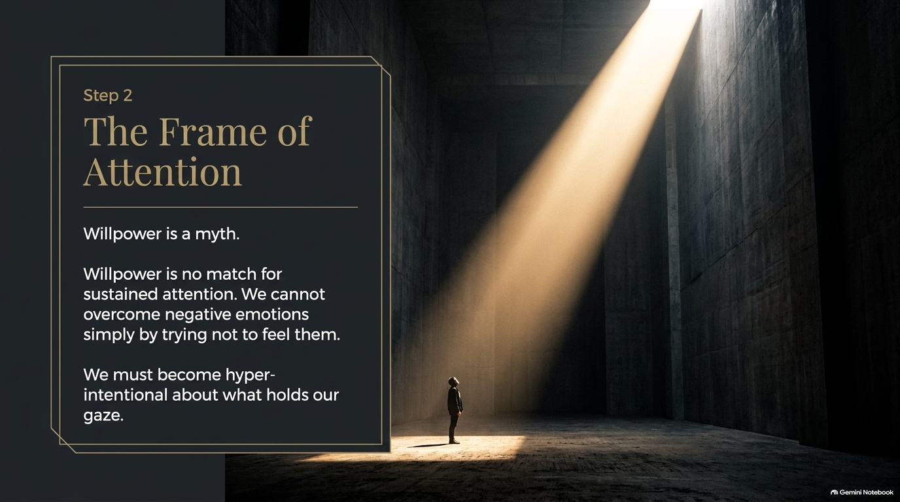
Notes:
Visual: A solitary figure standing in a vast, dark industrial hall illuminated by a powerful beam of light piercing through from above.
Suggested Speaking Time: 3–4 minutes
Speaker Notes:
"Step 2 brings us to The Frame of Attention. Here is a hard truth: Willpower is a myth. Willpower is no match for sustained attention. We cannot overcome negative emotions simply by trying not to feel them or White-knuckling our way through temptation. Think of Eve in the Garden—her mistake wasn't a lack of willpower; it was misplaced attention. Satan didn't have to force her to eat the fruit; he just had to engage her attention long enough for desire to take root. We must become hyper-intentional about what holds our gaze. Where your attention goes, your life follows."

Slide 8
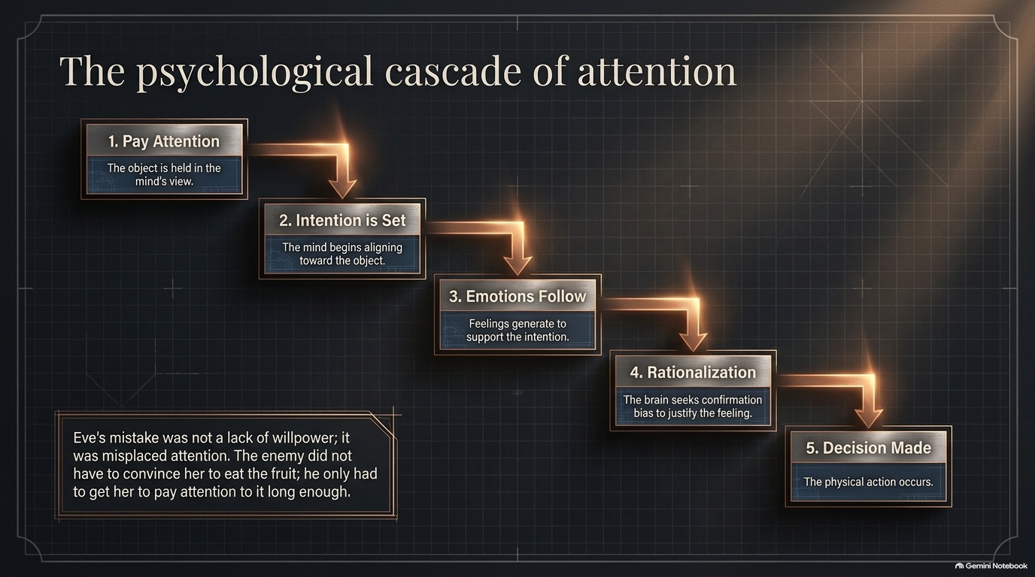
Notes:
Visual: A 5-step metallic glowing flowchart tracing the descent from paying attention to intention, emotion, rationalization, and decision.
Suggested Speaking Time: 4–5 minutes
Speaker Notes:
"Let's trace The Psychological Cascade of Attention:
1. Pay Attention: The object or thought is held in the mind's view.
2. Intention is Set: The mind begins aligning toward that object.
3. Emotions Follow: Feelings generate automatically to support that intention.
4. Rationalization: The brain seeks confirmation bias to justify the feeling.
5. Decision Made: The physical action occurs. Notice that the action didn't start with a bad decision; it started with where you parked your attention. If you want to change your actions, you cannot start at step 5. You must intercept the cascade at step 1: what are you paying attention to?"

Slide 9
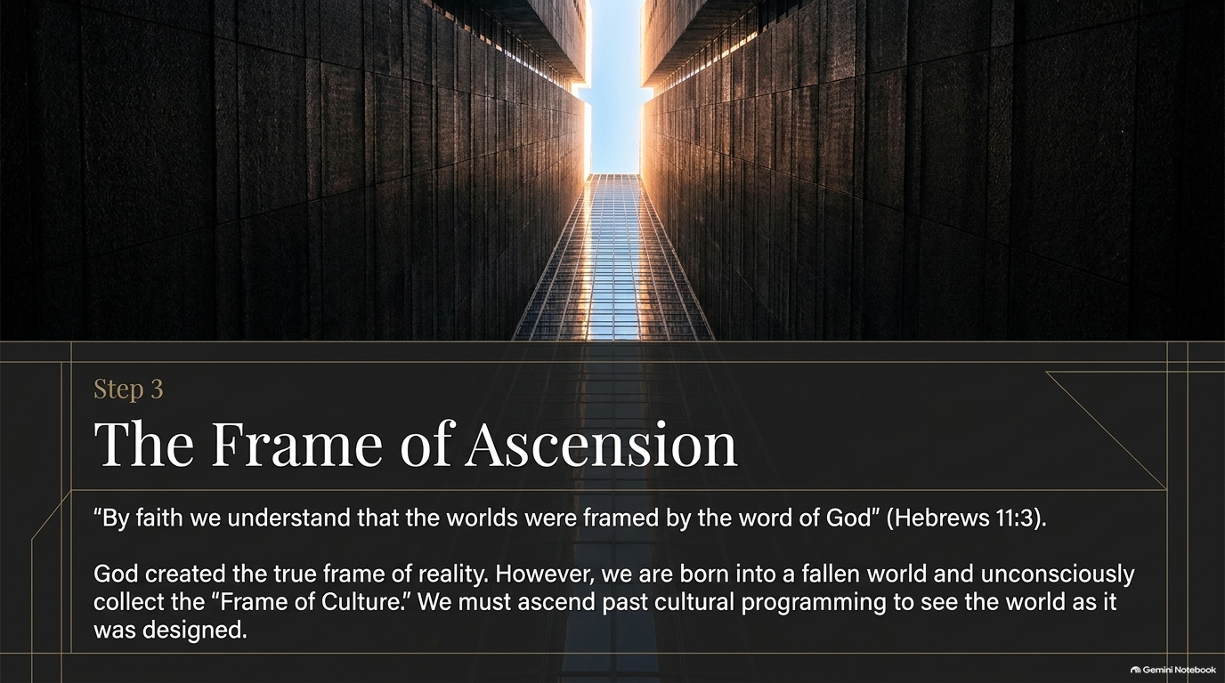
Notes:
Visual: A dramatic upward-looking perspective inside a towering modern architectural corridor opening up to a bright sky.
Suggested Speaking Time: 3–4 minutes
Speaker Notes:
"Step 3 is The Frame of Ascension. Hebrews 11:3 tells us: 'By faith we understand that the worlds were framed by the word of God.' God created the true, original frame of reality. However, because we are born into a fallen world, we unconsciously collect what Myron Golden calls 'The Frame of Culture'. We absorb society's definitions, fears, and compromises. To live victoriously, we must ascend past cultural programming and see the world through God's design. We have to rise above the noise of this world and adopt a heavenly perspective."

Slide 10
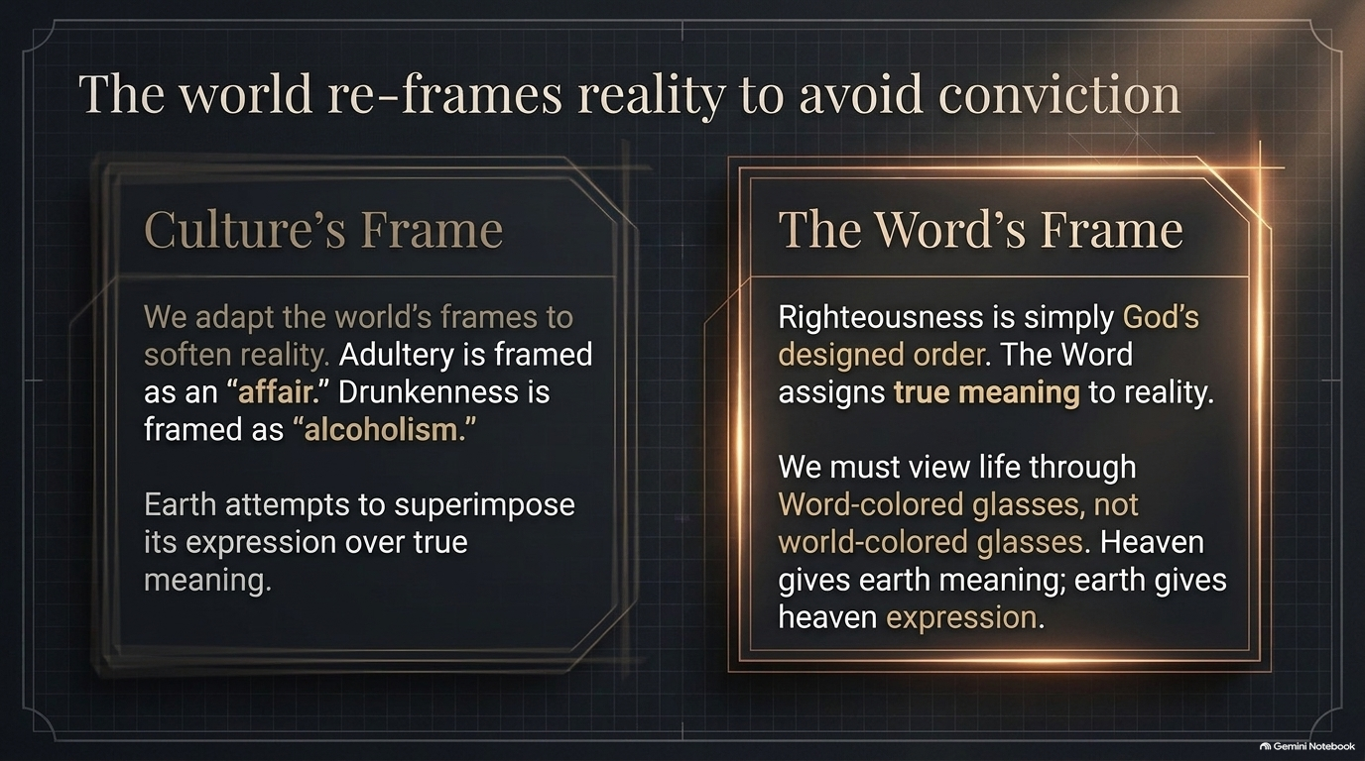
Notes:
Visual: A comparison layout contrasting 'Culture's Frame' (softening sin like affairs and alcoholism) with 'The Word's Frame' (righteousness as God's designed order).
Suggested Speaking Time: 4–5 minutes
Speaker Notes:
"Notice how the world constantly re-frames reality to avoid moral conviction. Culture's Frame attempts to soften hard truth: adultery is rebranded as a harmless 'affair,' drunkenness is excused as 'alcoholism,' and God's absolute standards are diluted to fit modern comfort. Earth attempts to superimpose its expression over divine meaning. But The Word's Frame establishes righteousness as simply God's designed order. The Word assigns true meaning to reality. We must view our lives through Word-colored glasses, not world-colored glasses. Heaven gives earth meaning; earth only gives heaven expression. When you let culture frame your life, you inherit culture's broken results."

Slide 11
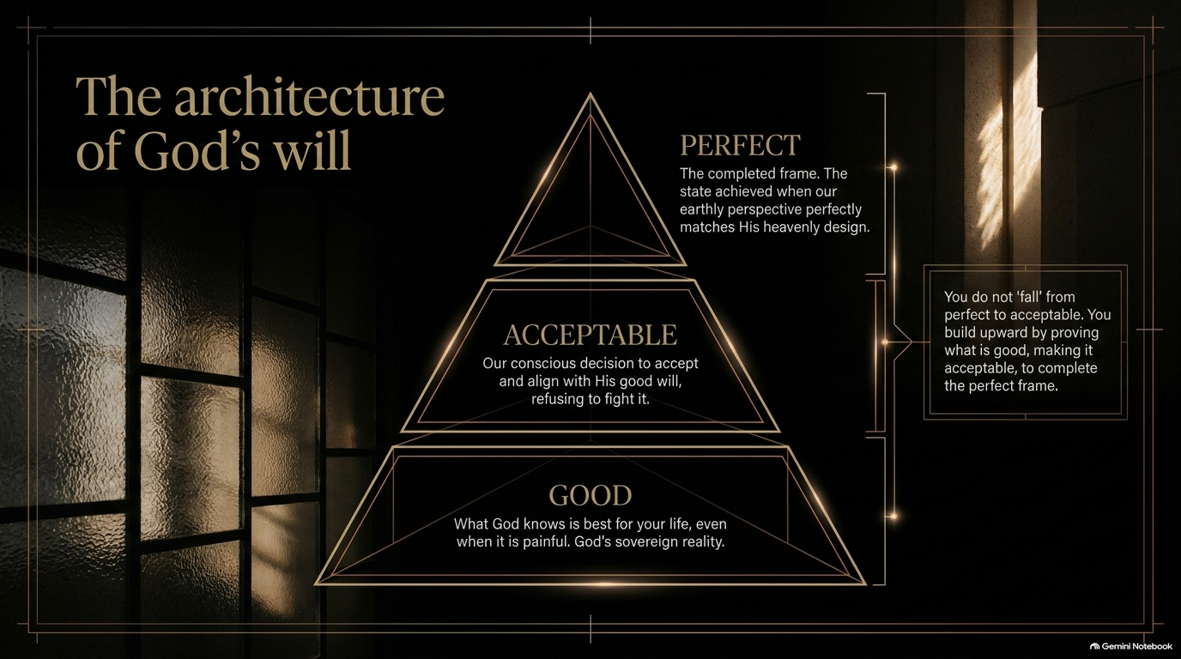
Notes:
Visual: An ascending 3-tier golden pyramid diagram mapping out 'Good', 'Acceptable', and 'Perfect' wills of God.
Suggested Speaking Time: 4–5 minutes
Speaker Notes:
"Let's examine Romans 12:2 and The Architecture of God's Will through this magnificent pyramid:
Good (The Base): What God knows is best for your life, even when it is painful. It is His sovereign reality.
Acceptable (The Middle): Our conscious decision to accept and align with His good will, refusing to fight or bitter-wrestle against God.
Perfect (The Apex): The completed frame achieved when our earthly perspective perfectly matches His heavenly design. You do not 'fall' from perfect to acceptable; you build upward by proving what is good, making it acceptable, to complete the perfect frame. When you accept God's sovereign hand in your trials, your perspective aligns with heaven."

Slide 12
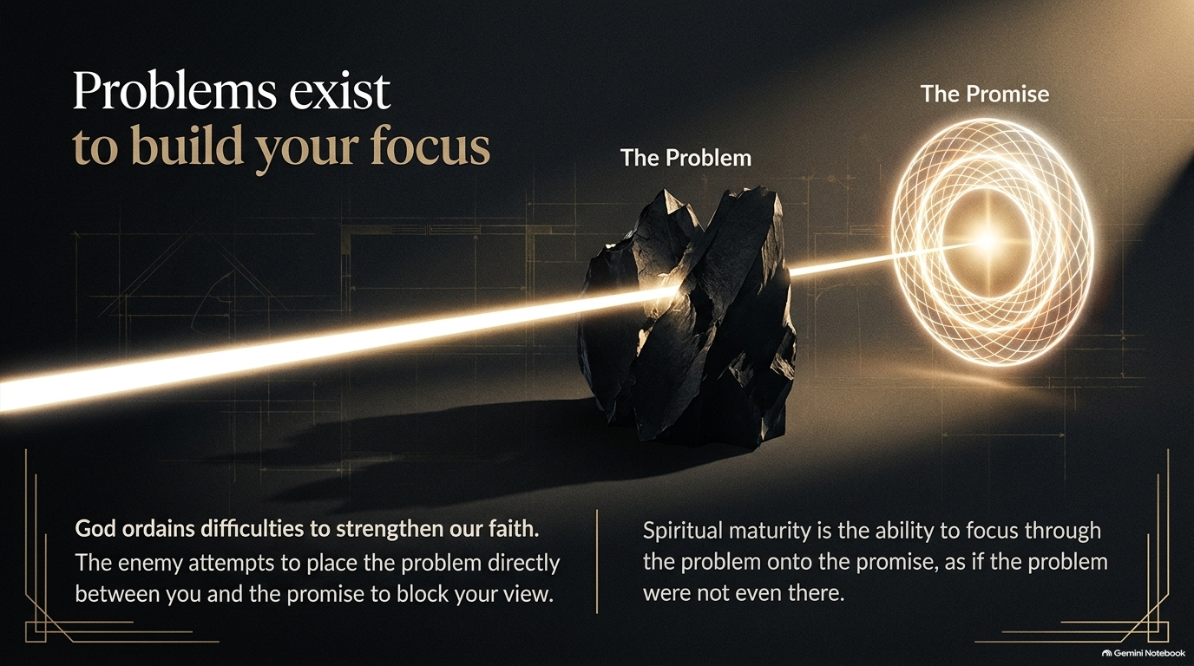
Notes:
Visual: A stark illustration of a bright beam of light cutting directly through a jagged, dark boulder ('The Problem') to illuminate a glowing golden target ('The Promise').
Suggested Speaking Time: 4–5 minutes
Speaker Notes:
"Why do we face trials? Because problems exist to build your focus. God ordains difficulties to strengthen our spiritual faith. Notice what the enemy tries to do: he attempts to place the problem directly between you and the promise to block your view. Satan wants you staring at the wall so you forget about the door. But spiritual maturity is not the absence of problems; spiritual maturity is the ability to focus through the problem onto the promise, as if the problem were not even there. Your life won't get better by having zero problems; your faith gets stronger by learning how to focus past them."

Slide 13
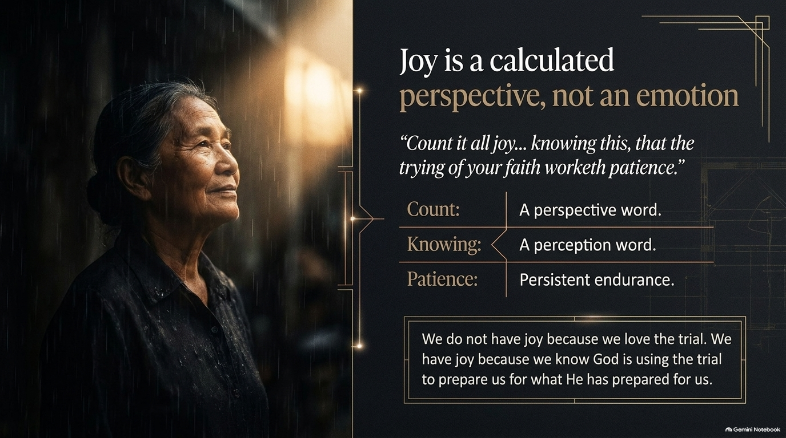
Notes:
Visual: A contemplative portrait of an elderly woman standing peacefully in the rain under a warm beam of light.
Suggested Speaking Time: 4–5 minutes
Speaker Notes:
"James 1:2-3 gives us a revolutionary paradigm: 'Count it all joy when ye fall into diverse temptations... knowing this, that the trying of your faith worketh patience.' Notice the linguistic precision:
Count: A perspective word.
Knowing: A perception word.
Patience: Persistent, consistent endurance. Joy is a calculated perspective, not a spontaneous emotion. We do not have joy because we love the trial or enjoy suffering. We have joy because we know God is using the trial to prepare us for what He has prepared for us. When God is getting you ready for a massive blessing, He uses pressure to build your capacity."

Slide 14
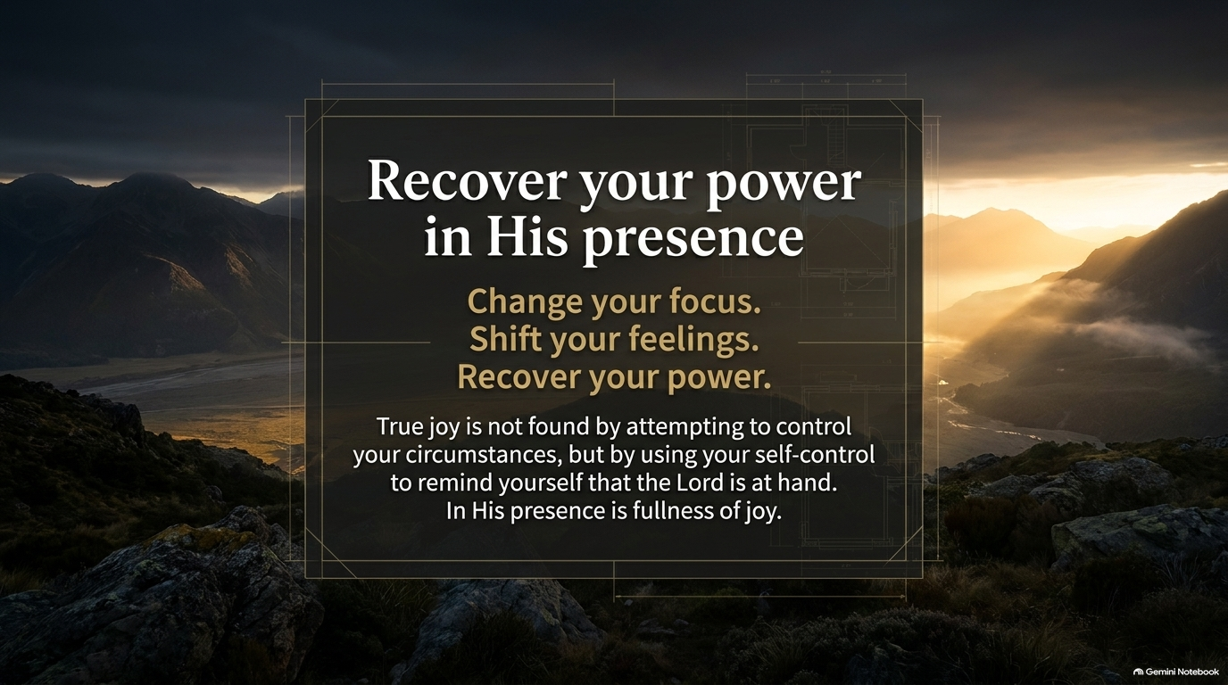
Notes:
Visual: A breathtaking panoramic landscape of majestic mountains at sunrise, bathed in golden light and morning mist.
Suggested Speaking Time: 3–4 minutes
Speaker Notes:
"Let's summarize the ultimate recovery sequence: Change your focus. Shift your feelings. Recover your power. True joy is never found by attempting to control your external circumstances—because you cannot control most of what happens around you. Instead, true joy is found by using your self-control and moderation to remind yourself that the Lord is at hand. As Philippians 4:5 reminds us, and as scripture affirms: In His presence is fullness of joy. When you shift your gaze from your problems back into His presence, your emotional battery recharges instantly."

Slide 15
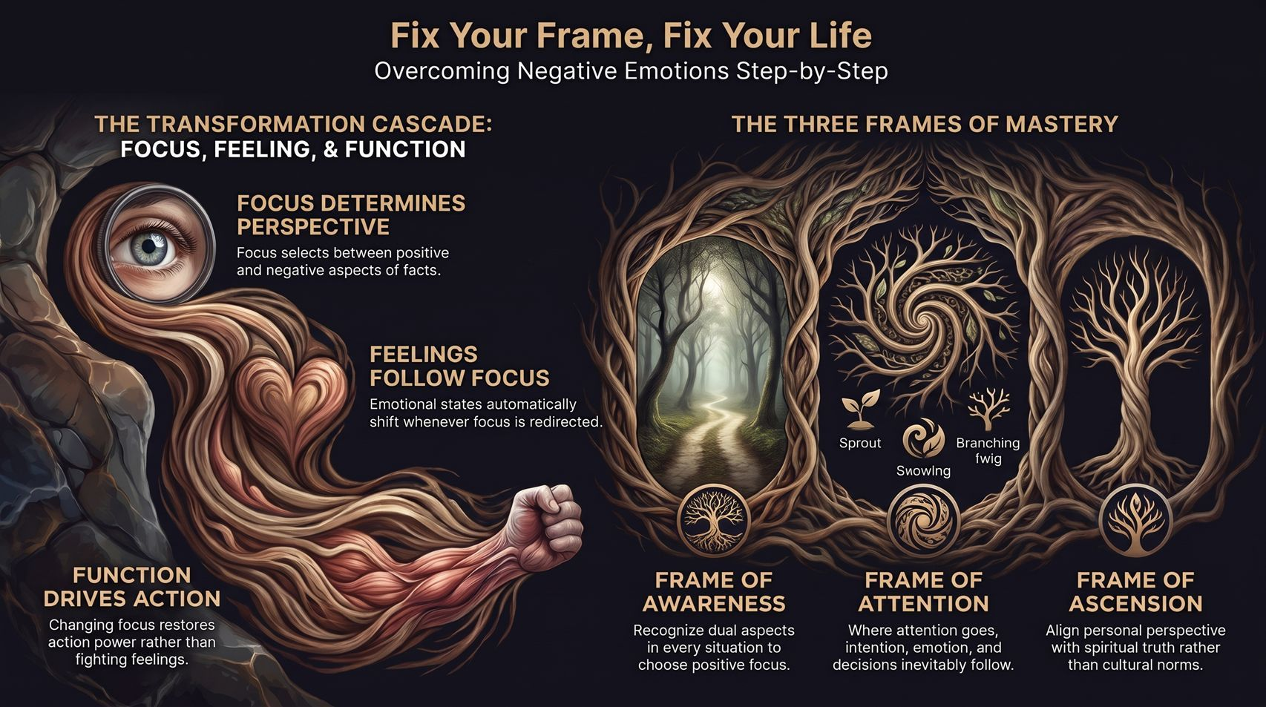
Notes:
Visual: A comprehensive synthesis summary slide illustrating the Transformation Cascade (Focus, Feeling, Function) alongside the Three Frames of Mastery (Awareness, Attention, Ascension).
Suggested Speaking Time: 4–6 minutes
Speaker Notes:
"As we bring our presentation to a powerful close on this summary dashboard, let's lock in the core mechanics of reframing reality:
The Transformation Cascade: Remember that Focus determines perspective, Feelings automatically follow focus, and Function drives action. Change your focus to restore your power rather than fighting your feelings.
The Three Frames of Mastery: Master the Frame of Awareness by recognizing dual aspects in every situation; master the Frame of Attention by guarding where your gaze and intention go; and master the Frame of Ascension by aligning your personal perspective with spiritual truth rather than cultural norms. Fix your frame, and watch God fix your life."

