Slide 1
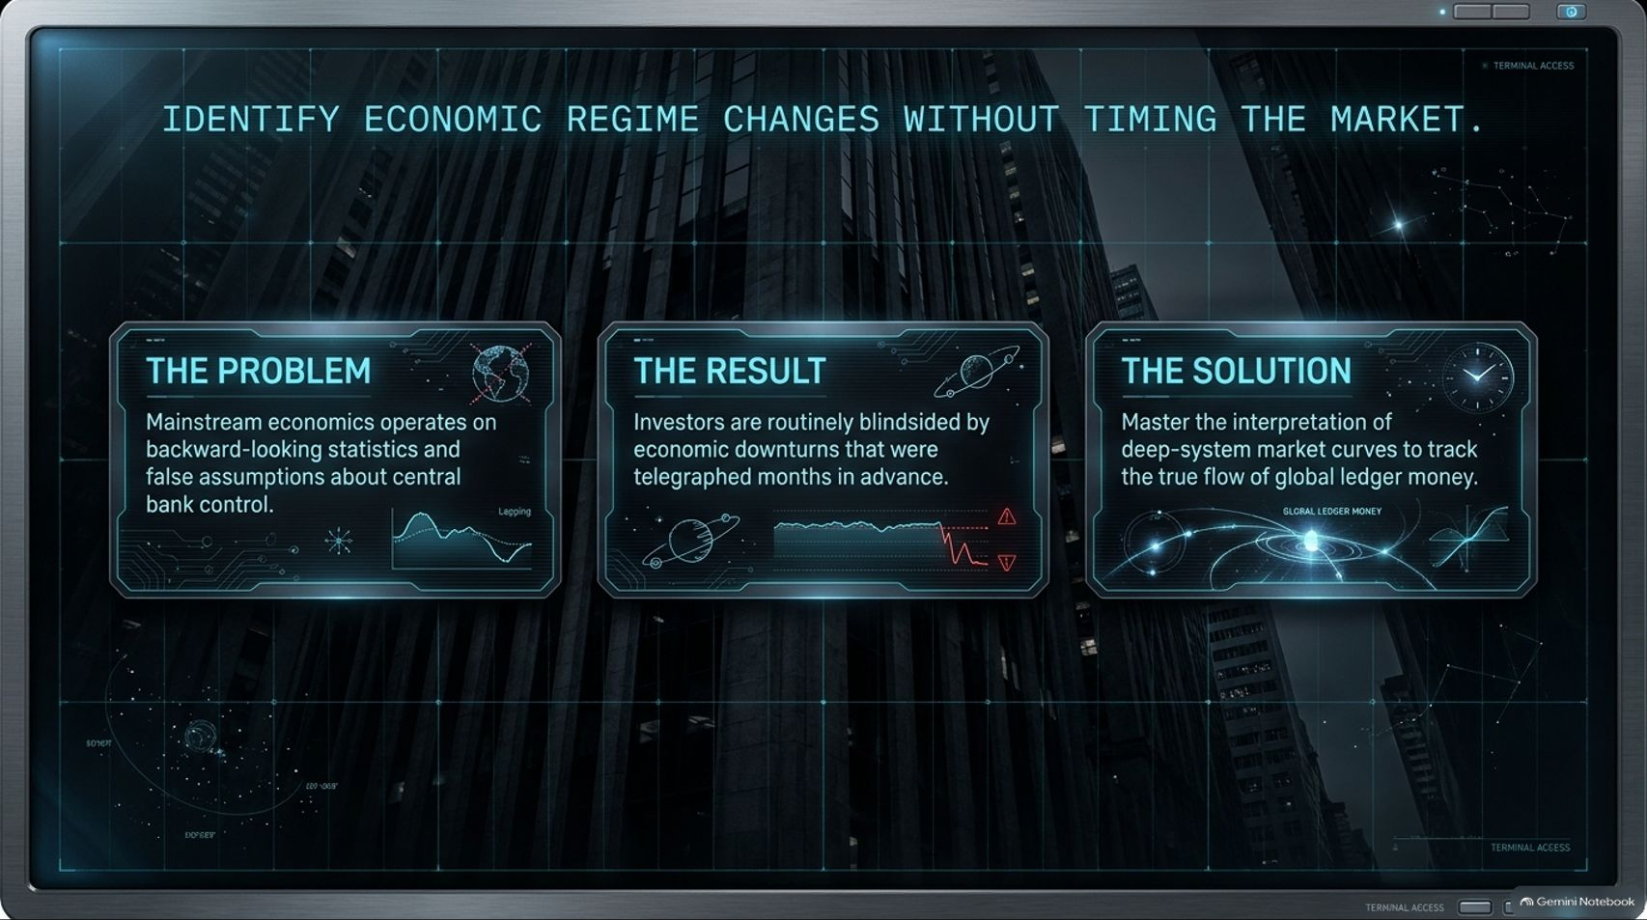
Notes:
Target Speaking Time: ~3–4 Minutes
Speaker Script:
"Good evening and welcome, everyone. Today, we are addressing one of the most persistent dilemmas facing investors, portfolio managers, and analysts today: how to identify major economic regime changes without falling into the trap of market timing.
Most institutional investors operate under The Problem: reliance on backward-looking macroeconomic indicators and a flawed, conventional belief that central bank policy controls global monetary reality.
The Result? Investors are routinely blindsided by severe economic downturns—even though every major downturn in modern history was telegraphed months, if not years, in advance through deep system market signals.
The Solution lies in shifting our focus away from central bank commentary and toward deciphering the deep-system market curves that govern global ledger money. Over the course of this deck, we will take apart the four key signals active in today's market to map out our exact macroeconomic position."
Are We Entering a New Economic Era? How to Prepare Your Portfolio Without Trying to Time the Market
https://www.youtube.com/watch?v=6Jjc1zQc-Pw

Slide 2
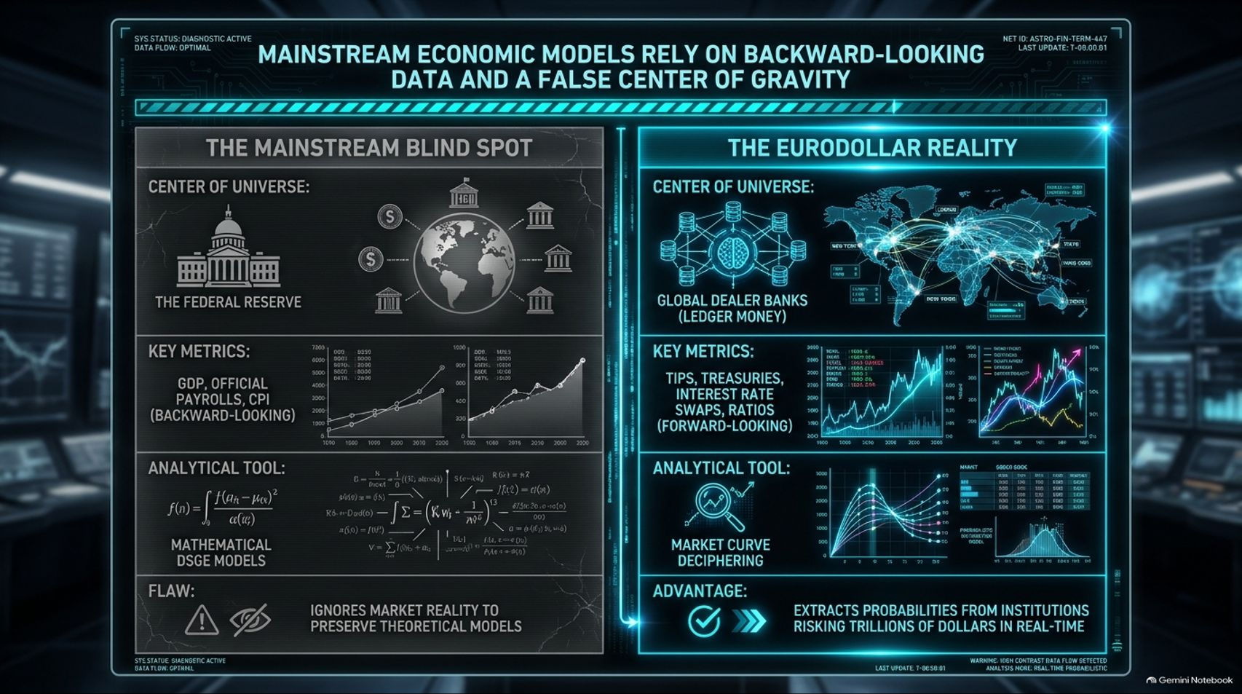
Notes:
Target Speaking Time: ~4–5 Minutes
Speaker Script:
"To understand why mainstream forecasts consistently fail, we must compare the traditional academic view with monetary reality.
On the left, we see The Mainstream Blind Spot. Mainstream economics treats the Federal Reserve as the center of the financial universe. They rely heavily on backward-looking data like GDP, official payroll numbers, and the Consumer Price Index (CPI), analyzing them through mathematical DSGE models. The fundamental flaw here is that these academic models force-fit market data to preserve theoretical assumptions, ignoring the reality of bank balance sheets.
On the right is The Eurodollar Reality. The real center of monetary gravity isn't Washington D.C.; it is a decentralized, global network of commercial dealer banks operating ledger money. Instead of lagged economic prints, we track forward-looking financial market metrics—TIPS, Treasury yield curves, interest rate swap spreads, and commodity ratios. By deciphering these curves, we extract real-time, probabilistic signals from institutions risking trillions of dollars of actual capital."

Slide 3
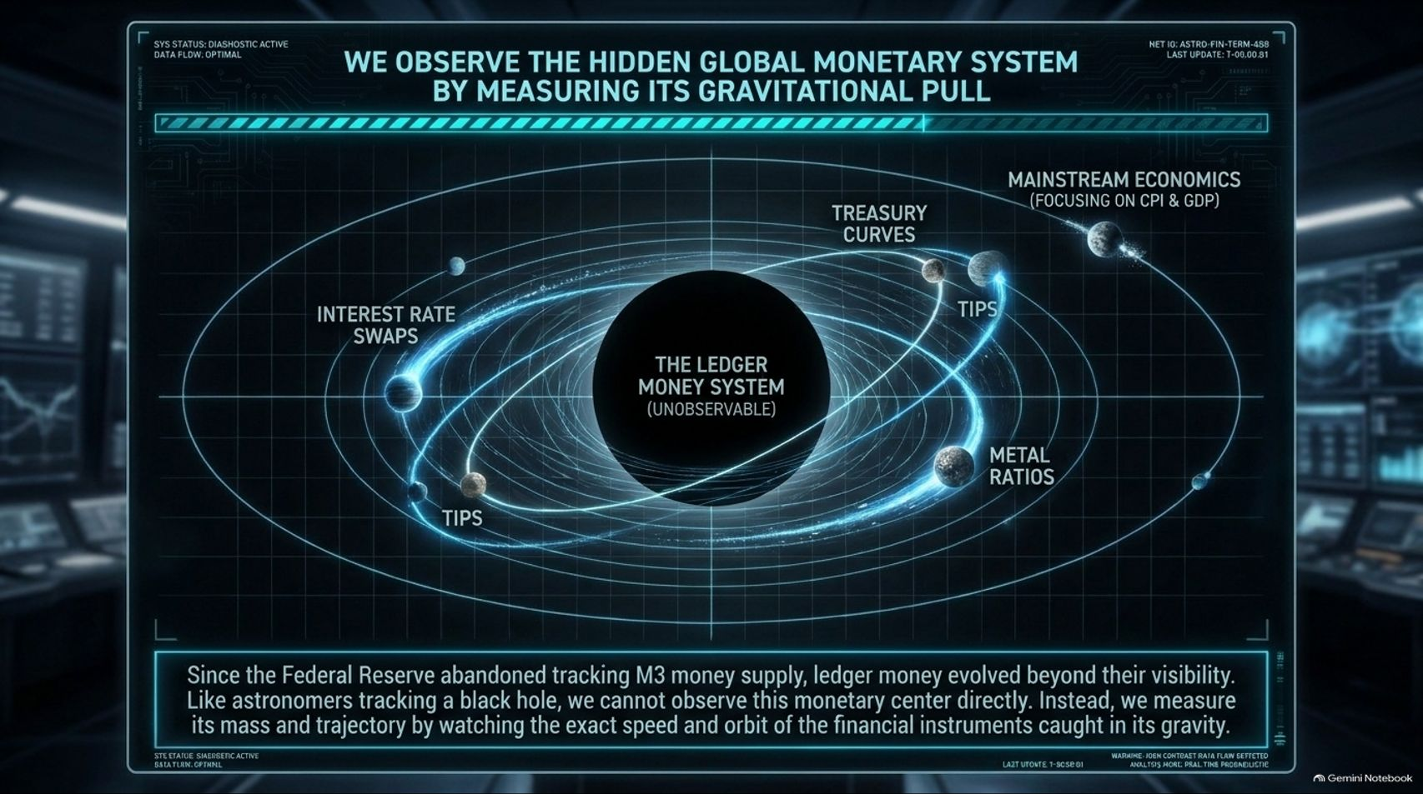
Notes:
Target Speaking Time: ~4 Minutes
Speaker Script:
"Ever since central banks abandoned tracking M3 money supply decades ago, global ledger money evolved far beyond their visibility and official reporting.
Think of the global monetary system like astrophysicists tracking a black hole. You cannot observe the black hole directly with an optical telescope. Instead, you observe its presence, mass, and gravitational pull by tracking the speed, trajectory, and behavior of the celestial bodies caught in its orbit.
In our framework, the unobservable core is the offshore ledger money system. Surrounding it are our observable market instruments: Interest Rate Swaps, US Treasury Yield Curves, TIPS, and Metal Ratios. While mainstream economics is fixated on lagged CPI figures on the outer edge, we measure the gravitational pull of dealer balance sheet capacity through these forward-looking instruments."

Slide 4
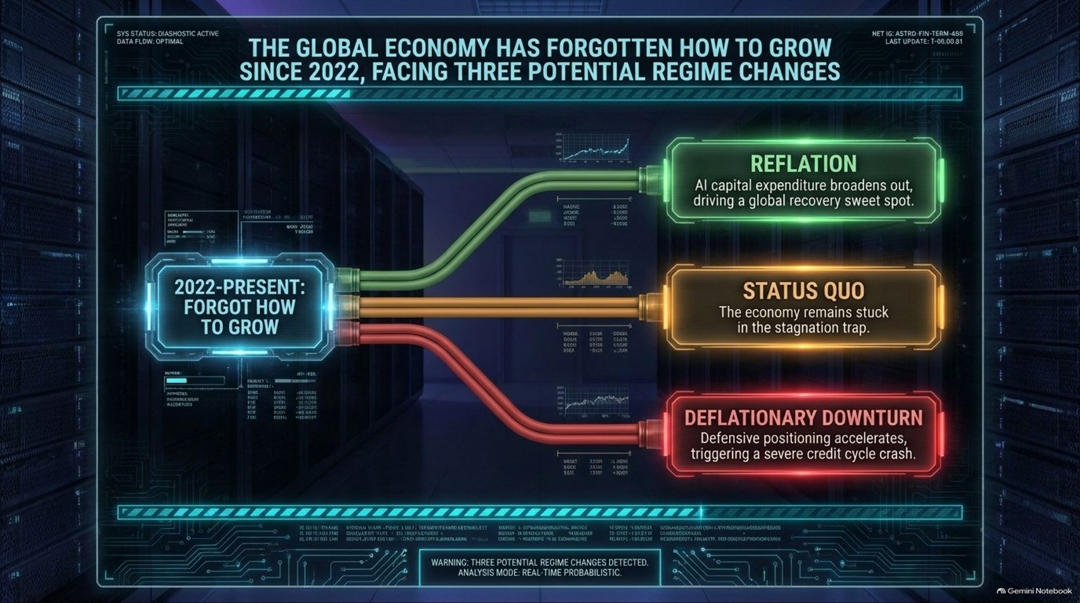
Notes:
Target Speaking Time: ~4–5 Minutes
Speaker Script:
"Since 2022, the global economy has entered a structural phase where it has essentially forgotten how to grow. We are straddling the fence between three potential economic regimes:
Reflation (The Green Pathway): The optimistic case, where AI capital expenditures and global productivity broaden out into a sustainable macroeconomic expansion.
Status Quo (The Yellow Pathway): The economy remains locked in a stagnation trap—neither accelerating into true expansion nor falling off a cliff.
Deflationary Downturn (The Red Pathway): Defensive positioning among bank dealers accelerates, liquidity shrinks, and a severe credit cycle crash is triggered.
Our goal as analysts and investors is not to predict the future with a crystal ball, but to read current market signals to determine which path gravity is actively pulling us toward."

Slide 5
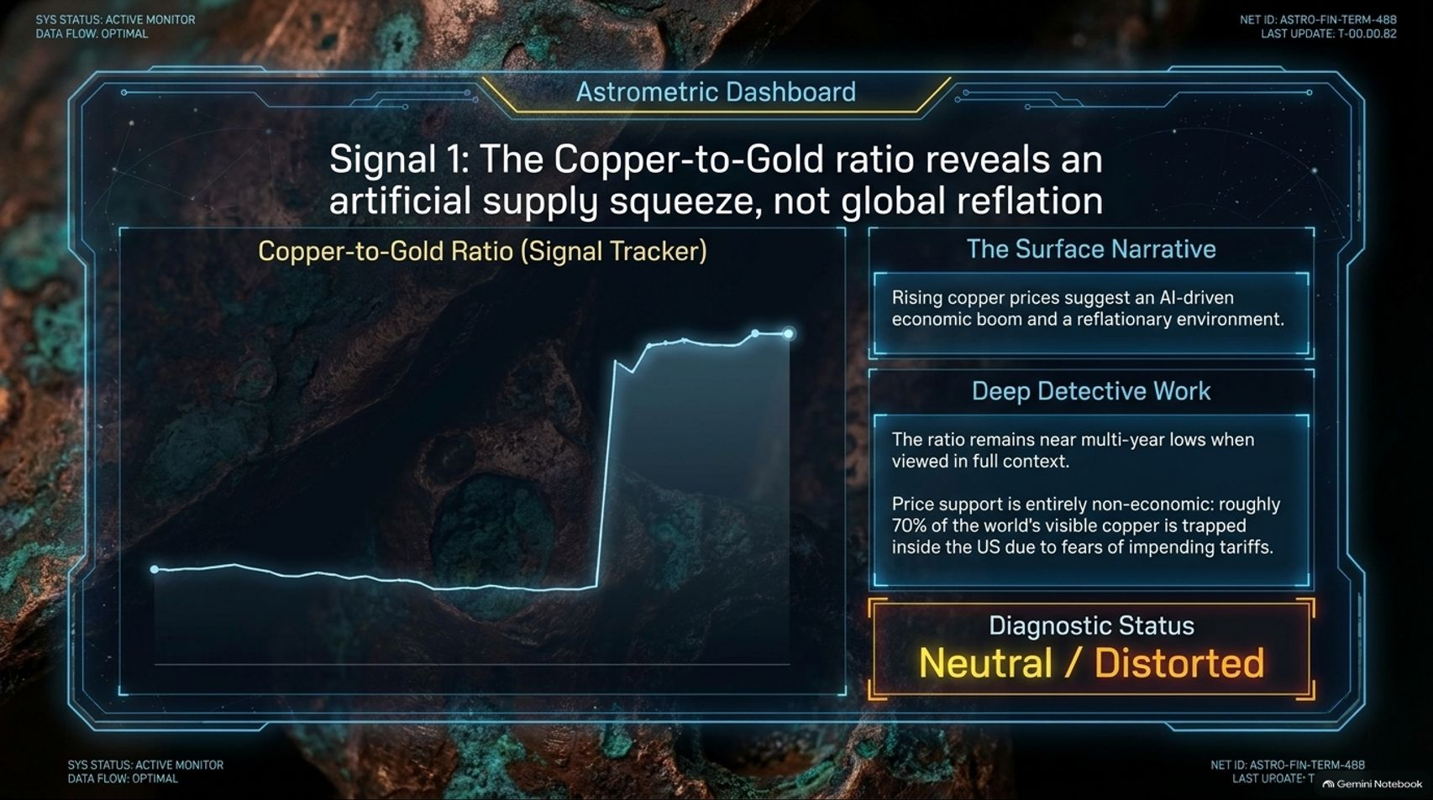
Notes:
Target Speaking Time: ~4–5 Minutes
Speaker Script:
"Let's examine Signal 1: The Copper-to-Gold Ratio.
The Surface Narrative: Mainstream commentary points to recent rallies in copper prices as proof of an AI-driven manufacturing boom and global economic reflation.
The Deep Detective Work: When you zoom out and place the ratio in its full macro context, the Copper-to-Gold ratio remains near multi-year historical lows. Furthermore, the recent price support in copper is non-macroeconomic. Roughly 70% of visible global copper inventory is currently trapped inside US warehouses due to defensive stockpiling ahead of impending trade tariffs.
Diagnostic Status: Neutral / Distorted. This ratio is reflecting localized trade distortion and supply friction, not genuine global economic reflation."

Slide 6
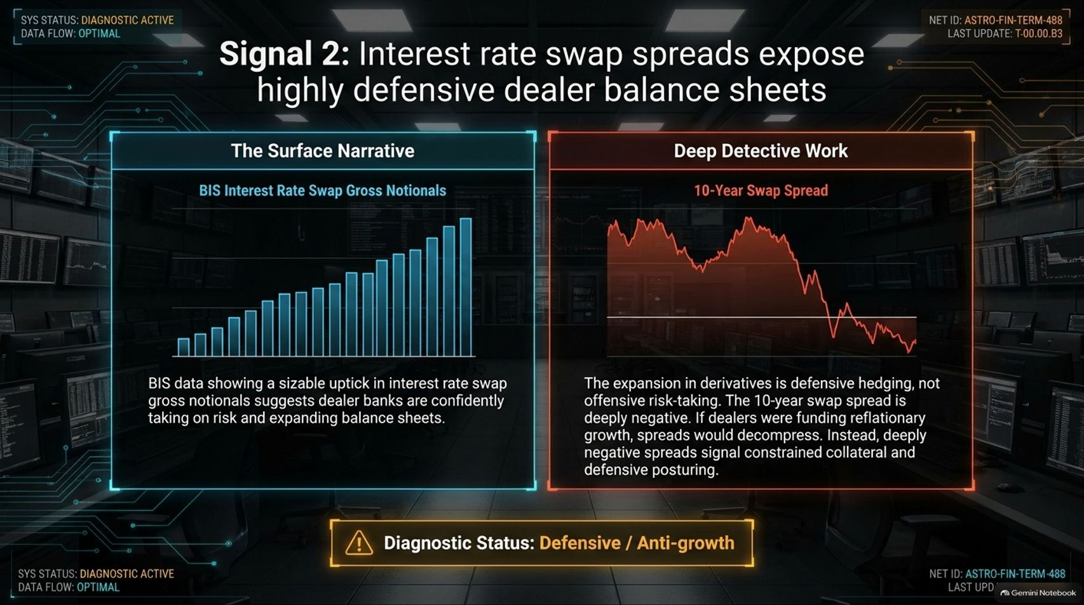
Notes:
Target Speaking Time: ~4–5 Minutes
Speaker Script:
"Moving to Signal 2: Interest Rate Swap Spreads.
The Surface Narrative: Data from the Bank for International Settlements (BIS) shows a substantial expansion in gross derivative notionals. Mainstream observers interpret this as dealer banks confidently expanding balance sheets and embracing risk.
The Deep Detective Work: If dealer banks were taking on risk to fund economic expansion, swap spreads would decompress into positive territory. Instead, the 10-year swap spread is deeply negative. Deeply negative swap spreads signal severe balance sheet constraints, collateral shortages, and heavy defensive hedging among dealers.
Diagnostic Status: Defensive / Anti-Growth. The surge in derivatives represents panic-hedging and balance sheet constriction, not risk-seeking behavior."

Slide 7
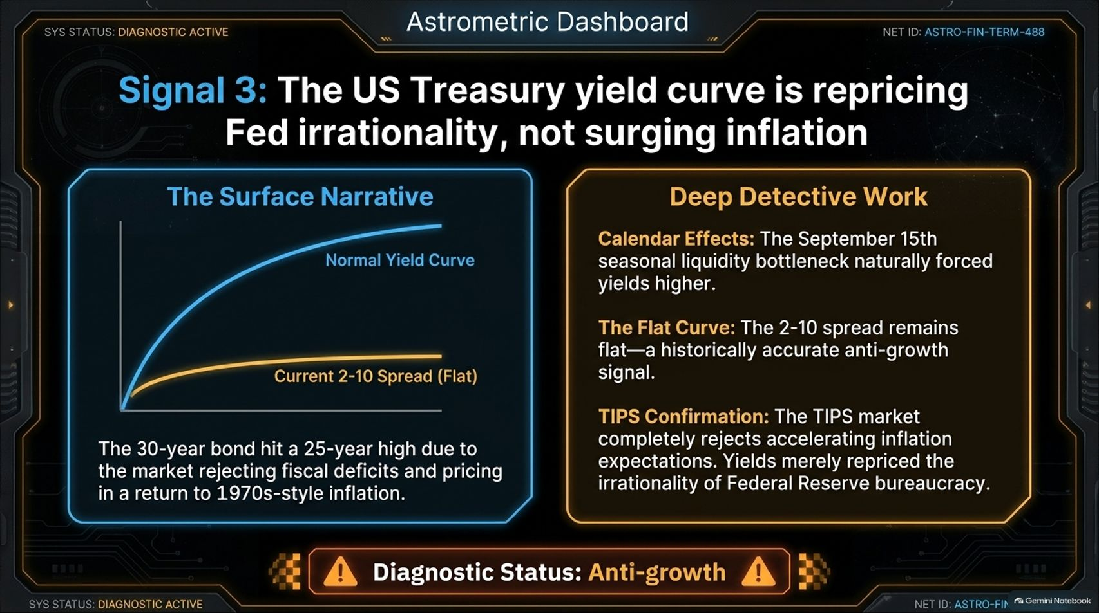
Notes:
Target Speaking Time: ~4–5 Minutes
Speaker Script:
"Now let me direct your attention to Signal 3: The US Treasury Yield Curve.
The Surface Narrative: Commentators claim long-term Treasury yields hit multi-decade highs because the market is rejecting fiscal deficits and pricing in a permanent return to 1970s-style inflation.
The Deep Detective Work: This narrative ignores two key technical facts:
Yield spikes around mid-September were driven by predictable seasonal illiquidity bottlenecks.
The 2-10 spread remains flat, which is historically a persistent anti-growth signal.
Furthermore, Treasury Inflation-Protected Securities (TIPS) completely reject the hyperinflation narrative. TIPS yields confirm that inflation expectations are muted; long yields repriced Federal Reserve policy irrationality, not runaway economic growth.
Diagnostic Status: Anti-Growth."

Slide 8
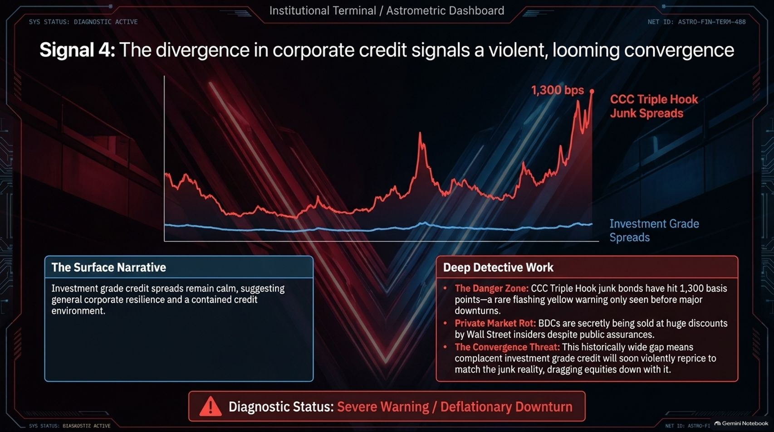
Notes:
Target Speaking Time: ~4–5 Minutes
Speaker Script:
"Signal 4 is the most critical warning light currently flashing on our dashboard: Corporate Credit Divergence.
The Surface Narrative: Investment-grade credit spreads remain remarkably quiet and narrow, leading mainstream economists to celebrate corporate resilience.
The Deep Detective Work: Look beneath the surface at CCC-rated high-yield junk spreads. Spreads on the weakest corporate borrowers have spiked past 1,300 basis points—a historical danger zone seen only before major credit contractions. Additionally, private debt and Business Development Companies (BDCs) are quietly being discounted.
History shows that investment grade credit cannot stay decoupled from CCC junk forever. This wide gap portends a violent convergence, where credit repricing spreads upward and drags equity valuations down with it.
Diagnostic Status: Severe Warning / Deflationary Downturn."

Slide 9
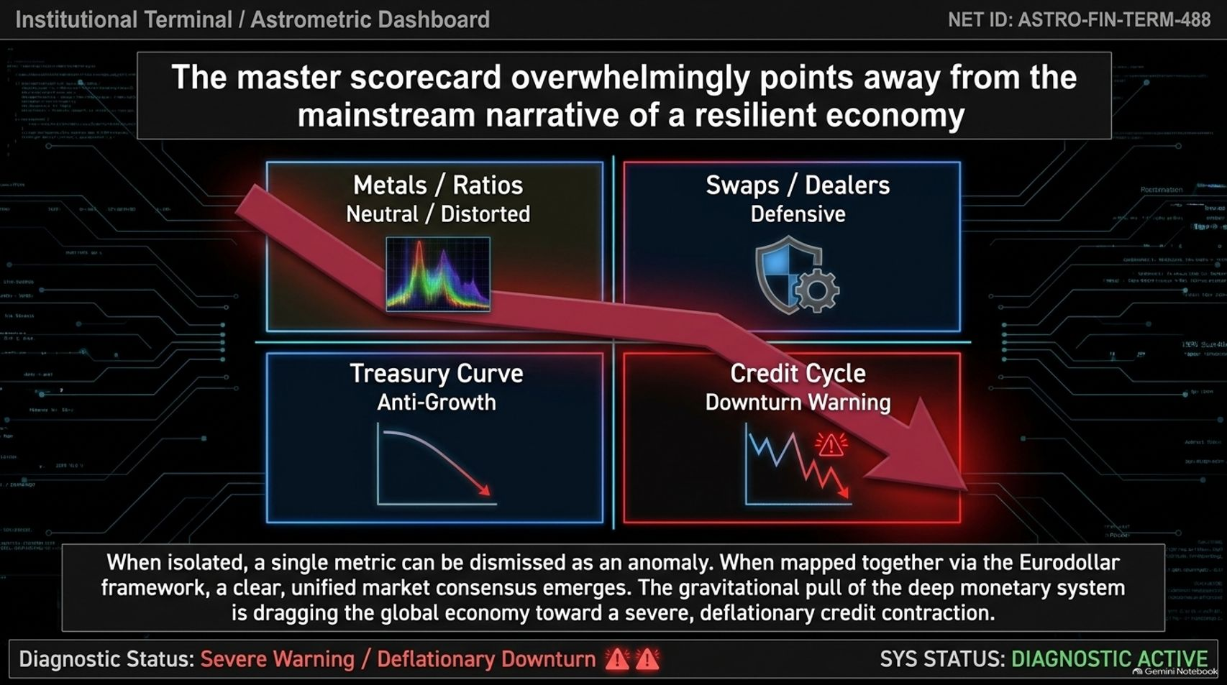
Notes:
Target Speaking Time: ~4–5 Minutes
Speaker Script:
"When viewed in isolation, financial commentators often dismiss single metrics as temporary anomalies. But when we place all four signals on our Master Scorecard, a clear consensus emerges:
Metals Ratios: Distorted by tariffs.
Swaps & Dealer Balance Sheets: Heavily defensive.
Treasury Yield Curves: Firmly anti-growth.
Credit Cycles: Flashing severe downturn warnings.
Map these together through the Eurodollar framework, and the conclusion is clear: the gravitational pull of the deep monetary system is actively dragging the global economy toward a deflationary credit contraction."

Slide 10
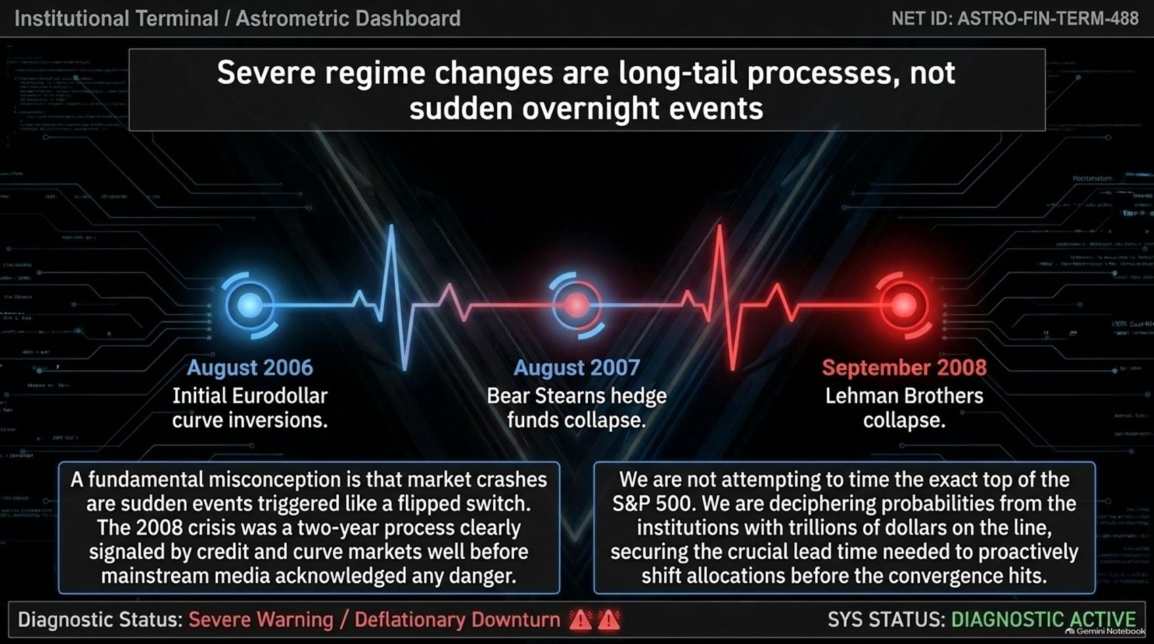
Notes:
Target Speaking Time: ~4 Minutes
Speaker Script:
"A major misconception among retail investors is that market crashes are sudden, overnight events that happen without warning.
Real regime shifts are long-tail processes that play out over months or years. Consider the 2008 Global Financial Crisis:
August 2006: Eurodollar yield curves inverted.
August 2007: Bear Stearns hedge funds collapsed.
September 2008: Lehman Brothers filed for bankruptcy.
That was a two-year sequence telegraphed step-by-step by credit and curve markets. We aren't trying to time the exact top of the stock market today; we are reading deep system probabilities to gain the lead time required to shift portfolio allocations before the final convergence occurs."

Slide 11
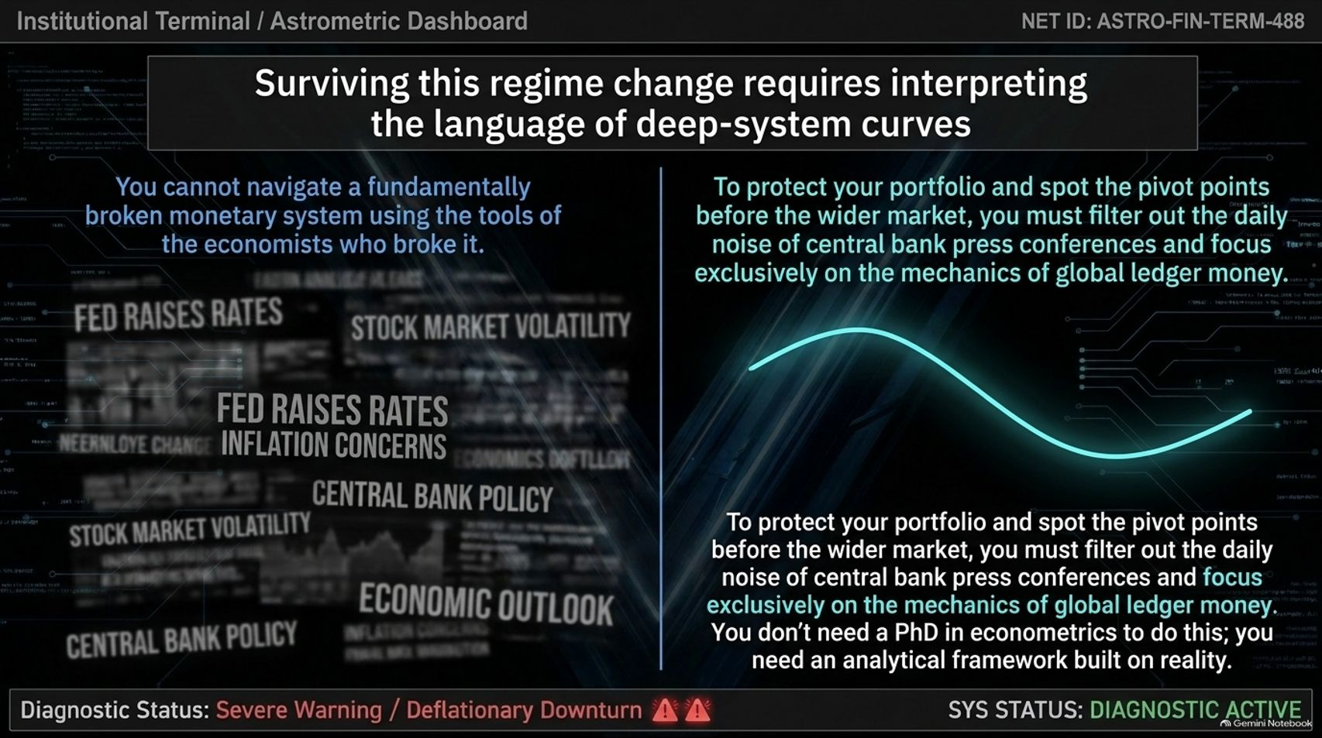
Notes:
Target Speaking Time: ~3–4 Minutes
Speaker Script:
"You cannot navigate a broken monetary system using the tools of the economists who broke it.
If your investment strategy relies on analyzing central bank press conferences, rate hikes, or daily stock volatility noise, you are reacting after the damage is already done.
To protect capital and identify major market pivot points ahead of the crowd, you must focus on the mechanics of global ledger money. You don't need a PhD in complex econometric modeling; you need an analytical framework rooted in monetary reality."

Slide 12
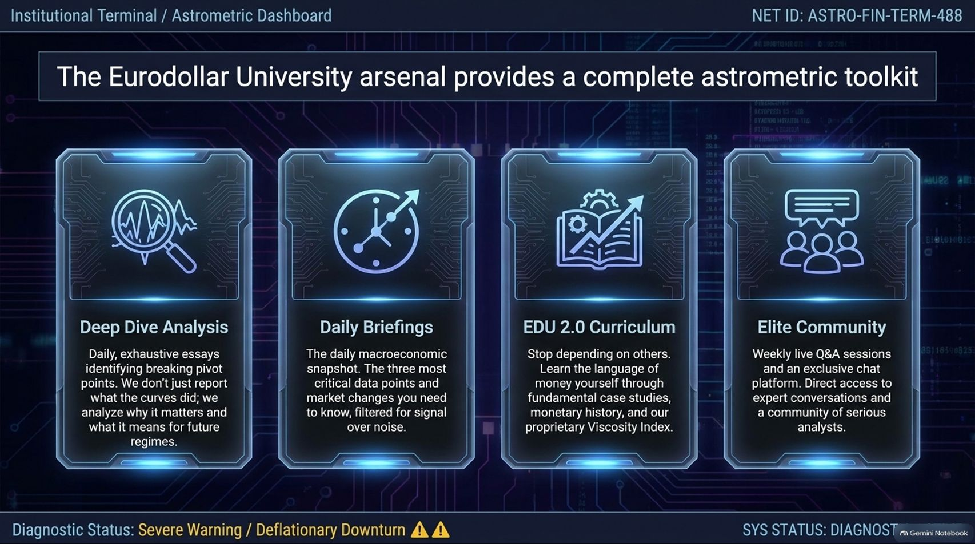
Notes:
Target Speaking Time: ~3–4 Minutes
Speaker Script:
"To help institutional investors and portfolio managers navigate these regime shifts, Eurodollar University provides a structured analytical toolkit:
Deep Dive Analysis: Exhaustive daily essays breaking down curve movements and explaining what they mean for future regimes.
Daily Briefings: The three most critical macroeconomic data points filtered out from the daily noise.
EDU 2.0 Curriculum: Structured courses covering monetary history, case studies, and proprietary tools like our upcoming Viscosity Index.
Elite Community: Direct access to weekly live Q&As and an exclusive network of serious macro analysts and asset managers."

Slide 13
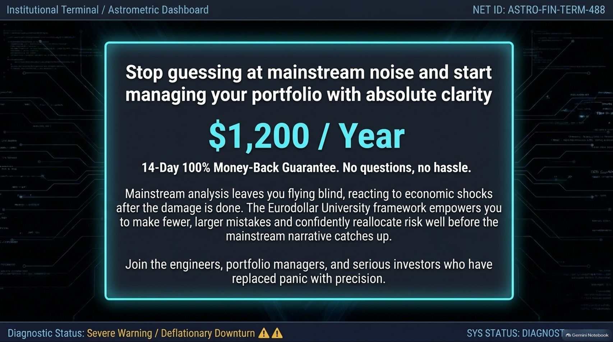
Notes:
Target Speaking Time: ~3 Minutes
Speaker Script:
"Mainstream financial media leaves investors flying blind, forcing them to react to economic shocks after capital has already been impaired.
At $1,200 per year (backed by a 14-day money-back guarantee), Eurodollar University empowers you to make fewer, larger mistakes. It gives you the clarity to reallocate risk confidently long before mainstream consensus catches up. Join the portfolio managers and analysts who have replaced panic with precision."

Slide 14
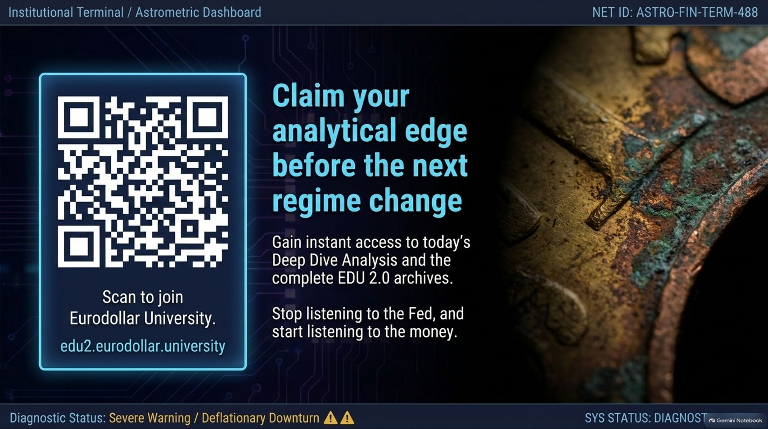
Notes:
Target Speaking Time: ~2–3 Minutes
Speaker Script:
"Claim your analytical edge today before the next regime shift fully takes hold.
You can scan the QR code on the screen or visit edu2.eurodollar.university to access today's Deep Dive Analysis and the complete research archive. Stop listening to central bank narratives, and start listening to the money."

Slide 15
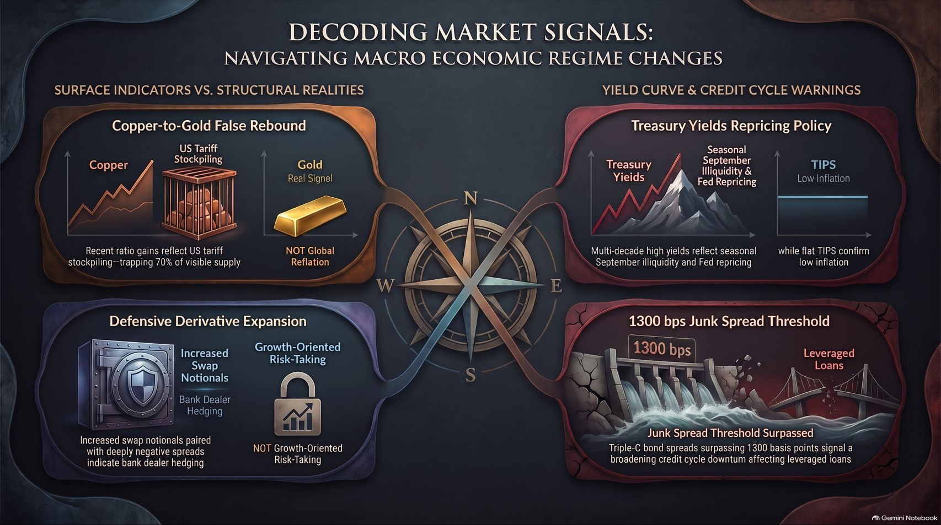
Notes:
Target Speaking Time: ~4–5 Minutes
Speaker Script:
"To summarize our technical analysis, this final visual dashboard brings together our key diagnostic indicators:
Top Left (Copper/Gold): Stockpiling trapped 70% of copper supply in the US due to tariffs, masking low underlying demand.
Bottom Left (Swaps): Deeply negative swap spreads expose bank dealer balance sheet constriction and defensive hedging.
Top Right (Yields & TIPS): Yield curve spikes reflect seasonal illiquidity bottlenecks, while flat TIPS confirm suppressed inflation expectations.
Bottom Right (Credit Spreads): CCC junk bond spreads breaking past the critical 1,300 bps threshold signal a broader credit cycle downturn that will inevitably spread to leveraged loans and investment-grade debt.
Thank you for your time, and I look forward to taking your questions."

